Slide 1

Notes:
It’s the Alpha Series!

Slide 2
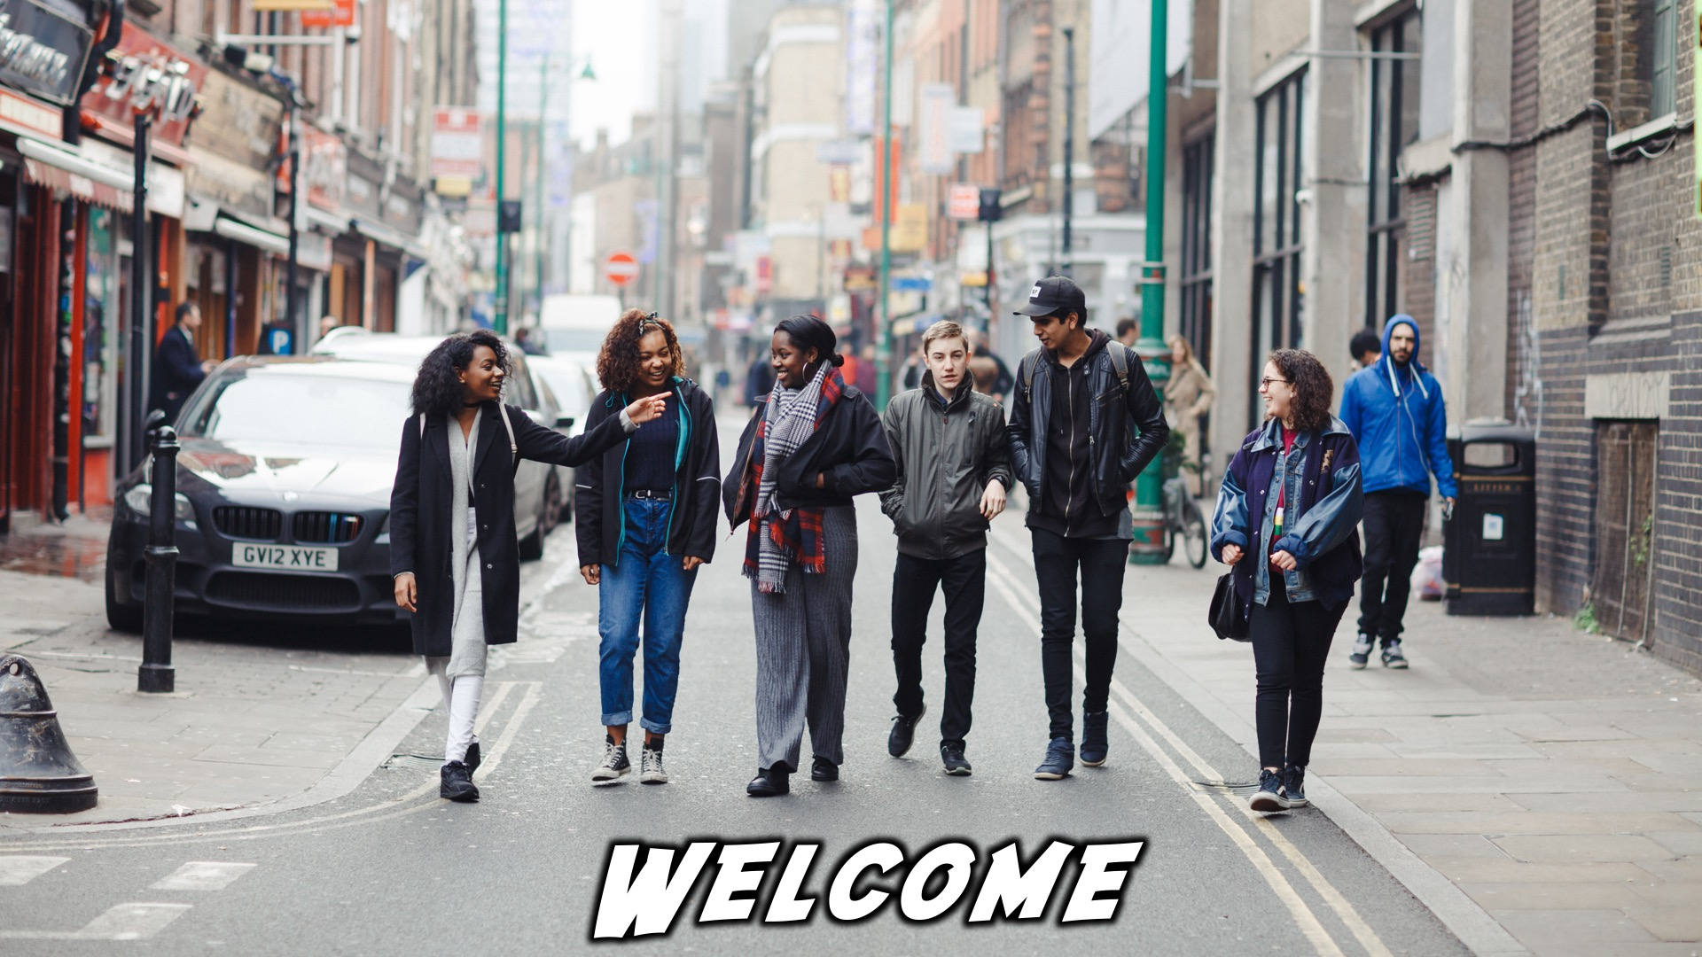
Welcome
Notes:
Welcome to regulars and newcomers!

Slide 3
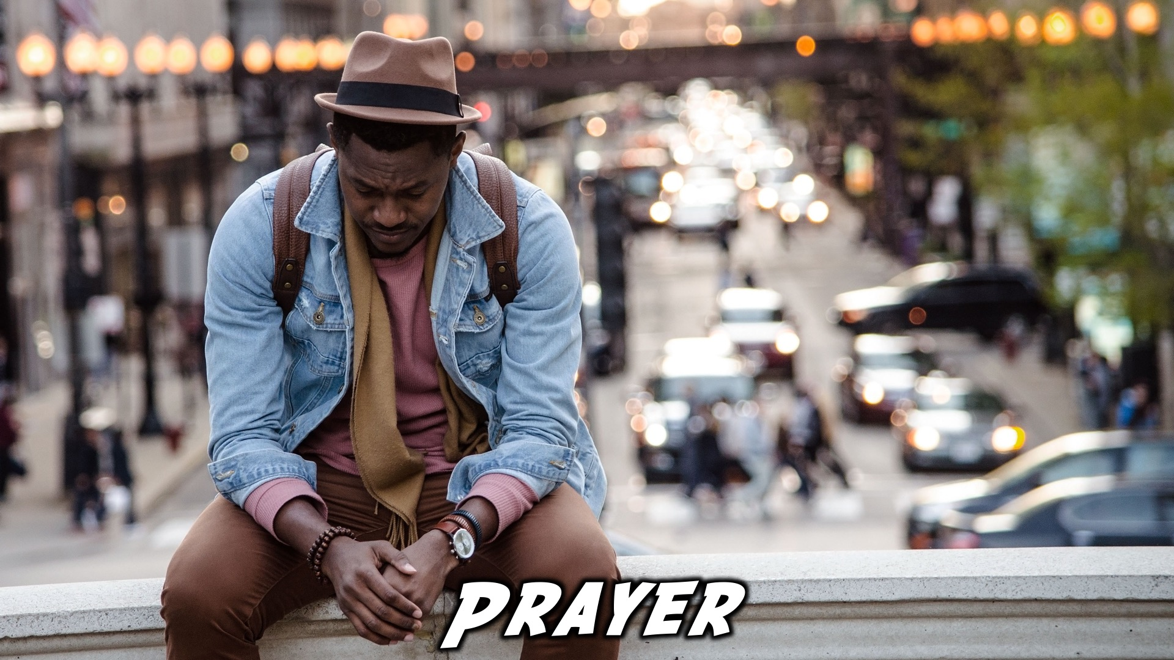
Prayer
Notes:
Prayer: Let’s open our meeting in prayer.

Slide 4

Announcements
Notes:
Announcements: Please Listen up to the following announcement.

Slide 5

Sunday Morning
Notes:
On Sunday we will be doing the David Series. This Sunday the topic is Destiny!

Slide 6

Next Friday
Notes:
Next week we’ll look at being filled with the Holy Spirit!

Slide 7

Notes:
Band Rehearsals

Slide 8

If you want to be involved
in taking photos and
videos on Friday
nights, join the
photography team.
Write your name and
number on the sign-up
sheet after youth.
Photography Team
Notes:
Photo / Video Crew

Slide 9

Follow us on Social Media! @EncounterYouth_Rosebank
Notes:
Announcements: Follow us on Instagram! @EncounterYouth_Rosebank

Slide 10

Join our Group
Notes:
Announcements: Join our Friday Night WhatsApp group!

Slide 11

Tonight
Notes:
Tonight we will explore the topic, “Holy Spirit”

Slide 12

What has been the best and worst parts of your week?
If you could be a superhero, which superhero would you be?
Dinner Time
Notes:
Dinner Time – A simple meal will be served. During the meal there is a question up so that teens can get to know each other.
What has been the best and worst parts of your week?
If you could be a superhero, which superhero would you be?

Slide 13
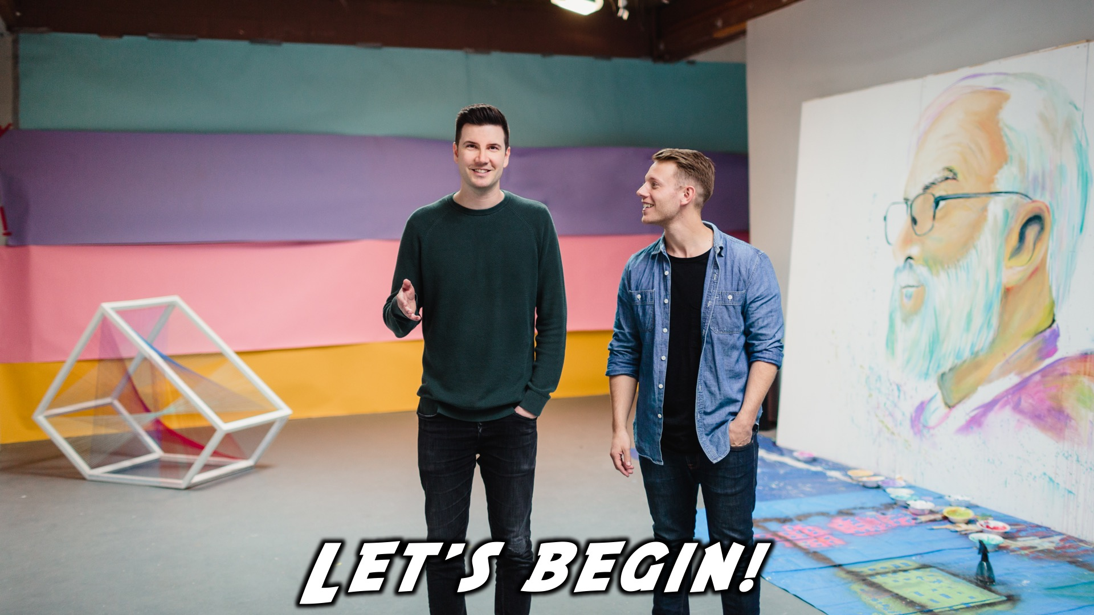
Let’s begin!
Notes:
Let’s begin the journey.

Slide 14
Notes:
Video: Part 1

Slide 15

Notes:
Question 1: What do you find scary?

Slide 16
Notes:
Video: Part 2

Slide 17
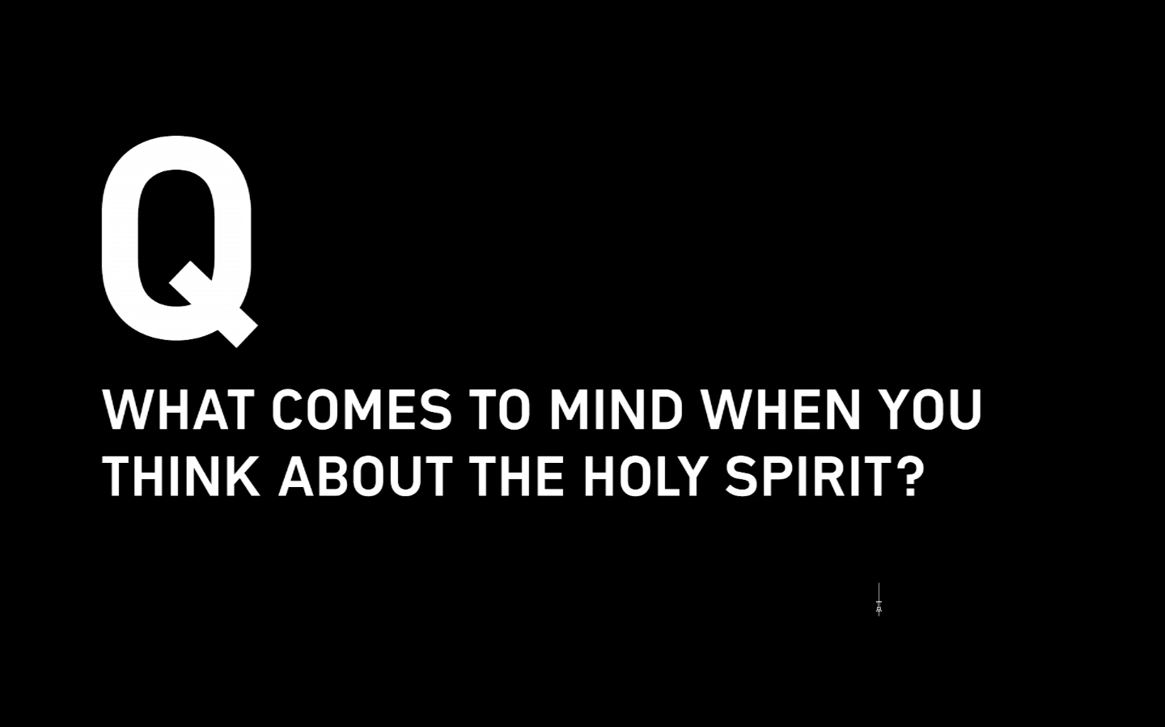
Notes:
Question 2: What comes to mind when you think about the Holy Spirit?

Slide 18
Notes:
Video: Part 3

Slide 19
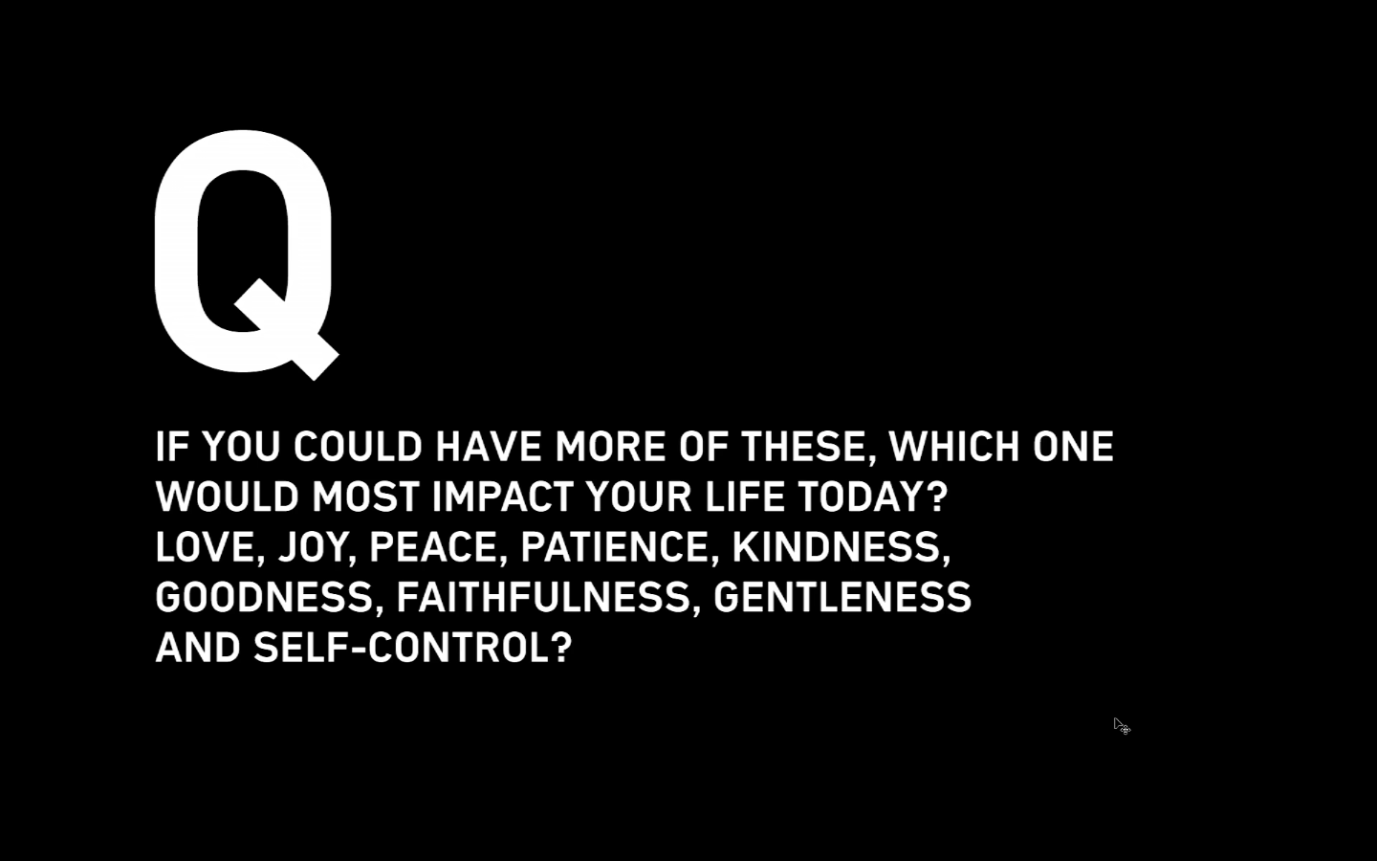
Notes:
Question 3: If you could have more of these, which would most impact your life today? Love, Joy, Peace, Patience, Kindness, Goodness, Faithfulness, Gentleness and Self-Control?

Slide 20
Notes:
Video: Part 4

Slide 21
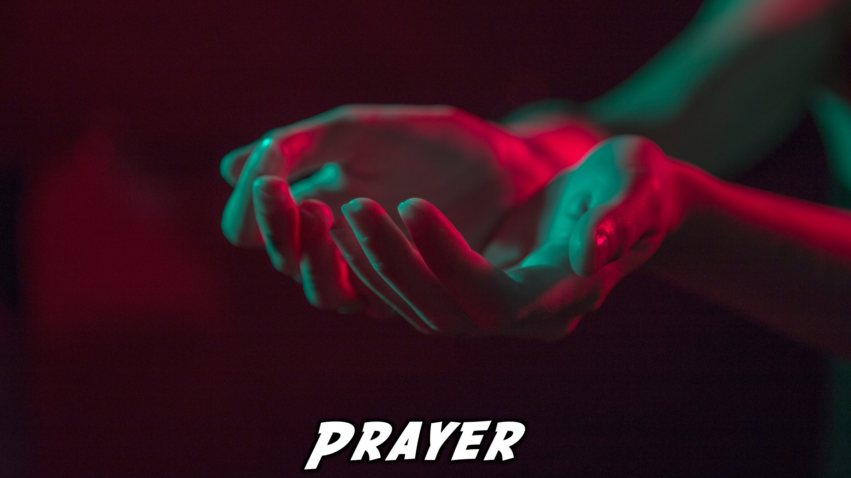
Prayer
Notes:
Close in Prayer

Slide 22

Refreshments
Notes:
Refreshments

Slide 23
Notes:
Thanks for coming – See you next week Friday!

