Slide 1

Notes:
It’s the Alpha Series!

Slide 2

Notes:
Welcome to regulars and newcomers!

Slide 3

Notes:
Prayer: Let’s open our meeting in prayer.

Slide 4

Notes:
Announcements: Please Listen up to the following announcement.

Slide 5

Notes:
On Sunday we will be doing the David Series. This Sunday the topic is Friends!

Slide 6

Notes:
Next week is Games Night!

Slide 7

Notes:
Band Rehearsals

Slide 8

Notes:
Announcements: Follow us on Instagram! @EncounterYouth_Rosebank

Slide 9

Notes:
Announcements: Join our Friday Night WhatsApp group!

Slide 10

Notes:
Tonight we will explore the topic, “Being Filled”

Slide 11

Notes:
Dinner Time – A simple meal will be served. During the meal there is a question up so that teens can get to know each other.
What has been the best and worst parts of your week?
What’s the most ridiculous thing you have bought?
What was the last photo you took?

Slide 12
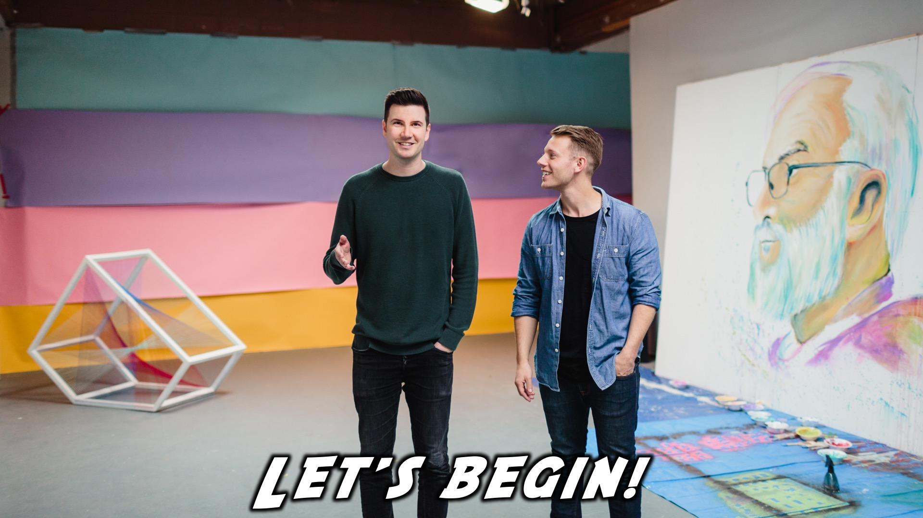
Notes:
Let’s begin the journey.

Slide 13

Notes:
Video: Alpha Video.

Slide 14
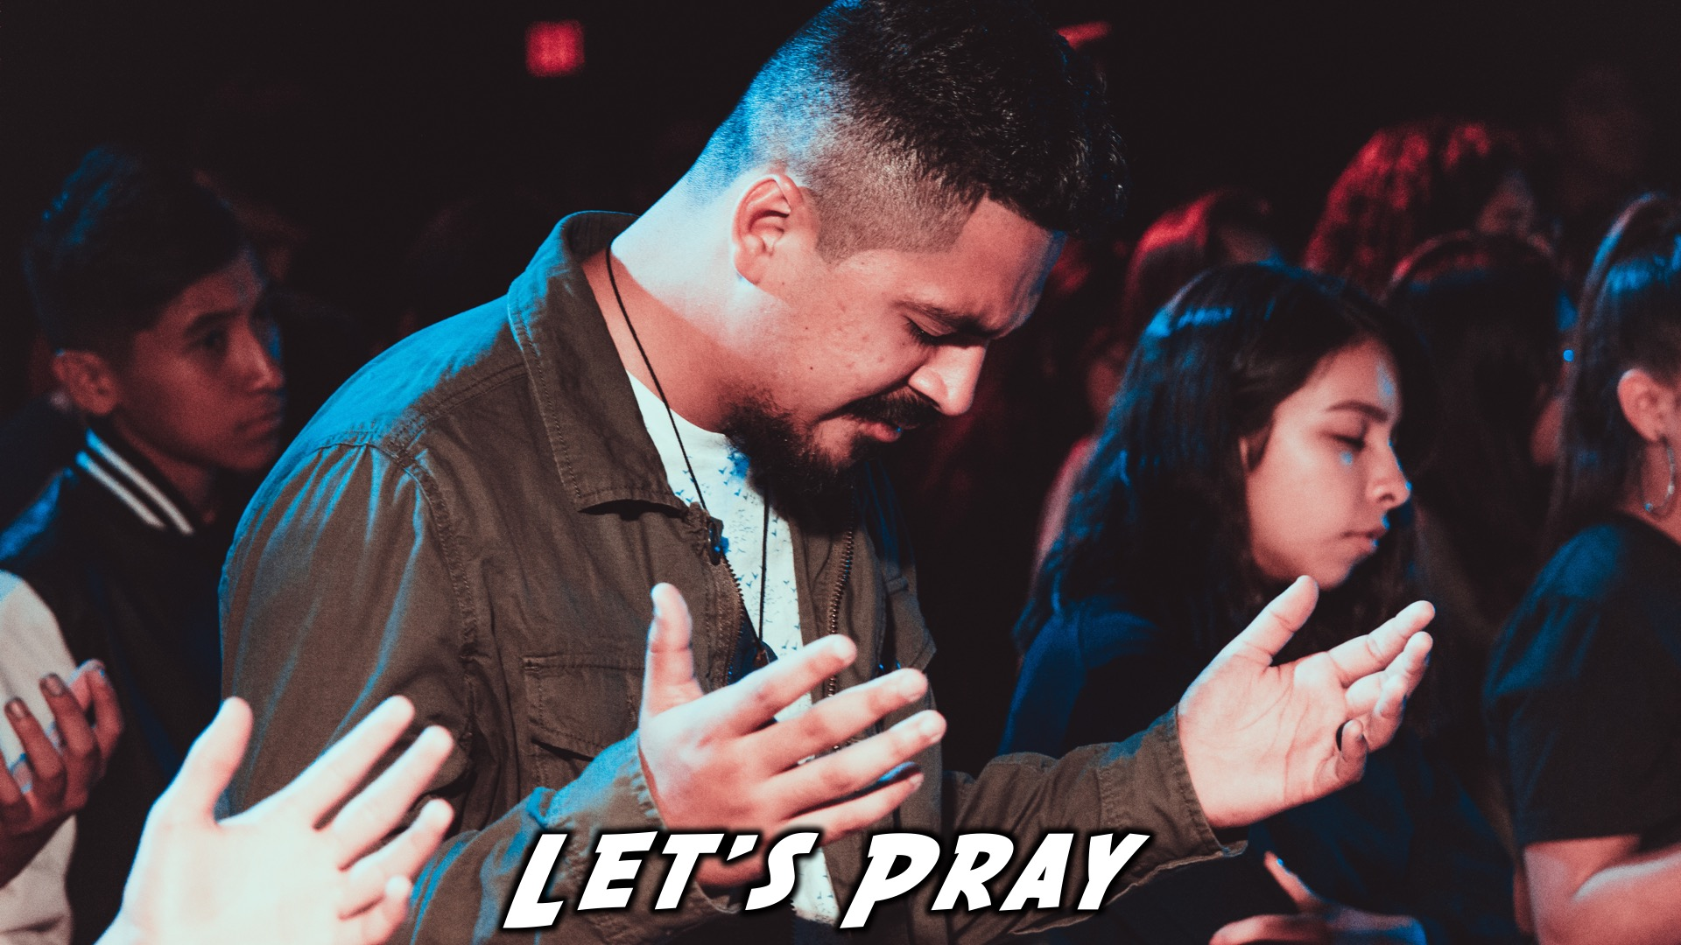
Notes:
Ministry time: We would like to ask that the leaders at the tables handle this ministry moment for their table. It will mean asking each person in the group if they have been baptized in the Holy Spirit, and if not would they like to be. As the leader you would then pray for the teens in your groups to be filled with the Holy Spirit.

Slide 15

Notes:
Refreshments

Slide 16

Notes:
Thanks for coming – See you next week Friday!

