Slide 1

Notes:
It’s the Alpha Series!

Slide 2

Notes:
Welcome to regulars and newcomers!

Slide 3
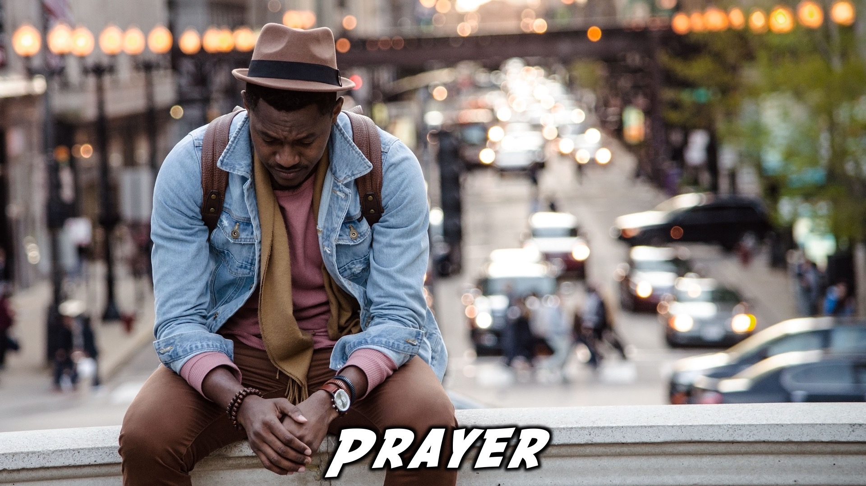
Notes:
Prayer: Let’s open our meeting in prayer.

Slide 4

Notes:
Announcements: Please Listen up to the following announcement.

Slide 5
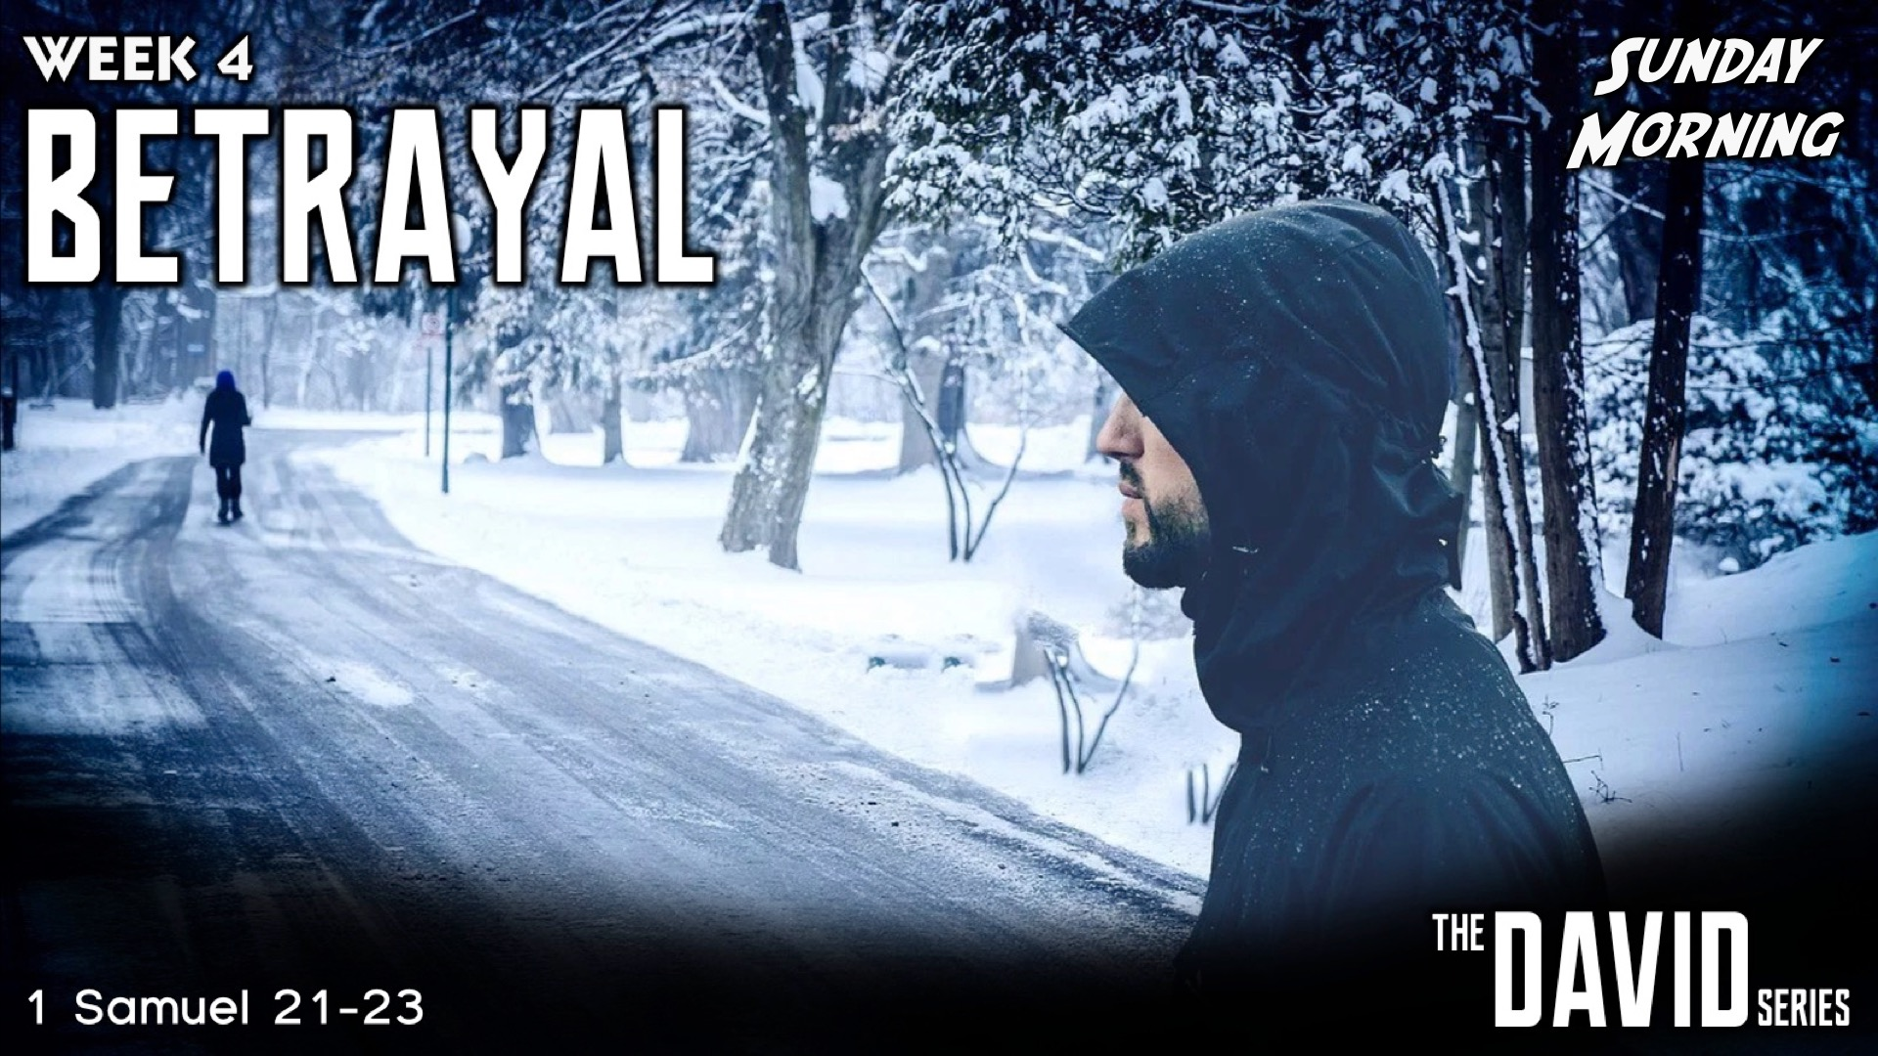
Notes:
On Sunday we will be doing the David Series. This Sunday the topic is Betrayal!

Slide 6

Notes:
Next week we will be exploring the topic, “Life”

Slide 7

Notes:
Band Rehearsals

Slide 8

Notes:
Announcements: Follow us on Instagram! @EncounterYouth_Rosebank

Slide 9

Notes:
Announcements: Join our Friday Night WhatsApp group!

Slide 10
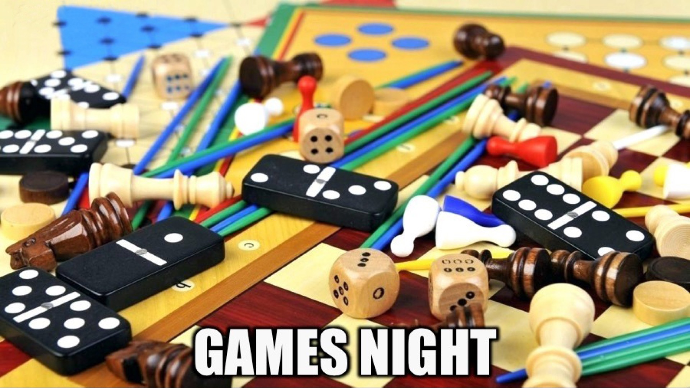
Notes:
Tonight is Games Night!!

Slide 11
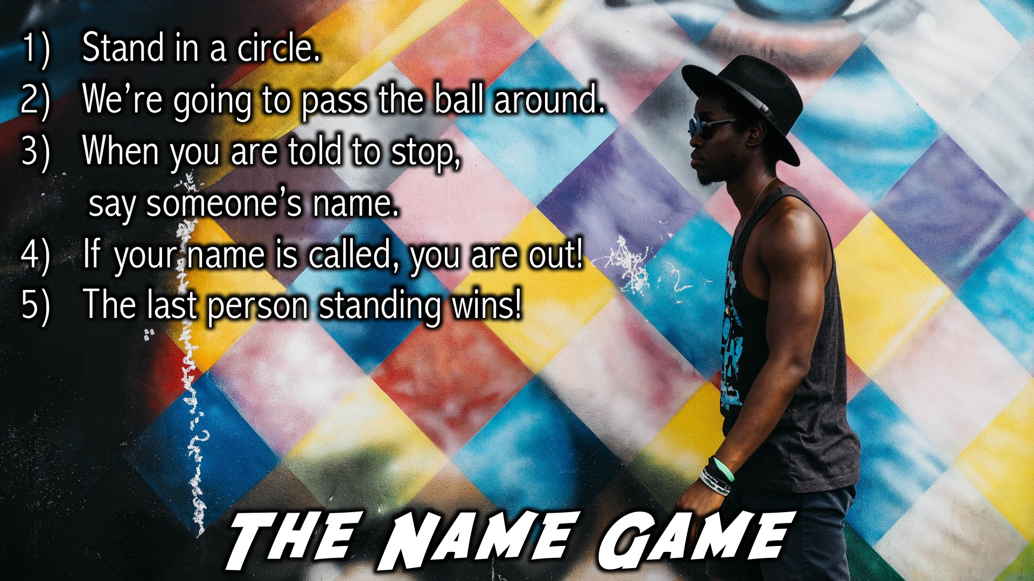
Notes:
The Name Game: (1) Stand in a circle. (2) We’re going to pass the ball around. (3) When you are told to stop, say someone’s name. (4) If your name is called, you are out! (5) The last person standing wins!

Slide 12
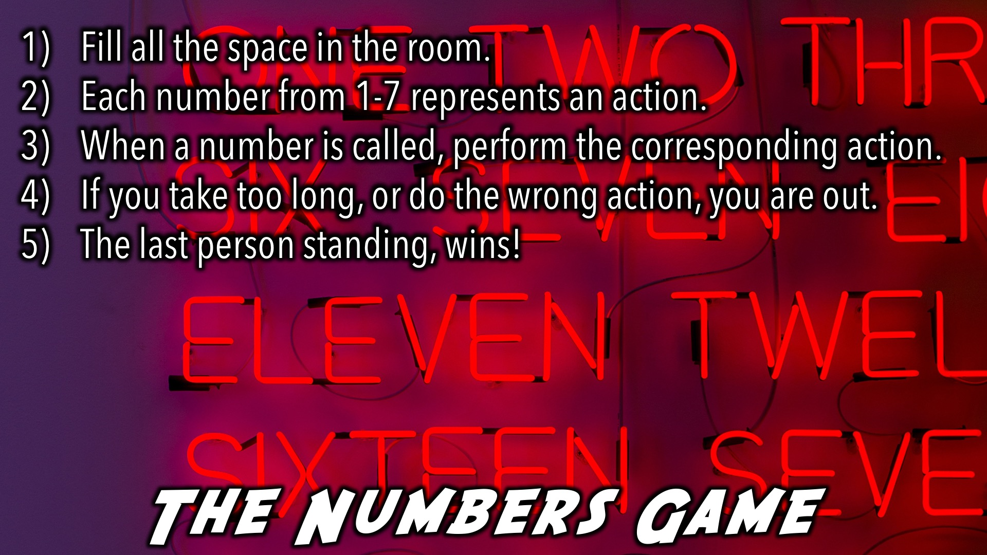
Notes:
The Numbers Game: (1) Fill all the space in the room. (2) Each number from 1-7 represents an action. ¹Walk on the spot, ²Sit on the floor, ³Lie on your back, ⁴Lie on your Stomach, ⁵Do not move, ⁶Run on the Spot, ⁷Kneel and pray!) (3) When a number is called, perform the corresponding action. (4) If you take too long, or do the wrong action, you are out. (5) The last person standing, wins!

Slide 13
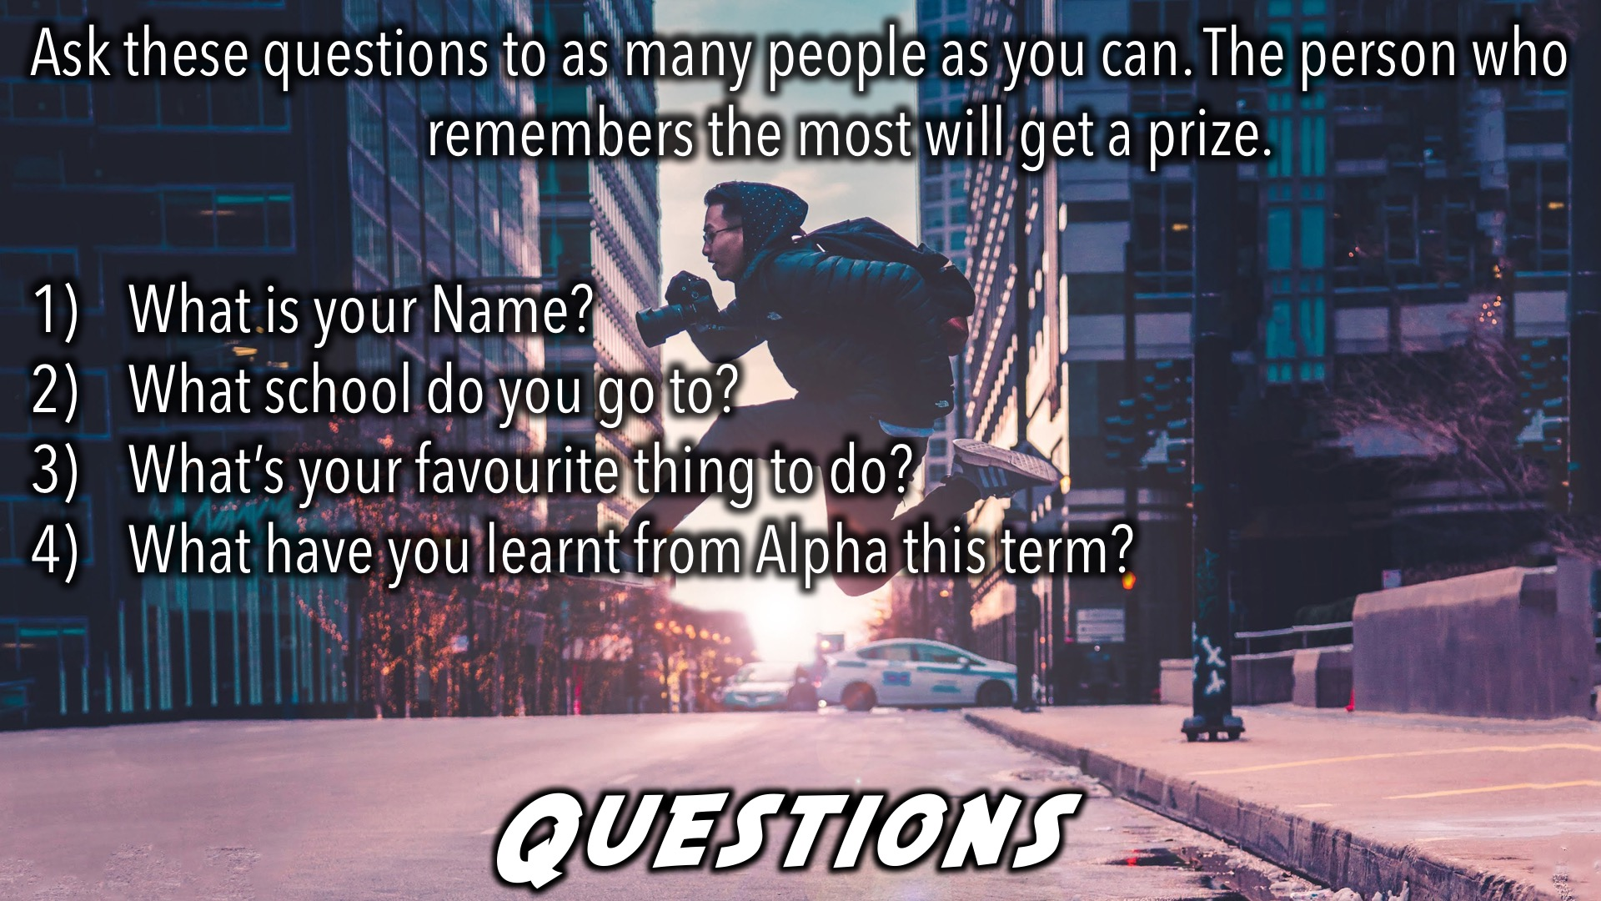
Notes:
Ask these questions to as many people as you can. The person who remembers the most will get a prize.
(1) What is your Name? (2) What school do you go to? (3) What’s your favourite thing to do? (4) What have you learnt from Alpha this term?

Slide 14

Notes:
Tonight is chilled, pick a game and have fun, getting to know different people.

Slide 15

Notes:
Tonight is chilled, pick a game and have fun, getting to know different people.

Slide 16

Notes:
Tonight is chilled, pick a game and have fun, getting to know different people.

Slide 17
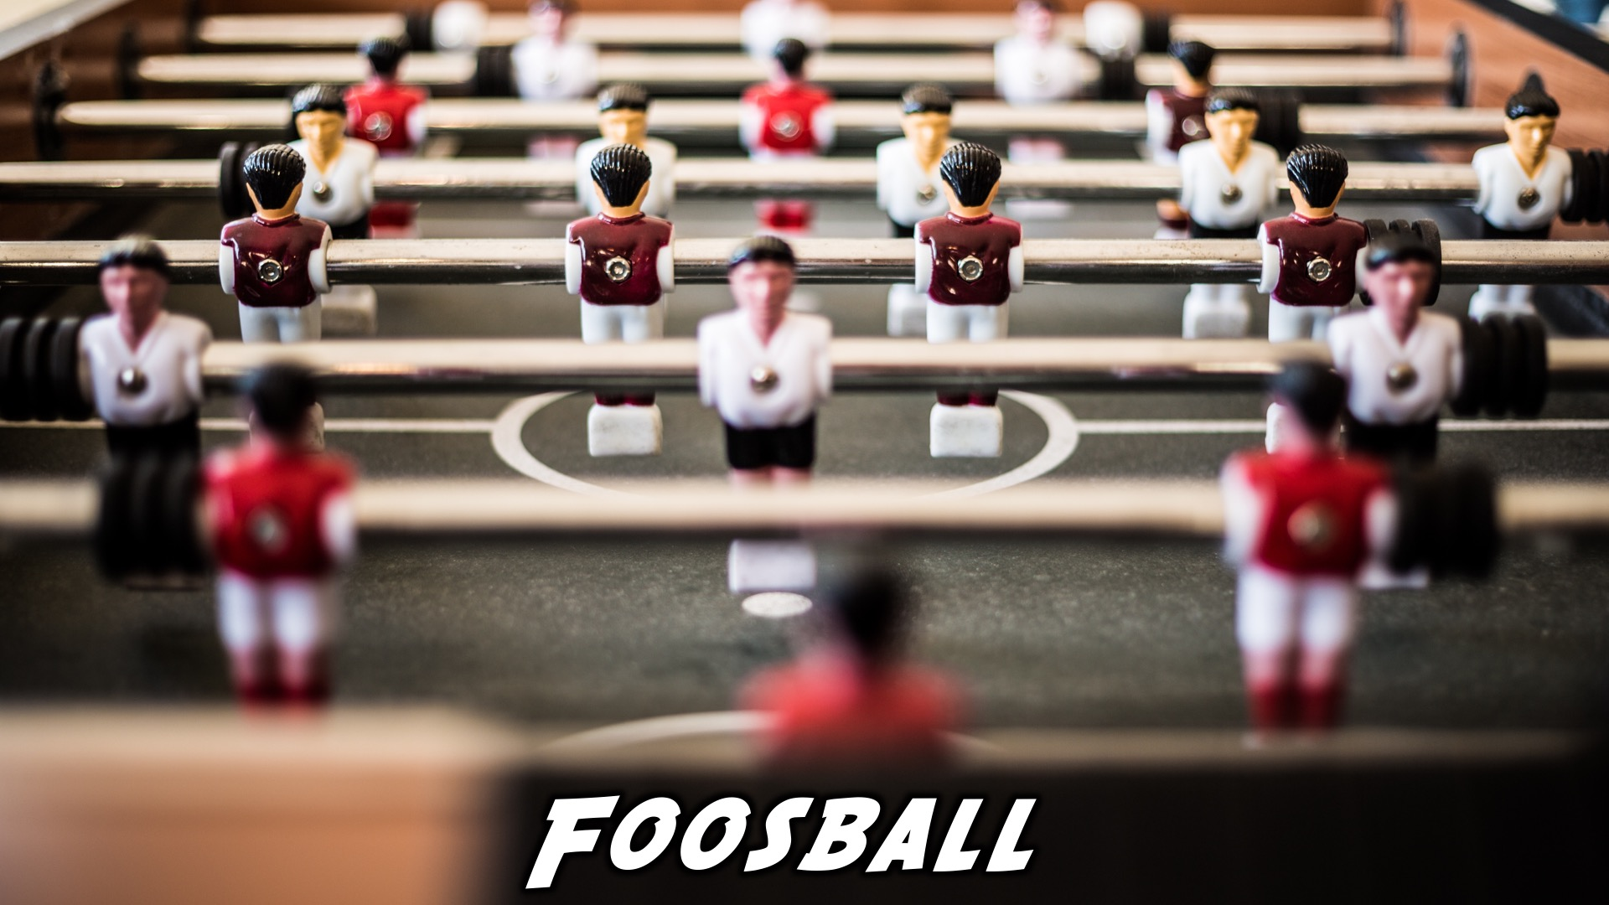
Notes:
Tonight is chilled, pick a game and have fun, getting to know different people.

Slide 18

Notes:
Tonight is chilled, pick a game and have fun, getting to know different people.

Slide 19
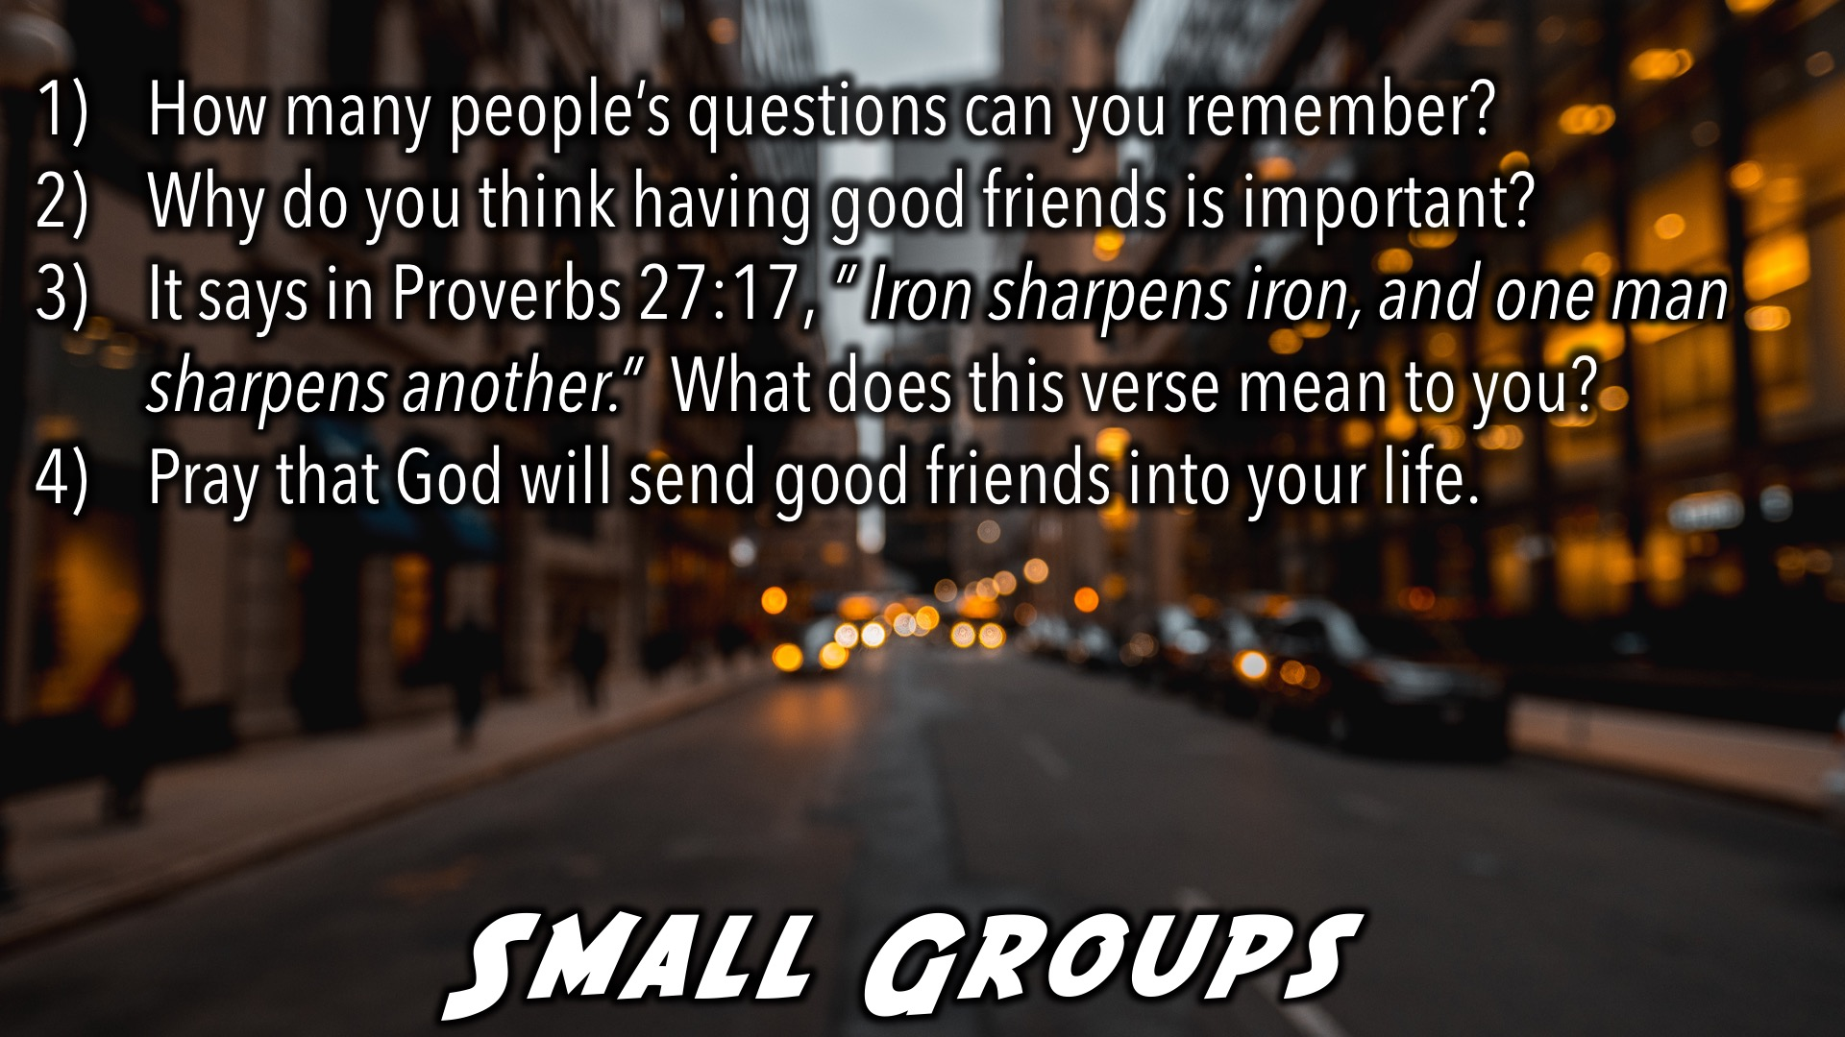
Notes:
Small Groups: (1) How many people’s questions can you remember? (2) Why do you think good friends are important to have? (3) It says in Proverbs 27:17, ” Iron sharpens iron, and one man sharpens another.” What does this verse mean to you? (4) Pray that God will send good friends into your life.

Slide 20

Notes:
Refreshments

Slide 21
Notes:
Thanks for coming – See you next week Friday!

