Slide 1

Notes:
It’s the Alpha Series!

Slide 2

Notes:
Welcome to regulars and newcomers!

Slide 3
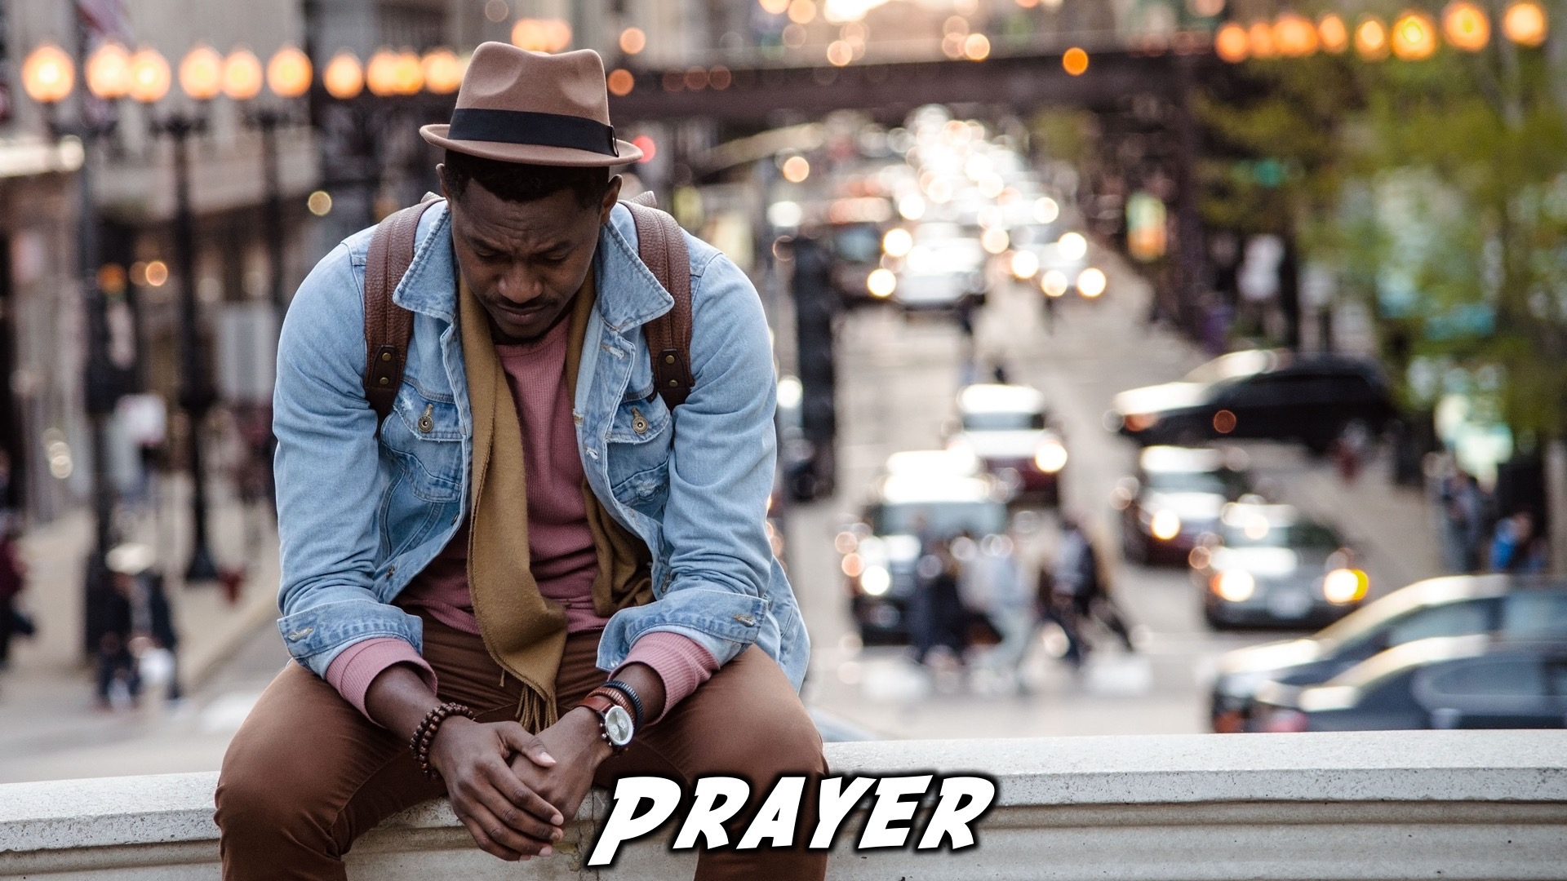
Notes:
Prayer: Let’s open our meeting in prayer.

Slide 4

Notes:
Announcements: Please Listen up to the following announcement.

Slide 5

Notes:
On Sunday we will be doing the David Series. This Sunday the topic is Revenge!

Slide 6

Notes:
Next week on Alpha, we’ll look at Telling Others!

Slide 7

Notes:
Band Rehearsals

Slide 8

Notes:
Announcements: Follow us on Instagram! @EncounterYouth_Rosebank

Slide 9

Notes:
Announcements: Join our Friday Night WhatsApp group!

Slide 10

Notes:
Tonight we will explore the topic, “New Life.”

Slide 11

Notes:
Dinner Time – A simple meal will be served. During the meal there is a question up so that teens can get to know each other.
What has been the best and worst parts of your week?
If you had to disappear and start a whole new life, what would you want your new life to look like?

Slide 12
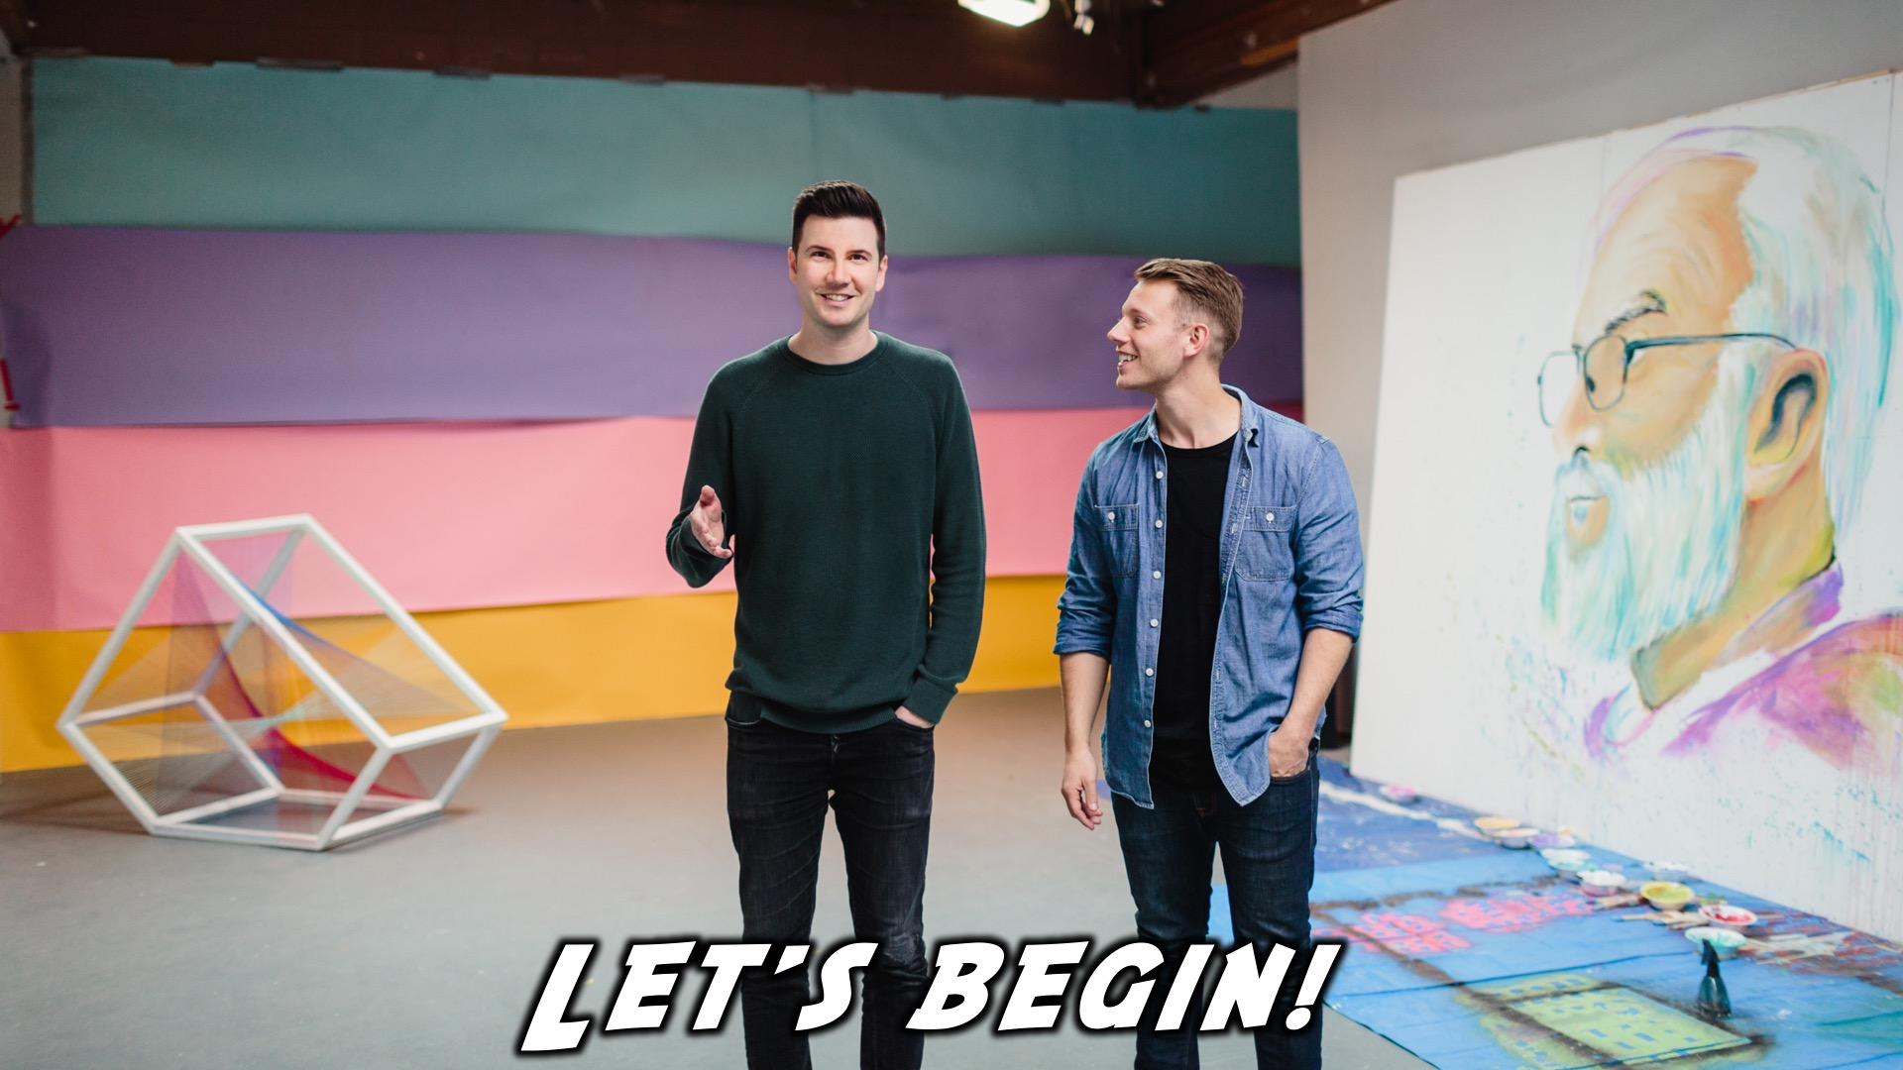
Notes:
Let’s begin the journey.

Slide 13

Notes:
Video: Part 1

Slide 14

Notes:
Question 1: If you could go back in time and give your past self some advice, what would you say?

Slide 15

Notes:
Video: Part 2

Slide 16

Notes:
Question 2: How have you felt pressured to fit in?

Slide 17

Notes:
Video: Part 3

Slide 18

Notes:
Question 3: How do you feel about the idea that God has a purpose for your life?

Slide 19

Notes:
Video: Part 4

Slide 20
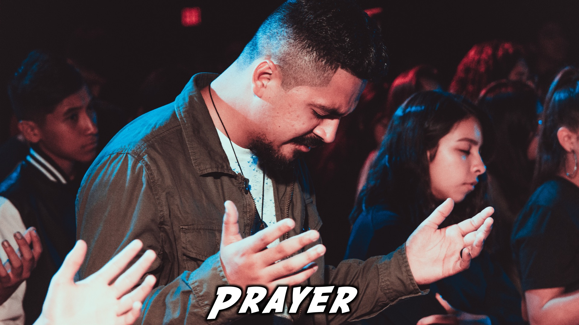
Notes:
Prayer

Slide 21

Notes:
Refreshments

Slide 22
Notes:
Thanks for coming – See you next week Friday!

