Slide 1

Notes:
It’s the Alpha Series!

Slide 2

Notes:
Welcome to regulars and newcomers!

Slide 3
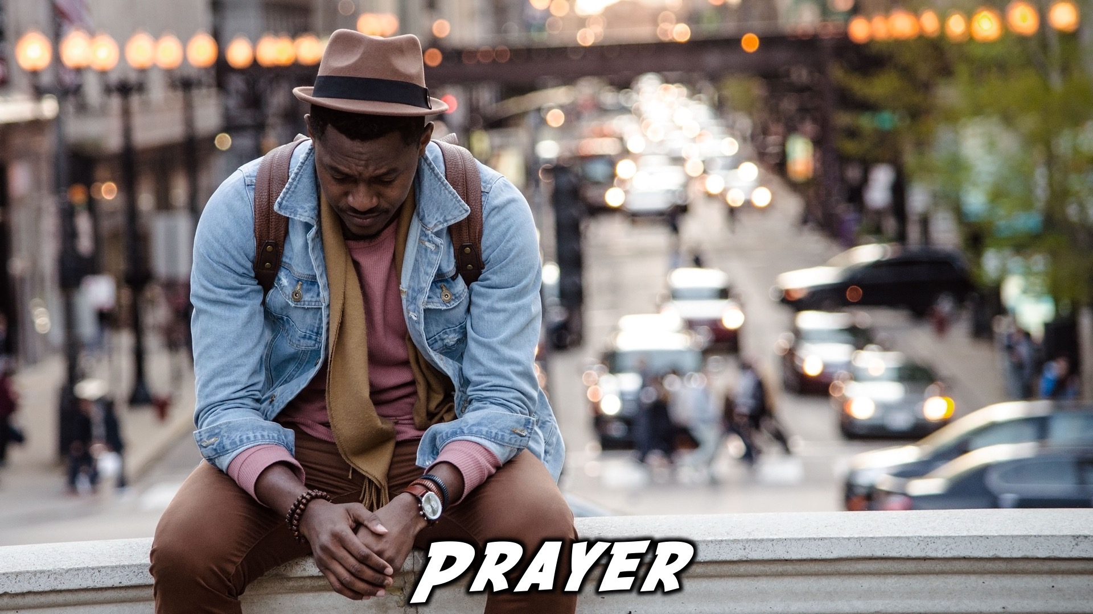
Notes:
Prayer: Let’s open our meeting in prayer.

Slide 4

Notes:
Announcements: Please Listen up to the following announcement.

Slide 5

Notes:
On Sunday we will be doing the David Series. This Sunday the topic is Trials.

Slide 6

Notes:
Next week we’ll be having our Quiz night!

Slide 7

Notes:
Announcements: Follow us on Instagram! @EncounterYouth_Rosebank

Slide 8

Notes:
Announcements: Join our Friday Night WhatsApp group!

Slide 9

Notes:
Tonight we will explore the topic, “Telling Others.”

Slide 10
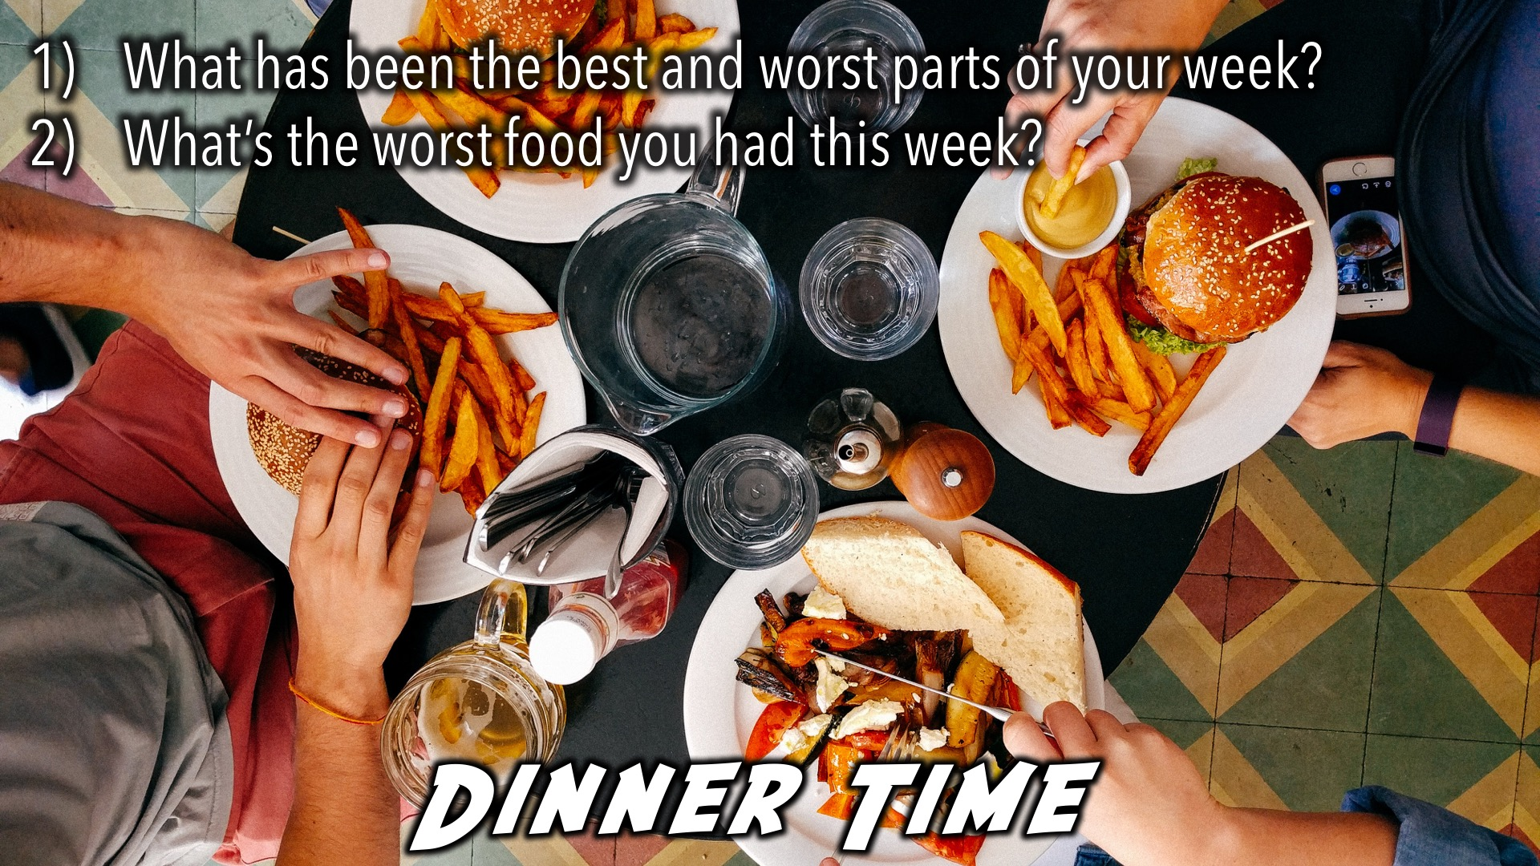
Notes:
Dinner Time – A simple meal will be served. During the meal there is a question up so that teens can get to know each other.
What has been the best and worst parts of your week?
What’s the worst food you had this week?

Slide 11
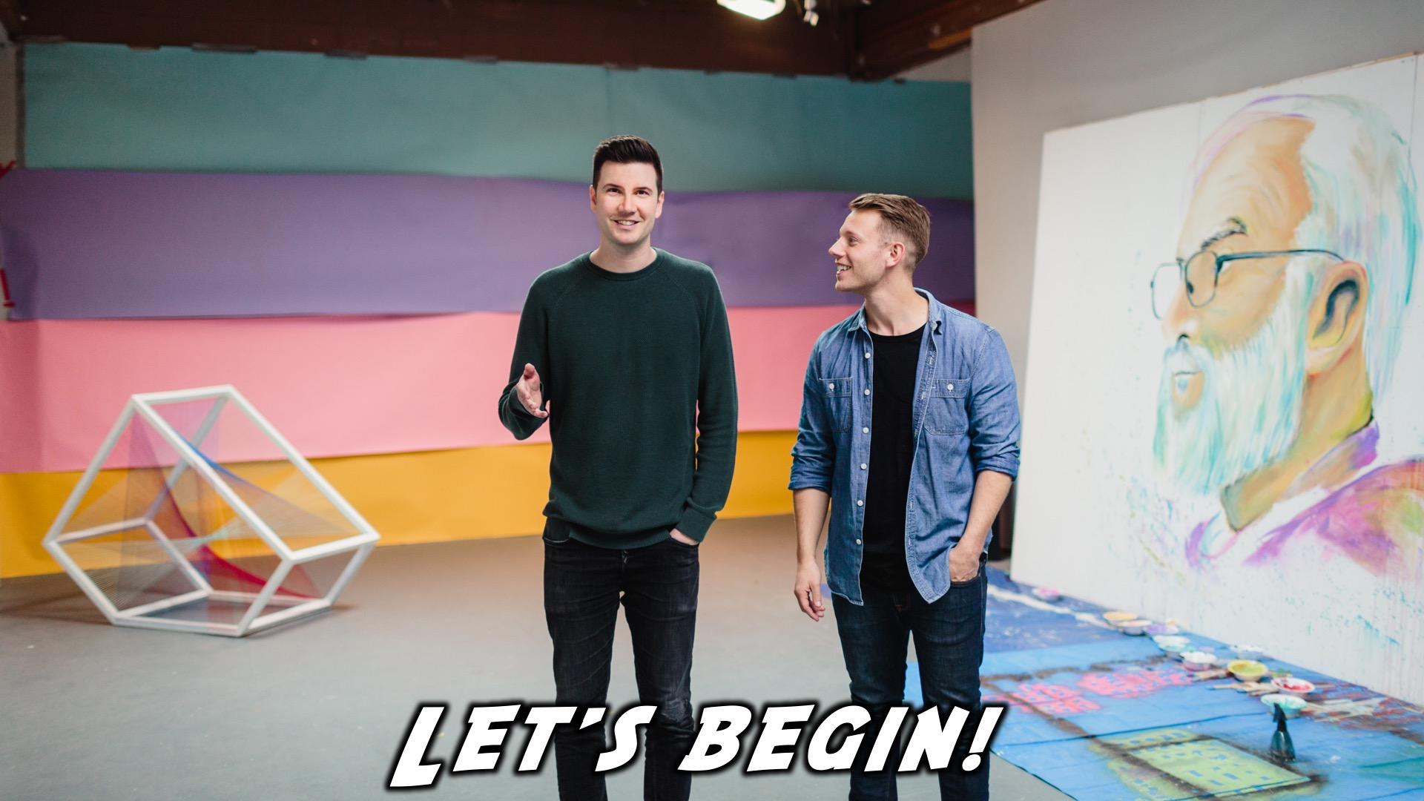
Notes:
Let’s begin the journey.

Slide 12

Notes:
Video: Part 1

Slide 13

Notes:
Question 1: What is your most embarrassing moment?

Slide 14

Notes:
Video: Part 2

Slide 15
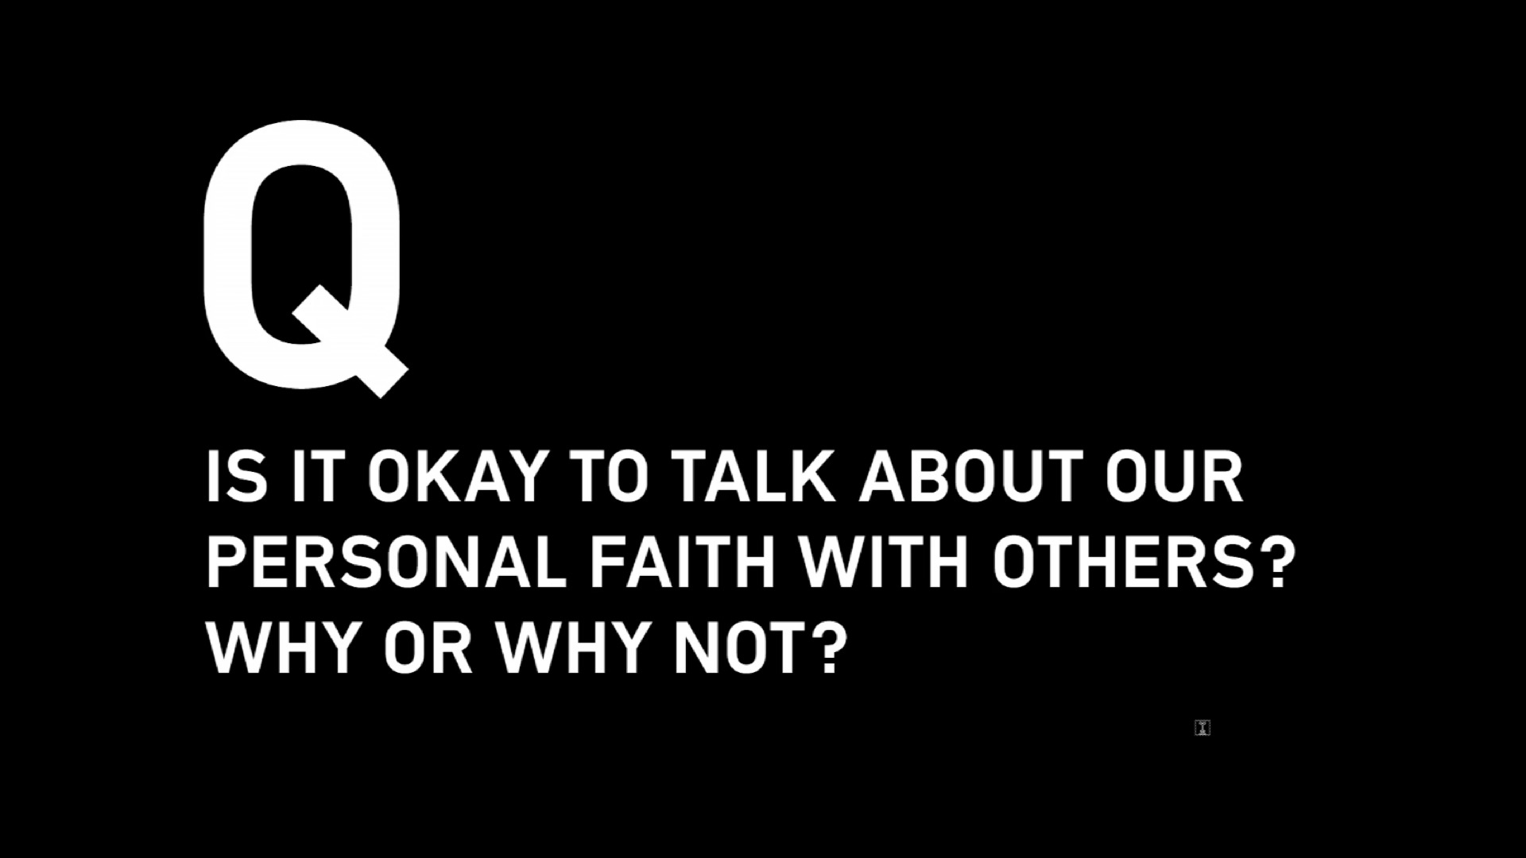
Notes:
Question 2: Is it okay to talk about our personal faith with others? Why or Why not?

Slide 16

Notes:
Video: Part 3

Slide 17

Notes:
Question 3: What should the impact of Christians be in society?

Slide 18

Notes:
Video: Part 4

Slide 19
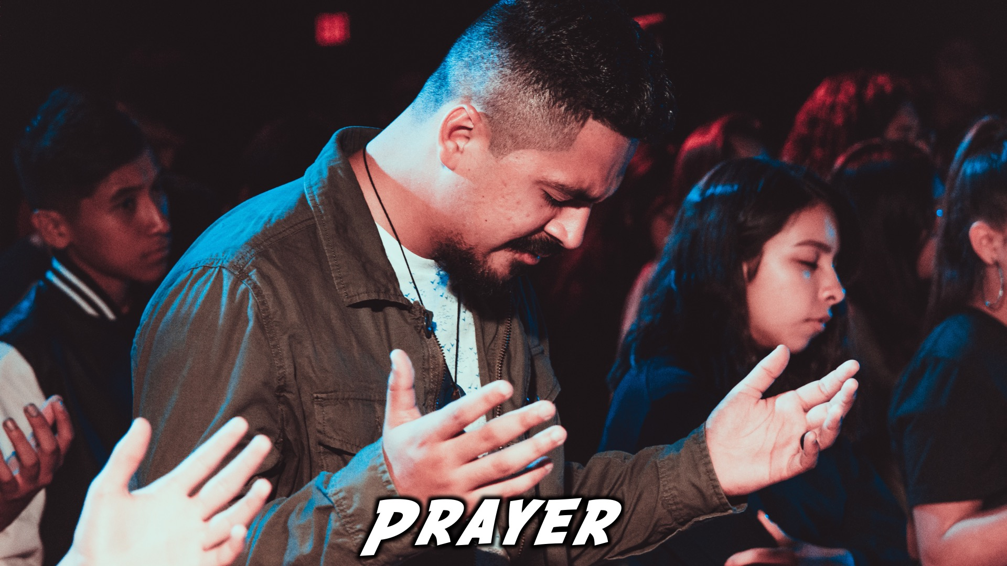

Slide 20

Notes:
Refreshments

Slide 21
Notes:
Thanks for coming – See you next week Friday!

Slide 22
Notes:
Next week we’ll be having our Quiz night!

