Slide 1

Notes:
It’s the Alpha Series!

Slide 2

Notes:
Welcome to regulars and newcomers!

Slide 3
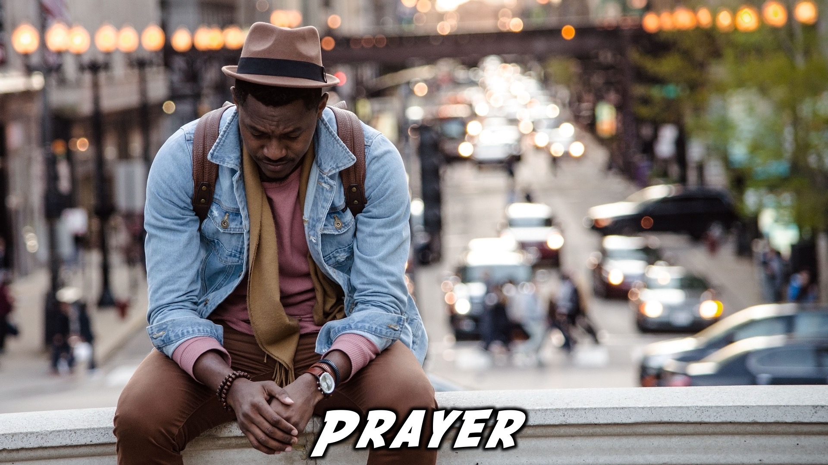
Notes:
Prayer: Let’s open our meeting in prayer.

Slide 4

Notes:
Announcements: Please Listen up to the following announcement.

Slide 5

Notes:
On Sunday we will be doing the David Series. This Sunday the topic is Power.

Slide 6

Notes:
Next week we’ll be discussing the topic, “Healing”

Slide 7

Notes:
Join us for our Gospel Outreach tomorrow!

Slide 8

Notes:
Announcements: Follow us on Instagram! @EncounterYouth_Rosebank

Slide 9

Notes:
Announcements: Join our Friday Night WhatsApp group!

Slide 10

Notes:
Tonight is Quiz Night!

Slide 11

Notes:
The Quiz

Slide 12
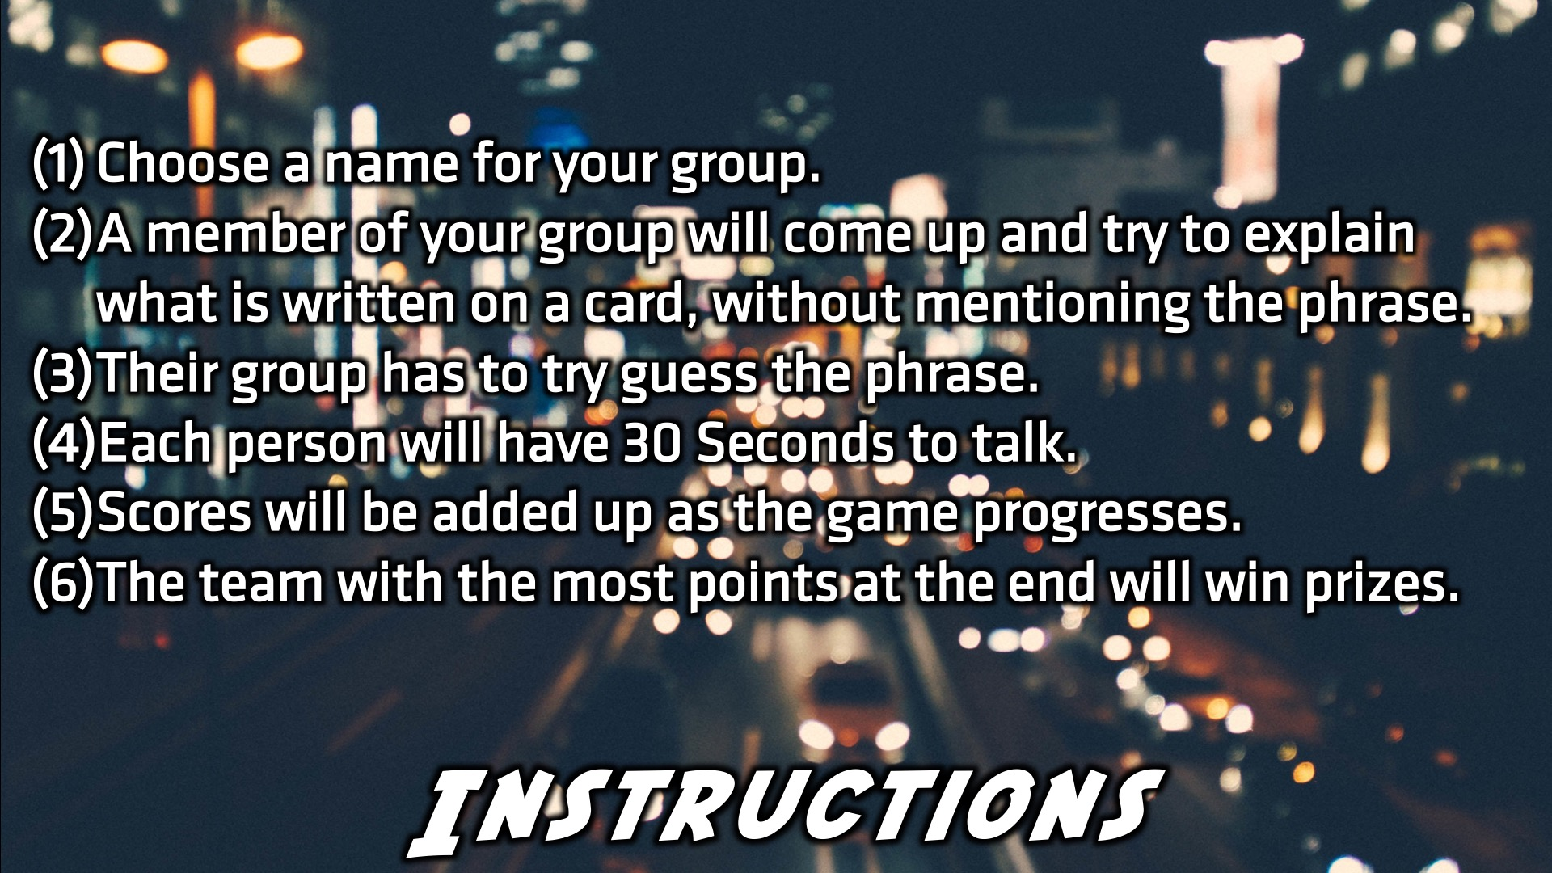
Notes:
The Quiz Instructions

Slide 13
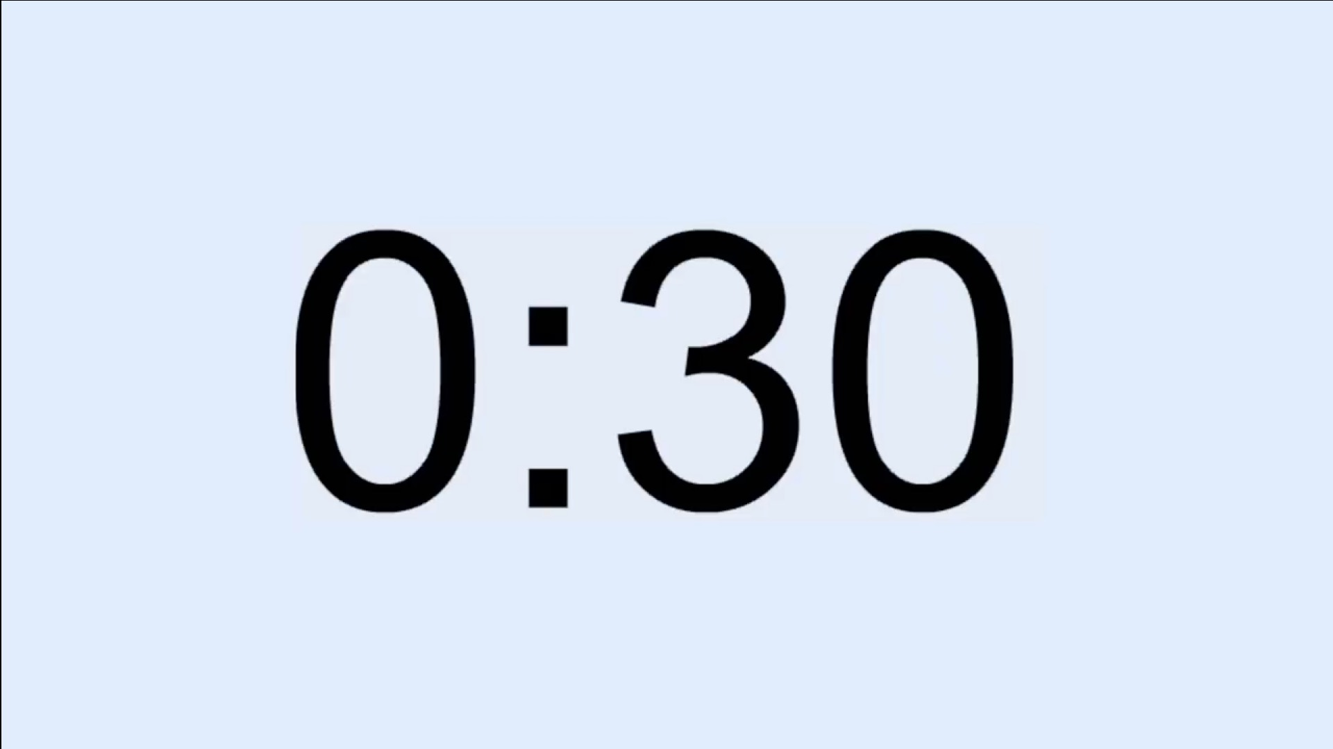
Notes:
30 Second Timer: Find on YouTube at https://www.youtube.com/watch?v=JytX3FX_nNg

Slide 14
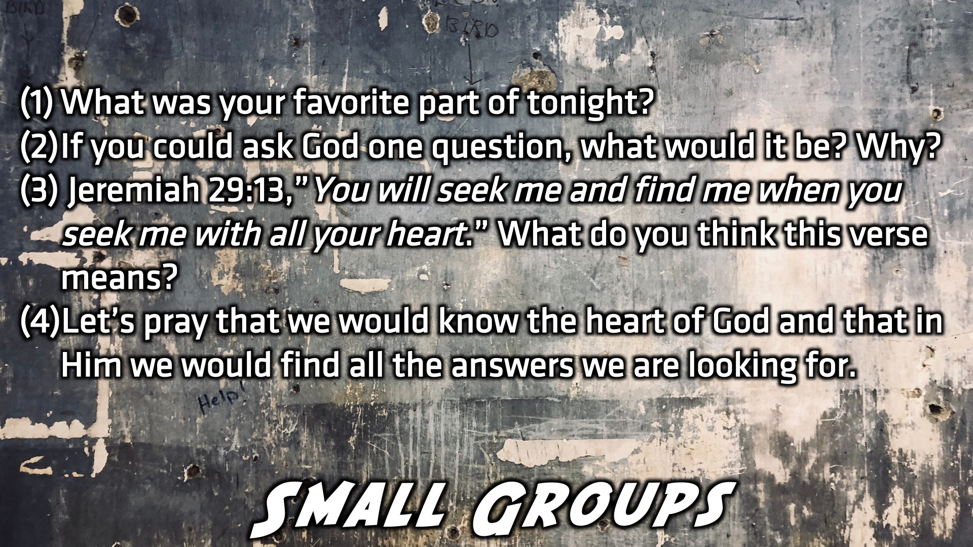
Notes:
Small Group Discussion: (1) What was your favorite part of tonight? (2) If you could ask God one question, what would it be? Why? (3) Jeremiah 29:13,” You will seek me and find me when you seek me with all your heart.” What do you think this verse means? (4) Let’s pray that we would know the heart of God and that in Him we would find all the answers we are looking for.

