Slide 1

Notes:
It’s the Alpha Series!

Slide 2
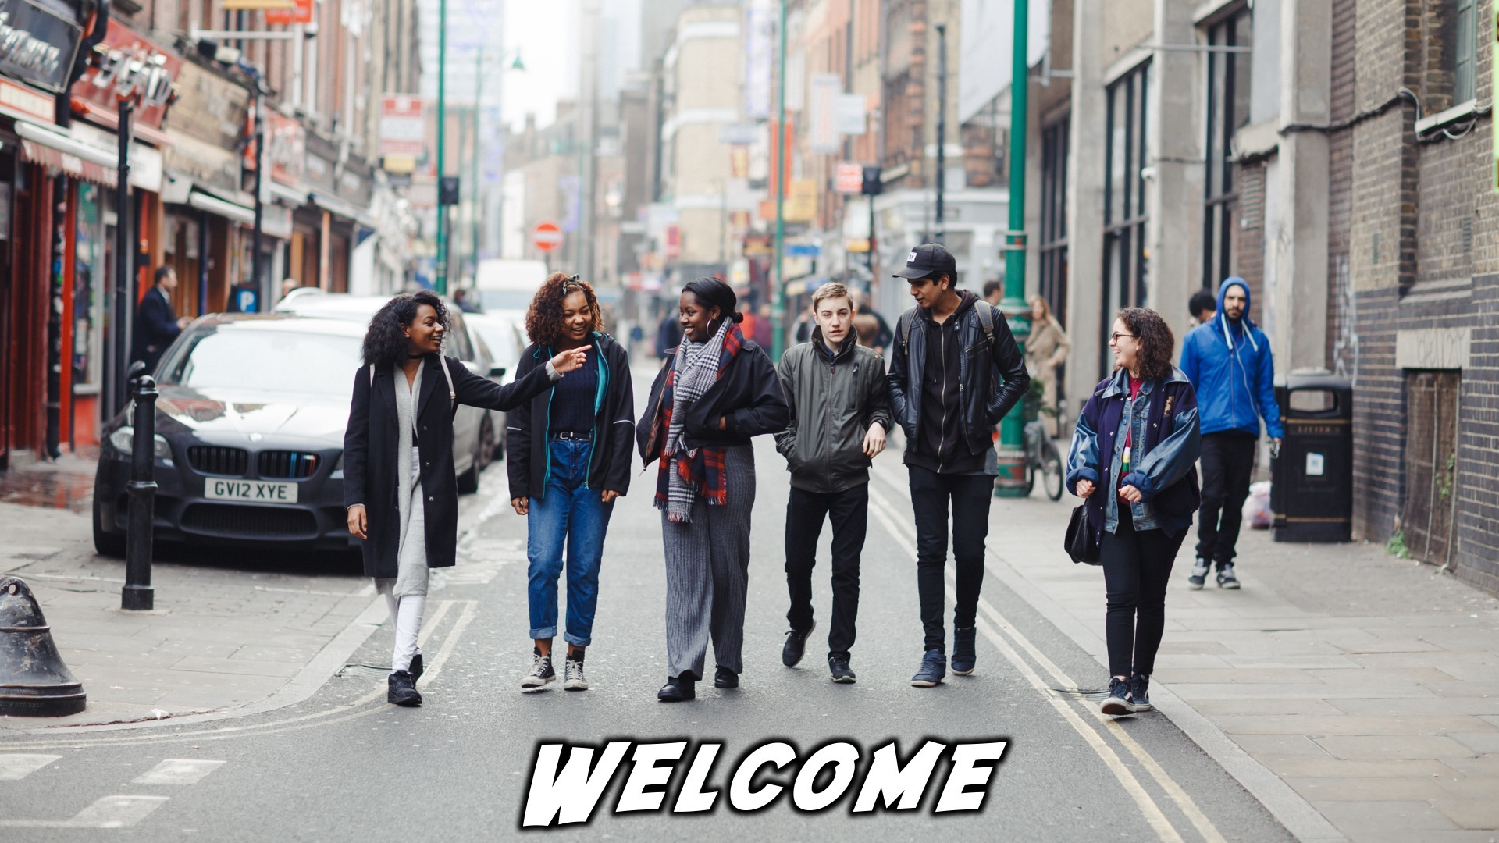
Notes:
Welcome to regulars and newcomers!

Slide 3
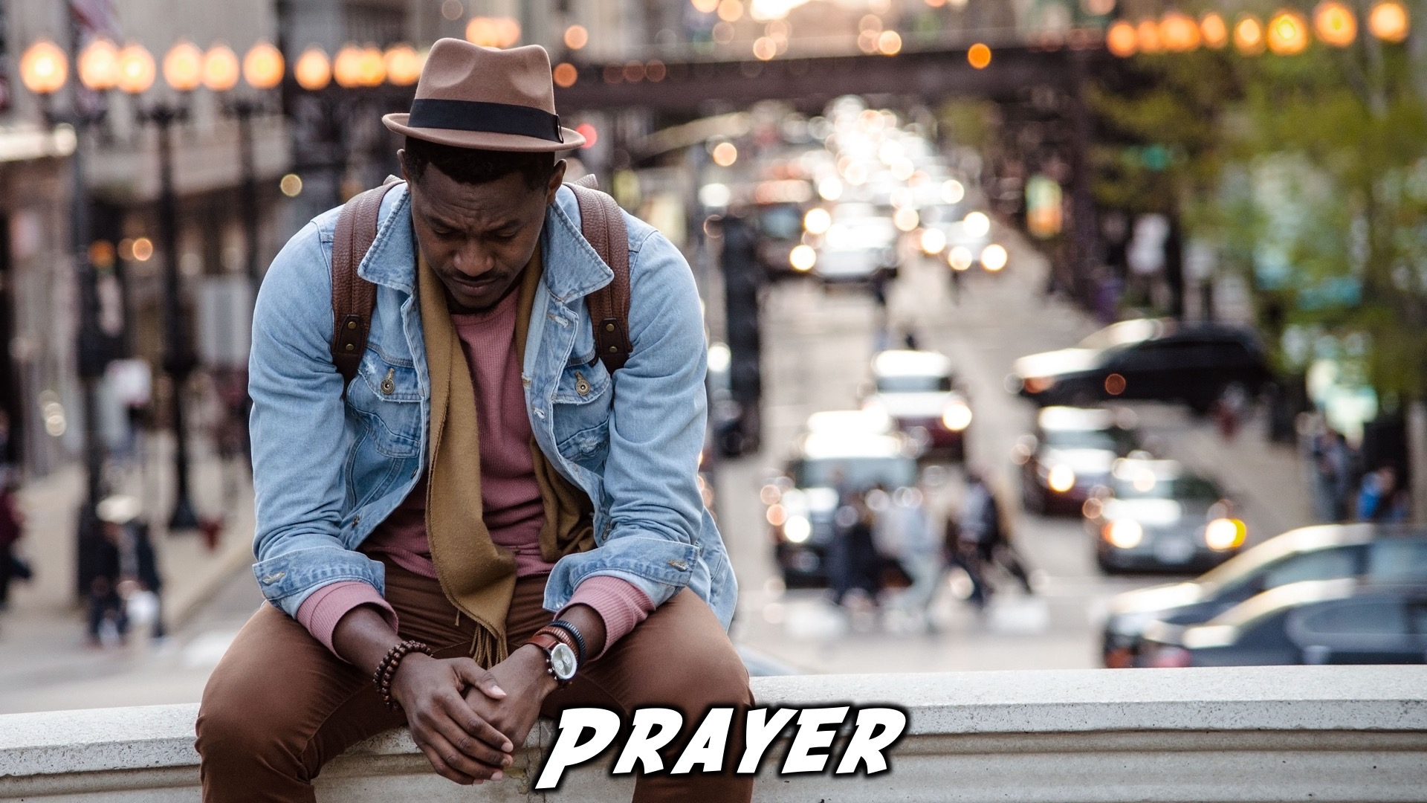
Notes:
Prayer: Let’s open our meeting in prayer.

Slide 4

Notes:
Announcements: Please Listen up to the following announcement.

Slide 5

Notes:
On Sunday we will be doing the David Series. This Sunday the topic is Lust.

Slide 6

Notes:
Next week we’ll be exploring the topic. “Church.”

Slide 7

Notes:
Announcements: Follow us on Instagram! @EncounterYouth_Rosebank

Slide 8

Notes:
Announcements: Join our Friday Night WhatsApp group!

Slide 9

Notes:
Tonight we will explore the topic, “Healing.”

Slide 10

Notes:
Dinner Time – A simple meal will be served. During the meal there is a question up so that teens can get to know each other. (1)What has been the best and worst parts of your week? (2) What’s your proudest moment?

Slide 11
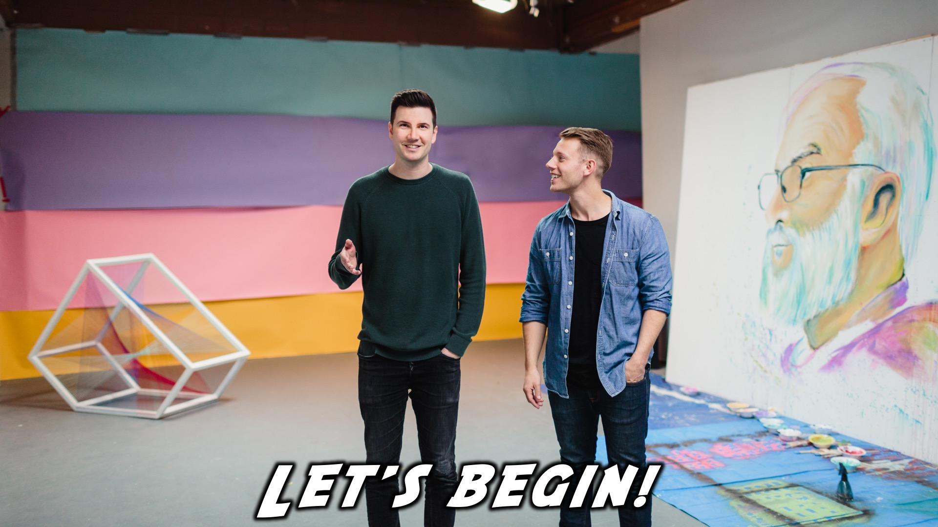
Notes:
Let’s begin the journey.

Slide 12

Notes:
Video: Part 1

Slide 13

Notes:
Question 1: What technology would you love to see invented?

Slide 14

Notes:
Video: Part 2

Slide 15

Notes:
Question 2: What do you think about the idea that God heals people today?

Slide 16
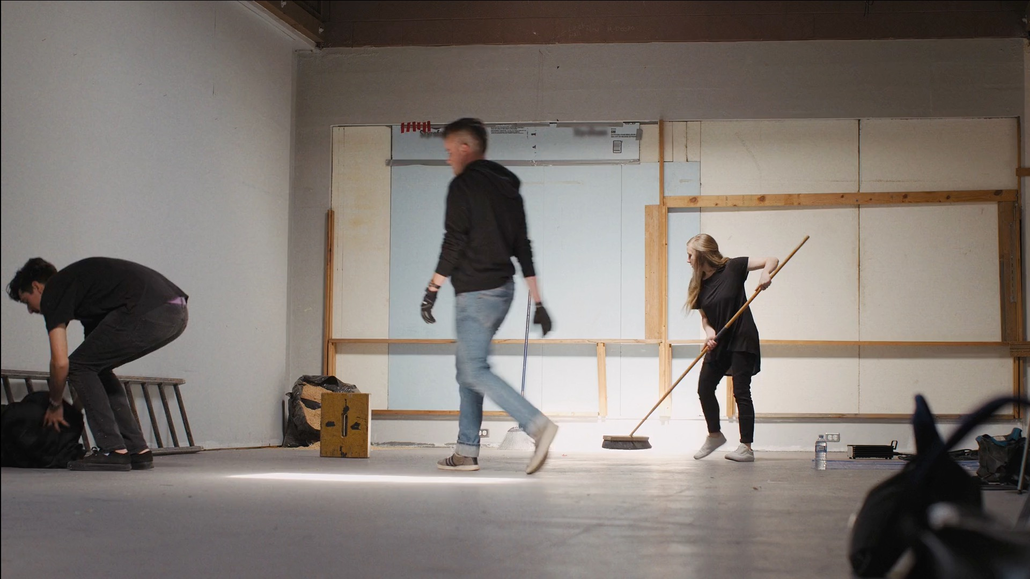
Notes:
Video: Part 3

Slide 17
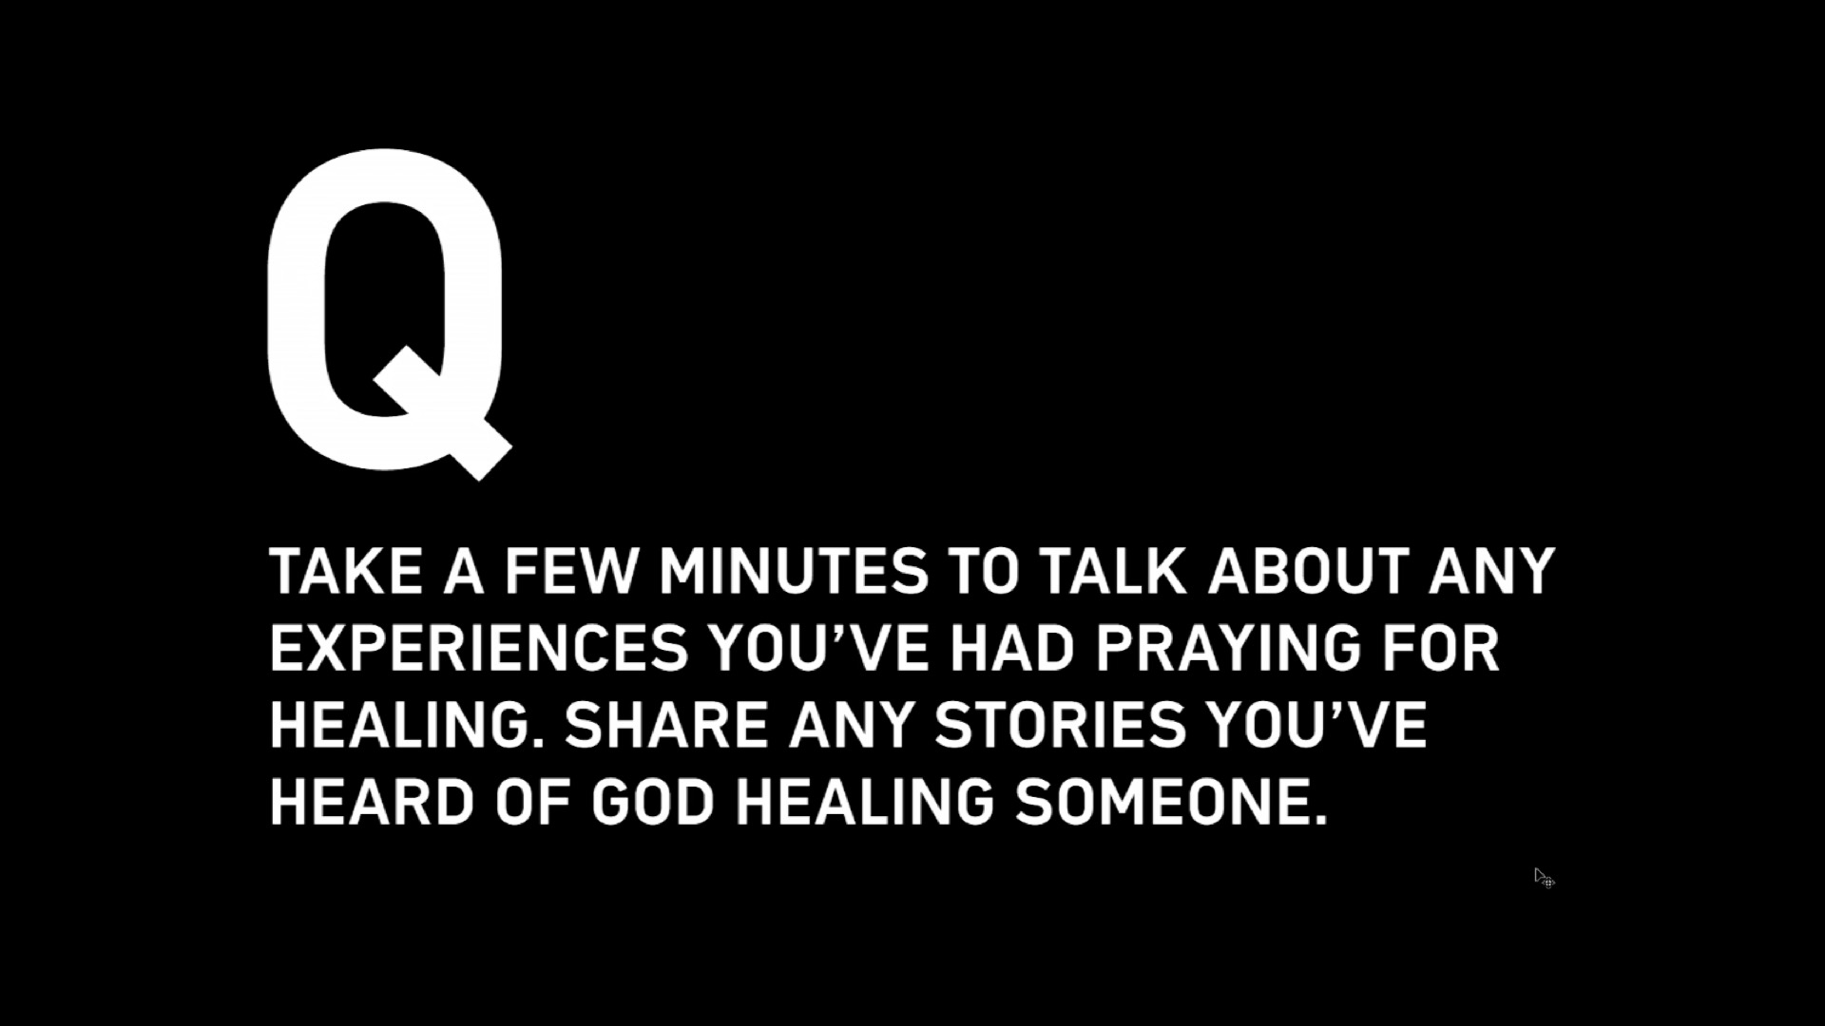
Notes:
Question 3: Take a few minutes to talk about any experiences you’ve had praying for healing. Share any stories you’ve heard of God healing someone.

Slide 18
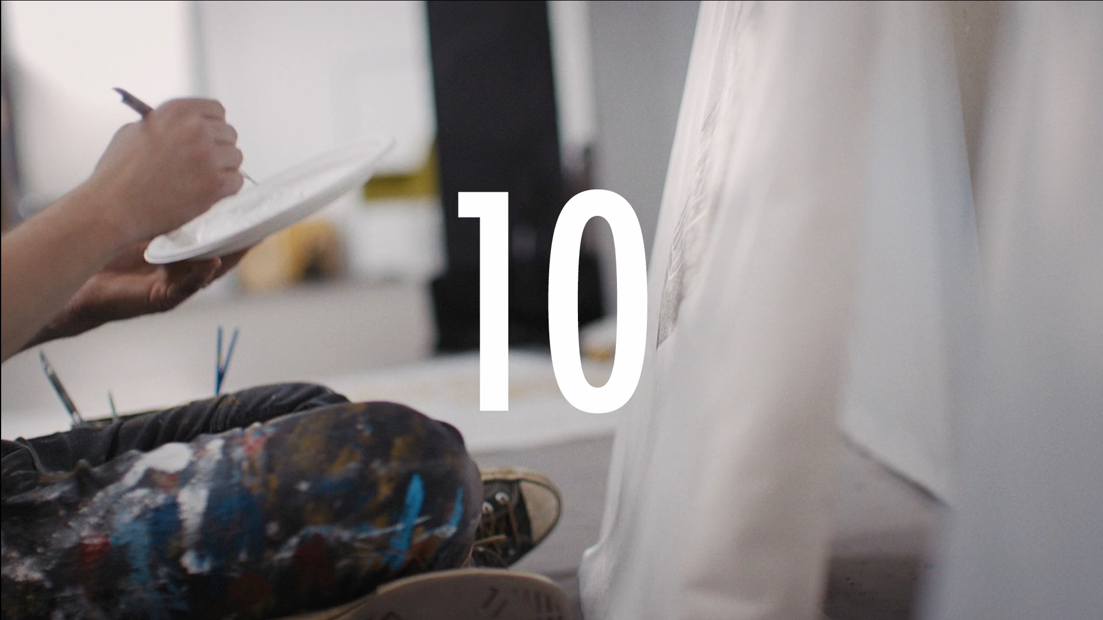
Notes:
Video: Part 4

Slide 19
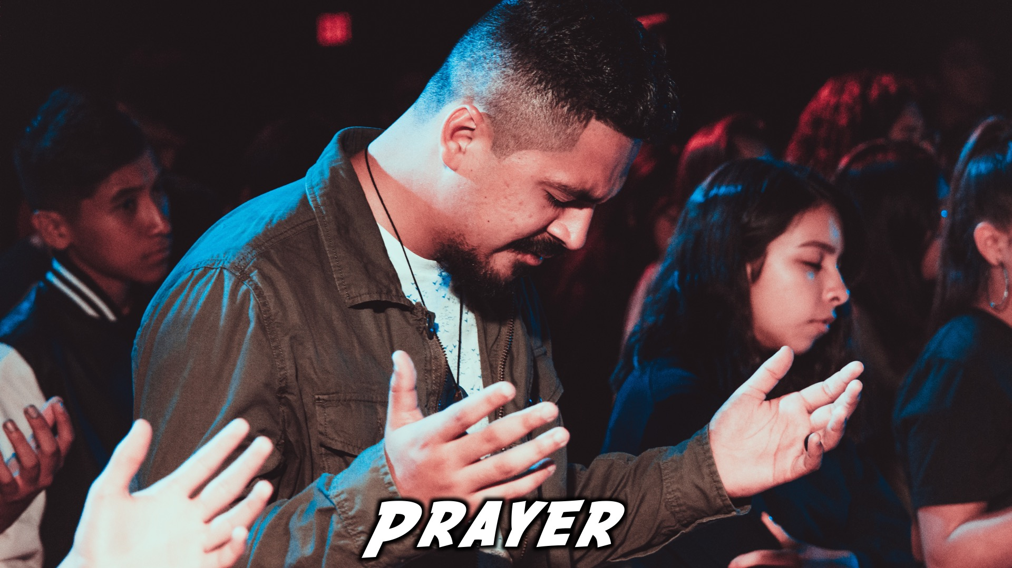
Notes:
Close in Prayer

Slide 20

Notes:
Refreshments

Slide 21
Notes:
Thanks for coming – See you next week Friday!

