Slide 1

Notes:
It’s the Alpha Series!

Slide 2

Notes:
Welcome to regulars and newcomers!

Slide 3
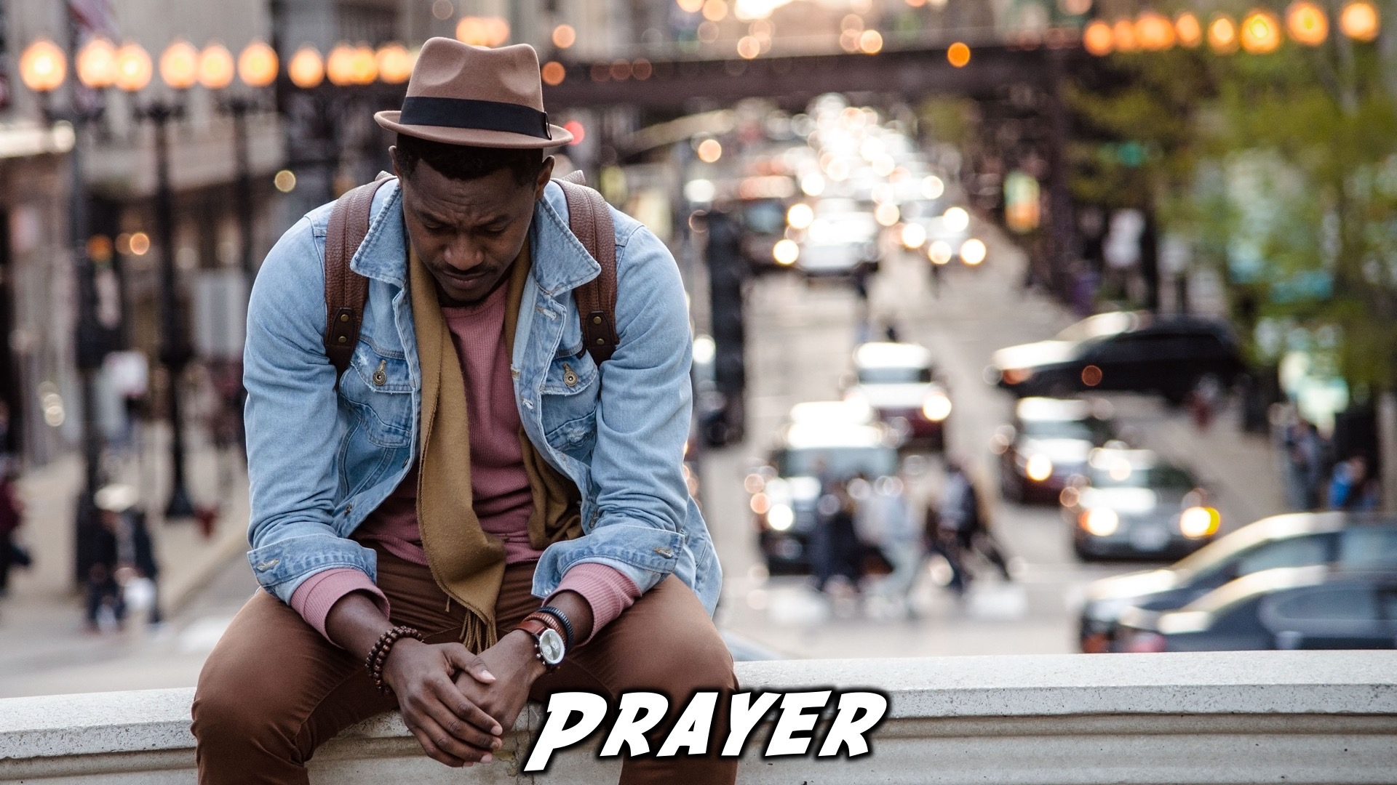
Notes:
Prayer: Let’s open our meeting in prayer.

Slide 4

Notes:
Announcements: Please Listen up to the following announcement.

Slide 5

Notes:
On Sunday we will be doing the David Series. This Sunday the topic is Tragedy.

Slide 6

Notes:
Next week is our Encounter Youth Talent show! Sign up tonight! There will also be a live performance by the talented artist, Ricwa!

Slide 7

Notes:
Announcements: Follow us on Instagram! @EncounterYouth_Rosebank

Slide 8

Notes:
Announcements: Join our Friday Night WhatsApp group!

Slide 9

Notes:
Tonight we will explore the topic, “Church.”

Slide 10

Notes:
Picnic Time – Chelsea Buns and picnic food will be served. During the meal there will be two questions up so that teens can get to know each other. (1)What has been the highlight of your week? (2) What’s your favourite picnic memory?

Slide 11
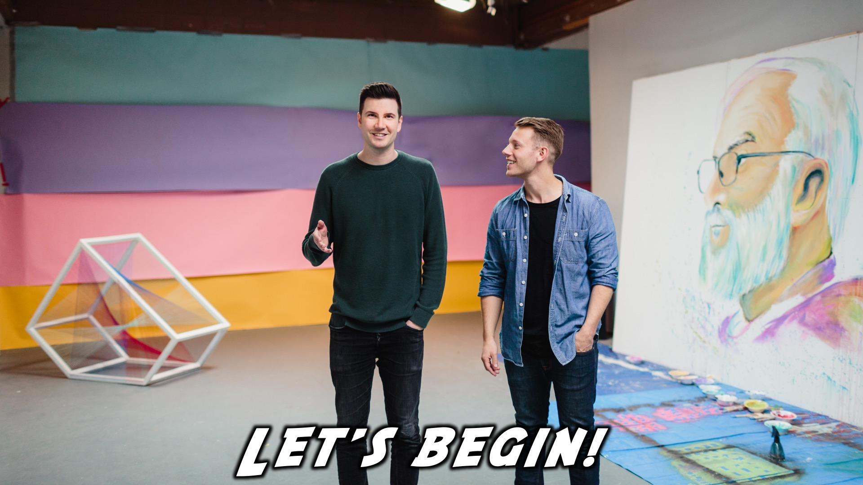
Notes:
Let’s begin the journey.

Slide 12

Notes:
Video: Part 1

Slide 13

Notes:
Question 1: How have you enjoyed Alpha so far? Any Highlights?

Slide 14

Notes:
Video: Part 2

Slide 15

Notes:
Question 2: What has your experience been with the church?

Slide 16

Notes:
Video: Part 3

Slide 17
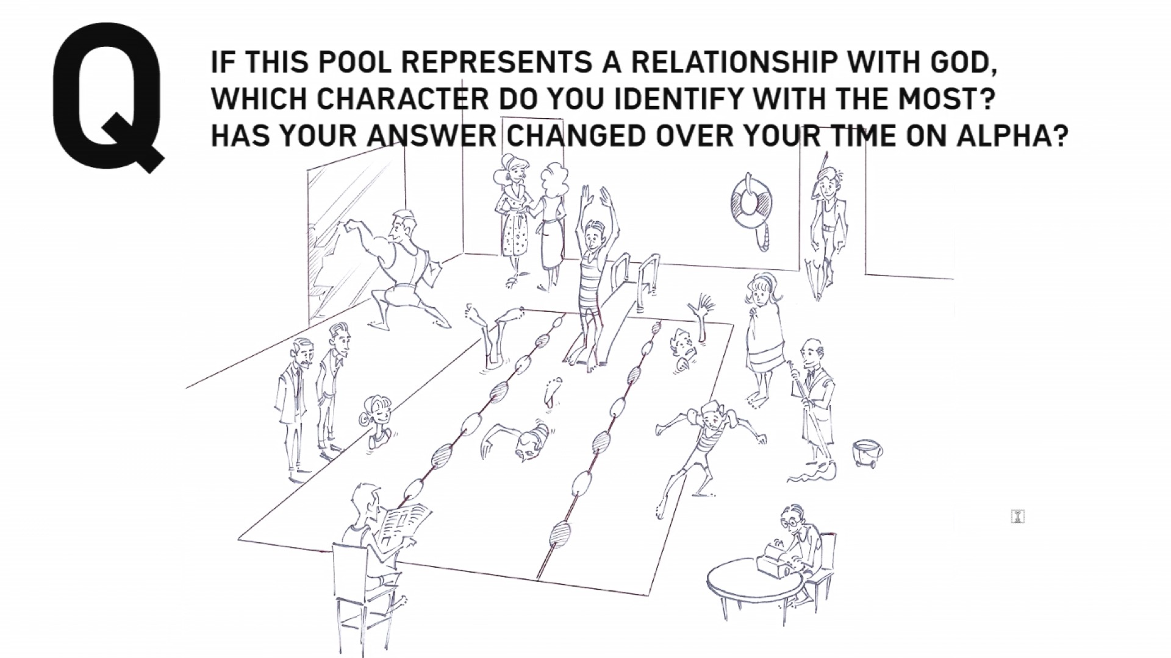
Notes:
Question 3: If this pool represents a relationship with God, which character do you identify with the most?

Slide 18

Notes:
Video: Part 4

Slide 19
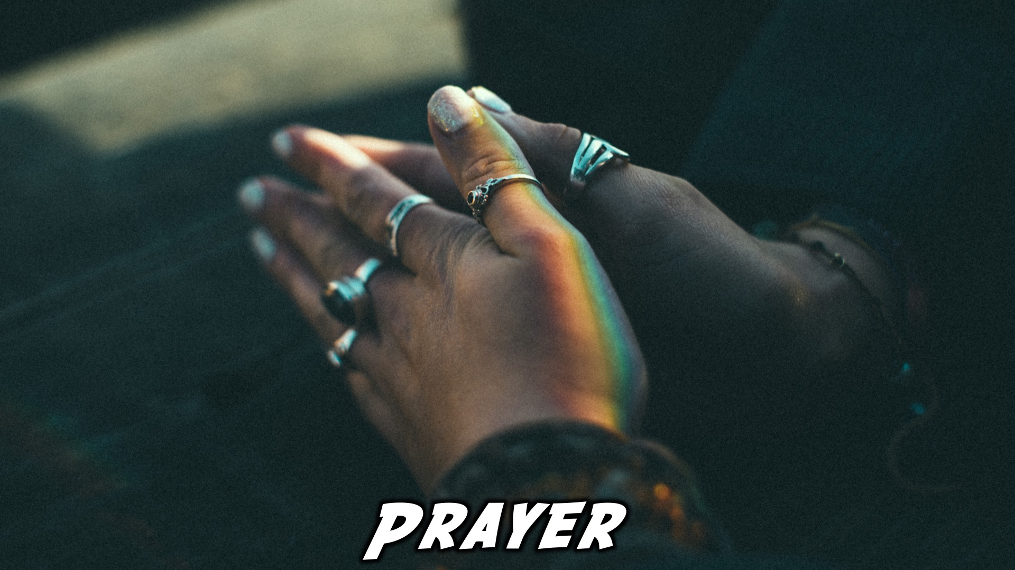
Notes:
Close in Prayer

Slide 20

Notes:
If you’re not coming on Sundays, and you don’t go to another church, why not join us on Sundays!

Slide 21
Notes:
Thanks for coming – See you next week Friday!

Slide 22
Notes:
Next week is our Encounter Youth Talent show! Sign up tonight! There will also be a live performance by the talented artist, Ricwa!

