Slide 1
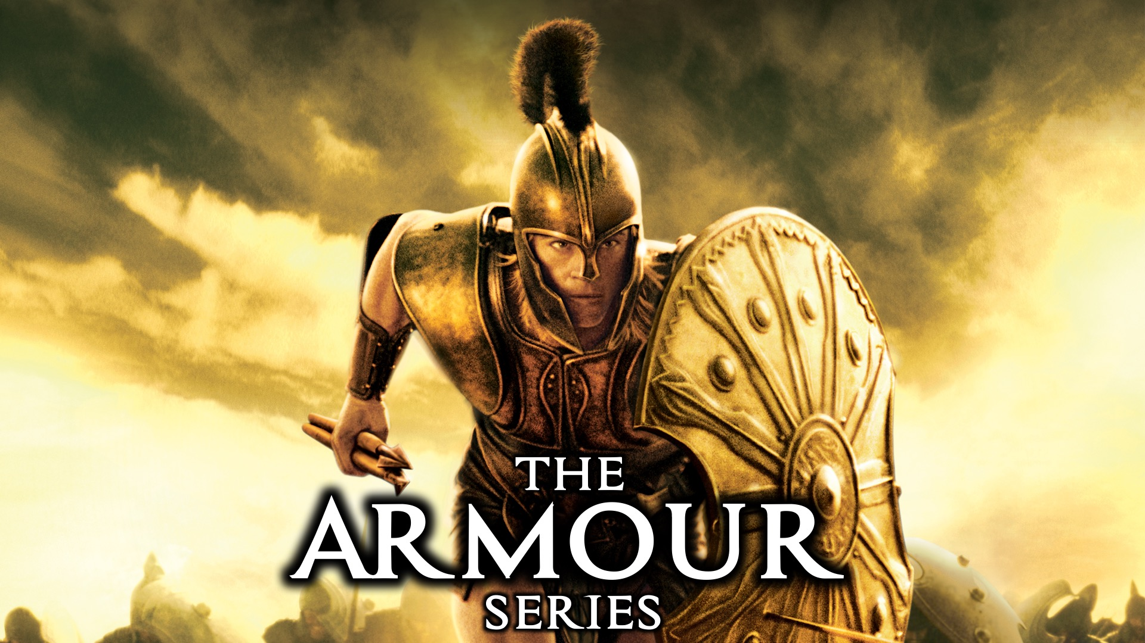
Notes:
Welcome to the Armour Series.

Slide 2
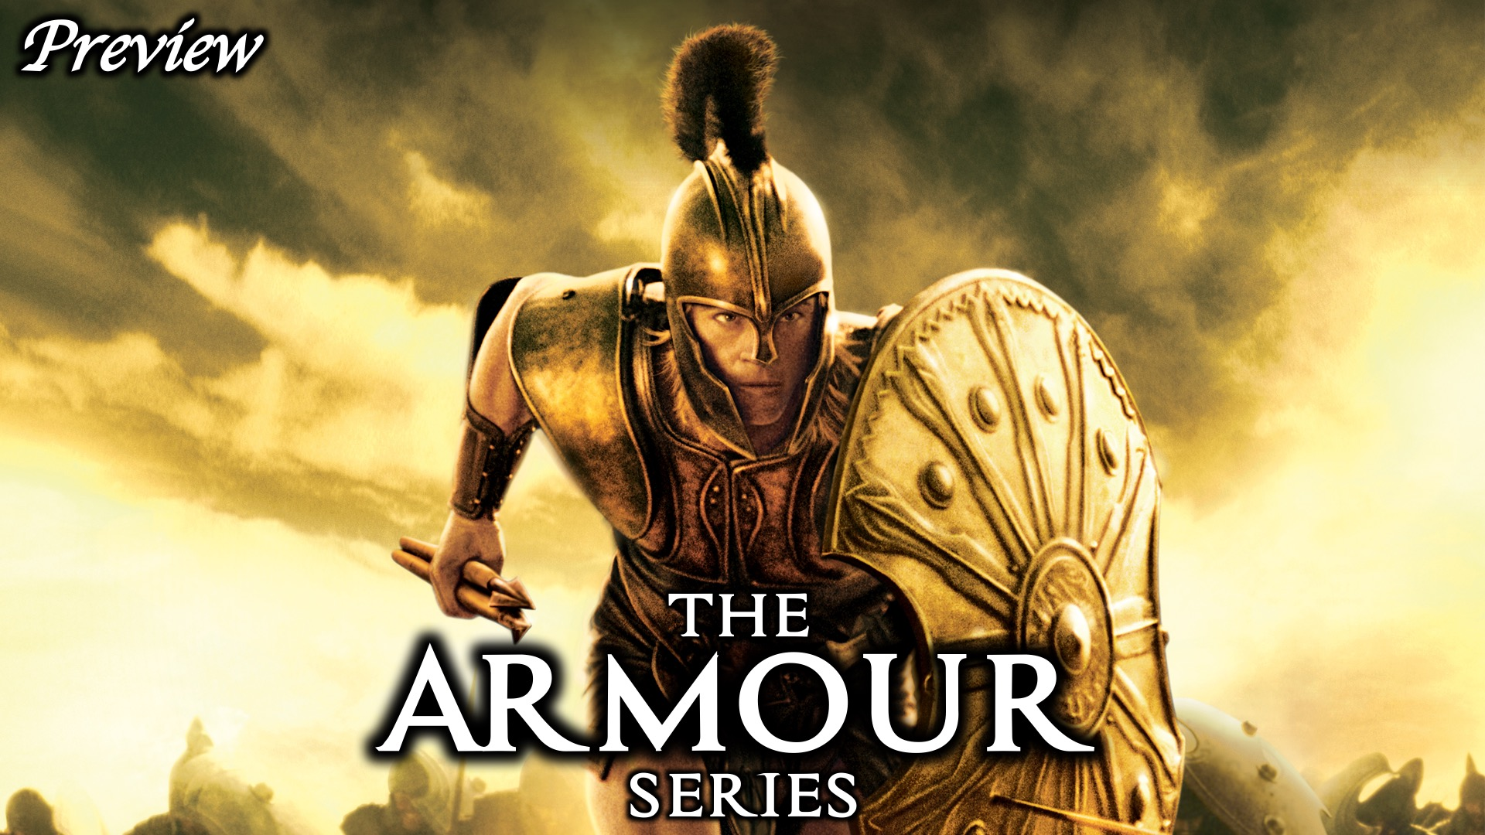
Notes:
Here is a preview of what we are going to explore in the coming weeks…

Slide 3
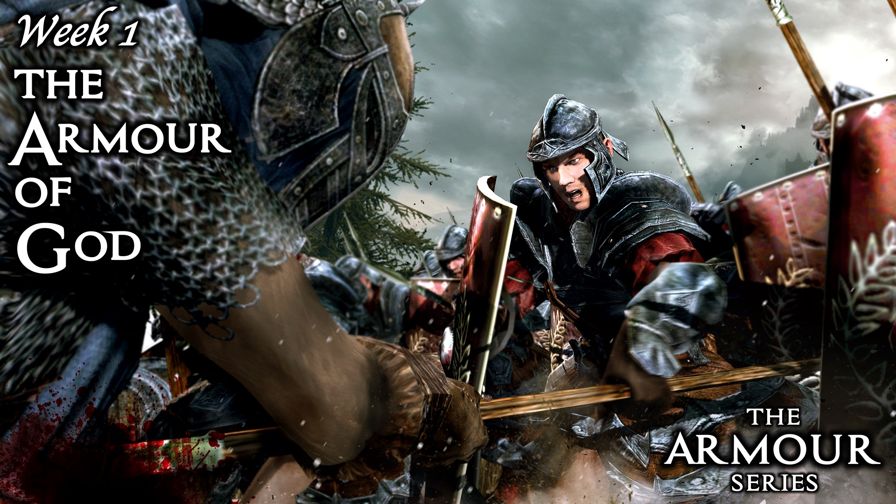
Notes:
Week 1: The Armour of God

Slide 4
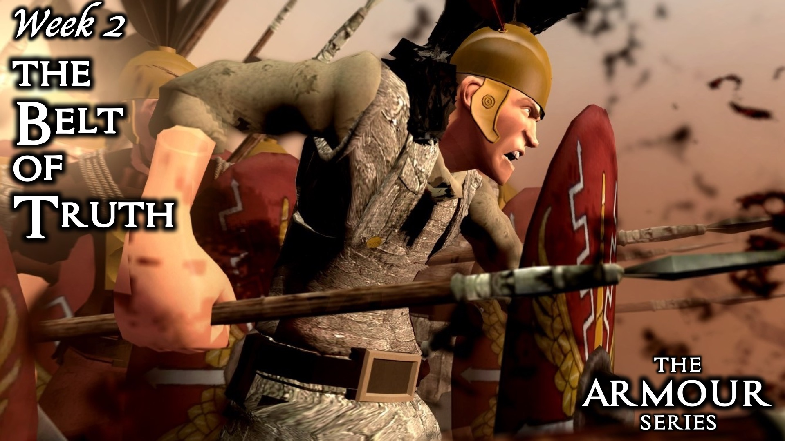
Notes:
Week 2: The Belt of Truth

Slide 5
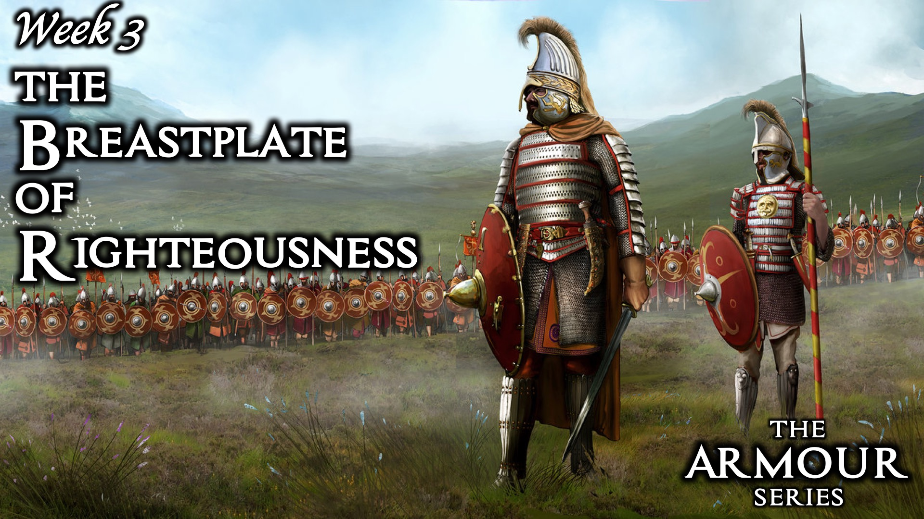
Notes:
Week 3: The Breastplate of Righteousness

Slide 6
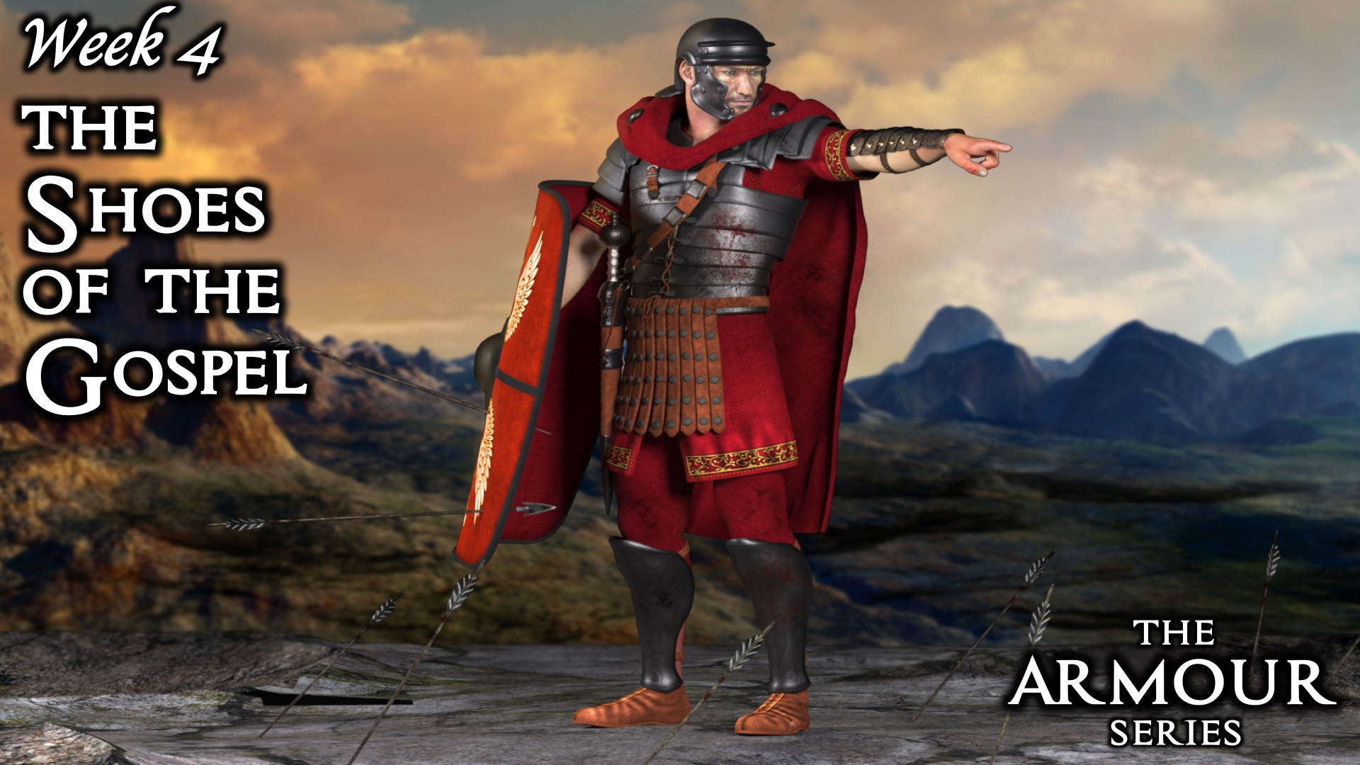
Notes:
Week 4: The Shoes of the Gospel

Slide 7
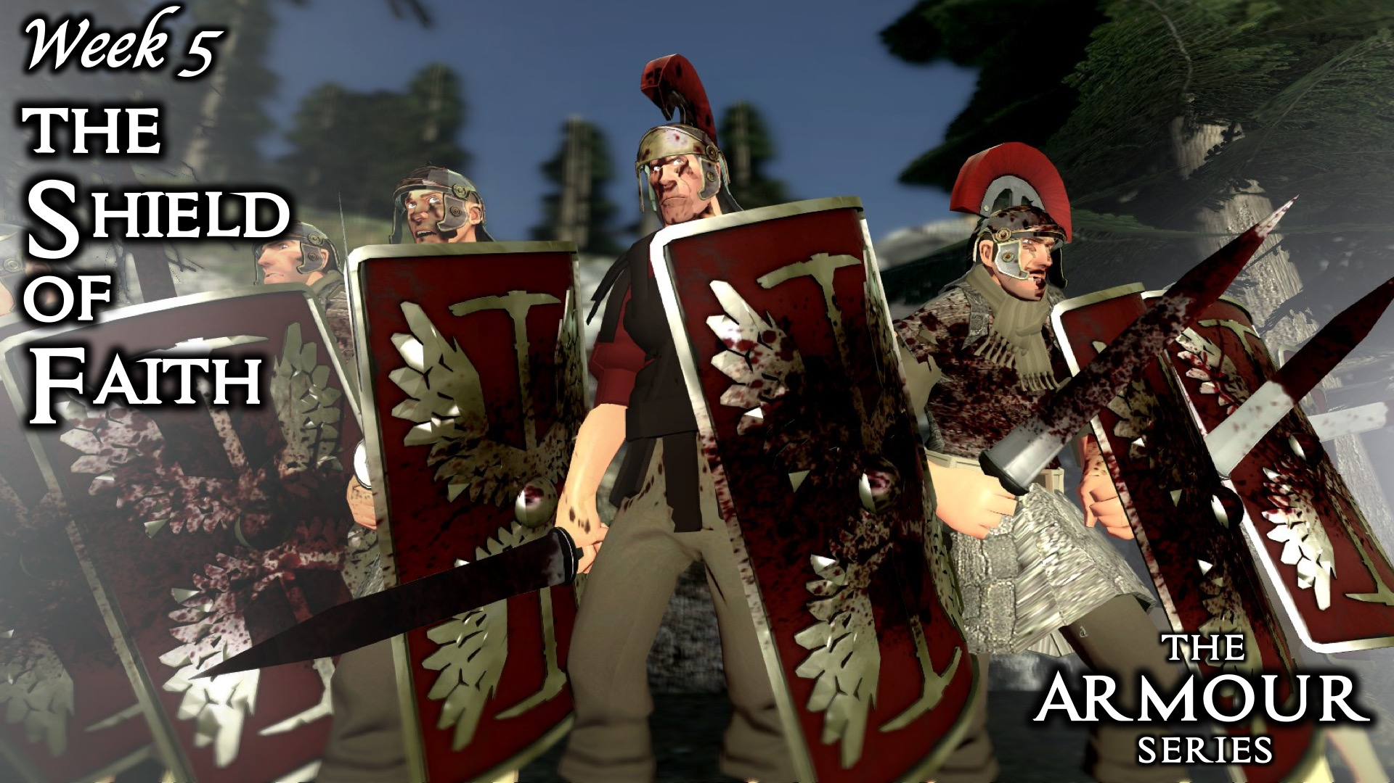
Notes:
Week 5: The Shield of Faith

Slide 8

Notes:
Week 6: The Helmet of Salvation

Slide 9
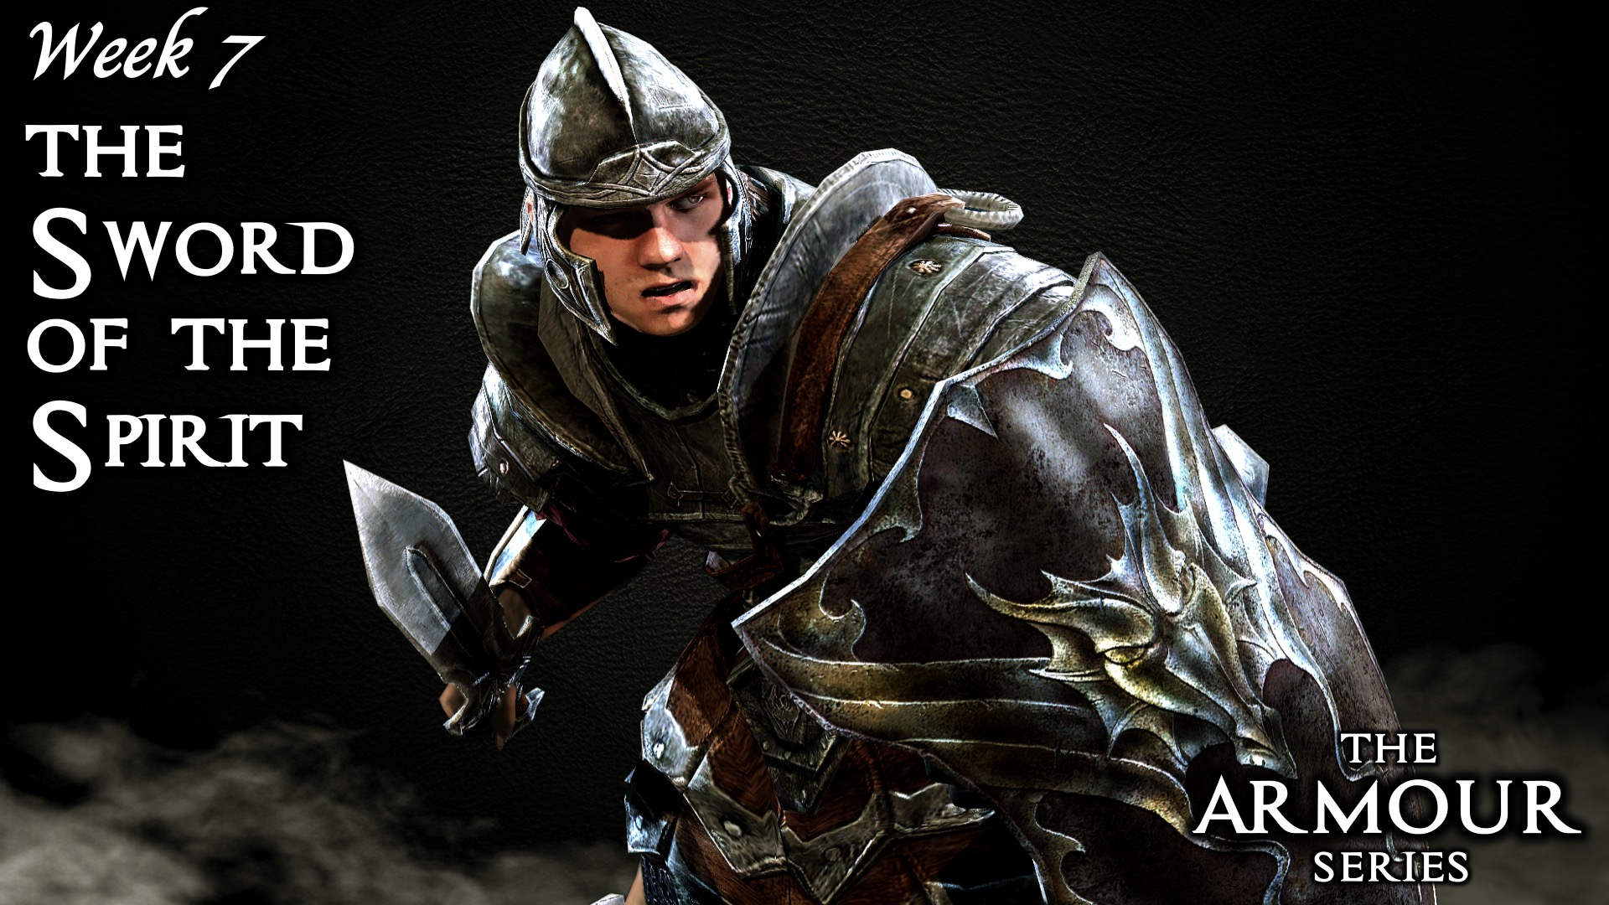
Notes:
Week 7: The Sword of the Spirit

Slide 10
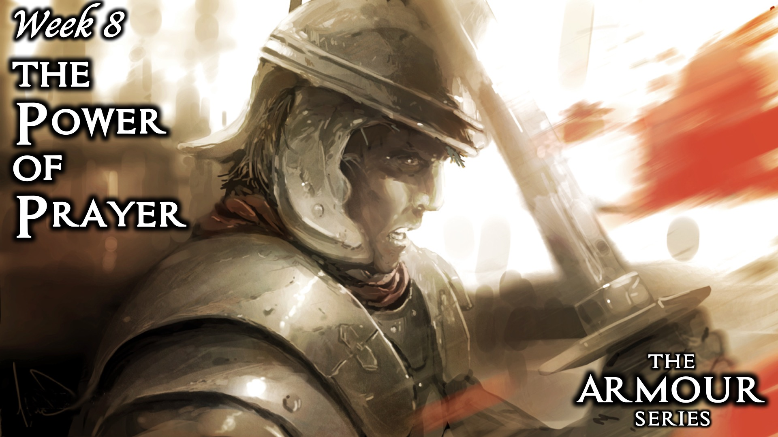
Notes:
Week 8: The Power of Prayer

Slide 11
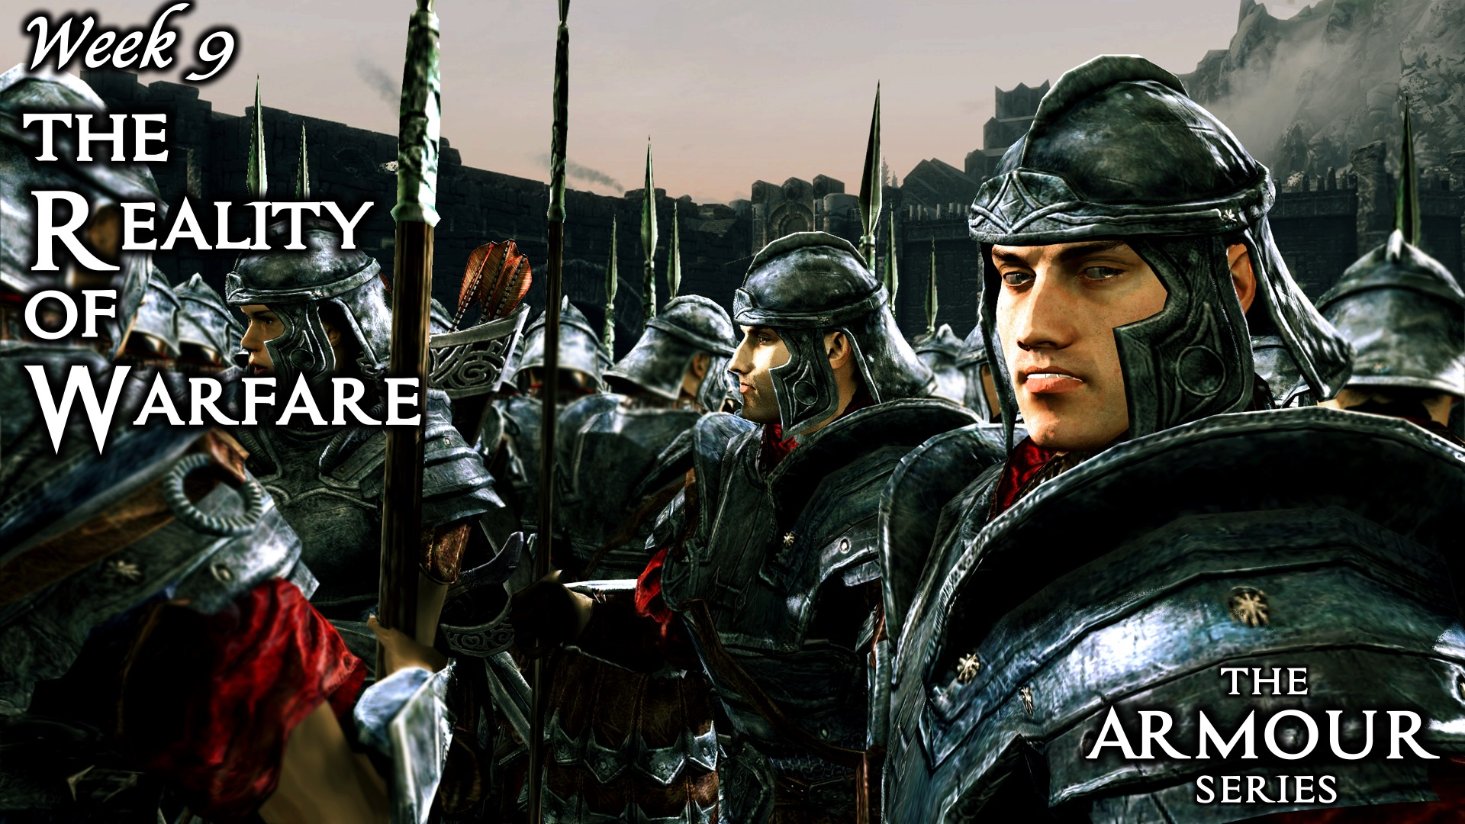
Notes:
Week 9: The Reality of Warfare

Slide 12
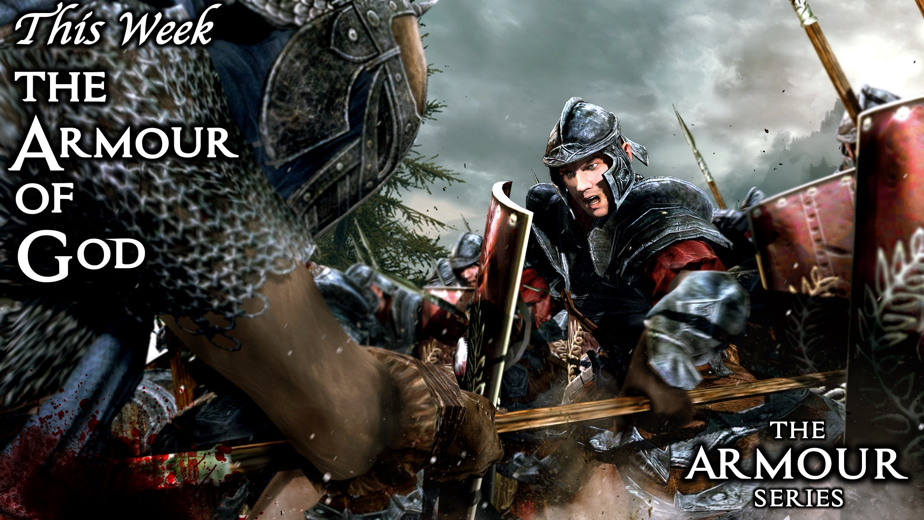
Notes:
This week we are going to learn about the Armour of God.

Slide 13

Notes:
Video clip: The armour of God, find it on YouTube at https://www.youtube.com/watch?v=YyWX__9vDsE

Slide 14
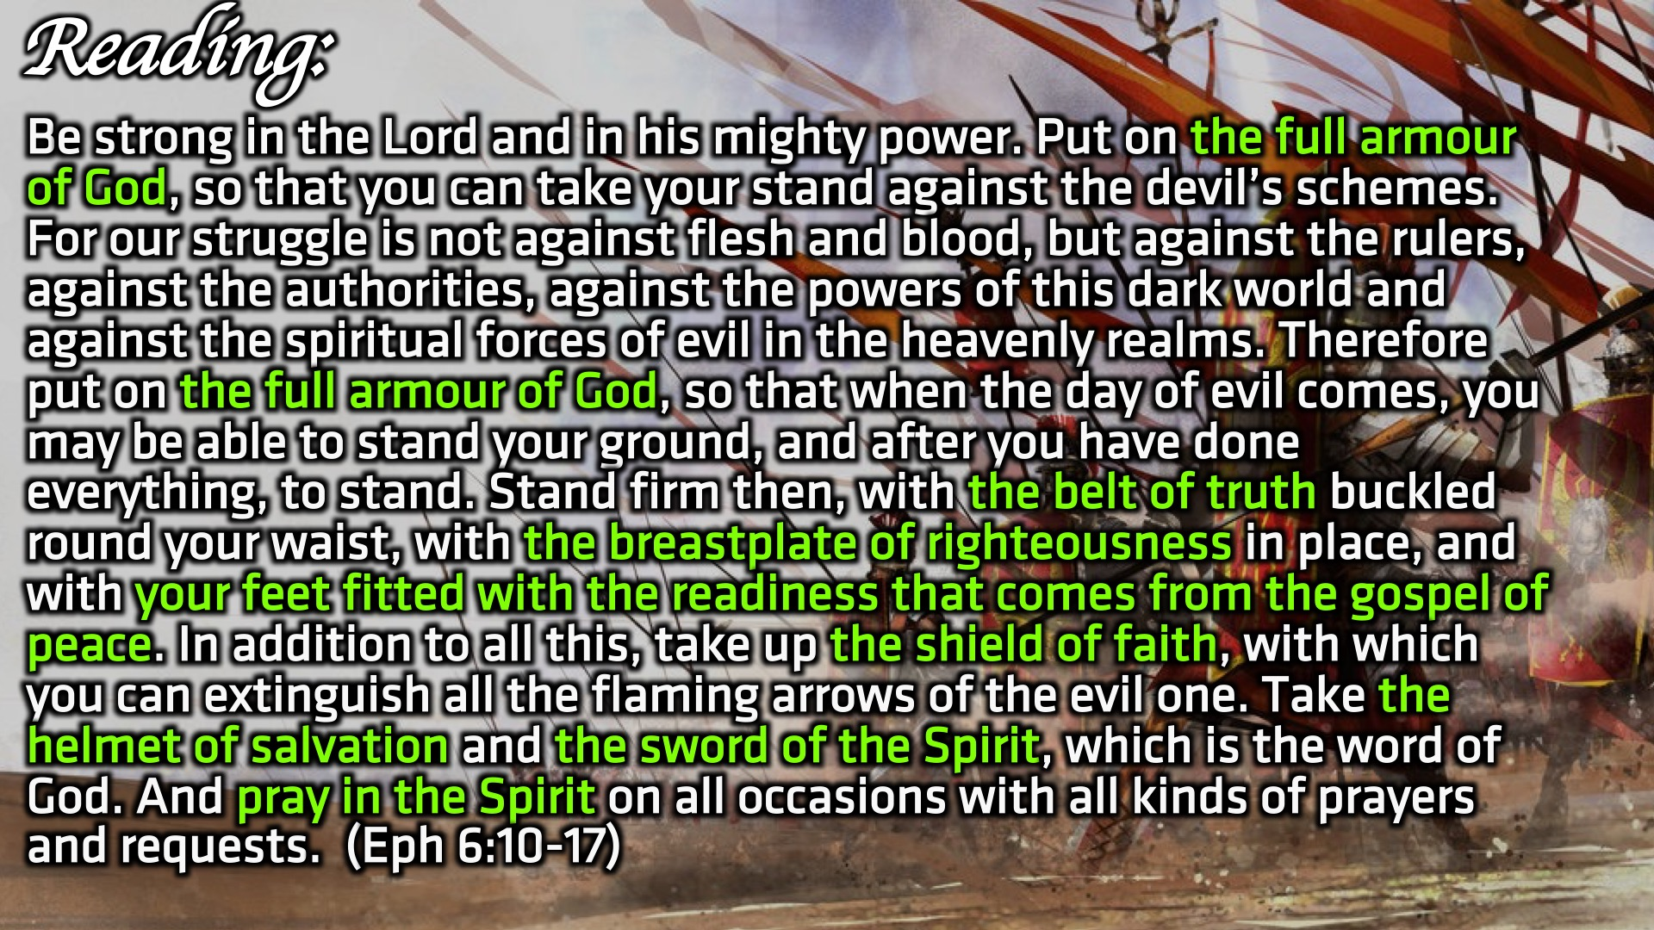
Notes:
Reading: Be strong in the Lord and in his mighty power. Put on the full armour of God, so that you can take your stand against the devil’s schemes. For our struggle is not against flesh and blood, but against the rulers, against the authorities, against the powers of this dark world and against the spiritual forces of evil in the heavenly realms. Therefore put on the full armour of God, so that when the day of evil comes, you may be able to stand your ground, and after you have done everything, to stand. Stand firm then, with the belt of truth buckled round your waist, with the breastplate of righteousness in place, and with your feet fitted with the readiness that comes from the gospel of peace. In addition to all this, take up the shield of faith, with which you can extinguish all the flaming arrows of the evil one. Take the helmet of salvation and the sword of the Spirit, which is the word of God. And pray in the Spirit on all occasions with all kinds of prayers and requests. With this in mind, be alert and always keep on praying for all the Lord’s people. (Ephesians 6:10-17)

Slide 15
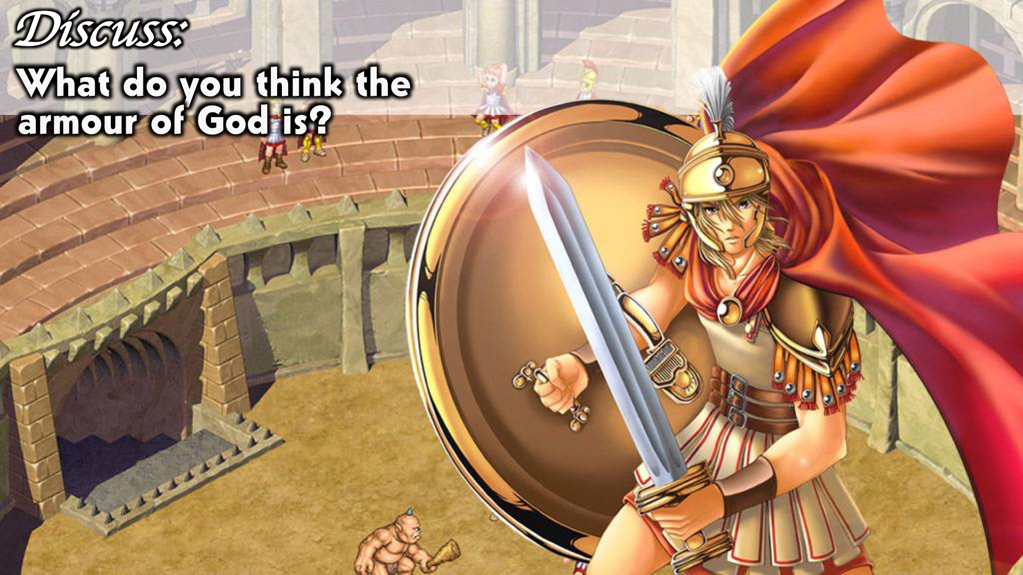
Notes:
Discuss: What do you think the armour of God is?

Slide 16
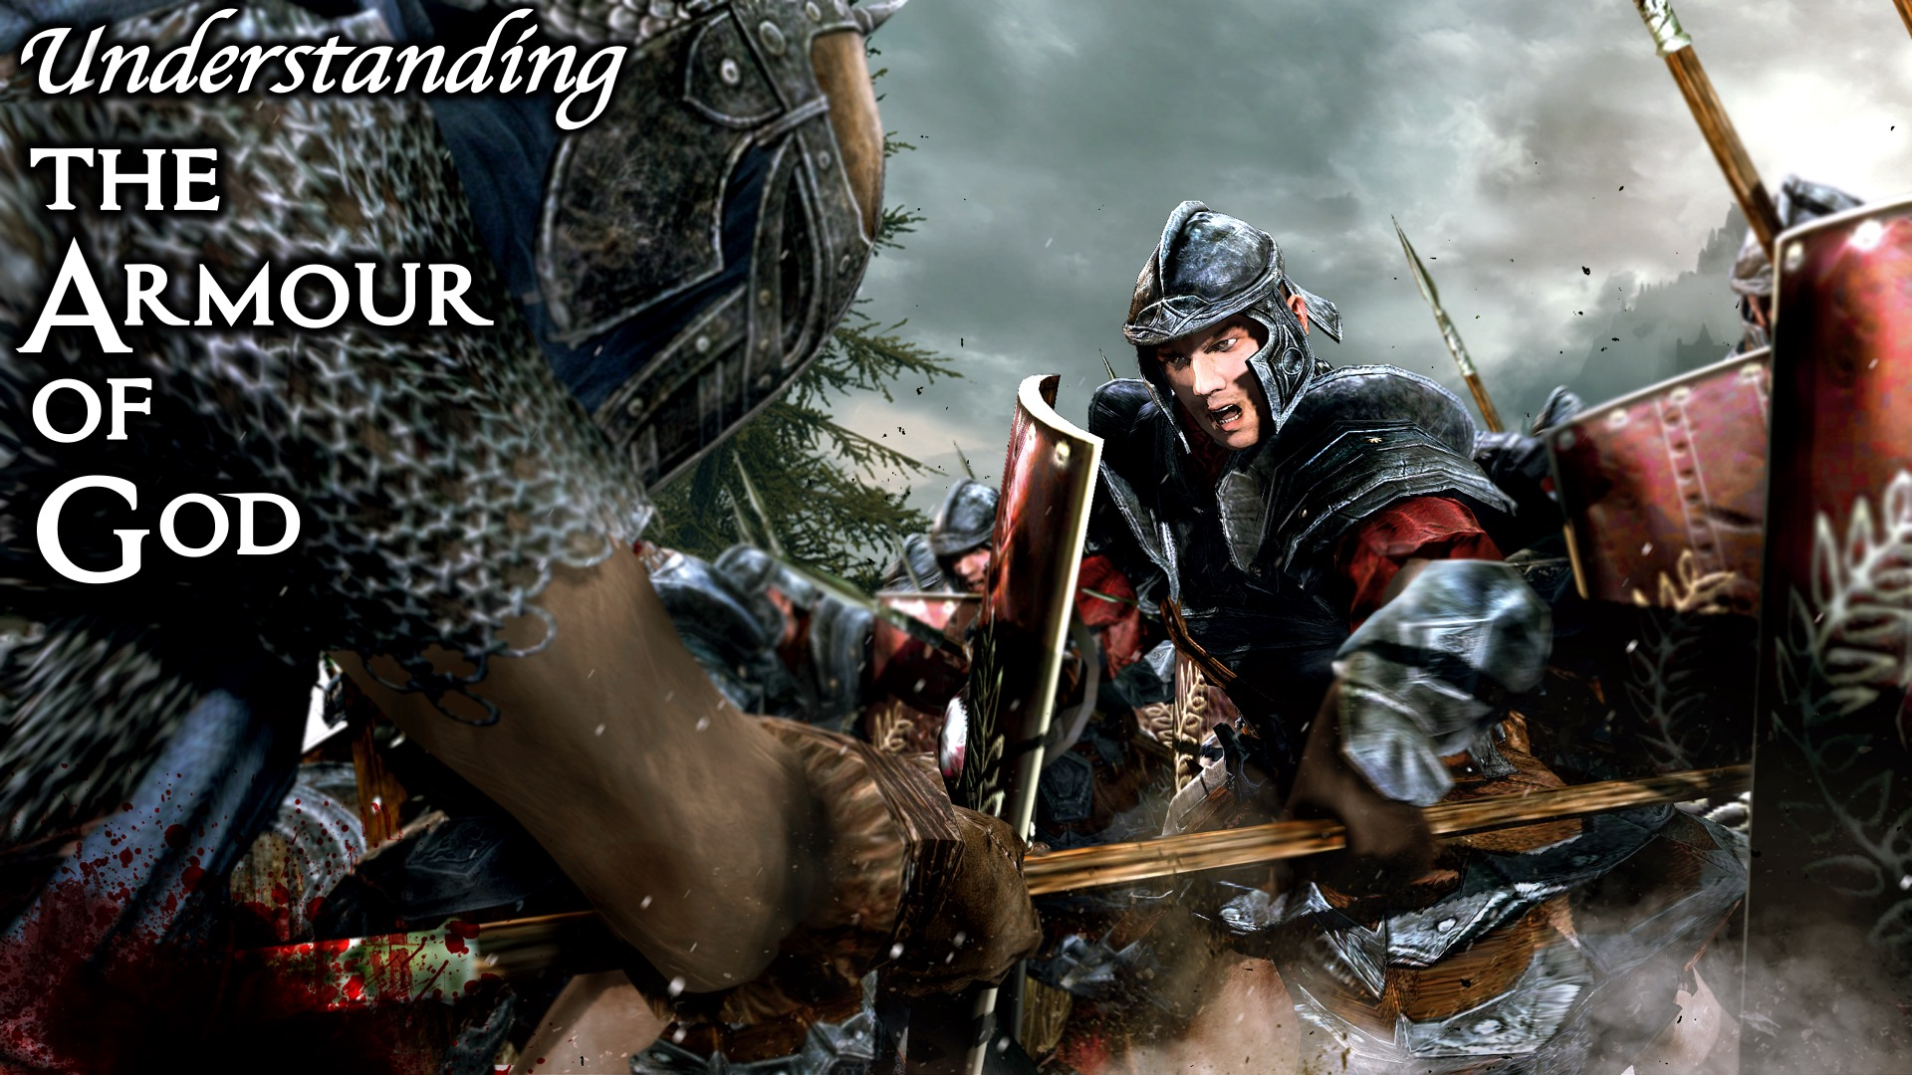
Notes:
Understanding the Armour of God:

Slide 17
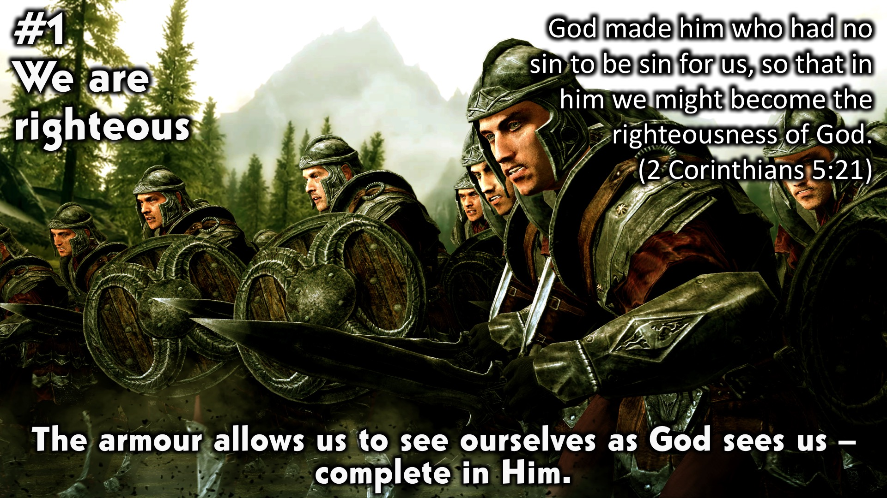
Notes:
1. We are righteous: The armour allows us to see ourselves as God sees us – complete in Him. “God made him who had no sin to be sin for us, so that in him we might become the righteousness of God.” (2 Corinthians 5:21)

Slide 18
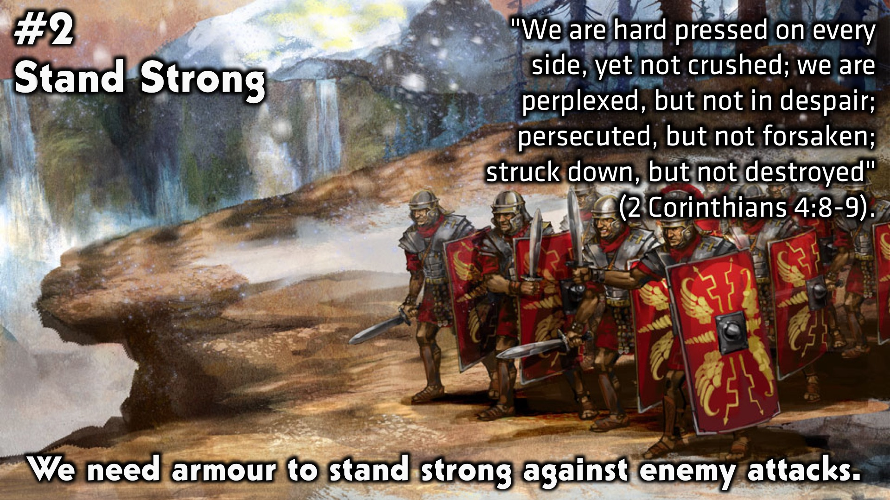
Notes:
2. Stand Strong: We need armour to stand strong against enemy attacks. "We are hard pressed on every side, yet not crushed; we are perplexed, but not in despair; persecuted, but not forsaken; struck down, but not destroyed" (2 Corinthians 4:8-9).

Slide 19
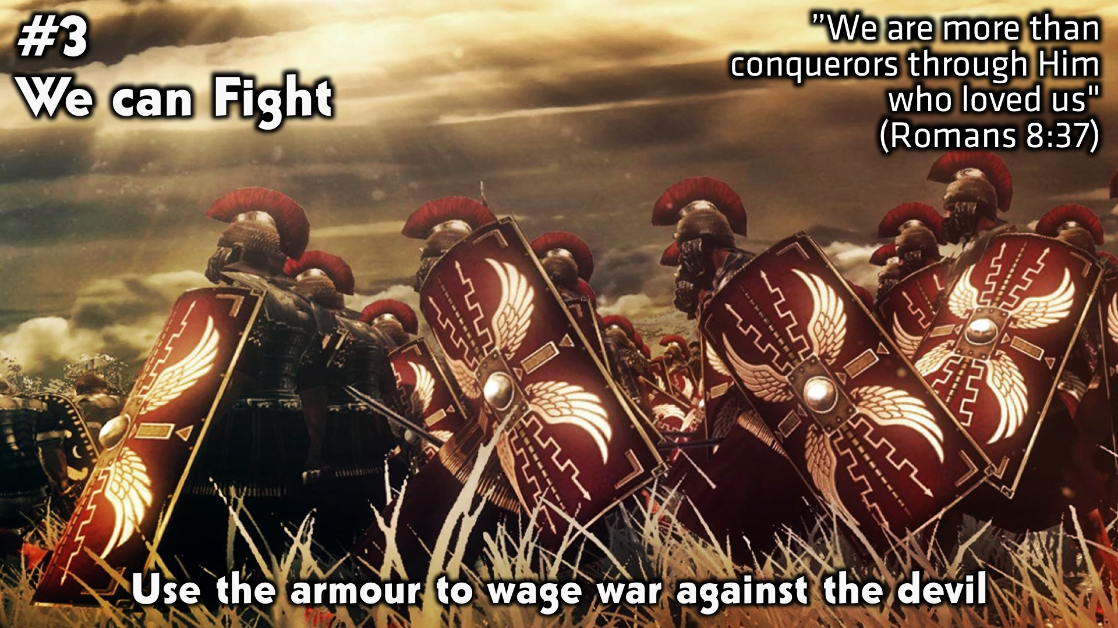
Notes:
3. We can fight: Use the armour to wage war against the devil. ”We are more than conquerors through Him who loved us" (Romans 8:37)

Slide 20
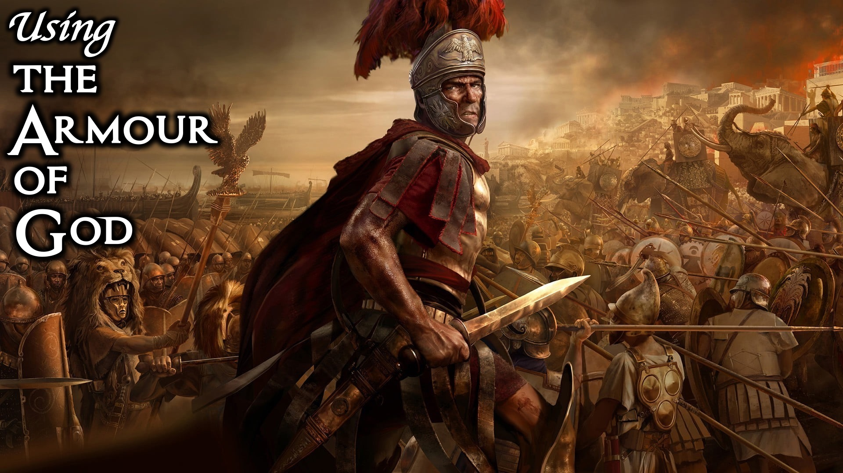
Notes:
Using the Armour of God.

Slide 21
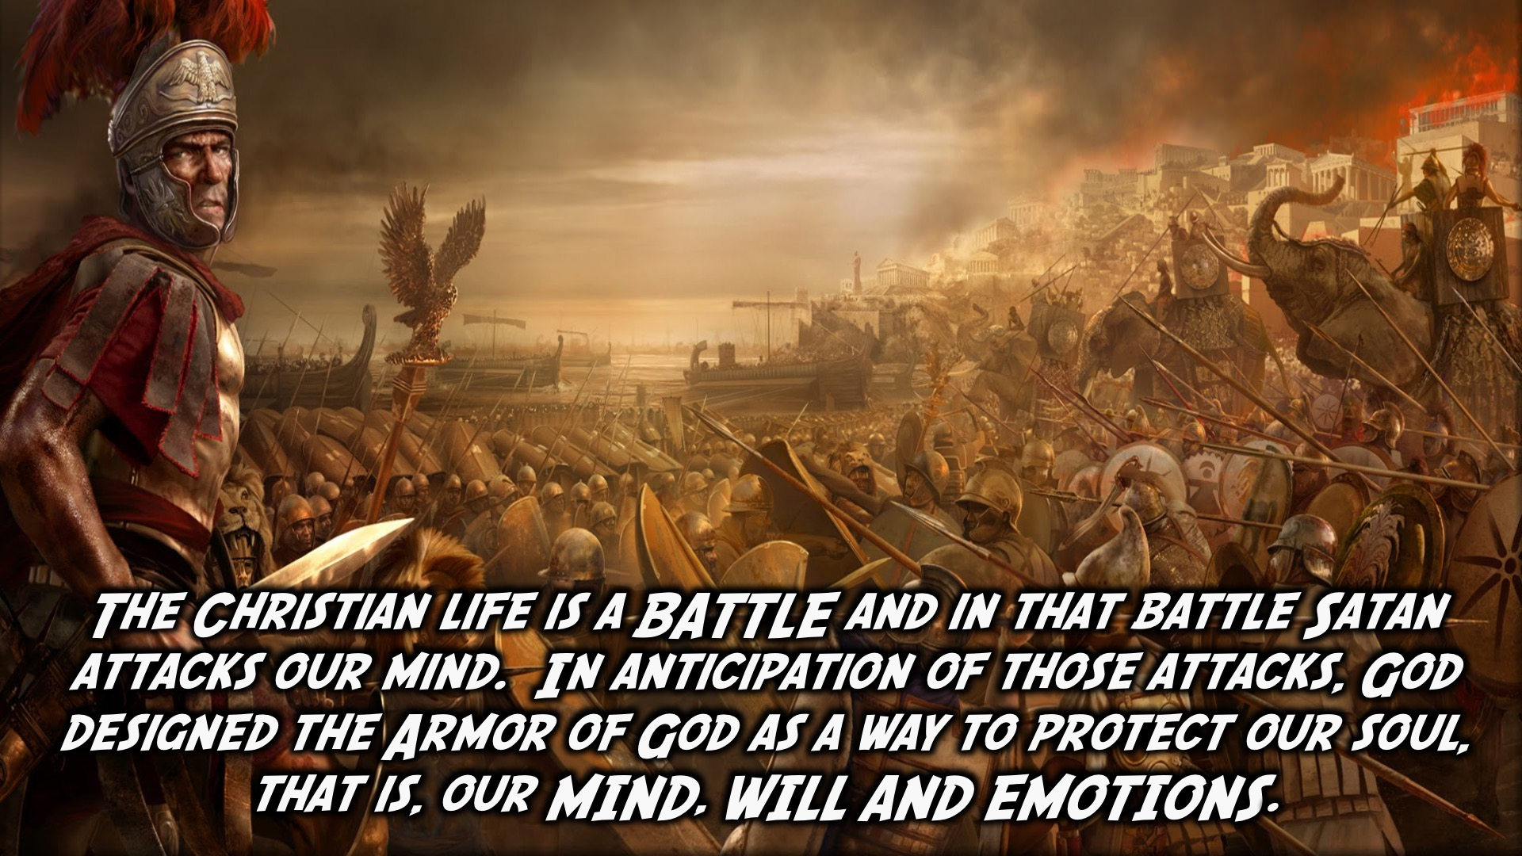
Notes:
The Christian life is a BATTLE and in that battle Satan attacks our mind. In anticipation of those attacks, God designed the Armor of God as a way to protect our soul, that is, our MIND, WILL AND EMOTIONS.

Slide 22
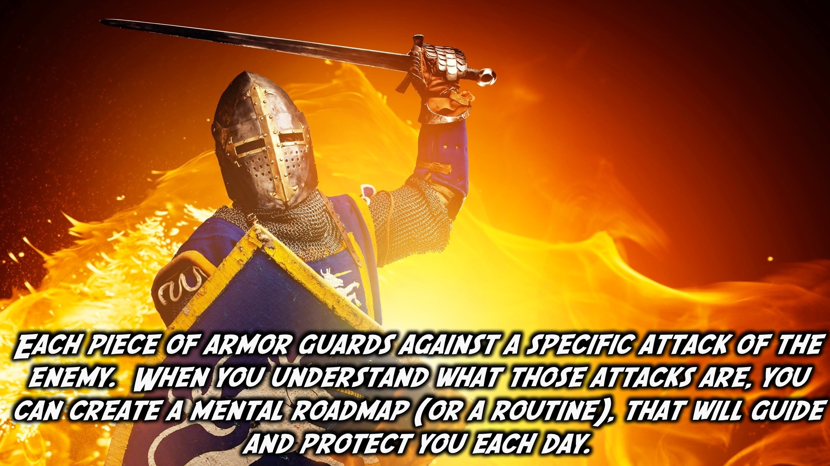
Notes:
Each piece of armor guards against a specific attack of the enemy. When you understand what those attacks are, you can create a mental roadmap (or a routine), that will guide and protect you each day.

Slide 23
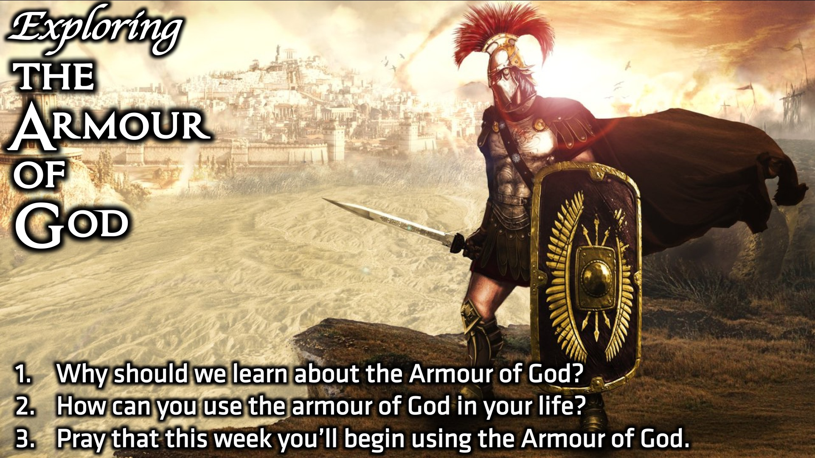
Notes:
Small Group Discussion: You have ten minutes to apply the message to your life in small groups using these 3 questions: (1) Why should we learn about the Armour of God? (2) How can you use the armour of God in your life? (3) Pray that this week you’ll begin using the Armour of God.

Slide 24
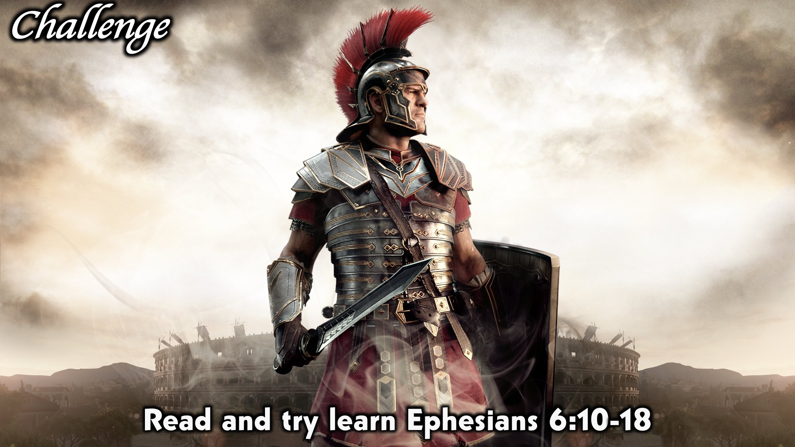
Notes:
Challenge: Read and try learn Ephesians 6:10-18

Slide 25
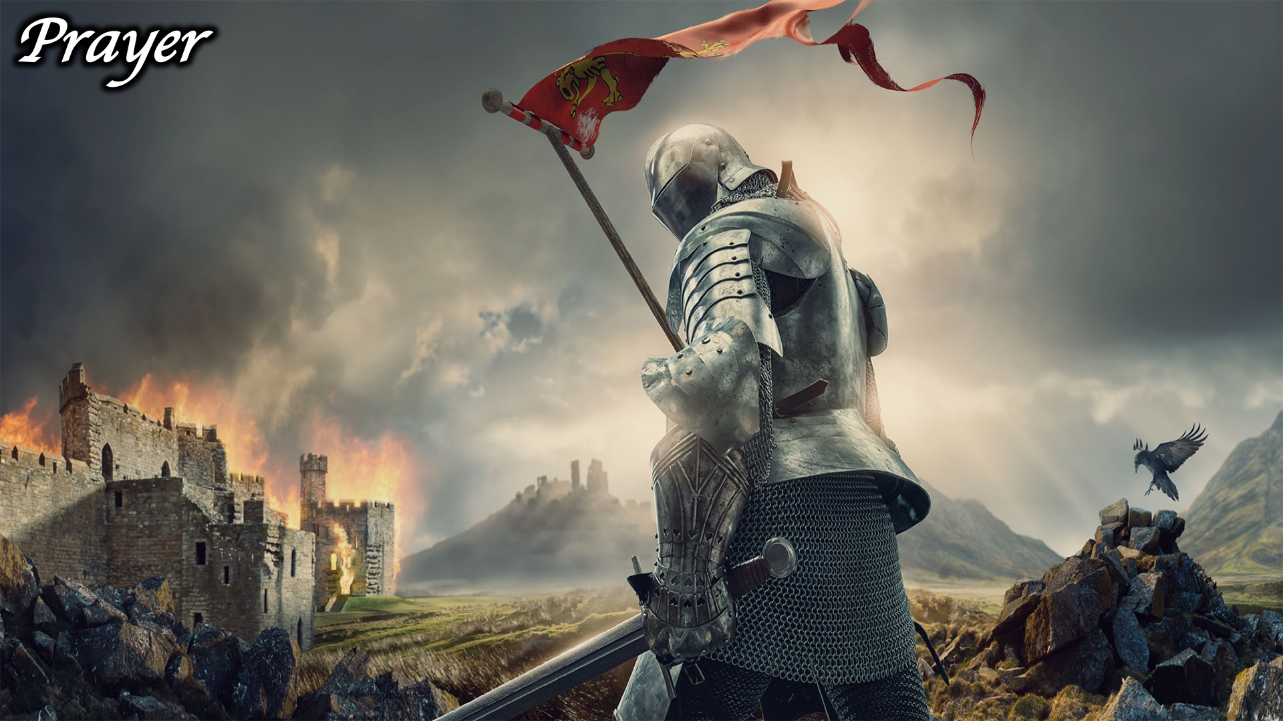
Notes:
Prayer:

Slide 26
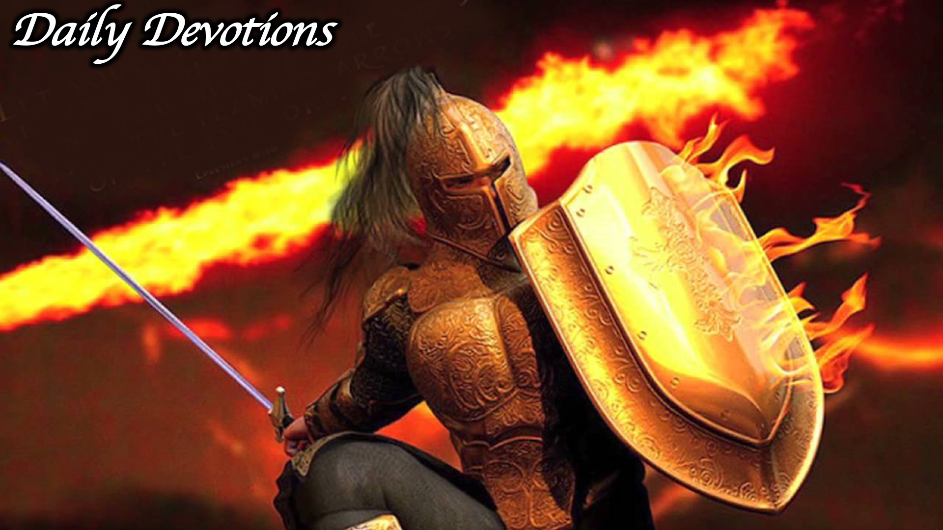
Notes:
Daily Devotions: We will post devotions on the Sunday WhatsApp group every night of the week throughout this series. Do everything you can to be a part of the daily journey in the armour of God.

Slide 27
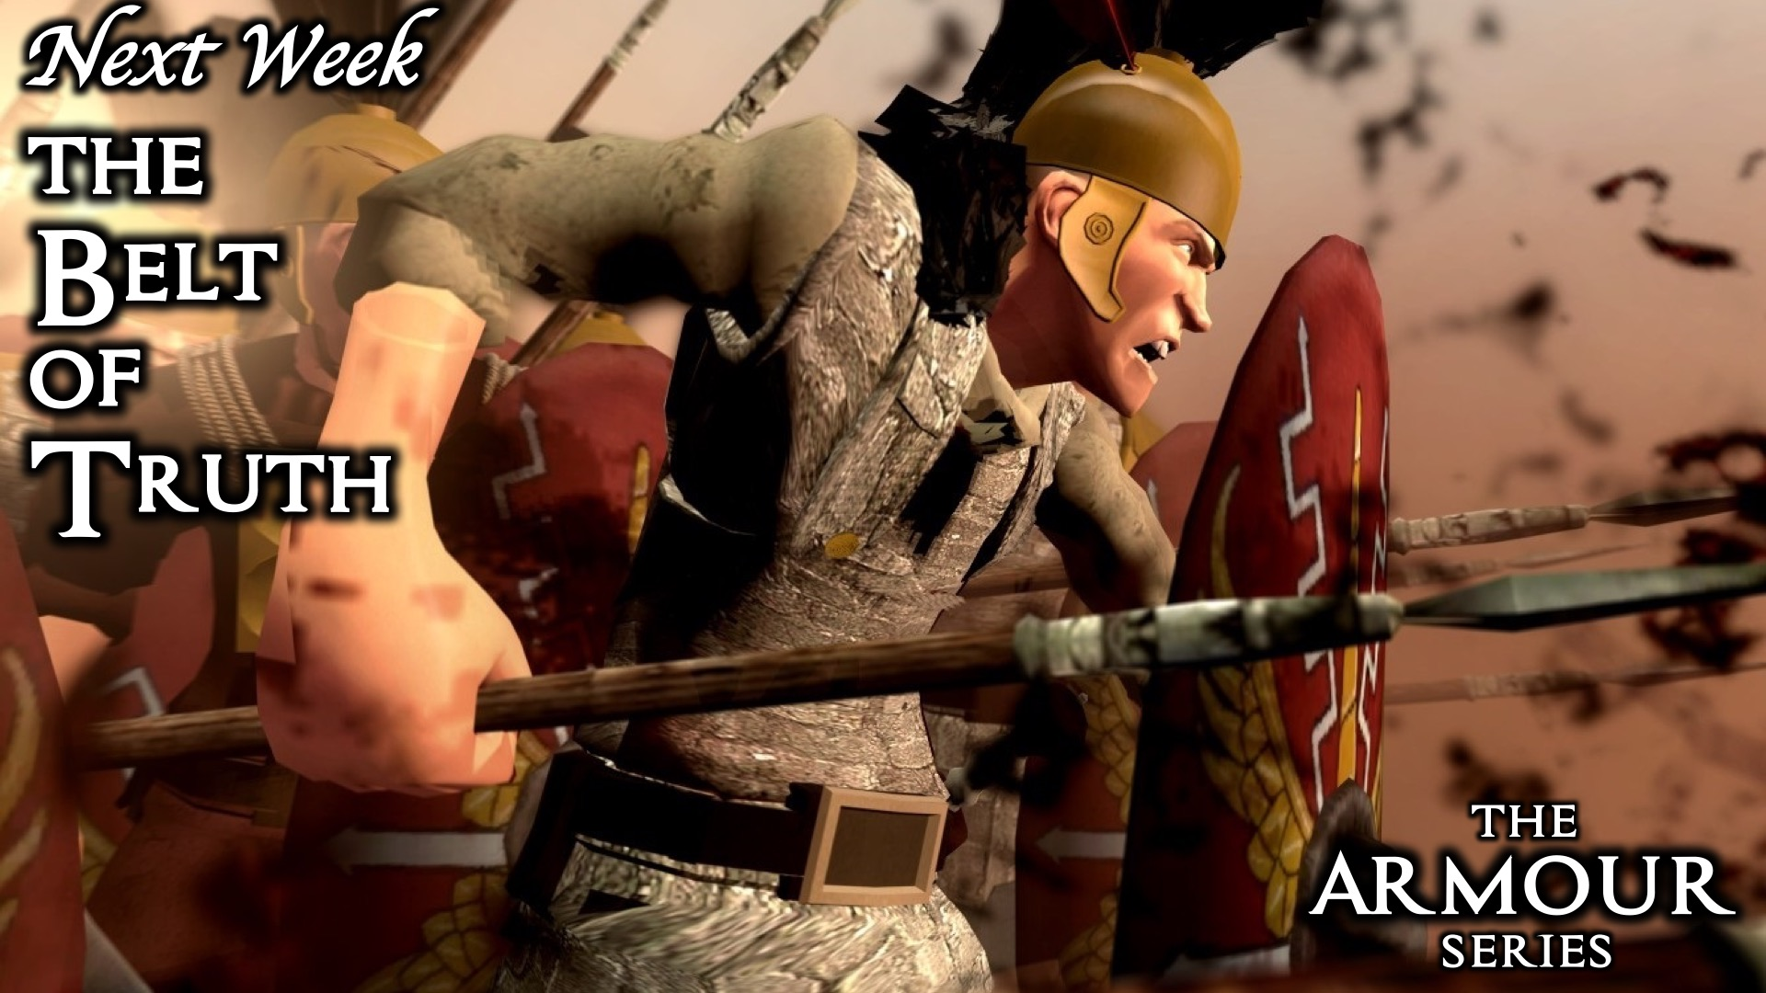
Notes:
Next Week: Next week we will look at the first piece of the armour of God: Belt of Truth.

