Slide 1

Notes:
Welcome to the Armour Series.

Slide 2
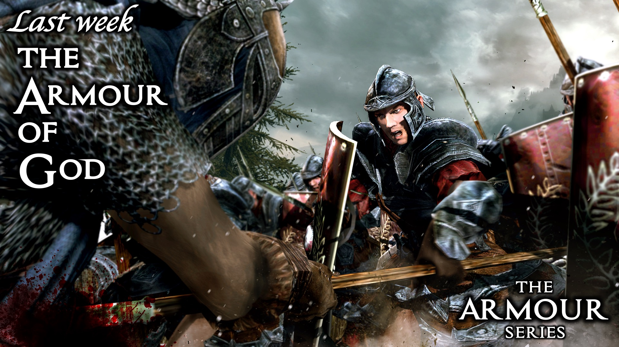
Notes:
Last week: The Armour of God

Slide 3
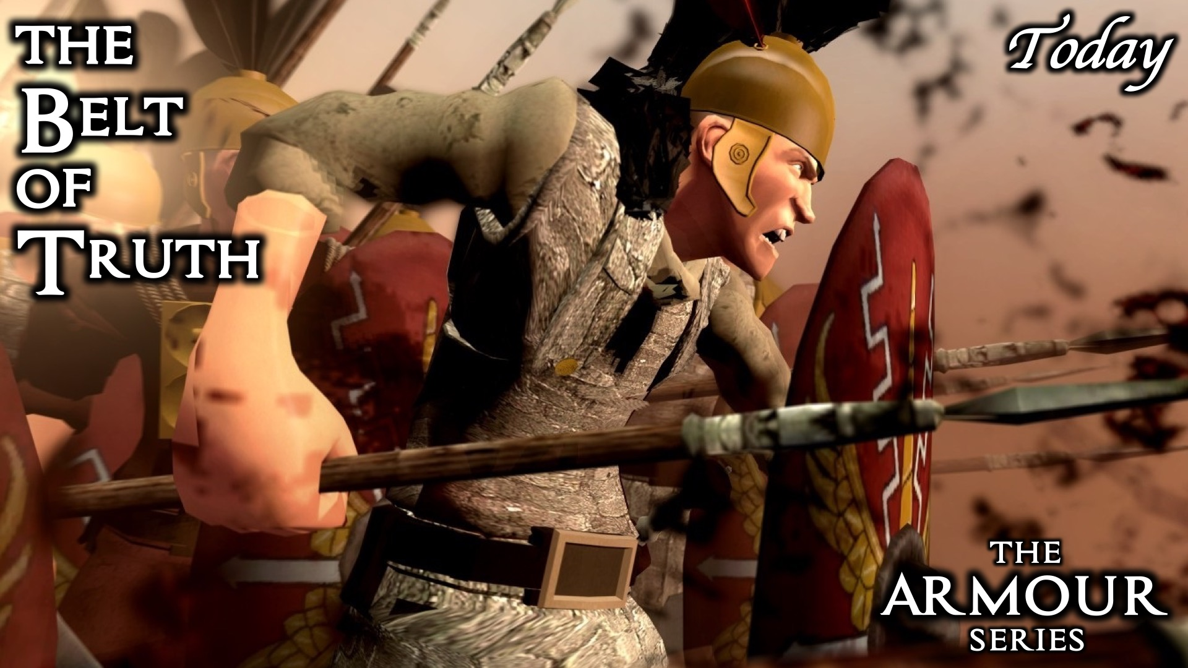
Notes:
This week: The Belt of Truth

Slide 4
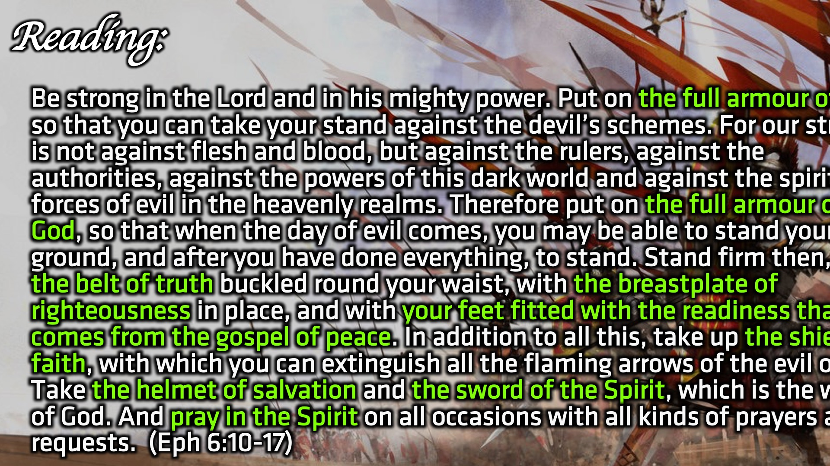
Notes:
Reading: Be strong in the Lord and in his mighty power. Put on the full armour of God, so that you can take your stand against the devil’s schemes. For our struggle is not against flesh and blood, but against the rulers, against the authorities, against the powers of this dark world and against the spiritual forces of evil in the heavenly realms. Therefore put on the full armour of God, so that when the day of evil comes, you may be able to stand your ground, and after you have done everything, to stand. Stand firm then, with the belt of truth buckled round your waist, with the breastplate of righteousness in place, and with your feet fitted with the readiness that comes from the gospel of peace. In addition to all this, take up the shield of faith, with which you can extinguish all the flaming arrows of the evil one. Take the helmet of salvation and the sword of the Spirit, which is the word of God. And pray in the Spirit on all occasions with all kinds of prayers and requests. With this in mind, be alert and always keep on praying for all the Lord’s people. (Ephesians 6:10-17)

Slide 5
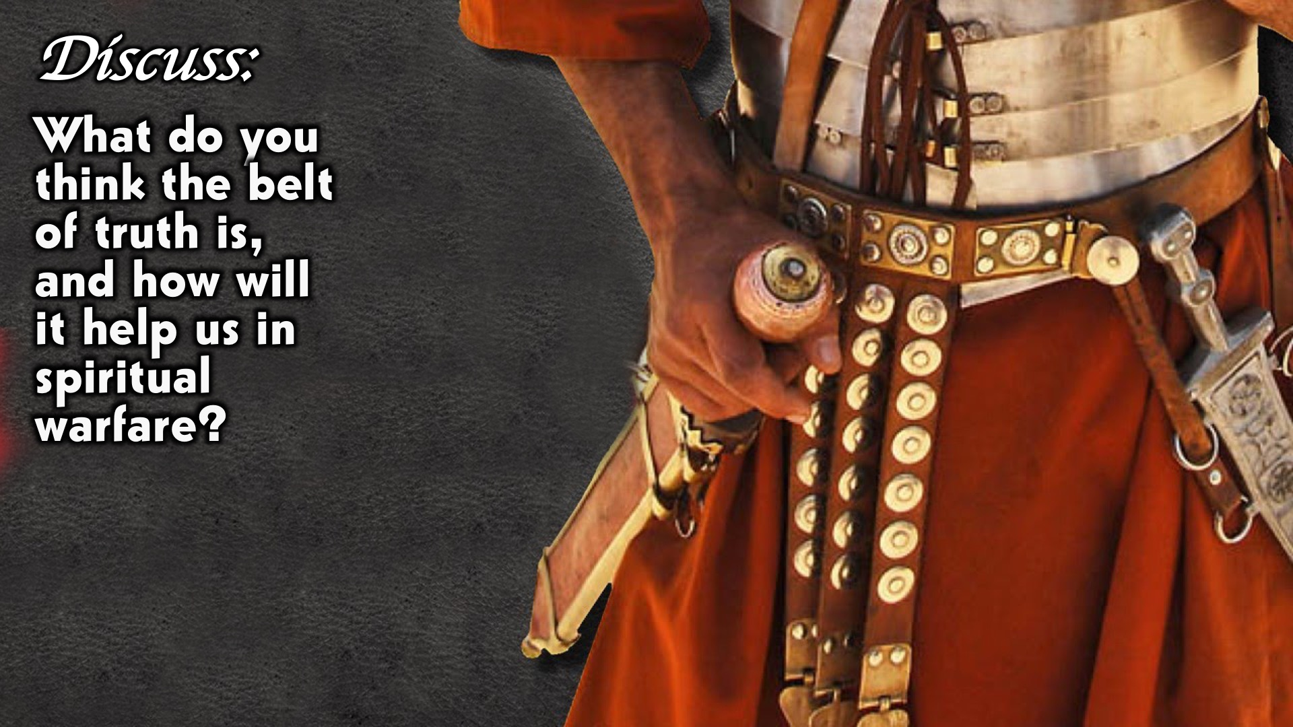
Notes:
Discuss: What do you think the belt of truth is, and how will it help us in spiritual warfare?

Slide 6
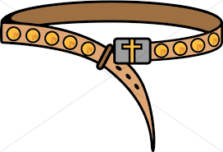
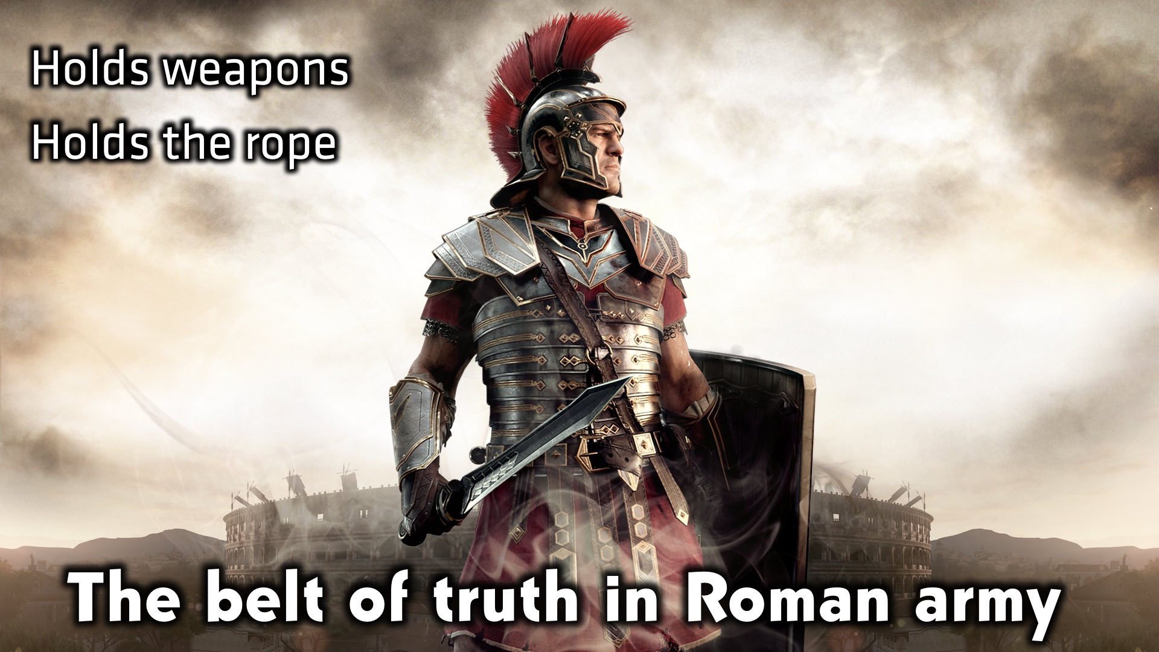
Notes:
The belt of truth in the Roman Army: It was used to hold weapons and hold the rope

Slide 7
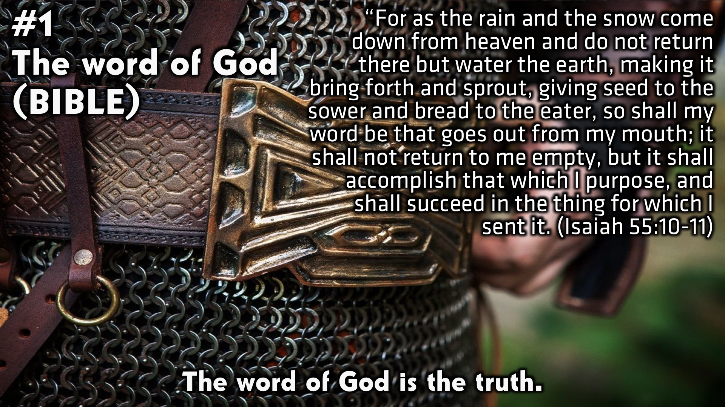
Notes:
#1: The word of God: The word of God is the truth. (Isaiah 55:1—11)

Slide 8
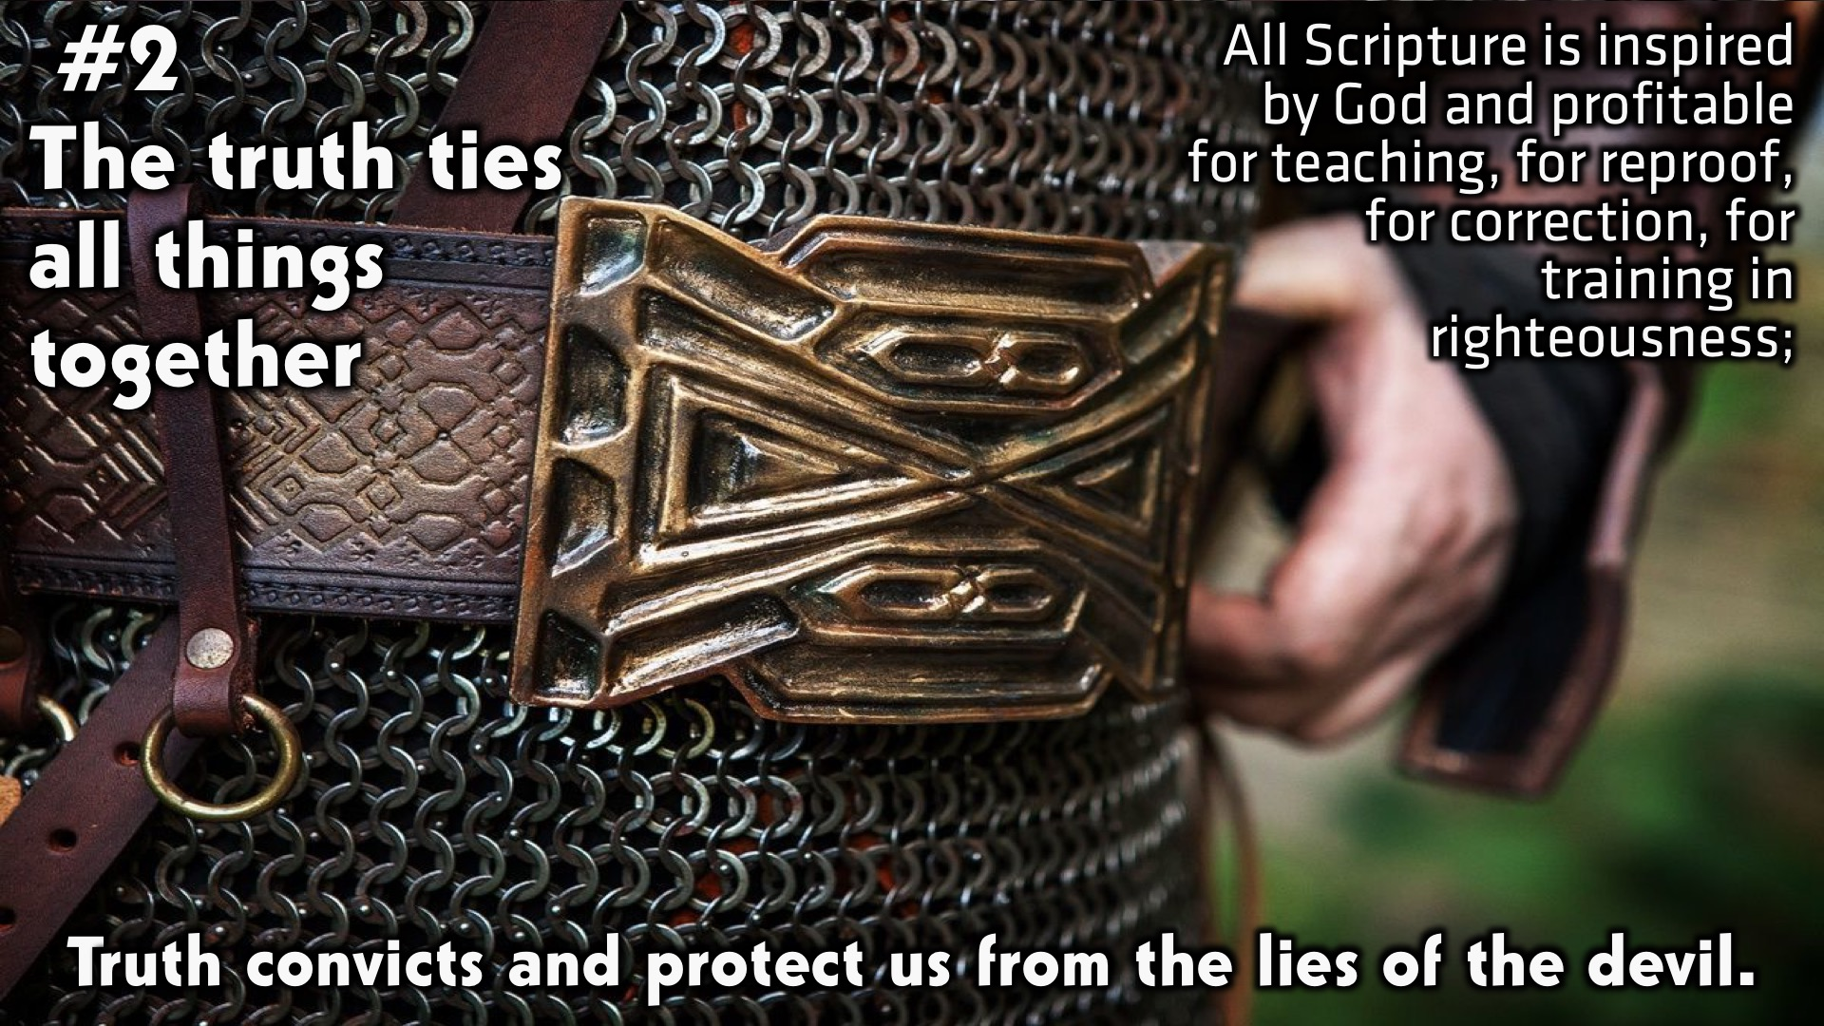
Notes:
#2 The truth ties all things together. Truth convicts and protects us from the lies of the devil. All scripture is inspired by God and profitable for teaching, for reproof, for correction, for training in righteousness.

Slide 9
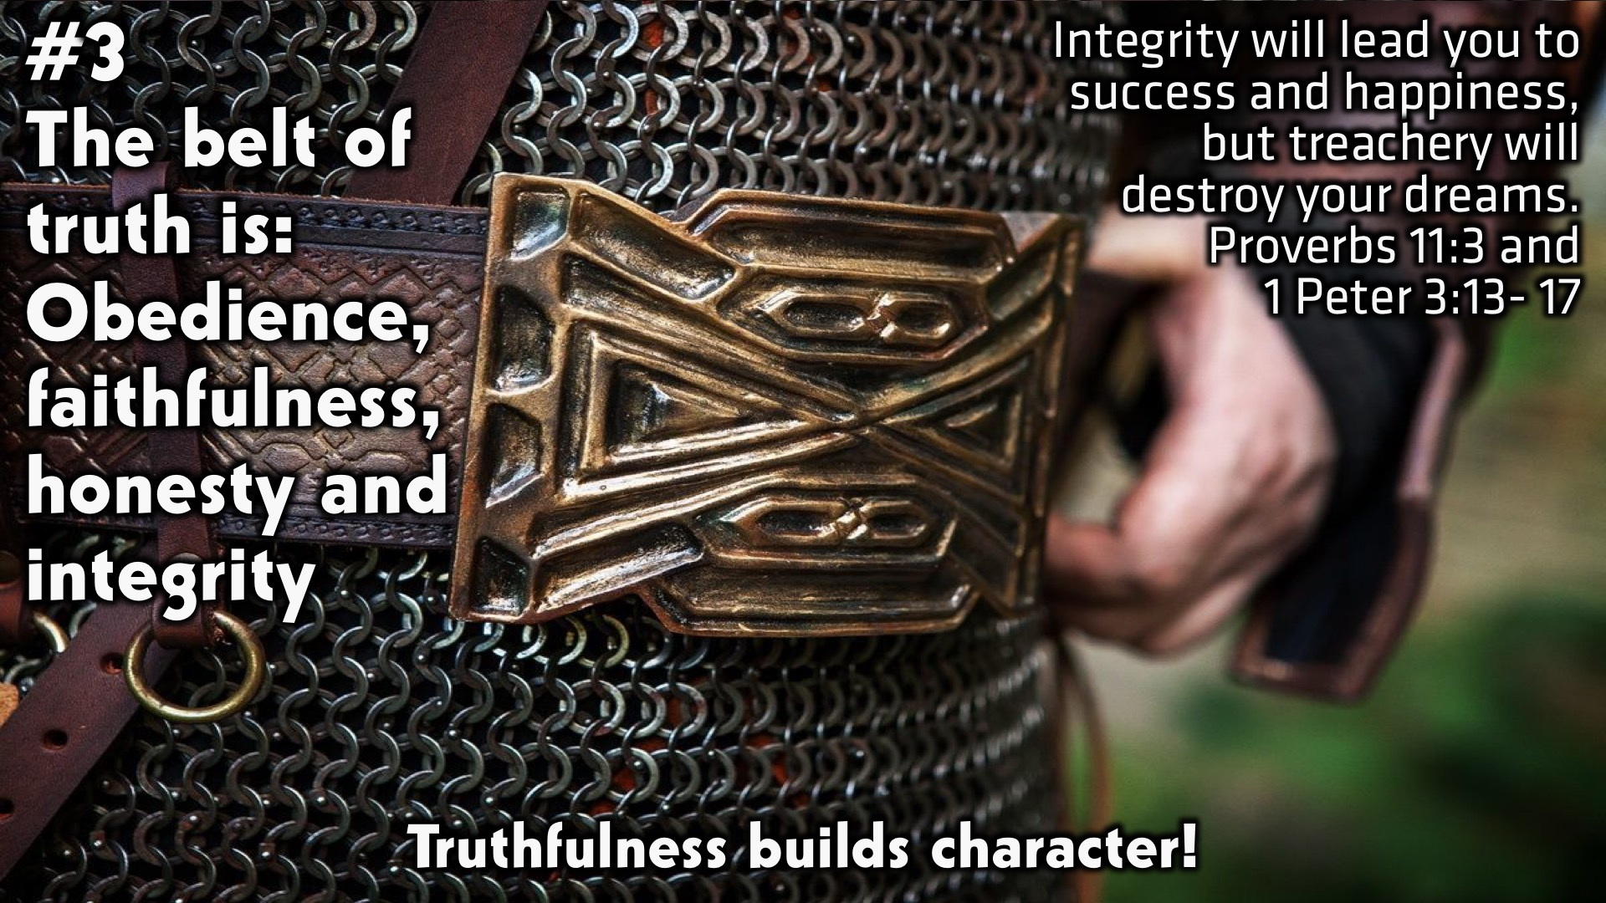
Notes:
#3: The belt of truth is: Obedience, faithfulness, honesty and integrity. Truthfulness builds character. (Proverbs 11:3 & 1 Peter 3:13-17)

Slide 10
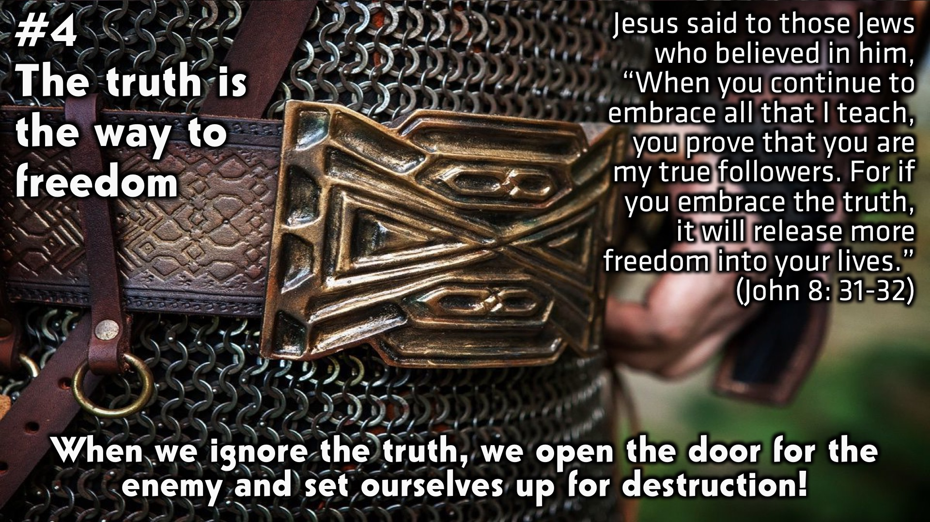
Notes:
#4: The truth is the way to Freedom. When we ignore the truth, we open the door for the enemy and set ourselves up for destruction. (John 8:31-32)

Slide 11
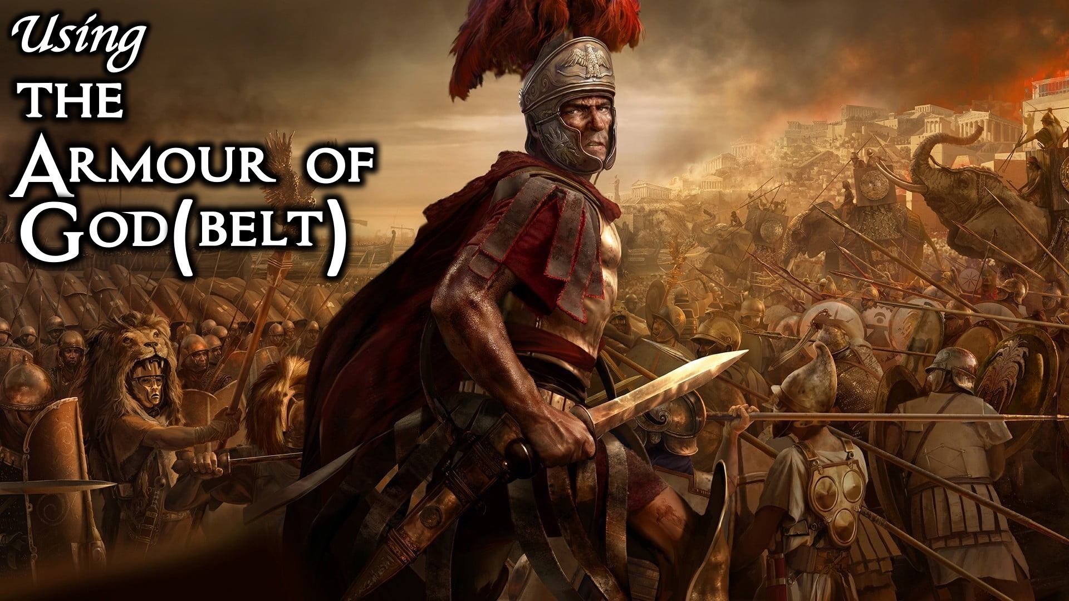
Notes:
Using the Armour of God.

Slide 12
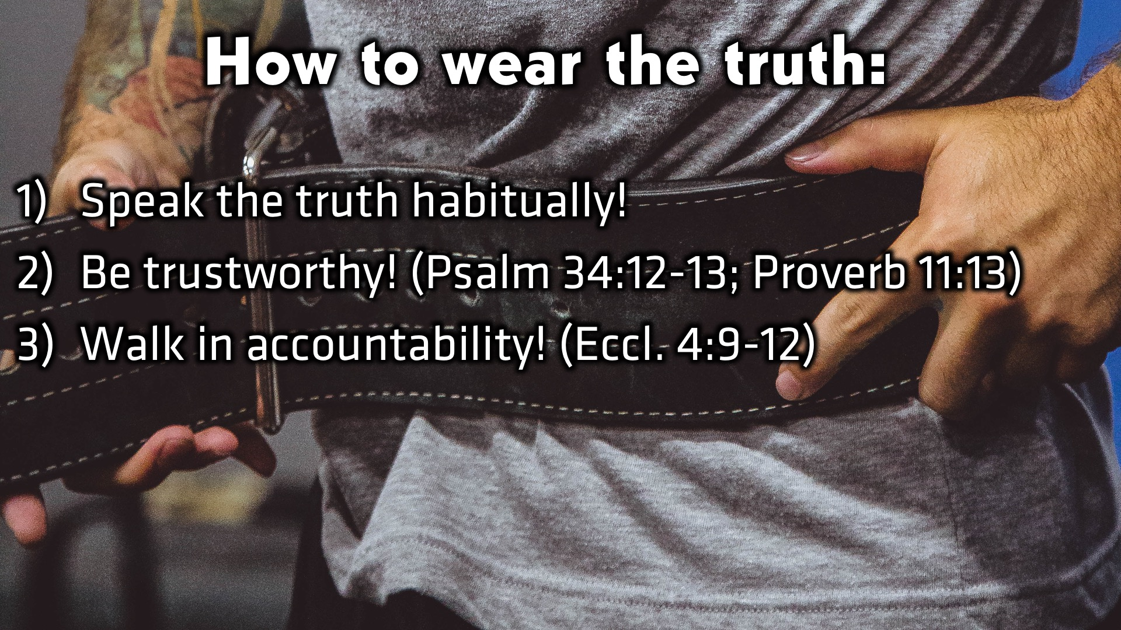
Notes:
How to wear the truth: (1) Speak the truth habitually (2) Be trustworthy (Psalm 34:12-13 and Proverbs 11:13) (3) Walk in accountability (Ecclesiastes 4:9-12)

Slide 13
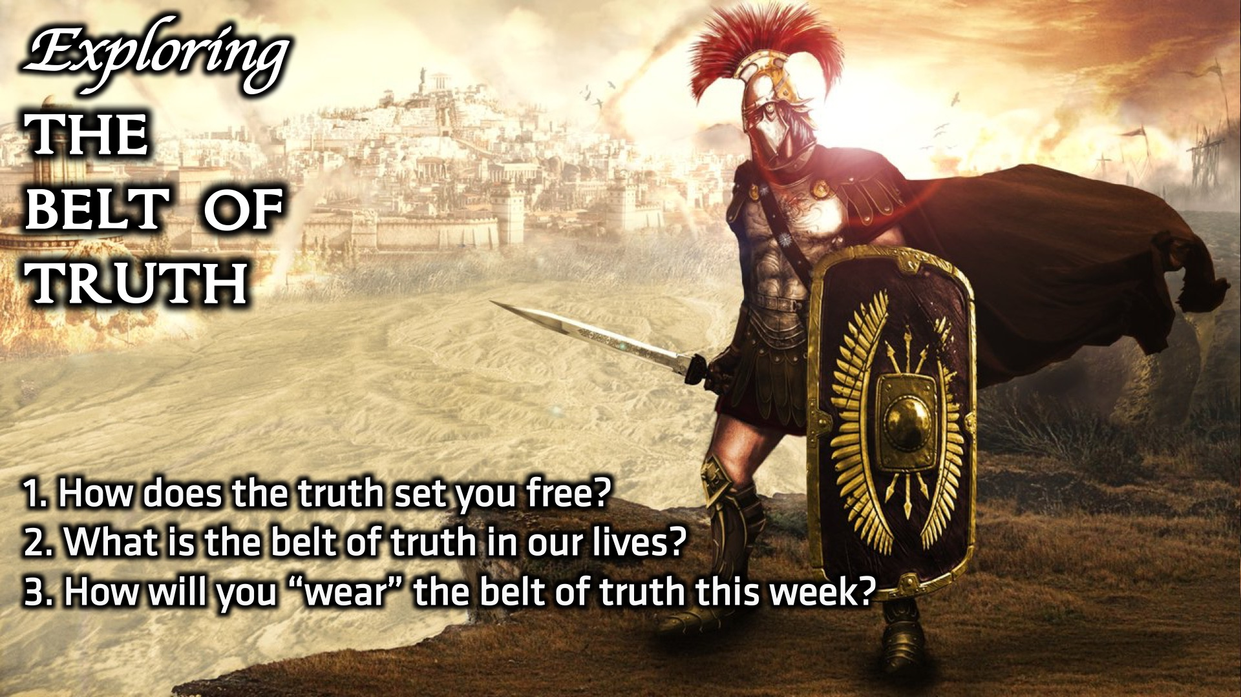
Notes:
Small group discussion: (1) How does the truth set you free? (2) What is the belt of truth in our lives? (3) How will you “wear” the belt of truth this week?

Slide 14
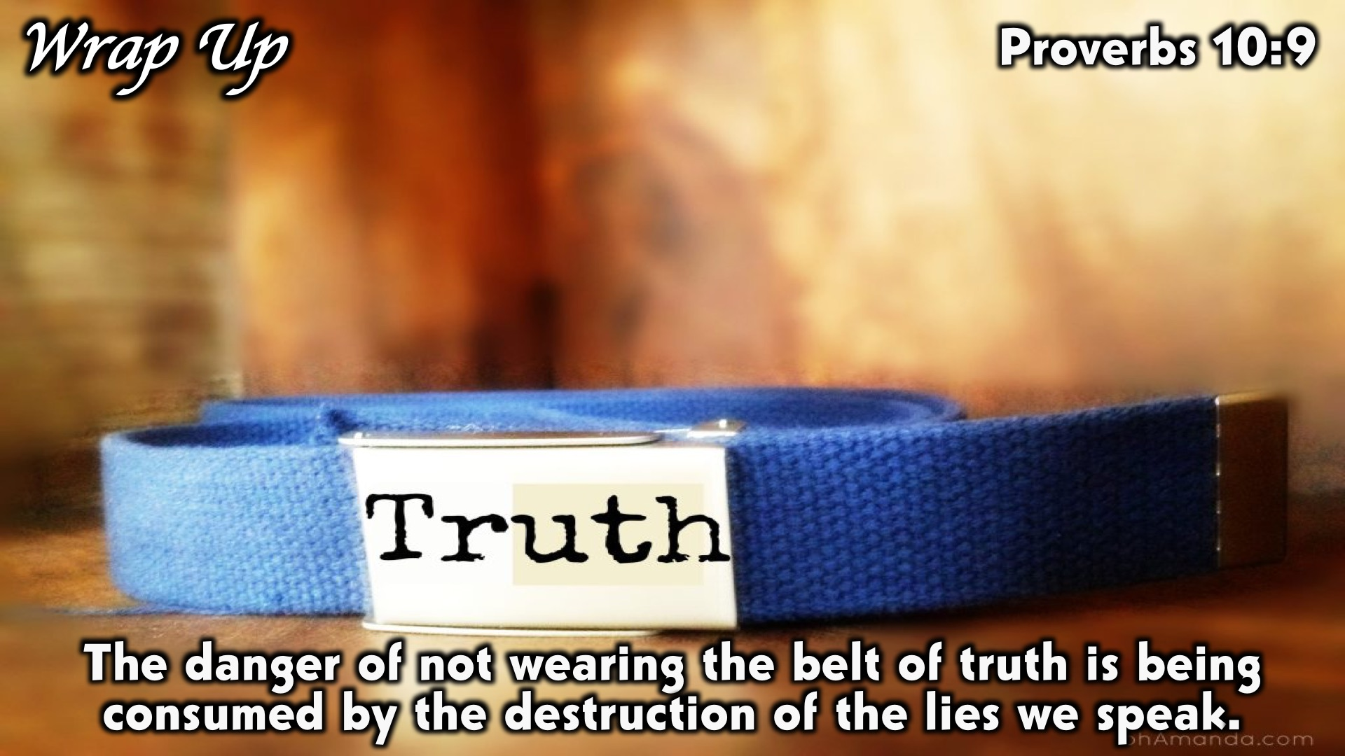
Notes:
Wrap Up: The danger of not wearing the belt of truth is being consumed by the destruction of the lies we speak.

Slide 15
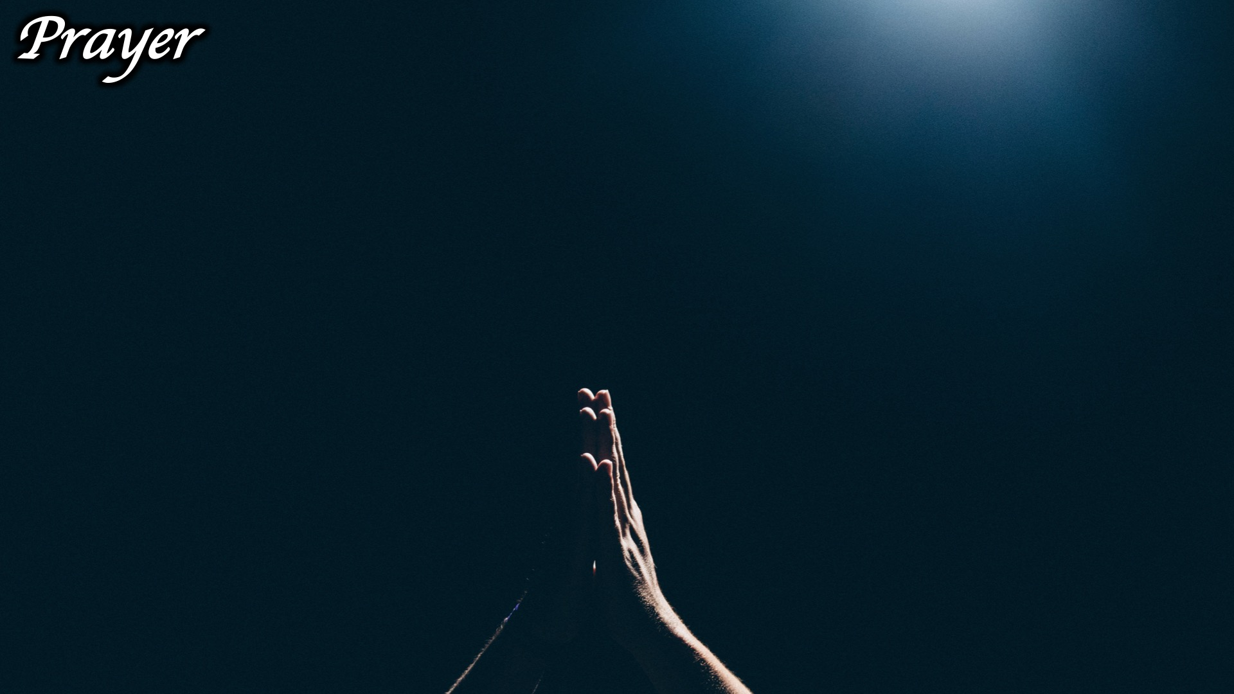
Notes:
Prayer:

Slide 16
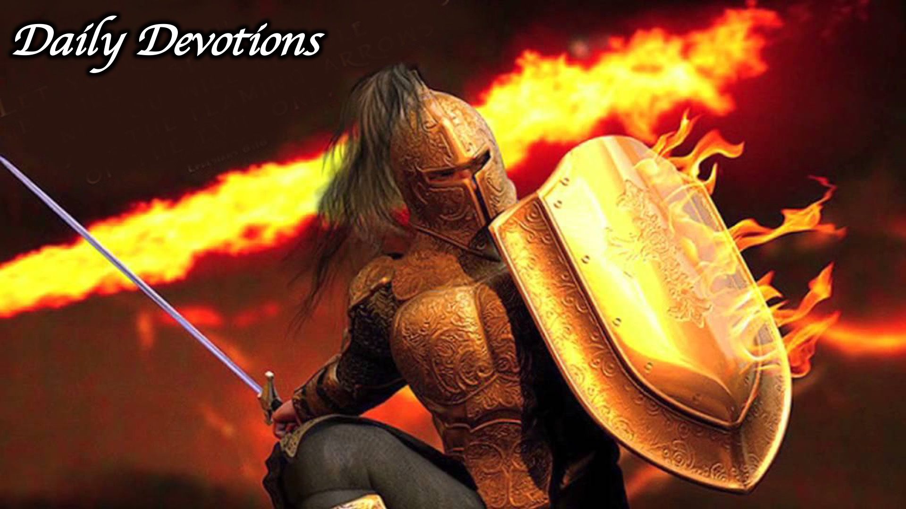
Notes:
Daily Devotions: We will post devotions on the Sunday WhatsApp group every night of the week throughout this series. Do everything you can to be a part of the daily journey in the armour of God.

Slide 17
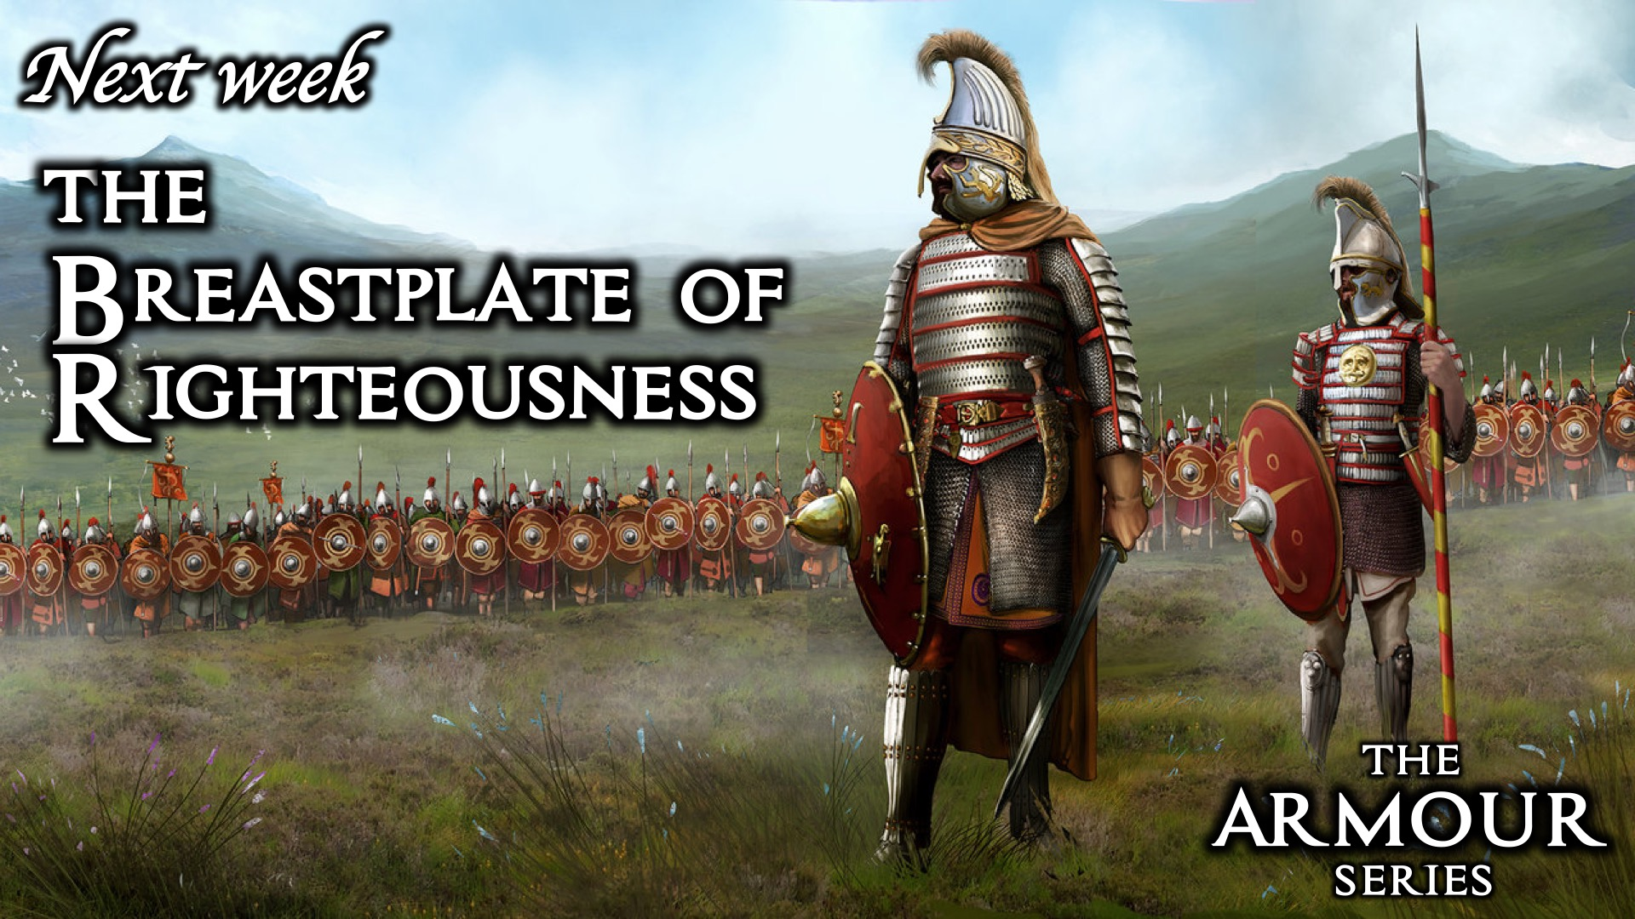
Notes:
Week 3: The Breastplate of Righteousness

