Slide 1
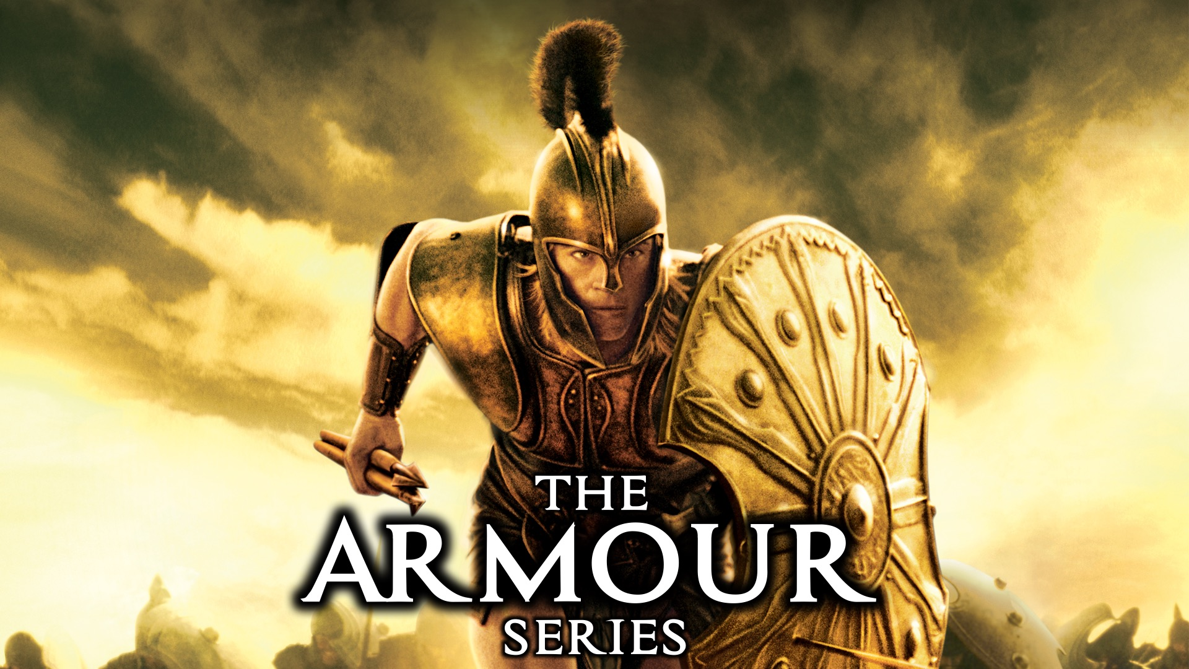
Notes:
Welcome to the Armour Series.

Slide 2
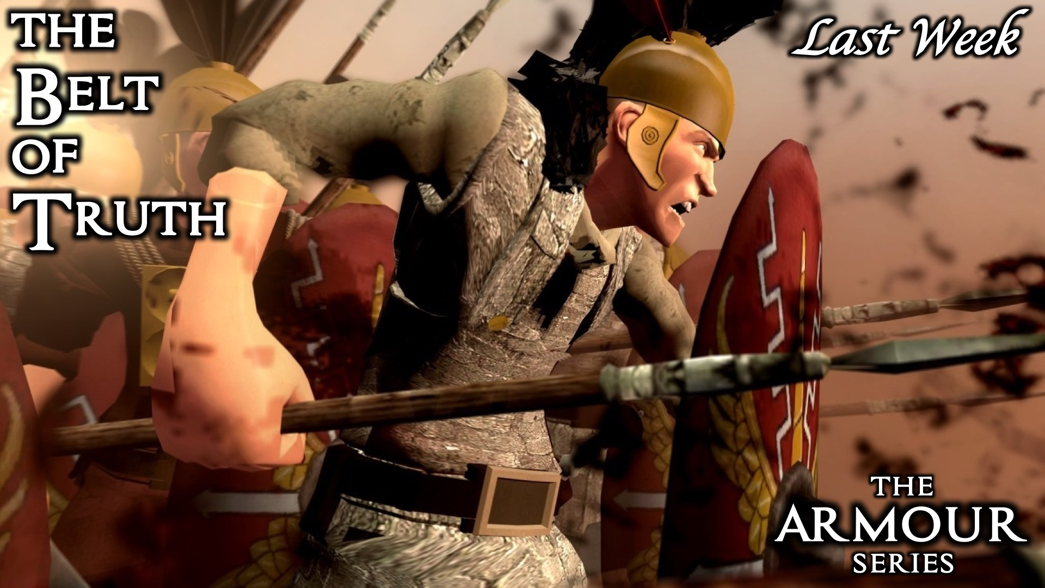
Notes:
Last week we learnt about the Belt of Truth.
Talk about what stood out for me: Isaiah 55 vs 10: “ As the rain and snow come down from heaven, and do not return to it without watering the earth and making it bud and flourish, so that it yields seed for the sower and bread for the eater, so is my word that goes out from my mouth: it will not return to me empty, but it will accomplish what I desire and achieve the purpose for which I sent it”

Slide 3
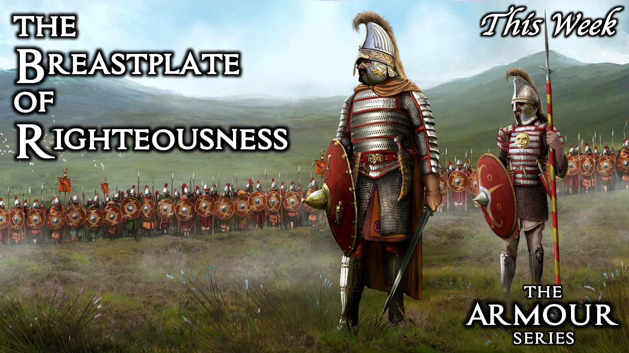
Notes:
This week we are exploring the Breastplate of Righteousness.

Slide 4
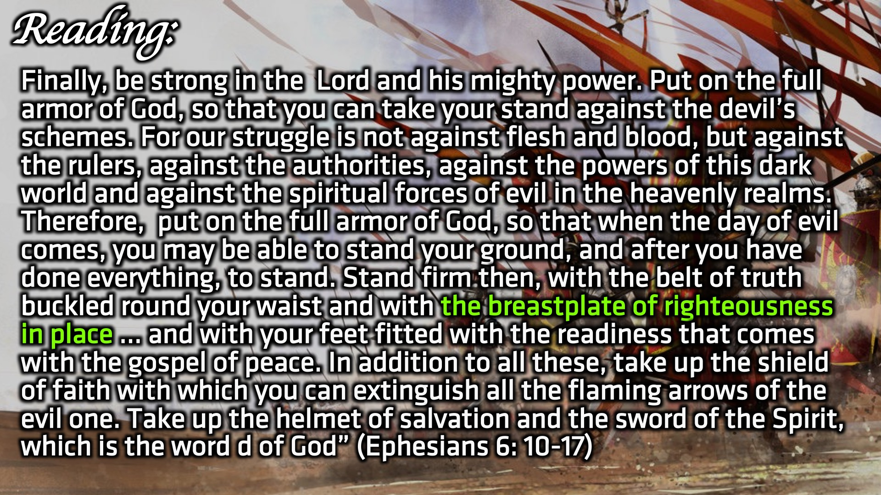
Notes:
Reading: Be strong in the Lord and in his mighty power. Put on the full armour of God, so that you can take your stand against the devil’s schemes. For our struggle is not against flesh and blood, but against the rulers, against the authorities, against the powers of this dark world and against the spiritual forces of evil in the heavenly realms. Therefore put on the full armour of God, so that when the day of evil comes, you may be able to stand your ground, and after you have done everything, to stand. Stand firm then, with the belt of truth buckled round your waist and with the breastplate of righteousness in place… (Ephesians 6:10)

Slide 5
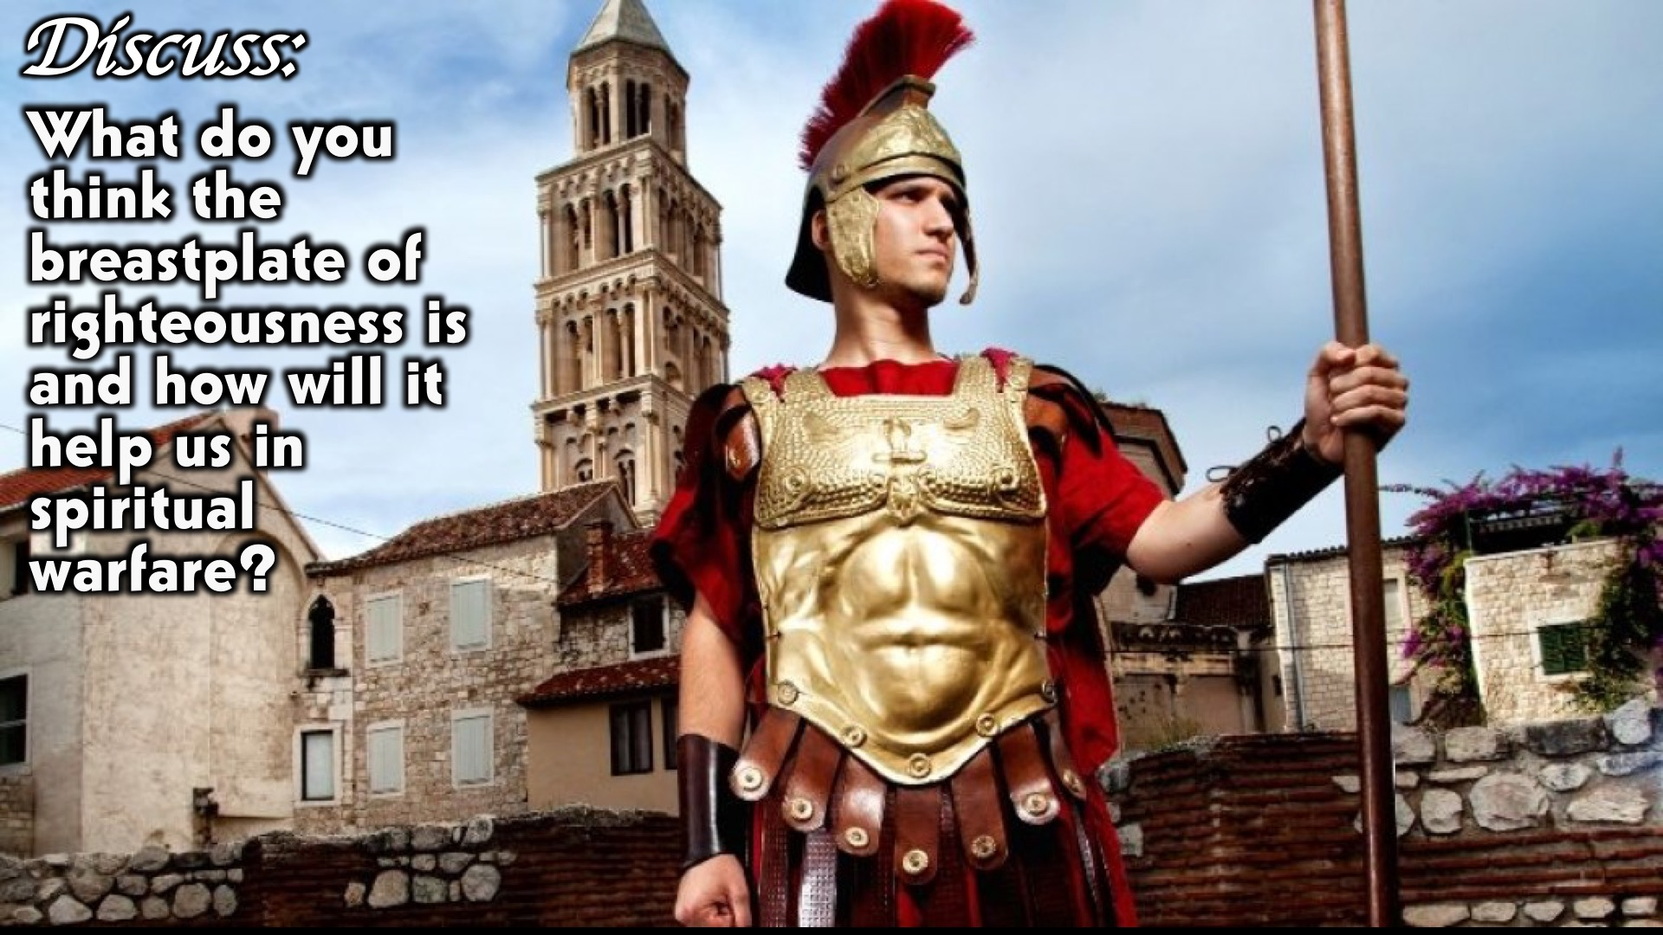
Notes:
Discuss: What do you think the breastplate of righteousness is and how will it help us in spiritual warfare?
Scripture to emphasize the danger in not having a Breastplate
1 kings 21
1 kings 16:30)
1 kings 22
1 kings 22: 31-35
The unrighteous king lost his life due to an opening in his armor
LETS BREAK IT DOWN
Breastplate – this was a central part of the Roman soldier’s armor, it provided protection for the torso, which contains vital organs like the heart and lungs.
A set of straps attached to the front of a saddle, which pass across the horse’s chest and prevent the saddle from slipping backward
Righteousness- “upright” heart (AMP) – to be upright is to be INCORRUPTABLE, therefore you are not influenced by your environment, you do not succumb to pressure. To be righteous is to do what is right in God’s eyes

Slide 6
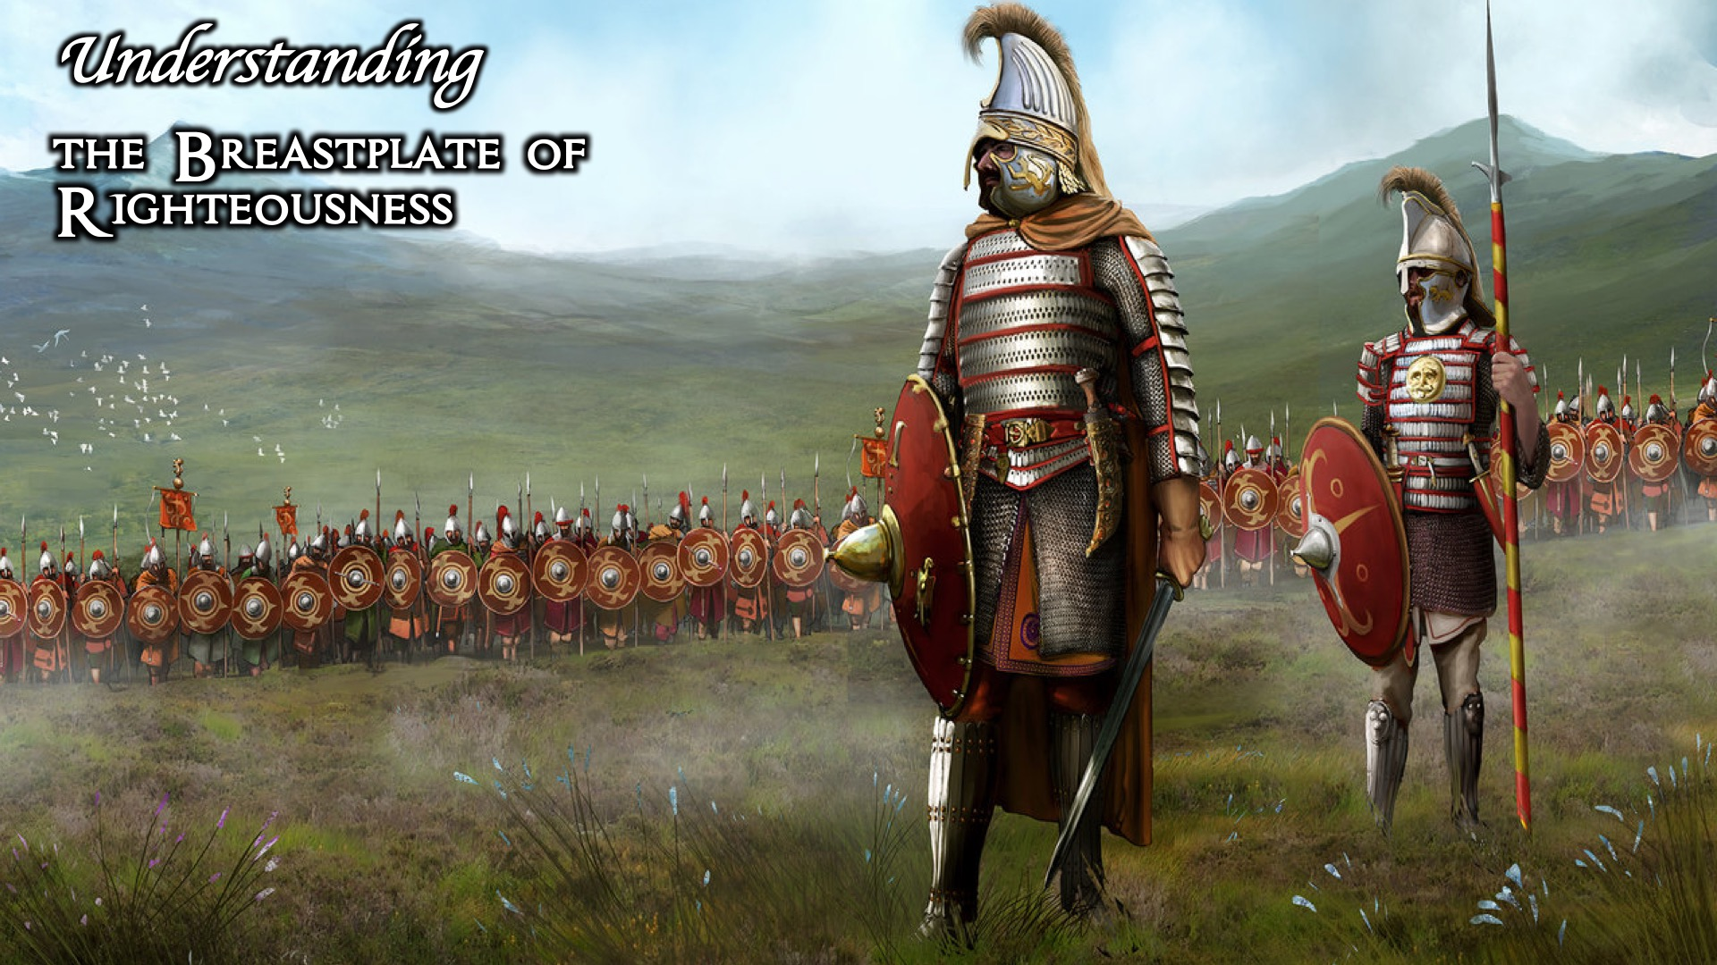
Notes:
Understanding the Breastplate of Righteousness.

Slide 7
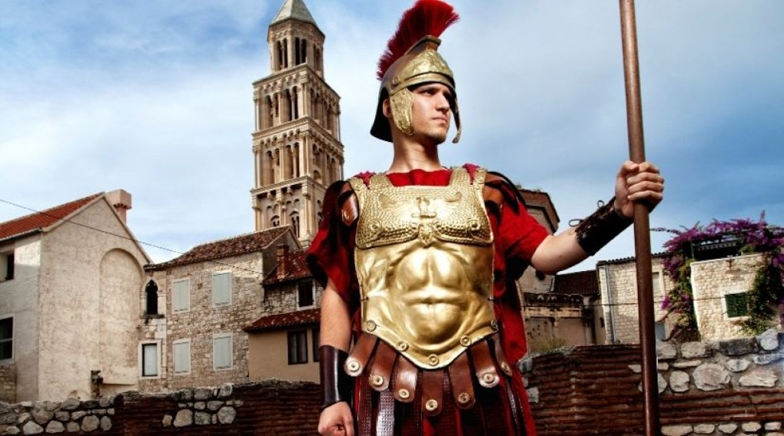
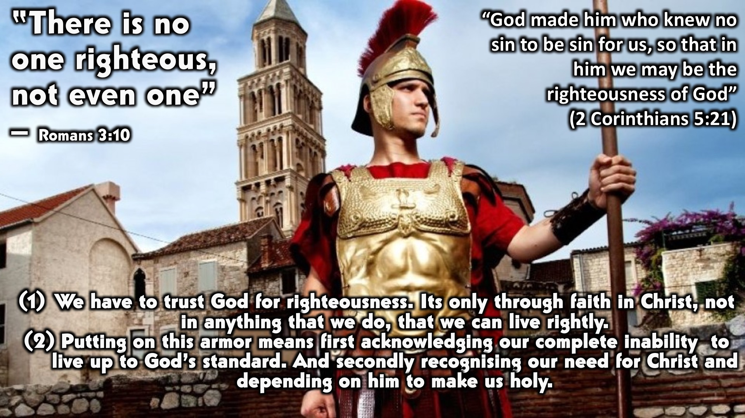
Notes:
2 Corinthians 5:21 explains how we attain the “righteousness” status
God is holy, he is good, he is perfect, he is pure, sin cannot exist in God’s presence, he cannot stand sin, sin does not have any power in Gods presence
The dilemma was then that we were in sin and there was a separation between us and God and there was absolutely no amount of sacrifice that could reconcile us to this holy God that he decided that He will sacrifice his only son, his righteous son, so that you and I may be the righteousness of God, God’s holy nation.
God is a God of relationship, he wants us, he wants to be in relationship with us, he chose us, he intended for us to be in perfect harmony with him, to be seated at his right hand, to be in right standing with Him.
Use Isaiah 6:1-7 to add more context : In the year that King Uzziah died, I saw the Lord, high and exalted, seated on a throne; and the train of his robe filled the temple. Above him were seraphim, each with six wings: With two wings they covered their faces, with two they covered their feet, and with two they were flying. And they were calling to one another: “Holy, holy, holy is the Lord Almighty; the whole earth is full of his glory.” At the sound of their voices the doorposts and thresholds shook and the temple was filled with smoke. “Woe to me!” I cried. “ I am ruined! For I am a man of unclean lips, and I live among a people of unclean lips, and my eyes have seen the King, the LORD Almighty.” Then one of the seraphim flew to me with a live coal in his hand, which he had taken with tongs from the altar. With it he touched my mouth and said “see, this has touched your lips; your guilt is taken away and your sin atoned for.”

Slide 8
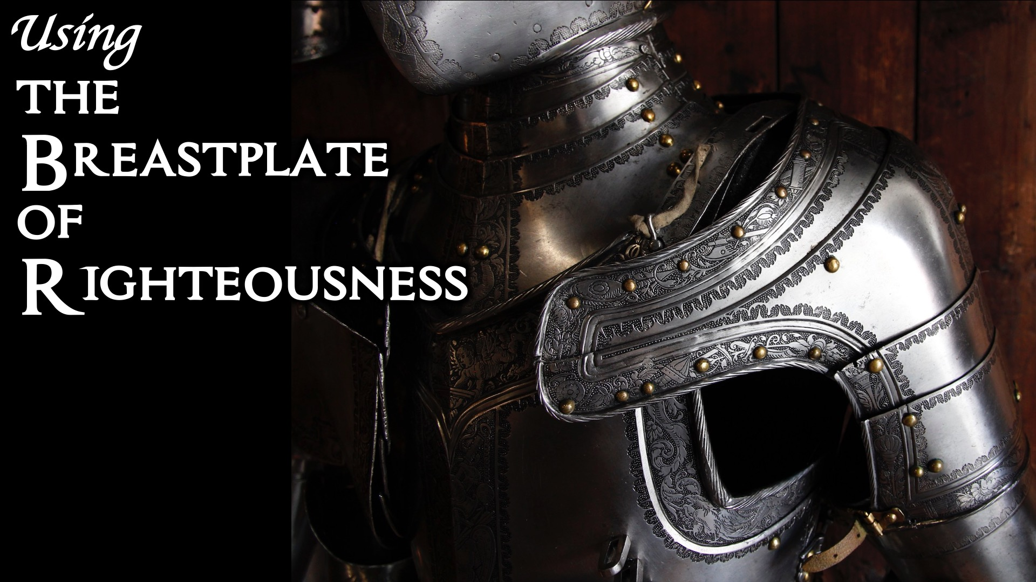
Notes:
Using the Breastplate of Righteousness.

Slide 9
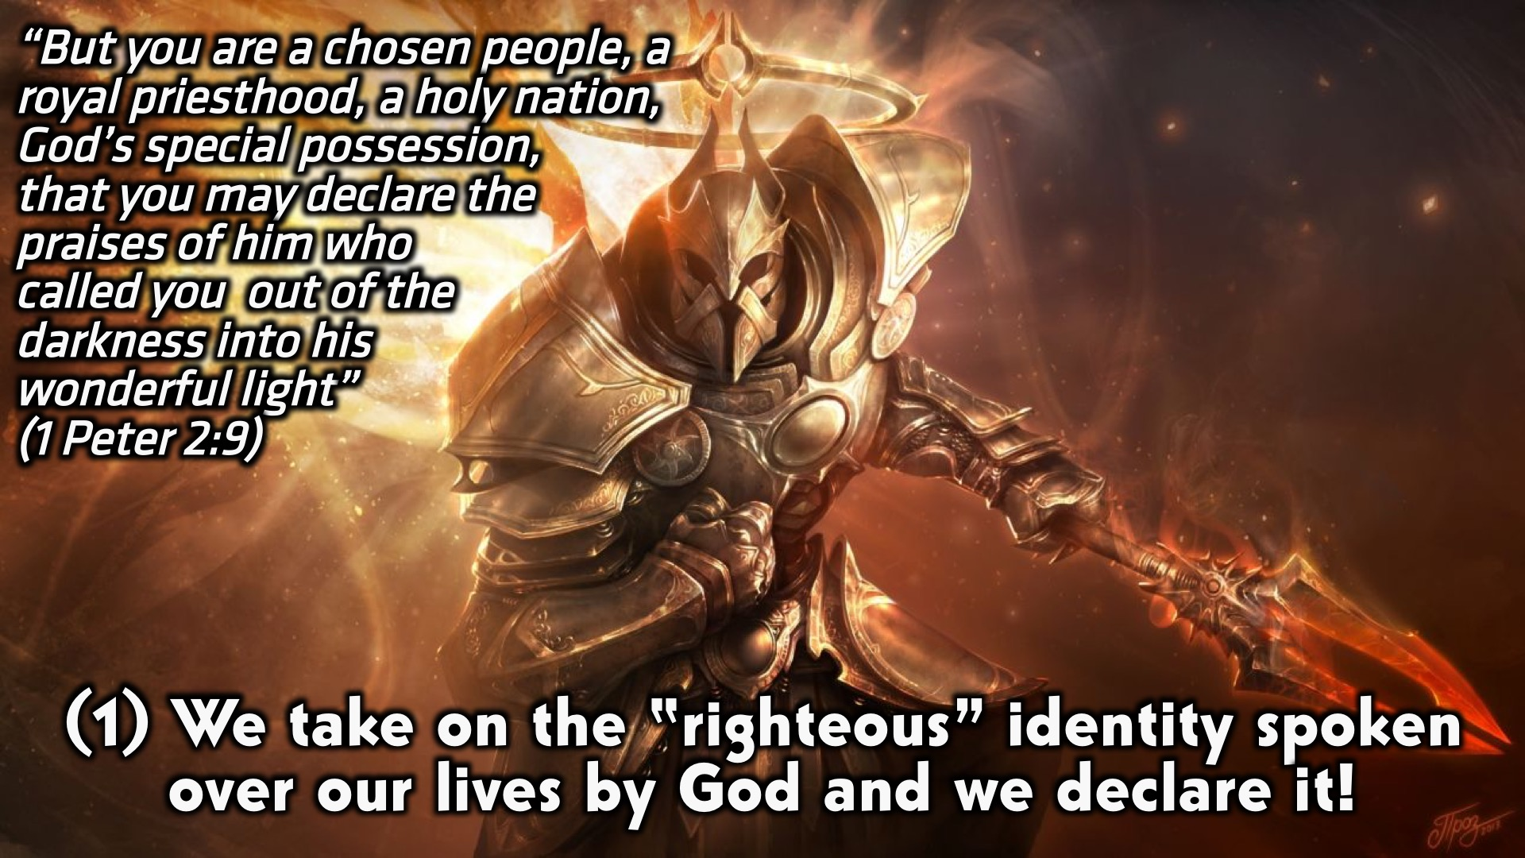
Notes:
One thing that threatens our righteousness is sin, I say “threaten” because its exactly that.
The bible says that when the veil was torn, the power of sin was broken, sin has no power in/over our lives!
“Where sin abounds, his grace abounds even more”

Slide 10
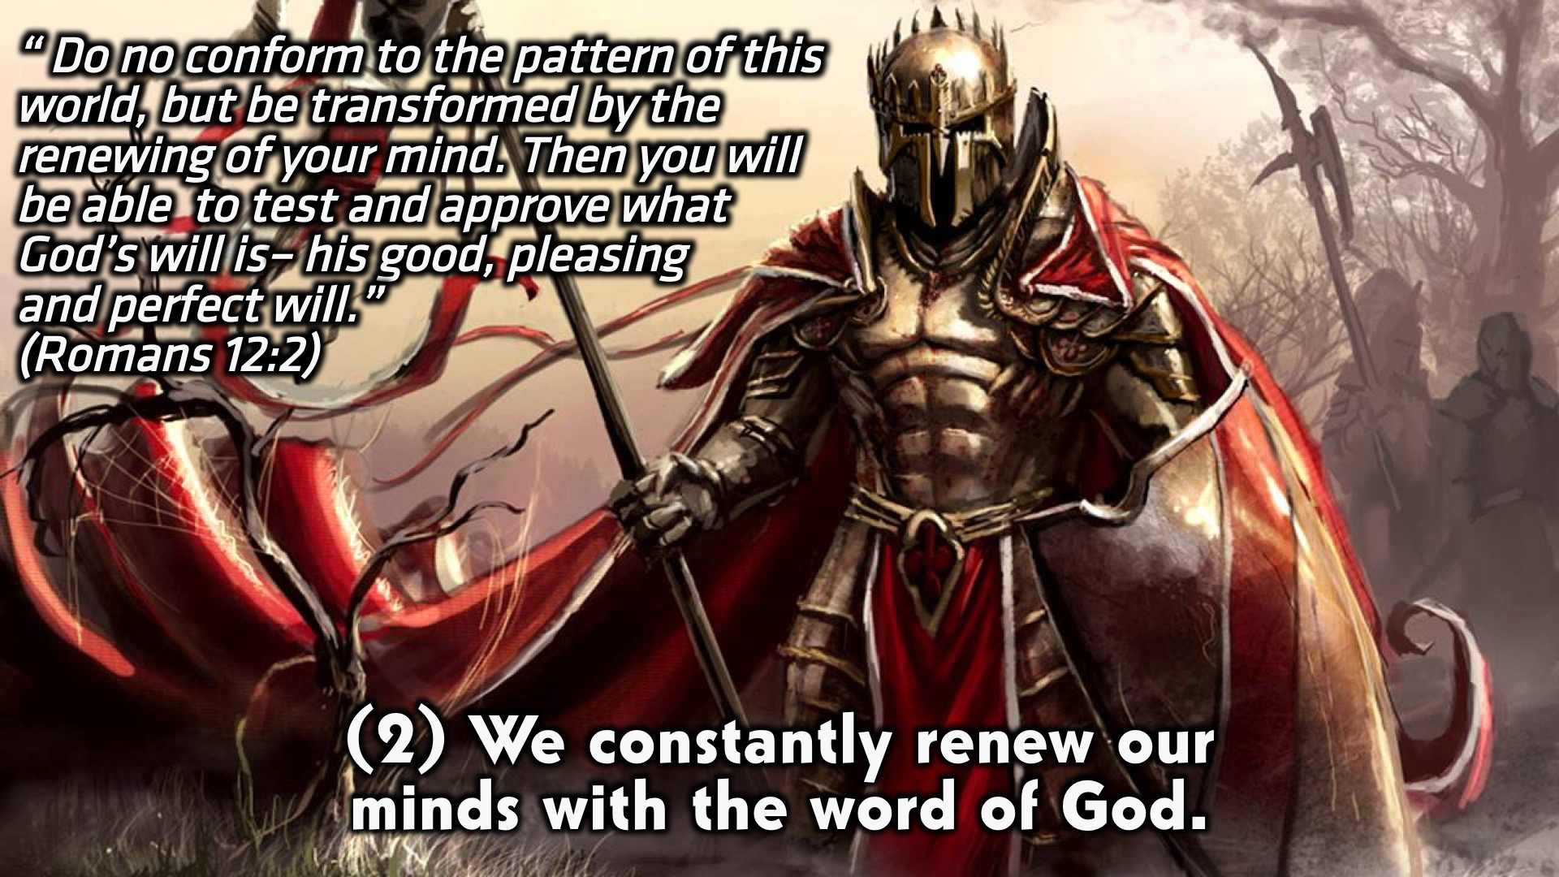
Notes:
One thing that threatens our righteousness is sin, I say “threaten” because its exactly that.
The bible says that when the veil was torn, the power of sin was broken, sin has no power in/over our lives!
“Where sin abounds, his grace abounds even more”

Slide 11
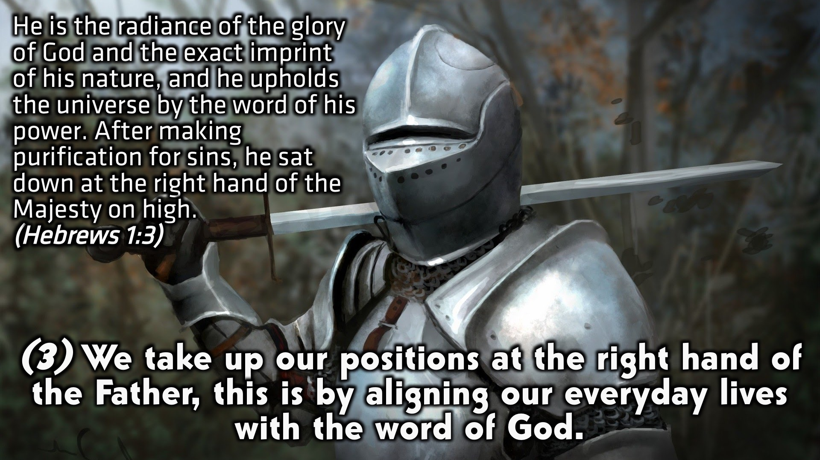
Notes:
One thing that threatens our righteousness is sin, I say “threaten” because its exactly that.
The bible says that when the veil was torn, the power of sin was broken, sin has no power in/over our lives!
“Where sin abounds, his grace abounds even more”

Slide 12
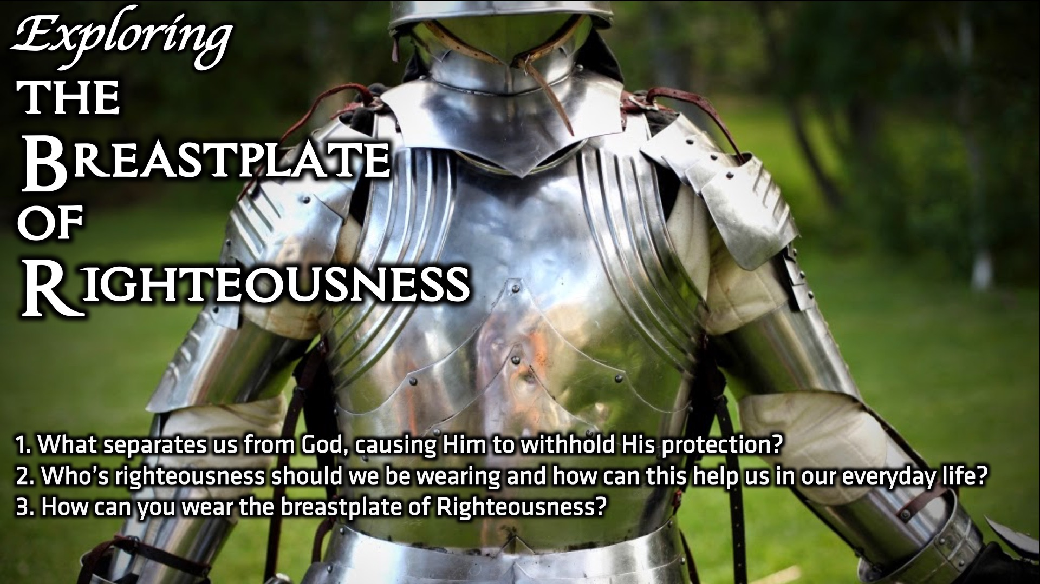
Notes:
Small Group Discussion: You have ten minutes to apply the message to your life in small groups using these 3 questions:
Isaiah 59:1-2
Jeremiah 23:6
Ezekiel 33: 13 “ If I tell a righteous person that they will surely live, but then they trust in their righteousness and do evil, none of the righteous things that person has done will be remembered; they will die for the evil they have done” – once we have put on the breastplate of righteousness, we must be sure not to remove it, this is not a one time event; rather it requires a lifetime action.

Slide 13
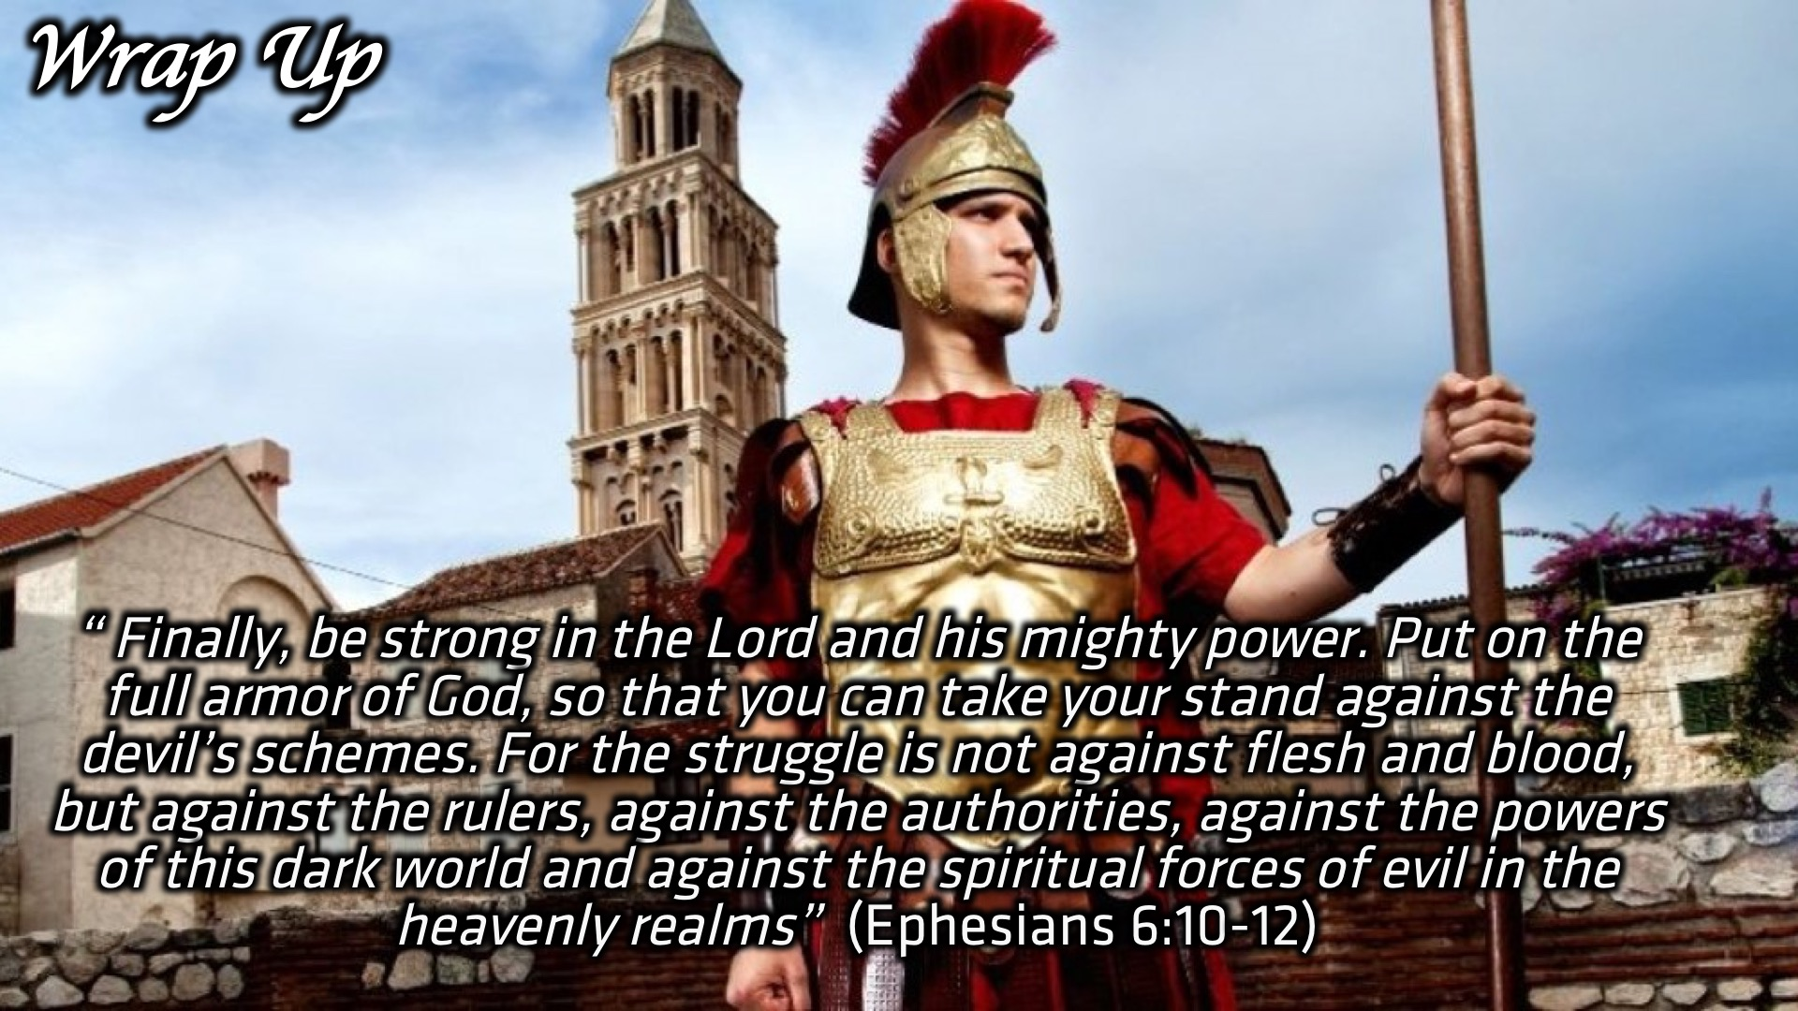
Notes:
Wrap Up: So this scripture perfectly highlights the importance of putting on the full armor of God. So lets take up all the weapons that God has laid out for us. This is no afternoon athletic contest that we’ll walk away from and forget about in a couple of hours. This is for keeps, a life-or-death fight to the finish against the devil and all his angels

Slide 14
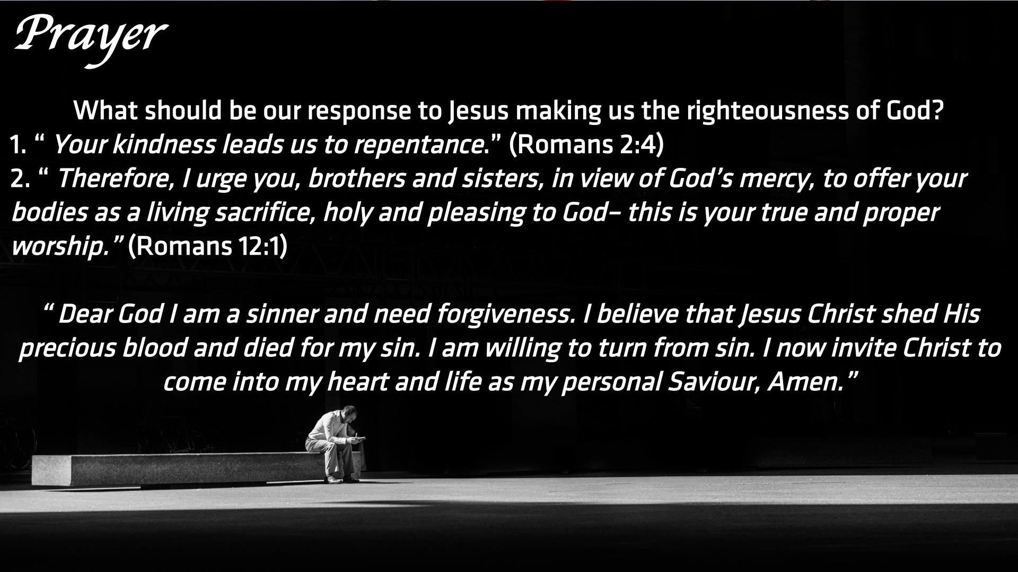
Notes:
Prayer: What should be our response to Jesus making us the righteousness of God? (1) “ Your kindness leads us to repentance.” (Romans 2:4) (2)“ Therefore, I urge you, brothers and sisters, in view of God’s mercy, to offer your bodies as a living sacrifice, holy and pleasing to God– this is your true and proper worship.” (Romans 12:1)
“ Dear God I am a sinner and need forgiveness. I believe that Jesus Christ shed His precious blood and died for my sin. I am willing to turn from sin. I now invite Christ to come into my heart and life as my personal Saviour, Amen.”

Slide 15
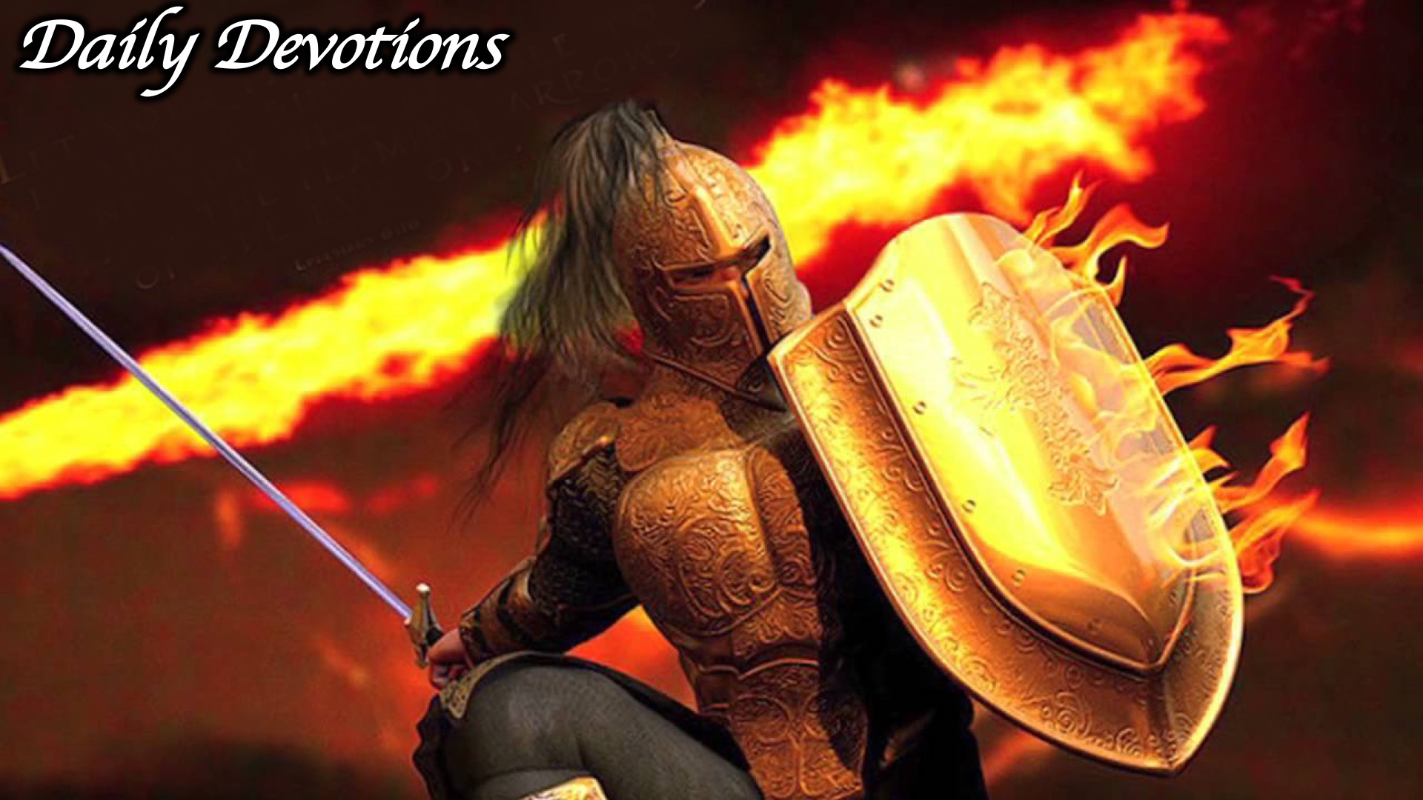
Notes:
Daily Devotions: We will post devotions on the Sunday WhatsApp group every night of the week throughout this series. Do everything you can to be a part of the daily journey in the armour of God.

Slide 16
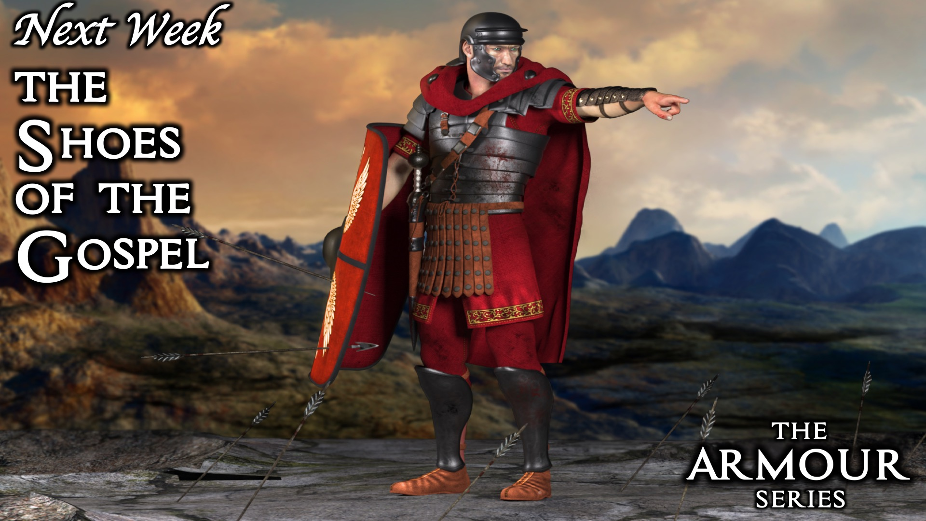
Notes:
Next Week: Next week we will look at the third piece of the armour of God: The Shoes of the Gospel.

