Slide 1

Notes:
Welcome to the Armour Series.

Slide 2
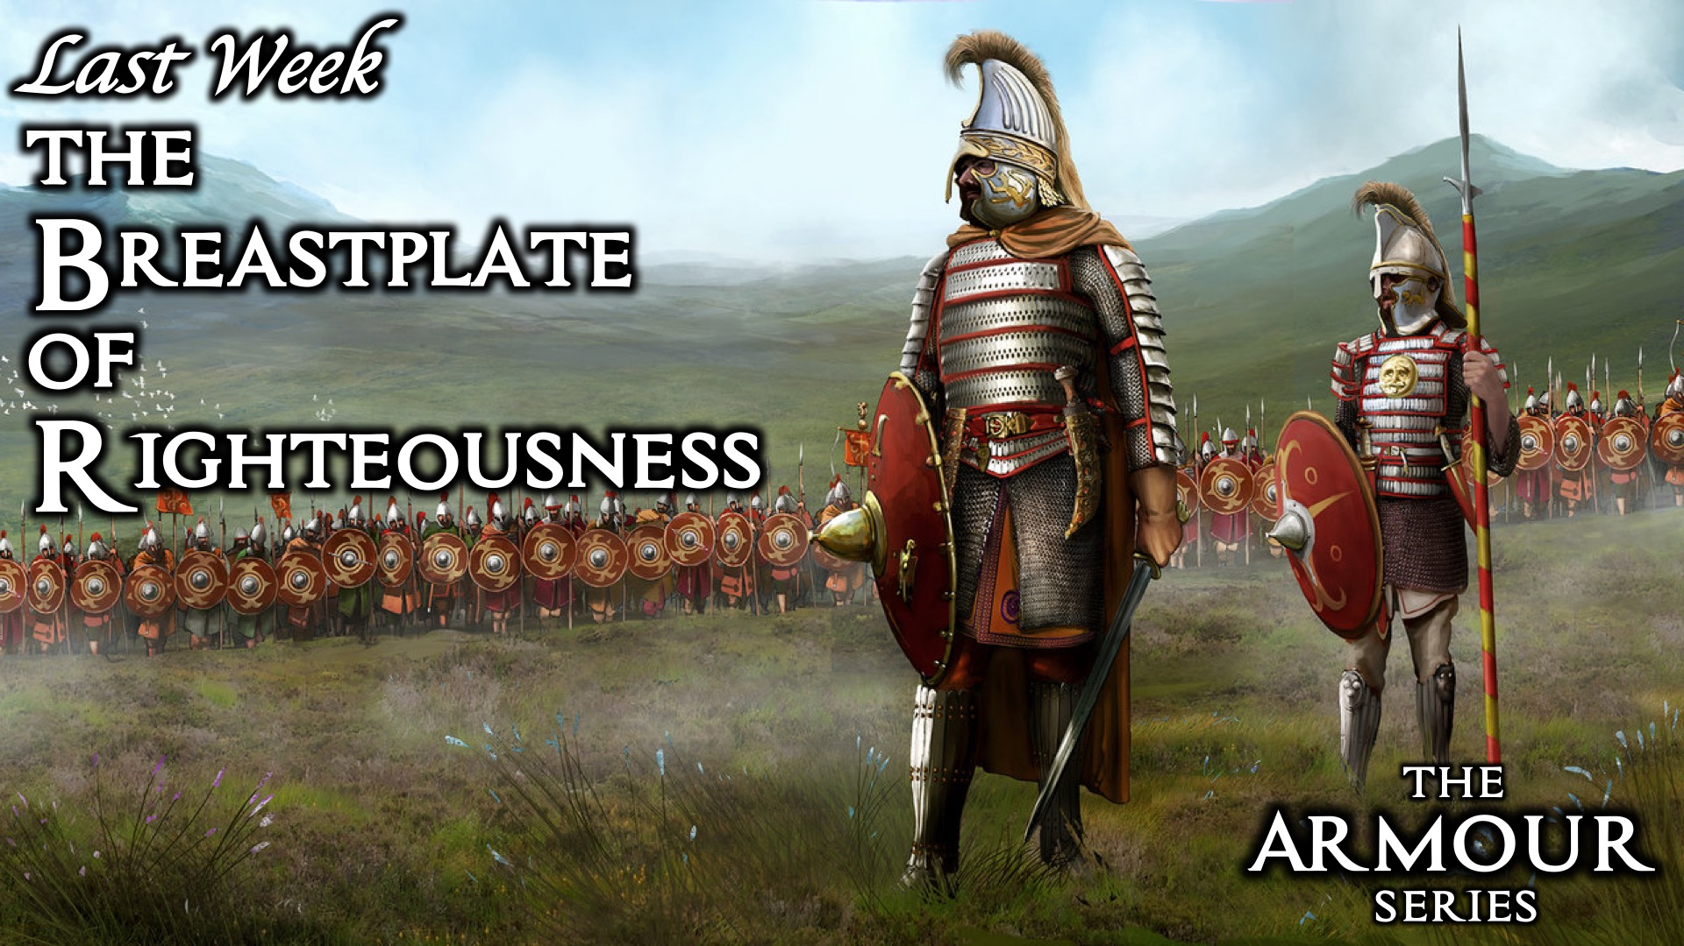
Notes:
Last week we learnt about the Breastplate of Righteousness.

Slide 3
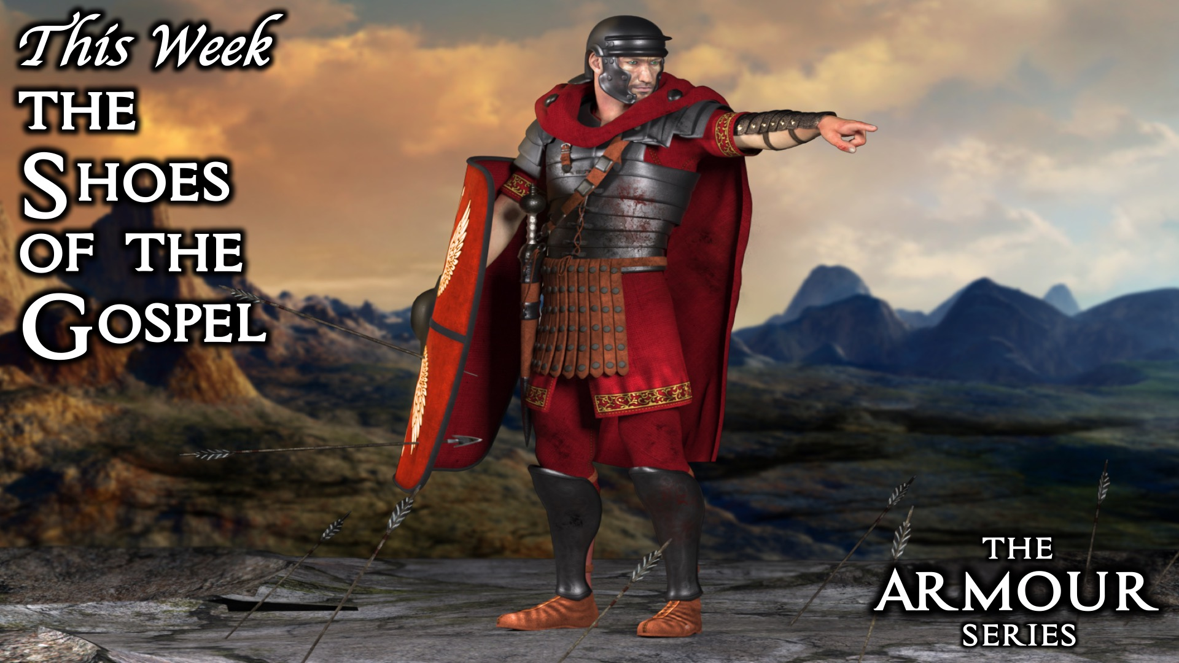
Notes:
This week we are exploring the Shoes of the Gospel.

Slide 4
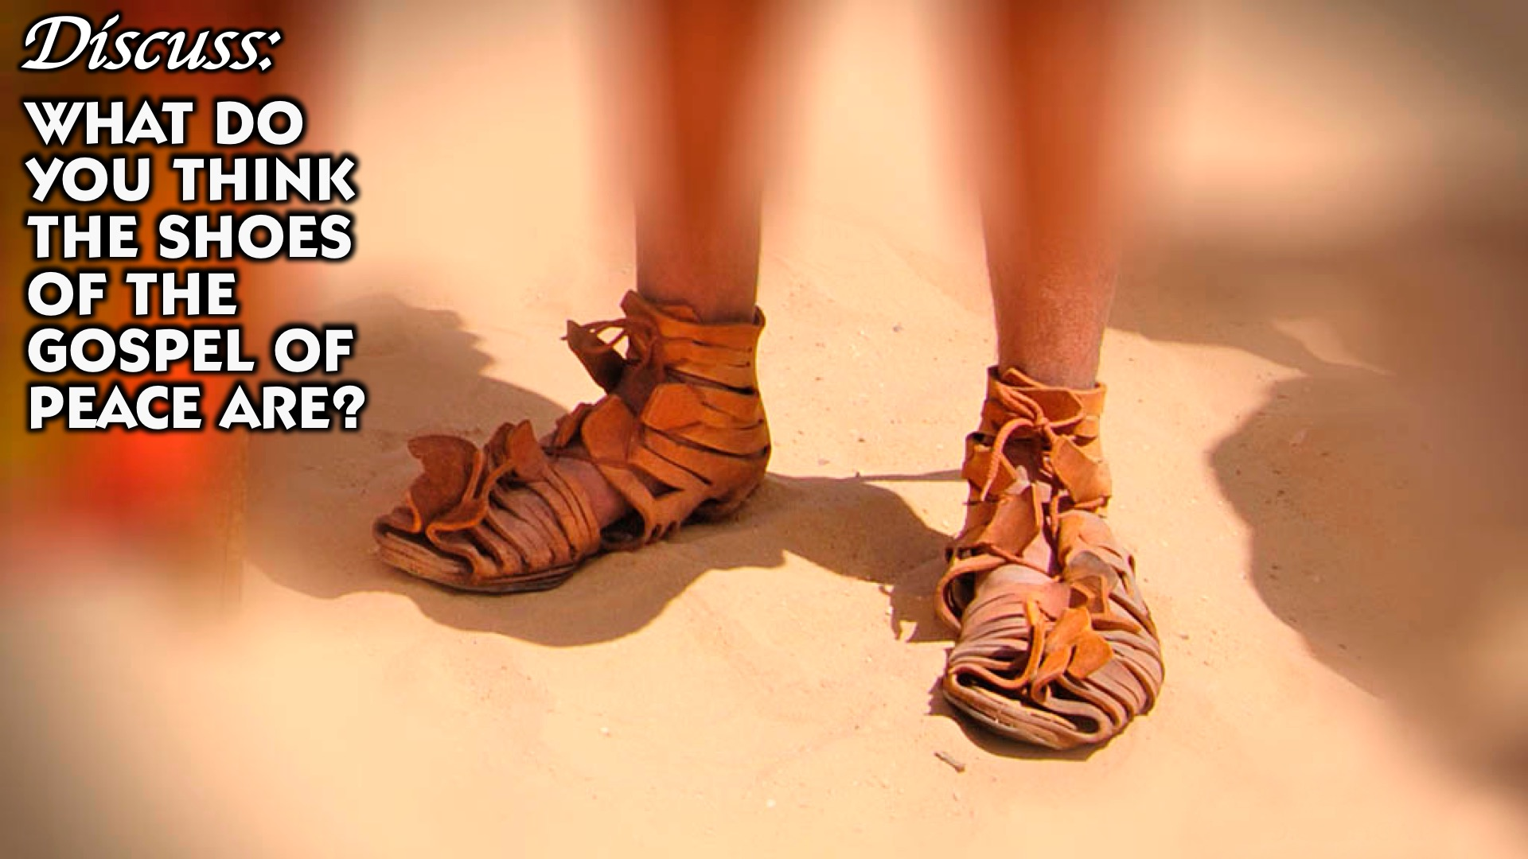
Notes:
Discuss: What do you think the shoes of the gospel are?

Slide 5
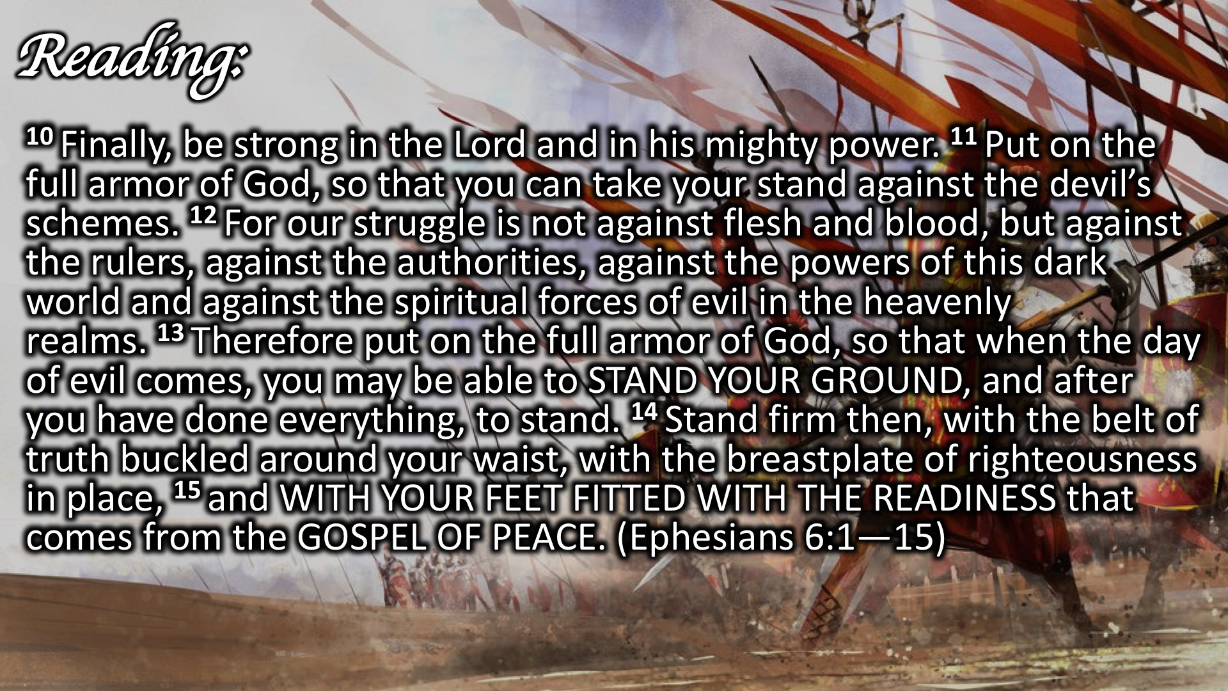
Notes:
Reading: ¹⁰ Finally, be strong in the Lord and in his mighty power. ¹¹ Put on the full armor of God, so that you can take your stand against the devil’s schemes. ¹² For our struggle is not against flesh and blood, but against the rulers, against the authorities, against the powers of this dark world and against the spiritual forces of evil in the heavenly realms. ¹³ Therefore put on the full armor of God, so that when the day of evil comes, you may be able to STAND YOUR GROUND, and after you have done everything, to stand. ¹⁴ Stand firm then, with the belt of truth buckled around your waist, with the breastplate of righteousness in place, ¹⁵ and WITH YOUR FEET FITTED WITH THE READINESS that comes from the GOSPEL OF PEACE. (Ephesians 6:1—15)

Slide 6
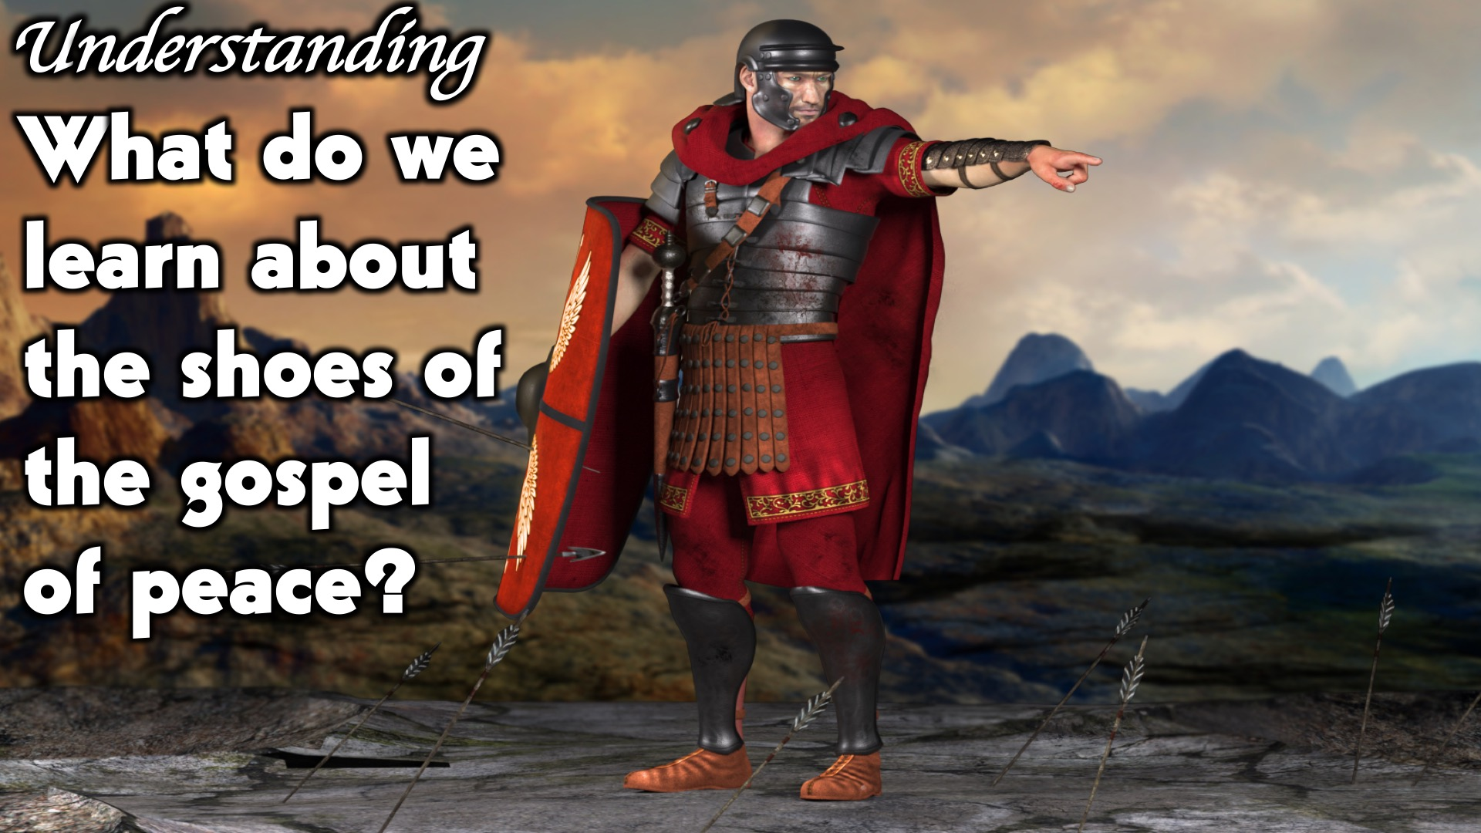
Notes:
Understanding: What do we learn about the shoes of the gospel of peace?

Slide 7
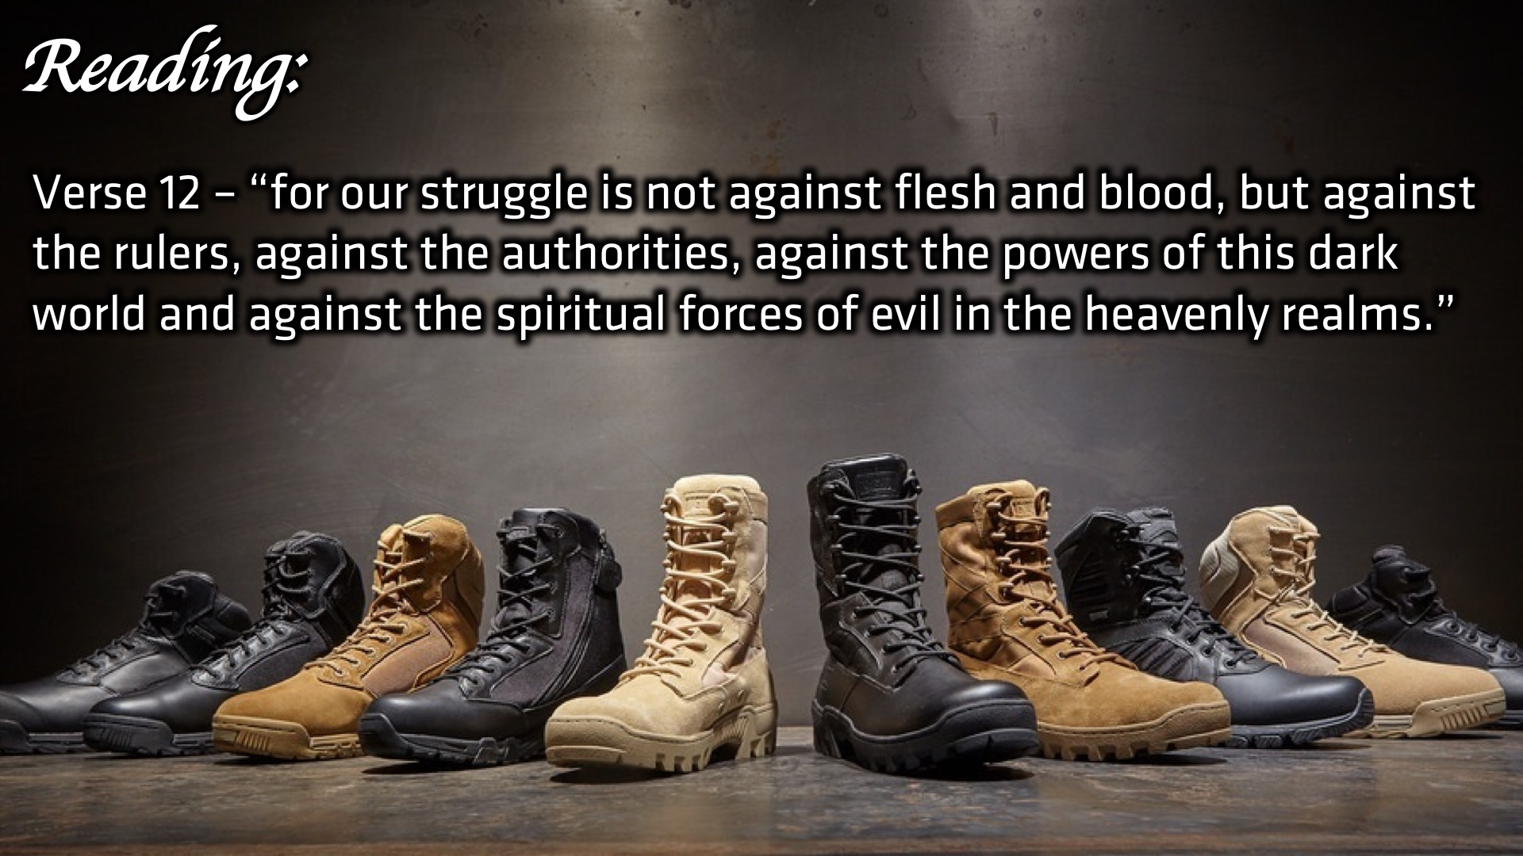
Notes:
Reading: Verse 12 – “for our struggle is not against flesh and blood, but against the rulers, against the authorities, against the powers of this dark world and against the spiritual forces of evil in the heavenly realms.”

Slide 8
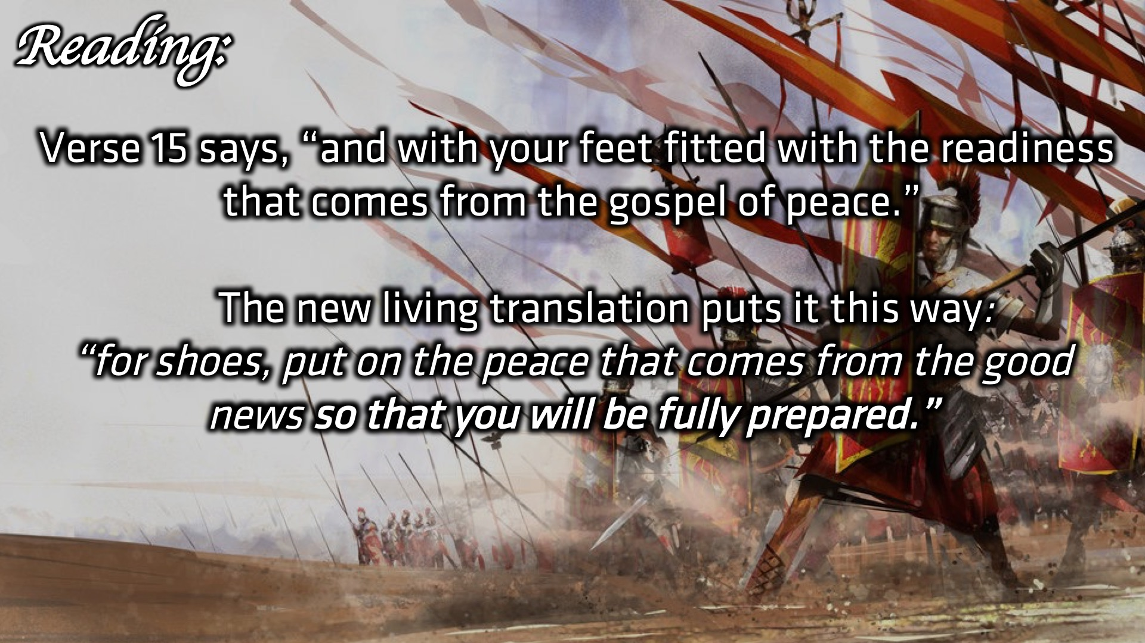
Notes:
Reading: Verse 15 says, “and with your feet fitted with the readiness that comes from the gospel of peace.” The new living translation puts it this way: “for shoes, put on the peace that comes from the good news so that you will be fully prepared.”

Slide 9
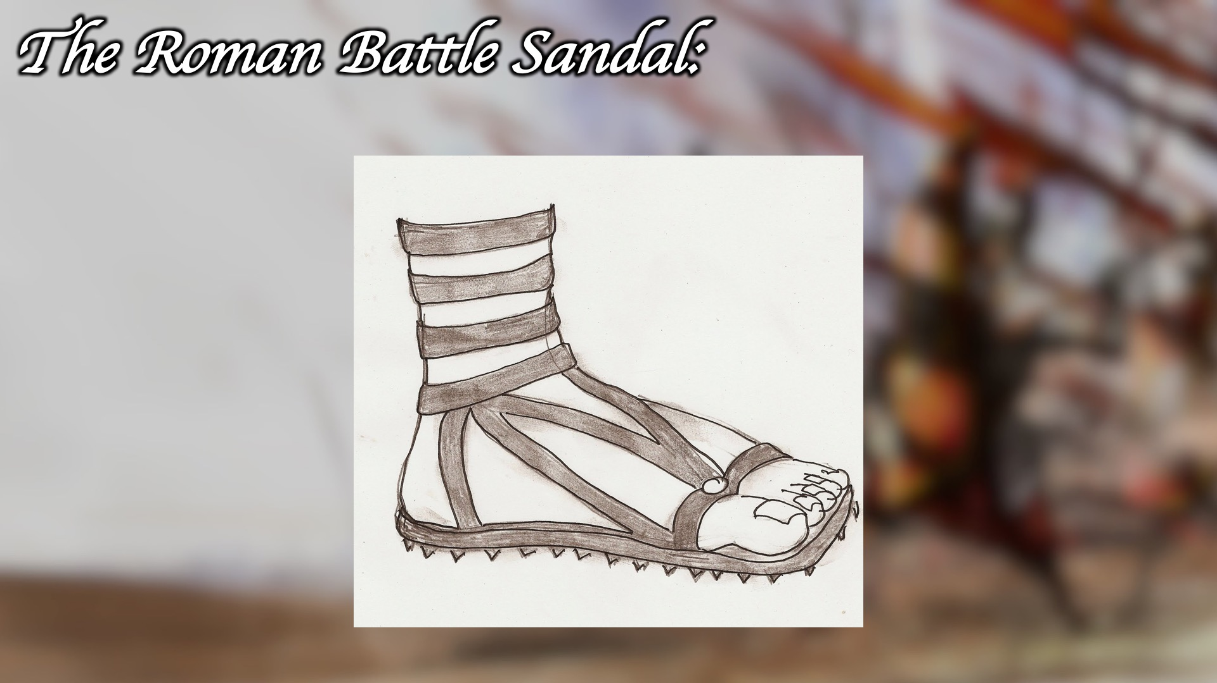
Notes:
The Roman battle sandal

Slide 10
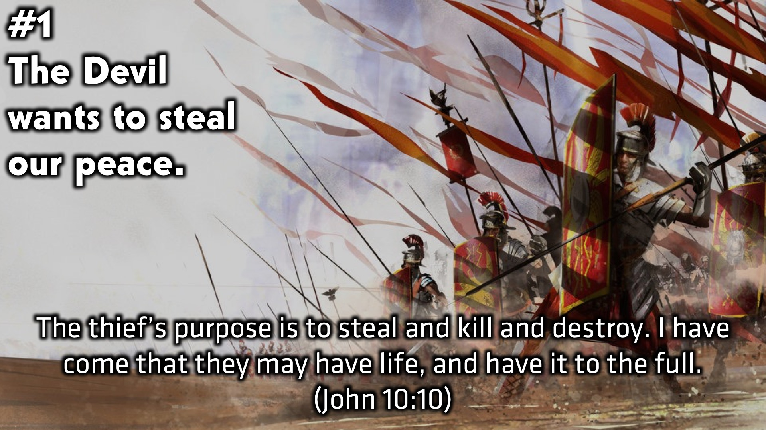
Notes:
(1) The Devil wants to steal our peace. “The thief’s purpose is to steal and kill and destroy. I have come that they may have life, and have it to the full.” (John 10:10)

Slide 11
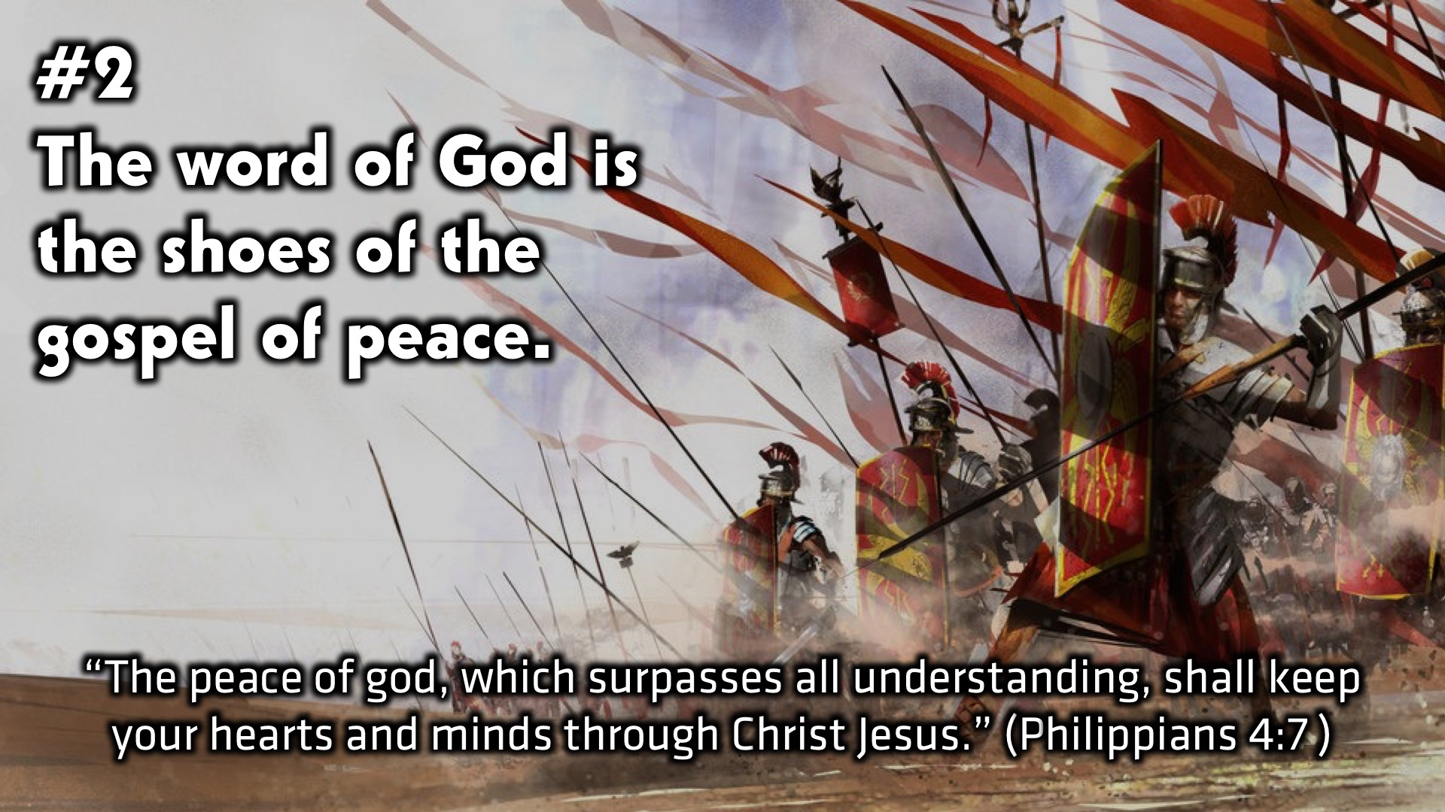
Notes:
(2) The word of God is the shoes of the gospel of peace. “The peace of god, which surpasses all understanding, shall keep your hearts and minds through Christ Jesus.” (Philippians 4:7 )

Slide 12
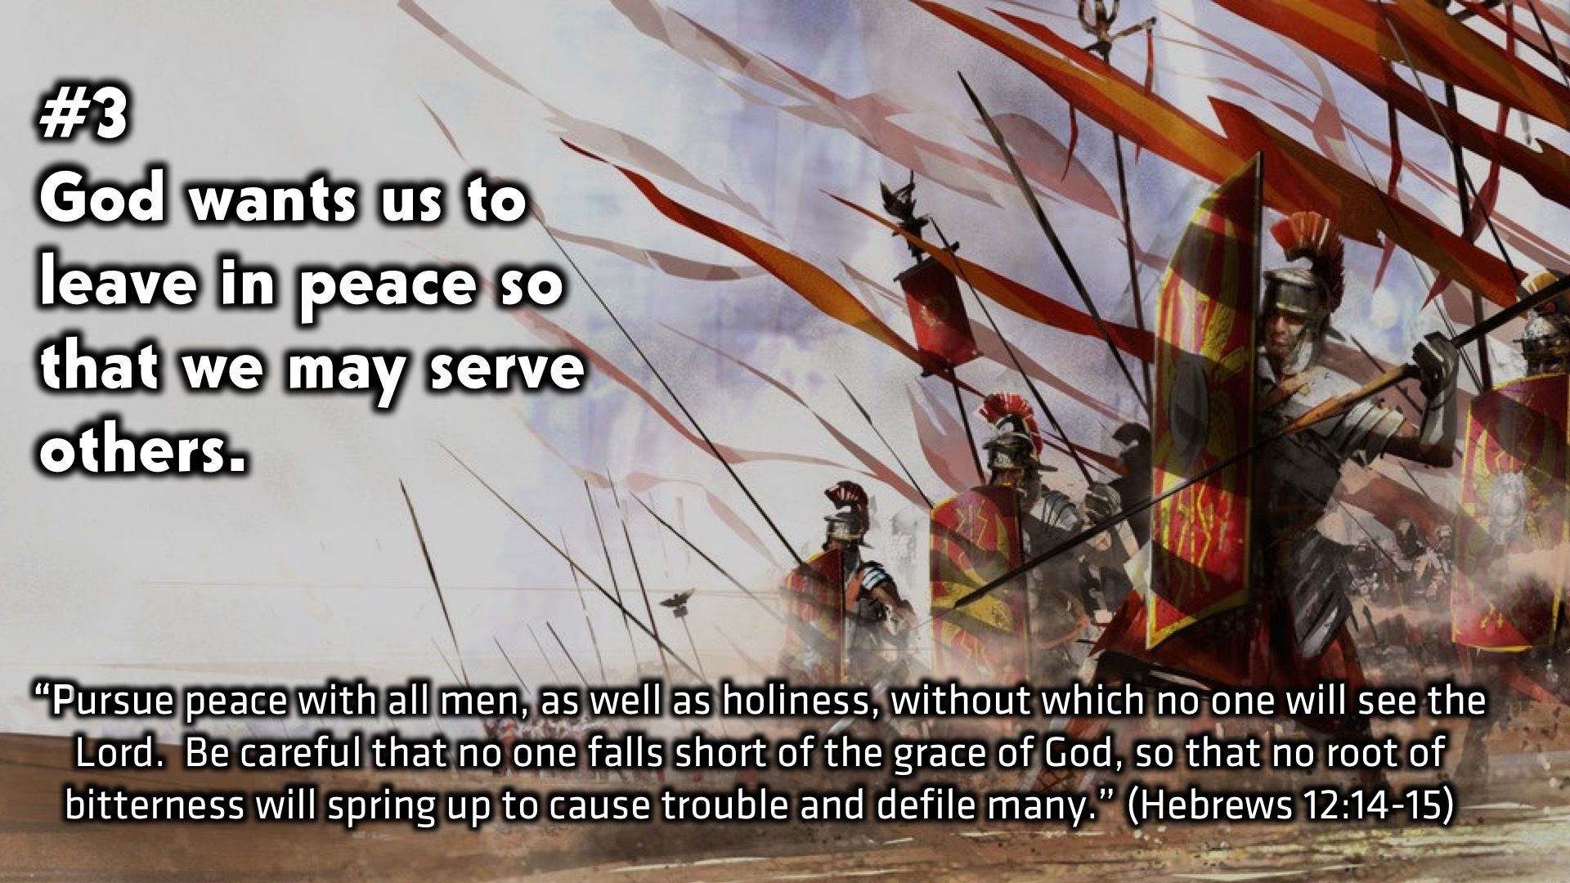
Notes:
(3) God wants us to leave in peace so that we may serve others. “Pursue peace with all men, as well as holiness, without which no one will see the Lord. Be careful that no one falls short of the grace of God, so that no root of bitterness will spring up to cause trouble and defile many.” (Hebrews 12:14-15)

Slide 13
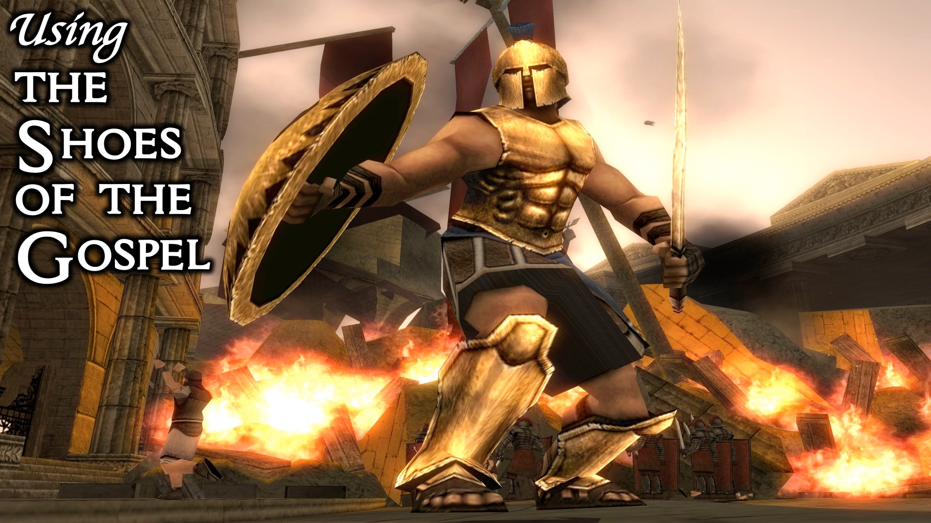
Notes:
Using the Shoes of the Gospel.

Slide 14
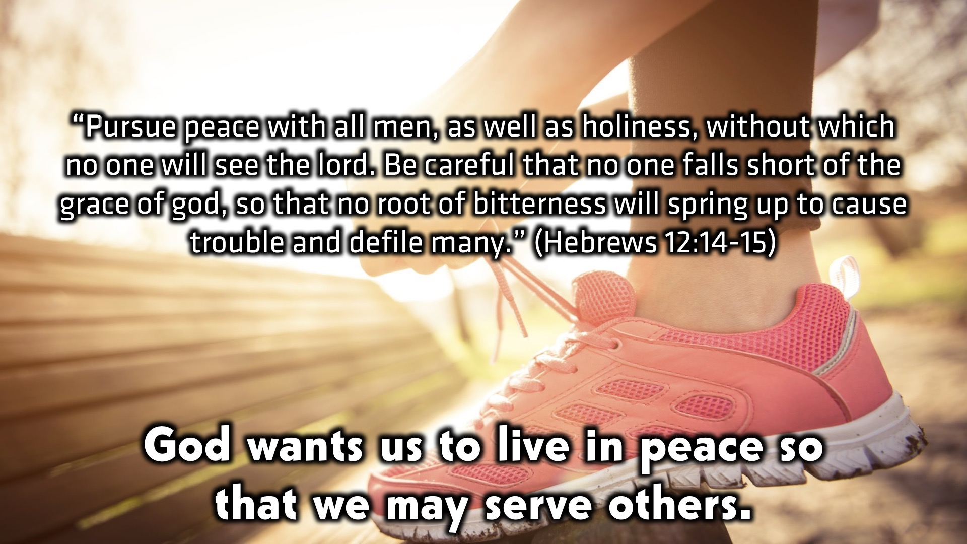
Notes:
God wants us to live in peace so that we may serve others. “Pursue peace with all men, as well as holiness, without which no one will see the lord. Be careful that no one falls short of the grace of god, so that no root of bitterness will spring up to cause trouble and defile many.” (Hebrews 12:14-15)

Slide 15
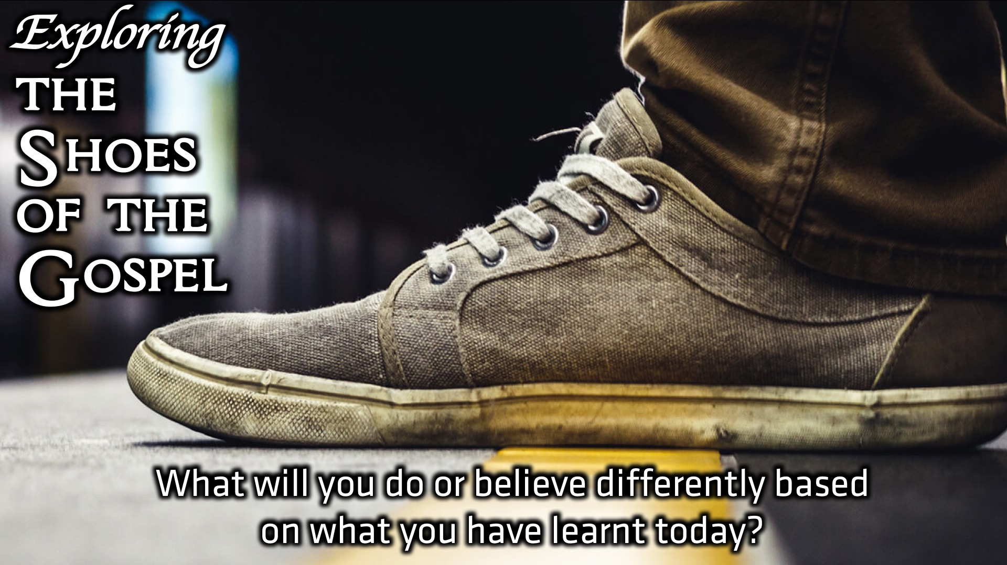
Notes:
Small Group Discussion: You have 2 minutes to apply the message to your life in small groups using this question: What will you do or believe differently based on what you have learnt today?

Slide 16
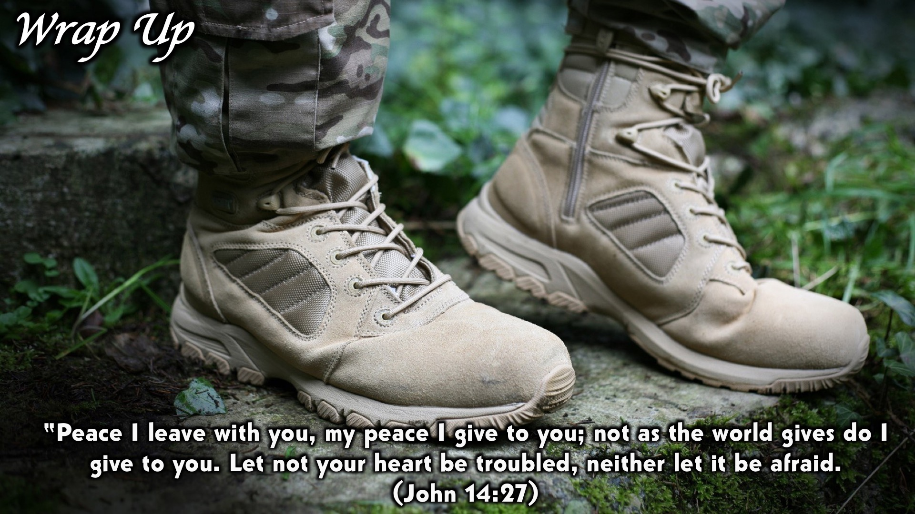
Notes:
Wrap Up: “Peace I leave with you, my peace I give to you; not as the world gives do I give to you. Let not your heart be troubled, neither let it be afraid. (John 14:27)

Slide 17
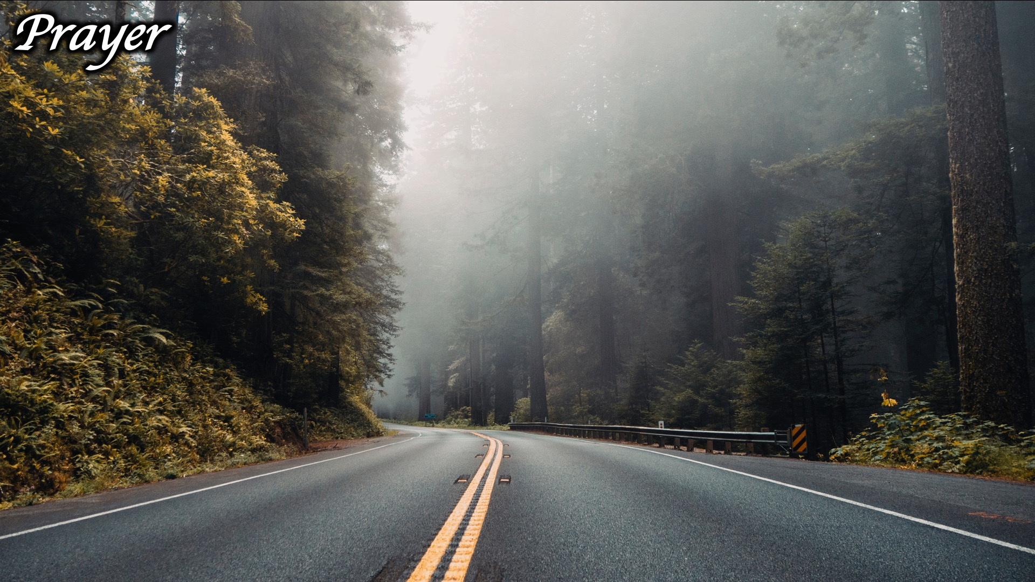
Notes:
Prayer

Slide 18
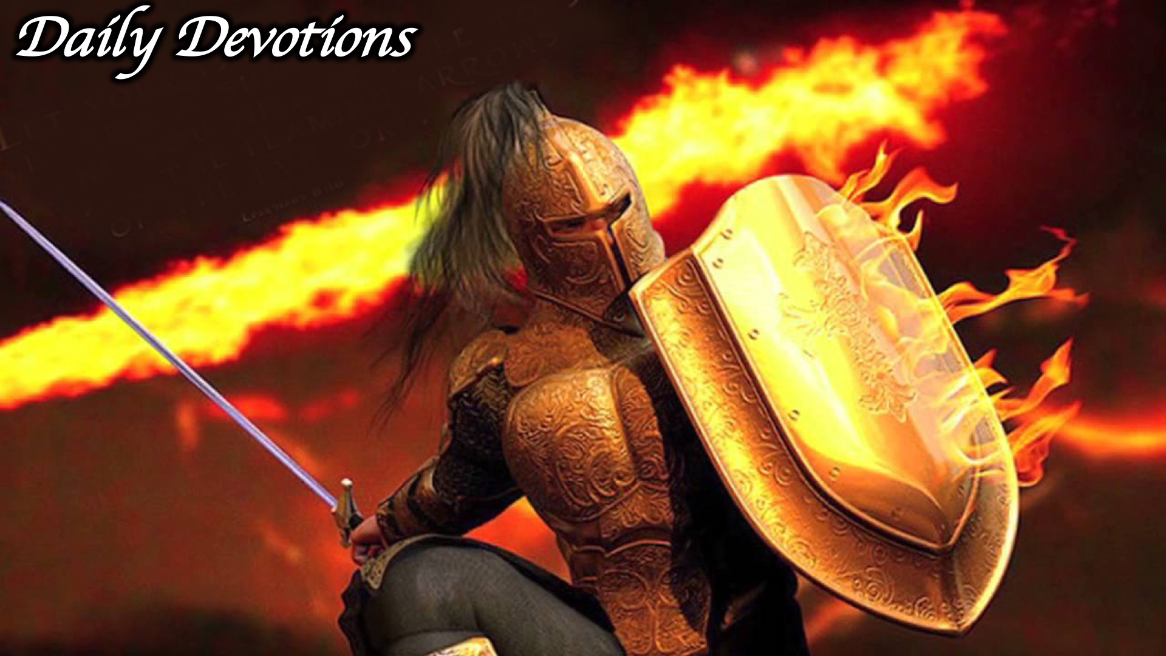
Notes:
Daily Devotions: We will post devotions on the Sunday WhatsApp group every night of the week throughout this series. Do everything you can to be a part of the daily journey in the armour of God.

Slide 19
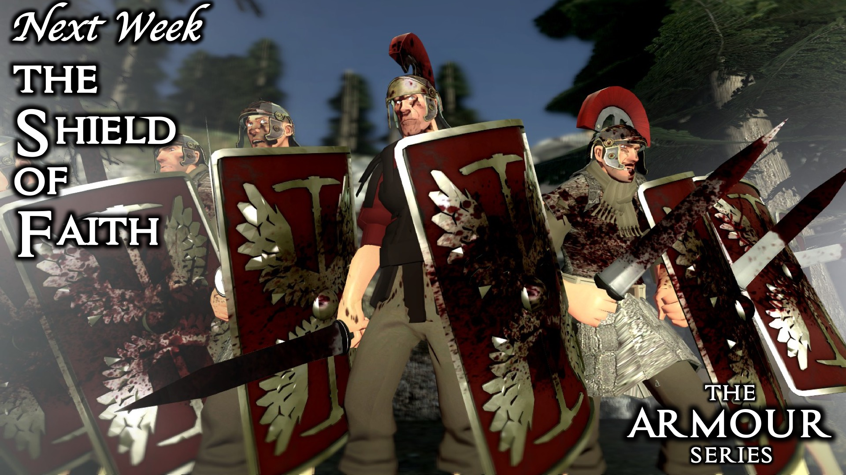
Notes:
Next Week: Next week we will look at the fourth piece of the armour of God: The Shield of Faith.

