Slide 1
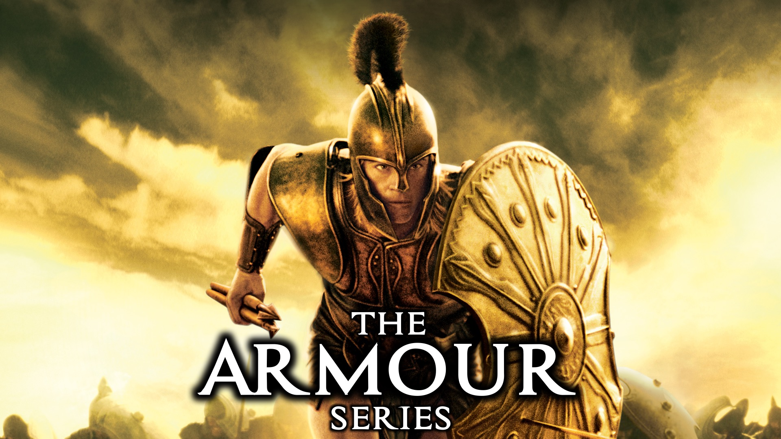
Notes:
Welcome to the Armour Series.

Slide 2
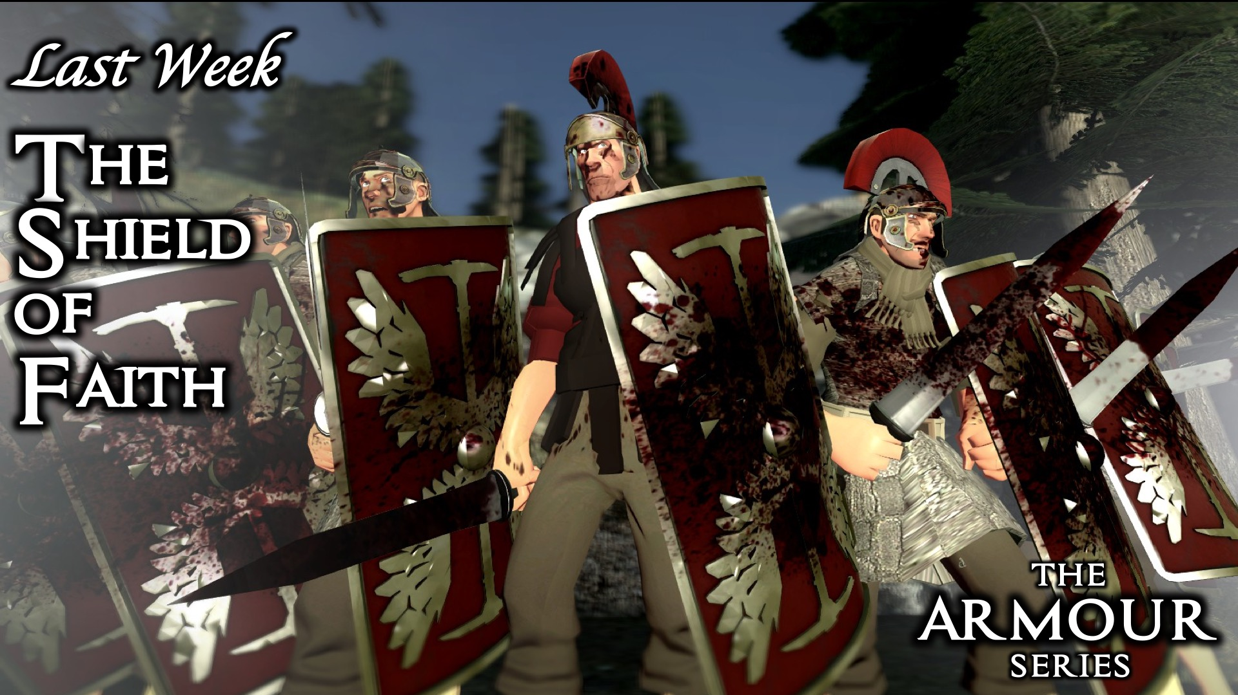
Notes:
Last week we learnt about the Shield of the Faith.

Slide 3
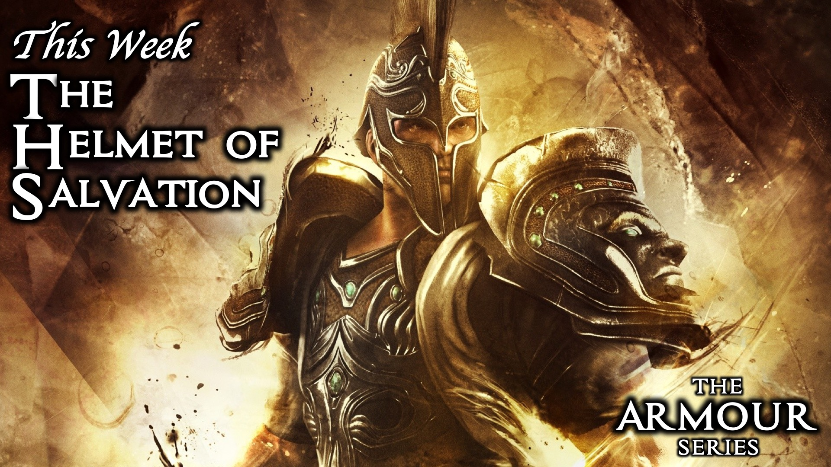
Notes:
This week we are exploring the Helmet of Salvation.

Slide 4
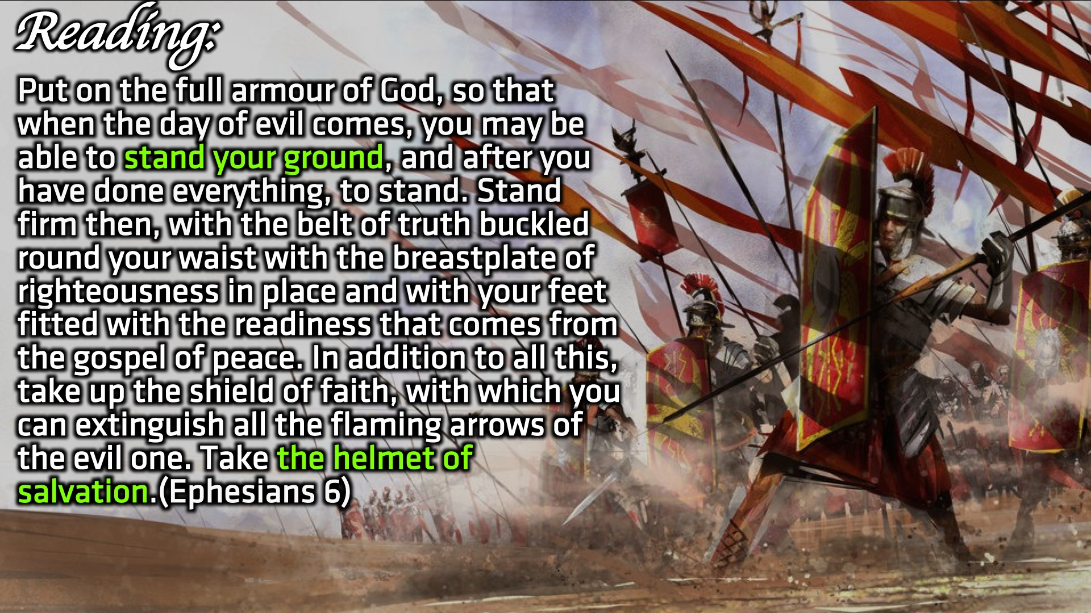
Notes:
Reading: Put on the full armour of God, so that when the day of evil comes, you may be able to stand your ground, and after you have done everything, to stand. Stand firm then, with the belt of truth buckled round your waist with the breastplate of righteousness in place and with your feet fitted with the readiness that comes from the gospel of peace. In addition to all this, take up the shield of faith, with which you can extinguish all the flaming arrows of the evil one. Take the helmet of salvation. (Ephesians 6)

Slide 5
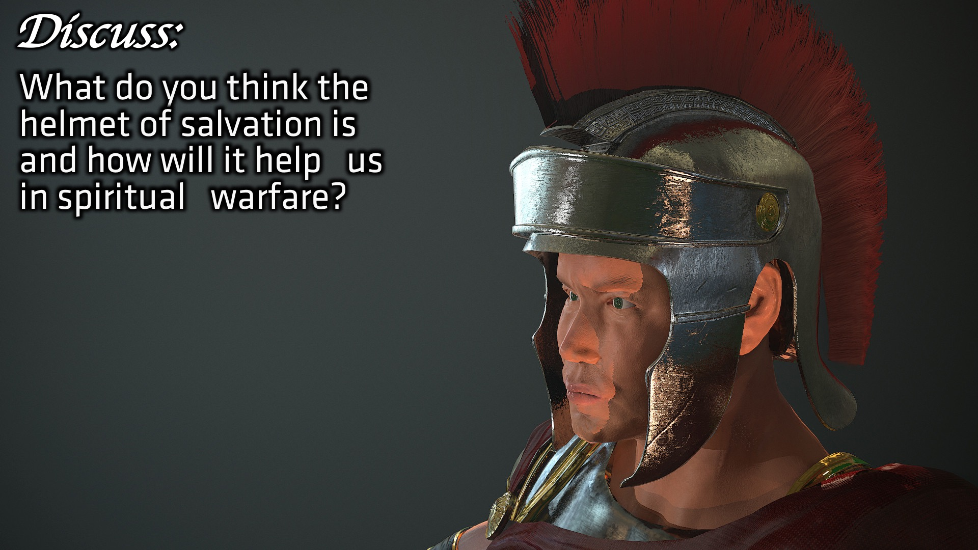
Notes:
Discuss: What do you think the helmet of salvation is and how will it help us in spiritual warfare?

Slide 6
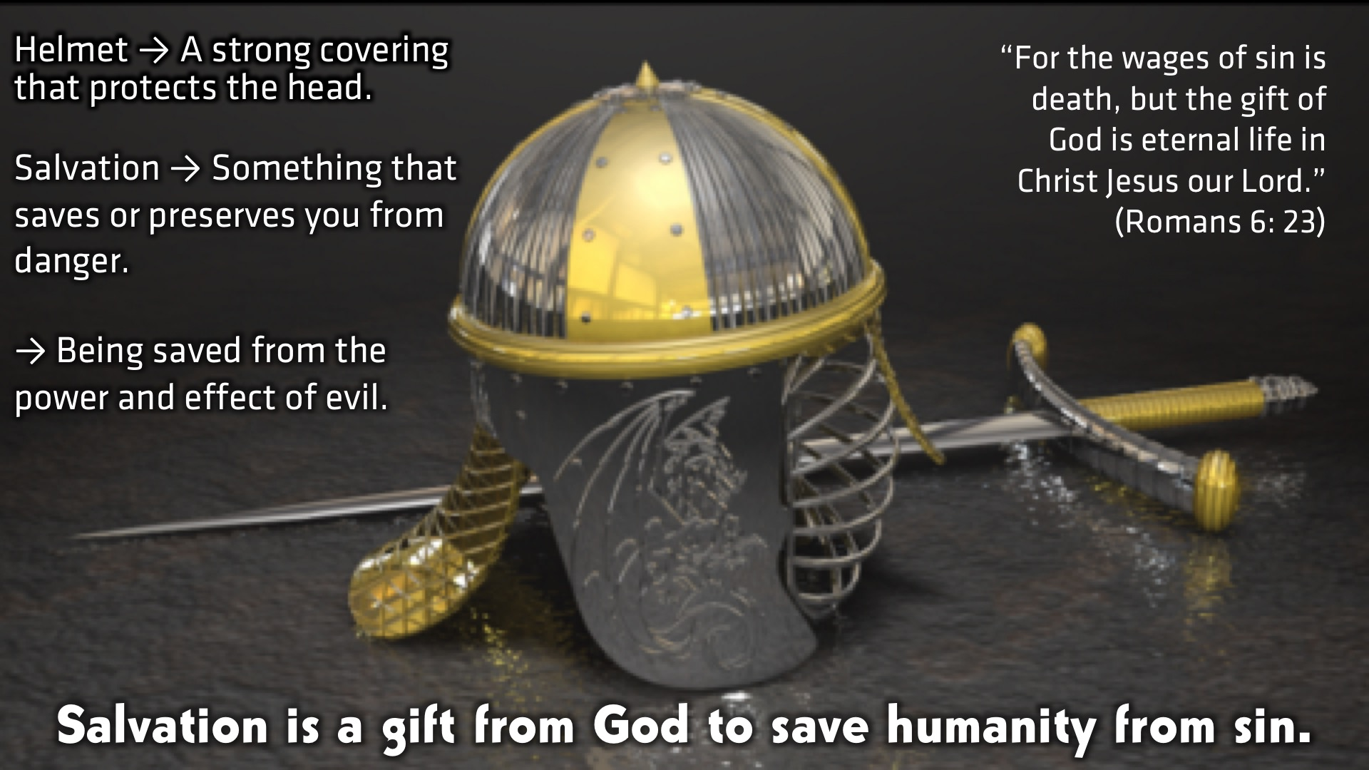
Notes:
Definition: The Helmet is a strong covering that protects the head
Salvation is something that saves or preserves you from danger.
Salvation is being saved from the power and effect of evil.
Therefore: Salvation is a gift from God to save humanity from sin. “For the wages of sin is death, but the gift of God is eternal life in Christ Jesus our Lord.” (Romans 6: 23)

Slide 7
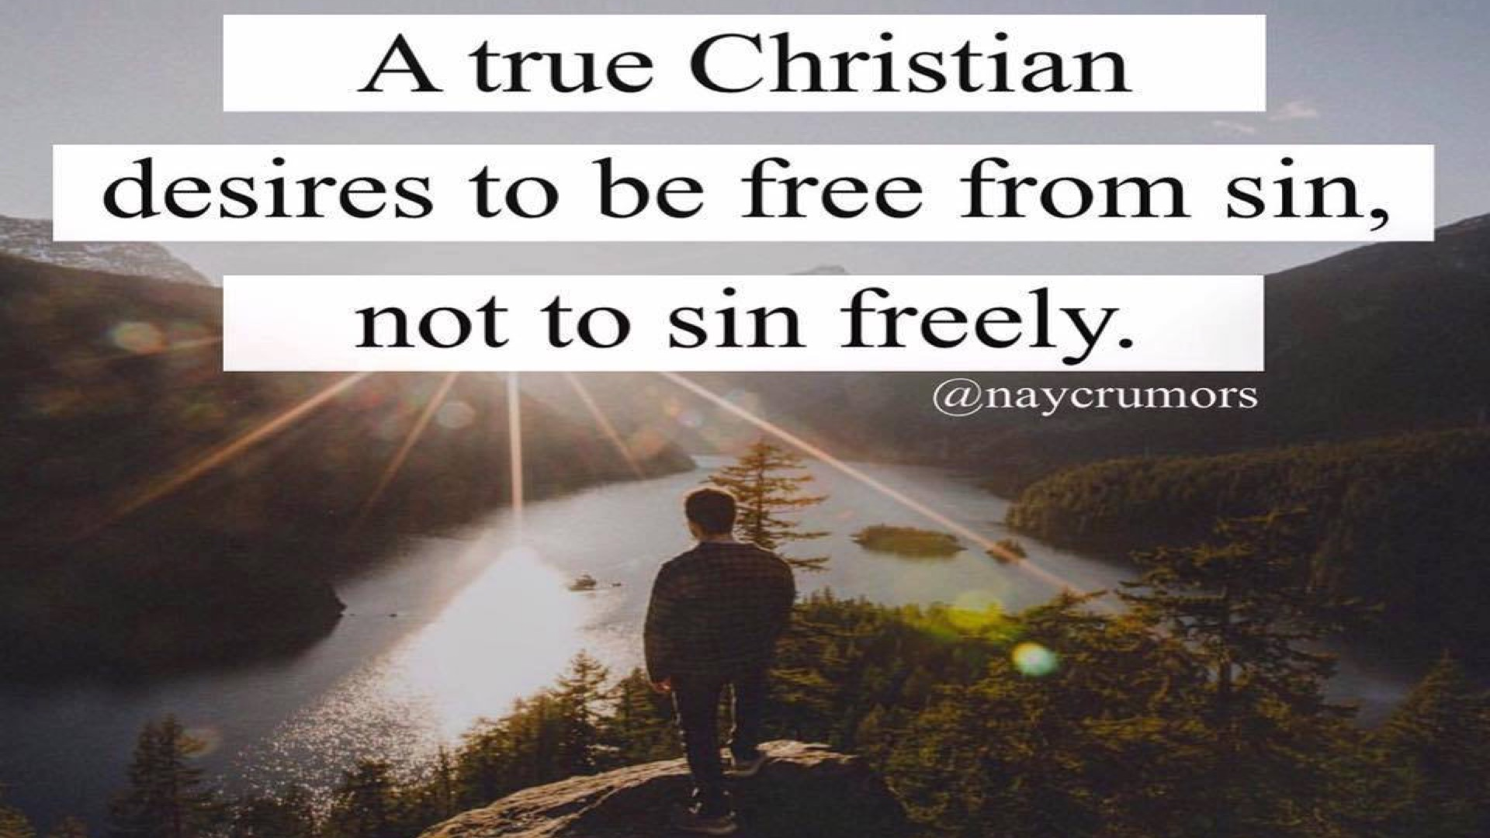
Notes:
A True Christian desires to be free from sin, not to sin freely.

Slide 8
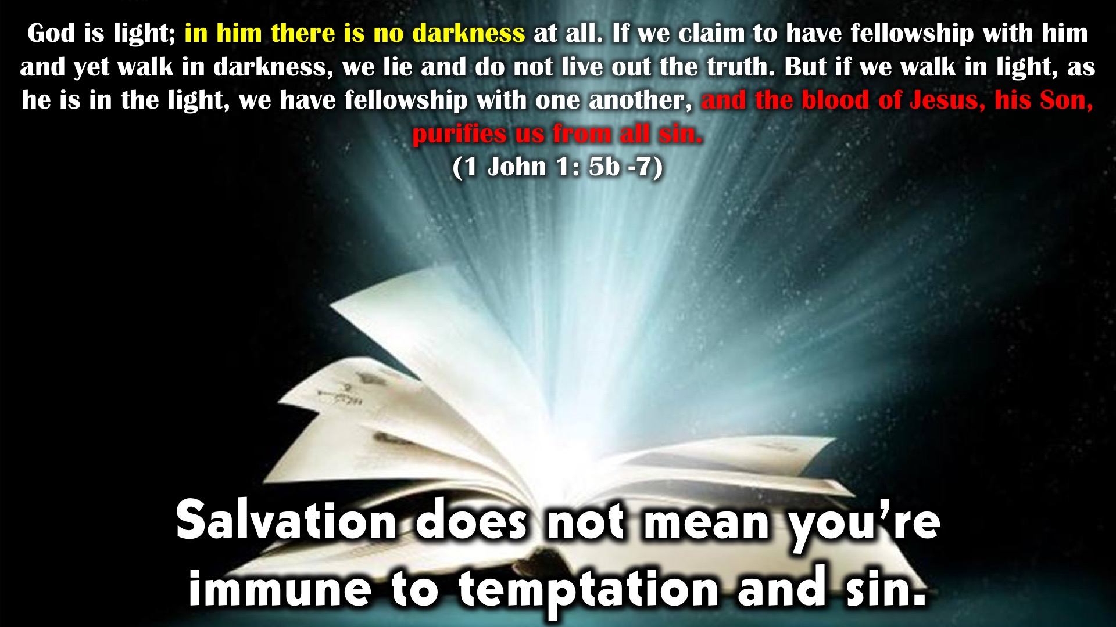
Notes:
Salvation does not mean you’re immune to temptation and sin. God is light; in him there is no darkness at all. If we claim to have fellowship with him and yet walk in darkness, we lie and do not live out the truth. But if we walk in light, as he is in the light, we have fellowship with one another, and the blood of Jesus, his Son, purifies us from all sin. (1 John 1: 5b -7)

Slide 9
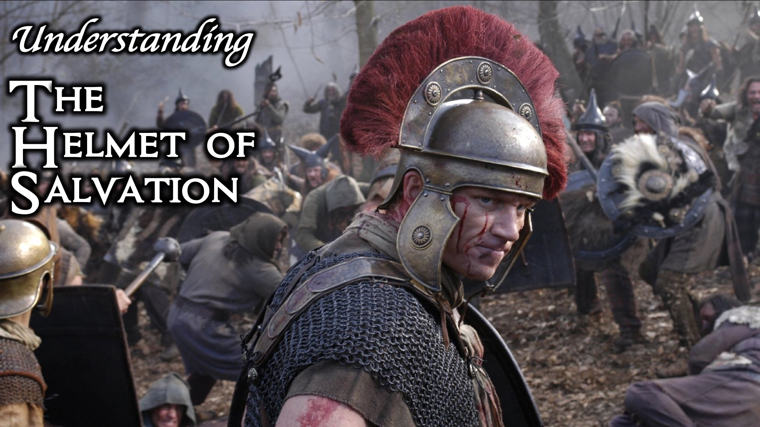
Notes:
Understanding the Helmet of Salvation.

Slide 10
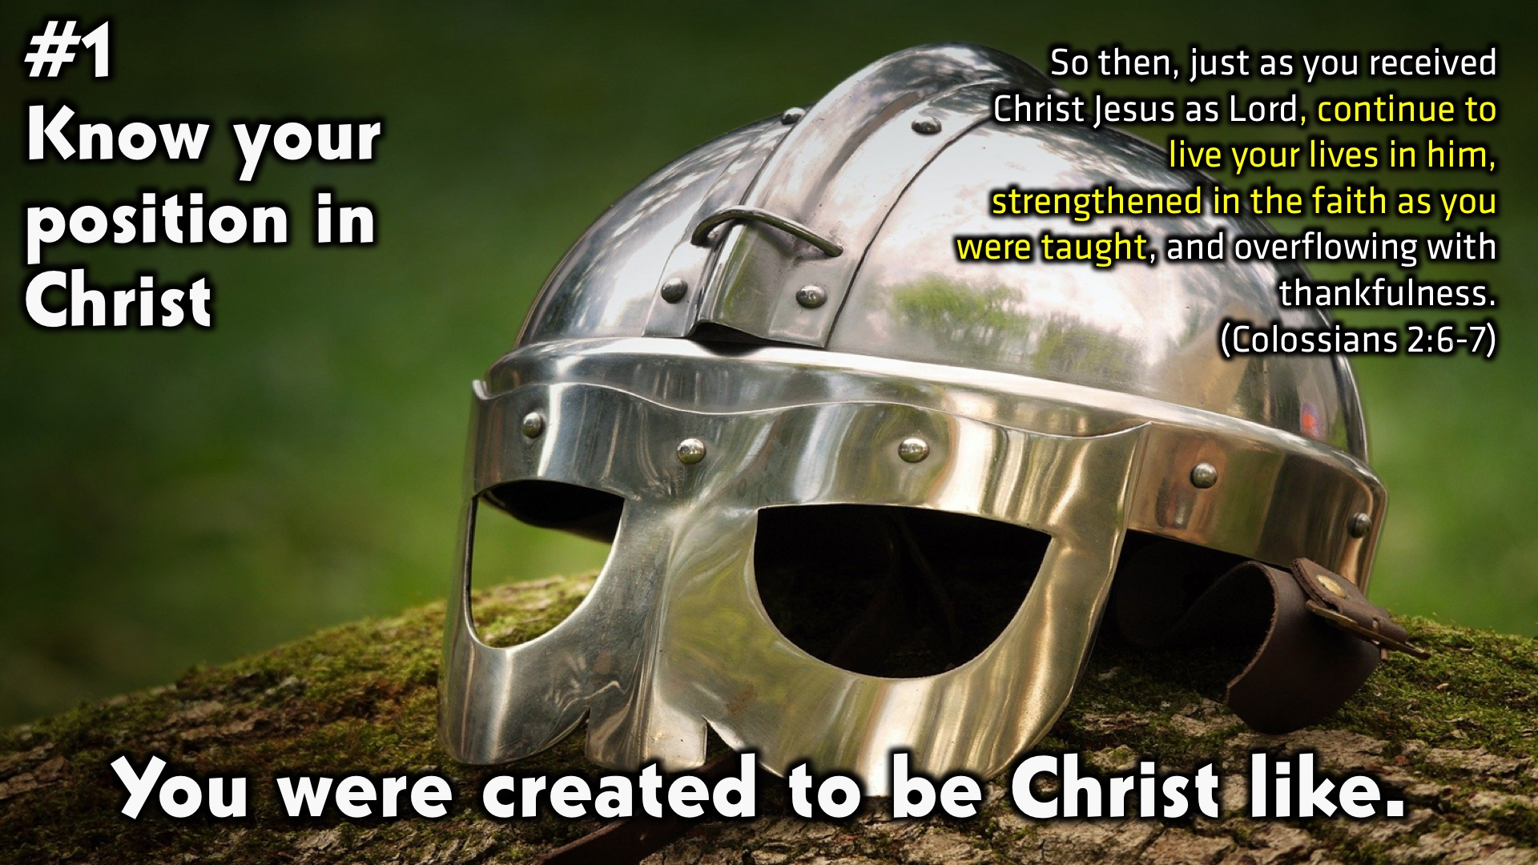
Notes:
#1: Know your position in Christ. You were created to be Christ like. “So then, just as you received Christ Jesus as Lord, continue to live your lives in him, strengthened in the faith as you were taught, and overflowing with thankfulness.” (Colossians 2:6-7)

Slide 11
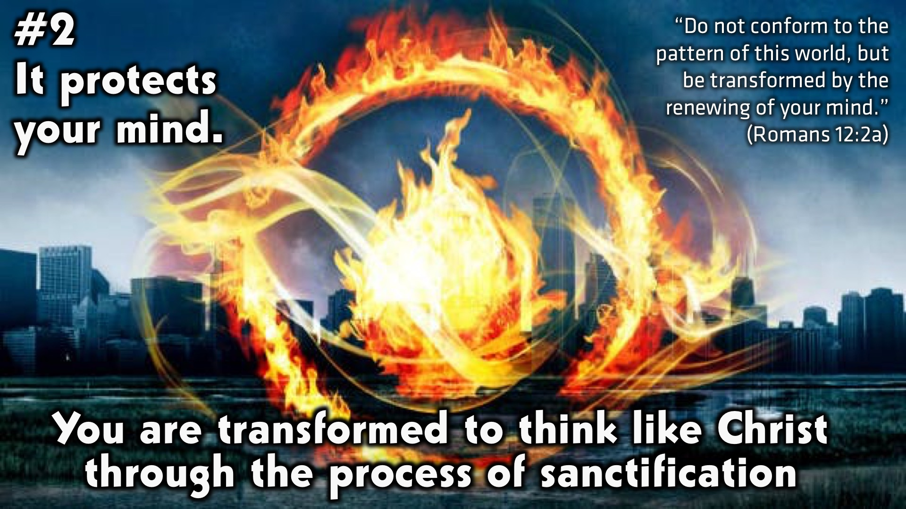
Notes:
#2: It protects your mind. You are transformed to think like Christ through the process of sanctification. “Do not conform to the pattern of this world, but be transformed by the renewing of your mind.” (Romans 12:2a)

Slide 12

Notes:
“Finally, brothers and sisters, whatever is true, whatever is noble, whatever is right, whatever is pure, whatever is lovely, whatever is admirable—if anything is excellent or praiseworthy—think about such things.” (Philippians 4:8)

Slide 13
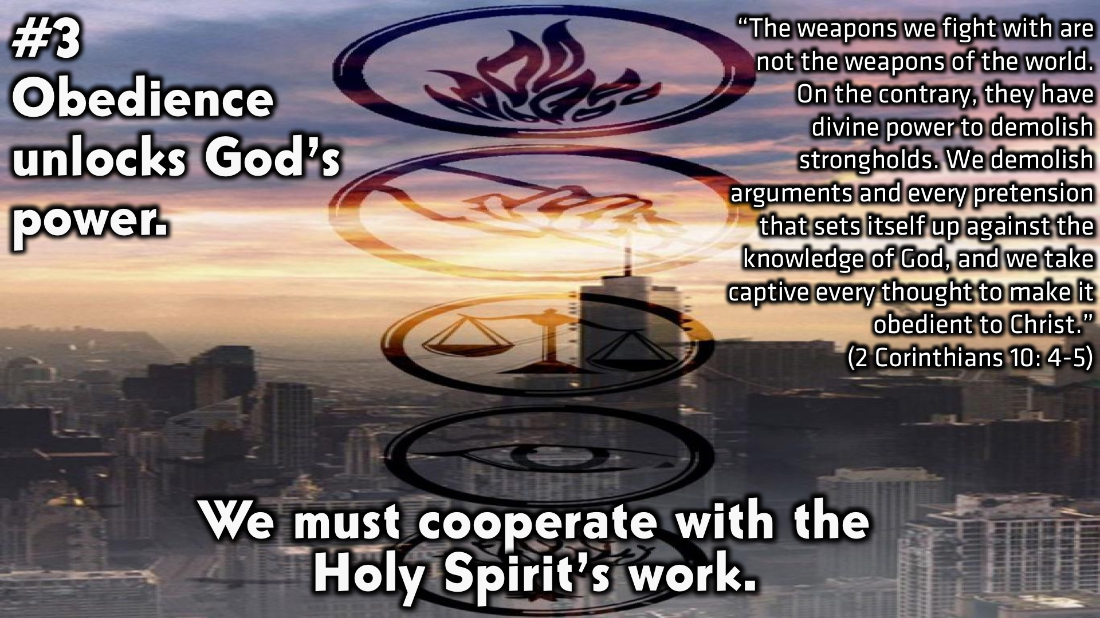
Notes:
#3 Obedience unlocks God’s power. We must cooperate with the Holy Spirit’s work. “The weapons we fight with are not the weapons of the world. On the contrary, they have divine power to demolish strongholds. We demolish arguments and every pretension that sets itself up against the knowledge of God, and we take captive every thought to make it obedient to Christ.” (2 Corinthians 10: 4-5)

Slide 14
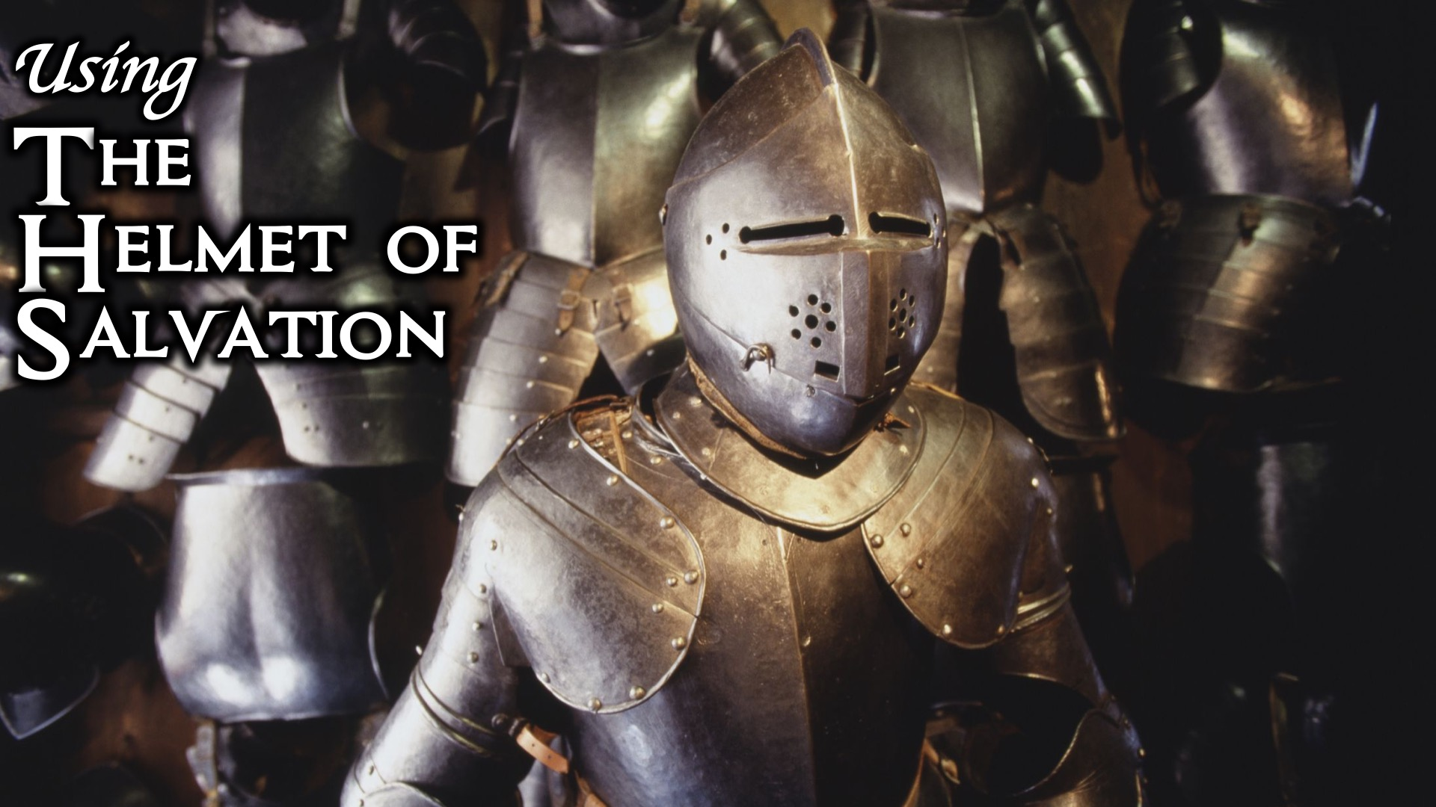
Notes:
Using the Helmet of Salvation.

Slide 15
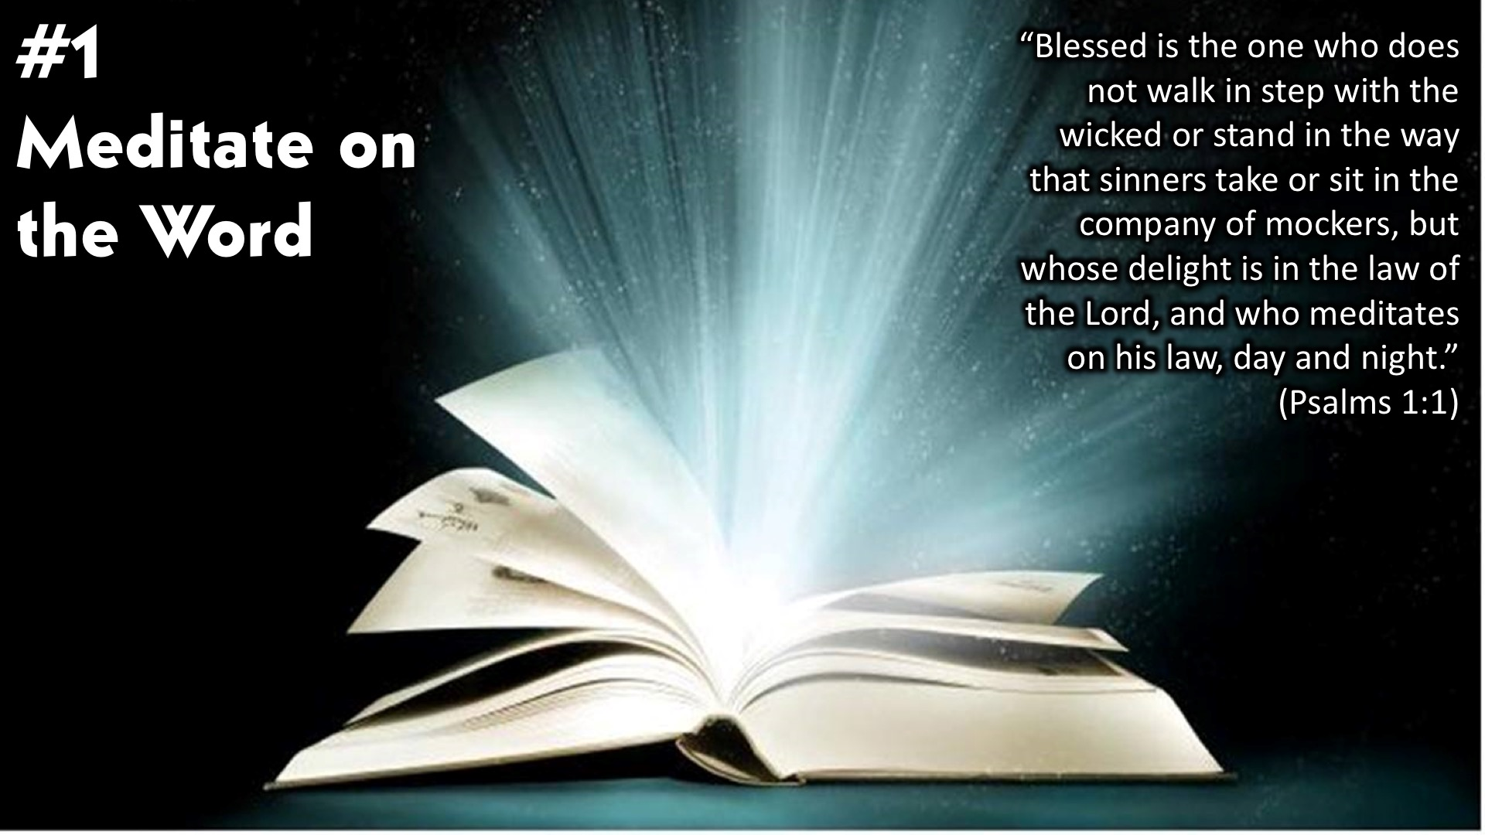
Notes:
#1: Meditate on the Word. “Blessed is the one who does not walk in step with the wicked or stand in the way that sinners take or sit in the company of mockers, but whose delight is in the law of the Lord, and who meditates on his law, day and night.” (Psalms 1:1)

Slide 16
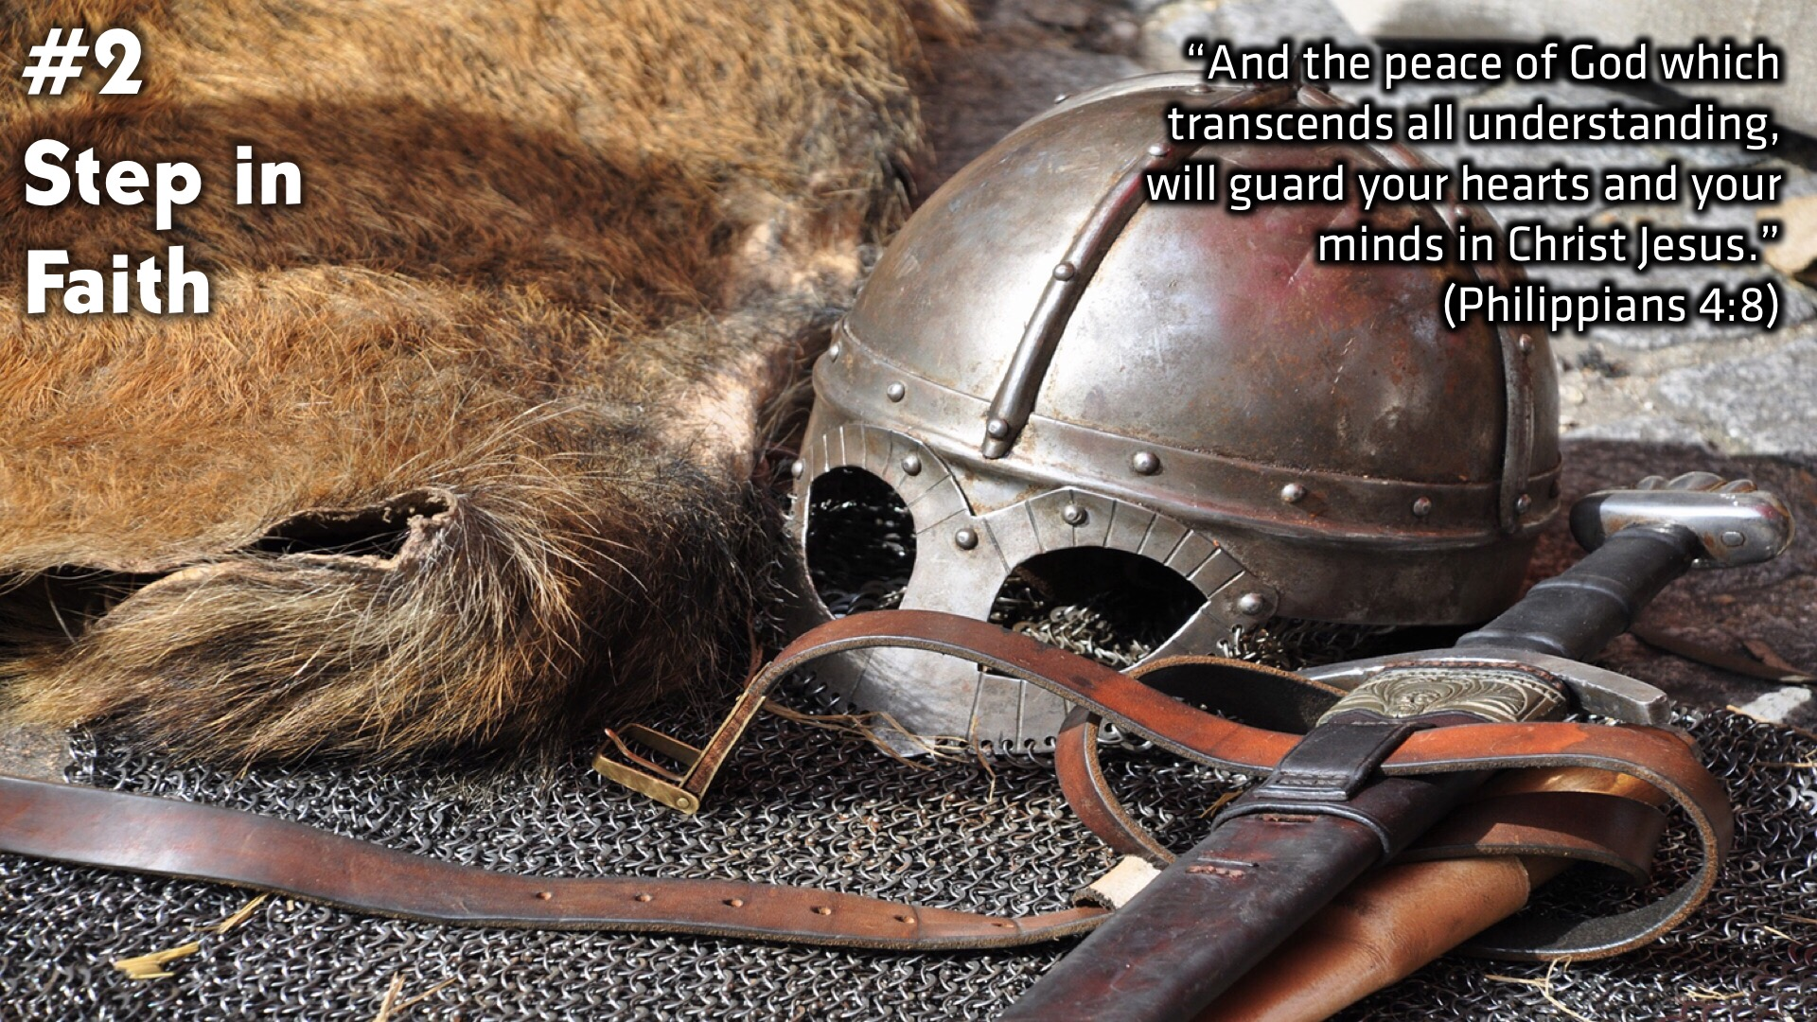
Notes:
#2: Step in Faith. “And the peace of God which transcends all understanding, will guard your hearts and your minds in Christ Jesus.” (Philippians 4:8)

Slide 17
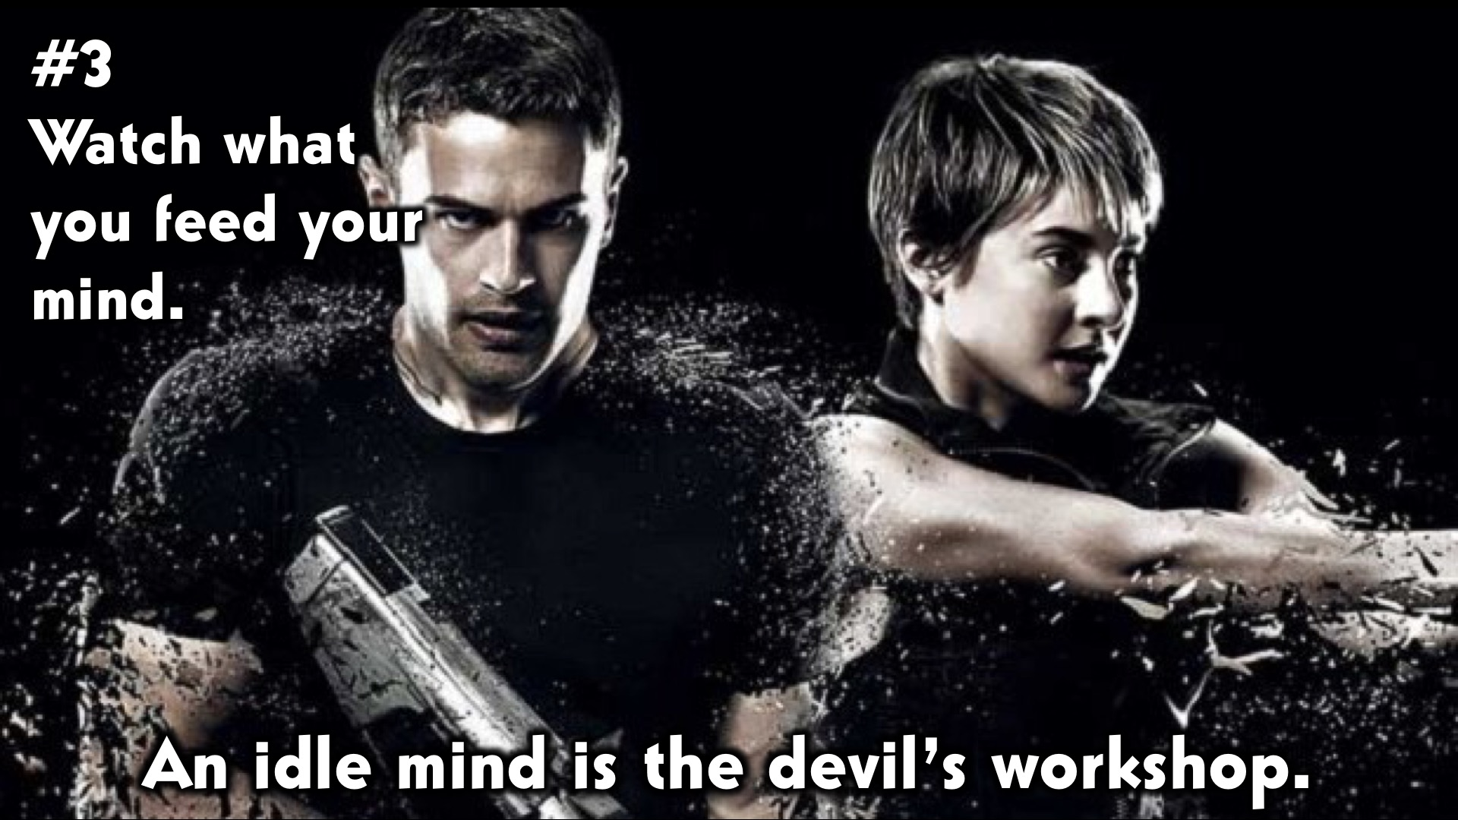
Notes:
#3” Watch what you feed your mind. An idle mind is the devil’s workshop.

Slide 18
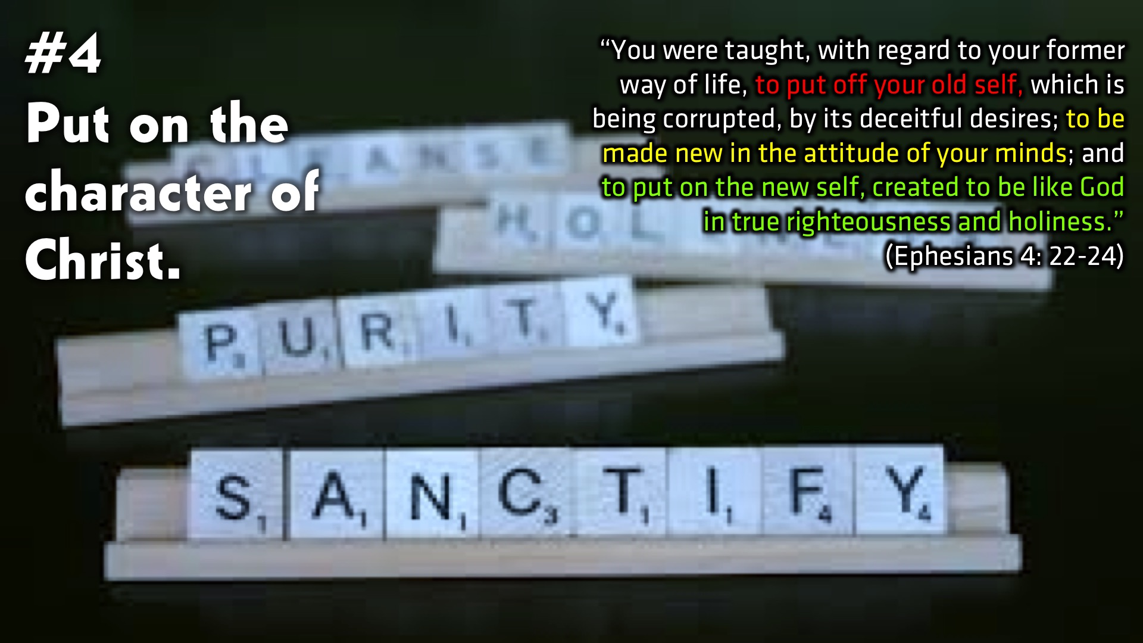
Notes:
#4: Put on the character of Christ. “You were taught, with regard to your former way of life, to put off your old self, which is being corrupted, by its deceitful desires; to be made new in the attitude of your minds; and to put on the new self, created to be like God in true righteousness and holiness.” (Ephesians 4: 22-24)

Slide 19
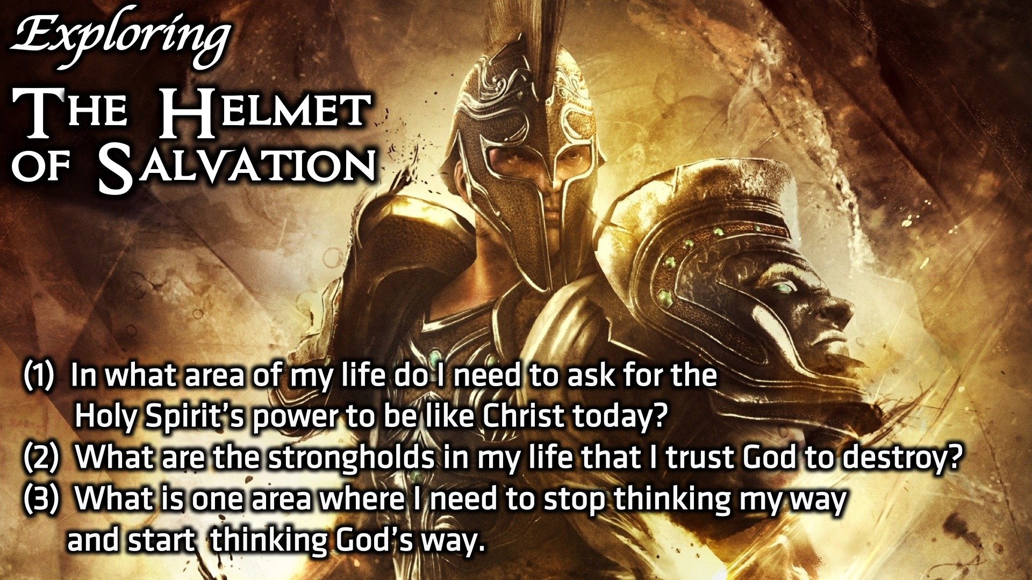
Notes:
Small Group Discussion: You have ten minutes to apply the message to your life in small groups using these 3 questions: (1) In what area of my life do I need to ask for the Holy Spirit’s power to be like Christ today? (2) What are the strongholds in my life that I trust God to destroy. (3) What is one area where I need to stop thinking my way and start thinking God’s way.

Slide 20

Notes:
Wrap Up: Share some concluding thoughts.

Slide 21
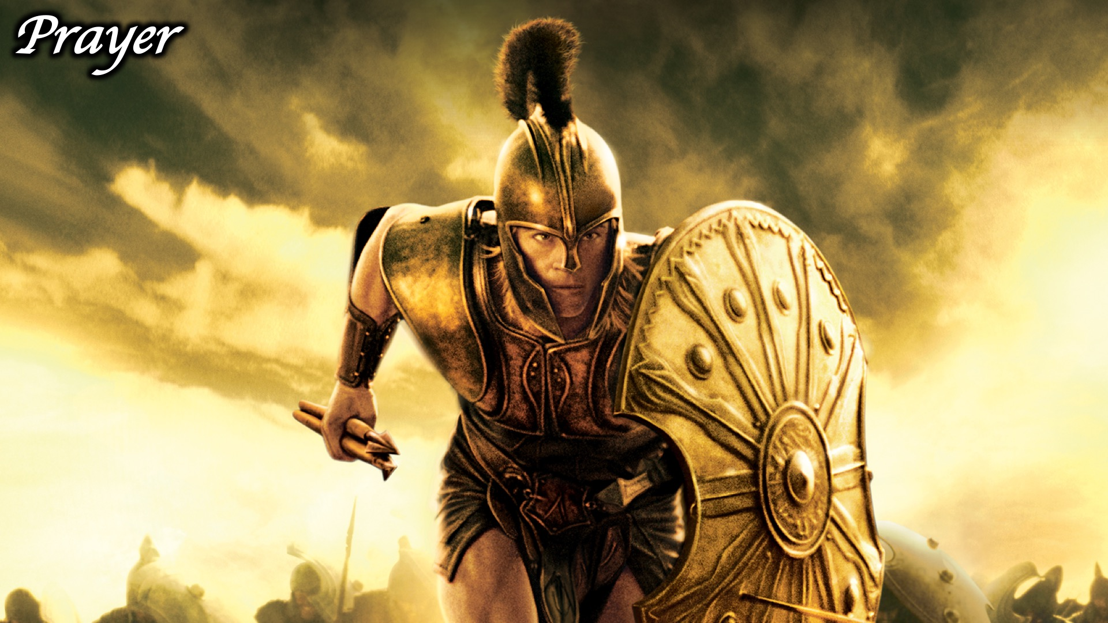
Notes:
Prayer:

Slide 22
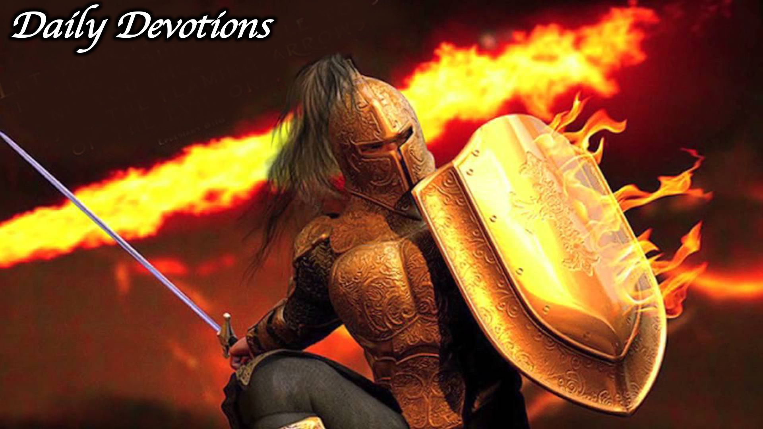
Notes:
Daily Devotions: We will post devotions on the Sunday WhatsApp group every night of the week throughout this series. Do everything you can to be a part of the daily journey in the armour of God.

Slide 23
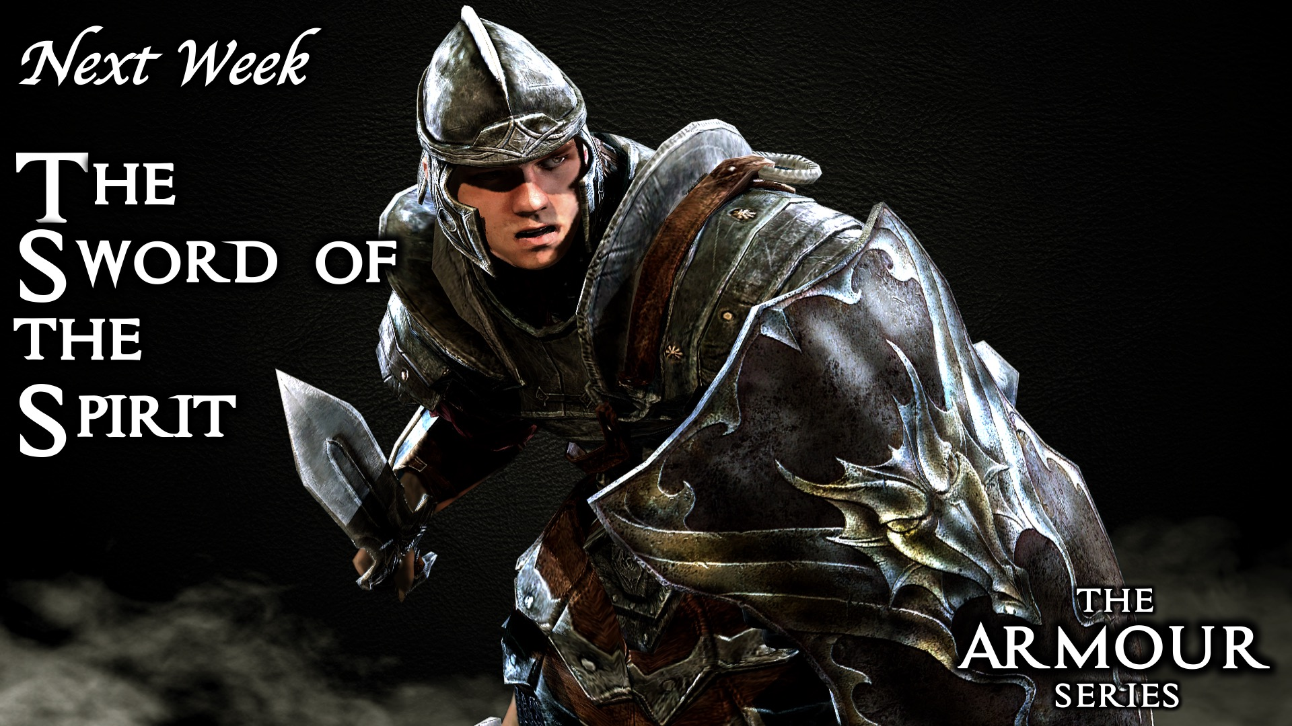
Notes:
Next Week: Next week we will look at the sixth piece of the armour of God: The Sword of the Spirit.

