Slide 1
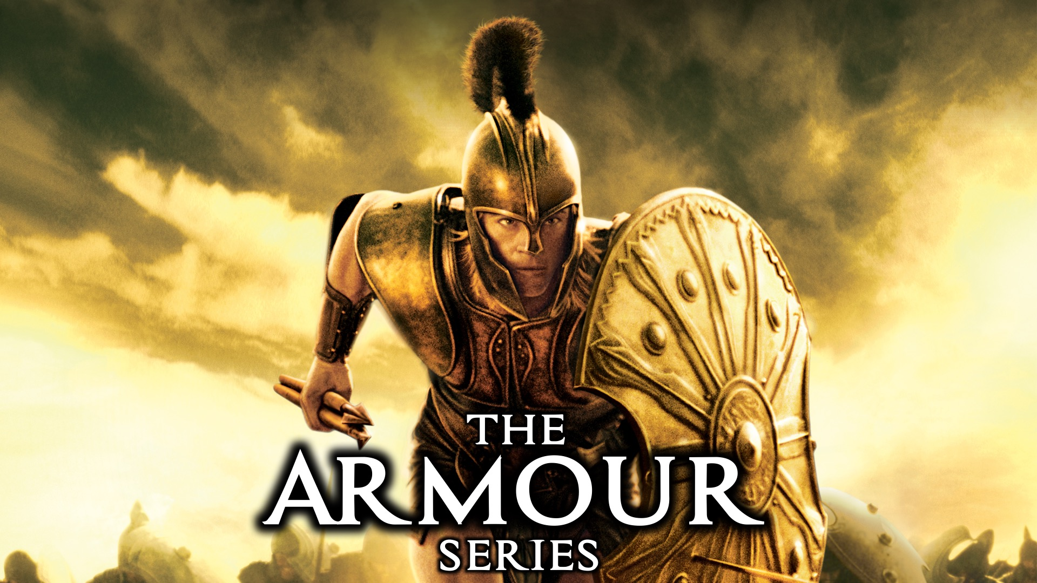
Notes:
Welcome to the Armour Series.

Slide 2

Notes:
Last week we learnt about the Helmet of Salvation.

Slide 3
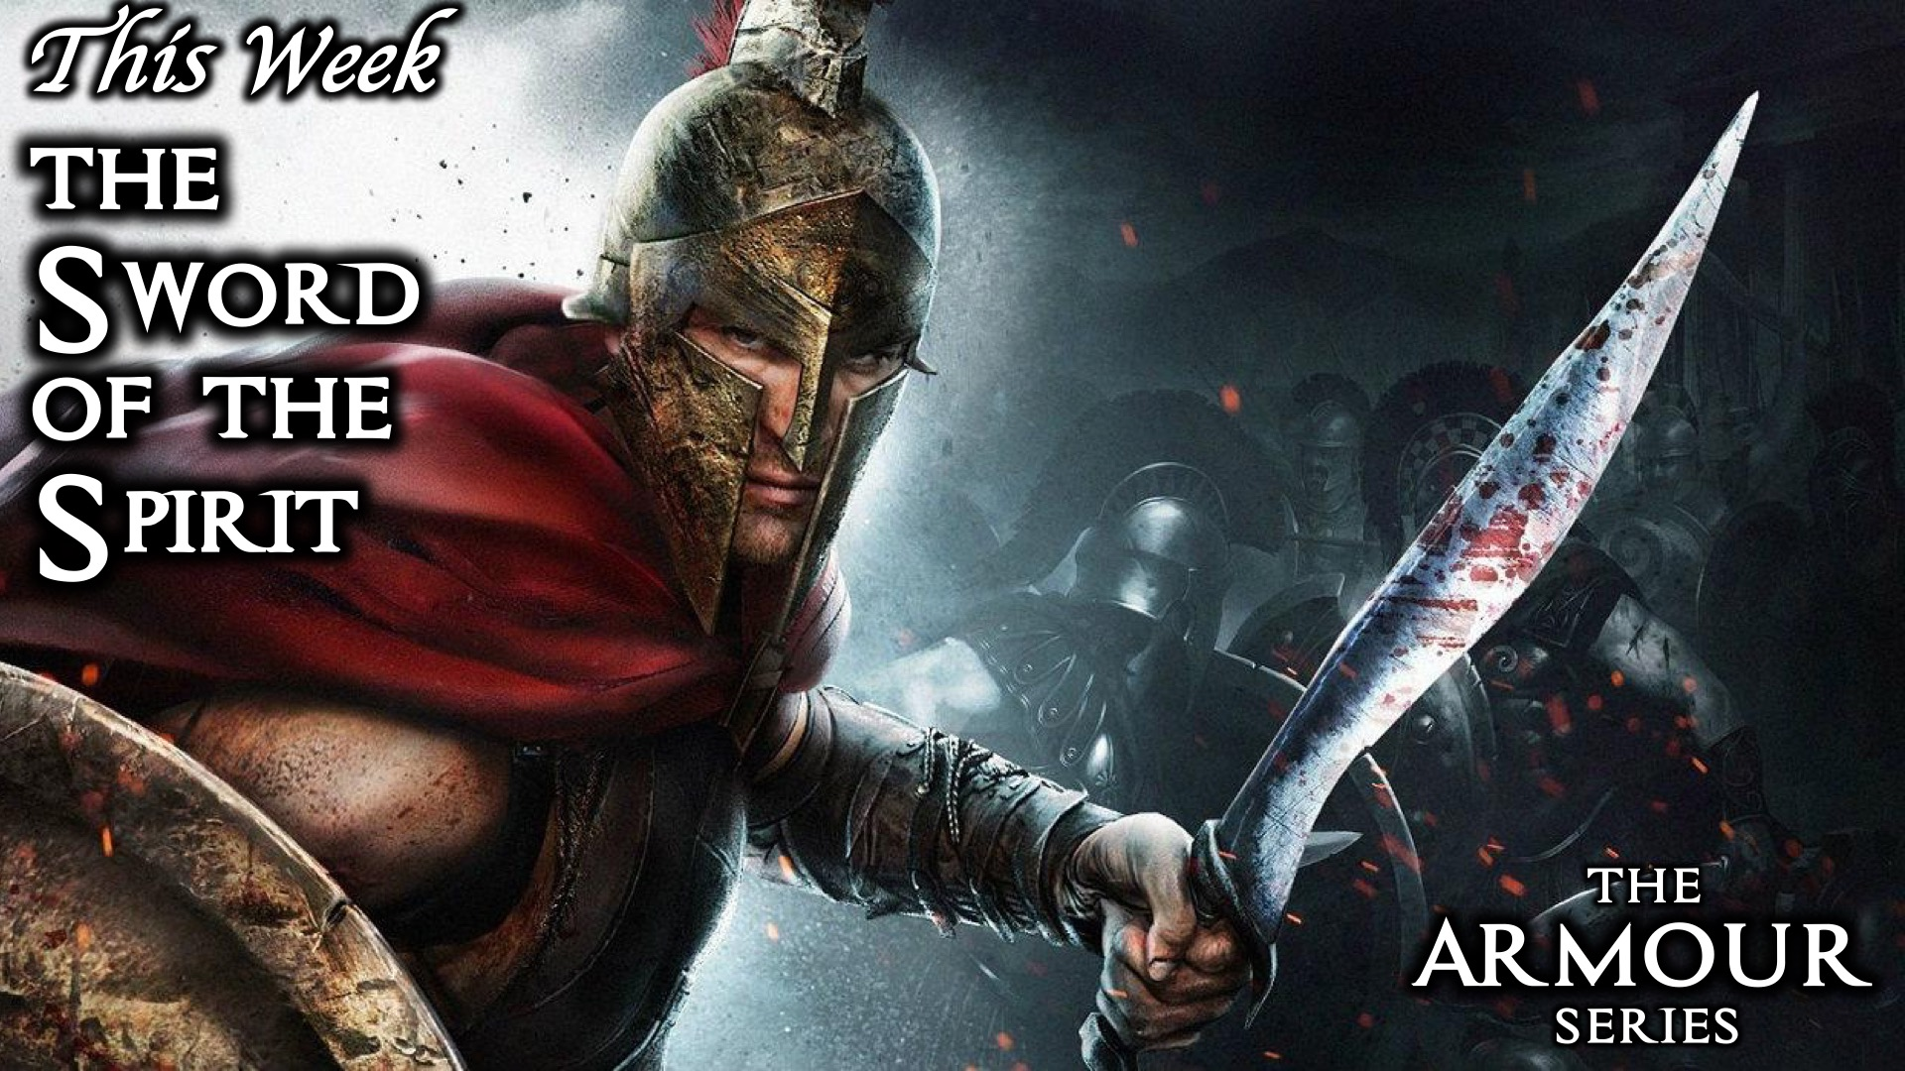
Notes:
This week we are exploring the Sword of the Spirit.

Slide 4
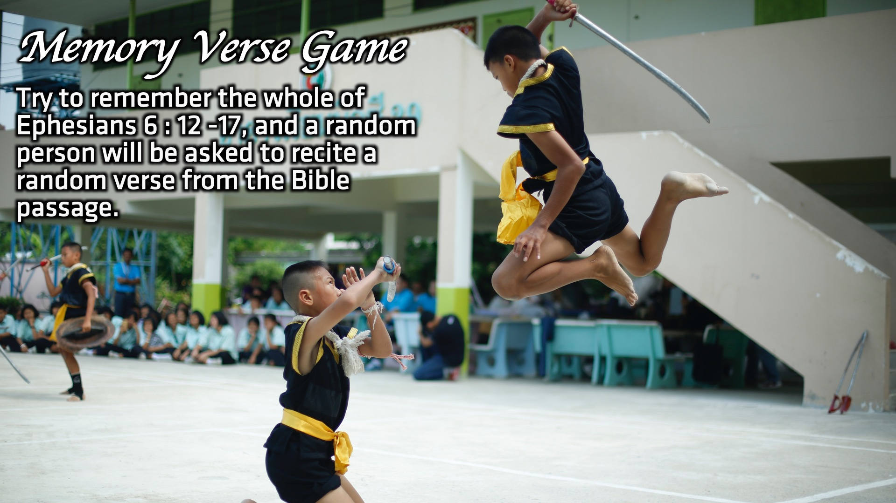
Notes:
Memory Verse Game: Try to remember the whole of Ephesians 6 : 12 -17, and a random person will be asked to recite a random verse from the Bible passage.

Slide 5
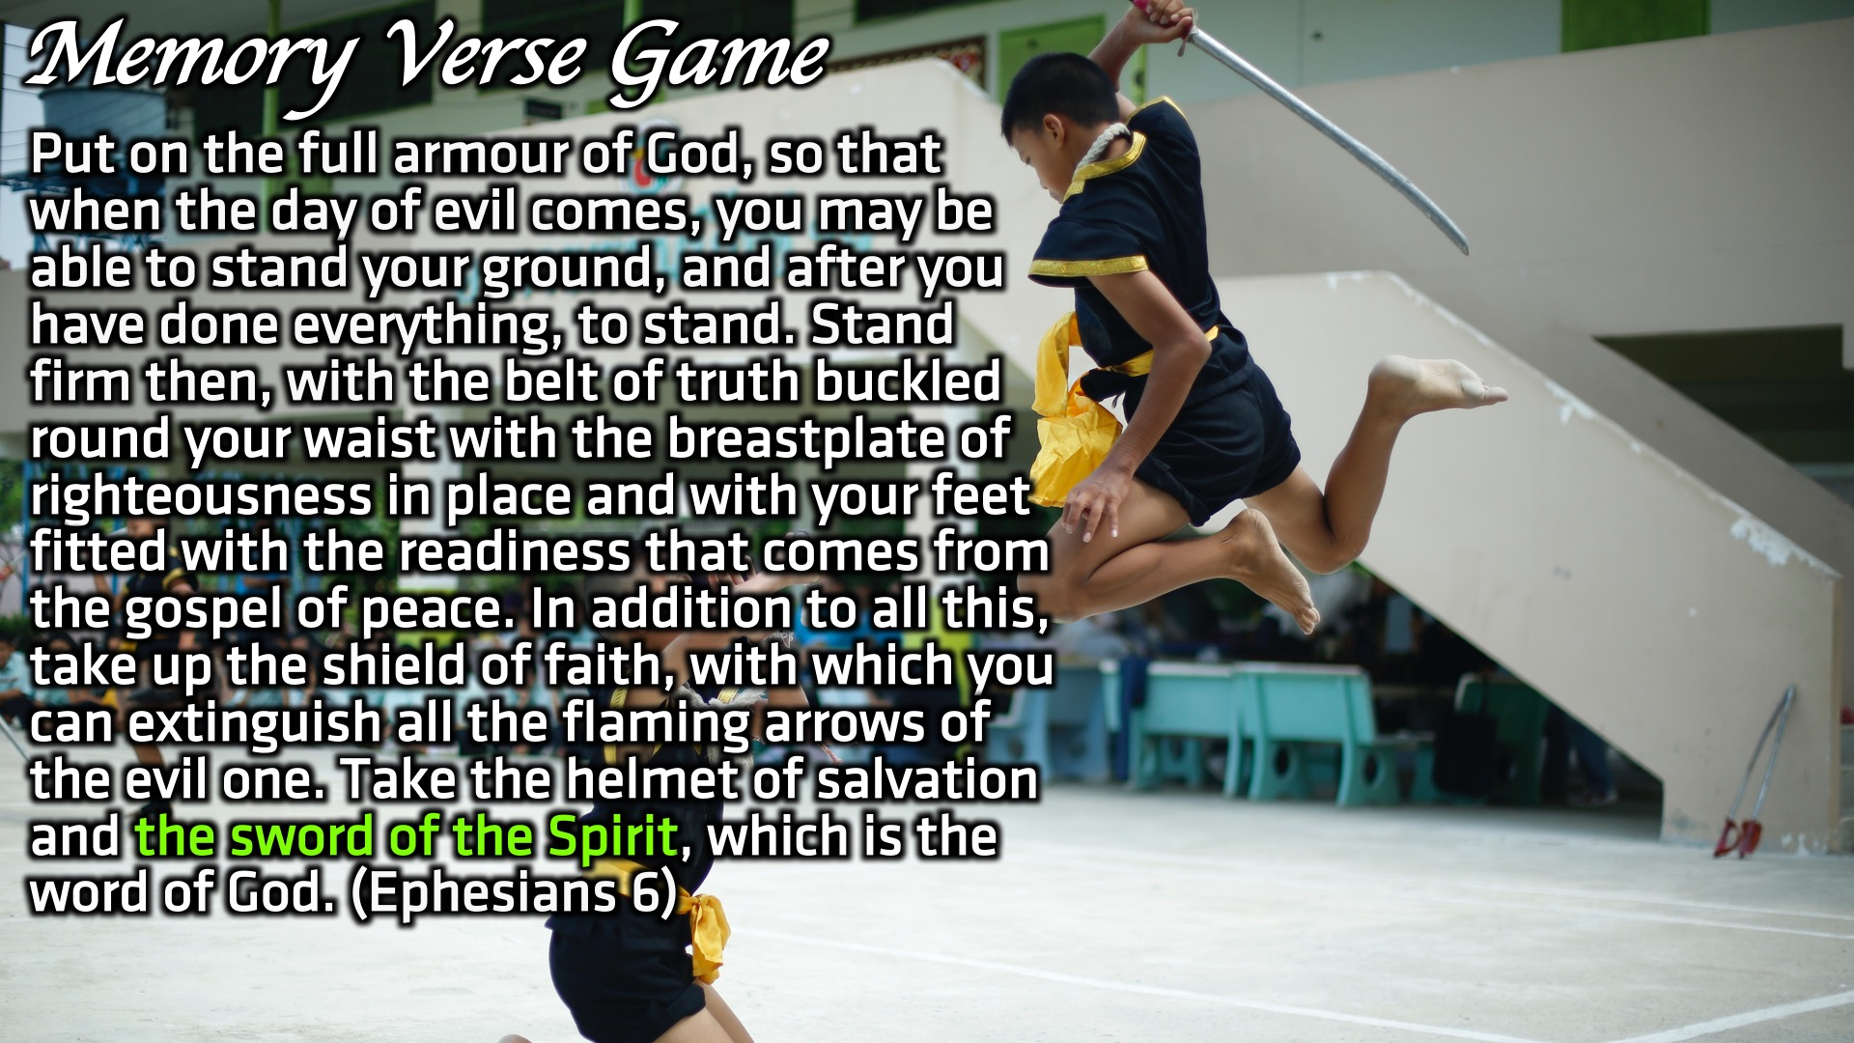
Notes:
Reading: Put on the full armour of God, so that when the day of evil comes, you may be able to stand your ground, and after you have done everything, to stand. Stand firm then, with the belt of truth buckled round your waist with the breastplate of righteousness in place and with your feet fitted with the readiness that comes from the gospel of peace. In addition to all this, take up the shield of faith, with which you can extinguish all the flaming arrows of the evil one. Take the helmet of salvation and the sword of the Spirit, which is the word of God. (Ephesians 6)

Slide 6
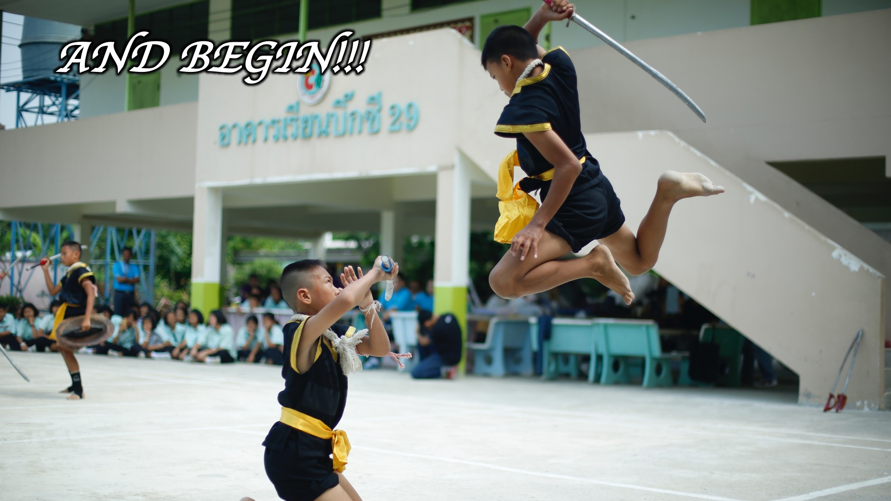
Notes:
Memory Verse Game: Try to remember the whole of Ephesians 6 : 12 -17, and a random person will be asked to recite a random verse from the Bible passage.

Slide 7
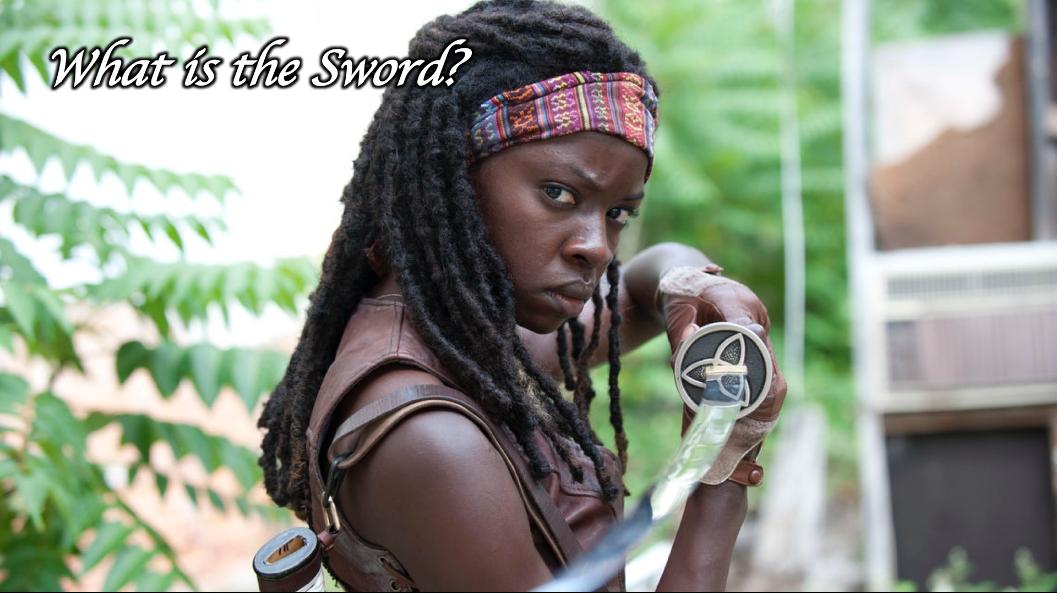
Notes:
What is the Sword of the Spirit?

Slide 8
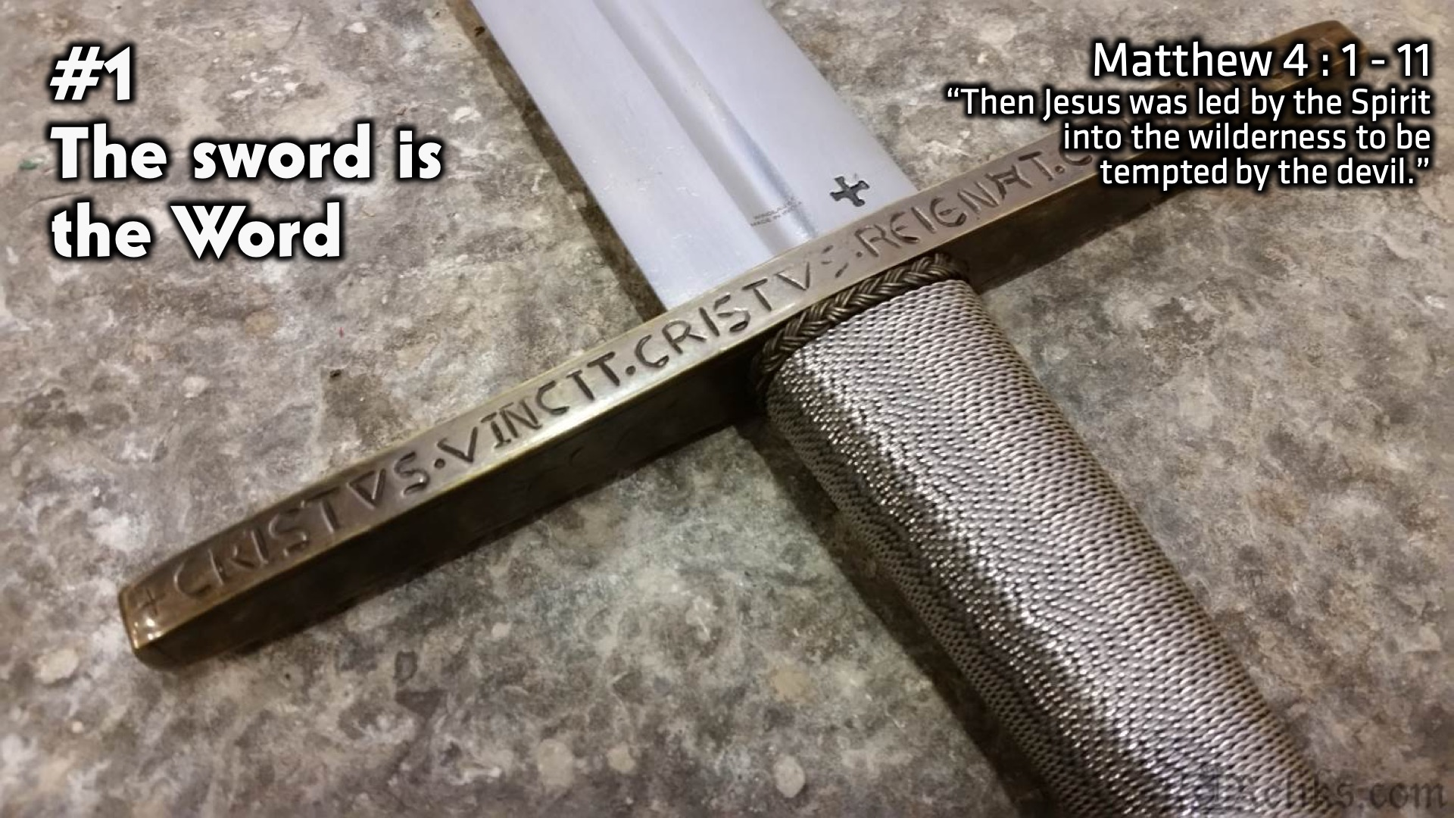
Notes:
#1: The sword is the Word. “Then Jesus was led by the Spirit into the wilderness to be tempted by the devil.” (Matthew 4 : 1 – 11)

Slide 9
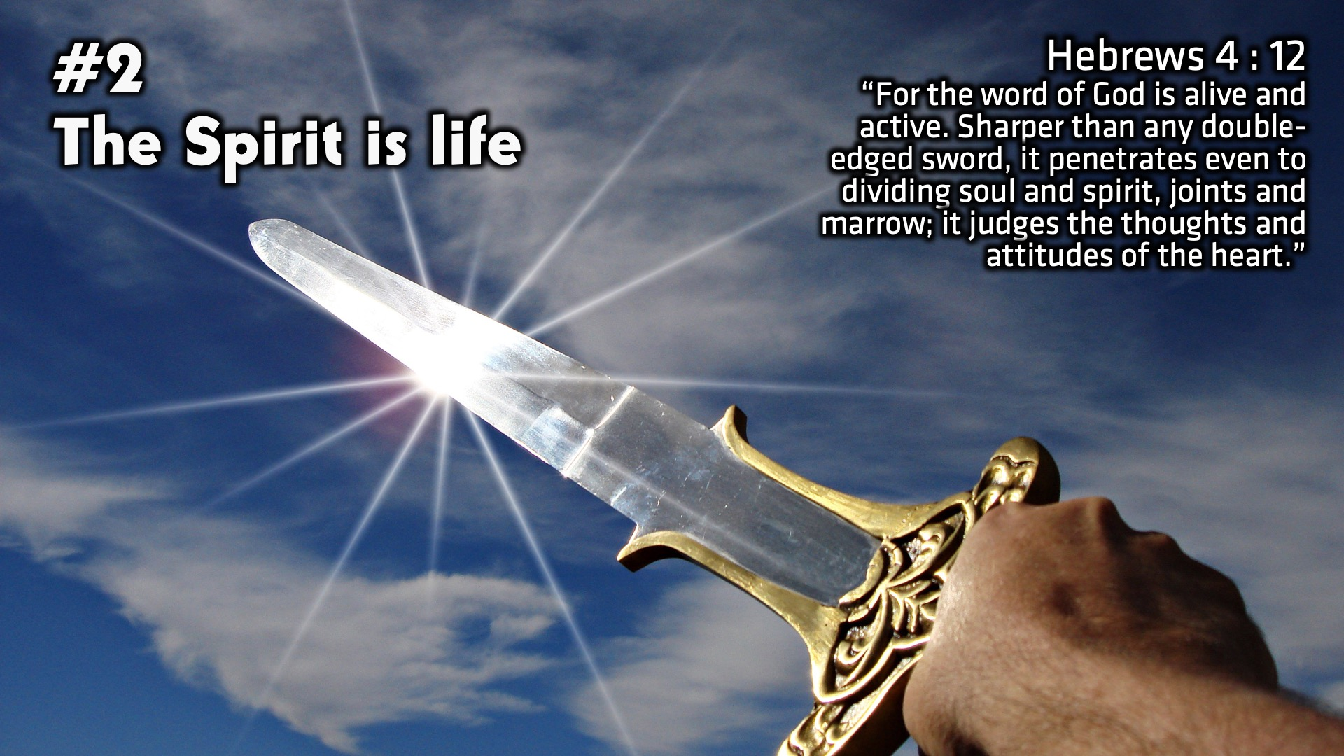
Notes:
#2: The Spirit is life. “For the word of God is alive and active. Sharper than any double-edged sword, it penetrates even to dividing soul and spirit, joints and marrow; it judges the thoughts and attitudes of the heart.” (Hebrews 4 : 12)

Slide 10
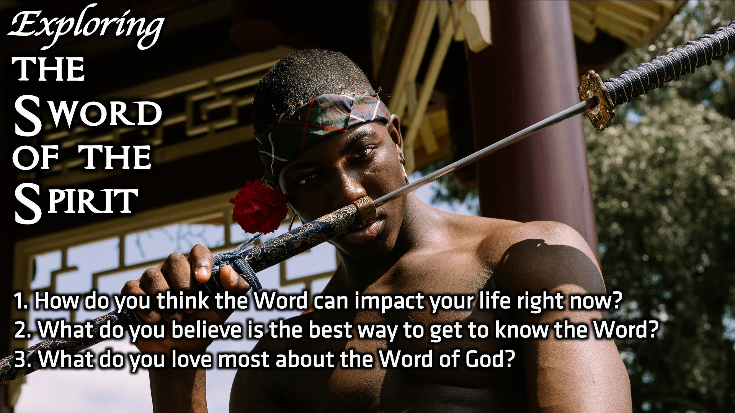
Notes:
Small Group Discussion: You have ten minutes to apply the message to your life in small groups using these 3 questions: (1) How do you think the Word can impact your life right now? (2) What do you believe is the best way to get to know the Word? (3) What do you love most about the Word of God?

Slide 11
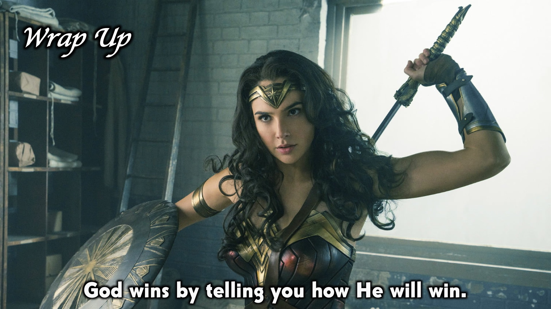
Notes:
Wrap Up: God wins by telling you how He will win.

Slide 12
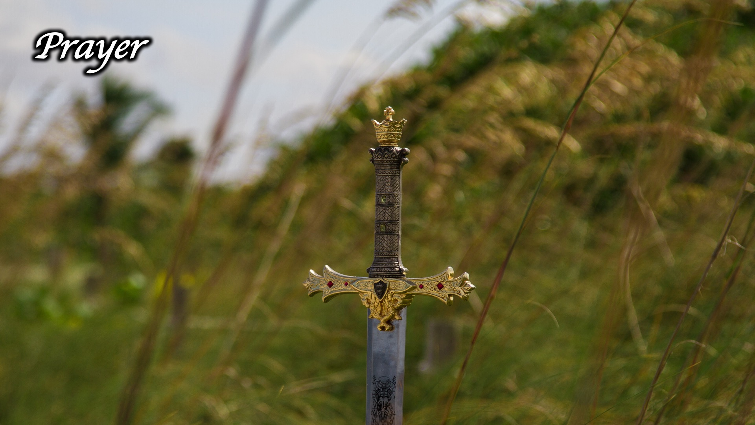
Notes:
Prayer.

Slide 13
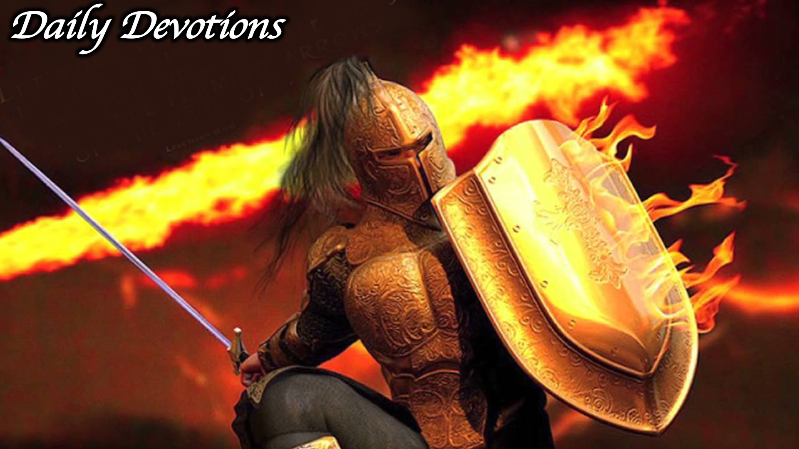
Notes:
Daily Devotions: We will post devotions on the Sunday WhatsApp group every night of the week throughout this series. Do everything you can to be a part of the daily journey in the armour of God.

Slide 14
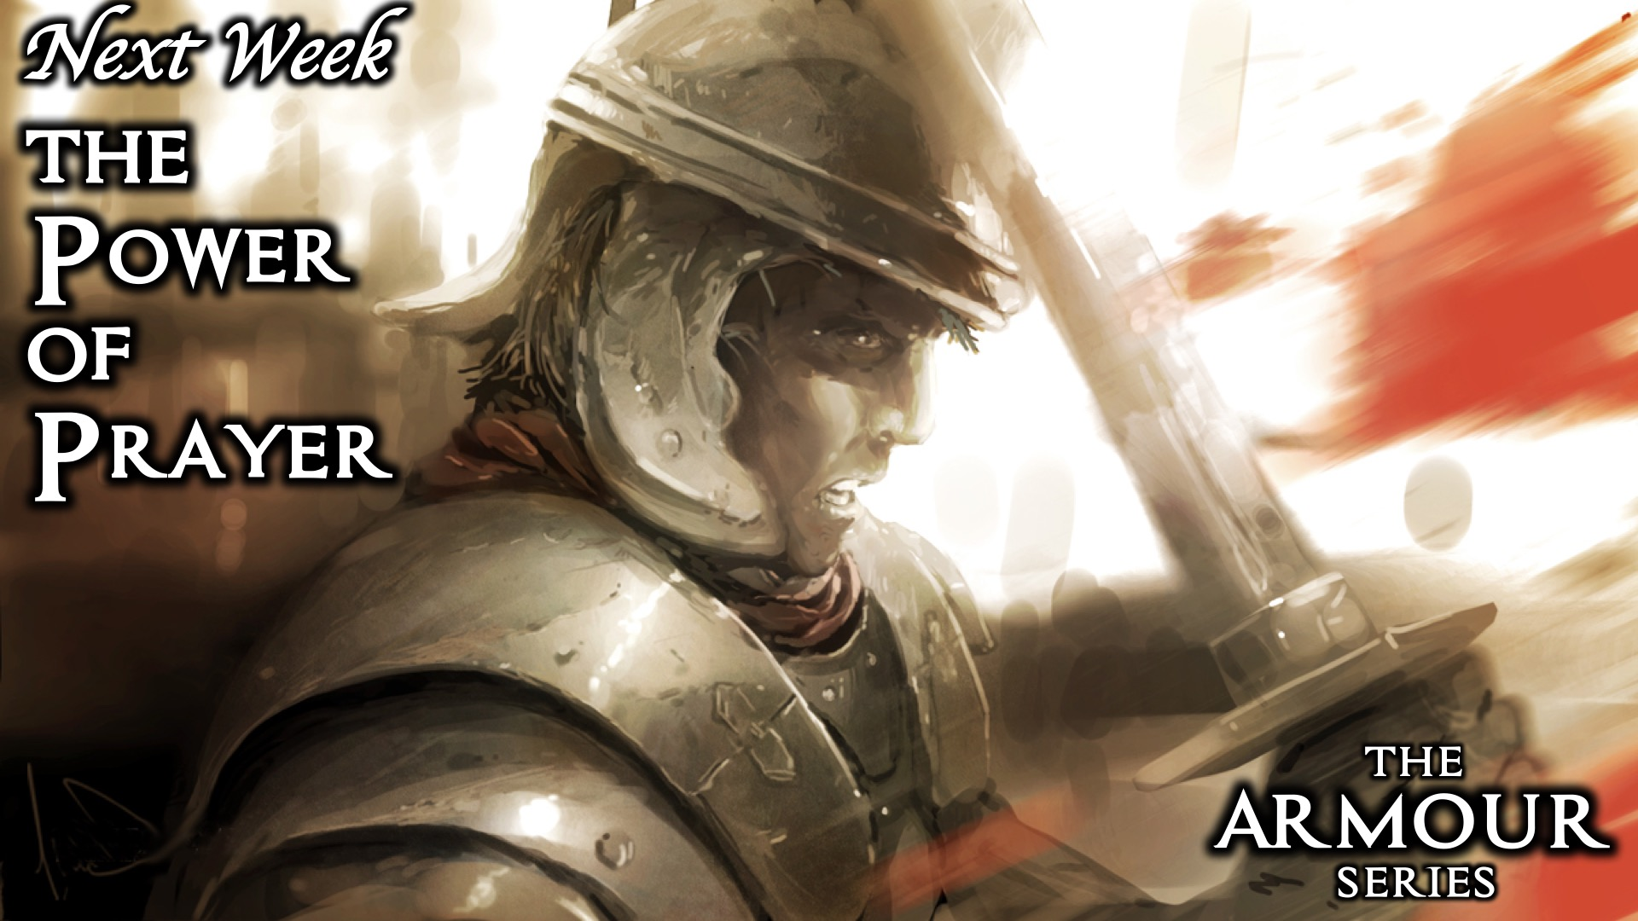
Notes:
Next Week: Next week we will look at the sixth piece of the armour of God: The Power of Prayer.

