Slide 1

Notes:
Welcome to the Armour Series.

Slide 2

Notes:
Last week we learnt about the Sword of the Spirit.

Slide 3
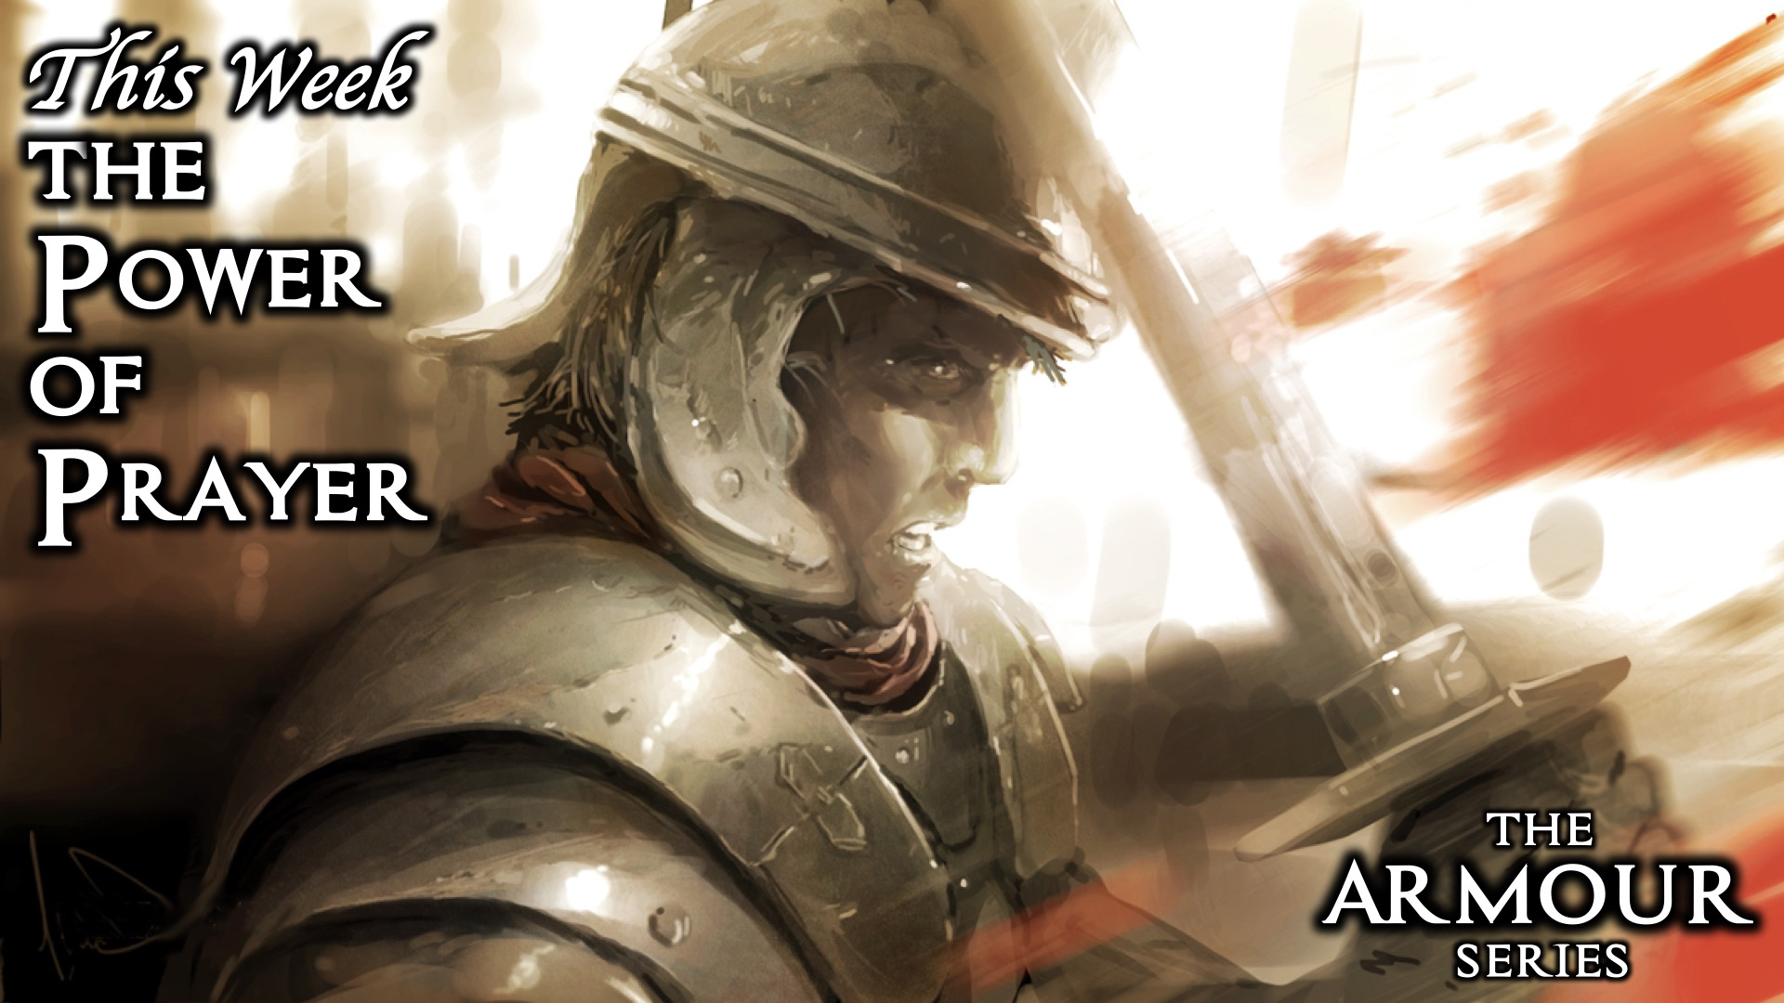
Notes:
This week we are exploring the Power of Prayer.

Slide 4
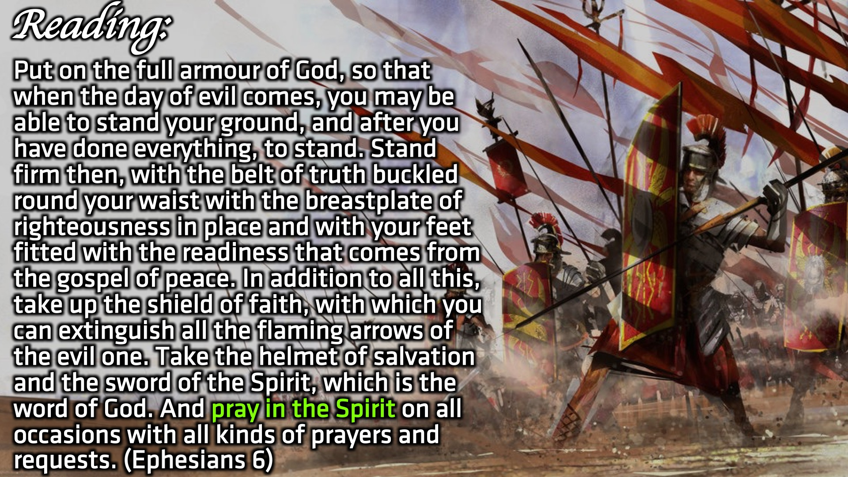
Notes:
Reading: Put on the full armour of God, so that when the day of evil comes, you may be able to stand your ground, and after you have done everything, to stand. Stand firm then, with the belt of truth buckled round your waist with the breastplate of righteousness in place and with your feet fitted with the readiness that comes from the gospel of peace. In addition to all this, take up the shield of faith, with which you can extinguish all the flaming arrows of the evil one. Take the helmet of salvation and the sword of the Spirit, which is the word of God. And pray in the Spirit on all occasions with all kinds of prayers and requests. (Ephesians 6)

Slide 5
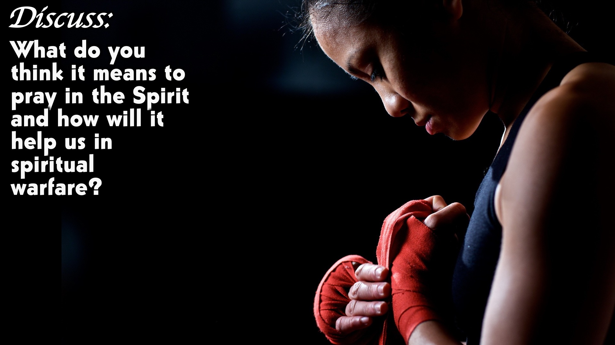
Notes:
Discuss: What do you think it means to pray in the Spirit and how will it help us in spiritual warfare?

Slide 6
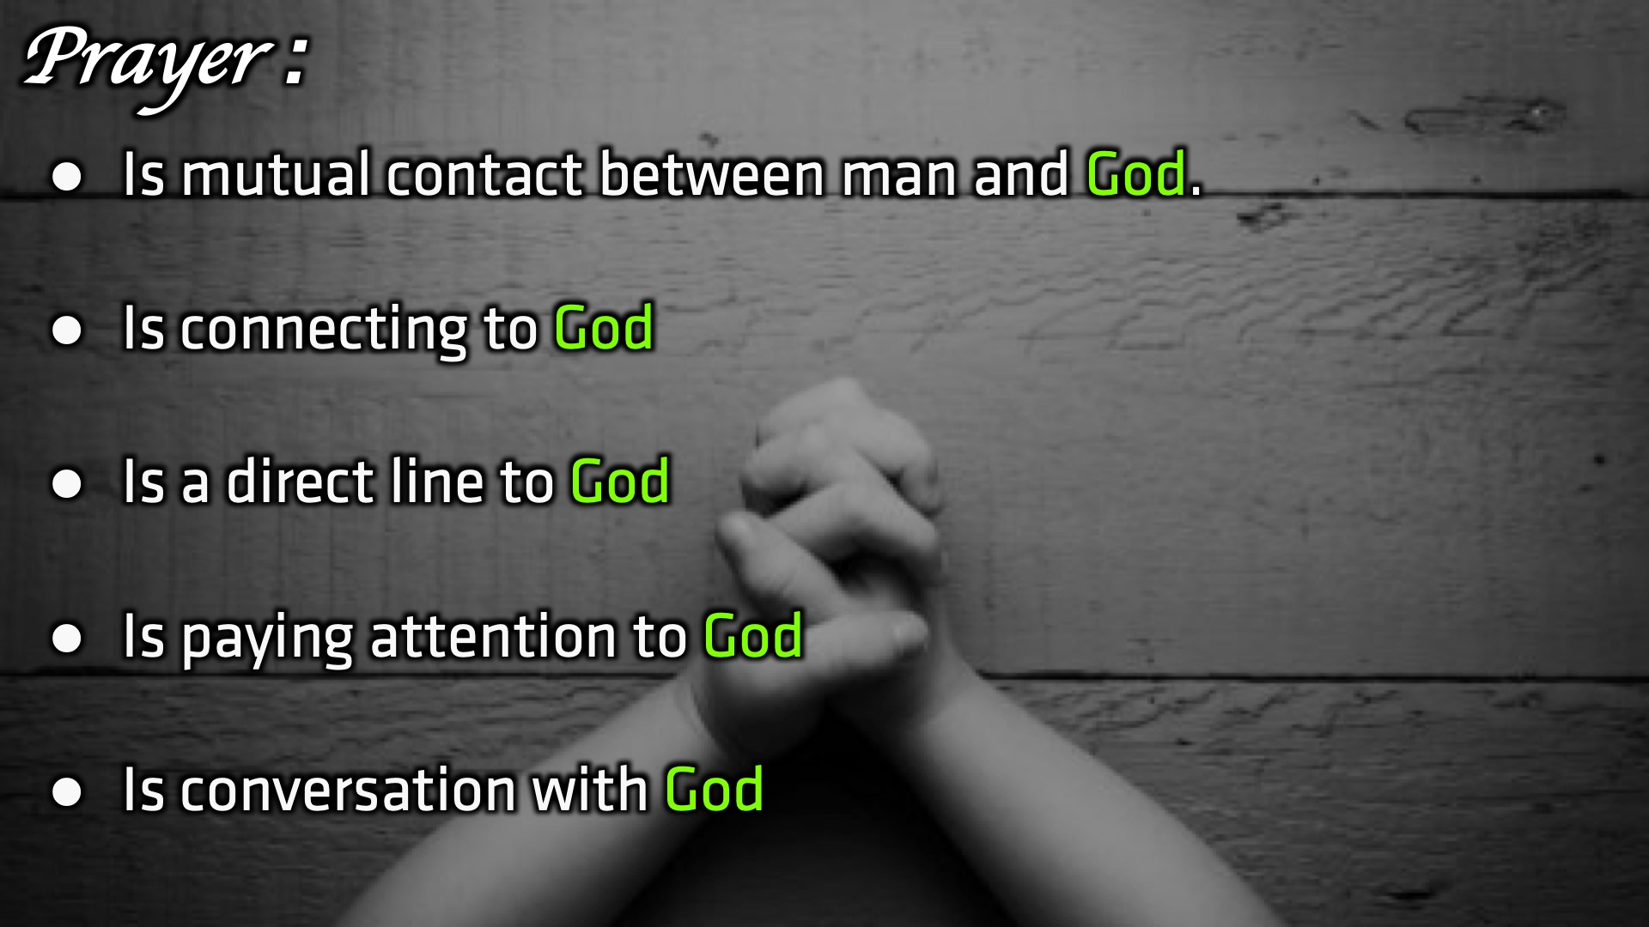
Notes:
Prayer: (1) Is mutual contact between man and God. (2) Is connecting to God (3) Is a direct line to God (4) Is paying attention to God (5) Is conversation with God
As we can see God is the main focus in all these definitions. Sometimes we tend to make prayer about ourselves and our needs forgetting who the ultimate focus is. Our source of power, strength, comfort, deliverance, faith, wisdom , forgiveness of our sins and so much more all come from God.

Slide 7
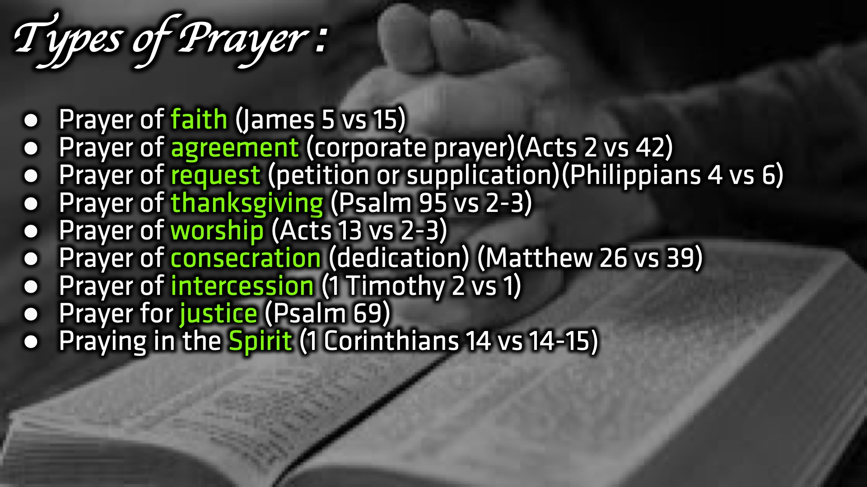
Notes:
Types of Prayer: (1) Prayer of faith (James 5 vs 15) (2) Prayer of agreement (corporate prayer)(Acts 2 vs 42) (3) Prayer of request (petition or supplication)(Philippians 4 vs 6) (4) Prayer of thanksgiving (Psalm 95 vs 2-3) (5) Prayer of worship (Acts 13 vs 2-3) (6) Prayer of consecration (dedication) (Matthew 26 vs 39) (7) Prayer of intercession (1 Timothy 2 vs 1) (8) Prayer for justice (Psalm 69) (9) Praying in the Spirit (1 Corinthians 14 vs 14-15)

Slide 8
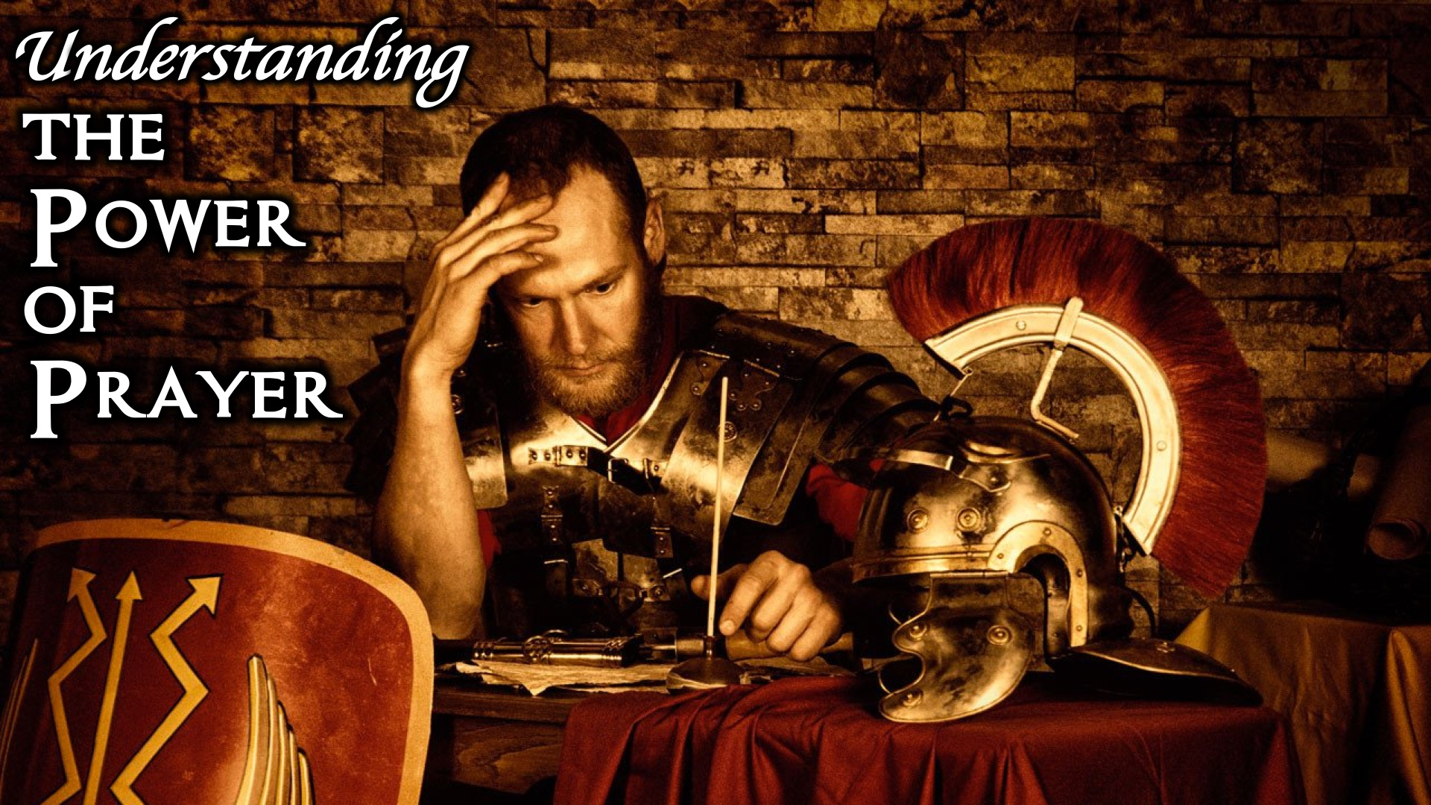
Notes:
Understanding the power of prayer.

Slide 9
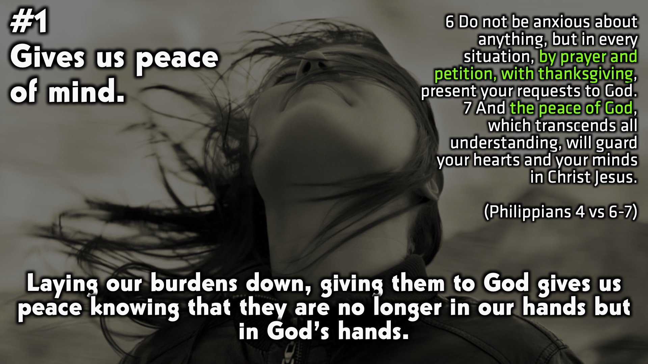
Notes:
#1 Gives us peace of mind. Laying our burdens down, giving them to God gives us peace knowing that they are no longer in our hands but in God’s hands. (Philippians 4 vs 6-7)

Slide 10
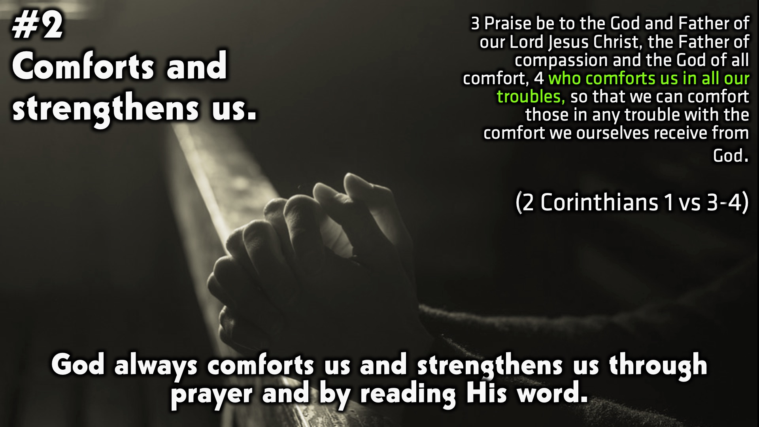
Notes:
#2 Comforts and strengthens us. God always comforts us and strengthens us through prayer and by reading His word. (2 Corinthians 1 vs 3-4)

Slide 11
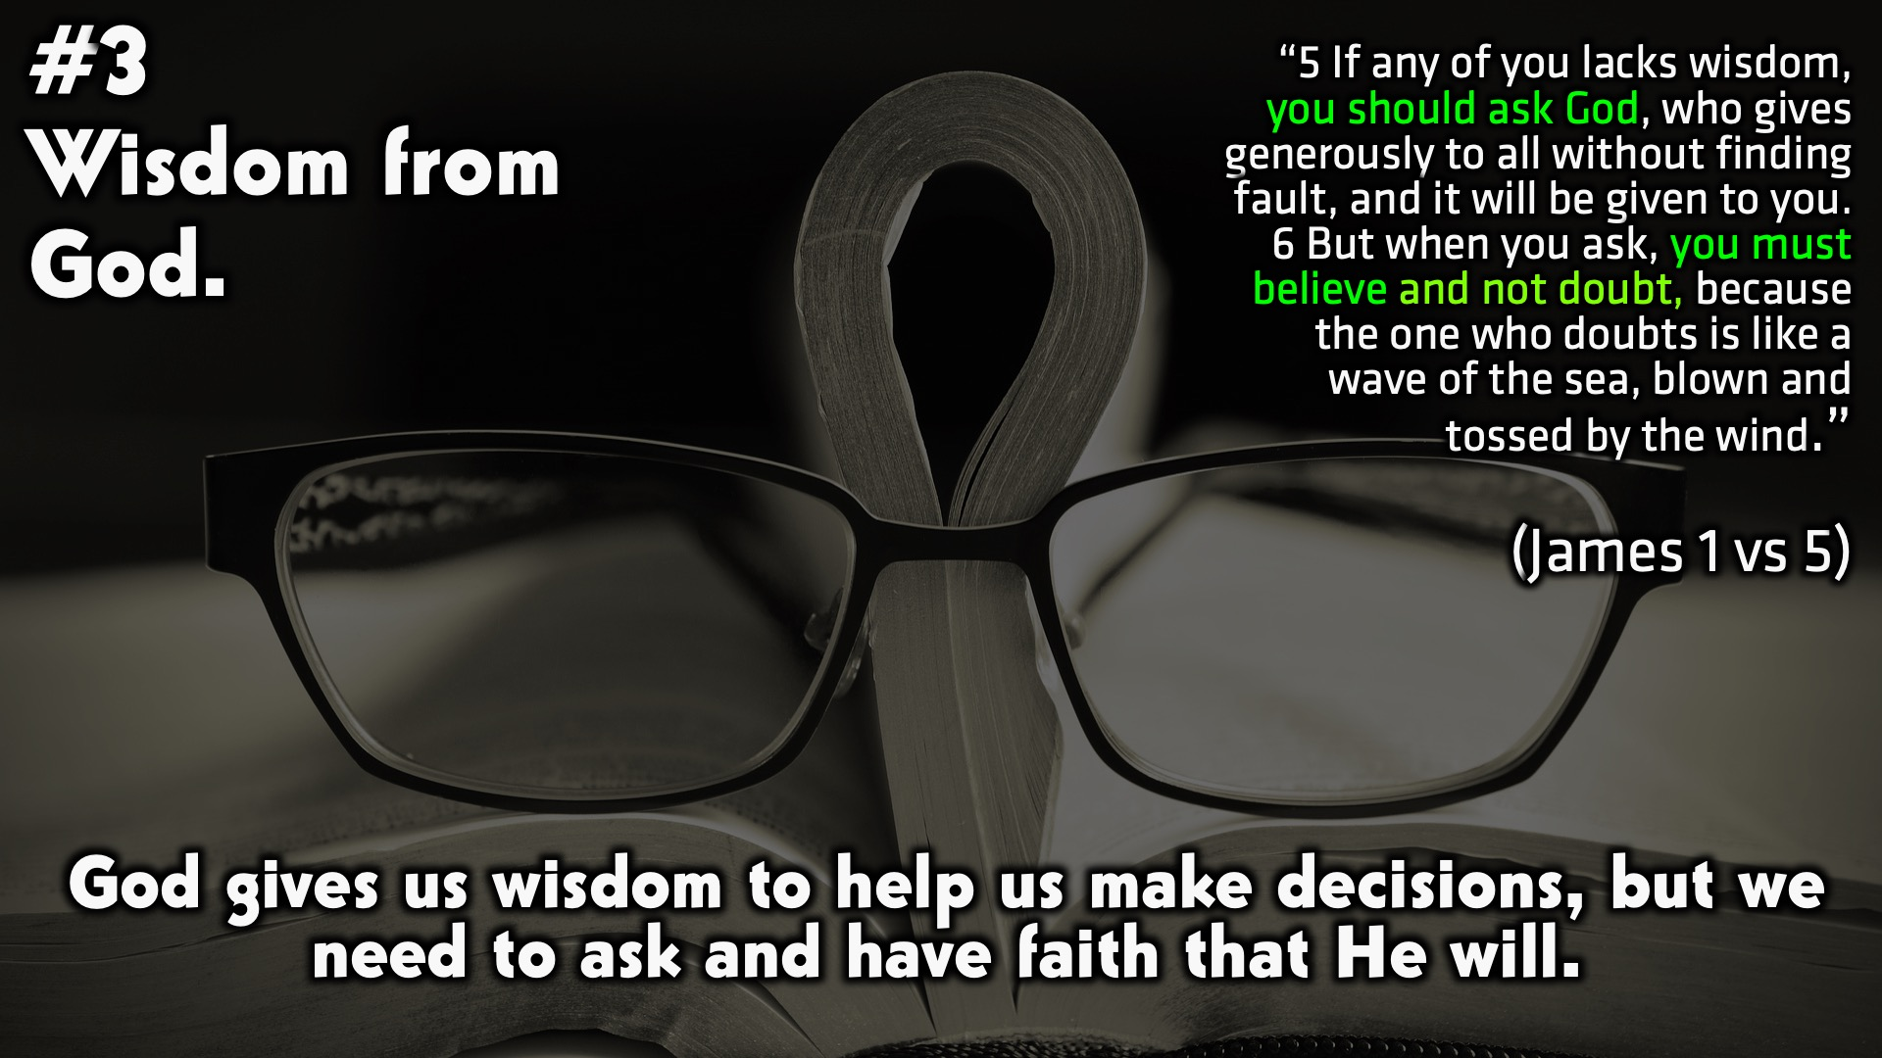
Notes:
#3 Wisdom from God. God gives us wisdom to help us make decisions, but we need to ask and have faith that He will. (James 1 vs 5)

Slide 12
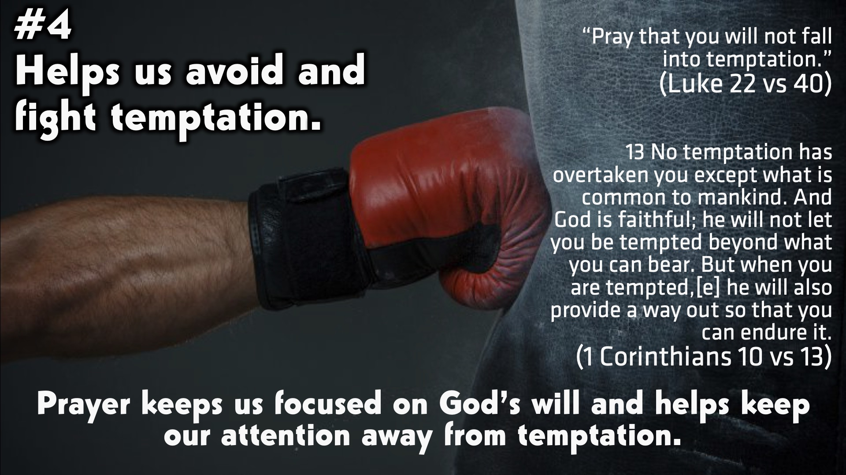
Notes:
#4 Helps us avoid and fight temptation. Prayer keeps us focused on God’s will and helps keep our attention away from temptation. (Luke 22 vs 40) (1 Corinthians 10 vs 13)

Slide 13
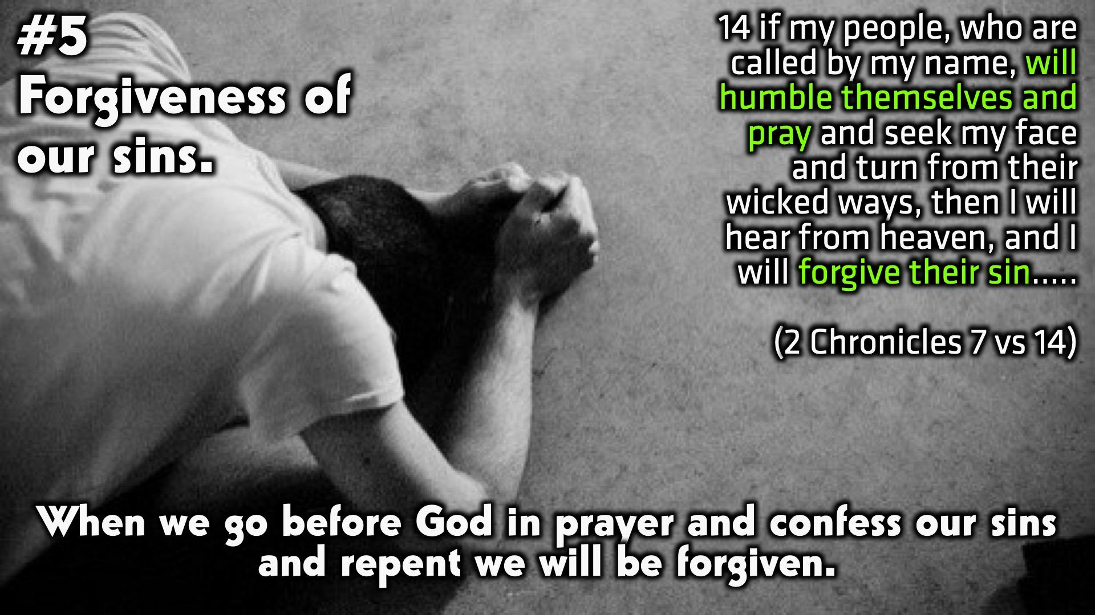
Notes:
#5 Forgiveness of our sins. When we go before God in prayer and confess our sins and repent we will be forgiven. (2 Chronicles 7 vs 14)

Slide 14
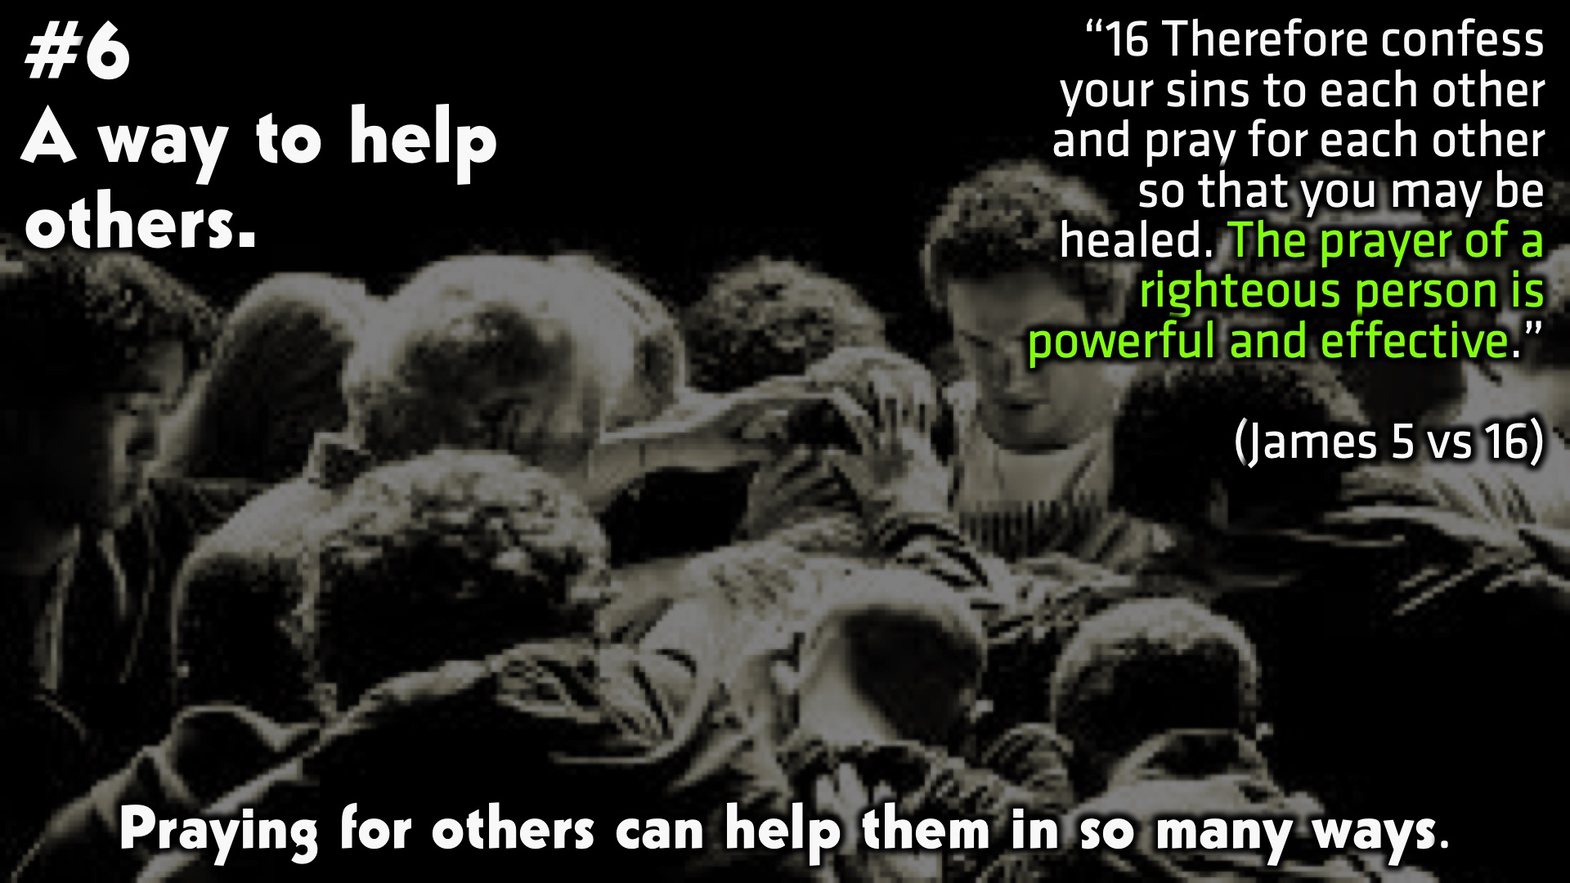
Notes:
#6 A way to help others. Praying for others can help them in so many ways. (James 5 vs 16)

Slide 15
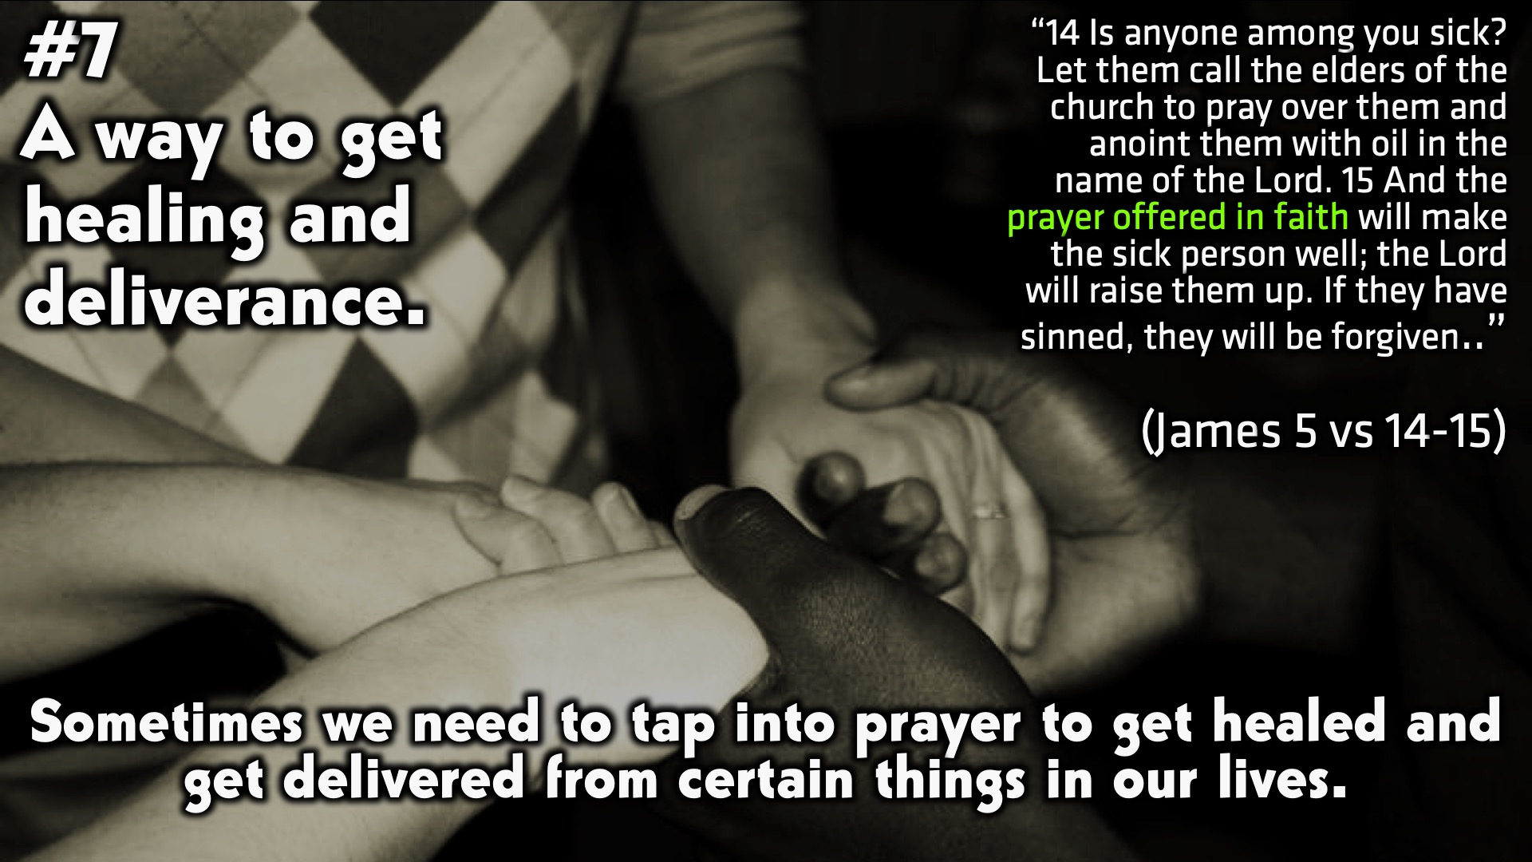
Notes:
#7 A way to get healing and deliverance. Sometimes we need to tap into prayer to get healed and get delivered from certain things in our lives. (James 5 vs 14-15)

Slide 16
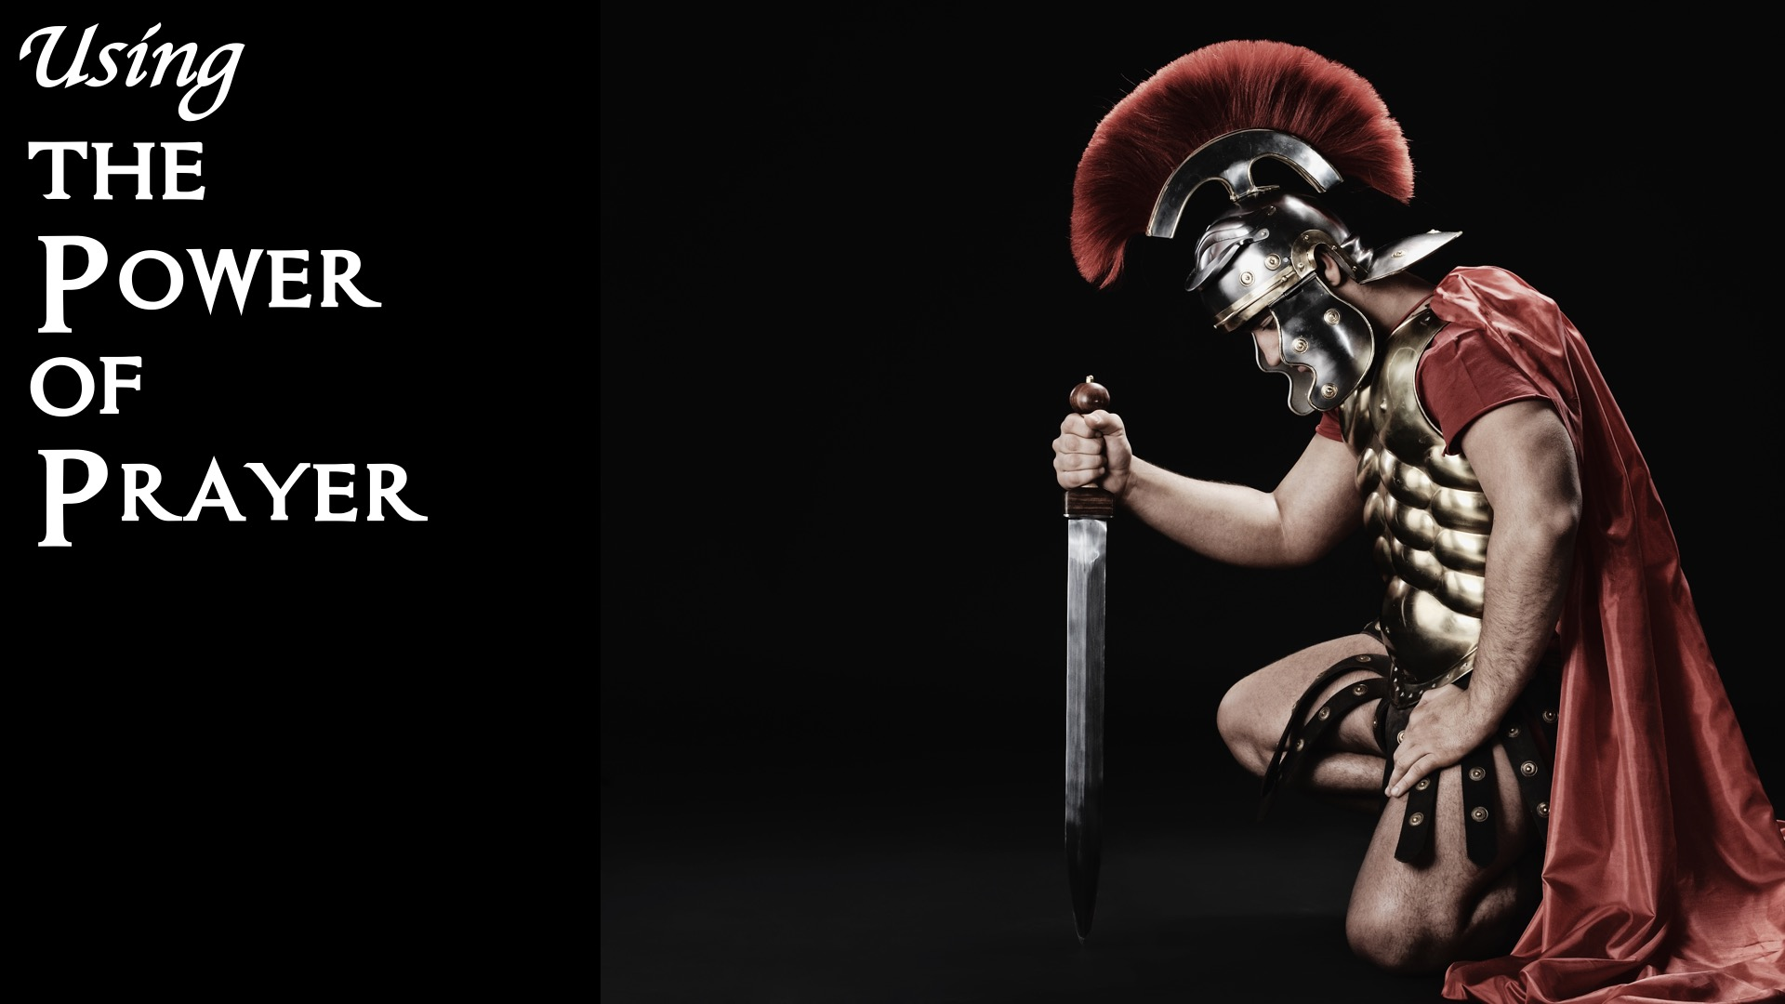
Notes:
Using the Power of prayer.

Slide 17
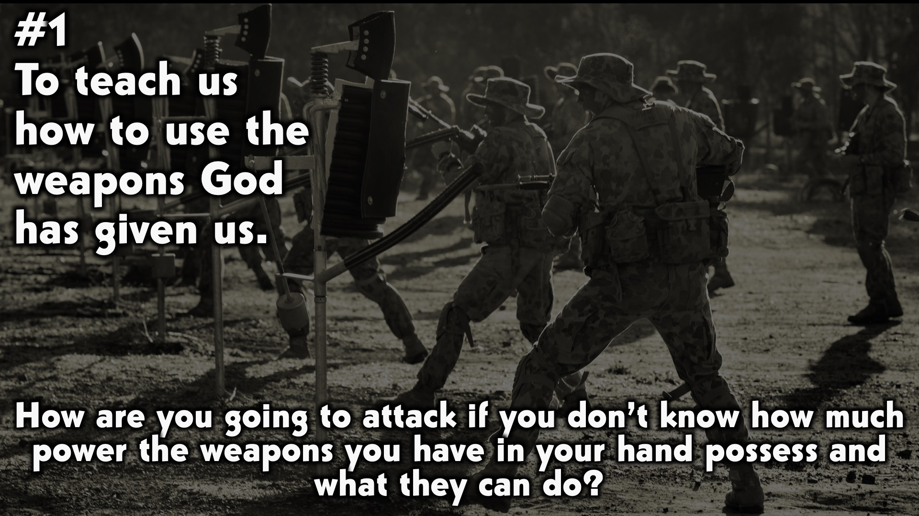
Notes:
When Jesus was tempted by satan in desert he responded saying it is written , referencing the word.
Matthew 4 vs 1-11
When you are attacked you need to know what weapons to use. If you do not know how to use the weapons at your disposal you will be in danger. What's the point of wearing the armour without actually knowing how to use the weapons God has given us.
We get attacked everyday of our lives. We need to study the word of God and spend time in prayer to get strength to attack. I like to view reading and studying the word of God and praying as training and strengthening me for battle. This is where I get my instructions as a soldier the more I am trained and listen to the instructions from God (being the Commander in Chief) the more I am confident and prepared to go to battle.

Slide 18
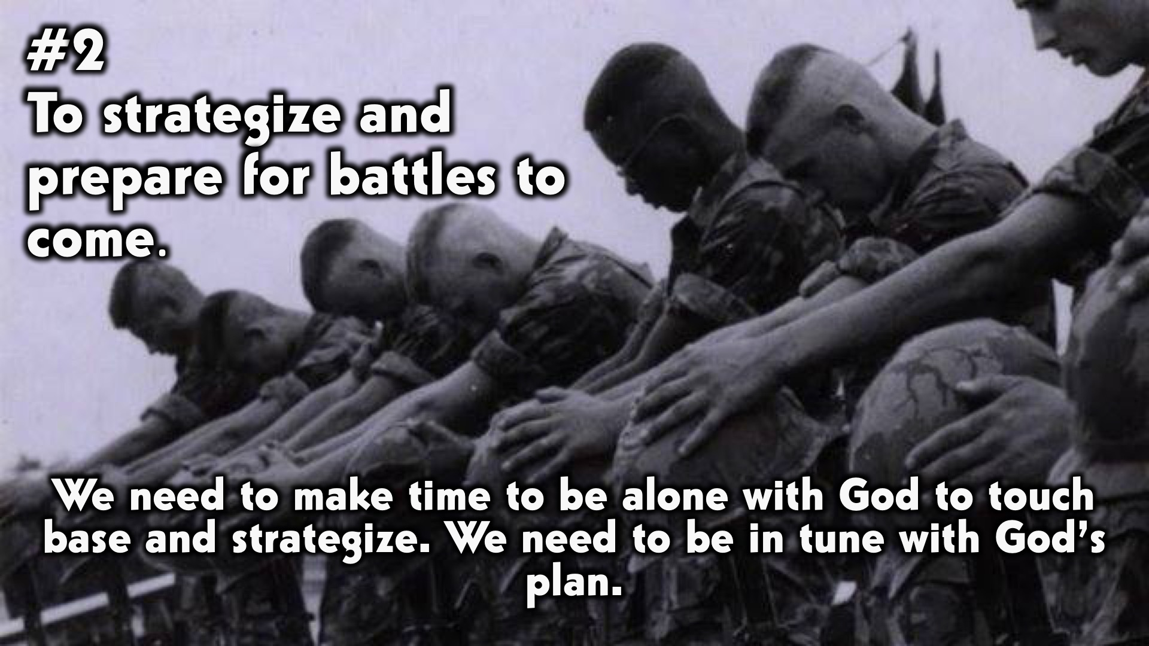
Notes:
There are many ways we can communicate with God on a deeper level. The two I want to point out that usually go hand in hand with prayer is Fasting and Speaking in tongues.
Matthew 6 vs 6-8
“6 But when you pray, go into your room, close the door and pray to your Father, who is unseen. Then your Father, who sees what is done in secret, will reward you. 7 And when you pray, do not keep on babbling like pagans, for they think they will be heard because of their many words. 8 Do not be like them, for your Father knows what you need before you ask him.”
“15 Yet the news about him spread all the more, so that crowds of people came to hear him and to be healed of their sicknesses. 16 But Jesus often withdrew to lonely places and prayed.” Luke 5 vs 15-16

Slide 19
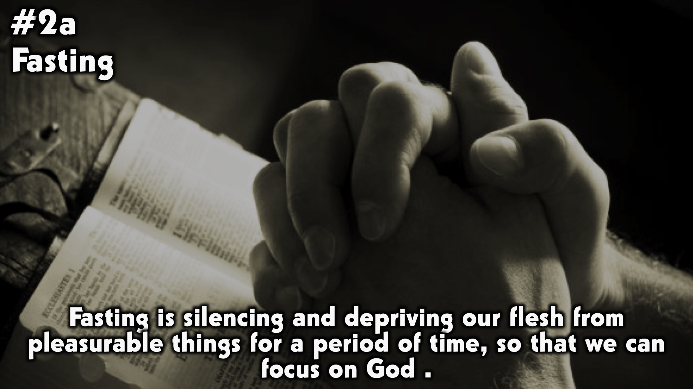
Notes:
Fasting and praying can help us hear from God.
Fasting and praying can strengthen our intimacy with God
Fasting and praying can teach us to pray with right motives
Fasting and praying can build our faith

Slide 20
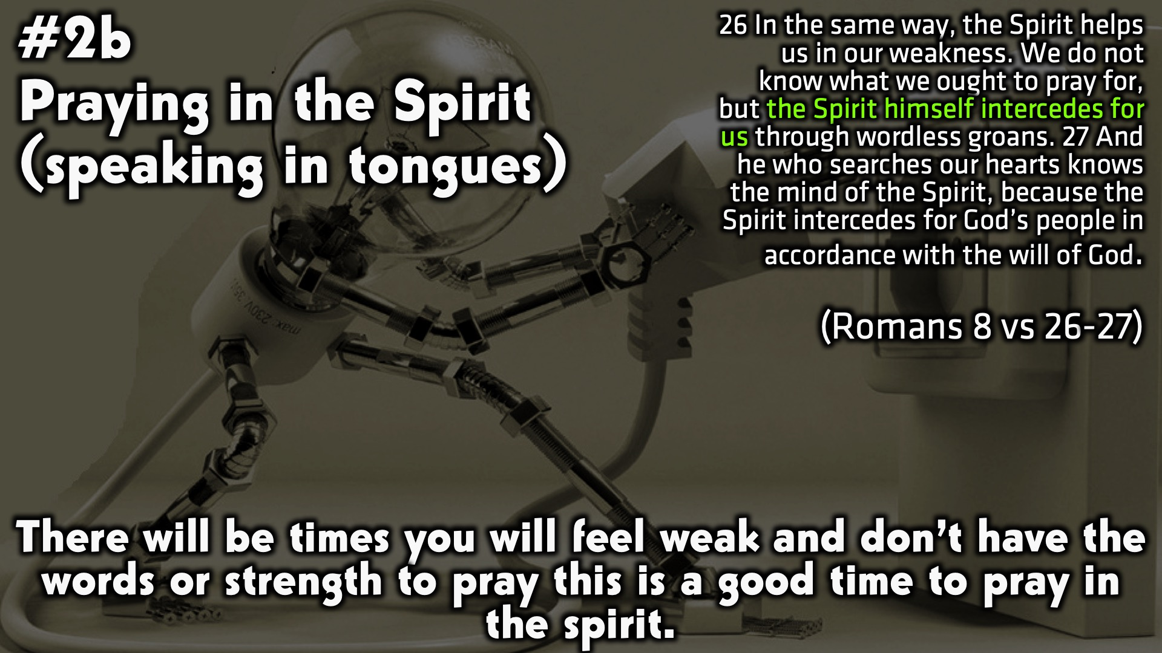
Notes:
When you give the Holy Spirit opportunity by praying in tongues, He can pray out things you don’t even know you need yet!
When we spend time praying in the Spirit, we are praying out divine secrets, or spiritual laws. We know that things happen first in the spiritual realm and then in the natural. So praying in the Holy Spirit is praying spiritual laws into action so that circumstances (natural laws) line up with the purpose and plan of God for our lives.
Have you ever had that feeling that something was wrong and you felt uneasy? I tend to start praying in tongues because I wont know what to pray for but the Holy Spirit does, so I allow him to intercede on my behalf. Yes although I may not know what the problem is I have the faith that God will assign angels to take care of it. When it comes to speaking in tongues faith plays a big part. I must admit it was difficult when I first started because I didn't understand the words that were coming out of my mouth, but I carried on praying and asking God to help me understand what I was doing and the more I stayed believing God and trying to understand I went deeper. Now speaking in tongues and the word of God is my go to when I go for battle.
Its important to know that if you don't speak in tongues yet its ok its a journey. It doesn’t mean you won’t be able to get closer to God. Speaking in tongues is a gift available to every believer all you have to do is ask God, believe and have faith you can.

Slide 21
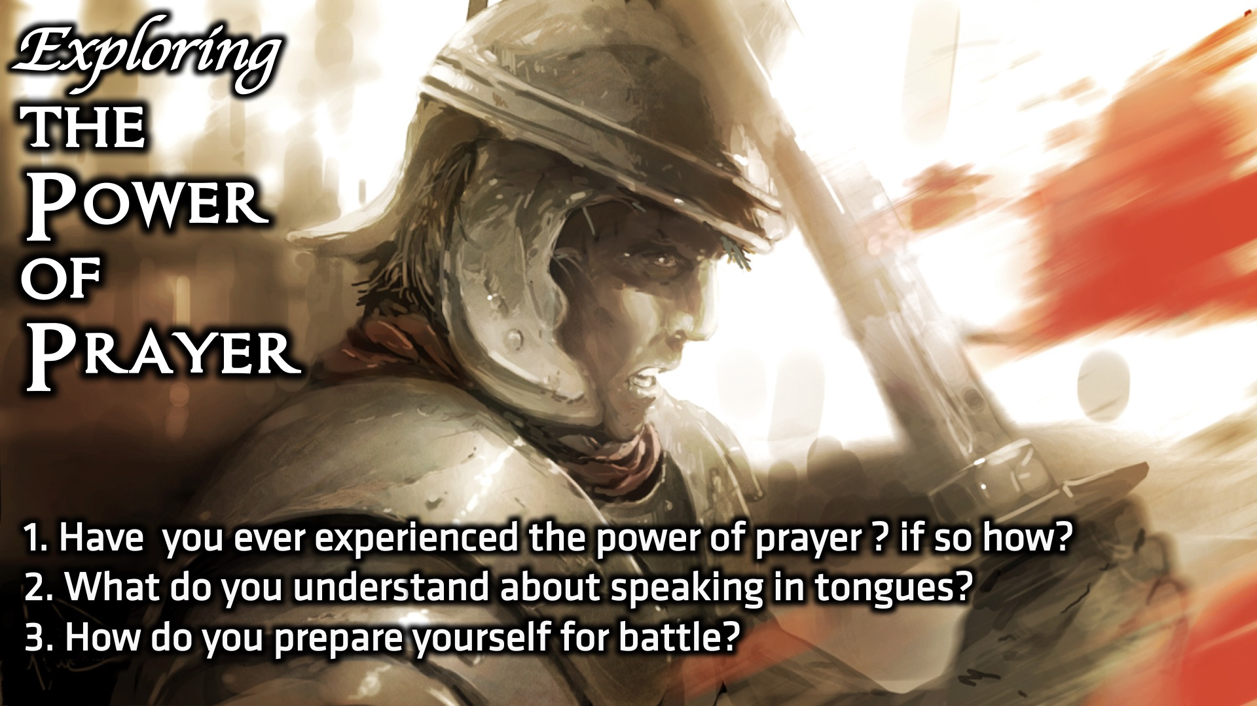
Notes:
Small Group Discussion: You have ten minutes to apply the message to your life in small groups using these 3 questions: (1) Have you ever experienced the power of prayer ? if so how? (2) What do you understand about speaking in tongues? (3) How do you prepare yourself for battle?

Slide 22
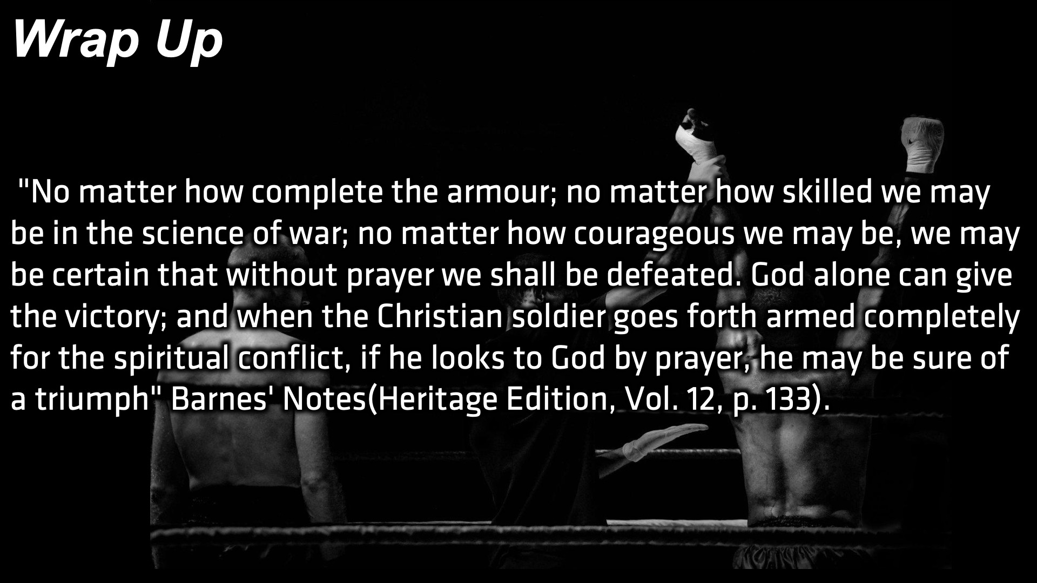
Notes:
Wrap Up: If Jesus needed to separate himself from the crowds often to pray, what more us? If Jesus the most powerful man ever needed to communicate with God , we need God even more.
I encourage you to study the word and understand the weapons you have at your disposal and seek God’s counsel through prayer and prepare yourself for battle.

Slide 23
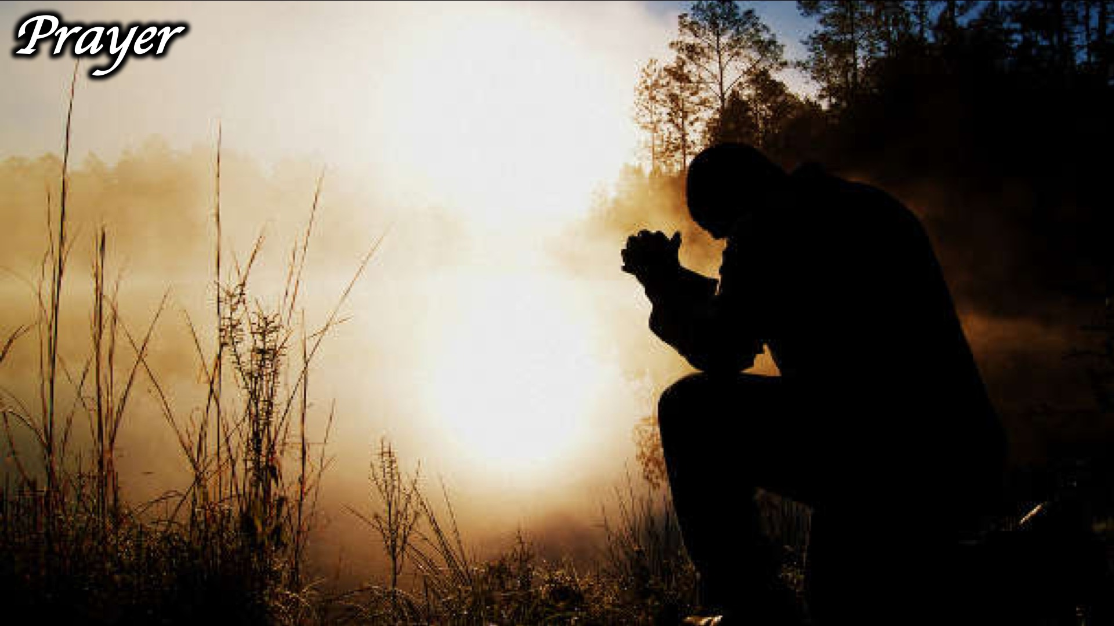
Notes:
Prayer:

Slide 24
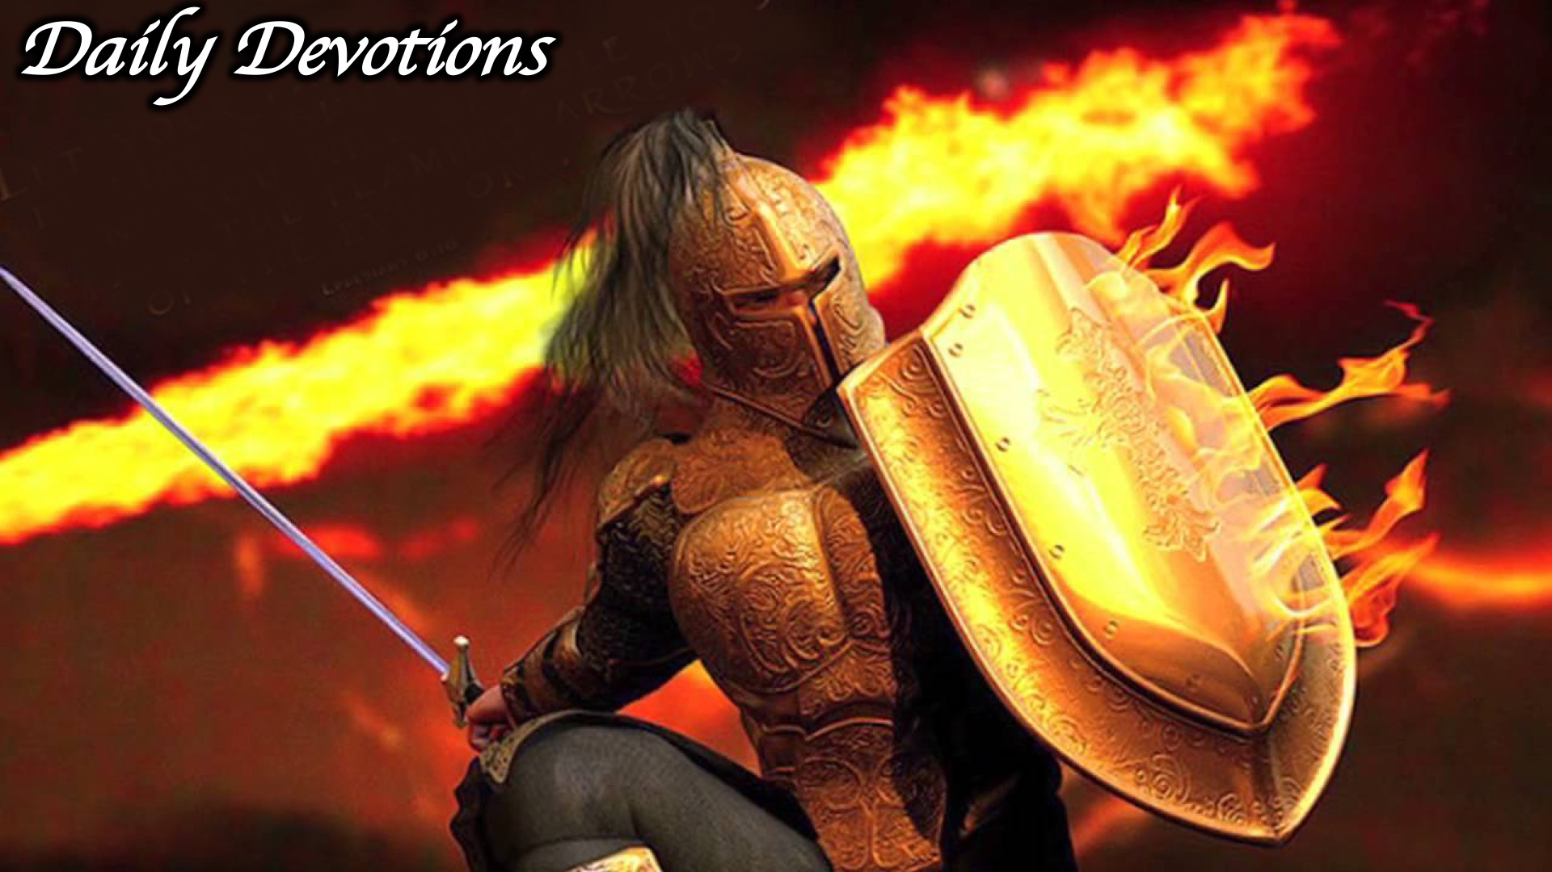
Notes:
Daily Devotions: We will post devotions on the Sunday WhatsApp group every night of the week throughout this series. Do everything you can to be a part of the daily journey in the armour of God.

Slide 25
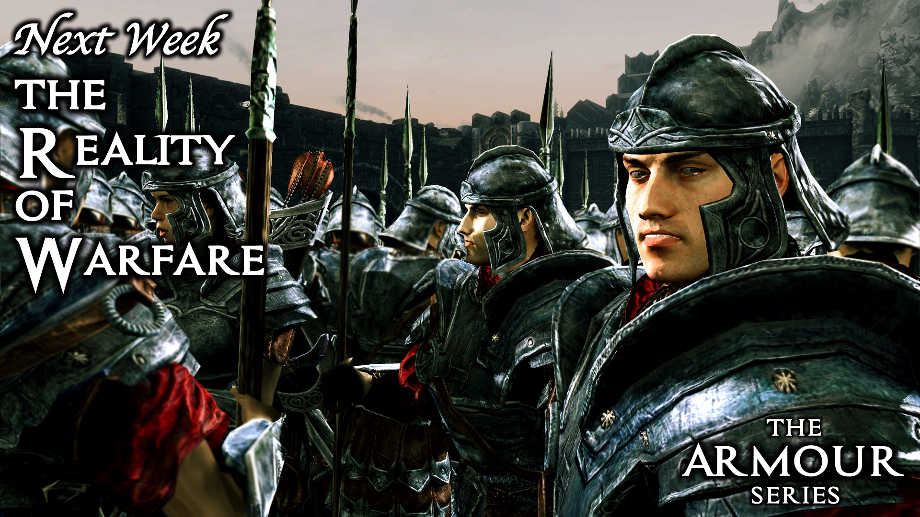
Notes:
Next Week: Next week we will will wrap up our series on the armour of God: The Start of Warfare.

