Slide 1
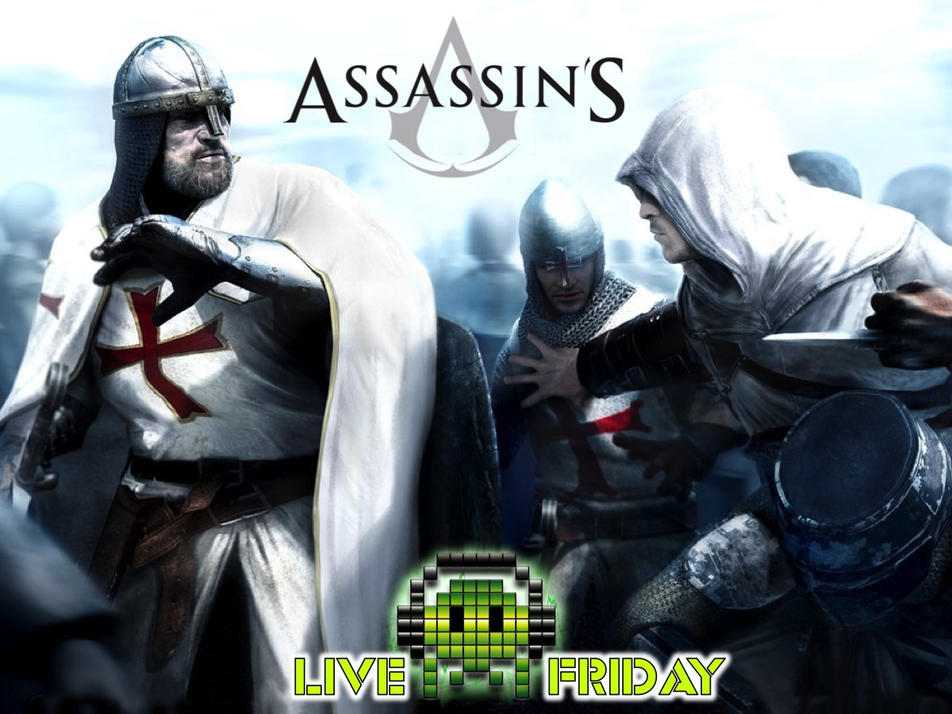
Notes:
Assassin’s Night.

Slide 2

Notes:
Welcome to Live Friday.

Slide 3
Notes:
Tonight is Assassin’s Night

Slide 4
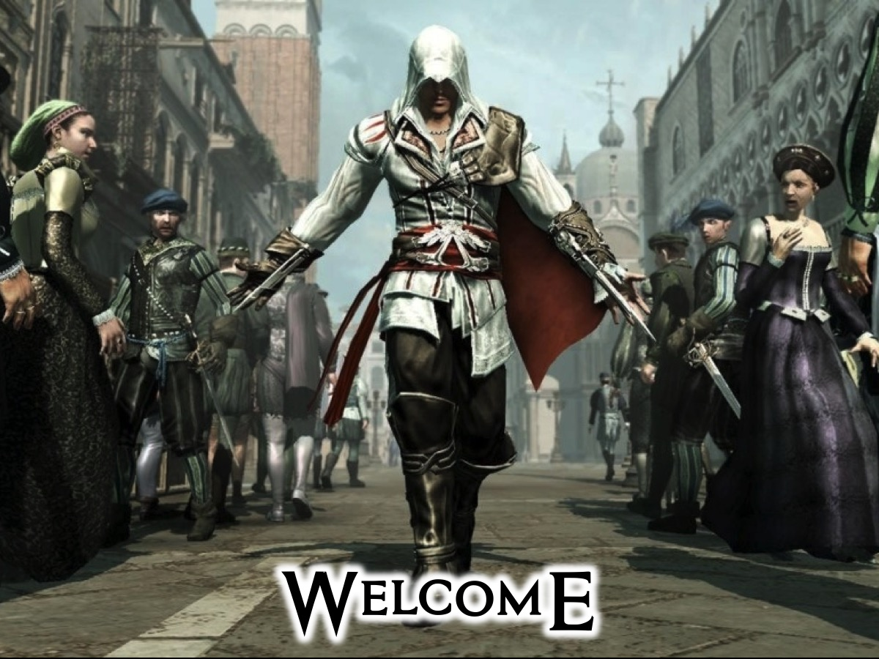
Notes:
Welcome to any newcomers.

Slide 5

Notes:
Video: Assassin’s Creed: Brotherhood Launch Trailer. Get it on YouTube at: https://www.youtube.com/watch?v=jCD0LmXrkm8

Slide 6
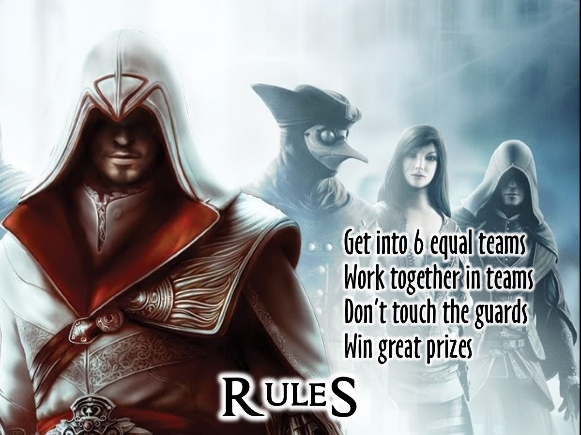
Notes:
Rules: Get into groups of 6. Work together in teams. Don’t touch the guards. Win great prizes.

Slide 7
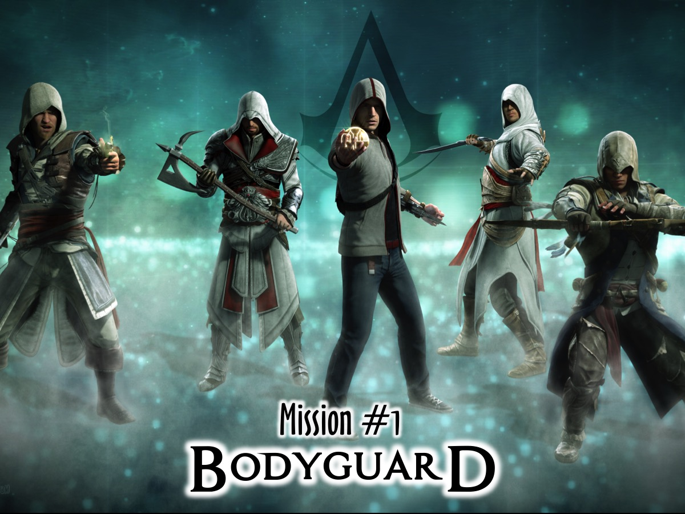
Notes:
Mission #1 is Bodyguard

Slide 8
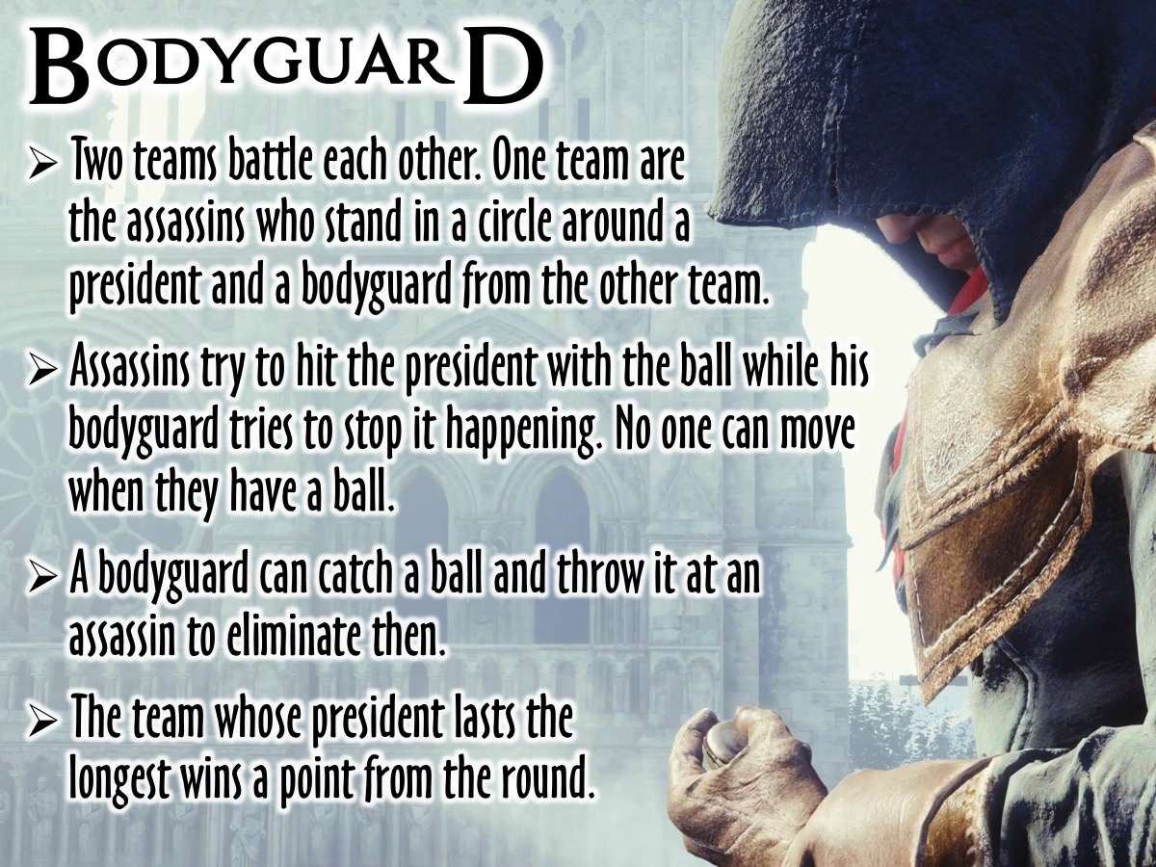
Notes:
1. Bodyguard: Two teams battle each other. One team are the assassins who stand in a circle with a president and a bodyguard from the other team in the middle. Assassins try to hit the president with the ball while his bodyguard tries to stop it happening. No one can move when they have a ball. A bodyguard can catch a ball and throw it at an assassin to eliminate then. The team whose president lasts the longest wins a point from the round.

Slide 9
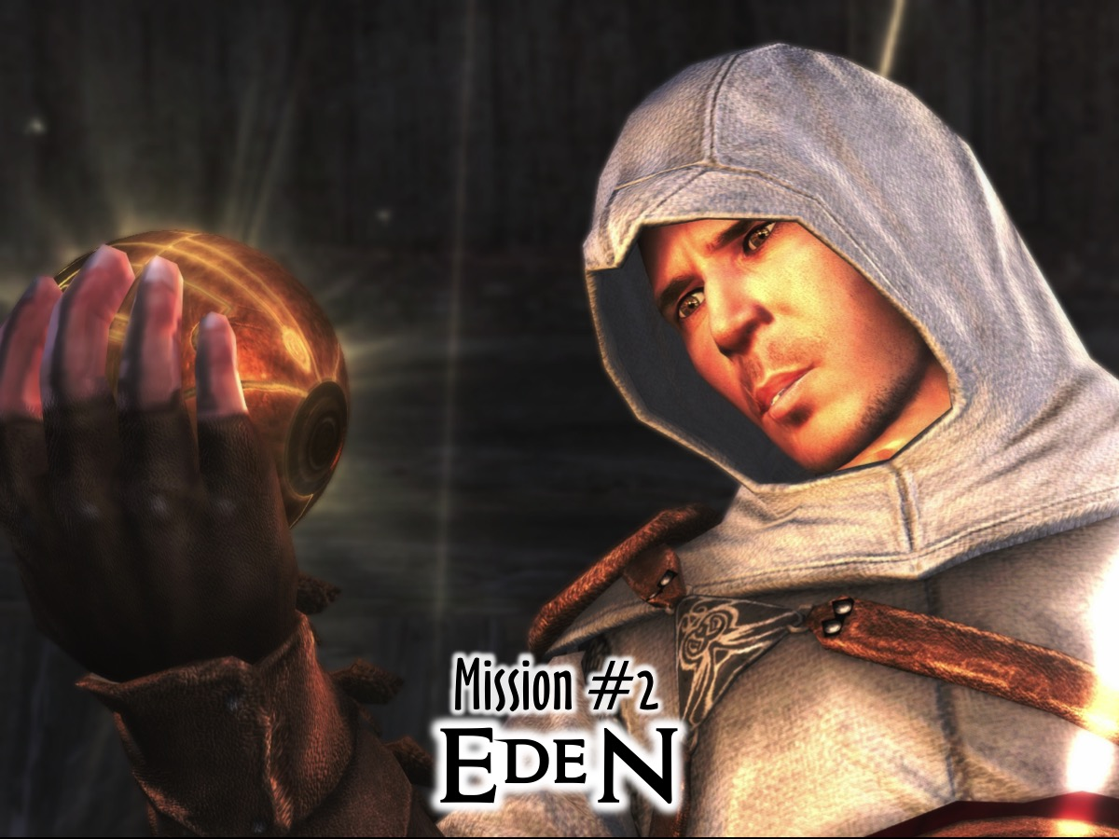
Notes:
Mission # 2 is Eden

Slide 10
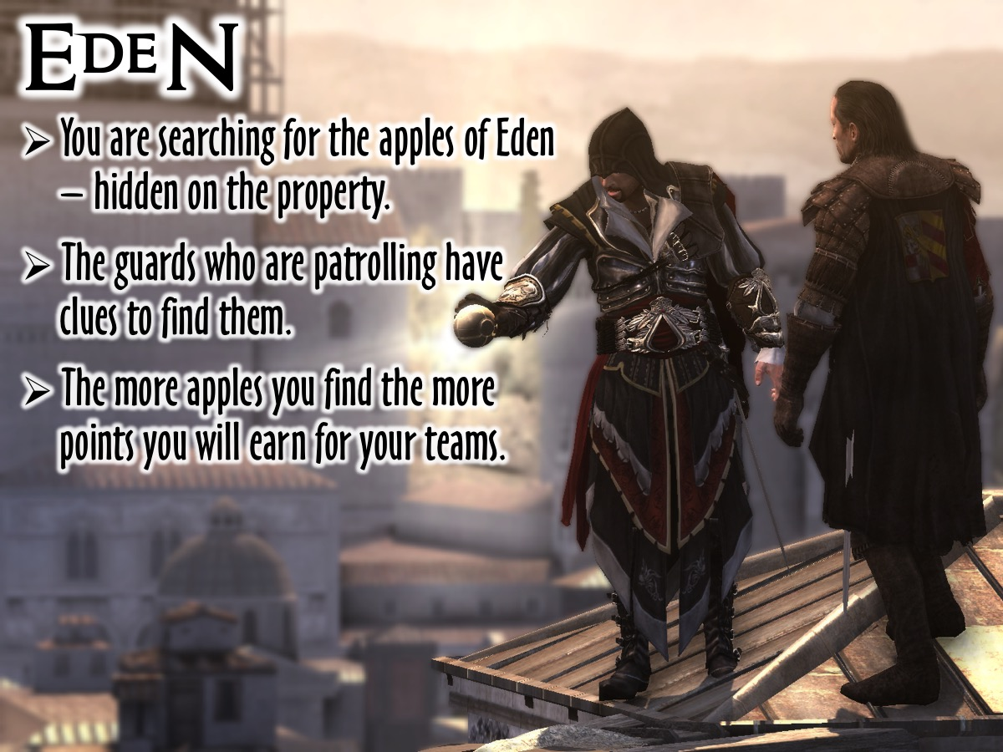
Notes:
2. Eden: You are searching for the apples of Eden - hidden on the property. The guards who are patrolling have clues to their location. The more apples you find the more points you will earn for your teams.

Slide 11
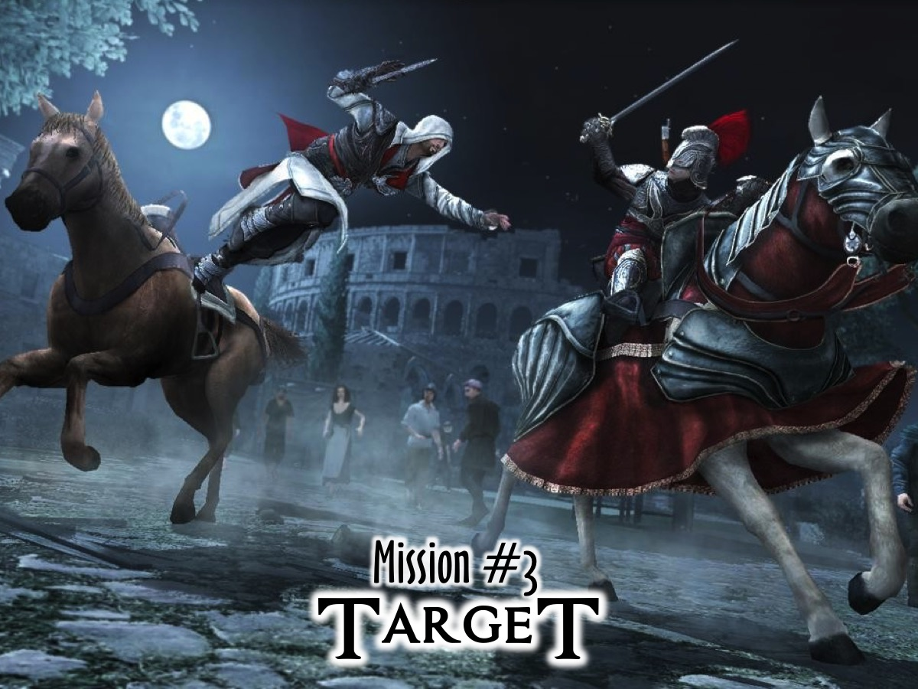
Notes:
Mission #3 is Target.

Slide 12
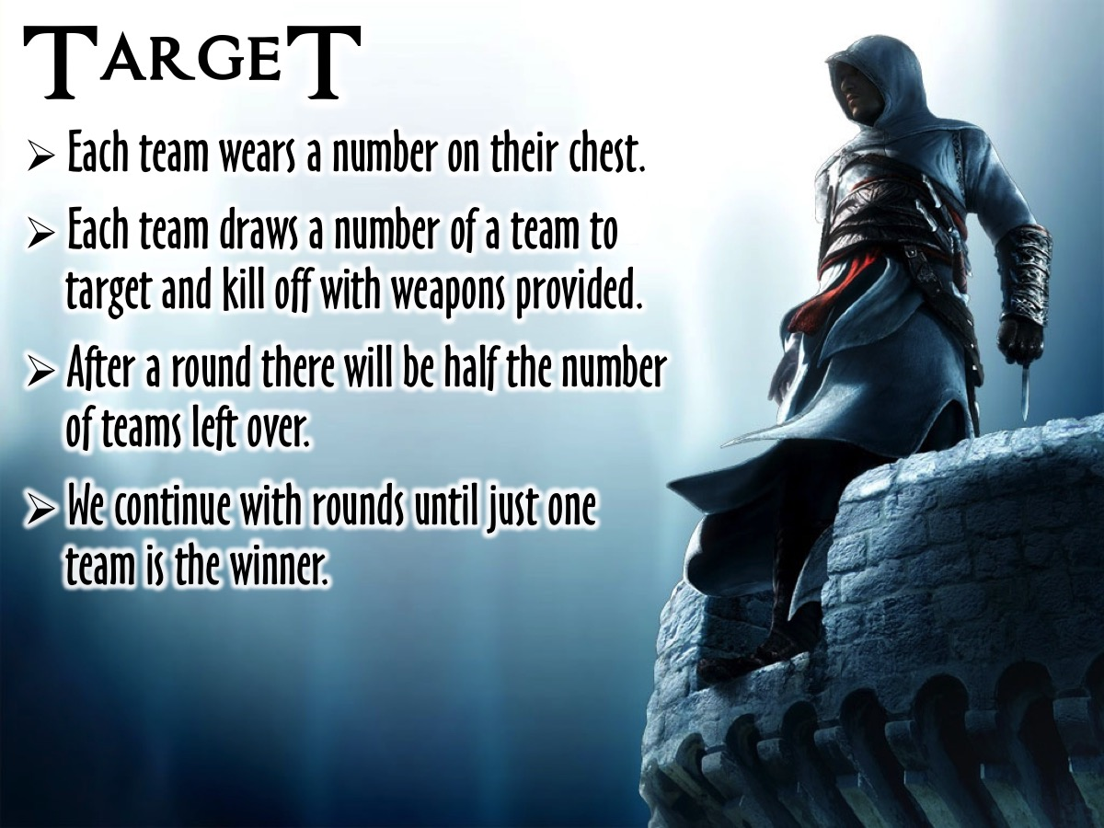
Notes:
3. Target: Each team wears a number on their chest. Each team draws a number of a team to target and kill off with weapons provided. After a round there will be half the number of teams left over. We contianue with rounds until just one team is the winner.

Slide 13
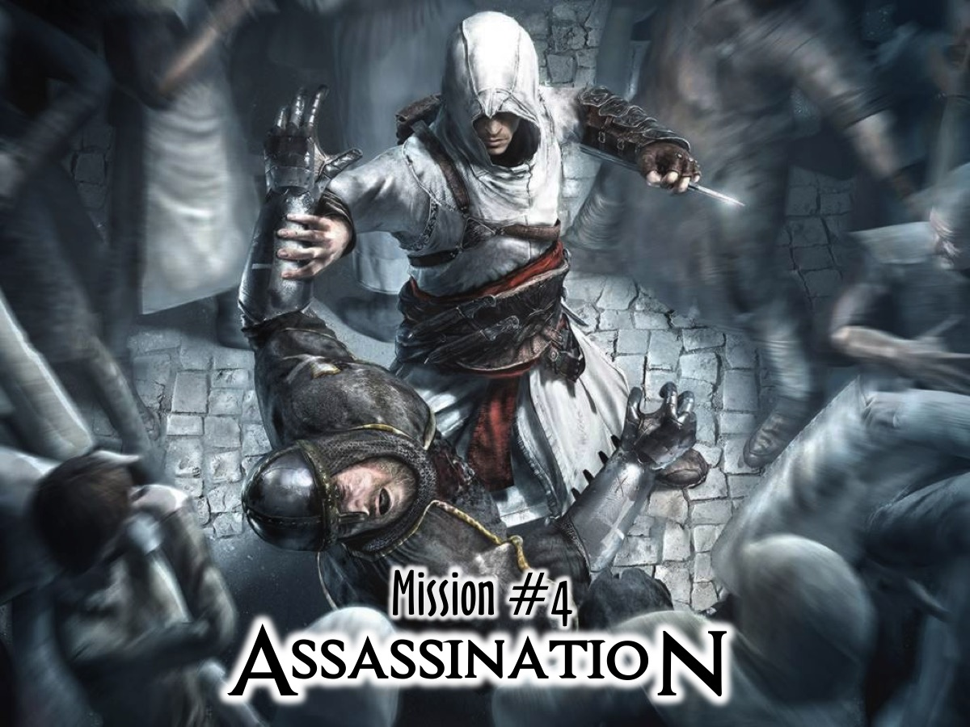
Notes:
Mission #4 is Assassination.

Slide 14
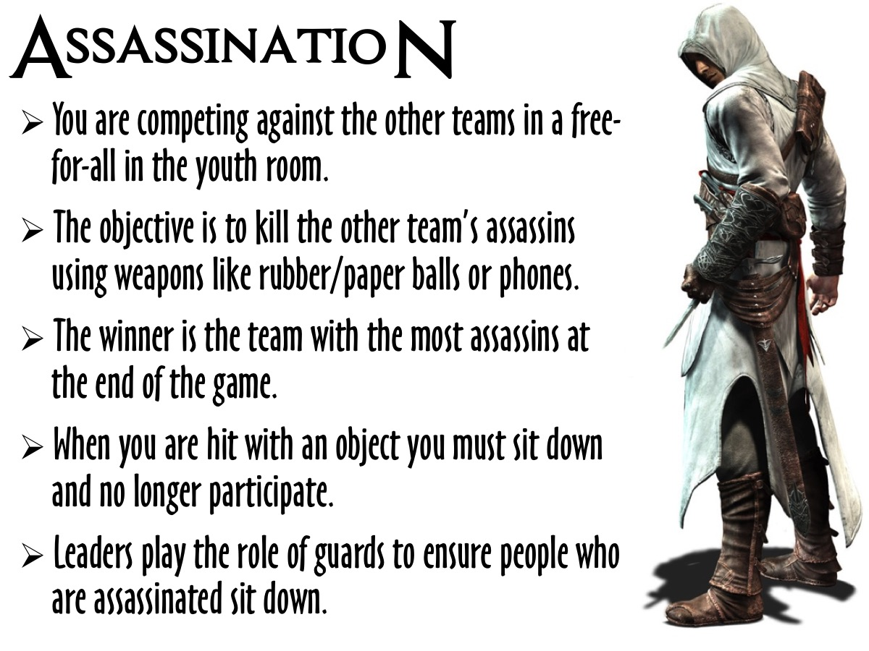
Notes:
Assassination: You are competing against the other teams in a free-for-all in the youth room. The objective is to kill the other team’s assassins using the weapons provided (soft balls, A4 paper that can be crumpled into balls, cellphones where you can call someone and they are out). The winner is the team with the most assassins at the end of the game. When you are hit with an object you must sit down and no longer participate. Leaders play the role of guards to ensure people who are hit actually sit down.

Slide 15
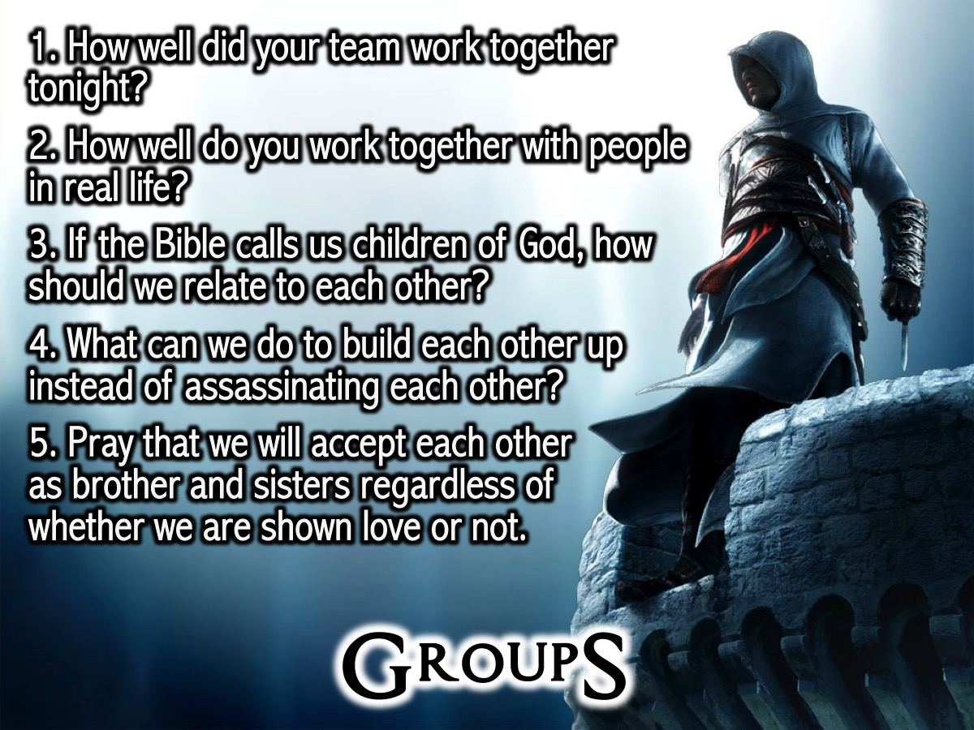
Notes:
Small Groups: Here are the questions for our small group time: (1) How well did your team work together tonight? (2) How well do you work together with people in real life? (3) If the Bible calls us children of God, how should we relate to each other? (4) What can we do to build each other up instead of assassinating each other? (5) Pray that we will accept each other as brother and sisters regardless of whether we are shown love or not.

Slide 16

Notes:
Refreshments

Slide 17

Notes:
On Sunday morning we continue with our new Revolution Series. And next Friday night it is SIMS Night.

