Slide 1
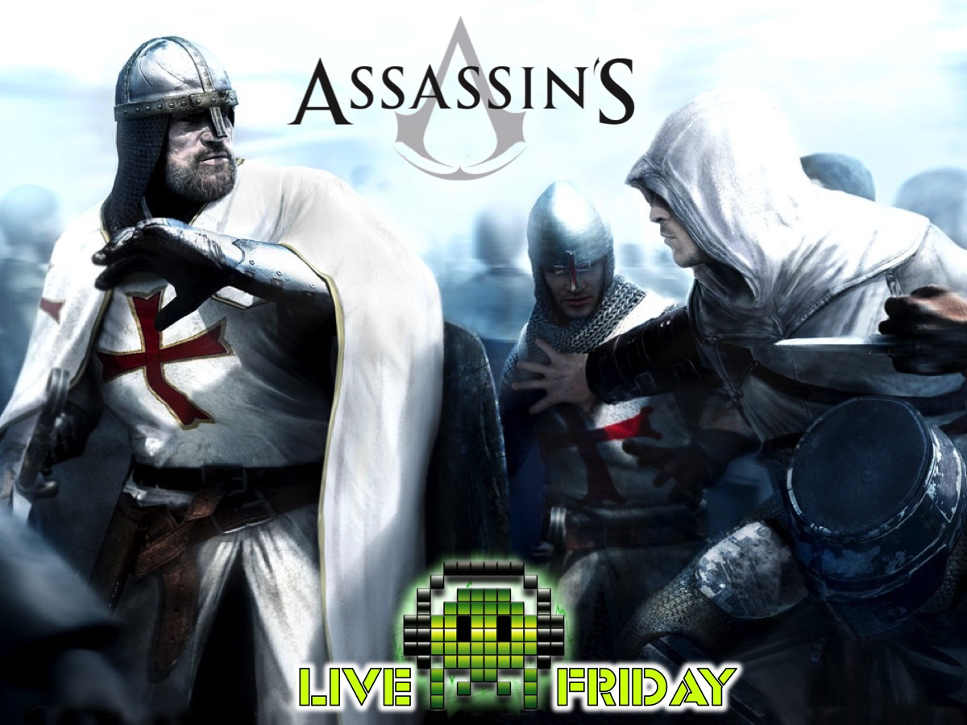

Slide 2
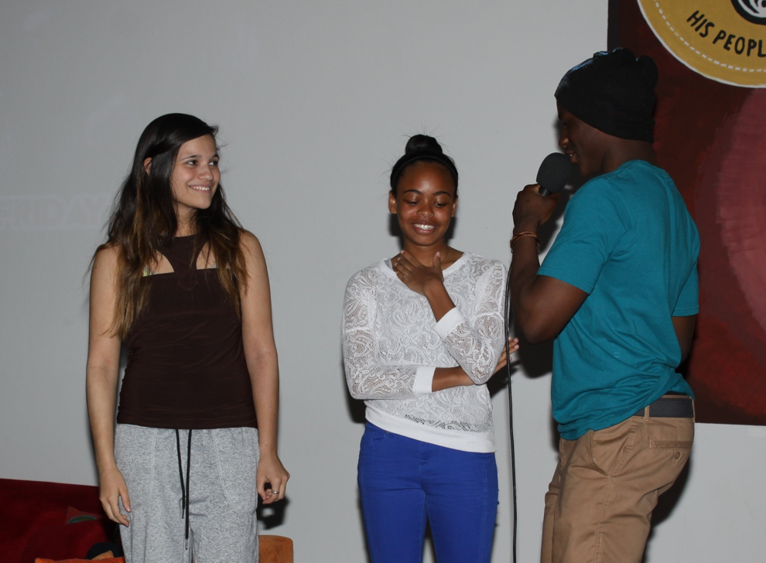
Notes:
Welcoming newcomers

Slide 3
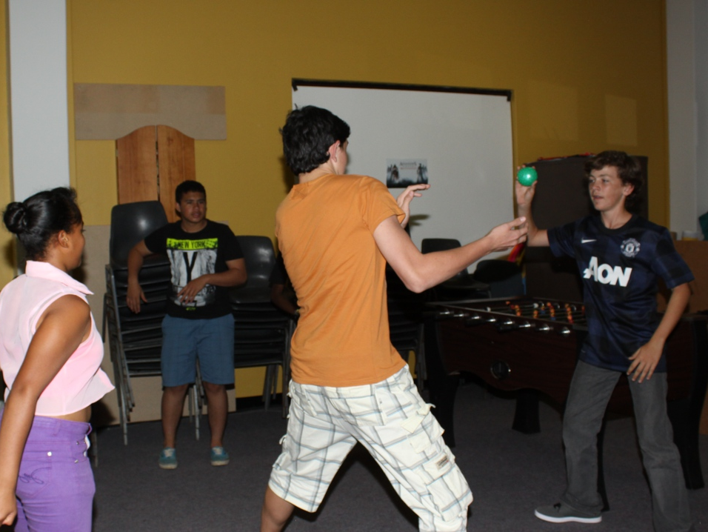
Notes:
The first mission was called Bodyguard: Two teams had to battle each other where one team are the assassins who stand in a circle with a president and a bodyguard from the other team in the middle. Assassins try to hit the president with the ball while his bodyguard tries to stop it happening. No one can move when they have a ball. A bodyguard can catch a ball and throw it at an assassin to eliminate then. The team whose president lasts the longest wins a point from the round.

Slide 4
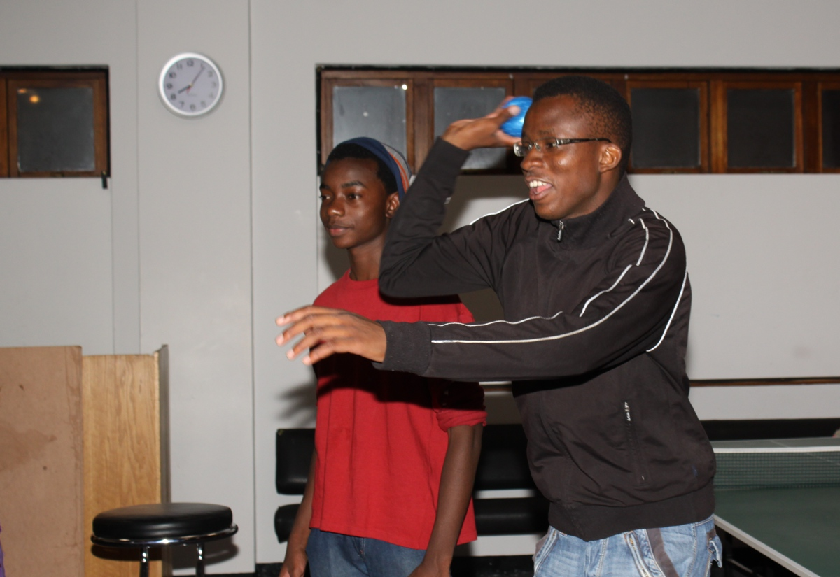
Notes:
The first mission was called Bodyguard: Two teams had to battle each other where one team are the assassins who stand in a circle with a president and a bodyguard from the other team in the middle. Assassins try to hit the president with the ball while his bodyguard tries to stop it happening. No one can move when they have a ball. A bodyguard can catch a ball and throw it at an assassin to eliminate then. The team whose president lasts the longest wins a point from the round.

Slide 5
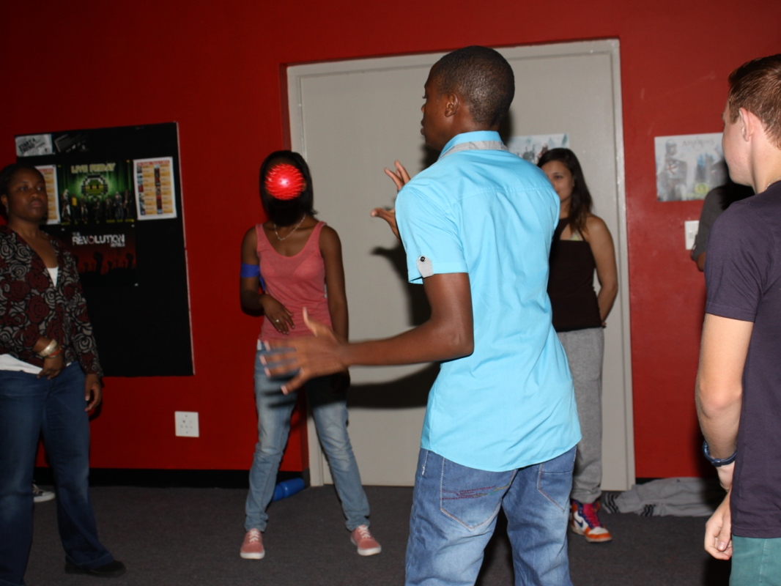
Notes:
The first mission was called Bodyguard: Two teams had to battle each other where one team are the assassins who stand in a circle with a president and a bodyguard from the other team in the middle. Assassins try to hit the president with the ball while his bodyguard tries to stop it happening. No one can move when they have a ball. A bodyguard can catch a ball and throw it at an assassin to eliminate then. The team whose president lasts the longest wins a point from the round.

Slide 6
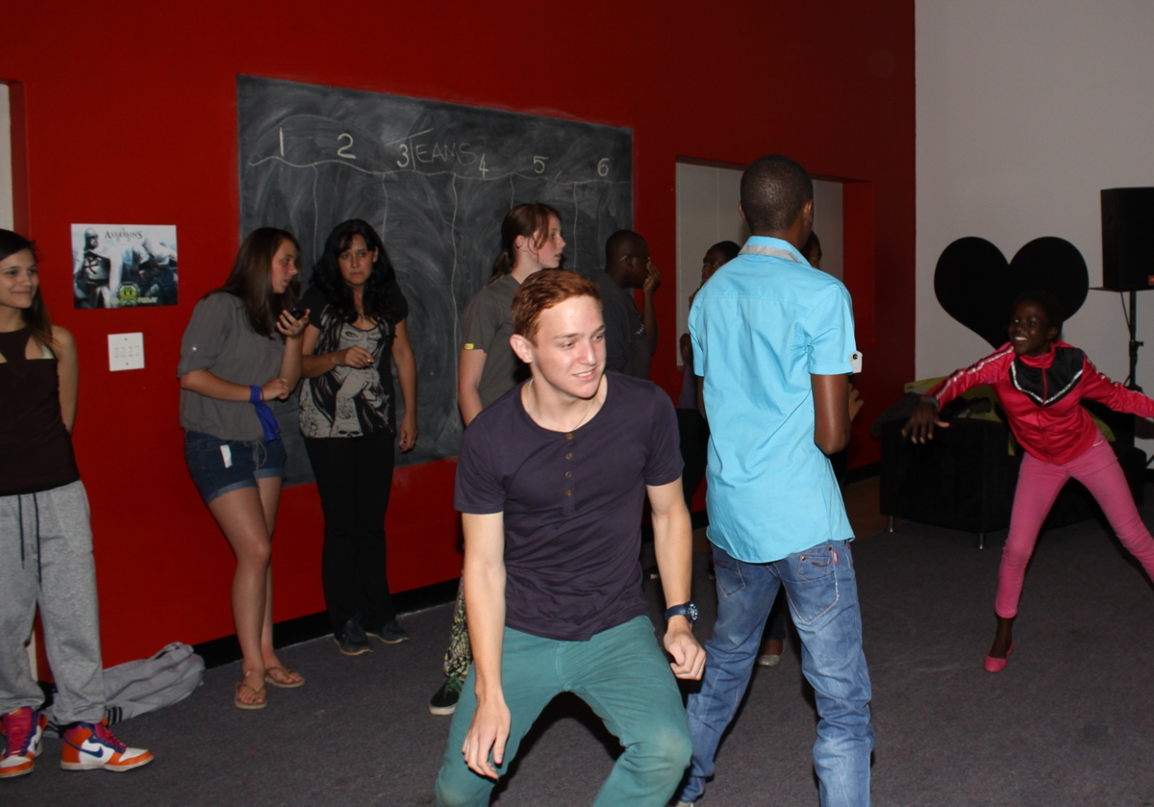
Notes:
The first mission was called Bodyguard: Two teams had to battle each other where one team are the assassins who stand in a circle with a president and a bodyguard from the other team in the middle. Assassins try to hit the president with the ball while his bodyguard tries to stop it happening. No one can move when they have a ball. A bodyguard can catch a ball and throw it at an assassin to eliminate then. The team whose president lasts the longest wins a point from the round.

Slide 7
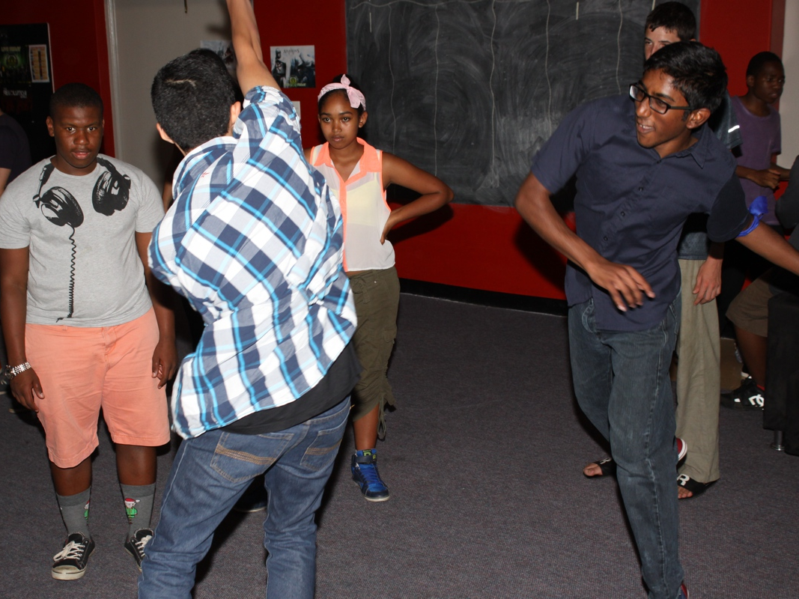
Notes:
The first mission was called Bodyguard: Two teams had to battle each other where one team are the assassins who stand in a circle with a president and a bodyguard from the other team in the middle. Assassins try to hit the president with the ball while his bodyguard tries to stop it happening. No one can move when they have a ball. A bodyguard can catch a ball and throw it at an assassin to eliminate then. The team whose president lasts the longest wins a point from the round.

Slide 8
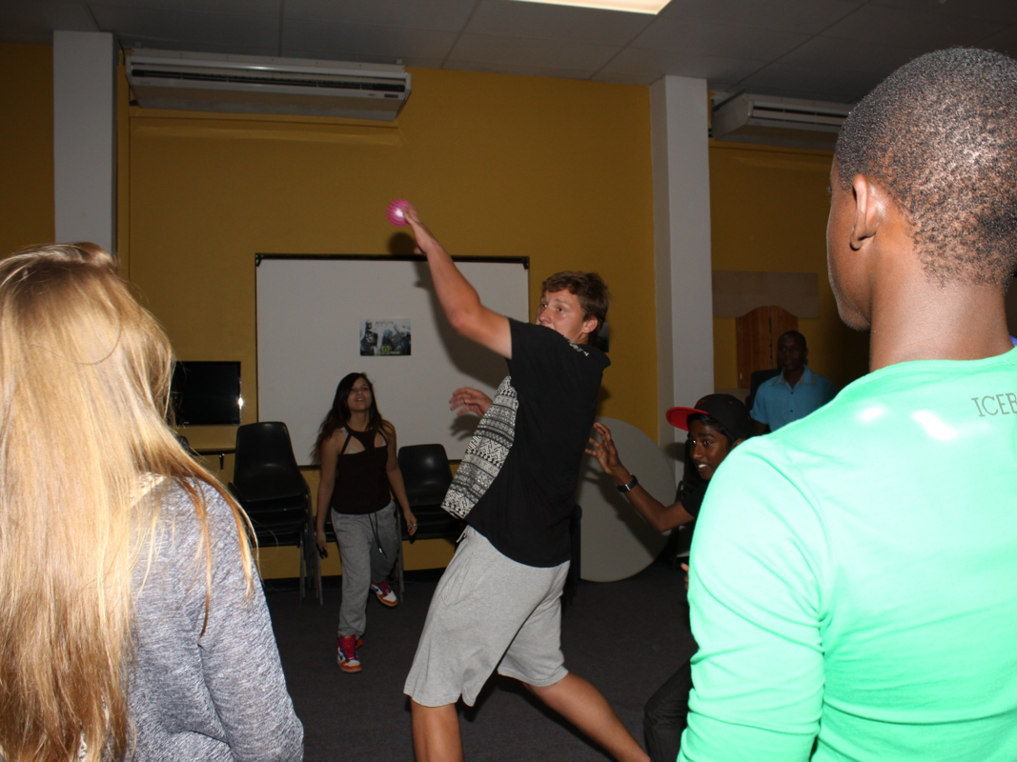
Notes:
The first mission was called Bodyguard: Two teams had to battle each other where one team are the assassins who stand in a circle with a president and a bodyguard from the other team in the middle. Assassins try to hit the president with the ball while his bodyguard tries to stop it happening. No one can move when they have a ball. A bodyguard can catch a ball and throw it at an assassin to eliminate then. The team whose president lasts the longest wins a point from the round.

Slide 9
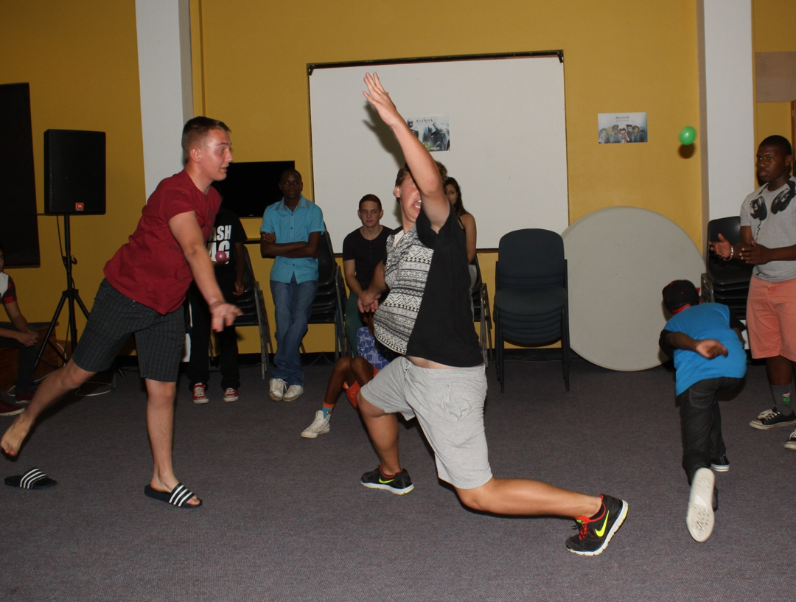
Notes:
The first mission was called Bodyguard: Two teams had to battle each other where one team are the assassins who stand in a circle with a president and a bodyguard from the other team in the middle. Assassins try to hit the president with the ball while his bodyguard tries to stop it happening. No one can move when they have a ball. A bodyguard can catch a ball and throw it at an assassin to eliminate then. The team whose president lasts the longest wins a point from the round.

Slide 10
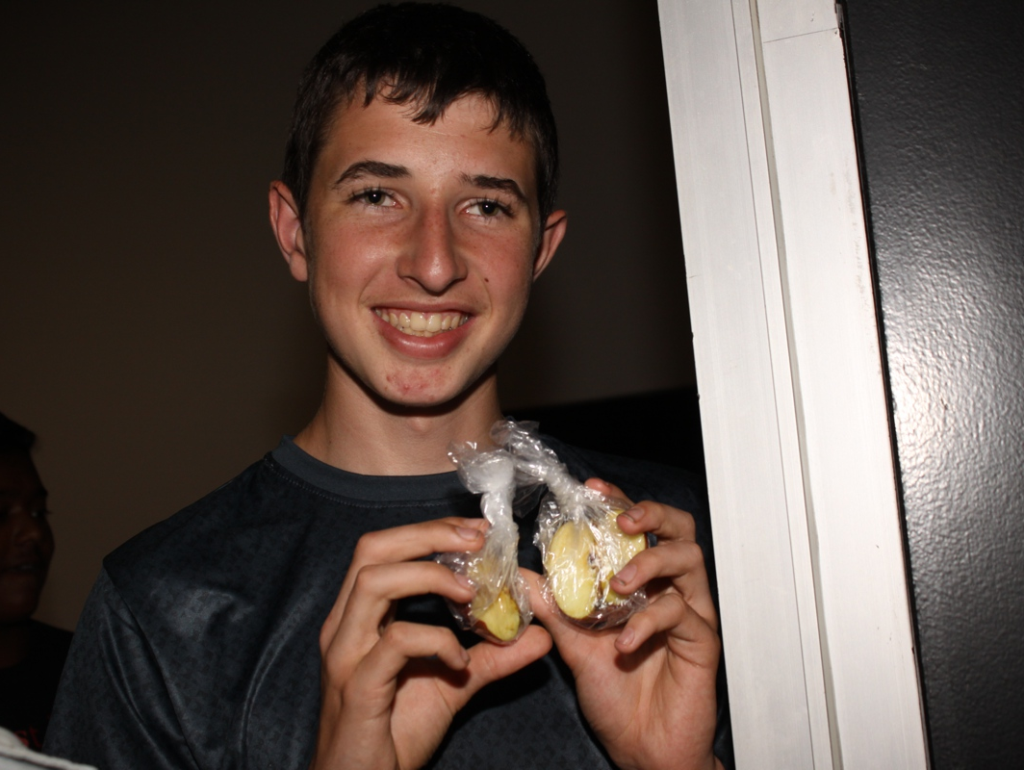
Notes:
The second mission was Apples of Eden: Teens had to search for apples hidden on the property. The guards who are patrolling have clues to their location. The more apples you find the more points you will earn for your teams.

Slide 11
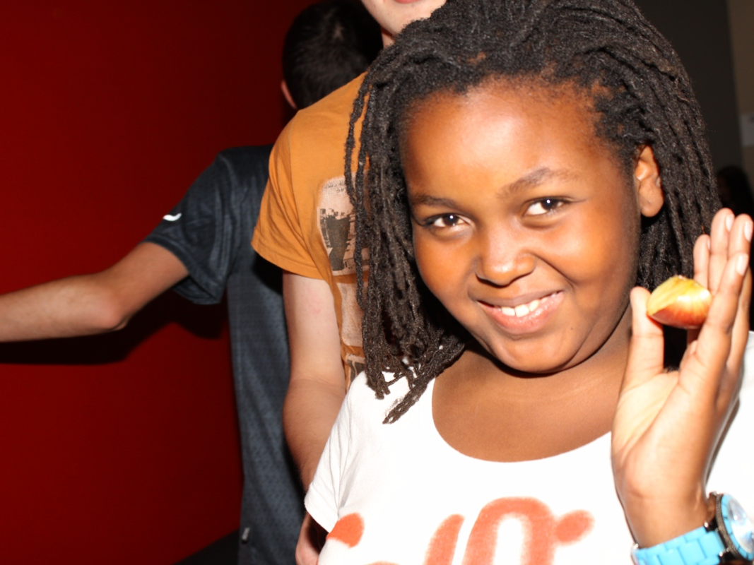
Notes:
The second mission was Apples of Eden: Teens had to search for apples hidden on the property. The guards who are patrolling have clues to their location. The more apples you find the more points you will earn for your teams.

Slide 12
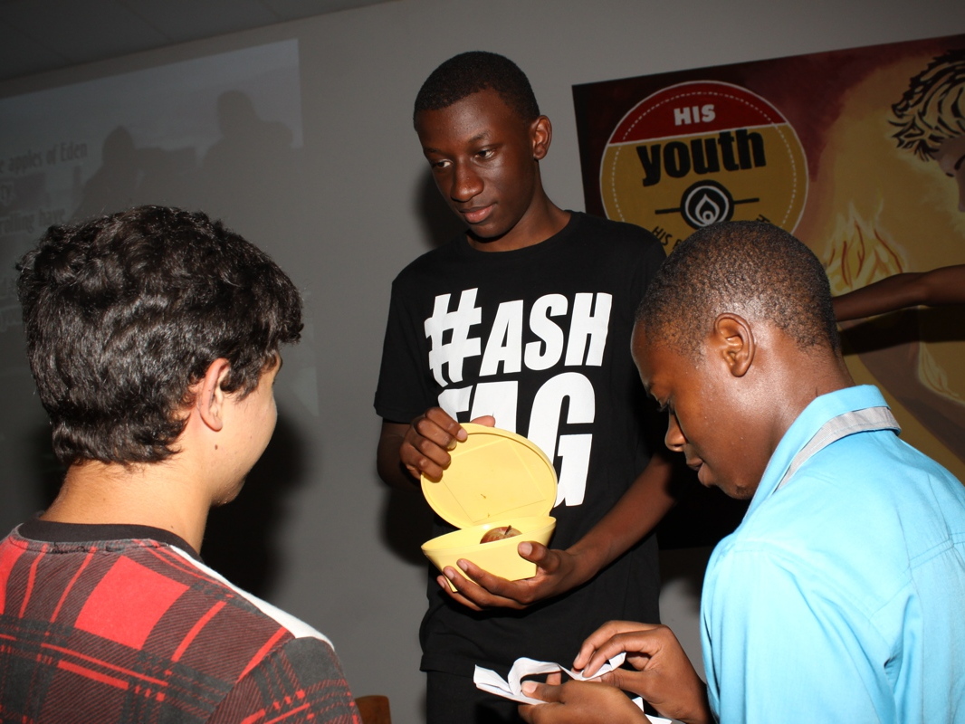
Notes:
The second mission was Apples of Eden: Teens had to search for apples hidden on the property. The guards who are patrolling have clues to their location. The more apples you find the more points you will earn for your teams.

Slide 13
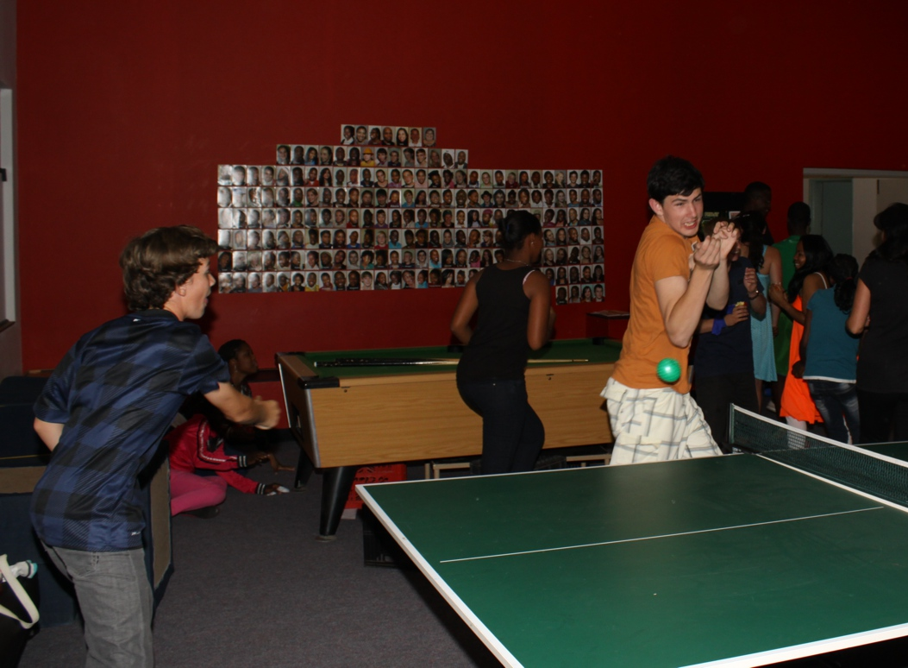
Notes:
The third mission was called Target: Each team wears a number on their chest. Each team draws a number of a team to target and kill off with weapons provided. After a round there will be half the number of teams left over. We contianue with rounds until just one team is the winner.

Slide 14
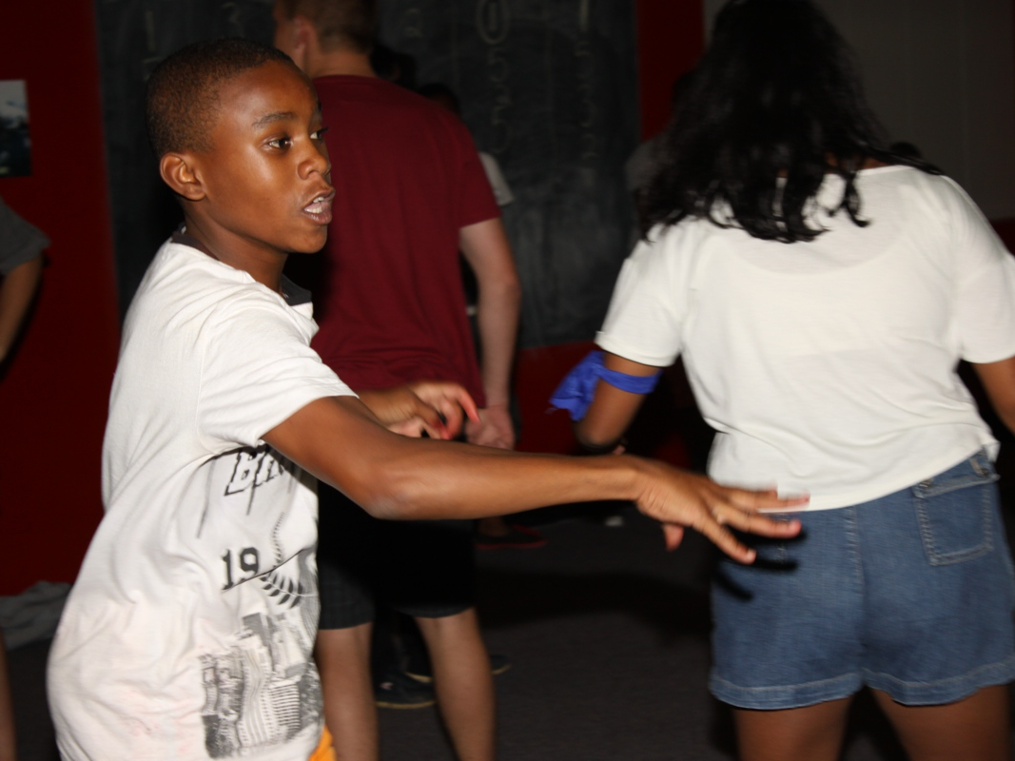
Notes:
The third mission was called Target: Each team wears a number on their chest. Each team draws a number of a team to target and kill off with weapons provided. After a round there will be half the number of teams left over. We contianue with rounds until just one team is the winner.

Slide 15
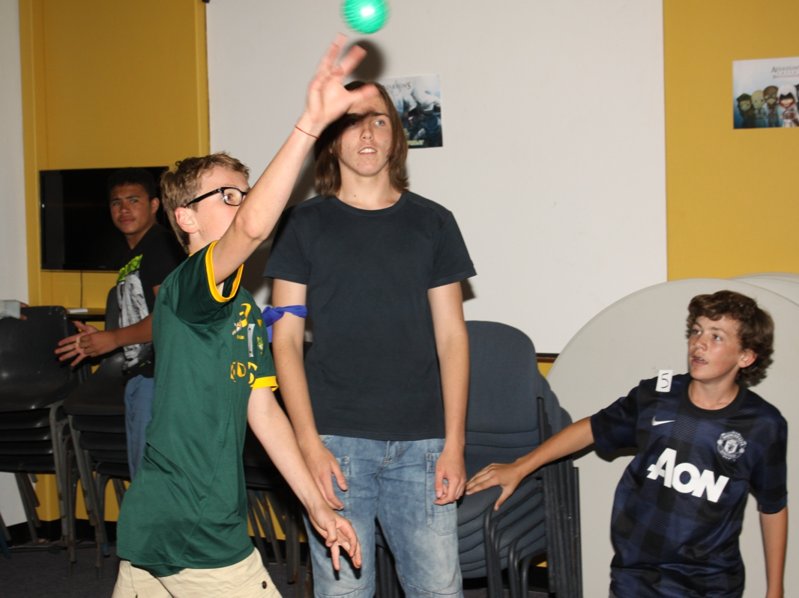
Notes:
The last mission was Assassination: You are competing against the other teams in a free-for-all in the youth room. The objective is to kill the other team’s assassins using the weapons provided (soft balls, A4 paper that can be crumpled into balls, cellphones where you can call someone and they are out). The winner is the team with the most assassins at the end of the game. When you are hit with an object you must sit down and no longer participate. Leaders play the role of guards to ensure people who are hit actually sit down.

Slide 16
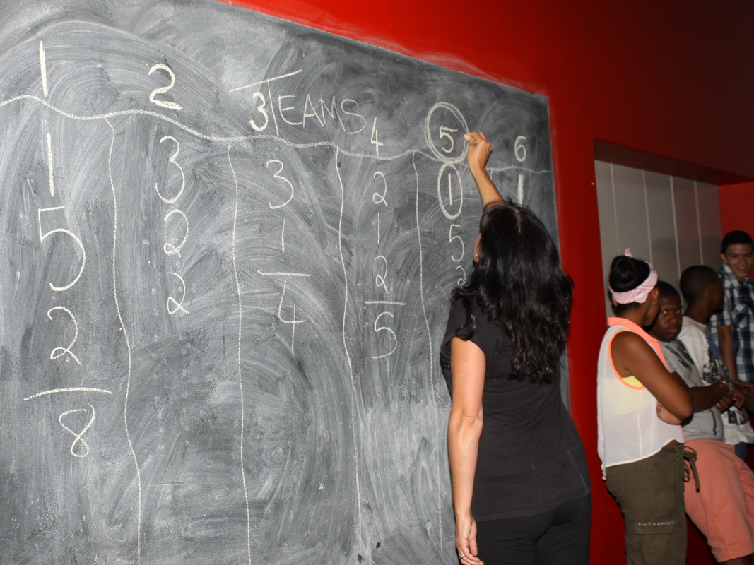
Notes:
The final scores

Slide 17
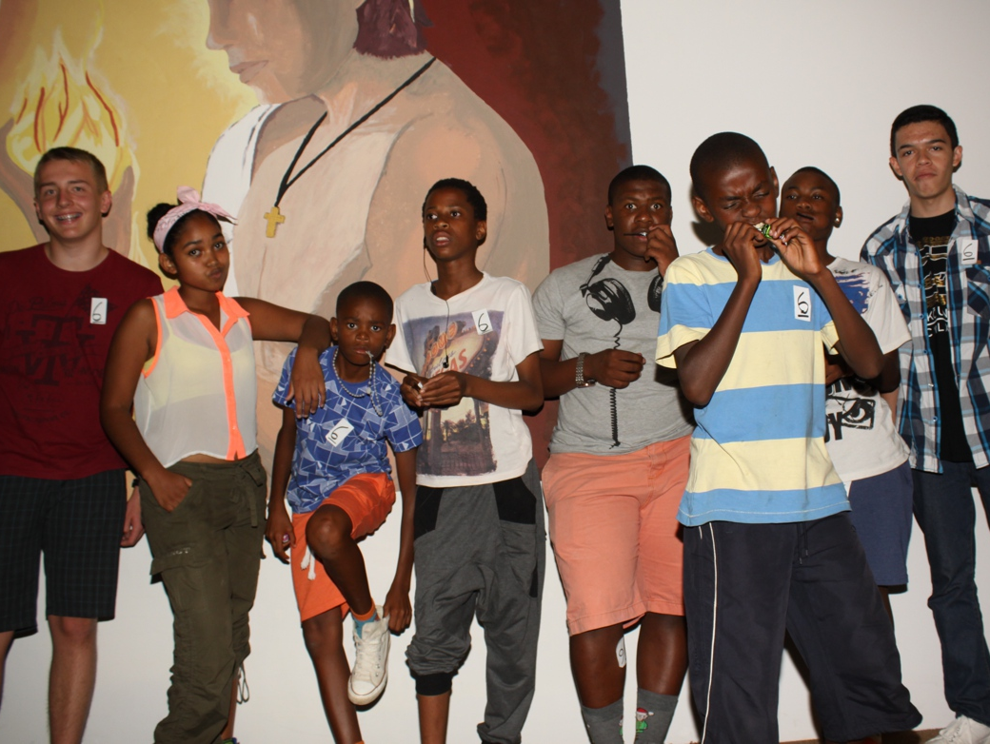
Notes:
The second place team receives their prizes.

Slide 18
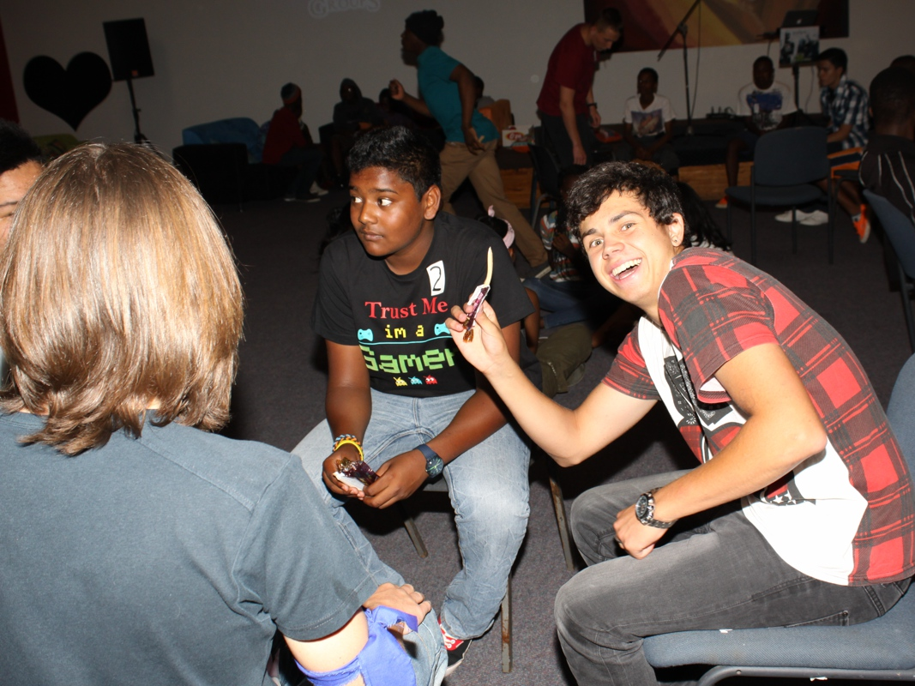
Notes:
Small group time.

Slide 19
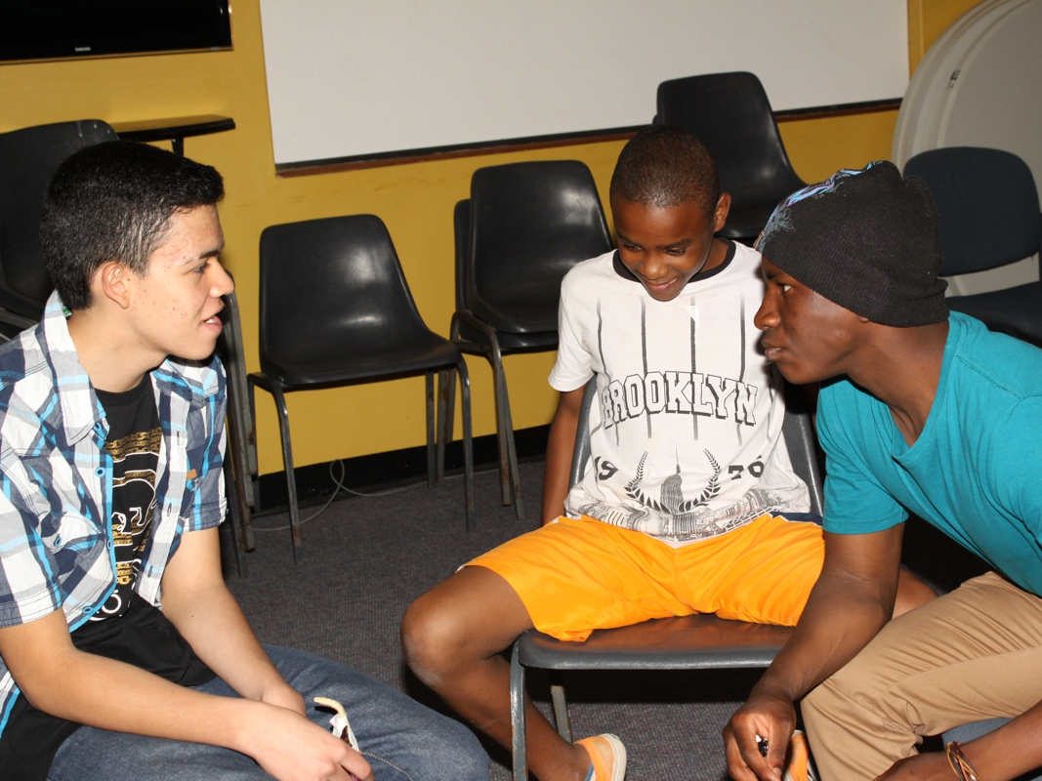
Notes:
Small group time.

Slide 20
