Slide 1
Notes:
Here is a presentation on what Awesome Leaderships is all about. It was written and presented by Thabile Chiliza to the leaders of His Youth.

Slide 2
Notes:
1. Introduction - Leadership is a necessary part of human life. When a baby is born into a family he grows up looking to his parents for guidance and direction. When the baby grows he/she gets to be a leader in one way or the other. Leadership is so much part of everyday life that is present frequently without our being aware of it. The introduction to leadership, which one received at school is repeated at every stage of life.

Slide 3
Notes:
2. A Definition: A leader is someone who exercises influence over other people.

Slide 4
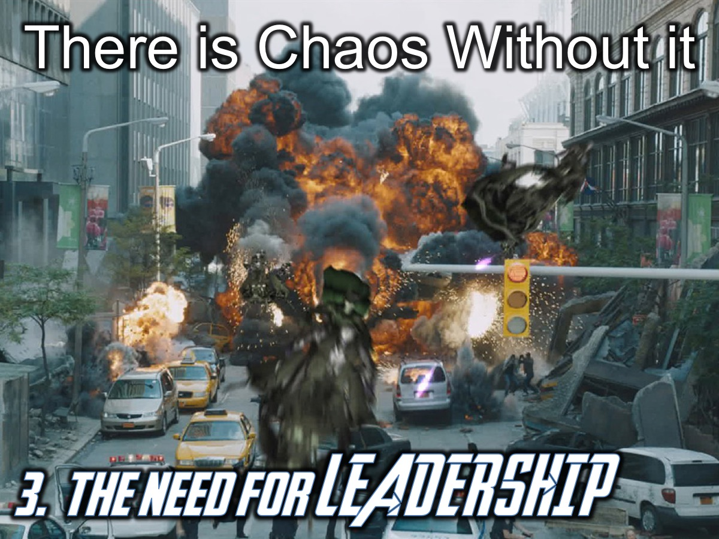
Notes:
3. The Need for Leaders: There is chaos without leadership.

Slide 5
Notes:
Leaders are essential to:
* Prevent chaos
* Prevent duplication
* Prevent friction
* Get things done

Slide 6
Notes:
4. Tests For Leaders: (1) Good reputation; (2) Blameless character; (3) Life Marked by Self-control; and (4) Reflect Spiritual Maturity

Slide 7
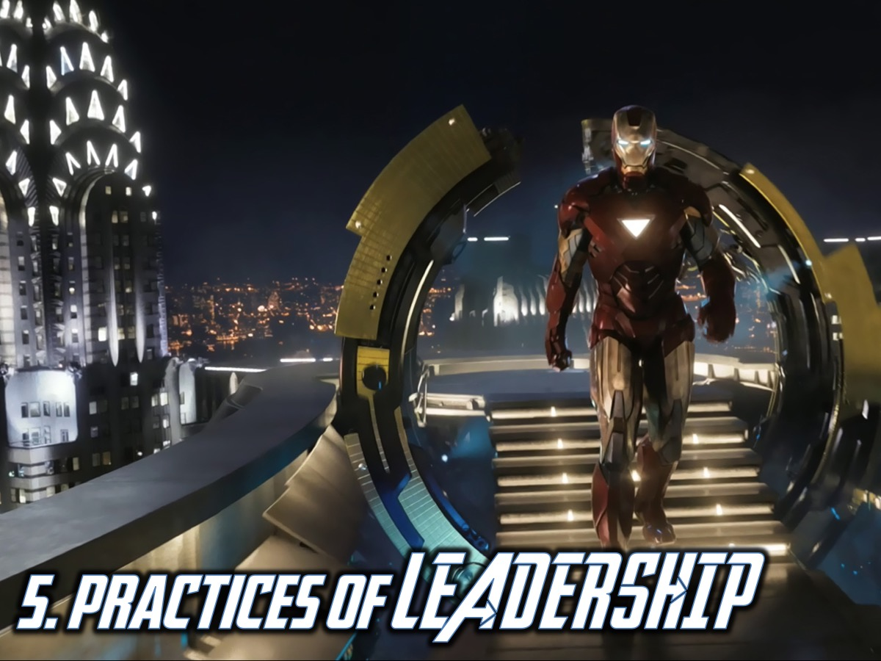
Notes:
5. Practices of Leadership

Slide 8
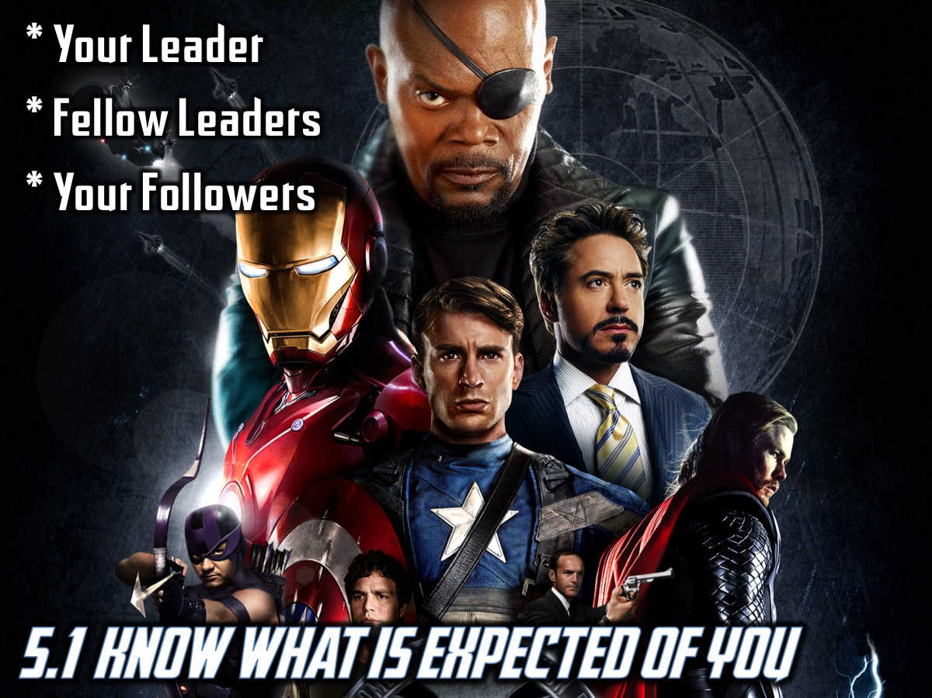
Notes:
5.1 Know what is EXPECTED of you from…
* Your Leader
* Fellow Leaders
* Your Followers

Slide 9
Notes:
5.2 Know your PEOPLE:
* Learn and use their names
* Recognize that each person has a different potential or contribution to make and will need different forms of encouragement and recognition.

Slide 10
Notes:
5.3 Know WHAT has to be done
* Have knowledge of the task before you.
* See how the small details fit into the whole
* See the relationship of the individual (your role) to the whole (Vision).

Slide 11
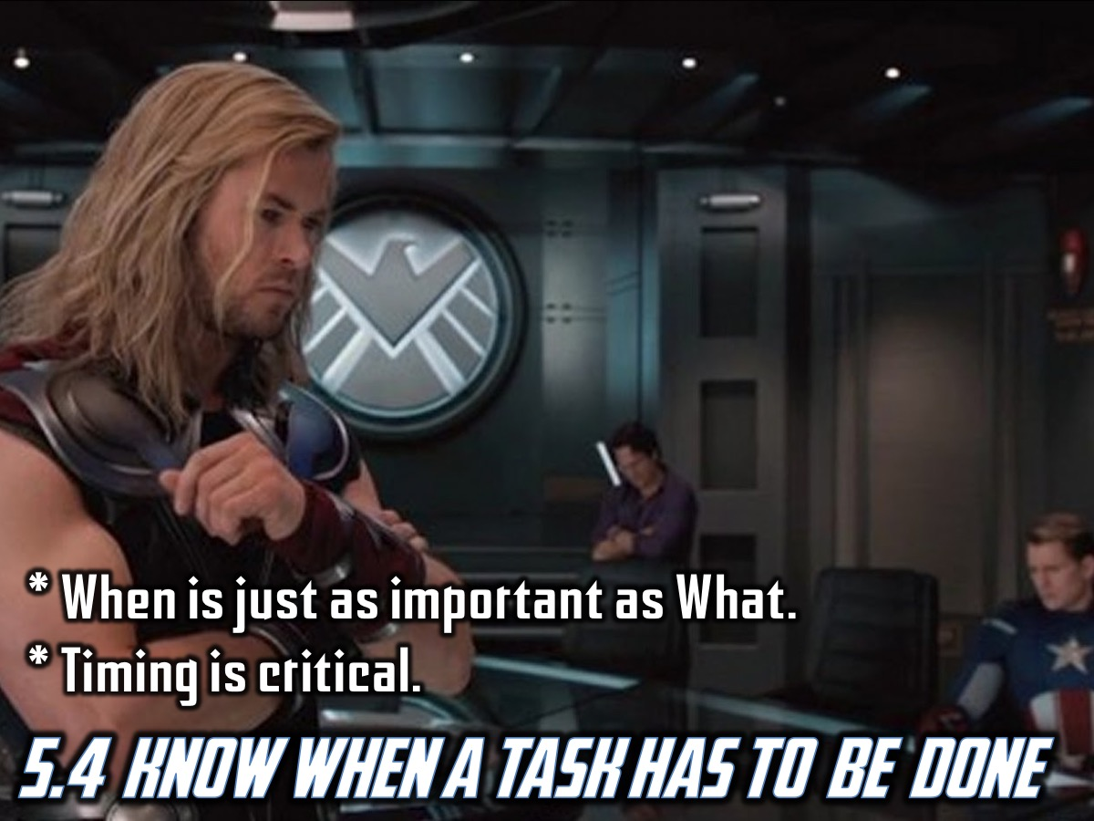
Notes:
5.4 Know WHEN a task should be done
* It is not enough to know what needs to be done, the time when it is to be done is just as important.
* Timing

Slide 12
Notes:
5.5 Know HOW a task should be done
* Be clear as to the method
* Know the skills needed
* See how the task is to be accomplished
* Without a knowledge of how the task is to be done, you have lost before you start.

Slide 13
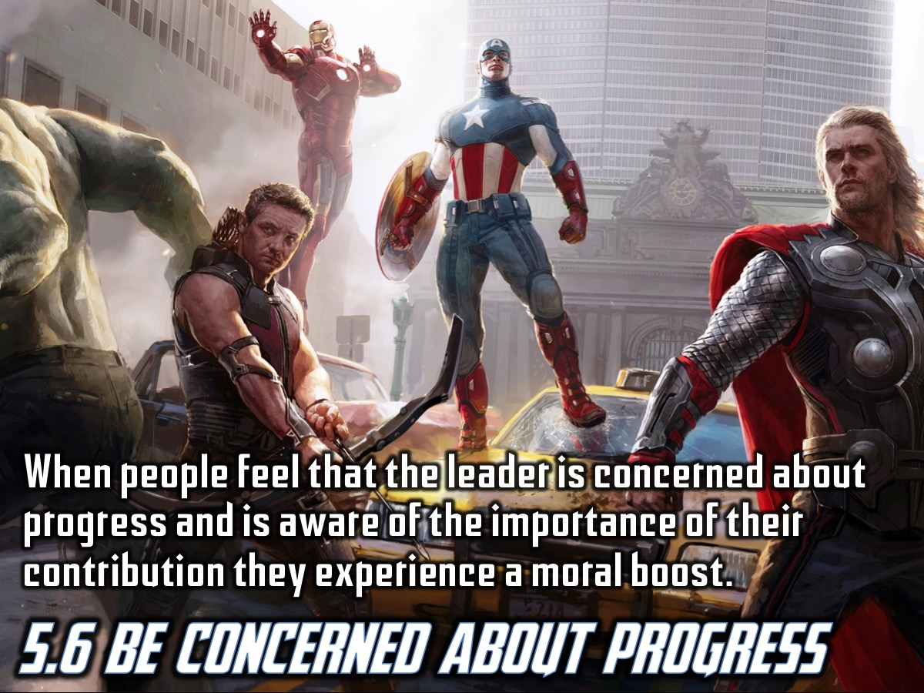
Notes:
5.6 Be concerned about progress
When people feel that the leader is concerned for progress and is aware of the importance of their contribution, they experience a moral boost.

Slide 14
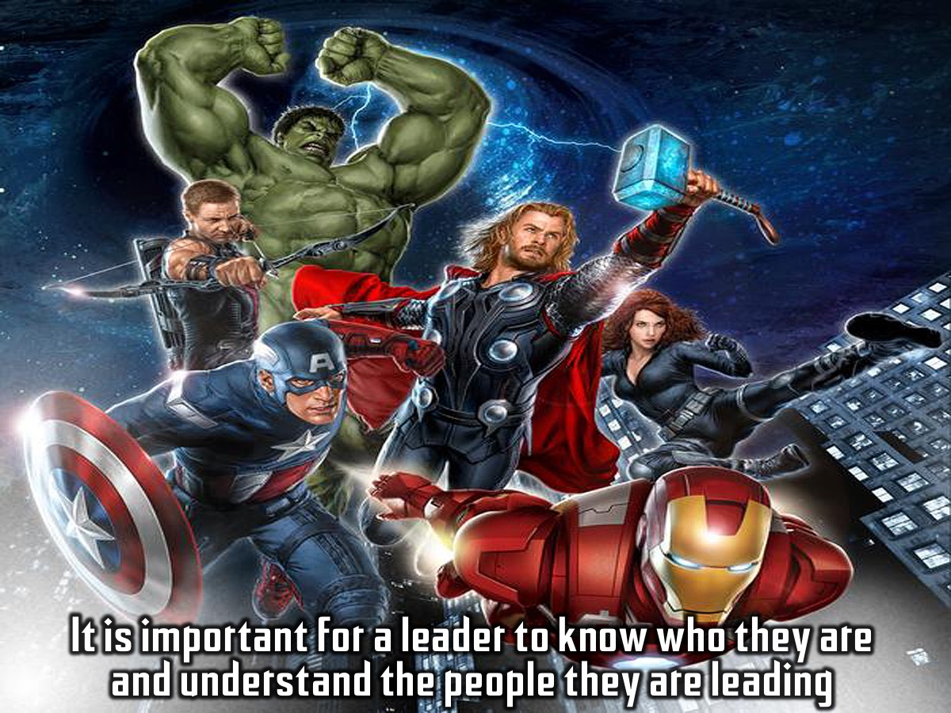
Notes:
It is important for a leader to know who they are and understand the people they are leading.

Slide 15
Notes:
1. How People Define Themselves
* Status
* Family
* Associates
* Power

Slide 16
Notes:
2. Different Views People Have About Themselves

Slide 17
Notes:
3. Types Of Self
> Self Image
> Self Concept
> Self Esteem
> Self Knowledge
> Self Worth

Slide 18
Notes:
4. Who Are You
* Genesis 1:31 (God’s Creation) therefore you can do all through Christ
* Psalm 139

Slide 19
Notes:
5. Helpful Hints for leadership:
* Reflect on your unique characteristics
* Reflect on impressions God has placed within you
* Know God
* Receive the discerning counsel of the Holy Spirit
* Be obedient
* Be prepared to be stretched
* Be prepared to participate in difficult situations
* Develop the drive to know your vision

Slide 20
Notes:
6. Increase Your Self Knowledge
* Mind Power
* Self-fulfilling Prophecy
* Personal Style Profile
* Things Known To Self
* Things Not Known To Others
* Things Not Known To Self
* Unknown Areas (Potential)

Slide 21
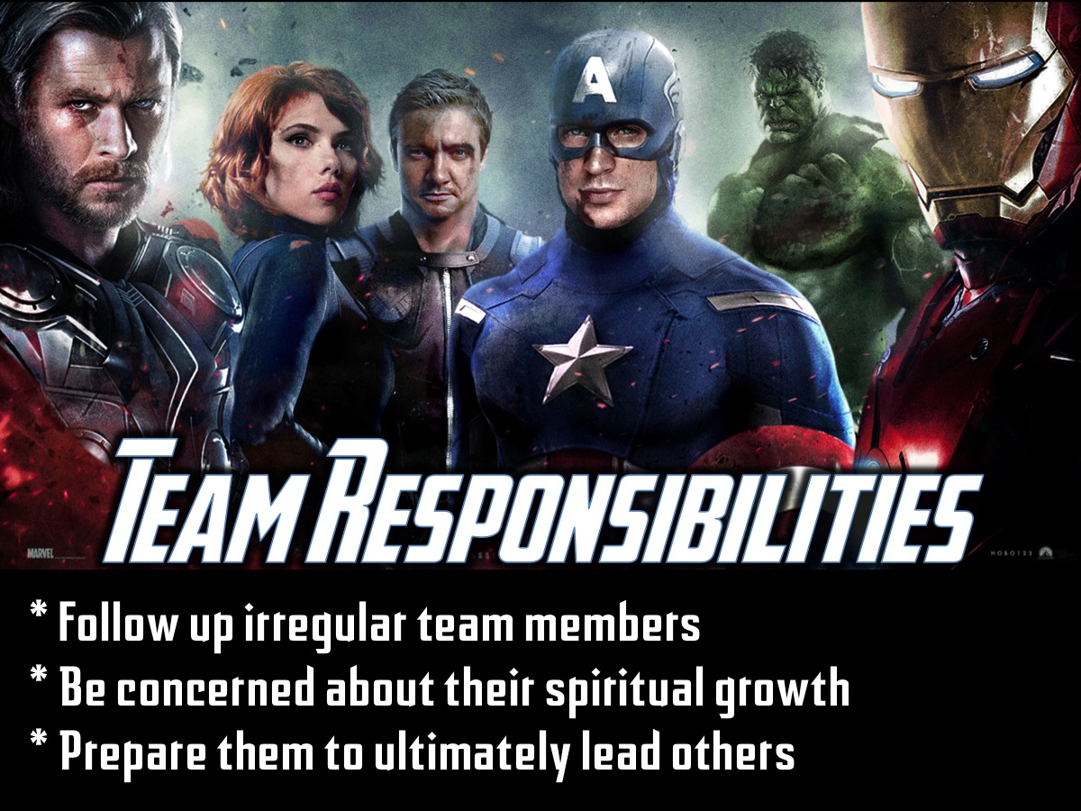
Notes:
Team Responsibilities
* Follow up irregular team members
* Be concerned about their spiritual growth
* Its good to have a close relationship with your member, but you need to know that one day you will have to let go, and let them go out and others the skills that you taught them.

