Slide 1

Notes:
The Baewatch Series.

Slide 2
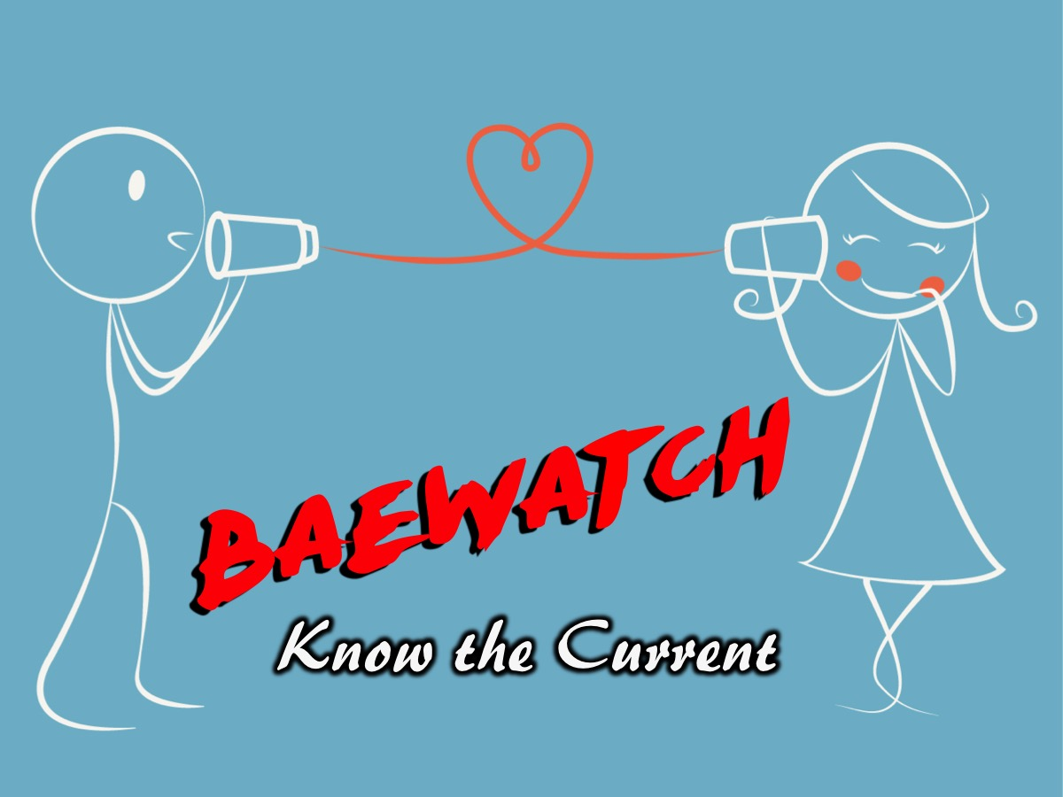
Notes:
This is week 1 of the Baewatch Series: Feel the Current.

Slide 3
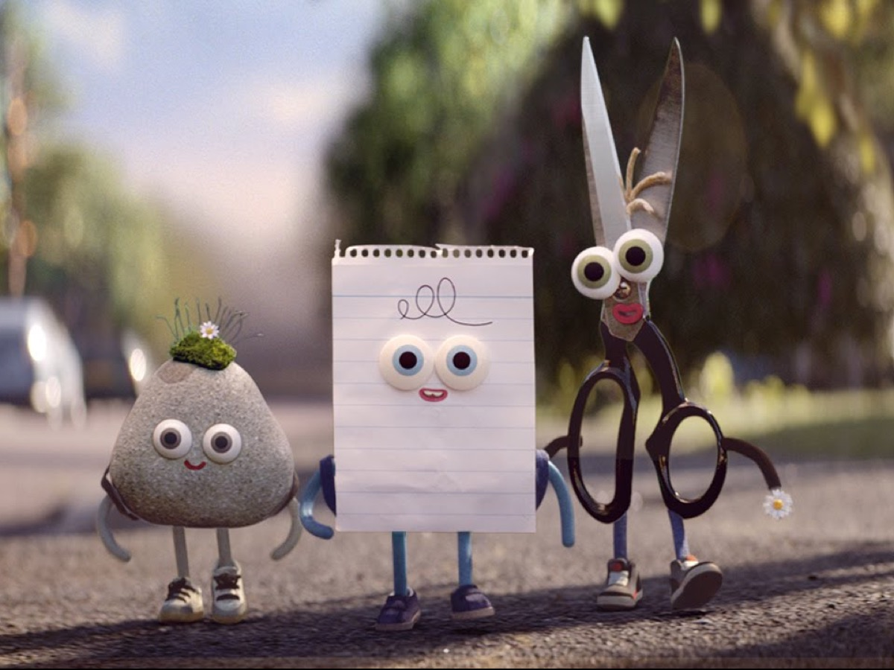
Notes:
Ice-Breaker: Play a group version of “rock, paper, scissors”. It starts with everyone turning to the person and playing a best of 3 round of rock, paper, scissors. The loser has to stand behind the winner chanting their name and follow them to the next person that they play against. Winners keep finding another winner to play against while the losers keep joining the back of a line of people supporting the winner. Play until there is an ultimate winner and reward them with a prize.

Slide 4
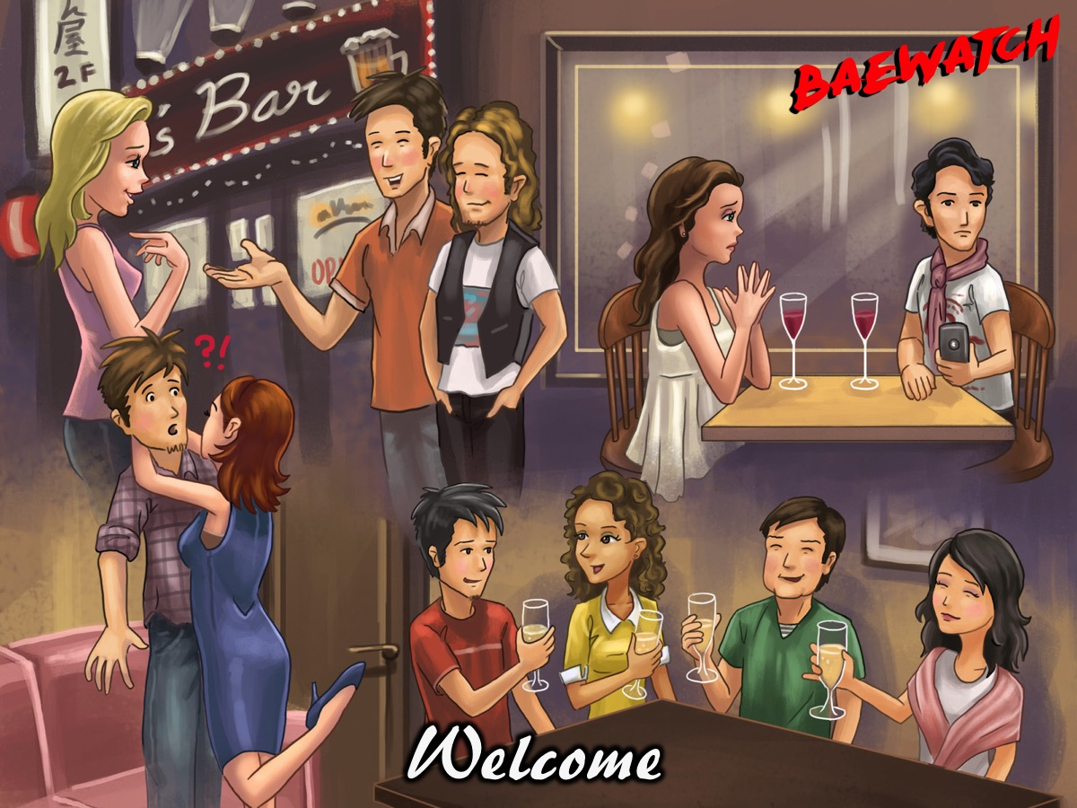
Notes:
Welcome to regulars and newcomers.

Slide 5
Notes:
Video: Boy meets girl, things gets awkward. Get it at: http://www.huffingtonpost.com/2012/11/15/boy-meets-girl-things-get_n_2139686.html

Slide 6
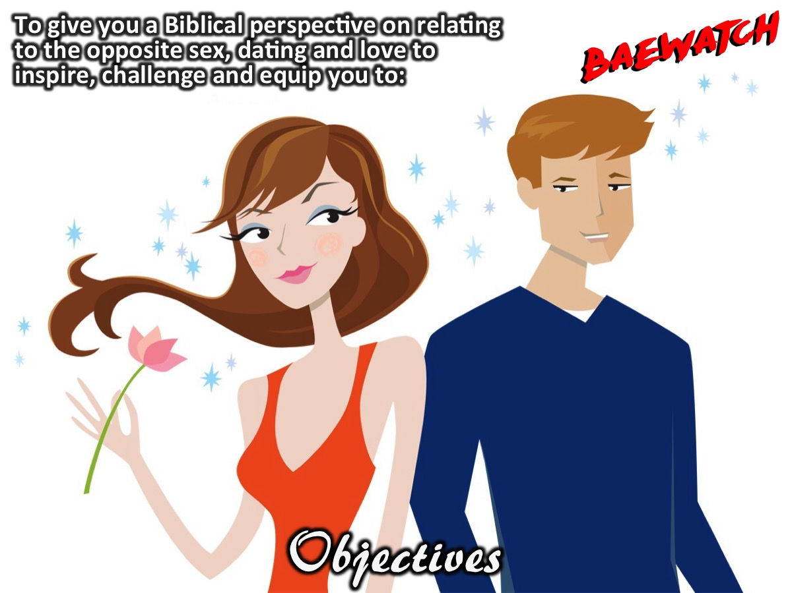
Notes:
Objectives: To provide you with a Biblical perspective on relating to the opposite sex, dating, and love so that you are inspired, challenged, and equipped to:

Slide 7
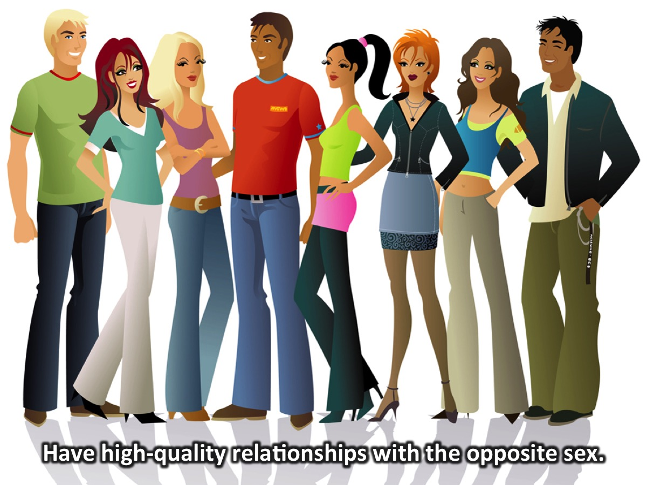
Notes:
1. Have high-quality relationships with the opposite sex.

Slide 8
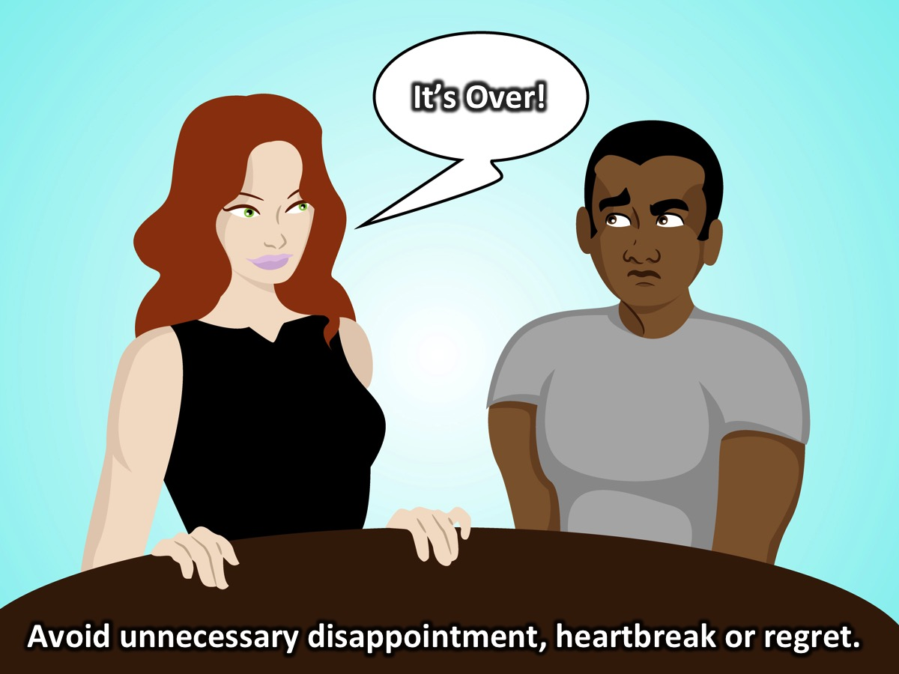
Notes:
2. Avoid unnecessary relational disappointment, heartbreak, and regret.

Slide 9
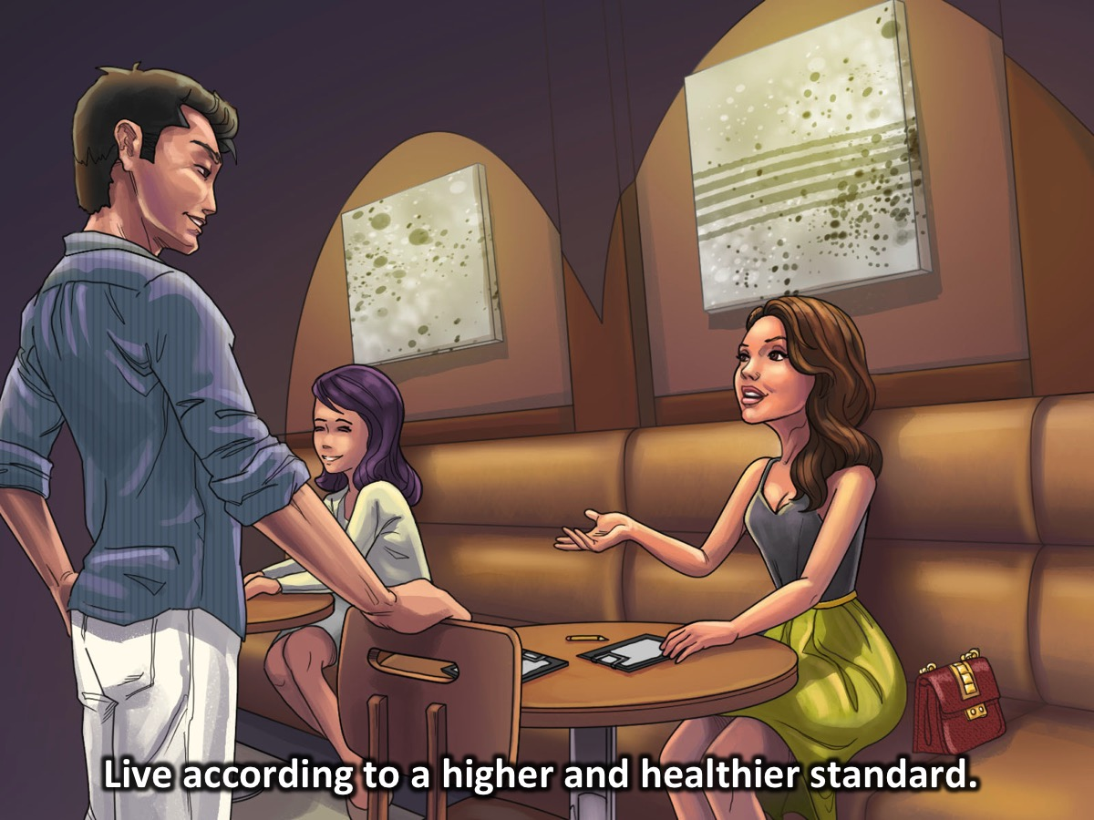
Notes:
3. Live according to a higher and healthier standard.

Slide 10
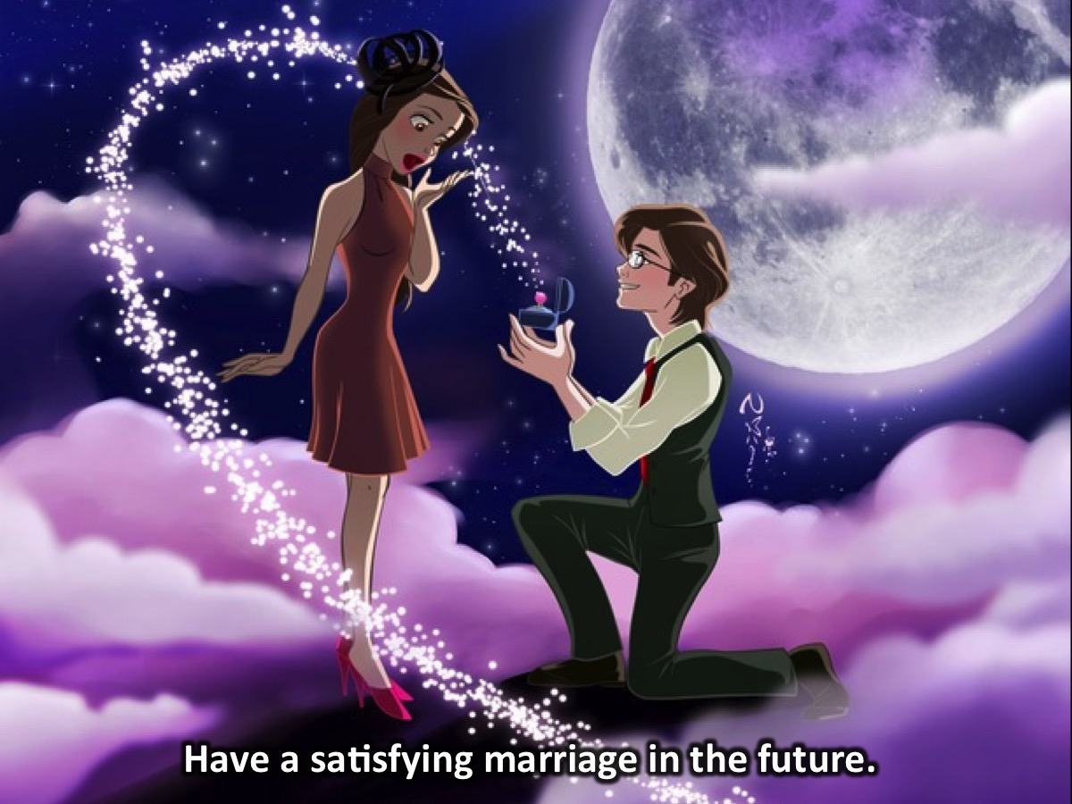
Notes:
4. Have a satisfying marriage in the future.

Slide 11
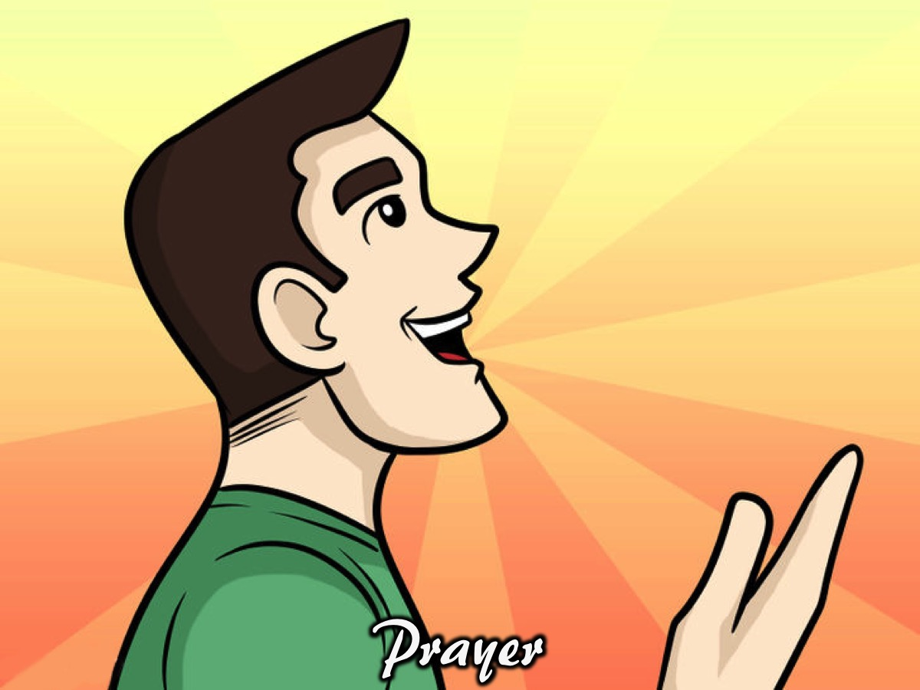
Notes:
Prayer

Slide 12
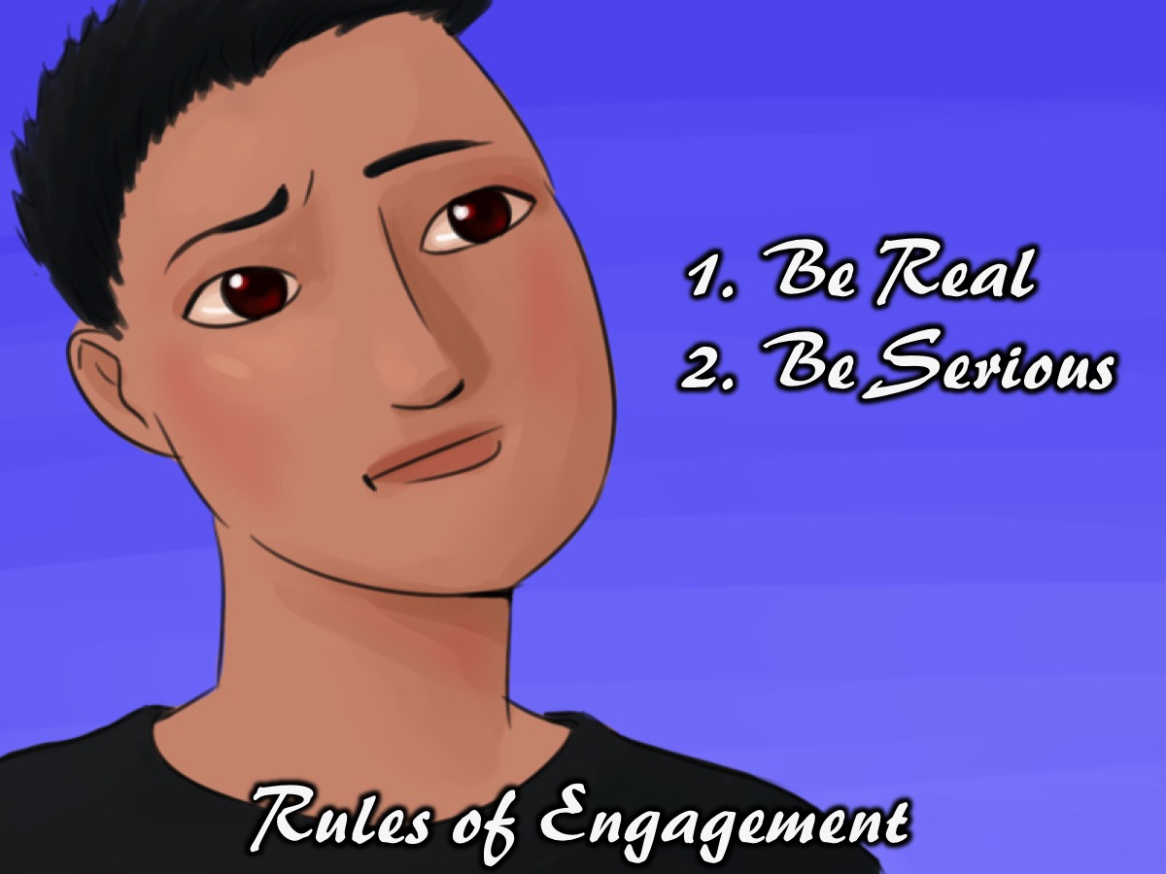
Notes:
Rules of Engagement: (1) Be Real. (2) Be Serious (Take This Seriously).

Slide 13
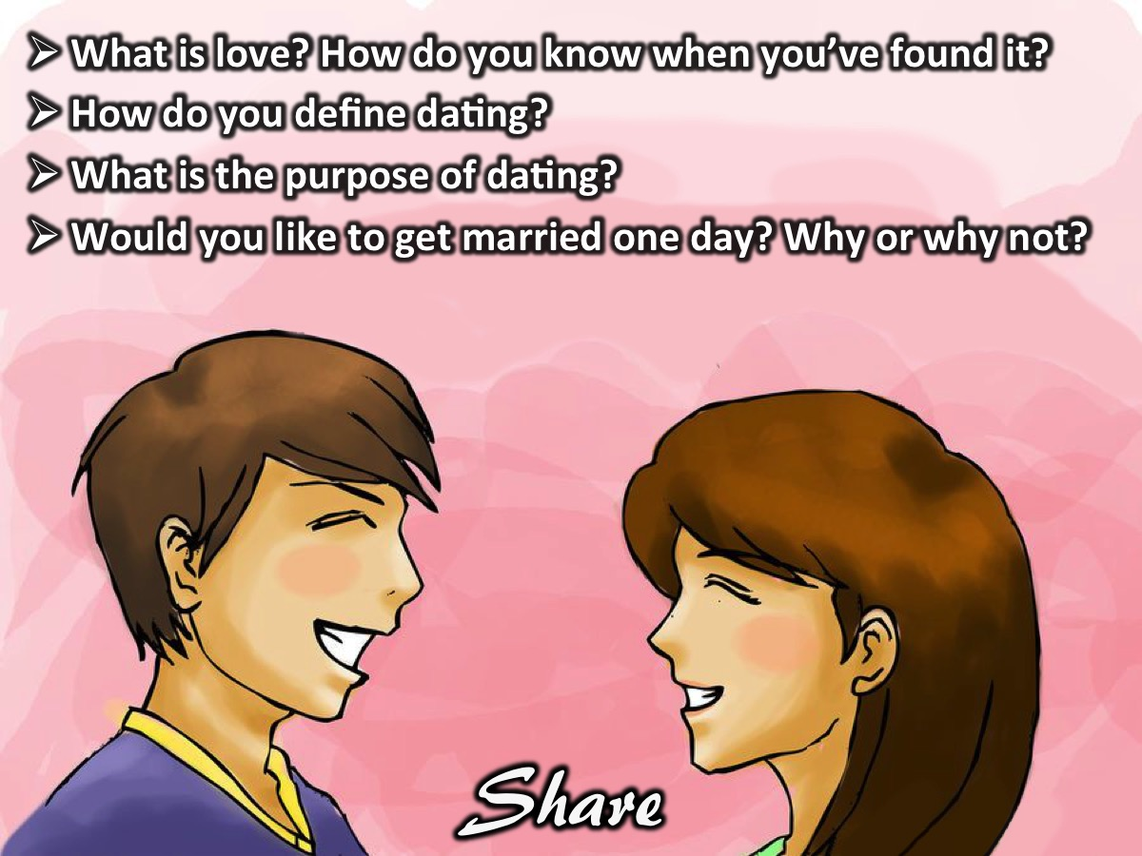
Notes:
Activity: Share, with the person sitting next to you, your thoughts on the following questions:
* What is love? How do you know when you’ve found it?
* How do you define dating?
* What is the purpose of dating?
* Would you like to get married one day? Why or why not?

Slide 14
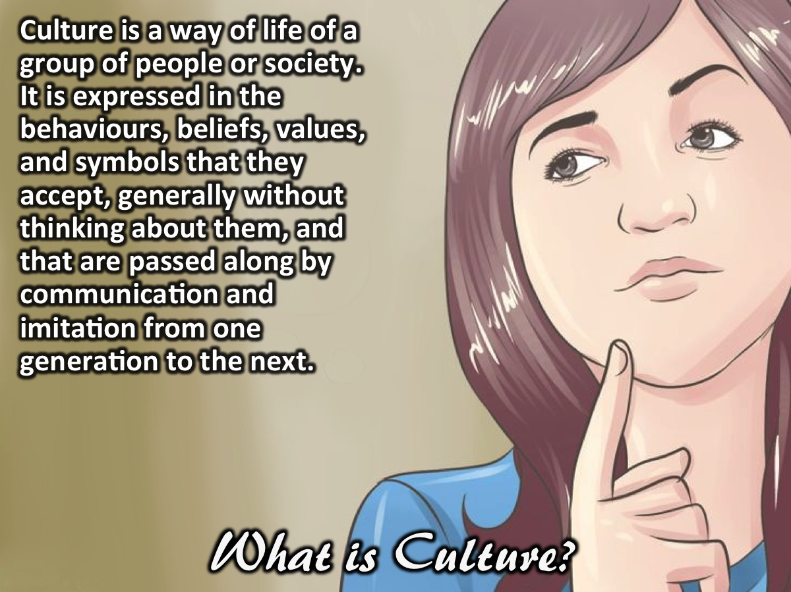
Notes:
What is Culture? Culture is a way of life of a group of people or society. It is expressed in the behaviours, beliefs, values, and symbols that they accept, generally without thinking about them, and that are passed along by communication and imitation from one generation to the next.

Slide 15
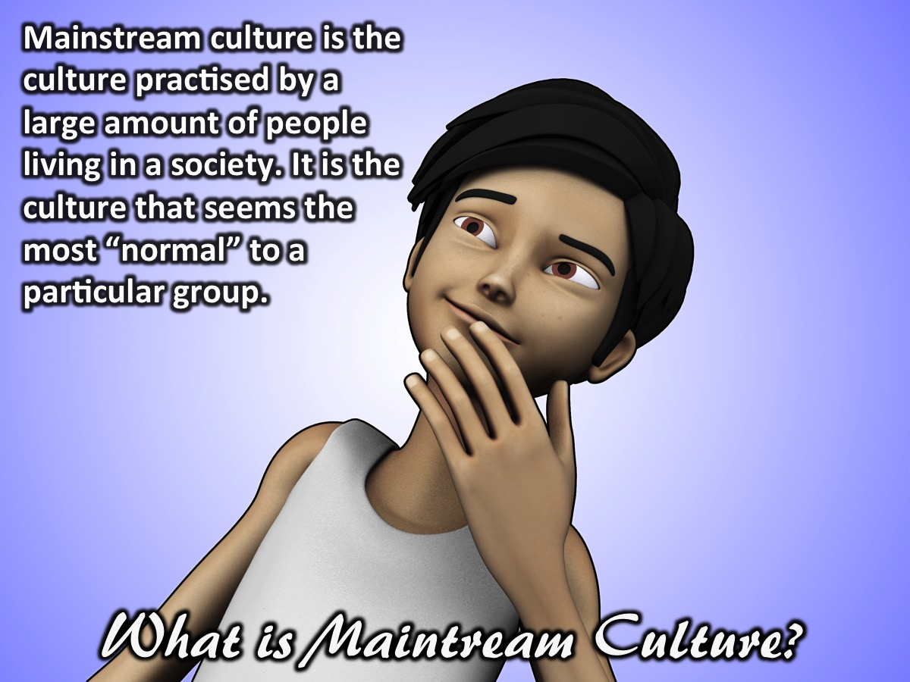
Notes:
What is Mainstream Culture? Mainstream (or dominant) culture is the culture that is practised by a large amount of people residing in a society. In other words, it is the culture that seems the most “normal” to a particular group or society.

Slide 16

Notes:
Video: Happily Ever After [3D animated short film]. Get it on YouTube at: https://www.youtube.com/watch?v=xoU4CwbOifM
[Only show the first 2 minutes of this short film - until the couple gets married]

Slide 17
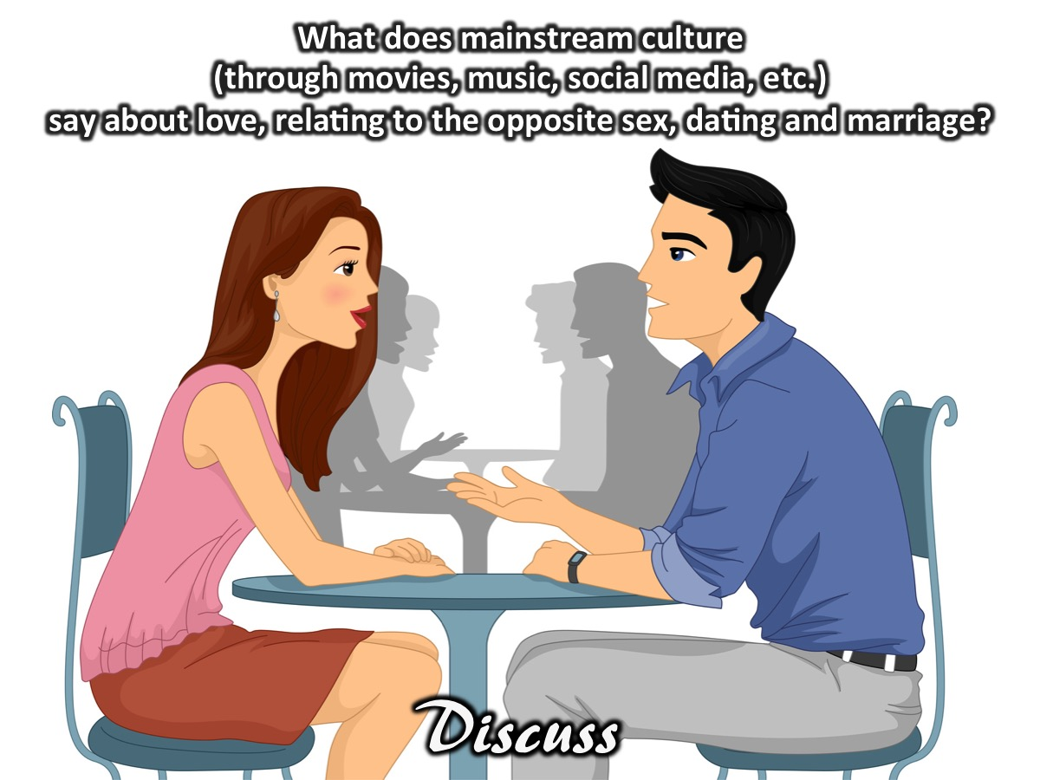
Notes:
Activity: Get into same sex groups and discuss the following questions: What does mainstream (or dominant) culture – through movies, music, social media, etc. – say about love, relating to the opposite sex, dating, and marriage?

Slide 18
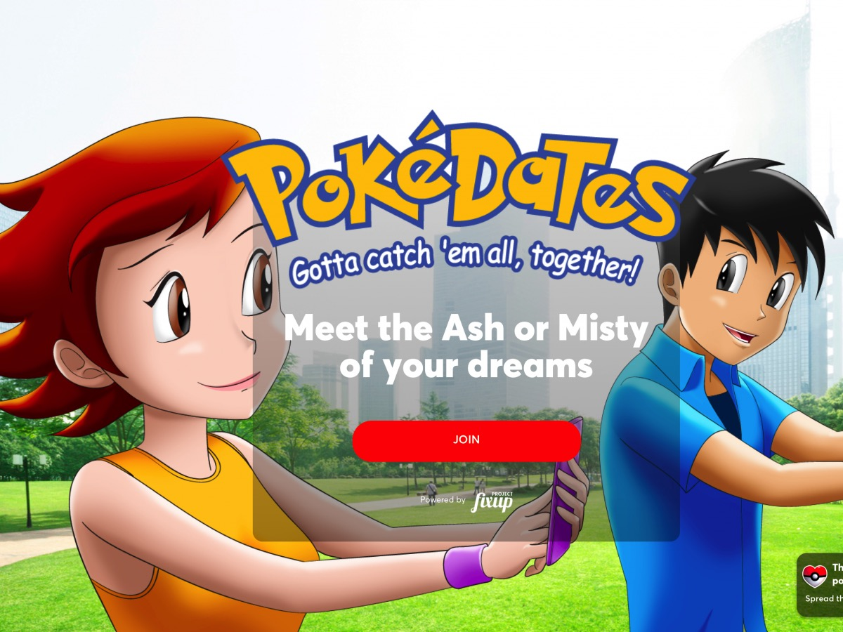
Notes:
Examples of Messages from Mainstream Culture: Games

Slide 19

Notes:
Examples of Messages from Mainstream Culture: Movies

Slide 20

Notes:
Examples of Messages from Mainstream Culture: Books

Slide 21
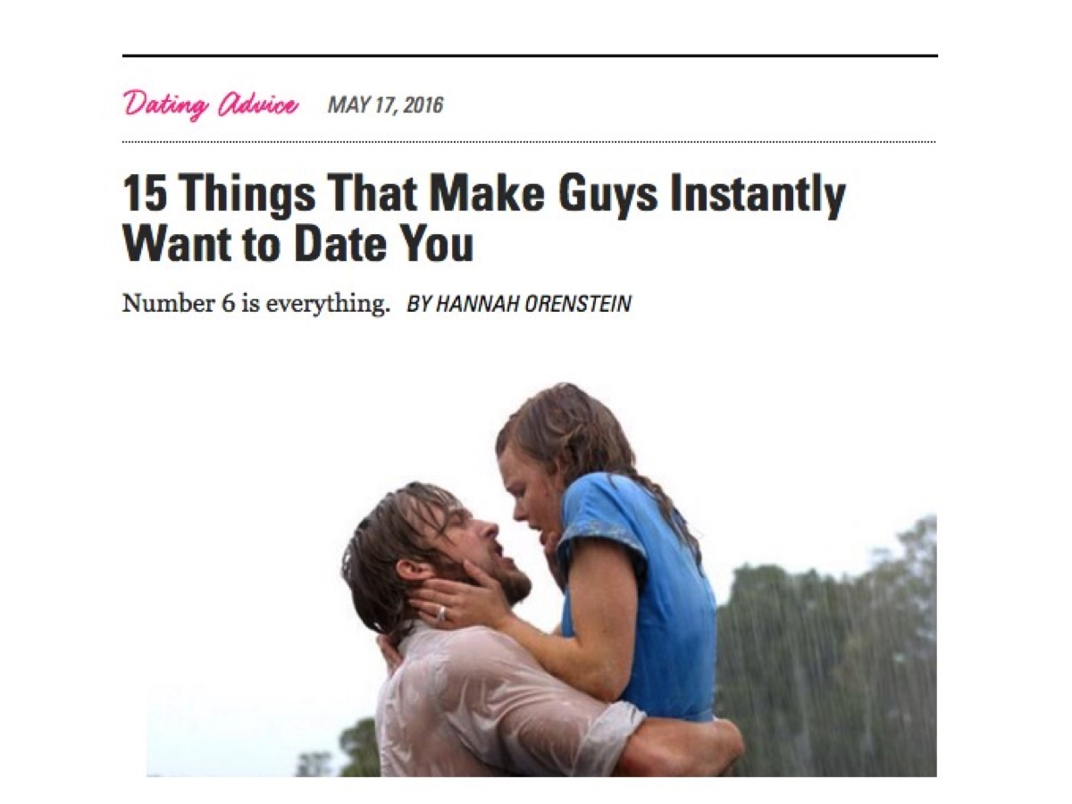
Notes:
Examples of Messages from Mainstream Culture: Advice

Slide 22
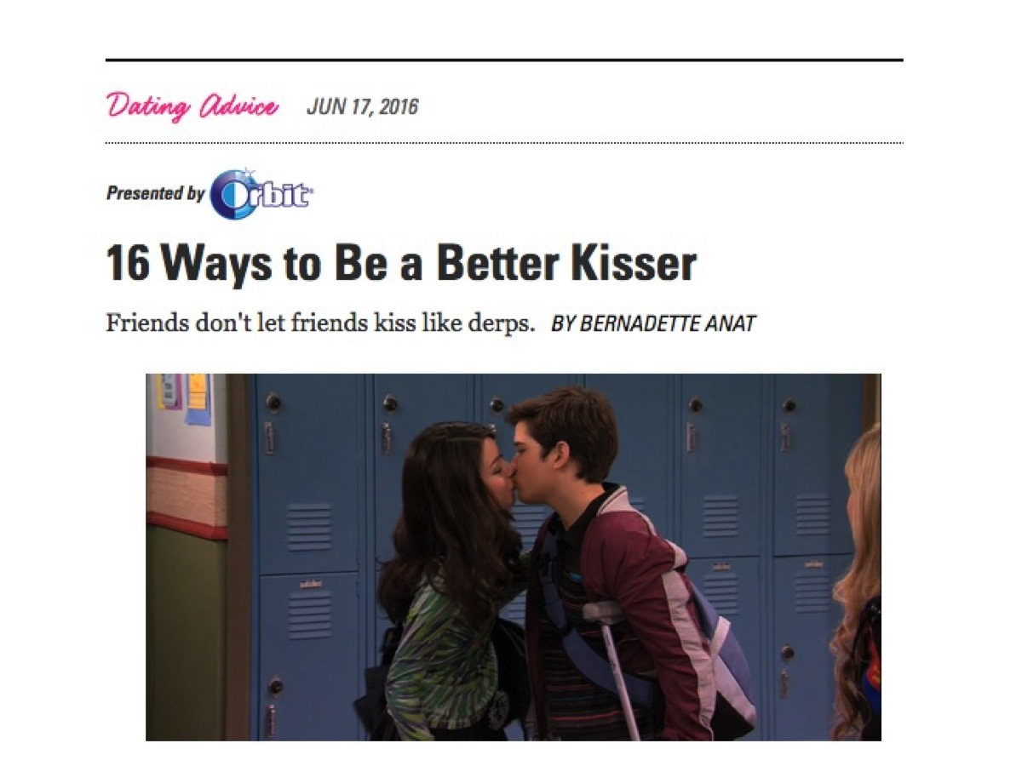
Notes:
Examples of Messages from Mainstream Culture: Advice

Slide 23
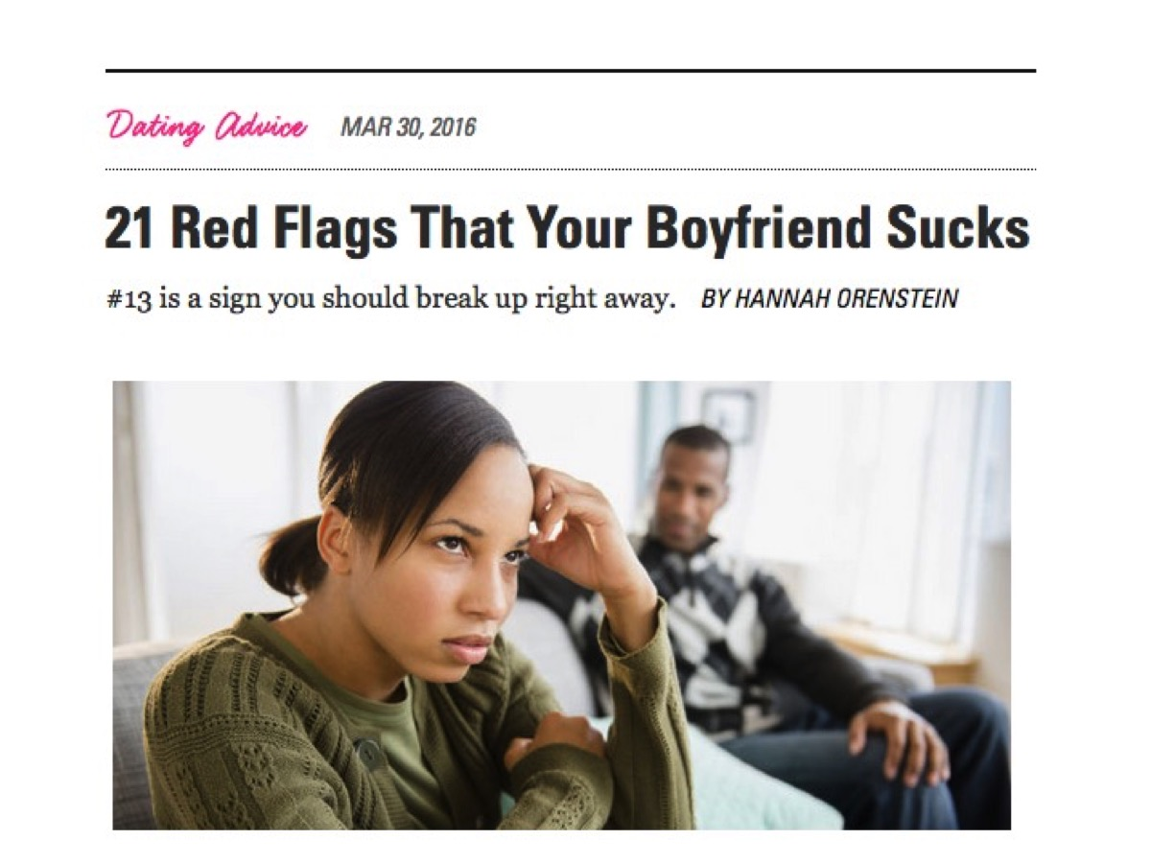
Notes:
Examples of Messages from Mainstream Culture: Advice

Slide 24
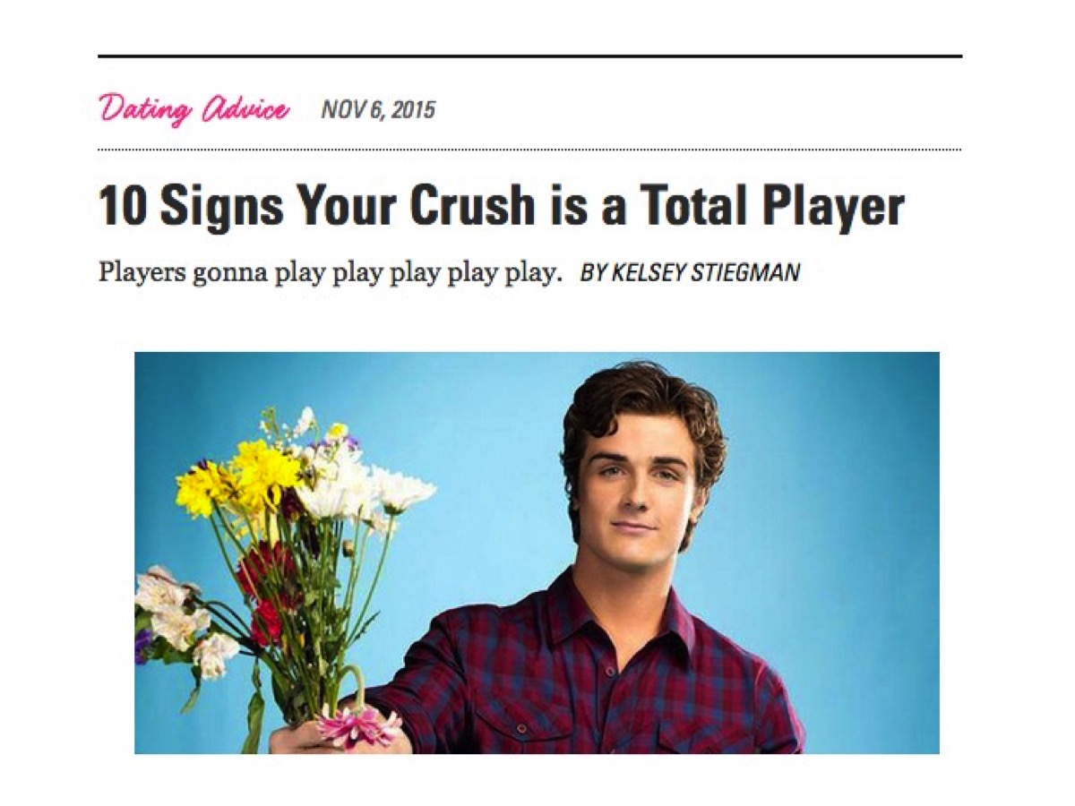
Notes:
Examples of Messages from Mainstream Culture: Advice

Slide 25
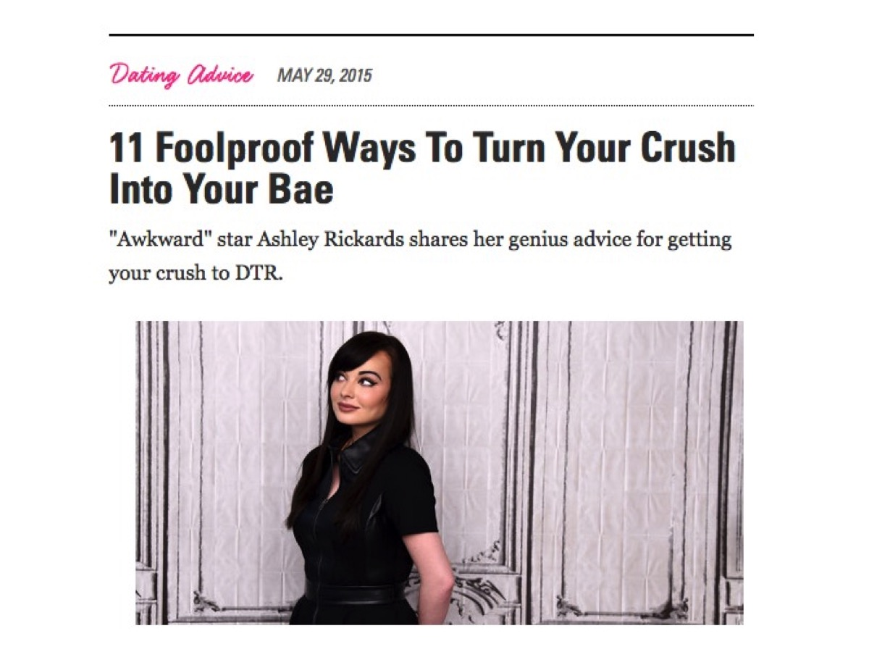
Notes:
Examples of Messages from Mainstream Culture: Advice

Slide 26
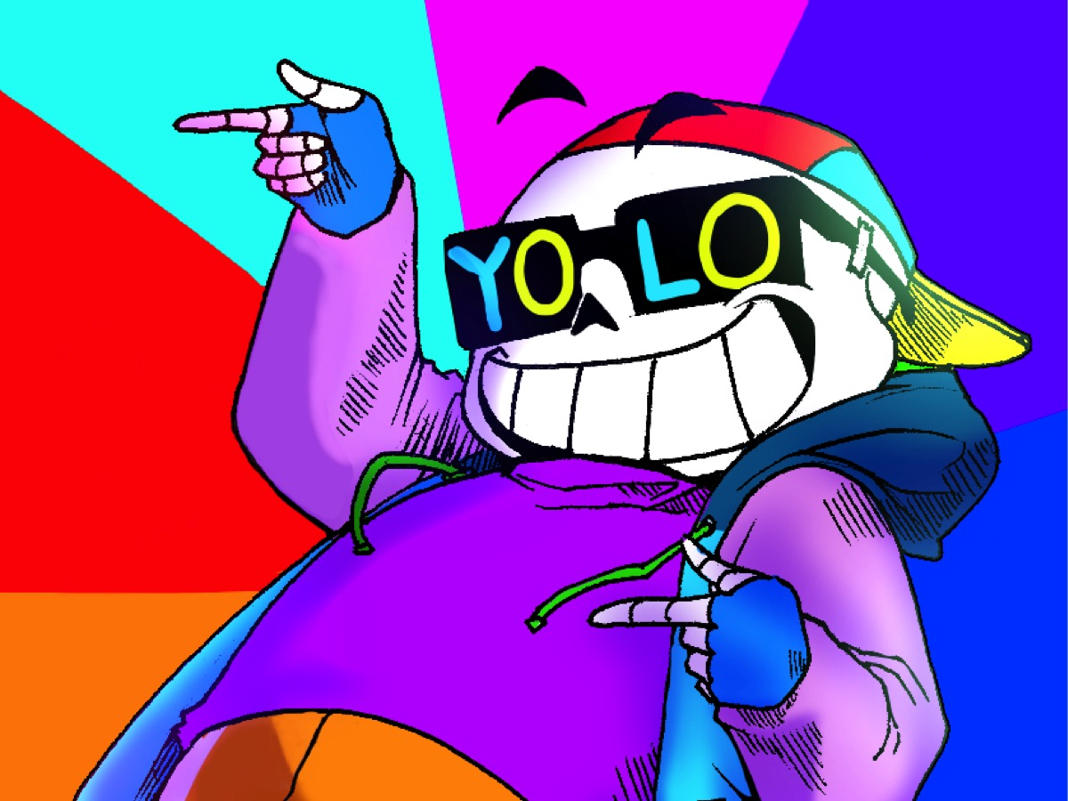
Notes:
YOLO - we are told that we only live once so we need to hurry up and experience everything that life has to offer.

Slide 27
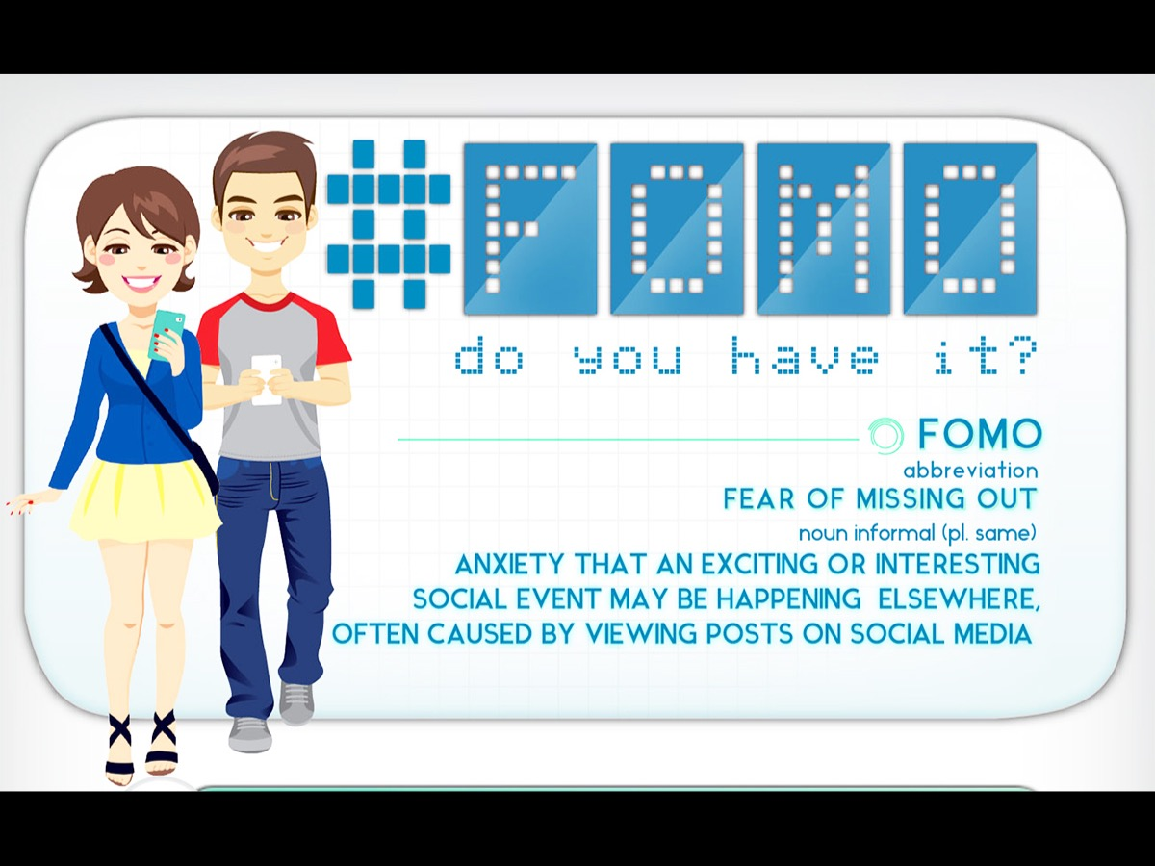
Notes:
FOMO - we are often afraid of missing out and want to do what everyone elses is doing.

Slide 28
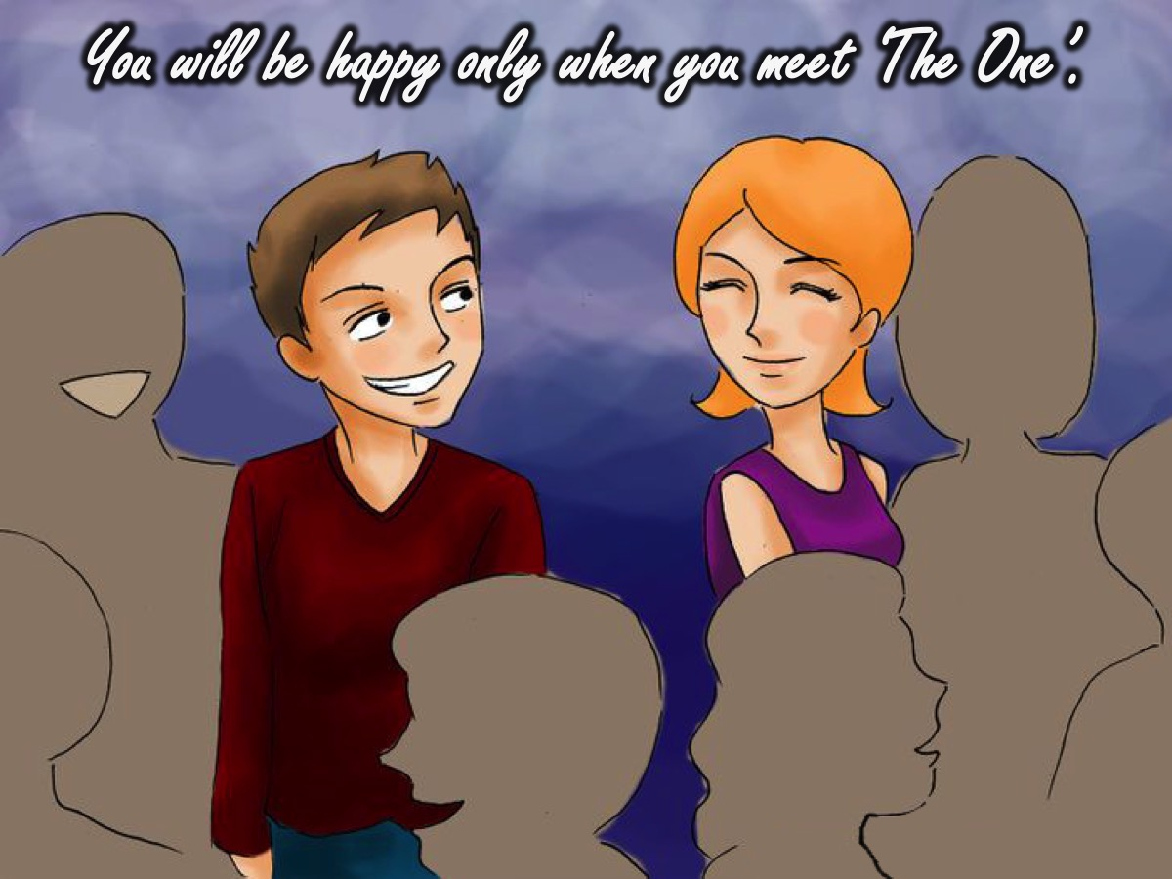
Notes:
We hear this message: “You will be happy only when you meet ‘The One’” and we think that being single is not a place where we can be fulfilled.

Slide 29
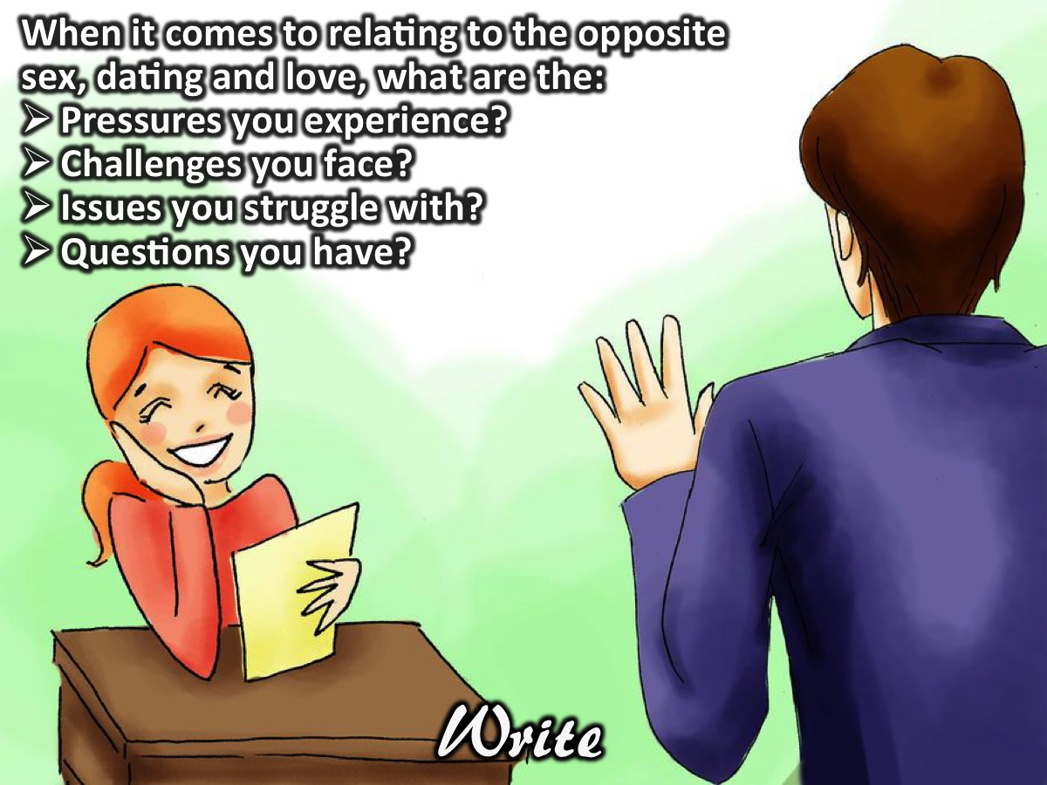
Notes:
Activity: Respond to the following question in writing using the handout provided: When it comes to relating to the opposite sex, dating, and love what are the: Pressures you experience? Challenges you face? Issues you struggle with? Questions you have?

Slide 30
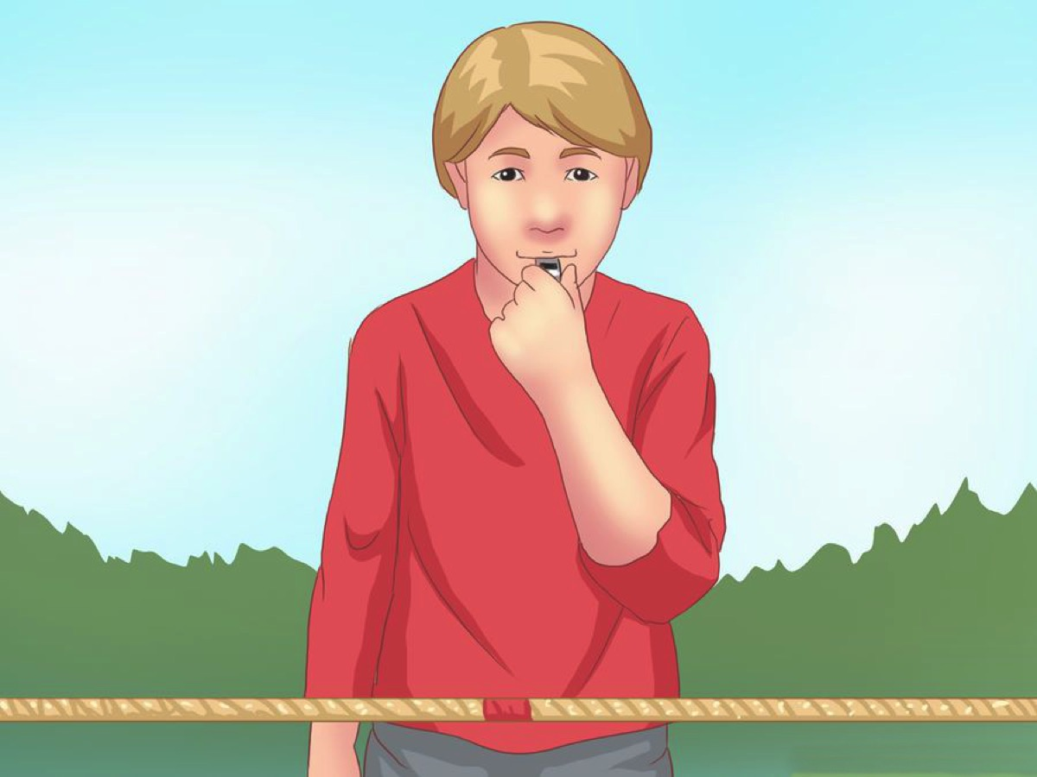
Notes:
Activity: A twist on Tug of War. In pairs - one person stands on a chair and the other stands on the ground. Each person extends their right hands and the person on the chair tries to pull the person on the ground up onto the chair and the person on the ground tries to pull the person on the chair off the chair.

Slide 31
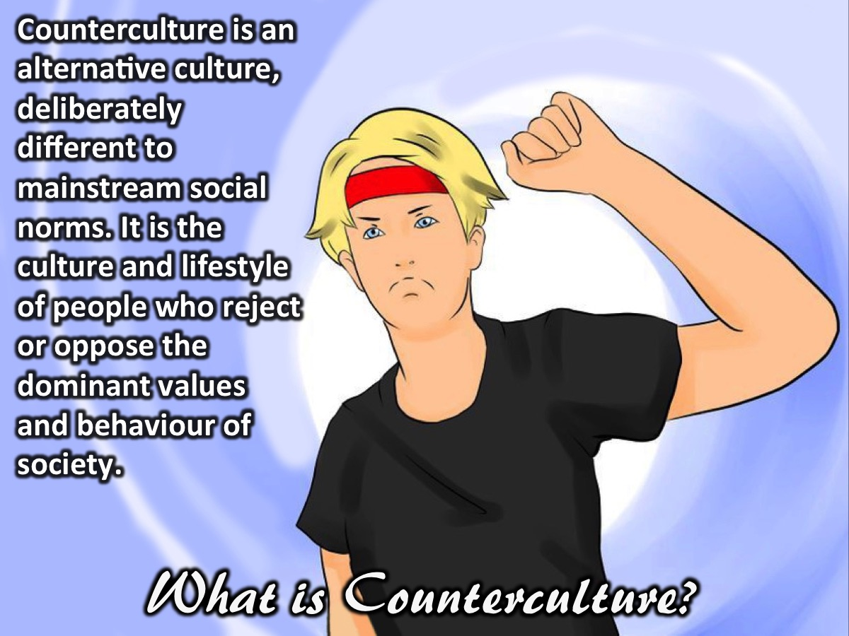
Notes:
What is Counterculture? Counterculture is an alternative culture, deliberately different to (mainstream or dominant) social norms. It is the culture and lifestyle of people, especially among young people, who reject or oppose the dominant values and behaviour of society.

Slide 32
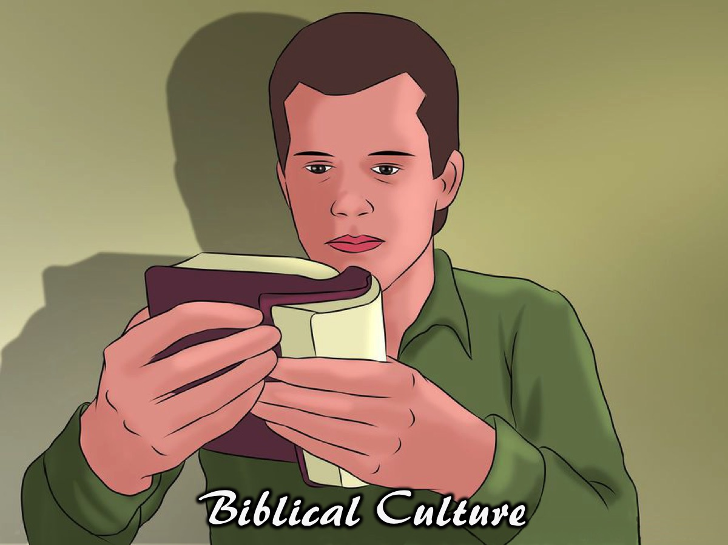
Notes:
Biblical Culture - in this series we are going to look at what the Bible says - it is a counter culture message. In this video clip, Joe, is going to introduce us to what the Bible has to say about dating and relating to the opposite sex.

Slide 33
Notes:
Video: Christians & Dating. Get it on YouTube at: https://youtu.be/ysCtpNH8yEs

Slide 34
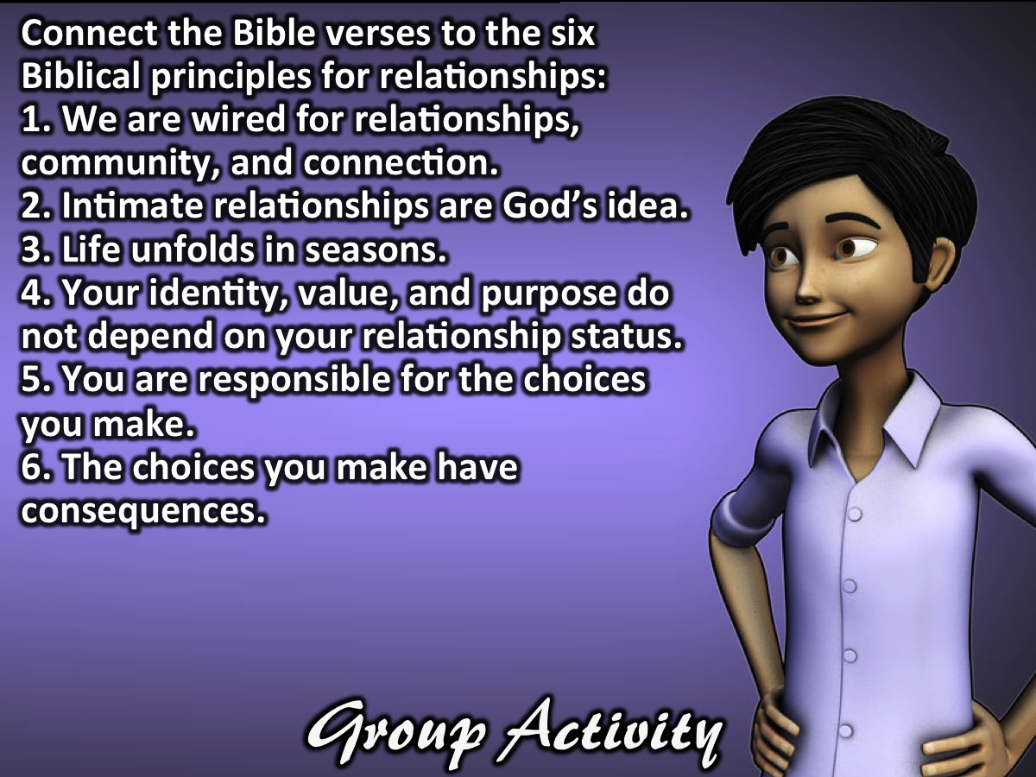
Notes:
Group Activity: In mixed groups, your task is to connect the Bible verses to the six Biblical principles for relationships:
1. We are wired for relationships, community, and connection:
2. Intimate (relationships are God’s idea
3. Life unfolds in seasons
4. Your identity, value, and purpose do not depend on your relationship status
5. You are responsible for the choices you make
6. The choices you make have consequences

Slide 35
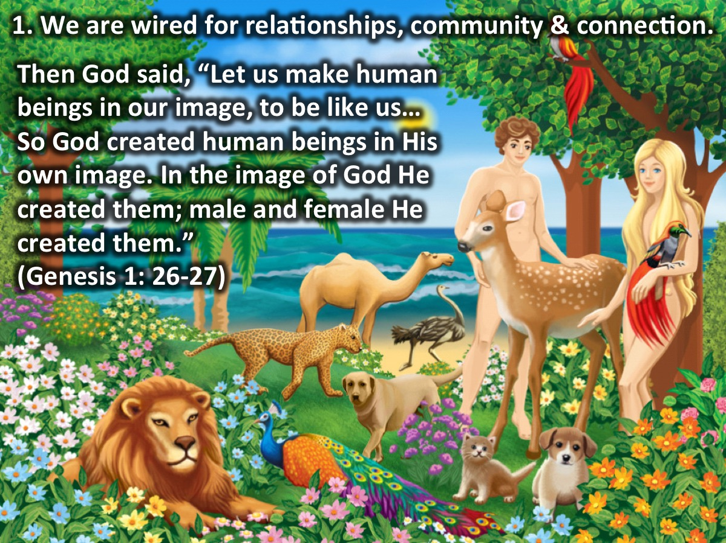
Notes:
1. We are wired for relationships, community and connection: “Then God said, “Let us make human beings in our image, to be like us…So God created human beings in His own image. In the image of God He created them; male and female He created them.” (Genesis 1: 26-27, NLT)

Slide 36
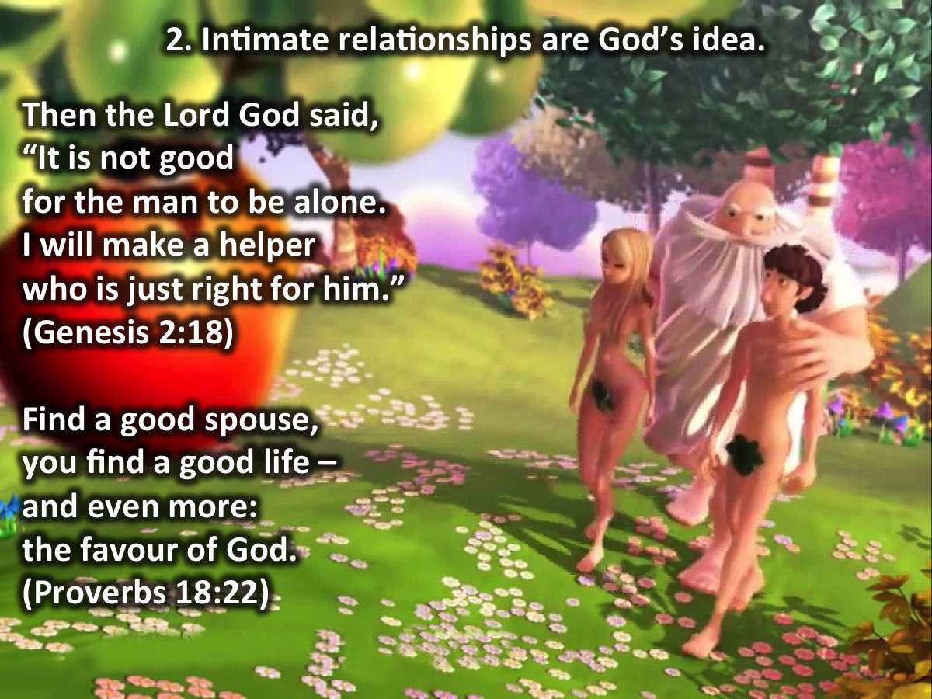
Notes:
2. Intimate (romantic) relationships are God’s idea: “Then the Lord God said, “It is not good for the man to be alone. I will make a helper who is just right for him.” (Genesis 2:18). “Find a good spouse, you find a good life – and even more: the favour of God.” (Proverbs 18:22)

Slide 37
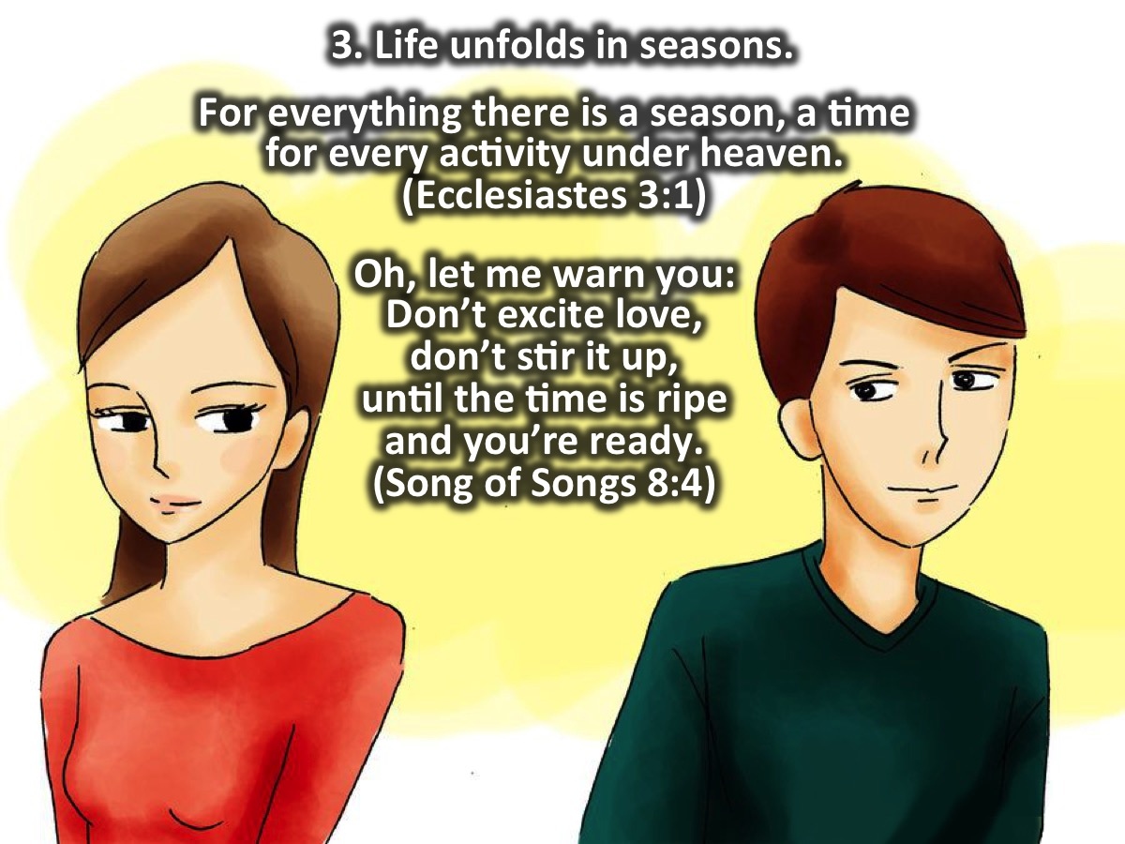
Notes:
3. Life unfolds in seasons. For everything there is a season, a time for every activity under heaven. (Ecclesiastes 3:1). Oh, let me warn you: Don’t excite love, don’t stir it up, until the time is ripe and you’re ready. (Song of Songs 8:4)

Slide 38
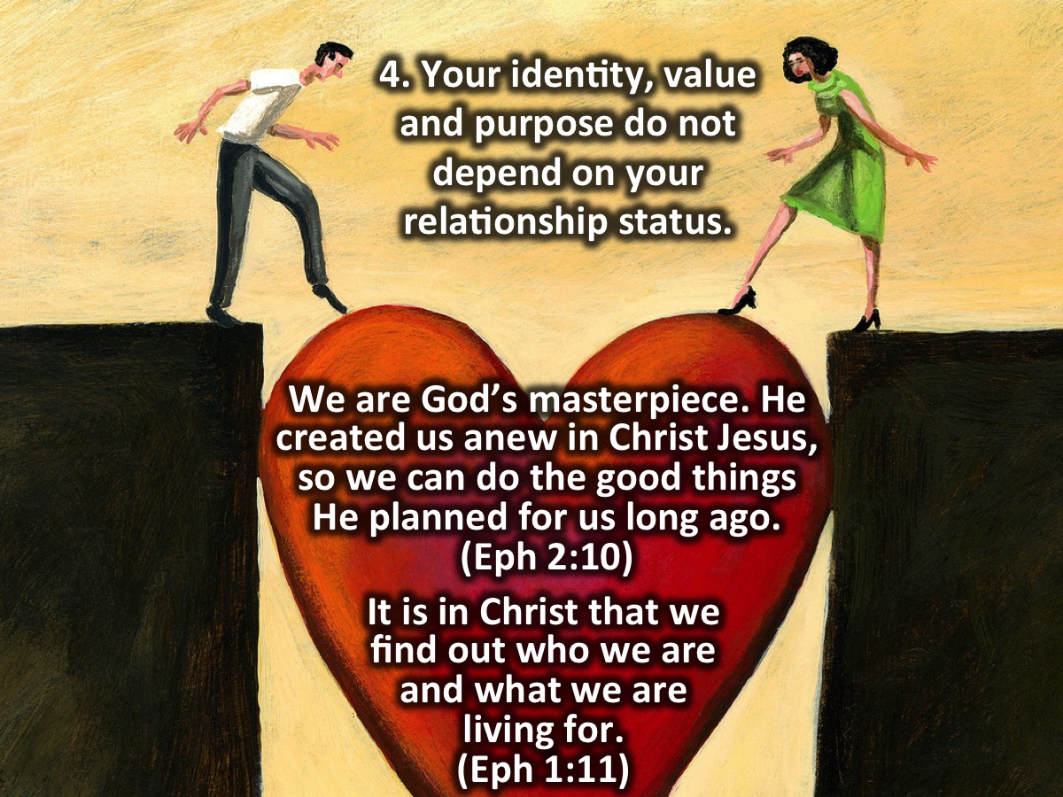
Notes:
4. Your identity, value, and purpose do not depend on your relationship status:
“It is in Christ that we find out who we are and what we are living for.” (Ephesians 1:11, MSG)
“You…knit me together in my mother’s womb…You saw me before I was born. Every day of my life was recorded in your book. Every moment was laid out before a single day had passed. How precious are your thoughts about me, O God. They cannot be numbered! I can’t even count them; they outnumber the grains of sand!” (Psalm 139:13; 16-18, NLT)
“Before I shaped you in the womb, I knew all about you. Before you saw the light of day, I had holy plans for you…” (Jeremiah 1:5, MSG)
“For we are God’s masterpiece. He created us anew in Christ Jesus, so we can do the good things He planned for us long ago.” (Ephesians 2:10, NLT)

Slide 39
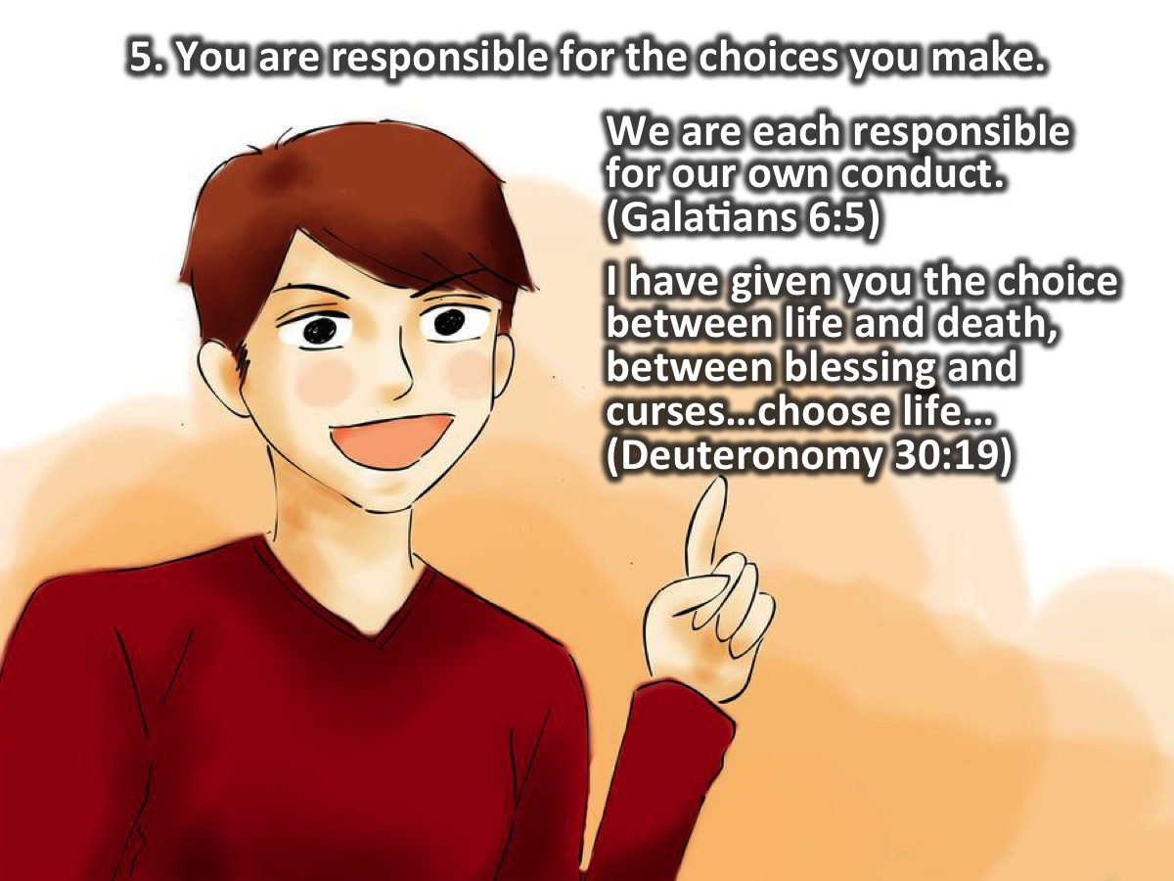
Notes:
5. You are responsible for the choices you make.
“…we are each responsible for our own conduct.” (Galatians 6:5, NLT)
“…I have given you the choice between life and death, between blessing and curses…choose life…” (Deuteronomy 30:19, NLT)

Slide 40
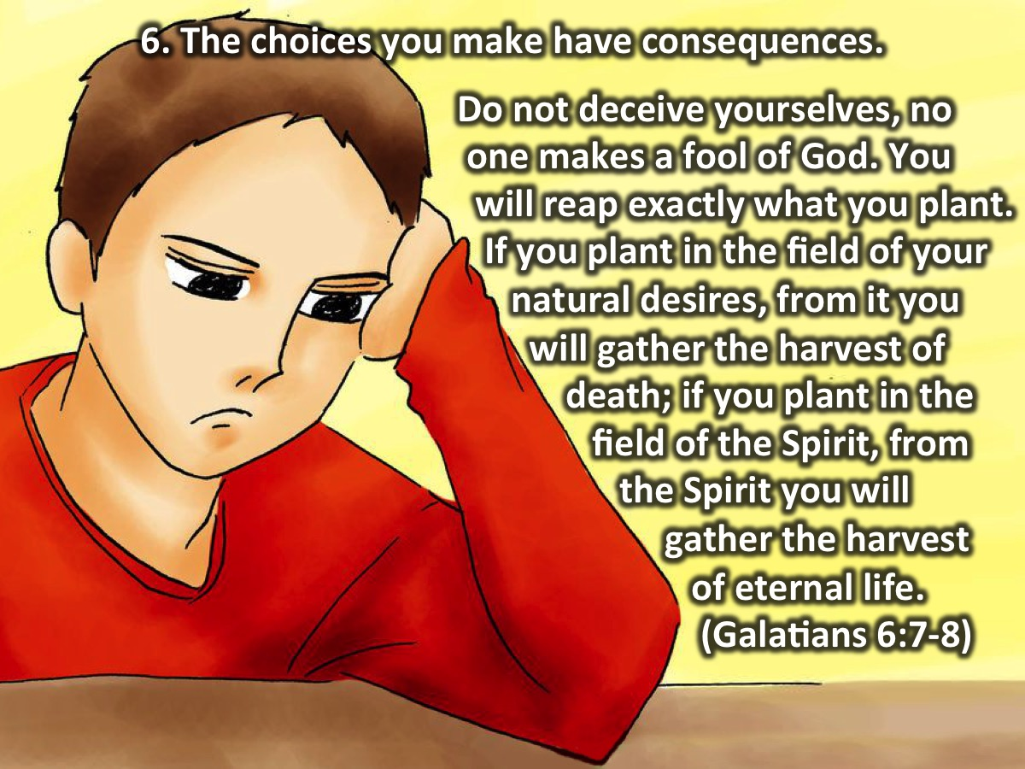
Notes:
6. The choices you make have consequences:
“Do not deceive yourselves, no one makes a fool of God. You will reap exactly what you plant. If you plant in the field of your natural desires, from it you will gather the harvest of death; if you plant in the field of the Spirit, from the Spirit you will gather the harvest of eternal life.” (Galatians 6:7-8; GNT)

Slide 41
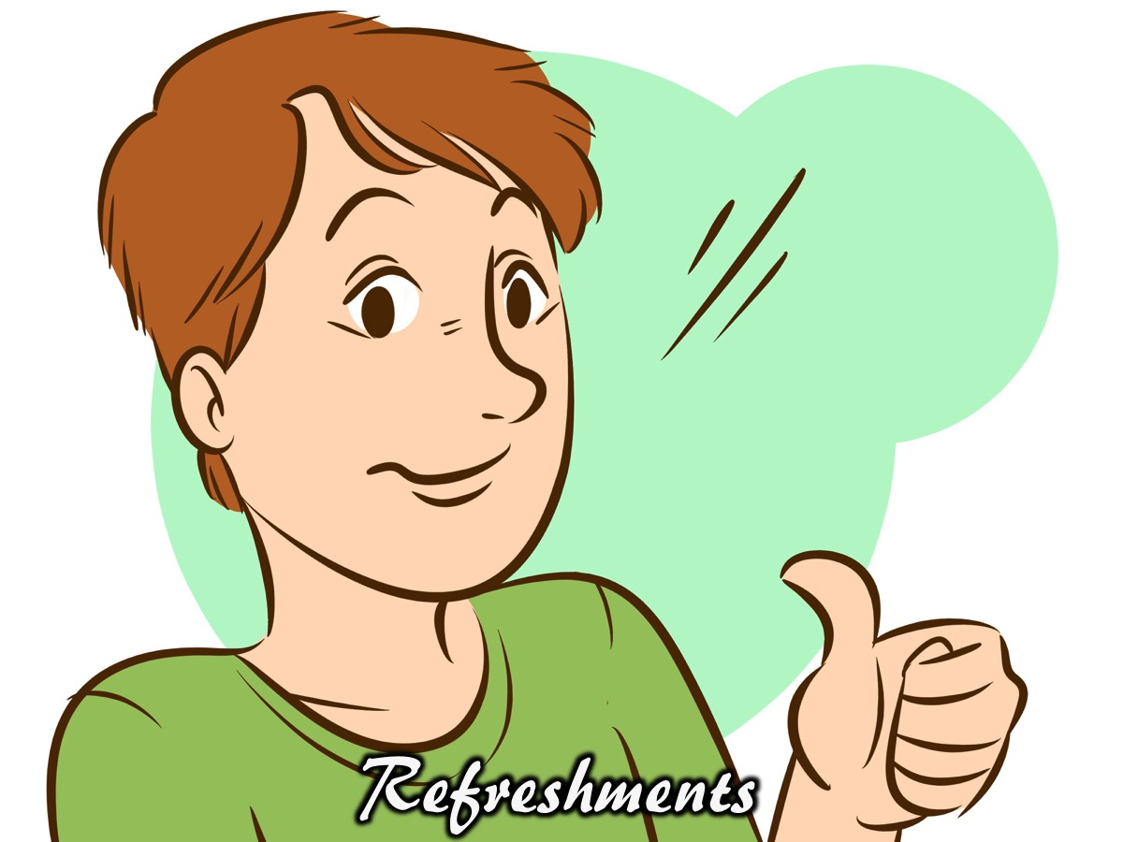
Notes:
Refreshments are served.

Slide 42

Notes:
Announcements: On Sunday morning it is week 3 of our Spirit Series - Mark will be preaching on the Gifts of the Holy Spirit.

Slide 43
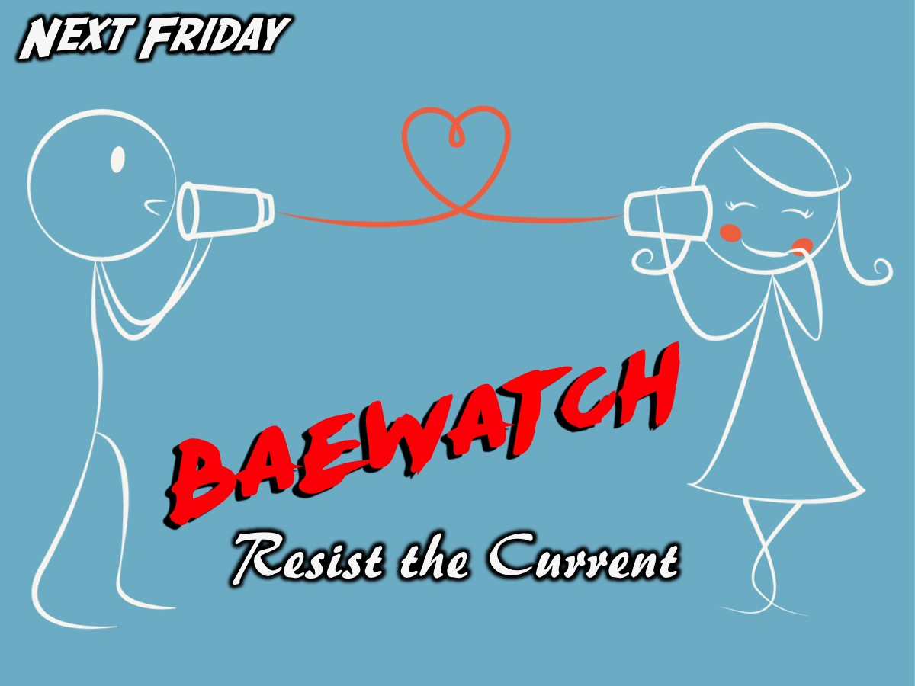
Notes:
Next Friday night is the second week of our Baewatch series.

