Slide 1

Notes:
The Baewatch Series.

Slide 2

Notes:
Week 2 of the Baewatch Series: Resist the Current.

Slide 3
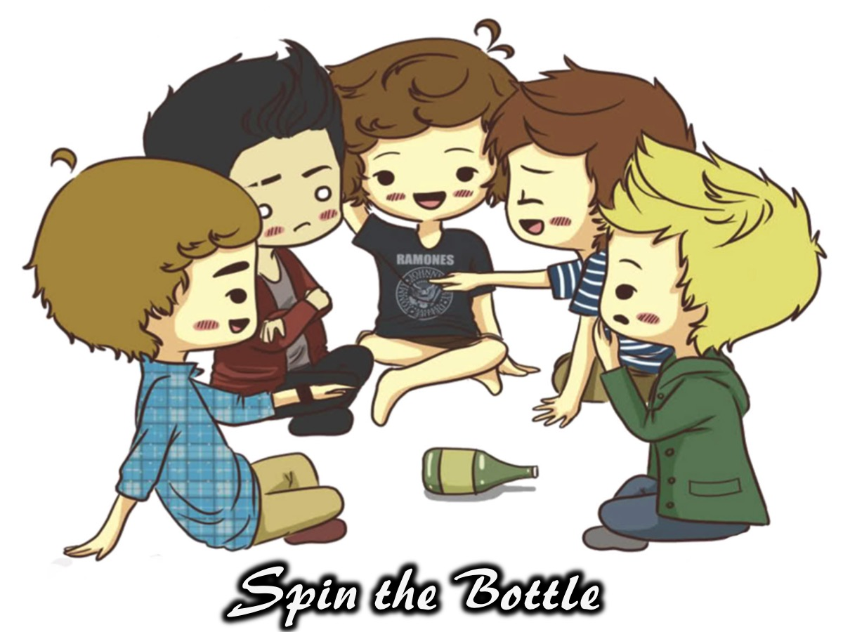
Notes:
Ice-Breaker: Spin the Bottle. You are going to sit on the ground in groups of 8 and play spin the bottle. No - you dont have to kiss the person that the bottle lands on - they just have to pick up a card and do what it says - they contain the following Truth or Dares:
Truth
1. If you were a billionaire, what would you spend your time doing?
2. What have you stolen anything in your life? What was it?
3. What is the most expensive thing you own?
4. If you could marry anyone in this room, who would it be and why?
5. What movie or TV star would you like to look like?
6. If you had to change your first name what would you change it to?
7. What is the craziest thing that you have ever done without your parents knowing?
8. What is the last thing that you got into trouble for?
9. What do you think is your best physical feature?
10. If you could live anywhere else in the world where would it be?
Dare
1. Make funny faces until everyone laughs.
2. Give someone in the group a compliment.
3. Sing a nursery rhythm.
4. Hop around like a rabbit.
5. Do an impression of one of the adult leaders.
6. Do a death scene.
7. Do 5 push-ups.
8. Hug a person in the group.
9. Walk around the group like a dog and bark.
10. Suck your thumb and cry like a baby.

Slide 4
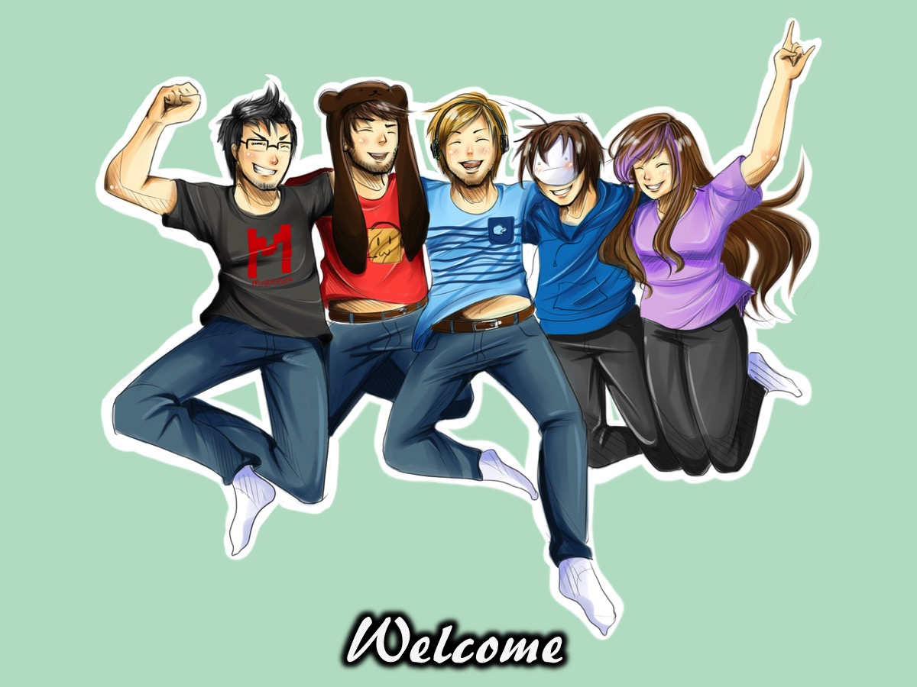
Notes:
Welcome to regulars and newcomers.

Slide 5
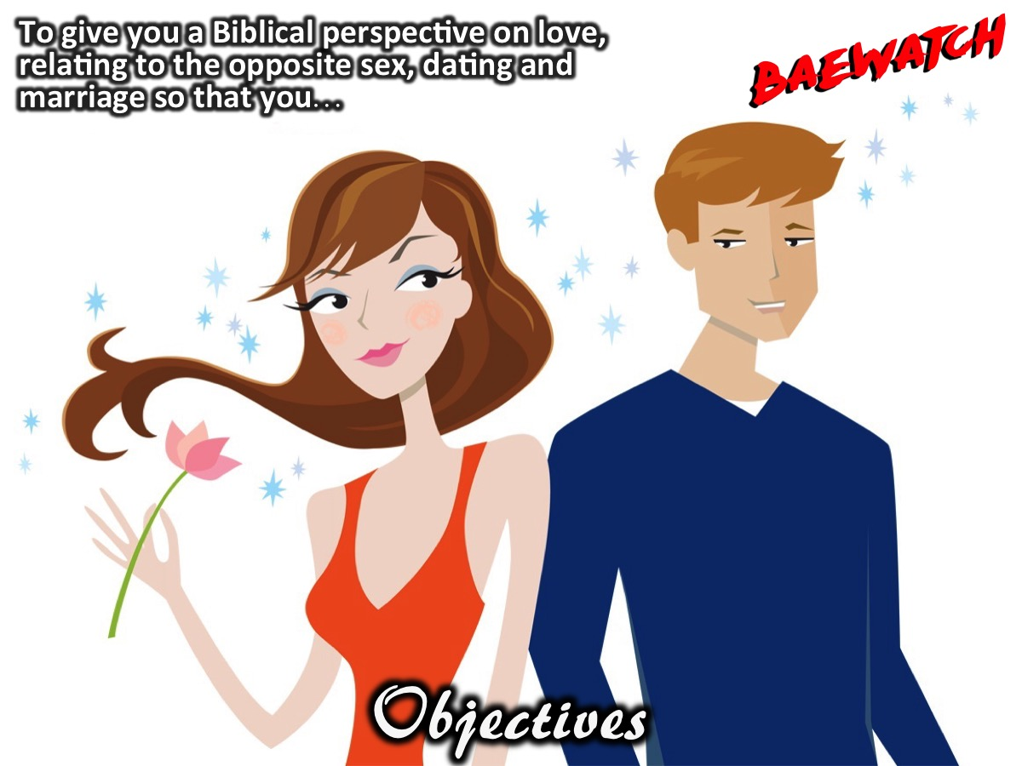
Notes:
Objectives: To give you a Biblical perspective on love, relating to the opposite sex, dating and marriage so that you…

Slide 6
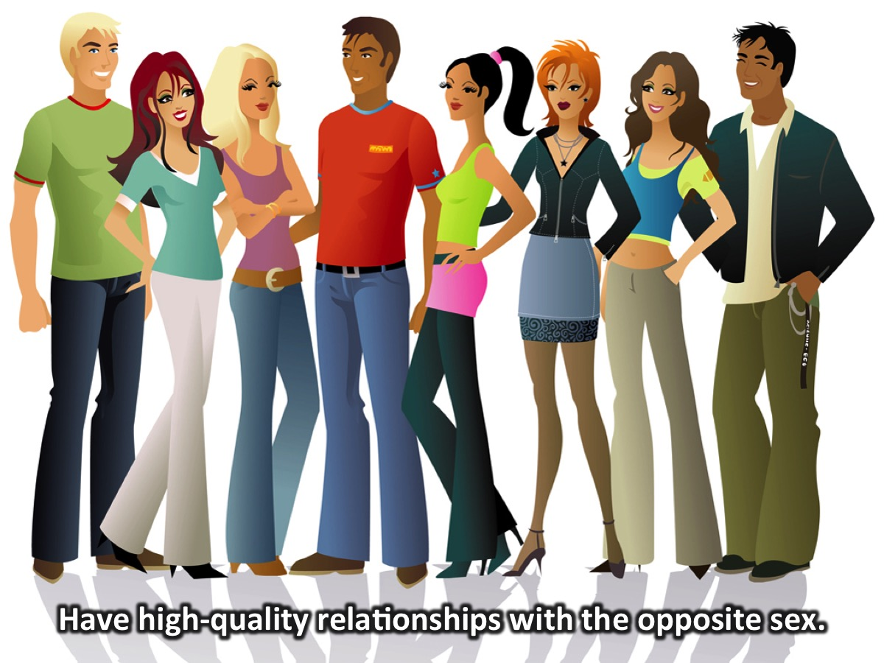
Notes:
1. Have high-quality relationships with the opposite sex.

Slide 7
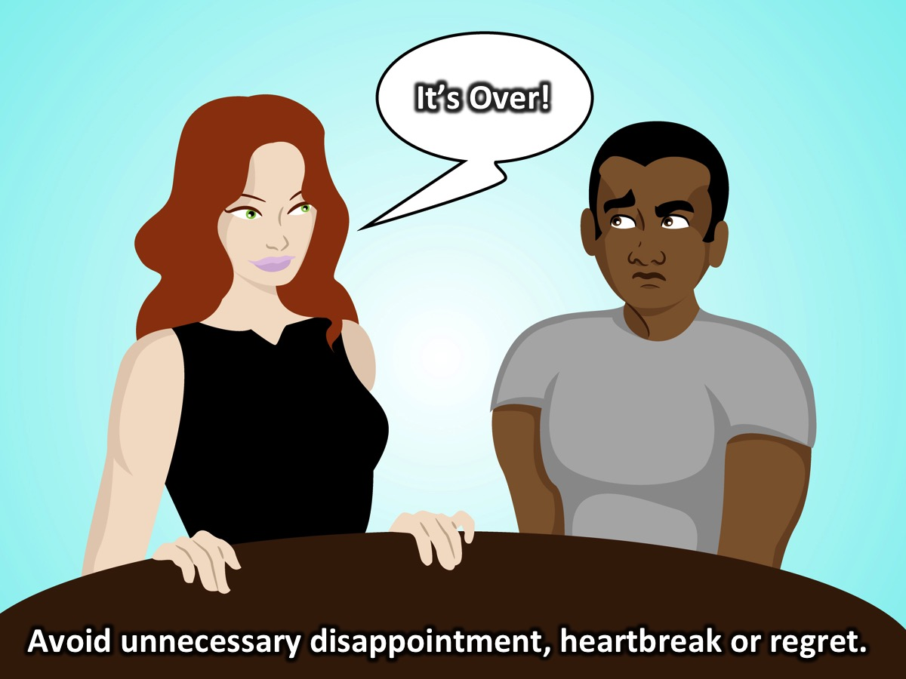
Notes:
2. Avoid unnecessary relational disappointment, heartbreak, and regret.

Slide 8
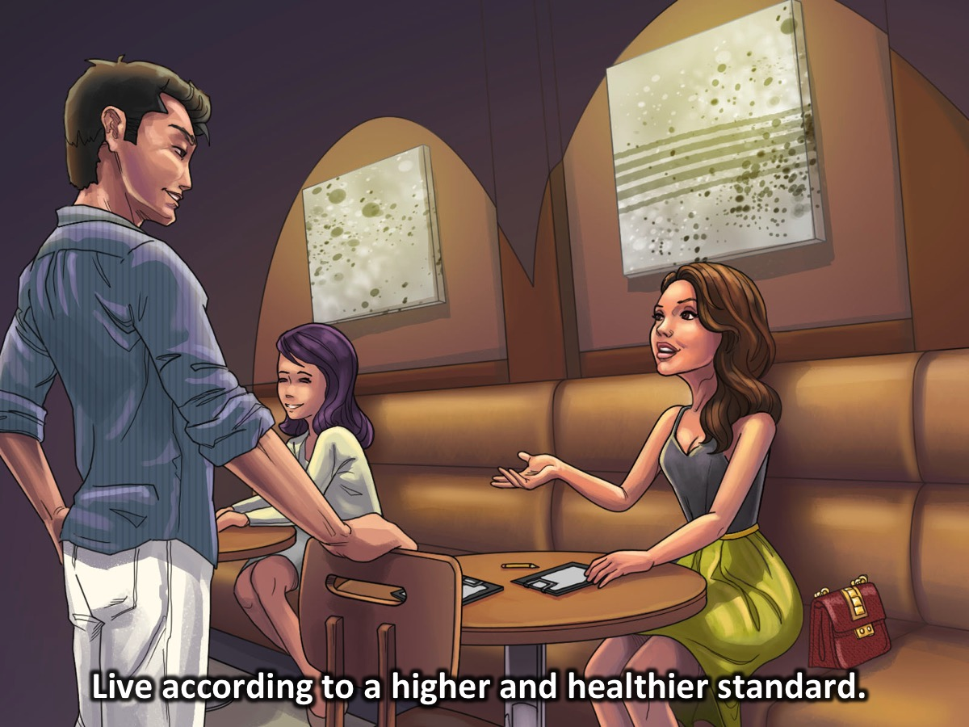
Notes:
3. Live according to a higher and healthier standard.

Slide 9
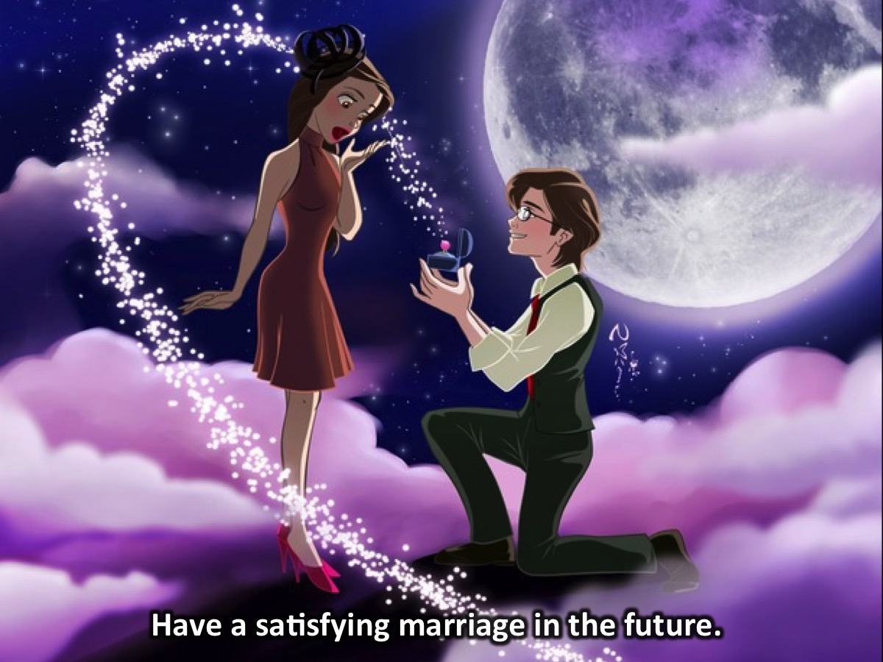
Notes:
4. Have a satisfying marriage in the future.

Slide 10
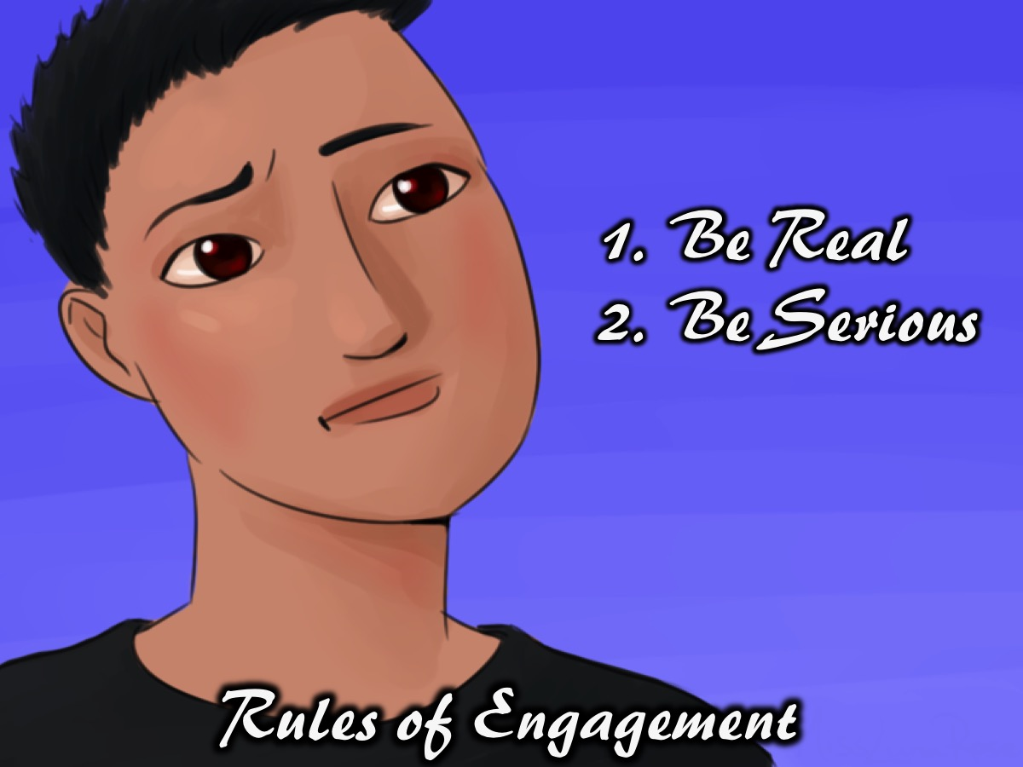
Notes:
Rules of Engagement: (1) Be Real. (2) Take This Seriously (or Be Serious).

Slide 11

Notes:
Prayer

Slide 12
Notes:
Video: Ask a Tween: What is Dating like? Get it on YouTube at: https://www.youtube.com/watch?v=tFmiHWTWcrI

Slide 13
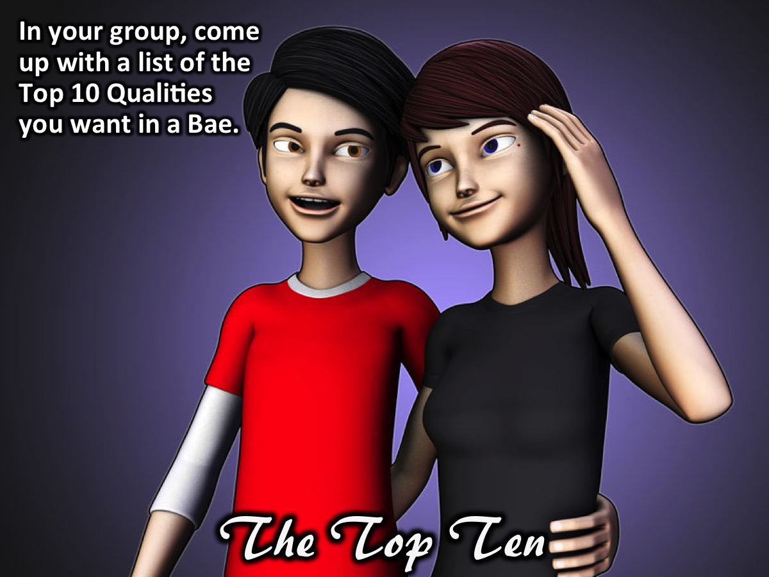
Notes:
Activity: The Top Ten List. In your group, come up with a list of the Top 10 Qualities you want in a Bae. Share the list on stage.

Slide 14
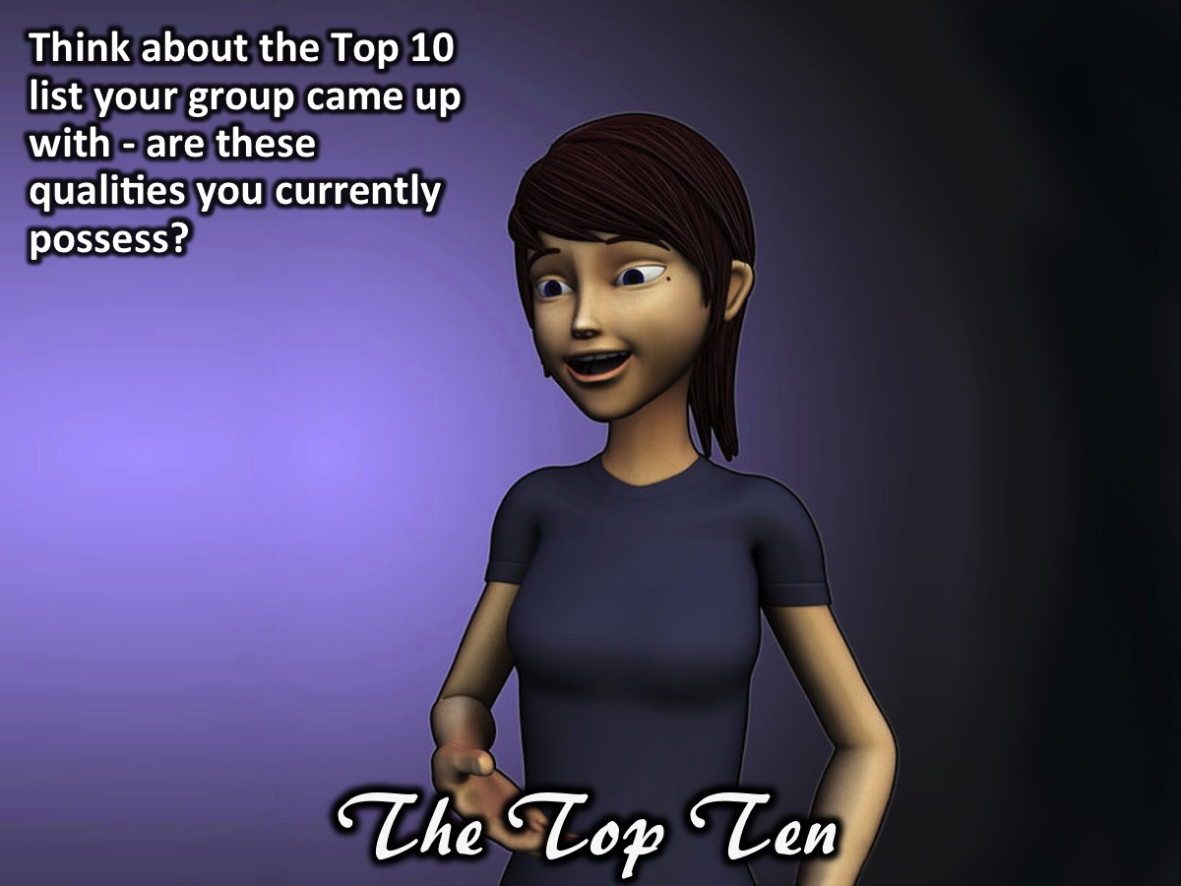
Notes:
Activity: The Top Ten Test. Think about the Top 10 list your group came up with - are these qualities you currently possess? Give yourself a grade (percentage) for each of the ten qualities you are looking for in someone else.

Slide 15
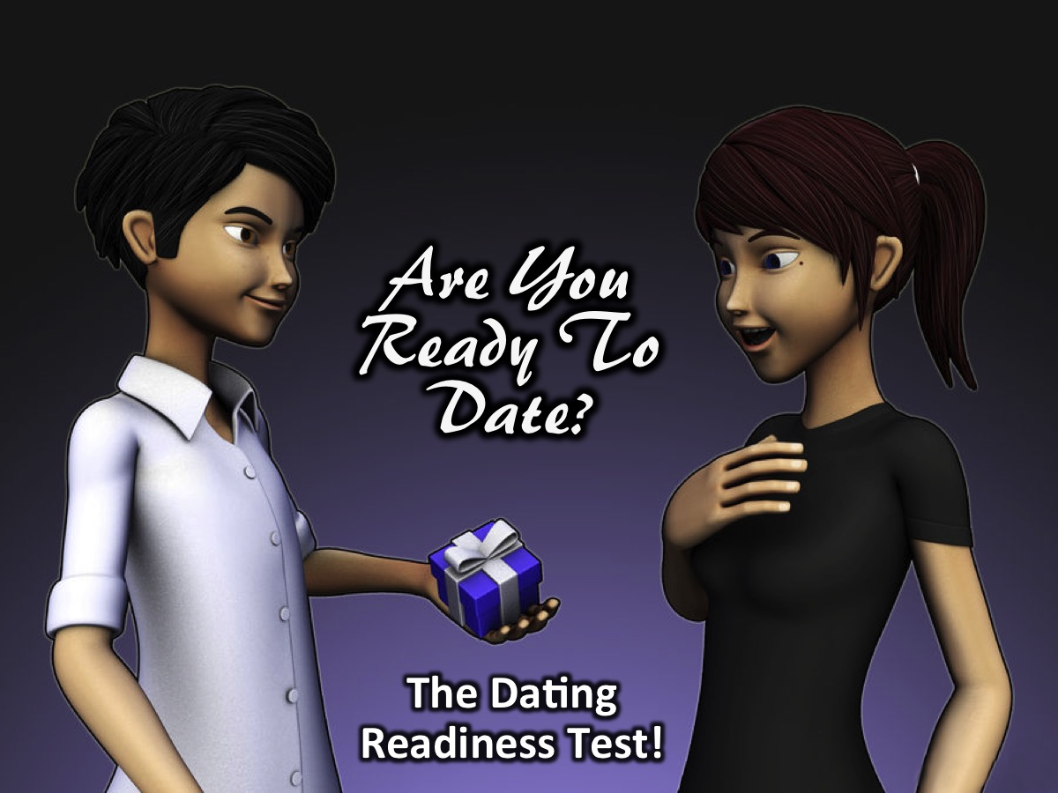
Notes:
Activity: Are You Ready To Date? You must sit on the ground in groups of 8 and each of you will be given 10 heart-shaped sweets. You are going to take the Dating Readiness Test - to see whether you are ready to start dating. For every wrong answer you give you will have to throw one of your sweets into the bowl in the middle of the group. There are 12 questions in total:
1. Are you still at school? Throw away a sweet if you answered: YES!
2. Do you believe that sex is only meant for marriage? Throw away a sweet if you answered: NO!
3. Have you had a break up in the last 3 months? Throw away a sweet if you answered: YES!
4. Have you ever felt pressure to find a Bae? Throw away a sweet if you answered: YES!
5. Do you ask God for permission before starting a relationship? Throw away a sweet if you answered: NO!
6. Do you know the exact qualities you are looking for in someone to marry? Throw away a sweet if you answered: NO!
7. Will you feel better about yourself if you have a pretty or handsome Bae? Throw away a sweet if you answered: YES!
8. Is your relationship with God the most important thing in your life? Throw away a sweet if you answered: NO!
9. Do you have any habits or harmful behaviors you can’t quit? Throw away a sweet if you answered: YES!
10. Do you know who you are and what your beliefs and qualities are? Throw away a sweet if you answered: NO!
11. Do you know your future goals and are you taking steps to achieve them? Throw away a sweet if you answered: NO!
12. Do you expect a relationship to give you healing, security or identity? Throw away a sweet if you answered: YES!
What are you left with? Are you ready to date? Not unless you have most of the sweets left that you started with!

Slide 16
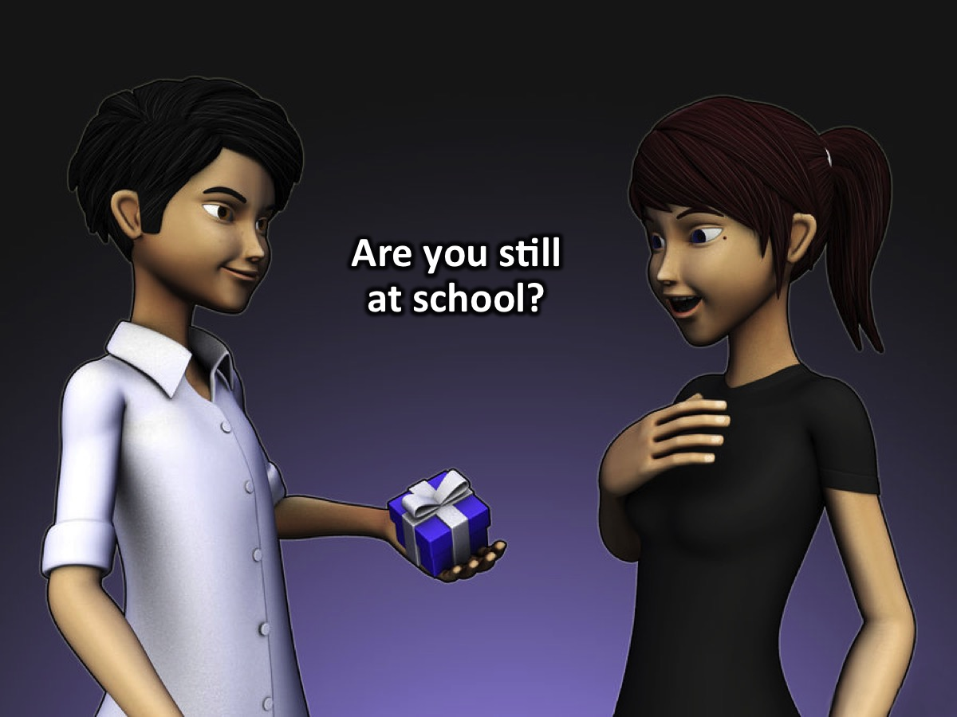
Notes:
1. Are you still at school?

Slide 17
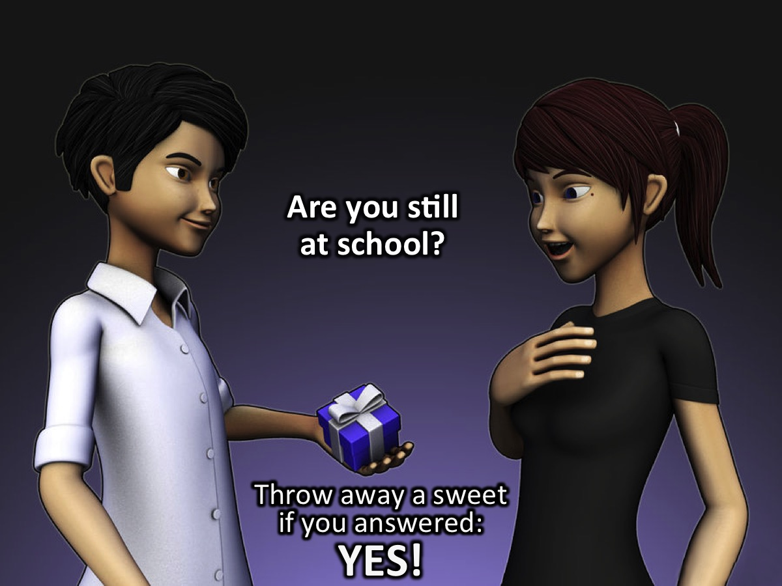
Notes:
Throw away a sweet if you answered: YES!

Slide 18
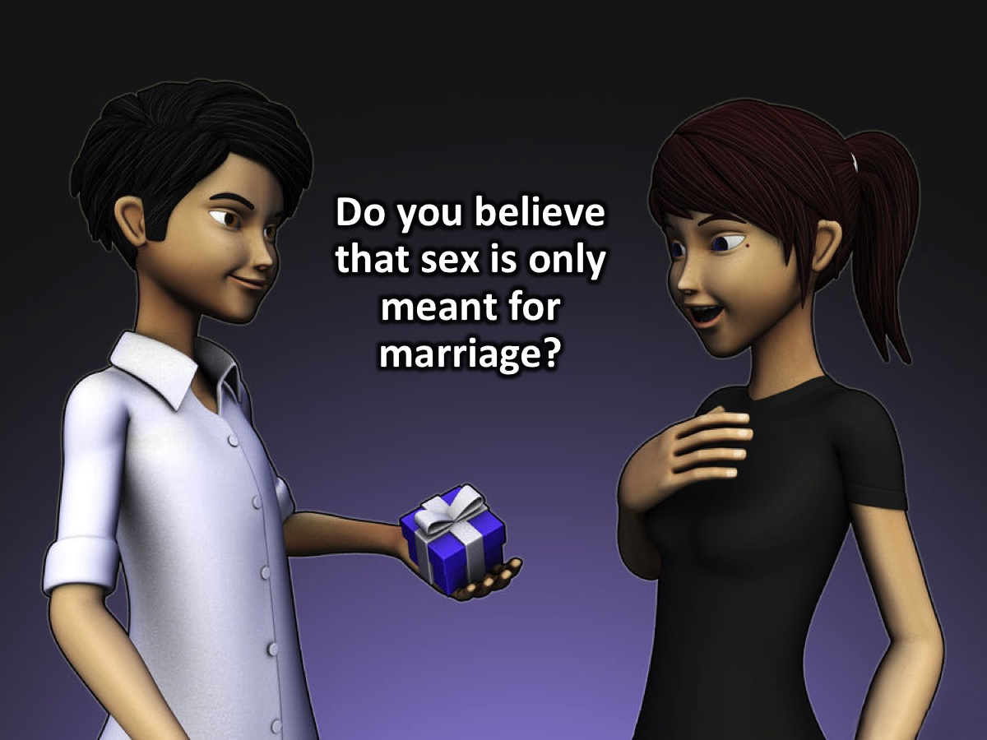
Notes:
2. Do you believe that sex is only meant for marriage?

Slide 19
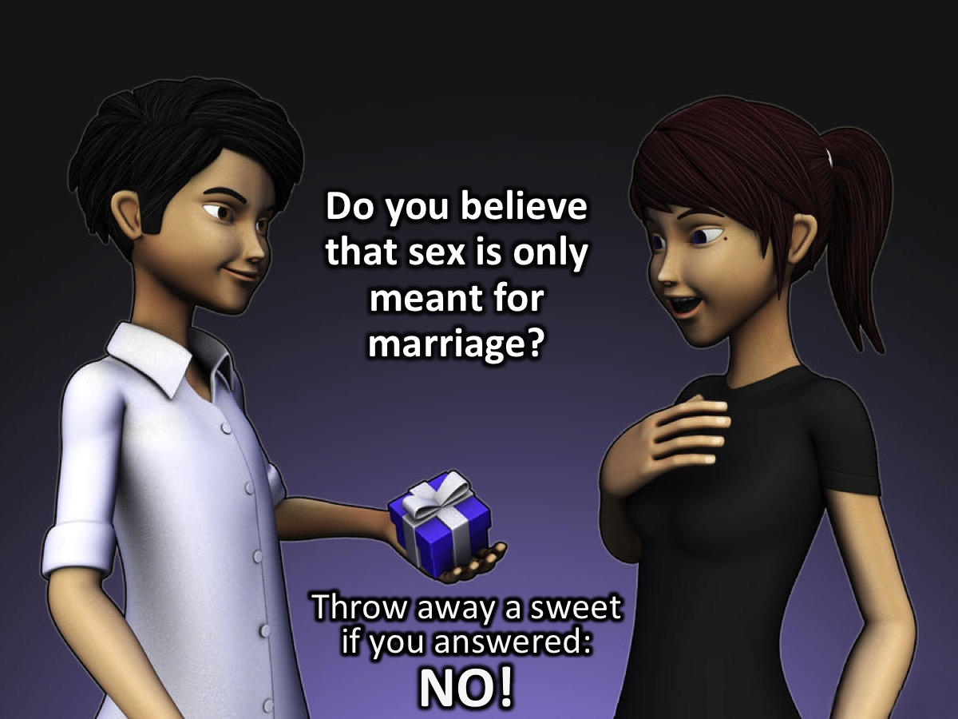
Notes:
Throw away a sweet if you answered: NO!

Slide 20
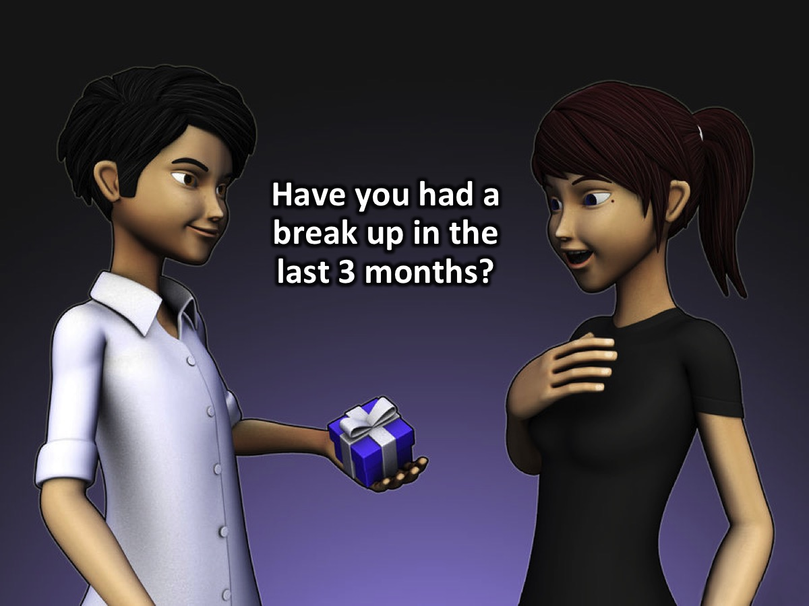
Notes:
3. Have you had a break up in the last 3 months?

Slide 21
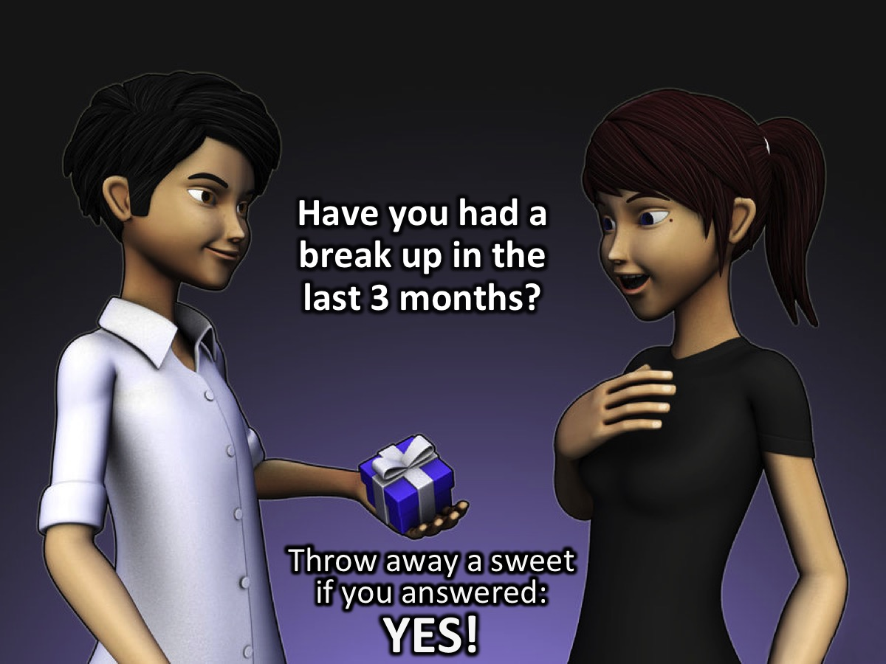
Notes:
Throw away a sweet if you answered: YES!

Slide 22

Notes:
4. Have you ever felt pressure to find a Bae?

Slide 23

Notes:
Throw away a sweet if you answered: YES!

Slide 24

Notes:
5. Do you ask God for permission before starting a relationship?

Slide 25
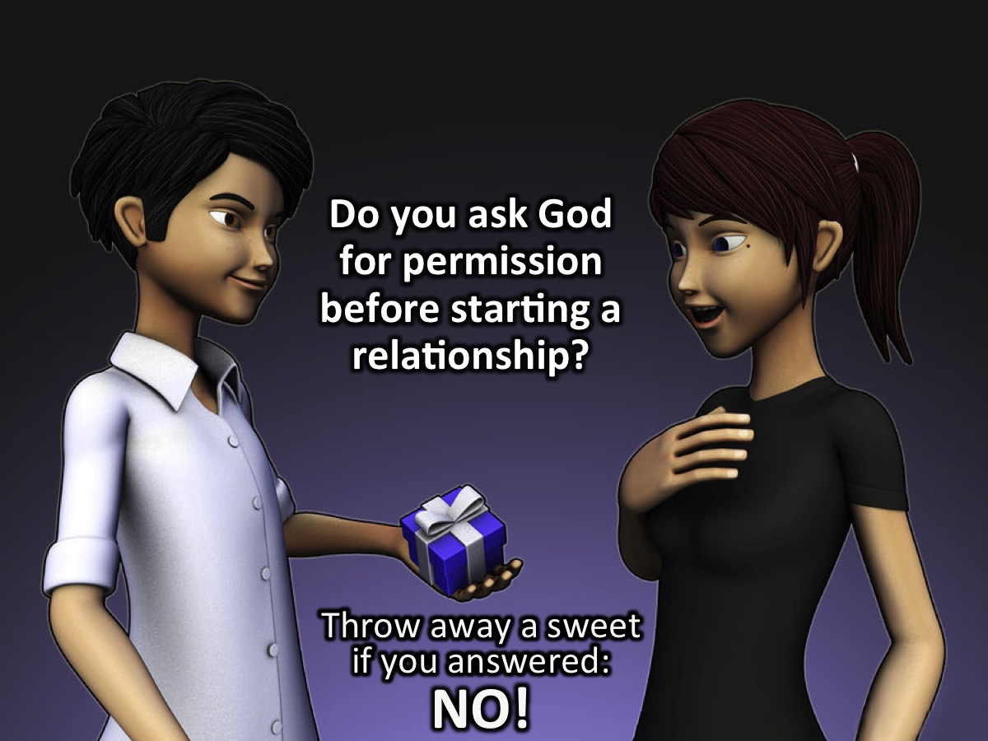
Notes:
Throw away a sweet if you answered: NO!

Slide 26
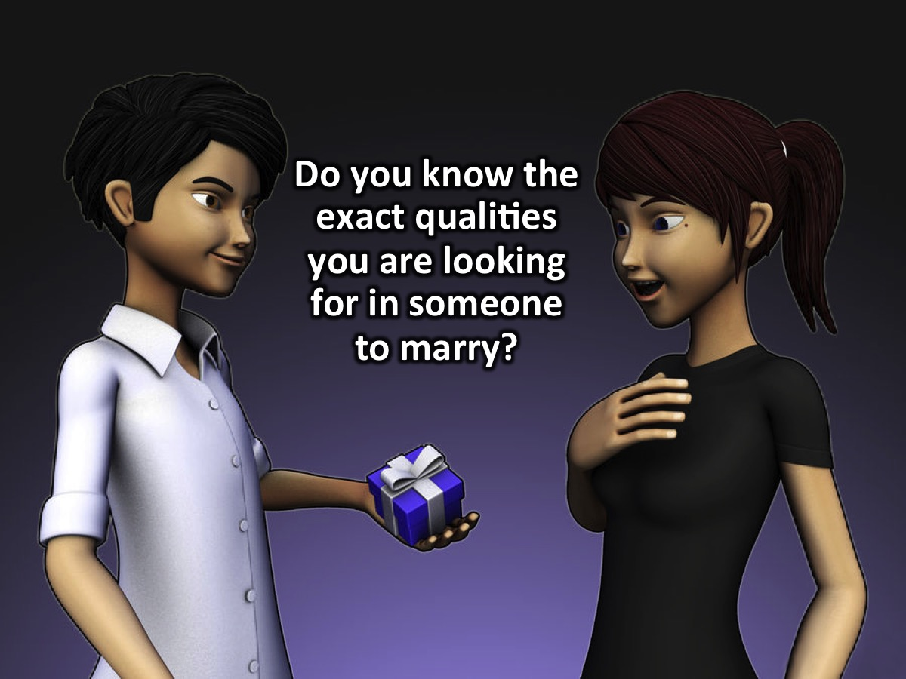
Notes:
6. Do you know the exact qualities you are looking for in someone to marry?

Slide 27

Notes:
Throw away a sweet if you answered: NO!

Slide 28
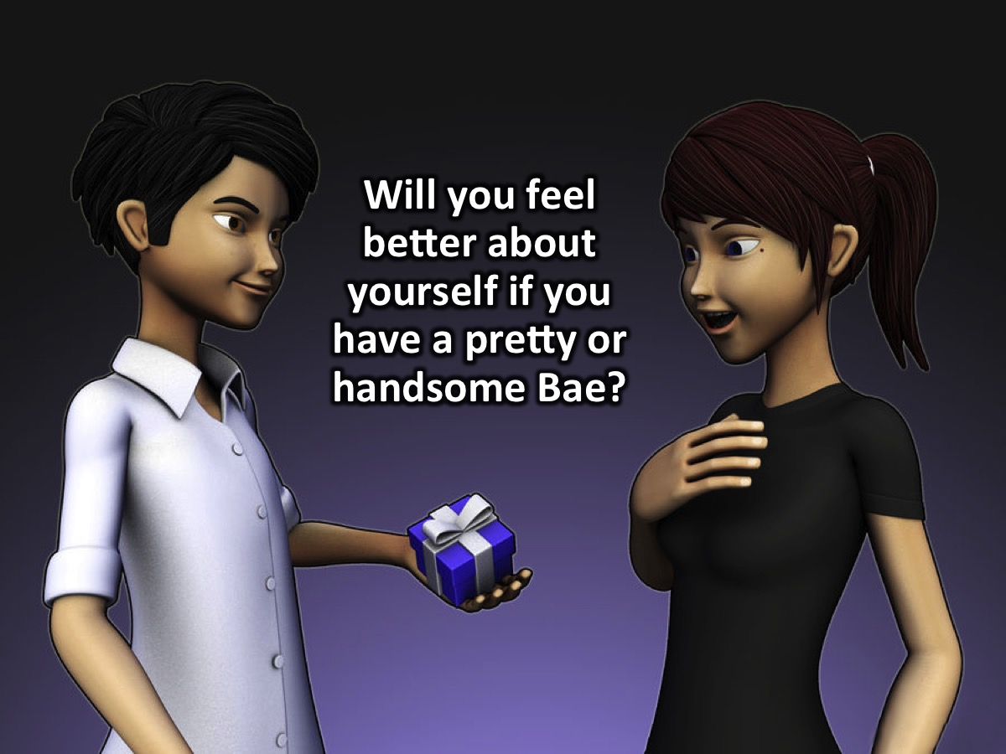
Notes:
7. Will you feel better about yourself if you have a pretty or handsome Bae?

Slide 29

Notes:
Throw away a sweet if you answered: YES!

Slide 30
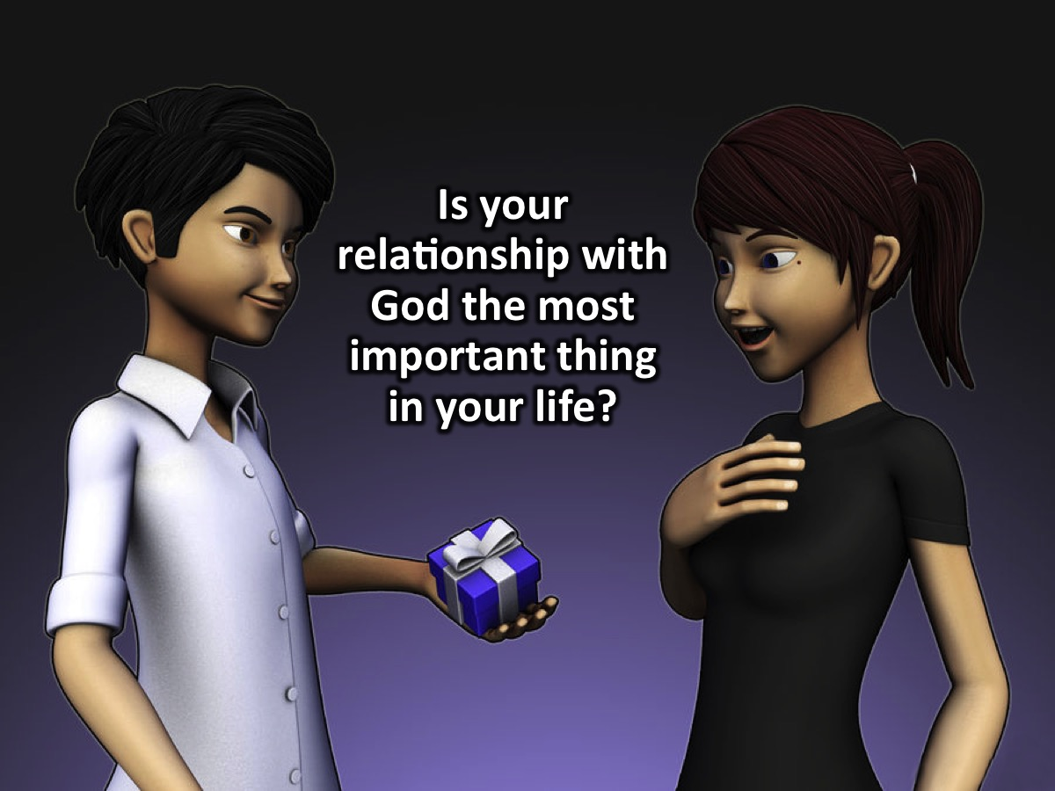
Notes:
8. Is your relationship with God the most important thing in your life?

Slide 31

Notes:
Throw away a sweet if you answered: NO!

Slide 32
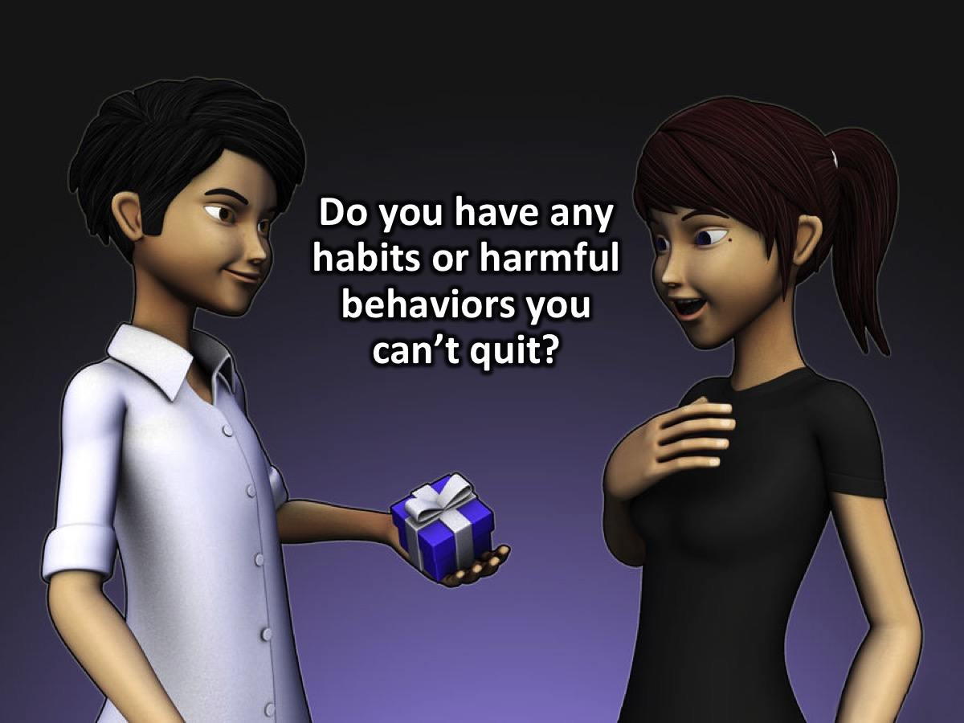
Notes:
9. Do you have any habits or harmful behaviors you can’t quit?

Slide 33
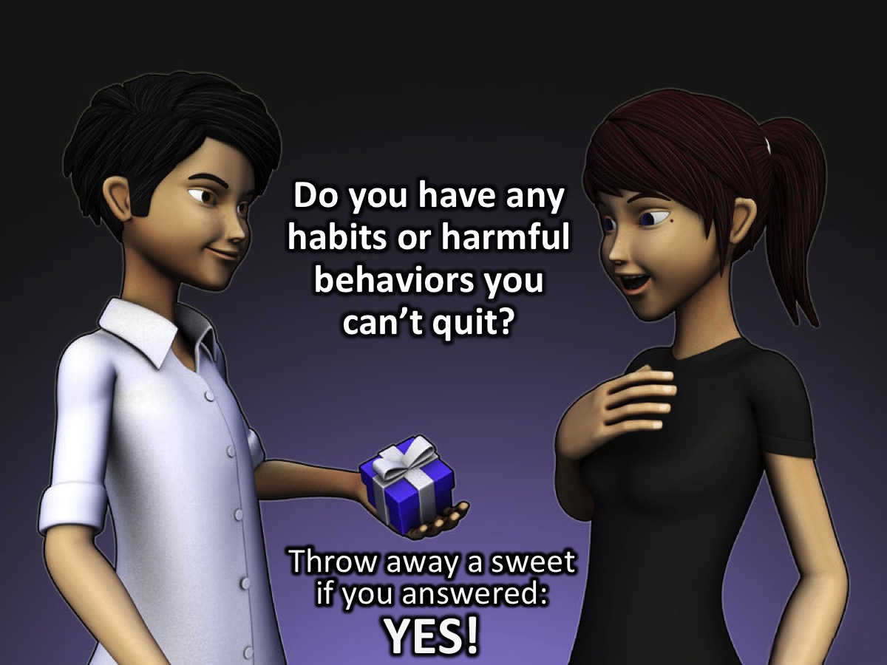
Notes:
Throw away a sweet if you answered: YES!

Slide 34
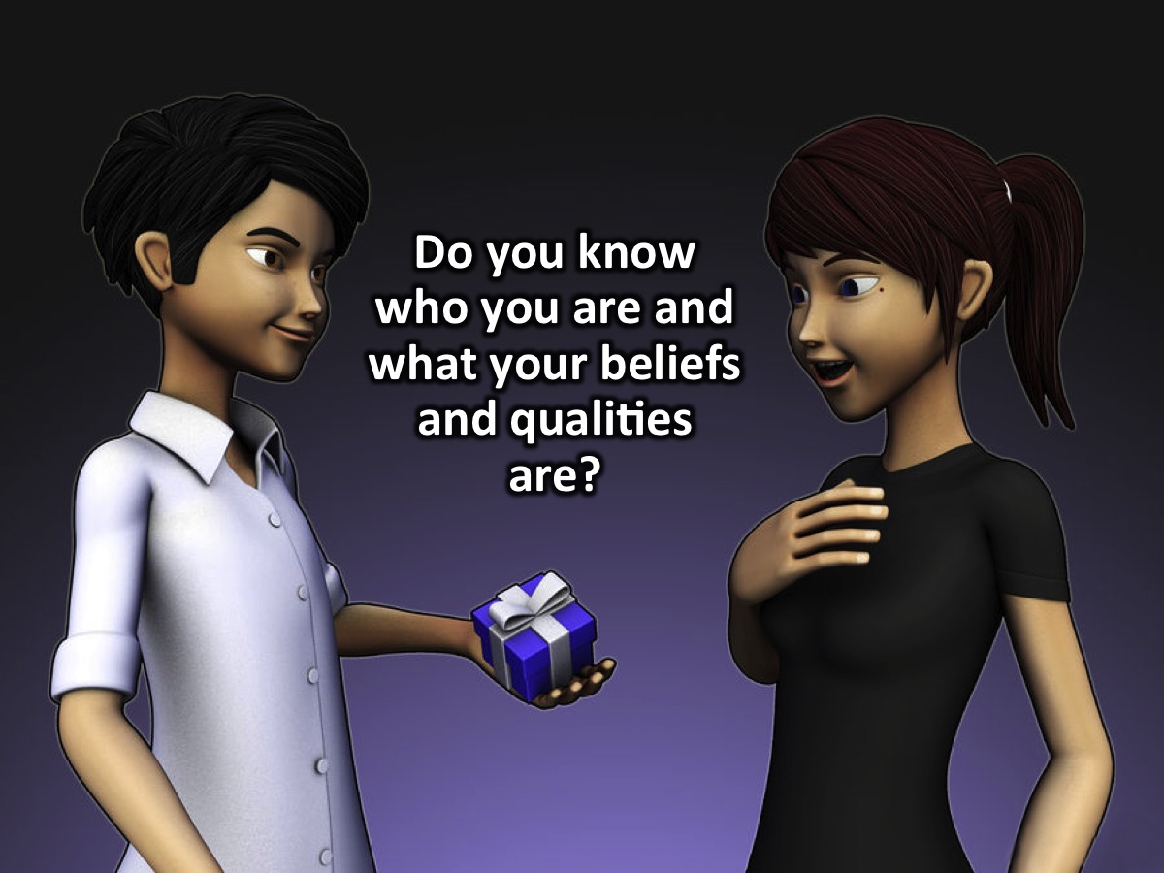
Notes:
10. Do you know who you are and what your beliefs and qualities are?

Slide 35

Notes:
Throw away a sweet if you answered: NO!

Slide 36

Notes:
11. Do you know your future goals and are you taking steps to achieve them?

Slide 37

Notes:
Throw away a sweet if you answered: NO!

Slide 38
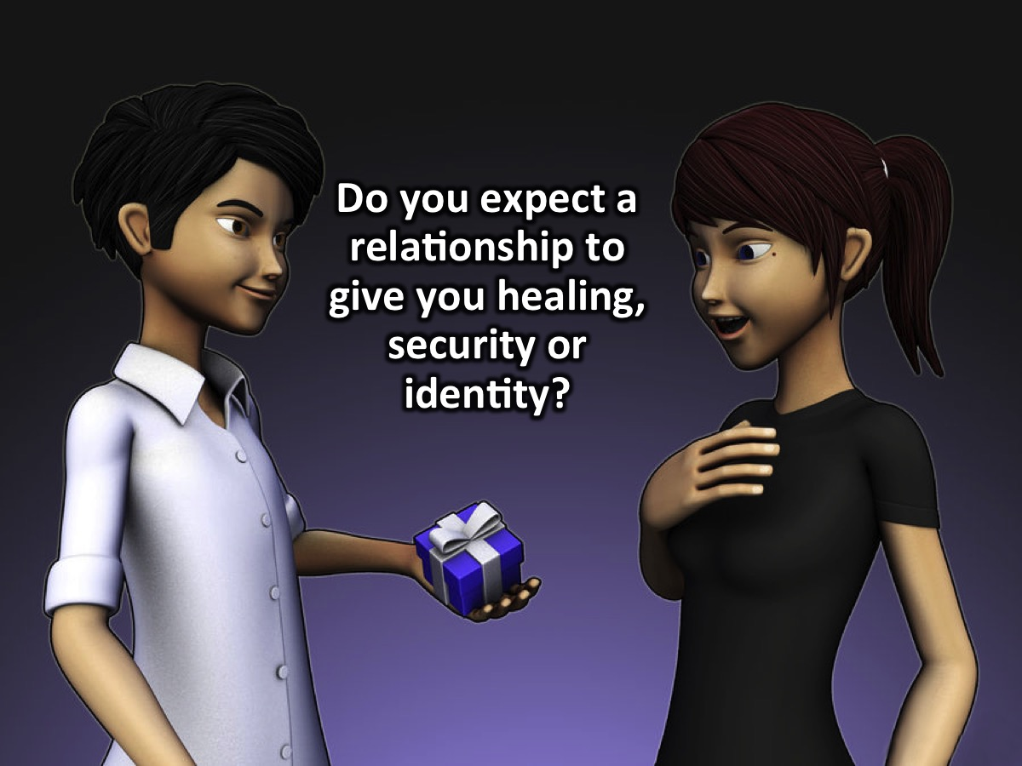
Notes:
12. Do you expect a relationship to give you healing, security or identity?

Slide 39
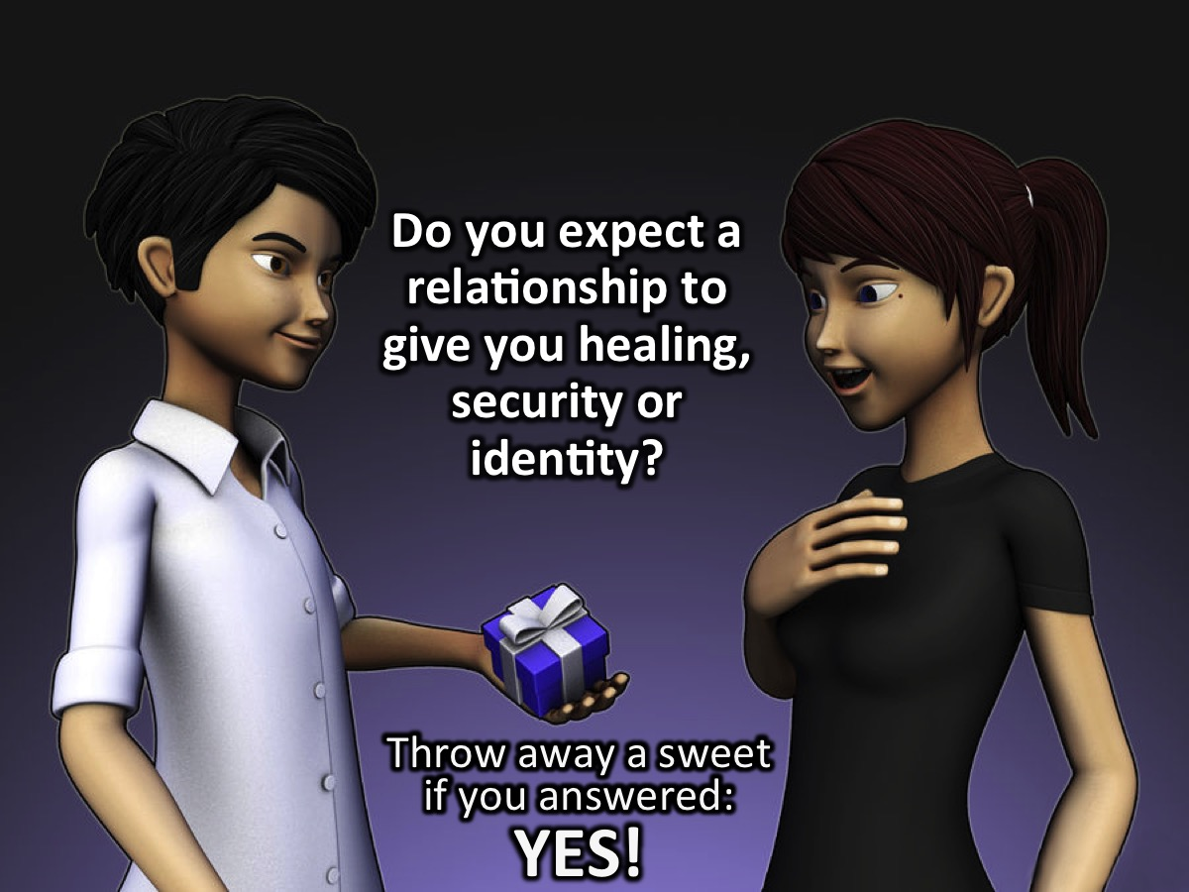
Notes:
Throw away a sweet if you answered: YES!

Slide 40
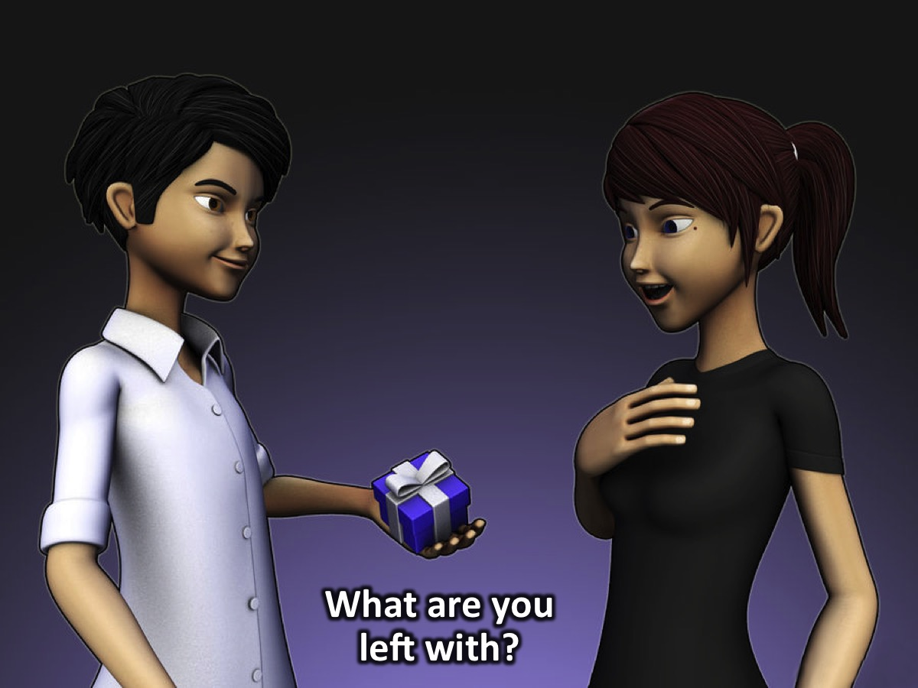
Notes:
What are you left with? Are you ready to date? Not unless you have most of the sweets left that you started with!

Slide 41
Notes:
Video: Don’t Waste Your Singlenes. Get it on YouTube at: https://youtu.be/5qwveeNk2vI

Slide 42
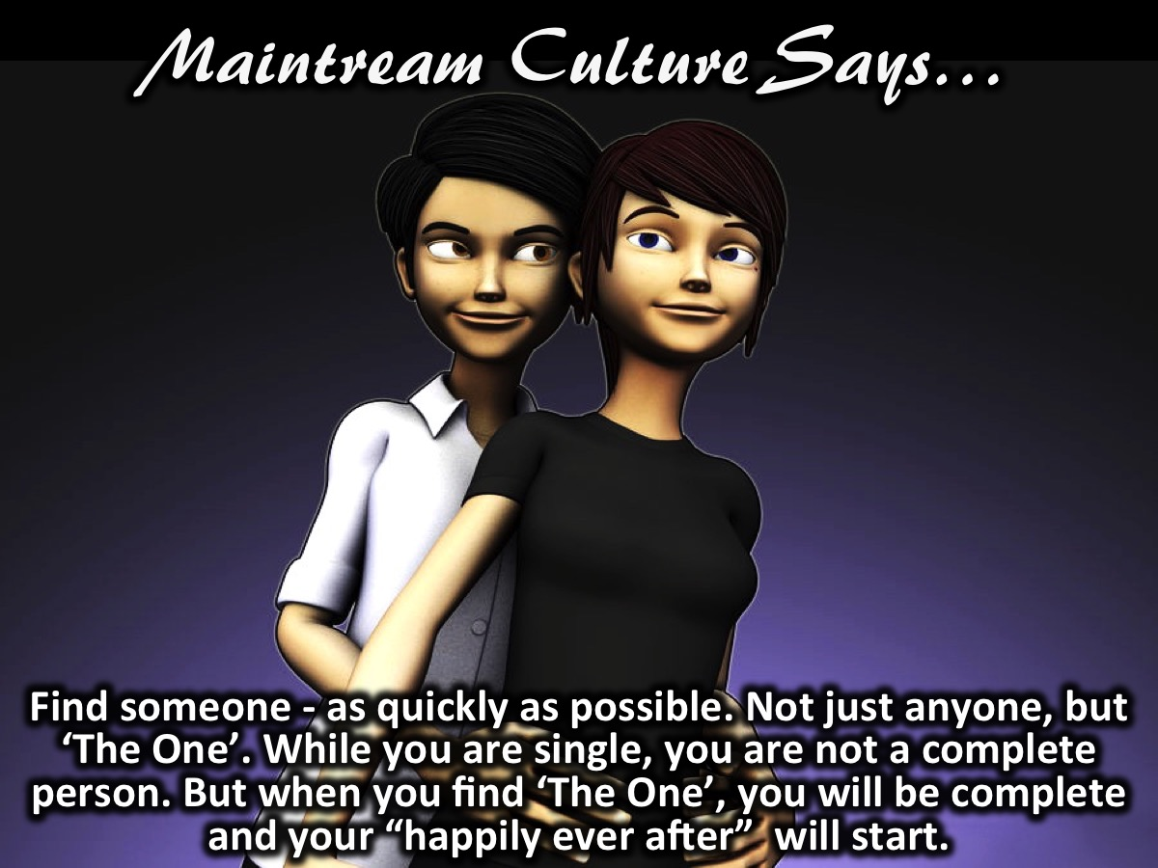
Notes:
Mainstream Culture Says: Find someone - as quickly as possible. Not just anyone, but ‘The One’. While you are single, you are not a complete person. But when you find ‘The One’, you will be complete and your “happily ever after” will start.

Slide 43

Notes:
Biblical Culture Says: Become someone not just anyone; but who God created you to be. Not for the sake of finding someone, but so that you can walk in the fullness of God’s plan, purpose and destiny for your life.

Slide 44
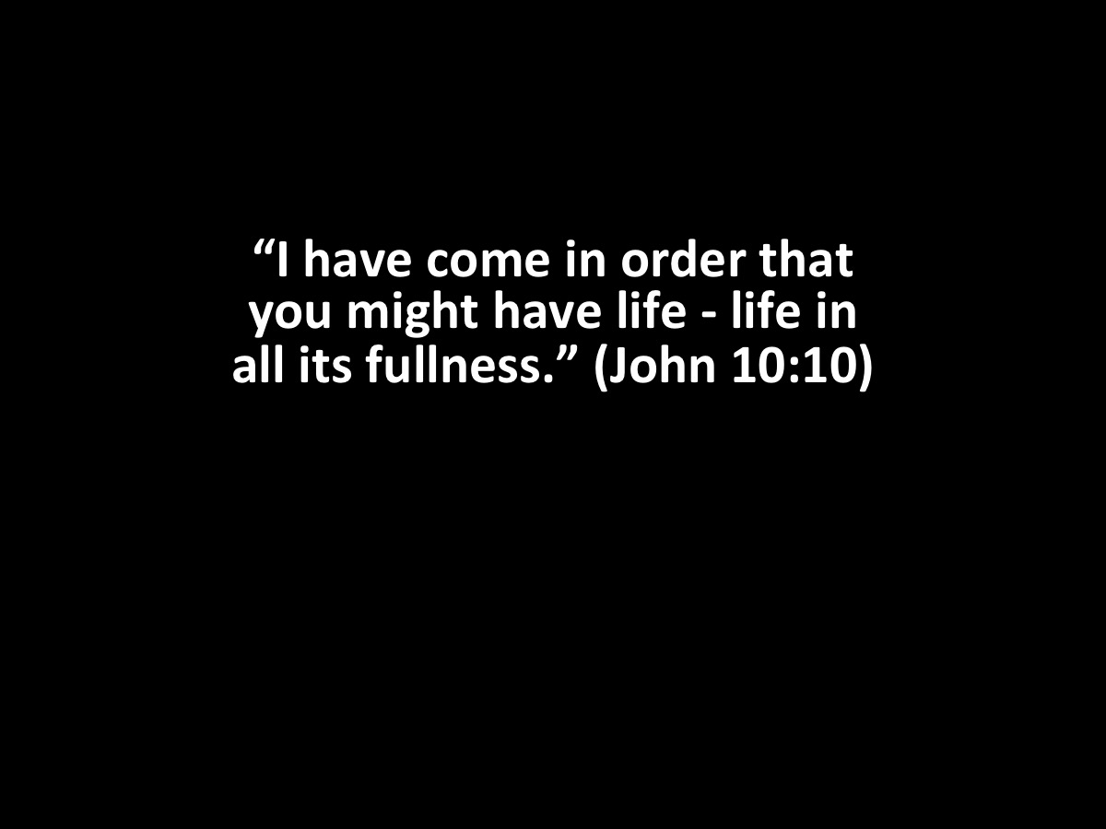
Notes:
“I have come in order that you might have life - life in all its fullness.” (John 10:10)

Slide 45
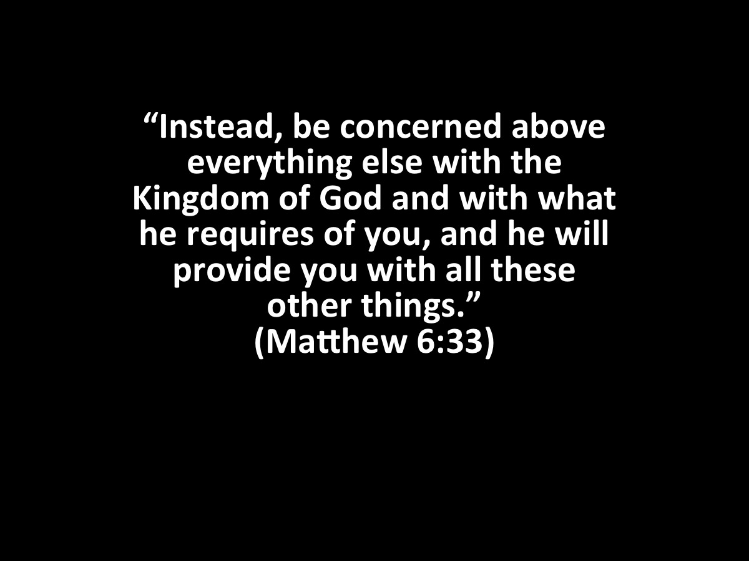
Notes:
“Instead, be concerned above everything else with the Kingdom of God and with what he requires of you, and he will provide you with all these other things.” (Matthew 6:33)

Slide 46
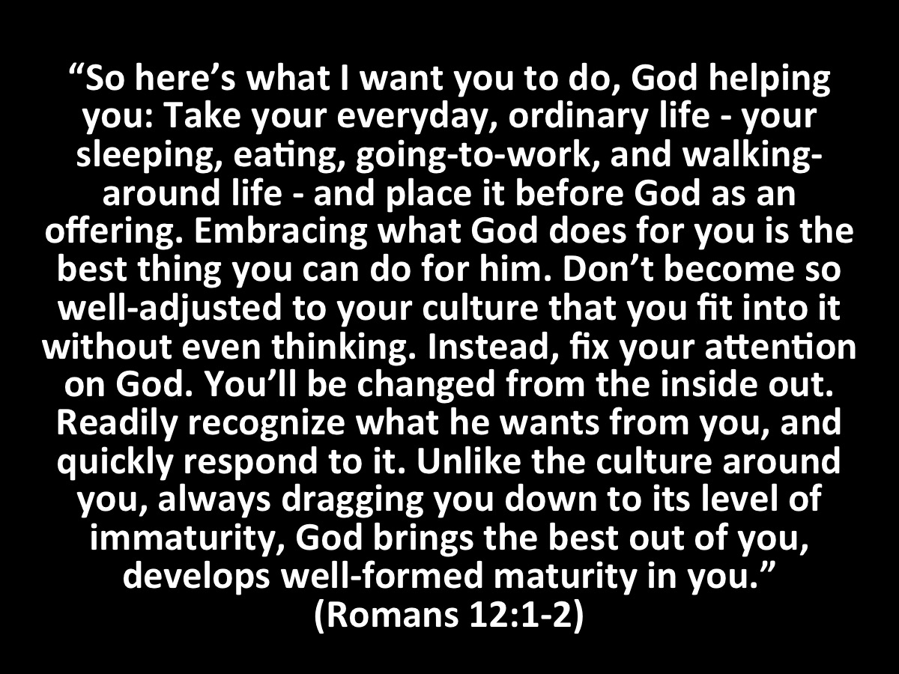
Notes:
“So here’s what I want you to do, God helping you: Take your everyday, ordinary life - your sleeping, eating, going-to-work, and walking-around life - and place it before God as an offering. Embracing what God does for you is the best thing you can do for him. Don’t become so well-adjusted to your culture that you fit into it without even thinking. Instead, fix your attention on God. You’ll be changed from the inside out. Readily recognize what he wants from you, and quickly respond to it. Unlike the culture around you, always dragging you down to its level of immaturity, God brings the best out of you, develops well-formed maturity in you.” (Romans 2:1-2, The Message)

Slide 47
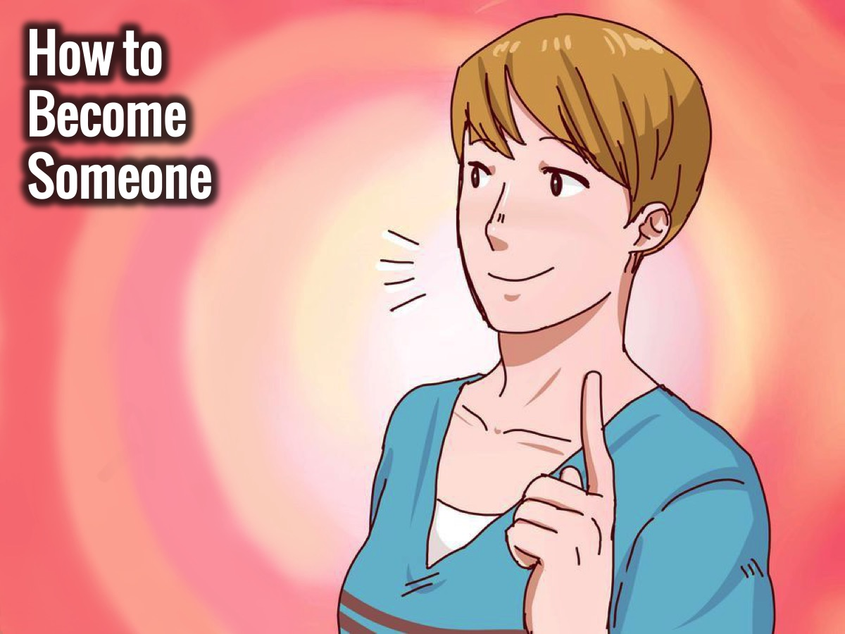
Notes:
How To Become Someone

Slide 48
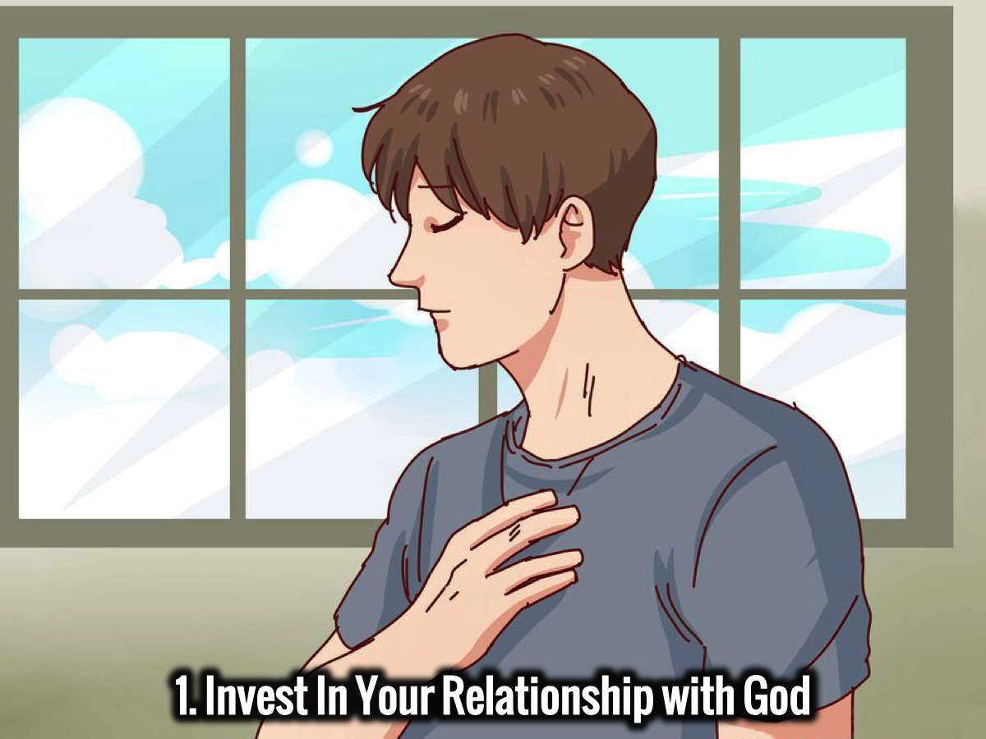
Notes:
1. Invest in Your Relationship with God

Slide 49
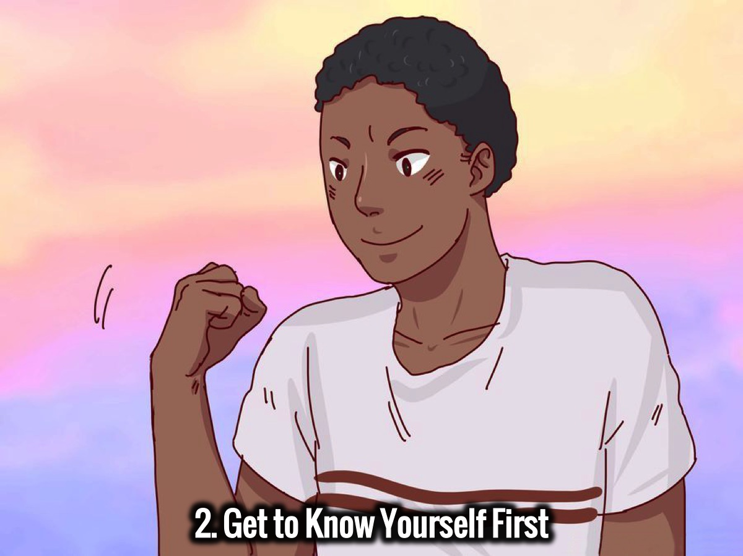
Notes:
2. Get to Know Yourself First

Slide 50
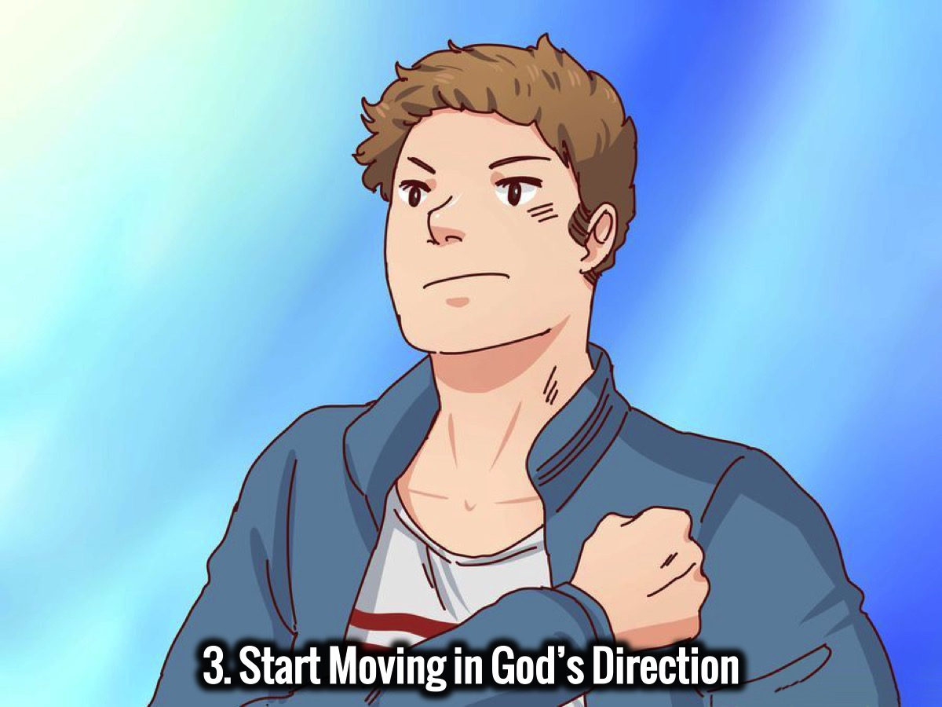
Notes:
3. Start Moving in God’s Direction

Slide 51
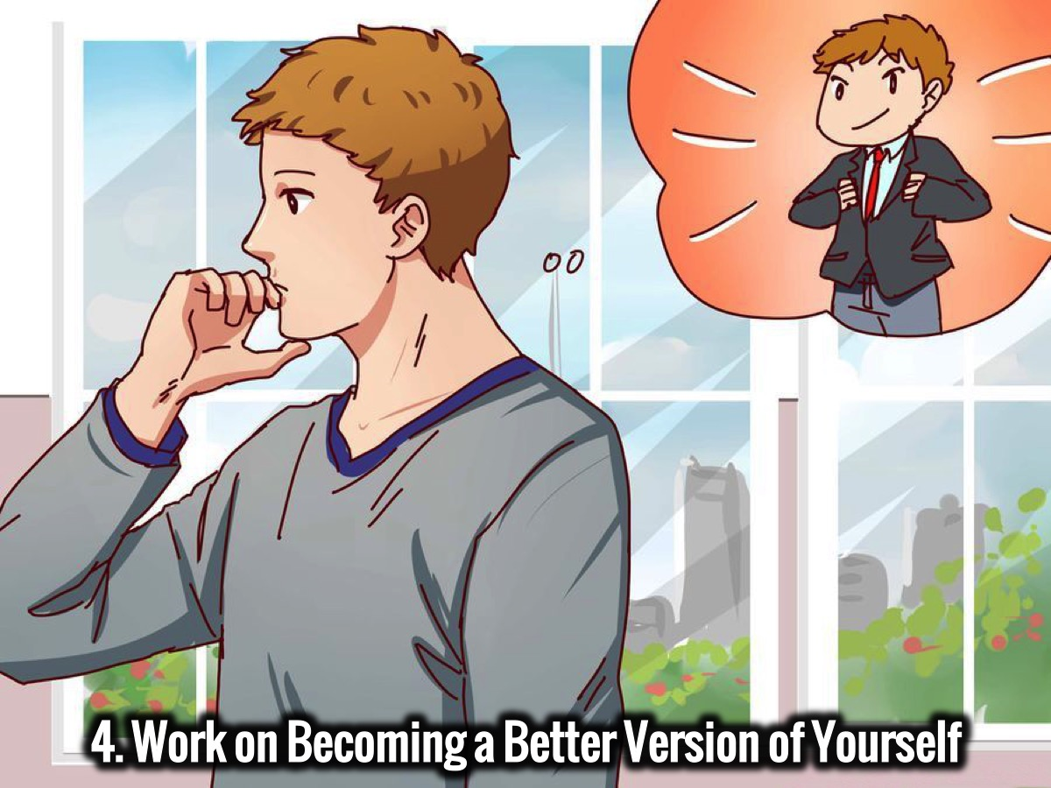
Notes:
4. Work on Becoming a Better Version of Yourself.

Slide 52
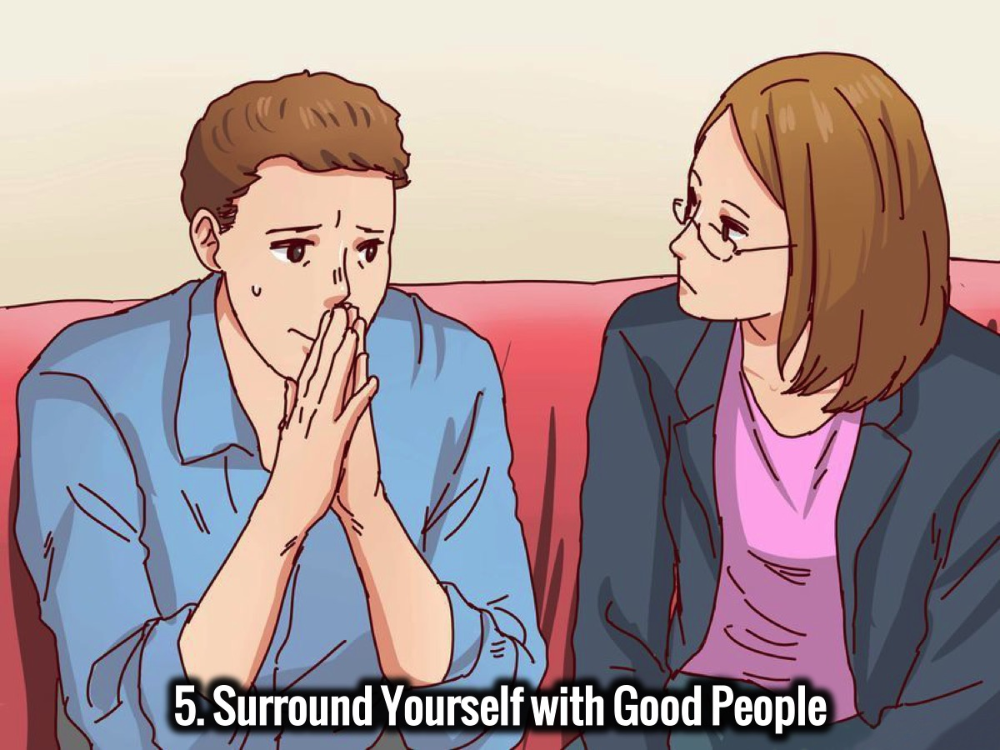
Notes:
5. Surround Yourself with Good People

Slide 53
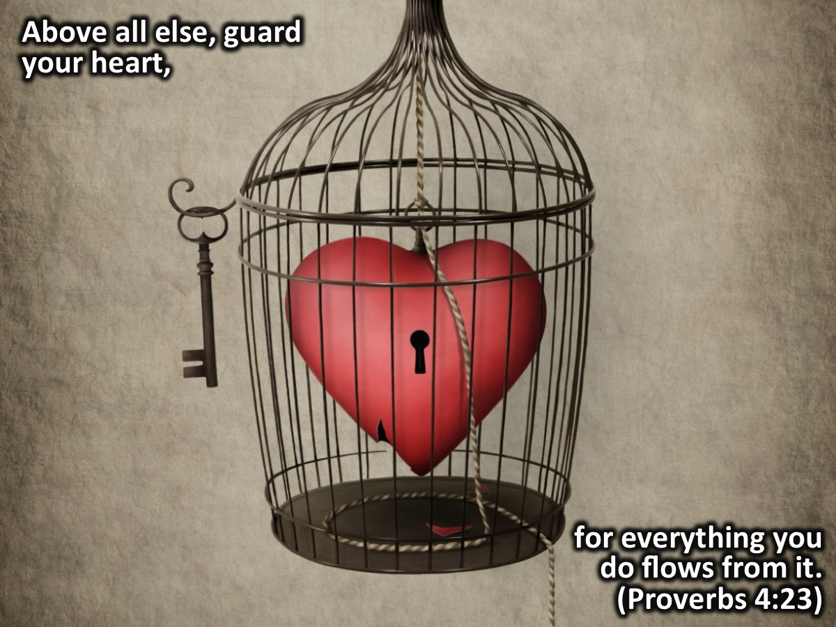
Notes:
We need to guard our hearts! The Bible says in Proverbs 4:23 “Above all else, guard your heart, for everything you do flows from it.”

Slide 54
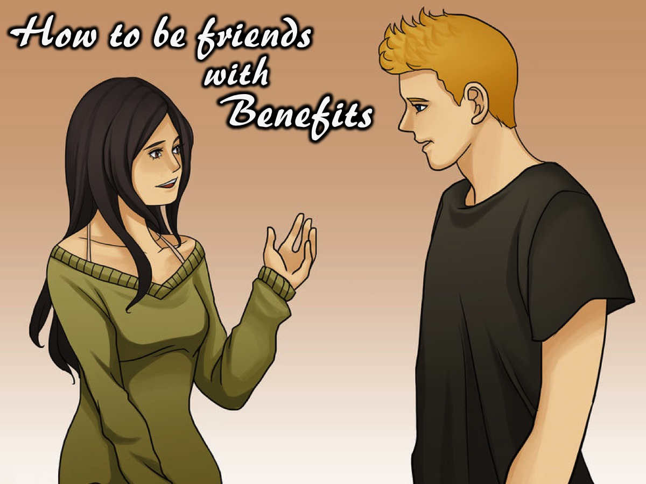
Notes:
How To Be Friends “With Benefits”. Here are 4 principles to help you develop friends with benefits:

Slide 55
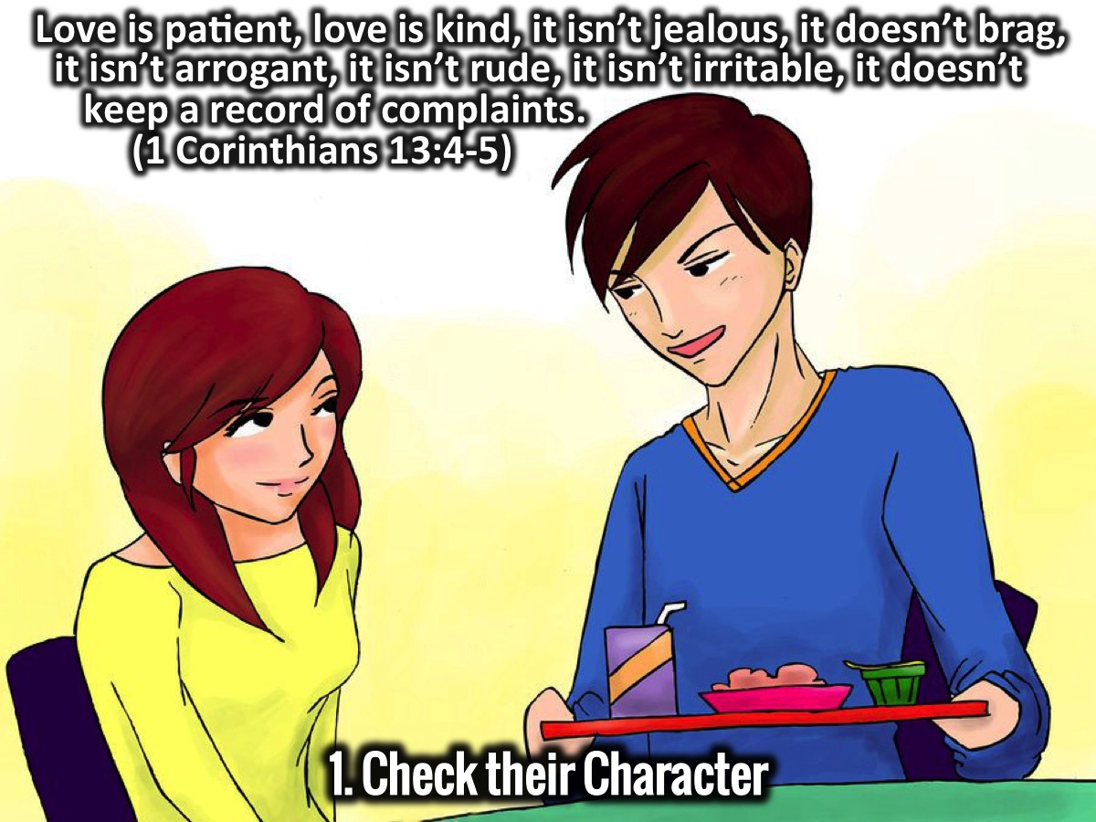
Notes:
1. Check Their Character: “Love is patient, love is kind, it isn’t jealous, it doesn’t brag, it isn’t arrogant, it isn’t rude, it isn’t irritable, it doesn’t keep a record of complaints.” (1 Corinthians 13:4-5)

Slide 56
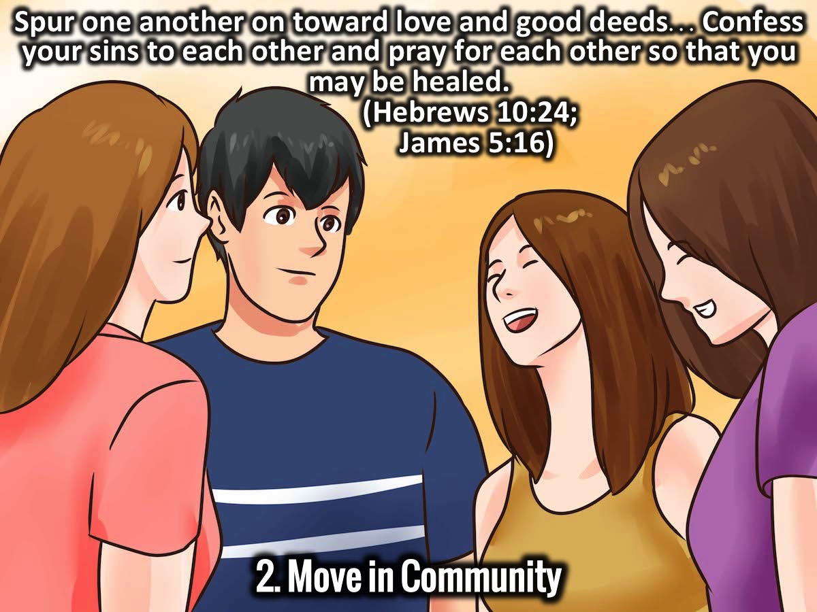
Notes:
2. Move in Community: “Spur one another on toward love and good deeds…Confess your sins to each other and pray for each other so that you may be healed.” (Hebrews 10:24; James 5:16)

Slide 57
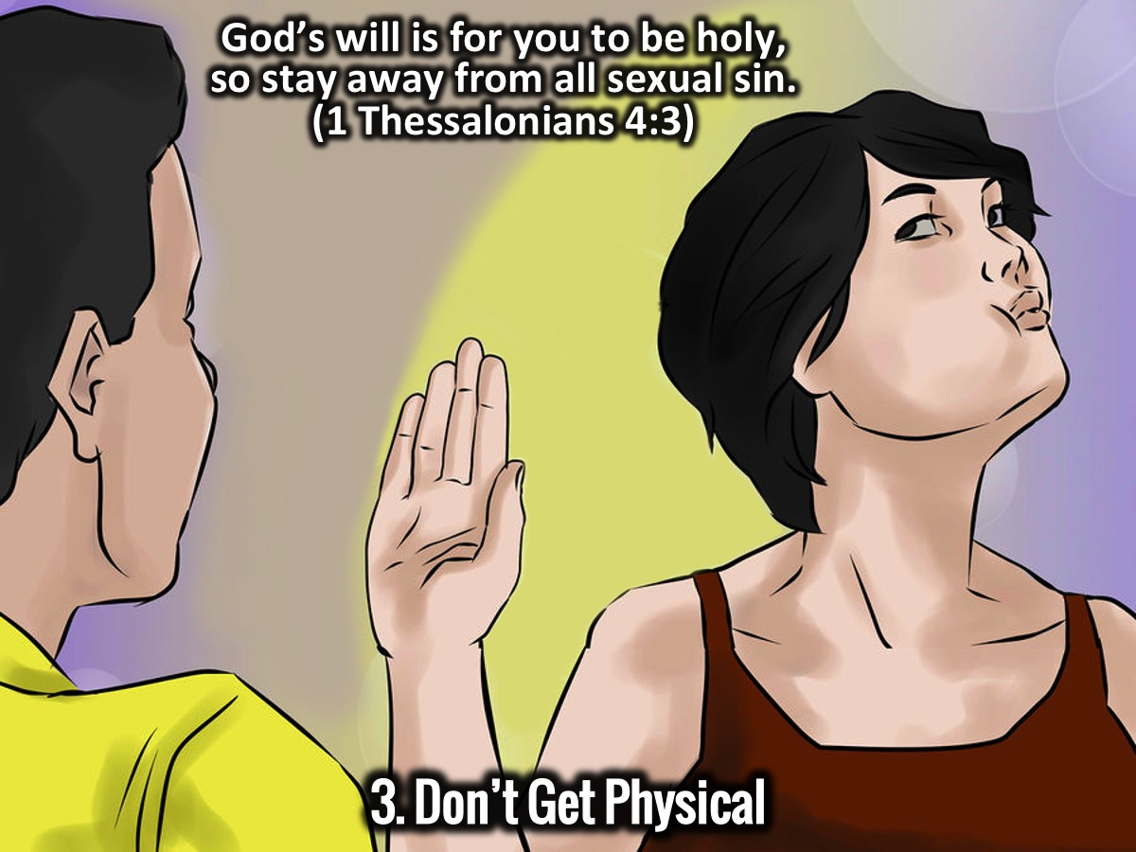
Notes:
3. Don’t Get Physical: God’s will is for you to be holy, so stay away from all sexual sin. (1 Thessalonians 4:3)

Slide 58
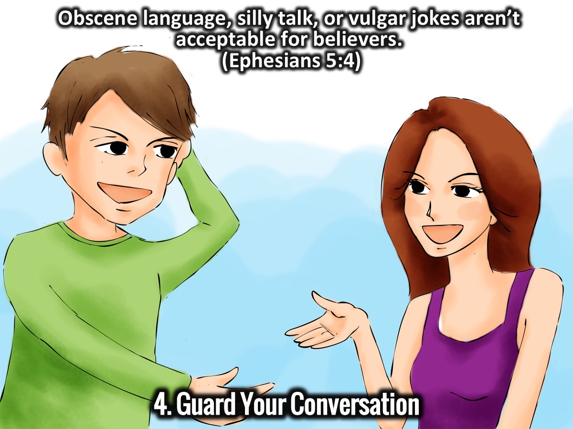
Notes:
4. Guard Your Conversation: Obscene language, silly talk, or vulgar jokes aren’t acceptable for believers.” (Ephesians 5:4)

Slide 59
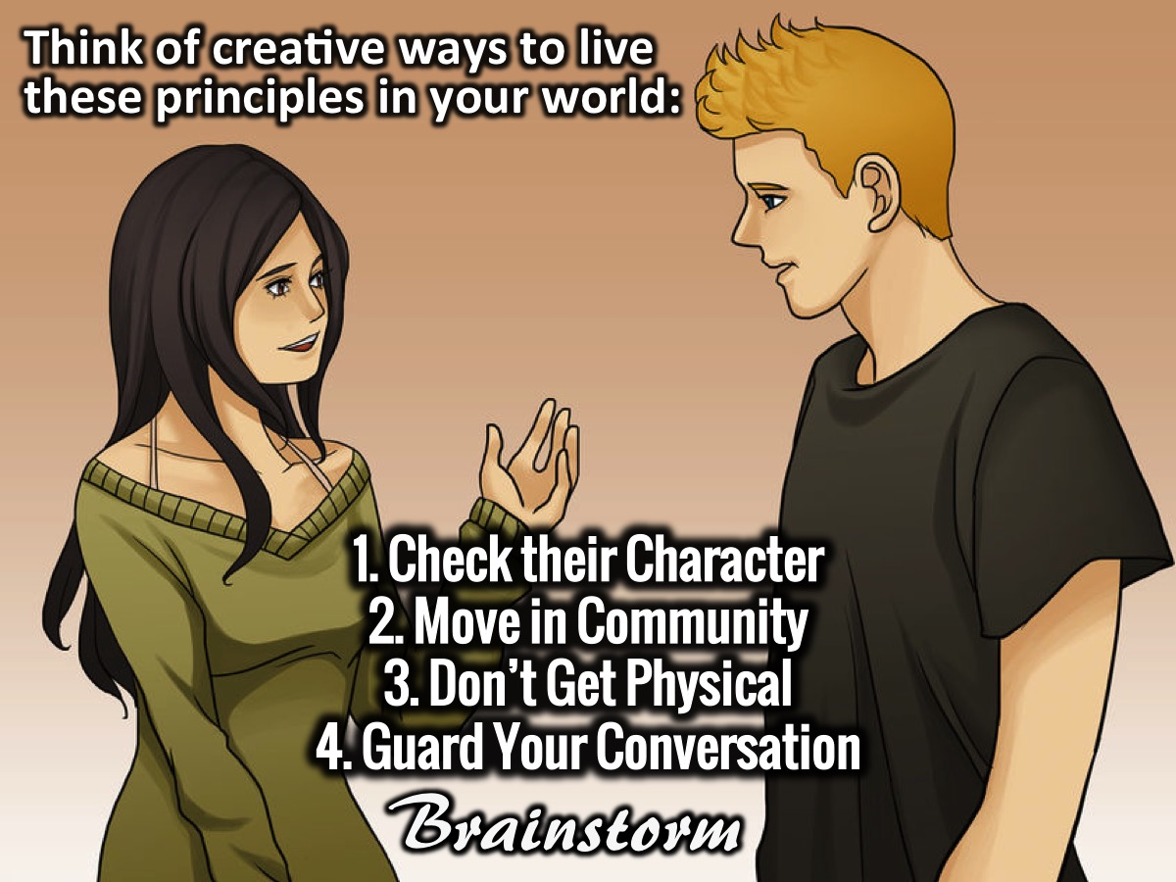
Notes:
Brainstorm: In your small groups you are going to think of creative ways to live these principles in your world: (1) Check their Character. (2) Move in Community. (3) Don’t Get Physical. (4) Guard Your Conversation.
Feedback: Each group will share 1 creative idea for each of the principles.

Slide 60
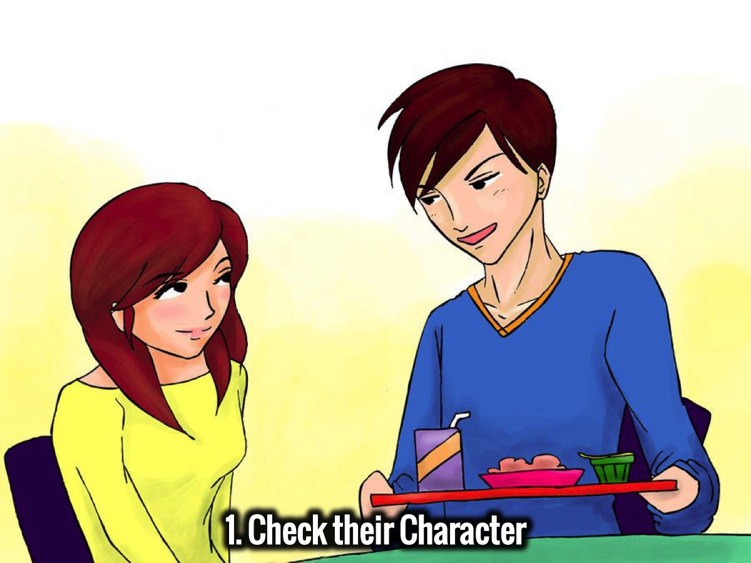
Notes:
1. Check Their Character.

Slide 61
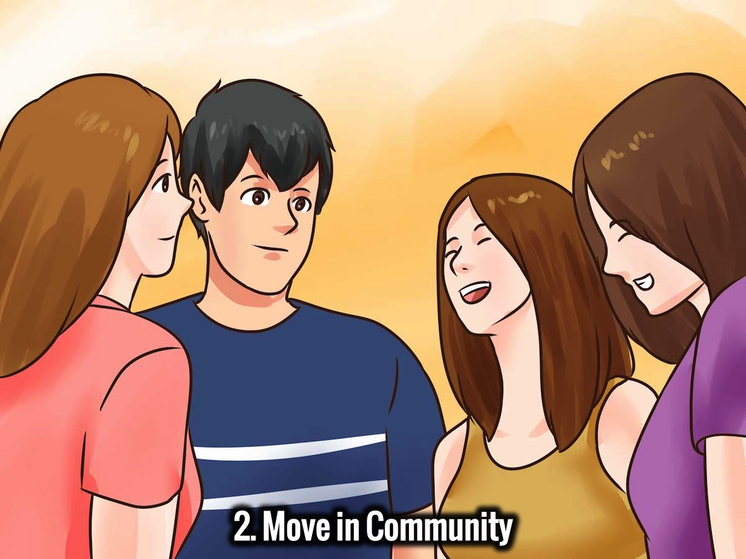
Notes:
2. Move in Community.

Slide 62
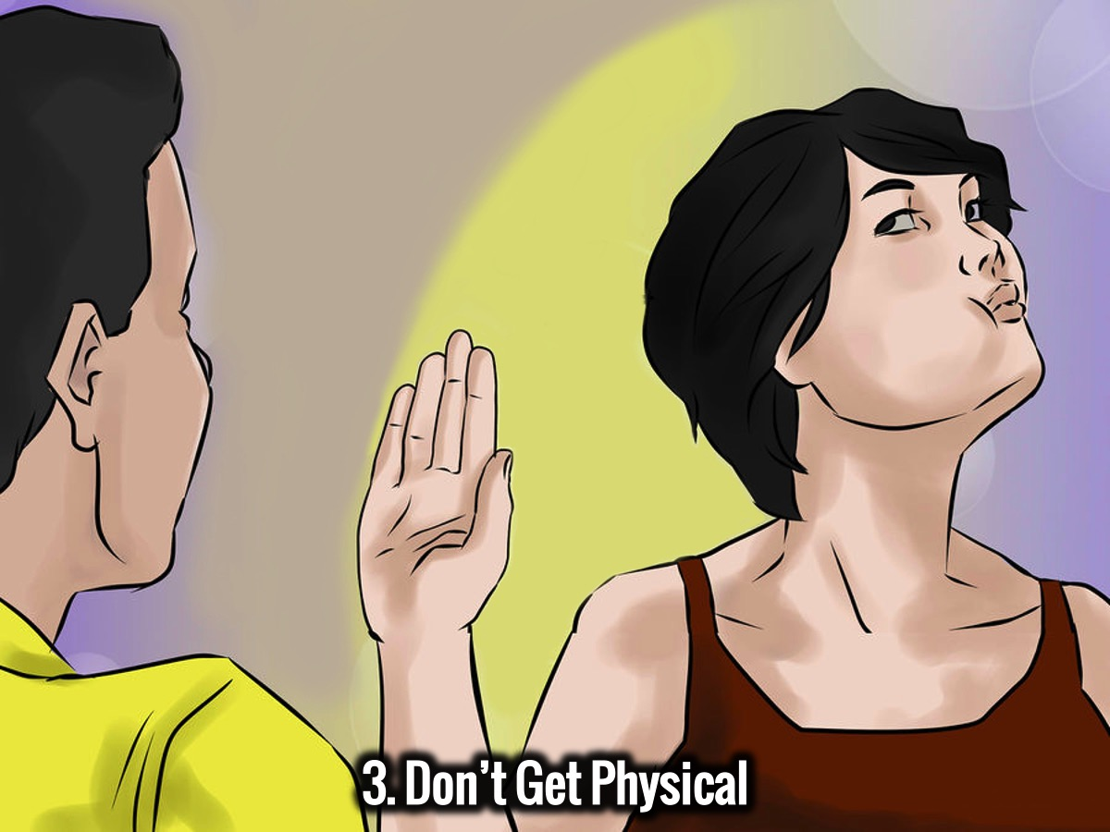
Notes:
3. Don’t Get Physical.

Slide 63
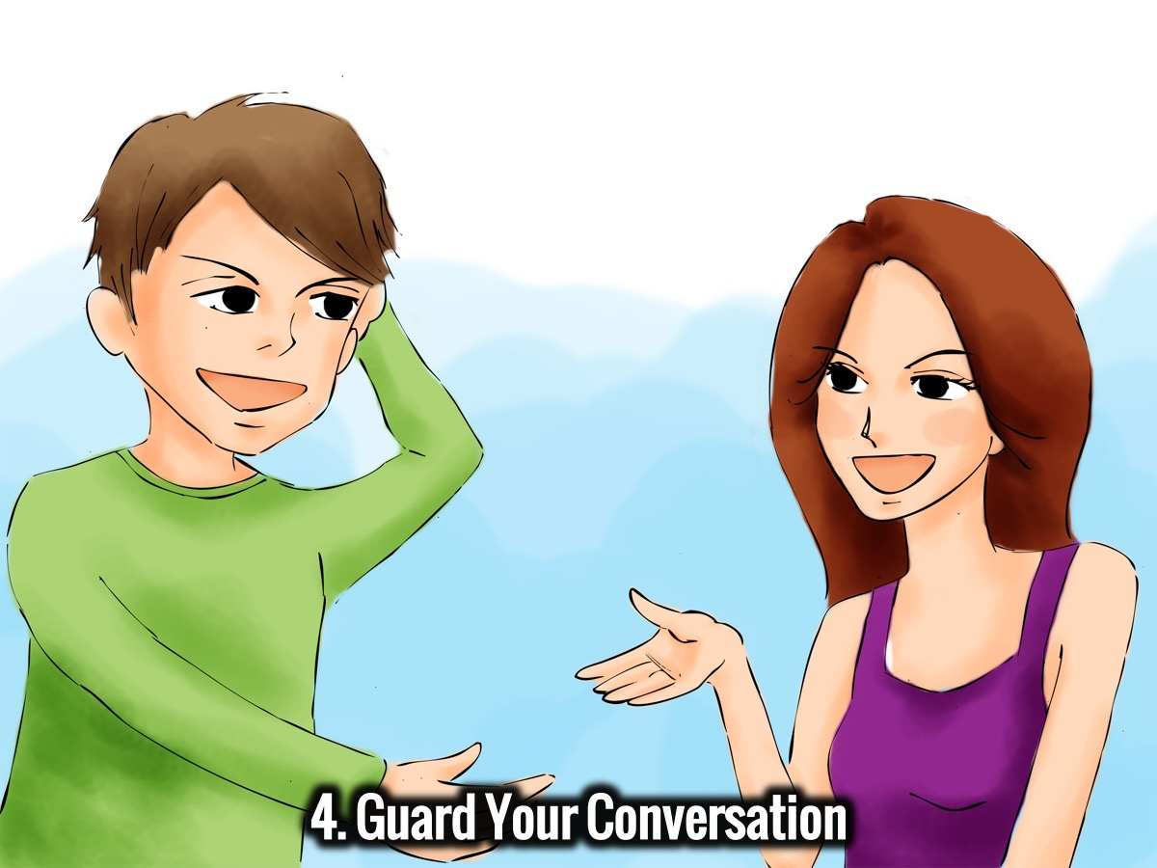
Notes:
4. Guard Your Conversation.

Slide 64
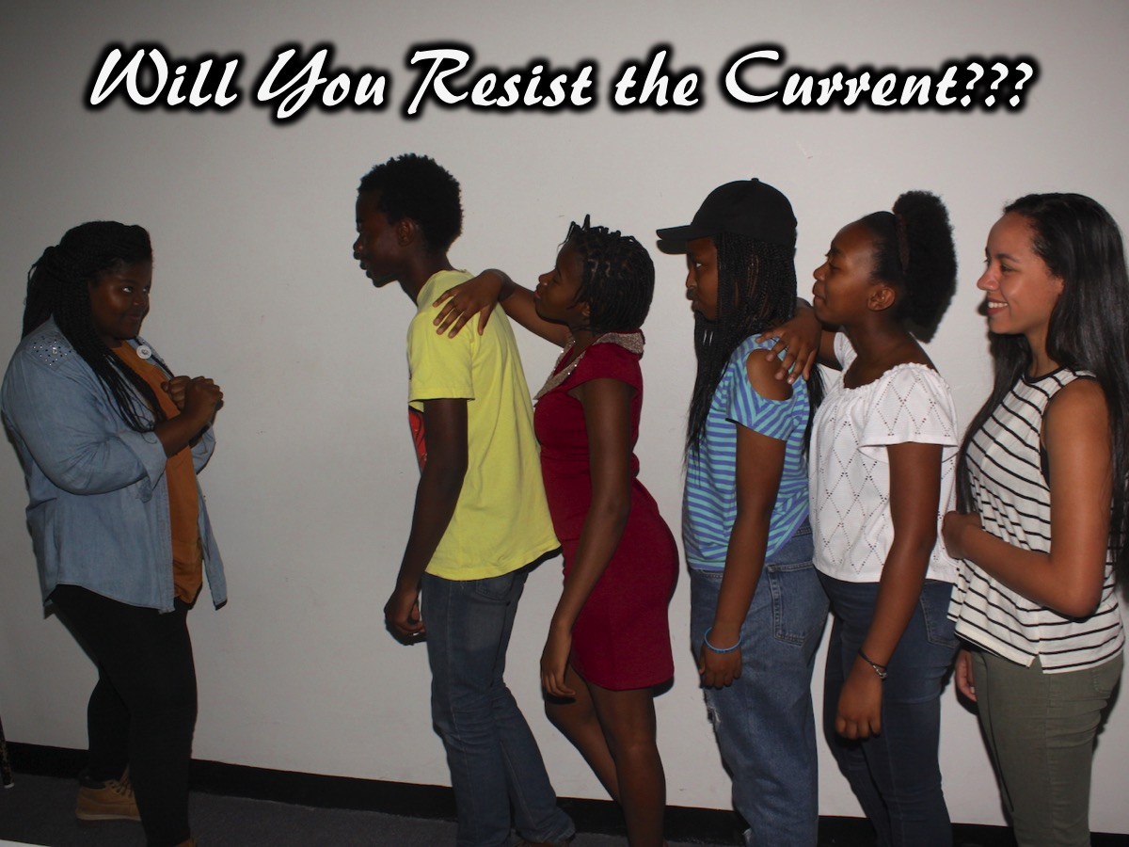
Notes:
Will You Resist the Current? Let’s close in a word of prayer before refreshments are served.

Slide 65

Notes:
On Sunday morning it is week 4 of our Spirit Series - Genevieve’s Dad will be preaching on the filling of the Holy Spirit.

Slide 66

Notes:
Next Friday night is the third week of our Baewatch Series - His and Hers Beaches!

Slide 67

Refreshments
Notes:
Refreshments are served.

