Slide 1

Notes:
So welcome to week 3 of our Baewatch series.

Slide 2
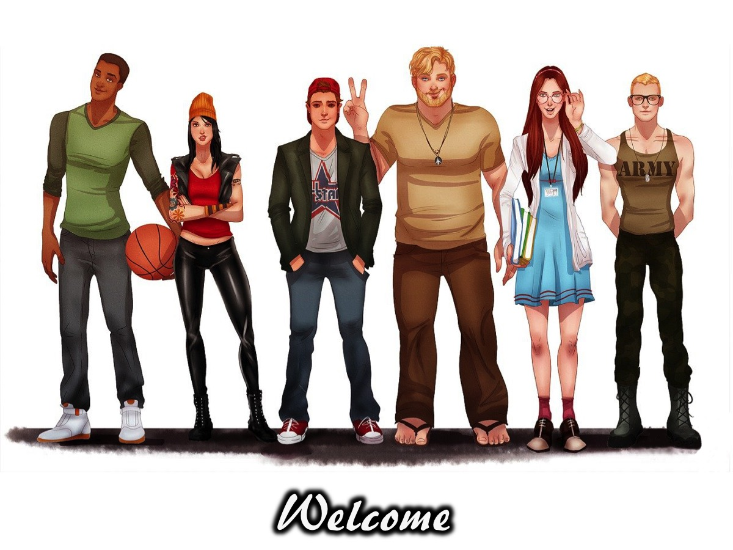
Notes:
Welcome to regulars and newcomers.

Slide 3
Notes:
So welcome to another Baewatch session.

Slide 4
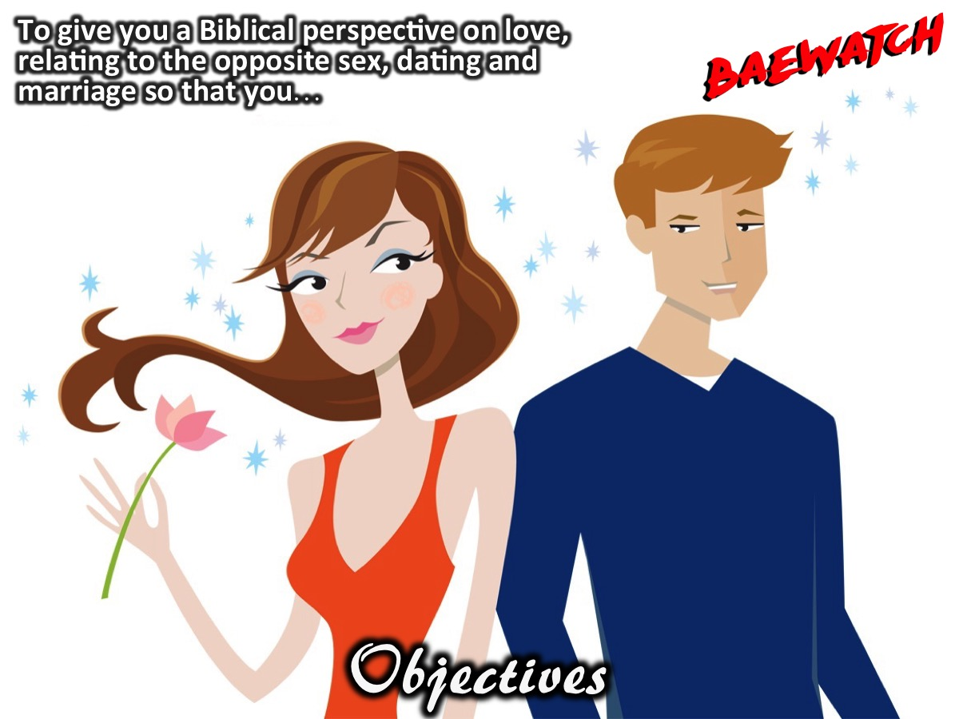
Notes:
Objectives: To give you a Biblical perspective on love, relating to the opposite sex, dating and marriage so that you…

Slide 5
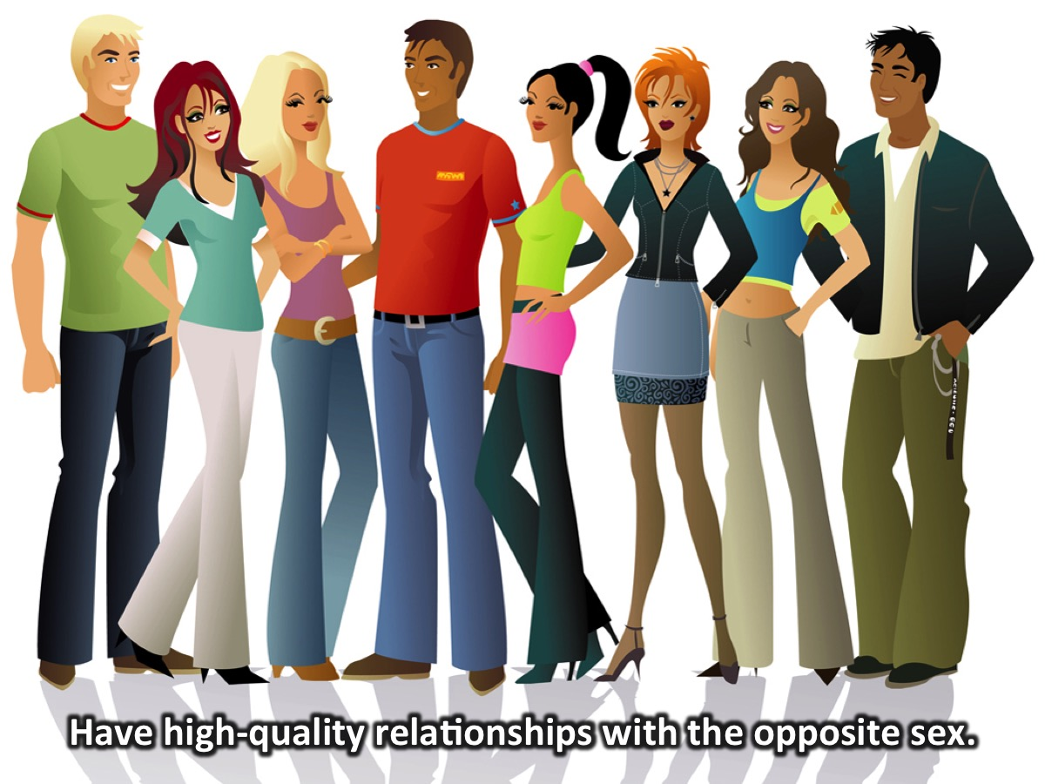
Notes:
1. Have high-quality relationships with the opposite sex.

Slide 6
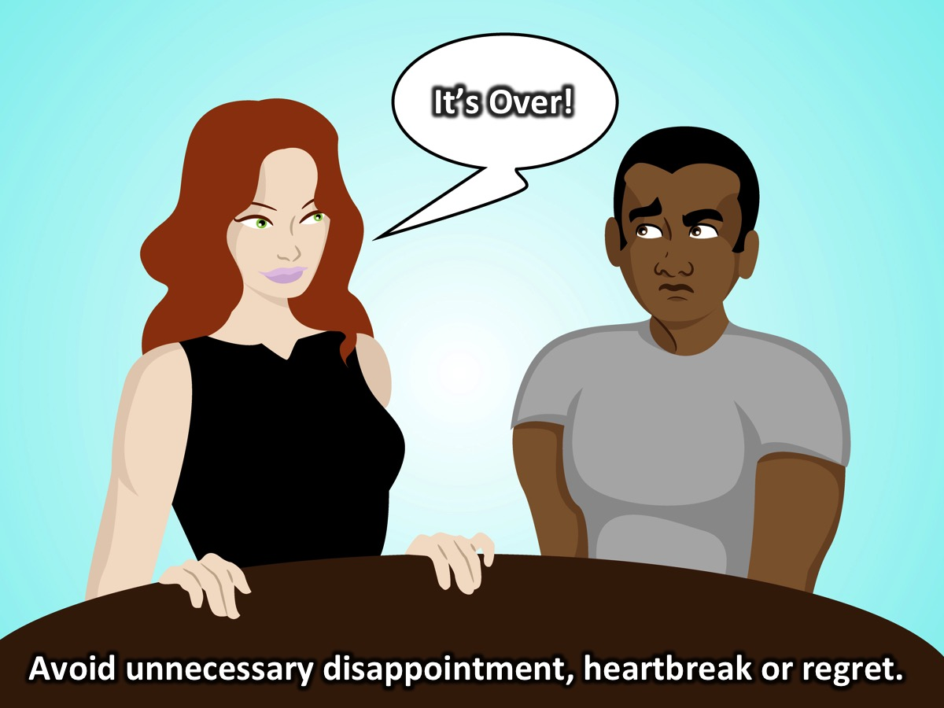
Notes:
2. Avoid unnecessary relational disappointment, heartbreak, and regret.

Slide 7
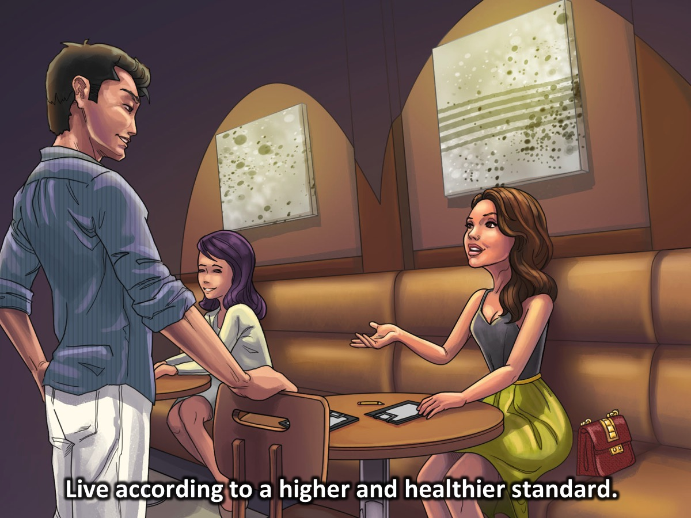
Notes:
3. Live according to a higher and healthier standard.

Slide 8
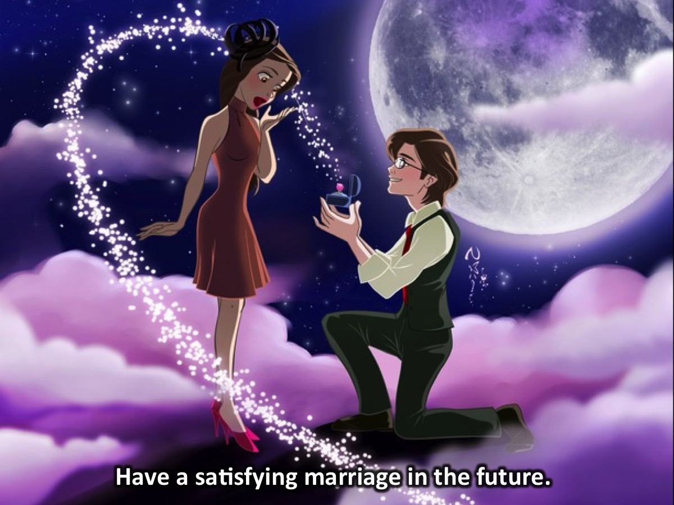
Notes:
4. Have a satisfying marriage in the future.

Slide 9
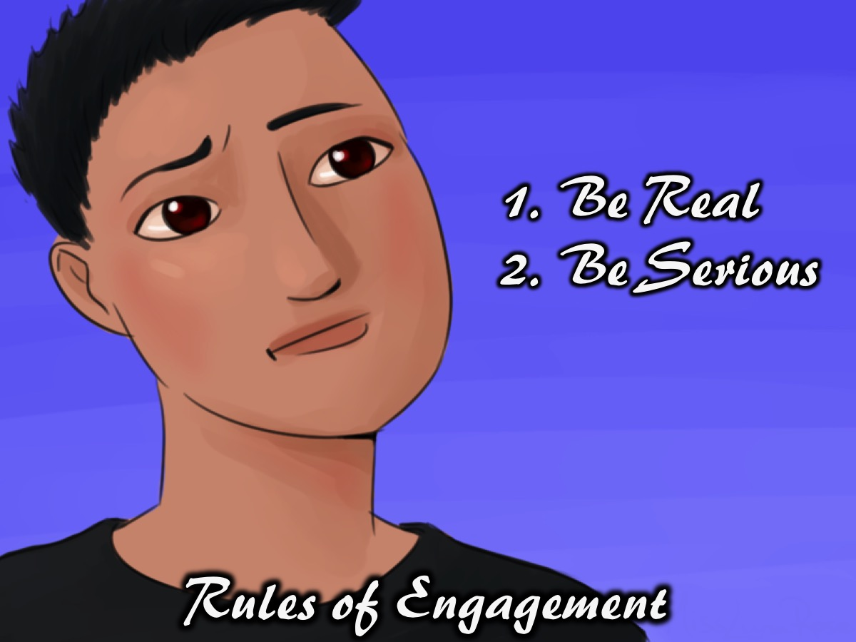
Notes:
Rules of Engagement: (1) Be Real. (2) Take This Seriously (or Be Serious).

Slide 10
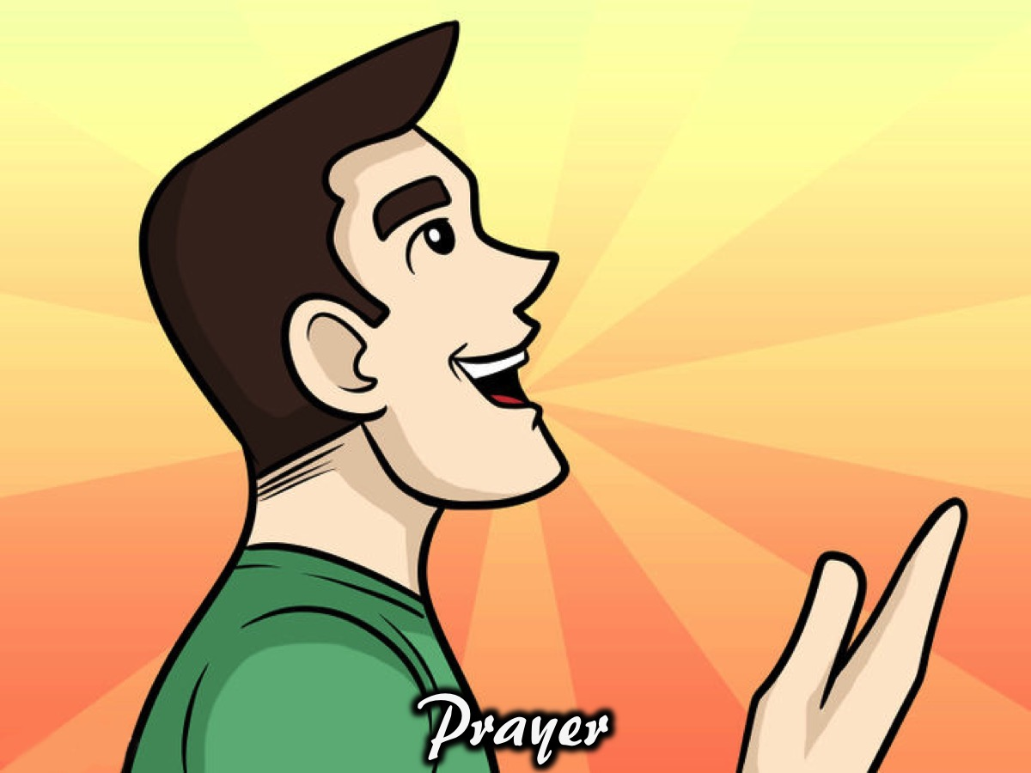
Notes:
Prayer

Slide 11

Notes:
Tonight is His & Her Beaches - the guys are going to stay in the youth room and the girls are going to follow Debbie, Genevieve and Ashley to a different venue.

Slide 12
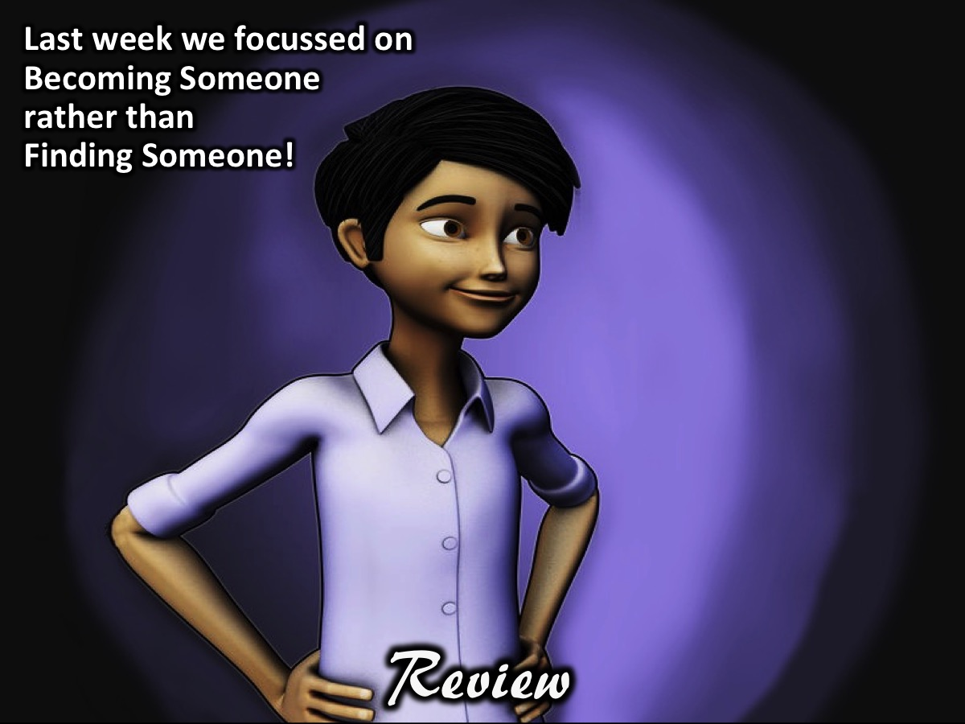
Notes:
Review: Last week about focusing on becoming someone rather than finding someone.

Slide 13
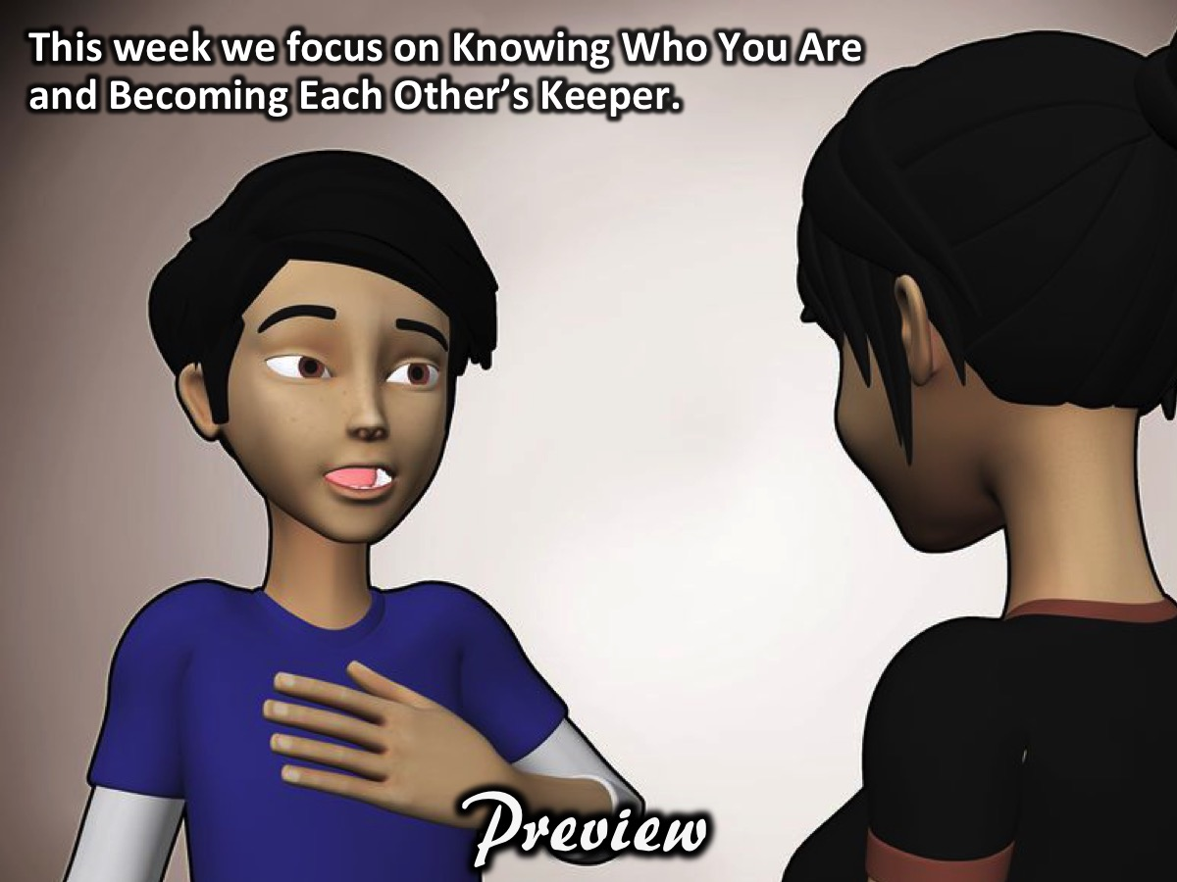
Notes:
Preview: The focus this week is on Identity and Community. We are going to focus on knowing who you are and being each others' keeper in the sense of calling each other to that identity.

Slide 14
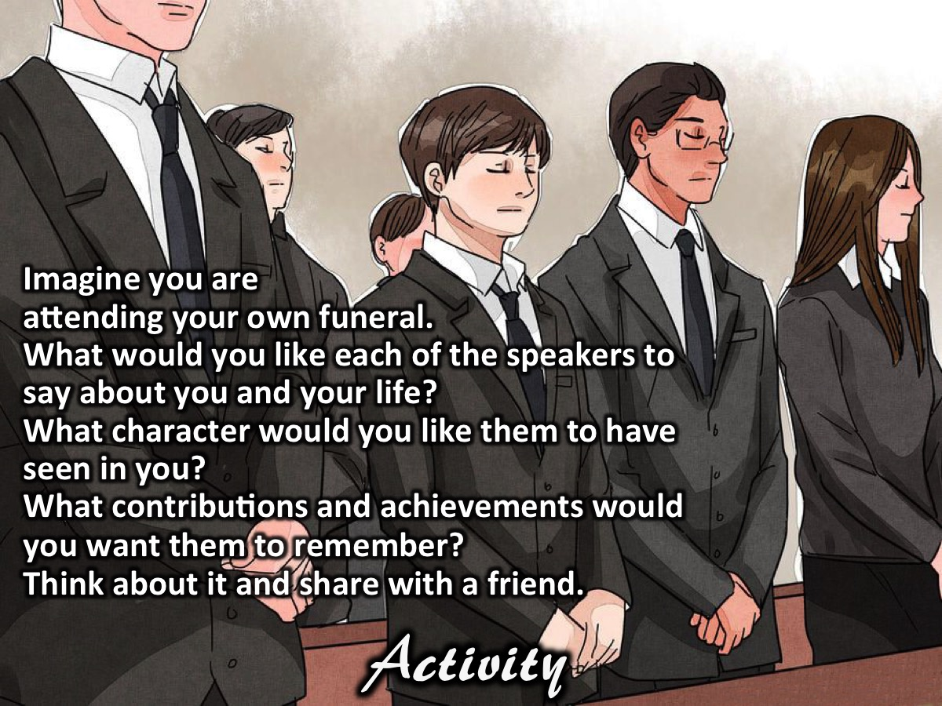
Notes:
Activity: Imagine you are attending your own funeral. What would you like each of the speakers to say about you and your life? What character would you like them to have seen in you? What contributions and achievements would you want them to remember? Think about it and share with a friend.

Slide 15
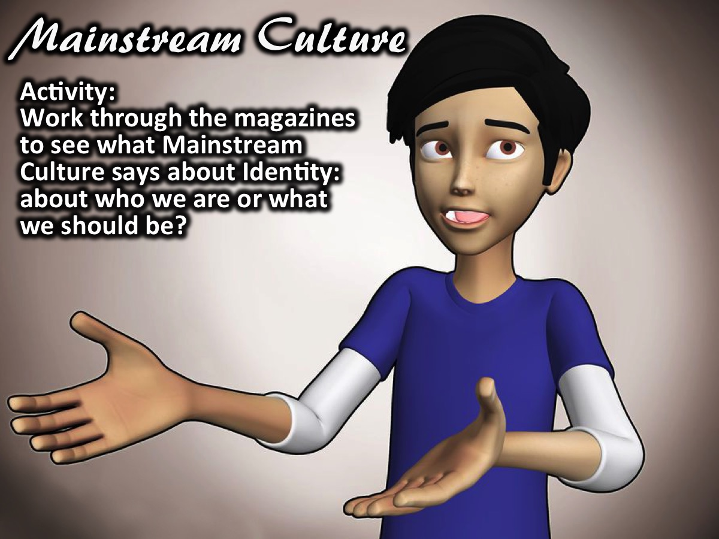
Notes:
Activity: Our Identity According to Mainstream Culture: Work through the magazines to see what Mainstream Culture says about who you are or what you should be?

Slide 16
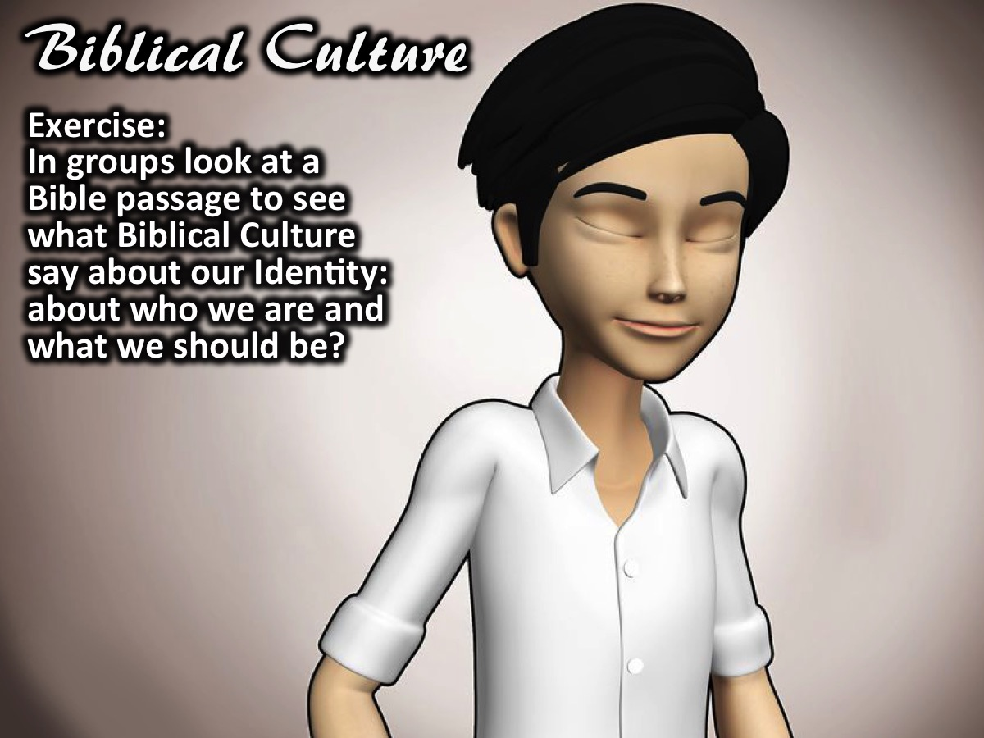
Notes:
Exercise: Our Identity According to Biblical Culture: In small groups look at a Bible passage to see what Biblical Culture says about our Identity: about who we are and what we should be? Here are the scripture that will be given to the groups (one passage each):
You are chosen people, a royal priesthood, a holy nation, people who belong to God. You were chosen to tell about the excellent qualities of God, who called you out of darkness into his marvelous light. Dear friends, since you are foreigners and temporary residents in the world, I’m encouraging you to keep away from the desires of your corrupt nature. These desires constantly attack you. Live decent lives among unbelievers. Then, although they ridicule you as if you were doing wrong while they are watching you do good things, they will praise God on the day he comes to help you. (1 Peter 2:9-12)
Don’t you realize that your bodies are parts of Christ’s body? Should I take the parts of Christ’s body and make them parts of a prostitute’s body? That’s unthinkable! Don’t you realize that the person who unites himself with a prostitute becomes one body with her? God says, “The two will be one.” However, the person who unites himself with the Lord becomes one spirit with him. Stay away from sexual sins. Other sins that people commit don’t affect their bodies the same way sexual sins do. People who sin sexually sin against their own bodies. Don’t you know that your body is a temple that belongs to the Holy Spirit? The Holy Spirit, whom you received from God, lives in you. You don’t belong to yourselves. You were bought for a price. So bring glory to God in the way you use your body. (1 Corinthians 6:15-20)
Put to death, therefore, whatever belongs to your earthly nature: sexual immorality, impurity, lust, evil desires and greed, which is idolatry. Because of these, the wrath of God is coming. You used to walk in these ways, in the life you once lived. But now you must also rid yourselves of all such things as these: anger, rage, malice, slander, and filthy language from your lips. Do not lie to each other, since you have taken off your old self with its practices and have put on the new self, which is being renewed in knowledge in the image of its Creator. (Colossians 3:5-10)
So I tell you this, and insist on it in the Lord, that you must no longer live as the Gentiles do, in the futility of their thinking. They are darkened in their understanding and separated from the life of God because of the ignorance that is in them due to the hardening of their hearts. Having lost all sensitivity, they have given themselves over to sensuality so as to indulge in every kind of impurity, and they are full of greed. That, however, is not the way of life you learned when you heard about Christ and were taught in him in accordance with the truth that is in Jesus. You were taught, with regard to your former way of life, to put off your old self, which is being corrupted by its deceitful desires; to be made new in the attitude of your minds; and to put on the new self, created to be like God in true righteousness and holiness. (Ephesians 4:17-24)
Therefore, as God’s chosen people, holy and dearly loved, clothe yourselves with compassion, kindness, humility, gentleness and patience. Bear with each other and forgive one another if any of you has a grievance against someone. Forgive as the Lord forgave you. And over all these virtues put on love, which binds them all together in perfect unity. Let the peace of Christ rule in your hearts, since as members of one body you were called to peace. And be thankful. And whatever you do, whether in word or deed, do it all in the name of the Lord Jesus, giving thanks to God the Father through him. (Colossians 3:12-17)
Do nothing out of selfish ambition or vain conceit. Rather, in humility value others above yourselves, not looking to your own interests but each of you to the interests of the others. Do everything without grumbling or arguing, so that you may become blameless and pure, “children of God without fault in a warped and crooked generation.” Then you will shine among them like stars in the sky as you hold firmly to the word of life. (Philippians 2:3-4,14-16)

Slide 17
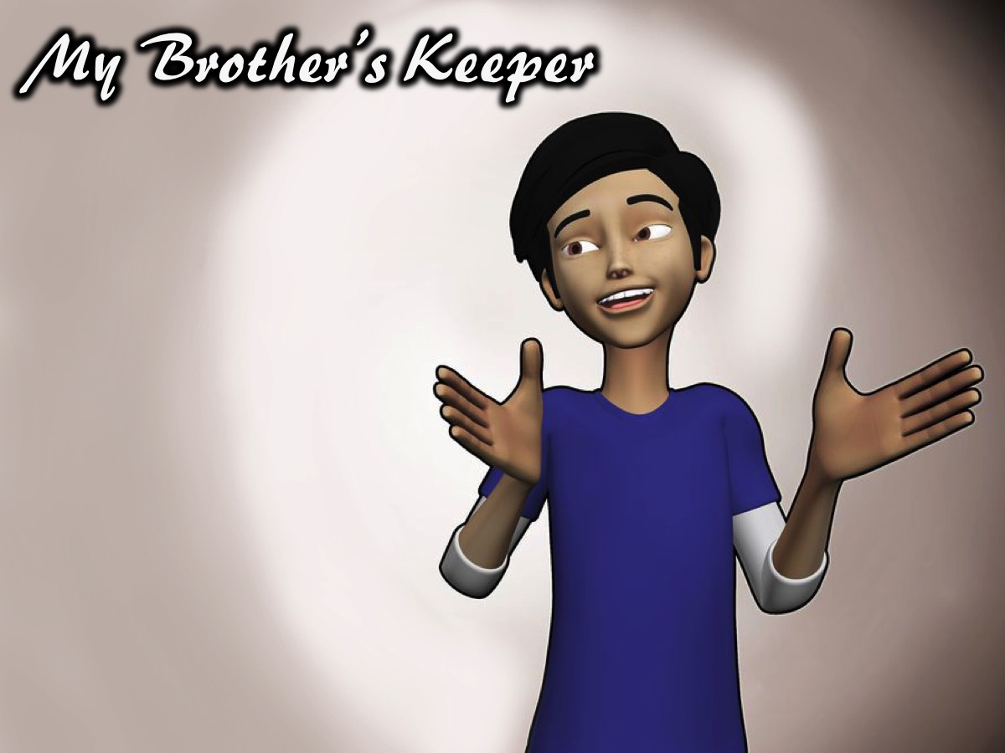
Notes:
Becoming Keepers: Challenge guys to become a community that holds each other accountable to that standard.

Slide 18
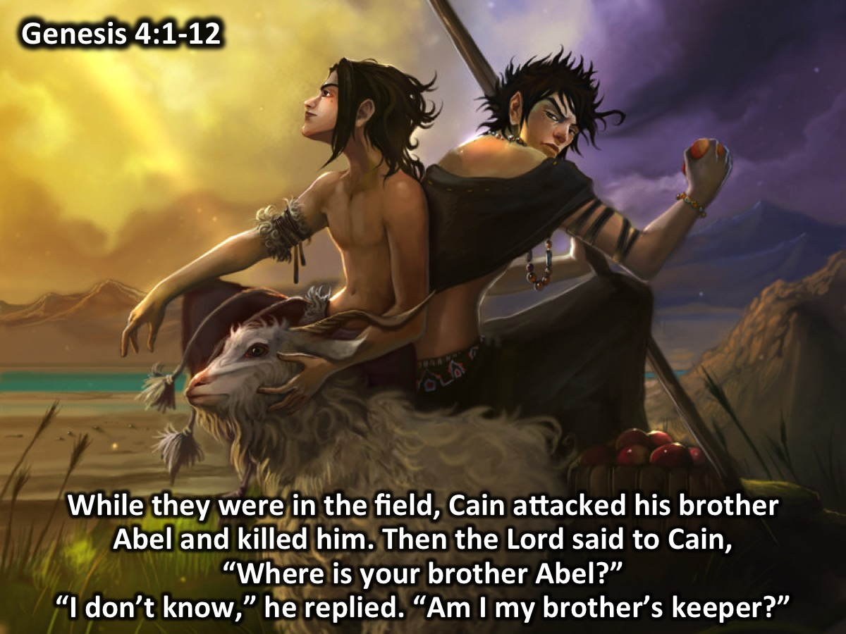
Notes:
The Story of Cain and Abel (Genesis 4:1-12)
Adam made love to his wife Eve, and she became pregnant and gave birth to Cain. She said, “With the help of the Lord I have brought forth a man.” Later she gave birth to his brother Abel. Now Abel kept flocks, and Cain worked the soil. In the course of time Cain brought some of the fruits of the soil as an offering to the Lord. And Abel also brought an offering—fat portions from some of the firstborn of his flock. The Lord looked with favor on Abel and his offering, but on Cain and his offering he did not look with favor. So Cain was very angry, and his face was downcast. Then the Lord said to Cain, “Why are you angry? Why is your face downcast? If you do what is right, will you not be accepted? But if you do not do what is right, sin is crouching at your door; it desires to have you, but you must rule over it.” Now Cain said to his brother Abel, “Let’s go out to the field.” While they were in the field, Cain attacked his brother Abel and killed him. Then the Lord said to Cain, “Where is your brother Abel?” “I don’t know,” he replied. “Am I my brother’s keeper?” The Lord said, “What have you done? Listen! Your brother’s blood cries out to me from the ground. Now you are under a curse and driven from the ground, which opened its mouth to receive your brother’s blood from your hand. When you work the ground, it will no longer yield its crops for you. You will be a restless wanderer on the earth.”

Slide 19
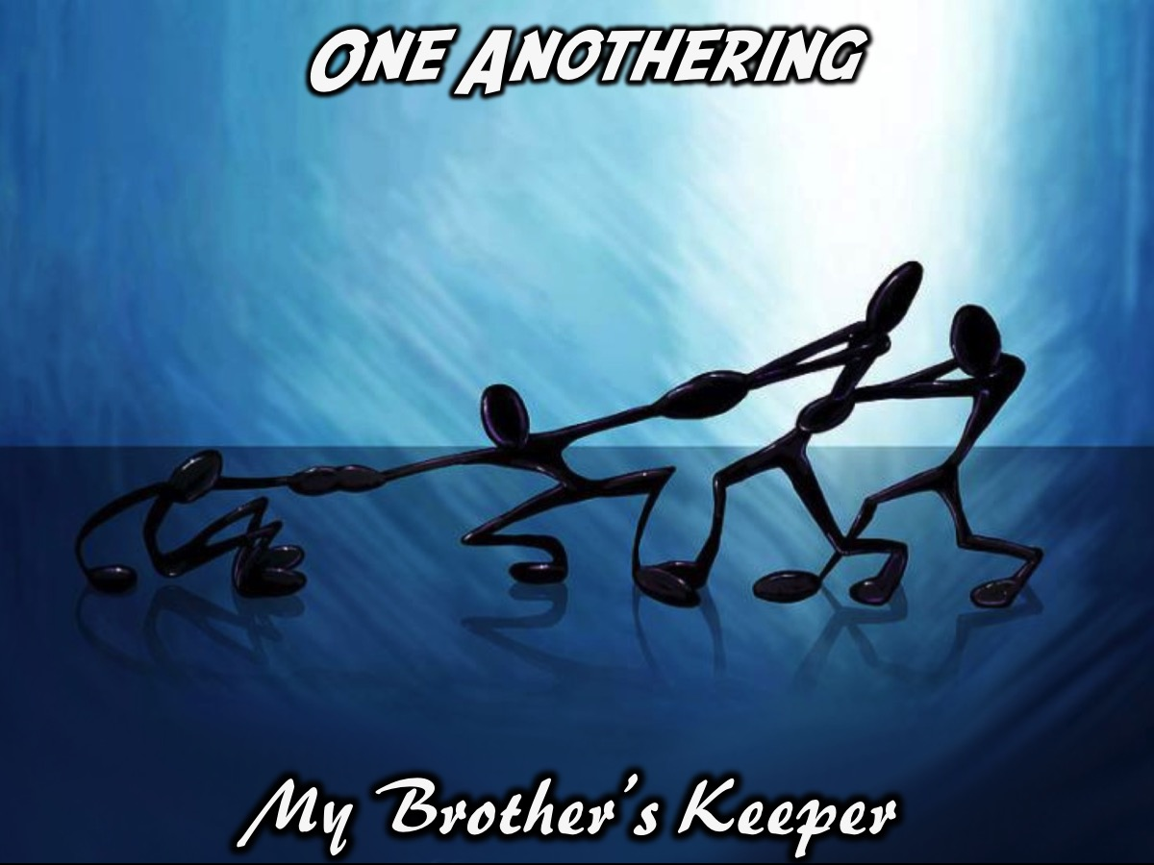
Notes:
Exercise: One Anothering. Each person is given a one another command from the new testament and they have 5 minutes to wander around and practice being a keeper using that command. Here are the commands that will be handed out:
Be devoted to one another: Romans 12:10
Live in harmony with one another: Romans 12:16
Accept one another: Romans 15:7
Instruct one another: Romans 15:14
Greet one another with a brotherly hug: Romans 16:16
Agree with one another: 1 Corinthians 1:10
Serve one another: Galatians 5:13
Bear with one another: Ephesians 4:2
Be kind to one another: Ephesians 4:32
Submit to one another: Ephesians 5:21
Forgive one another: Colossians 3:13
Teach and warn one another: Colossians 3:16
Encourage one another: 1 Thessalonians 5:11
Spur one another on to love and good deeds: Hebrews 10:24-25
Confess your sins to one another: James 5:16
Pray for one another: James 5:16
Love one another: 1 Peter 1:22

Slide 20
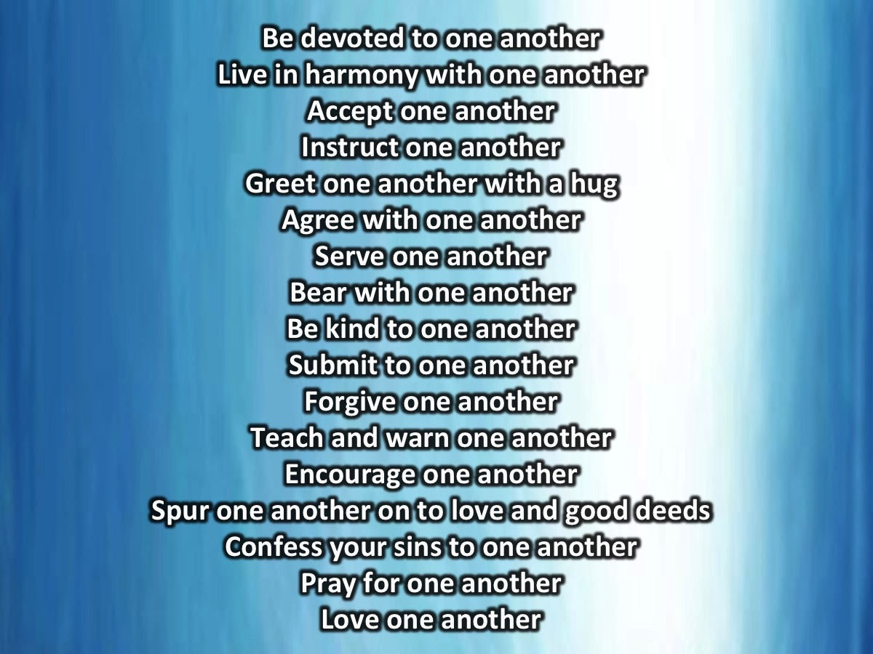
Notes:
Spend a few minutes reflecting on the One Anothering Activity:
Be devoted to one another
Live in harmony with one another
Accept one another
Instruct one another
Greet one another with a hug
Agree with one another
Serve one another
Bear with one another
Be kind to one another
Submit to one another
Forgive one another
Teach and warn one another
Encourage one another
Spur one another on to love and good deeds
Confess your sins to one another
Pray for one another
Love one another

Slide 21
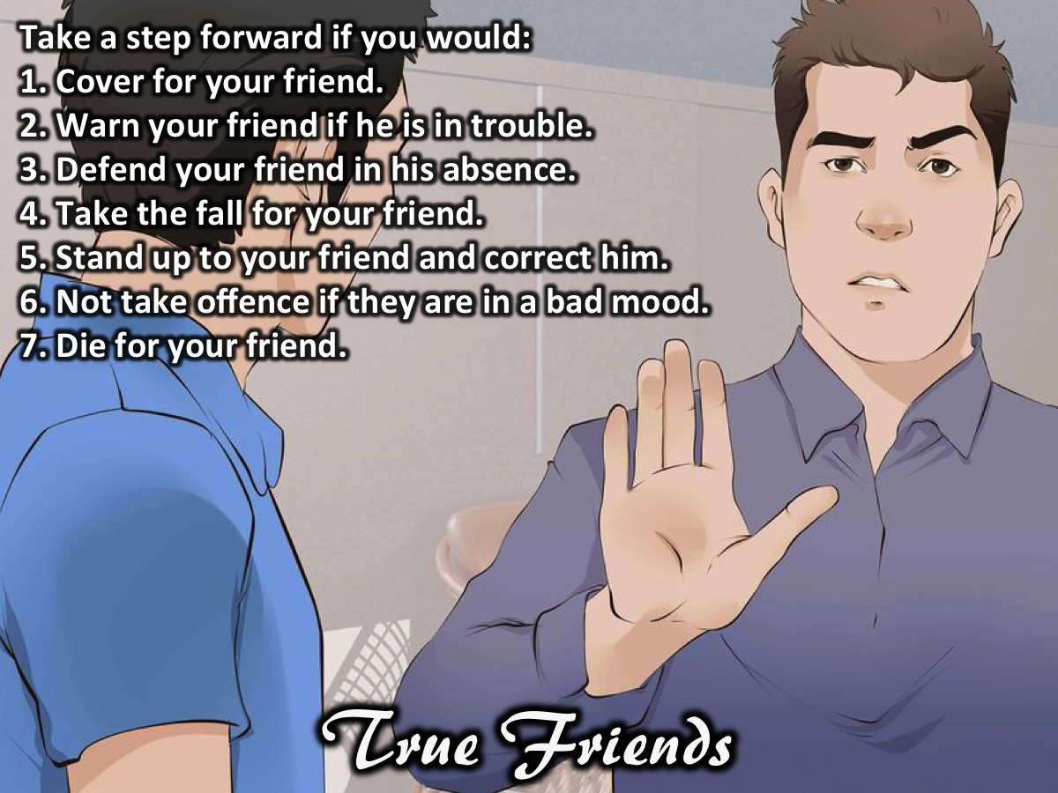
Notes:
True Friends Activity: (Have Guys take a step forward if they agree with the statement):
Take a step forward if you would:
1. Cover for your friend.
2. Warn your friend if he is in trouble.
3. Defend your friend in his absence.
4. Take the fall for your friend.
5. Stand up to your friend and correct him.
6. Not take offence if they are in a bad mood.
7. Die for your friend.
Impartation:
How many of you will cover for your friend? How many of you will give your friend a heads up if you know they in trouble? How many of you will defend your friend when she is not there to defend herself?
That's what good friends do for each other even though sometimes they know it's wrong but a friend always wants to protect their friend from harm. Today we want to be more than just friend good friends we want to be sisters - friends who hold each other accountable. What this means is not only standing up for them when they not there it also means speaking life to each other, reminding them of their worth, beauty and who they are in Christ. It also means that sometimes you will be the friend that says NO when the world says yes e.g. When all your friends say it's cool to have sex before marriage you need to remind her of the Biblical principles, When the world says that homosexual relationships are ok you need to bring your friend back to the Word of God, When you can see or when she tells you thinks are getting hot and heavy you need to tell her to take a cold shower and think about what is happening. It is important that all of this is done and said in love and remember that God gives us all freedom of choice so if your friend decides not to heed your guidance you don't need to judge them or stop being friends with them you might want to remind them that you love them and God loves them because people need to know they can come to you even after they have gone down the wrong path that you still be there for them.

Slide 22
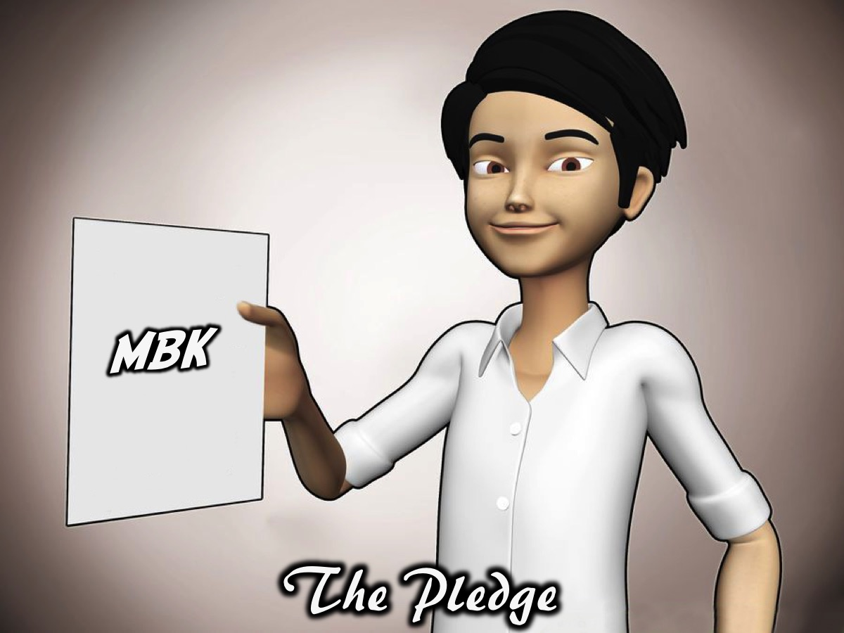
Notes:
The Pledge: As guys we commit ourselves to being MBK’s: My Brother’s Keepers. Provide Permanent Marker pens for teens to tattoo themselves with the letters MBK to remember what they have pledged to be.

Slide 23
Notes:
Video: Kid Mac - My Brother's Keeper. Get it on YouTube at: https://www.youtube.com/watch?v=3Pzvuw-ZKgE

Slide 24

Notes:
On Sunday morning it is week 1 of our Hearing God Series.

Slide 25

Notes:
Next Friday night is the fourth week of our Baewatch Series: Lifeguards Speak. Come and enjoy our Human Library!!!

Slide 26

Notes:
Refreshments are served.

Slide 27
Notes:
Video: Kid Mac - My Brother's Keeper. Get it on YouTube at: https://www.youtube.com/watch?v=3Pzvuw-ZKgE

Slide 28

Notes:
Here are the slides for the girls session.

Slide 29
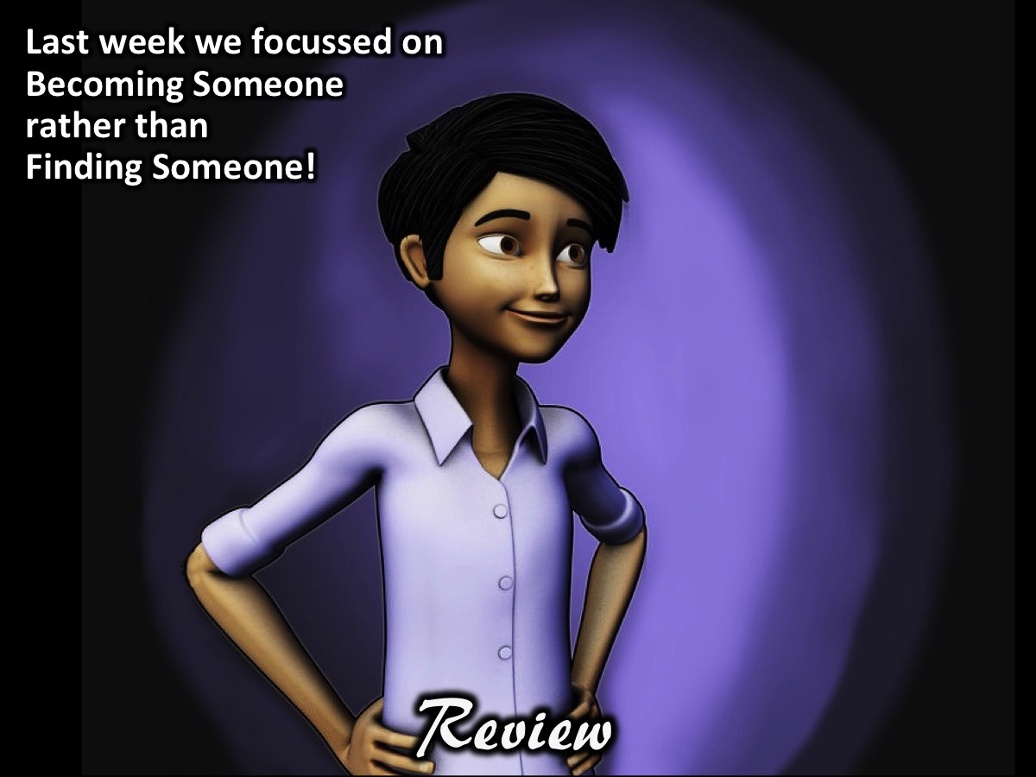
Notes:
Review: Last week about focusing on becoming someone rather than finding someone.

Slide 30
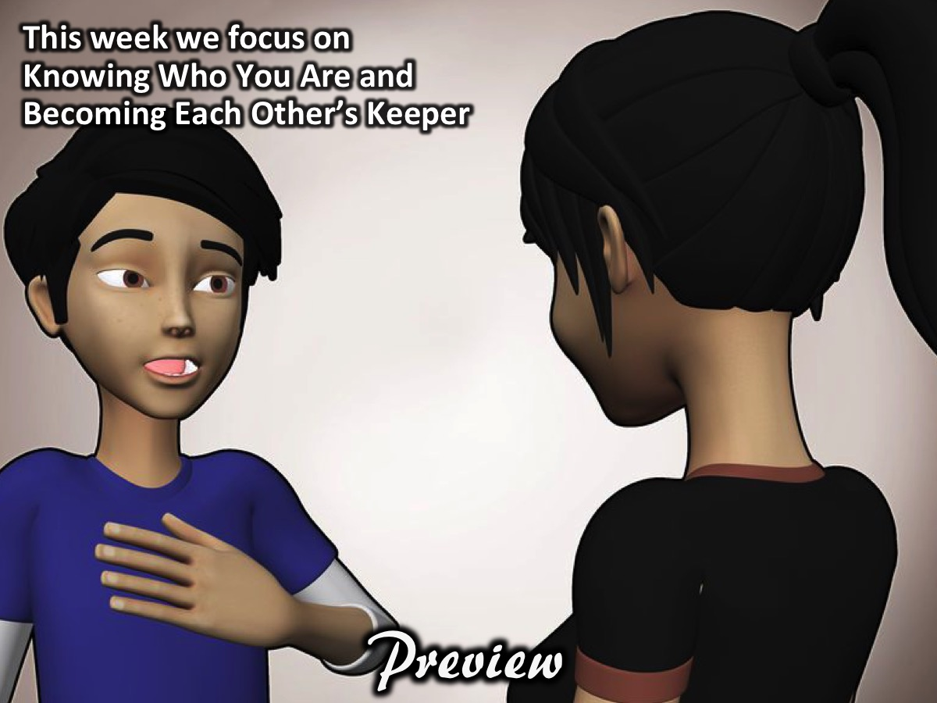
Notes:
Preview: The focus this week is on Identity and Community. We are going to focus on knowing who you are and being each others' keeper in the sense of calling each other to that identity.

Slide 31
Notes:
Activity: Imagine you are attending your own funeral. What would you like each of the speakers to say about you and your life? What character would you like them to have seen in you? What contributions and achievements would you want them to remember? Think about it and share with a friend.

Slide 32
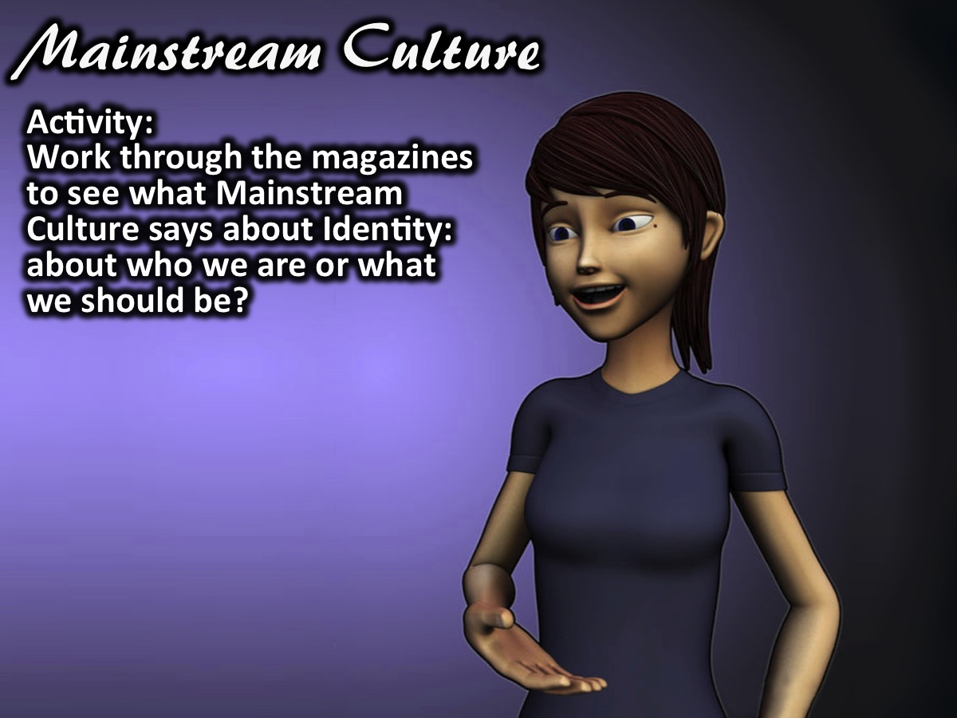
Notes:
Activity: Our Identity According to Mainstream Culture: Work through the magazines to see what Mainstream Culture says about who you are or what you should be?

Slide 33
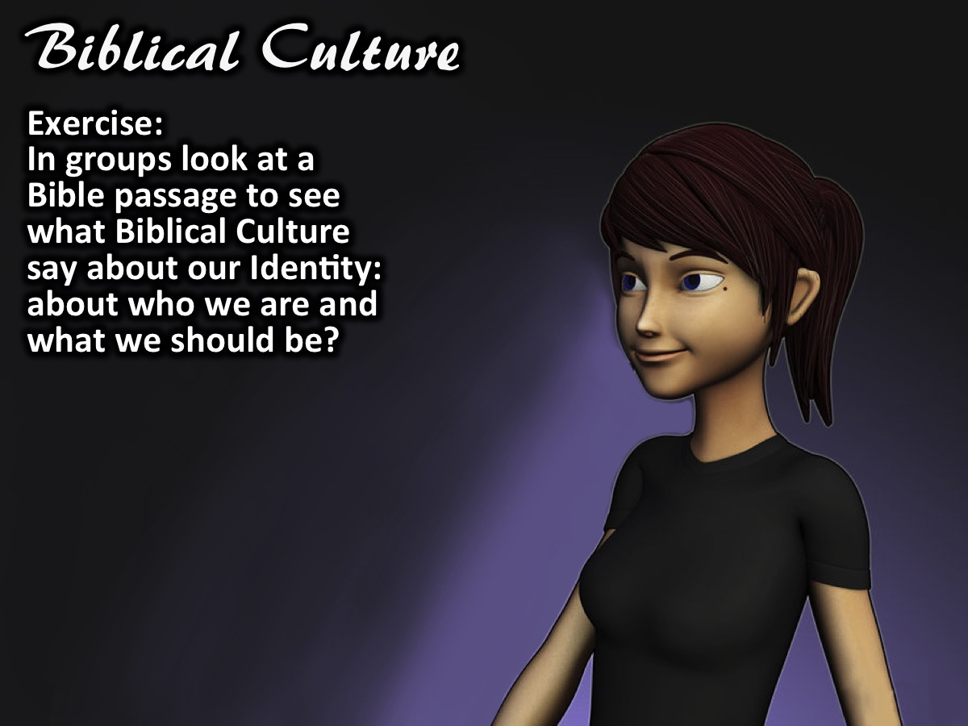
Notes:
Exercise: Our Identity According to Biblical Culture: In small groups look at a Bible passage to see what Biblical Culture says about our Identity: about who we are and what we should be? Here are the scripture that will be given to the groups (one passage each):
You are chosen people, a royal priesthood, a holy nation, people who belong to God. You were chosen to tell about the excellent qualities of God, who called you out of darkness into his marvelous light. Dear friends, since you are foreigners and temporary residents in the world, I’m encouraging you to keep away from the desires of your corrupt nature. These desires constantly attack you. Live decent lives among unbelievers. Then, although they ridicule you as if you were doing wrong while they are watching you do good things, they will praise God on the day he comes to help you. (1 Peter 2:9-12)
Don’t you realize that your bodies are parts of Christ’s body? Should I take the parts of Christ’s body and make them parts of a prostitute’s body? That’s unthinkable! Don’t you realize that the person who unites himself with a prostitute becomes one body with her? God says, “The two will be one.” However, the person who unites himself with the Lord becomes one spirit with him. Stay away from sexual sins. Other sins that people commit don’t affect their bodies the same way sexual sins do. People who sin sexually sin against their own bodies. Don’t you know that your body is a temple that belongs to the Holy Spirit? The Holy Spirit, whom you received from God, lives in you. You don’t belong to yourselves. You were bought for a price. So bring glory to God in the way you use your body. (1 Corinthians 6:15-20)
Put to death, therefore, whatever belongs to your earthly nature: sexual immorality, impurity, lust, evil desires and greed, which is idolatry. Because of these, the wrath of God is coming. You used to walk in these ways, in the life you once lived. But now you must also rid yourselves of all such things as these: anger, rage, malice, slander, and filthy language from your lips. Do not lie to each other, since you have taken off your old self with its practices and have put on the new self, which is being renewed in knowledge in the image of its Creator. (Colossians 3:5-10)
So I tell you this, and insist on it in the Lord, that you must no longer live as the Gentiles do, in the futility of their thinking. They are darkened in their understanding and separated from the life of God because of the ignorance that is in them due to the hardening of their hearts. Having lost all sensitivity, they have given themselves over to sensuality so as to indulge in every kind of impurity, and they are full of greed. That, however, is not the way of life you learned when you heard about Christ and were taught in him in accordance with the truth that is in Jesus. You were taught, with regard to your former way of life, to put off your old self, which is being corrupted by its deceitful desires; to be made new in the attitude of your minds; and to put on the new self, created to be like God in true righteousness and holiness. (Ephesians 4:17-24)
Therefore, as God’s chosen people, holy and dearly loved, clothe yourselves with compassion, kindness, humility, gentleness and patience. Bear with each other and forgive one another if any of you has a grievance against someone. Forgive as the Lord forgave you. And over all these virtues put on love, which binds them all together in perfect unity. Let the peace of Christ rule in your hearts, since as members of one body you were called to peace. And be thankful. And whatever you do, whether in word or deed, do it all in the name of the Lord Jesus, giving thanks to God the Father through him. (Colossians 3:12-17)
Do nothing out of selfish ambition or vain conceit. Rather, in humility value others above yourselves, not looking to your own interests but each of you to the interests of the others. Do everything without grumbling or arguing, so that you may become blameless and pure, “children of God without fault in a warped and crooked generation.” Then you will shine among them like stars in the sky as you hold firmly to the word of life. (Philippians 2:3-4,14-16)

Slide 34
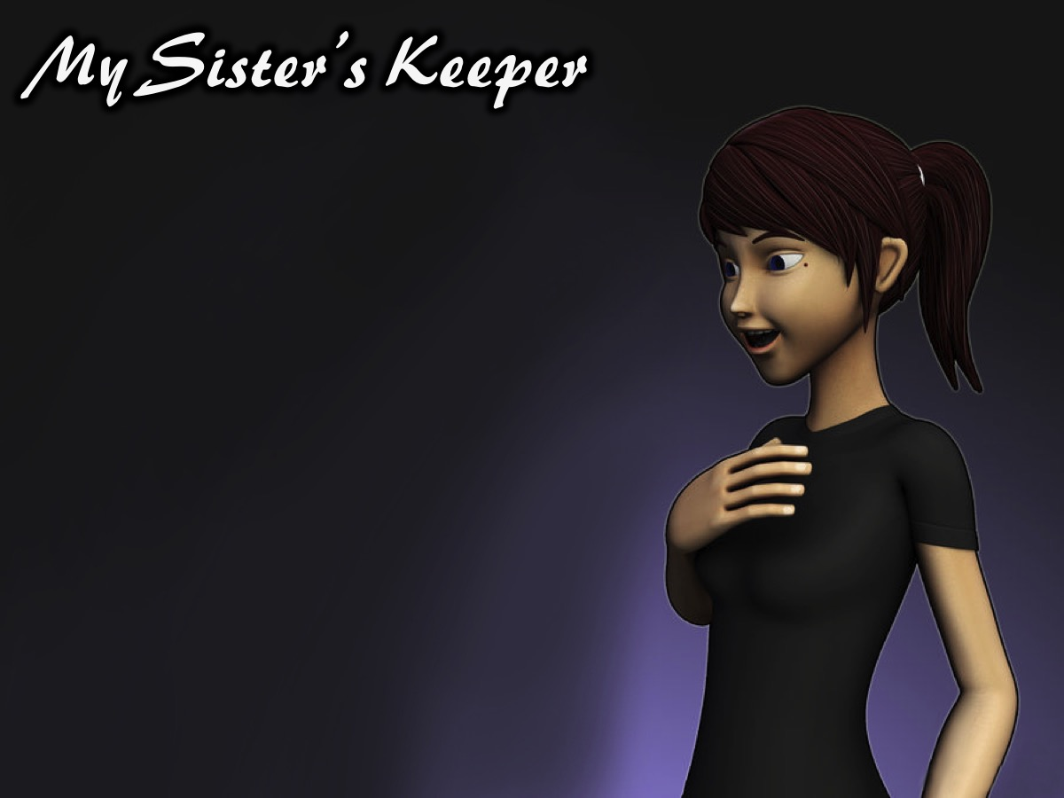
Notes:
Becoming Keepers: Challenge teens to become a community that holds each other accountable to that standard.

Slide 35
Notes:
The Story of Cain and Abel (Genesis 4:1-12)
Adam made love to his wife Eve, and she became pregnant and gave birth to Cain. She said, “With the help of the Lord I have brought forth a man.” Later she gave birth to his brother Abel. Now Abel kept flocks, and Cain worked the soil. In the course of time Cain brought some of the fruits of the soil as an offering to the Lord. And Abel also brought an offering—fat portions from some of the firstborn of his flock. The Lord looked with favor on Abel and his offering, but on Cain and his offering he did not look with favor. So Cain was very angry, and his face was downcast. Then the Lord said to Cain, “Why are you angry? Why is your face downcast? If you do what is right, will you not be accepted? But if you do not do what is right, sin is crouching at your door; it desires to have you, but you must rule over it.” Now Cain said to his brother Abel, “Let’s go out to the field.” While they were in the field, Cain attacked his brother Abel and killed him. Then the Lord said to Cain, “Where is your brother Abel?” “I don’t know,” he replied. “Am I my brother’s keeper?” The Lord said, “What have you done? Listen! Your brother’s blood cries out to me from the ground. Now you are under a curse and driven from the ground, which opened its mouth to receive your brother’s blood from your hand. When you work the ground, it will no longer yield its crops for you. You will be a restless wanderer on the earth.”

Slide 36
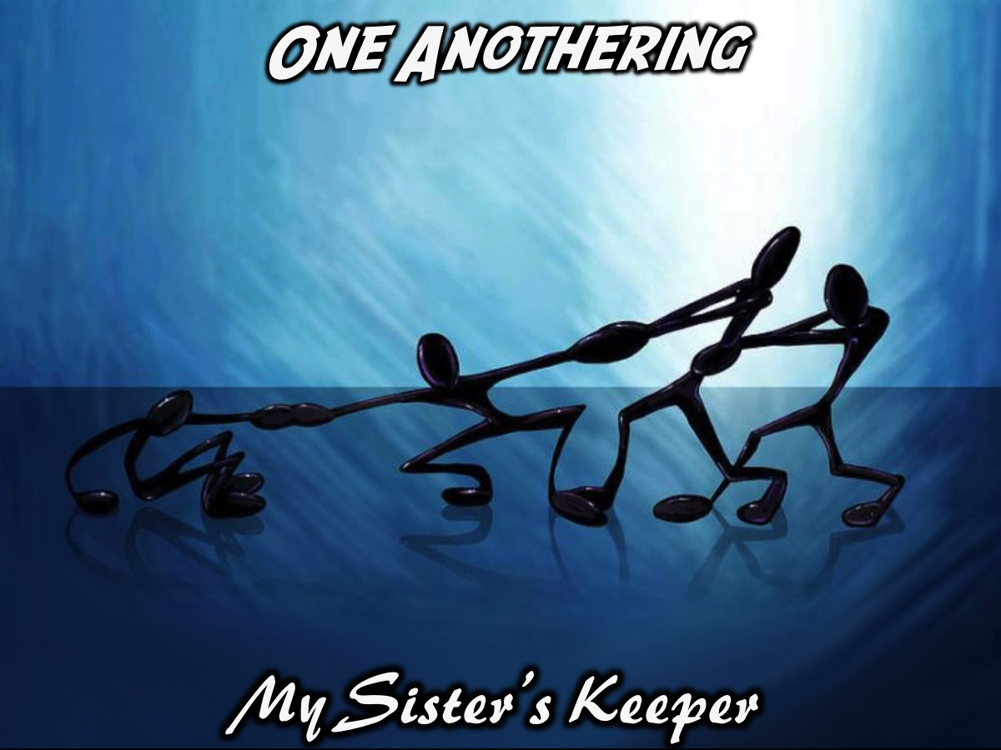
Notes:
Exercise: One Anothering. Each person is given a one another command from the new testament and they have 5 minutes to wander around and practice being a keeper using that command. Here are the commands that will be handed out:
Be devoted to one another: Romans 12:10
Live in harmony with one another: Romans 12:16
Accept one another: Romans 15:7
Instruct one another: Romans 15:14
Greet one another with a brotherly hug: Romans 16:16
Agree with one another: 1 Corinthians 1:10
Serve one another: Galatians 5:13
Bear with one another: Ephesians 4:2
Be kind to one another: Ephesians 4:32
Submit to one another: Ephesians 5:21
Forgive one another: Colossians 3:13
Teach and warn one another: Colossians 3:16
Encourage one another: 1 Thessalonians 5:11
Spur one another on to love and good deeds: Hebrews 10:24-25
Confess your sins to one another: James 5:16
Pray for one another: James 5:16
Love one another: 1 Peter 1:22

Slide 37

Notes:
Spend a few minutes reflecting on the One Anothering Activity:
Be devoted to one another
Live in harmony with one another
Accept one another
Instruct one another
Greet one another with a hug
Agree with one another
Serve one another
Bear with one another
Be kind to one another
Submit to one another
Forgive one another
Teach and warn one another
Encourage one another
Spur one another on to love and good deeds
Confess your sins to one another
Pray for one another
Love one another

Slide 38
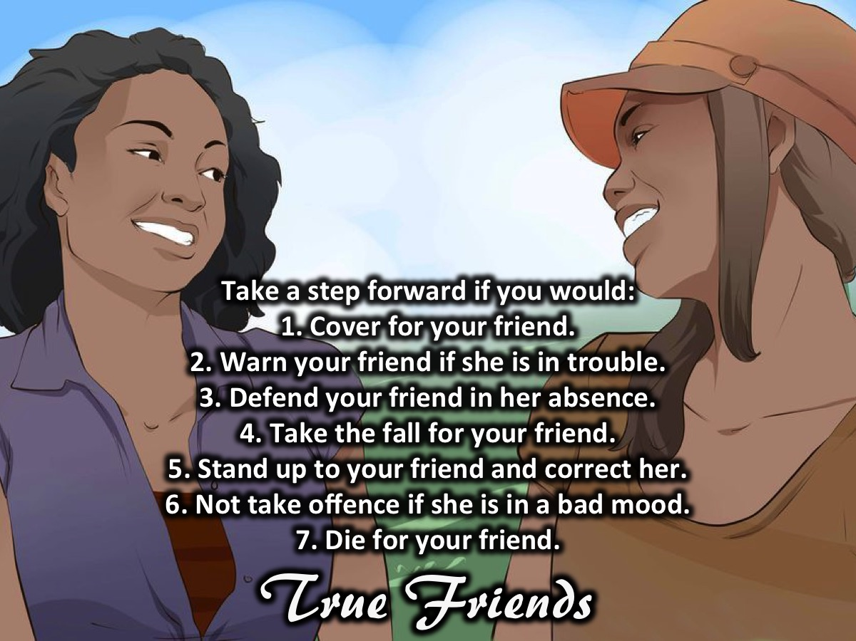
Notes:
True Friends Activity (Have teens take a step forward if they agree with the statements):
Take a step forward if you would:
1. Cover for your friend.
2. Warn your friend if she is in trouble.
3. Defend your friend in her absence.
4. Take the fall for your friend.
5. Stand up to your friend and correct her.
6. Not take offence if she is in a bad mood.
7. Die for your friend.
Impartation:
How many of you will cover for your friend? How many of you will give your friend a heads up if you know they in trouble? How many of you will defend your friend when she is not there to defend herself?
That's what good friends do for each other even though sometimes they know it's wrong but a friend always wants to protect their friend from harm. Today we want to be more than just friend good friends we want to be sisters - friends who hold each other accountable. What this means is not only standing up for them when they not there it also means speaking life to each other, reminding them of their worth, beauty and who they are in Christ. It also means that sometimes you will be the friend that says NO when the world says yes e.g. When all your friends say it's cool to have sex before marriage you need to remind her of the Biblical principles, When the world says that homosexual relationships are ok you need to bring your friend back to the Word of God, When you can see or when she tells you thinks are getting hot and heavy you need to tell her to take a cold shower and think about what is happening. It is important that all of this is done and said in love and remember that God gives us all freedom of choice so if your friend decides not to heed your guidance you don't need to judge them or stop being friends with them you might want to remind them that you love them and God loves them because people need to know they can come to you even after they have gone down the wrong path that you still be there for them.

Slide 39

Notes:
The Pledge: As girls we commit ourselves to being MSK’s: My Sister’s Keepers. Girls are challenged to take a pledge to be MSK’s and if they do they are given a bracelet to remember their pledge.

