Slide 1

Notes:
The Baewatch Series.

Slide 2
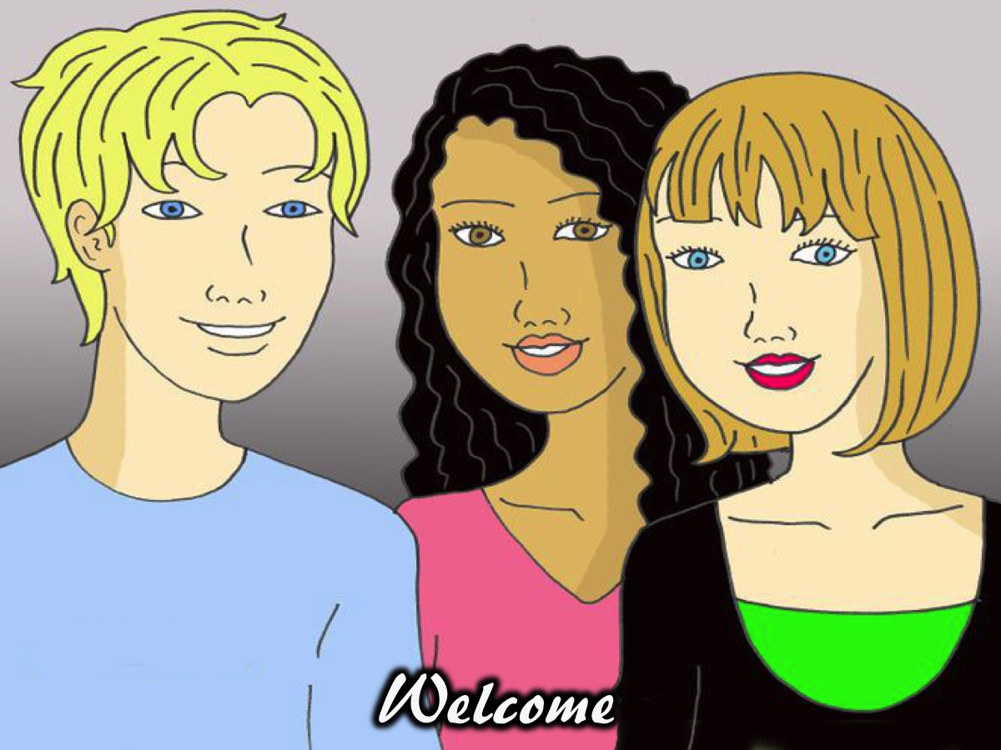
Notes:
Welcome to regulars and newcomers.

Slide 3
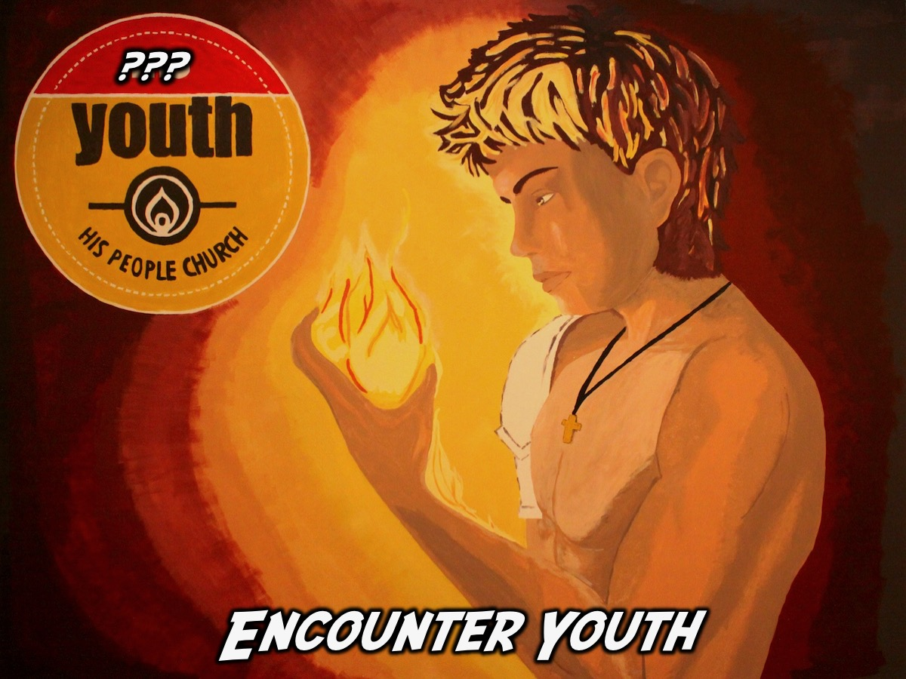
Notes:
Last weekend we had a name changing exercise and the name we have chosen is Encounter Youth. Teboho from our AM2 service submitted this name and he will receive the reward of R500!

Slide 4
Notes:
So welcome to another Baewatch session.

Slide 5
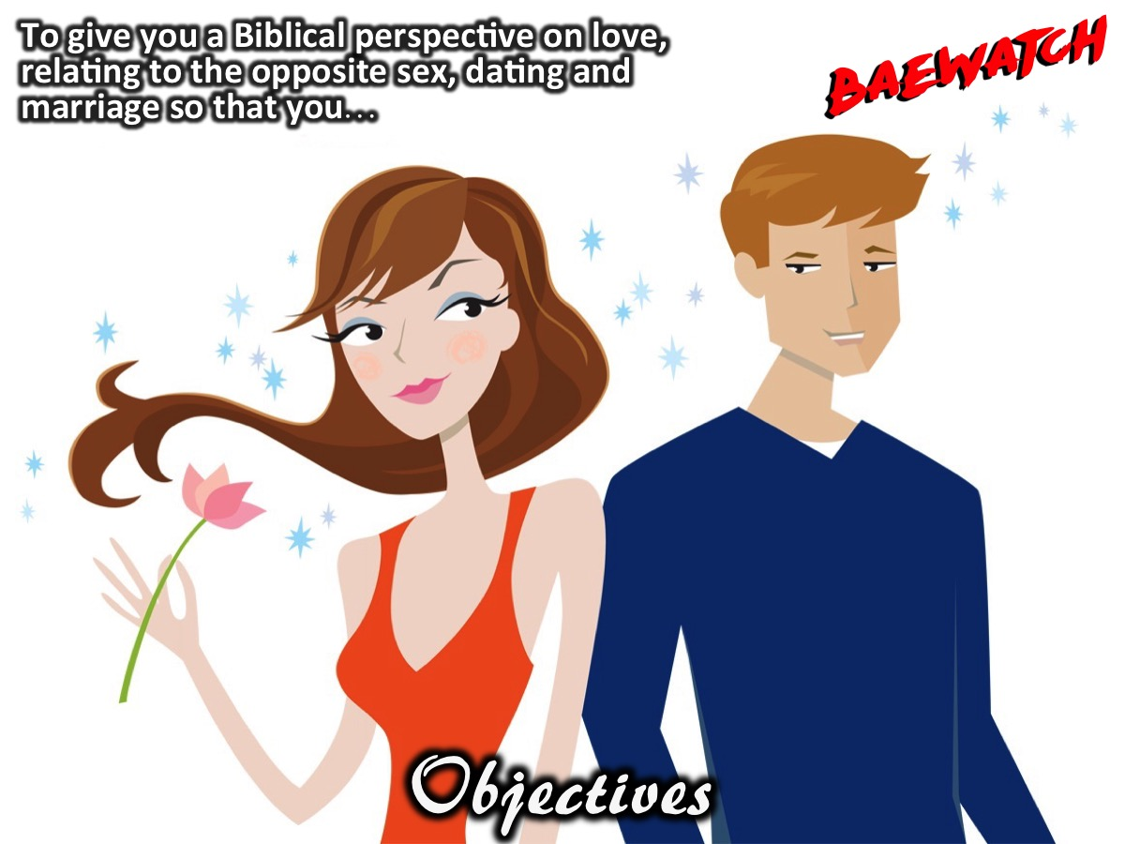
Notes:
Objectives: To give you a Biblical perspective on love, relating to the opposite sex, dating and marriage so that you…

Slide 6
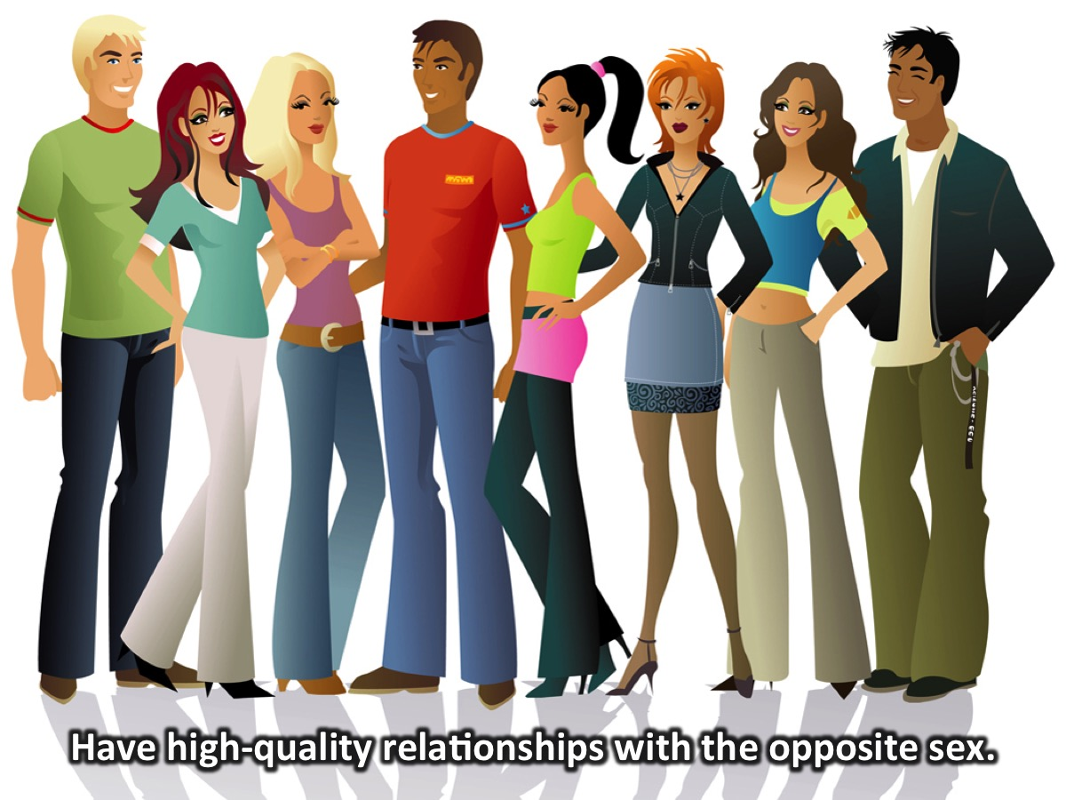
Notes:
1. Have high-quality relationships with the opposite sex.

Slide 7
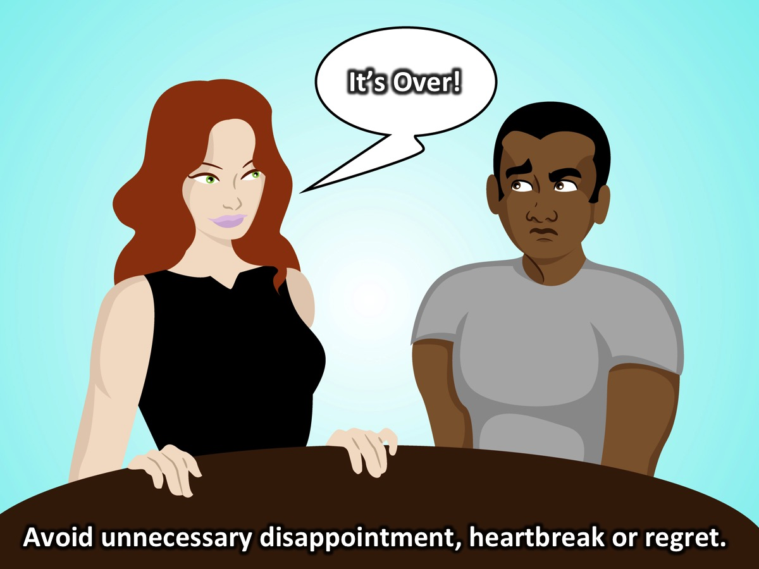
Notes:
2. Avoid unnecessary relational disappointment, heartbreak, and regret.

Slide 8
Notes:
3. Live according to a higher and healthier standard.

Slide 9
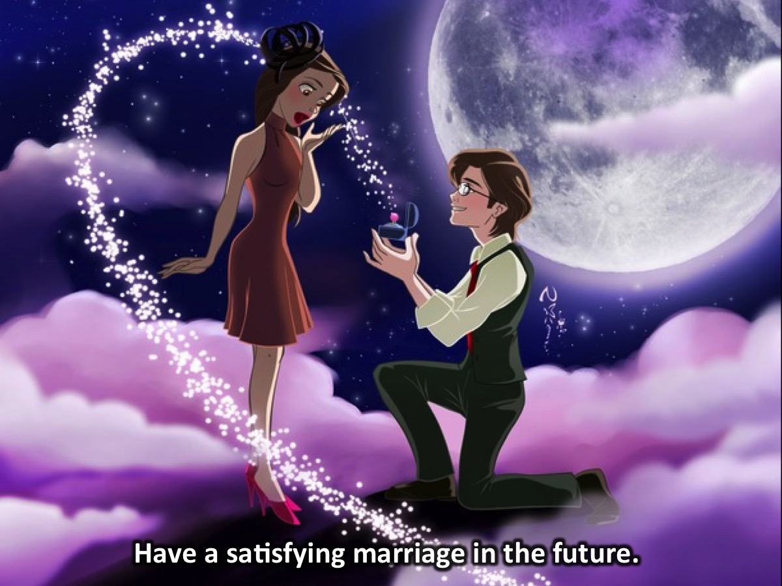
Notes:
4. Have a satisfying marriage in the future.

Slide 10
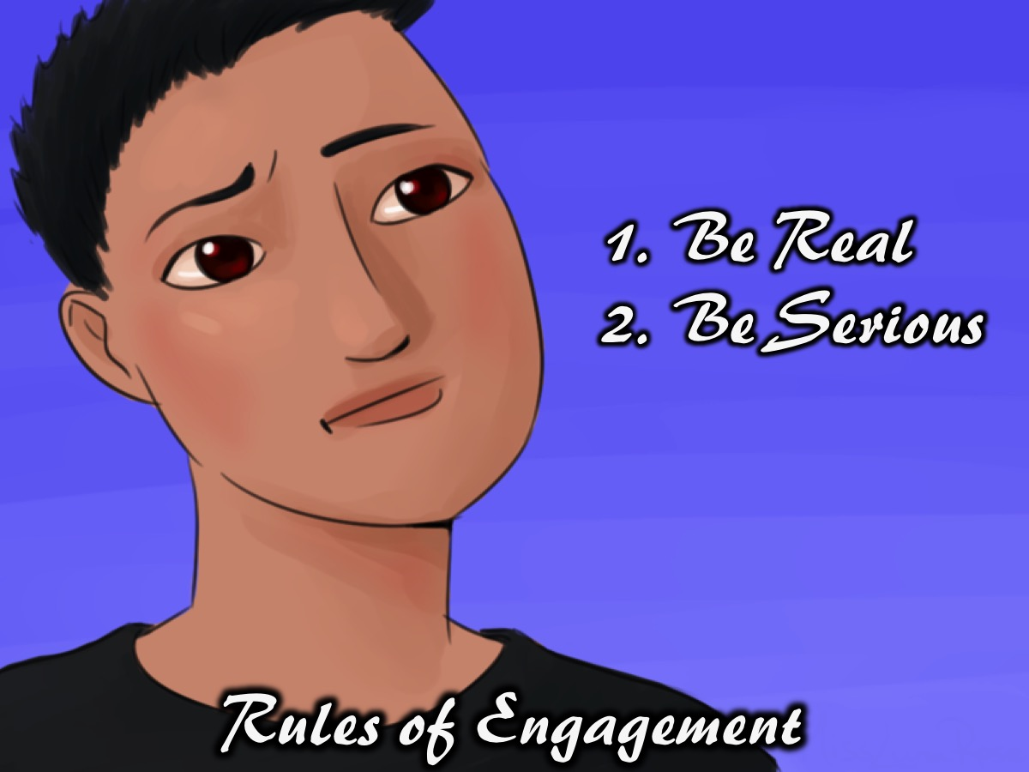
Notes:
Rules of Engagement: (1) Be Real. (2) Take This Seriously (or Be Serious).

Slide 11
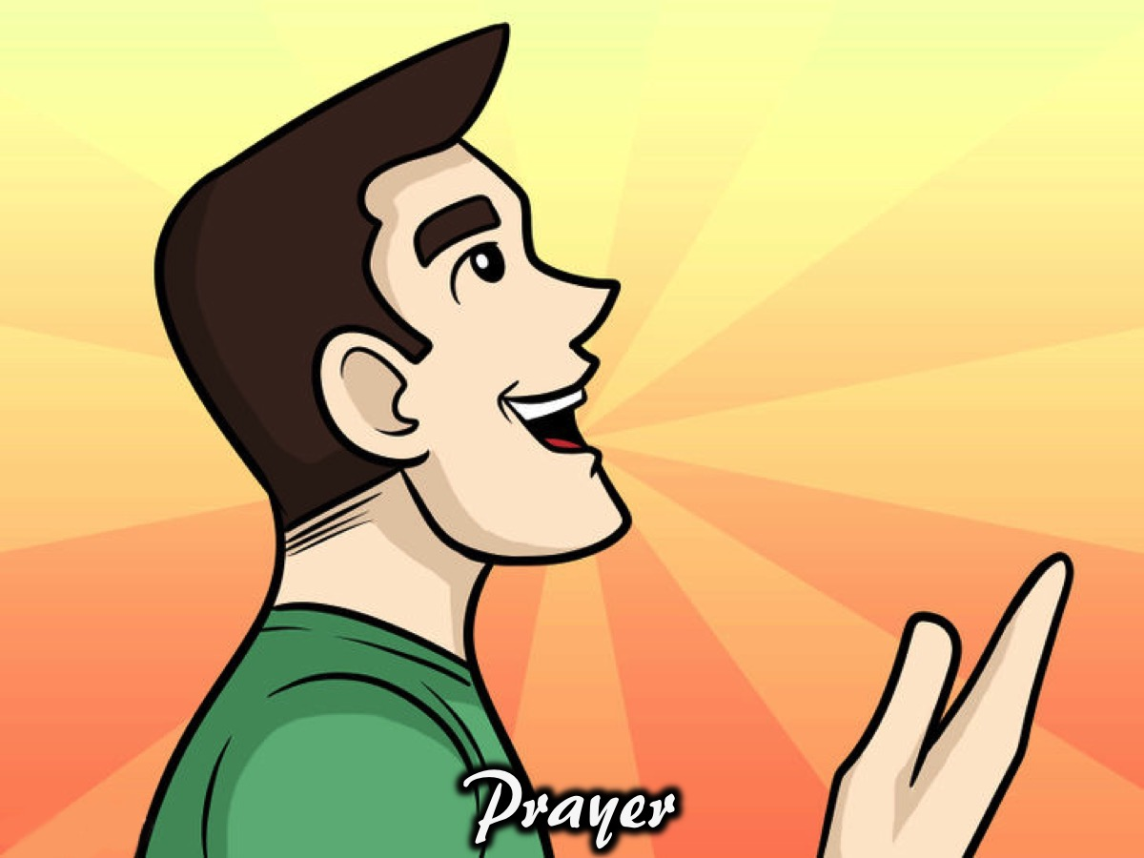
Notes:
Prayer

Slide 12

Notes:
Tonight is Life Guards speak.

Slide 13
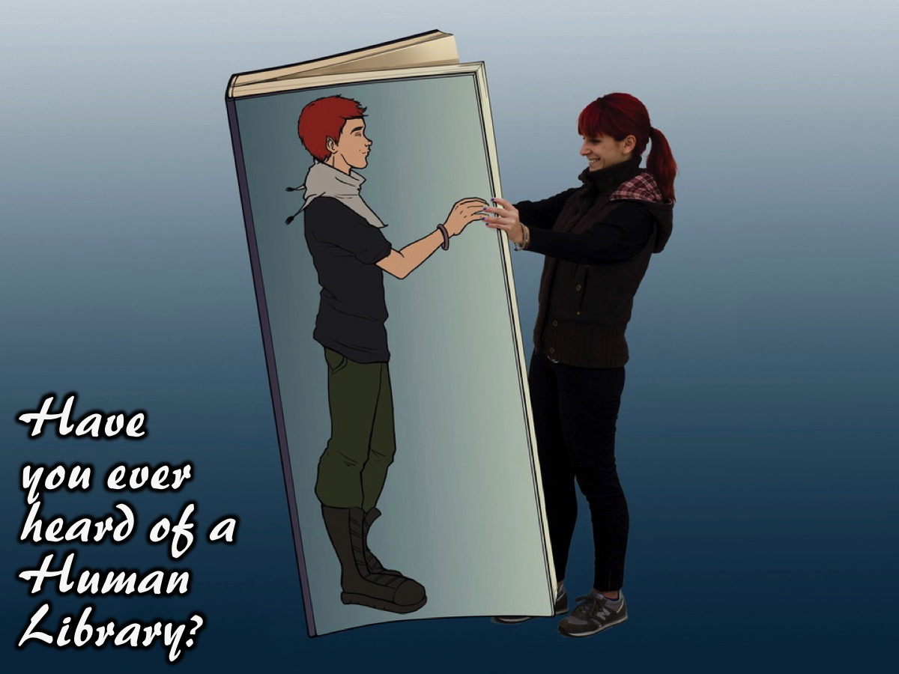
Notes:
Have you ever heard of a human library?

Slide 14
Notes:
Video: The Joy of Books. Get it on YouTube at: https://youtu.be/SKVcQnyEIT8?list=PL3F1508DA64F14E1E

Slide 15
Notes:
Video: The Human Library. Get it on YouTube at: https://youtu.be/1cetgqORZ0

Slide 16
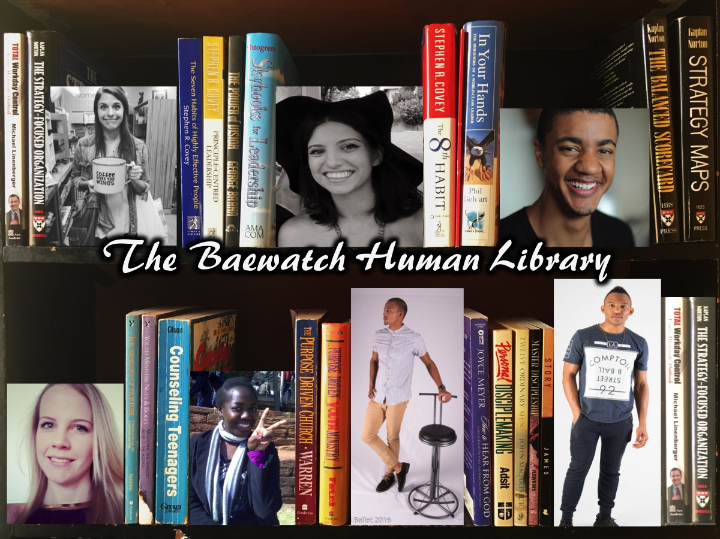
Notes:
Our Human Library for tonight consists of seven young adults with great experience that you can explore.

Slide 17
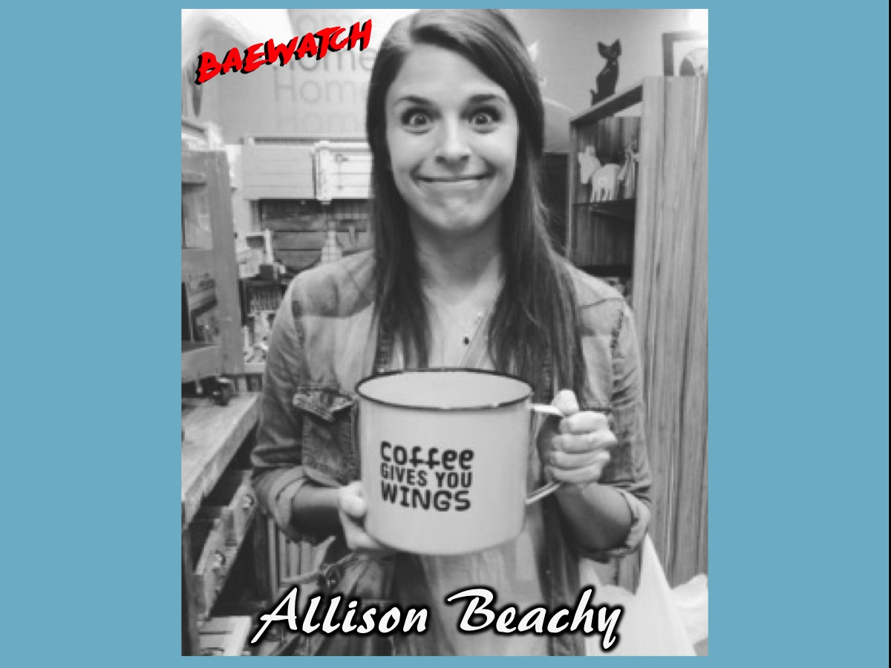
Notes:
Hey, I'm Allison Beachy! I'm a 22 American who wishes she was South African. I'm here in Jozi for 6 months volunteering at the Child, Boys and, Baby Havens from good ol Indiana (if you don't know where that is in the States – it's okay, it's just a bunch of Amish people and corn fields). I love big cups of coffee, kids and, social justice. I have a dream to one day hold a baby panda, I never turn down free food, and I can flare my nostrils like nobody's business. If you come visit me tonight we can have a good chat about what the Lord taught me through 21 years of singleness, learning to live life to the fullest through contentment and how this all affects my relationship now.

Slide 18
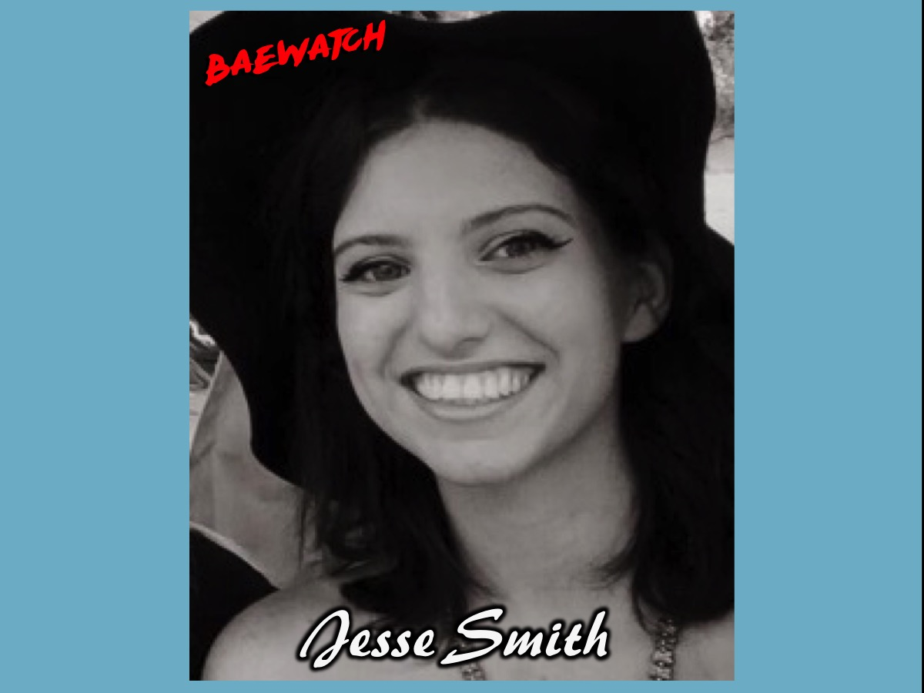
Notes:
I am Jesse Smith. I was born in Pietermaritzburg but have lived in Joburg most of my life. I became a member of Ignite Youth at the age of 12, and have been part of His People ever since. I have been in full-time ministry since I was 18, serving for 3 years at His Kids and 3 years in the Discipleship Team. I help pastor two of the Sunday services, have a BA in ministry and am currently doing a BSc in International Relations. I have been single for… most of my life. My relationship experience can be summed up as: one high school boyfriend, almost dating a dodgy, unsaved guy and then meeting an amazing man that I ran away from because I was scared. I have learnt a thing or two about relationships in this time (and I know a lot about singleness!) so come and hear some of my story.

Slide 19
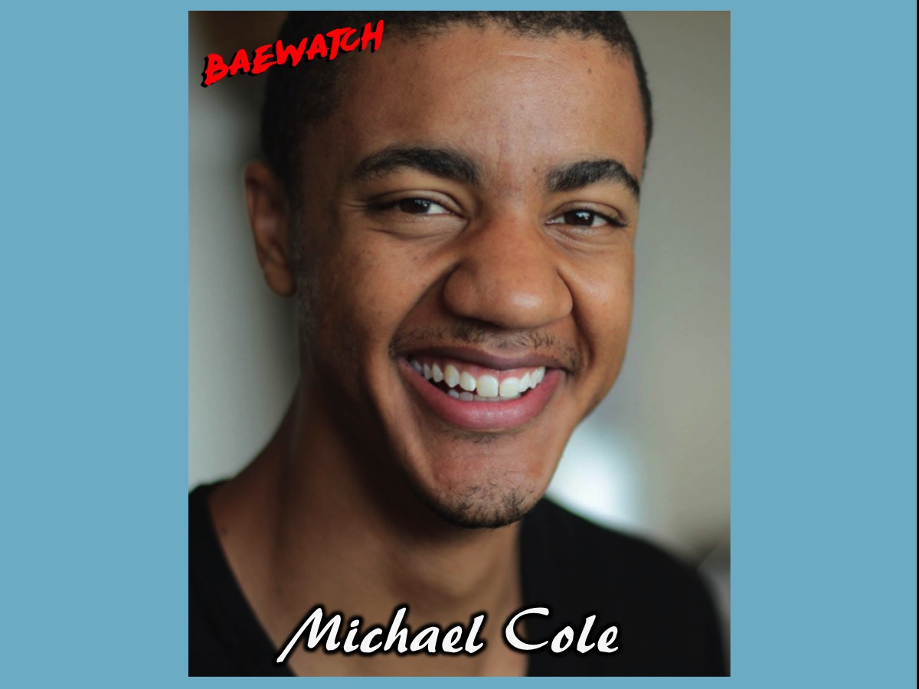
Notes:
My name is Michael Anthony Pelham Kabali Cole. I am a 26 year old, mixed race South African with a dual British and Ugandan heritage. I got saved when I was around 9 years old, but only started following Him when I was 15. Not much has changed since my teens. I still love Christ, my family, my friends, basketball, skateboarding and business. However, one thing that has changed over the last year (and for the better) is my perspective on relationships. Looking forward to sharing a bit about my story, my views on relationships and what I've learnt 8 months in to dating Gail Ingle - one incredible, godly woman.

Slide 20
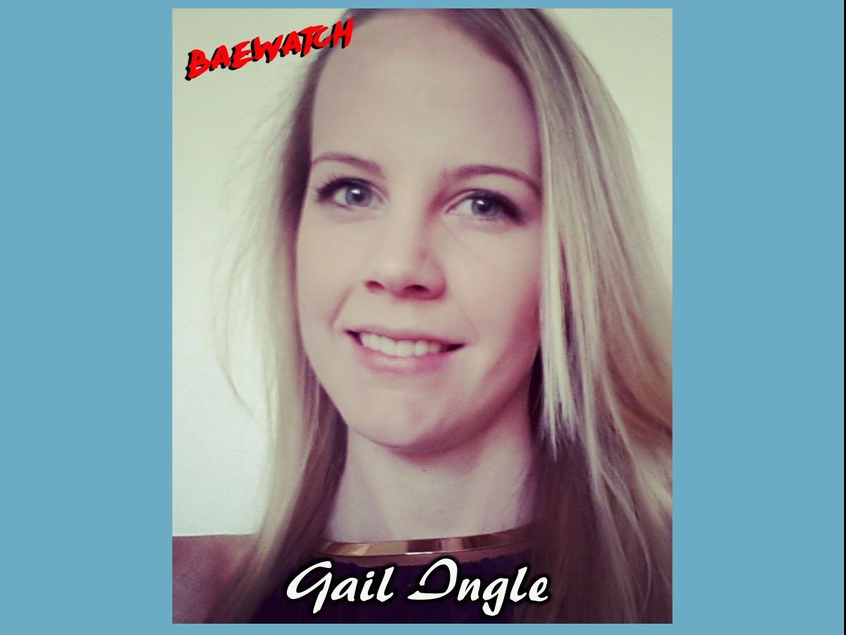
Notes:
My name is Gail Ingle. I am 26 years old. I have a passion for South Africa, and for being the hands and feet of Christ. I am currently a final year medical student, and spend much of my time interacting with an amazing variety of people from different backgrounds and cultures. I wholeheartedly believe that as Christians we are called to love our brothers and sisters, but in an appropriate way of course! I was saved when I was 15, but spent most of my energy investing myself in unhealthy relationships. Over the past 5 years, God has done a work in me, and I believe I have been blessed to gain a lot of experience in both the right and the wrong way to date. I am now in a healthy, God-centred relationship with Michael. It has been such an easy, joy-filled 8 months, and I look forward to many more happy times

Slide 21
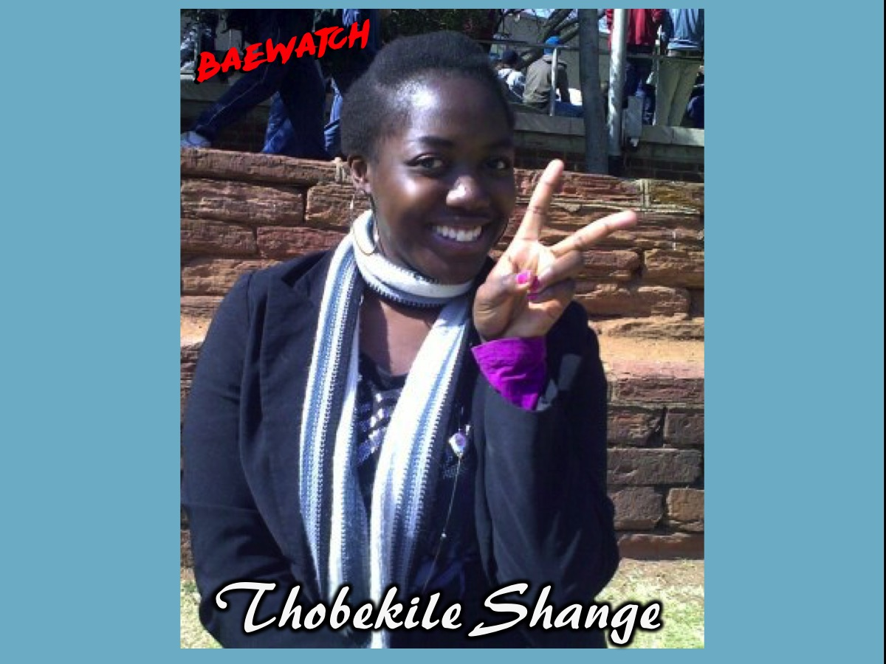
Notes:
Hi there peeps! I am Thobi. A dark skinned Zulu girl with dreams that reach the heavens! I cannot live without sweets (those soft gums by Maynards are life!), spicy chicken wings, and of course Jesus. I am most proud of my relationship with Jesus, because it has been the most intentional relationship I have ever had in my life. Jesus is my life. I am single and loving it! That doesn’t mean that I don’t desire to be married: when the time comes (and it will) I will love being married as well. It’s all about enjoying your season. I have dated A LOT in my youth, and in the same way I have made A LOT of mistakes within those relationships. Needless to say, I know a lot about how not to do life. A lot of the errors I made in relationships affected how I loved. I am an open book about these things – ask any questions and I will answer honestly. I am not ashamed. I have been schooled by Jesus, and He has totally done His work here – took some time, but He healed me, teaches me, and loves me. He is the testimony. This is what my station is about: Life | Love | Lessons

Slide 22
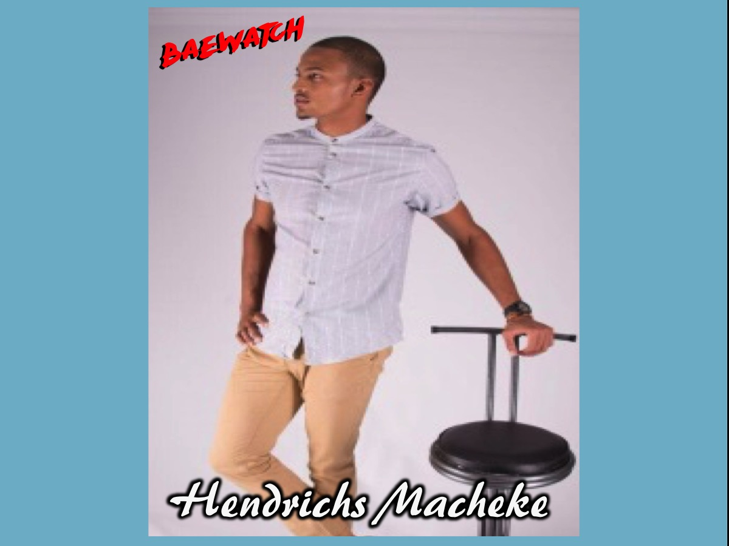
Notes:
My name is Hendrichs Joshua Macheke a mixed race and proud Zimbabwean. I am 21 and grew up in a Christian family but only really came to know Christ a few years back. I'm very passionate about sports particularly cricket and basketball. Apart from that I'm a student at Boston City Campus in Rosebank studying Management Marketing and got a couple of jobs that I do on the side. With regards to relationships, based on experiences I've had in the past, I feel like I've learnt quite a bit. I would love to help in sharing some of these experiences and hope they can offer a bit of guidance.

Slide 23
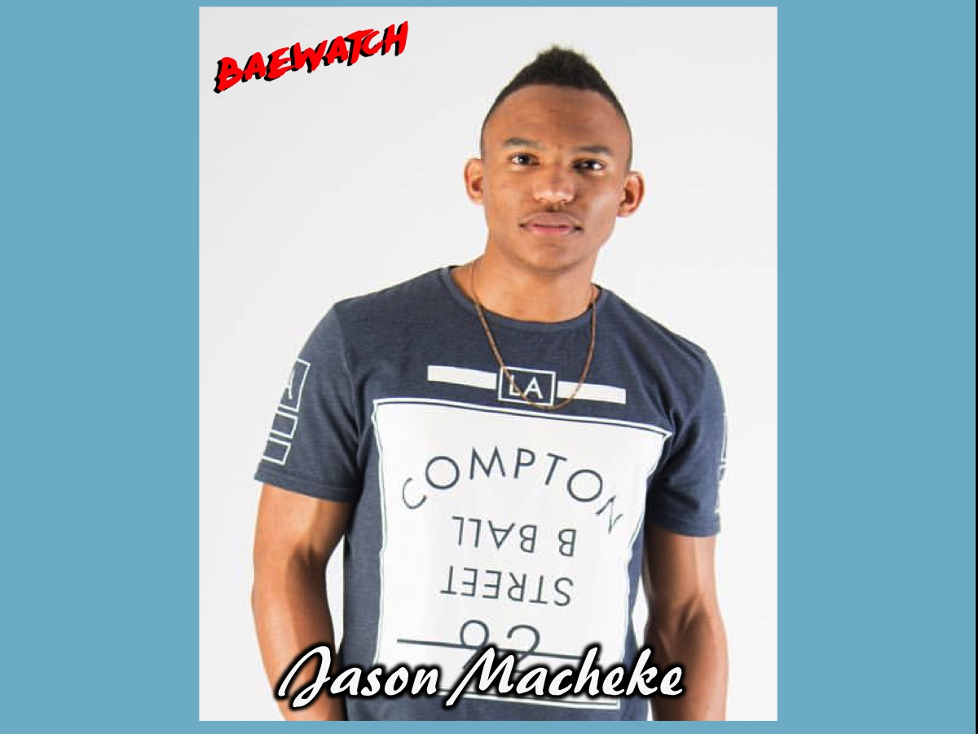
Notes:
I am Jason Macheke and gym is my thing. Super fun times happen in the place I enjoy the most because I make the best kind of progress happen in the gym 😆 . I love food too much. I've dated a few for looooong periods of time and learnt my portion from them. Made some poor choices but learnt some valuable lessons. I love the idea of getting to know people and what they are about, best kinda of relationships are friendships in my opinion. My relationship with God is the most important and every other relationship revolves around that one! My relationship with God has been the most fruitful and taught me the most. I am currently in a relationship and happy 😊 . Questions are most welcome and I will answer openly and honestly.

Slide 24
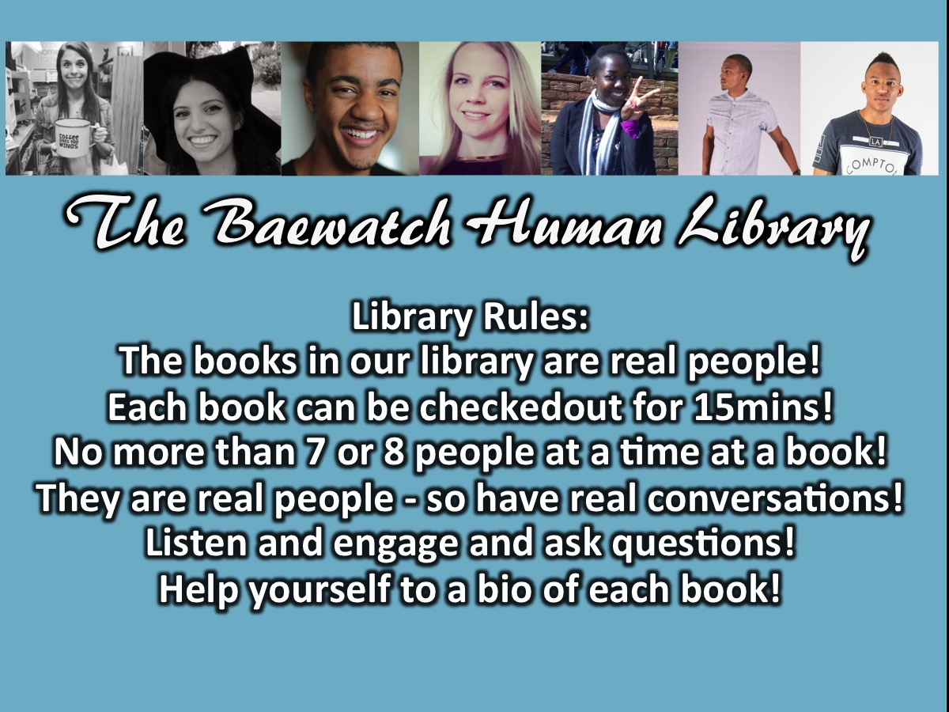
Notes:
Here are the Library Rules: (1) The books in our library are real people! (2) Each book can be checkedout for 15mins! (3) No more than 7 or 8 people at a time at a book! (4) They are real people - so have real conversations! (5) Listen and engage and ask questions! (6) Help yourself to a bio of each book!

Slide 25
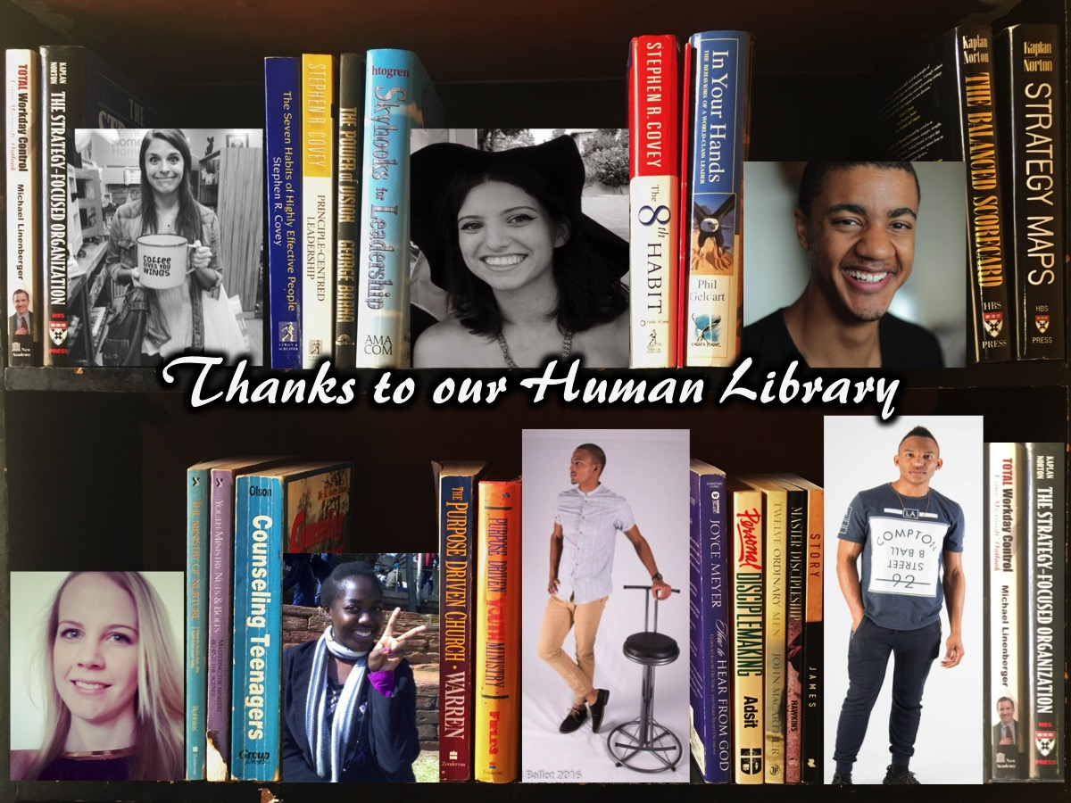
Notes:
Please join me in thanking our human library!

Slide 26

Notes:
On Sunday morning it is week 2 of our Hearing God Series. We will be looking at the ways in which God speaks to us.

Slide 27

Notes:
Next Friday night it is the last week of our Baewatch series and will be a fully interactive and life changing session!

Slide 28

Notes:
Refreshments are served.

