Slide 1
Notes:
The Baewatch Series.

Slide 2
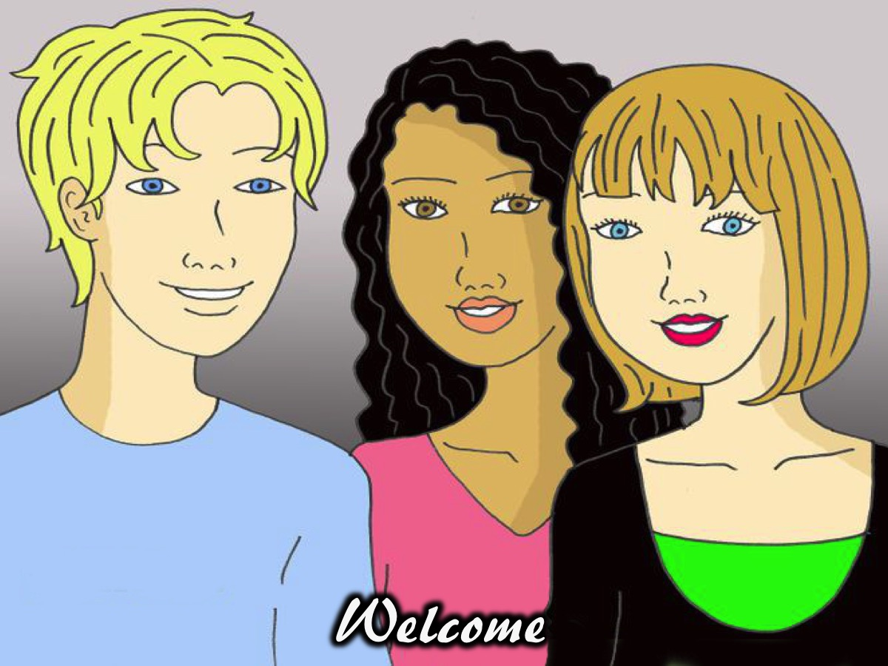
Notes:
Welcome to regulars and newcomers.

Slide 3
Notes:
So welcome to another Baewatch session.

Slide 4
Notes:
Objectives: To give you a Biblical perspective on love, relating to the opposite sex, dating and marriage so that you…

Slide 5
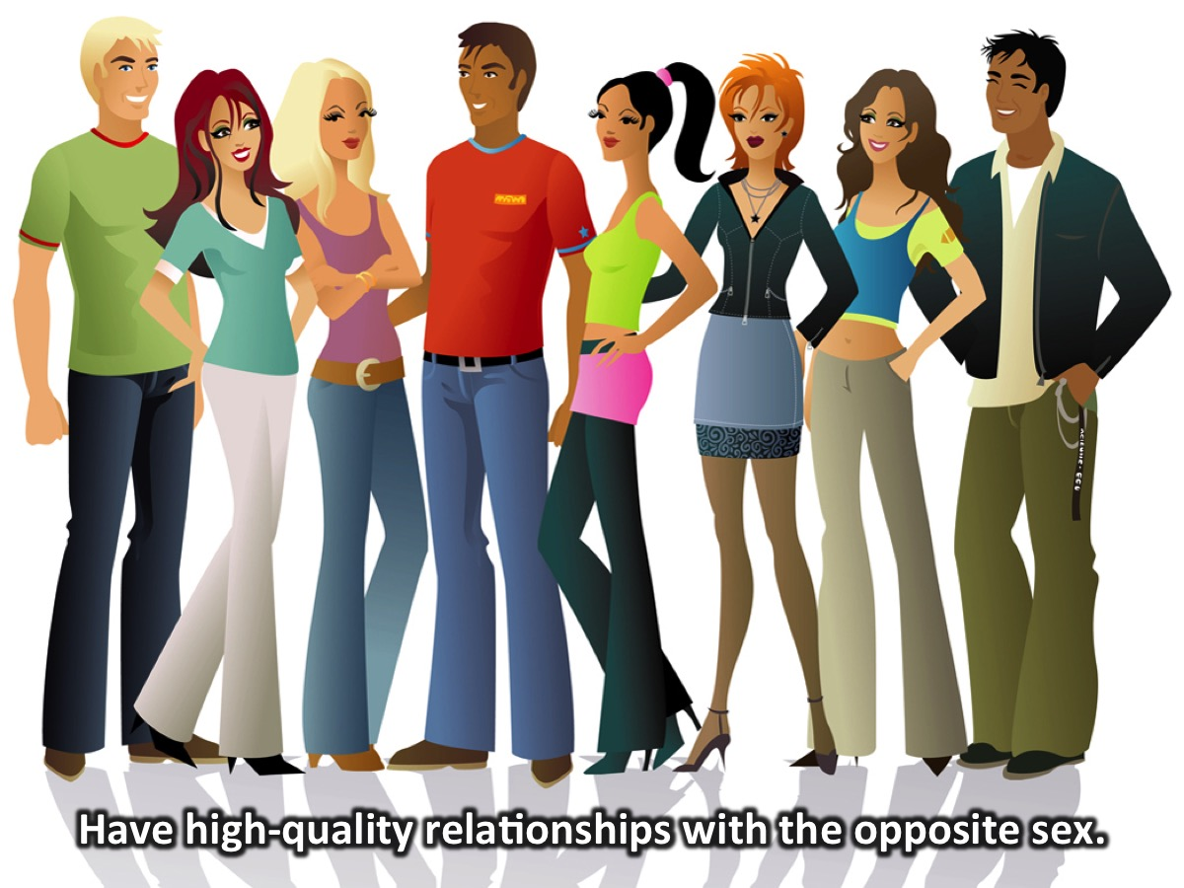
Notes:
1. Have high-quality relationships with the opposite sex.

Slide 6
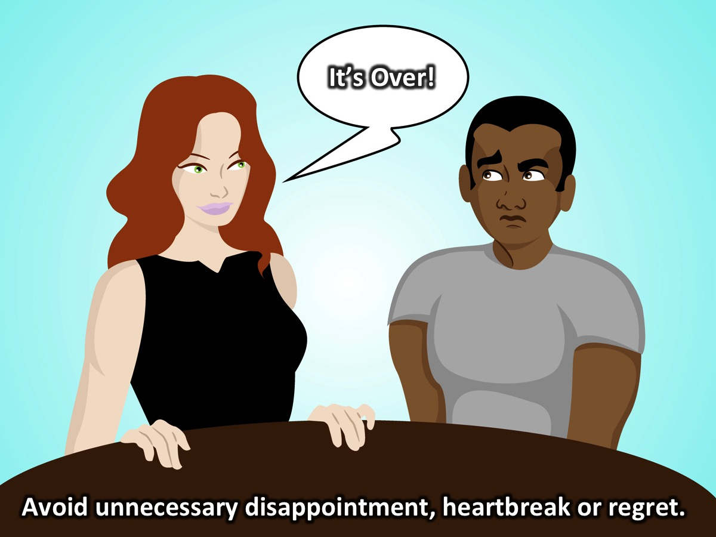
Notes:
2. Avoid unnecessary relational disappointment, heartbreak, and regret.

Slide 7
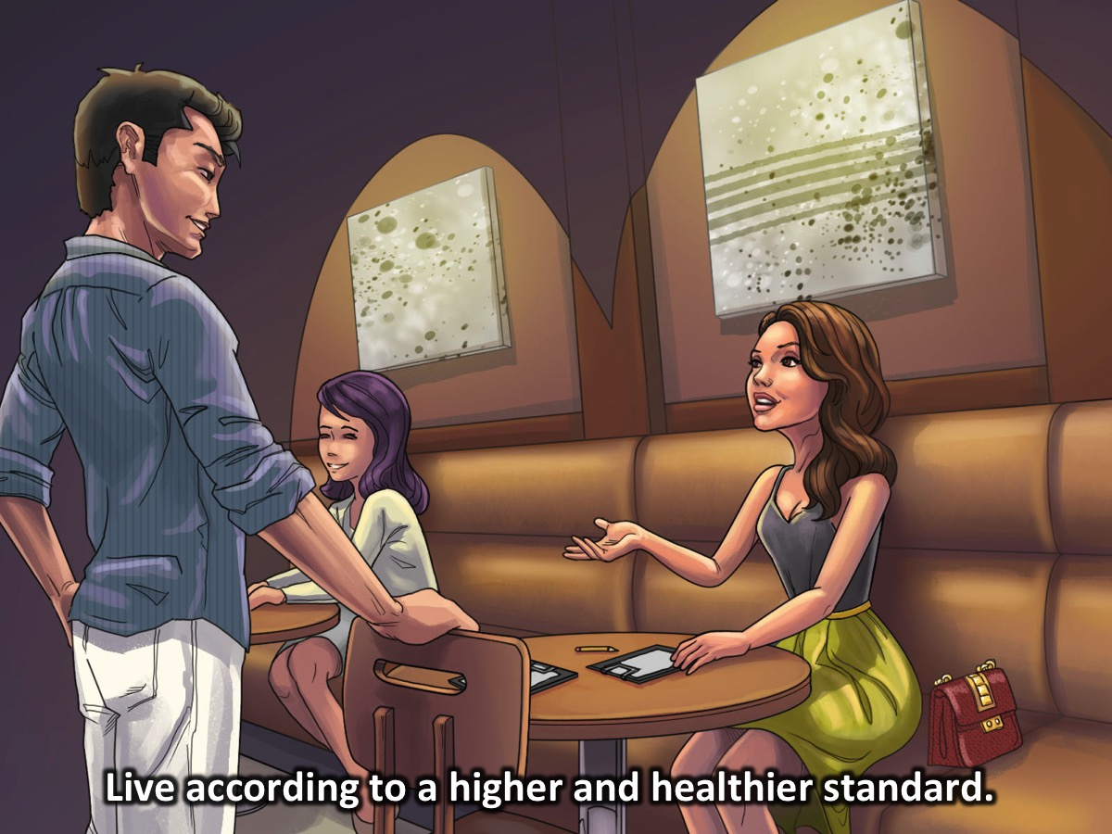
Notes:
3. Live according to a higher and healthier standard.

Slide 8
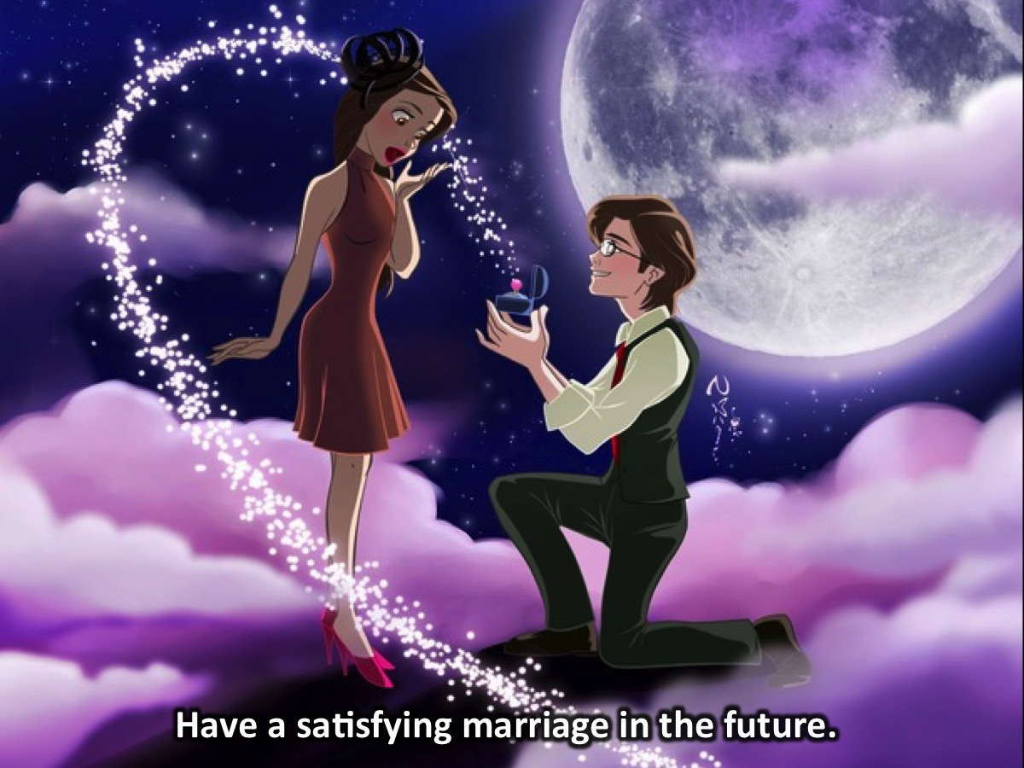
Notes:
4. Have a satisfying marriage in the future.

Slide 9
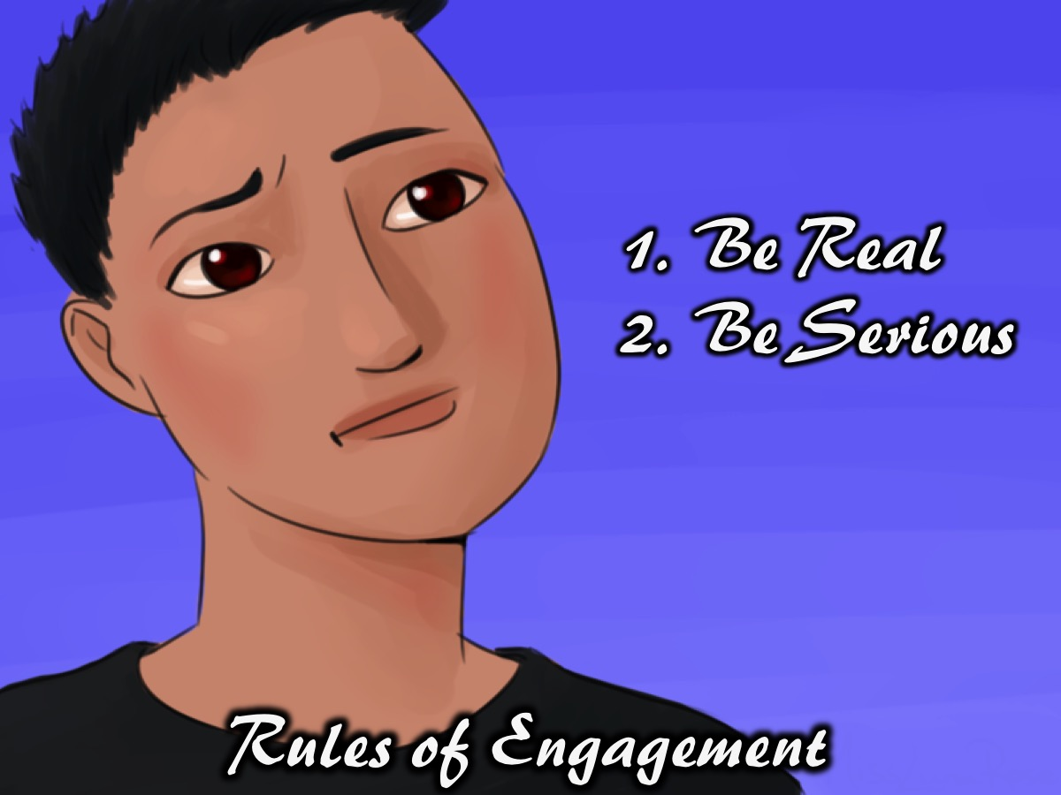
Notes:
Rules of Engagement: (1) Be Real. (2) Take This Seriously (or Be Serious).

Slide 10
Notes:
Week 1 of the Baewatch Series was Feel the Current.

Slide 11
Notes:
Mainstream culture is the culture that is practised by a large amount of people residing in a society.

Slide 12
Notes:
Biblical culture is an alternative culture and lifestyle of people who reject or oppose the dominant values and behaviour of society.

Slide 14
Notes:
Week 2 of the Baewatch Series: Resist the Current.

Slide 15
Notes:
Mainstream Culture Says: Find someone - as quickly as possible. Not just anyone, but ‘The One’. While you are single, you are not a complete person. But when you find ‘The One’, you will be complete and your “happily ever after” will start.

Slide 16
Notes:
Biblical Culture Says: Become someone not just anyone; but who God created you to be. Not for the sake of finding someone, but so that you can walk in the fullness of God’s plan, purpose and destiny for your life.

Slide 17
Notes:
We learnt how to Become Someone:

Slide 18
Notes:
We looked at 4 principles to help you develop friends with benefits: (1) Check their Character. (2) Move in Community. (3) Don’t Get Physical. (4) Guard Your Conversation.

Slide 19
Notes:
Week 3 was His & Her Beaches

Slide 20
Notes:
The focus was on Identity and Community - knowing who you are and being each others' keeper in the sense of calling each other to that identity.

Slide 21
Notes:
Week 4 was Life Guards speak…

Slide 22
Notes:
We had a Human Library where we checked out seven young adults with great experience.

Slide 23
Notes:
Tonight is the last night of our Baewatch series and it is called: Swimming Free.

Slide 24
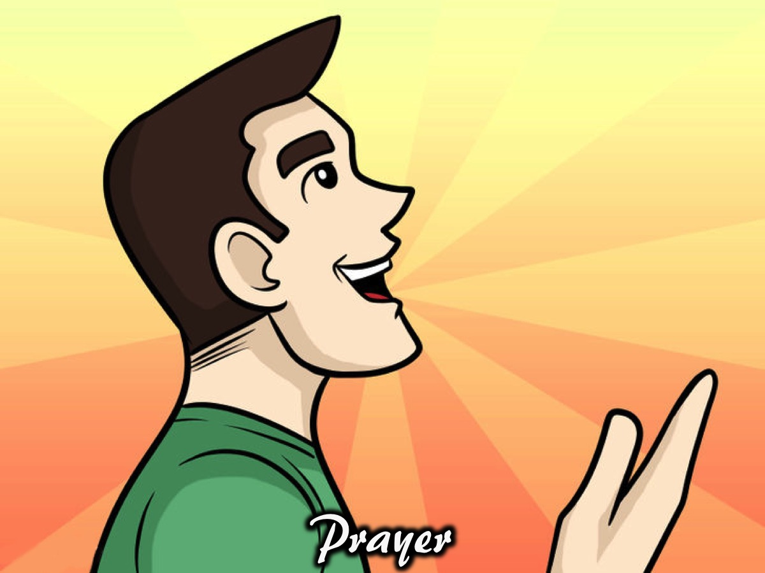
Notes:
Prayer

Slide 25
Notes:
Tonight you are going on a Silent Journey. Here are the rules for the journey: (1) Do not talk. (2) Travel alone. (3) Start Anywhere. (4) Move clockwise. (5) Respect those still travelling.

Slide 26
Notes:
1. At the Pledging Purity Station you will be challenged to pledge to be pure in your dating and relationships.
1. The Pledging Purity Station: Located in front of the TV. Cover the pool table with a board and place the A4 pages in order on the table. Place a mirror on the table that teens can look into. Consider having a bucket of water that teens can ceremonialy wash their hands in. Need: (1) Bucket of water and hand towel.
A. How can young people keep their lives pure? By obeying God’s commands. (Psalm 119:9). To be Pure, what do you need to: (1) Stop Doing? (2) Start Doing?
B. As you look into the mirror and see your reflection, remember that God made you special and that He has called you to be pure. Say to yourself: “I am going to be pure for God!”
C. Pray this prayer silently: “Lord, I want to be clean on the inside. Wash me and make me whiter than snow. Please forgive me for the things that I have done with my body. I want to live for You. I decide today to use my body for Your glory. I will not give myself away, but only to You. Amen”
D. As a sign that you have pledged to live a pure life - drip your hands in the water and dry them off to symbolise your commitment.

Slide 27
Notes:
2. At the Setting Boundaries Stations you will set boundaries for your lives when it comes to dating and relationships.
2. The Setting Boundaries Station: Located at the Graffitti Wall. Put the two cartoons on the wall - start with the two singles and end with the married couples - in between draw a windy road with chalk. Needed: (1) Cartoon cutouts for the grafitti wall. (2) Windy chalk line drawn between the two cartoon. (3) Chalk for people to draw.
God wants you to live a pure life. Keep yourselves from sexual sin. (1 Thessalonians 4:3). Draw or write one thing on the road to your wedding day that you must avoid to live a pure life.
Prayer: Ask God to help you set boundaries so you can live pure until you get married.

Slide 28
Notes:
3. At the Overcoming Hurts Station you will deal with hurts that you have experienced in your life.
3. The Overcoming Hurts Station: Located on the Table Tennis Table. Print and cut out the bandages, plasters and cast and provide pens. Needed: (1) Printed and cut bandages. (2) Pens. (3) Dustbin.
A. When you get a cut and forget to put something on it, it gets worse and goes septic. After a while the cut gets infected and needs attention. If you carry on ignoring it, it may get so bad that gangrene can set in and you need to get it amputated.
B. Think of a time you felt angry, depressed, sad, lonely or hurt? Remind yourself that these feelings were caused by an emotional wound.
C. Take a plaster, a bandage or a leg caste to represent some of the specific hurts you have received. Write the hurt on the back of the paper and give it to Jesus to heal by throwing it in the bin and asking Jesus to heal the hurt.

Slide 29
Notes:
4. At the Cutting Soul-Ties Station you will be challenged about how sex creates a soul-tie between two people and you will have a change to cut any ties you have created in the past.
4. The Cutting Soul-Ties Station: Located is front of the serving hatch. Needed: (1) Printed figures. (2) Frame and bar to hang figures. (3) Scissors . (4) String.
A. A man leaves father and mother, and in marriage he becomes one flesh with a woman - no longer two individuals, but forming a new unity. (Mark 10:7). When we have sex with someone, a soul-tie is created - you become one with that person through the act of sex.
B. If you have had sex with someone before marriage then confess that it was wrong and repent of what you’ve done.
C. Cancel any promises you made with a person of the opposite sex - like to be together for the rest of your lives, etc.
D. Say this Prayer: Lord I confess and repent of the ungodly soul ties formed by sleeping with ______ and I cut them in the name of Jesus.
E. Cut the rope of one of the people hanging from the strings to symbolise the cutting of a soul tie and bless the person as you do it.
F. Remind yourself of this verse: Anyone who belongs to Christ is a new person. The past is forgotten, and everything is new. (2 Corinthians 5:17)

Slide 30
Notes:
5. At the Receiving Guidance Station you will find someone who can guide you in your life.
5. The Receiving Guidance Station: Located on the Pool Table. Get a large map of your area and place it on the wall. Needed: (1) Large Map, (2) Green Pin.
A. You have ONE MINUTE to find where you are on the map and trace a path with your finger to where your home is located. Remember, you only have one minute. After that, move on whether you are finished or not.
B. Sometimes in life, time is not on our side and we are placed under pressure. Sometimes we get lost and we don't know which way to go or what to do. It is in those times that we need direction and help. If you don't ask for guidance it may take you longer to get where you need to be.
C. Do you have a guide in your life?
• Somebody who asks you how you are doing and actually listens.
• Somebody who helps you when you need them
• Somebody who tells you the truth instead of what is nice to hear
• Somebody who encourages you
• Somebody who loves God
D. In your life, who could be your guide? Make a commitment to ask the person who came to mind to be your guide.
E. Prayer for Wisdom and Guidance: Father, I need Your help. I don't know what to do when it comes to ________ (your problem). Please give me wisdom to handle myself in this situation. Give me the courage to do what you tell me. Thank you that you hear my prayers. Amen!

Slide 31
Notes:
Enjoy the silent journey.

Slide 32
Notes:
On Sunday morning it is week 3 of our Hearing God Series. We will be looking at how to actually hear God speak to us.

Slide 33
Notes:
Next Friday night it is the last week of the term and it is our Christmas Party!

Slide 34
Notes:
Refreshments are served.

