Slide 1

Notes:
Becoming a Great Leader

Slide 2
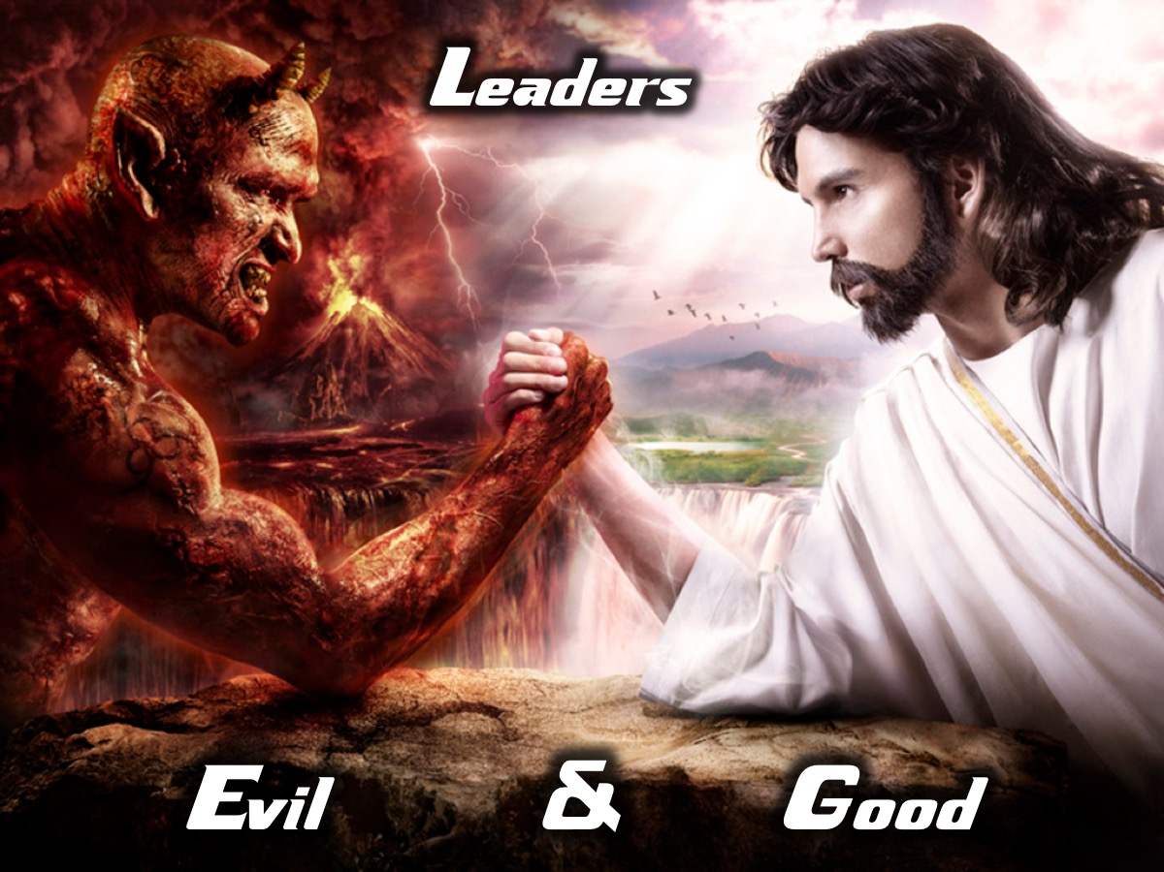
Notes:
There are Evil and Good leaders!

Slide 3

Notes:
We see both evil and good leaders in the Star Wars movie series.

Slide 4
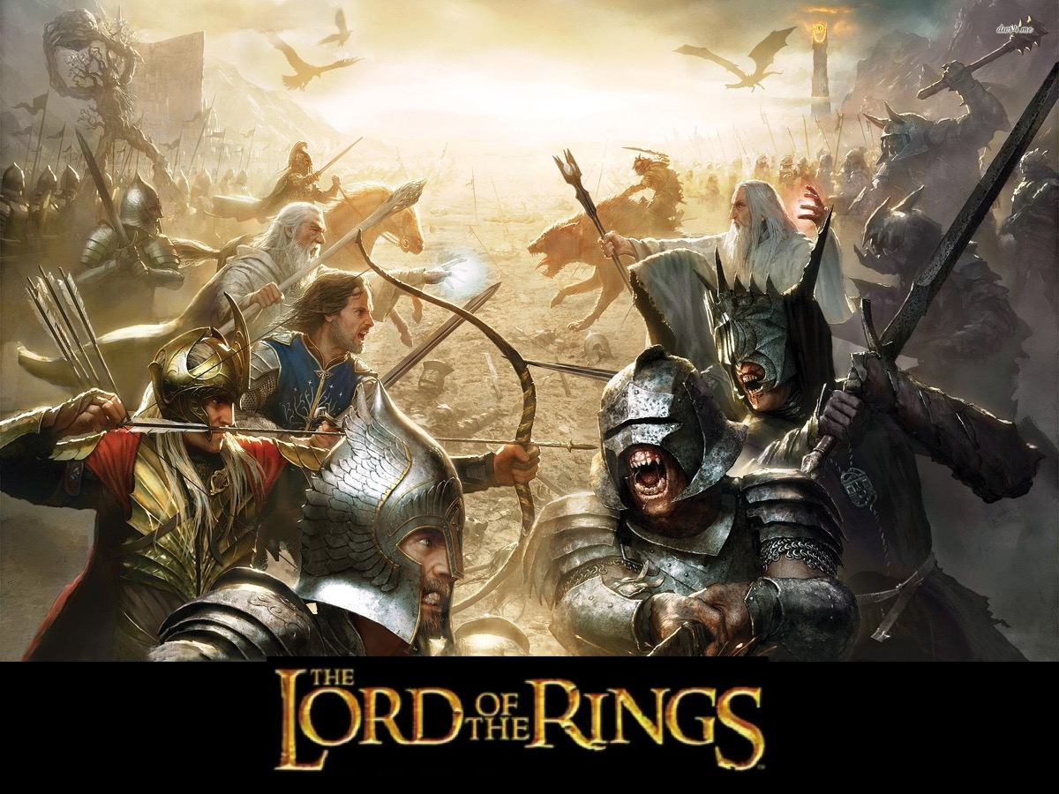
Notes:
We see both evil and good leaders in the Lord of the Rings trilogy.

Slide 5

Notes:
We see both evil and good leaders in the Harry Potter movie series.

Slide 6
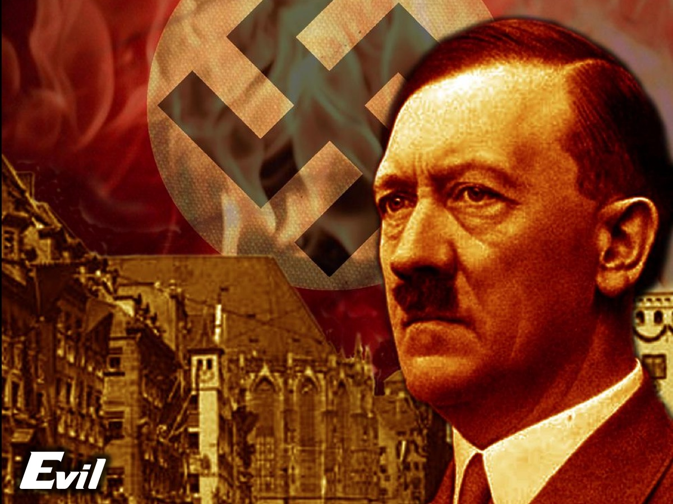
Notes:
An example of an evil leader.

Slide 7
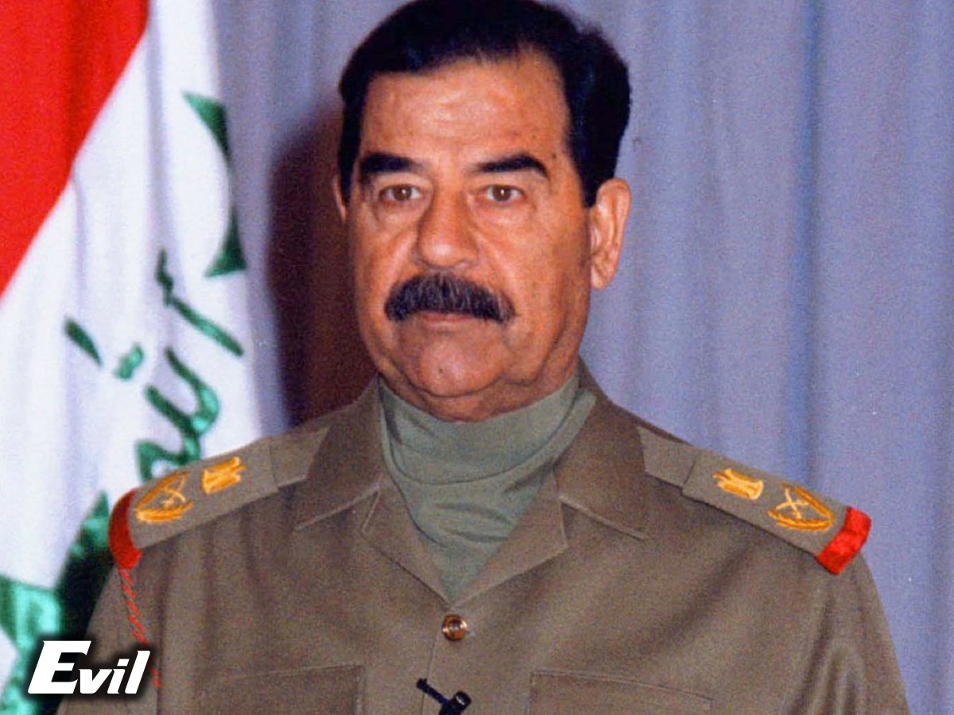
Notes:
An example of an evil leader.

Slide 8
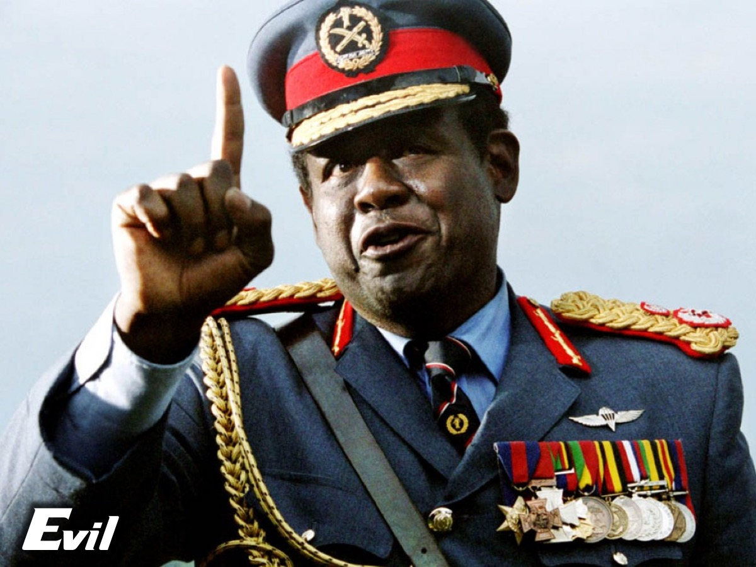
Notes:
An example of an evil leader.

Slide 9
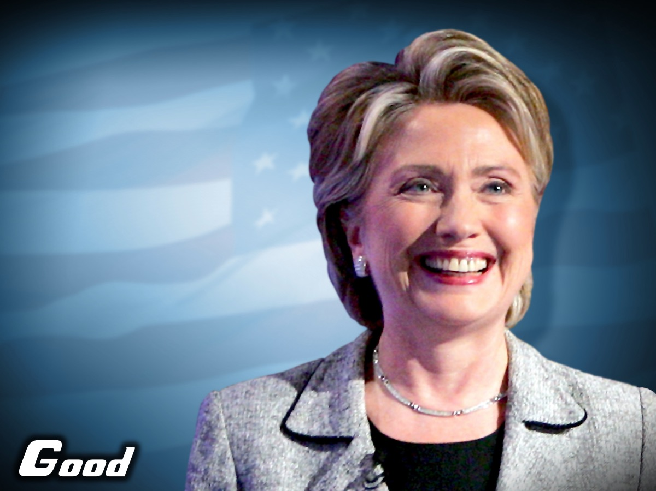
Notes:
An example of an good leader.

Slide 10
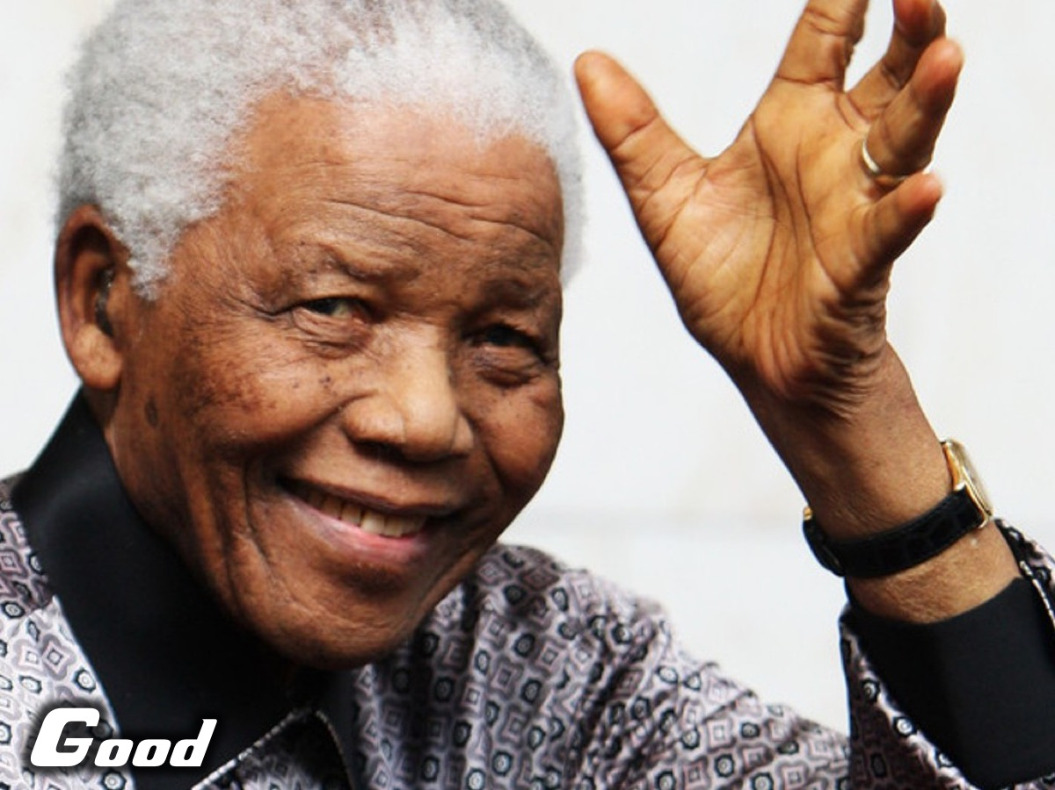
Notes:
An example of an good leader.

Slide 11
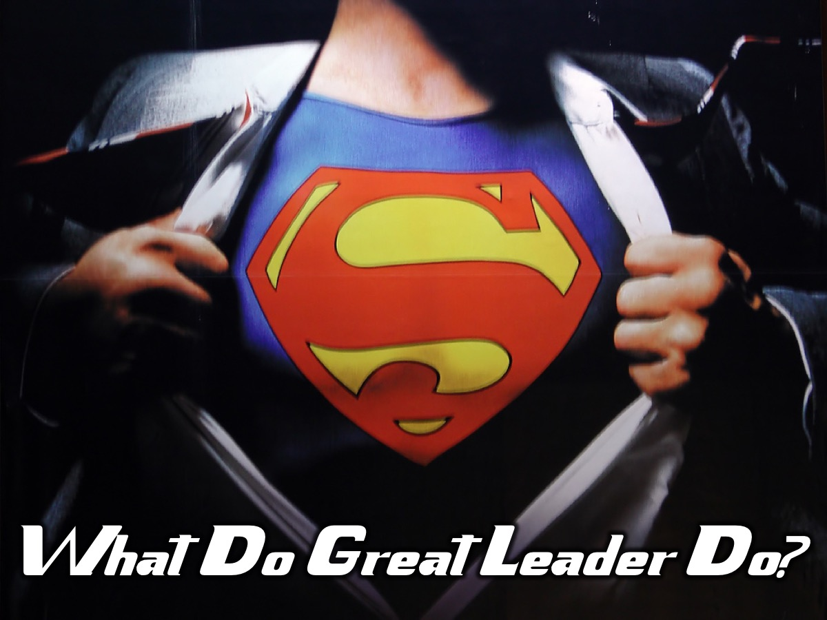
Notes:
What do great leaders do? I have recently stumbled across an amazing Blog by one of the leaders of an American fastfood franchise (Chick-fil-A). His name is Mark Miller and he has some amazing insights into leadership and teams.

Slide 12
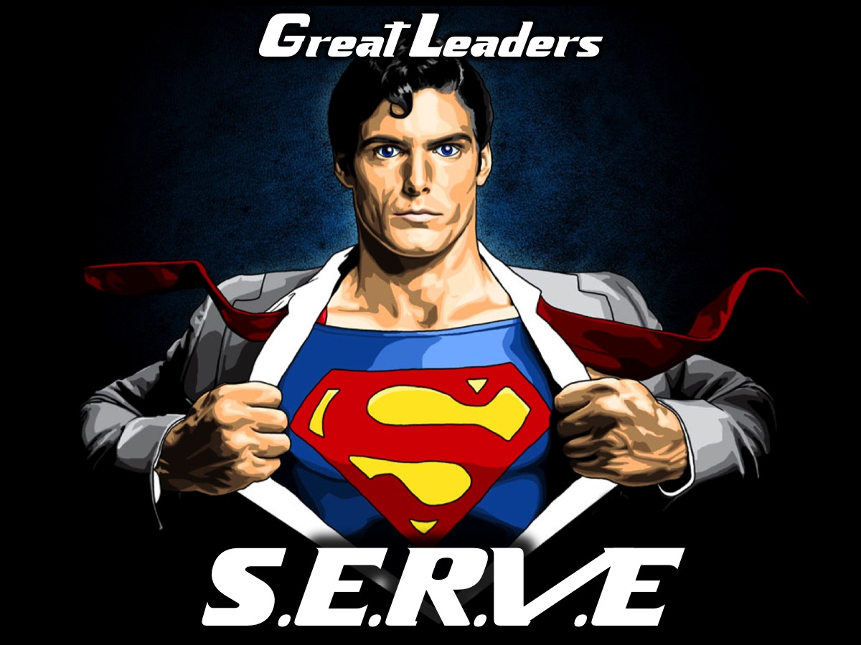
Notes:
He suggests that great leaders serve and that S.E.R.V.E is an acronym that stands for five things that great leaders do:

Slide 13

Notes:
1. See the Future. First, they must be willing to See the future. They must help the people they lead see the destination as well as the advantages of going there. Everybody needs to see who they are, where they are going, and what will guide their journey.

Slide 14

Notes:
2. Engage and Develop Others. Second, they must Engage and develop others. The first key element here is to recruit and select the right people for the right job. That means to get the right players on the team. The second element is to do whatever it takes to engage the hearts and the heads of the people you lead. Historically, many leaders have employed the hands and nothing else. That’s probably where the term “hired hand” comes from. We must get much more from people than just their hands. We must engage their hearts and heads as well.

Slide 15
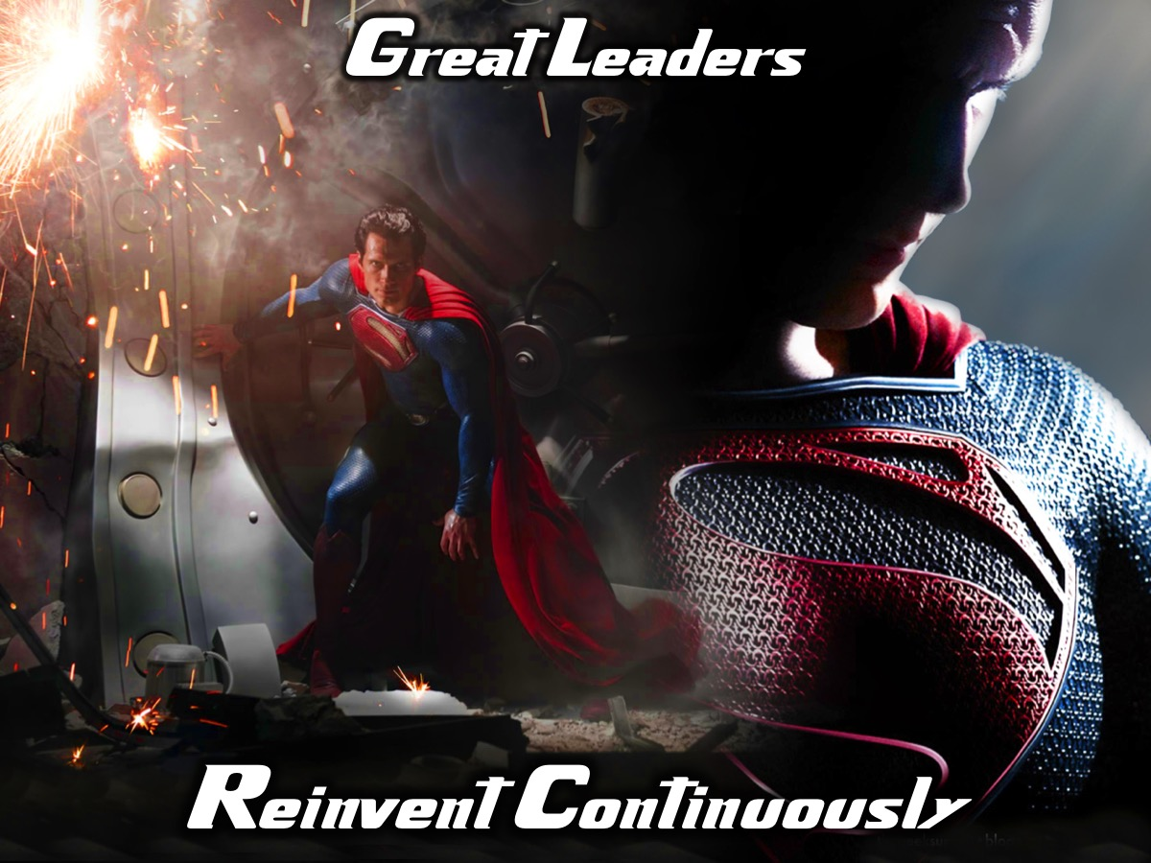
Notes:
3. Reinvent Continuously. Third, leaders must Reinvent continuously. This is where the value of creativity can really shine. The leader must be willing to re-invent on at least three levels. The first is personal. Some key questions to ask in this area are: How am I learning and growing as a leader? What am I doing to encourage others to constantly learn and reinvent themselves? The second level of reinvention is that of systems and processes. We must ask ourselves and our people: How are we doing the work? How can we do it better? How can we do it faster? How can we do it cheaper? What changes would enhance our ability to serve our customers and each other? Finally, the third level of reinvention involves the structure of the organization. A good question to ask here is What structural changes do we need to make to be more efficient and effective? Leaders must continually ask these types of questions in order to take themselves, their people, and their organization to the next level.

Slide 16
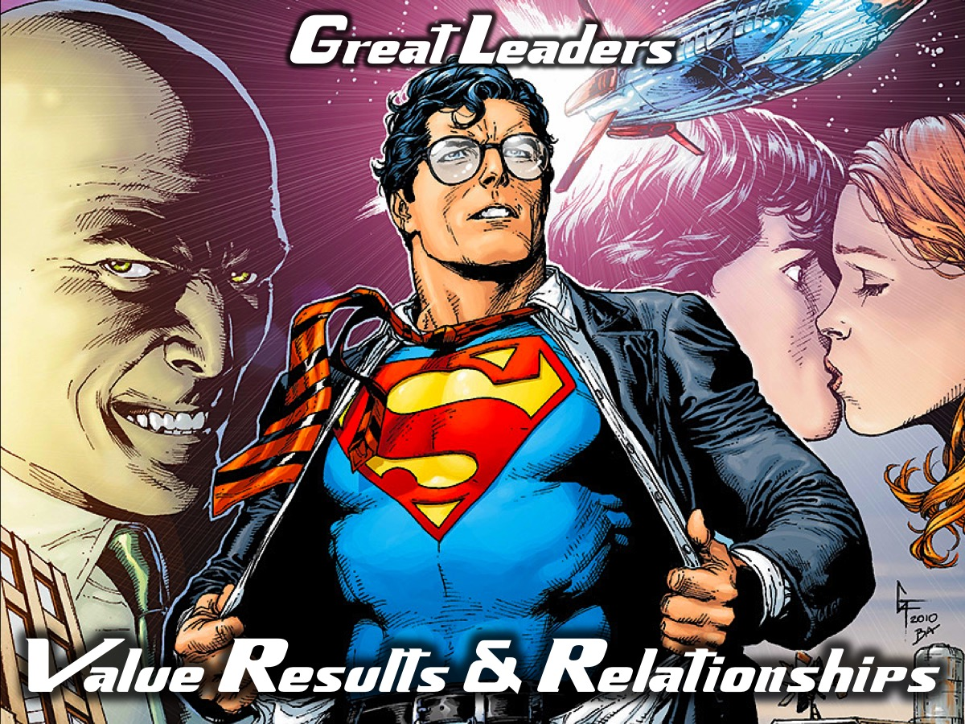
Notes:
4. Value Results and Relationships. Fourth, the “v” stands for Value results and relationships. We value our customers first – and that value guides our behavior and ensures our continuing success. What most people don’t understand is they can get better financial results if they have good relationships with their customers and their fellow workers. We have to raise the value of “relationships” to a position of equal importance with our value for “results.: It’s “both-and” not “either-or.” We traditionally teach people the important skills they need to get results: problem solving, decision making, and so on. What we have to continue working on is building good relationships and connection with people – while helping them continually to perform better. How do we do that? We value relationships when we listen to people, when we invest time with them, when we care deeply about them, and when we recognize their efforts.

Slide 17
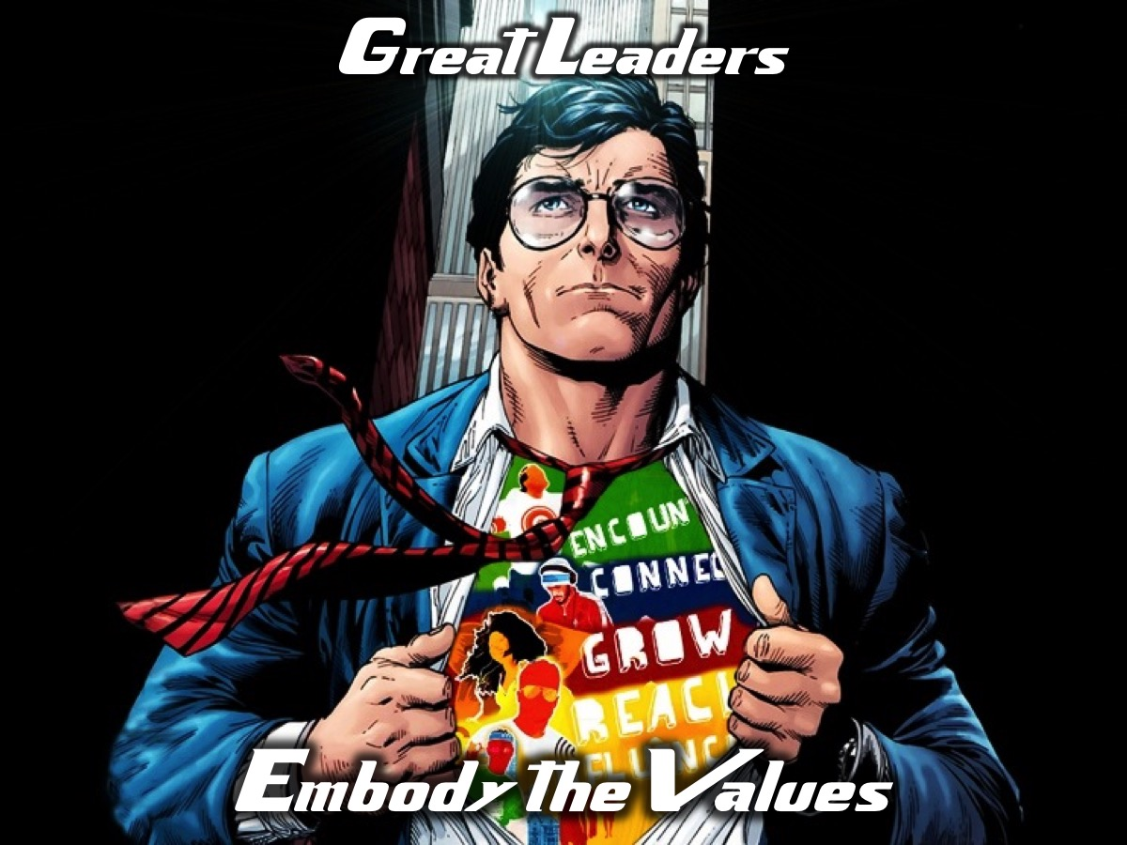
Notes:
5. Embody the Values. This is about walking the talk. Am I living in accord with the values that we say are important? This is all about trust! People don’t follow leaders they don’t trust.

Slide 18
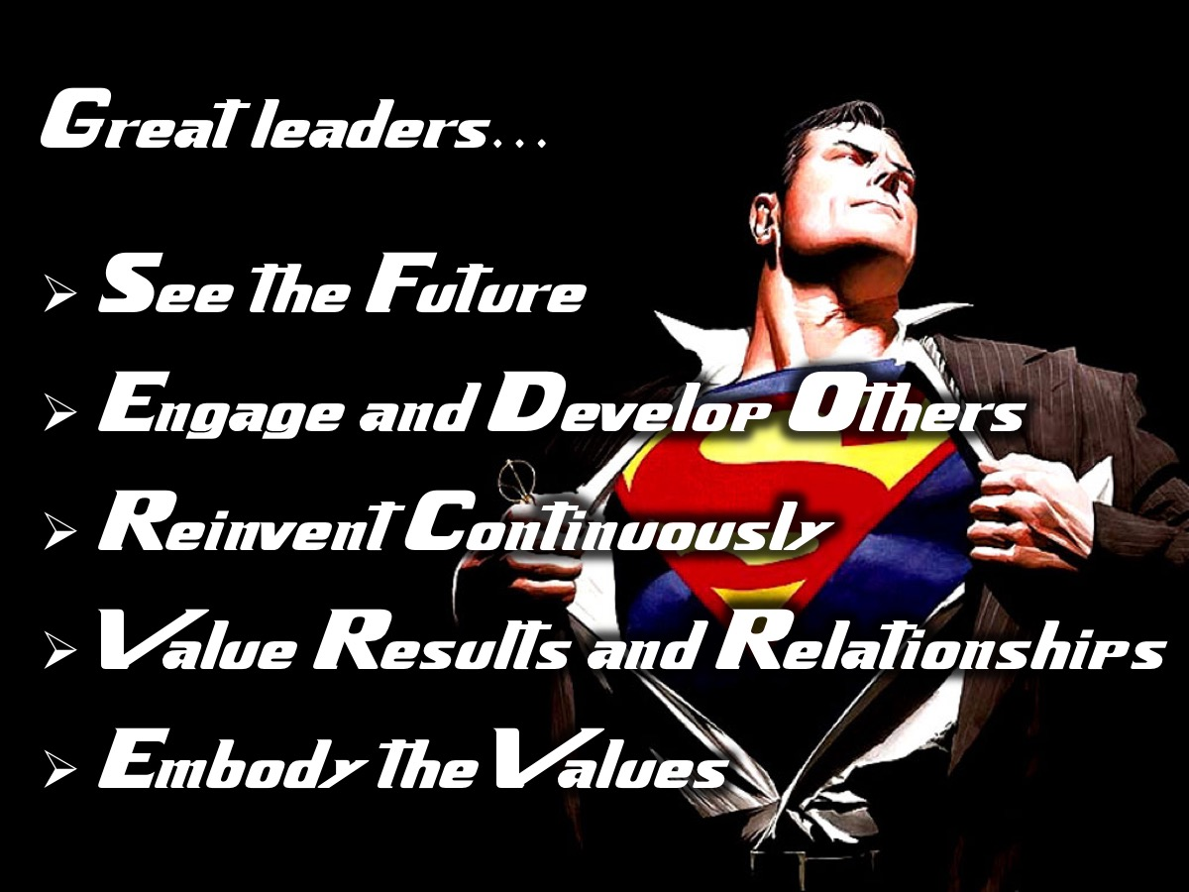
Notes:
That’s it. The “Secret” of Leadership is to S-E-R-V-E: See the Future, Engage and Develop Others , Reinvent Continuously, Value Results and Relationships and Embody the Values.

Slide 19
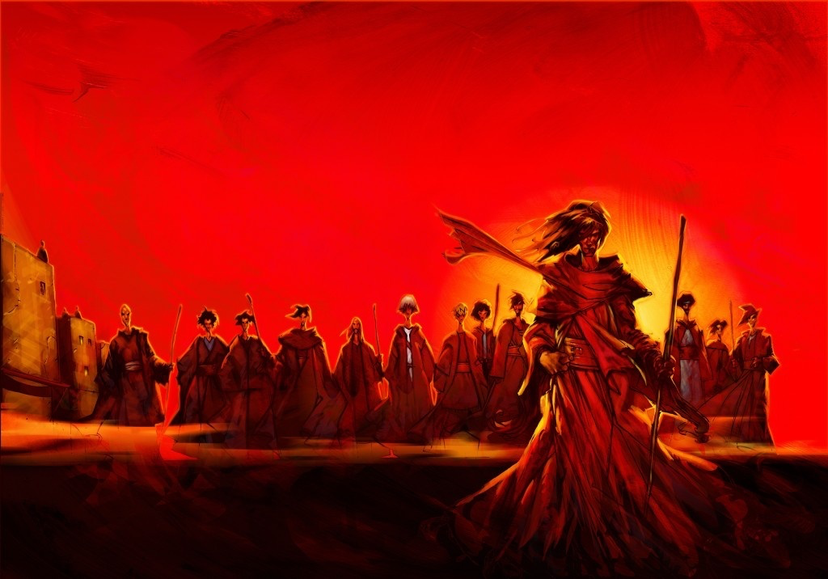
The greatest leader:
Knew the future
Empowered people
Acted wisely
Loved people & results
Lived his message
Notes:
And the one who modeled that more effectively than anyone in history? The One who came, not be served, but to serve and to give His life a ransom for many. Jesus selected twelve ordinary, inexperienced people and developed them into leaders who could carry on after He was no longer there in bodily form. When people asked Him questions, His answers showed a servant heart. “How do you lead?” “By following.” “How can I be first?” “By being last.” He symbolized His whole philosophy of servant leadership at the Last Supper, where He washed the feet of the disciples and essentially told them, “Just as I have done for you, you must do for others.” He constantly was talking about the future. He engaged His followers. He was continually challenging people to change not only themselves but also each other and their organizations. He cared about both people and results. And He certainly embodied the values that He spoke. Jesus is the greatest servant leader of all time. And we have a lot to learn. Each of us is in process. But be encouraged: as Dr. Martin Luther King Jr. said, “Everyone can be great, because everyone can serve.”

Slide 20
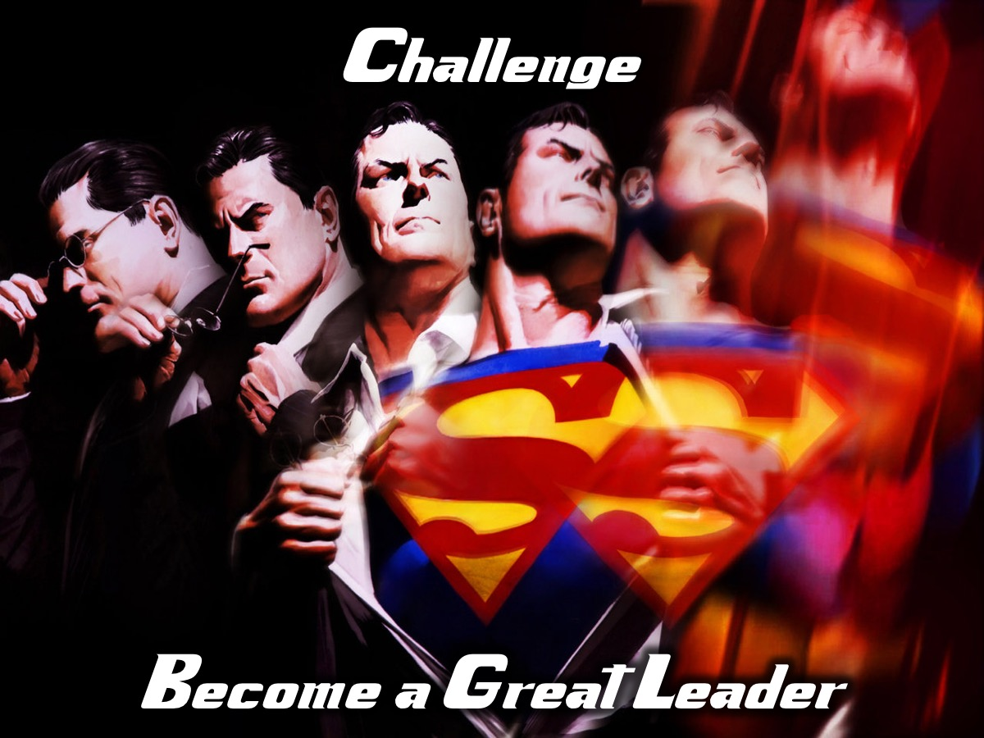
Notes:
Our challenge to you is to become a great leader!

