Slide 1
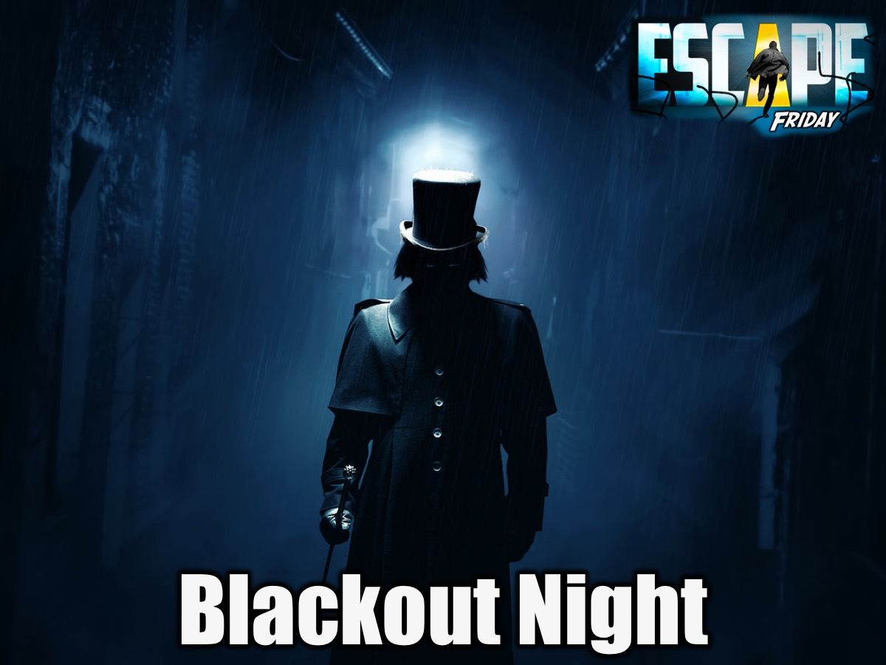
Notes:
This week is Blackout Night. The whole point of the night is to have all the lights off (maybe keep the lights on the staircases on, but besides that try to keep it all dark). We used our phones if a small portion of light was needed. You split everyone into about five groups (depends how many people you have). The objective is to get the most points before time is up. We placed objectives around the church property for them to find and complete. Each team had to find each objective and complete it within the fewest tries or in the quickest time (a leader at each objective would rate your performance and put it on a piece of paper for the team to carry to each objective with their ratings on it.
Here are some ideas for fun/team building objectives to use:
1. Marsh Picks: Each member of the team gets a toothpick to place in between their teeth, while standing in a circle. Without using their hands a marshmallow has to passed around the circle using the toothpicks. Once one person gets their toothpick in the marshmallow they pass their marshmallow and toothpick to the next person, and so on.
2. Dark Room: Gets two stuffed animals and place them in a dark room. When a team goes into find the hidden toys you have two leaders with Nerf guns running around shooting the team members and keeping them from finding the stuffed animals.
3. Banana Feet: Make a team stand in line facing the back of the person in front of them, then make them lay down with their feet in the air. (So pretty much your head in by the butt of the person behind you. starting from the front of he line pass the banana with their feet to the back of the line.
4. Spaghetti Face: Make spaghetti noodles with a lot of grease so when needed to be used it will not be stale (make sure it is not hot, so it will not burn when in contact with skin). Spread a portion of the spaghetti onto a platter, burying small toys into it. Without using hands three members of the team have to fish the toys out with their mouths.
5. Donut String: Tie a donut to the end of a string. With one member on their back and the other standing over them. The person standing has to feed the donut to the person on the ground. Obviously the person the ground cannot use their hands.
If you want to make it more challenging then each team could have a “paralyzed” person to carry, but once at an objective they can use their legs again. Only paralyzed when travelling between objectives.

Slide 2

Notes:
Welcome to His Youth and to Term 1.

Slide 3
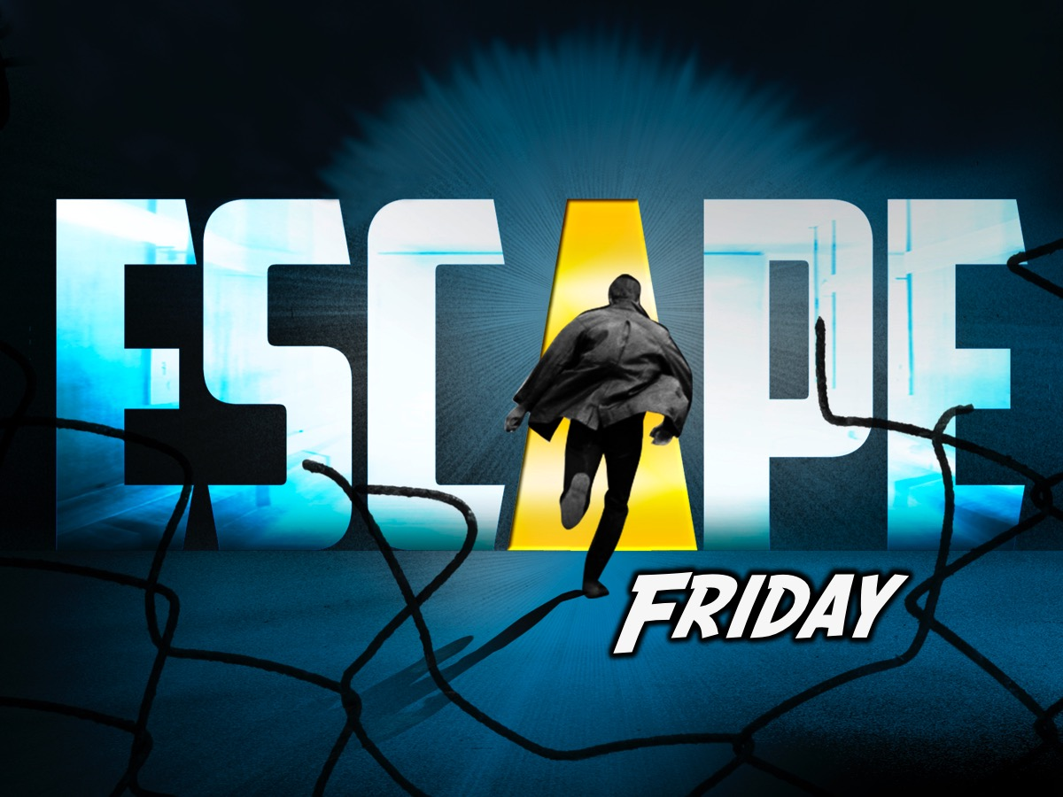
Notes:
On Friday nights we are launching the Escape Friday series…

Slide 4
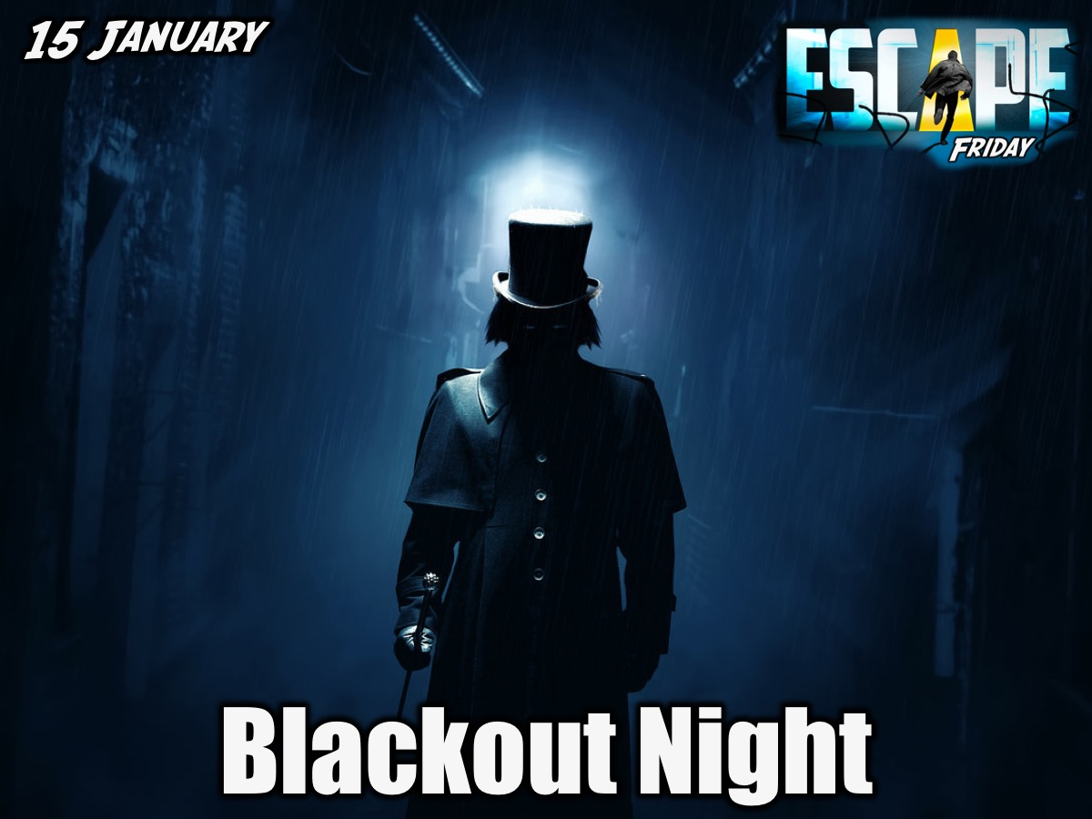
Notes:
Blackout Night. The whole point of the night is to have all the lights off (maybe keep the lights on the staircases on, but besides that try to keep it all dark). We used our phones if a small portion of light was needed. You split everyone into about five groups (depends how many people you have). The objective is to get the most points before time is up. We placed objectives around the church property for them to find and complete. Each team had to find each objective and complete it within the fewest tries or in the quickest time (a leader at each objective would rate your performance and put it on a piece of paper for the team to carry to each objective with their ratings on it.
Here are some ideas for fun/team building objectives to use:
1. Marsh Picks: Each member of the team gets a toothpick to place in between their teeth, while standing in a circle. Without using their hands a marshmallow has to passed around the circle using the toothpicks. Once one person gets their toothpick in the marshmallow they pass their marshmallow and toothpick to the next person, and so on.
2. Dark Room: Gets two stuffed animals and place them in a dark room. When a team goes into find the hidden toys you have two leaders with Nerf guns running around shooting the team members and keeping them from finding the stuffed animals.
3. Banana Feet: Make a team stand in line facing the back of the person in front of them, then make them lay down with their feet in the air. (So pretty much your head in by the butt of the person behind you. starting from the front of he line pass the banana with their feet to the back of the line.
4. Spaghetti Face: Make spaghetti noodles with a lot of grease so when needed to be used it will not be stale (make sure it is not hot, so it will not burn when in contact with skin). Spread a portion of the spaghetti onto a platter, burying small toys into it. Without using hands three members of the team have to fish the toys out with their mouths.
5. Donut String: Tie a donut to the end of a string. With one member on their back and the other standing over them. The person standing has to feed the donut to the person on the ground. Obviously the person the ground cannot use their hands.
If you want to make it more challenging then each team could have a “paralyzed” person to carry, but once at an objective they can use their legs again. Only paralyzed when travelling between objectives.

Slide 5


Slide 6


Slide 7
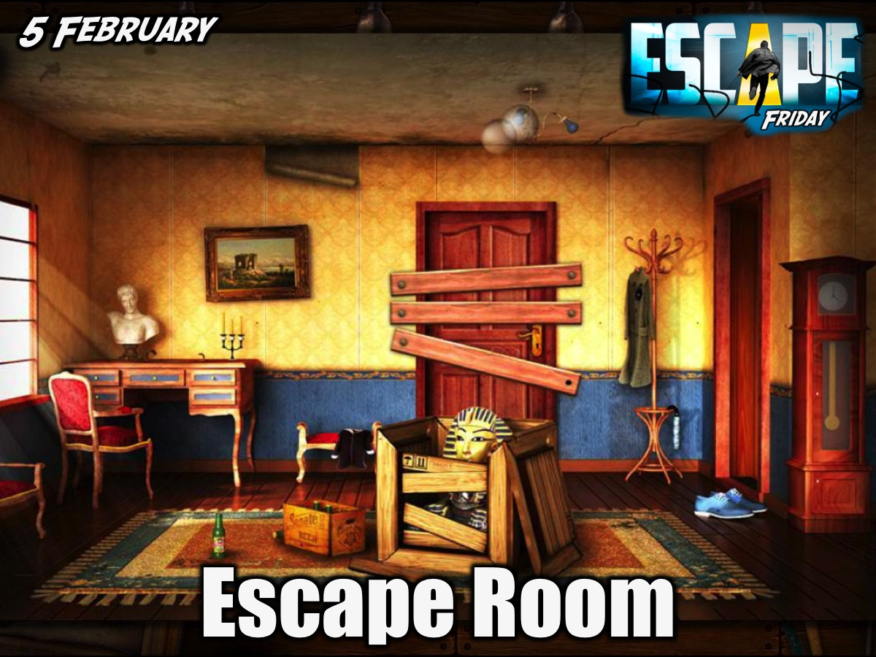

Slide 8


Slide 9
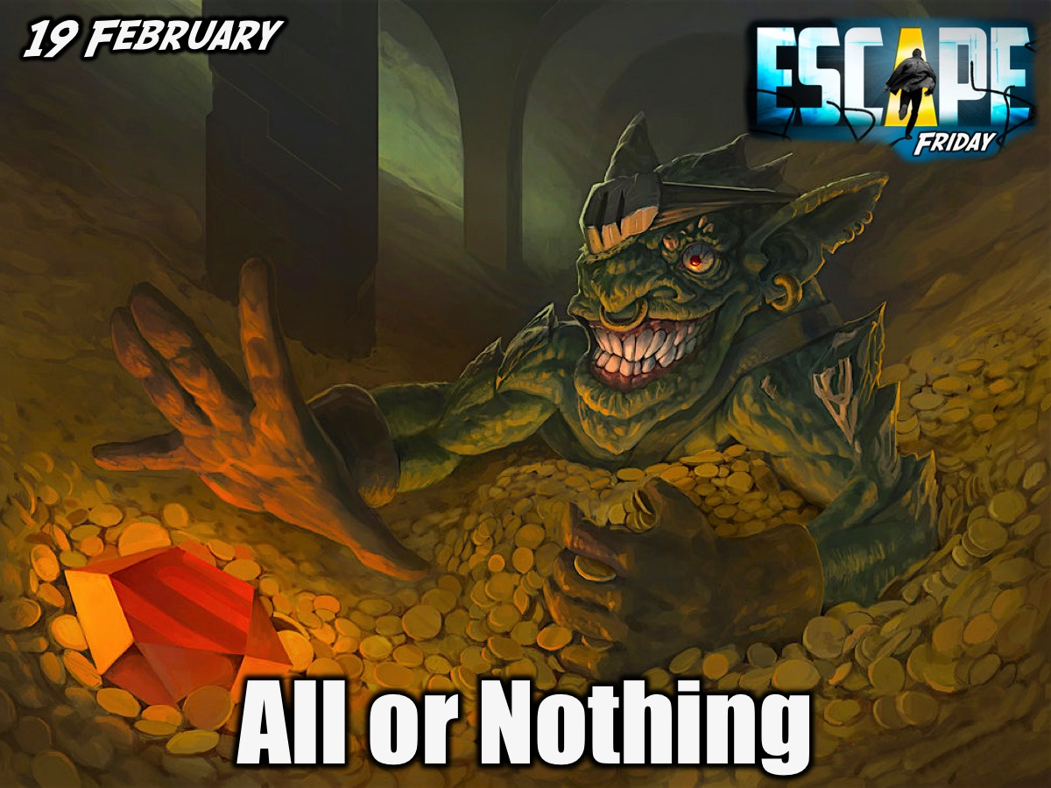

Slide 10


Slide 11


Slide 12
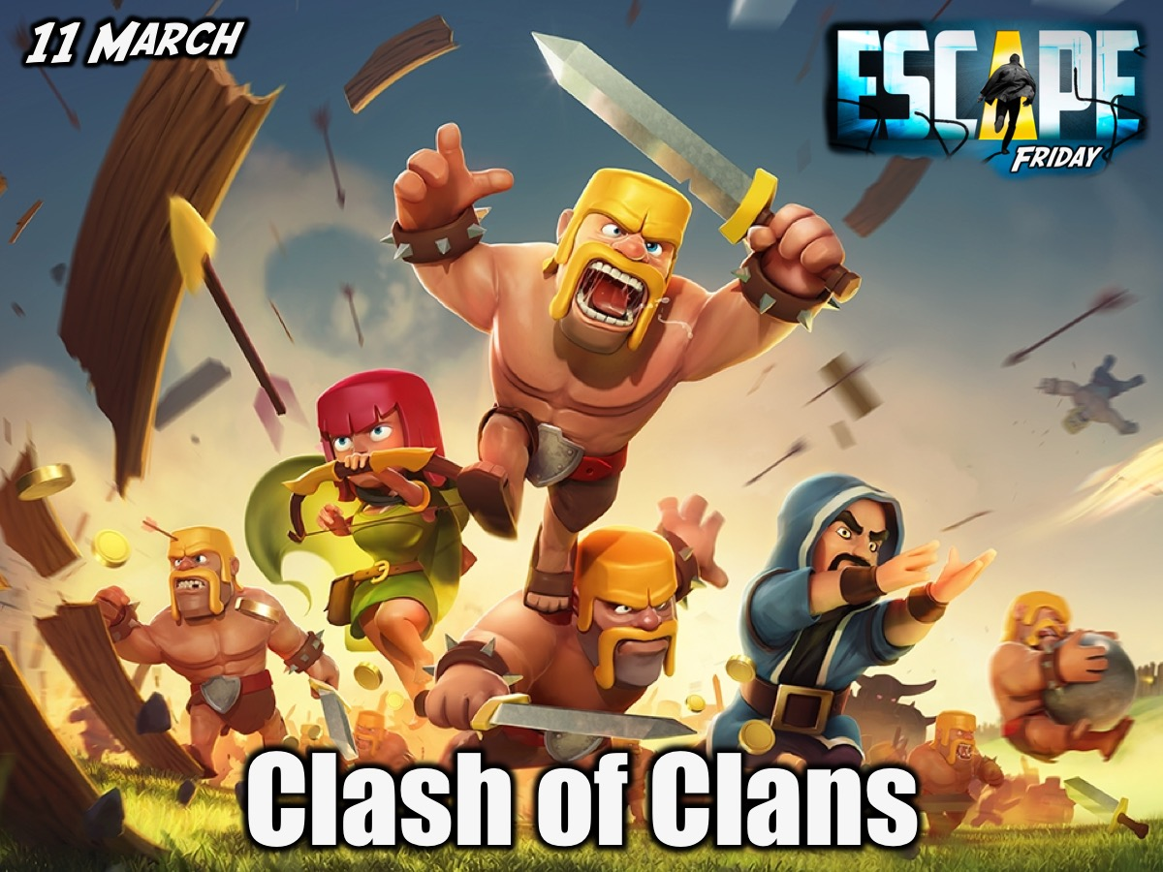

Slide 13
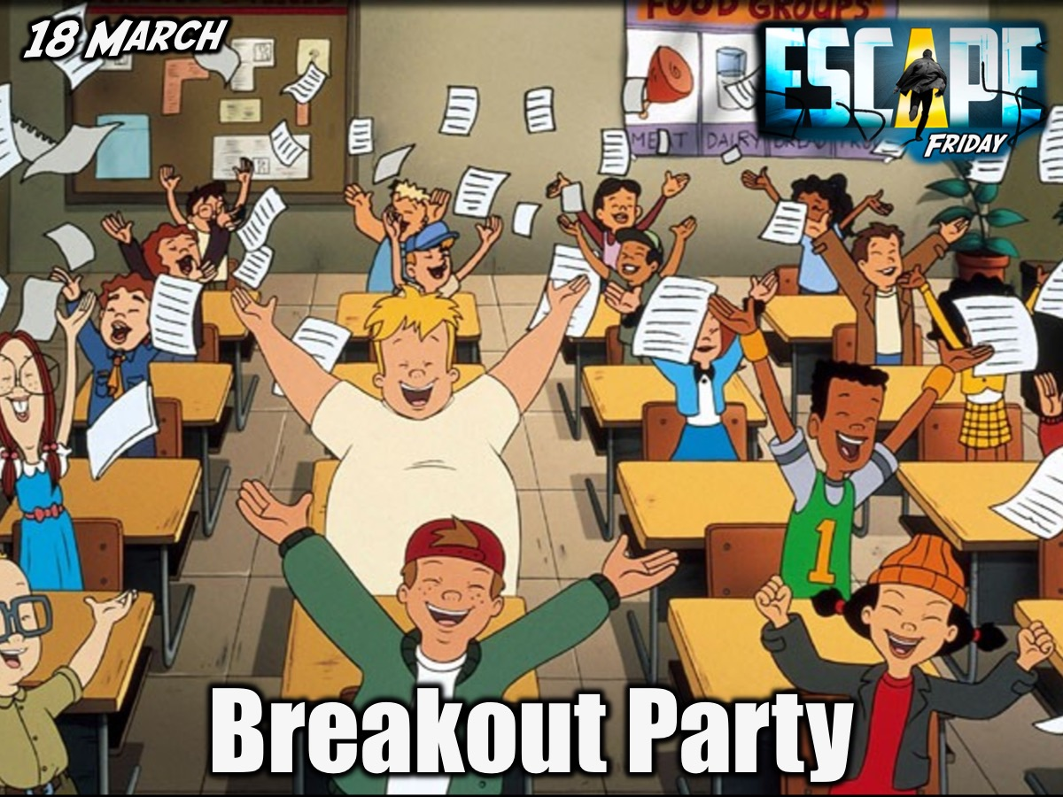

Slide 14
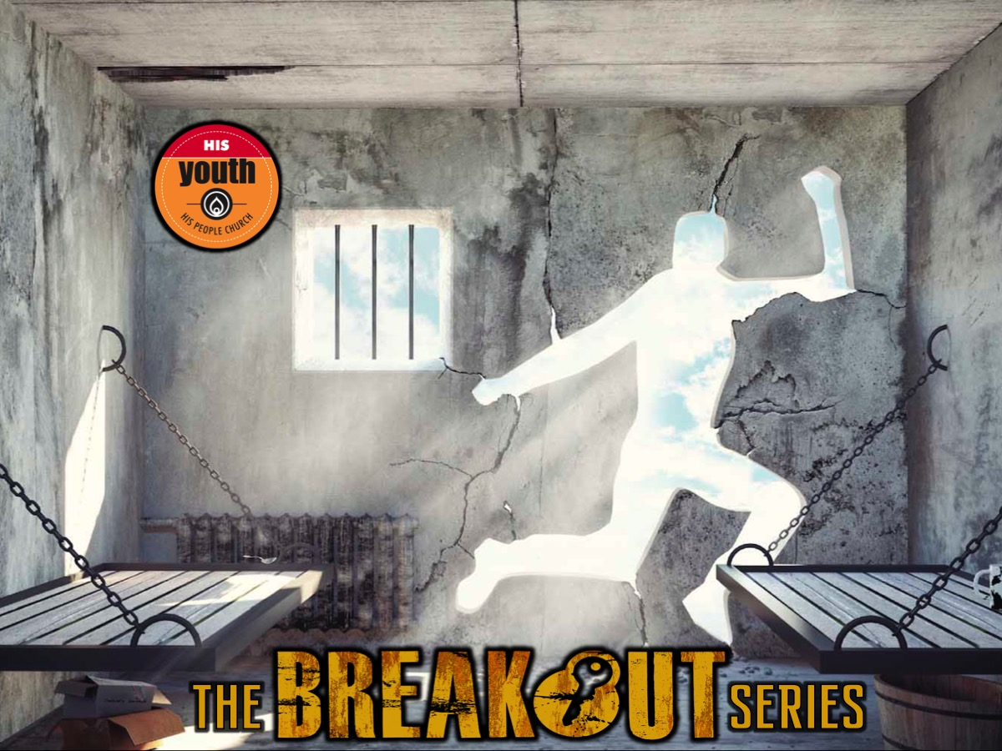
Notes:
On Sunday mornings in Term 1 will are launch a brand new series to establish you in your faith called The Breakout Series and will help you to break out of anything that is holding you in prison.

Slide 15
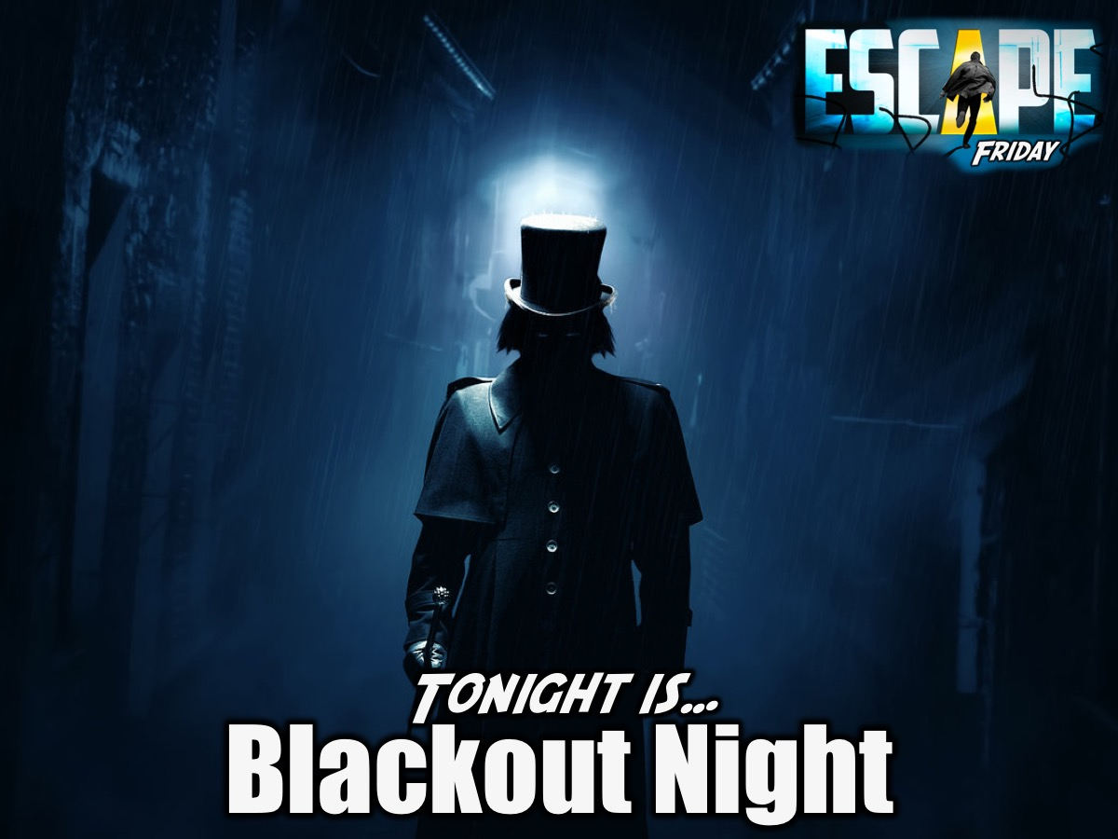
Notes:
But tonight it is Blackout Night.

Slide 16
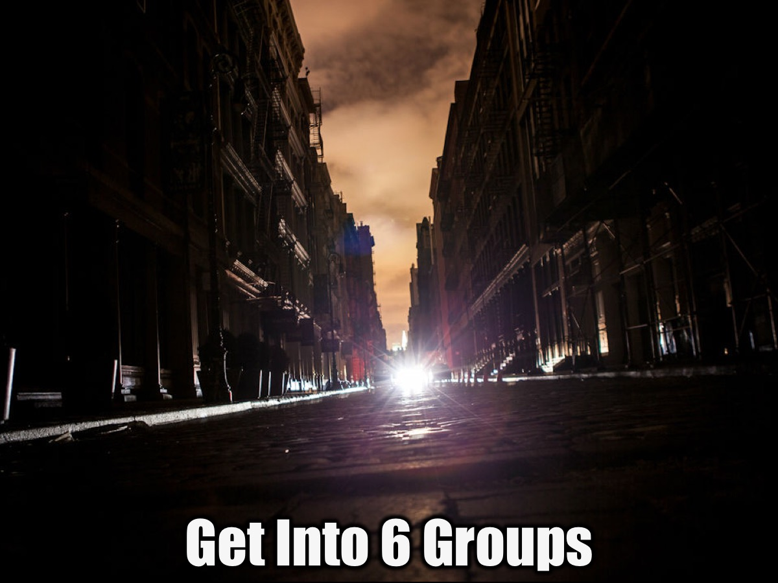
Notes:
Get Into 6 Groups – There will be six groups for the event.

Slide 17
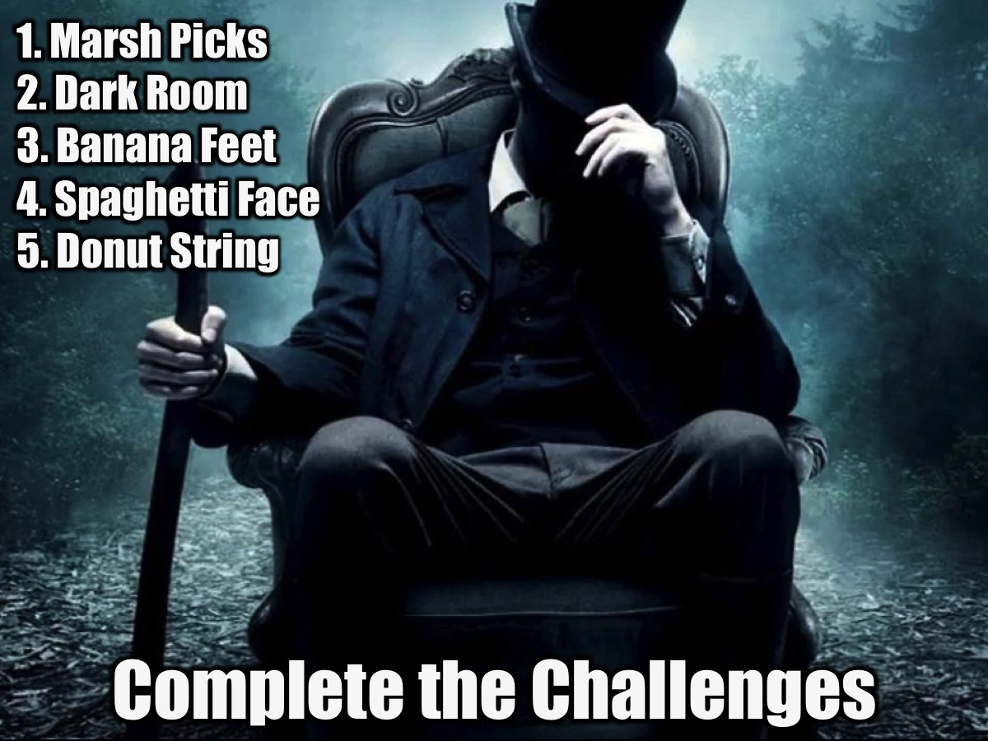
Notes:
Complete the Challenges:
1. Marsh Picks: Each member of the team gets a toothpick to place in between their teeth, while standing in a circle. Without using their hands a marshmallow has to passed around the circle using the toothpicks. Once one person gets their toothpick in the marshmallow they pass their marshmallow and toothpick to the next person, and so on.
2. Dark Room: Gets two stuffed animals and place them in a dark room. When a team goes into find the hidden toys you have two leaders with Nerf guns running around shooting the team members and keeping them from finding the stuffed animals.
3. Banana Feet: Make a team stand in line facing the back of the person in front of them, then make them lay down with their feet in the air. (So pretty much your head in by the butt of the person behind you. starting from the front of he line pass the banana with their feet to the back of the line.
4. Spaghetti Face: Make spaghetti noodles with a lot of grease so when needed to be used it will not be stale (make sure it is not hot, so it will not burn when in contact with skin). Spread a portion of the spaghetti onto a platter, burying small toys into it. Without using hands three members of the team have to fish the toys out with their mouths.
5. Donut String: Tie a donut to the end of a string. With one member on their back and the other standing over them. The person standing has to feed the donut to the person on the ground. Obviously the person the ground cannot use their hands.
If you want to make it more challenging then each team could have a “paralyzed” person to carry, but once at an objective they can use their legs again. Only paralyzed when travelling between objectives.

Slide 18
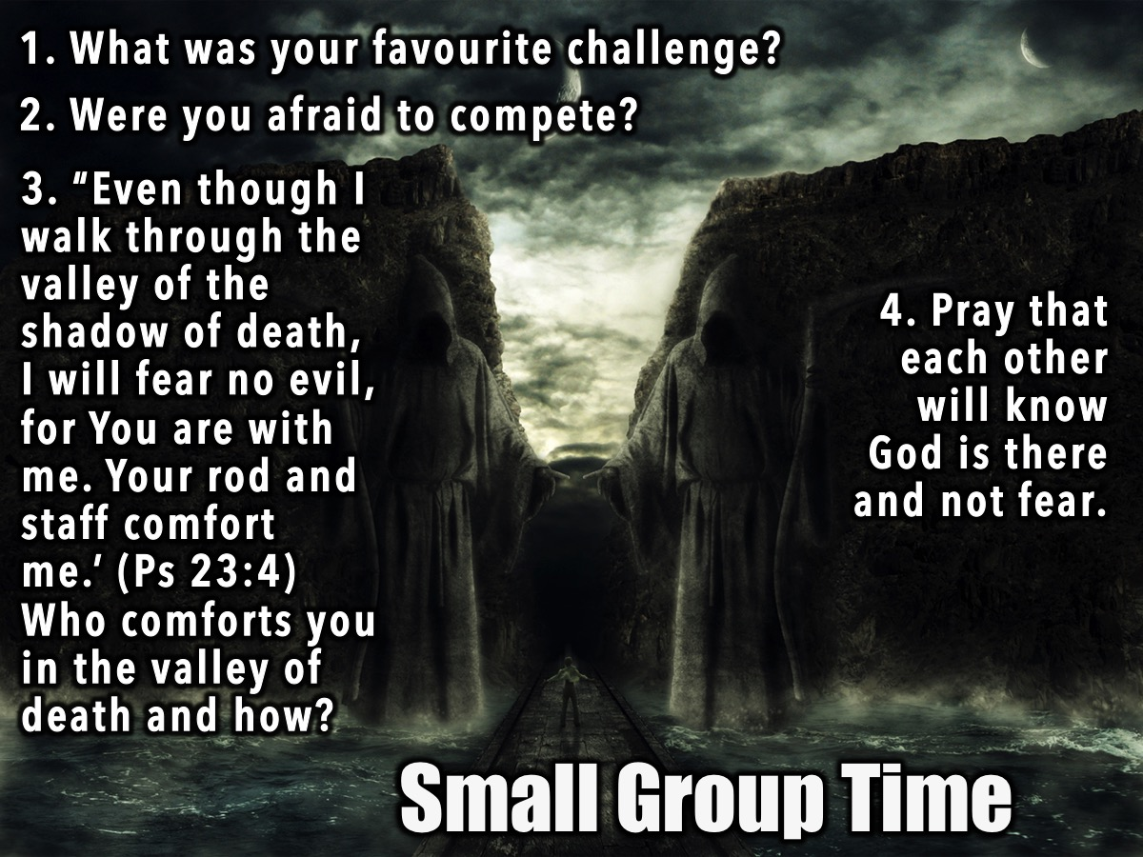
Notes:
Small Group Time. Here are the questions for our small group time: (1) What was your favourite challenge? (2) Did you ever feel frightened or scared to compete in a challenge? (3) The Bible says in Psalms 23:4: 'Even though I walk through the valley of the shadow of death, I will fear no evil, for You are with me. Your rod and staff comfort me' Who do you think is the one comforting you in the valley of death? (4) Pray that we will not fear if we know our God is there with us!

Slide 19

Notes:
Next week is Fear Factor Night.

Slide 20

Notes:
Join us on Sunday for week 1 of the Breakout Series where we will be focusing on Breaking free from Anxiety

Slide 21
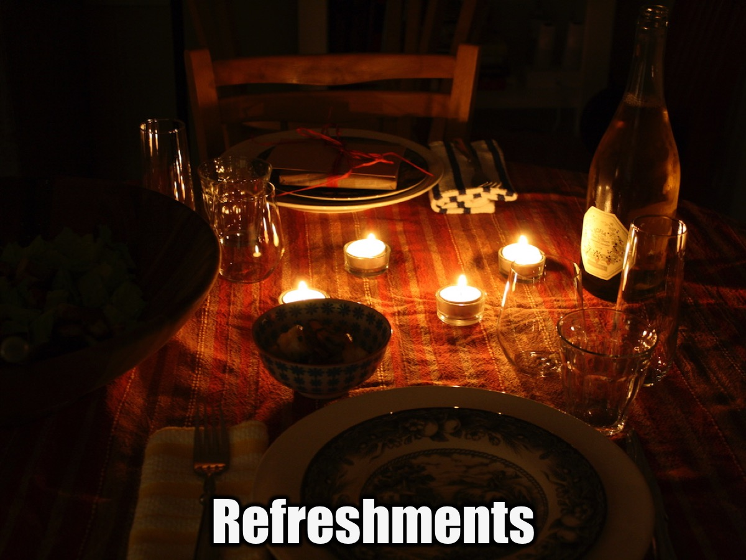
Notes:
Refreshments are served.

