Slide 1

Notes:
Welcome to the start of a new term at His Youth. We are launching The Breakout Series!

Slide 2
Notes:
Video: An edited version of Prison Escape - A GTA V Short Film (Rockstar Editor). Get it on YouTube at: https://www.youtube.com/watch?v=TX5aKVFScBg

Slide 3

Notes:
Today we are looking at how to breakout of the prison of Anxiety.

Slide 4

Notes:
In Week 2 we look at how to breakout of the prison of Fear.

Slide 5
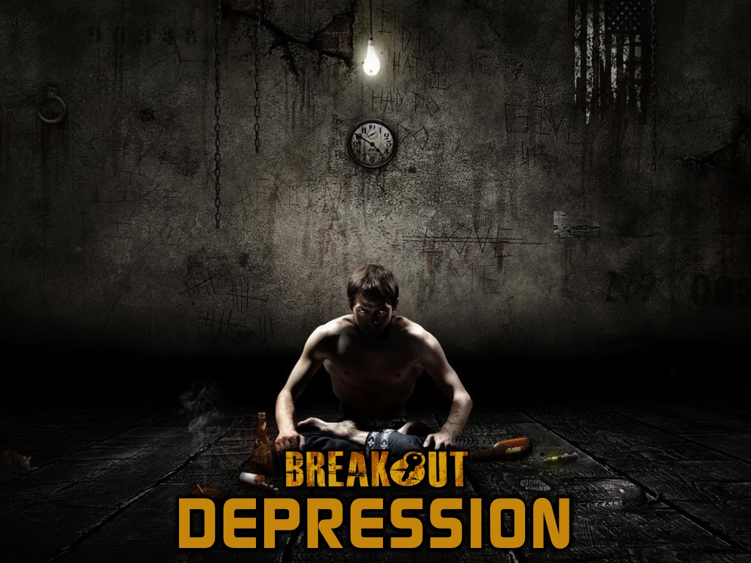
Notes:
In Week 3 we look at how to breakout of the prison of Depression.

Slide 6
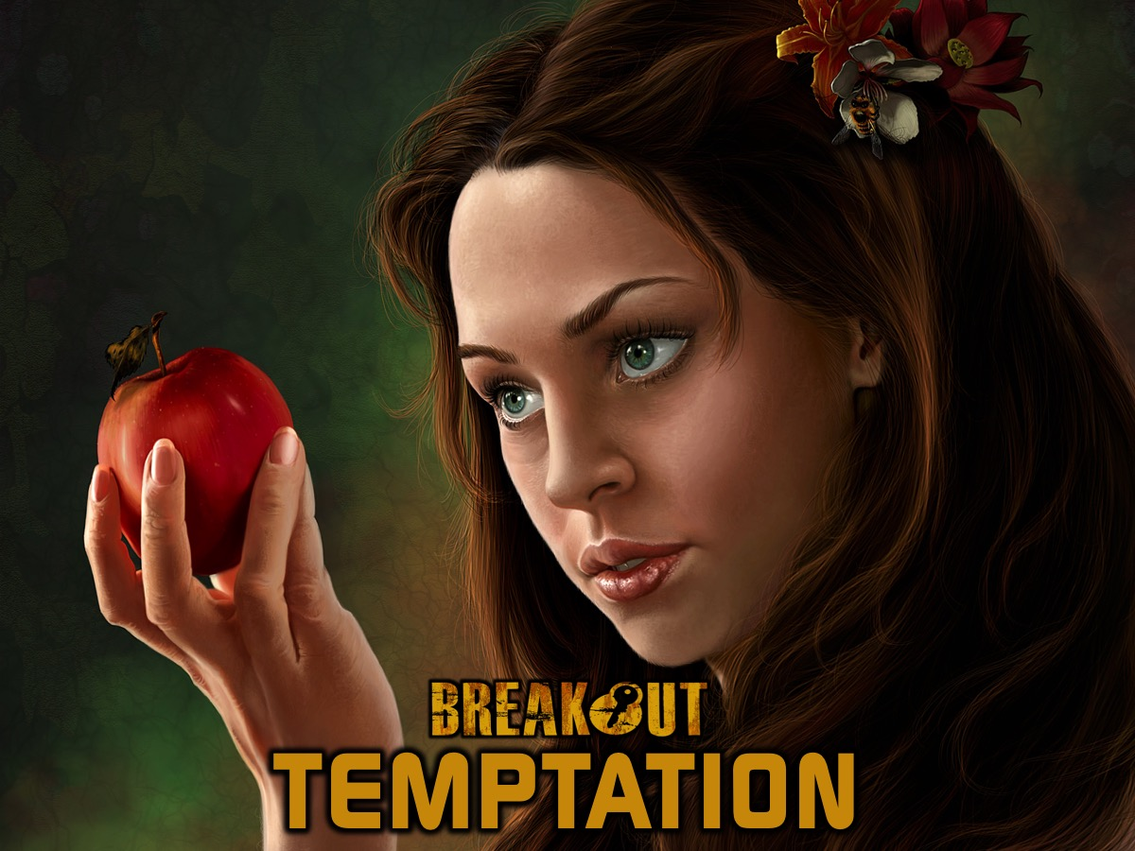
Notes:
In Week 4 we look at how to breakout of the prison of Temptation.

Slide 7

Notes:
In Week 5 we look at how to breakout of the prison of Heartache.

Slide 8

Notes:
In Week 6 we look at how to breakout of the prison of Greed.

Slide 9

Notes:
In Week 7 we look at how to breakout of the prison of Anger.

Slide 10

Notes:
In Week 8 we look at how to breakout of the prison of Doubt.

Slide 11
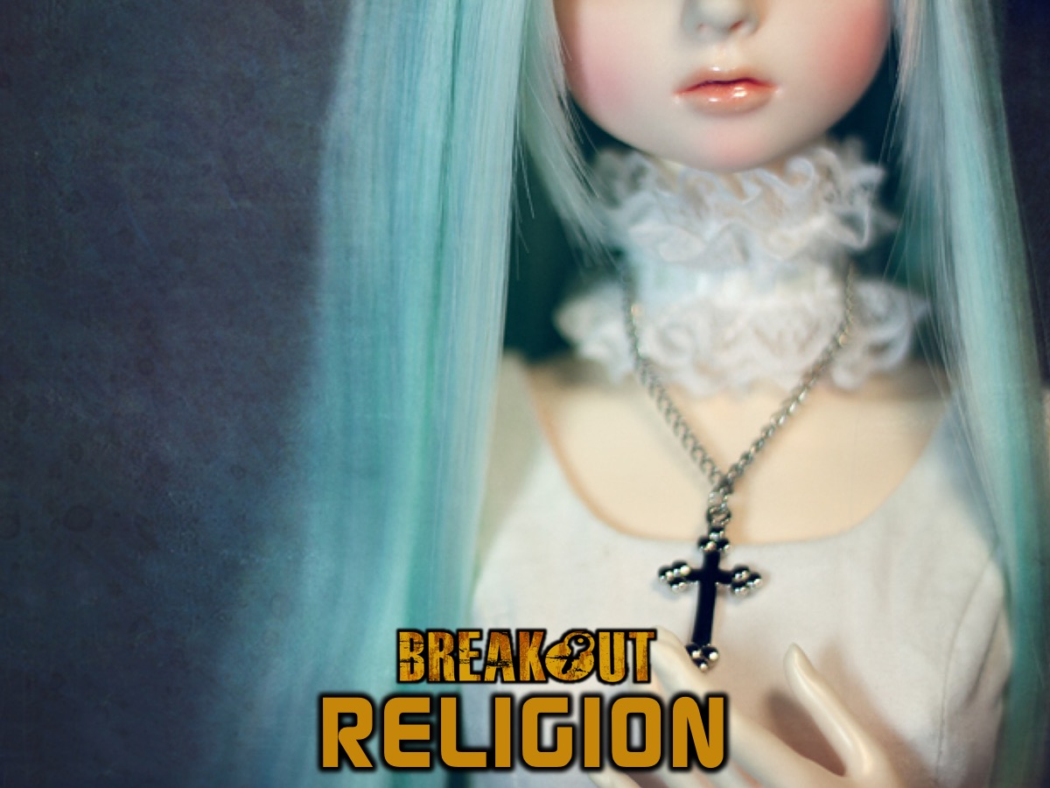
Notes:
Finally in Week 9 we look at how to breakout of the prison of Religion.

Slide 12

Notes:
So welcome to The Breakout Series!

Slide 13

Notes:
Today we are looking at how to breakout of the prison of Anxiety.

Slide 14

Notes:
We are privileged today to have Dr. Terry Linhart, professor of Youth Ministry from Bethel College in Indiana, USA, sharing the word with us!

Slide 15
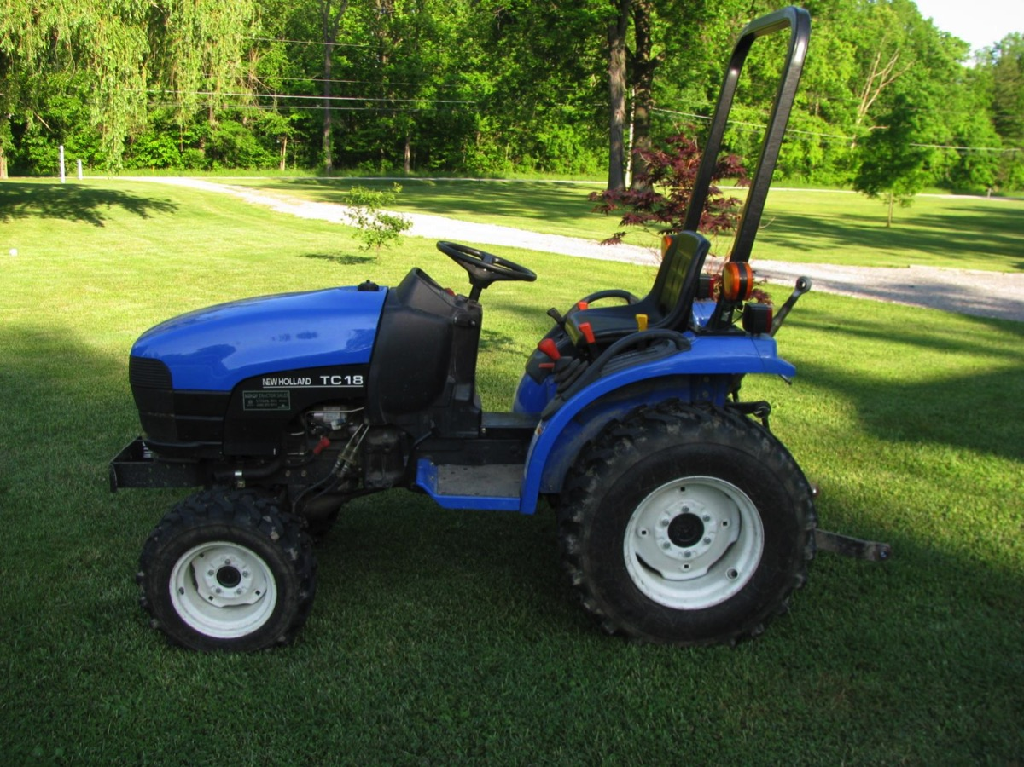
Notes:
Some years back I had a part time job at an ice cream factor and my job was to mow the lawn on a tractor like this one. There were settling ponds designed to deal with waste water – you know how milk can go off and smell really bad. Well, one day the tractor got stuck and then when I got it out it started running down the hill to the pond. I stood in the rotten milk and could not catch It as it went and sank in the pond. I am sitting there with no tractor. I though I had lost my job and when I called someone and told them what had happened they said I was going to get fired. Have you ever been in trouble? My boss came and started rocking and then laughed and told me to get it out. We went back to the factory and made a fish hook and rowed out to the tractor. We hooked it up to a winch but only managed to pull the steering off. We towed back out to the spot where it had sunk and managed to hitch the rope and slowly got it out of the water. Everyone was happy. My boss was standing right next to the muffler (the exhaust pipe) and I said lets see if it starts and it blew goo all over him. They put it on a trailer and had it cleaned up and got it running. It has become legendary. Someone drew a picture on my face and a submarine. Life is like this somethings – where things are going well something happens and we experience anxiety.

Slide 16

Notes:
So the new school year has started in South Africa and I am sure many of you are anxious about what lies ahead!

Slide 17
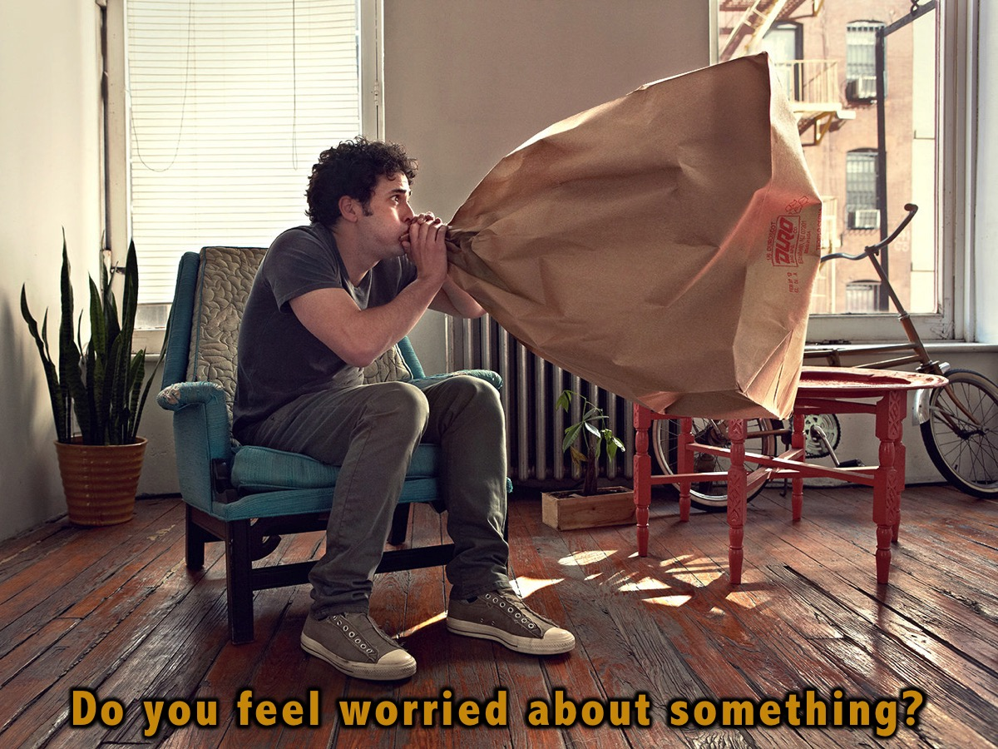
Notes:
Sharing: Pick a friend near you and answer these questions: How many of you feel anxious about things? Share something you are anxious about.

Slide 18
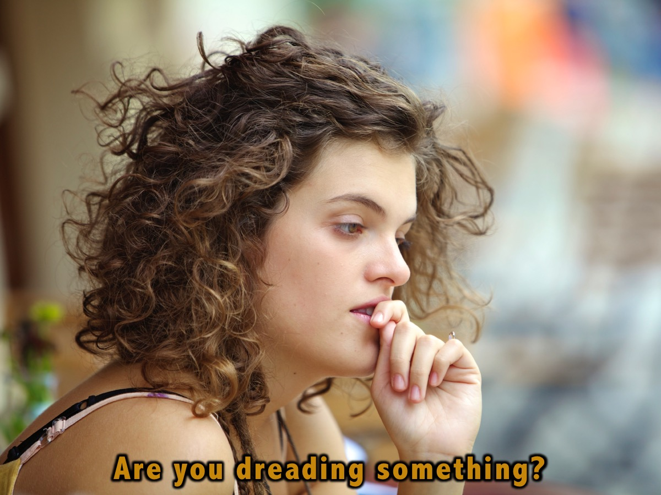
Notes:
Is there something you are dreading in the future – maybe six months away?

Slide 19
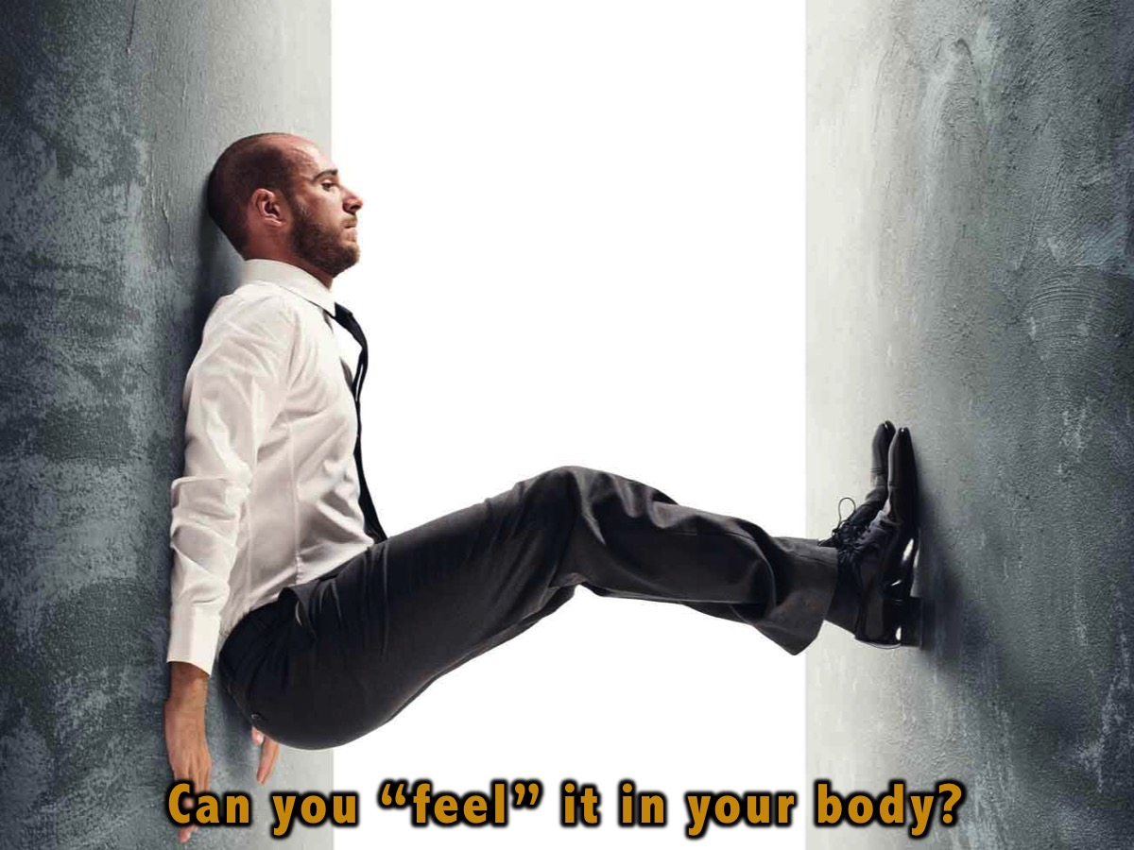
Notes:
Research shows that one of the biggest things teens experience is anxiety. About relationships, family – and it causes stress in our lives. Some of us actually feel anxiety – heart rate goes us, lose sleep, do crazy things, etc.
We will end with this but in our most anxious moments God is there and reminds us he is our God and wants to walk with us. Let’s pray before we continue…

Slide 20

Notes:
What does anxiety look like?

Slide 21

Notes:
Worry – most common form of misery.
Fear – what degree does it interfere with everyday life?
Stress – mobilizes us for “fight or flight”
Concern

Slide 22
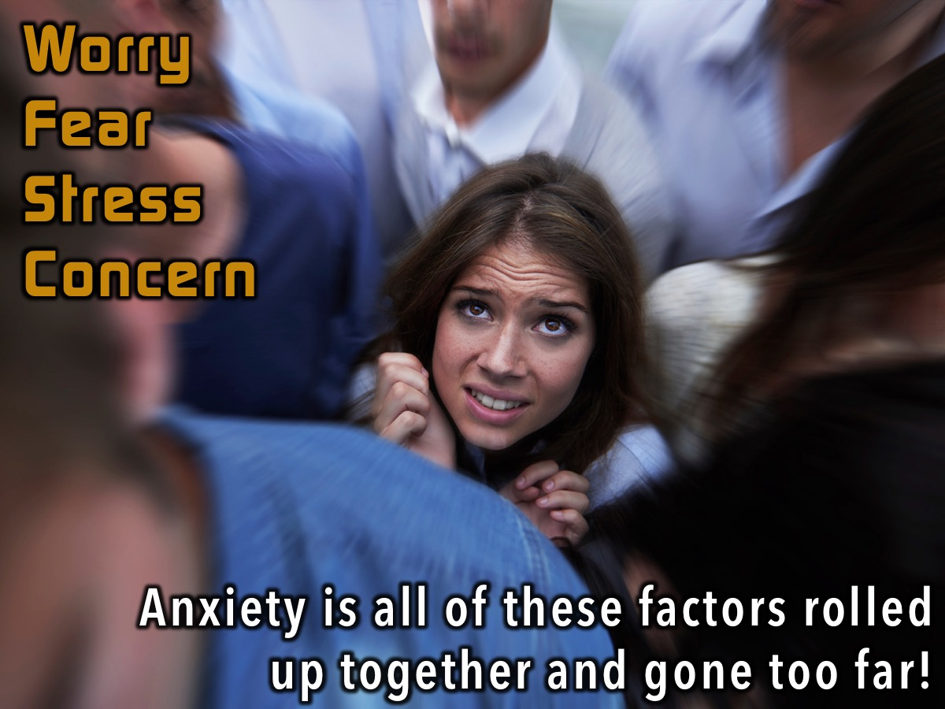
Notes:
Anxiety is all of these factors rolled up together and gone too far!

Slide 23
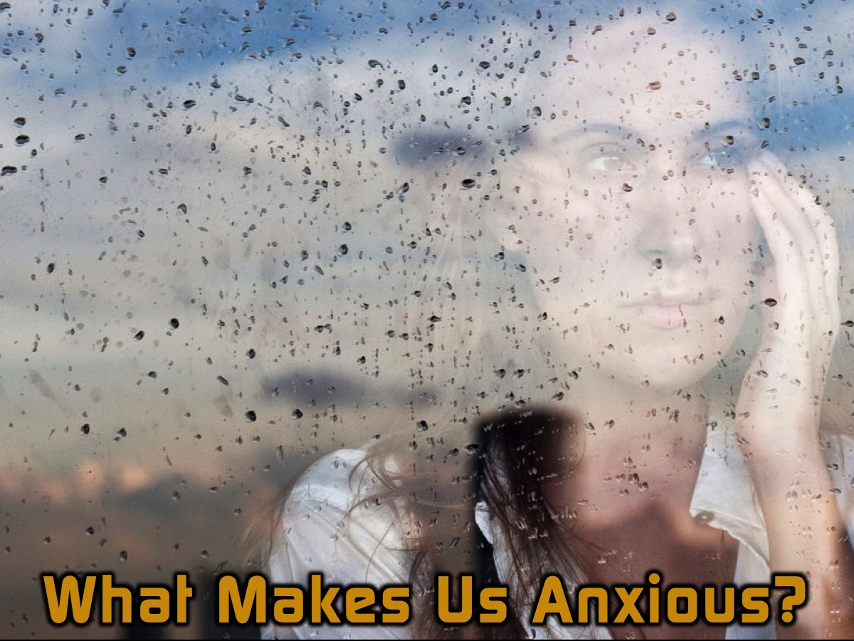
Notes:
What makes us anxious?

Slide 24
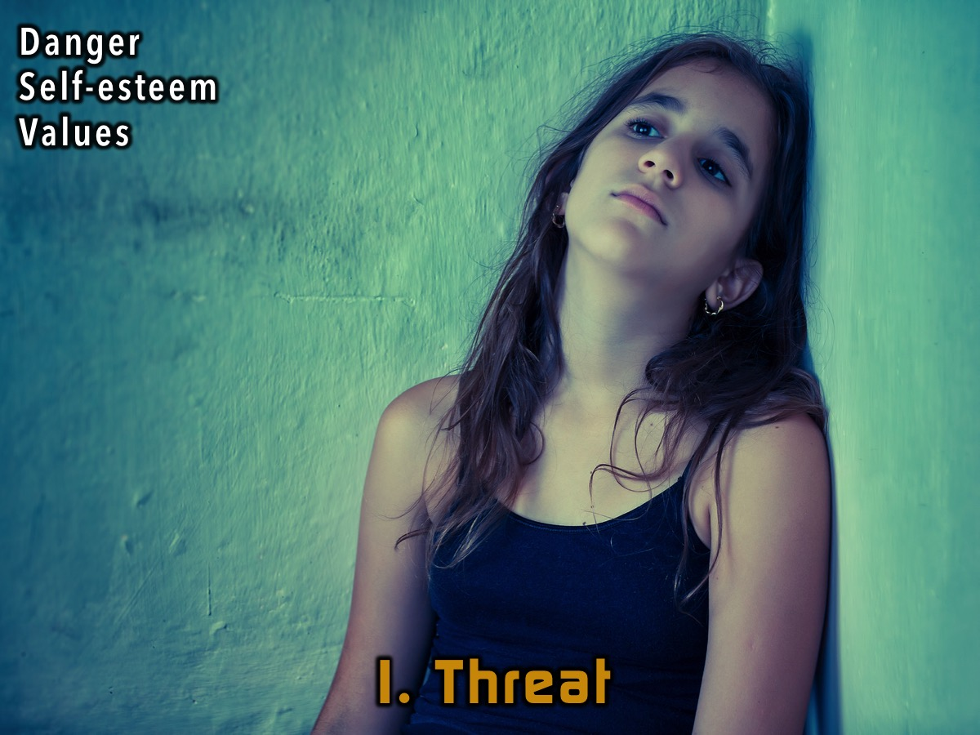
Notes:
1. Threat – When we feel like we are in danger, or someone does not like us.

Slide 25
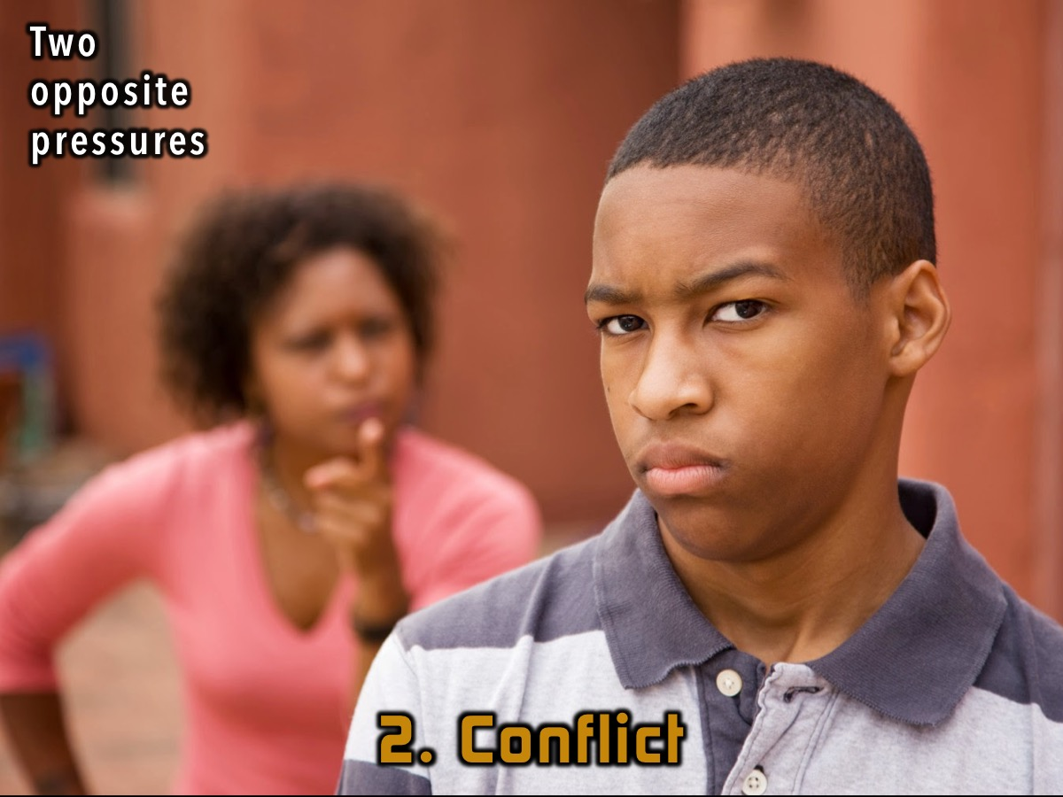
Notes:
2. Conflict – two opposing pressures – battling with people.

Slide 26
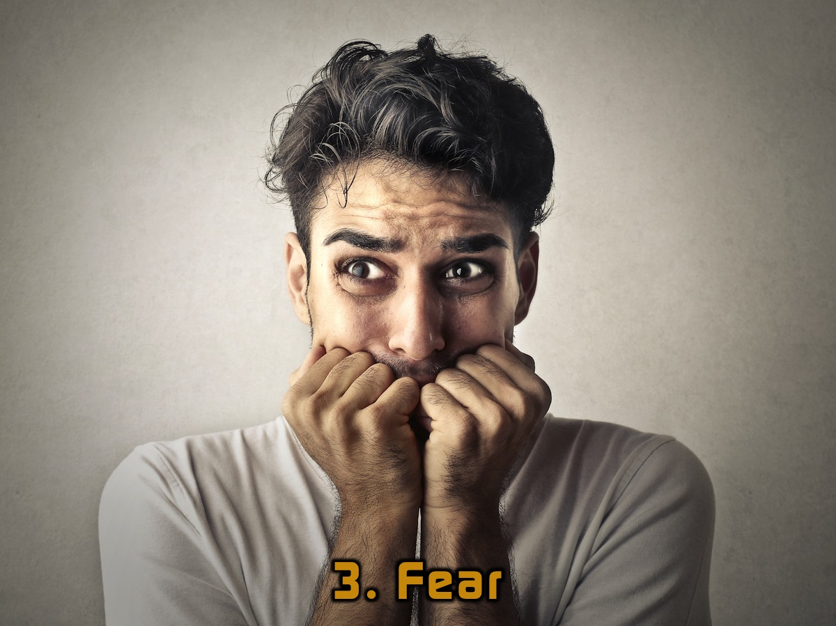
Notes:
3. Fear - we won’t say much about this as it is the topic for next week…

Slide 27
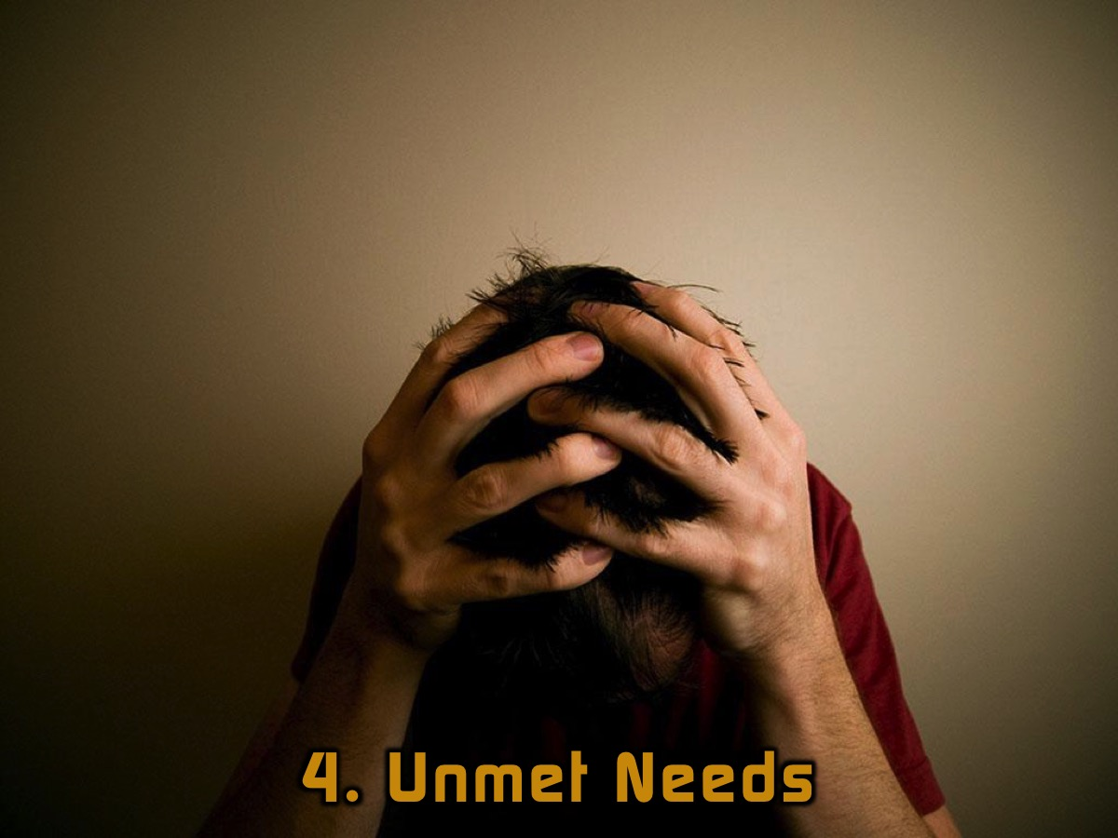
Notes:
4. Unmet Needs – the economy, the future, an injury

Slide 28
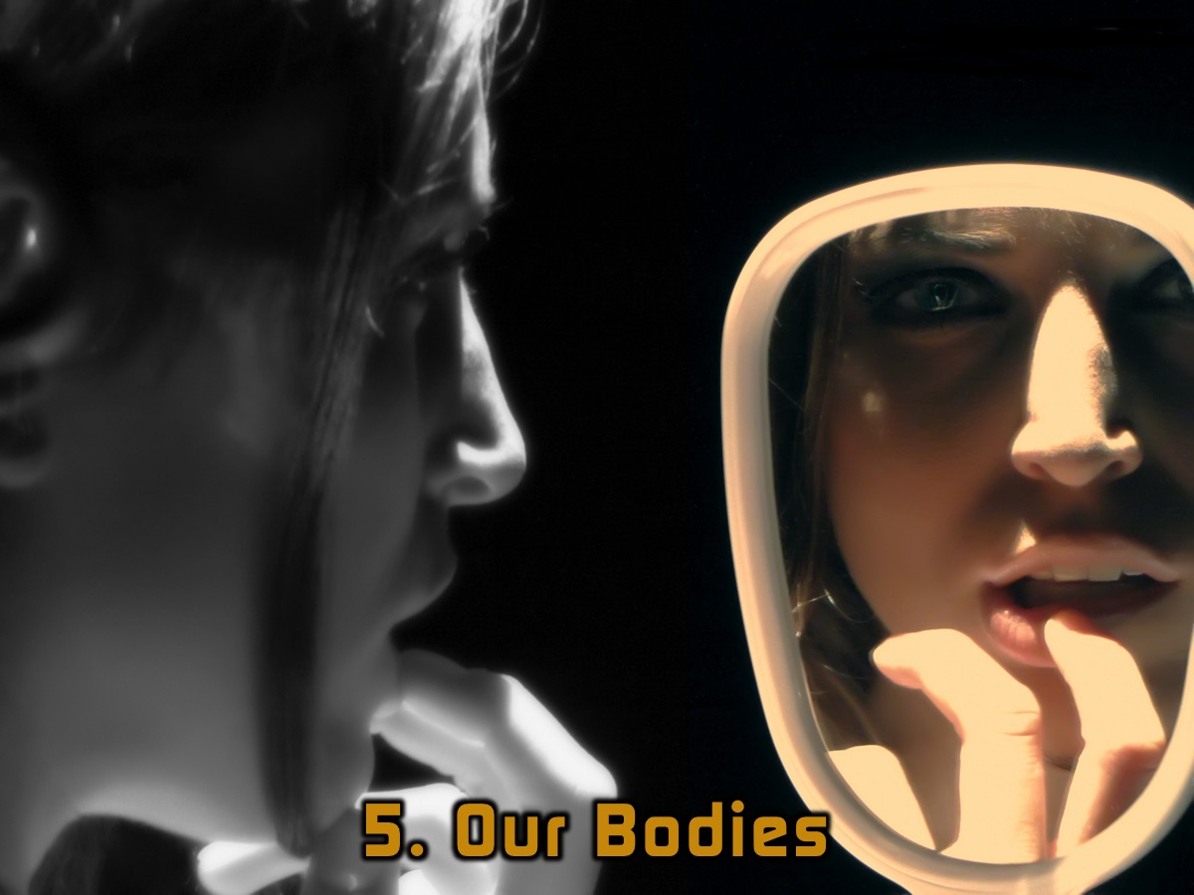
Notes:
5. Our bodies - we can have anxiety about what we look like.

Slide 29

Notes:
Three Different Types of Anxiety:

Slide 30
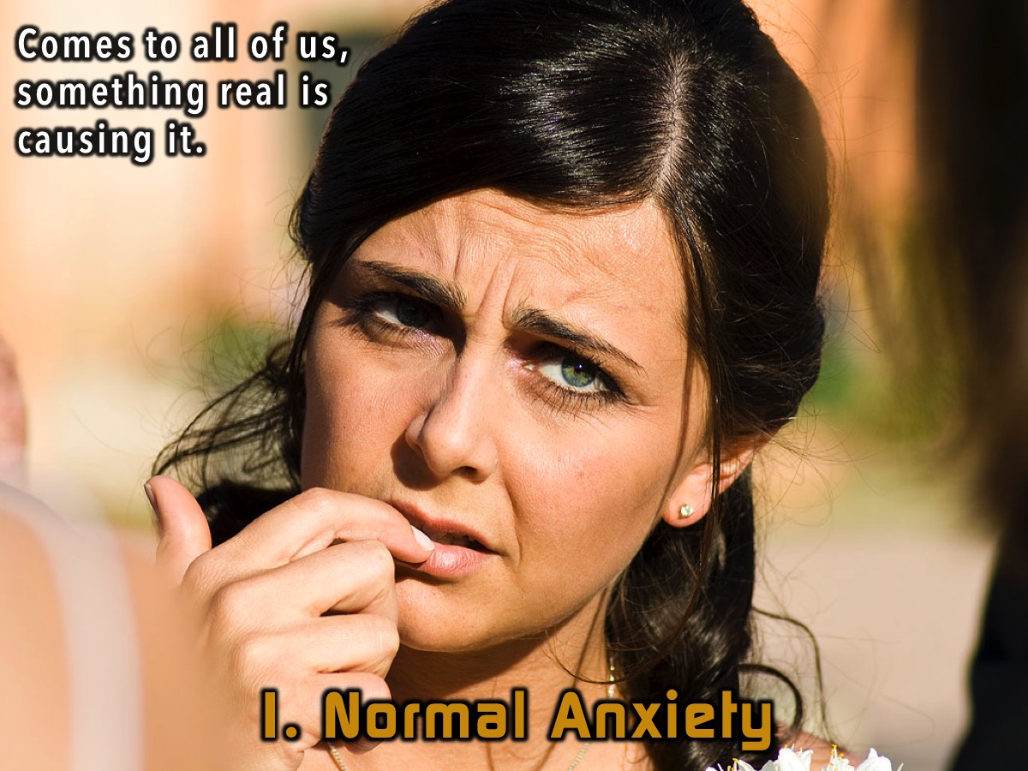
Notes:
1. Normal Anxiety – it does not mean you are doing wrong when you feel anxiety. Something real may be causing it.

Slide 31

Notes:
2. Irrational Anxiety – Exaggerated feelings of helplessness or dread. We have a pump in our basement that drains the water to make sure it does not flood. I could not sleep because it bothered me so much that maybe it would not work and we would be flooded. Some people fear public speaking.

Slide 32

Notes:
3. Trait Anxiety - Ever-present emotional tension, a “worry all the time.” Some people tend to worry about things all the time.

Slide 33

Notes:
What does the Bible say about anxiety?

Slide 34
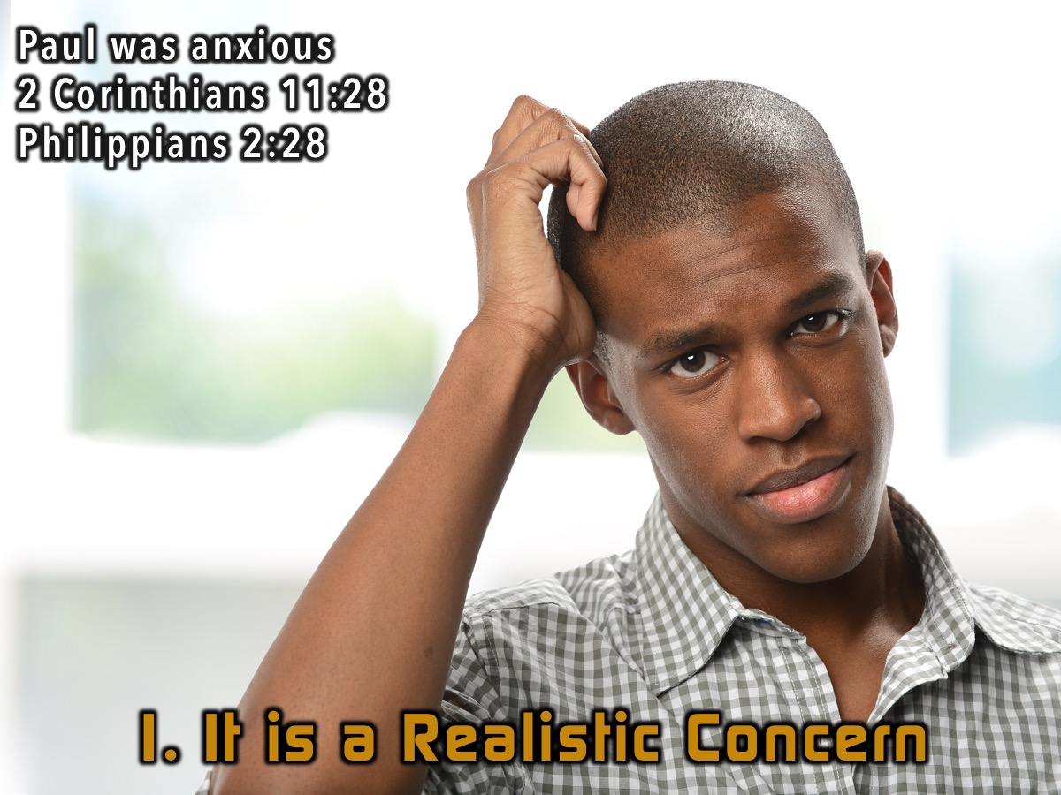
Notes:
1. It is a Realistic concern – Paul was an anxious person – daily pressure and worry about things. He spoke about having less anxiety after something took place. -(2 Corinthians 11:28; Philippians 2:28)

Slide 35
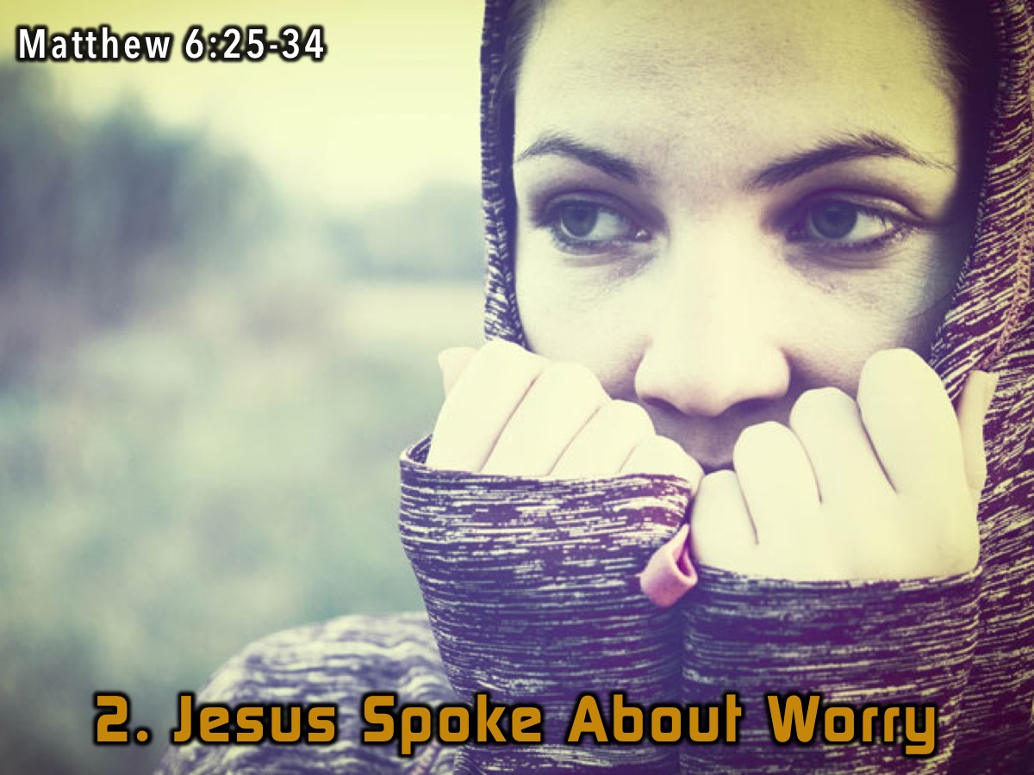
Notes:
2. Jesus spoke about worry – Matthew 6:25-34. He often said, “Do No Fear!” We should not worry because God knows everything – even the hairs on our head are known to him. We run after things that God does not want us to worry about.

Slide 36
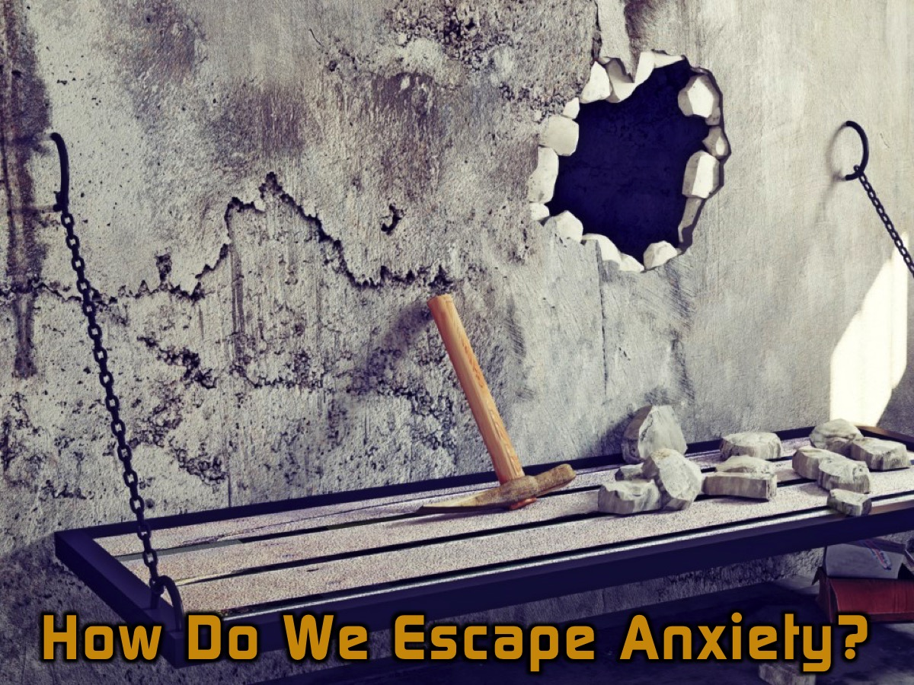
Notes:
How do we escape anxiety?

Slide 37
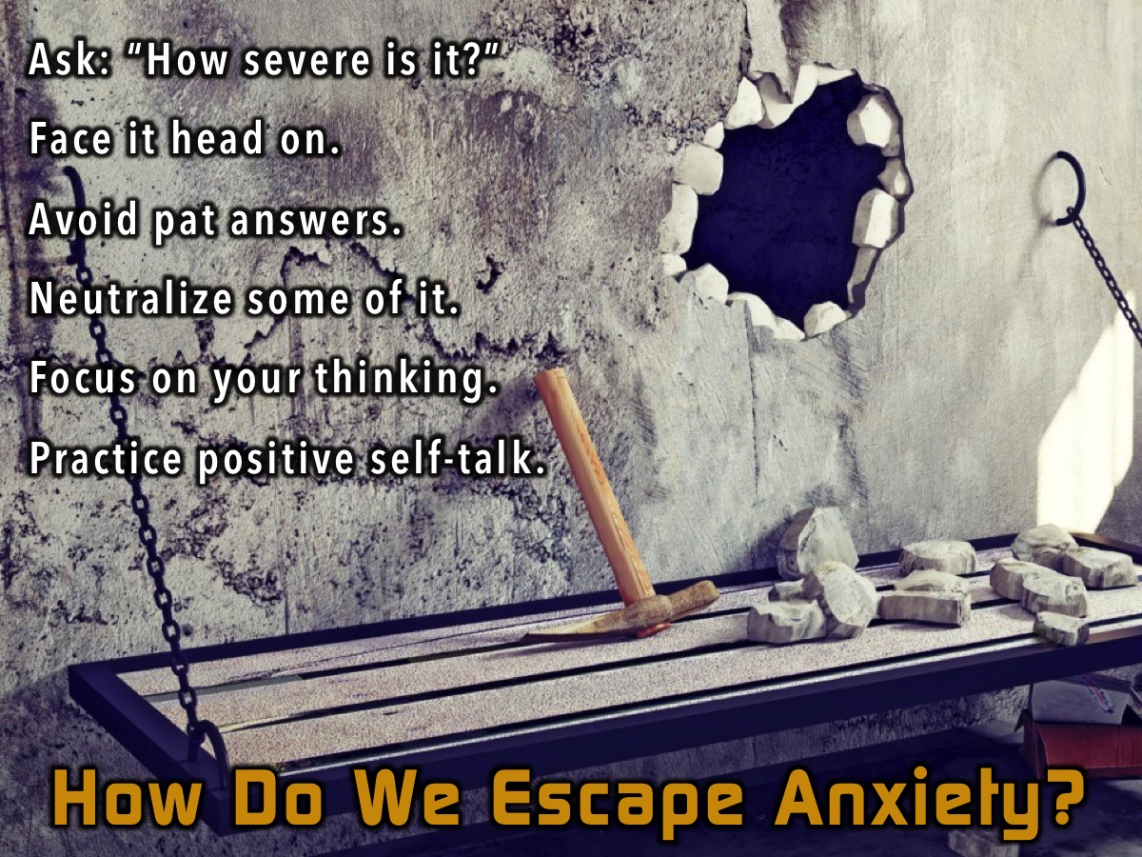
Notes:
1. Ask whether it is really severe or something that is going to come right or go away. Recognise overgrown fears
2. Face it head on – you can’t run away from it.
3. Avoid pat answers – prayer helps but sometimes we have to do other things.
4. Neutralise some of it – find ways to make it less – write down things that are true about the situation. Stop procrastinating which will reduce anxiety – plan ahead.
5. Focus on your thinking – check your thoughts.
6. Practise positive self talk. Some of us say things about our self that are not God’s thoughts about us. Satan uses these to keep us in prison.

Slide 38
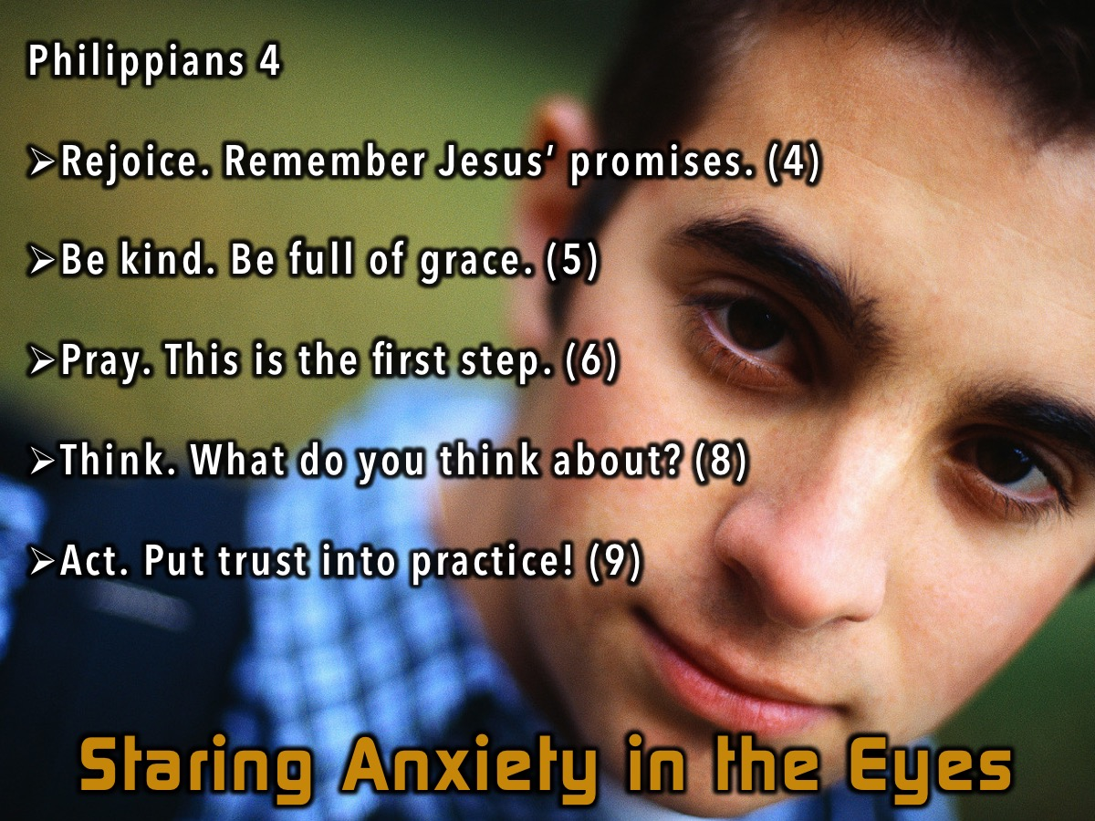
Notes:
Staring Anxiety in the Eyes
(1) Rejoice - Remember all that Jesus has promised you. (4)
(2) Be kind – full of grace – anxious people hunch over because their bodies are reacting to the situation or their thoughts. (5)
(3) Pray – ask God for help. (6)
(4) Think – What your thoughts that create anxiety.
(6) Act – we must not look at ourselves but outwards and act on what God wants us to do. (9)

Slide 39
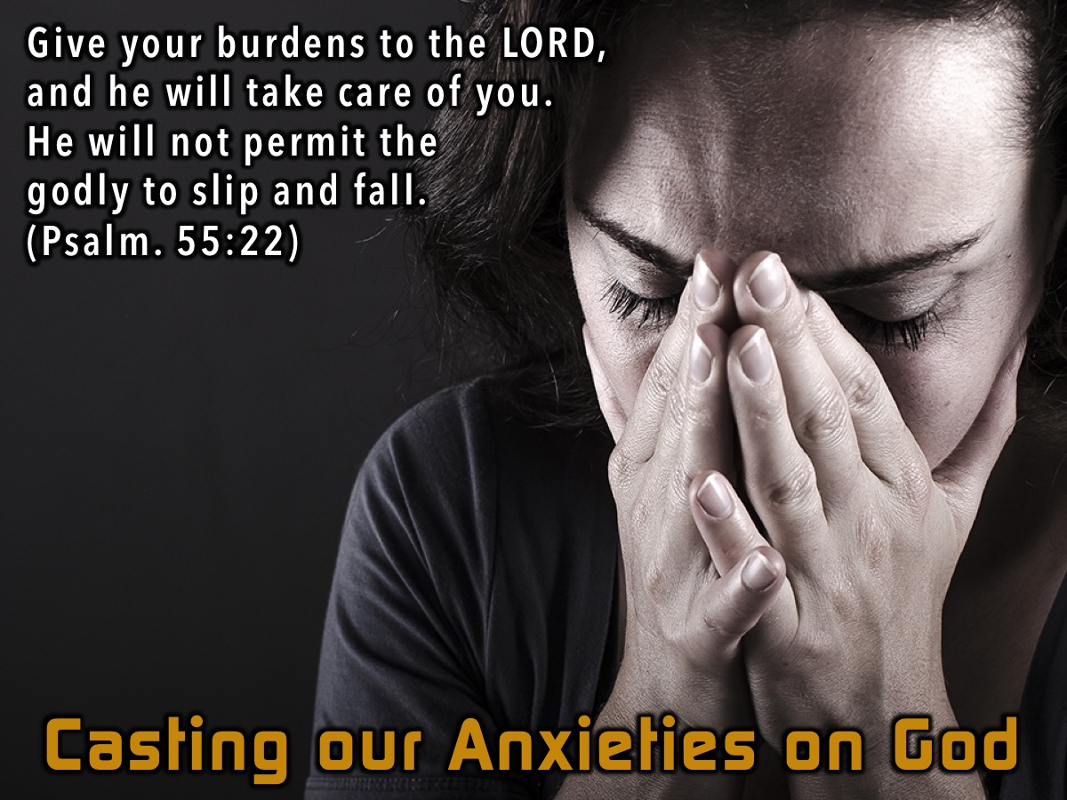
Notes:
Cast your anxieties on God – Psalm 55:22

Slide 40
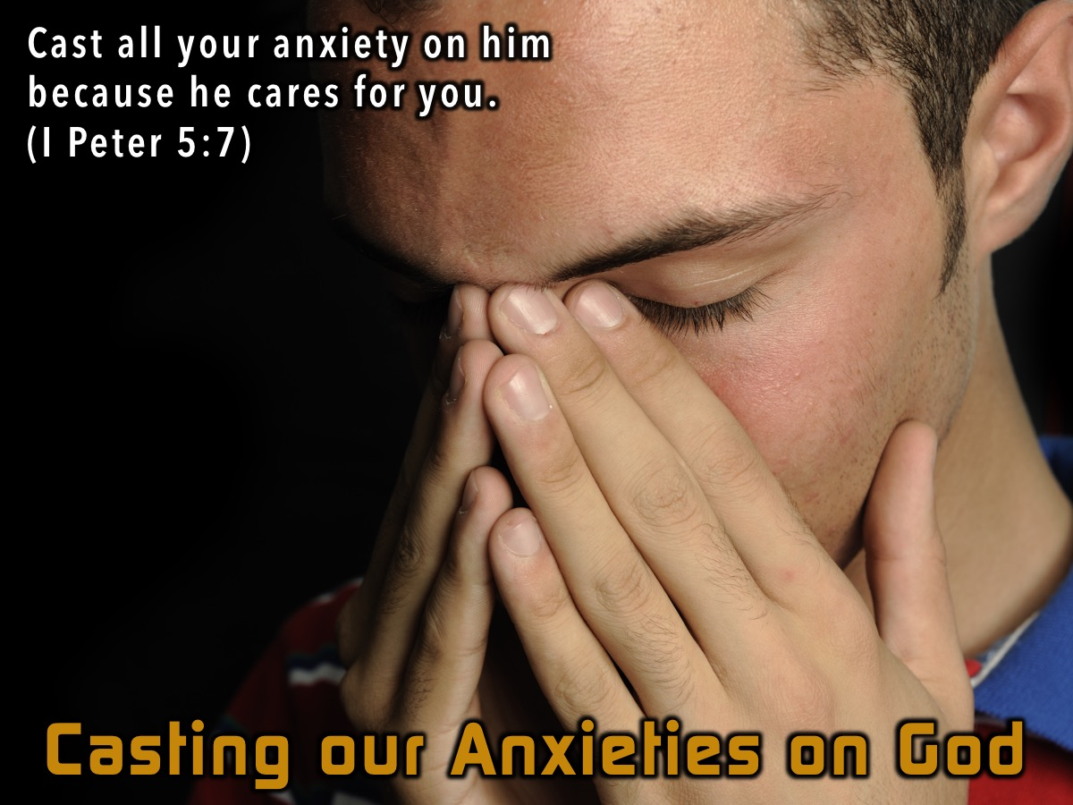
Notes:
Cast your anxieties on God – 1 Peter 5:7. Give your burdens to the Lord – give Him the things that are worrying you.
Activity: Take a sheet of paper - and things of all that is causing you anxiety and crumple the paper which has all your anxiety that you are giving it to God.

Slide 41

Notes:
Next Week: We will deal with how to break out from fear.

