Slide 1

Notes:
Welcome to the breakout series.

Slide 2

Notes:
Last week we looked at how to breakout of the prison of Anxiety.

Slide 3

Notes:
Today we are going to look at how to breakout of the prison of Fear.

Slide 4
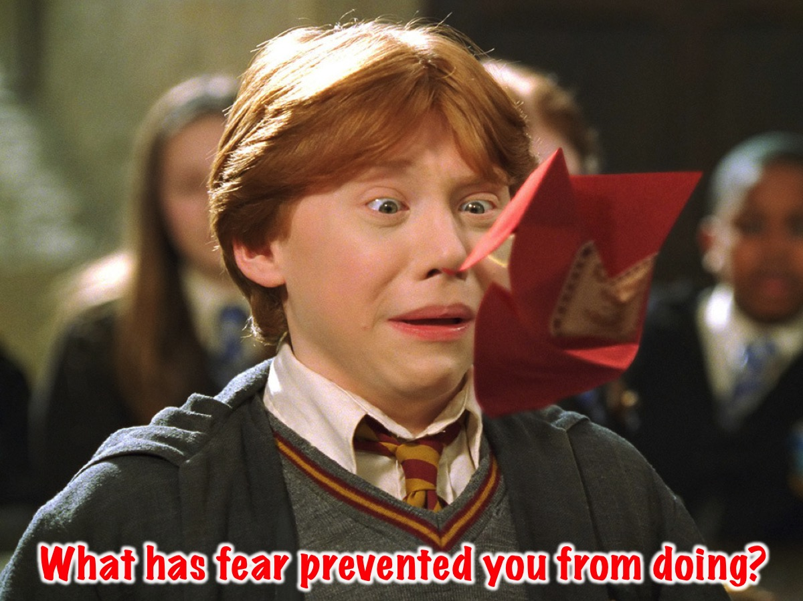
Notes:
I’d like you to take a moment and ask the person next to you to answer this challenging question: What has fear prevented you from doing?

Slide 5
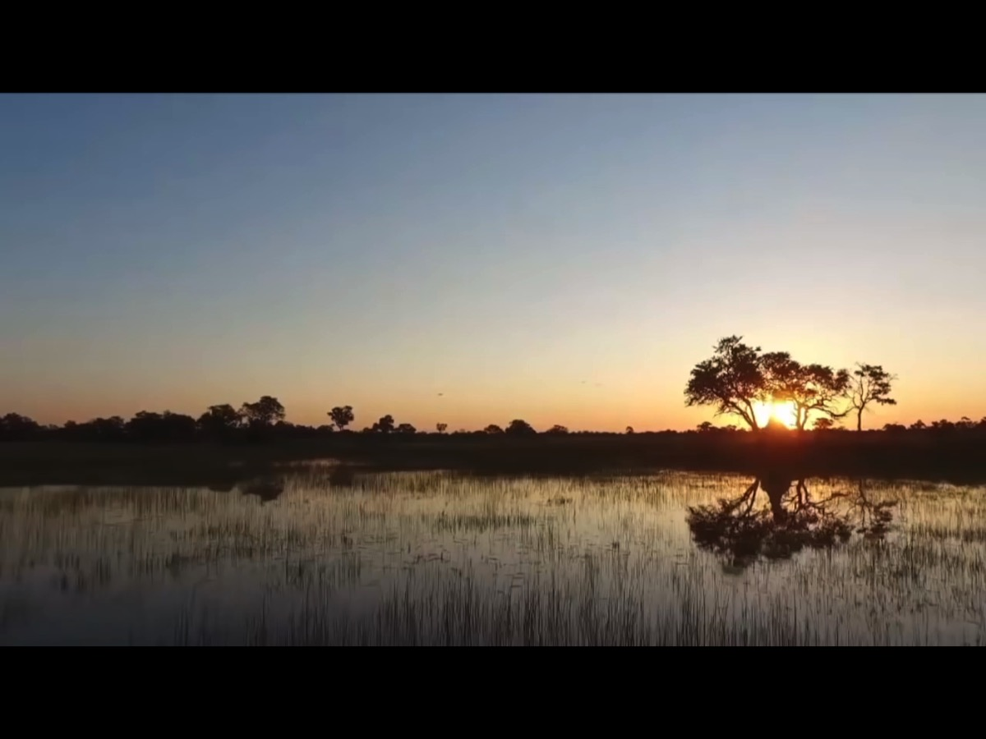
Notes:
Video: The Other Side of Fear - Motivational Video. Get it on YouTube at: https://www.youtube.com/watch?v=TmkUwToXLEc

Slide 6
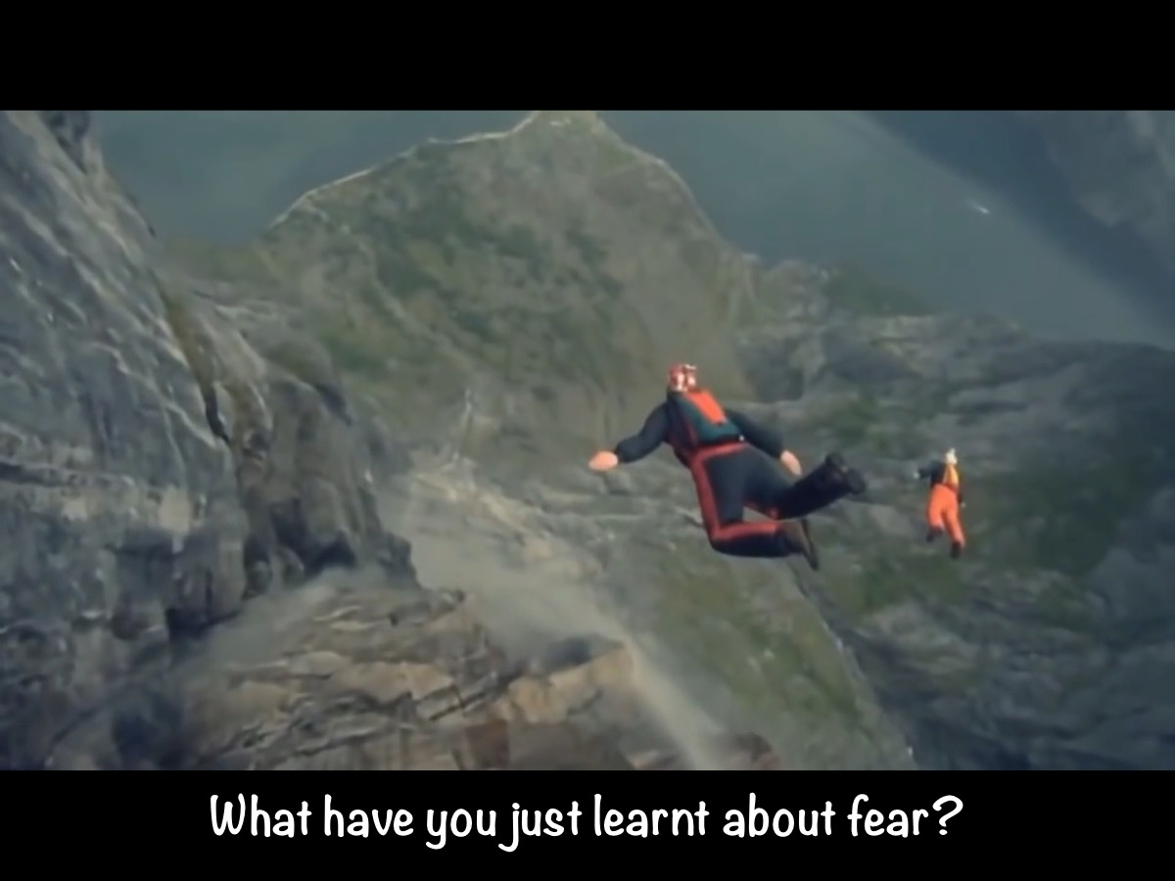
Notes:
Discuss: What does the video teach us about fear?

Slide 7
Notes:
Video: A TED talk by Karen Thompson Walker entitled: What Fear Can Teach Us. Get it on YouTube at: https://www.youtube.com/watch?v=OwgWkUIm9Gc

Slide 8
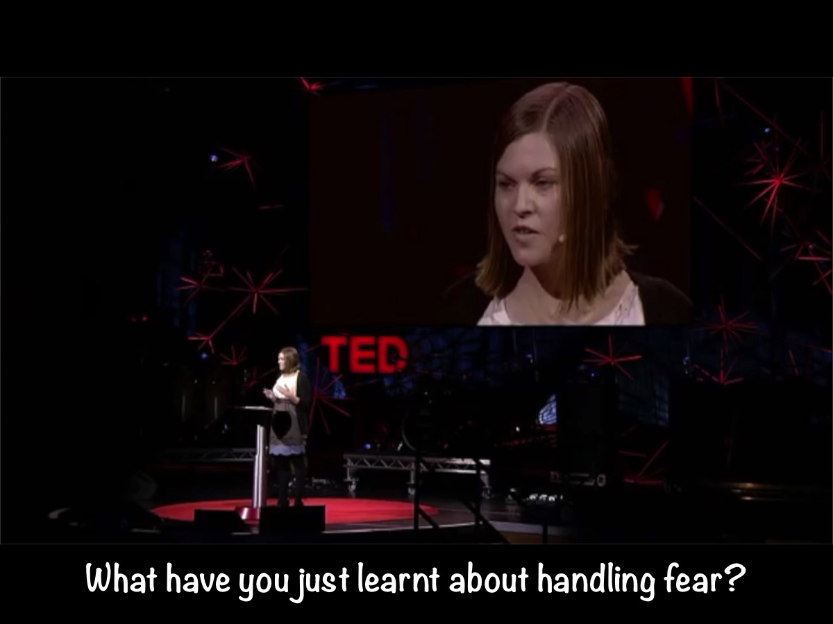
Notes:
Discuss: What have you just learnt about handling fear?

Slide 9
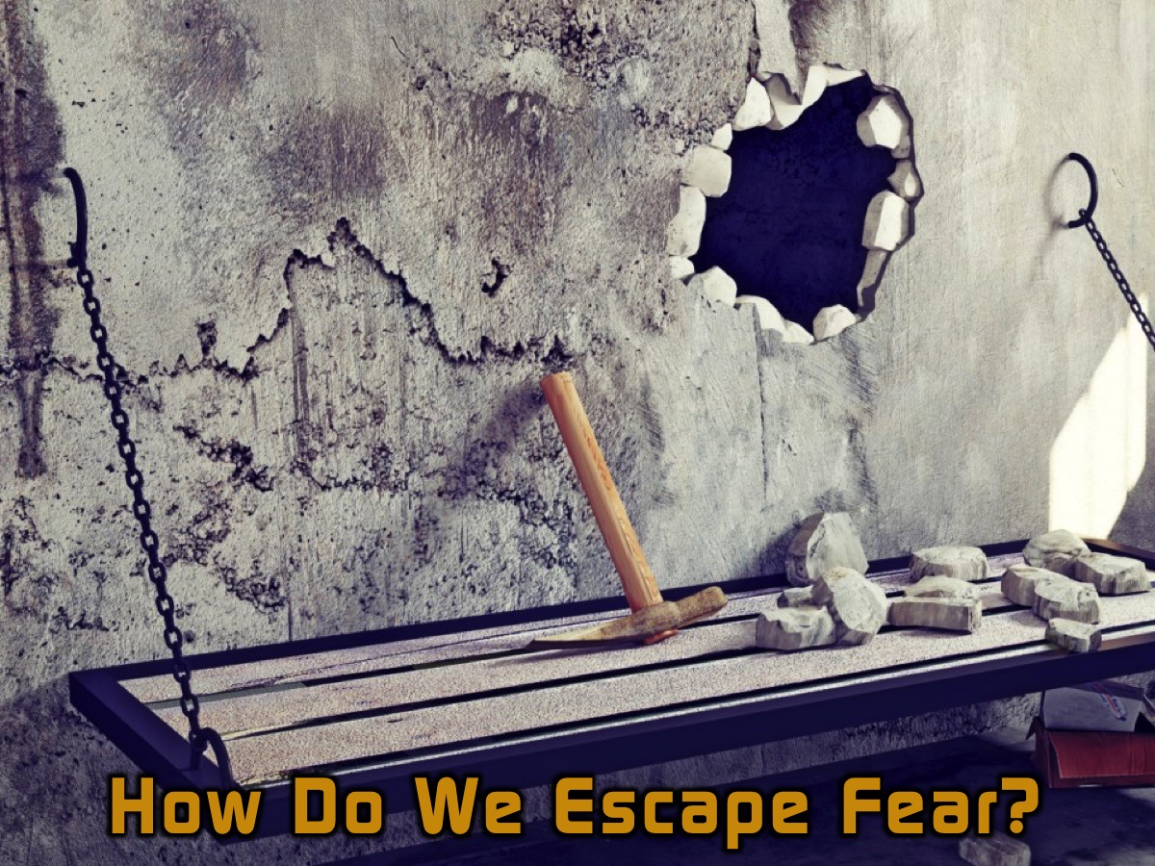
Notes:
So How Do We Escape the Prison of Fear?

Slide 10
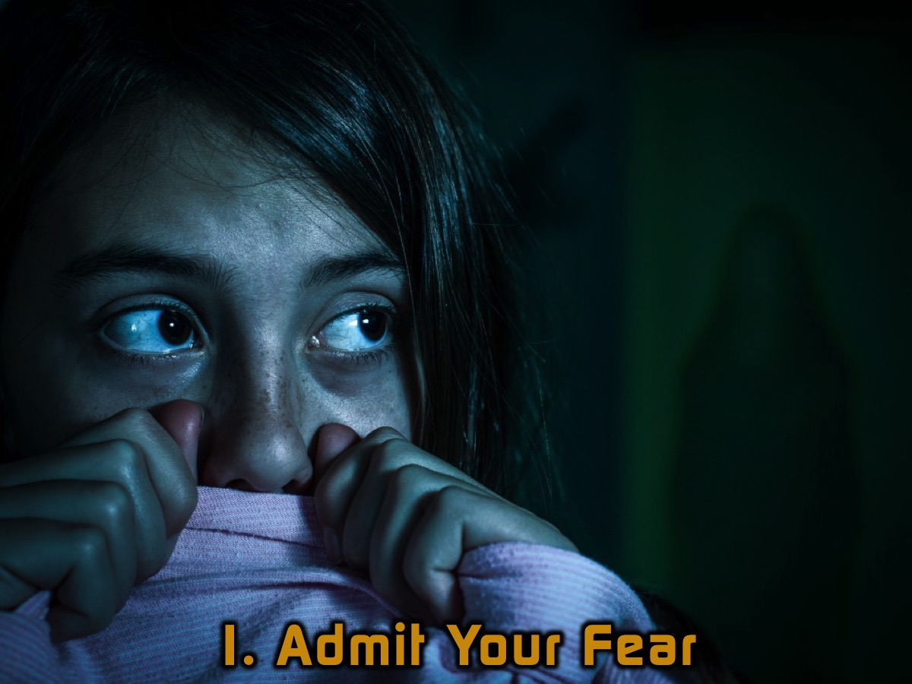
Notes:
1. Admit Your Fear. Don’t pretend that fear is not real! Be honest when you are afraid of something. This is the first step to escaping the prison of fear.

Slide 11
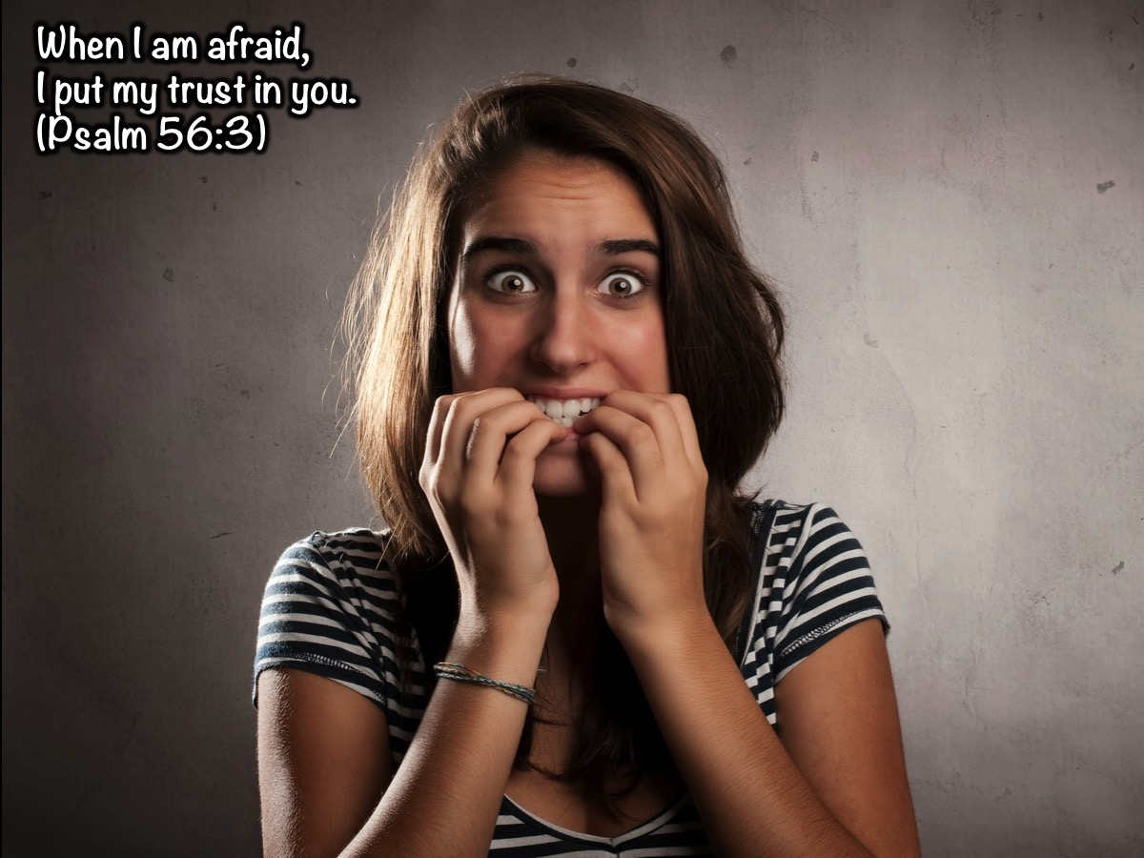
Notes:
David said, "When I am afraid, I put my trust in you." (Psalm 56:3)

Slide 12

Notes:
2. Check Your Story. In the TED talk video by Karen Thompson Walker we leant that we create stories in our mind when we experience fear - and sometimes we think that the story we have come up with is the only story - but it may not be true nor the best story and possibly there is another story we need to consider.

Slide 13
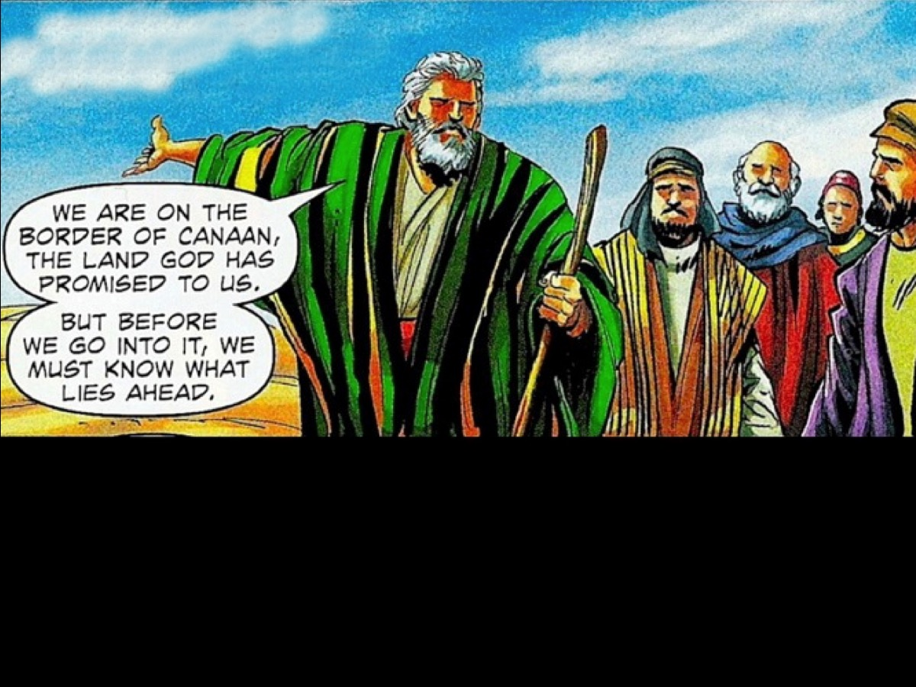
Notes:
In the book of Numbers where we find the Israelites are on the border of the Promised Land. Moses sends out spies to check out the land…

Slide 14
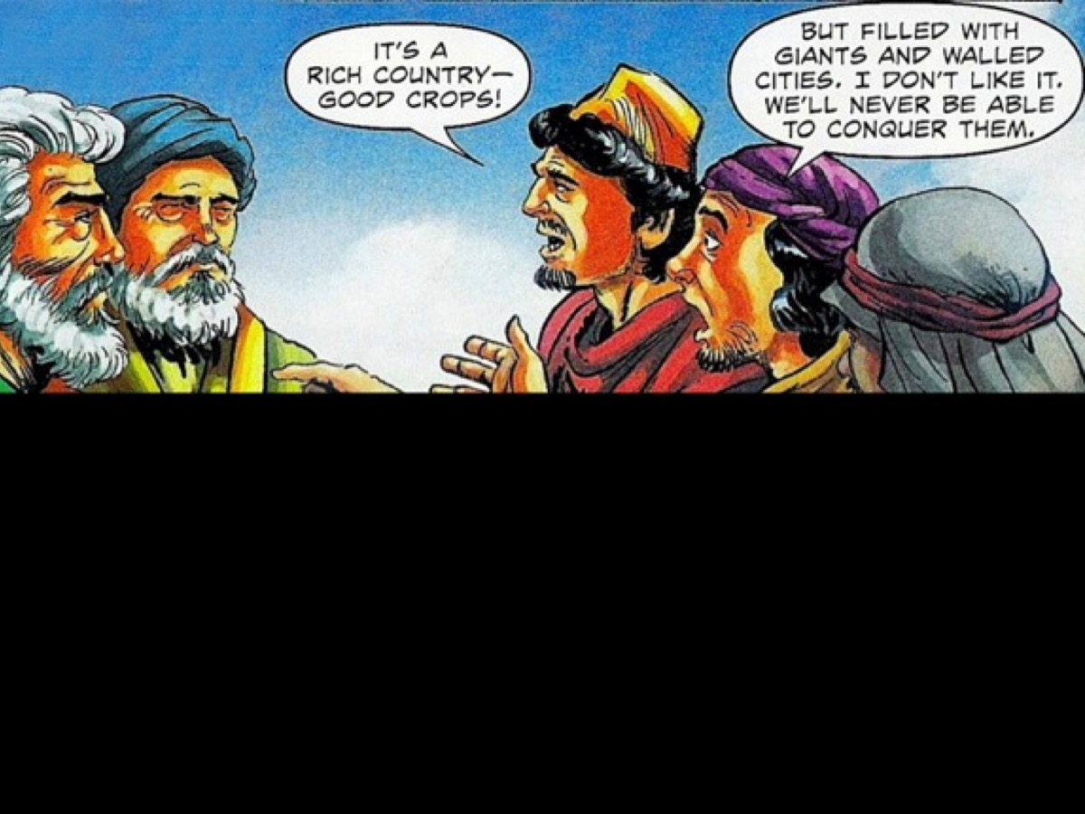
Notes:
The spies return with a report on what they have learnt: It’s a rich country filled with good crops but it is filled with Giants and walled cities.

Slide 15
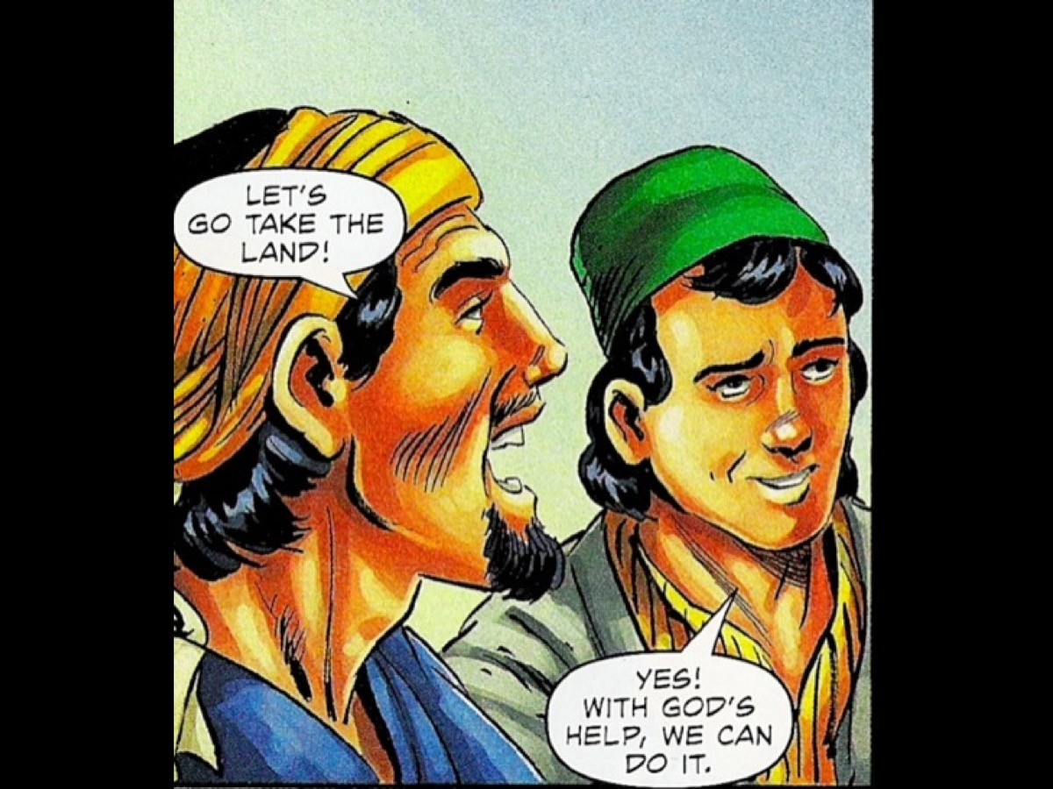
Notes:
However two of the spies, Joshua and Caleb had a different story to tell - they saw the situation not through their own eyes but through God’s eyes and believed that they could talk the land.

Slide 16
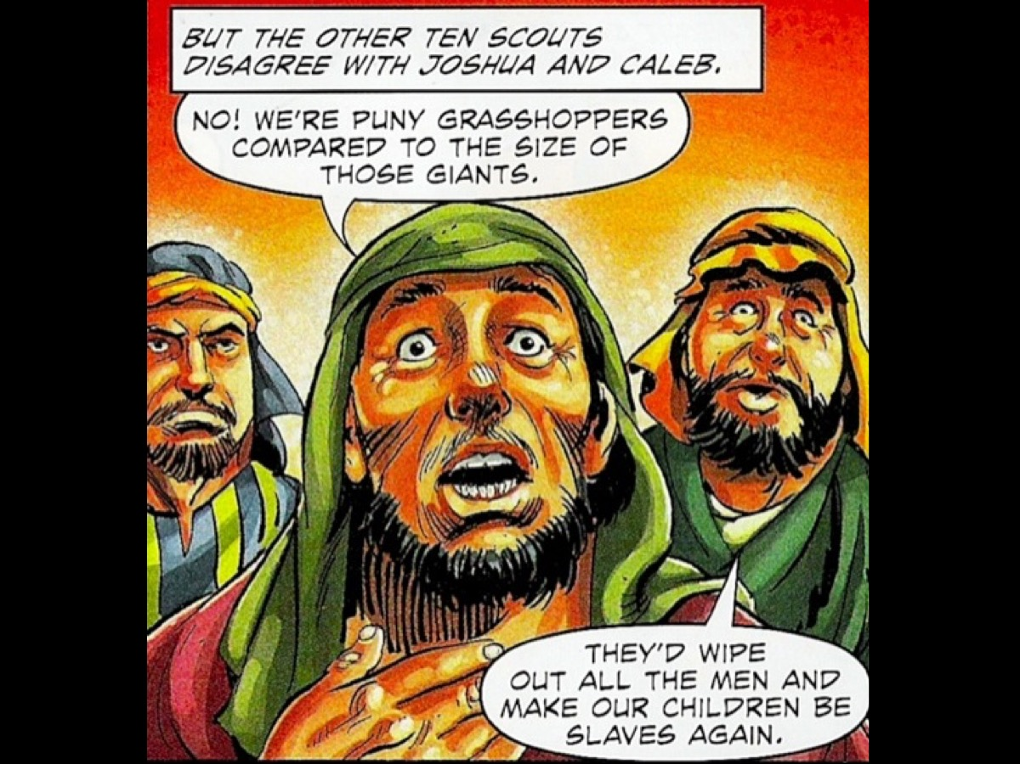
Notes:
The other eight spies stuck to their story that it would be a suicide mission to do what God had told them to do!

Slide 17
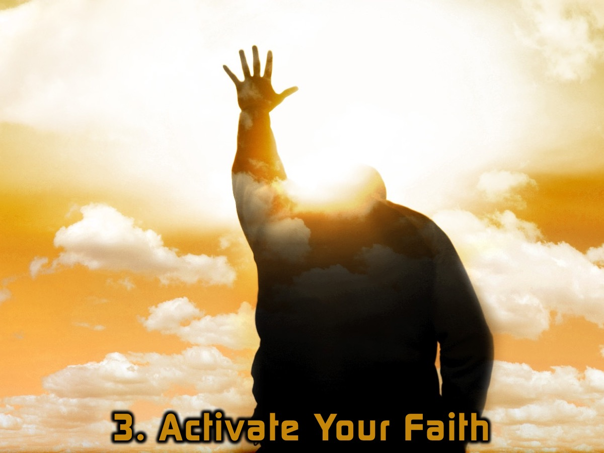
Notes:
3. Activate Your Faith.

Slide 18
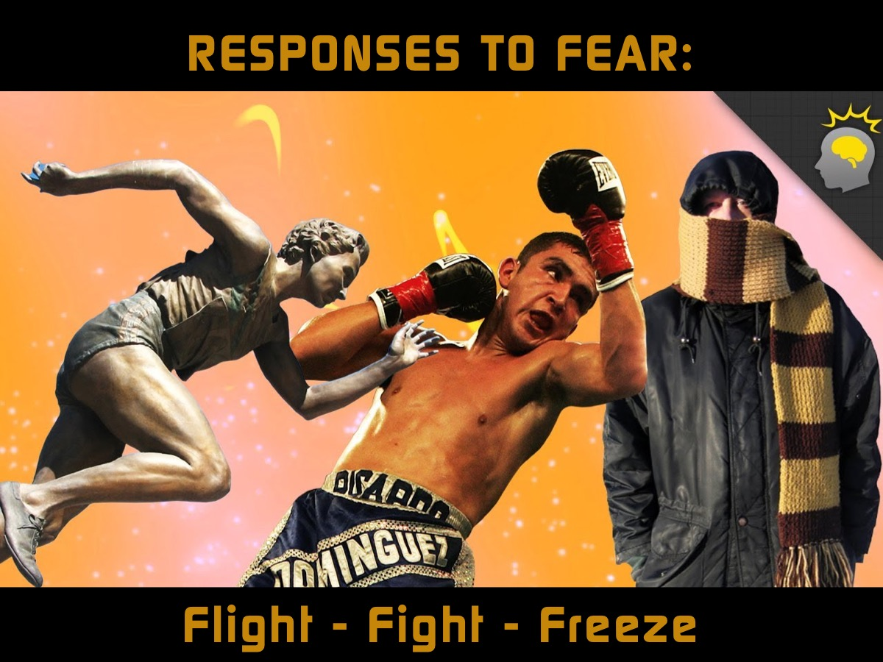
Notes:
When we experience fear there are at least three responses we can have: Flight (where we run away), Fight (where we fight to defend ourselves) or Freeze (where we hide so we don’t get noticed). But I think there is a fourth response we can take - and that involves activating our Faith in God who has told us not to be afraid but to have faith in him.

Slide 19
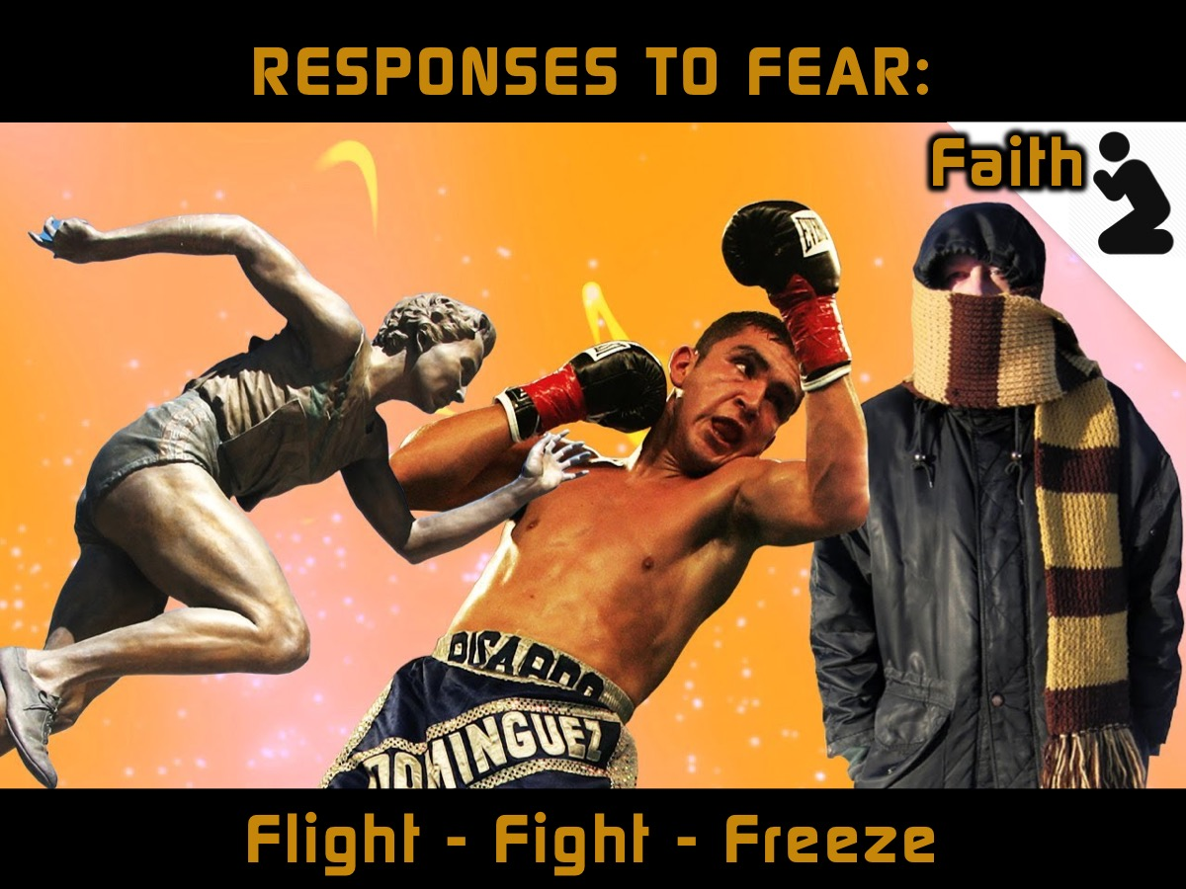
Notes:
But I think there is a fourth response we can take - and that involves activating our Faith in God who has told us not to be afraid but to have faith in him.

Slide 20
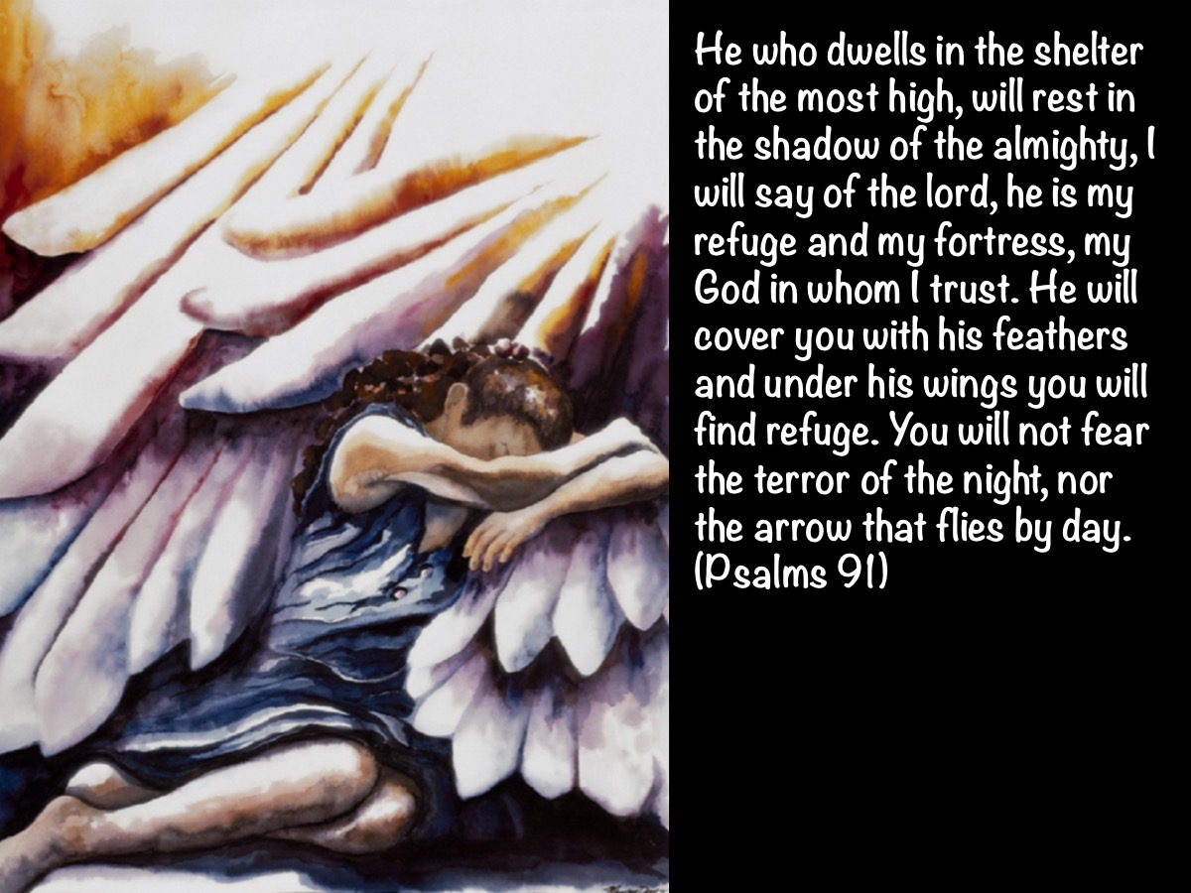
Notes:
He who dwells in the shelter of the most high, will rest in the shadow of the almighty, I will say of the lord, he is my refuge and my fortress, my God in whom I trust. He will cover you with his feathers and under his wings you will find refuge. You will not fear the terror of the night, nor the arrow that flies by day. (Psalm 91)

Slide 21
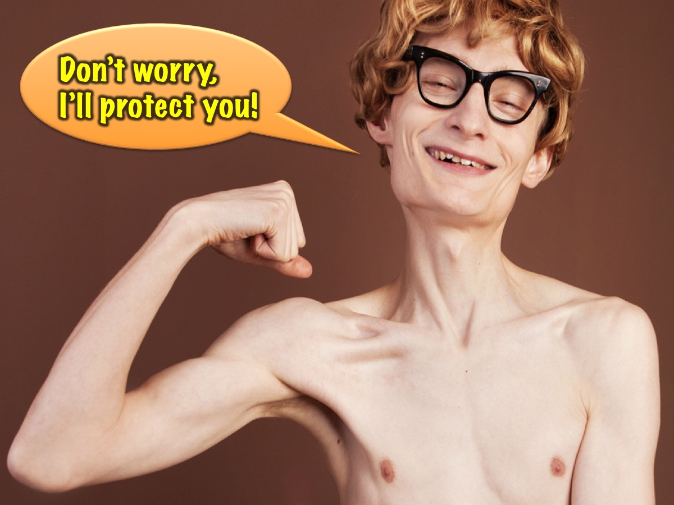
Notes:
Now if some random person had said those words to you, you have reason not to believe them right? I mean, what have they done? What evidence is there that they can actually pull it off?

Slide 22
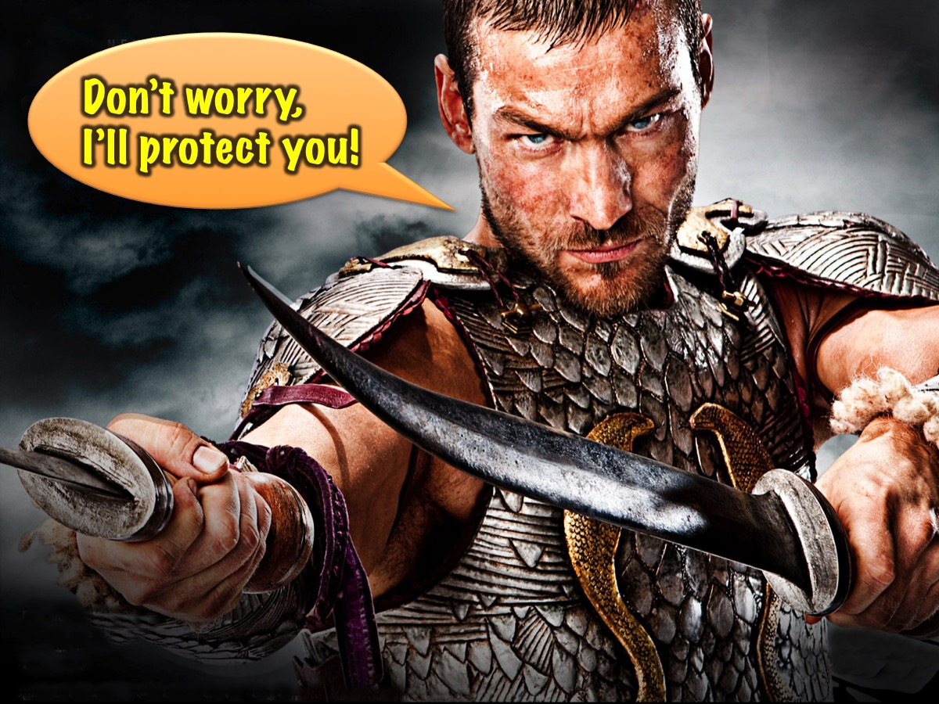
Notes:
But if it is someone strong and powerful who says these words – what difference would that make to you?

Slide 23
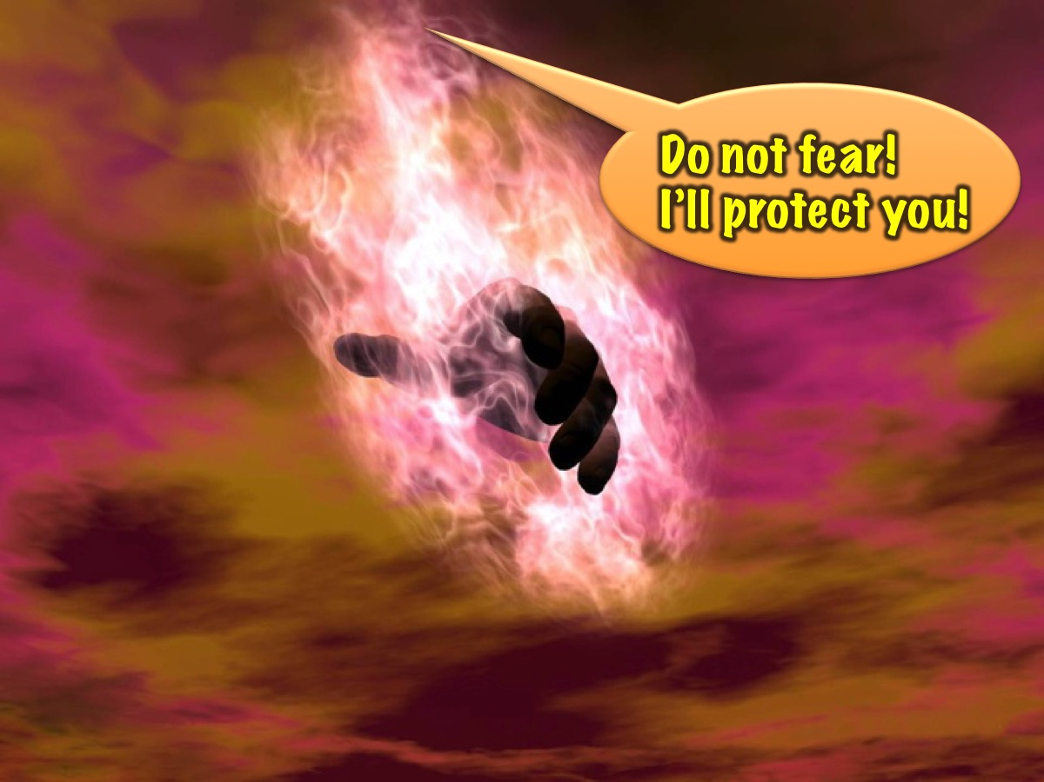
Notes:
However when the creator of the of all things, says “Do not fear”... You have absolutely nothing to loose.

Slide 24
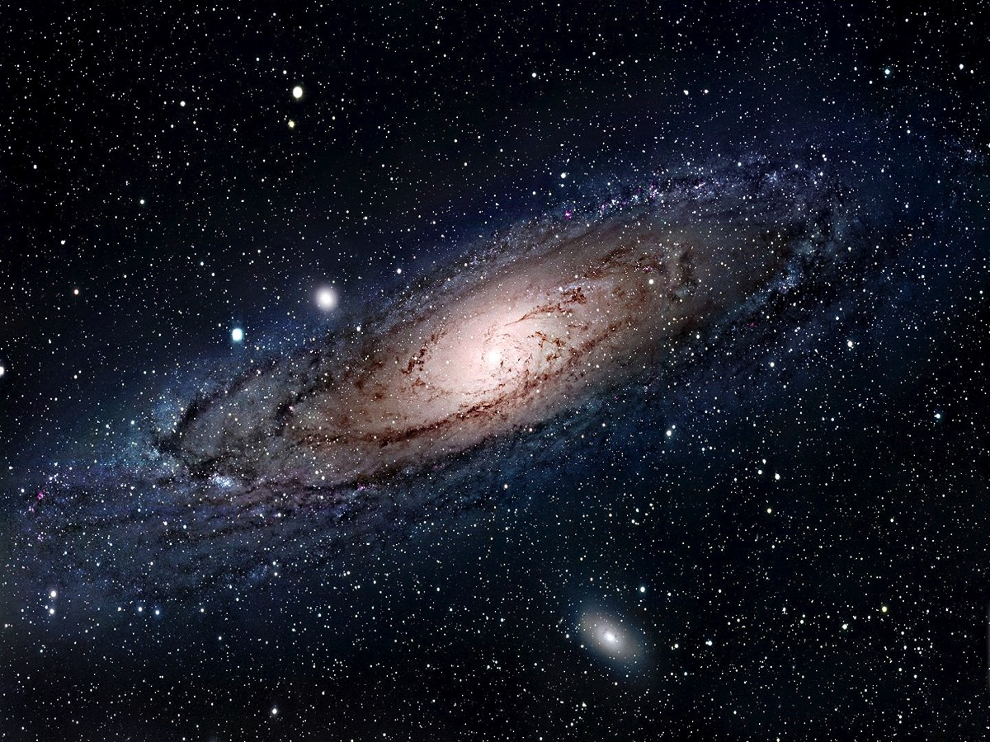
Notes:
We’re talking about the God who created ALL CREATION - the galaxies, the sun, moon and stars.

Slide 25
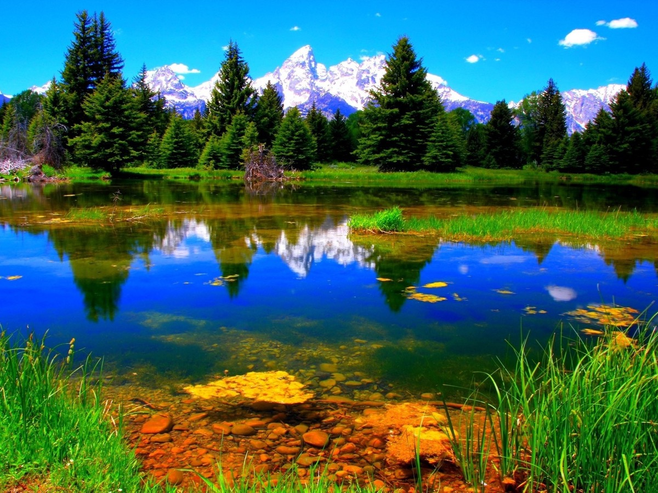
Notes:
And he made the world that we live in - he can protect us!!!

Slide 26
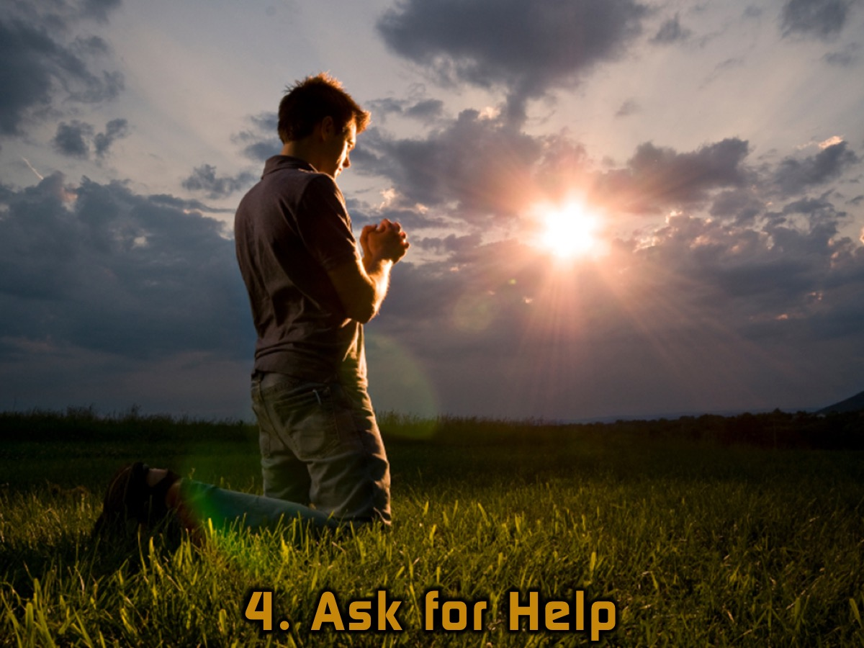
Notes:
4. Ask for Help – You can show that you trust God by asking Him for his help when you are afraid.

Slide 27
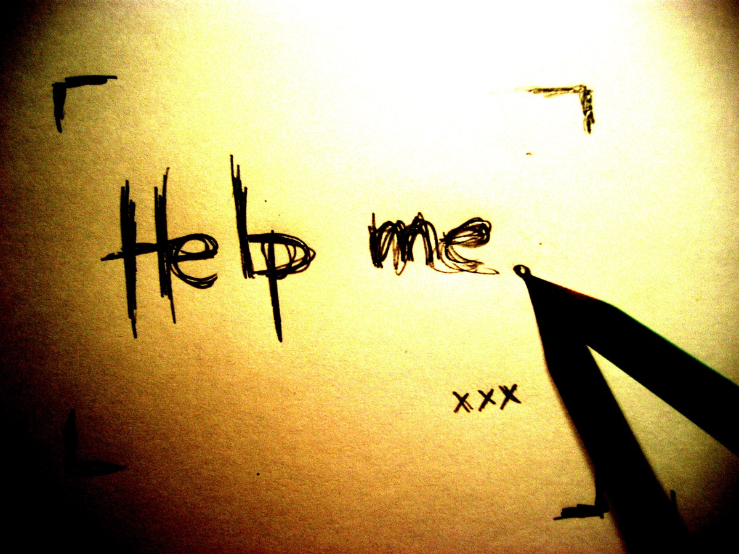
Notes:
When we ask God for help he is able to step into our situation and bring the help we need!

Slide 28
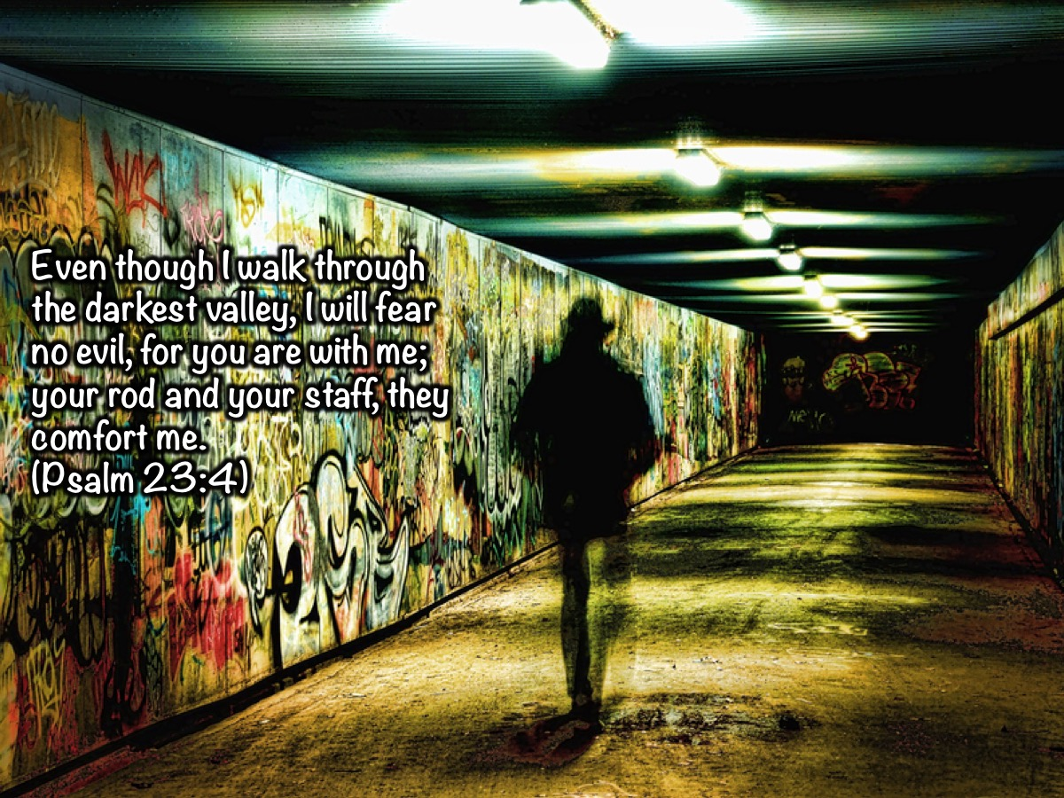
Notes:
“Even though I walk through the darkest valley, I will fear no evil, for you are with me; your rod and your staff, they comfort me.” (Psalm 23:4)

Slide 29
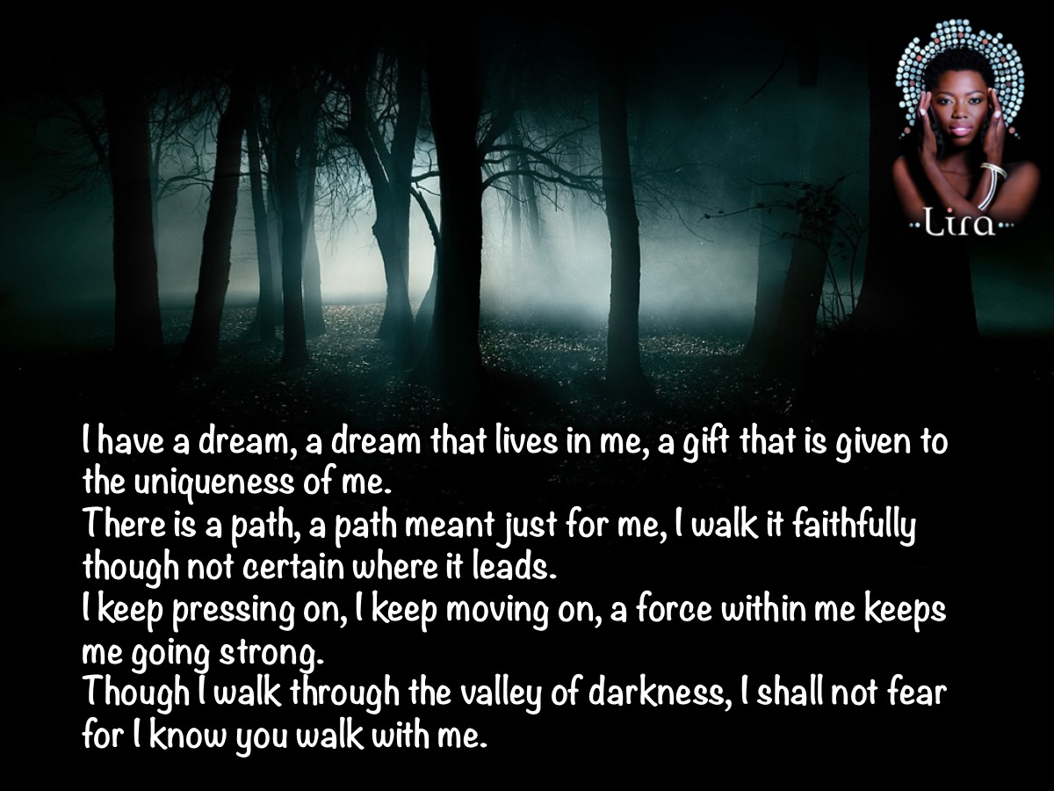
Notes:
There’s a song I’ve come to like by one of SA’s finest vocalist’s that puts this Psalm quite nicely: “I have a dream, a dream that lives in me, a gift that is given to the uniqueness of me. There is a path, a path meant just for me, I walk it faithfully though not certain where it leads. I keep pressing on, I keep moving on, a force within me keeps me going strong. Though I walk through the valley of darkness, I shall not fear for I know you walk with me.”

Slide 30
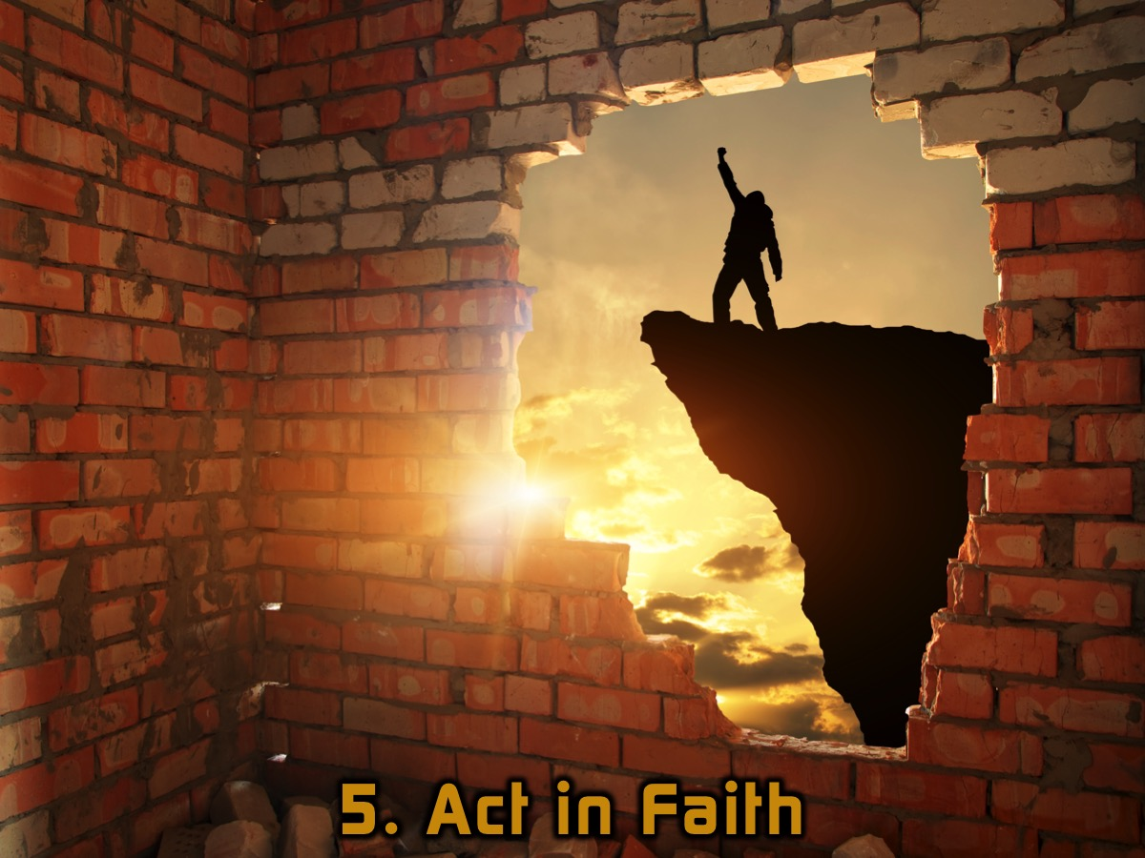
Notes:
5. Act in Faith.

Slide 31
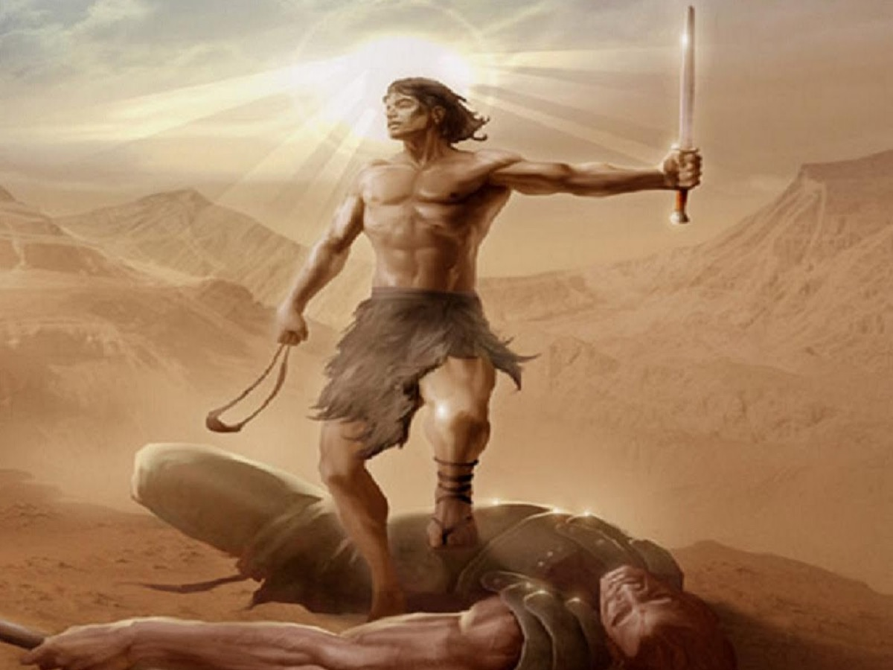
Notes:
What would have happened if David had allowed his fear to keep him from facing up to Goliath?

Slide 32
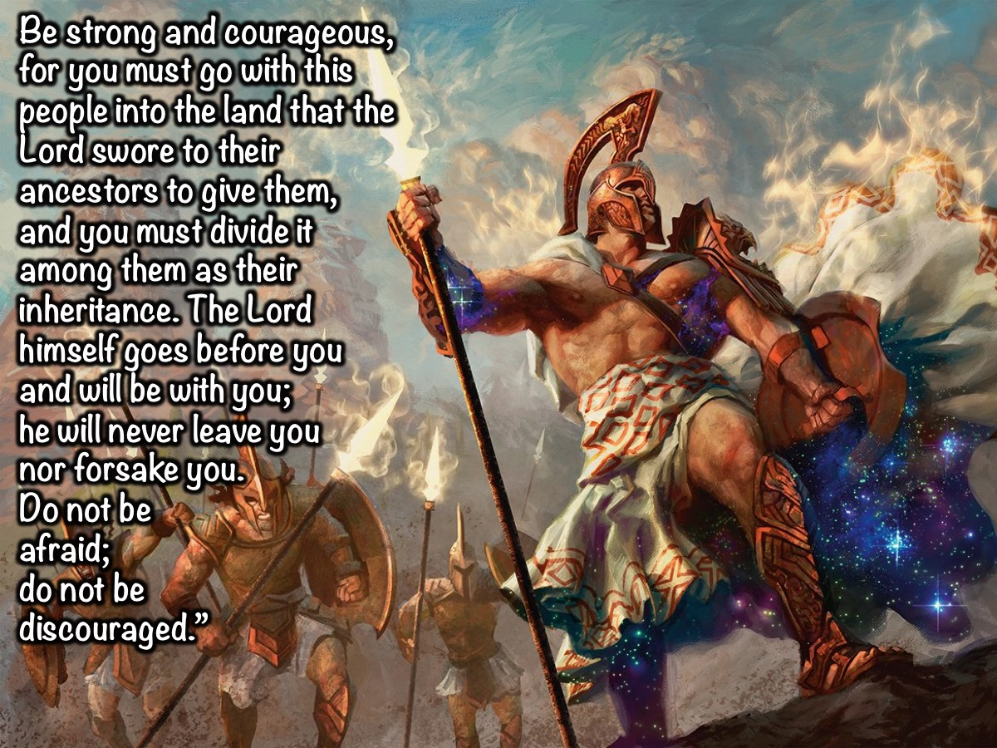
Notes:
Then Moses summoned Joshua and said to him in the presence of all Israel, “Be strong and courageous, for you must go with this people into the land that the Lord swore to their ancestors to give them, and you must divide it among them as their inheritance. The Lord himself goes before you and will be with you; he will never leave you nor forsake you. Do not be afraid; do not be discouraged.” (Deuteronomy 31:7-8)

Slide 33
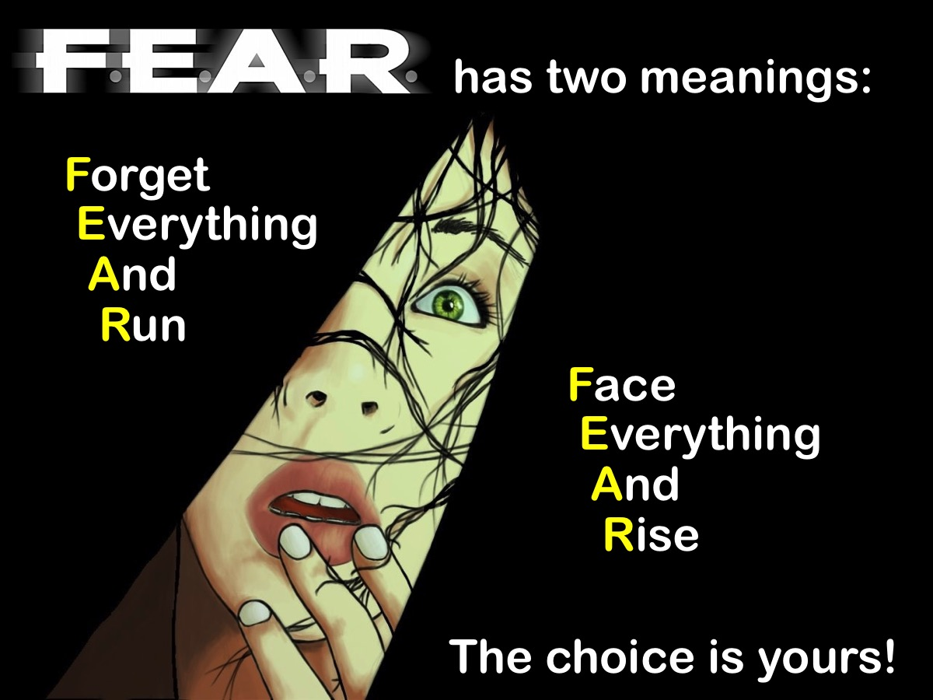
Notes:
Fear has two meanings: Forget Everything And Run or Face Everything And Rise. The Choice is Yours!

Slide 34
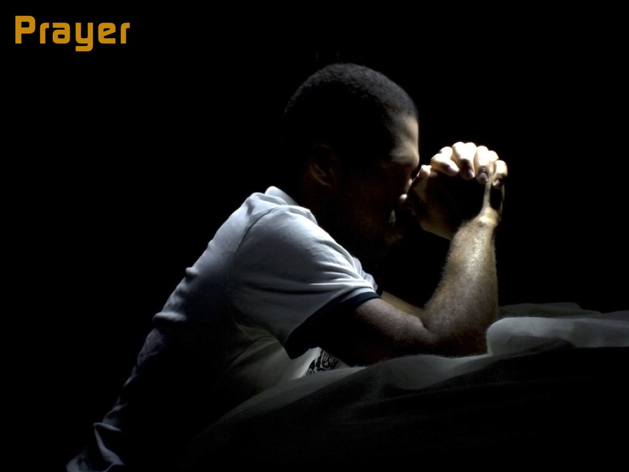
Notes:
Prayer

Slide 35

Notes:
Next week we will look at how to breakout from the prison of Depression.

