Slide 1

Notes:
Welcome to the breakout series.

Slide 2

Notes:
In Week 1 we looked at how to breakout of the prison of Anxiety. Professor Terry told us how he had anxiety over his basement flooding and when it did it wasn’t as bad as he thought it would be!

Slide 3

Notes:
In Week 2 we looked at how to breakout of the prison of Fear. Pastor Mark shared about his experience being on his bike and God asking him to pray for a crippled man. But he popped a great wheelie because he was afraid of failure.

Slide 4
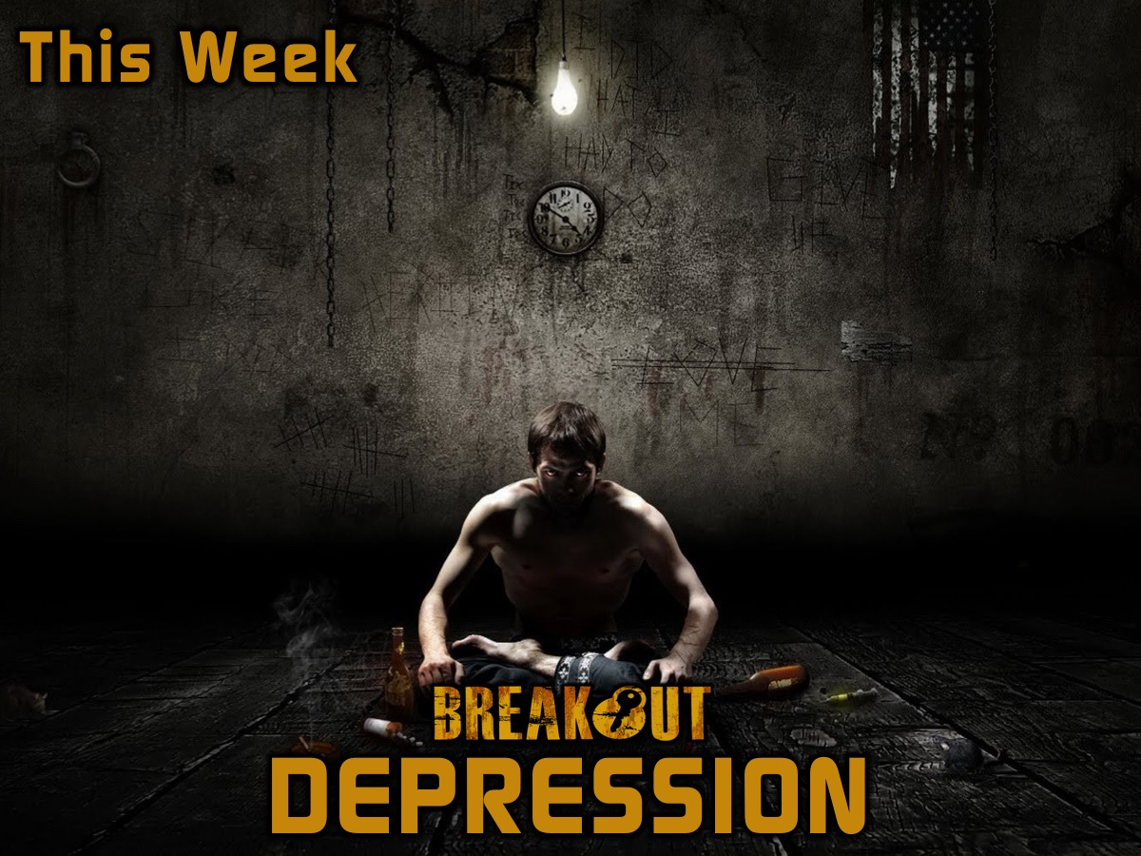
Notes:
This week we are going to look at how to breakout of the prison of Depression. Fear leads to Anxiety and in the end if not dealt with it leads to Depression!!! In this you will hear my story how I am breaking out of Depression.

Slide 5
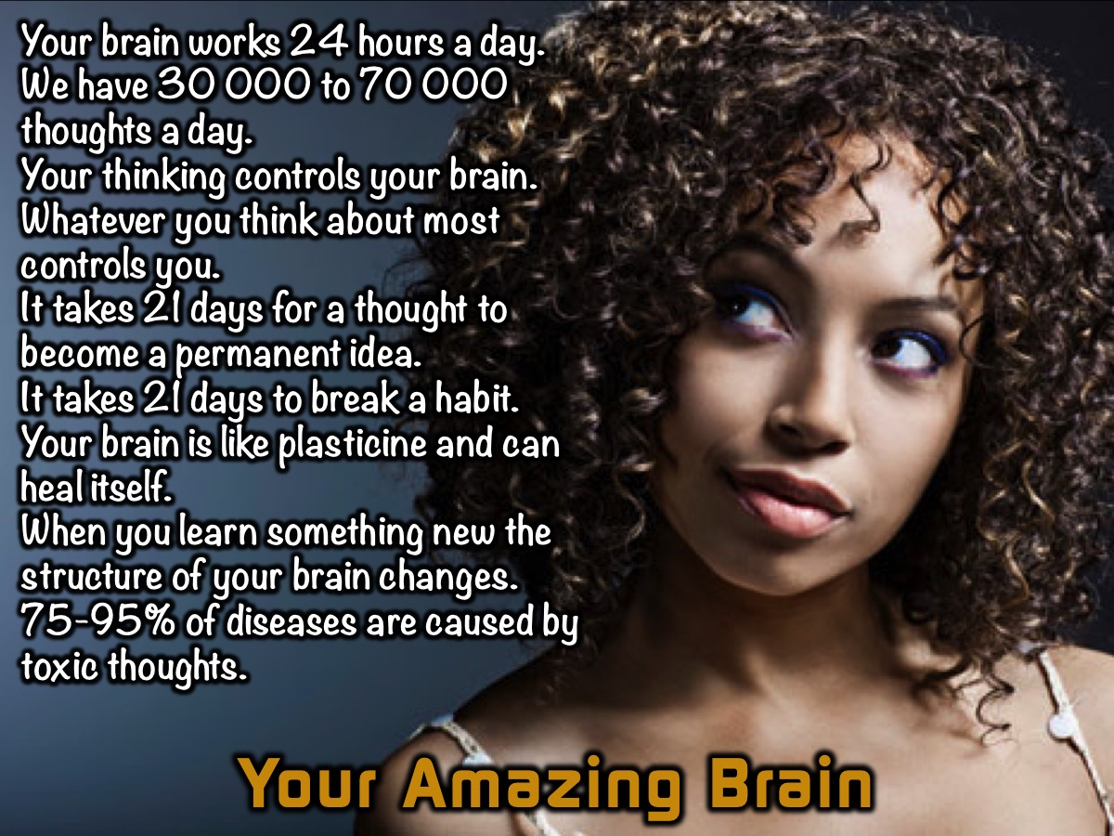
Notes:
Your Amazing Brain: Here are some amazing facts about the brain:
Your brain works 24 hours a day.
We have 30 000 to 70 000 thoughts a day.
Your thinking controls your brain.
Whatever you think about most controls you.
It takes 21 days for a thought to become a permanent idea.
It takes 21 days to break a habit.
Your brain is like plasticine and can heal itself.
When you learn something new the structure of your brain changes.
75-95% of diseases are caused by toxic thoughts.

Slide 6

Notes:
Sometimes Things Go Wrong – the brain may be amazing but sometimes things can go wrong. 3 out of 4 people will experience depression in their lives.

Slide 7
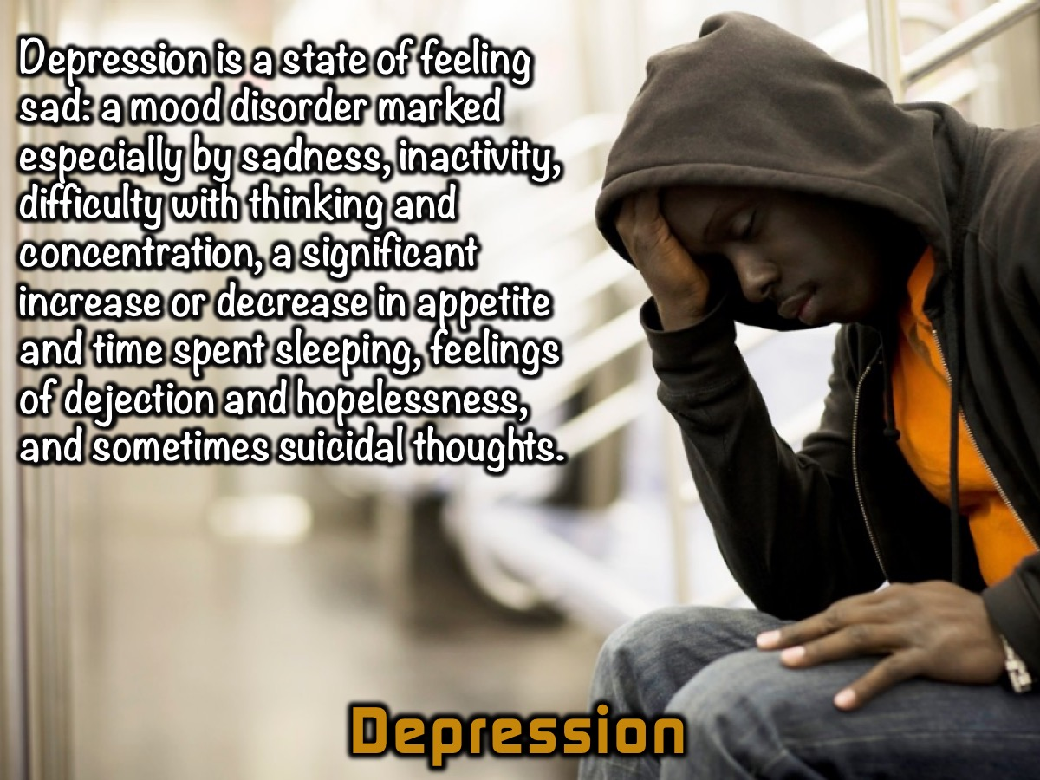
Notes:
Depression is a state of feeling sad: a mood disorder marked especially by sadness, inactivity, difficulty with thinking and concentration, a significant increase or decrease in appetite and time spent sleeping, feelings of dejection and hopelessness, and sometimes suicidal thoughts. This is a very broad definition of depression and just because you feel one or more of these symptoms doesn’t make you “clinically depressed” In fact do you know that there is no physical test to take that can prove that you are depressed. If you have diabetes they can test your sugar contents and that proves you are a diabetic. There is no test for depression!!! What I'm looking at, at the moment is depression as a disease?

Slide 8
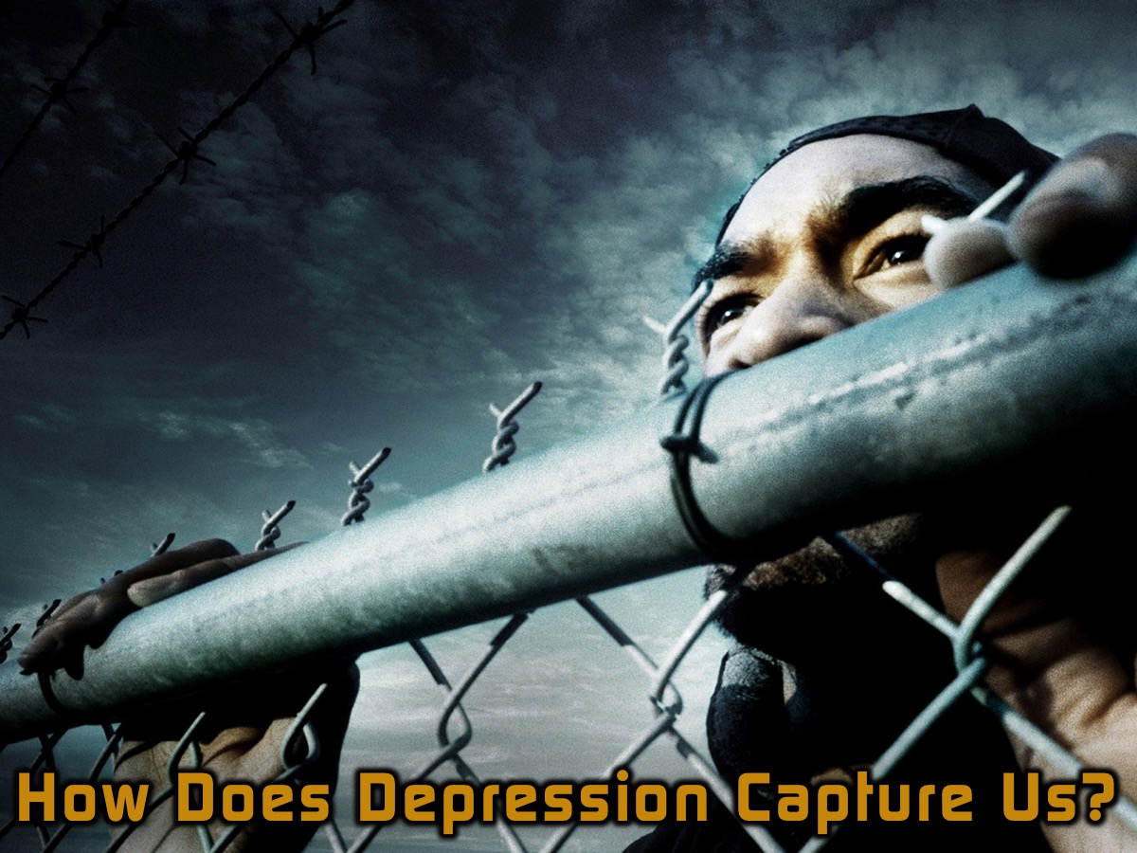
Notes:
How does depression capture us?

Slide 9

Notes:
Negative Thinking: Most depression is caused by negative thinking.

Slide 10

Notes:
Toxic Thinking: And depression is also caused by toxic thinking. Have you ever found yourself saying these things to yourself: I could have, I should have, I would have, if only, nothing ever goes right for me, I always mess up, I'm an idiot, I'm stupid, I'm not good enough! If you say these things to yourself enough times in a day and over a week and a month your brain accepts that toxic thought and it becomes you. And then it craves more thoughts and eventually you are so toxic that you find yourself depressed.

Slide 11
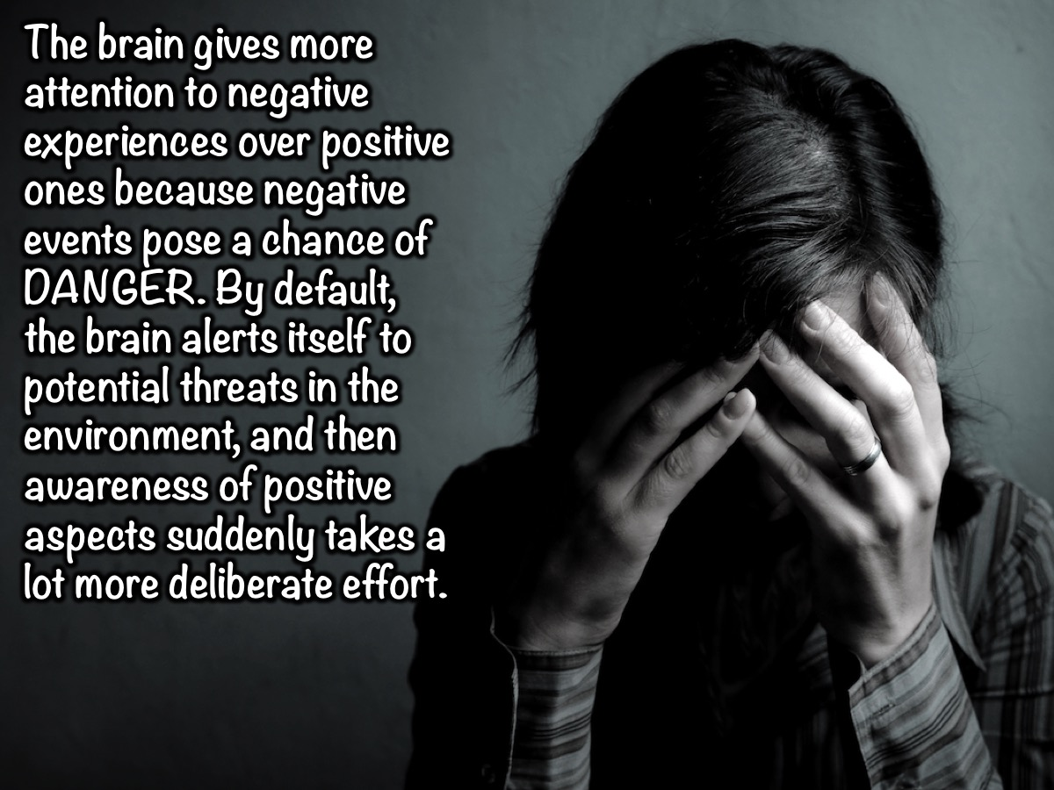
Notes:
The brain gives more attention to negative experiences over positive ones because negative events pose a chance of DANGER. By default, the brain alerts itself to potential threats in the environment, and then awareness of positive aspects suddenly takes a lot more deliberate effort.

Slide 12
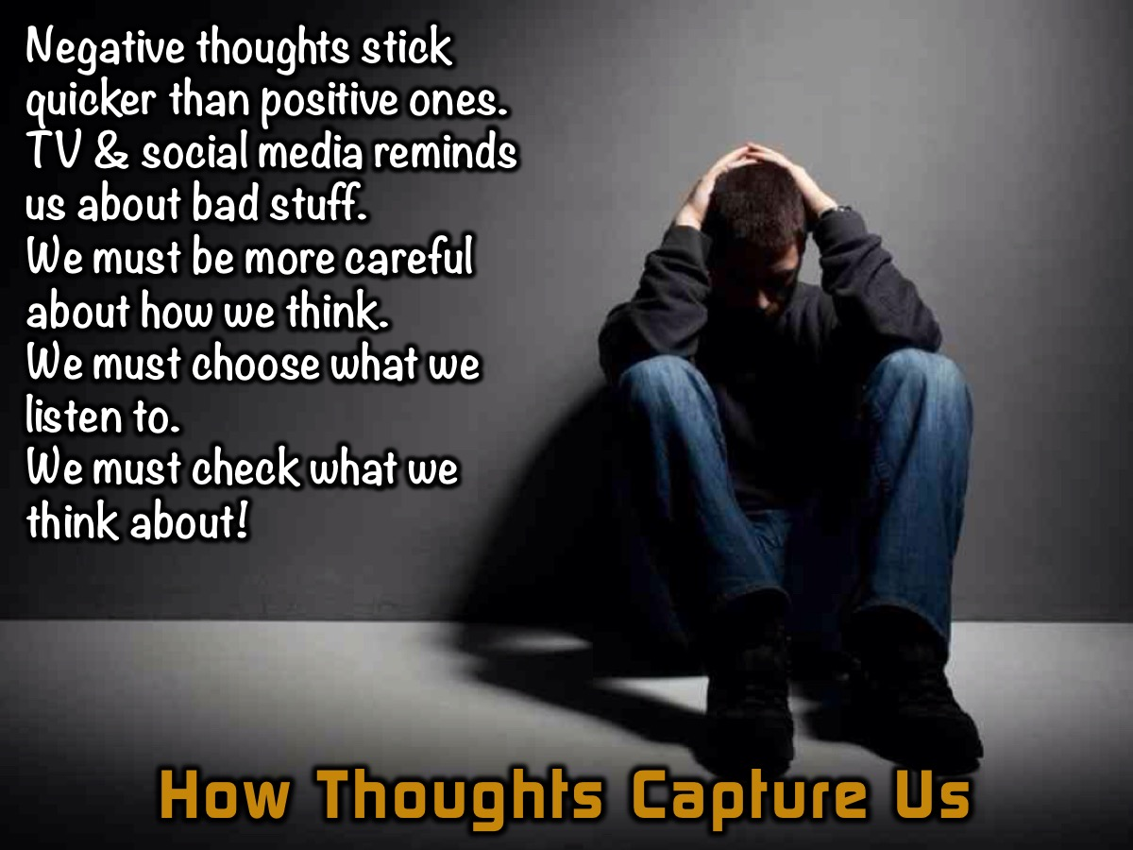
Notes:
How do thoughts take hold of our minds? It seems that in our day and age negative thoughts seem to stick quicker than positive thoughts. Maybe because we live in a time when TV reminds us about all the bad stuff around us. So we are going to have to be more specific about how we think. We are going to have to choose what we listen to or what we spend our time thinking about!

Slide 13
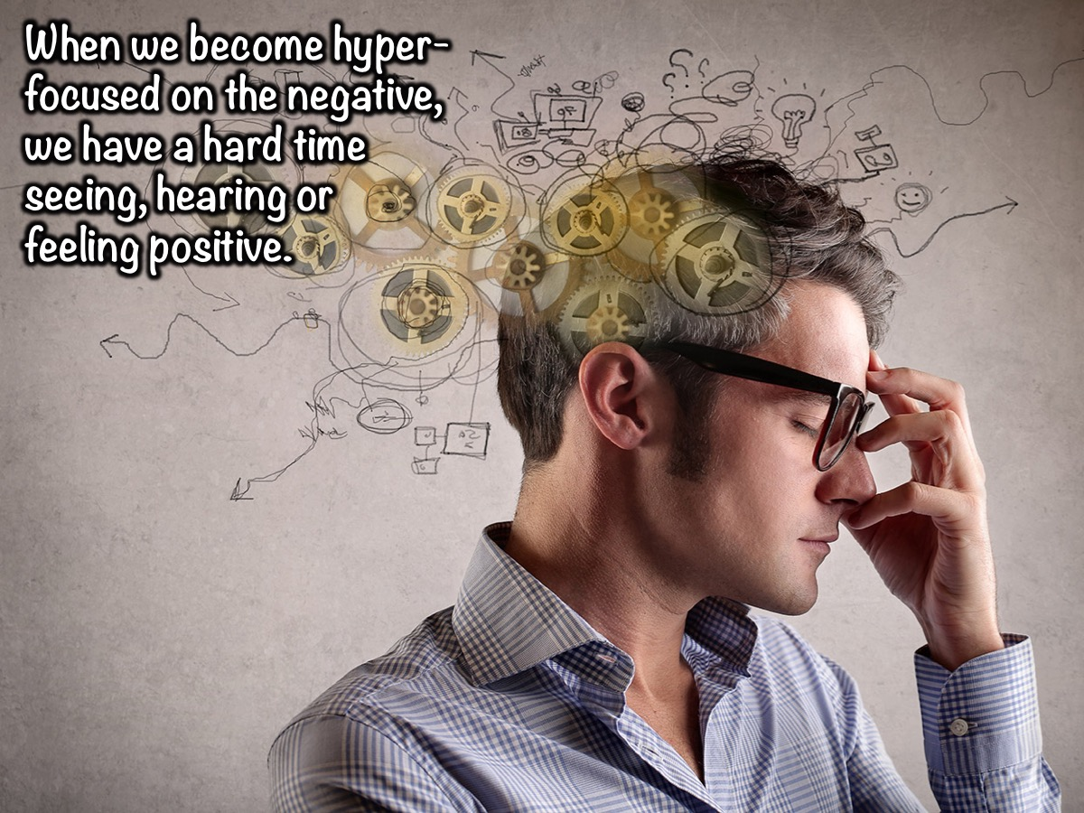
Notes:
When we become hyper-focused on the negative, we have a hard time seeing, hearing or feeling positive.

Slide 14
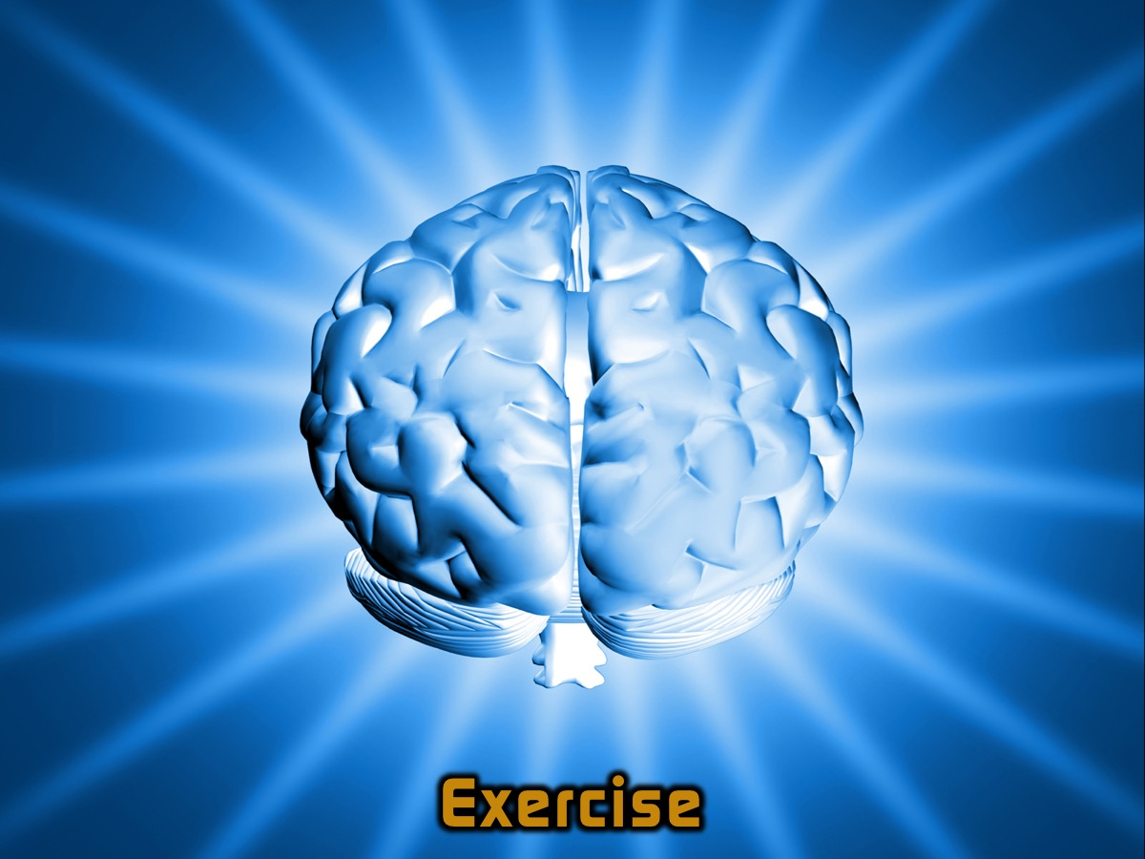
Notes:
Exercise: Positive and Negative Thoughts. Teens are shown a copy of a Whatsapp Message where they are dumped by a boy/girl friend.

Slide 15
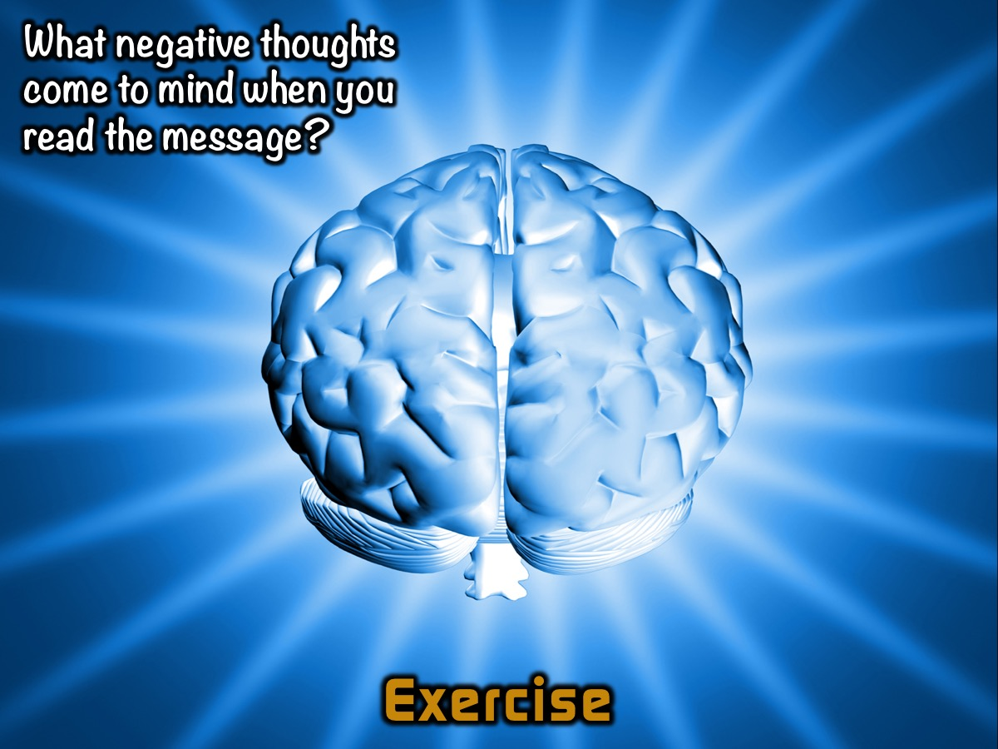
Notes:
What negative thoughts come to mind when you see the handout?

Slide 16
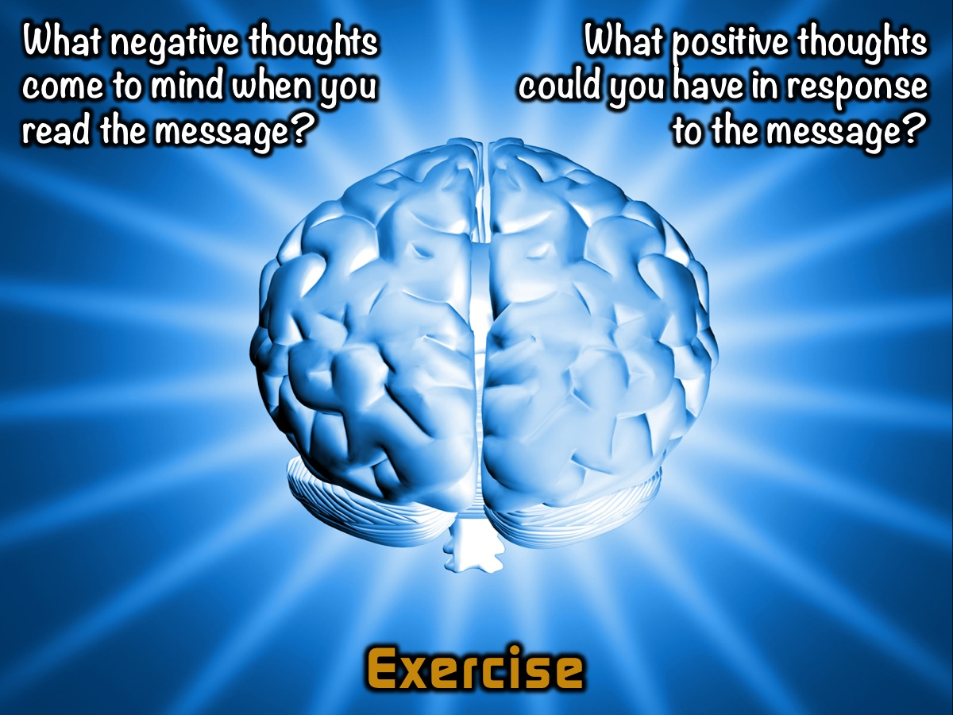
Notes:
What positive thoughts could you have with a bit of effort?

Slide 17

Notes:
“I have set before you life and death, blessings and curses. Now choose life, so that you and your children may live”. (Deuteronomy 30:19)

Slide 18

Notes:
What do you see when you look at this glass of water? Some see it as half full while others may see it as half empty.

Slide 19

Notes:
We can choose the see the glass as half full rather than half empty.

Slide 20

Notes:
Whether you think you can or you can’t, you’re right. (Henry Ford). Can you think of a time when this statement was true in your life?

Slide 21
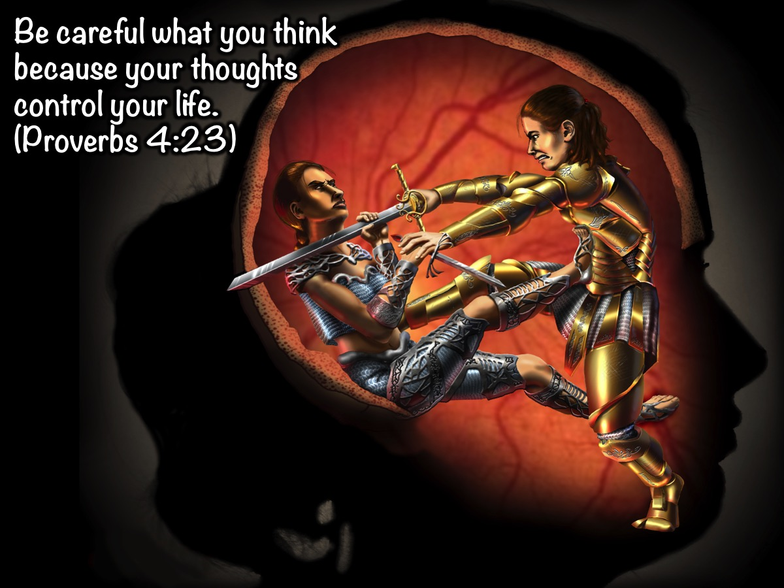
Notes:
Be careful what you think because your thoughts control your life. (Proverbs 4:23)

Slide 22
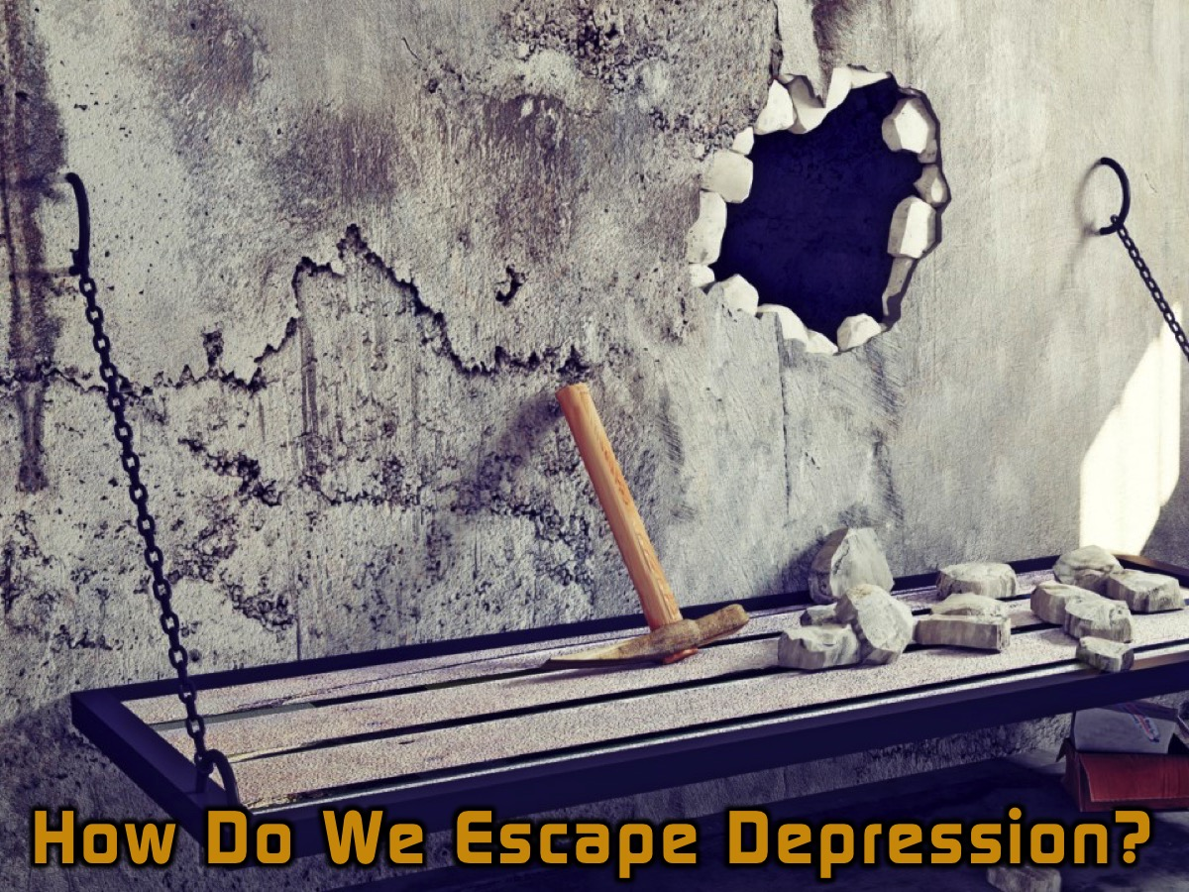
Notes:
So How Do We Escape the Prison of Depression? I believe that these steps will help you even if you are not depressed and are just struggling with negative thoughts!!!

Slide 23

Notes:
Start!

Slide 24

Notes:
1. Start involving God. (2 Timothy 1:7). If God has not given us a spirit of fear but of love, self control and a sound mind, then it makes sense that we should go to him for help when we are afraid or feeling depressed. We are challenged to go to God when we need help: Let us then approach God’s throne of grace with confidence, so that we may receive mercy and find grace to help us in our time of need. (Hebrews 4:16)

Slide 25

Notes:
2. Start Recording Thoughts. Start a thankful diary. Everyday look for things that you are thankful for, things that are beautiful, things that make you smile and write them in the diary. Record positive thoughts. This truly helps. Here is my book I’ve worked on. It helps me to stop lying to myself! It helps me see that God is good!

Slide 26

Notes:
3. Start Being Honest With Yourself. Ask yourself: “Why am I sad?” Is it something that will pass e.g. I'm failing at school, but if I work harder I have 3 other terms to catch up. This time will pass.

Slide 27

Notes:
4. Start Doing Things that you used to love doing. Even if at first you don’t have the energy for it. I stopped painting, gardening and many other things because I just didn’t have the energy!!! But now I force myself to do the things I love!!! Still working on it but I am getting there!

Slide 28

Notes:
5. Start Loving Again. God created us for love. How many of you when you are in a relationship feel as if you could climb a mountain? Love helps us to see things in a positive way!

Slide 29

Notes:
6. Start Forgiving People. Let go of hurt feelings and grudges. Unforgiveness suffocates joy and paralyzes your ability to move on. Unforgiveness is the cancer of the soul. It slowly eats away the marrow of your existence and impairs your judgment and your ability to love and trust again. Matthew 6:14-15 challenges us to practise forgiveness: “If you forgive other people when they sin against you, your heavenly Father will also forgive you. But if you do not forgive others their sins, your Father will not forgive your sins.”

Slide 30

Notes:
7. Start With Counseling. If things still don’t improve then consider seeing a counselor at school or at church. Sometimes we have harboured these things for so long that we need a professional to help us figure it out!

Slide 31

Notes:
Prayer

Slide 32
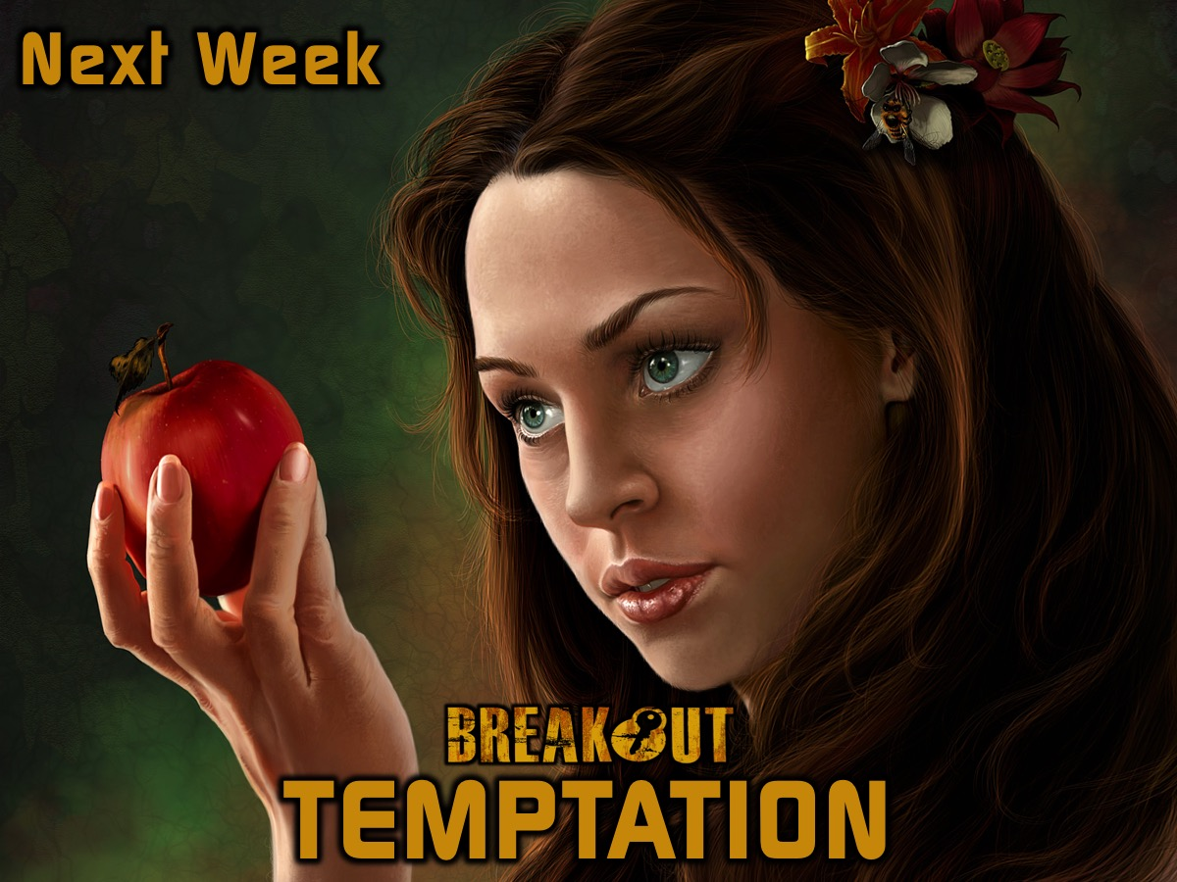
Notes:
Next week we will look at how to breakout from the prison of Temptation.

