Slide 1

Notes:
Welcome to the Breakout series.

Slide 2

Notes:
In Week 1 we looked at how to breakout from the prison of Anxiety.

Slide 3

Notes:
In Week 2 we looked at how to breakout from the prison of Fear.

Slide 4
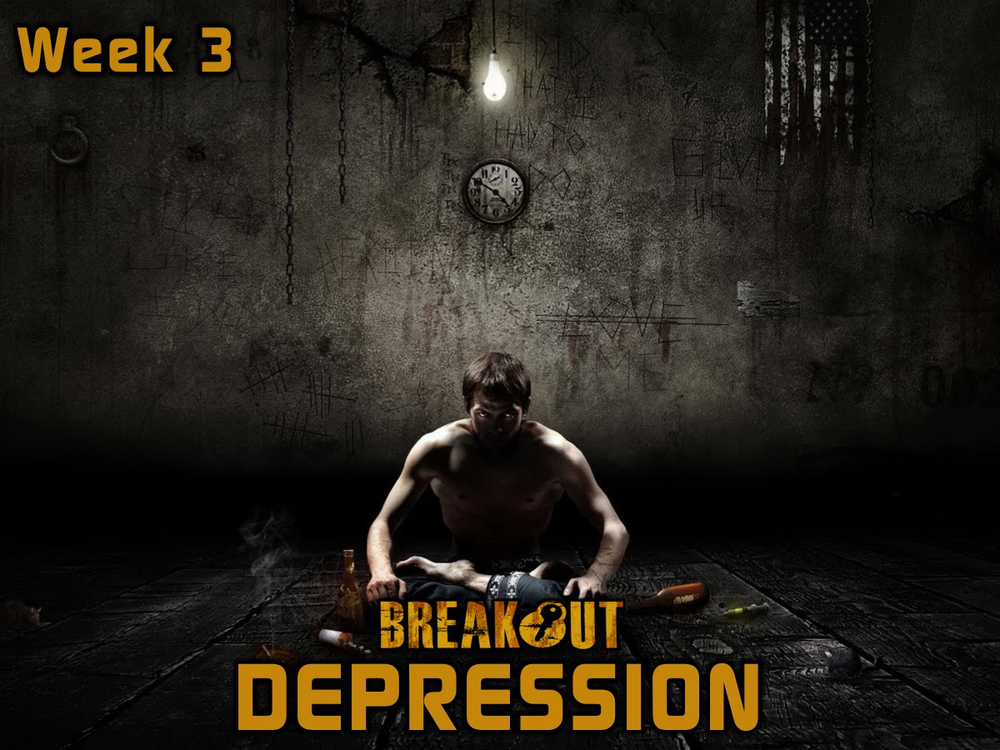
Notes:
In Week 3 we looked at how to breakout from the prison of Depression.

Slide 5

Notes:
In Week 4 we looked at how to breakout from the prison of Temptation.

Slide 6

Notes:
This week we are going to look at how to breakout from the prison of Heartache.

Slide 7
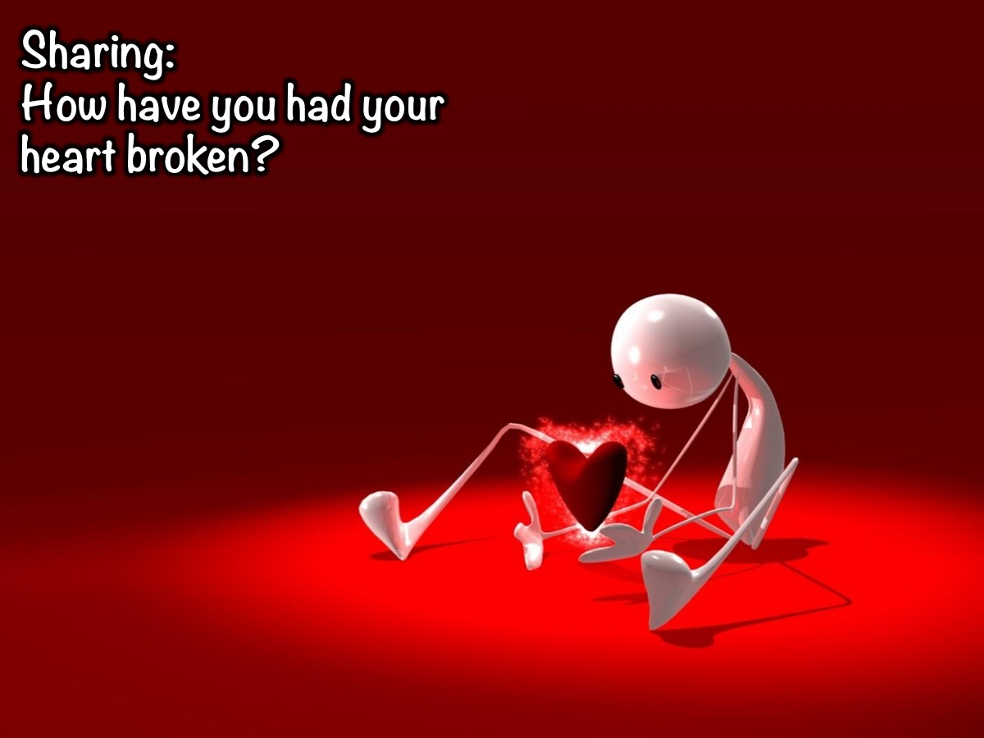
Notes:
Sharing: How have you had your heart broken?

Slide 8
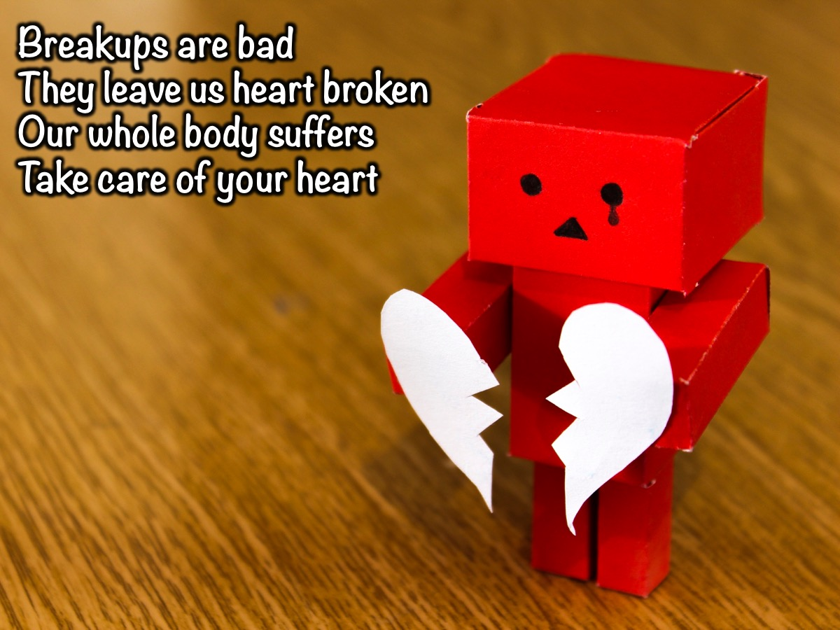
Notes:
Whether we like it or not. Breakups are bad. Even if it was through mutual agreement. They leave us heart broken, and the heart is a vital organ in our body. When the heart is not healthy, the whole body suffers. It is therefore very important to take care of the heart. Its not easy but its possible.

Slide 9

Notes:
Today is the 14th February (Valentine's day). Some of us have dates, and some of us don't. Some of us may go through breakups after today.

Slide 10
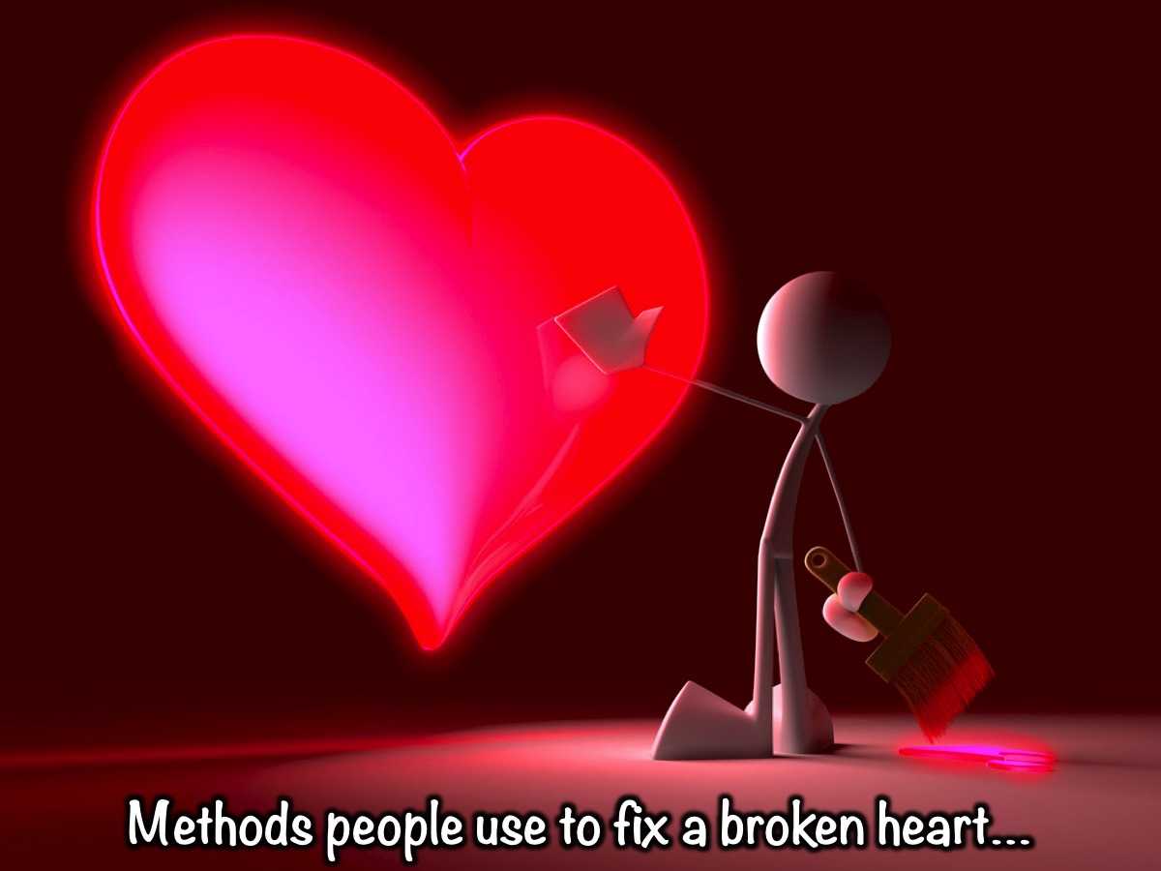
Notes:
There are different methods that people use to try fix a broken heart.

Slide 11
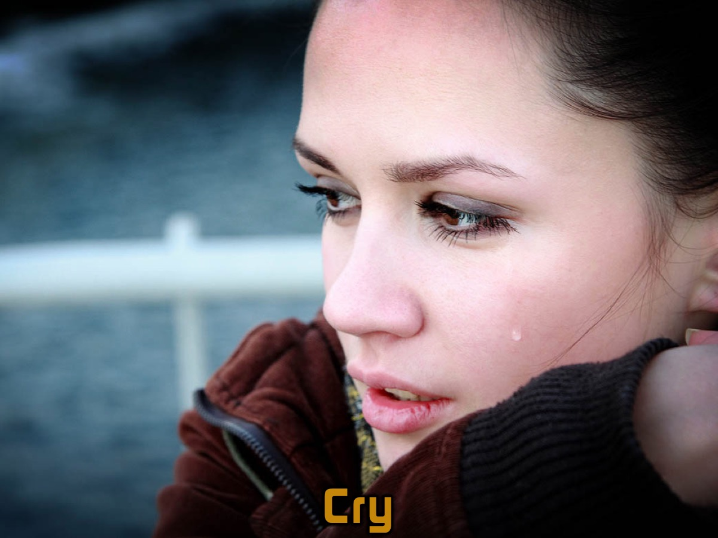
Notes:
1. Cry

Slide 12
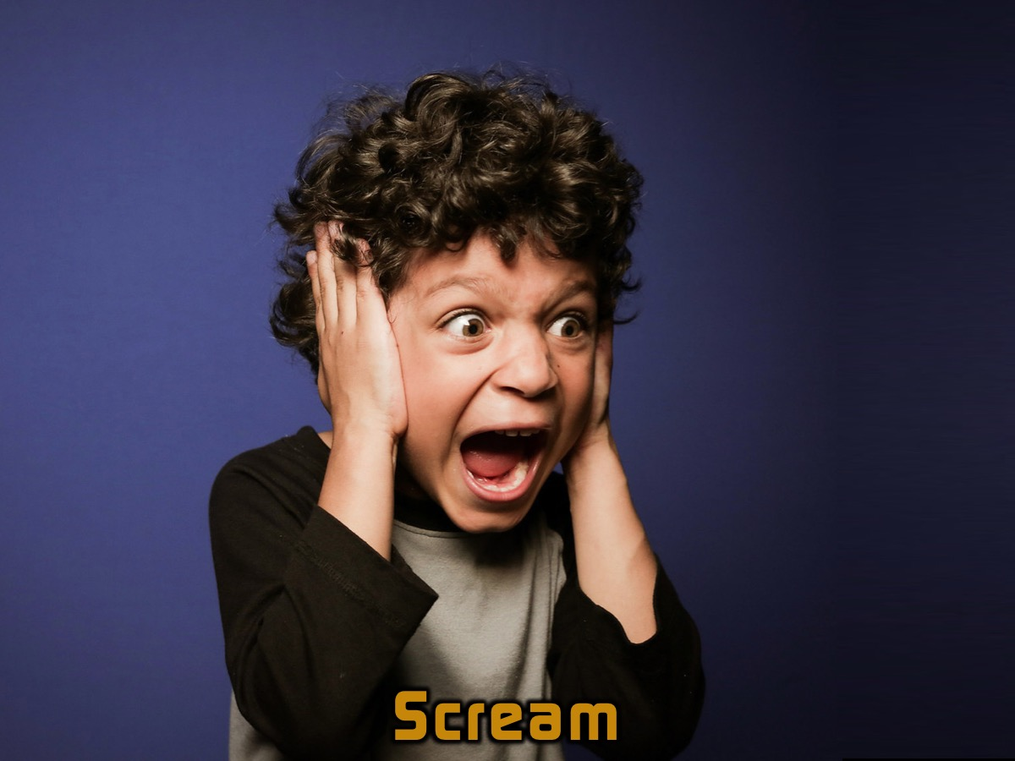
Notes:
2. Scream

Slide 13
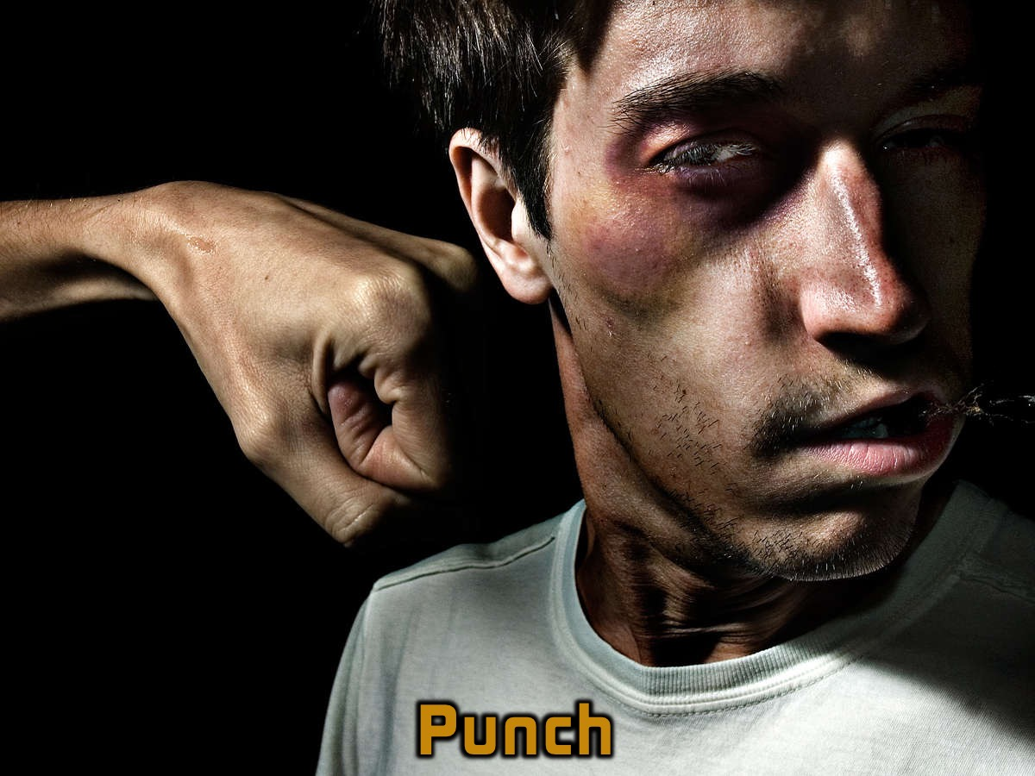
Notes:
3. Punch - get violent.

Slide 14

Notes:
4. Gossip. Bad mouth the person who broke our heart.

Slide 15

Notes:
5. Drugs - some people escape by using drugs or alcohol.

Slide 16
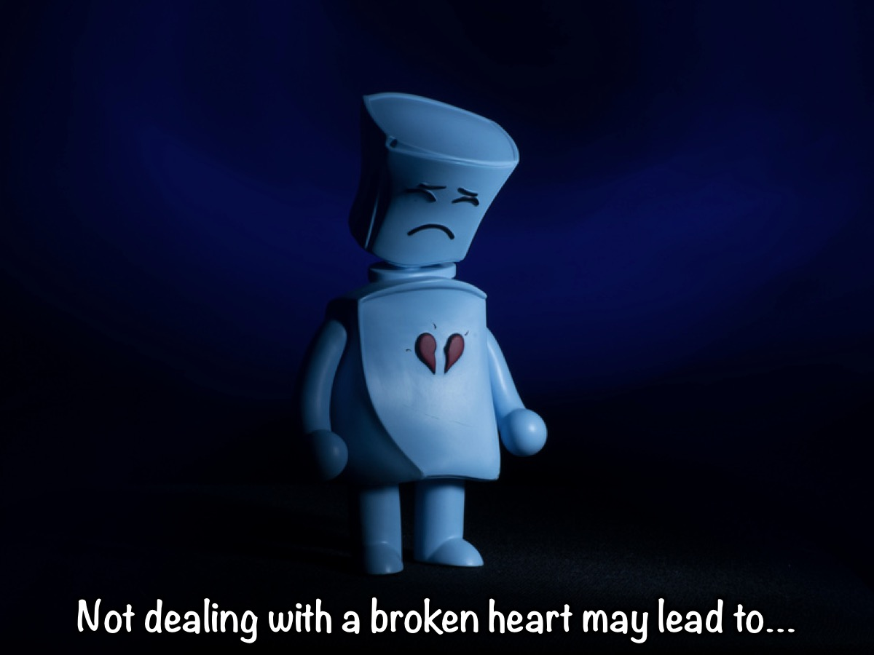
Notes:
Not dealing with a broken heart may lead to…

Slide 17
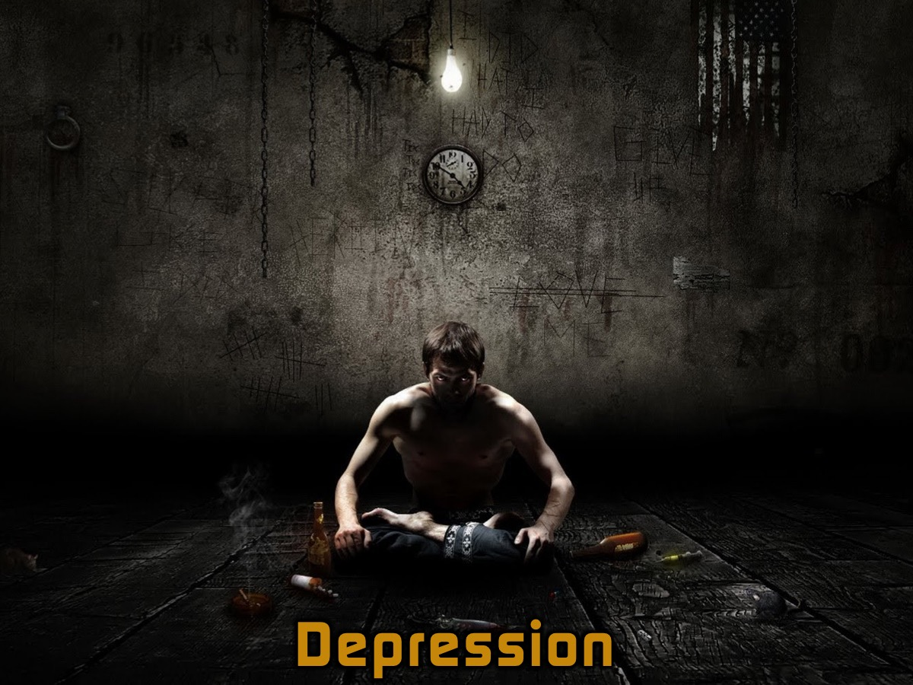
Notes:
1. Depression

Slide 18
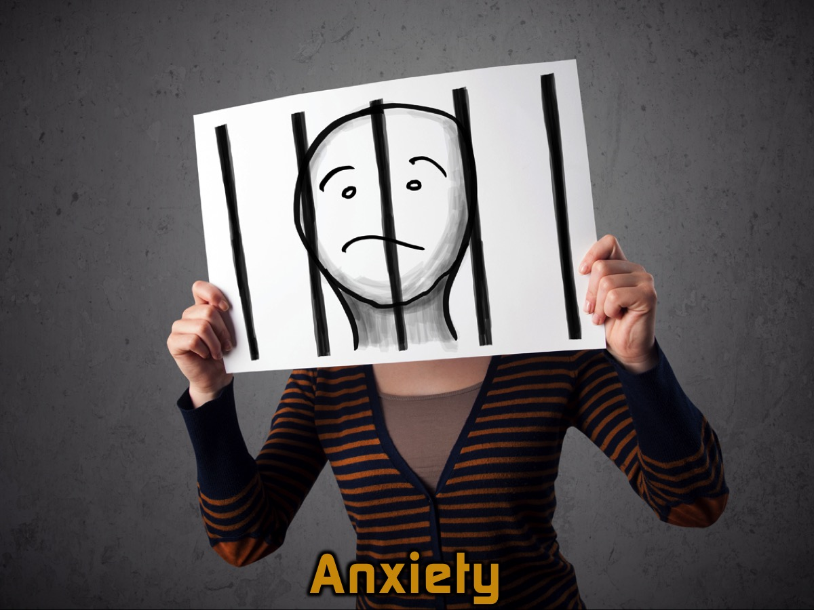
Notes:
2. Anxiety

Slide 19
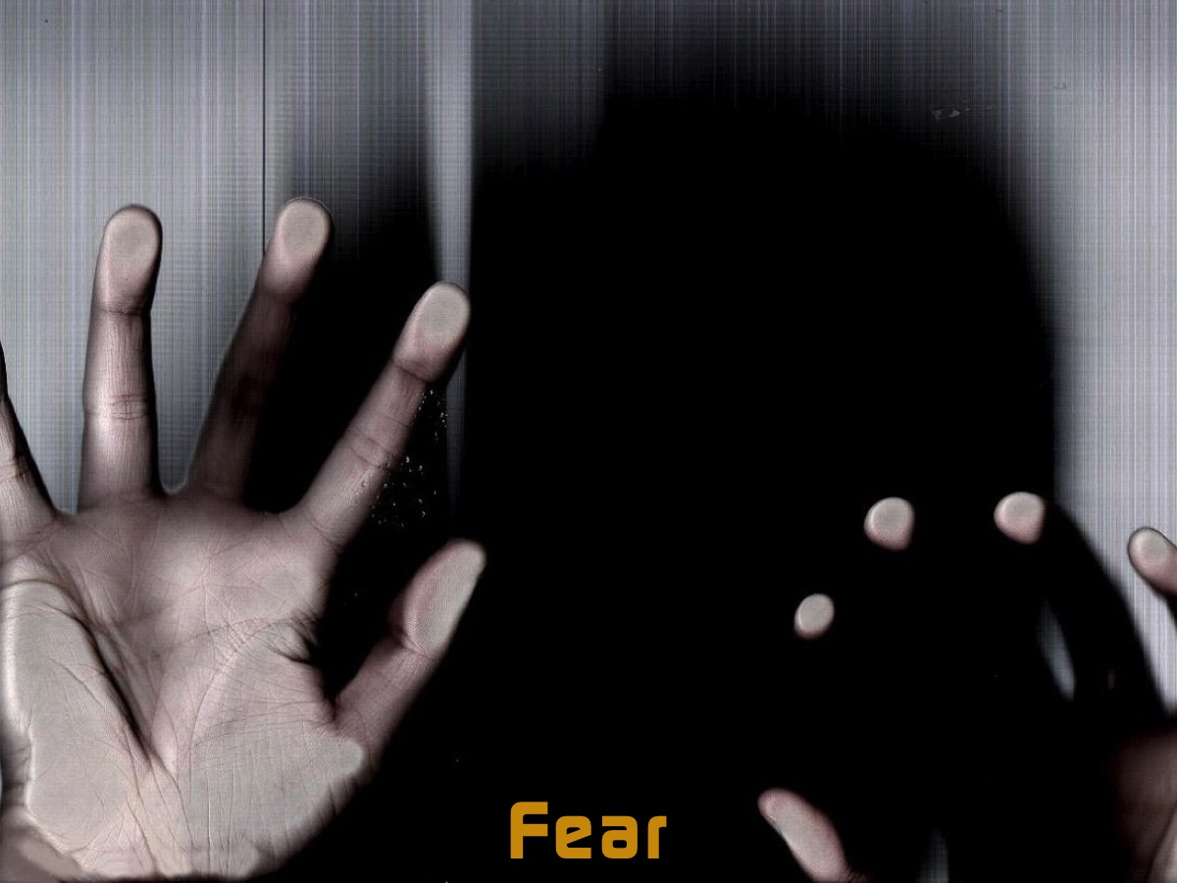
Notes:
3. Fear

Slide 20
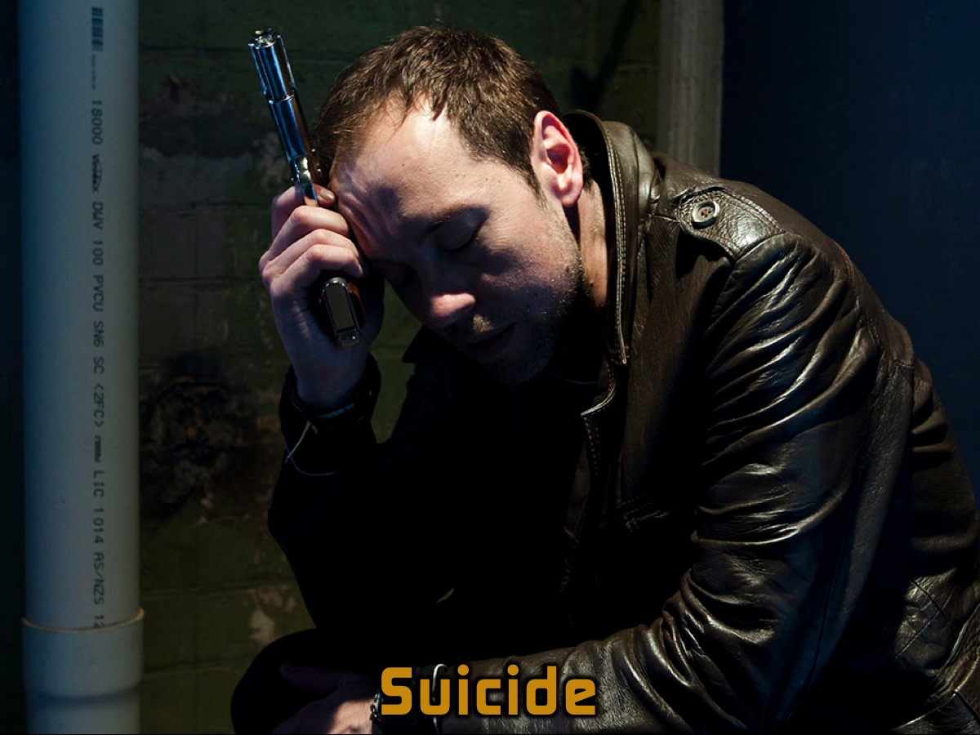
Notes:
4. Suicide, and many more unpleasant things.

Slide 21
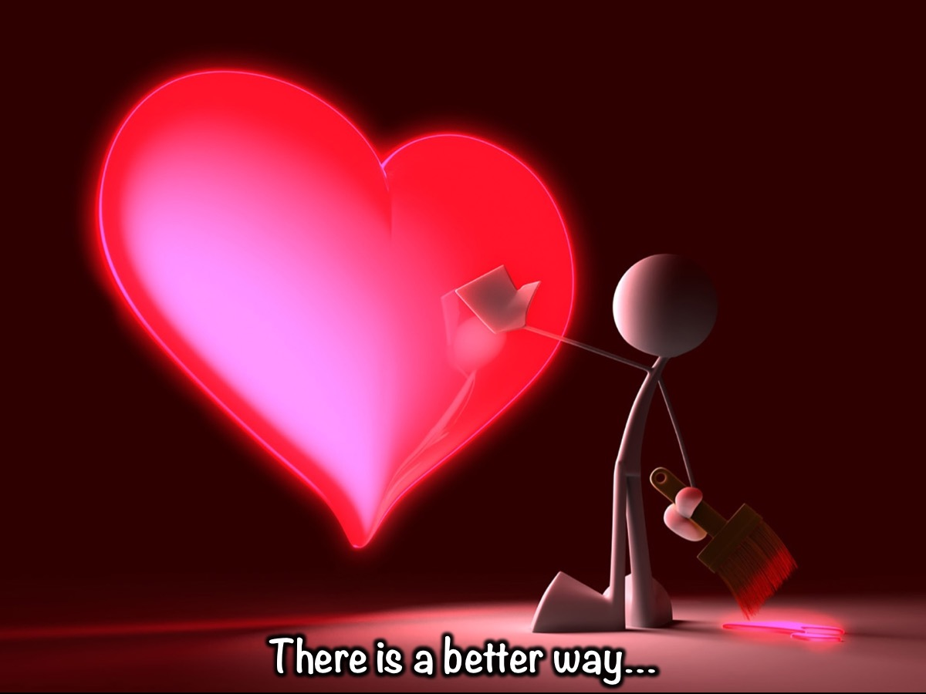
Notes:
There is a better way to deal with a broken heart…

Slide 22
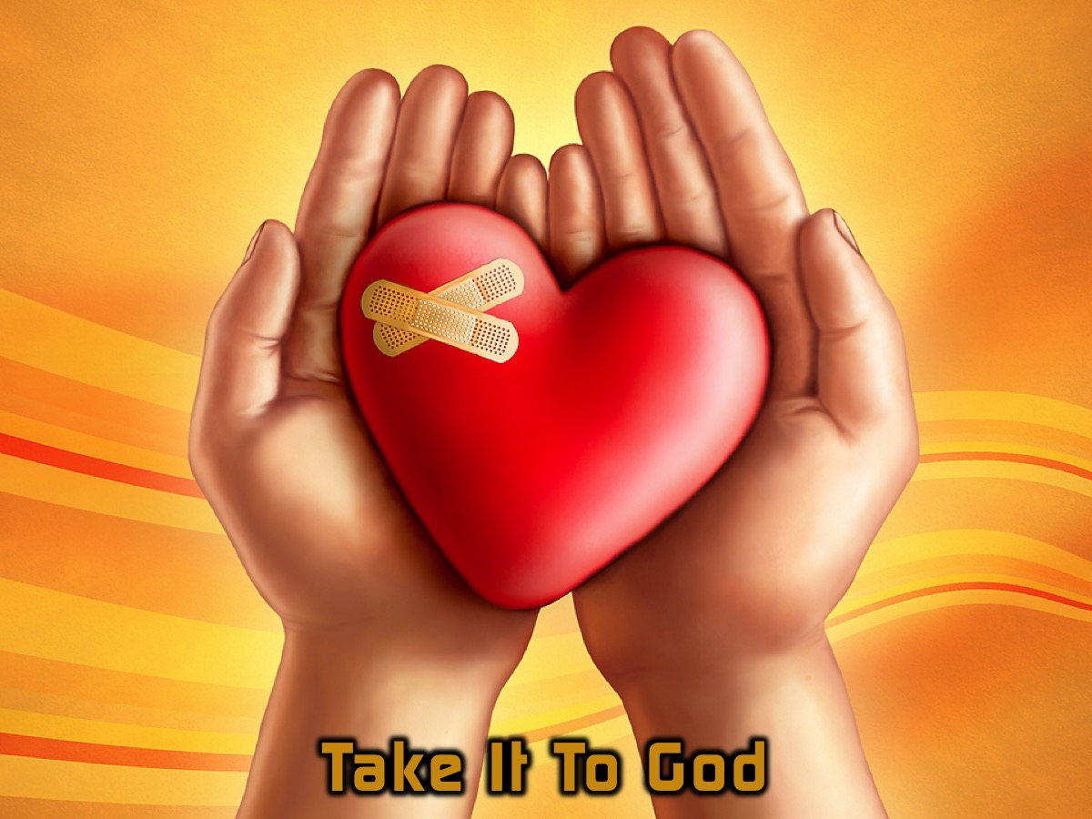
Notes:
The best solution is to take it to God! We should take everything to God in prayer!

Slide 23
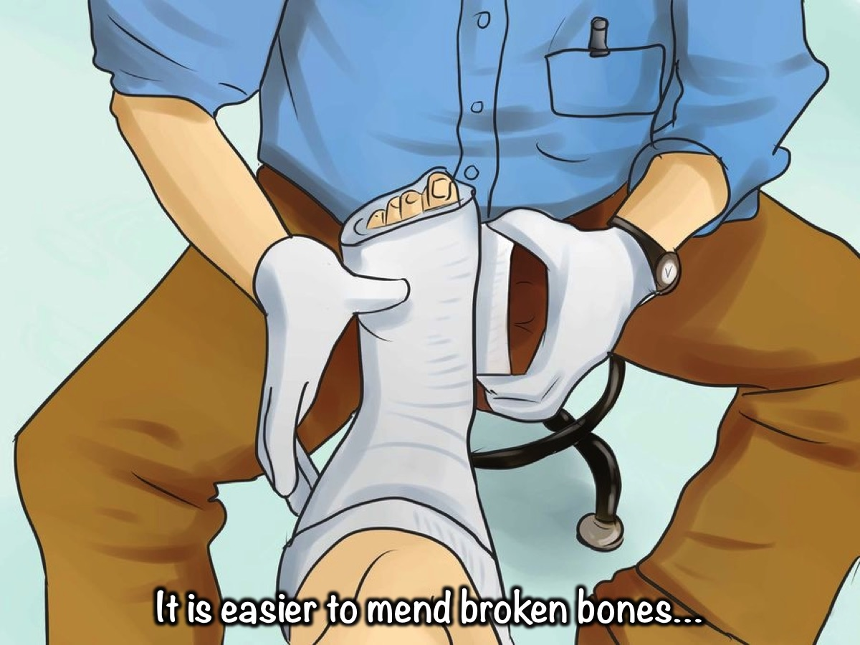
Notes:
It is easier to mend broken bones…

Slide 24
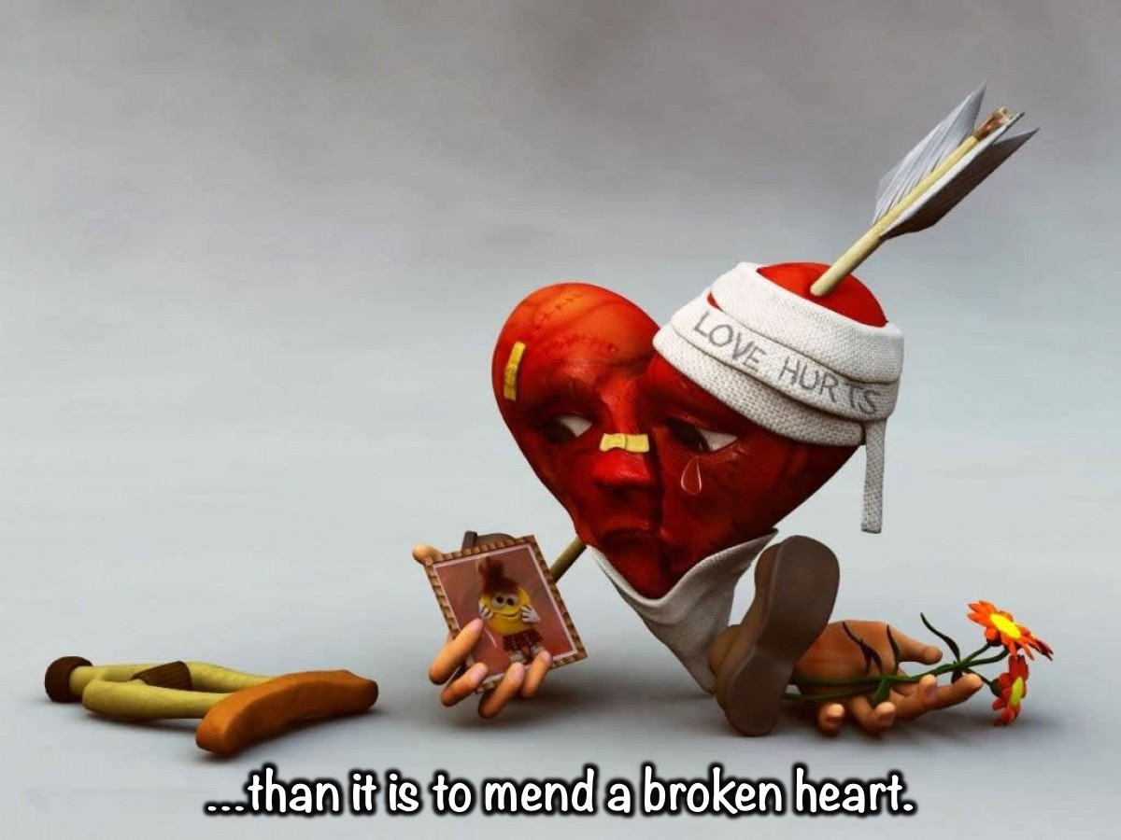
Notes:
…than it is to mend a broken heart.

Slide 25
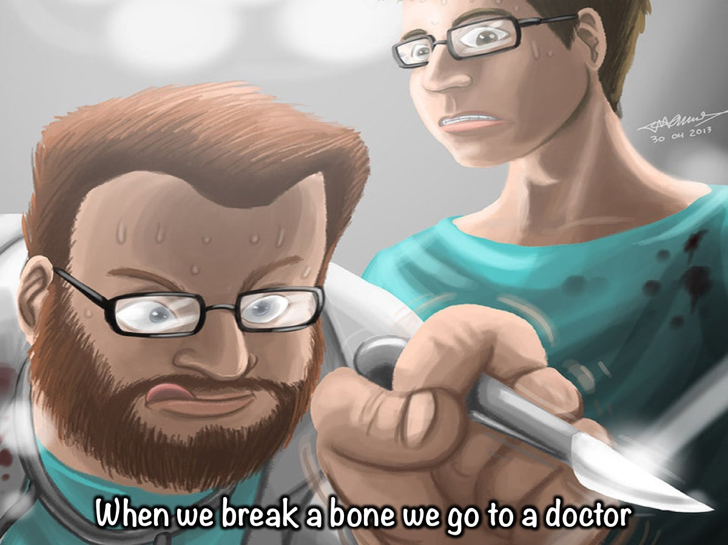
Notes:
When we break a bone we go to a doctor.

Slide 26
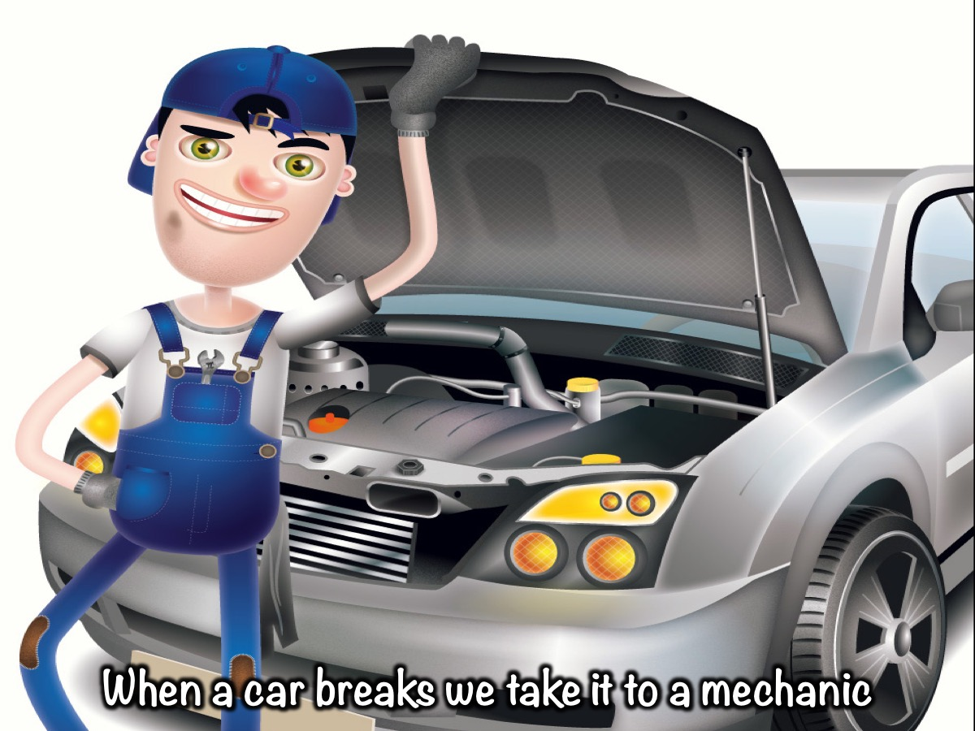
Notes:
When a car breaks we take it to a mechanic.

Slide 27
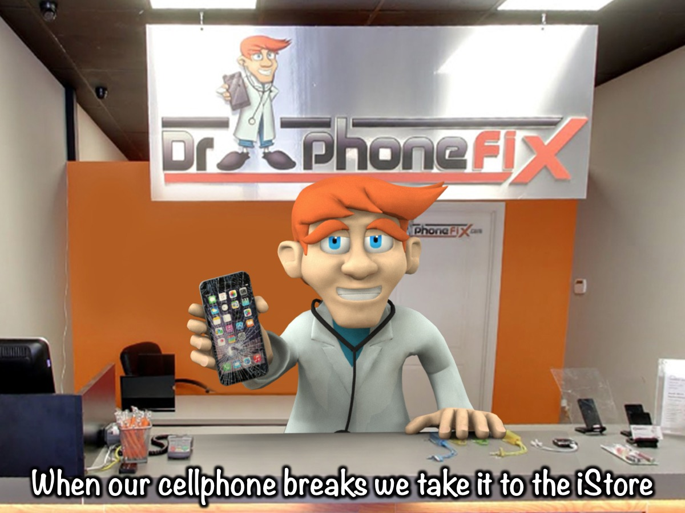
Notes:
When our cellphone breaks we take it to the iStore.

Slide 28
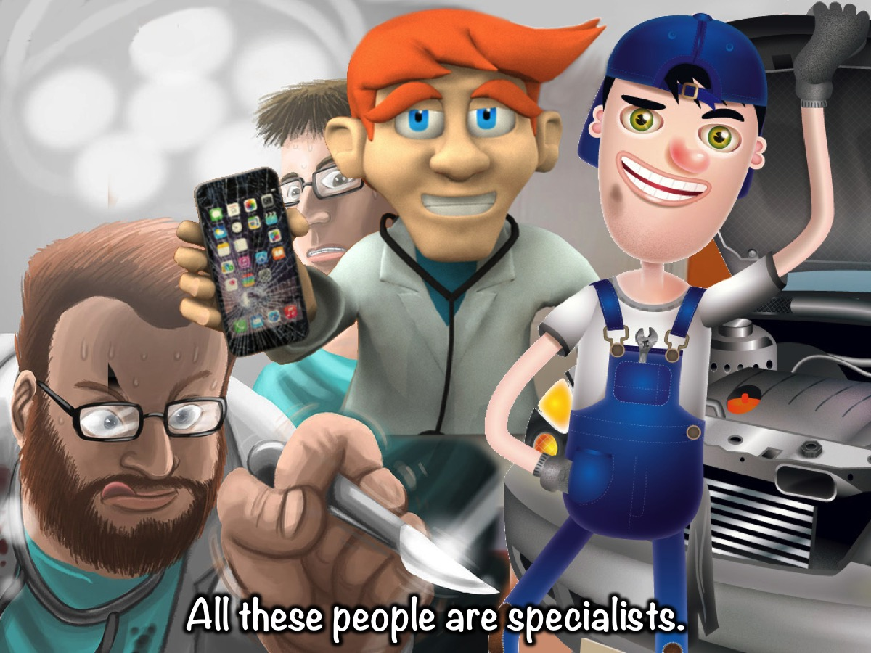
Notes:
All these people are specialists.

Slide 29
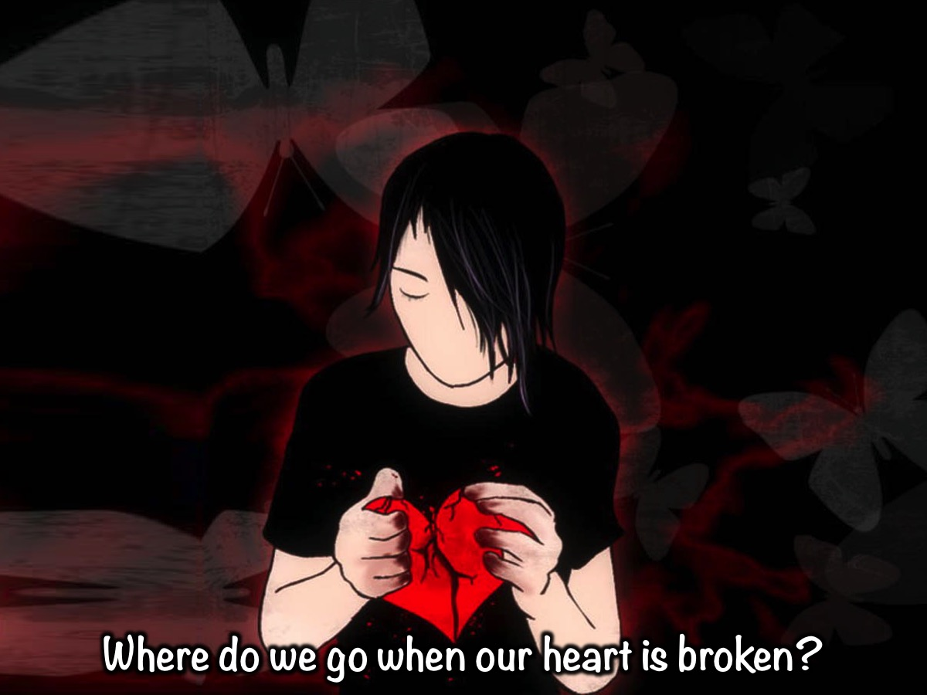
Notes:
Where do we go when our heart is broken?

Slide 30
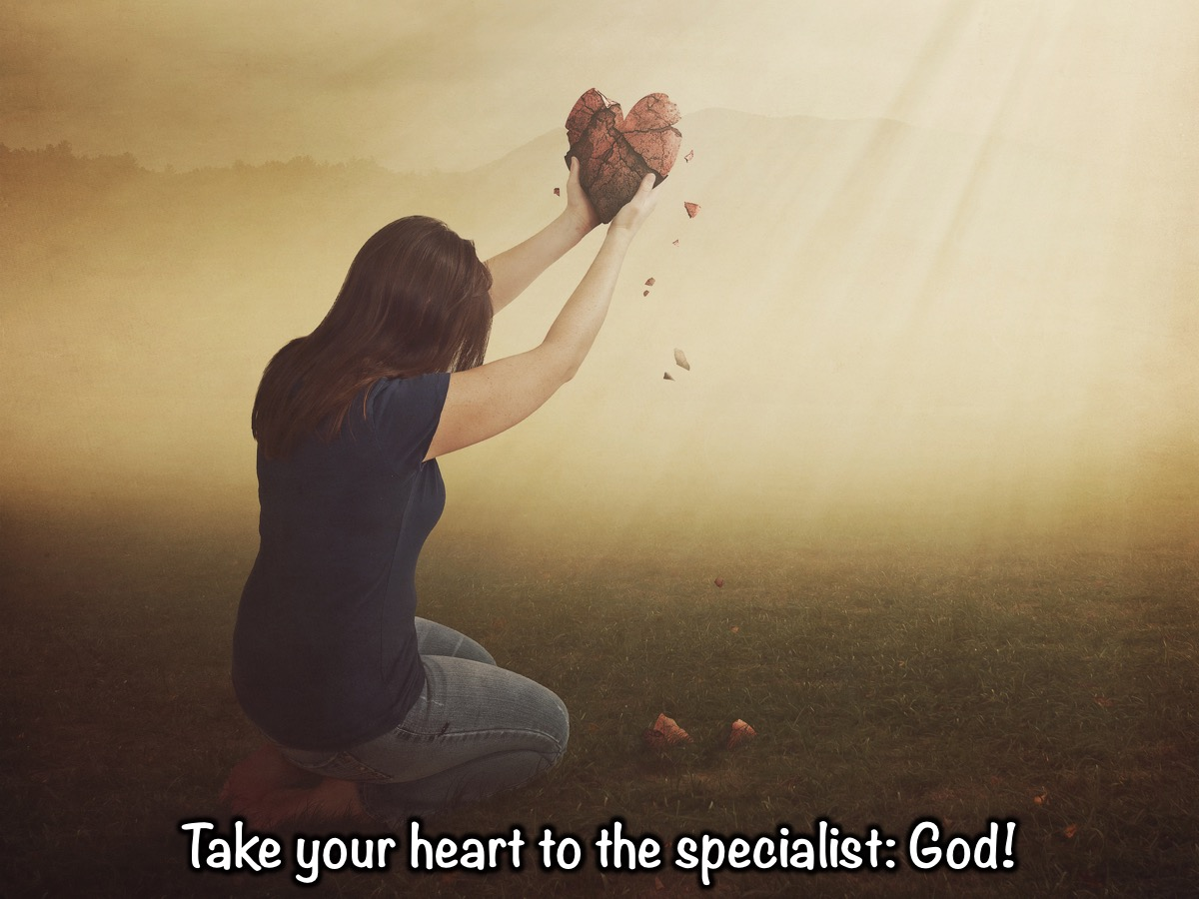
Notes:
So when our hearts are broken, we need to go see a specialist. We are so privileged that our specialist is the very person who created the heart - God Himself. Taking a broken heart to God is the best way to recovery.

Slide 31
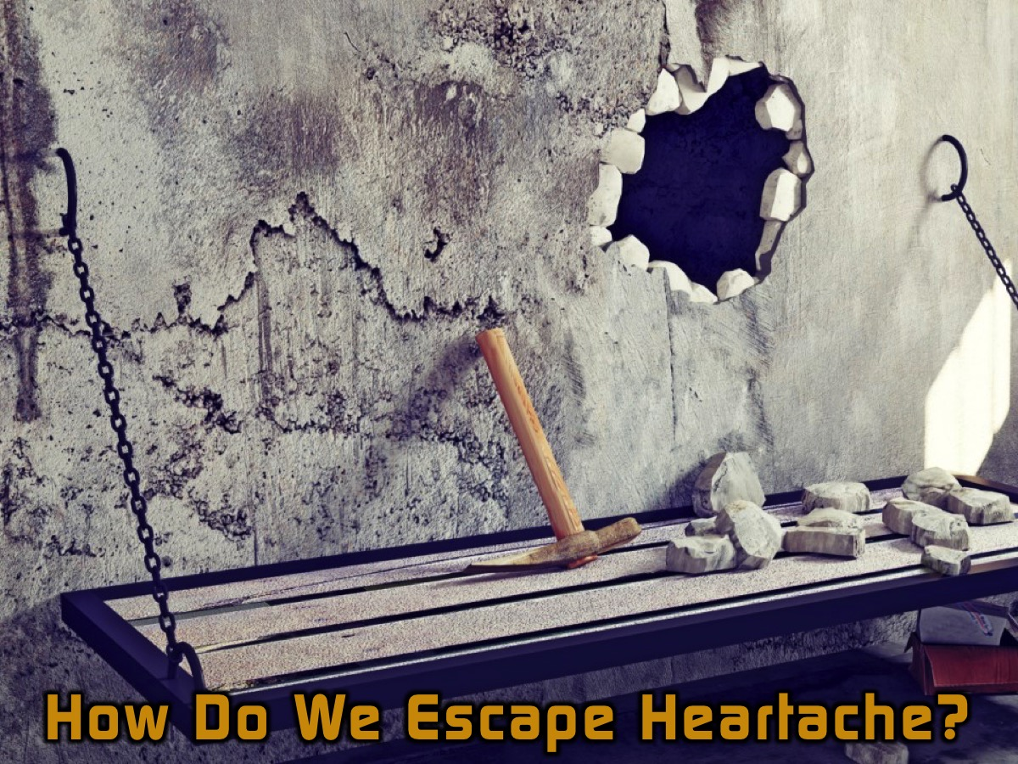
Notes:
So how do we escape Heartache?

Slide 32

Notes:
The Scripture Activity: Lets look at some scriptures and discover some principles for escaping from heartache. Each table is going to be given a verse and you have to discover what you can learn about escaping from heartache from the verse. List of verses: Deuteronomy 31:8, Jeremiah 29:11, Isaiah 41:10, Proverbs 4:23 and Colossians 3:13.

Slide 33
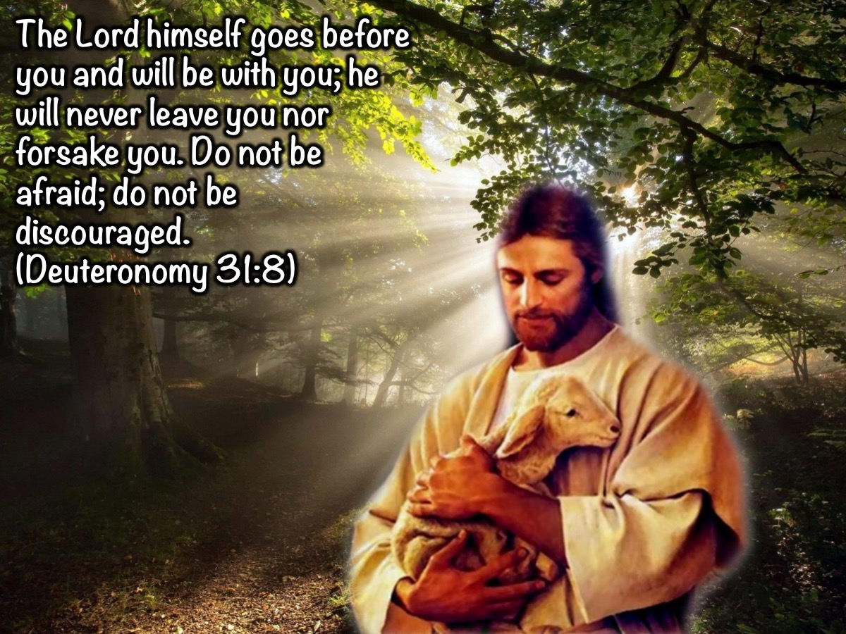
Notes:
“The Lord himself goes before you and will be with you; he will never leave you nor forsake you. Do not be afraid; do not be discouraged”. (Deuteronomy 31:8)

Slide 34
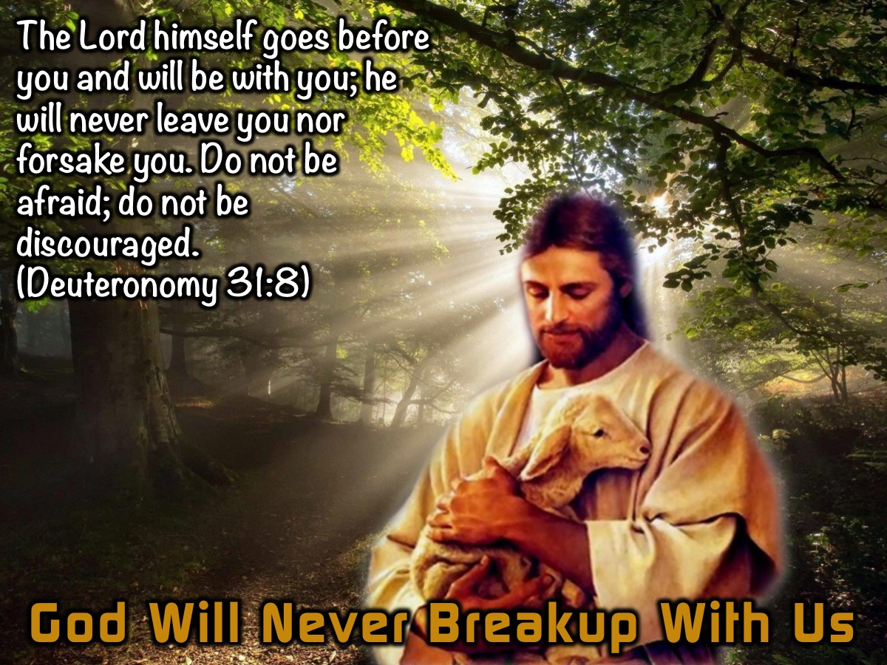
Notes:
1. God Will Never Breakup With Us. “The Lord himself goes before you and will be with you; he will never leave you nor forsake you. Do not be afraid; do not be discouraged”. (Deuteronomy 31:8). Before we give our hearts to someone. Why don’t we first give our hearts to God, who promises never to break up with us. When the Lord is in our hearts, then our hearts cannot be imprisoned. Let your faith set you free.

Slide 35
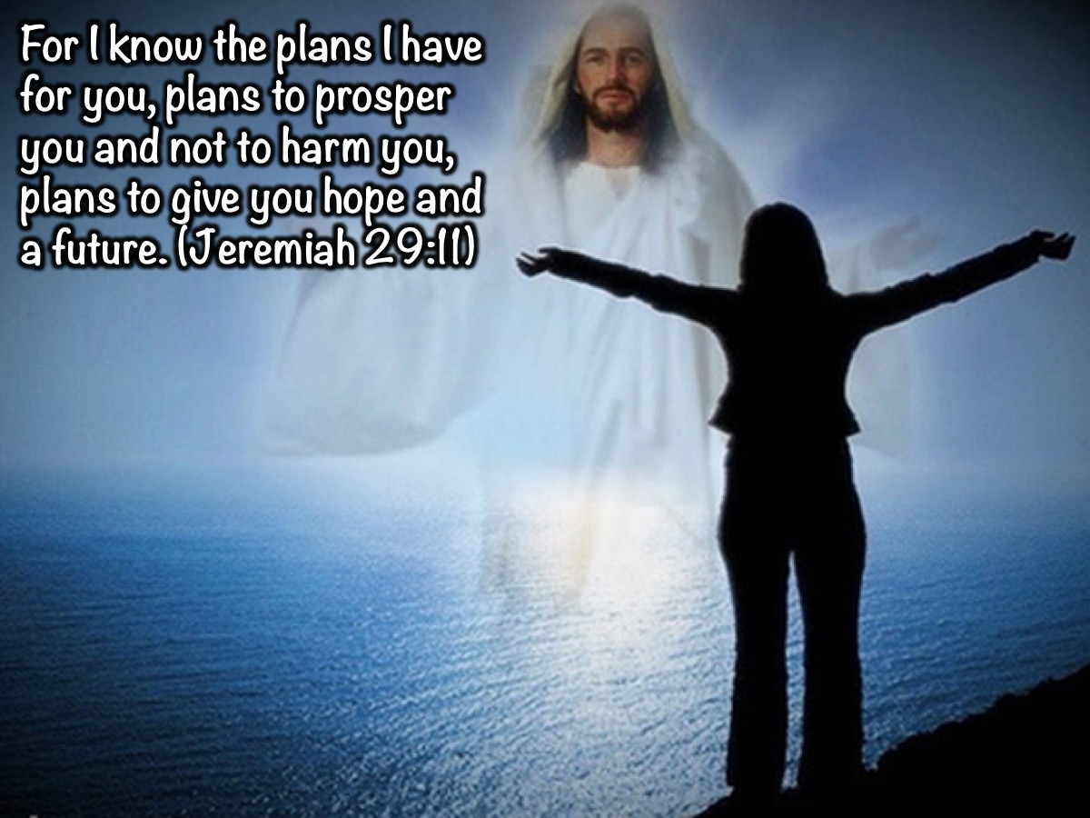
Notes:
“For I know the plans I have for you, plans to prosper you and not to harm you, plans to give you hope and a future.” (Jeremiah 29:11).

Slide 36
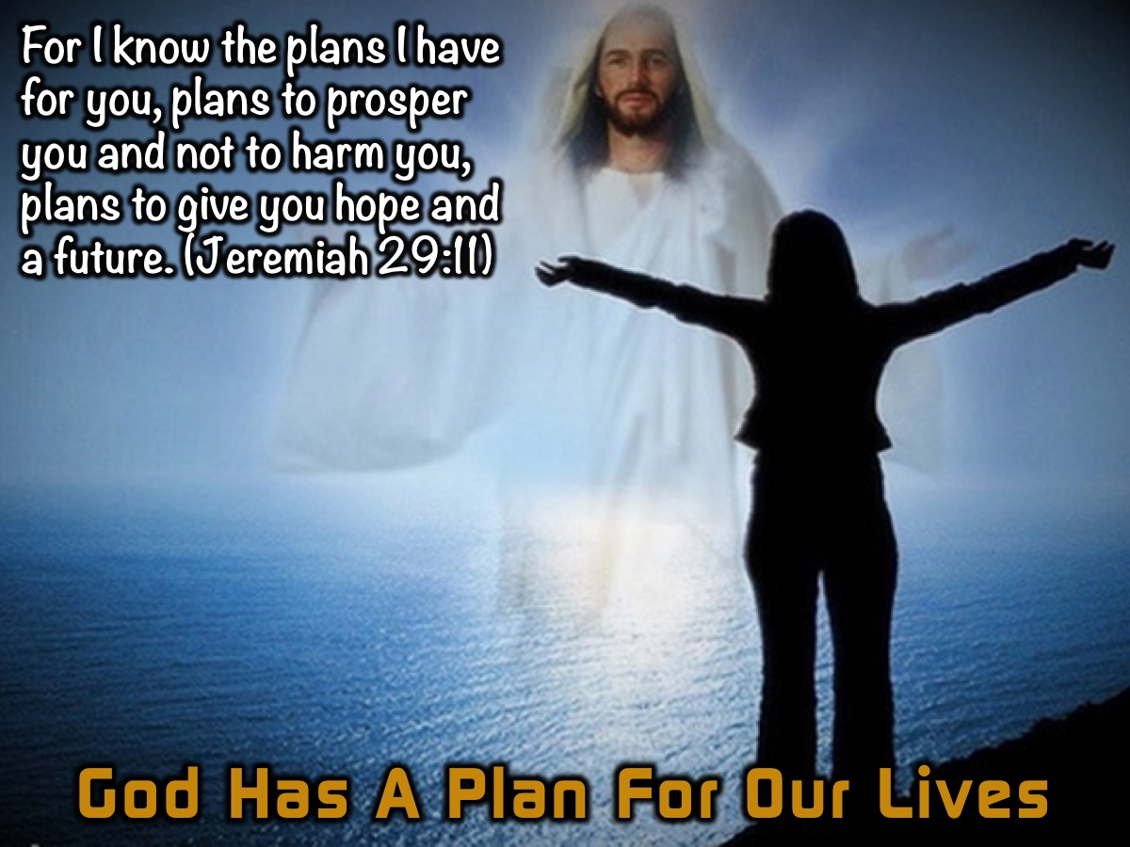
Notes:
2. God Has A Plan For Our Lives. “For I know the plans I have for you, plans to prosper you and not to harm you, plans to give you hope and a future.” (Jeremiah 29:11). God wants to protect us, and for us to have peace and a great future.

Slide 37
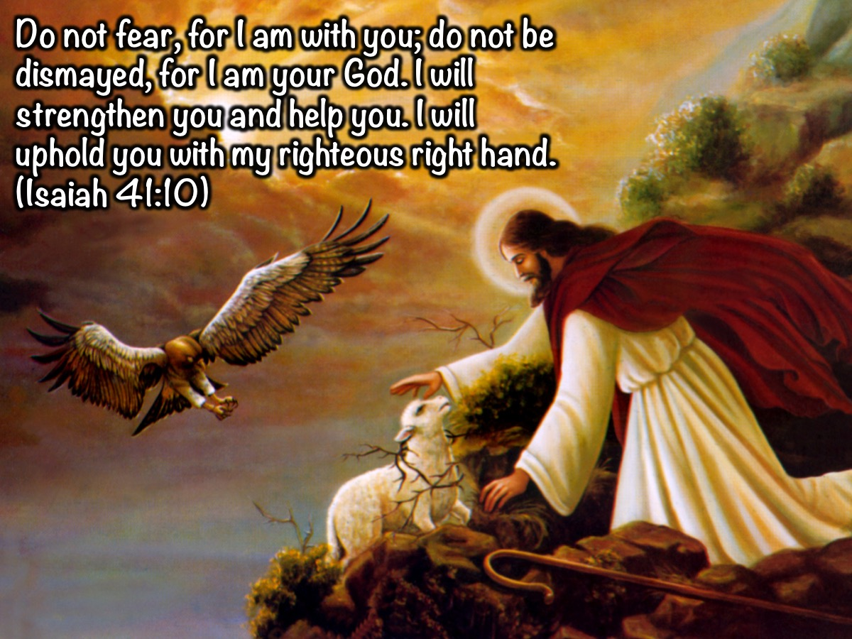
Notes:
“Do not fear, for I am with you; do not be dismayed, for I am your God. I will strengthen you and help you. I will uphold you with my righteous right hand.” (Isaiah 41:10).

Slide 38
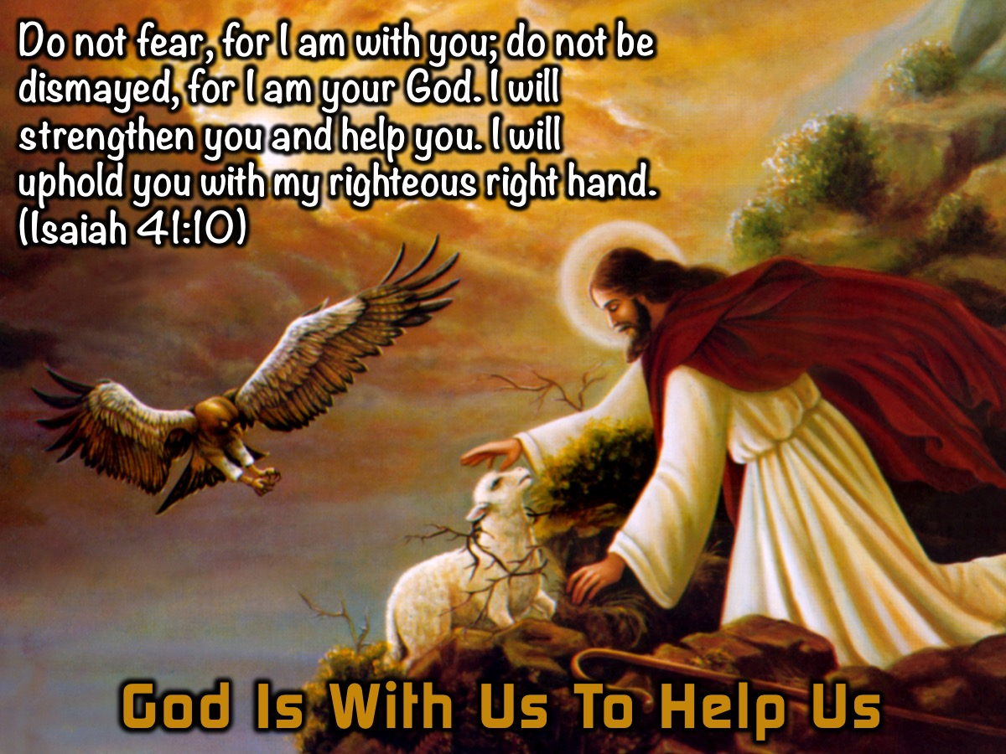
Notes:
3. God Is With Us To Help Us. “Do not fear, for I am with you; do not be dismayed, for I am your God. I will strengthen you and help you. I will uphold you with my righteous right hand.” (Isaiah 41:10).

Slide 39
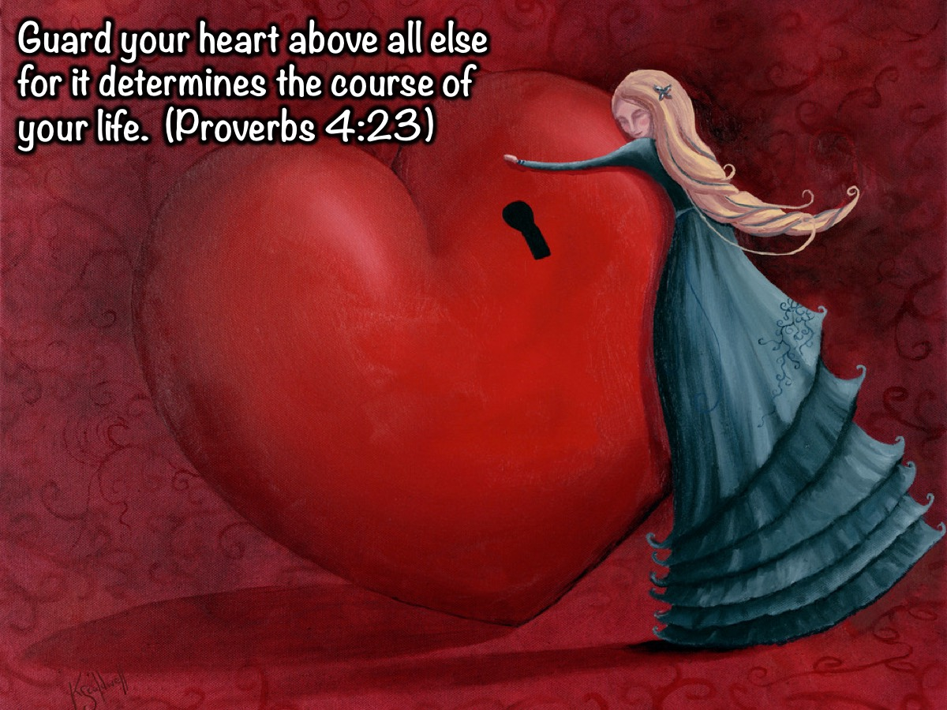
Notes:
“Guard your heart above all else for it determines the course of your life.” (Proverbs 4:23).

Slide 40
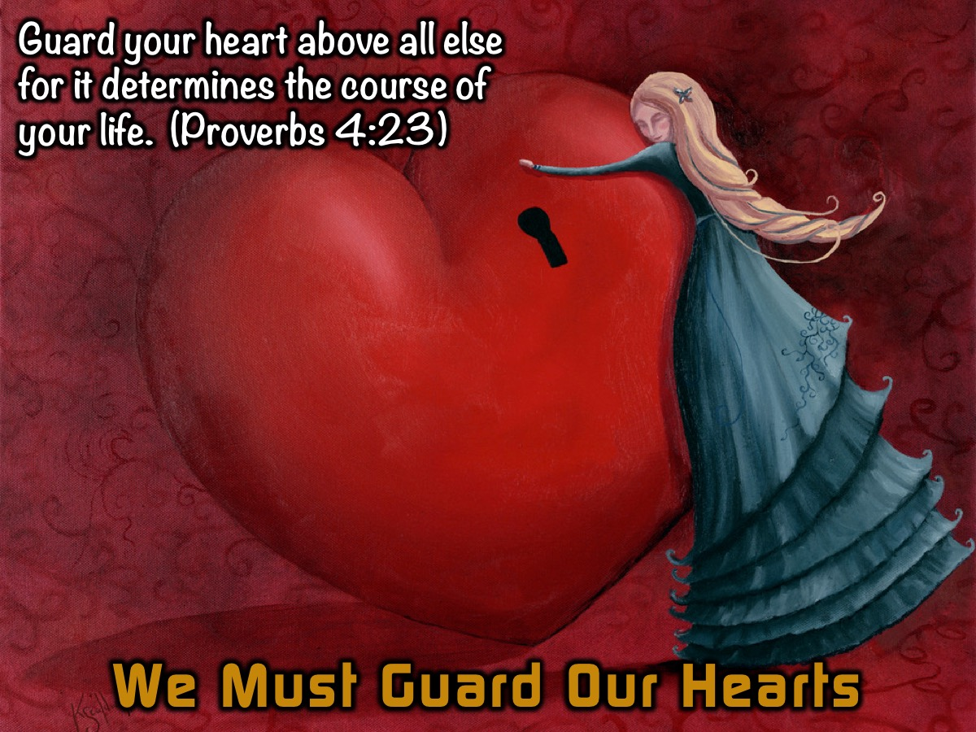
Notes:
4. We Must Guard Our Hearts. “Guard your heart above all else for it determines the course of your life.” (Proverbs 4:23). We must not be too quick to fall in love or get attached to someone who is obviously not good for us, who does not have a good track record.

Slide 41
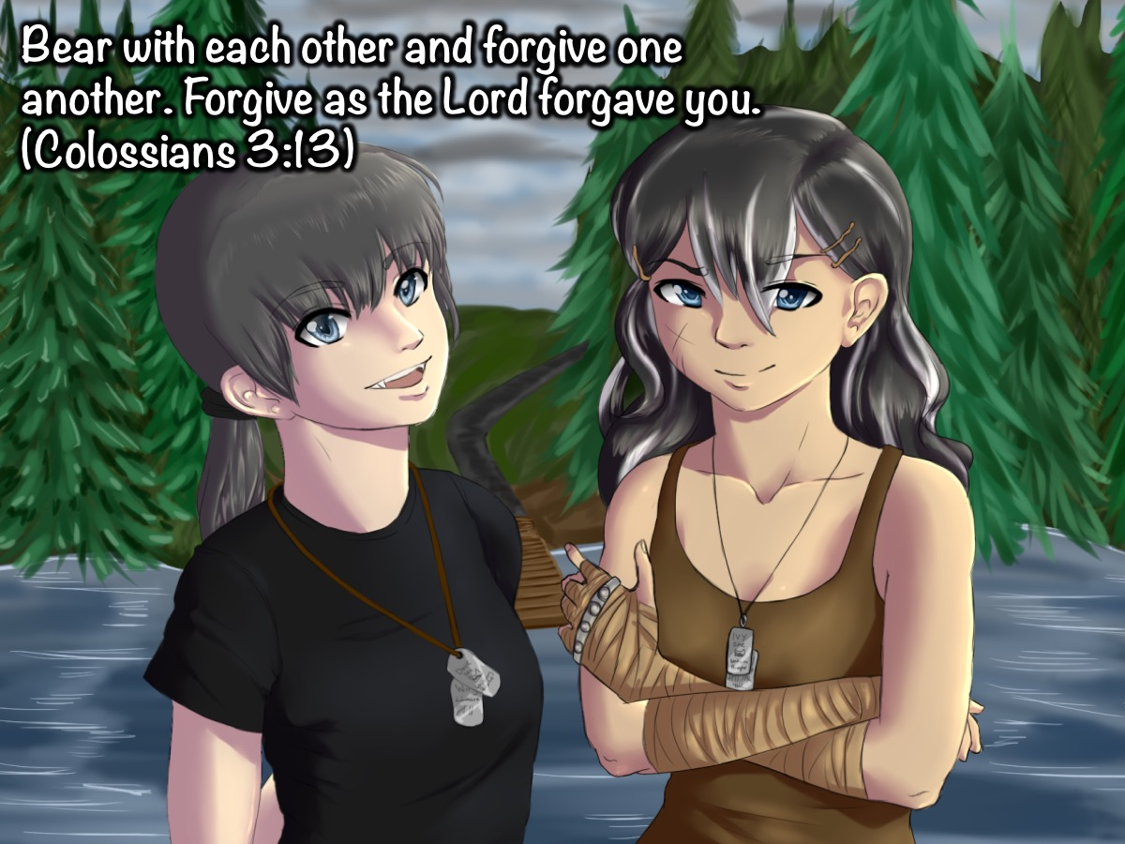
Notes:
“Bear with each other and forgive one another if any of you has a grievance against someone. Forgive as the Lord forgave you.” (Colossians 3:13).

Slide 42
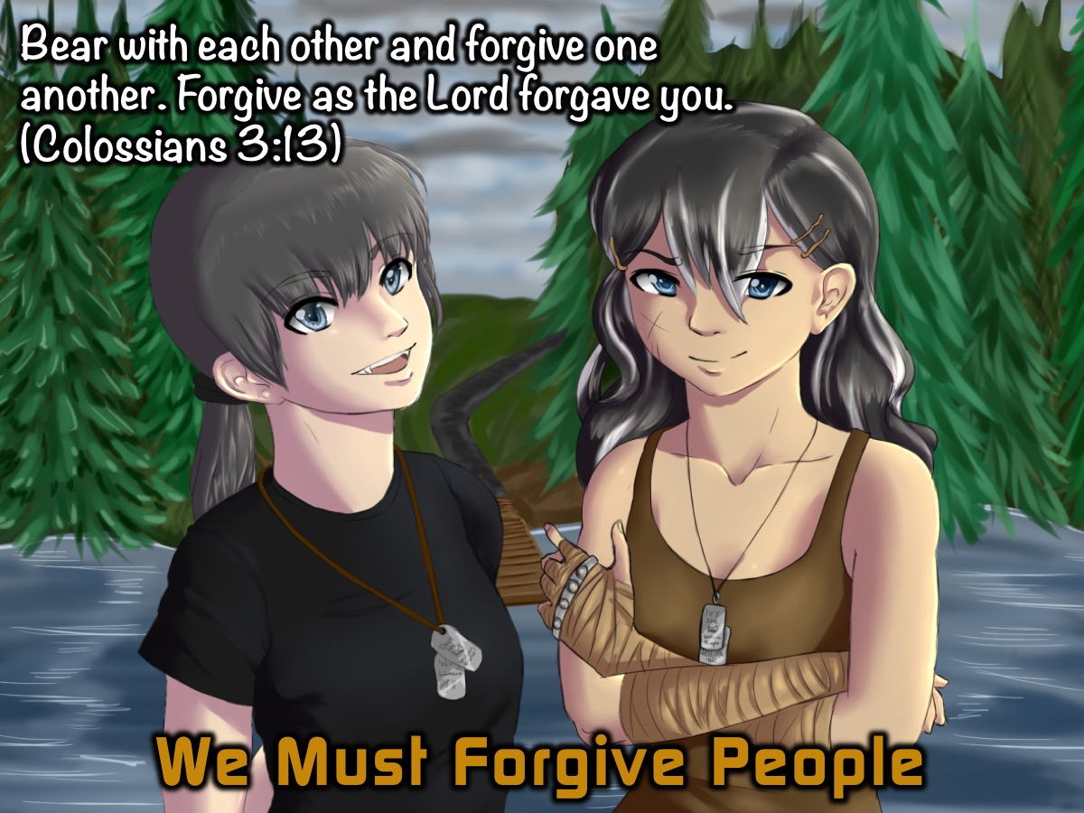
Notes:
5. We Must Forgive People. “Bear with each other and forgive one another if any of you has a grievance against someone. Forgive as the Lord forgave you.” (Colossians 3:13). Have a heart of Forgiveness.

Slide 43
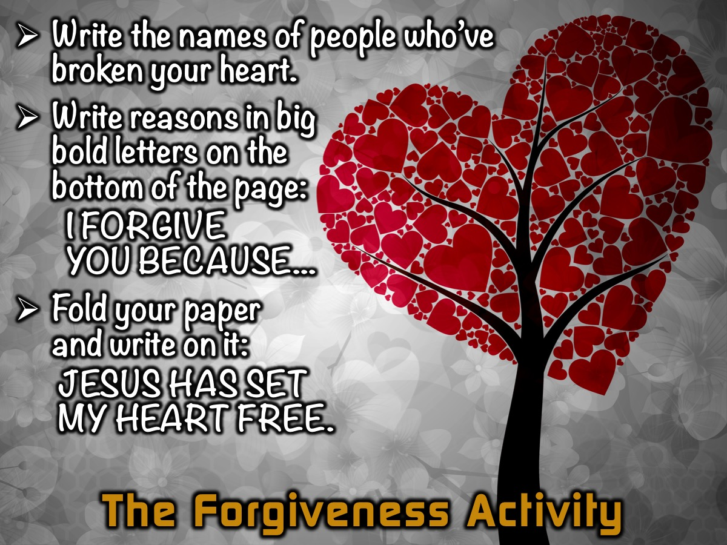
Notes:
The Forgiveness Activity: Think of all the people who have left you heartbroken. Write their names on a piece of paper. At the bottom of the paper, write in big bold letters: I FORGIVE YOU BECAUSE.............. state your reasons. then fold your paper and write JESUS HAS SET MY HEART FREE.

Slide 44
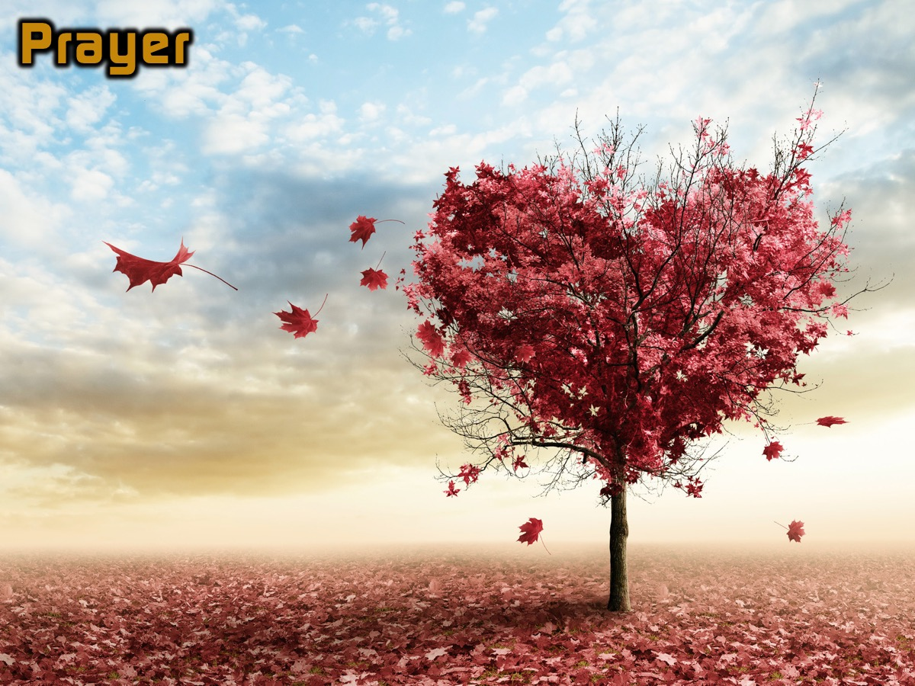
Notes:
Prayer

Slide 45

Notes:
Next week we will look at how to breakout from the prison of Greed.

