Slide 1
Notes:
Welcome to the Breakout series.

Slide 2
Notes:
In Week 1 we looked at how to breakout from the prison of Anxiety.

Slide 3
Notes:
In Week 2 we looked at how to breakout from the prison of Fear.

Slide 4
Notes:
In Week 3 we looked at how to breakout from the prison of Depression.

Slide 5
Notes:
In Week 4 we looked at how to breakout from the prison of Temptation.

Slide 6
Notes:
In week 5 we looked at how to breakout from the prison of Heartache.

Slide 7
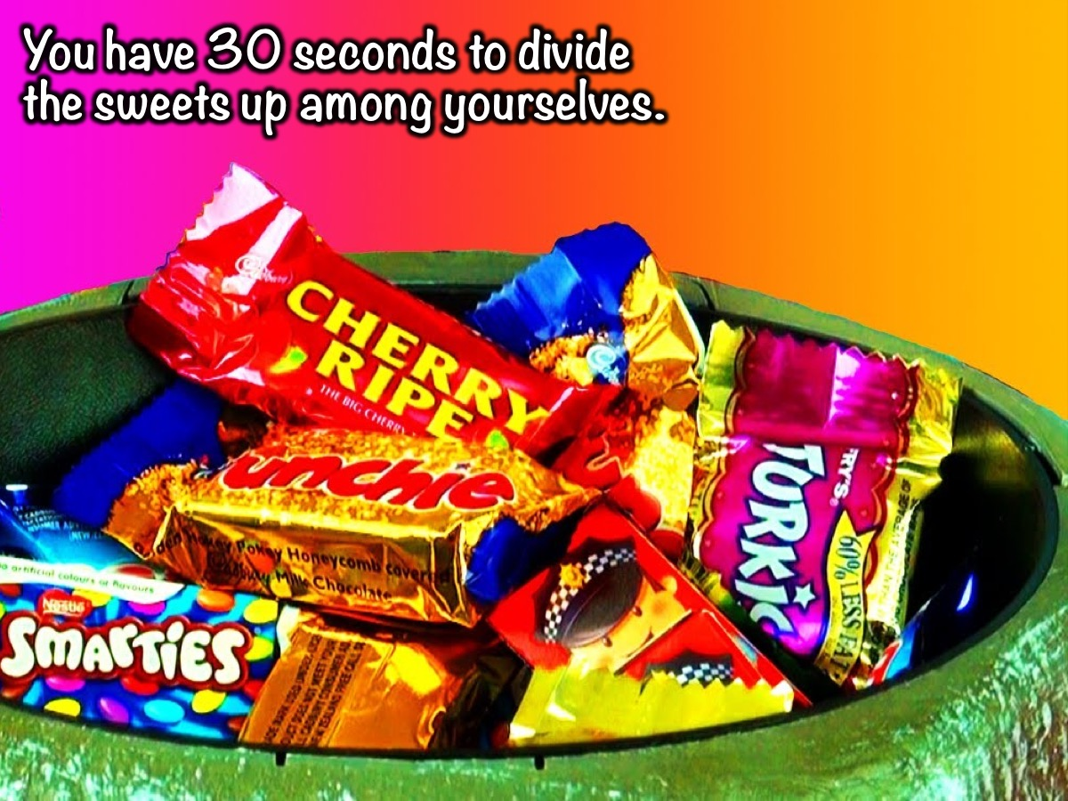
Notes:
Experiencing Greed Activity: There is a bowl of sweets on each table. You have 30 seconds to divide the sweets up among yourselves.

Slide 8
Notes:
Debrief: How did you divide the sweets up? Were the sweets divided up equally? Who was greedy and who was generous during the time you had to share the sweets among yourselves?

Slide 9
Notes:
This week we are going to look at how to breakout from the prison of Greed.

Slide 10
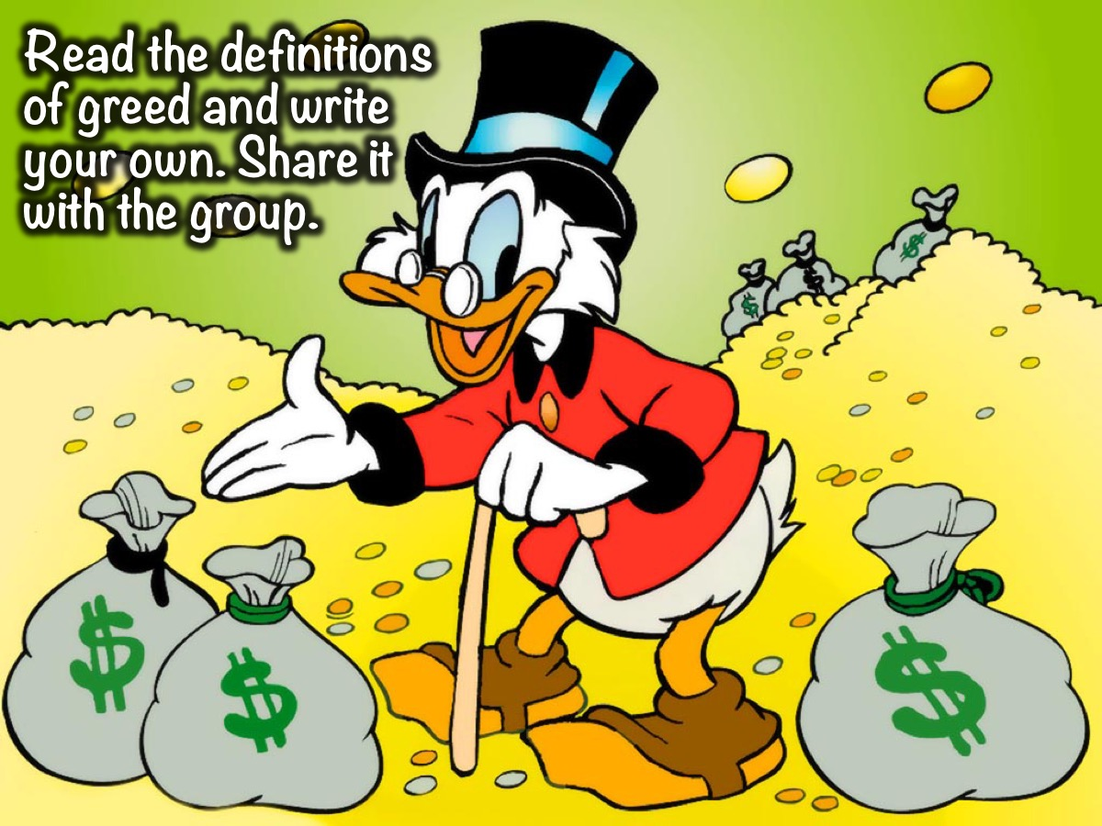
Notes:
Defining Greed Activity. In your small groups you will be given a few definitions of greed and you have to write a short definition of what it is.
Definition #1: Greed is an intense and selfish desire for something, especially wealth, power, or food.
Definition #2: Greed is an inordinate or insatiable longing, esp. for wealth, status, and power - more than one needs.
Definition #3: Greed is a sin against one's neighbor, since one cannot over-abound in external riches, without another lacks them.
Definition #4: Greed is a sin against God because it neglects eternal things for the sake of temporal things.

Slide 11
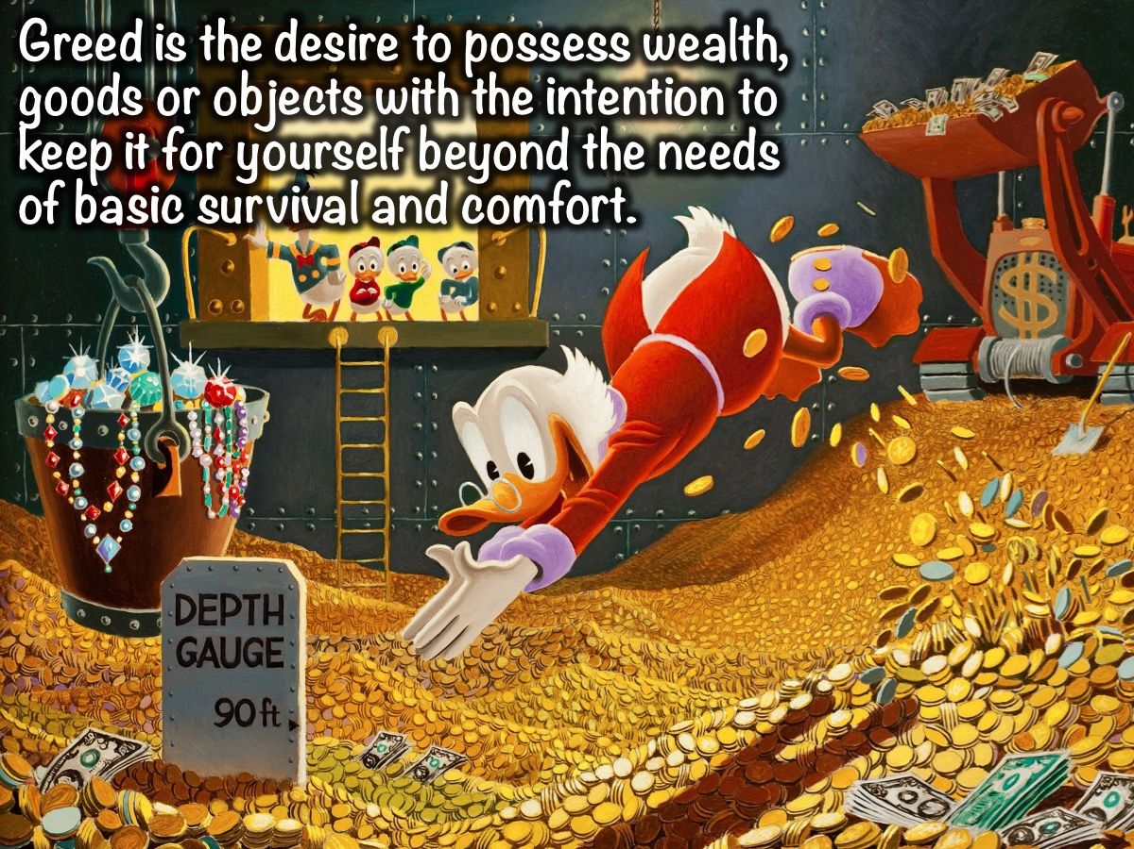
Notes:
Here is a fairly comprehensive definition of greed: “Greed is the desire to possess wealth, goods or objects with the intention to keep it for yourself beyond the needs of basic survival and comfort.”

Slide 12
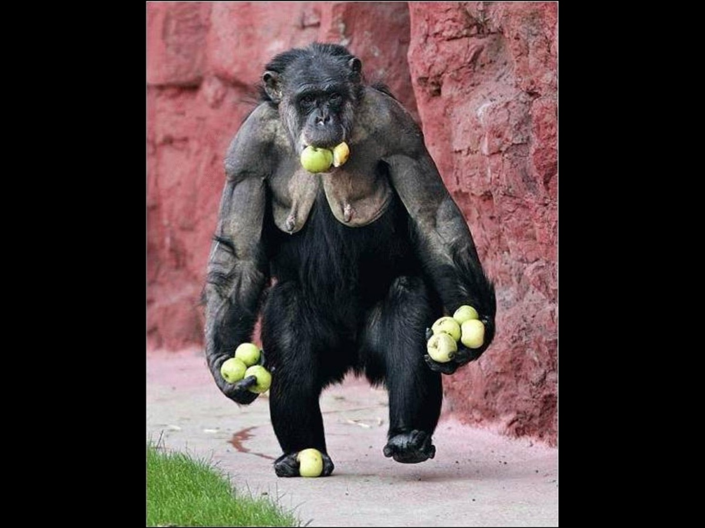
Notes:
Here are a few images that show greed:

Slide 13
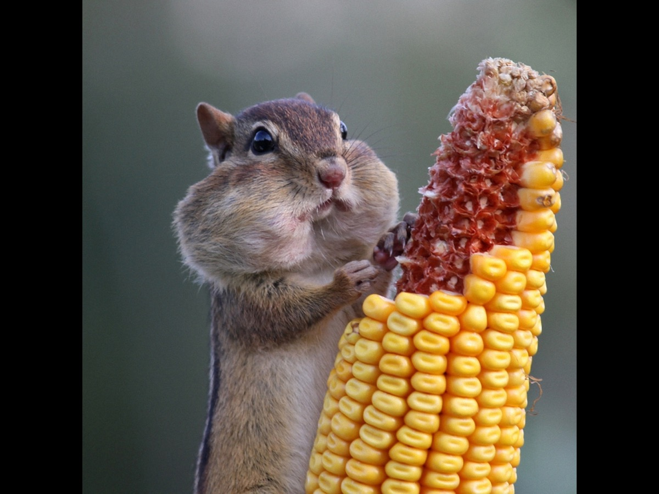
Notes:
Here is an image that show greed:

Slide 14
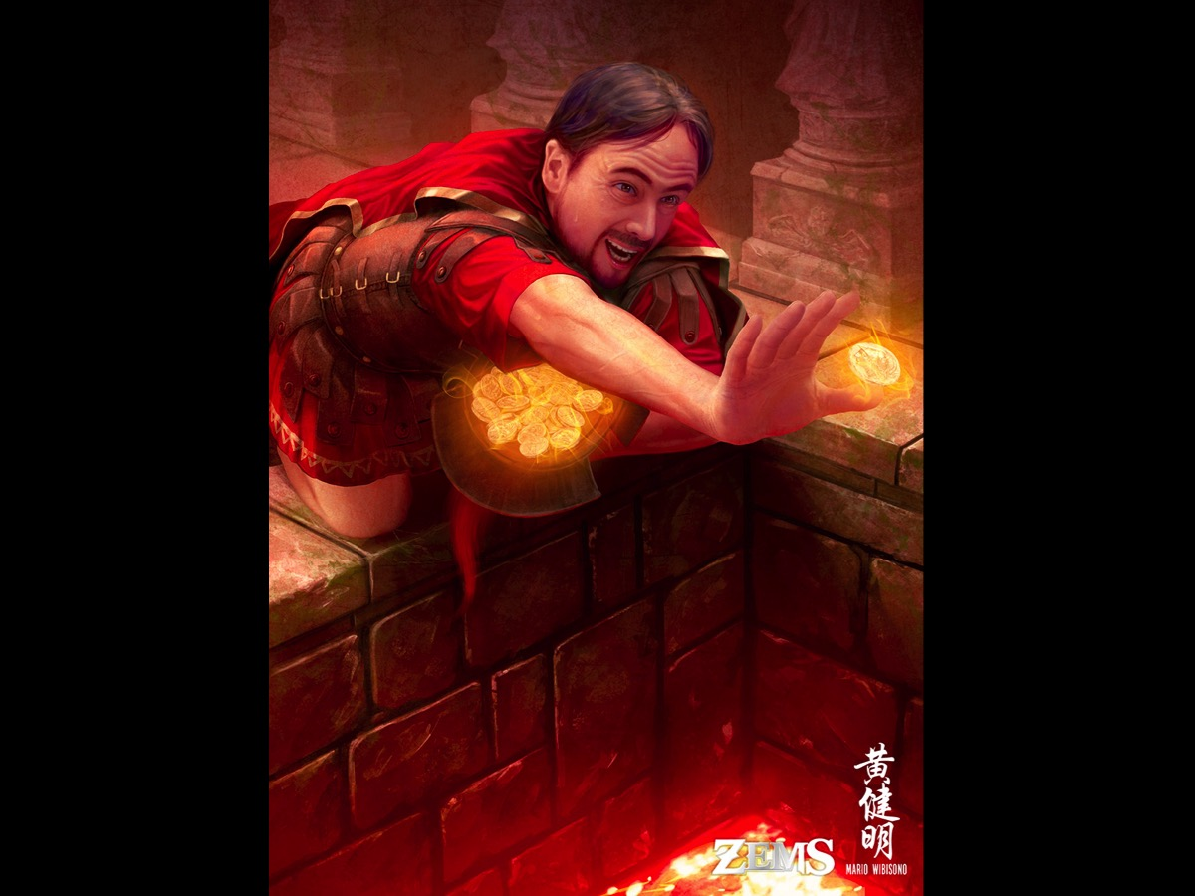
Notes:
Here is an image that show greed:

Slide 15
Notes:
Here is an image that show greed:

Slide 16
Notes:
Have you ever heard this saying: “He who dies with the most toys wins”. How is that for an example of greed?

Slide 17
Notes:
Where does greed come from?

Slide 18
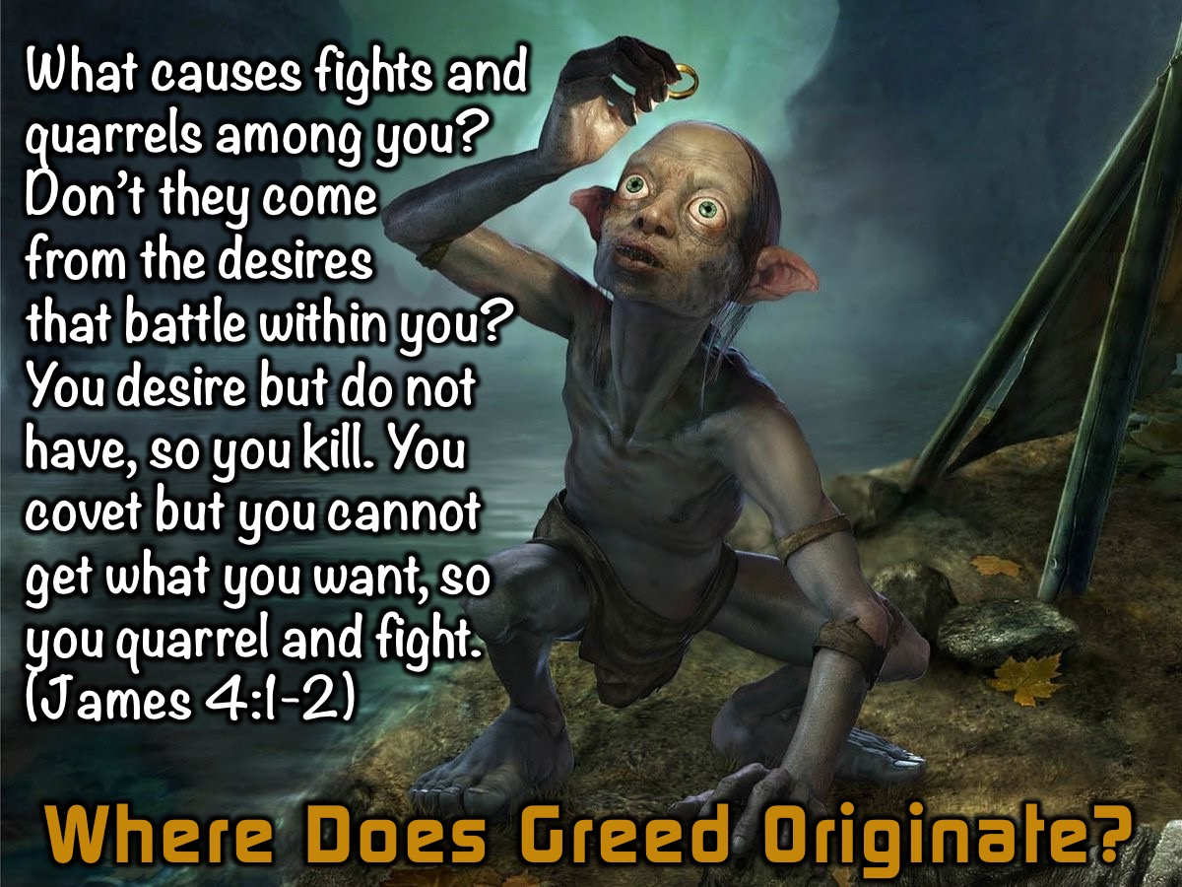
Notes:
Where does greed come from? This verse in the book of James helps us understand where greed comes from: “What causes fights and quarrels among you? Don’t they come from your desires that battle within you? You desire but do not have, so you kill. You covet but you cannot get what you want, so you quarrel and fight. You do not have because you do not ask God.” (James 4:1-2)

Slide 19
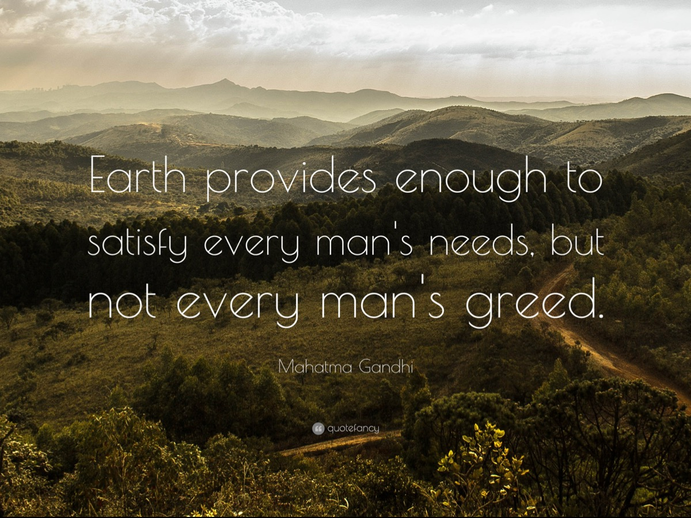
Notes:
Mahatma Gandhi once said that: “Earth provides enough to satisfy every man's needs, but not every man's greed.”

Slide 20
Notes:
How do we escape Greed?

Slide 21
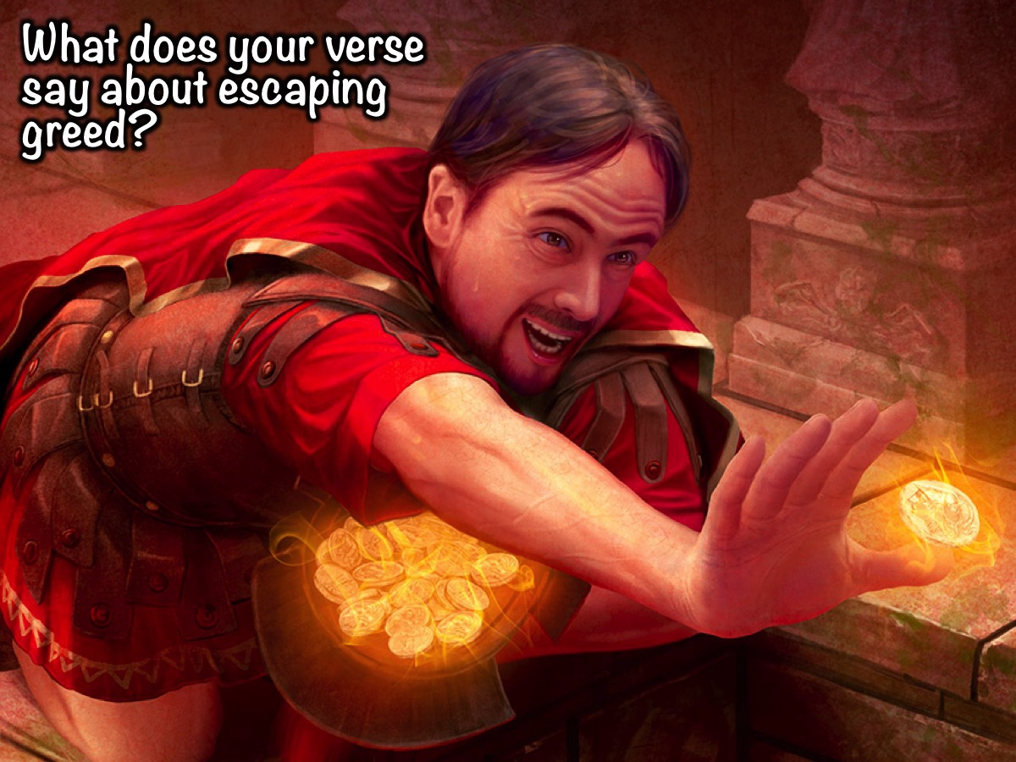
Notes:
Escaping Greed Activity: Look at your verse in your group. Discover what it says about escaping greed. Report back. The verses are: Luke 12:20-21, Philippians 4:11-13, Luke 12:13-15, 1 John 3:17 and 1 Timothy 6:17-19.

Slide 22
Notes:
Group #1 Report Back:
Jesus told them a story: A rich man had a fertile farm that produced fine crops. He said to himself, ‘What should I do? I don’t have room for all my crops.’ Then he said, ‘I know! I’ll tear down my barns and build bigger ones. Then I’ll have room enough to store all my wheat and other goods. And I’ll sit back and say to myself, “My friend, you have enough stored away for years to come. Now take it easy! Eat, drink, and be merry!”’ But God said to him, ‘You fool! You will die this very night. Then who’ll get everything you worked for?’ “Yes, a person is a fool to store up earthly wealth but not have a rich relationship with God.” (Luke 12:20-21)

Slide 23
Notes:
1. Live for Eternity.

Slide 24
Notes:
"Then the King, shall say to those on the right, 'Come, blessed of my Father, into the Kingdom prepared for you from the founding of the world. For I was hungry and you fed me; I was thirsty and you gave me water; I was a stranger and you invited me into your homes; naked and you clothed me; sick and in prison, and you visited me.’ "Then these righteous ones will reply, 'Sir, when did we ever see you hungry and feed you? Or thirsty and give you anything to drink? Or a stranger, and help you? Or naked, and clothe you? When did we ever see you sick or in prison, and visit you?’ "And the King will tell them, 'When you did it to these my brothers you were doing it to me!’

Slide 25
Notes:
Then the king will turn to those on the left and say, 'Away with you, you cursed ones, into the eternal fire prepared for the devil and his demons. For I was hungry and you wouldn't feed me; thirsty, and you wouldn't give me anything to drink; a stranger, and you refused me hospitality; naked, and you wouldn't clothe me; sick, and in prison, and you didn't visit me.’ "Then they will reply, 'Lord, when did we ever see you hungry or thirsty or a stranger or naked or sick or in prison, and not help you?’ "And the king will answer, 'When you refused to help the least of these my brothers, you were refusing help to me.’ "And they shall go away into eternal punishment; but the righteous into everlasting life." (Matthew 25:34-46)

Slide 26
Notes:
Group #2 Report Back:
“I have learned how to be content with whatever I have. I know how to live on almost nothing or with everything. I have learned the secret of living in every situation, whether it is with a full stomach or empty, with plenty or little. For I can do everything through Christ, who gives me strength.” (Philippians 4:11-13).

Slide 27
Notes:
2. Aim for Contentment.

Slide 28
Notes:
Group #3 Report Back: “Then someone called from the crowd, “Teacher, please tell my brother to divide our father’s estate with me.” Jesus replied, “Friend, who made me a judge over you to decide such things as that?” Then he said, “Beware! Guard against every kind of greed. Life is not measured by how much you own.” (Luke 12:13-15)

Slide 29
Notes:
3. Live on Less.

Slide 30
Notes:
Group 4 Report Back: “If you have a friend who is in need of food and clothing, and you say to him, "Well, good-bye and God bless you; stay warm and eat hearty," and then don't give him clothes or food, what good does that do? So you see, it isn't enough just to have faith. You must also do good to prove that you have it.” (James 2:15-17)

Slide 31
Notes:
4. Think of Others

Slide 32
Notes:
If anyone has material possessions and sees his brother in need but has no pity on him, how can the love of God be in him? (1 John 3:17)

Slide 33
Notes:
Group 5 Report Back: “Tell those who are rich not to be proud and not to trust in their money, which will soon be gone, but their pride and trust should be in the living God who always richly gives us all we need for our enjoyment. Tell them to use their money to do good. They should be rich in good works and should give happily to those in need, always being ready to share with others whatever God has given them.(1 Timothy 6:17-18)

Slide 34
Notes:
5. Share Your Stuff

Slide 35
Notes:
The Rewards of Greed: Give freely and become more wealthy; be stingy and lose everything. (Proverbs 11:24). Those who shut their ears to the cries of the poor will be ignored in their own time of need. (Proverbs 21:13)

Slide 36
Notes:
The Rewards of Generosity: Blessed is the one who considers the poor! In the day of trouble the Lord delivers him. (Psalm 41:1). It is well with the man who deals generously and lends; who conducts his affairs with justice. (Psalm 112:5). Whoever brings blessing will be enriched, and one who waters will himself be watered. (Proverbs 11:25). Whoever is generous to the poor lends to the Lord, and he will repay him for his deed. (Proverbs 19:17). And whoever gives one of these little ones even a cup of cold water because he is a disciple, truly, I say to you, he will by no means lose his reward. (Matthew 10:42). In all things I have shown you that by working hard in this way we must help the weak and remember the words of the Lord Jesus, how he himself said, “It is more blessed to give than to receive.” (Acts 20:35). Do not neglect to show hospitality to strangers, for thereby some have entertained angels unawares. (Hebrews 13:2).

Slide 37
Notes:
Prayer

Slide 38
Notes:
Next week we will look at how to breakout from the prison of Anger.

