Slide 1

Notes:
Welcome to the Breakout series.

Slide 2

Notes:
In Week 1 we looked at how to breakout from the prison of Anxiety.

Slide 3

Notes:
In Week 2 we looked at how to breakout from the prison of Fear.

Slide 4
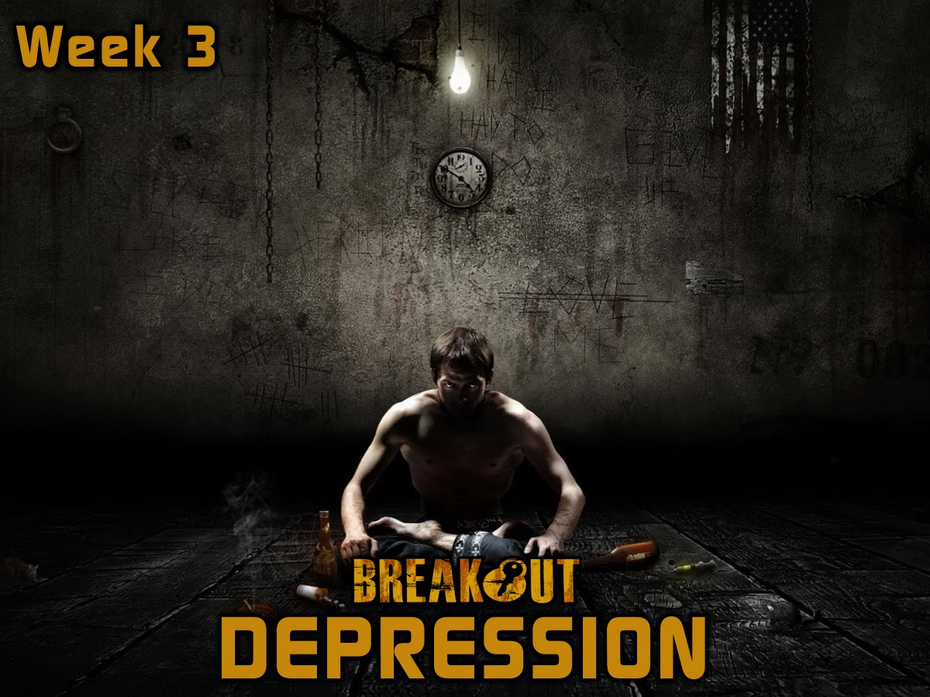
Notes:
In Week 3 we looked at how to breakout from the prison of Depression.

Slide 5
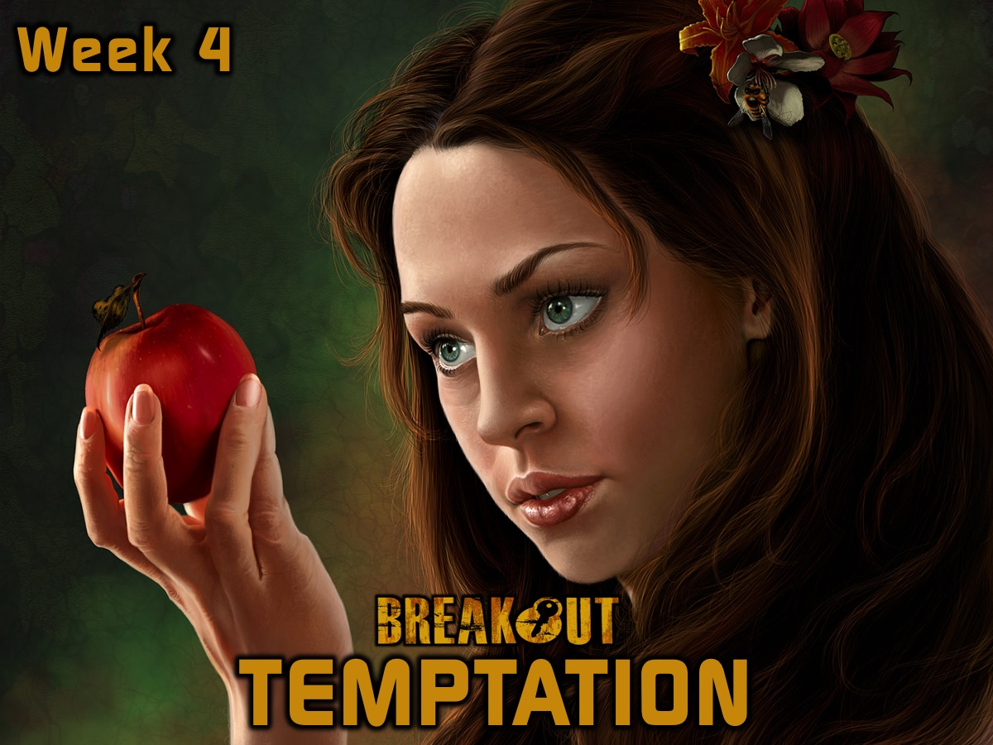
Notes:
In Week 4 we looked at how to breakout from the prison of Temptation.

Slide 6

Notes:
In week 5 we looked at how to breakout from the prison of Heartache.

Slide 7

Notes:
In Week 6 we looked at how to breakout from the prison of Greed.

Slide 8

Notes:
This week we are going to look at how to breakout from the prison of Anger.

Slide 9

Notes:
The Hulk is a great example of someone with anger issues. Here is a clip from the Avengers movie where Bruce Banner transforms into the Hulk and causes mayhem...
Video: Bruce Banner Transforms into Hulk from the first Avengers movie.

Slide 10

Notes:
If you have seen the movie, Big Hero 6, you will have seen another example of anger…
Video: A clip from Big Hero 6 where Hiro orders Baymax to destroy Krei (who is professor Callaghan). Get it on YouTube at: https://www.youtube.com/watch?v=Tpn7wDHMgfA

Slide 11
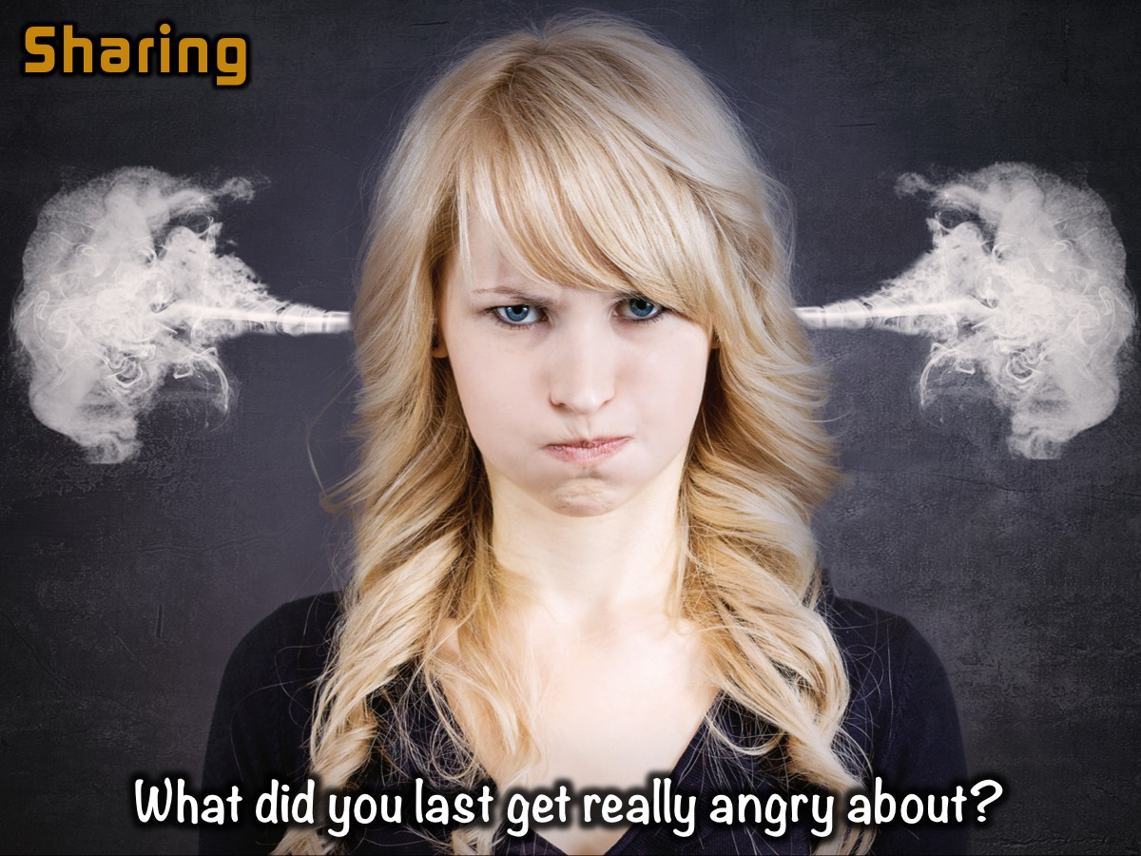
Notes:
Sharing: Turn to the person next to you and ask them this question: What did you last get really angry about?

Slide 12
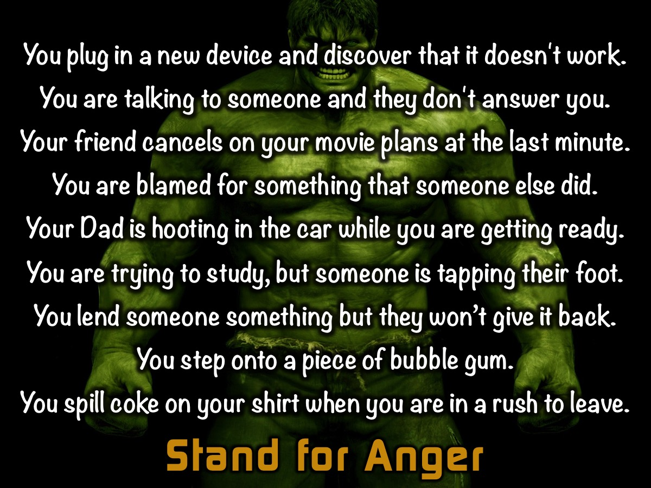
Notes:
Activity: I am going to read out some statements. You must stand up if you would get angry in this situation (Tell them to sit down if they have stood and before you read the next sentence):
You plug in a new device and discover that it doesn't work.
You are talking to someone and they don't answer you.
Your friend cancels on your movie plans at the last minute.
You are blamed for something that someone else did.
Your Dad is hooting in the car while you are getting ready.
You are trying to study, but someone is tapping their foot.
You lend someone something but they won’t give it back.
You step onto a piece of bubble gum.
You spill coke on your shirt when you are in a rush to leave.

Slide 13
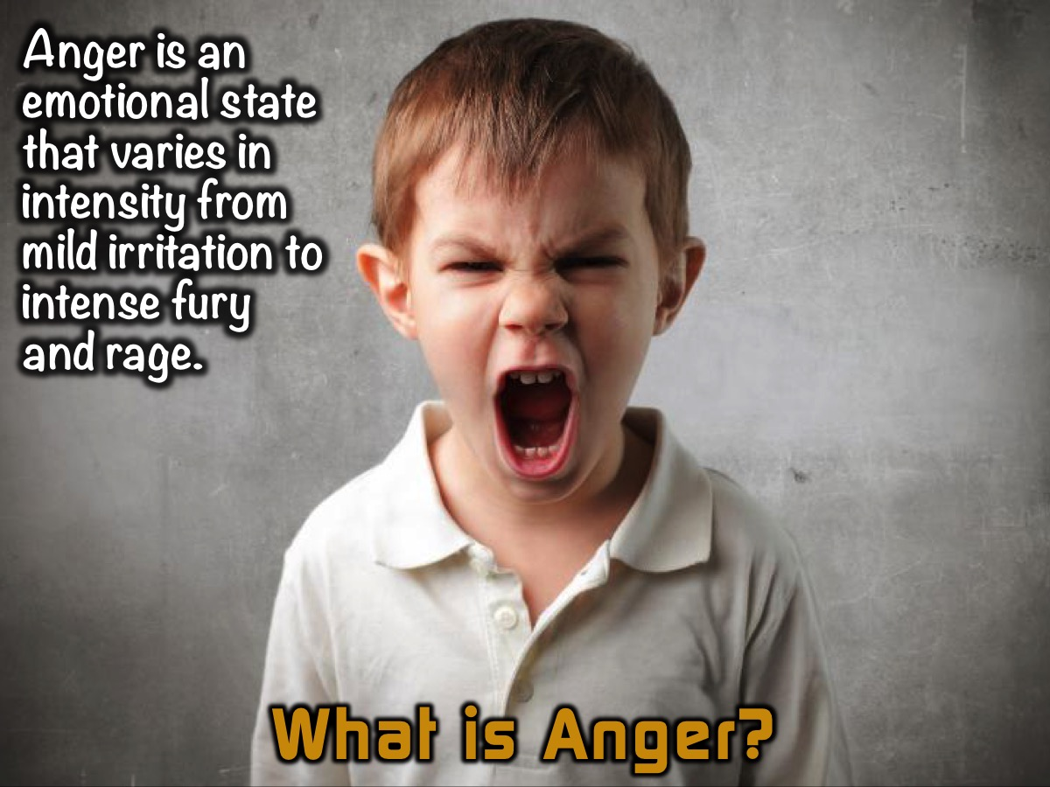
Notes:
What is Anger? Anger is an emotional state that varies in intensity from mild irritation to intense fury and rage.

Slide 14
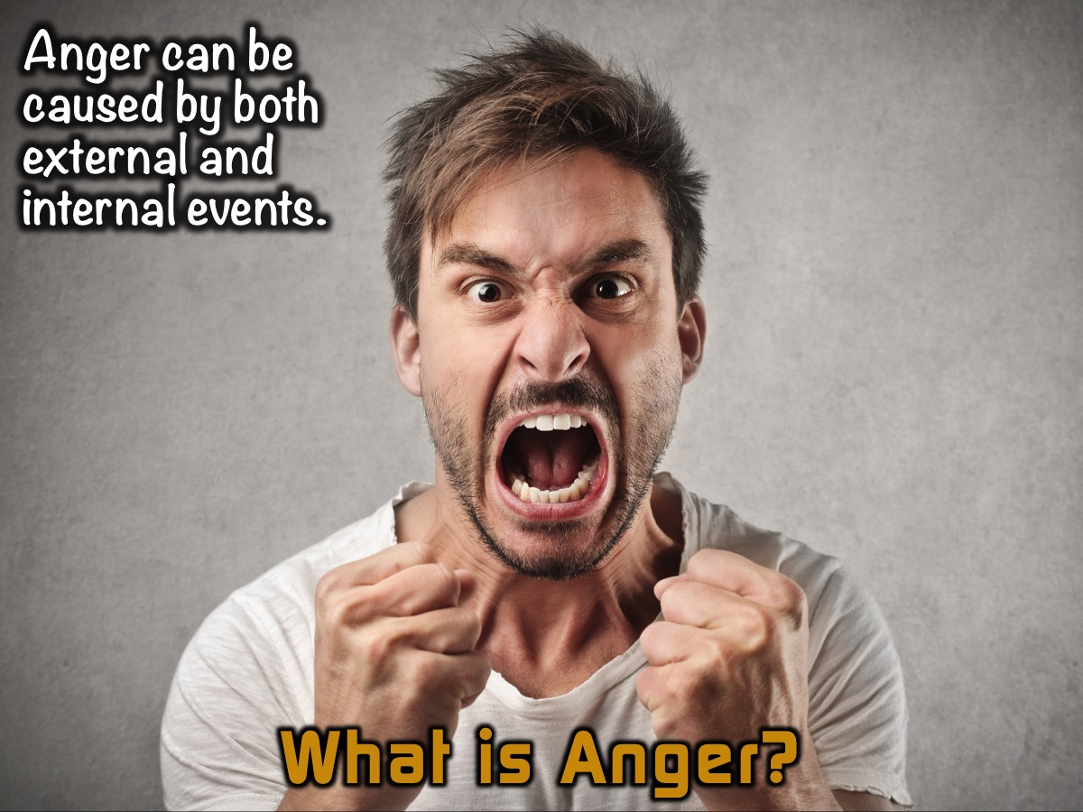
Notes:
Anger can be caused by both external and internal events. You could be angry at a specific person (such as a coworker or supervisor) or event (a traffic jam, a canceled flight), or your anger could be caused by worrying or brooding about your personal problems. Memories of traumatic or enraging events can also trigger angry feelings.

Slide 15
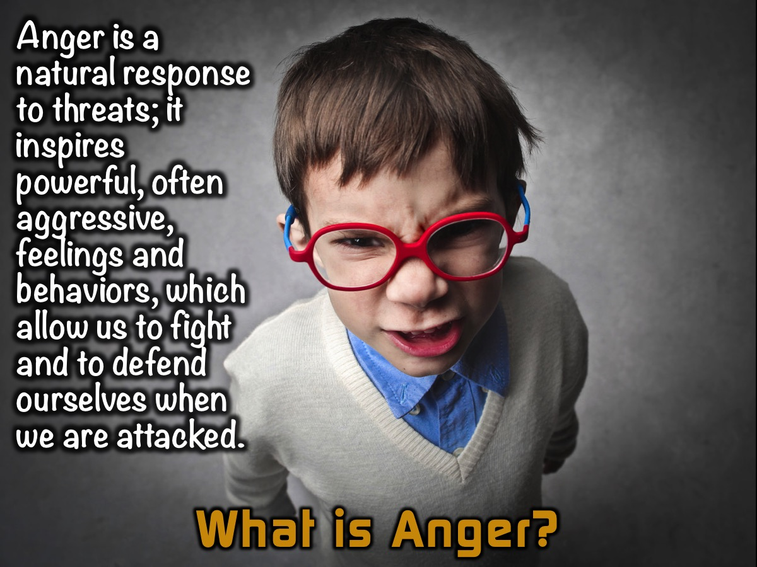
Notes:
Anger is a natural response to threats; it inspires powerful, often aggressive, feelings and behaviors, which allow us to fight and to defend ourselves when we are attacked. A certain amount of anger, therefore, is necessary to our survival.

Slide 16
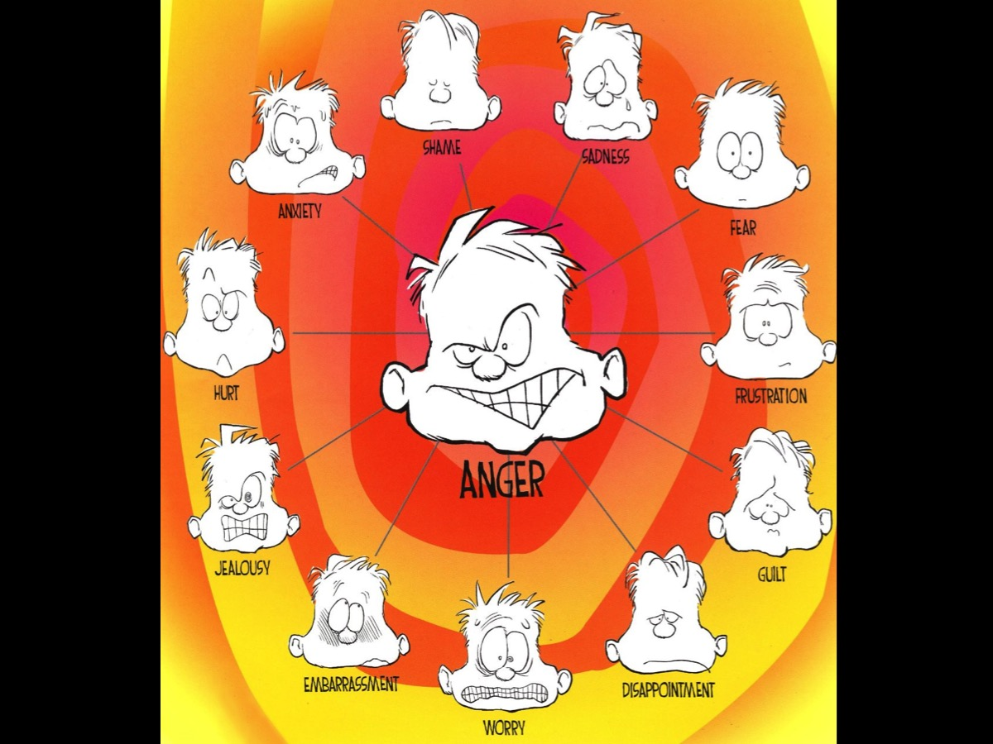
Notes:
There are many things that can cause anger in our lives: Shame, Sadness, Fear, Frustration, Guilt, Disappointment, Worry, Embarrassment, Jealousy, Hurt and Anxiety.

Slide 17
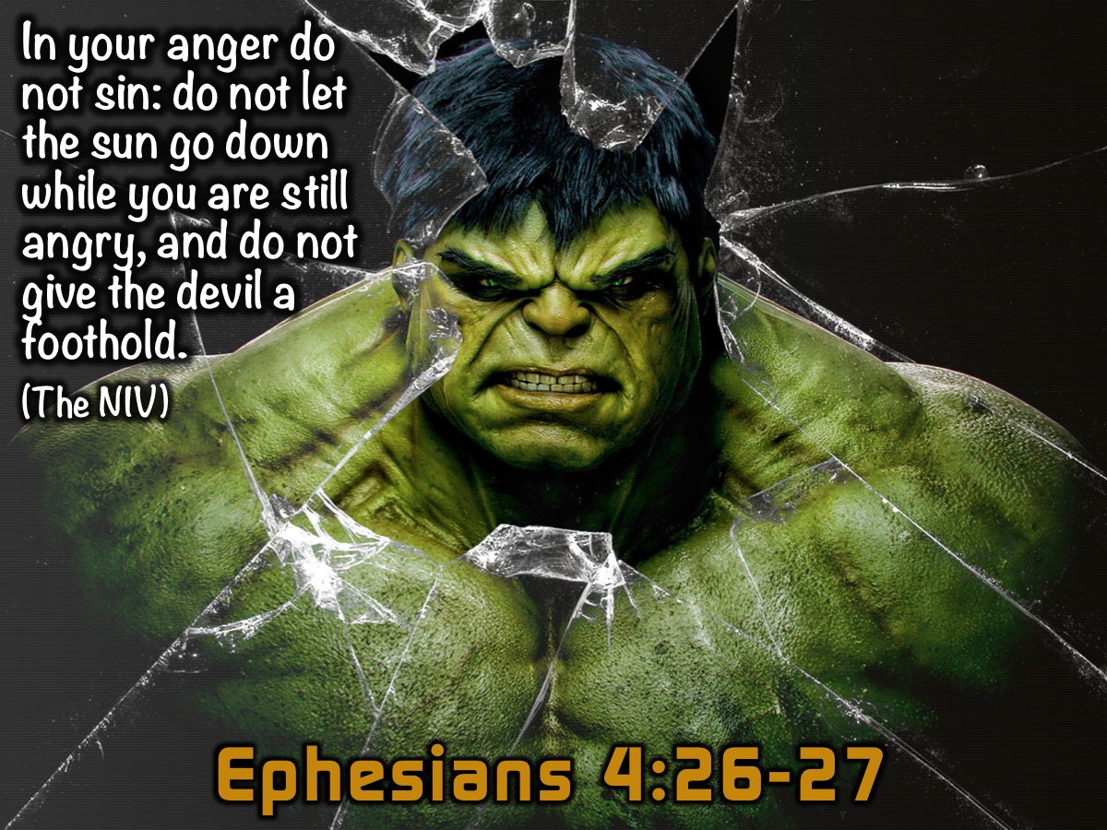
Notes:
Let’s take a look at a key verse in the New Testament about Anger (Ephesians 4:26-27). We will look at three different translations of the verse: “In your anger do not sin: do not let the sun go down while you are still angry, and do not give the devil a foothold”. (NIV)

Slide 18
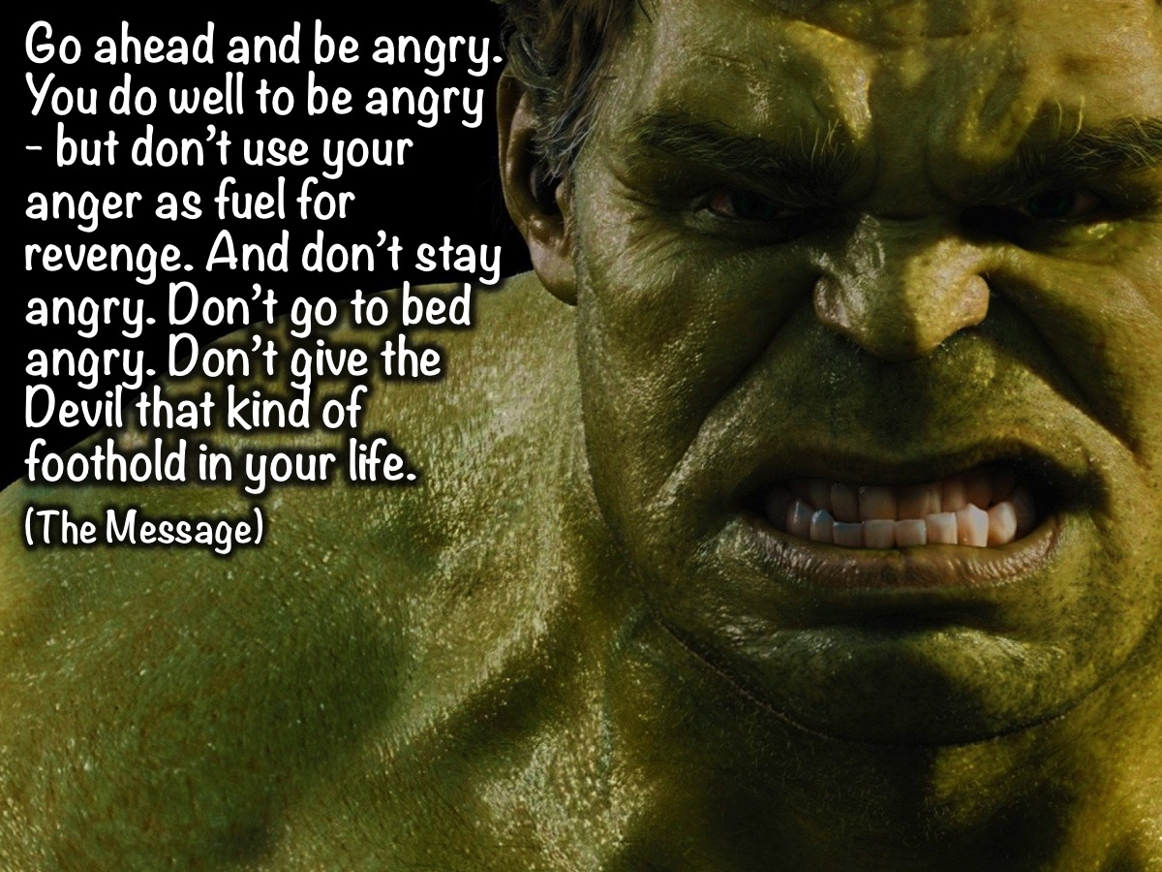
Notes:
“Go ahead and be angry. You do well to be angry - but don’t use your anger as fuel for revenge. And don’t stay angry. Don’t go to bed angry. Don’t give the Devil that kind of foothold in your life”. (Ephesians 4:26-27, The Message)

Slide 19
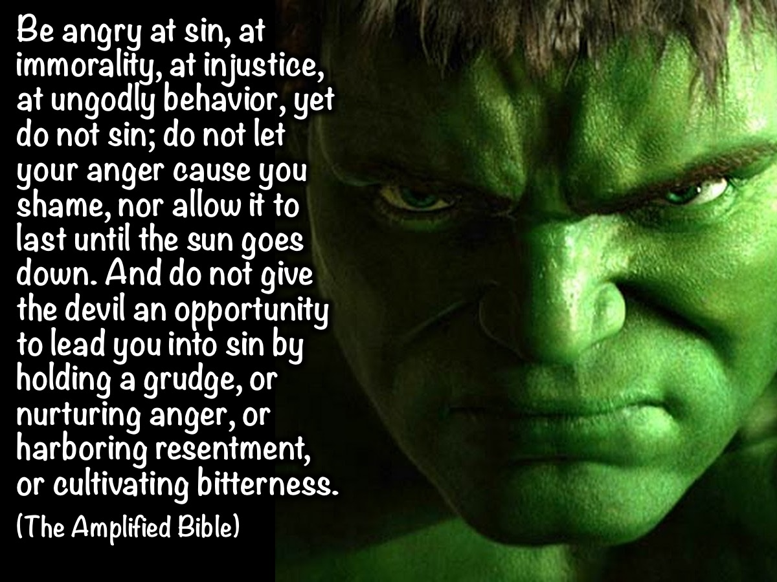
Notes:
“Be angry [at sin - at immorality, at injustice, at ungodly behavior], yet do not sin; do not let your anger [cause you shame, nor allow it to] last until the sun goes down. And do not give the devil an opportunity [to lead you into sin by holding a grudge, or nurturing anger, or harboring resentment, or cultivating bitterness].” (Ephesians 4:26-27 The Amplified Bible)

Slide 20

Notes:
So what can we learn from Ephesians 4:26-27 about anger? Here are some lessons that I found: (1) Don’t sin when you get angry. (2) Don’t let the devil take control. (3) Don’t do anything you’ll regret. (4) Don’t bottle anger up. (5) Don’t let anger ferment.

Slide 21
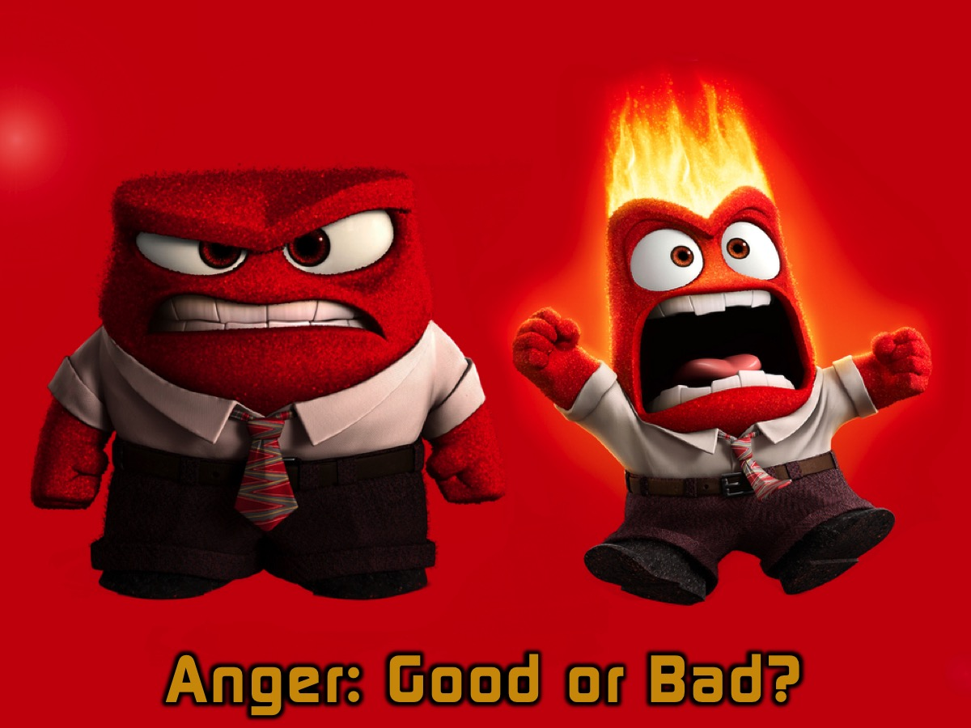
Notes:
So, is anger good or bad?

Slide 22
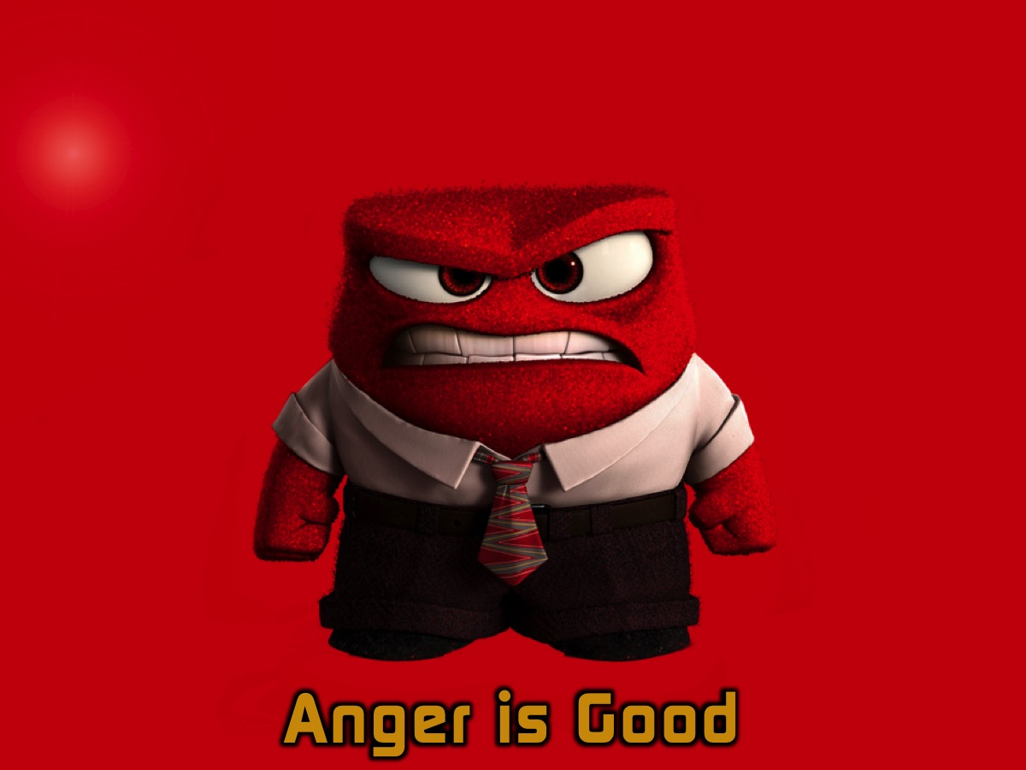
Notes:
Anger is Good. Examples of positive anger - by TK.

Slide 23

Notes:
Video: Inside Out clip where Disgust ignites Anger to get Joy and Sadness back into the command center. (from 1:14:40 to 1:15:37)

Slide 24
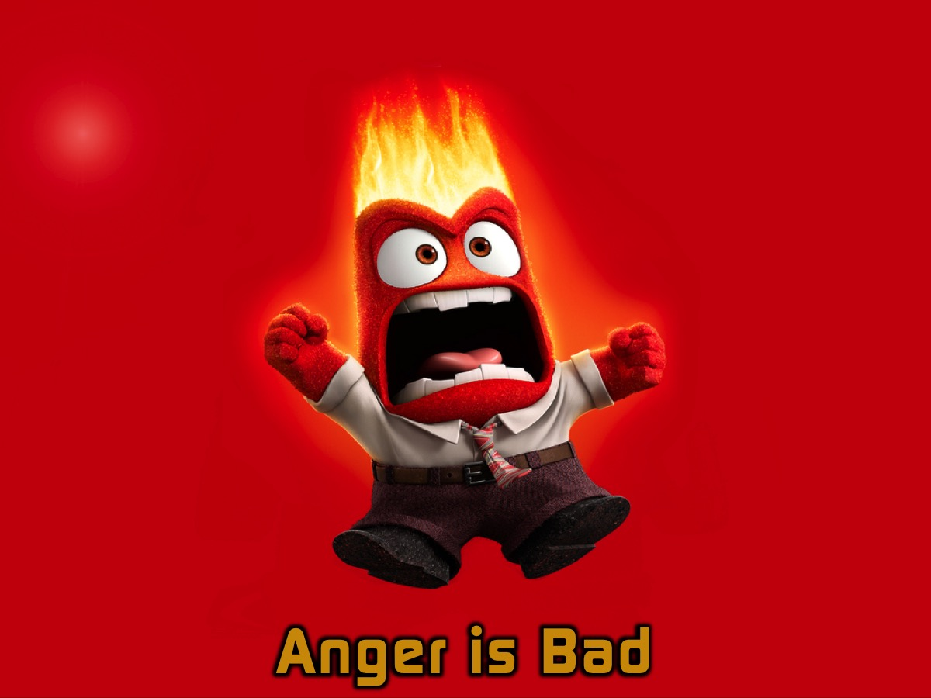
Notes:
Anger is Bad. The murder of the referee. César Flores was refereeing an amateur soccer match in the Córdoba province of Argentina when he sent one player off. In anger, the player left the field to get something from his bag. A short time later, the player returned to the field with a gun and shot the ref to death.

Slide 25
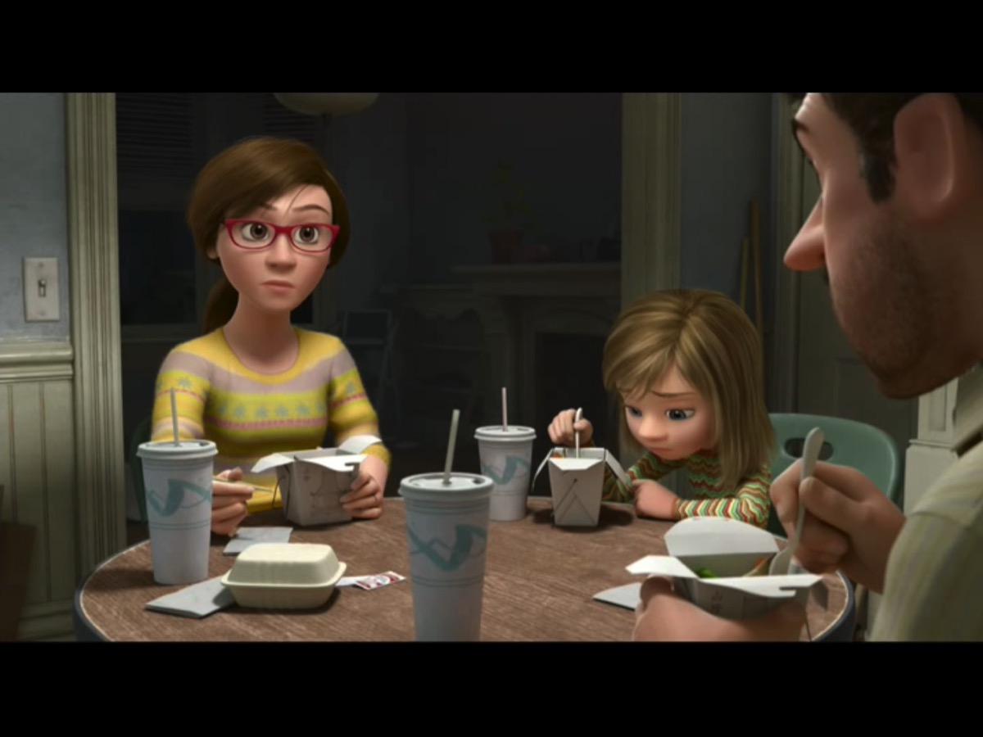
Notes:
Video: Inside Out clip where Anger gets Dad to put his foot down (from 27:27 to 28:44).

Slide 26

Notes:
Small Group Activity: At tables, teens will look at how anger was used in a negative and a positive way and report back on their findings. The negative example is where Cain killed Abel (Genesis 4:2-8) and the positive example is from Matthew 21:12-17 where Jesus cleared the temple.
Abel kept flocks, and Cain worked the soil. Cain brought some of the fruits of the soil as an offering to the Lord. But Abel also brought an offering – fat portions from some of the firstborn of his flock. The Lord looked with favour on Abel and his offering, but on Cain and his offering he did not look with favour. So Cain was very angry, and his face was downcast. Cain said to his brother Abel, ‘Let’s go out to the field.’ While they were in the field, Cain attacked his brother Abel and killed him. (Genesis 4:2-8)
On reaching Jerusalem, Jesus entered the temple courts and began driving out those who were buying and selling there. He overturned the tables of the money-changers and the benches of those selling doves, and would not allow anyone to carry merchandise through the temple courts. And as he taught them, he said, ‘Is it not written: My house will be called a house of prayer for all nations? But you have made it a den of robbers. (Mark 11:15-17)

Slide 27
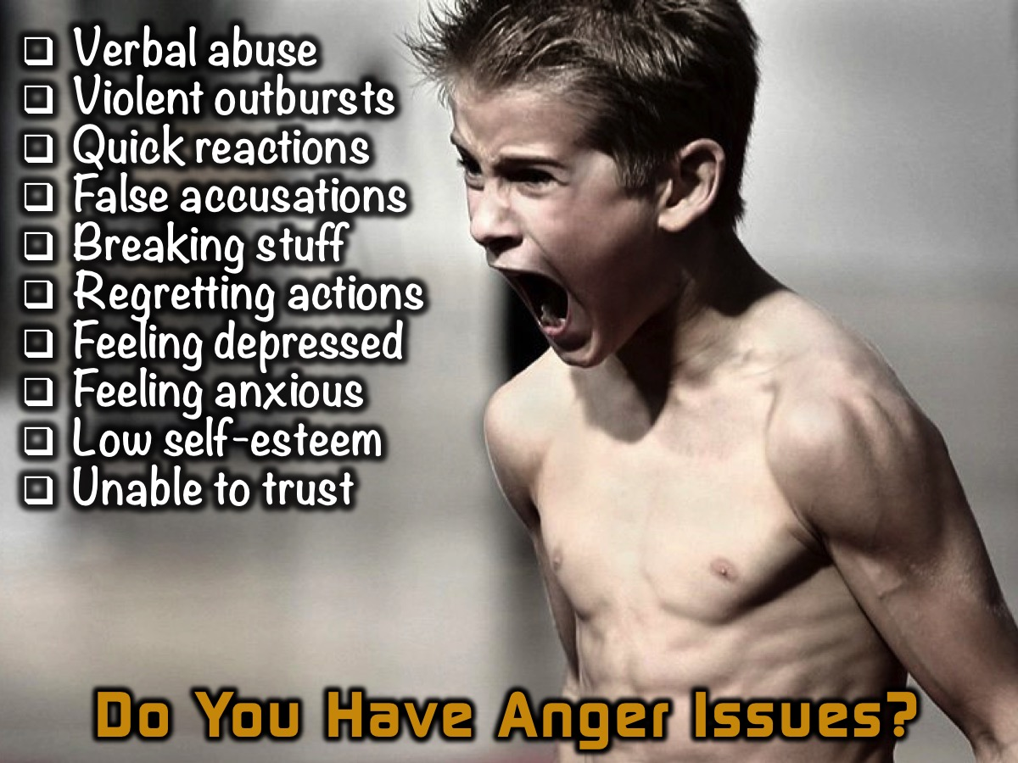
Notes:
Do You Have Anger Issues? Here are some signs that you may have anger issues: Verbal abuse; Violent outbursts; Quick reactions; False accusations; Breaking stuff; Regretting actions; Feeling depressed; Feeling Anxious; Low self-esteem and Unable to trust.

Slide 28

Notes:
There is an anger test that I found online. (The Kennedy sisters have done the assessment and here are their results). You can do the test online at:
http://www.5lovelanguages.com/profile/anger/ or your can download a test to print and score yourself from: https://s3.amazonaws.com/moody-profiles/uploads/profile/attachment/6/anger-profile.pdf

Slide 29
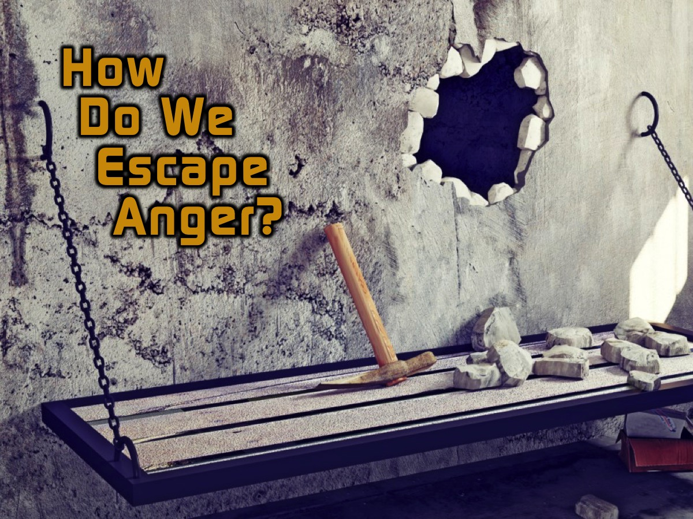
Notes:
How do we escape Anger?

Slide 30

Notes:
1. Admit Your Problem. The first step to recovery is to understand and accept that you have a problem. From this you can begin to look at your behaviour and what triggers certain reactions.

Slide 31
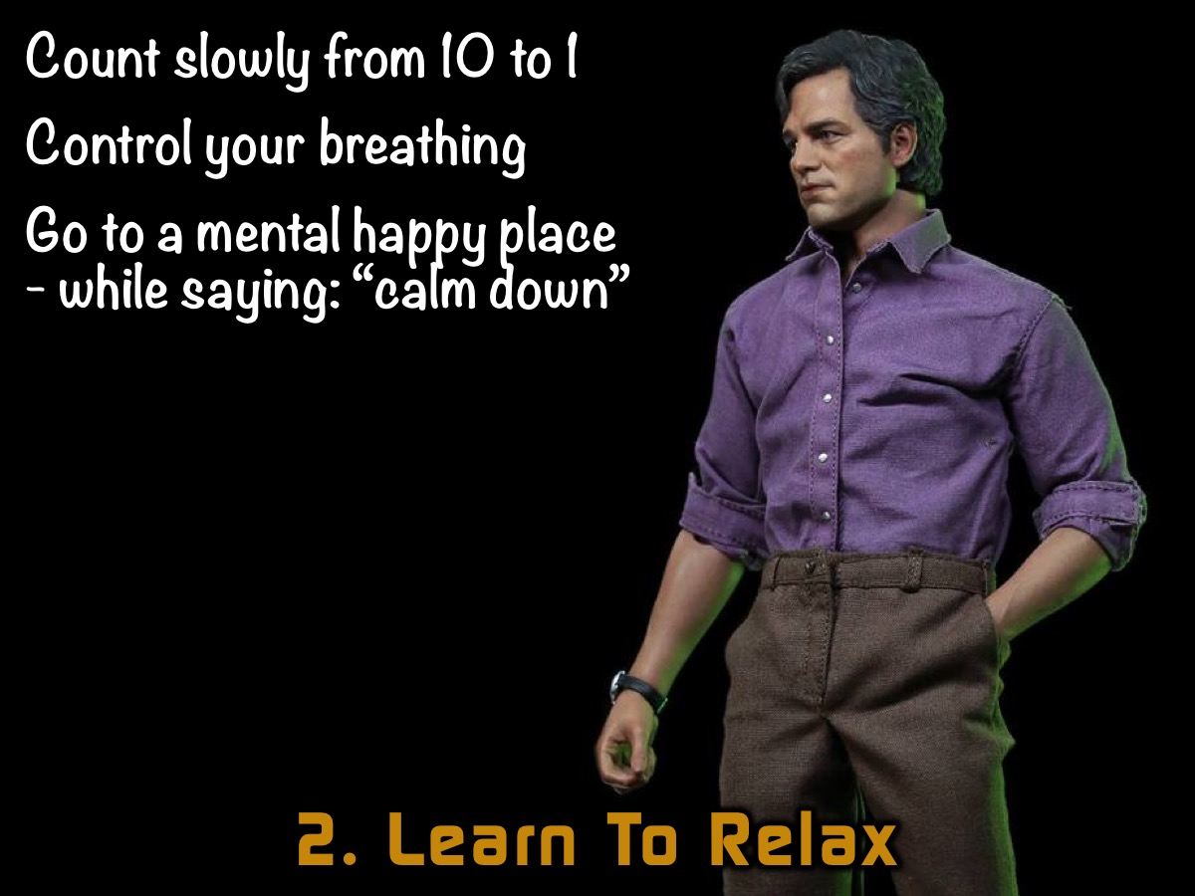
Notes:
2. Learn to Relax. Use relaxation techniques to calm down angry feelings. Here are some suggestions: (1) Count slowly from 10 to 1. (2) Control your breathing, take deep breathes in through your nose from your diaphragm and slowly breathe out your mouth whilst mentally counting to 10. (3) Take your mind to your happy place. Repeat calming phrases such as: "calm down" or "take it easy". Whilst doing so take your thoughts to a fond memory or to a place that brings forth positive emotions.

Slide 32

Notes:
3. Change your Thinking. “As a man thinks in his heart, so is he!” (Proverbs 23:7a). ” Your thoughts and words create your world. To get away from anger change the your words and thoughts. Refrain from profanity and negative thoughts. Refrain from using words such "always" and "never" when you are angry. For example: " you never say thank you!" or "you always doing your own thing”. Using these words alienates people who want to come up with solutions. It also makes it seem as though your anger is justify which not always be the case

Slide 33
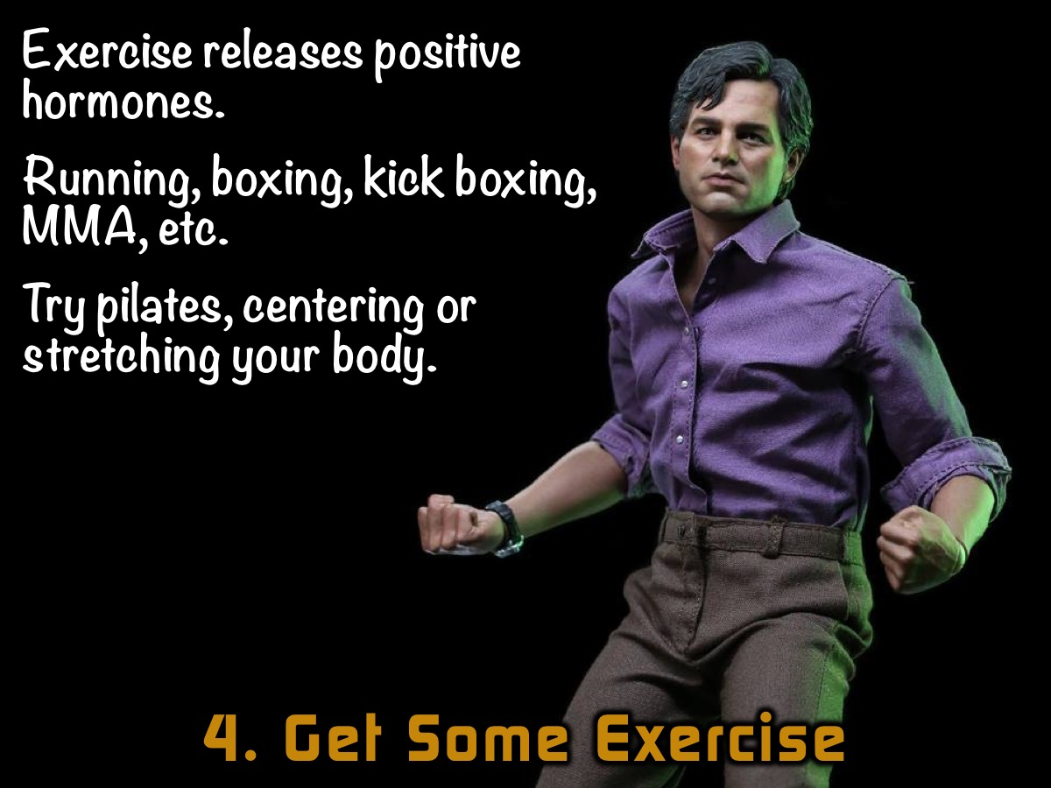
Notes:
4. Get Some Exercise. Exercise releases positive hormones in your body. So going for a run will turn your angry mood to a happy mood. Maybe running isn't for you, try boxing or kick boxing it will get the endorphins rushing plus you get to hit something and not someone. Or try pilates, centering and stretching out the body can be both calming and good for your soul.

Slide 34
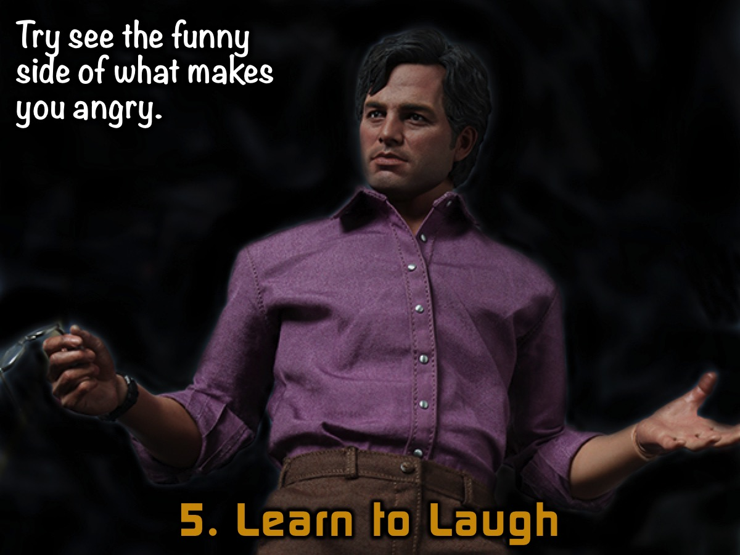
Notes:
5. Learn to Laugh - Try find the funny side to what made you angry. Ask yourself what is funny about this situation and try laughing it out.

Slide 35

Notes:
6. Connect With God. Make God's Word apart of your daily life, so when you find yourself in an angry situation the word of God can come alive in your heart. It's not always easy to read the Bible when you angry. “Guard your heart above all else, for it determines the course of your life”. (Proverbs 4:23 NLT).. Finally, brothers and sisters, whatever is true, whatever is noble, whatever is right, whatever is pure, whatever is lovely, whatever is admirable—if anything is excellent or praiseworthy—think about such things. (Philippians 4:8 NIV). If you can't come to meditating on God's Word. Sing God's Word. Worship Him and the more you focus on him the more your anger will float away. Give all your worries and cares to God, for he cares about you. (1 Peter 5:7 NLT)

Slide 36

Notes:
7. See a Counsellor. Sometimes using humour or doing exercise is just not enough. It's time to get counselling. Find an objective friend who you can vent it out to. However if the anger is from a deep seated issue then having structured counselling will be the way to go. You can see a psychologist, the adult leaders, pastor Mark and Debbie or confide in a teacher. But remember it is important to get counselling from someone who will speak positively into your situation. Be careful who you confide in.

Slide 37
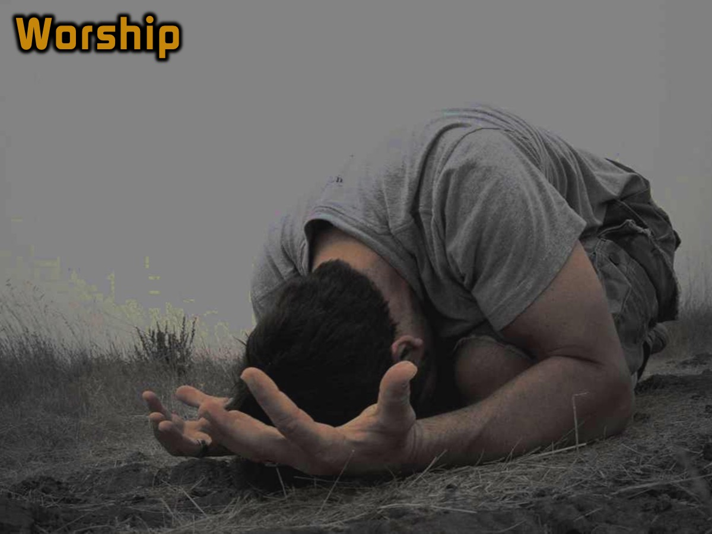
Notes:
Worship - we are going to play a worship song and we invite you to worship God and let go of any negative emotions or anger that you may be carrying! The song we are using has Lyrics by Megan Basson.

Slide 38

Notes:
Next week we will look at how to breakout from the prison of Doubt.

