Slide 1
Notes:
Welcome to the Breakout series.

Slide 2
Notes:
In Week 1 we looked at how to breakout from the prison of Anxiety.

Slide 3
Notes:
In Week 2 we looked at how to breakout from the prison of Fear.

Slide 4
Notes:
In Week 3 we looked at how to breakout from the prison of Depression.

Slide 5
Notes:
In Week 4 we looked at how to breakout from the prison of Temptation.

Slide 6
Notes:
In Week 5 we looked at how to breakout from the prison of Heartache.

Slide 7
Notes:
In Week 6 we looked at how to breakout from the prison of Greed.

Slide 8
Notes:
In Week 7 we looked at how to breakout from the prison of Anger.

Slide 9
Notes:
This week we are going to look at how to breakout from the prison of Doubt.

Slide 10
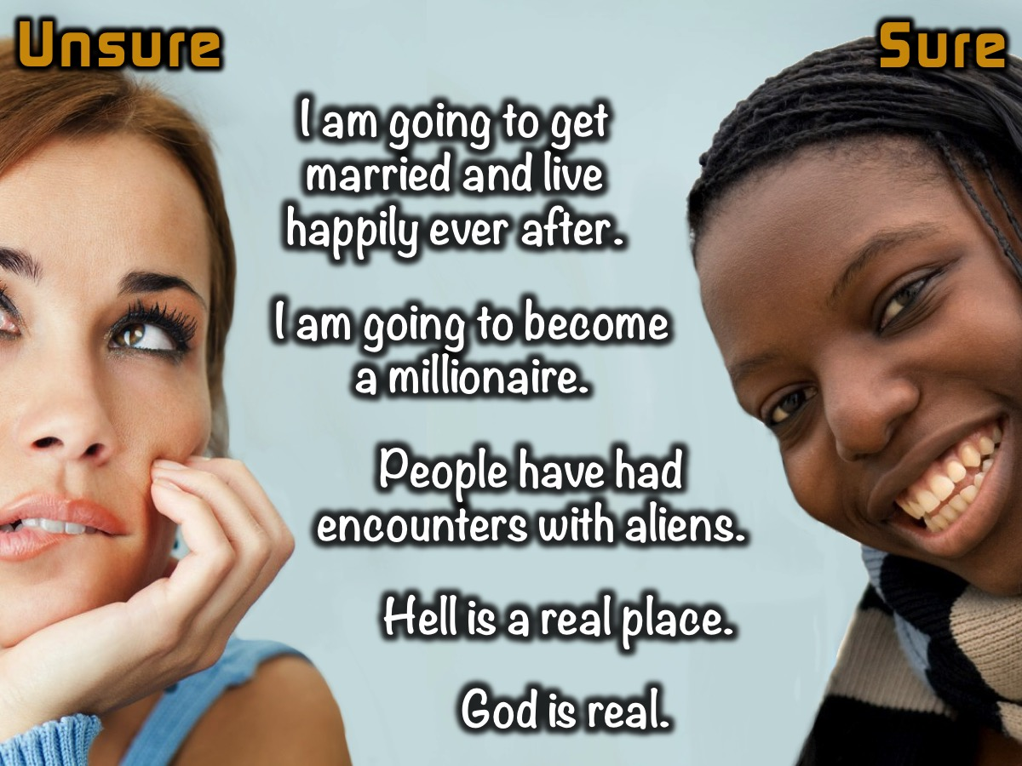
Notes:
The Continuum: I am going to throw a statement at you and if you are Unsure that it is true then move to the Unsure side of the room, but if you are Sure it is true then move to the Sure side of the room:
* I am going to get married and live happily ever after.
* I am going to become a millionaire.
* People have had encounters with aliens
* Hell is a real place.
* God is real.

Slide 11
Notes:
Sharing: Turn to the person next to you and share your answers to these questions: (1) Think of a person you have a close relationship with. (2) What do you appreciate about them? (3) What do you do together that you enjoy most?

Slide 12
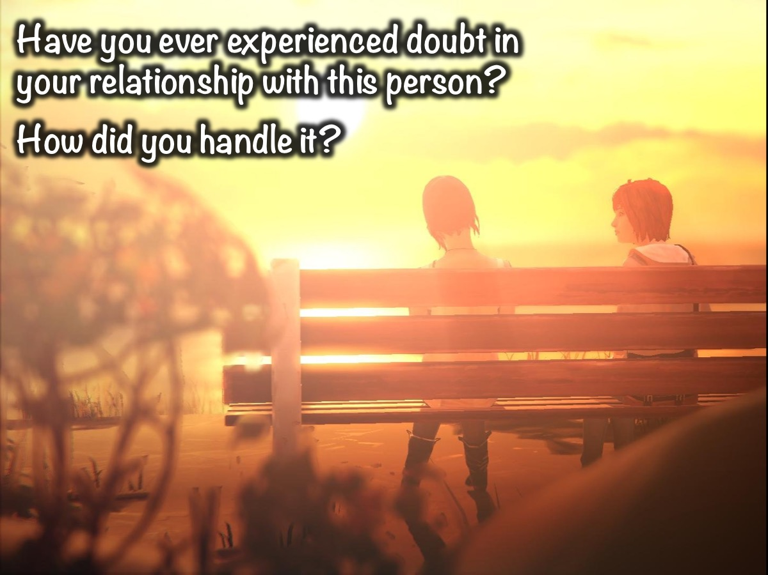
Notes:
Have you ever experienced doubt in your relationship with this person? How did you handle it?

Slide 13
Notes:
Activity 2: What doubts have you had/do you have about God, the Bible, or Christianity? What makes relating to God difficult?

Slide 14
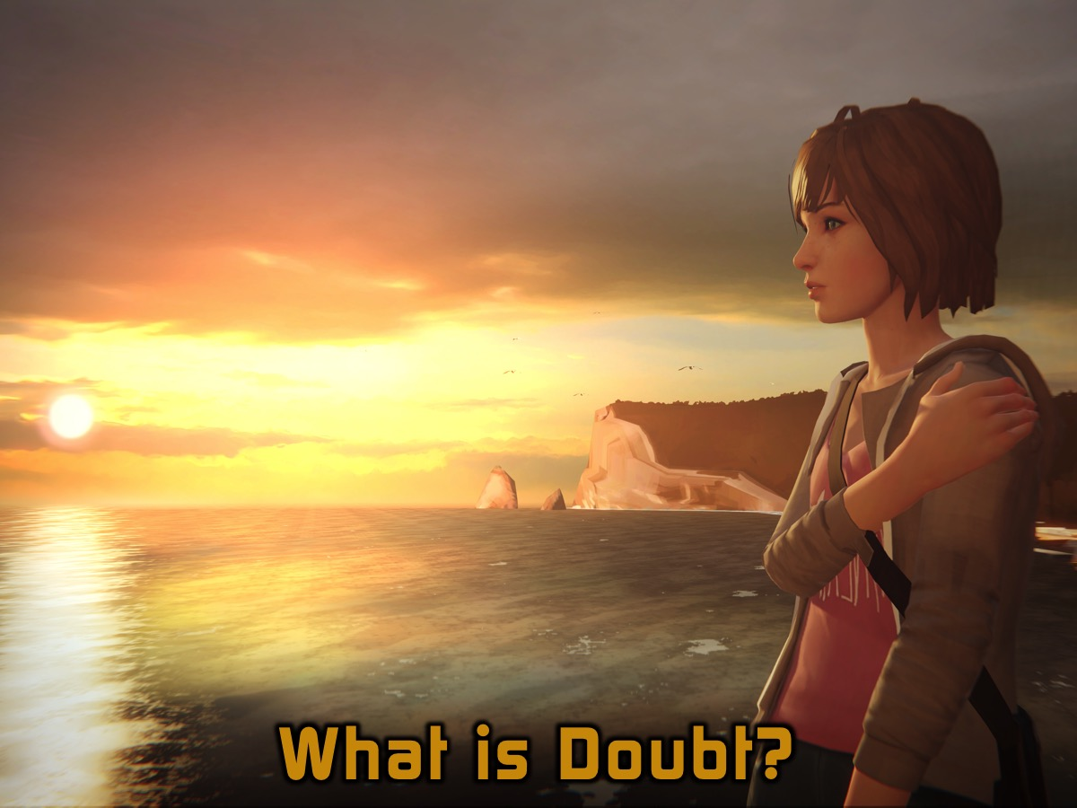
Notes:
What is Doubt?

Slide 15
Notes:
What is Doubt? (1) To be uncertain about something. (2) To believe that something may not be true or is unlikely. (3) To hesitate to believe. (4) To be undecided or sceptical about.

Slide 16
Notes:
Examples of People of Faith who Experienced Doubt.

Slide 17
Notes:
1. Sarah & Abraham. God also said to Abraham, ‘As for Sarai your wife, you are no longer to call her Sarai; her name will be Sarah. I will bless her and will surely give you a son by her. I will bless her so that she will be the mother of nations; kings of peoples will come from her.’ Abraham fell face down; he laughed and said to himself, ‘Will a son be born to a man a hundred years old? Will Sarah bear a child at the age of ninety?’ And Abraham said to God, ‘If only Ishmael might live under your blessing!’ Then God said, ‘Yes, but your wife Sarah will bear you a son, and you will call him Isaac. I will establish my covenant with him as an everlasting covenant for his descendants after him. And as for Ishmael, I have heard you: I will surely bless him; I will make him fruitful and will greatly increase his numbers. He will be the father of twelve rulers, and I will make him into a great nation. But my covenant I will establish with Isaac, whom Sarah will bear to you by this time next year.’ (Genesis 17:15-21). Where is your wife Sarah?’ they asked him. ‘There, in the tent,’ he said. Then one of them said, ‘I will surely return to you about this time next year, and Sarah your wife will have a son.’ Now Sarah was listening at the entrance to the tent, which was behind him. Abraham and Sarah were already very old, and Sarah was past the age of childbearing. So Sarah laughed to herself as she thought, ‘After I am worn out and my lord is old, will I now have this pleasure?’ Then the Lord said to Abraham, ‘Why did Sarah laugh and say, “Will I really have a child, now that I am old?” Is anything too hard for the Lord? I will return to you at the appointed time next year, and Sarah will have a son.’ Sarah was afraid, so she lied and said, ‘I did not laugh.’ But he said, ‘Yes, you did laugh.’(Genesis 18:9-15)

Slide 18
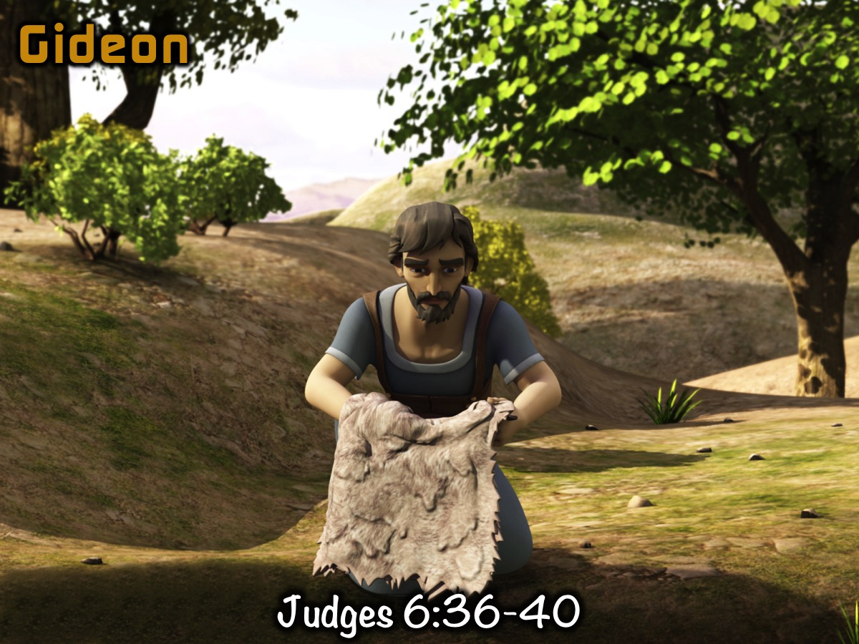
Notes:
2. Gideon. Gideon said to God, ‘If you will save Israel by my hand as you have promised – look, I will place a wool fleece on the threshing-floor. If there is dew only on the fleece and all the ground is dry, then I will know that you will save Israel by my hand, as you said.’ And that is what happened. Gideon rose early the next day; he squeezed the fleece and wrung out the dew – a bowlful of water. Then Gideon said to God, ‘Do not be angry with me. Let me make just one more request. Allow me one more test with the fleece, but this time make the fleece dry and let the ground be covered with dew.’ That night God did so. Only the fleece was dry; all the ground was covered with dew. (Judges 6:36-40)

Slide 19
Notes:
3. Thomas. Now Thomas (also known as Didymus), one of the Twelve, was not with the disciples when Jesus came. So the other disciples told him, ‘We have seen the Lord!’ But he said to them, ‘Unless I see the nail marks in his hands and put my finger where the nails were, and put my hand into his side, I will not believe.’ A week later his disciples were in the house again, and Thomas was with them. Though the doors were locked, Jesus came and stood among them and said, ‘Peace be with you!’ Then he said to Thomas, ‘Put your finger here; see my hands. Reach out your hand and put it into my side. Stop doubting and believe.’ Thomas said to him, ‘My Lord and my God!’ Then Jesus told him, ‘Because you have seen me, you have believed; blessed are those who have not seen and yet have believed.’ (John 20:24-29)

Slide 20
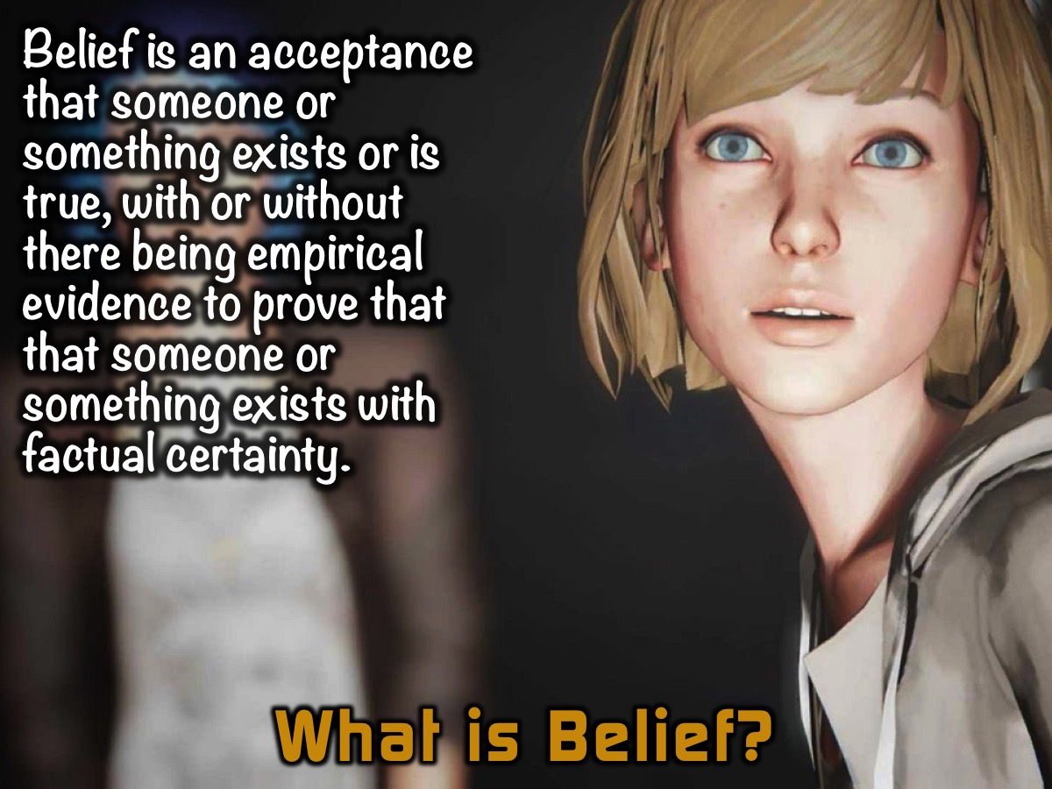
Notes:
What is Belief? Belief is an acceptance that someone or something exists or is true, with or without there being empirical evidence to prove that that someone or something exists with factual certainty.

Slide 21
Notes:
What is Unbelief? Unbelief is a lack of belief, a refusal to believe, a rejection of belief.

Slide 22
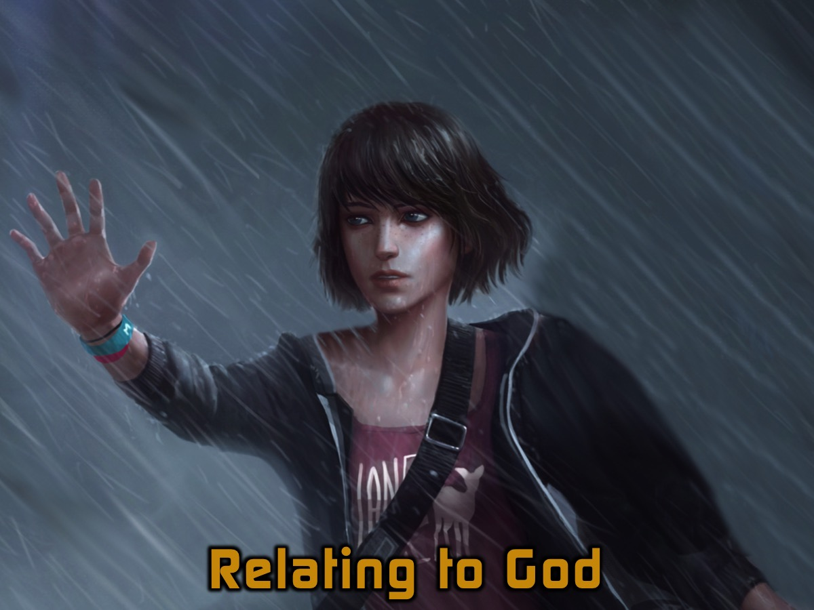
Belief
Unbelief
Notes:
Relating to God. It is a matter of Belief or Unbelief.

Slide 23
Notes:
Belief, in the context of relationship with God, is called ‘faith’. Faith ultimately boils down to a question of trust.

Slide 24
Notes:
Trust means having an assured reliance on the character, ability, strength, truth, and promises of God; it is to choose to believe that God is sovereign, good, reliable, etc.

Slide 25
Notes:
Unbelief, in the context of relationship with God, is the decision to live as if there is no God.

Slide 26
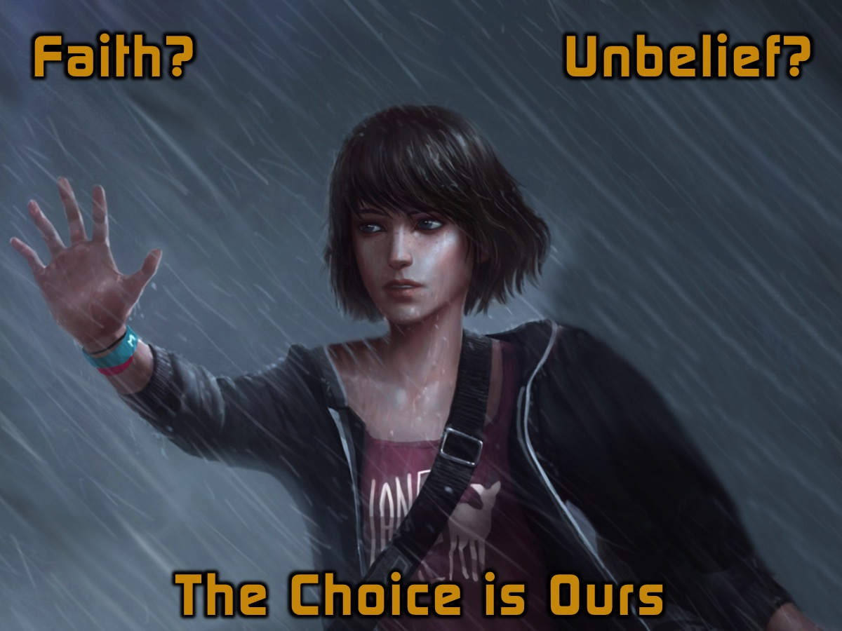
Notes:
The Choice is Ours. Each one of us have a choice to make: faith (trust) or unbelief (distrust / minimal trust). Ultimately, the choice we make is determined by whether we believe that God is trustworthy (i.e. worthy of our trust). God gives us the freedom to choose our response to Him.

Slide 27
Notes:
Today I have given you the choice between life and death, between blessings and curses. Now I call heaven and earth to witness the choice you make. Oh, that you would choose life, so that you and your descendants might live! You can make this choice by loving the Lord your God, obeying Him, and committing yourself firmly to Him. This is the key to your life. (Deuteronomy 30:19-20)

Slide 28
Notes:
Jesus said to him: “Because you have seen me, Thomas, do you now believe (trust, have faith)? Blessed and happy and to be envied are those who have never seen me and yet have believed and adhered to and trusted and relied on me.” (John 20:29)

Slide 29
Notes:
It would be much easier to trust God if He were more tangible. It would be much easier to trust God if we could experience Him in the same way that we experience other people, whom we can see, hear, touch, and smell. However, God, in His sovereign wisdom, has chosen to remain ‘invisible’, and to relate to us via the Holy Spirit. Relating to God in this way requires faith.

Slide 30
Notes:
What is Faith? Now faith is the assurance (the confirmation, the title deed) of the things we hope for, being the proof of things we do not see and the conviction of their reality [faith perceiving as real fact what is not revealed to the senses]. (Hebrews 11:1)

Slide 31
Notes:
Why Faith is Important? It is impossible to please God apart from faith. Because anyone who wants to approach God must believe both that He exists and that He cares enough to respond to those who seek Him. (Hebrews 11:6)

Slide 32
Notes:
God’s Response to Our Faith. God responds to our questions and doubt not with wrath but with patience. Rather than punish His doubting followers, God honours those who seek after Him with earnest questions and doubt.

Slide 33
Notes:
Despite their doubts, Sarah and Abraham, Gideon, and Thomas, trusted God and chose to be obedient. This ultimately resulted in a deeper faith, and a closer walk with God.

Slide 34
Notes:
How do we escape Doubt? Actually, the way to escape doubt (which is a feature of the human condition/experience) is to learn how to relate to God.

Slide 35
Notes:
1. Grow Faith Daily. Choose, daily, to grow in faith; Read,study and apply the Word of God in your day-to-day life; Pray without Ceasing, and Be part of a community of believers.

Slide 36
Notes:
2. Obey Despite Uncertainties. Accept that faith requires obedience without full knowledge. In the end, trust represents the proper fear of the Lord.

Slide 37
Notes:
3. Share Doubts Honestly. Share your doubts and questions with God, and with people in your life whom you trust.

Slide 38
Notes:
“Casting the whole of your care [all your anxieties, all your worries, all your concerns, once and for all] on Him, for He cares for you affectionately and cares about you watchfully.” (1 Peter 5:7).

Slide 39
Notes:
4. Know Jesus Personally. “Christ is the visible image of the invisible God…God in all His fullness was pleased to live in Christ.” (Colossians 1:15,19). God made an exception to being ‘invisible’ in the person of Jesus Christ. By getting to know Jesus (personally and intimately), who was a tangible (and full expression) of God, we get to know God better.

Slide 40
Notes:
5. Worship God Passionately. “I appeal to you therefore, brethren, and beg you in view of [all] the mercies of God, to make a decisive dedication of your bodies [presenting all your members and faculties] as a living sacrifice, holy (devoted, consecrated) and well pleasing to God, which is your reasonable (rational, intelligent) service and spiritual worship”. (Romans 12:1). We are profoundly different, God (the creator) and us (the created), which explains why friendship is not the primary model used in the Bible to describe our relationship with God. Worship is.

Slide 41
Notes:
Worship is the submission of all of my nature to God. It is the quickening of conscience by His holiness, nourishment of mind by His truth, purifying of imagination by His beauty, opening of the heart to His love, and submission of will to His purpose. All this gathered up in adoration is the greatest expression of which we are capable. (Archbishop William Temple)

Slide 42
Notes:
Summary: To escape doubt you need to learn how to relate to God: (1) Grow Faith Daily, (2) Obey Despite Uncertainties, (3) Share Doubts Honestly, (4) Know Jesus Personally and (5) Worship God Passionately.

Slide 43
Notes:
Prayer

Slide 44
Notes:
Next week we will look at how to breakout from the prison of Religion.

