Slide 1

Notes:
Welcome to the Breakout series.

Slide 2

Notes:
In Week 1 we looked at how to breakout from the prison of Anxiety.

Slide 3

Notes:
In Week 2 we looked at how to breakout from the prison of Fear.

Slide 4

Notes:
In Week 3 we looked at how to breakout from the prison of Depression.

Slide 5

Notes:
In Week 4 we looked at how to breakout from the prison of Temptation.

Slide 6

Notes:
In Week 5 we looked at how to breakout from the prison of Heartache.

Slide 7

Notes:
In Week 6 we looked at how to breakout from the prison of Greed.

Slide 8

Notes:
In Week 7 we looked at how to breakout from the prison of Anger.

Slide 9

Notes:
Last week we looked at how to breakout from the prison of Doubt.

Slide 10
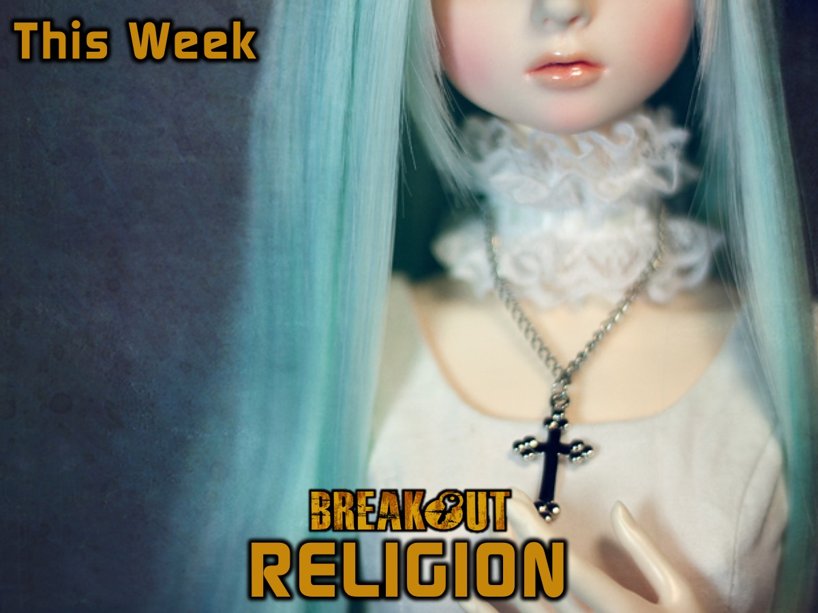
Notes:
This week we are going to look at how to breakout from the prison of Religion.

Slide 11
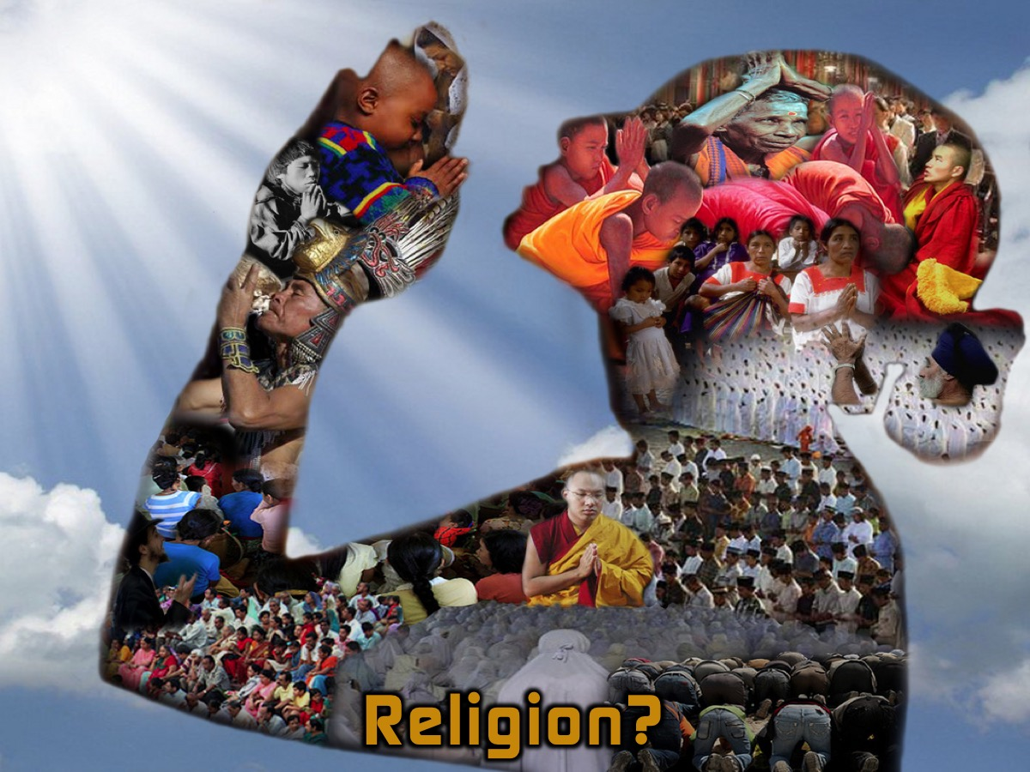
Notes:
Maybe you are a little confused this morning - because so far in this series we have tackled some issues that we needed to escape from (like Fear, Anxiety, Depression, Temptation, etc.) but now we are talking about escaping Religion. Isn’t Christianity a religion - that is a good thing right? Why should we escape it?

Slide 12
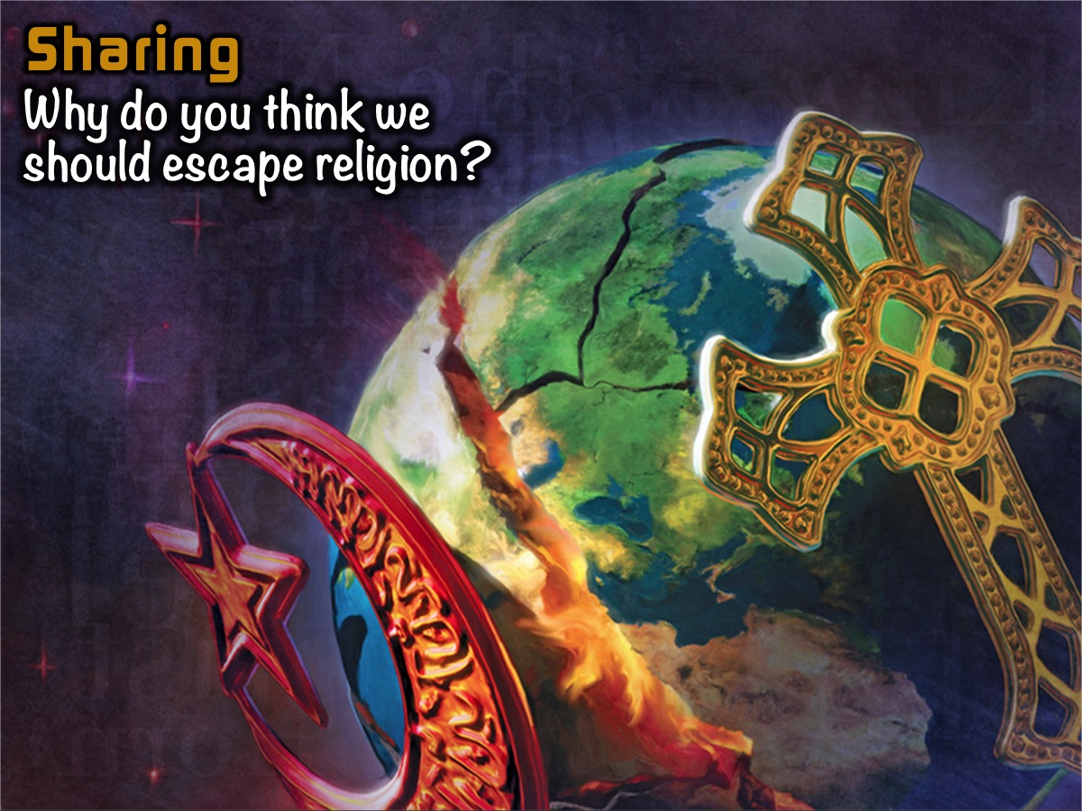
Notes:
Sharing: Why do you think we should escape religion?

Slide 13

Notes:
Is Christianity a Religion?

Slide 14

Notes:
Christianity can be called a religion - some people think of it as one of the four world’s major religions which included Islam, Judaish, Hindiusm and Buddhism. However, there is a key difference in how Christianity understands how we get salvation. The fundamental difference is all about whether we can make ourselves acceptable to God through our good deeds or whether God has done all that is necessary to save us.

Slide 15
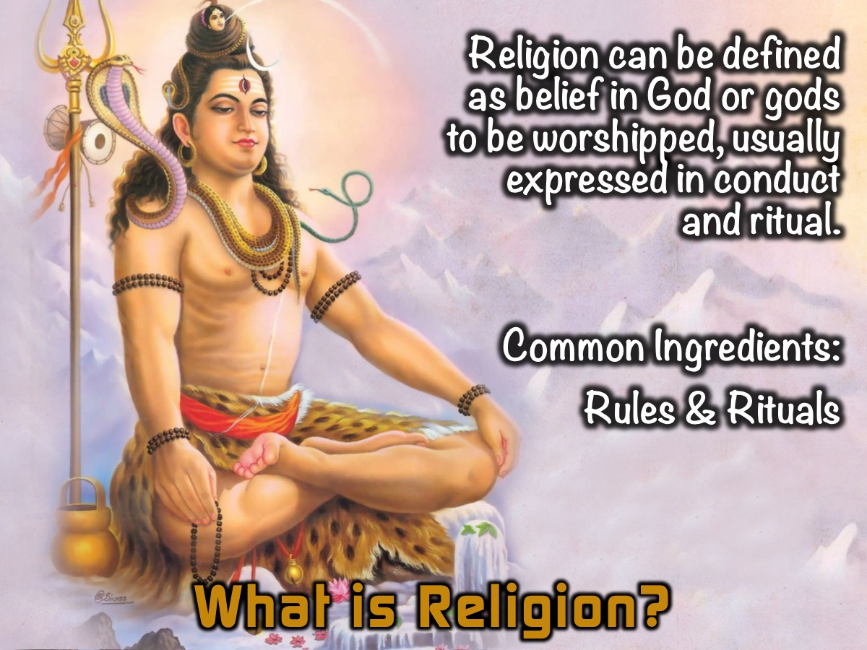
Notes:
What is Religion? Religion can be defined as belief in God or gods to be worshipped, usually expressed in conduct and ritual. The two most common ingredients in religions are rules and rituals.

Slide 16
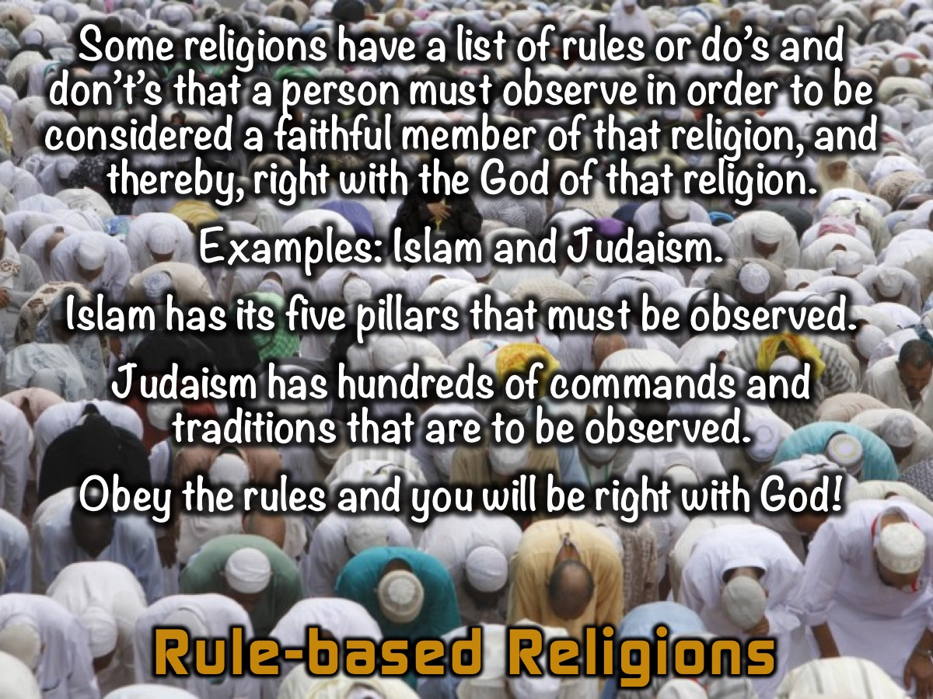
Notes:
Rule-based Religions: Some religions have a list of rules or do’s and don’t’s that a person must observe in order to be considered a faithful adherent of that religion, and thereby, right with the God of that religion. Two examples of rules-based religions are Islam and Judaism. Islam has its five pillars that must be observed. Judaism has hundreds of commands and traditions that are to be observed. Both religions, to a certain degree, claim that by obeying the rules of the religion, a person will be considered right with God.

Slide 17
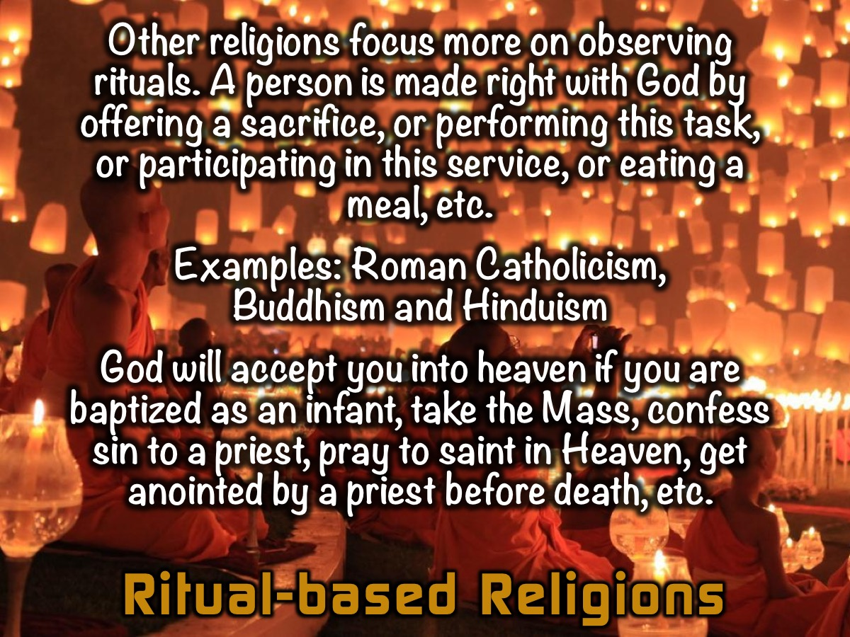
Notes:
Ritual-based Religion: Other religions focus more on observing rituals instead of obeying a list of rules. By offering this sacrifice, performing this task, participating in this service, consuming this meal, etc., a person is made right with God. The most prominent example of a ritual-based religion is Roman Catholicism. Roman Catholicism holds that by being water baptized as an infant, by partaking in the Mass, by confessing sin to a priest, by offering prayers to saints in Heaven, by being anointed by a priest before death, etc., etc., God will accept such a person into Heaven after death. Buddhism and Hinduism are also primarily ritual-based religions, but can also to a lesser degree be considered rules-based.

Slide 18
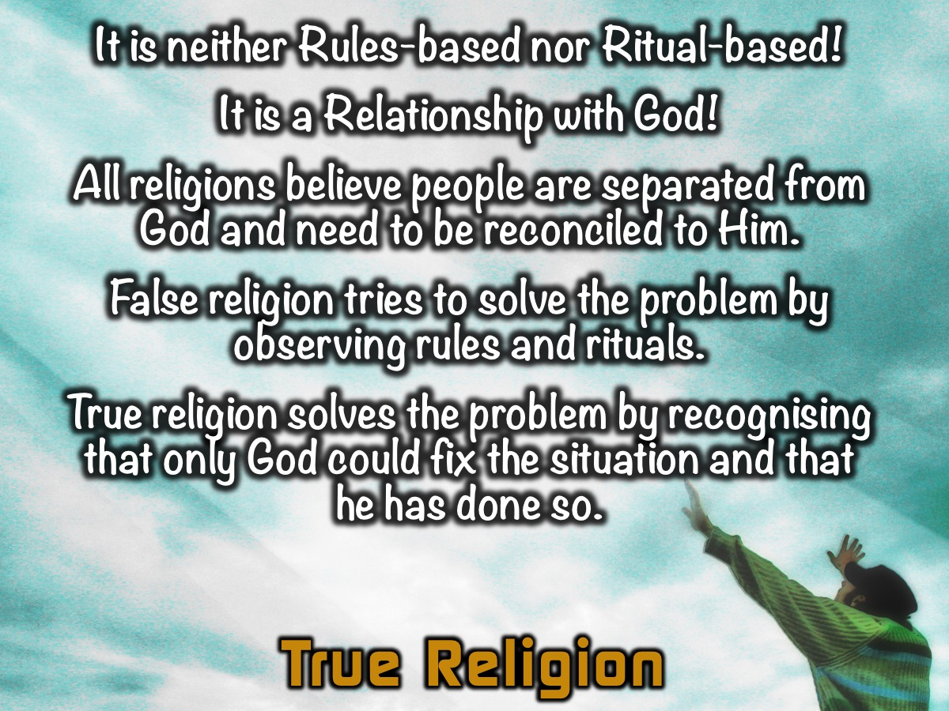
Notes:
What is True Religion? It is neither Rules-based nor Ritual-based! It is a Relationship with God! All Religions believe people are separated from God and need to be reconciled to Him. False religion tries to solve the problem by observing rules and rituals. True religion solves the problem by recognising that only God could fix the situation and that he has done so.

Slide 19
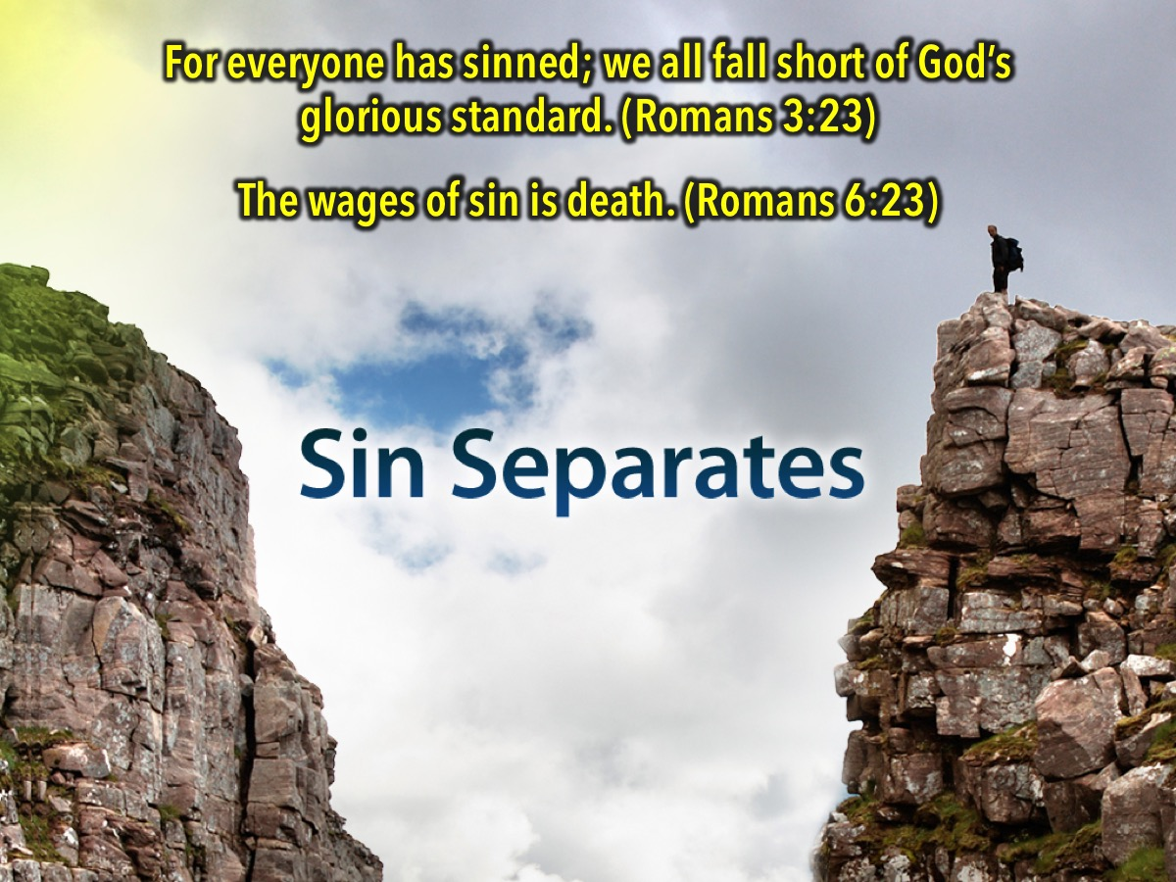
Notes:
Sin Separates. "For all have sinned, and come short of the glory of God;” (Romans 3:23). No one is good enough to go to Heaven on his or her own merit. God's Word reminds us that we all have sinned. We have all fallen short of God's requirements, for at one time or another, we have all deliberately chosen to disobey God. "For the wages of sin is death; but the gift of God is eternal life through Jesus Christ our Lord.” (Romans 6:23). A wage is a payment. The payment for your sin is death and separation from God in a place that the Bible calls "Hell."

Slide 20

Notes:
Good works or Religion cannot save us. No matter how much good we do, we still fall short of God’s glory. Mankind has tried unsuccessfully for thousands of years to pay their sin debt by things such as "good works" or "religion." Yet, man is still without a home in Heaven.

Slide 21

Notes:
Even if you try really really hard and take a running jump and give it everything you have got you still won’t come close to bridging the gap between you and God.

Slide 22

Notes:
The Only Way is Through Jesus. The only bridge that can span the gap is Jesus. Jesus lived a perfect life and made the way for us to be re-connected with God. "But God proved his love toward us, in that while we were yet sinners, Christ died for us.” (Romans 5:8). God proved His love for you by giving His own Son, Jesus Christ, to die on the cross for your sins. The Bible tells us in John 3:16, "For God so loved the world, that he gave his only begotten Son, that whosoever believeth in him should not perish, but have everlasting life."

Slide 23
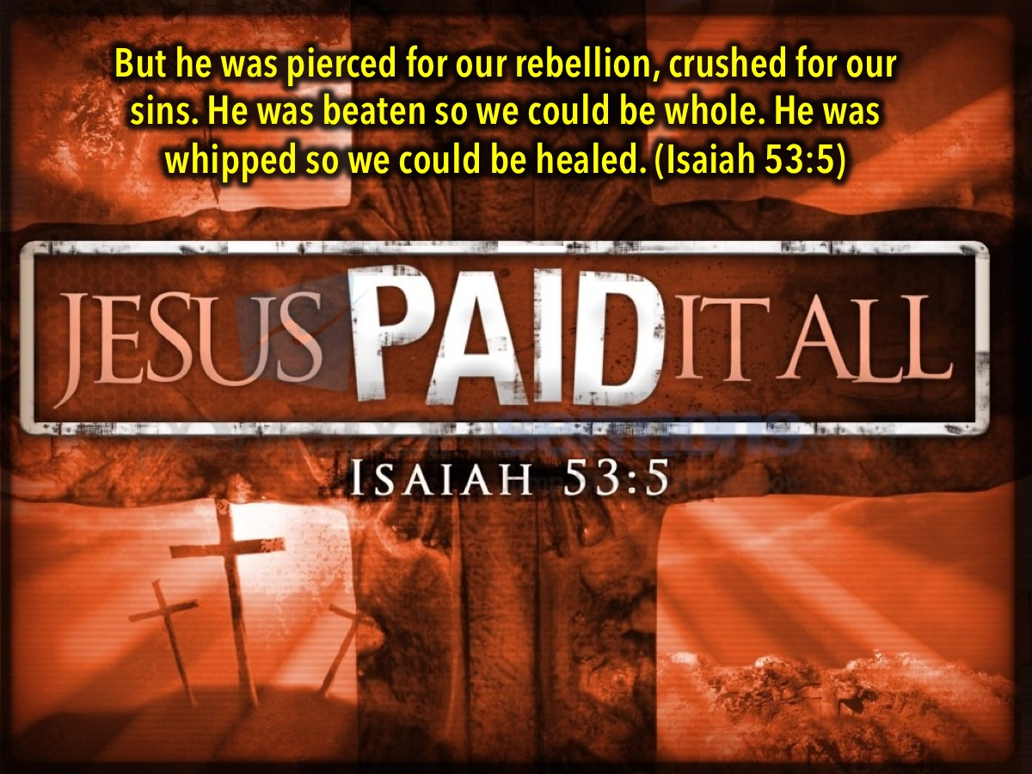
Notes:
But he was pierced for our rebellion, crushed for our sins. He was beaten so we could be whole. He was whipped so we could be healed. (Isaiah 53:5)

Slide 24
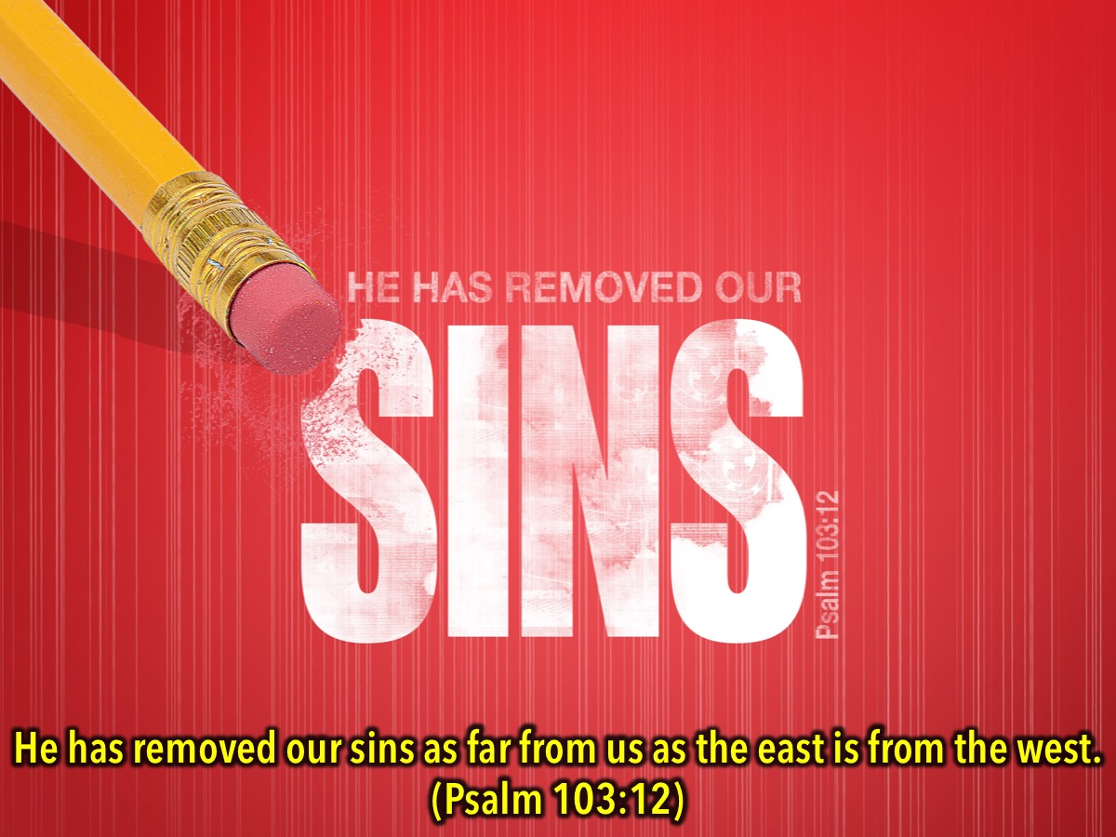
Notes:
Only the death of Jesus could remove our sins - nothing else can remove them! “He has removed our sins as far from us as the east is from the west.” (Psalm 103:12)

Slide 25

Notes:
We have to believe in Jesus to be saved. "That you confess with your mouth that Lord is Jesus, and believe in you heart that God has rasied Him from the dead, you will be saved.” (Romans 10:9). To believe on Jesus Christ as Saviour means to believe that He died for you, believe that He paid the price for sin, and believe that He is the only way to Heaven. You can express your belief in Jesus Christ by calling on Him in prayer: "Dear Jesus, I know that I am a sinner. I believe that you died on the cross and paid the penalty for my sin. I believe that you rose from the dead three days alter. I am placing my faith in you alone to forgive my sin and save me. Thank you for giving me eternal life. In Jesus' name, AMEN."

Slide 26
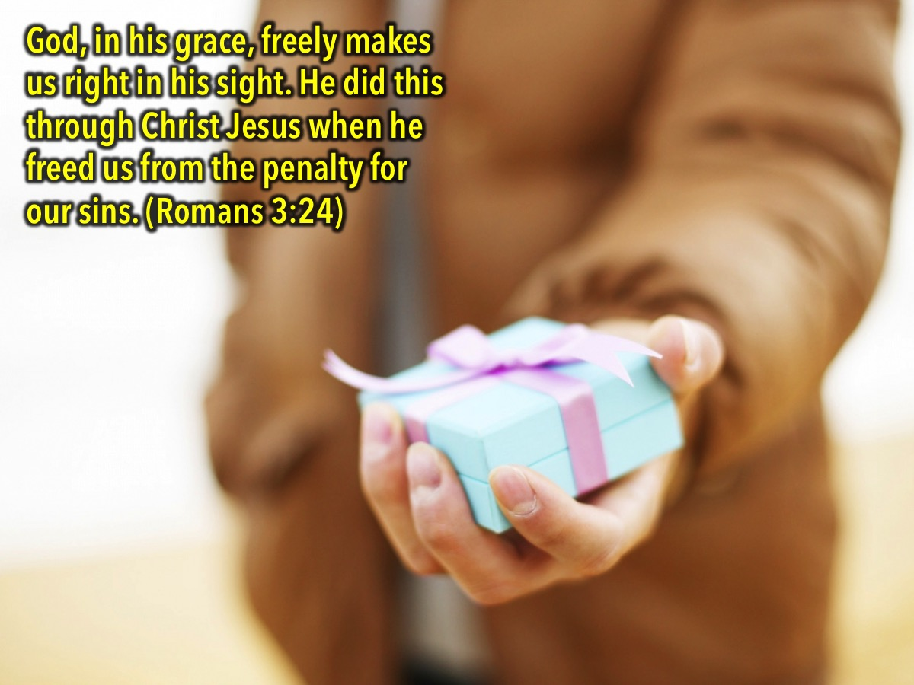
Notes:
God, in his grace, freely makes us right in his sight. He did this through Christ Jesus when he freed us from the penalty for our sins. (Romans 3:24). Jesus offers salvation to us as a free gift - it is not something that can be earned.

Slide 27
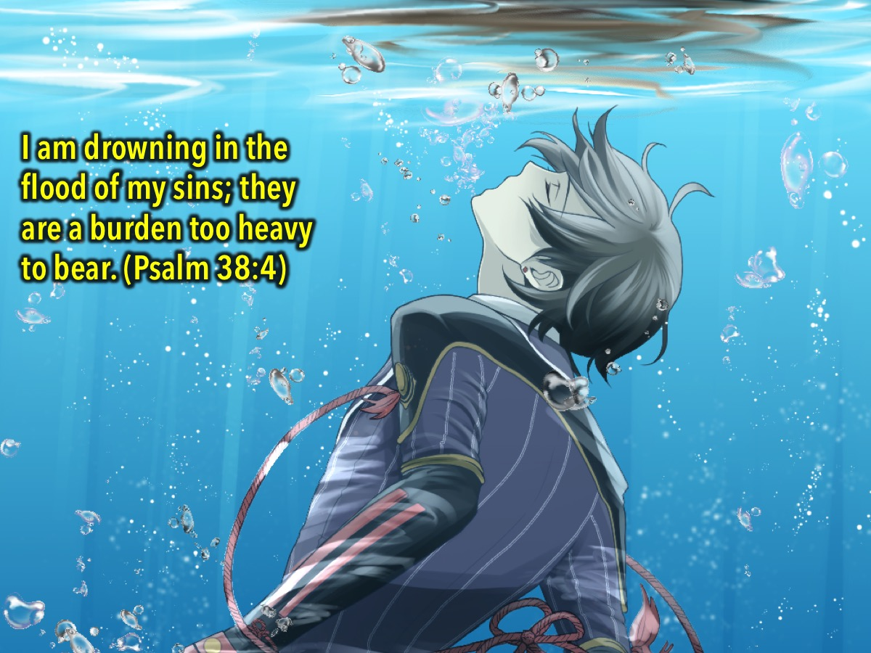
Notes:
I am drowning in the flood of my sins; they are a burden too heavy to bear. (Psalm 38:4). It is as if we were drowning in our sin and we were powerless to save ourselves.

Slide 28

Notes:
All we could do was put up our hand and call for help!

Slide 29

Notes:
We are saved by the grace of God not by anything that we do!

Slide 30

Notes:
In fact, we cannot accept God’s grace until we let go of our own righteousness. If we think we are good enough and deserve salvation we will never find it.

Slide 31
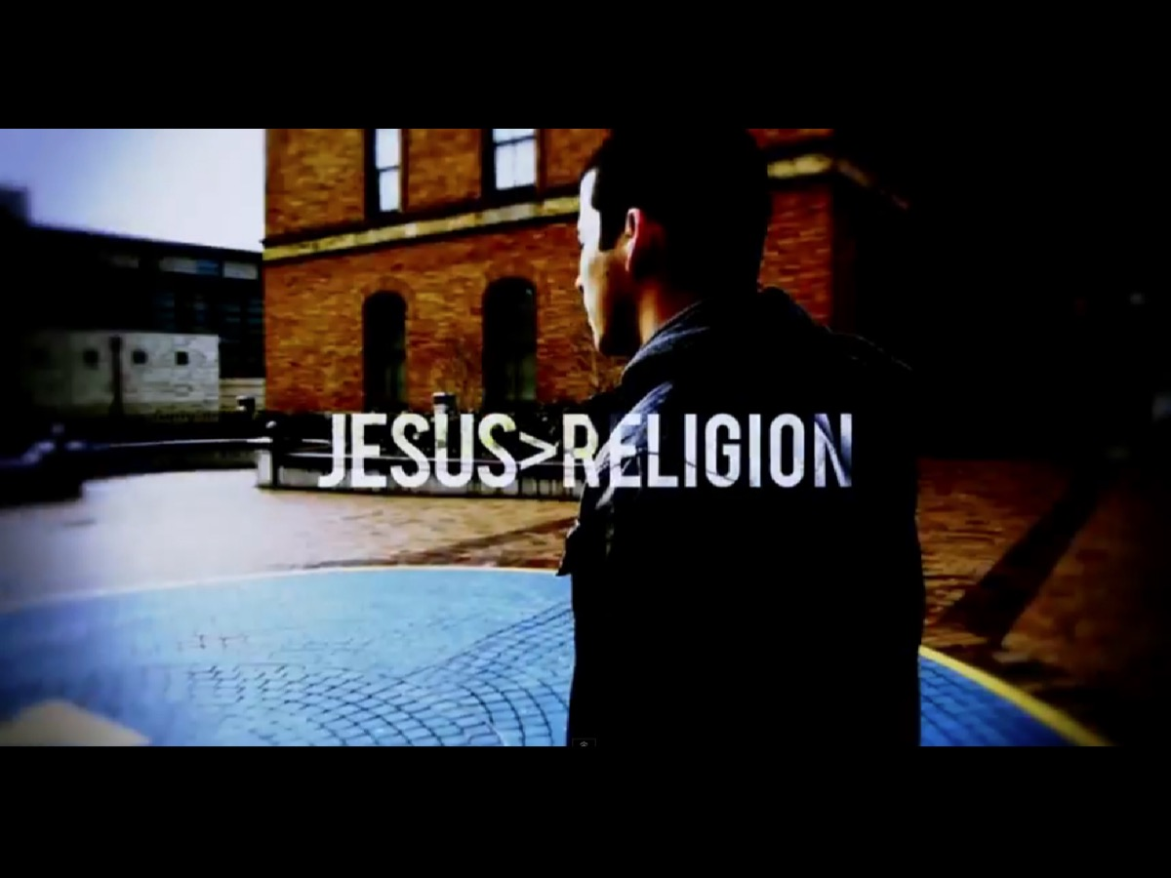
Notes:
Here is a spoken word video that talks about the difference between Jesus and Religion.

Slide 32
Notes:
Video: Why I Hate Religion, But Love Jesus. Get it on YouTube at: https://www.youtube.com/watch?v=1IAhDGYlpqY

Slide 33
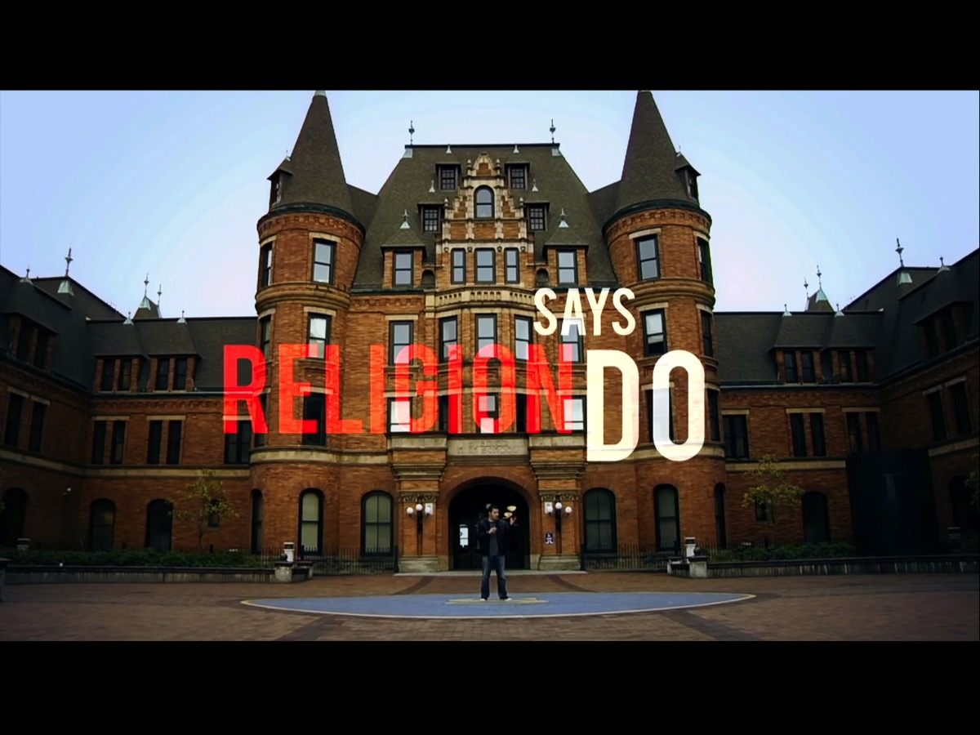
Notes:
So Religion Says Do…

Slide 34
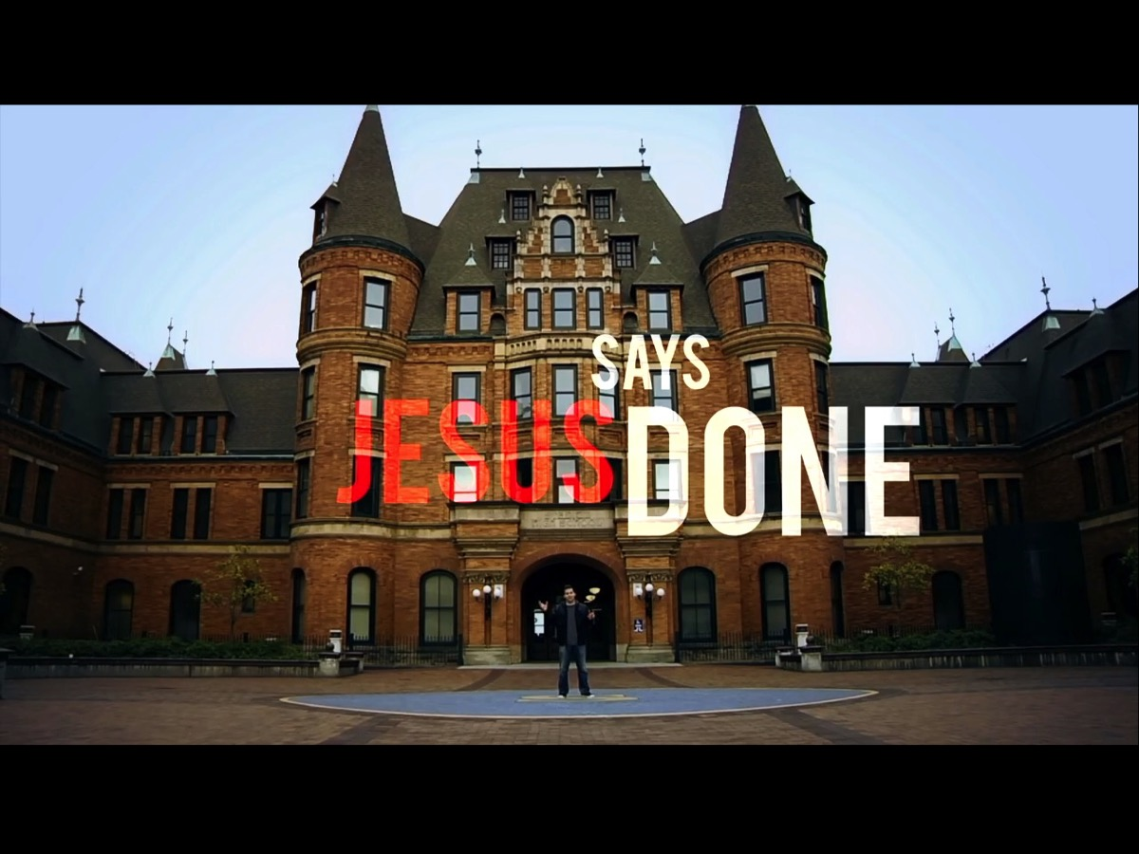
Notes:
But Jesus Says DONE.

Slide 35
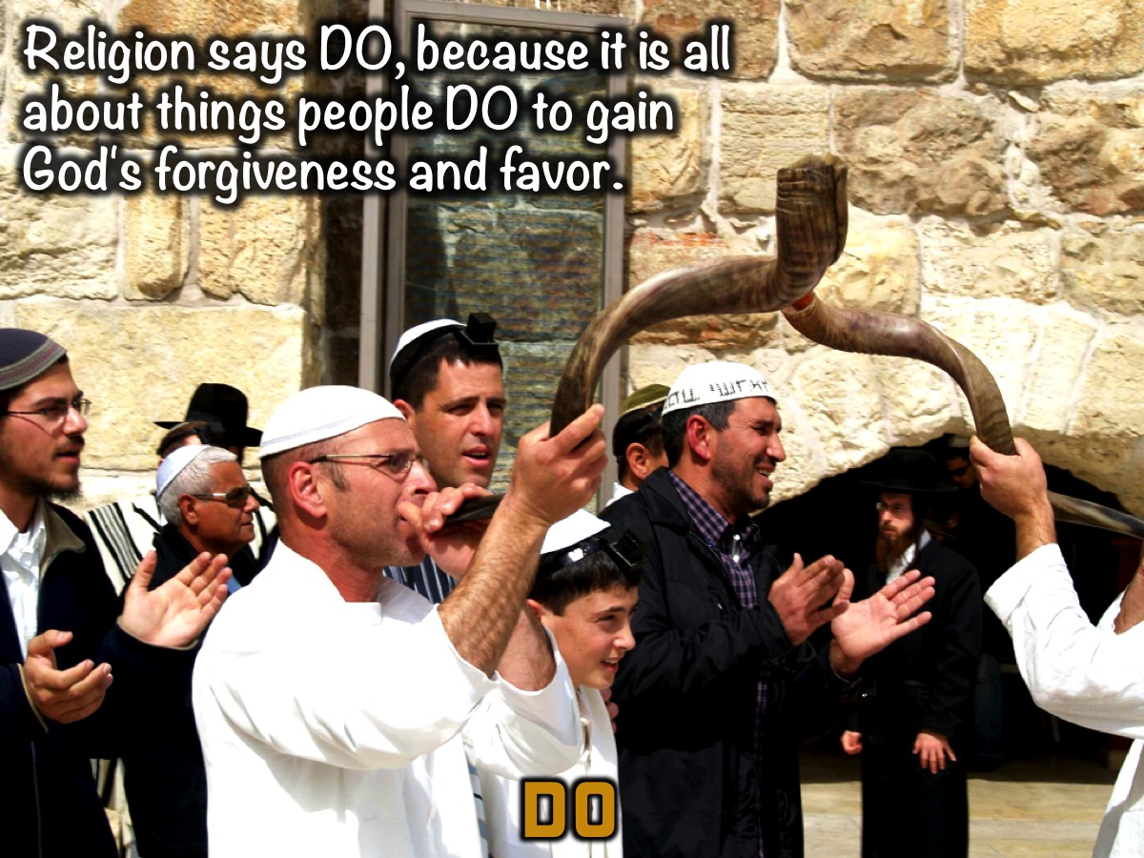
Notes:
The Do vs Done Illustration: The key difference between Christianity and other religions can be illustrated by the difference between Do and Done. “Religion says DO, because it is all about things people DO to gain God's forgiveness and favor.

Slide 36
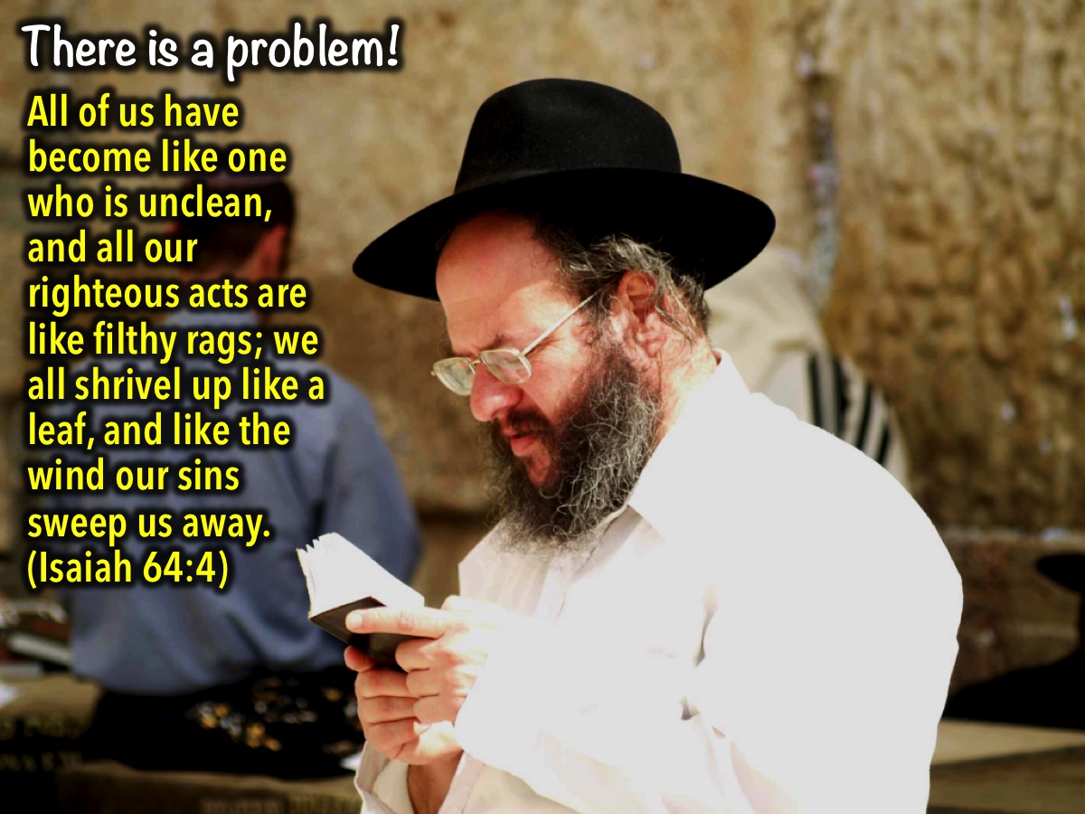
Notes:
But there is a problem… The Bible says that even our righteous acts are like filthy rages in God’s sight: “All of us have become like one who is unclean, and all our righteous acts are like filthy rags; we all shrivel up like a leaf, and like the wind our sins sweep us away”. (Isaiah 64:4)

Slide 37

Notes:
Jesus says DONE, because he has DONE what we could never do for ourselves. When we were utterly helpless, Christ came at just the right time and died for us sinners. God showed his great love for us by sending Christ to die for us while we were still sinners. (Romans 5:6,8)

Slide 38
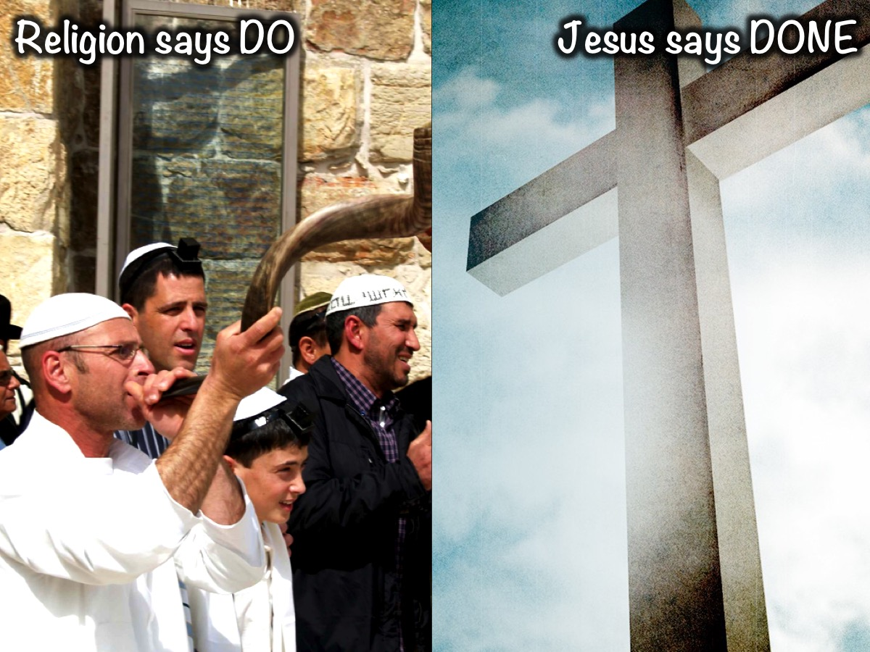
Notes:
So Religion says DO but Jesus says DONE.

Slide 39

Notes:
The Morality Ladder: We can think of morality (or how good or bad people are) as rungs on a ladder. God sits at the top of the ladder because he is holy — he’s perfectly moral or holy. And of course, really evil people are at the bottom: mass murderers and people like Hitler. The rest of humanity is somewhere in between. Mother Teresa would probably qualify for a rung about three-quarters of the way up. And Pastor Roger our lead pastor probably falls just below her. I think I should be on a run not too far below him because I work with teenagers and that is really hard work. Where do you think you would put yourself on the ladder - based on your morals? So, how do we make up the gap between ourselves and God? To hang out with God - who is perfect we have to be perfect ourselves? The only way that the gap can be closed is through the cross of Jesus Christ. There is no self-improvement program that will get us closer to God. The law was given for us to realise that we are sinners and cannot be holy on our own - apart from God. You will only get somewhere when you ditch your man-made plans and choose instead to accept the work that Jesus did on the cross. You can be forgiven. You can live an abundant life. Your morality gap can be closed once and for all by choosing faith in Christ.

Slide 40
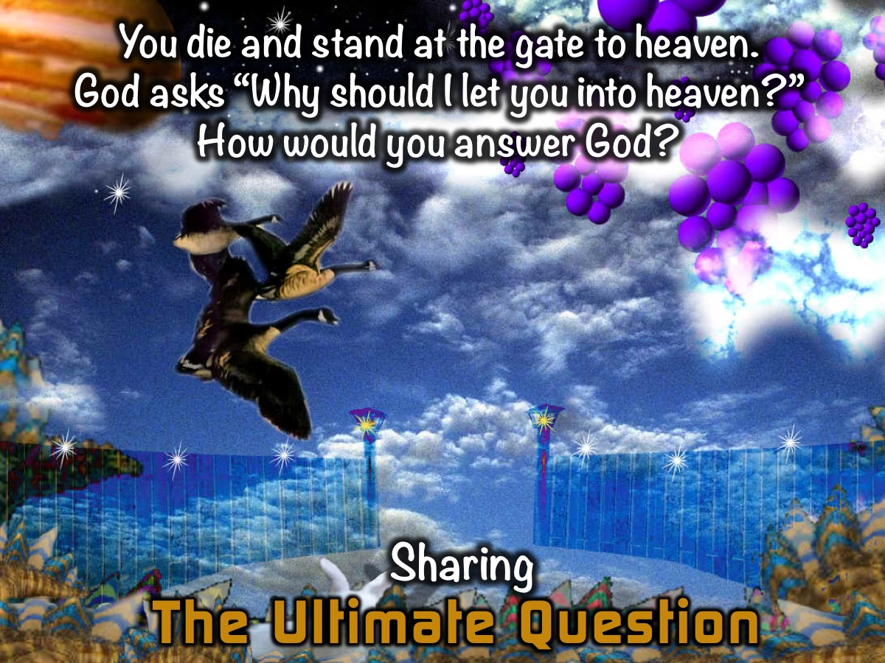
Notes:
Sharing: Imagine you die and you stand at the gate to heaven. God asks: Why should I let you into heaven? What would you say? Turn to the person next to you and each of you can play the role of God asking that question and think about the answers you each give.

Slide 41
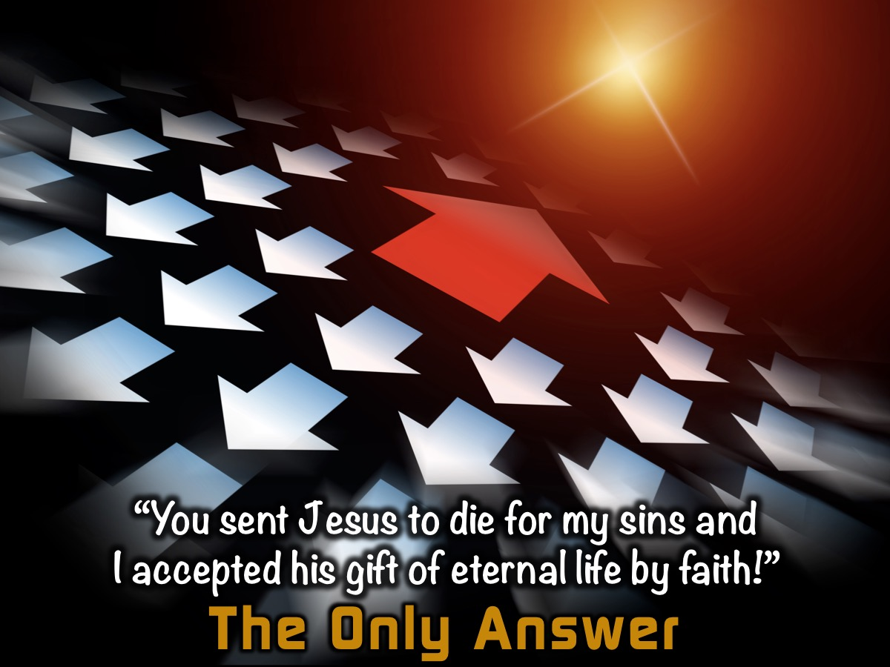
Notes:
The only right answer to that question is: You sent Jesus to die for my sins and I accepted his gift of eternal life by faith!

Slide 42

Notes:
Let me remind you - Religion says DO but Jesus says DONE.

Slide 43
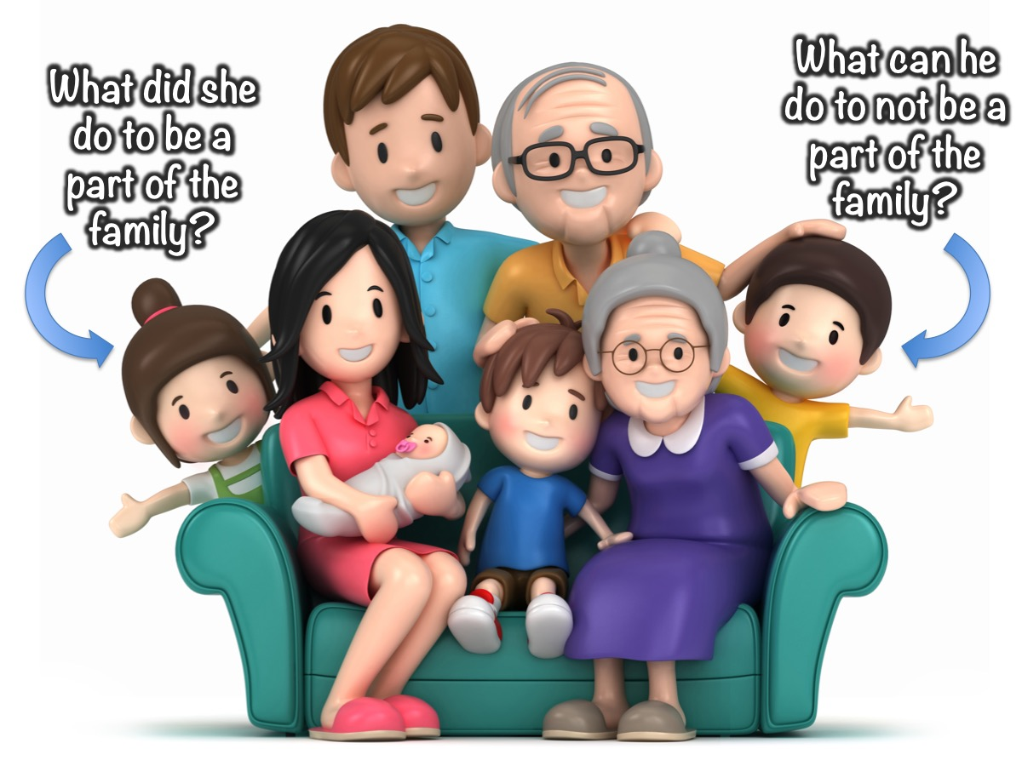
Notes:
Illustration: Once you are born into a family - what do you need to do to be a part of that family? Nothing! Of course you can displease your parents but you won’t be disowned for not doing certain things - you are their child because of what they have DONE and not because of anything you can DO!

Slide 44

Notes:
Once more: Religion says DO but Jesus says DONE.

Slide 45

Notes:
Religion is man working their way up to God.

Slide 46
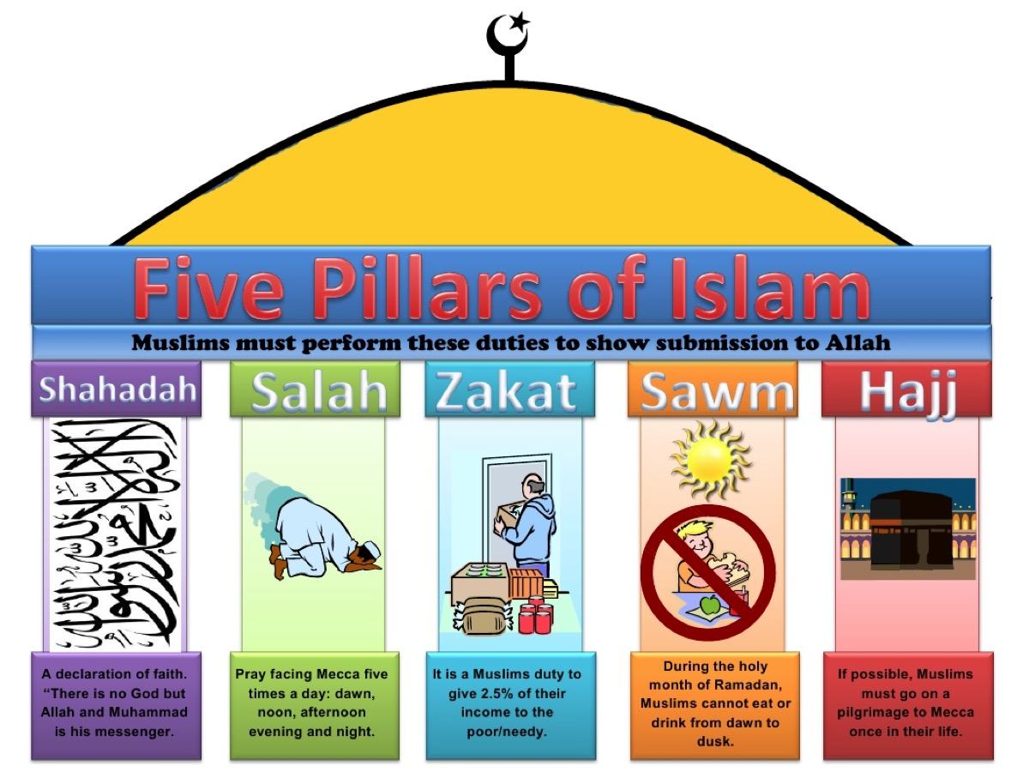
Notes:
For example here is an image showing the Five Pillars of Islam - and apart from a belief in Allah as God - all the rest are duties that must be performed.

Slide 47
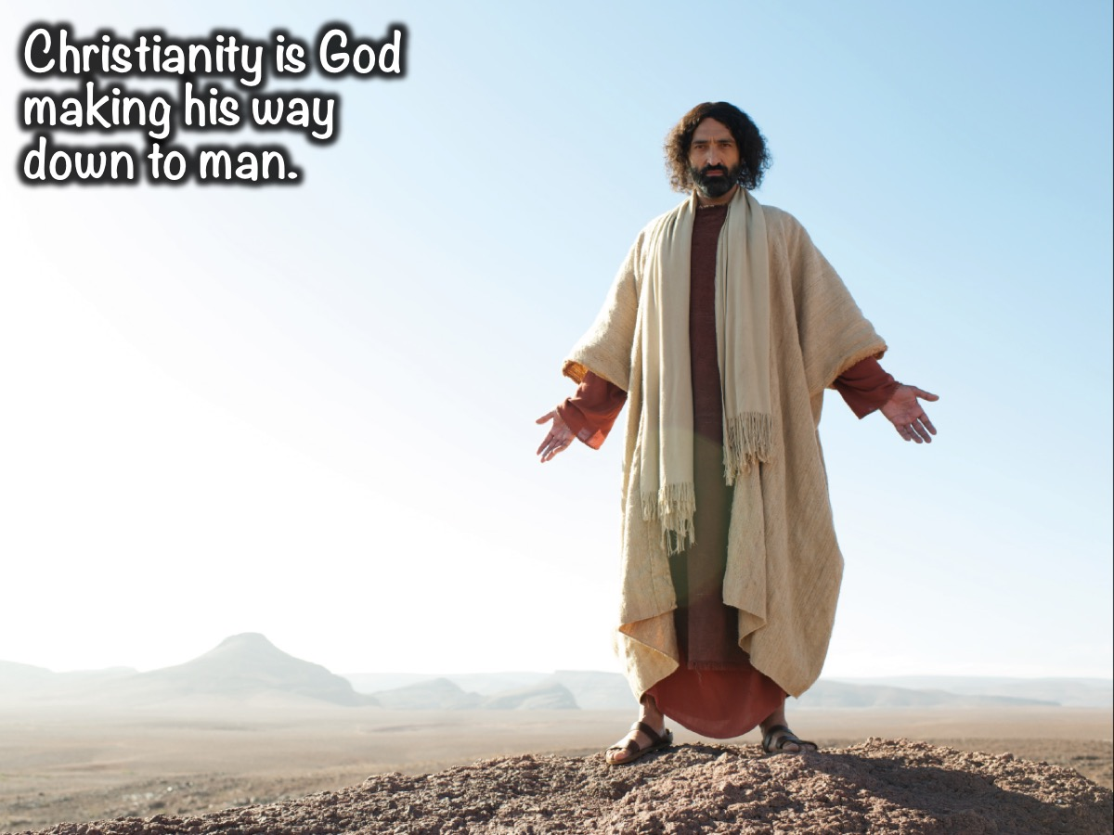
Notes:
But Christianity is God making his way down to man.

Slide 48

Notes:
Jesus is the Only Way to God! Jesus himself said: I am the way, the truth, and the life. No one can come to the Father except through me. (John 14:6)

Slide 49
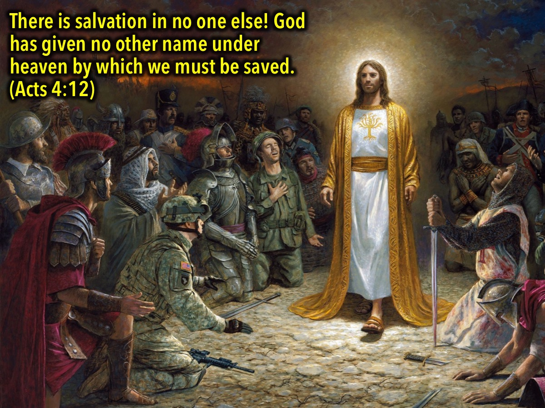
Notes:
According to Acts 4:12 salvation is found in no one else but in Jesus. There is salvation in no one else! God has given no other name under heaven by which we must be saved. (Acts 4:12)

Slide 50
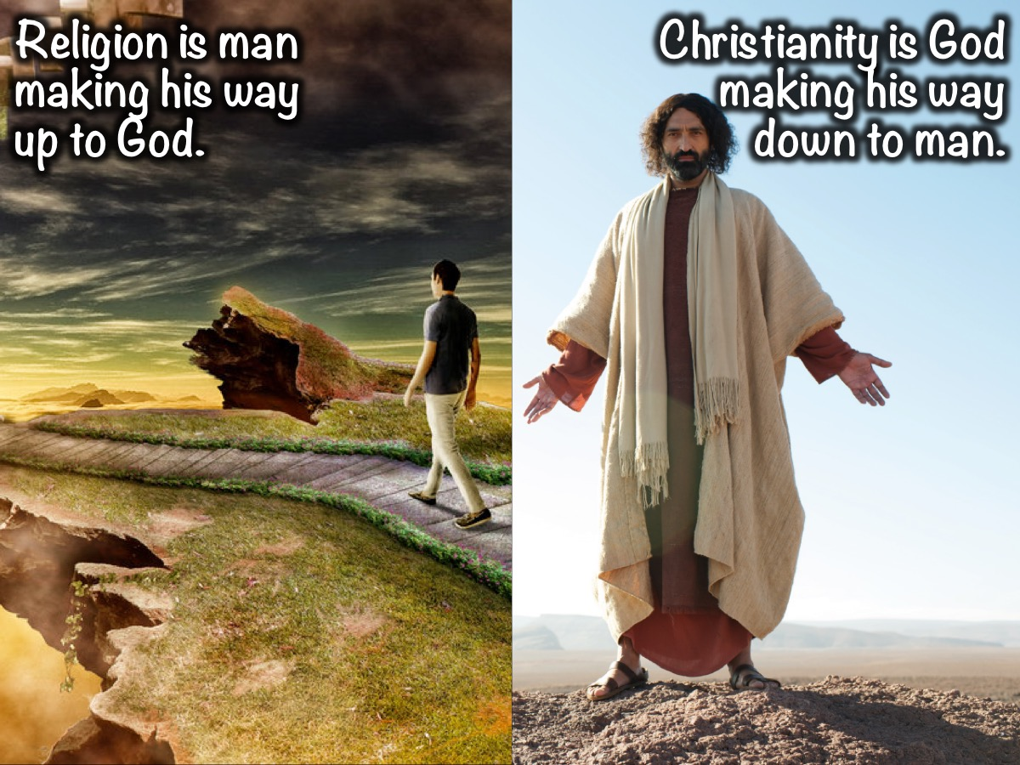
Notes:
Religion is man making their way up to God but Christianity is God making his way down to man.

Slide 51
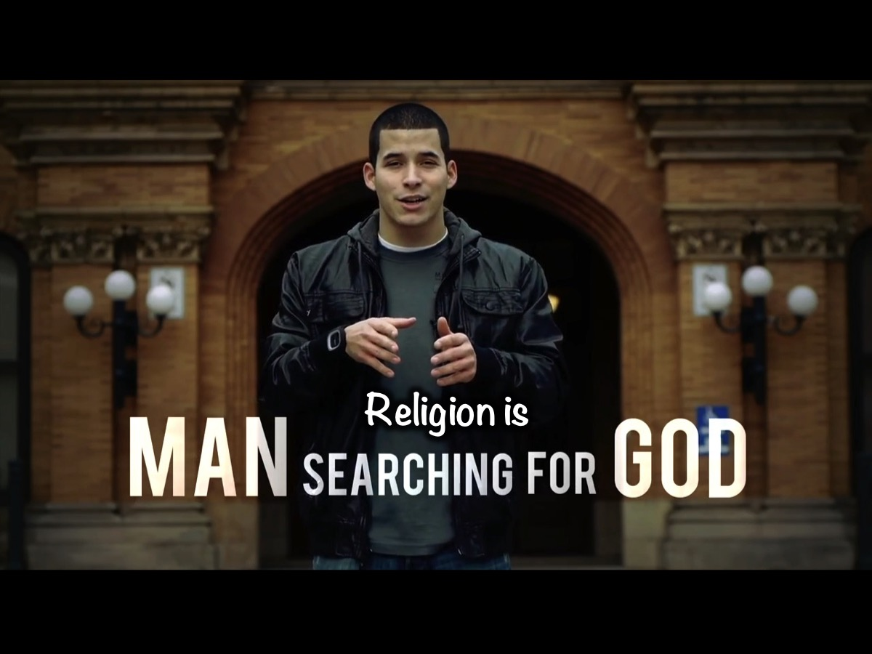
Notes:
In the video we learnt that: Religion is Man Searching for God,

Slide 52
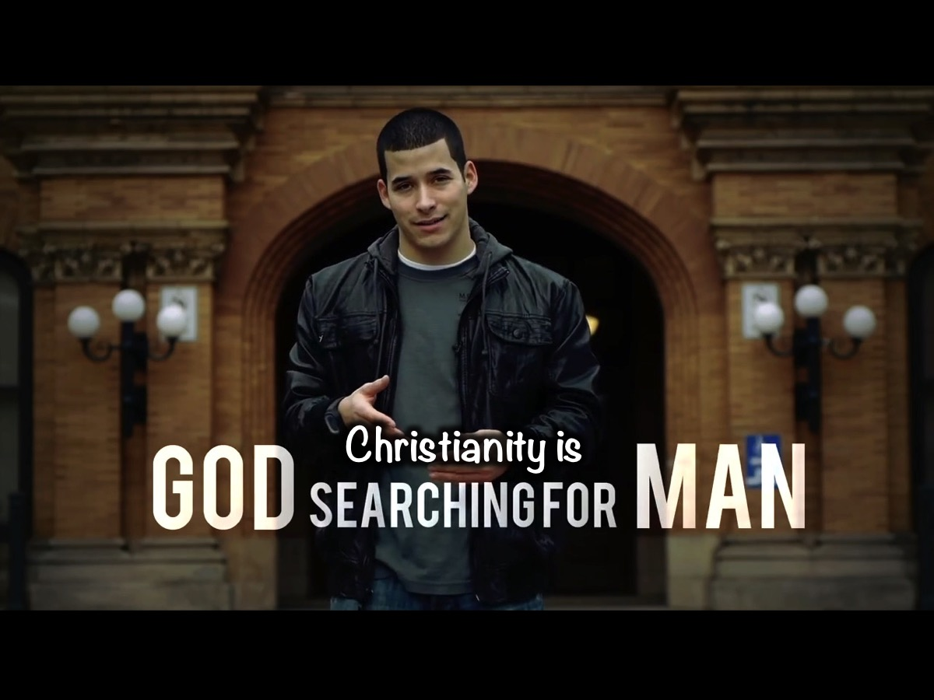
Notes:
…but Christianity is God Searching for Man.

Slide 53
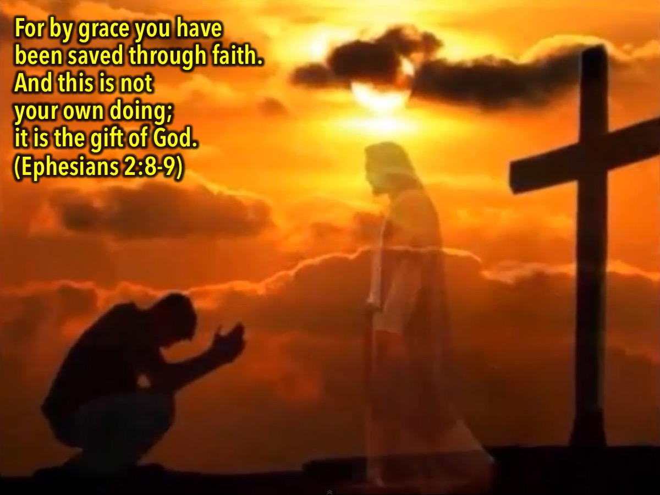
Notes:
"For by grace you have been saved through faith. And this is not your own doing; it is the gift of God…" (Ephesians 2:8-9)

Slide 54
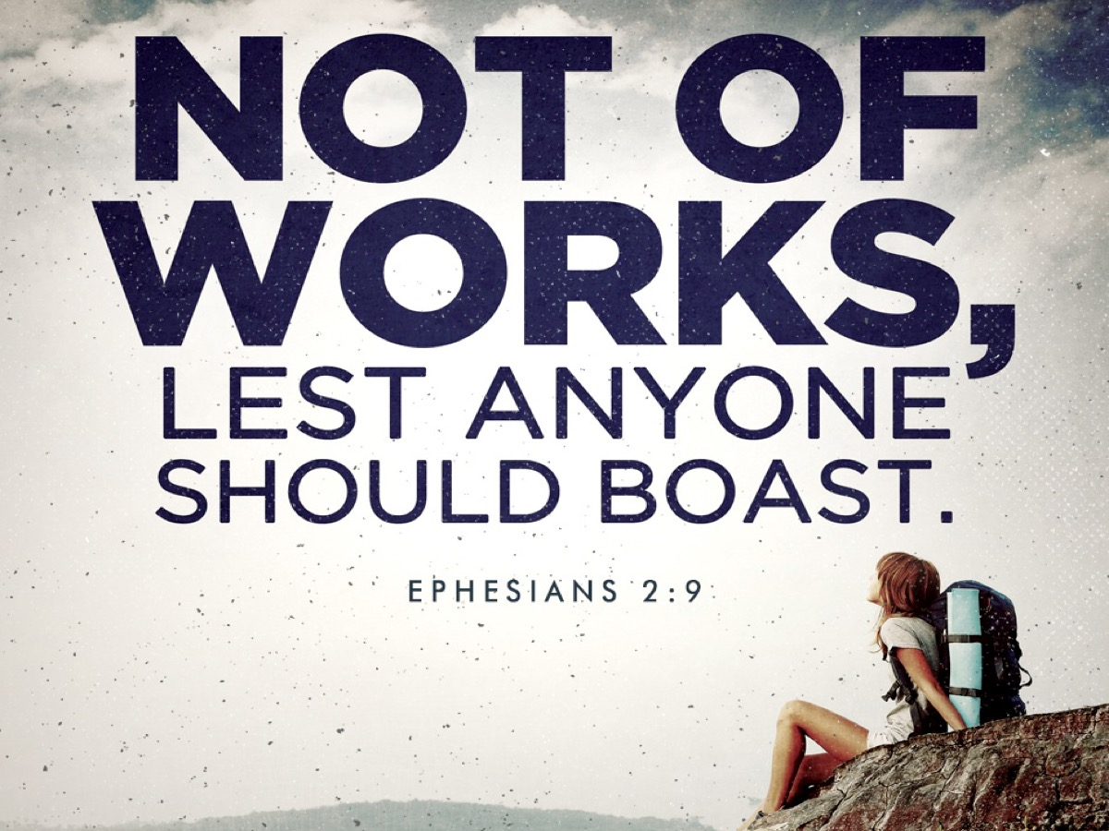
Notes:
“…not a result of works, so that no one may boast." (Ephesians 2:8-9)

Slide 55

Notes:
It is like we can get a free ticket to heaven - paid for by Jesus - and it is good for all eternity!

Slide 56
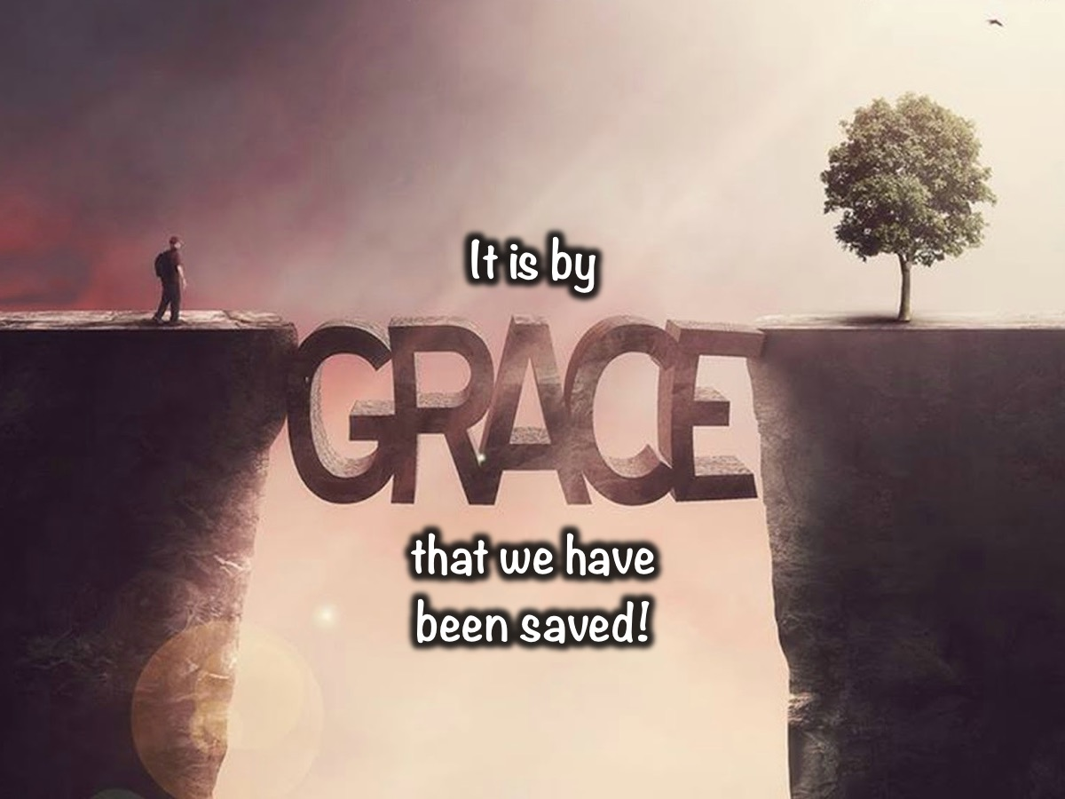
Notes:
Let me remind you that it is by grace that we have been saved!!!

Slide 57
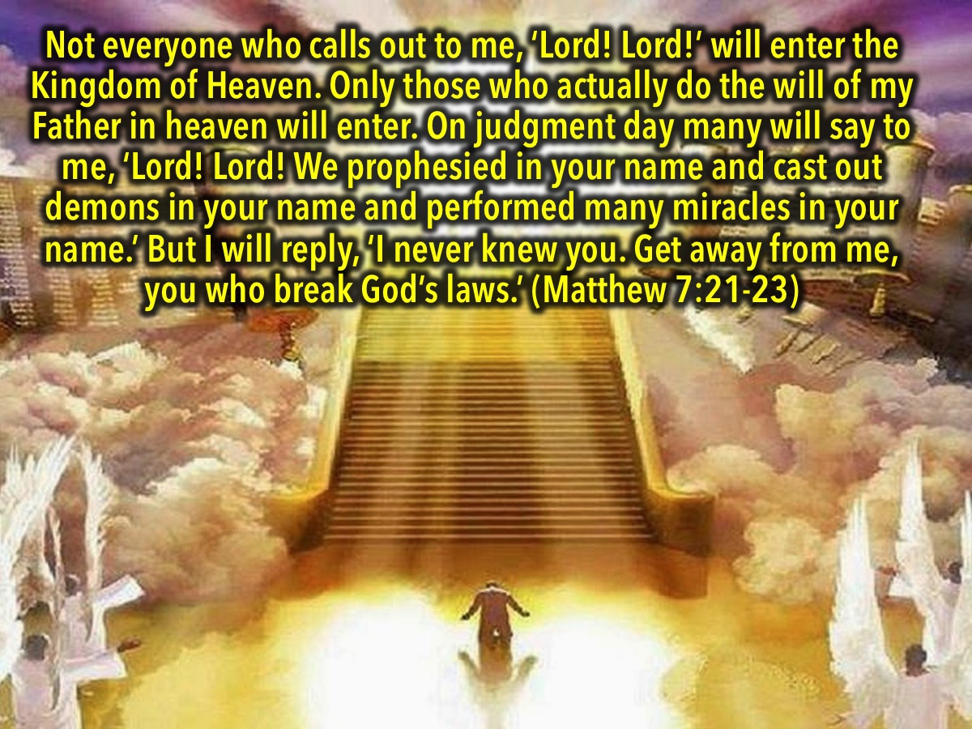
Notes:
Jesus said something very chilling that reminds us that it is not our works that save us: “Not everyone who calls out to me, ‘Lord! Lord!’ will enter the Kingdom of Heaven. Only those who actually do the will of my Father in heaven will enter. On judgment day many will say to me, ‘Lord! Lord! We prophesied in your name and cast out demons in your name and performed many miracles in your name.’ But I will reply, ‘I never knew you. Get away from me, you who break God’s laws.’” (Matthew 7:21-23)

Slide 58

Notes:
So what is the place for good deeds? Our good deeds cannot save us! Once we are saved, our good deeds probably bring a smile to God’s face and there will be rewards given out one day in glory for all that we have done - but they cannot get us into a relationship with God - no more than me buying someones parents chocolates and flowers will make me their son!

Slide 59

Notes:
For we are God’s handiwork, created in Christ Jesus to do good works, which God prepared in advance for us to do. (Ephesians 2:10)

Slide 60
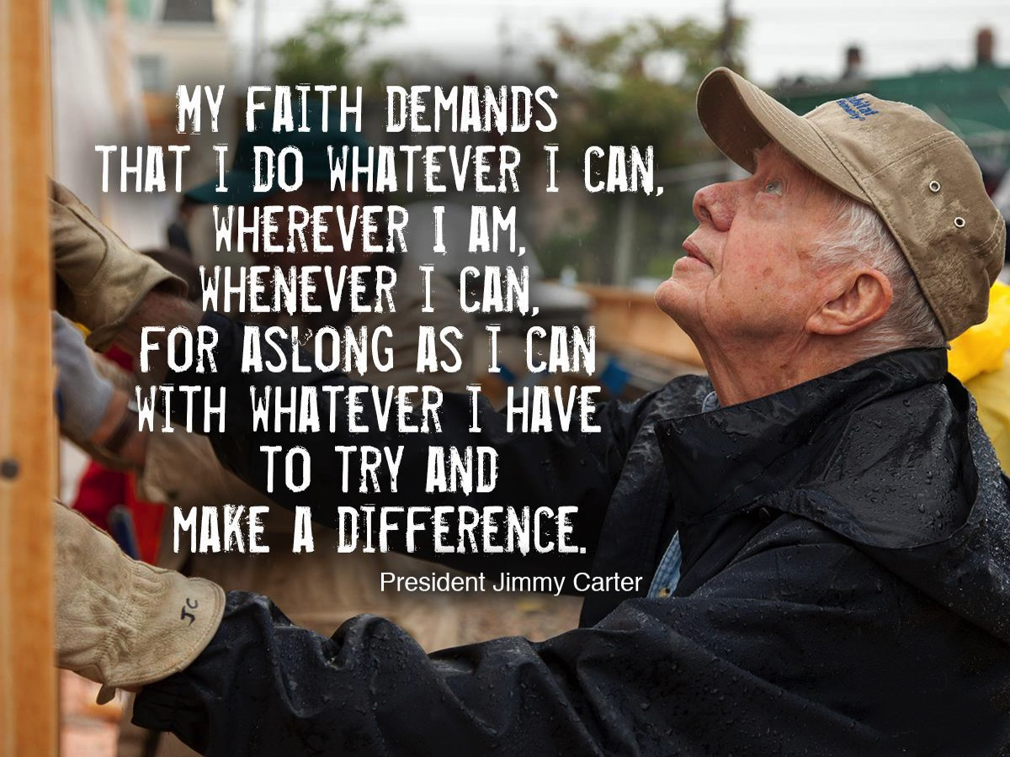
Notes:
One of the past presidents of America, Jimmy Carter who works with Habitat for Humanity providing housing for the poor said: “My faith demands--this is not optional--my faith demands that I do whatever I can, wherever I am, whenever I can, for as long as I can with whatever I have to try to make a difference.”

Slide 61
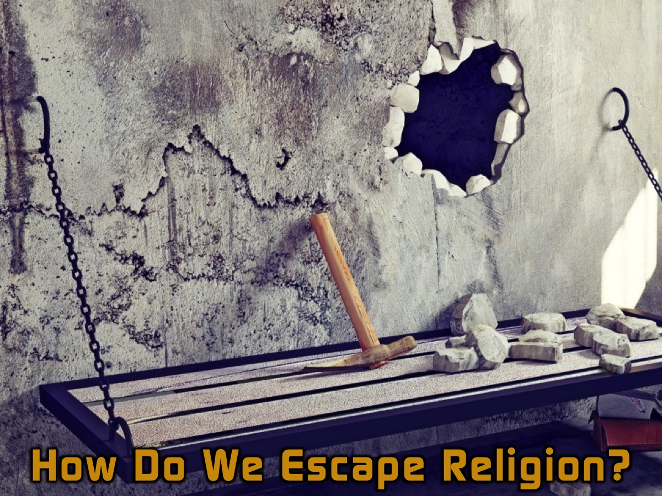
Notes:
How Do We Escape Religion?

Slide 62

Notes:
1. Accept God’s Gift - salvation is a free gift and cannot be bought or earned. it is pointless trying to deserve it or earn it!

Slide 63
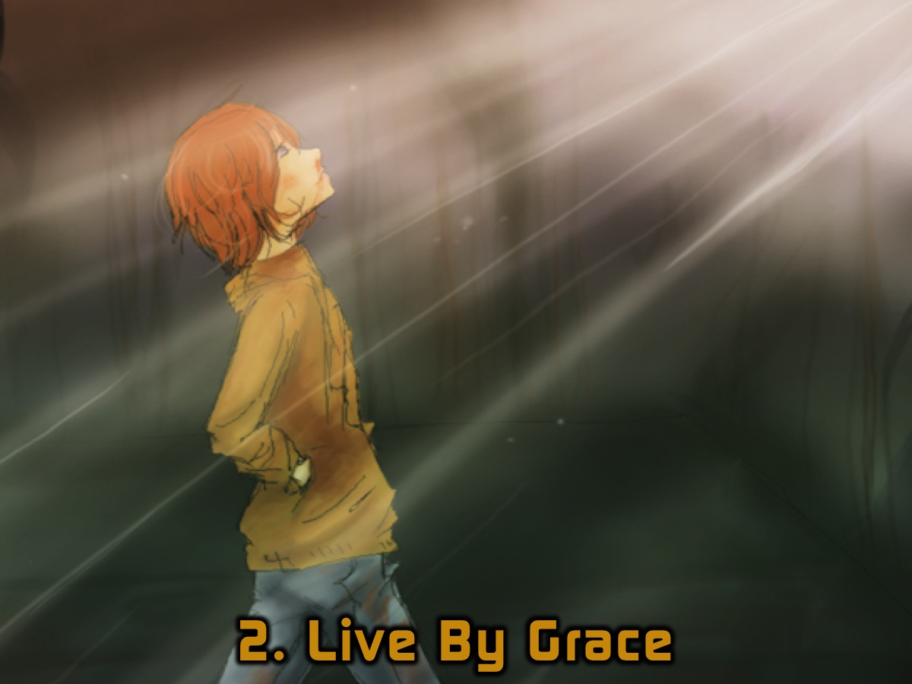
Notes:
2. Live By Grace. Once I am saved by all that God has done for me in Jesus on the cross, do I just live like I want and forget about other people or morality? Of course not, we are called to follow Jesus, to become like Jesus, to be perfect even as our Father in heaven is perfect - the difference is that we don’t do good deeds to earn salvation - we do them as evidence of our salvation - we love people because God loved us and because he loves them - we have a new nature that replaces our old sin nature and it compels us to act in line with our new nature.

Slide 64

Notes:
3. Check Your Motives. Whenever we do something “spiritual” maybe we should check what is making us do it. Is it to try and earn favour with God? If that is the reason then we should think twice because that won’t work! We must do things out of love for Jesus and not to make him love us more.

Slide 65
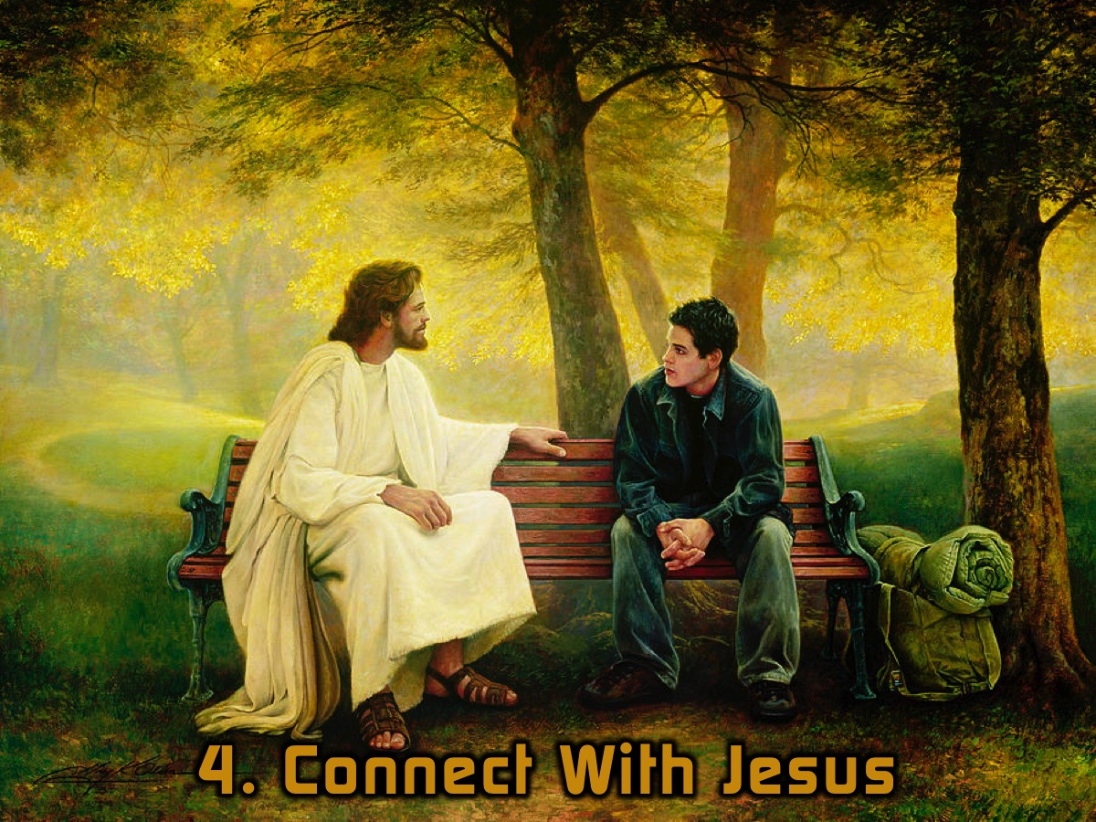
Notes:
4. Connect With Jesus - maybe this is the most important part of the whole deal - Christianity is all about Christ after all! Believers were called Christ Followers in the New Testament. It is all about developing a relationship with Jesus.

Slide 66
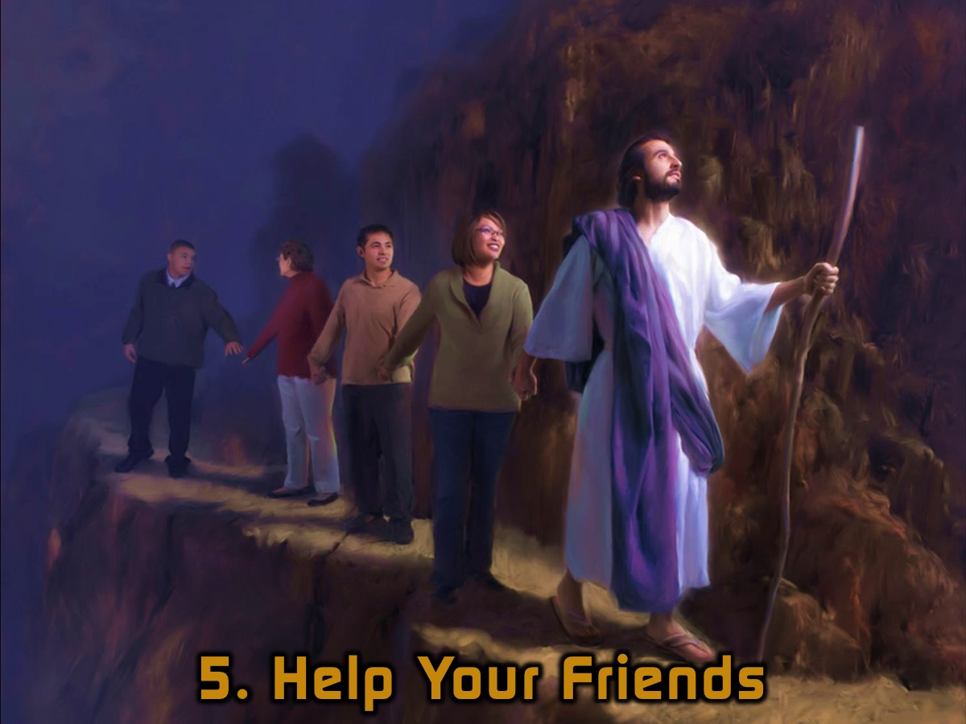
Notes:
5. Help Your Friends. As we were challenged at our Heaven or Hell Friday night event, we should be involved in telling other people about Jesus to help them enter into a relationship with him rather than trying to work their way to heaven.

Slide 67
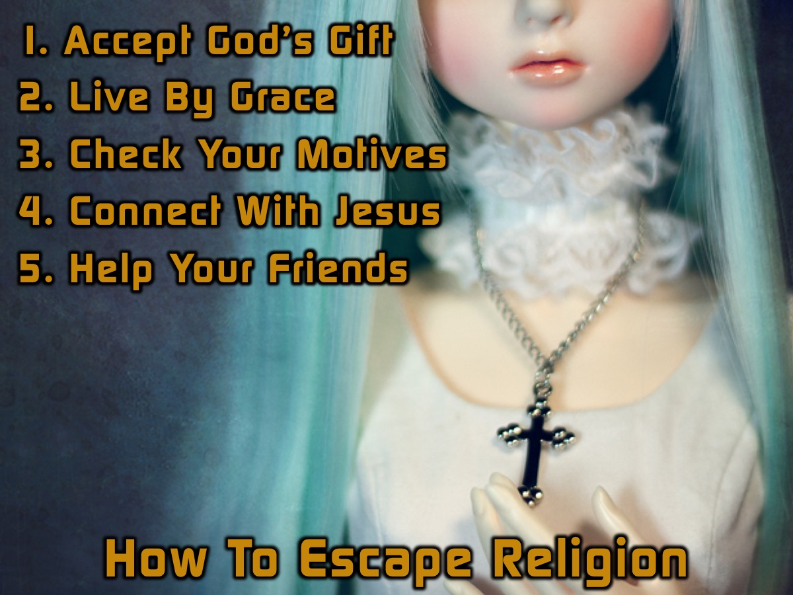
Notes:
Summary: To escape religion you need to: (1) Accept God’s Gift, (2) Live By Grace, (3) Check Your Motives, (4) Connect With Jesus and (5) Help Your Friends.

Slide 68
Notes:
Video: Jesus > Religion. Get it on YouTube at: https://www.youtube.com/watch?v=ug4HdUV0Ip8

Slide 69
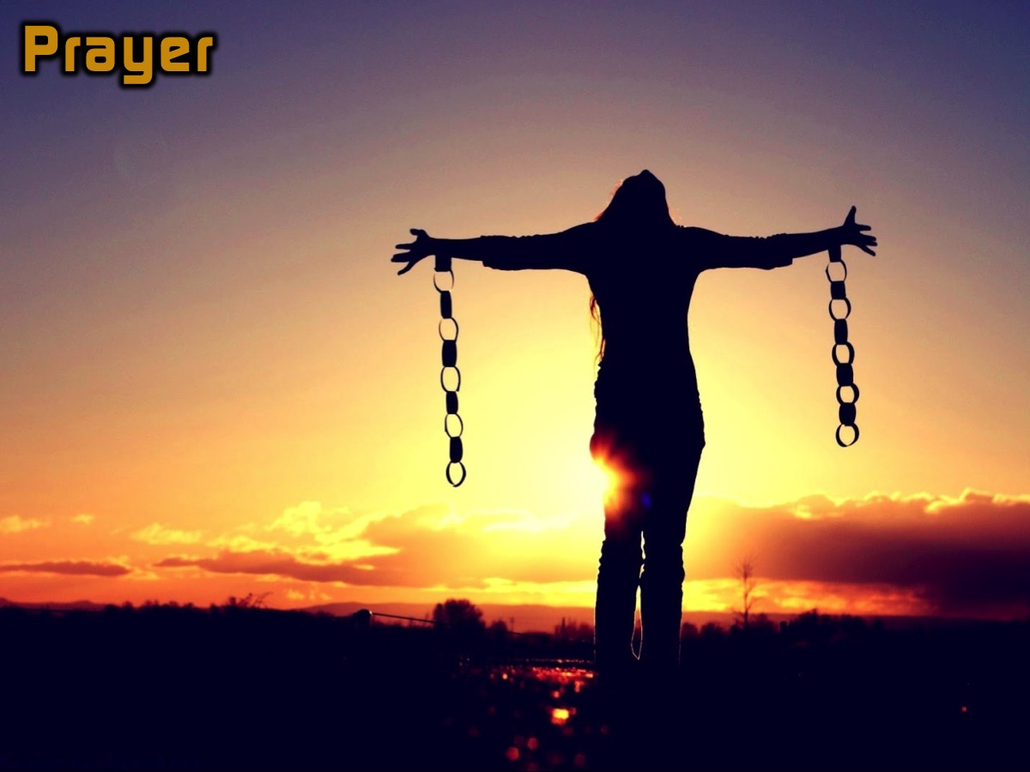
Notes:
Prayer

Slide 70

Notes:
Next term we will launching a brand new series: The Word-On Series where we will be looking at what the Word has to say about different topics like God, People, Suffering, Money, etc.

