Slide 1

Notes:
This week is our Breakout Party Night.

Slide 2

Notes:
On Sunday morning there is no youth service because of the term break.

Slide 3

Notes:
On Sunday morning we are meeting on the top of Northcliff Hill for a Easter Sunrise Service at 6am and then we will come through to church after that.

Slide 4

Notes:
Next Friday is term break - so no youth until the school starts again - in 2 weeks time.

Slide 5
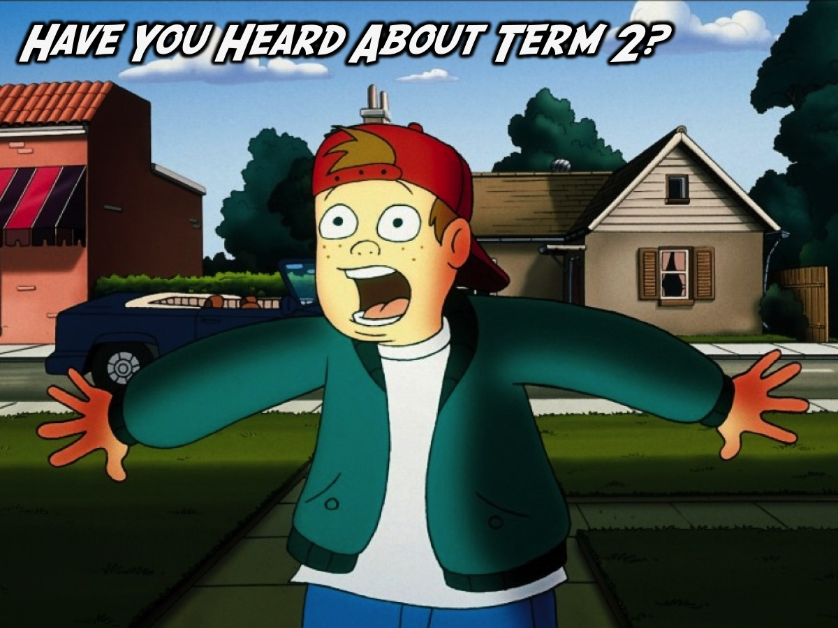
Notes:
Have you heard about Term 2?

Slide 6

Notes:
Next Term we are launching a brand new Friday night series called ReCharge Friday.

Slide 7

Notes:
There is a Pizza Night!

Slide 8

Notes:
There is a His-Her night!

Slide 9

Notes:
There is a Dodgeball Night

Slide 10

Notes:
There is a Talent Night.

Slide 11

Notes:
There is a CrossFit Night!

Slide 12

Notes:
There is a Power Night!

Slide 13

Notes:
Tonight is our Breakout Party Night.

Slide 14

Notes:
Welcome to newcomers and regulars.

Slide 15
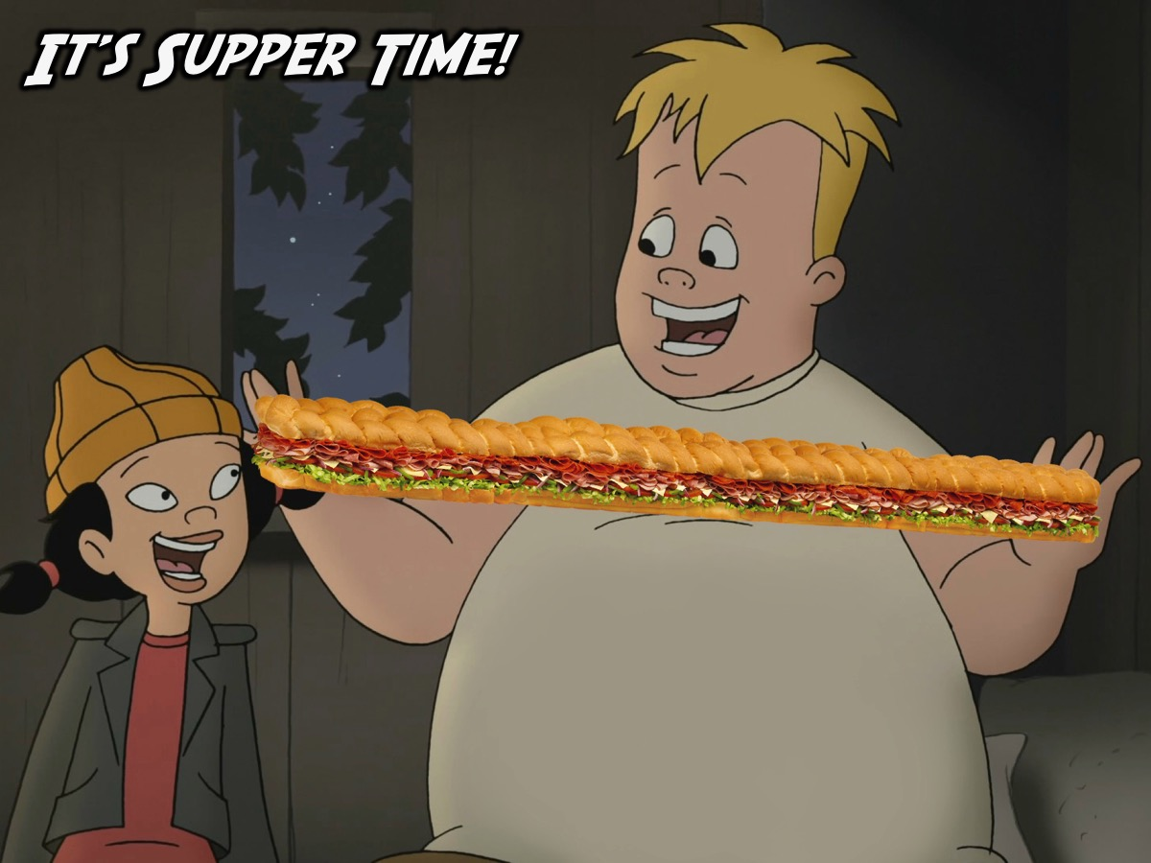
Notes:
It’s Supper Time. You are going to make Joburg’s biggest sandwich or Sub! Enjoy!

Slide 16
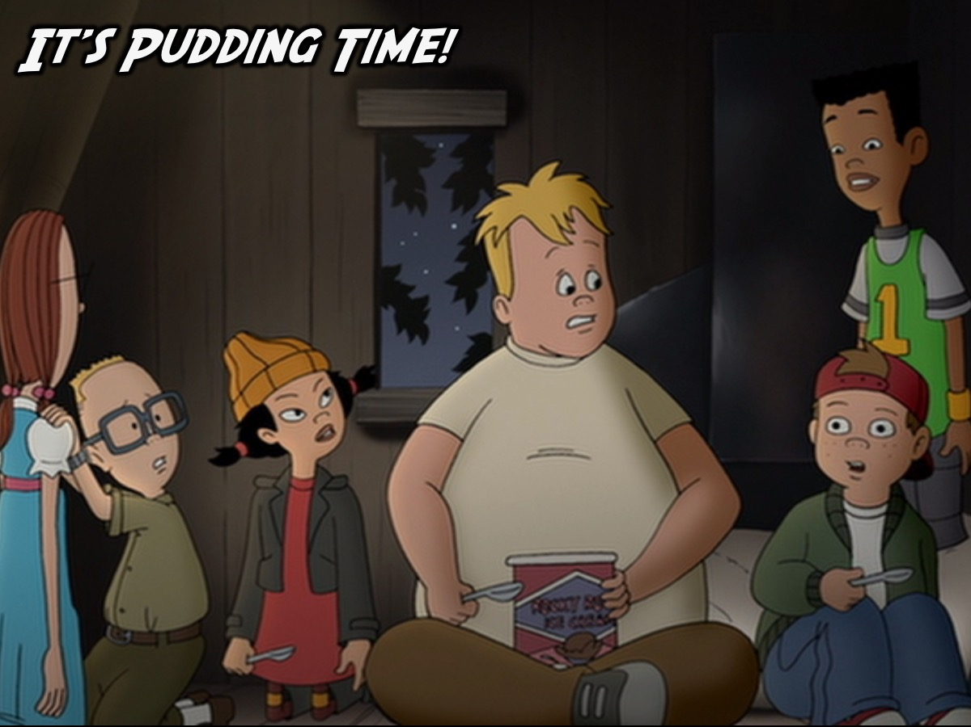
Notes:
It’s Pudding Time! Enjoy the ice-cream and topping!

Slide 17
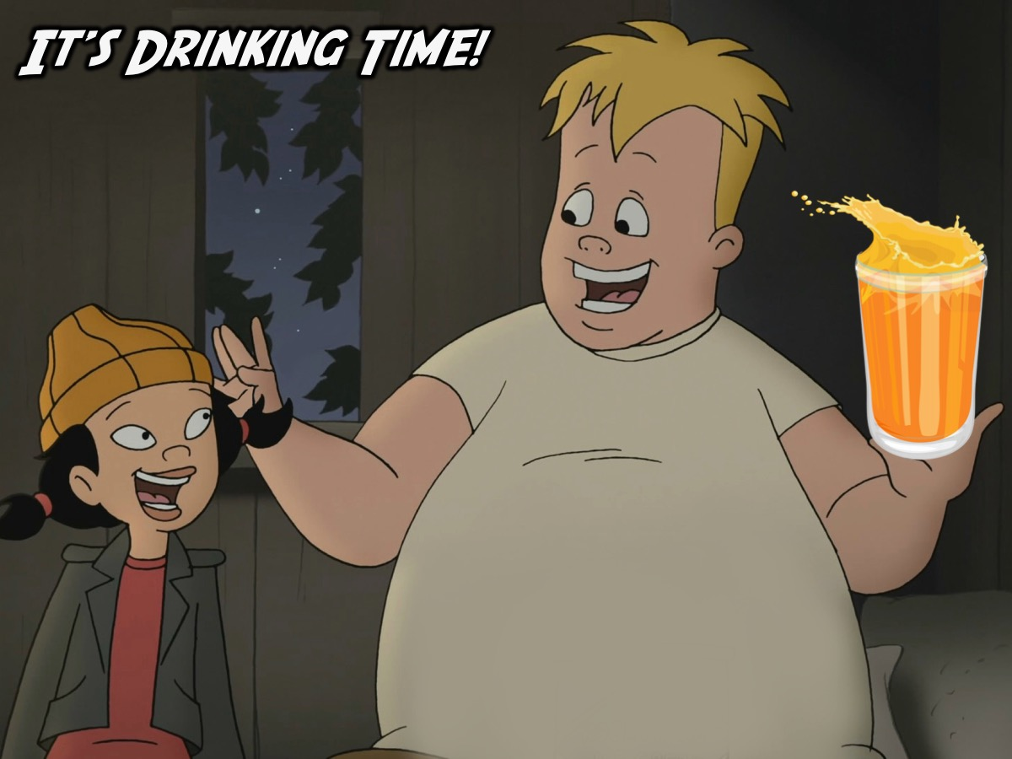
Notes:
It’s Drinking Time! Juice is served!

Slide 18
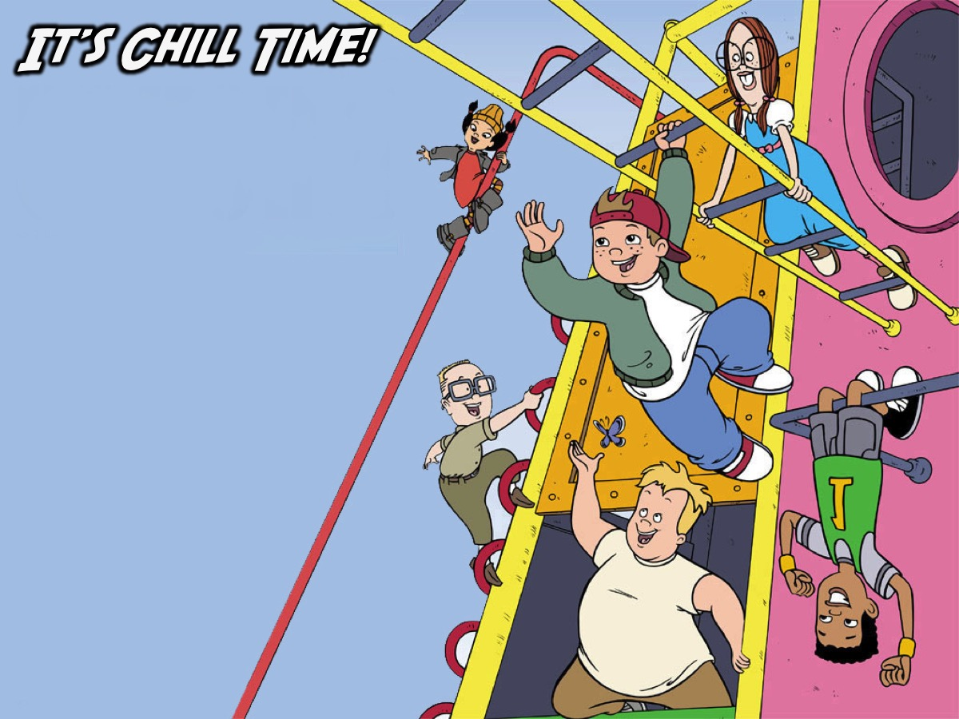
Notes:
It’s Chill Time!

Slide 19

Notes:
Enjoy the break!!!

