Slide 1
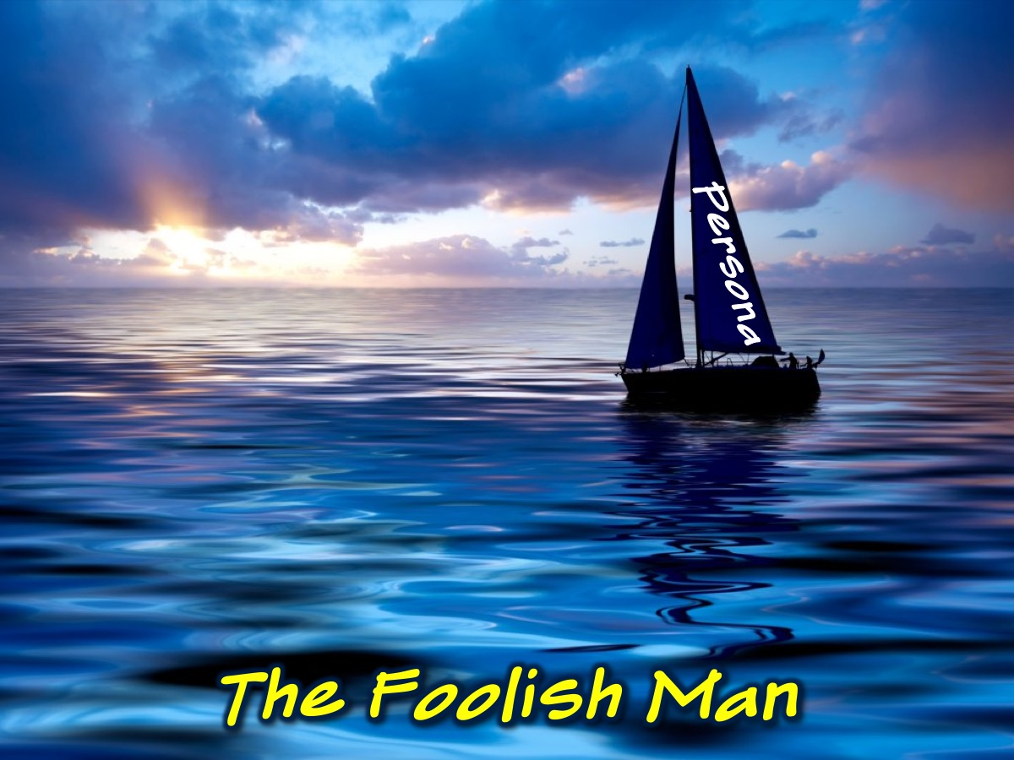
Notes:
The Parable of the Foolish Man
Once a foolish man built a boat. His intention was that it would be the grandest, the most talked-about boat that ever sailed from the harbour of the boat club of which he was a member, so he determined to spare no expense or effort.
As he built, the foolish man outfitted his craft with colourful sails, complex rigging, and comfortable appointments and conveniences in its cabin. The decks were made from beautiful teak-wood; all the fittings were custom-made of polished brass. And on the stern, painted in gold letters, readable from a considerable distance, was the name of the boat, the Persona.
As he built he could not resist fantasizing about the admiration and applause that would come from club members when his boat was launched. In fact, the more he thought about the coming praise, the more time and attention he gave to those aspects of the boat's appearance that would attract the crowd.
Because no one would ever see the underside of the Persona, the man saw little need to be concerned about the boat's keel or, for that matter, anything that had to do with the issue of properly distributed weight or ballast. Experienced sailors might wince at this, but one must remember that the boatbuilder was acting with the perceptions of the crowd in his mind - not the seaworthiness of the vessel. Seaworthiness seems not an important issue while in a dry dock.
Once when he was sorting out his priorities of time and resources, he said to himself, "Why should I spend money or time on what is out of anyone's sight? When I listen to the conversations of people at the club, I hear them praising only what they can see. I can never remember anyone admiring the underside of a boat. Instead, I sense that my yachting colleagues really find exciting the colour and shape of a boat's sails, its brass fittings, its cabin and creature comforts, decks and wood texture, speed and the skill that wins the Sunday afternoon regattas."
So driven by such reasoning, the foolish man built his boat. And everything that would be visible to the people soon began to gleam with excellence. But things that would be invisible when the boat entered the water were generally ignored. People did not seem to take notice of this, or if they did, they made no comment.
The builder's suspicions were correct: the people of the boat club understood and appreciated sails, rigging, decks, brass, and staterooms. And what they saw, they praised. Sometimes he over-heard people say that his efforts to build the grandest boat in the history of the club would someday result in his selection as commodore. That had no little effect upon his conviction that he had made good decisions and was on a correct course to boat-club acceptance and success.
When the day came for the boat's maiden voyage, the people of the club stood on the dockside. A bottle of champagne was broken over the bow, and he set sail. As the breeze filled the sails and pushed the Persona from the club's harbor, he stood at the helm and heard people say: "Our club has never seen a grander boat than this. This man will make us the talk of the yachting world." There were some boat owners who joined him, sailing on either side as they moved out beyond the break-water and into the ocean.
As the Persona cut through the swells, its builder gripped the rudder with a feeling of fierce pride. He was seized with a rush of confidence that everything - the boat, his future in the club and even the ocean was his to control.
But a few miles out to sea a storm arose. There were sudden wind gusts in excess of forty knots, waves above fifteen feet. The Persona began to shudder, and water swept over the sides. Bad things began to happen, and the poise of the "captain" began to waver. Perhaps this ocean wasn't his after all.
He looked around for the club members who had sailed with him from the harbour, but they have turned back when they saw the storm clouds gathering. Within minutes the Persona's colourful sails were in shreds, the splendid mast was splintered in pieces, and the rigging was draped all over the bow. The teakwood decks and the posh cabin were awash with water. And then a wave bigger than anything he'd ever seen hurled down upon the Persona, and the boat capsized.
When most boats would have righted themselves after such a battering, the Persona did not. Why? Because there was no weight below the waterline. A well-designed keel and adequate ballast might have saved the ship. The foolish man had concerned himself with the appearance of things and not enough with resilience and stability in the secret, unseen places where storms are withstood.
Also, because the foolish man had such confidence in his sailing abilities, he had never through about a situation he could not manage. Later investigations revealed that there were no rescue devices on the boat: rafts, life jackets, emergency radios. As a result of this mixture of poor planning and blind pride, the foolish man was lost at sea.
Only when the wreckage of the Persona was washed ashore did the drowned man's boat-club friends discover all of this. "Look," they said, "this boat lacks an adequate keel, and there is far more weight above the waterline than below."
They said more! "Only a fool would design and build a boat like this, much less sail in it. A man who builds only above the waterline does not realize that he has built less than half a boat. Didn't he know that the ocean is dangerous? Didn't he understand that a boat not built with storms in mind is a floating disaster waiting to happen? How absurd that we should have applauded him so enthusiastically."
The foolish man was never found. Today, when people speak of him they comment not upon the initial success of the man or upon the beauty of his boat but only upon the silliness of putting out on an ocean where storms are sudden and violent. And doing it with a boat that was really never built for anything else but the vanity of its builder and the praise of spectators. It was in such conversations that the owner of the Persona, whose name has long been forgotten, became known as simply the foolish man.
(Adapted from The Life God Blesses by Gordon MacDonald)

Slide 2
Notes:
How does the parable connect with your life?

Slide 3
Notes:
There must be more weight below the waterline than above it

Slide 4
Notes:
Scripture: "Therefore, everyone who hears what I say and obeys it will be like a wise person who built a house on rock. Rain poured, and floods came. Winds blew and beat against that house. But it did not collapse, because its foundation was on rock. Everyone who hears what I say but doesn't obey it will be like a foolish person who built a house on sand. Rain poured, and floods came. Winds blew and struck that house. It collapsed, and the result was a total disaster." (Matt 7:24-28)

Slide 5
Notes:
Building a strong foundation for life and ministry:

Slide 6
Notes:
1. Have Daily Devotions. You need a routine; a place to meet with God and a plan for your time with Him. You can worship, read, reflect, journal and pray!

Slide 7
Notes:
Figure out When you will have your devotions, Where you will have them and What you will do in your time of devotions.

Slide 8
Notes:
2. Practice God's Presence. Being persuaded that God is everywhere present on all sides, we praise Him as we till the ground, we sing hymns as we sow the seed, we feel His inspiration in all we do. (Clement of Alexander)

Slide 9
Notes:
The goal is to increase your level of awareness of God who is always with you!

Slide 10
Notes:
How can we practise the presence of God?

Slide 11
Notes:
A. Develop Reminders of God’s Presence. Think of some things you can do to help you remember that God is with you!

Slide 12
Notes:
B. Use Your Senses to Experience God:
(1) Sight
(2) Sound
(3) Taste
(4) Touch
(5) Smell

Slide 13
Notes:
3. Deal with Sin. Martin Luther once said that Christians should set aside time each day to reflect on the Ten Commandments and ask God to reveal which they had broken: (1) Worship no other Gods. (2) Make no idols or images. (3) Don’t use my name irreverently. (4) Observe the Sabbath. (5) Honour your parents. (6) Do not murder. (7) Do not commit adultery. (8) Do not steal. (9) Do not lie. (10) Do not envy.

Slide 14
Notes:
Here is a contemporary list of the Ten Commandments: (1) Make God your number one. (2) Don't put anything else before God. (3) Never use God's name as a swear word. (4) Have a day off once a week. (5) Always respect your mom and dad. (6) Don't kill anybody. (7) Be faithful in marriage. (8) Never steal. (9) Never lie. (10) Don't be jealous of other people’s stuff.

Slide 15
Notes:
According to Richard Foster (Celebration of Discipline) true confession involves three things: (1) Examination of conscience. (2) Sorrow at having committed sin. (3) Determination to avoid that sin in the future. The goal is to walk in forgiveness and to walk in victory!

Slide 16
Notes:
Practical: (1) Which one of the Ten Commandments do you need to practise confession about? (2) How has your action broken the heart of Father God? How does this make you feel? (3) What specific action can you take to avoid the sin in the future?

Slide 17
Notes:
4. Create Space for God. If the devil can’t make you bad, he’ll make you busy.

Slide 18
Notes:
A. What do you need to stop doing to create space for God?
B. What do you need to start doing to create space for God?

Slide 19
Notes:
5. Develop Spiritual Friendships. I need regular contact with a friend who keeps me close to Jesus and continues to call me to faithfulness. (Henri Nouwen)

Slide 20
Notes:
Find out who your Paul is, and your Barnabas and your Timothy!

Slide 21
Notes:
6. Do Practical Service. Spirituality is not simply an inward disposition. It is not only a peaceful state of mind. Spirituality must come to expression in acts of kindness, deeds of love and thankful service. (Charles Ringma)

Slide 22
Notes:
A. How are you currently involved in practical service?
B. Where can you serve outside your ministry context?

Slide 23
Notes:
The Parable of the Wise Man
Once a wise man prepared to build a boat. His intention was that his boat would provide opportunities for his family's recreation. But he also had in mind that it might be used for the enjoyment of others who could not afford to have a boat. He would love to welcome less advantaged people aboard his boat after it was built.
As the wise man planned for the day when the building would commence, he sat down with sailors with much more experience than himself. "What have you learned about boats?' he asked each one. "What does a good boat look like? "What have been your good and bad experiences? What should I avoid? What advice do you have about what is important in the building of a boat?' And as the old sailors with their accumulated experiences spoke, he listened carefully.
They spoke to him of seas that were both beautiful and dangerous. Of islands he might someday visit. But they also spoke of shoals and sandbars to avoid. They told of the beautiful seasons for sailing and warned of sudden storms at other times. And when they got to the subject of boats, they emphasized the importance of well-designed keels and properly distributed weight below the waterline. There was talk of the shape of the kind of hull that would best cut through the water and of materials that would guarantee the seaworthiness of the boat in the roughest of times.
When he asked about sails and rigging, about cabins and fittings, they cautioned him to be practical. "Don't worry half as much about the appearance of your boat, about those things that win nautical beauty contests. Concern yourself most about materials and designs that can withstand rough waters and brutal storms. Go for sails that will not tear, masts that will not easily topple, rigging that is designed for maximum stress. Don't make your cabin a castle; make it a safe place where you can be warm and dry when the seas are rough.' And so as the advice from the old sailors poured in, he recorded every comment in his notebooks.
The picture of a strong sailboat began to emerge on the architect's table. With every passing day, it became clear: this boat would provide maximum enjoyment for a wise man, his family, and his friends. It would offer safety and stability. "Why," some said, "this is the kind of boat you'd feel confident sailing to Europe or around the world."
Only when the plans were complete did the wise man begin to build. And as he'd been advised, he gave careful attention to those parts of the boat that no one would ever see once the boat was put into the water. Yes, there were moments of temptation to get more quickly to the more visible aspects of the boat. But when the temptations came, so also did the memory of the horror stories and the counsel of the older sailors. And he returned to what he'd learned was most important.
Thus, the keel was laid; the hull was carefully built. And upon that foundation the remainder of the boat was built. The old sailors often stopped by with words of encouragement and counsel. And each time they came, there were enthusiastic conversation and rich assurance. The wise man was on the right track, they said.
But other members of the boat club took little or no notice. They preferred their cocktails, the club dances, the Sunday afternoon regattas with all the clubbiness that went along with such life. When they spoke of boats in the harbor, they spoke of colour and brand names and expensive gadgets. But they spoke hardly at all about the wise man's craft, which was slowly being built at one end of the club's wharf. It was all too obvious: they weren't impressed, and they weren't interested.
On the day the boat that the wise man had built was finished, he arranged for it to be lowered into the water. His family were there, and the old sailors joined them. And they cheered as he pointed the boat toward the harbor's entrance for its maiden voyage. As the sailing craft turned its bow toward the sea, all those who were watching noticed the name the wise man had painted on the stern: the Christos. Some knew the significance of the name; but others did not, and they wondered.
It was a beautiful day when the wise man pointed the Christos out to sea. Across the horizon were a thousand boats, so it seemed, each bobbing along as the gentle rhythms of the waves moved them about. The sun was high and the breeze was moderate. It was, all in all, a magnificent day for sailing.
A magnificent day, that was, until midafternoon. And then suddenly a storm from seemingly nowhere swept in. There was hardly a warning! The Coast Guard had not predicted a storm, and it caught everyone as a terrible surprise. Suddenly, boats were no longer gently bobbing up and down. They were pitching and tossing. Soon everyone was headed at full power toward the harbor, but the wind made it difficult to make headway. In a few minutes the radio waves were filled with distress calls: Mayday! Mayday! Here and there one could see any number of boats lying on their sides, their owners climbing on to inflatable rafts and hoping for rescue.
The wise man in his new boat, the Christos, saw all of this. He could feel his newly built craft responding to the storm. Each wave that fell across the decks was a test of the boat's strength. But the wise man had built a strong yacht. The weight below the waterline kept it steady on course, and while the stiffest of wind gusts often blew the boat over to one side or the other, it always righted itself as sailboats were designed to do. Before long the wise man was filled with confidence that if he was diligent with his skills and strength, he could ride out the storm.
But riding out the storm was not enough. He also set forth to attempt the rescue of others whose boats were not built for such tempests. As the winds blew and the waves mounted with greater force, the wise man steered his boat in one direction and then another plucking hapless sailors from the sea. And only when the Christos was low in the water because of the weight of so many sailors pulled from the ocean did the wise man turn toward the harbour and for the safety of its calm waters.
Today in the front entrance of the club's restaurant, there is a large painting on the wall. Everyone who enters sees this first of all. The wise man stands in the foreground of this painting, and behind him is the Christos. Beneath the painting is a statement of commendation written and signed by the members of the boat club. It recalls the heroic efforts of the wise man and the incredible resiliency of his remarkable boat on the day of the great storm. When you look at this painting and you read the commendation, you know one thing for sure: this wise man will never be forgotten.

Slide 24
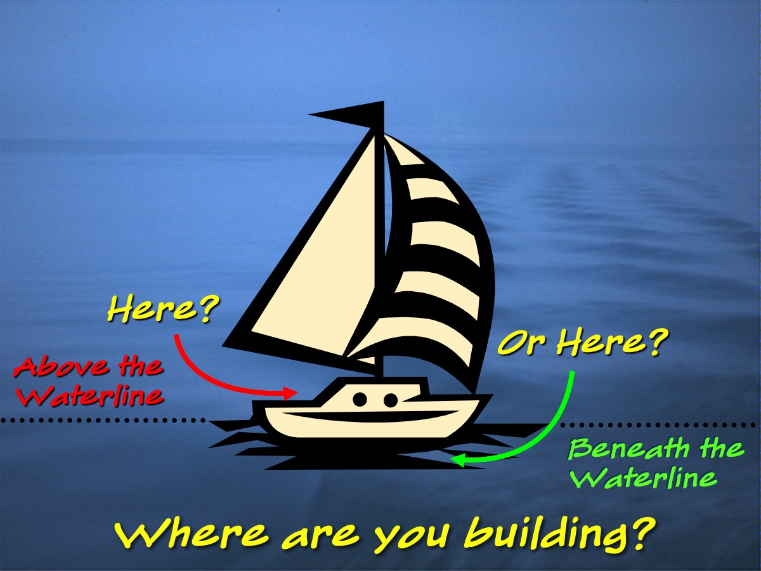
Notes:
So where are you building?

Slide 25
Notes:
Summary

