Slide 1

Notes:
Encounter Youth Disciplemaking Ministry.

Slide 2

Notes:
Our Ministry Purpose: The proposal is that our ministries use the Every Nation statement (We exist to honour God and make disciples) as our purpose statement and that we get our high schoolers to say it in each of our Sunday gatherings. This is not a rejection of the Every Nation Rosebank Mission statement but just a re-alignment with our wider movement and also something that we believe our high schoolers can resonate with and start to live. We will still use the existing vision statement to guide our ministry.

Slide 3
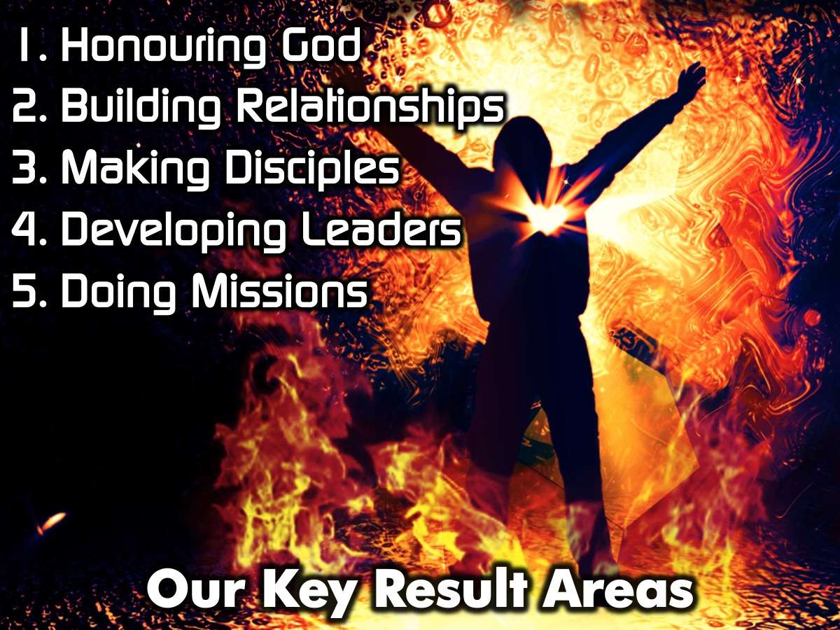
Notes:
Here are the Key Result Areas we have identified: (1) Honouring God. (2) Building Relationships. (3) Making Disciples. (5) Developing Leaders. (6) Doing Missions. The following slides describe each of our KRAs in details.

Slide 4
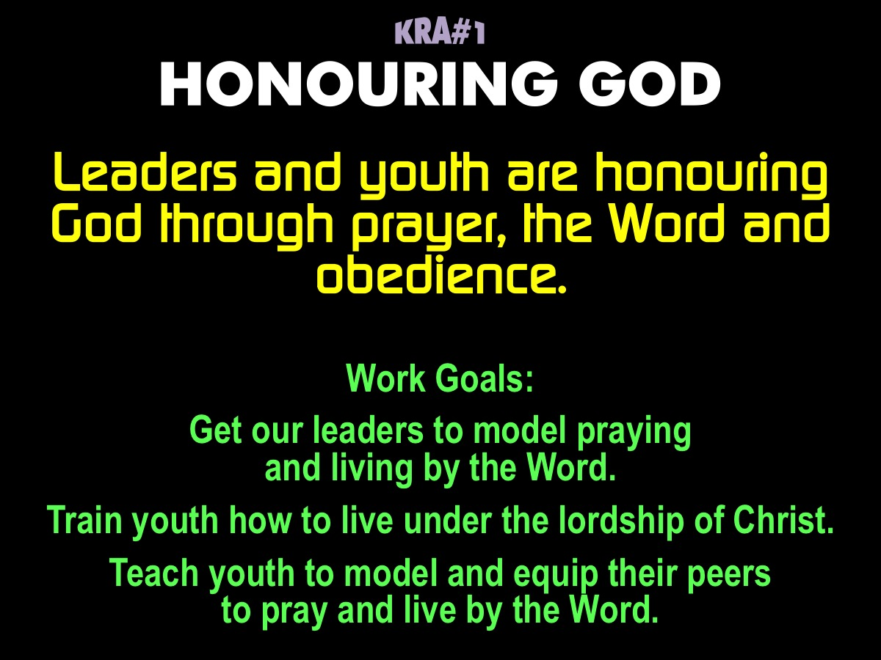
Notes:
Key Result Area #1: HONOURING GOD. Leaders and youth are honouring God through prayer, the Word and obedience. Our Work Goals are: (1) Get our leaders to model praying and living by the Word. (2) Train youth how to live under the lordship of Christ. (3) Teach youth to model and equip their peers to pray and live by the Word.

Slide 5
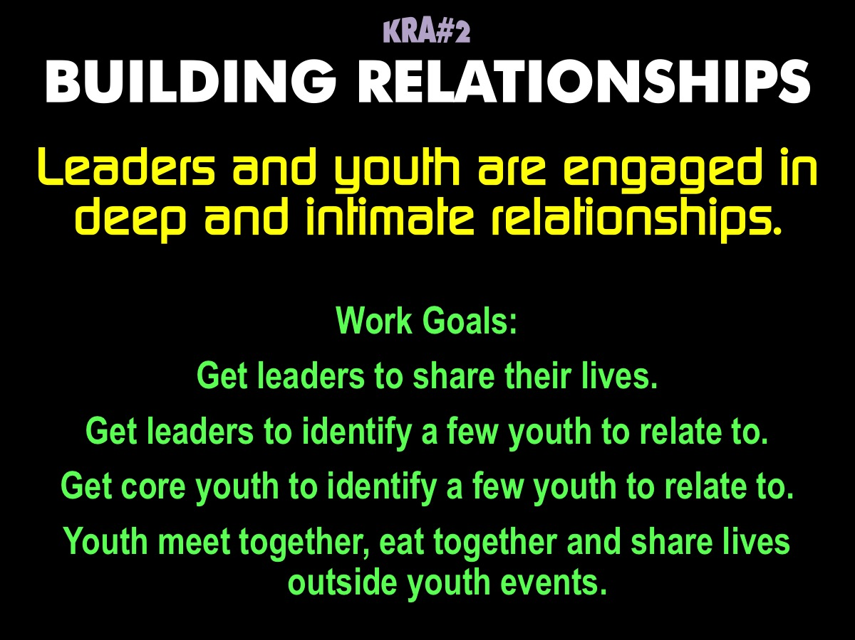
Notes:
Key Result Area #2: BUILDING RELATIONSHIPS. Leaders and youth are engaged in deep and intimate relationships. Our Work Goals are: (1) Get leaders to share their lives. (2) Get leaders to identify a few youth to relate to. (3) Get core youth to identify a few youth to relate to. (4) Youth meet together, eat together and share lives outside youth events.

Slide 6
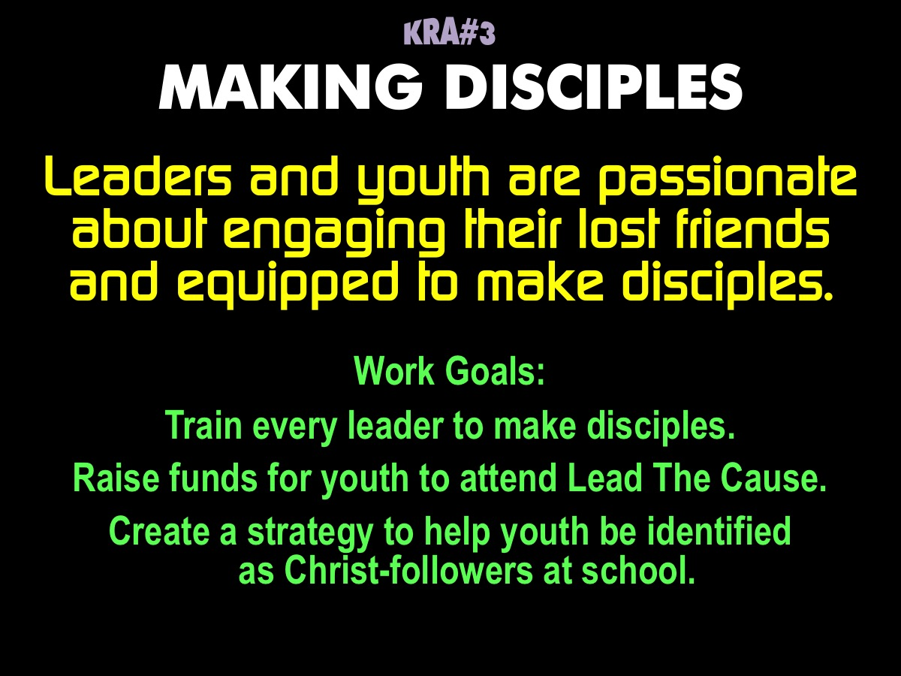
Notes:
Key Result Area #3: MAKING DISCIPLES. Leaders and youth are passionate about engaging their lost friends and equipped to make disciples. Our Work Goals are: (1) Train every leader to make disciples. (2) Raise funds for youth to attend Lead the Cause. (3) Create a strategy to help youth be identified as Christ-followers at school.

Slide 7
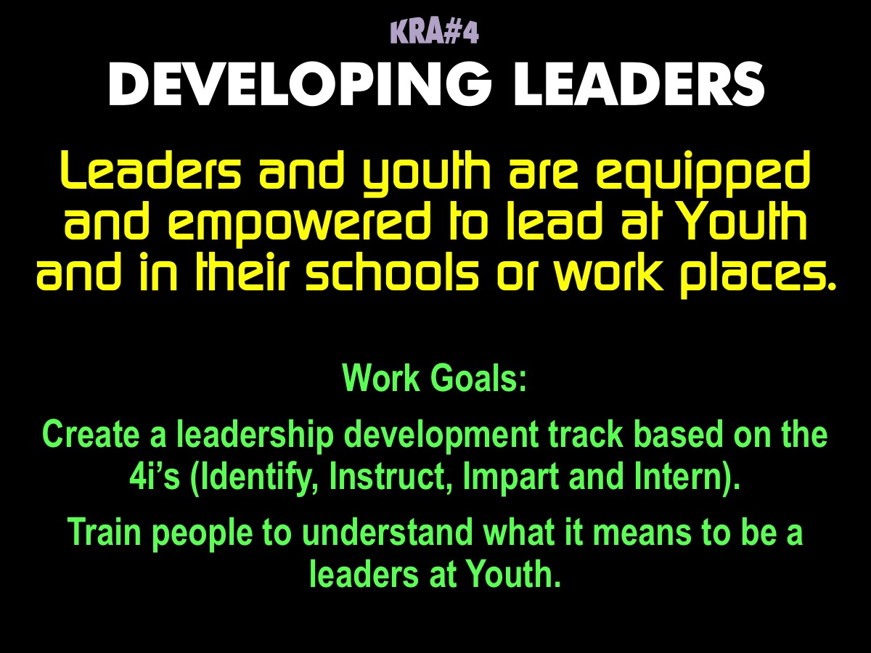
Notes:
Key Result Area #4: Leaders and youth are equipped and empowered to lead at Youth and in their schools or work places. Our Work Goals are: (1) Create a leadership development track based on the 4i’s (Identify, Instruct, Impart and Intern). (2) Train people to understand what it means to be a leader at Youth.

Slide 8
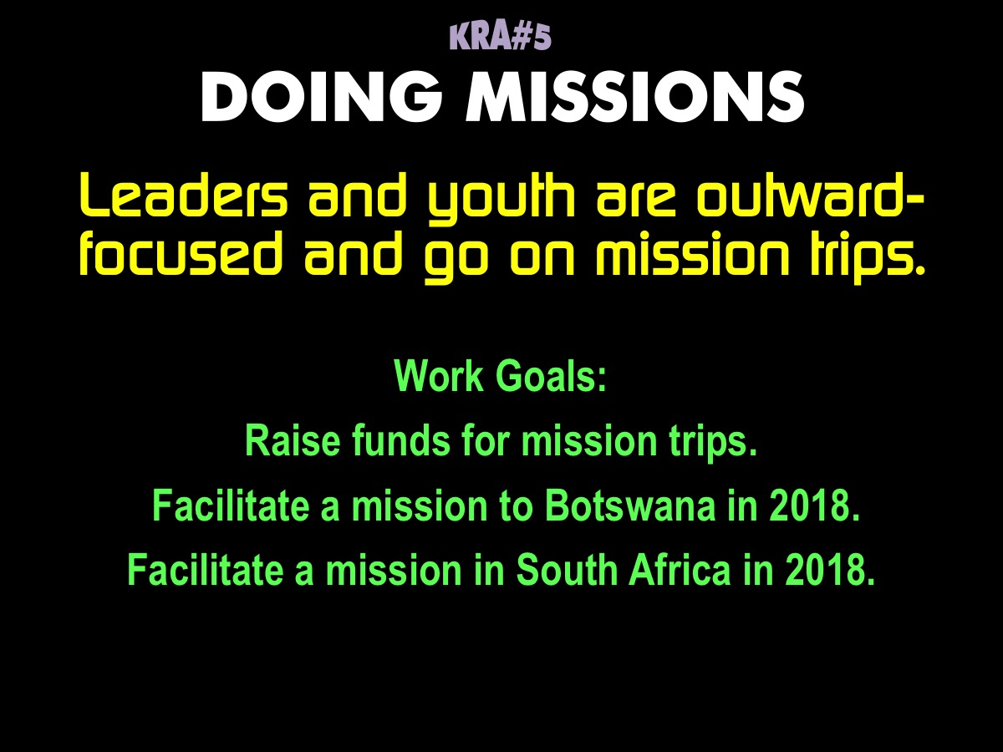
Notes:
Key Result Area #5: DOING MISSIONS. Leaders and youth are outward-focused and go on mission trips. Our Work Goals are: (1) Raise funds for mission trips. (2) Facilitate a mission to Botswana in 2018. (3) Facilitate a mission in South Africa in 2018.

Slide 9
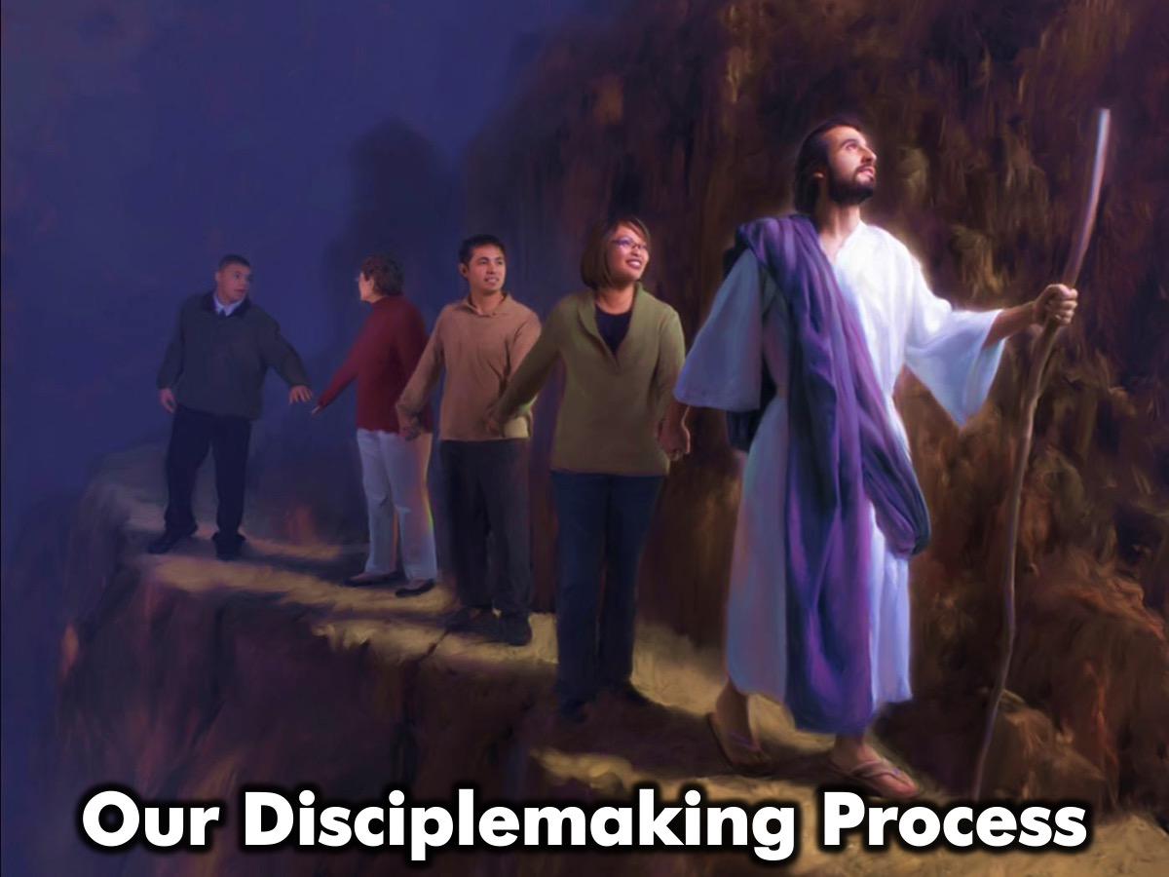
Notes:
Our Disciplemaking Process

Slide 10
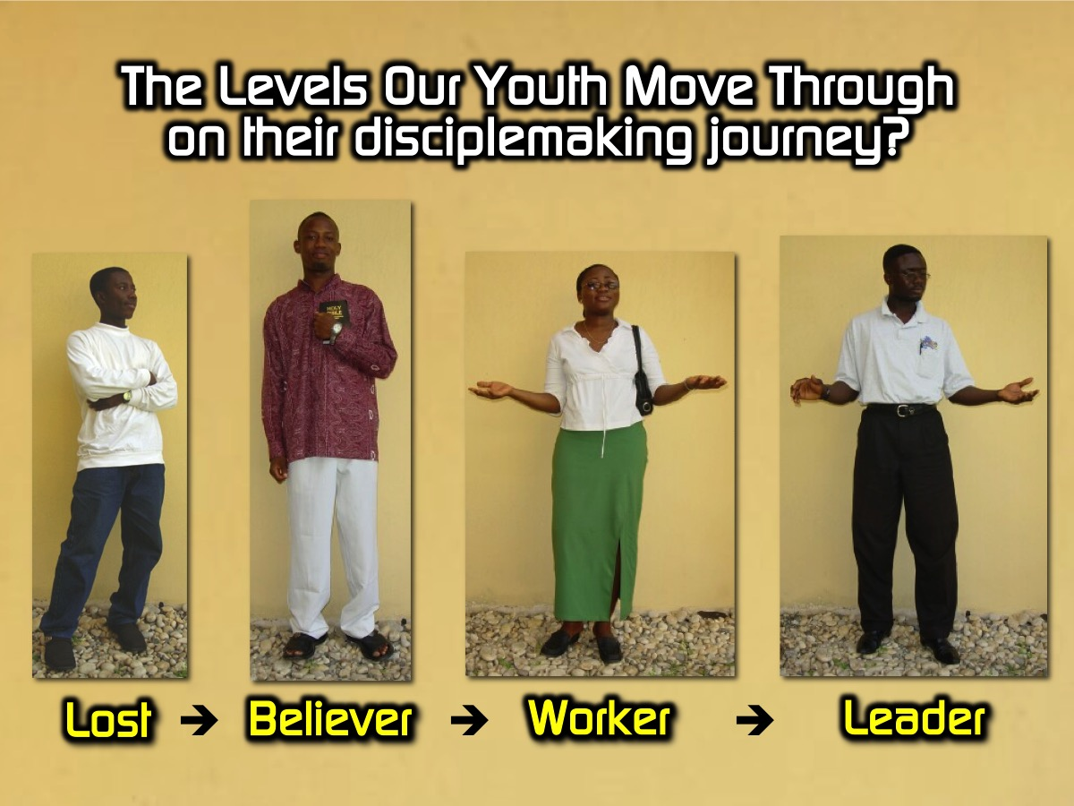
Notes:
Here are the levels that youth move through in the disciplemaking process: LOST - BELIEVER - WORKER - LEADER

Slide 11
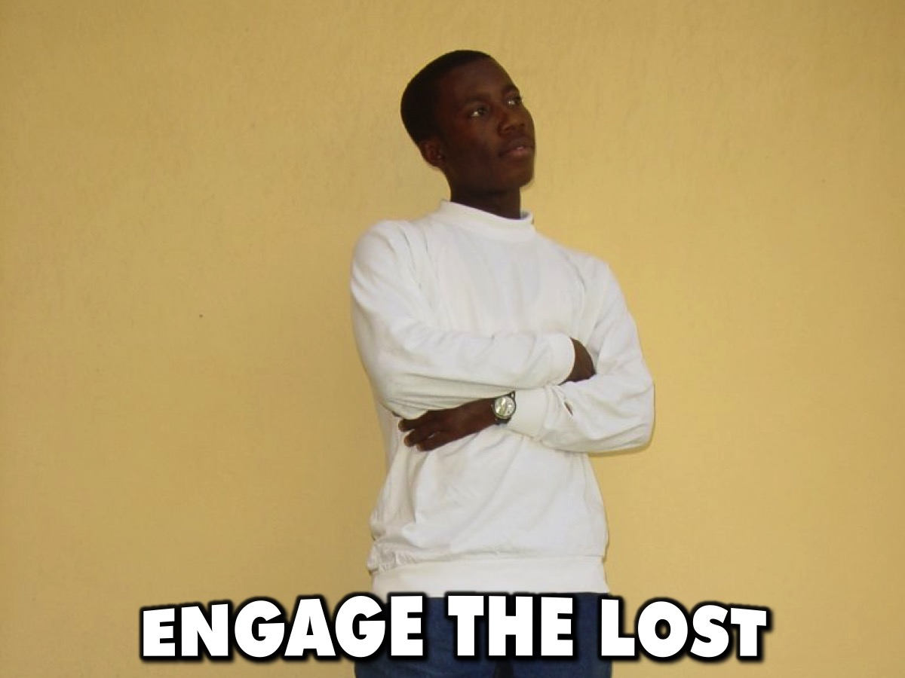
Notes:
Engage the Lost.

Slide 12
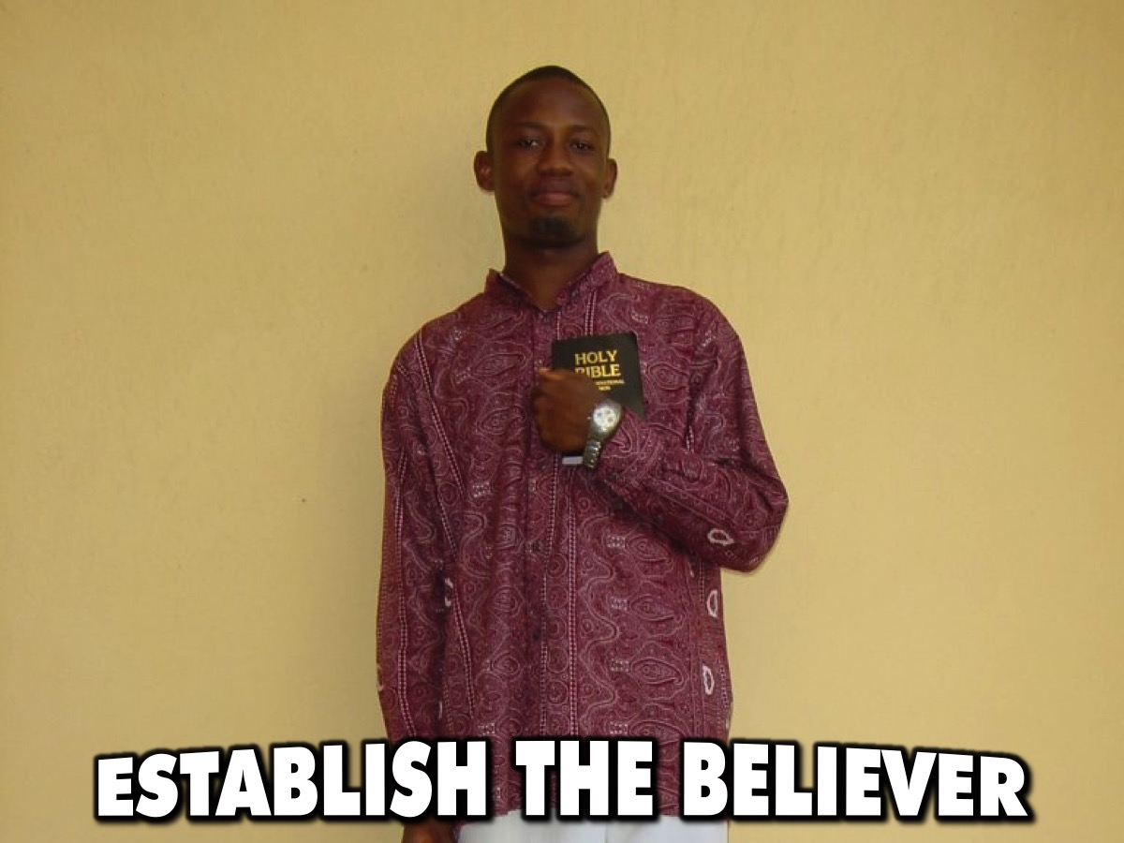
Notes:
Establish the Believer.

Slide 13

Notes:
Equip the Worker.

Slide 14
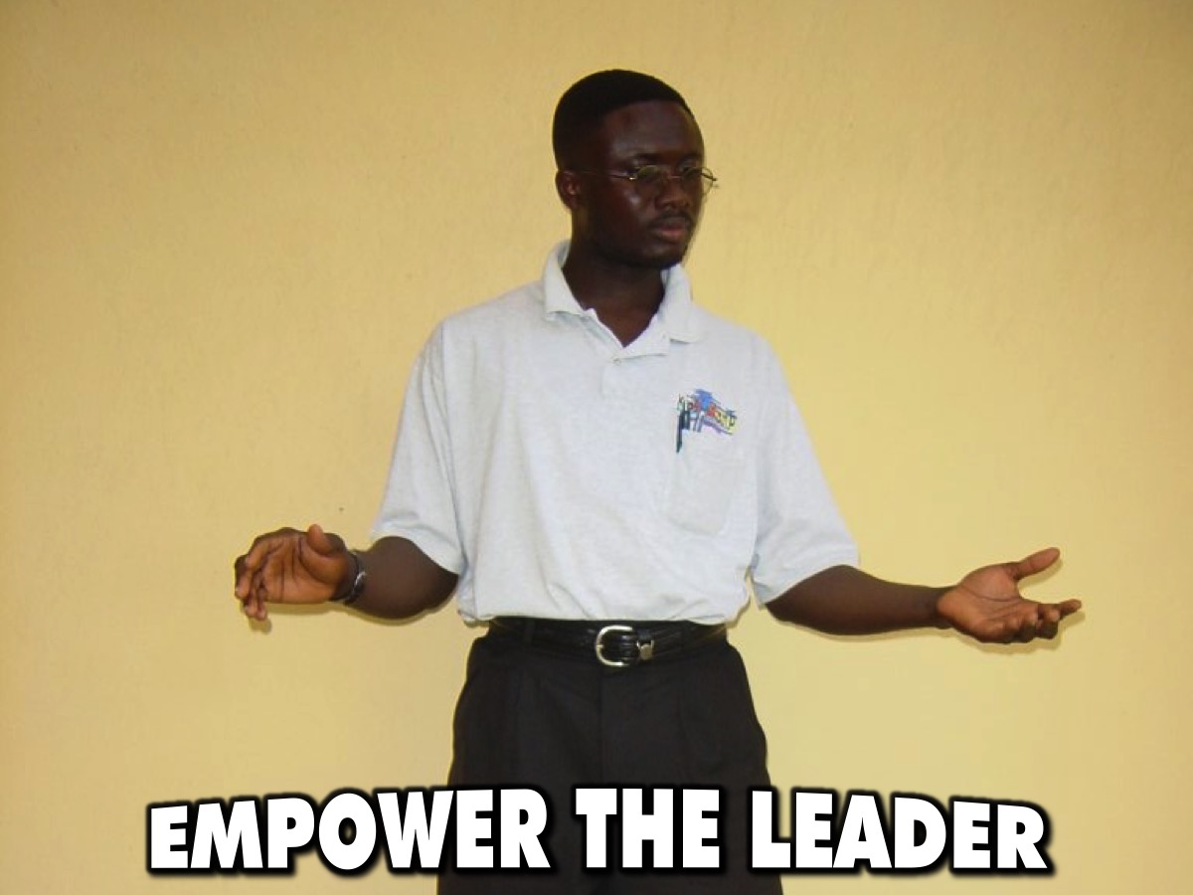
Notes:
Empower the Leader.

Slide 15
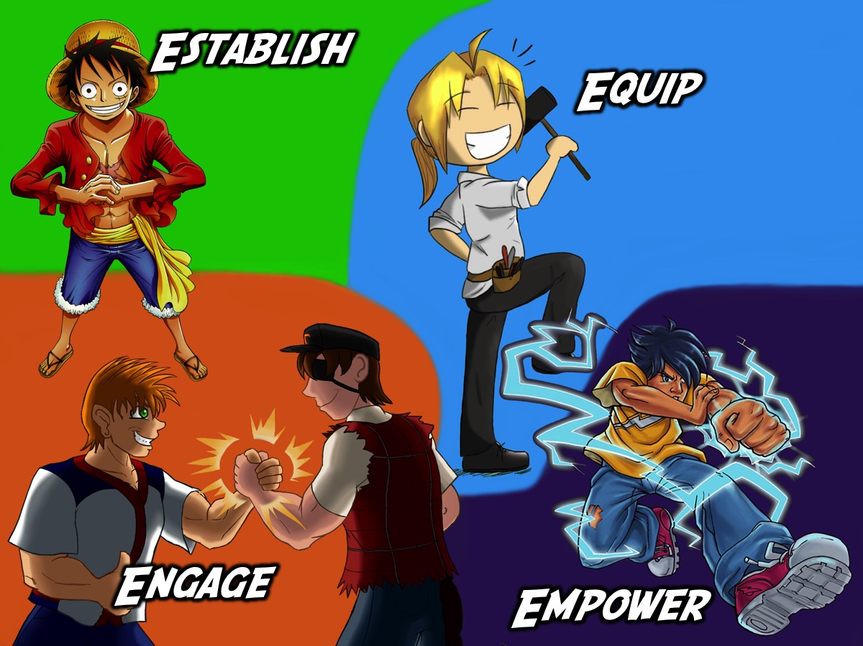
Notes:
Our disciplemaking process involves the 4Es: Engage, Establish, Equip and Empower.

Slide 16

Notes:
Our Disciplemaking Initiatives for each level

Slide 17
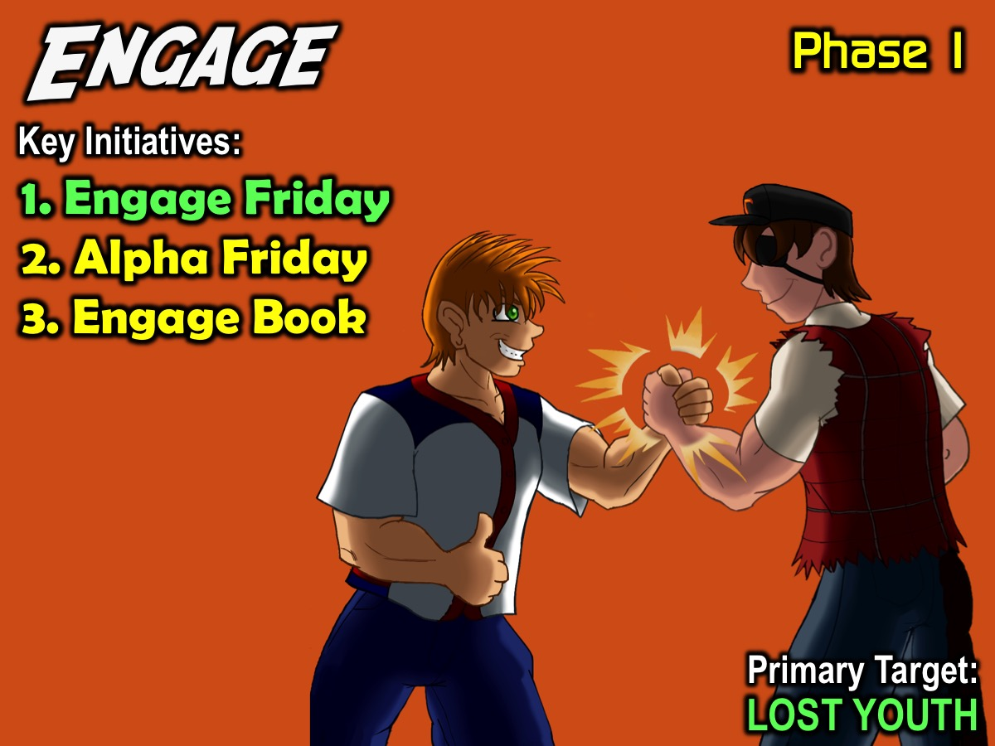
Notes:
1. ENGAGE: The first phase in our disciplemaking strategy is to Engage high schoolers by connecting with them and bringing them to faith in Christ. We have three interventions for this phase of our disciplemaking strategy: (1) Engage Friday. (2) Alpha Friday. (3) Engage Book. Our Primary Target for this phase of disciplemaking is: Lost Youth.

Slide 18
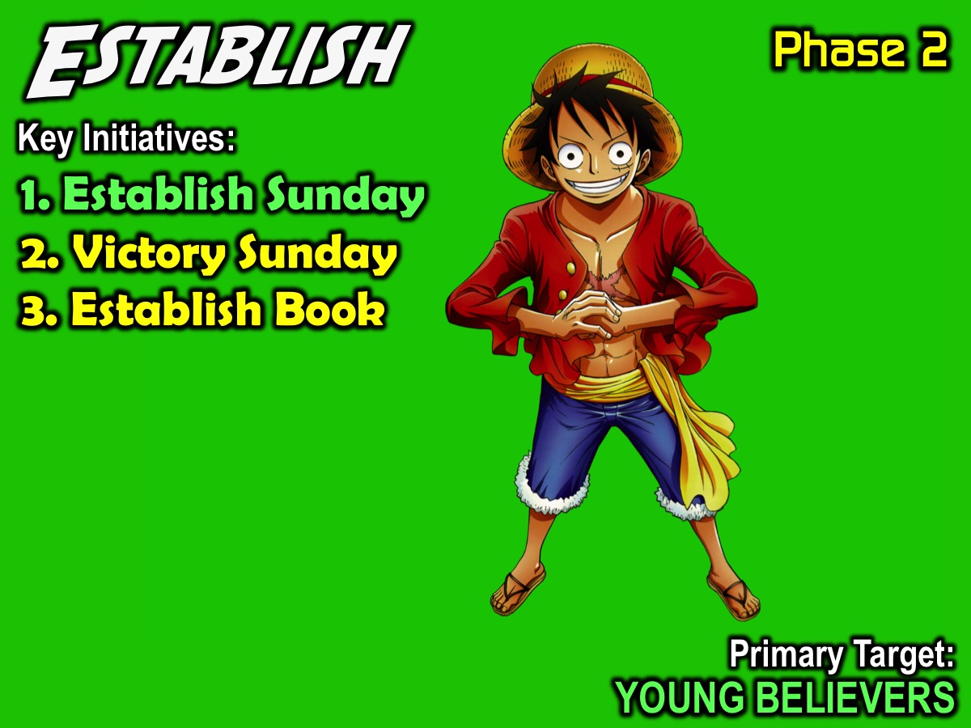
Notes:
2. ESTABLISH: The second phase in our disciplemaking strategy is to Establish high schoolers in the faith. We have 3 interventions at this level of our disciplemaking strategy: (1) Establish Sunday, (2) Victory Sunday and (3) Establish Book. Our Primary Target for this phase of disciplemaking is: Young Believers.

Slide 19
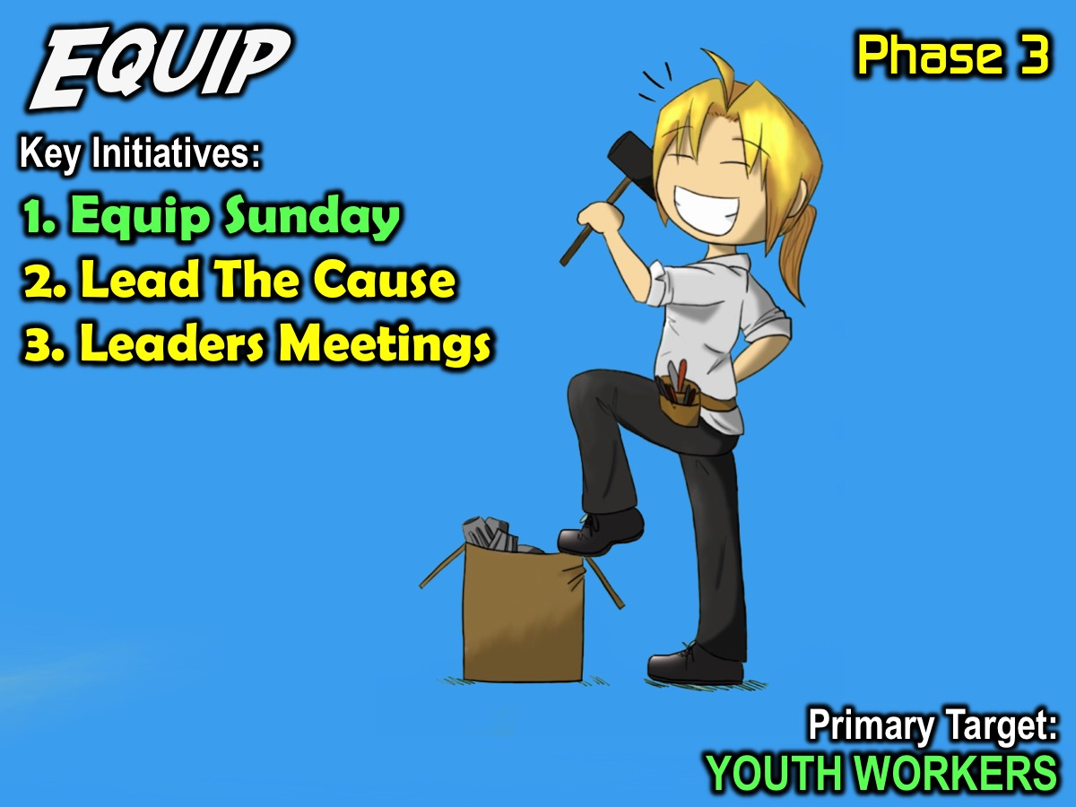
Notes:
3. EQUIP: The third phase in our disciplemaking strategy is to Equip high schoolers for ministry. As youth are being established in their faith we watch for those who are ready to be equipped to minister among their peers and we equip them through the following initiatives: (1) Sunday Series. (2) Lead The Cause. (3) Leaders Meetings. Our Primary Target for this phase of disciplemaking is: Youth Workers.

Slide 20
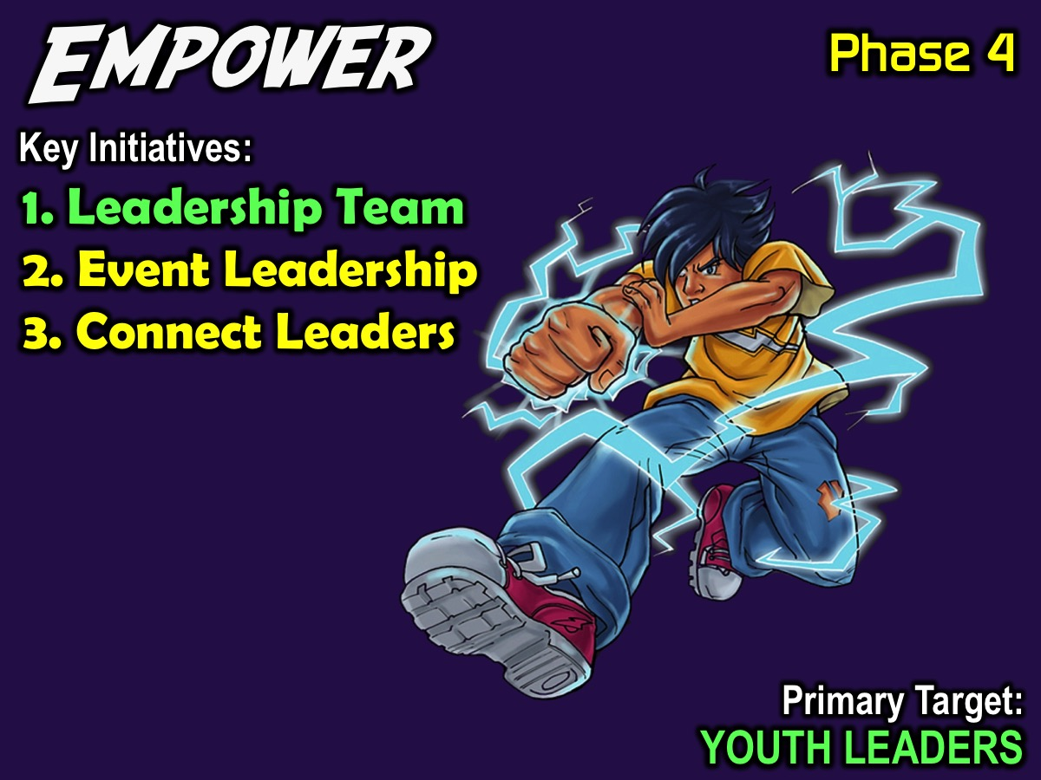
Notes:
4. EMPOWER: The fourth phase in our disciplemaking strategy is to Empower high schoolers to minister. We have three interventions at this level of our disciplemaking strategy: (1) Leadership Team; (2) Event Leadership, and (3) Connect Leaders. Our Primary Target for this phase of disciplemaking is: Youth Leaders.

Slide 21

Notes:
A youth ministry should use the same disciplemaking process used by the wider church. In Every Nation churches it is the 4Es process: Engage, Establish, Equip and Empower. At Encounter Youth we use the 4E process but have adapted the interventions for each of the levels:

Slide 22

Notes:
Our Bridges Between Phases

Slide 23
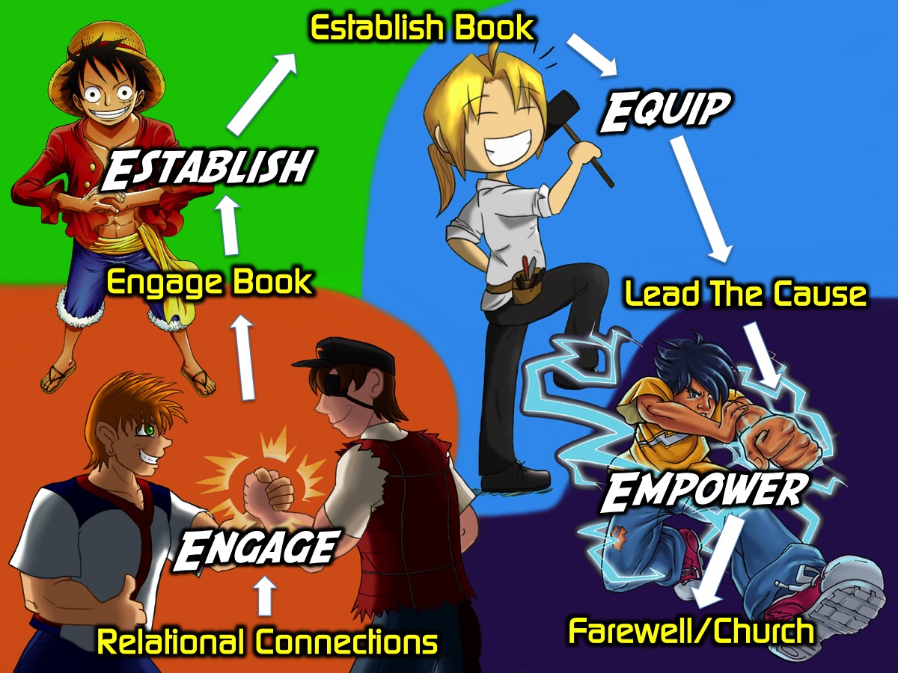
Notes:
Here are the Bridges we have created to help youth move through the four phases in our disciplemaking process..

Slide 24
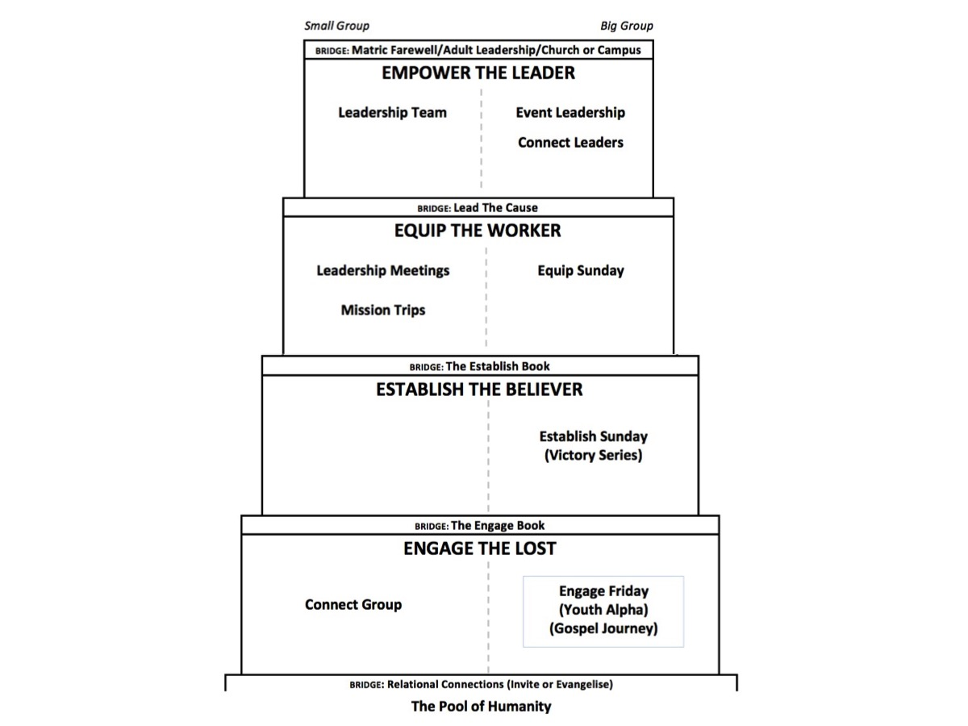
Notes:
Here are the initiatives and bridges in our disciplemaking process - showing which events are Small Group or Big Group orientated.

Slide 25
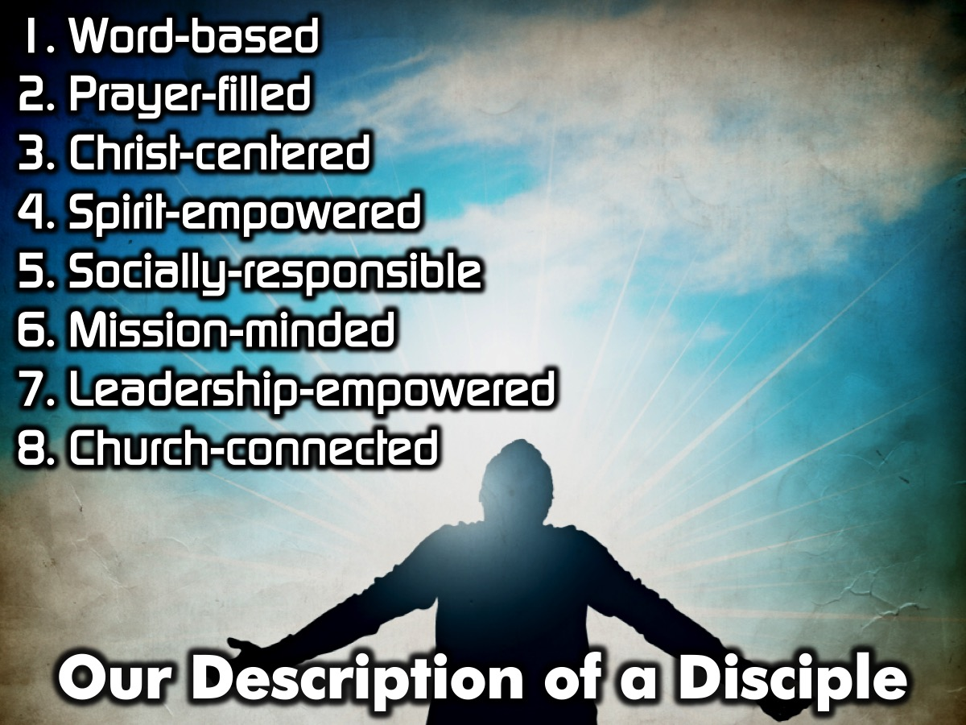
Notes:
Our Description of a Disciple: Here are the 8 qualities of a discipled person that we have identified: (1) Word-based. (2) Prayer-filled. (3) Christ-centered. (4) Spirit-empowered. (5) Socially-responsible. (6) Mission-minded. (7) Leadership-empowered. (8) Church-connected. The following slides will describe each one in detail.

Slide 26

Notes:
The next 8 slides are a shortened version of each quality.

Slide 27
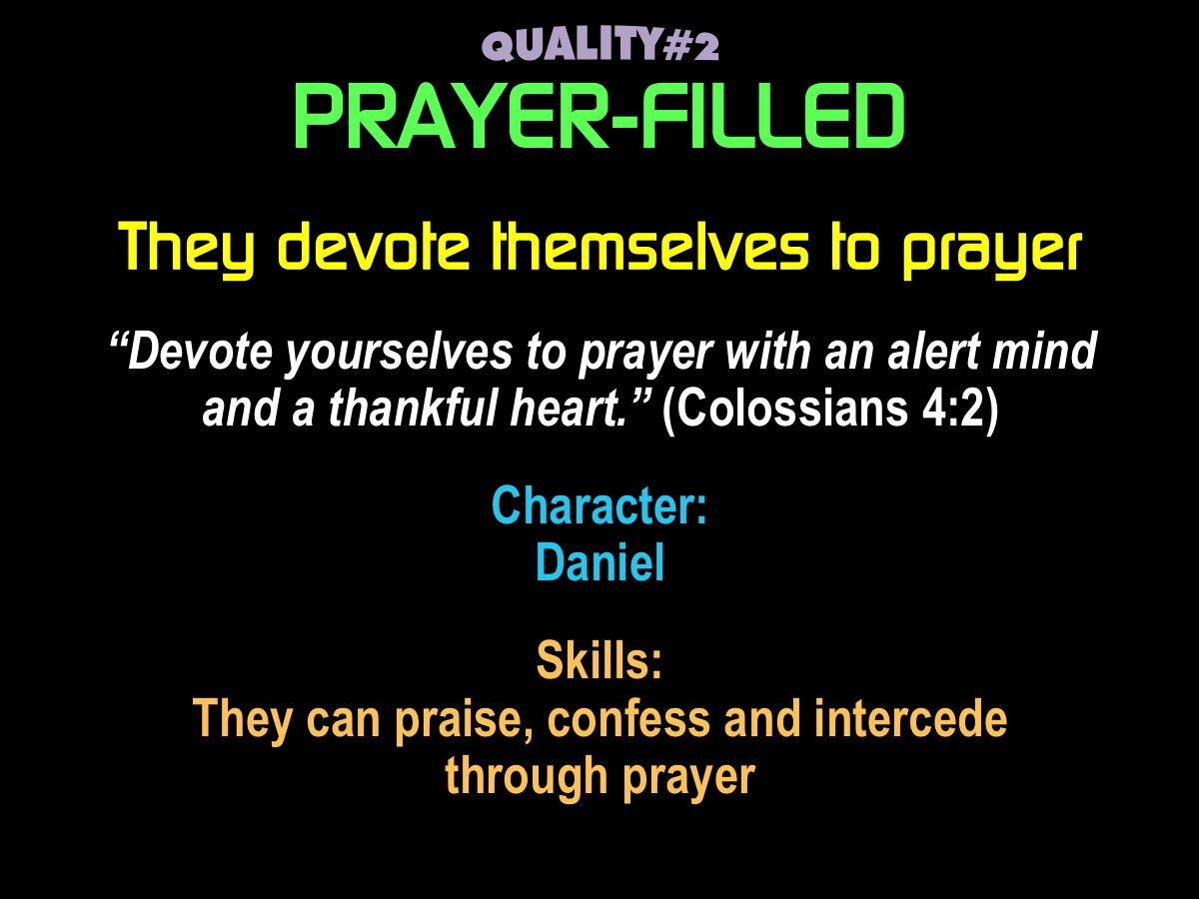

Slide 28
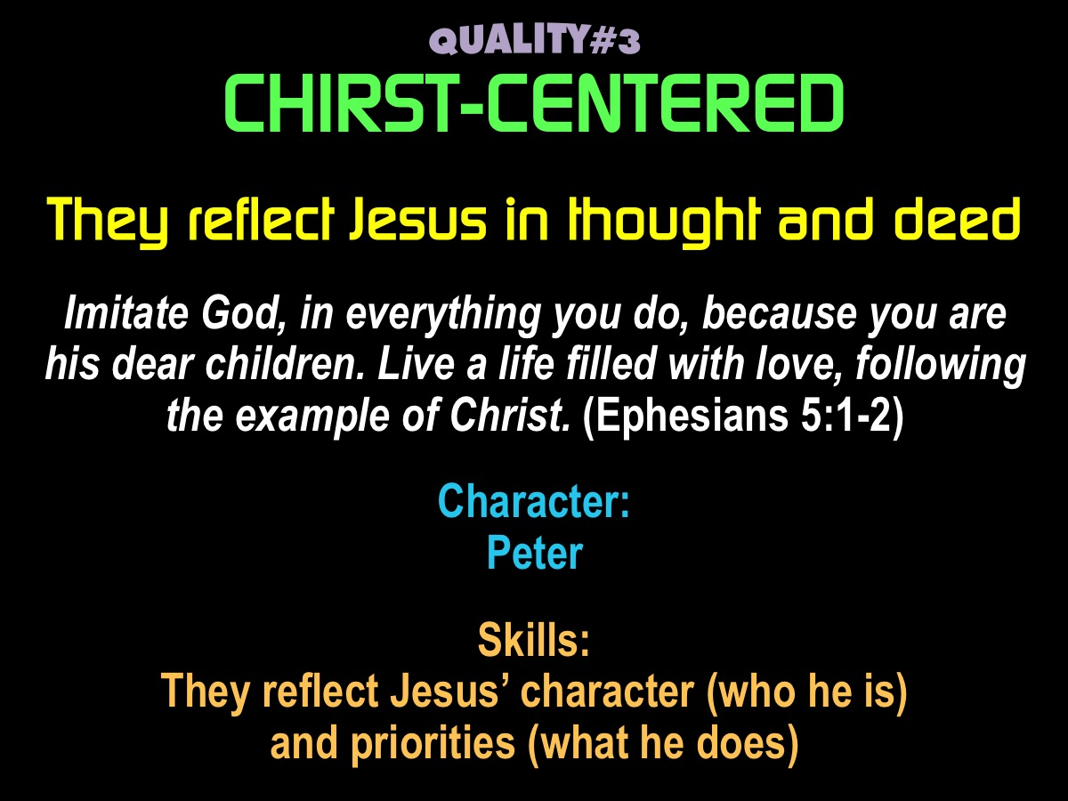

Slide 29
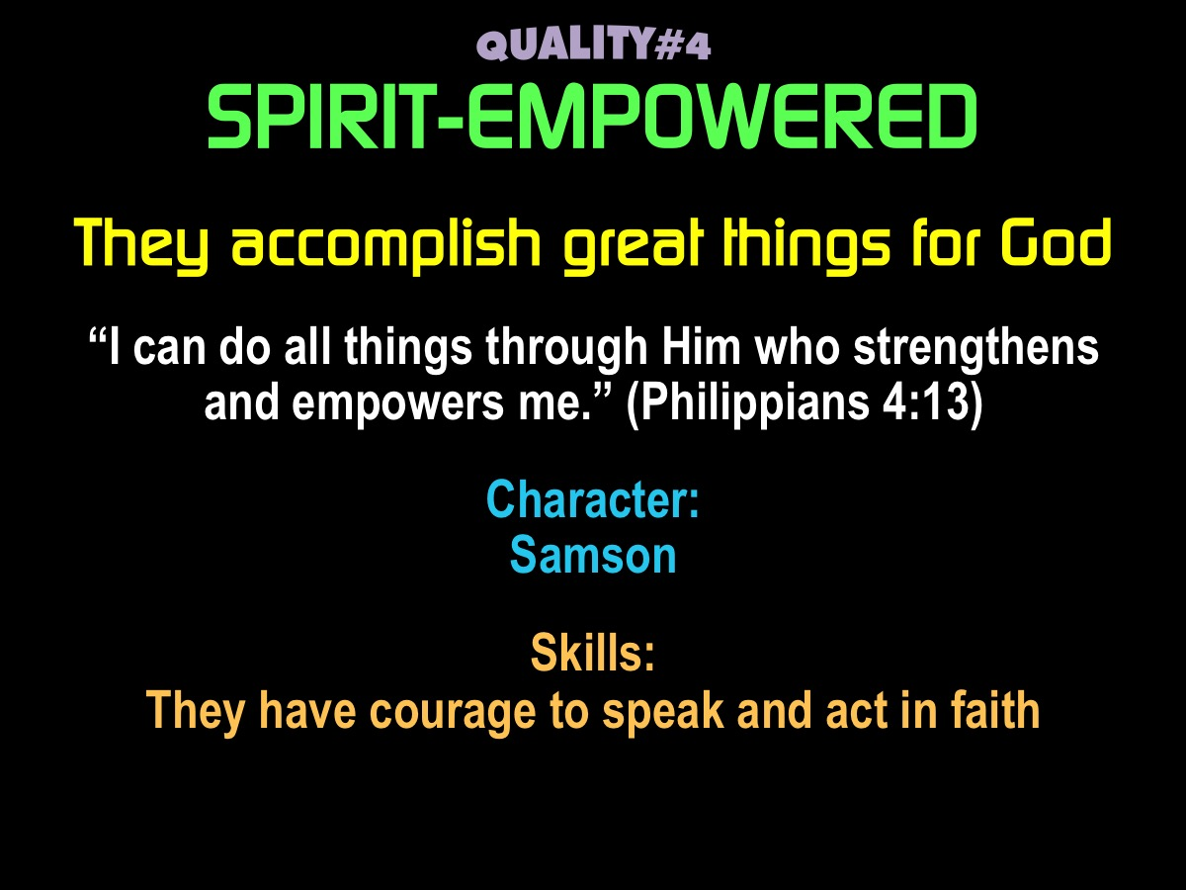

Slide 30
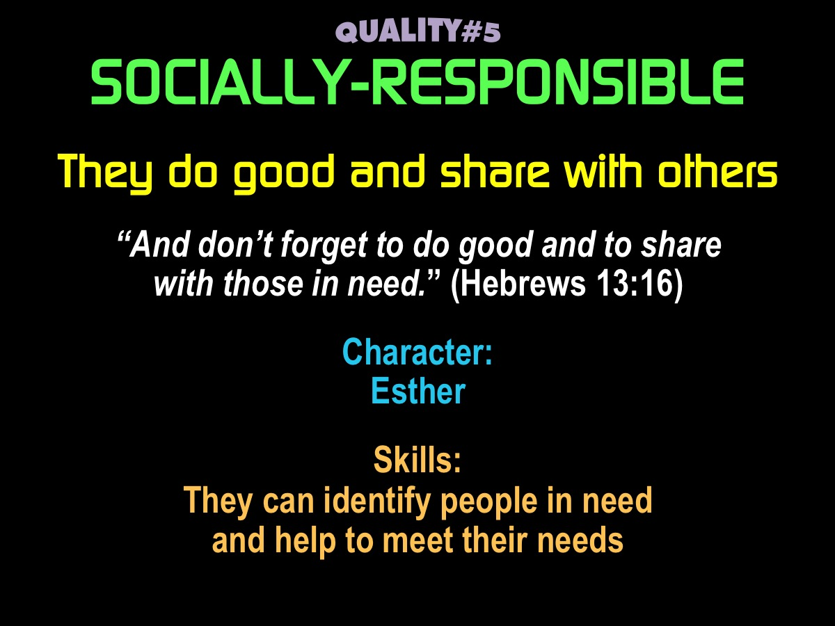

Slide 31
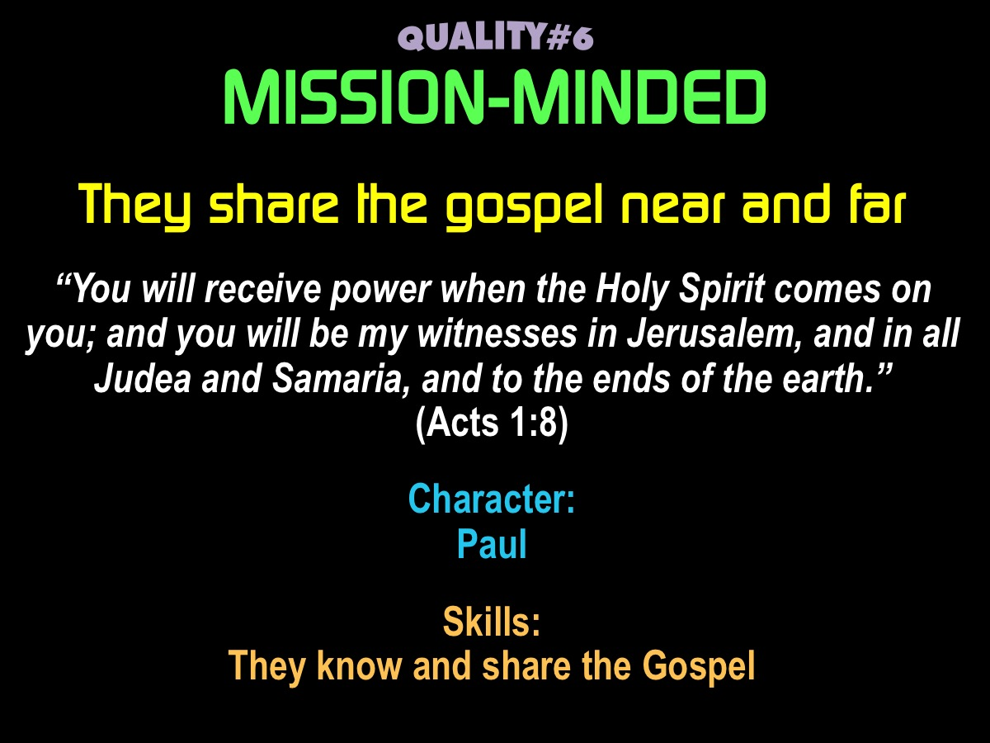

Slide 32
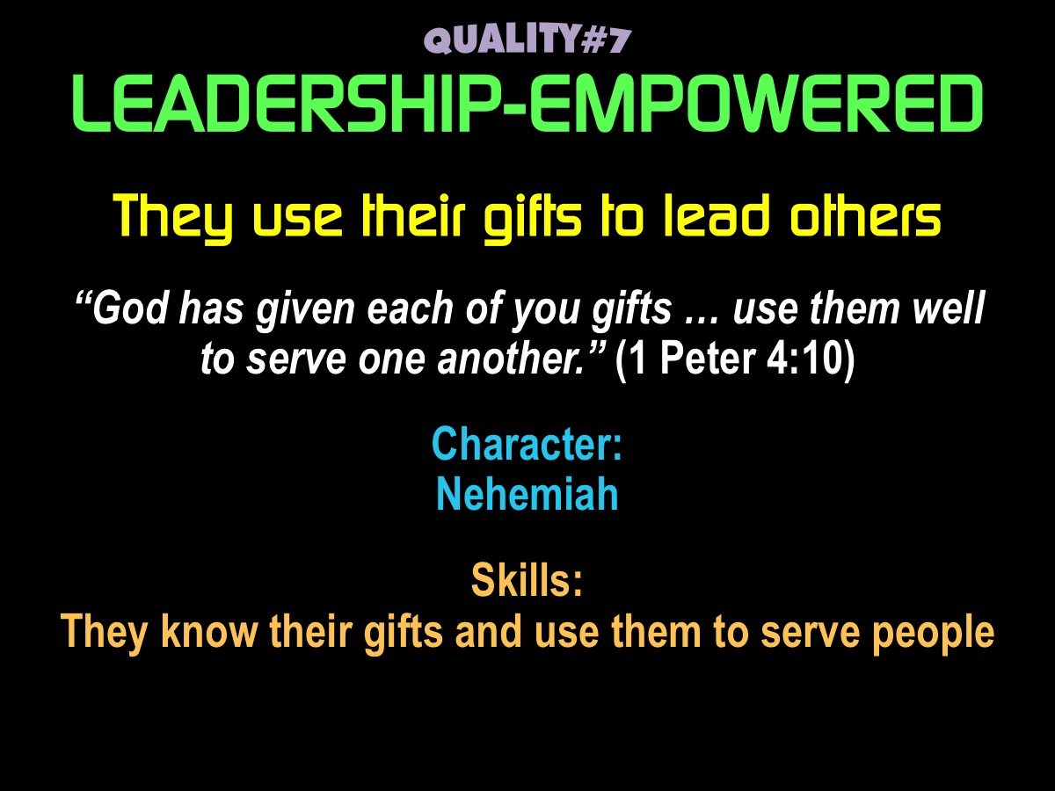

Slide 33
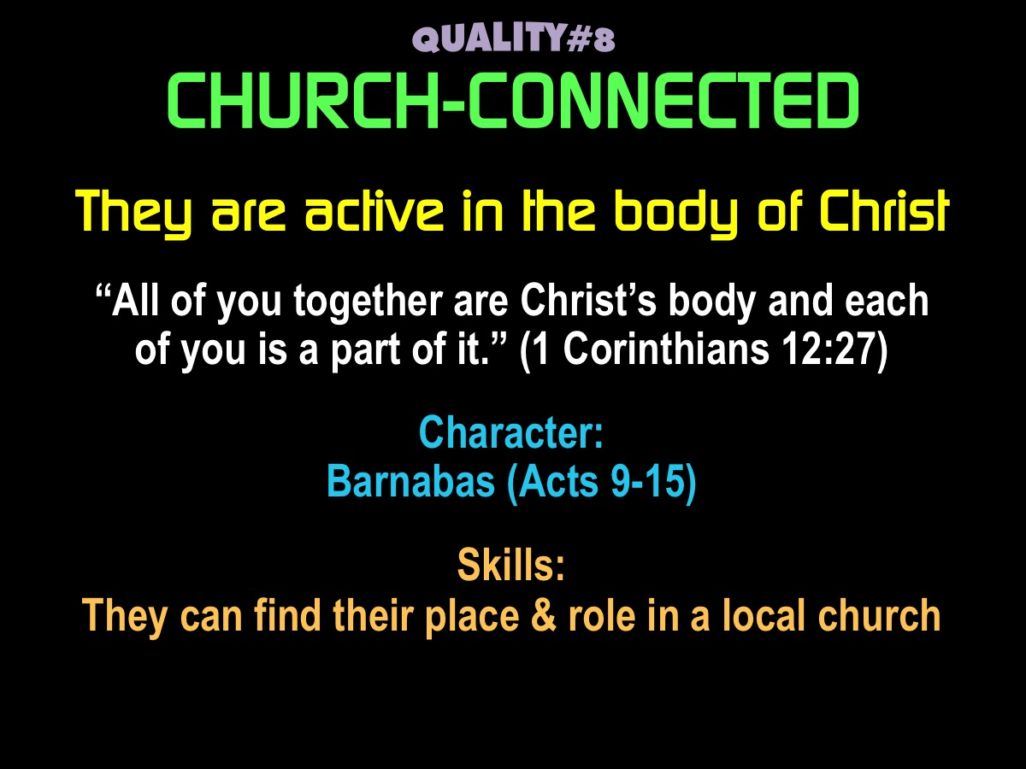

Slide 34
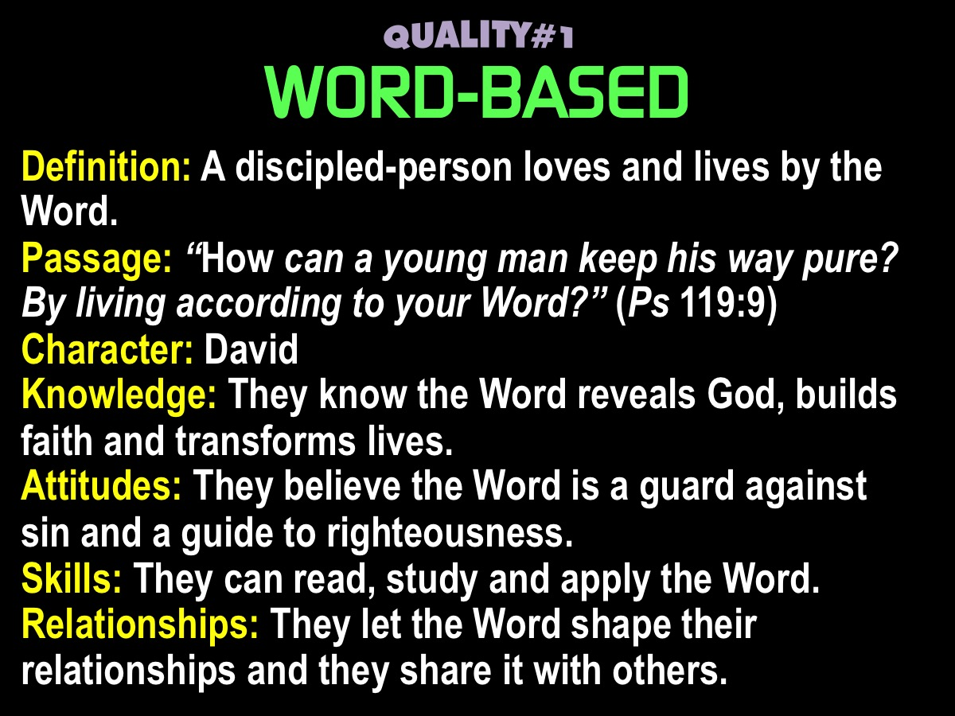
Notes:
The next 8 slides are the longer version of each quality.

Slide 35
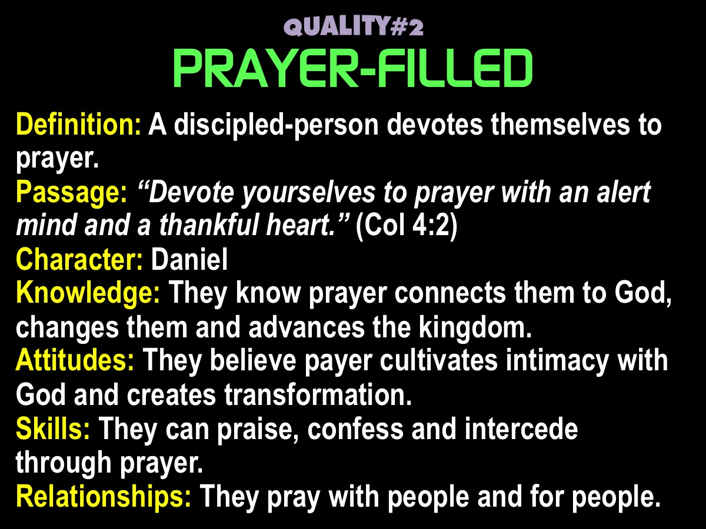

Slide 36
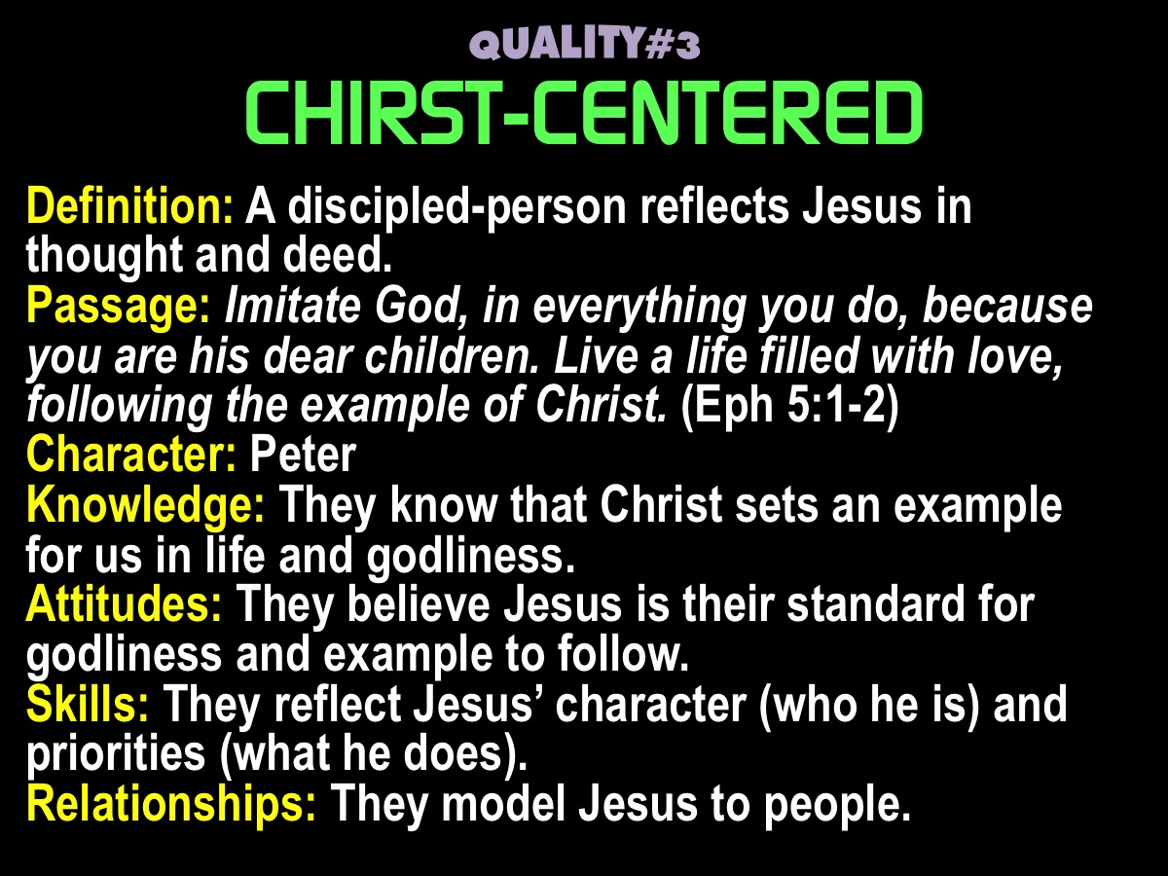

Slide 37
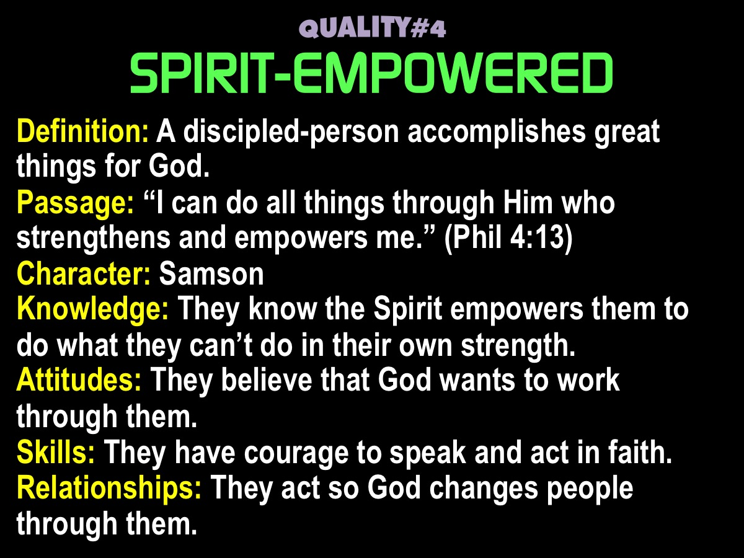

Slide 38
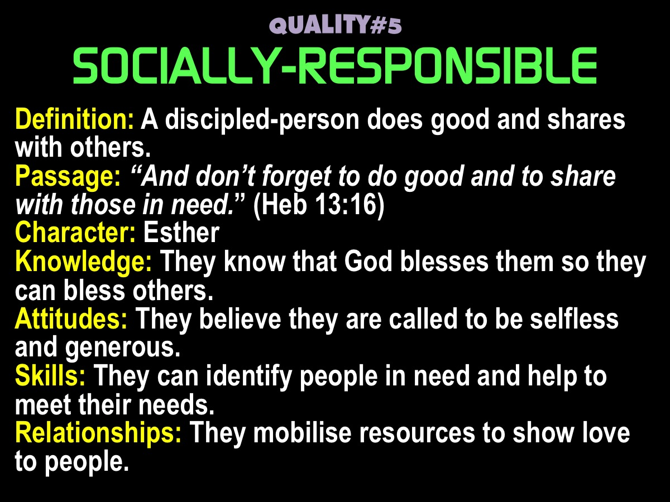

Slide 39


Slide 40
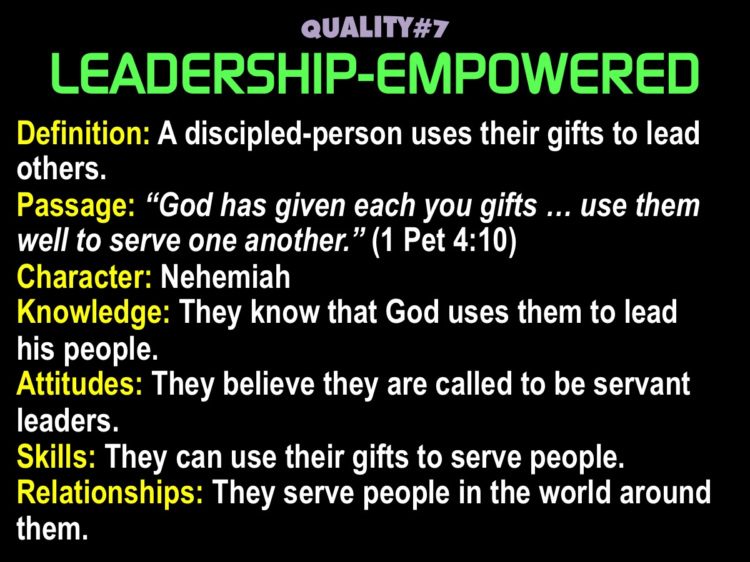

Slide 41
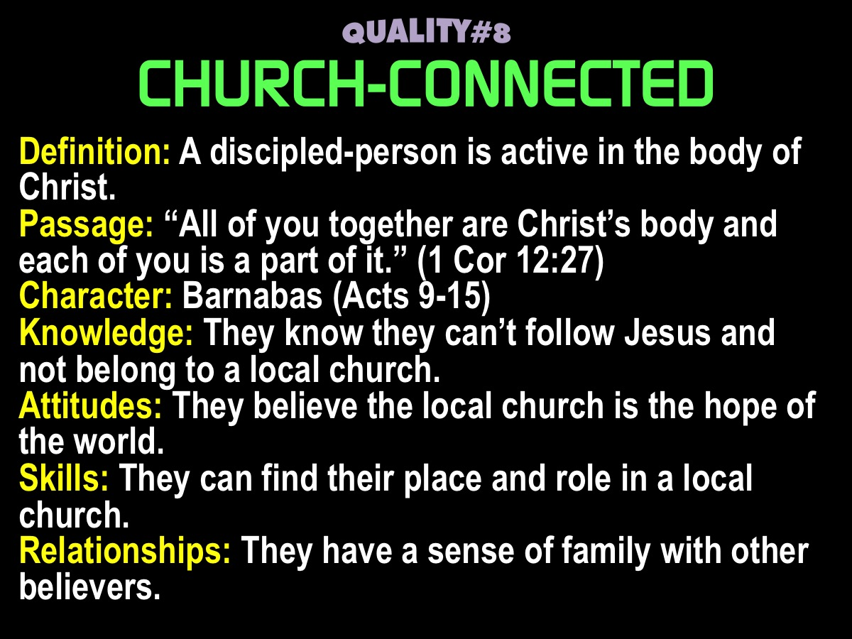

Slide 42
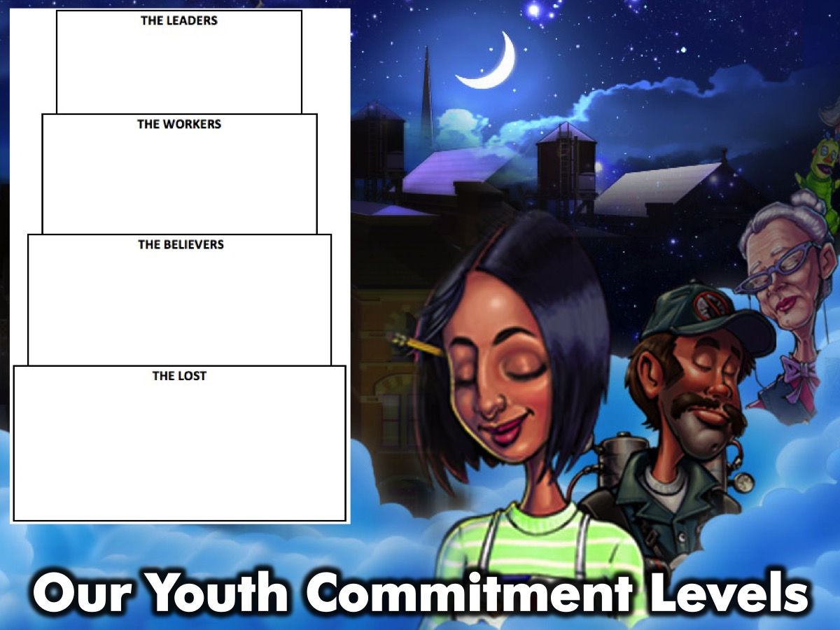
Notes:
Our Youth Commitment Levels

Slide 43
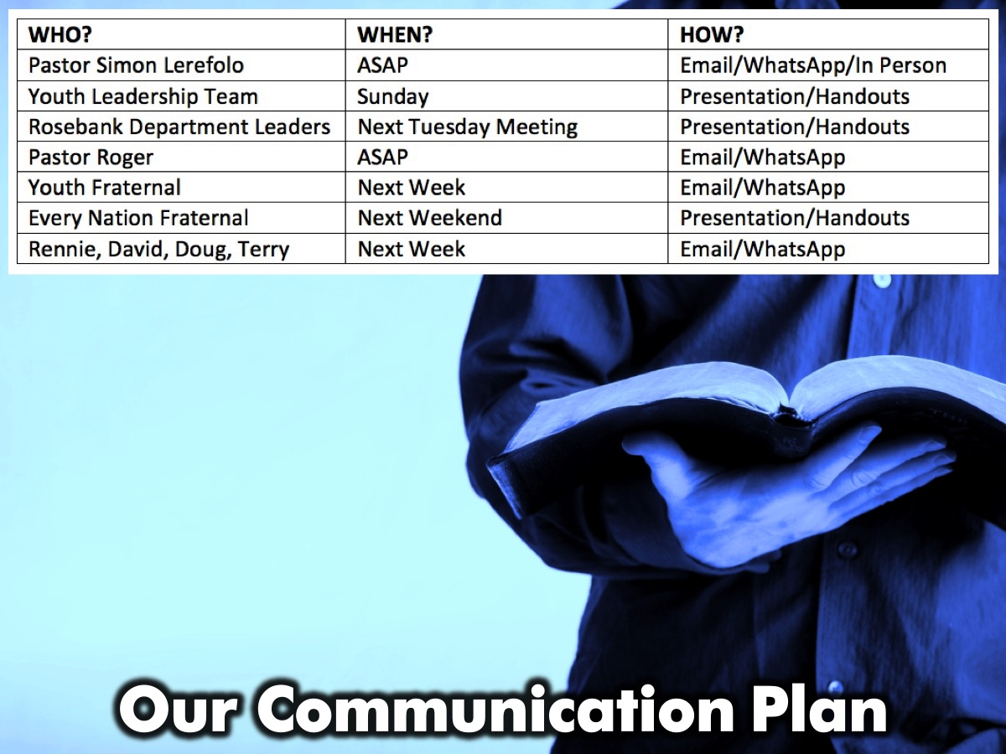
Notes:
Our Communication Plan: Here is how we will communicate our vision for disciplemaking with key people.

