Slide 1

Notes:
Welcome to the Call to Victory series!

Slide 2
Notes:
Video: An edited version of Official Call of Duty Advanced Warfare - Campaign Story Trailer. Get it on YouTube at: https://www.youtube.com/watch?v=pUysNWHffWg

Slide 3

Notes:
This is A 10-Week Journey to enable you to Walk in Victory!

Slide 4

Notes:
In week 1 we will be Preparing for Victory.

Slide 5

Notes:
In week 2 we will be taking at look at how Transformation happens.

Slide 6

Notes:
In week 3 we will be looking at what the Cross has to do with victory in our lives.

Slide 7

Notes:
In week 4 we will be looking at how our identity affects our victory.

Slide 8

Notes:
In week 5 we will look at the first of five big issues in our lives: Generational Curses.

Slide 9

Notes:
In week 6 we will look at the second of five big issues in our lives: Relational Issues.

Slide 10

Notes:
In week 7 we will look at the third of five big issues in our lives: Spiritual Errors.

Slide 11

Notes:
In week 8 we will look at the fourth of five big issues in our lives: Sexual Sins.

Slide 12

Notes:
In week 9 we will look at the fifth of five big issues in our lives: Addictions.

Slide 13

Notes:
In week 10 we will end with how to Live in Victory!

Slide 14

Notes:
So, once again, welcome to Victory Sunday!

Slide 15

Notes:
Today is all about preparing for Victory.

Slide 16
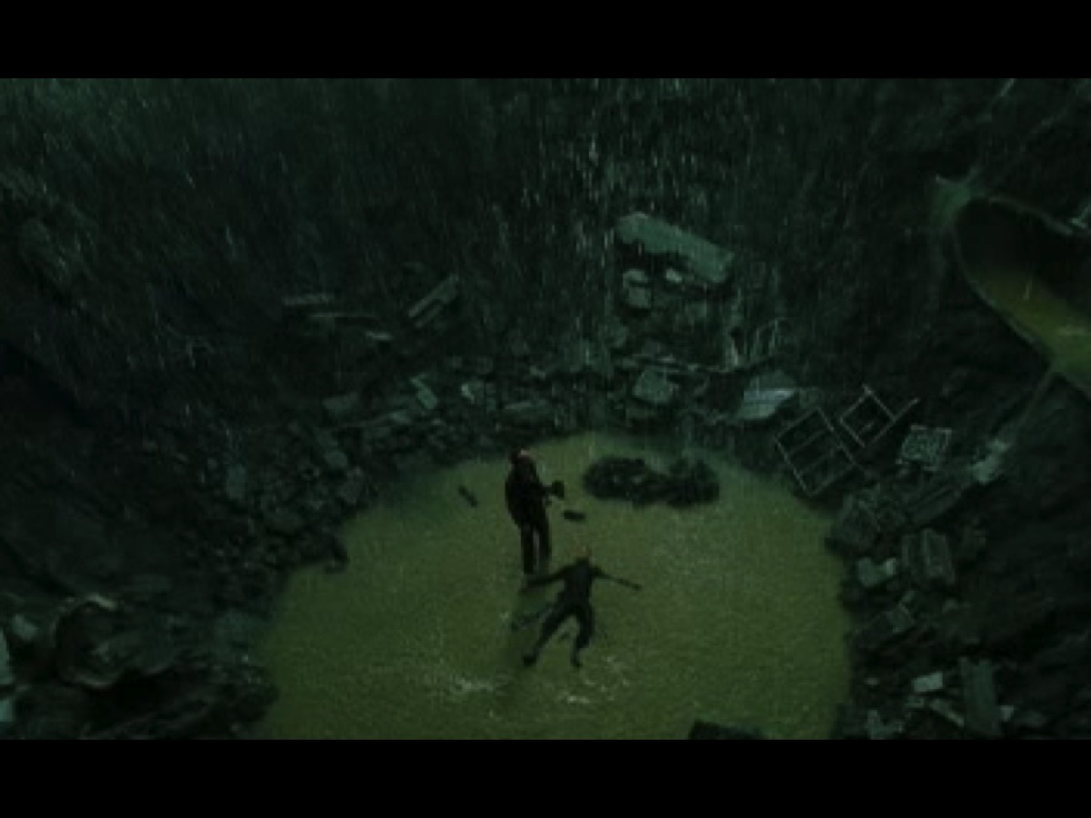
Notes:
Video: A clip from The Matrix movie where Neo does not give up but rises to walk in victory!

Slide 17

Notes:
The Bible teaches that we can and should live victorious lives.

Slide 18
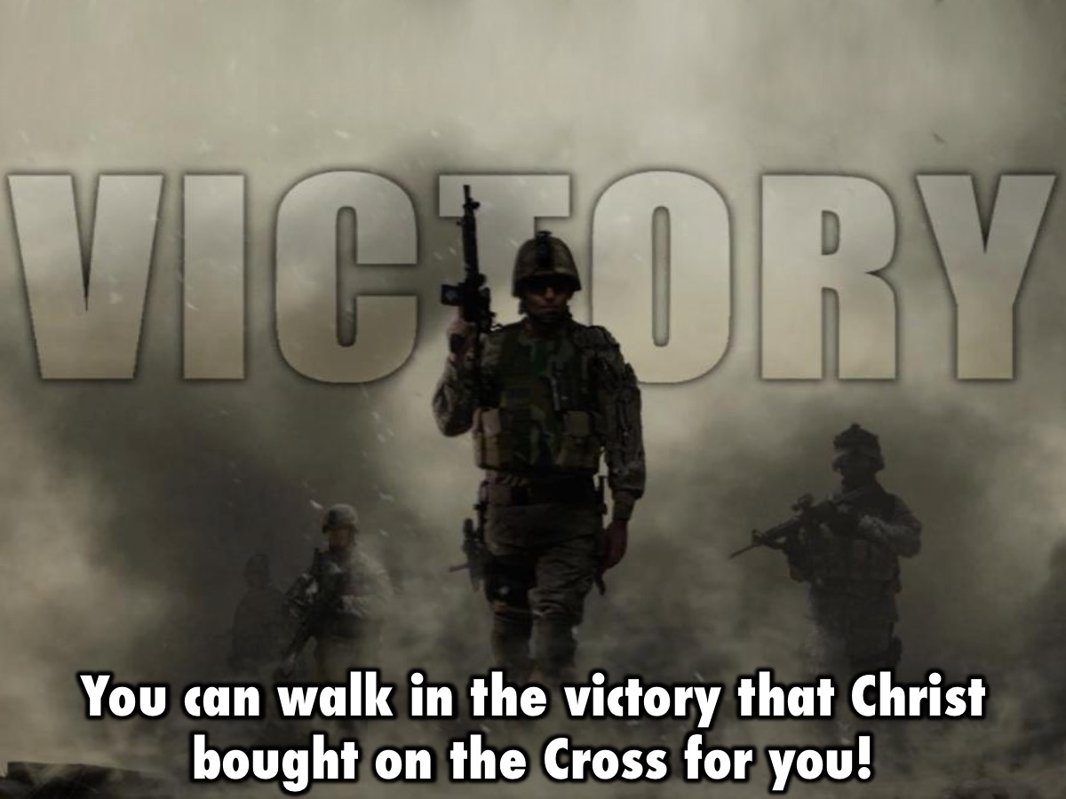
Notes:
This series will help you understand that you can walk in the victory that Christ bought on the Cross for you.

Slide 19
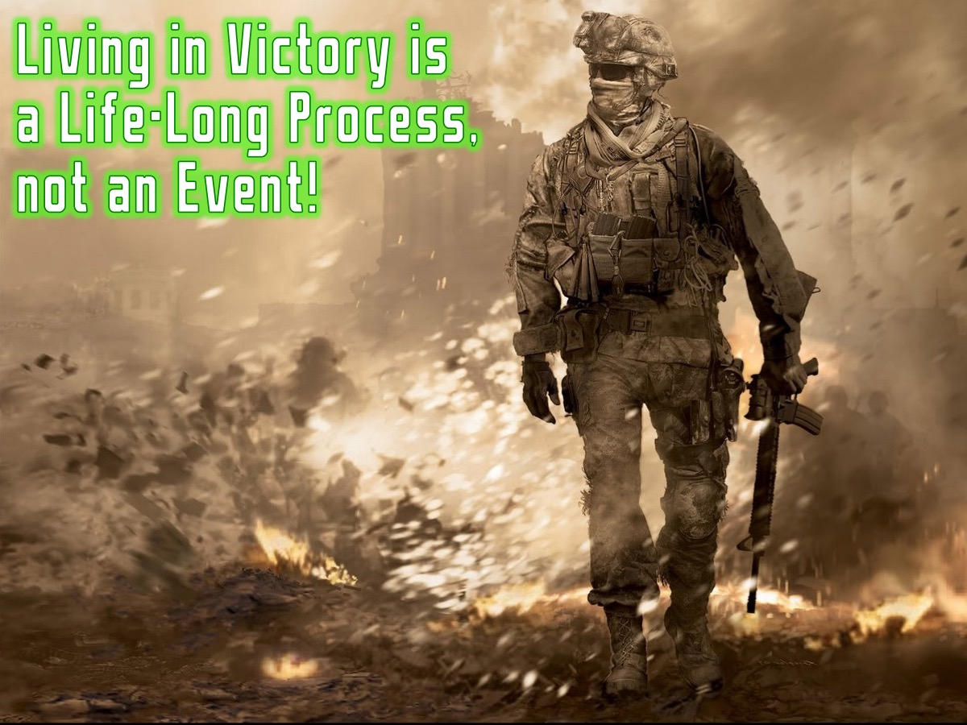
Notes:
Living in victory is a life-long process – not an event!

Slide 20

Notes:
Victory Sunday will be a launch pad into victory!

Slide 21

Notes:
As a soldier, before we went on patrol we had a mission briefing. Here is your mission briefing:

Slide 22

Notes:
(1) Sundays will lay a foundation for walking in victory (it is not intense inner healing. It is effective in laying foundations as part of the process of growing in God. It is not a quick-fix, but will bring significant breakthrough to launch out into the process of walking in victory).

Slide 23
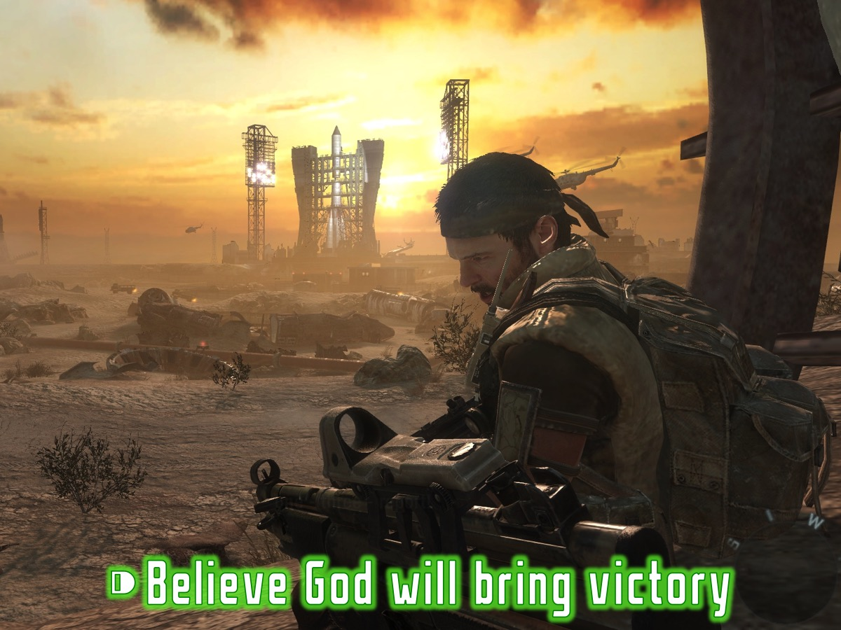
Notes:
(2) You must believe that God will bring healing and victory - we must come with expectation and faith for a supernatural work of healing and freedom – we believe that the same anointing of the Holy Spirit that rested on Jesus (Luke 4:17-21; Isaiah 61) is present with us this term to set us free.

Slide 24
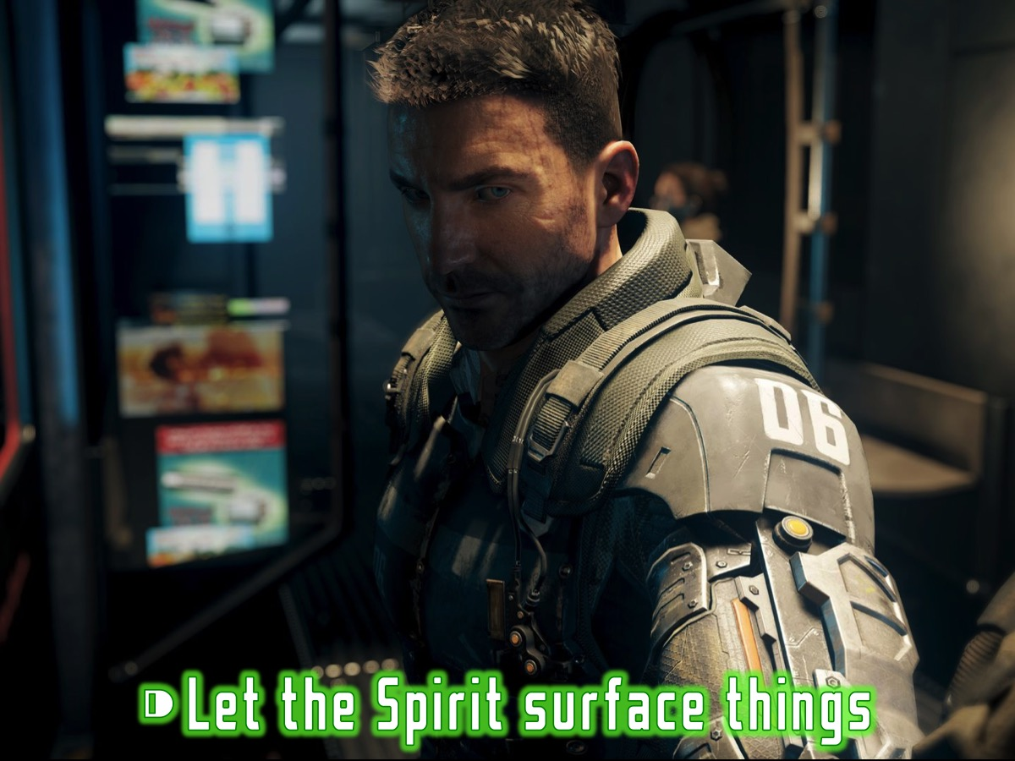
Notes:
(3) The Holy Spirit will bring things to the surface in his time - not everything will be dealt with during this time but you will receive tools and principles for dealing with things as they arise later in your Christian walk.

Slide 25

Notes:
There are three reasons to attend Victory Sunday:

Slide 26

Notes:
1. Build Foundations - The first goal of the Victory series is to ensure that our foundations are strong and biblical.

Slide 27
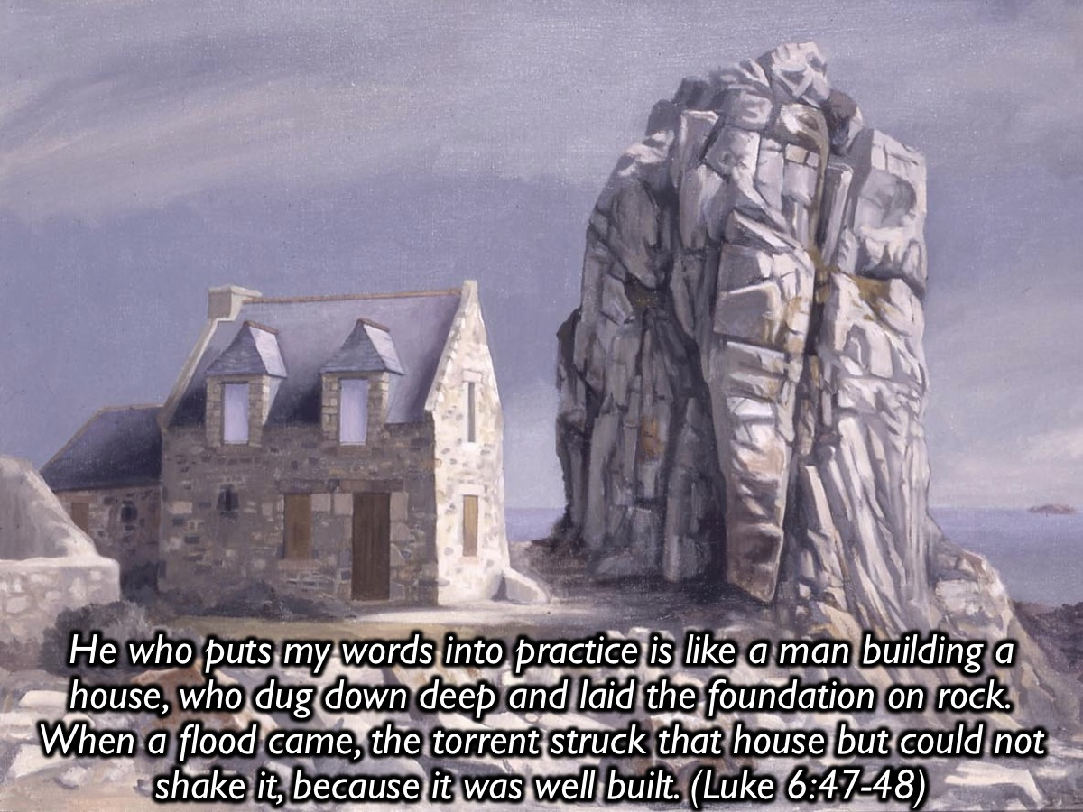
Notes:
He who comes to me and hears my words and puts them into practice is like a man building a house, who dug down deep and laid the foundation on rock. When a flood came, the torrent struck that house but could not shake it, because it was well built. (Luke 6:47-48)

Slide 28
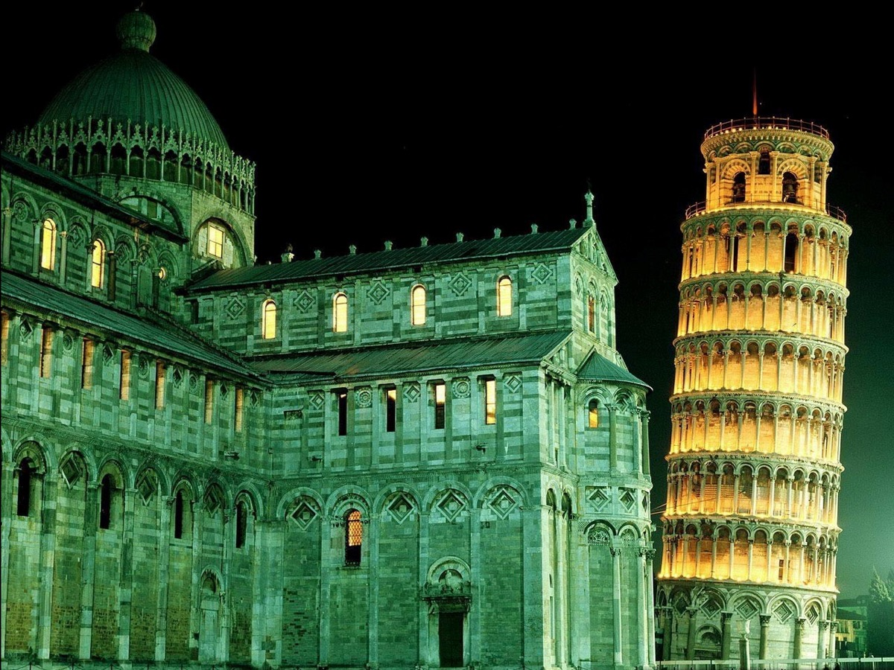
Notes:
This famous building (The Leaning Tower of Pisa) in Italy is collapsing because it’s foundations were not strong enough!

Slide 29
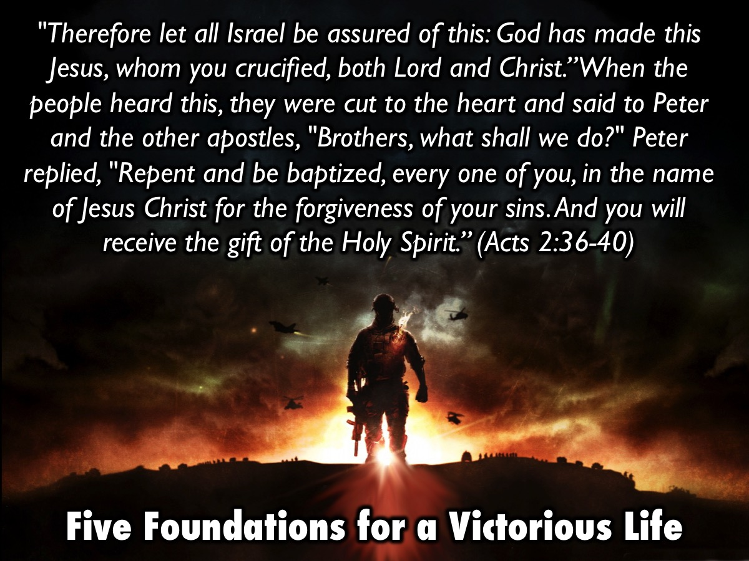
Notes:
There are five essential foundations for a victorious life in Acts 2:36-40:

Slide 30

Notes:
#1 Lordship - Therefore let all Israel be assured of this: God has made this Jesus, whom you crucified, both Lord and Christ. (Acts 2:36)

Slide 31

Notes:
#2 Repentance - When the people heard this, they were cut to the heart and said to Peter and the other apostles, "Brothers, what shall we do?" Peter replied, "Repent and be baptized, every one of you, in the name of Jesus Christ for the forgiveness of your sins." (Acts 2:37,38a)

Slide 32

Notes:
#3 Baptism - Peter replied, "Repent and be baptized, every one of you, in the name of Jesus Christ for the forgiveness of your sins." (Acts 2:38a)

Slide 33

Notes:
#4 Holy Spirit - And you will receive the gift of the Holy Spirit. The promise is for you and your children and for all who are far off-for all whom the Lord our God will call. (Acts 2:38b-39)

Slide 34

Notes:
#5 Church - Those who accepted his message were baptized, and about three thousand were added to their number that day. (Acts 2:41)

Slide 35

Notes:
2. Discover Freedom - the second reason you should be a part of this series is that you will discover how to walk in freedom.

Slide 36

Notes:
Freedom is the power to do what is right, not the right to do what we want!

Slide 37
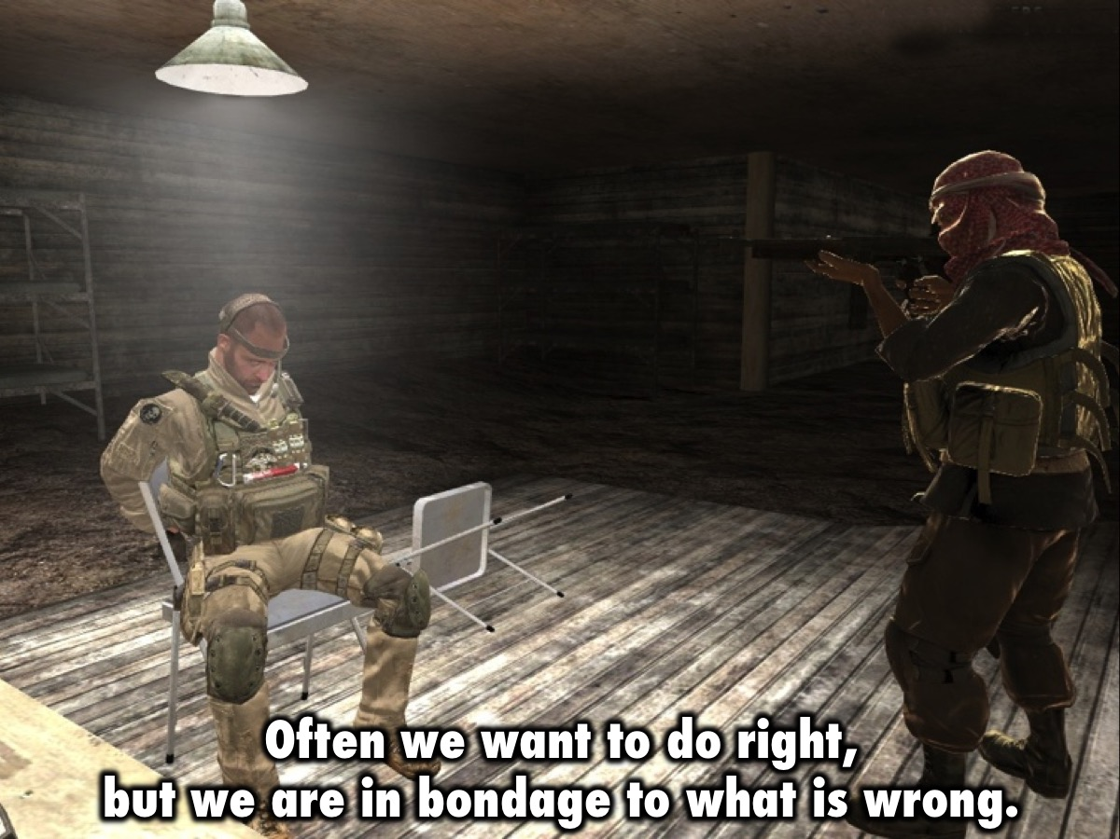
Notes:
Often we want to do right, but we are in bondage to what is wrong.

Slide 38
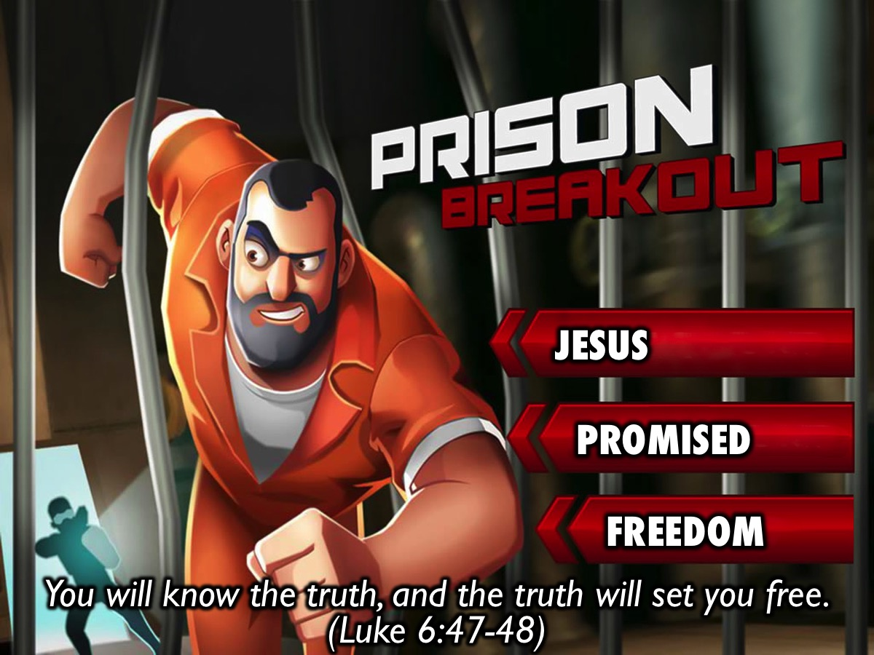
Notes:
Jesus promised spiritual freedom: “Then you will know the truth, and the truth will set you free.” (Luke 6:47-48)

Slide 39
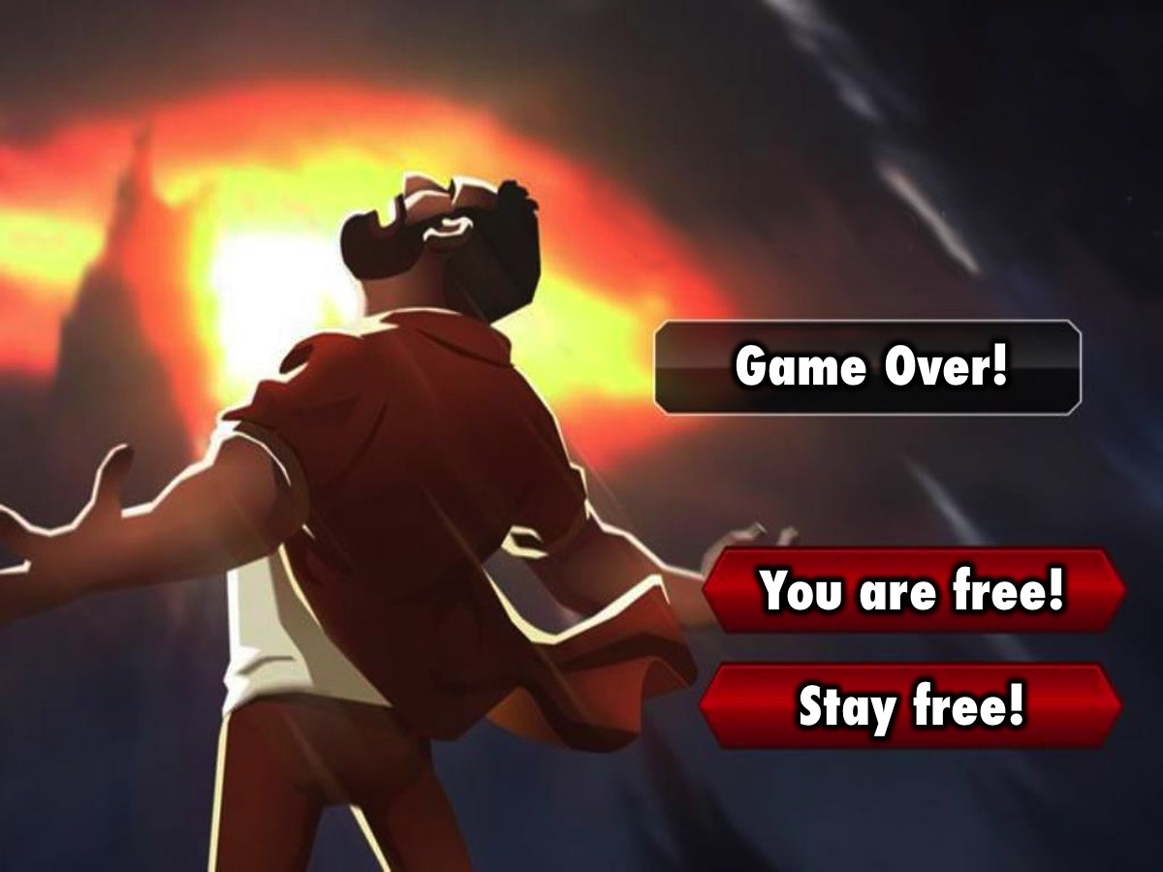
Notes:
So why are you still in prison, when Jesus has broken you out?

Slide 40
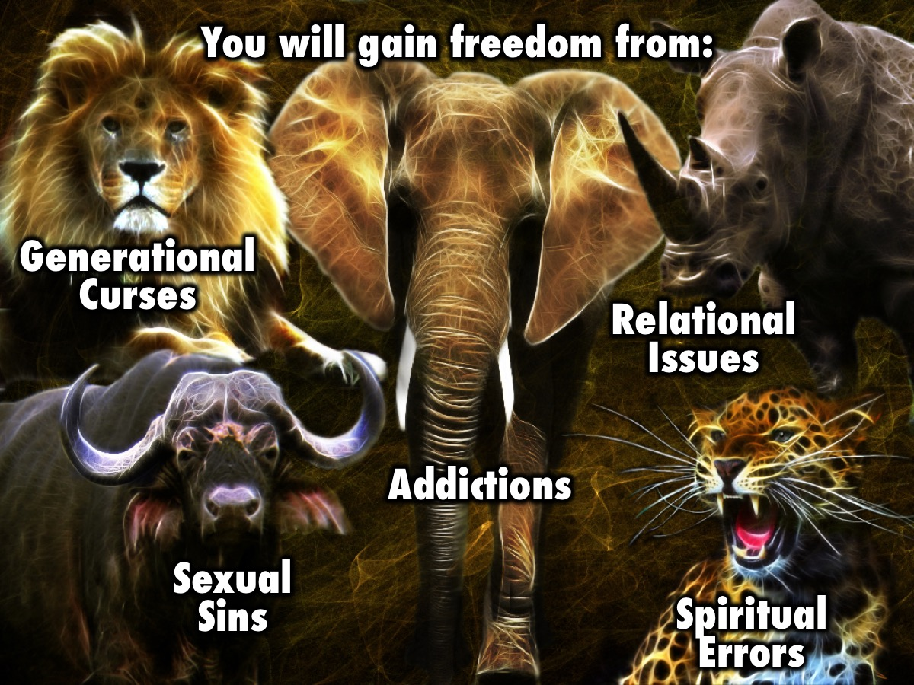
Notes:
You will gain freedom from the big five areas that we have identified: Generational curses, Relational issues, Spiritual errors, Sexual sins and Addiction.

Slide 41

Notes:
3. Become Fruitful. The third reason to be a part of this series is to become fruitful as a follower of Jesus!

Slide 42
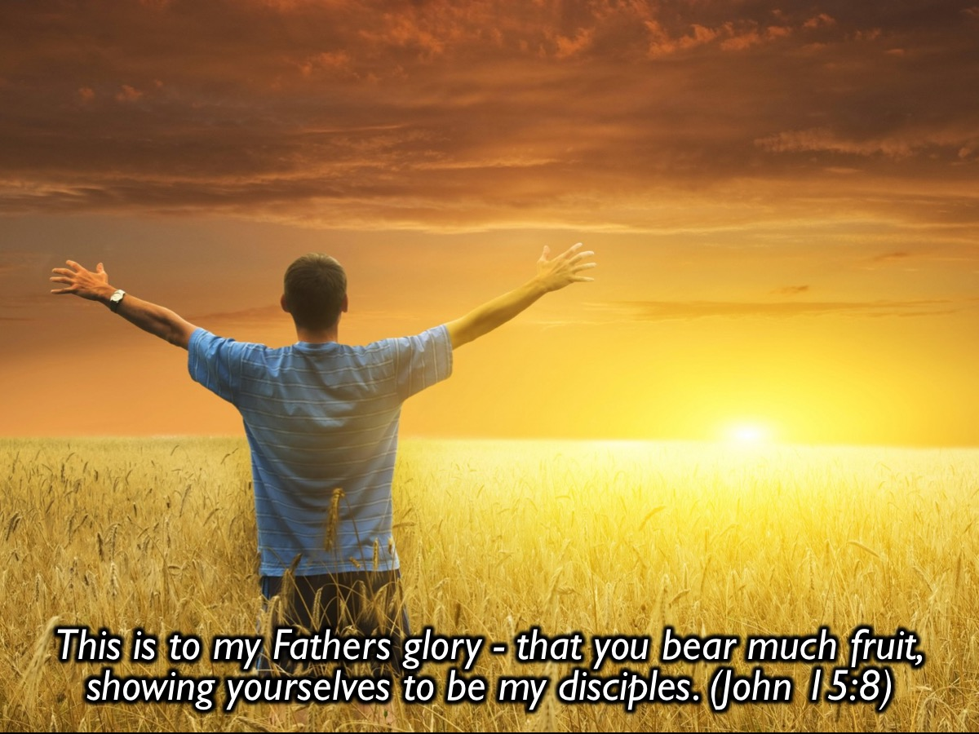
Notes:
Jesus said: This is to my father’s glory – that you bear much fruit, showing yourselves to be my disciples. (John 15:8)

Slide 43
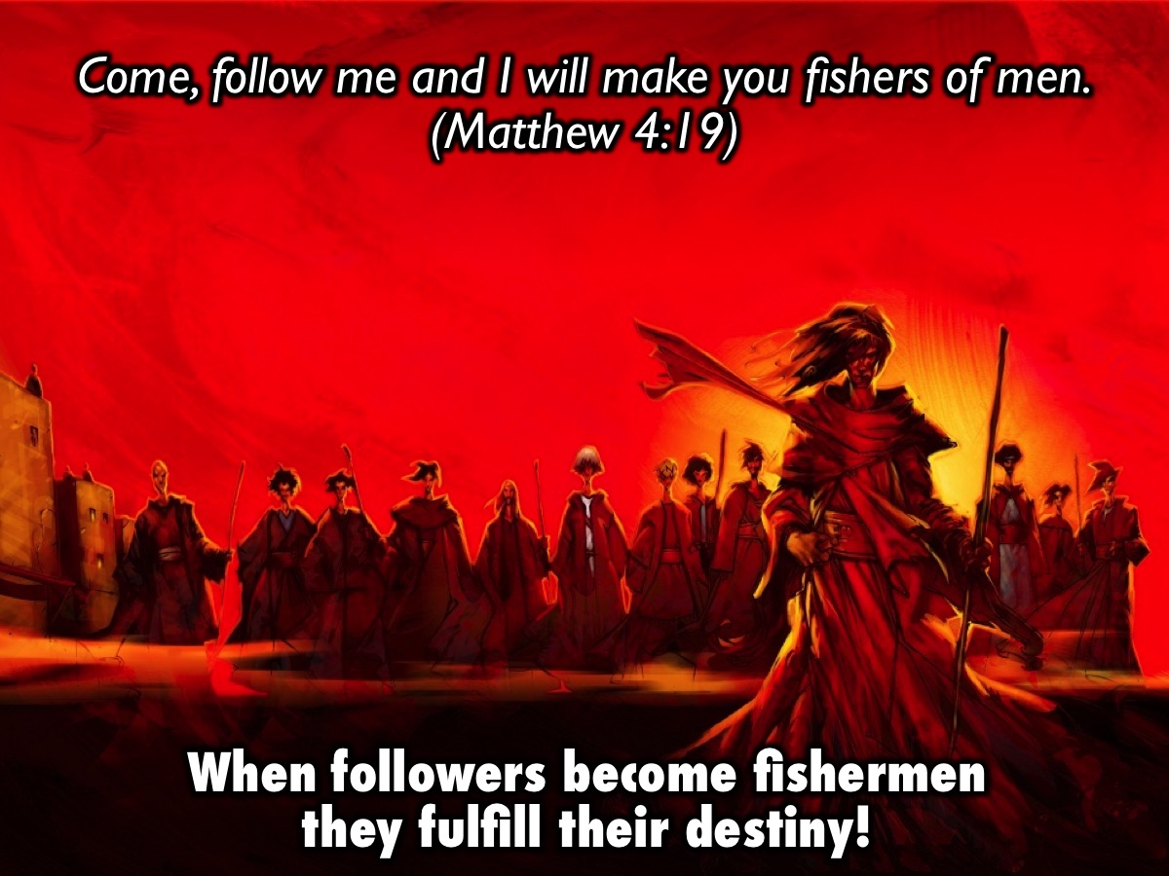
Notes:
Jesus said: "Come, follow me, and I will make you fishers of men.” (Matthew 4:19) - When followers become fishermen they fulfill their destiny!

Slide 44

Notes:
What’s next? Work through the Preparing for Victory Booklet this week – from Monday to Thursday – there is a page for each day!

Slide 45
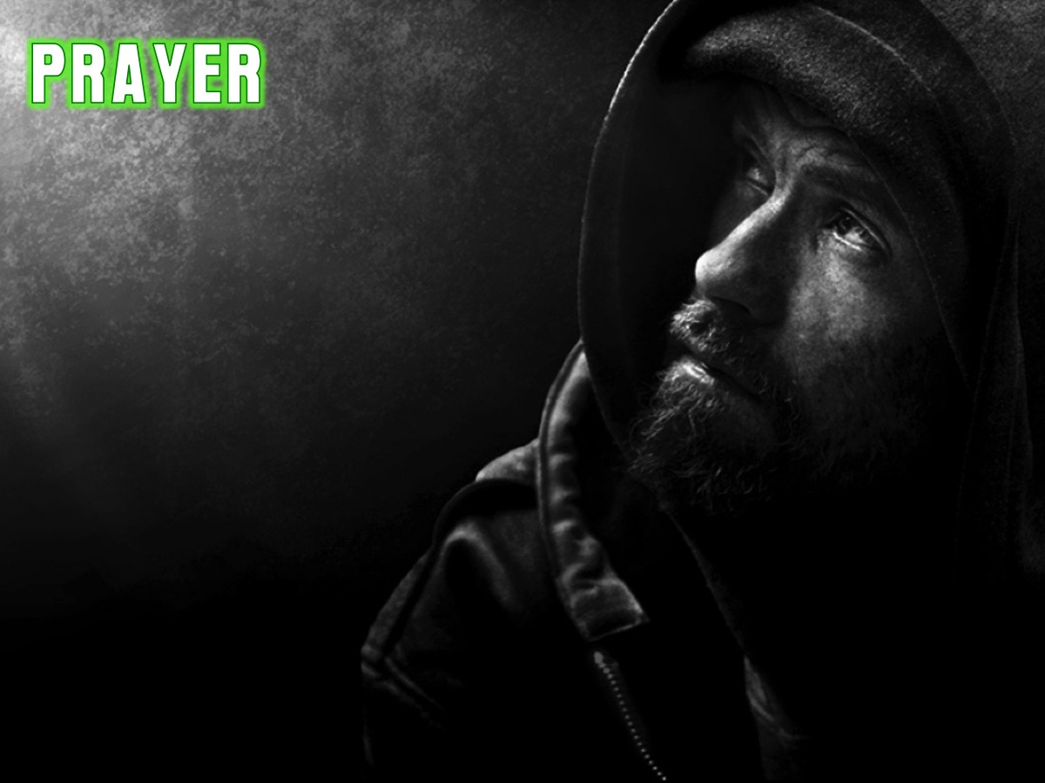
Notes:
Let’s pray!

Slide 46

Notes:
Next week we will look at how transformation happens in our lives.

