Slide 1

Notes:
Welcome to Victory Sunday!

Slide 2
Notes:
Video: Ghost Recon : Future Soldier - US Launch Trailer. Get it on YouTube at: https://www.youtube.com/watch?v=GB9c9C1dp7Q

Slide 3

Notes:
Week 1 was about preparing for victory

Slide 4

Notes:
We saw that there are three reasons to attend Victory Sunday: Build foundations, discover freedom and become fruitful.

Slide 5

Notes:
Week 2 was about Transformation.

Slide 6
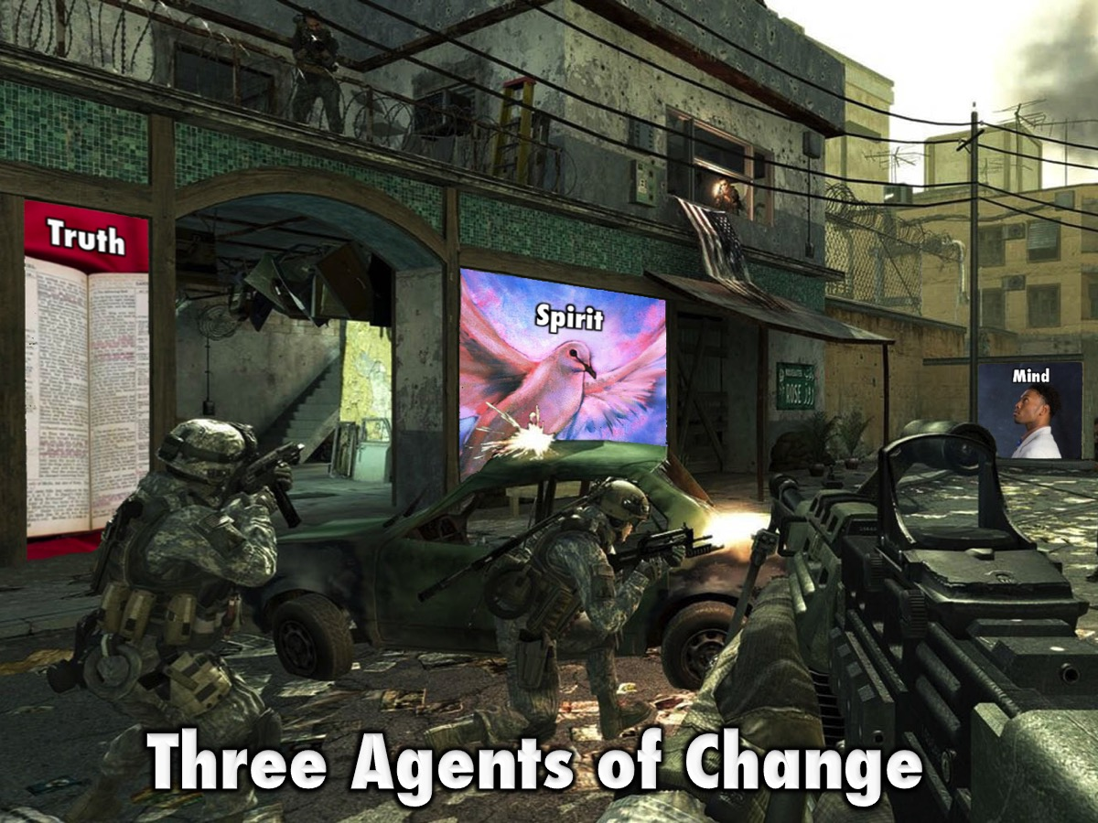
Notes:
We saw that God uses three things to transform us: (1) Truth, (2) Holy Spirit, (3) Renewed Mind.

Slide 7

Notes:
Week 3 was about the Cross.

Slide 8
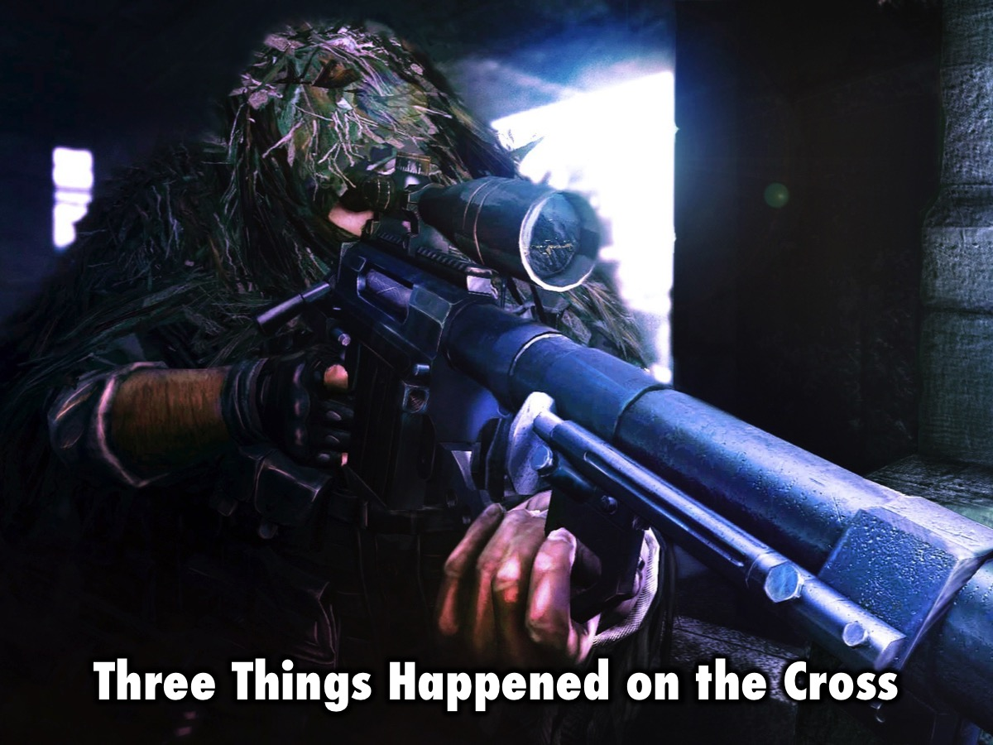
Notes:
Three things happened on the cross:

Slide 9
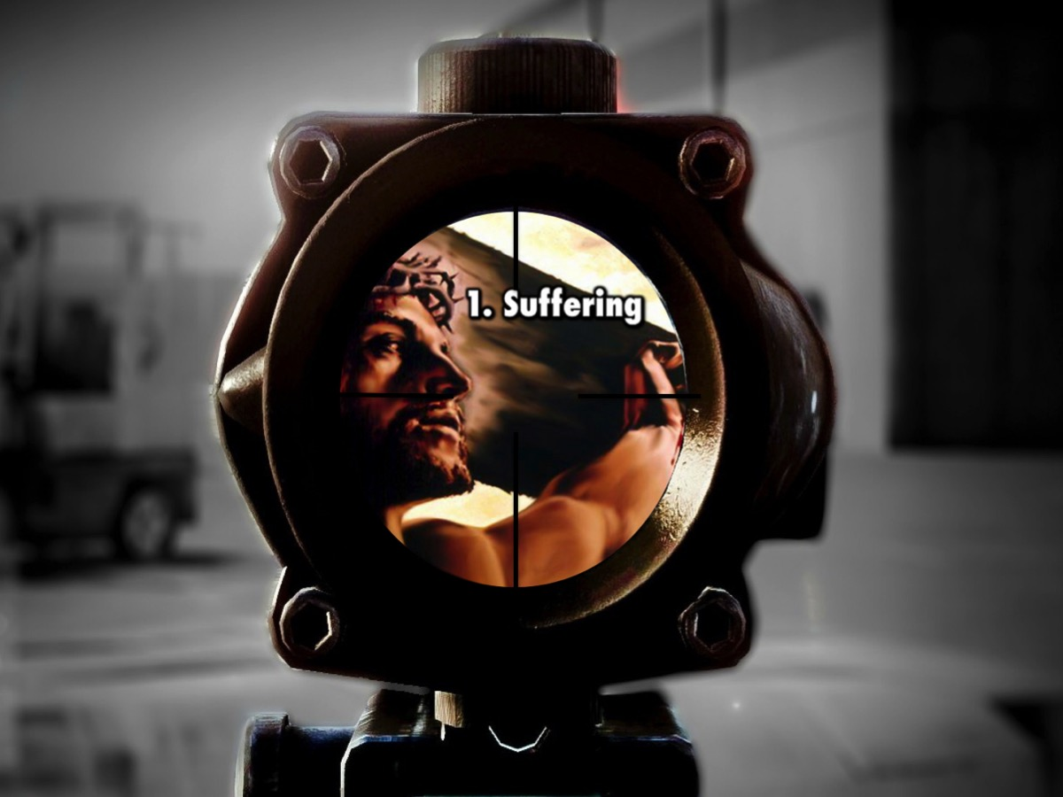
Notes:
1. Suffering. Jesus suffered the pain of the cross because of my sins.

Slide 10
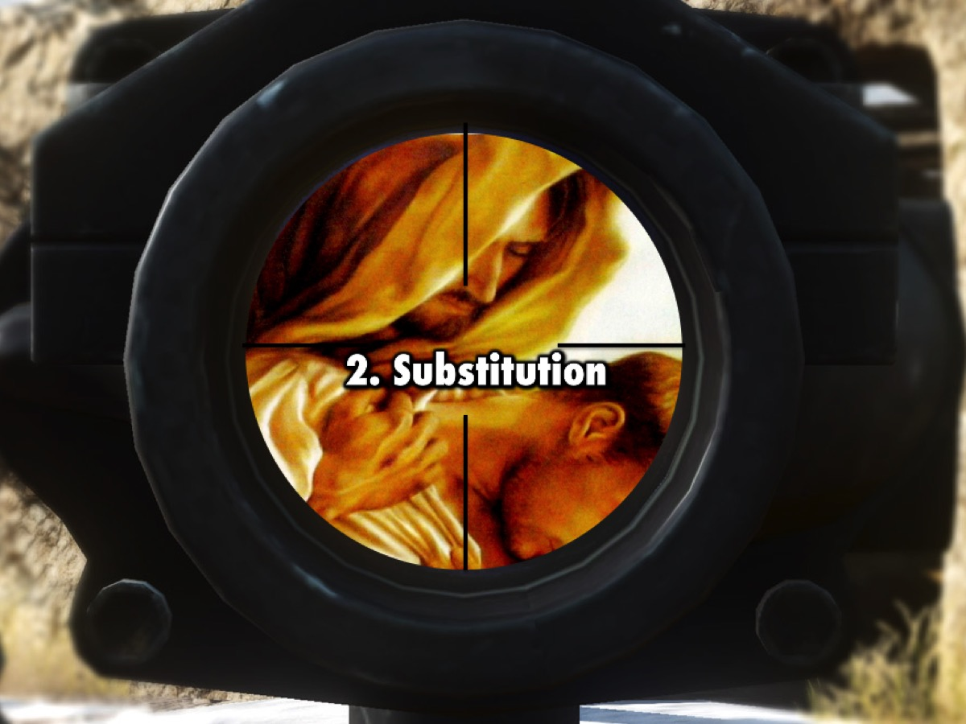
Notes:
2. Substitution. Jesus took our place on the cross, becoming our sin and suffering our punishment, so we could receive his righteousness.

Slide 11
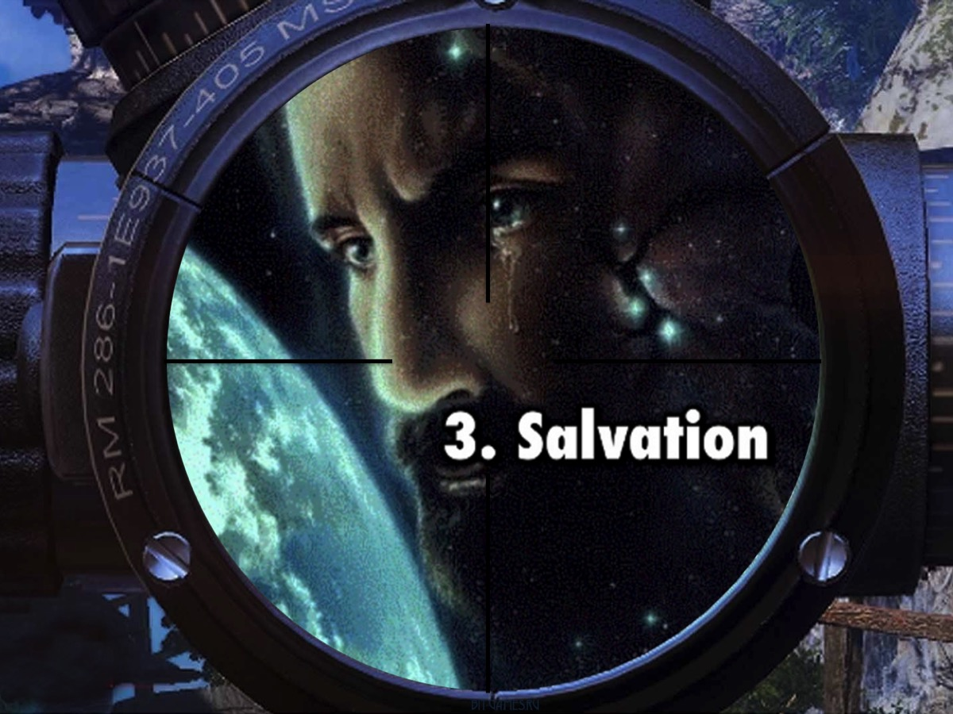
Notes:
3. Salvation. Jesus came to seek and save the Lost – to save sinners from the wrath of God.

Slide 12
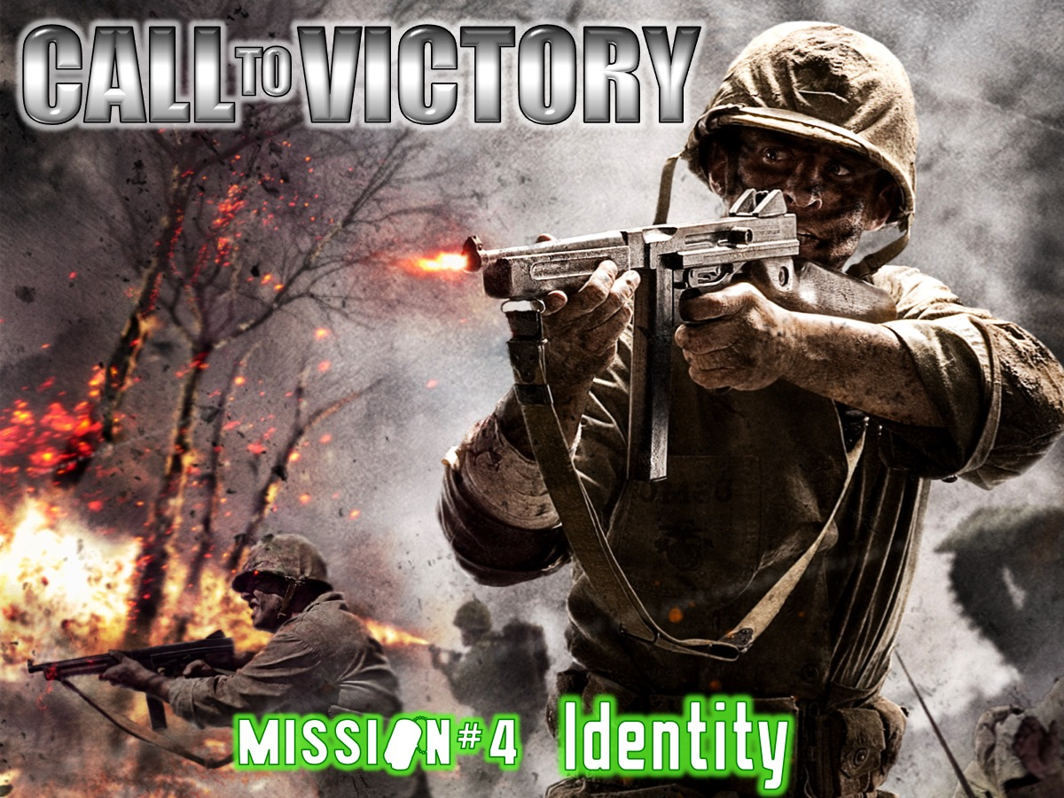
Notes:
Week 4 was about our Identity.

Slide 13

Notes:
We looked at who we are in Christ:

Slide 14
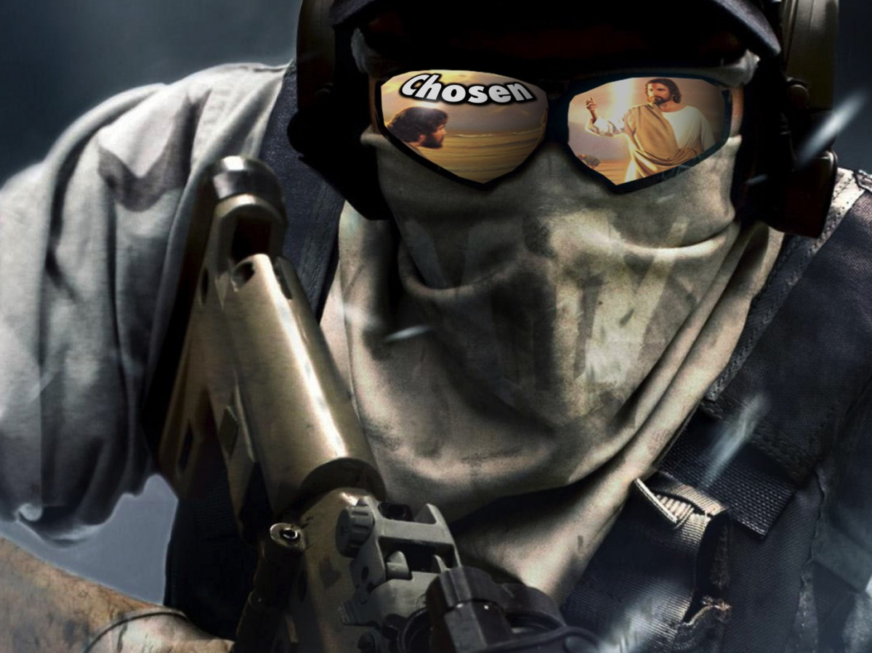
Notes:
1. We are Chosen

Slide 15
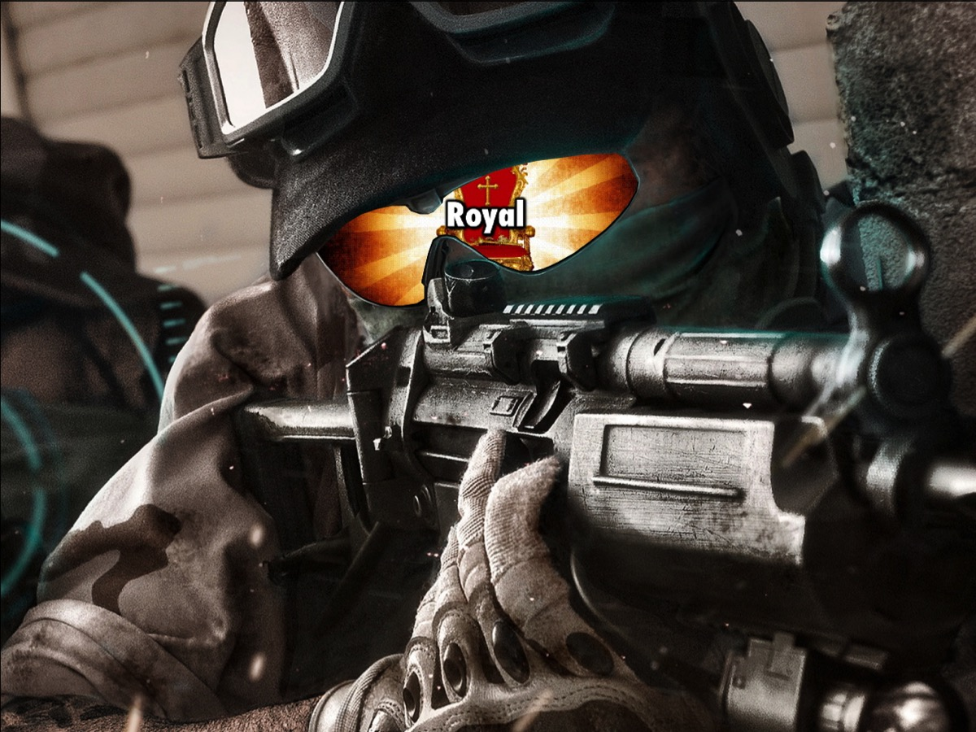
Notes:
2. We are Royal

Slide 16
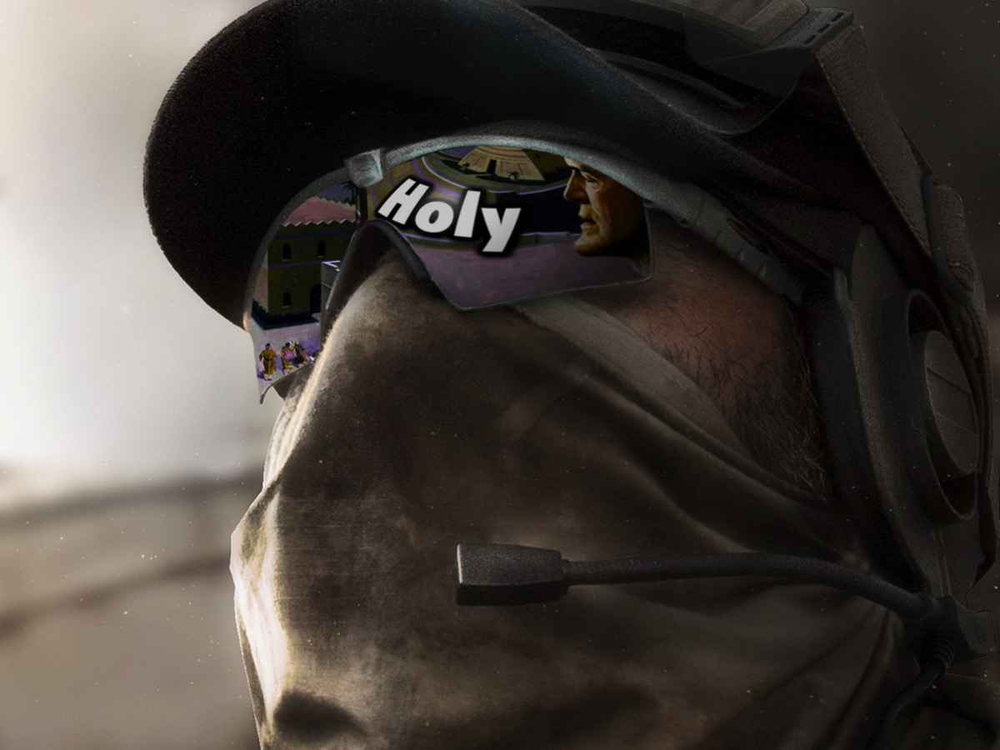
Notes:
3. We are Holy

Slide 17
Notes:
Video: Daniel Baron - Indestructible (Official Music Video). Get it on YouTube at: https://www.youtube.com/watch?v=XuVidcEXkEM

Slide 18

Notes:
Week 5 was about dealing with Generational Curses.

Slide 19

Notes:
We looked at some common generational curses: Financial Lack, Incurable Disease, Mental Illness, Pregnancy Trouble, Failure or Oppression or Home Disunity.

Slide 20
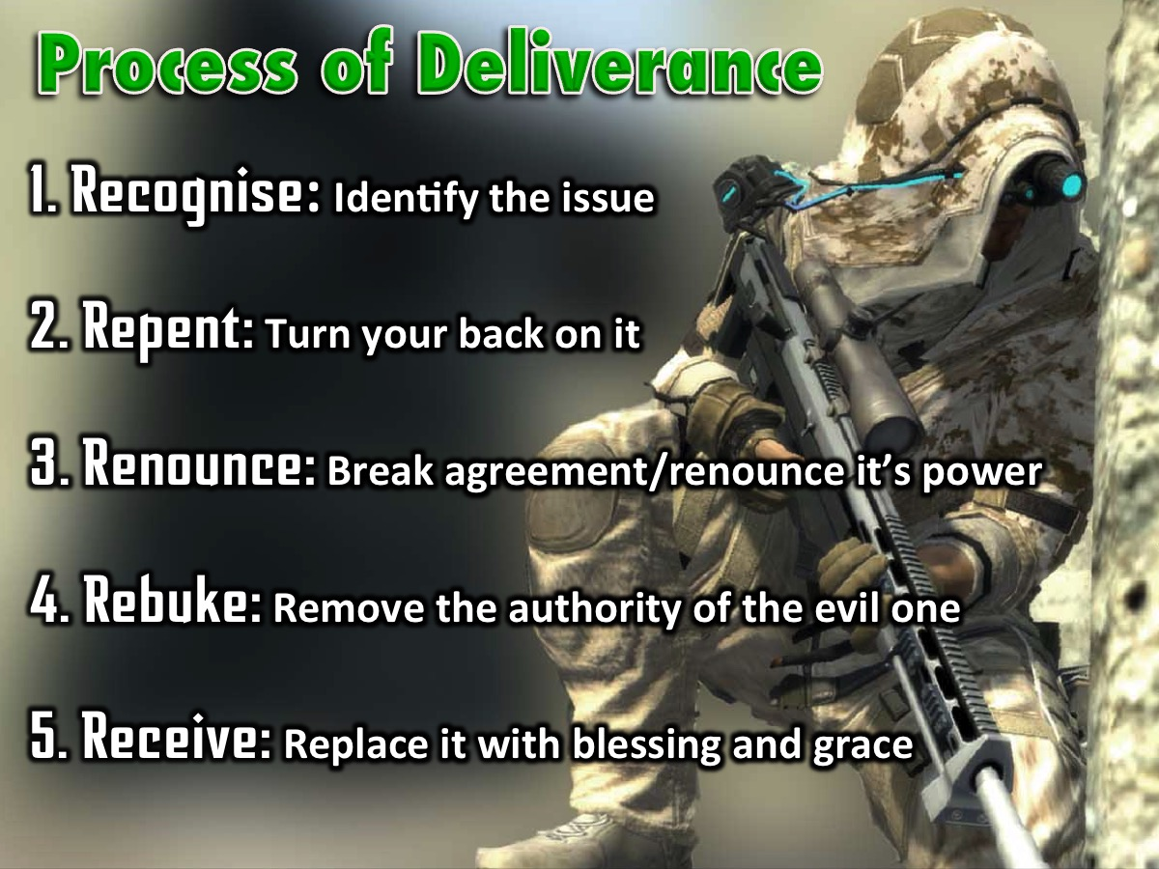
Notes:
The Process of Deliverance: (1) Recognise the issue. (2) Repent by turning your back on it. (3) Renounce by falling out of agreement with the issue and renouncing its power over your life. (4) Rebuke the evil one. (5) Receive by replacing it with blessing and grace.

Slide 21

Notes:
Week 6 was about dealing with Relational Issues.

Slide 22
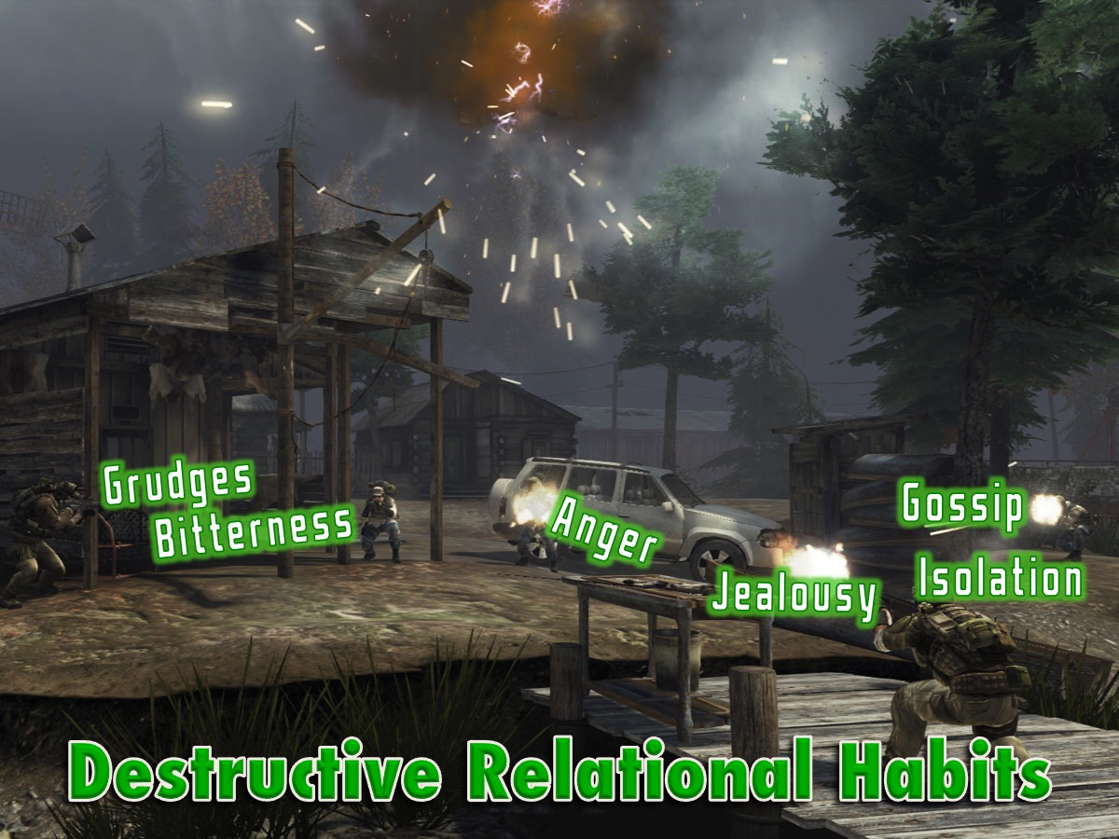
Notes:
We saw that there are at last six destructive relational habits: grudges, bitterness, anger, jealousy, gossip and isolation.

Slide 23
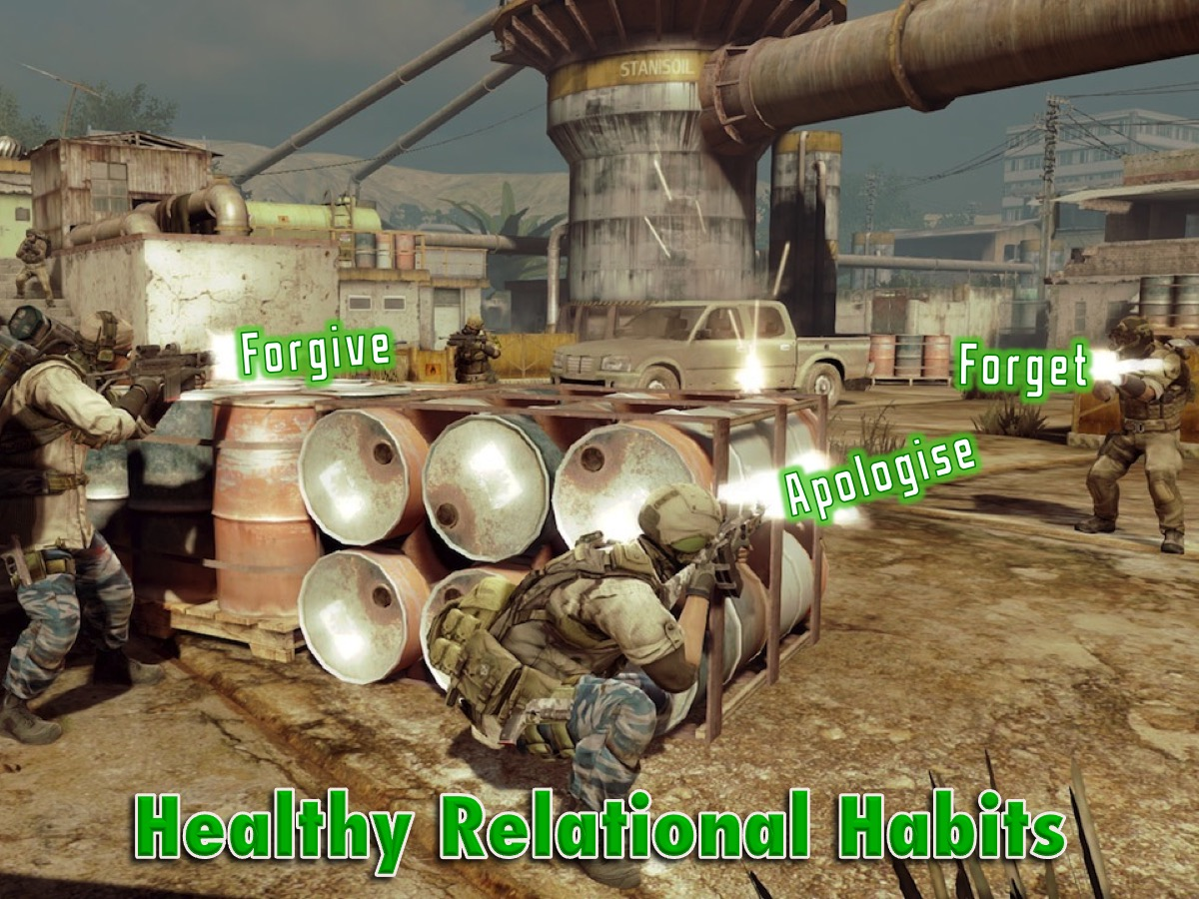
Notes:
But there are also healthy relational habits that we can practise, including forgive, apologise and forget.

Slide 24

Notes:
Week 7 was about dealing with Spiritual Errors.

Slide 25
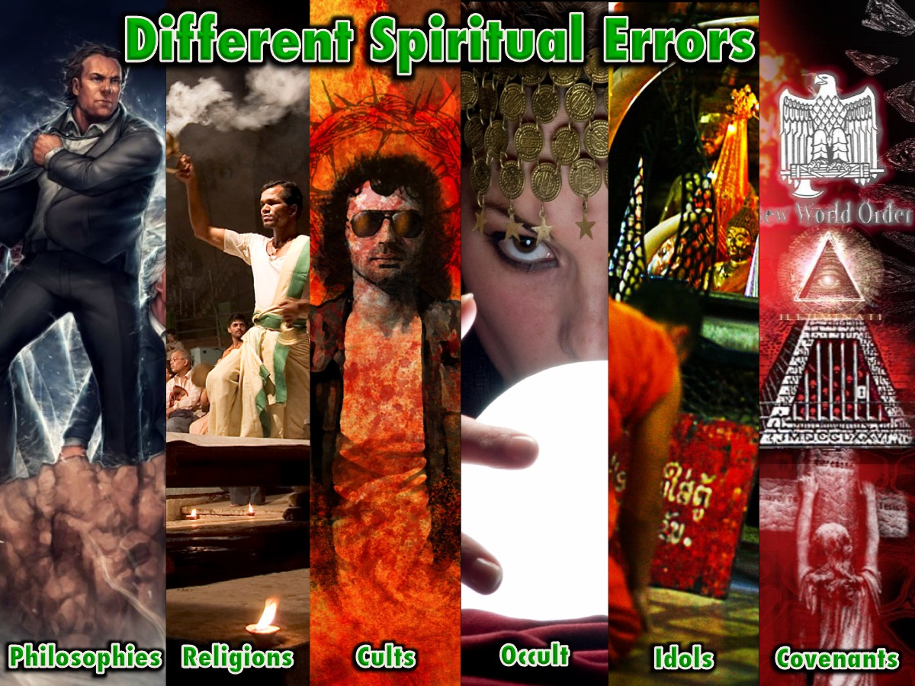
Notes:
We saw that there are many different spiritual errors we can fall into: Secular Philosophies, False Religions, cults, occult, idols and unbiblical covenants.

Slide 26
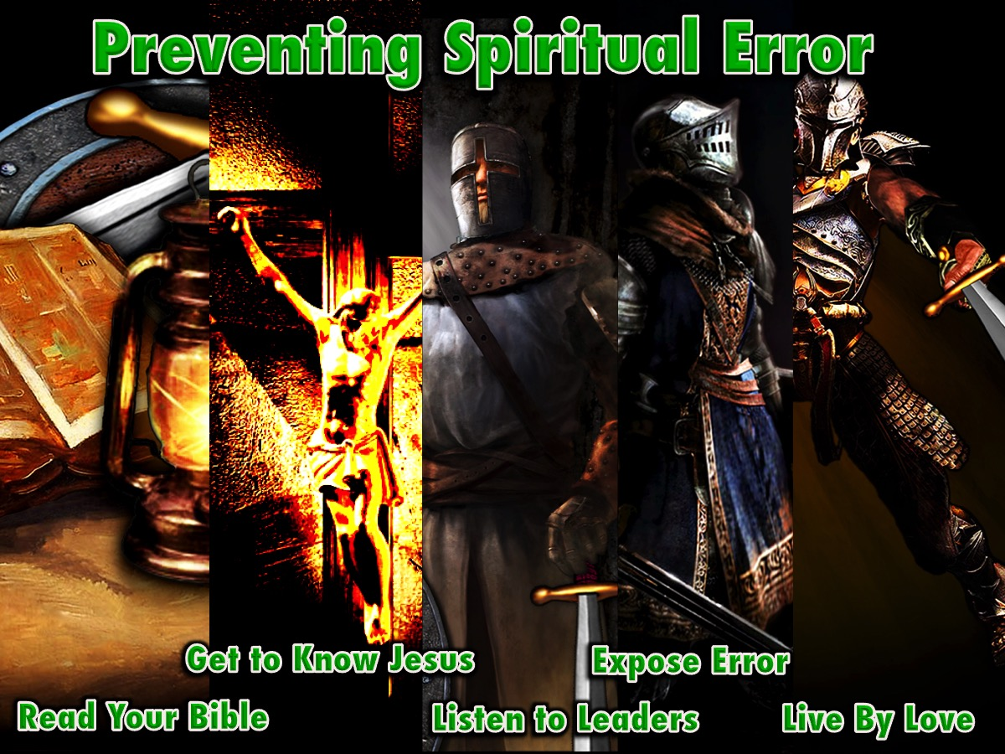
Notes:
We learnt that there are ways to prevent spiritual error: (1) Read Your Bible, (2) Get to Know Jesus, (3) Listen to Your Leaders, (4) Expose Spiritual Error and (5) Live by a New Standard of Love.

Slide 27

Notes:
Week 8 about dealing with Sexual Sins.

Slide 28
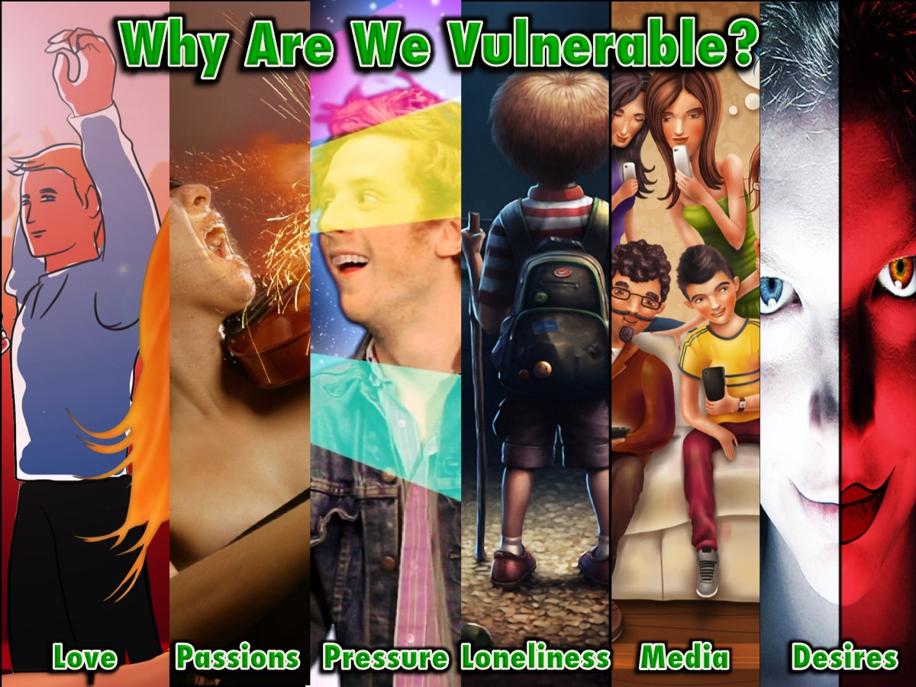
Notes:
We saw that we are vulnerable to attack because of: the need for love, passions and affections, peer pressure, loneliness, media influences and evil desires.

Slide 29
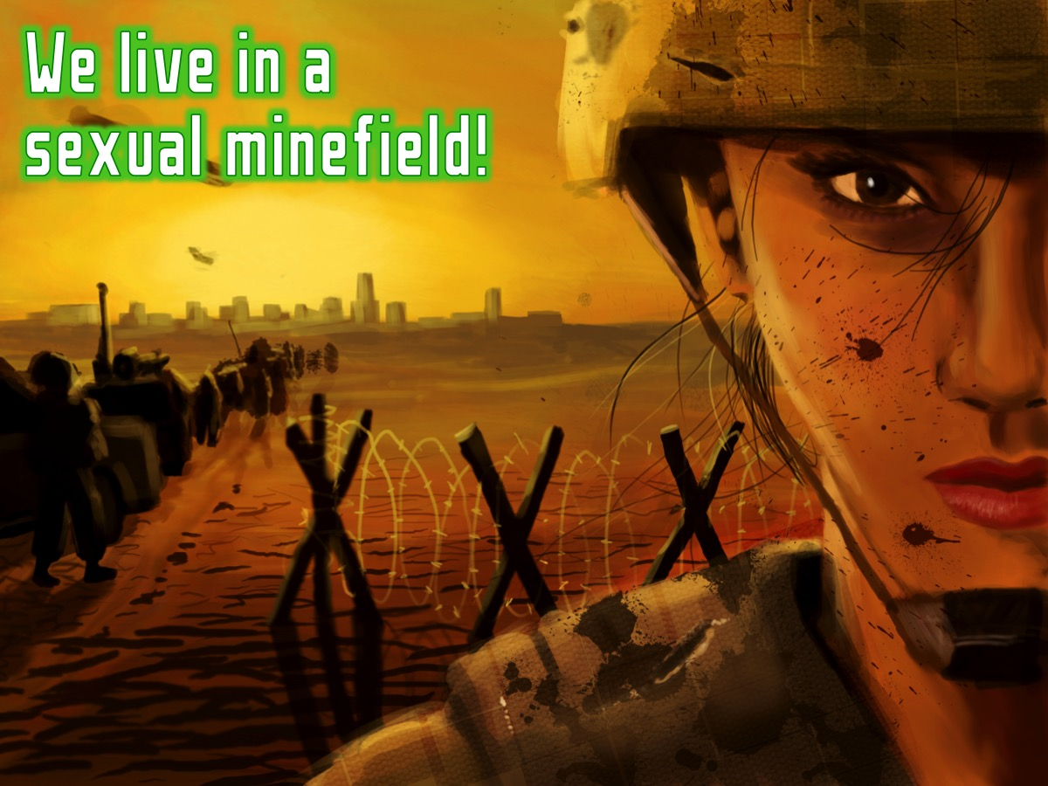
Notes:
We learnt that we live in a sexual mine field but…

Slide 30
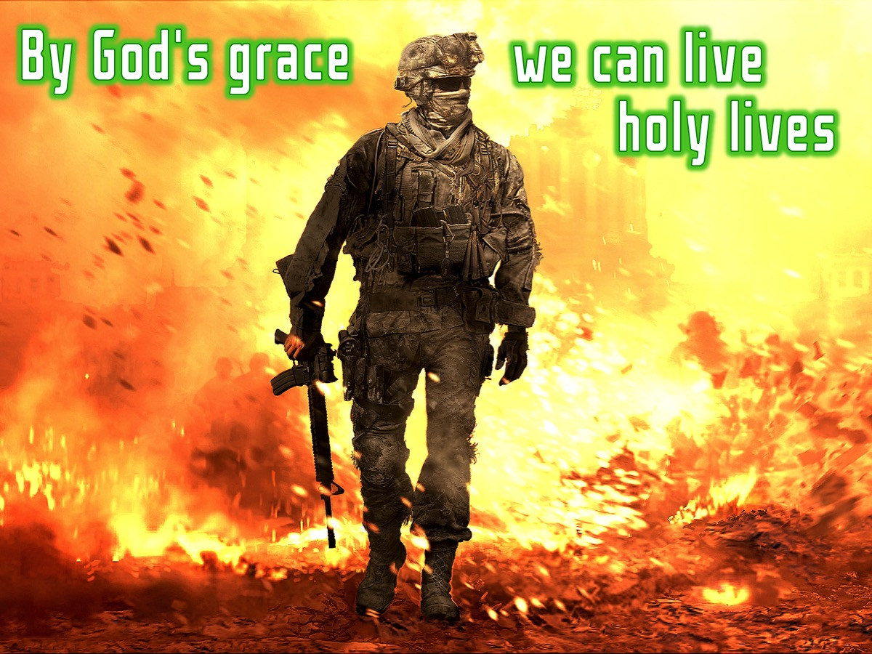
Notes:
By God’s grace we can live holy lives.

Slide 31

Notes:
Week 9 was about dealing with Addictions.

Slide 32
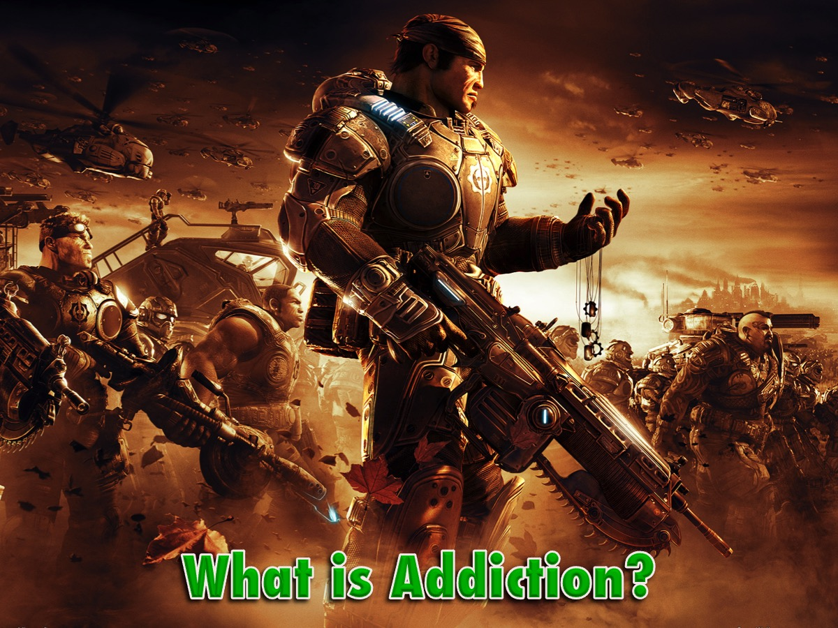
Notes:
We asked the question: What is Addiction?

Slide 33
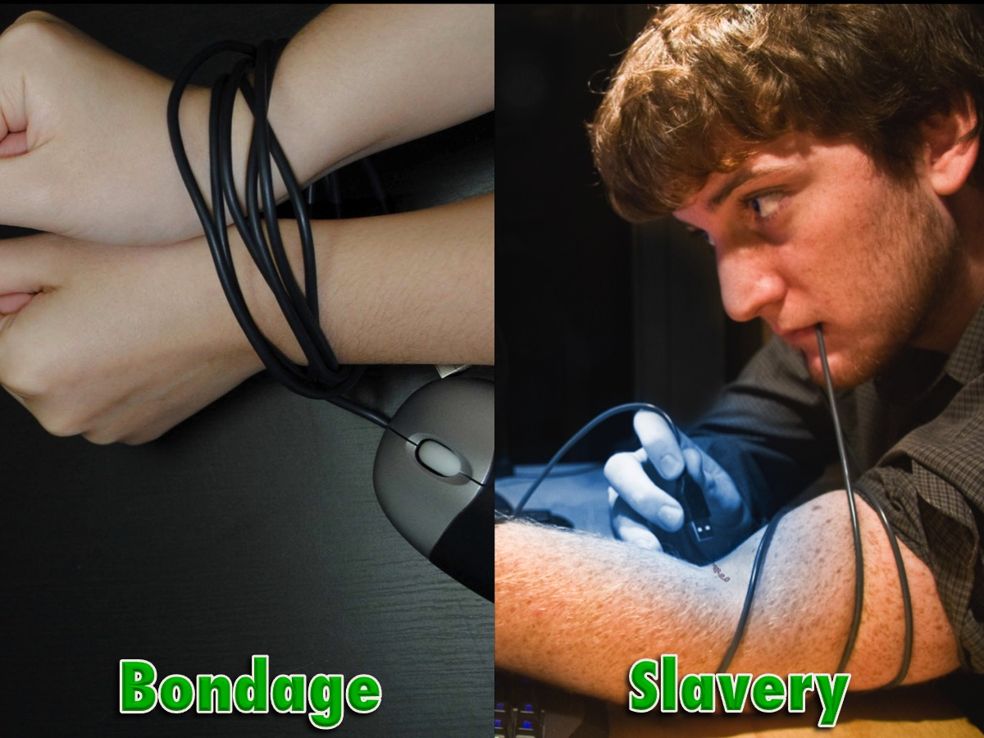
Notes:
We learnt that addiction is Bondage and Slavery.

Slide 34

Notes:
But we also learnt that addictions can be broken by:

Slide 35

Notes:
We learn that addictions can be broken by: (1) The Grace of God, (2) Confession and Prayer, (3) Surrender to God and (4) The filling of the Holy Spirit

Slide 36

Notes:
This week we are going to look at how to live in victory!

Slide 37
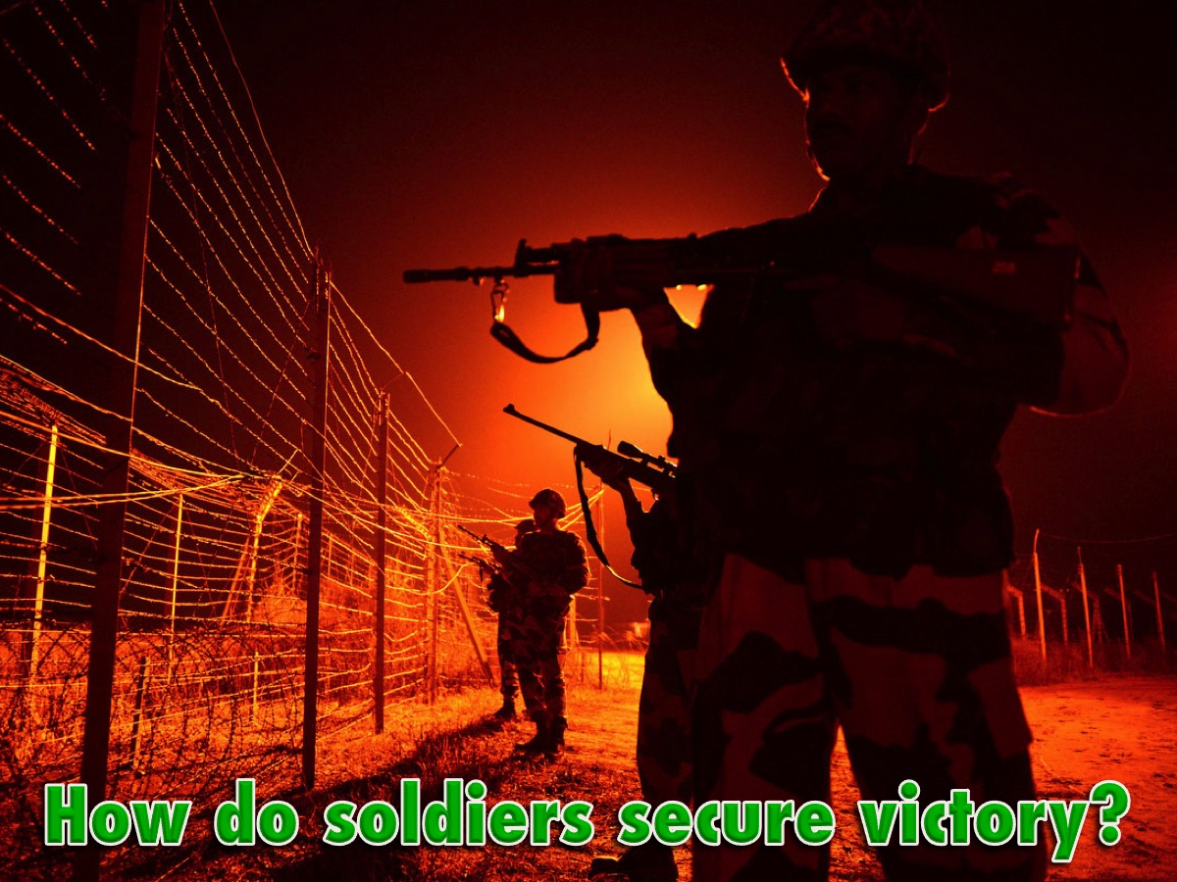
Notes:
How do soldiers secure their victory?

Slide 38
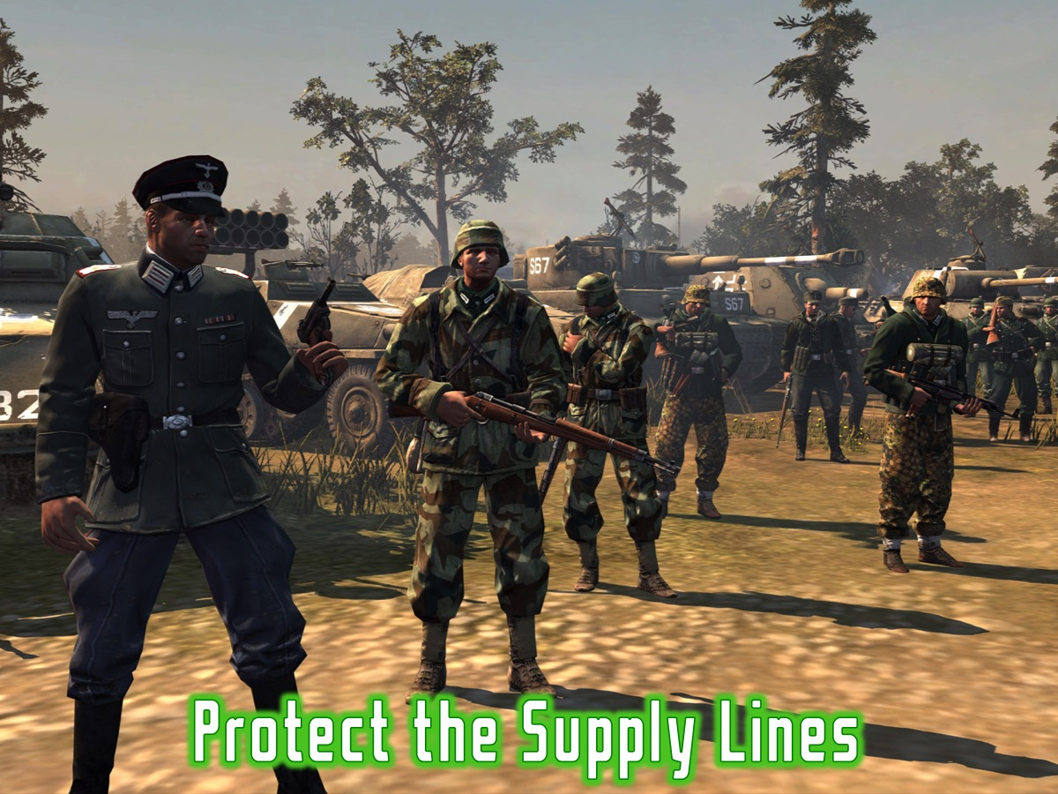
Notes:
1. Protect the supply lines

Slide 39
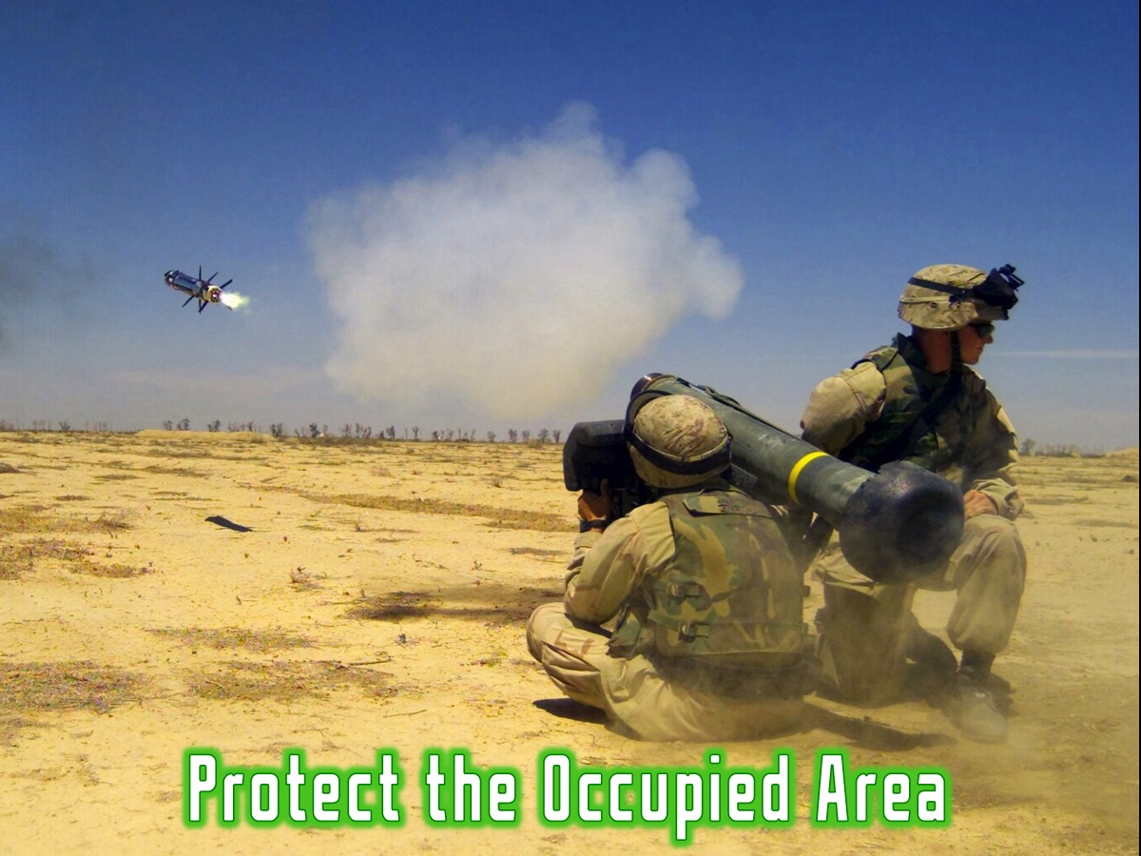
Notes:
2. Protect the occupied area (watch out for counter attacks)

Slide 40
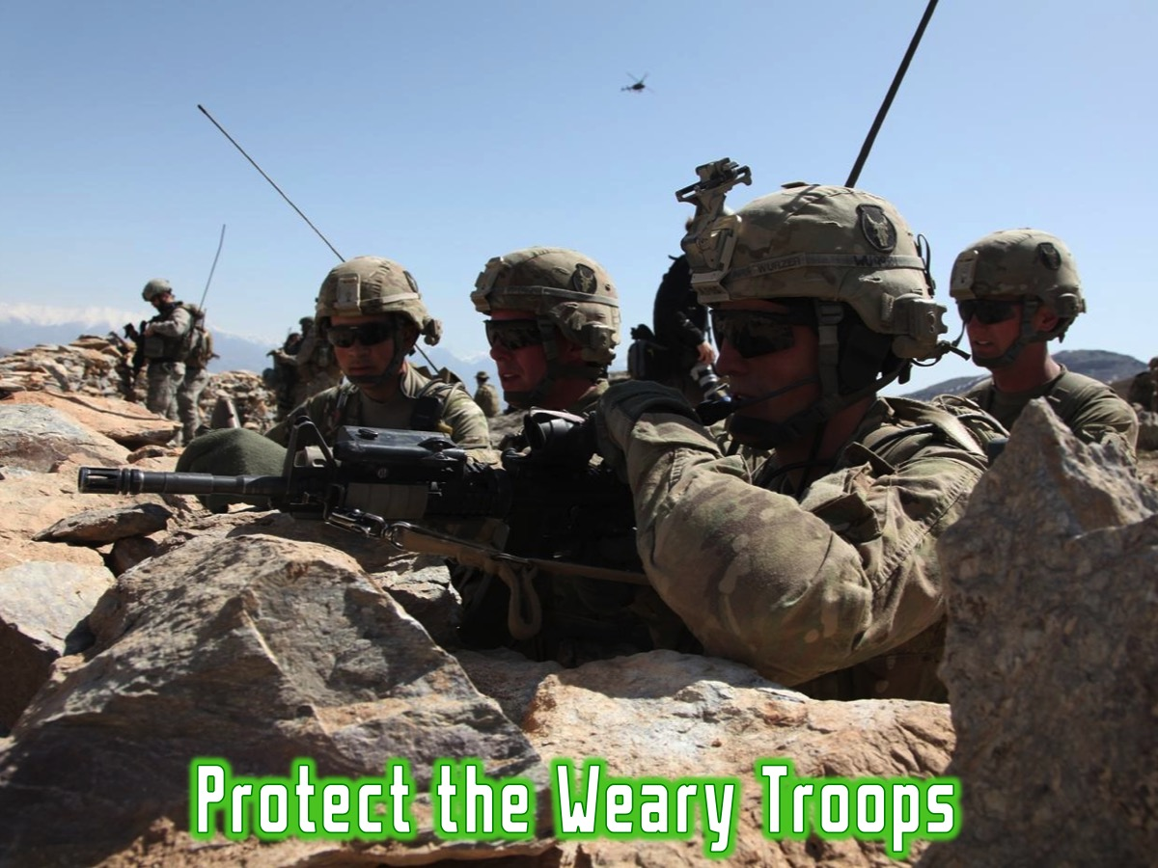
Notes:
3. Protect the Weary Troops

Slide 41
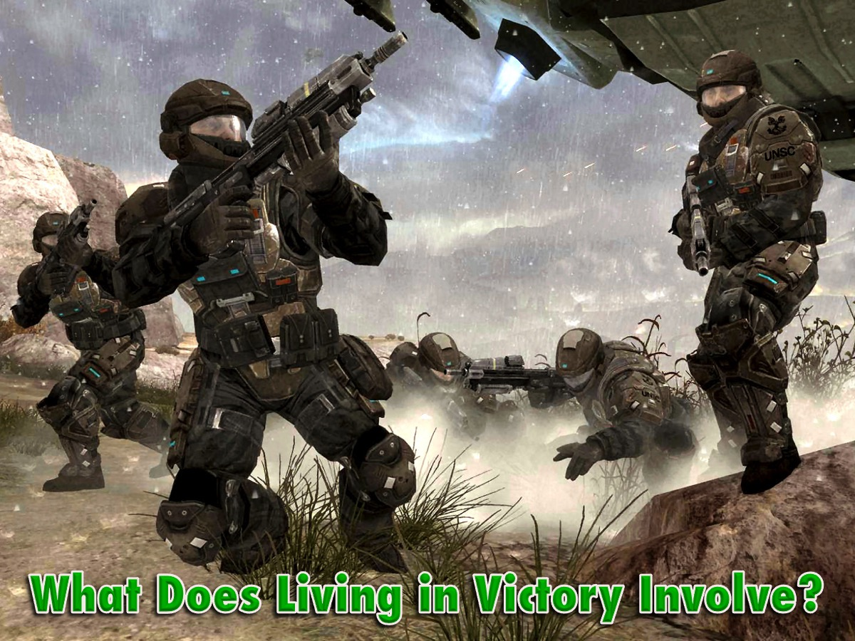
Notes:
What Does Living in Victory Involve for believers?

Slide 42
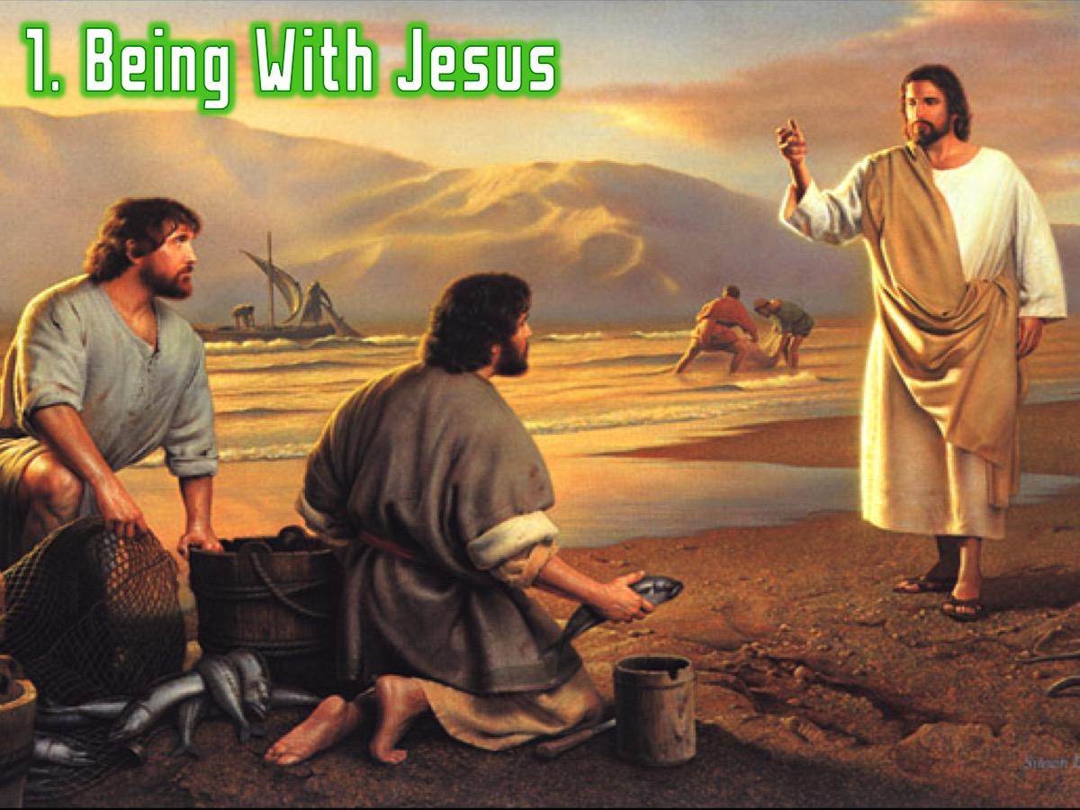
Notes:
1. Being With Jesus

Slide 43
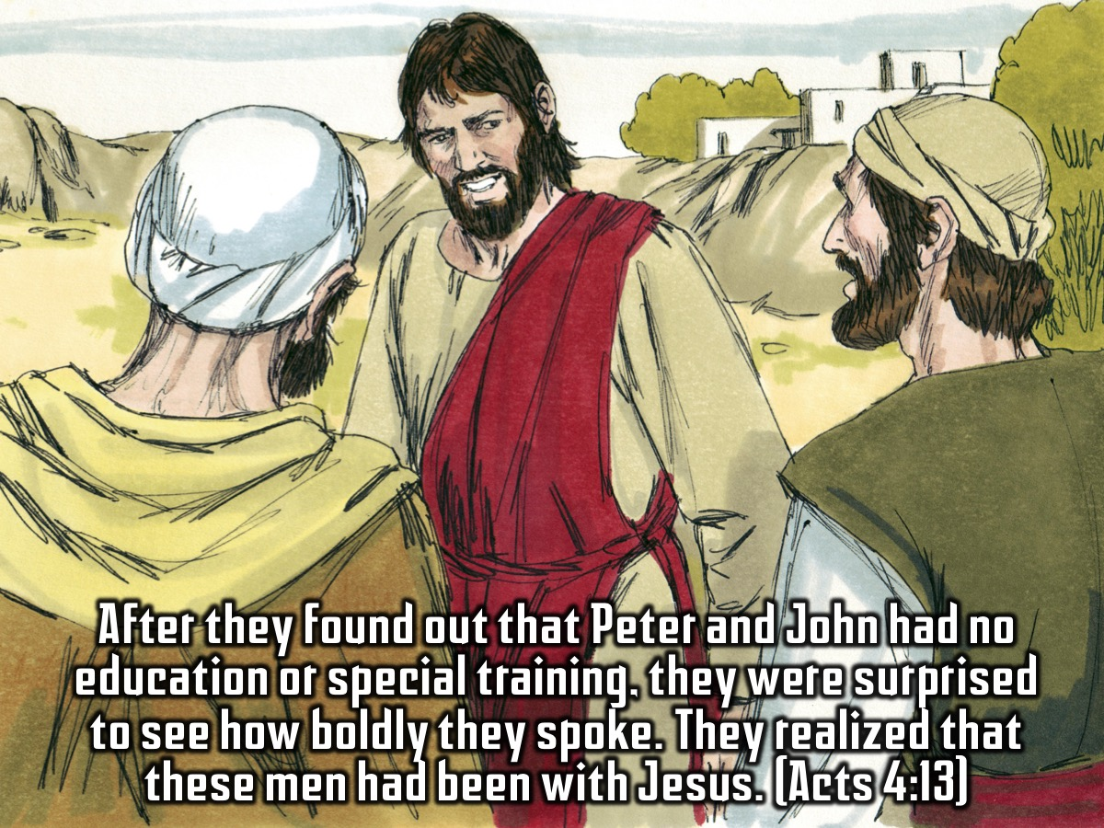
Notes:
After they found out that Peter and John had no education or special training, they were surprised to see how boldly they spoke. They realized that these men had been with Jesus. (Acts 4:13)

Slide 44
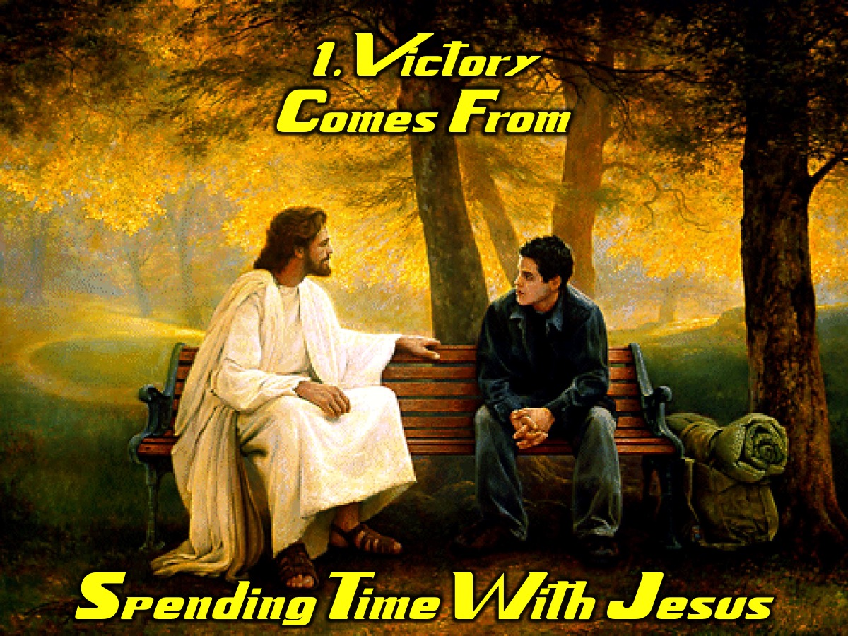
Notes:
Victory Comes From Spending Time With Jesus

Slide 45
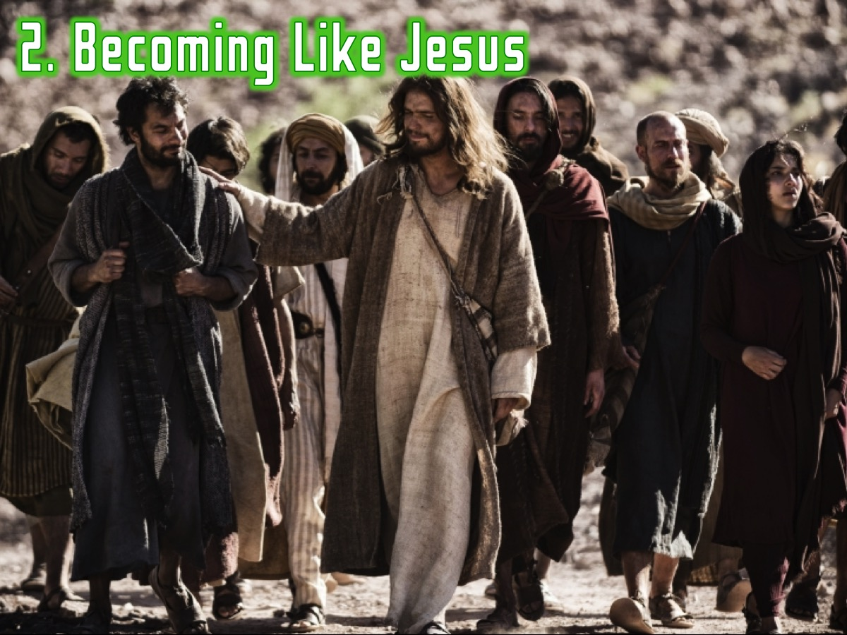
Notes:
2. Becoming Like Jesus

Slide 46
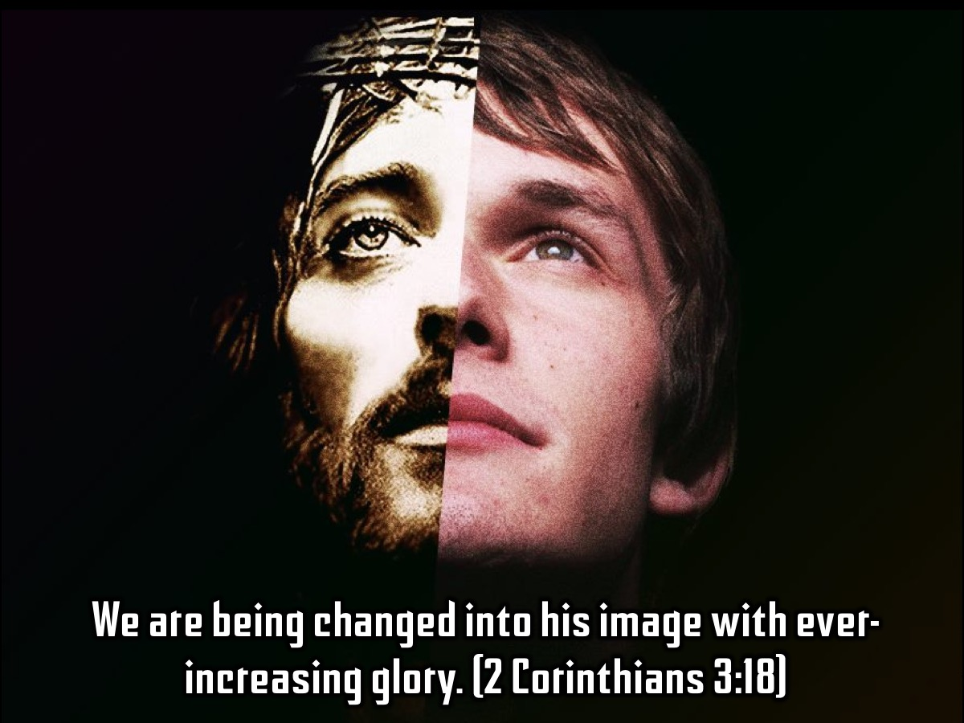
Notes:
We are being changed into his image with ever-increasing glory. (2 Corinthians 3:18)

Slide 47
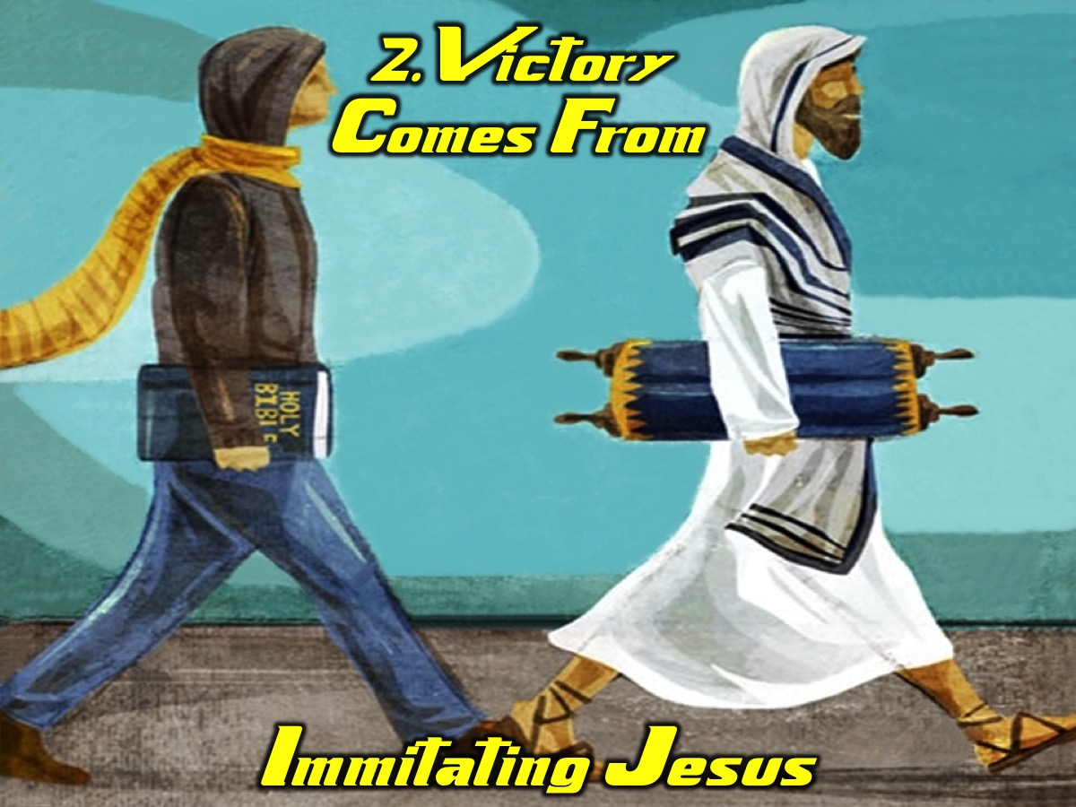
Notes:
Victory Comes From Imitating Jesus

Slide 48
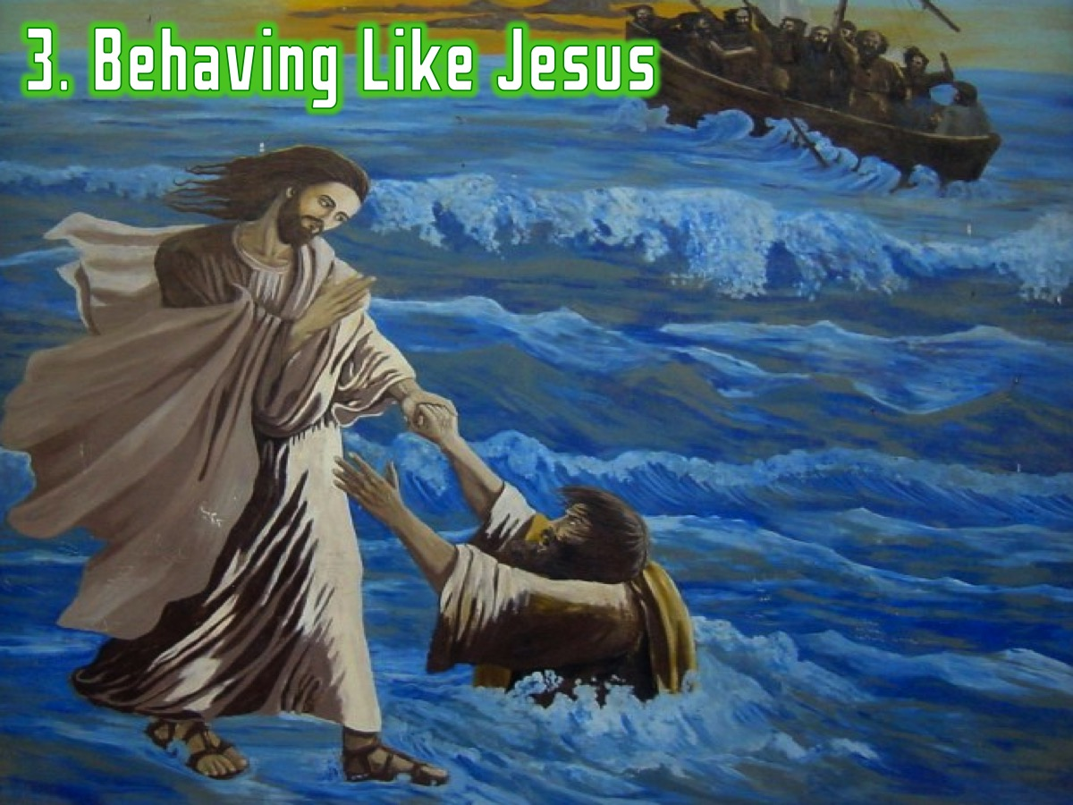
Notes:
3. Behaving Like Jesus

Slide 49
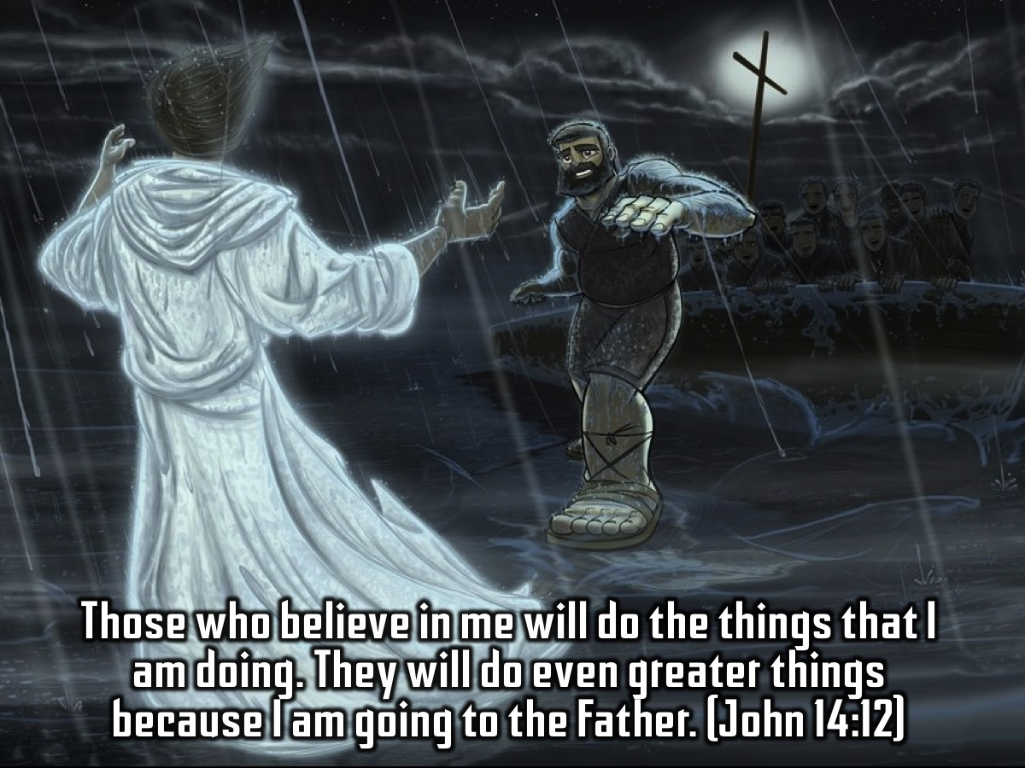
Notes:
Those who believe in me will do the things that I am doing. They will do even greater things because I am going to the Father. (John 14:12)

Slide 50

Notes:
Victory Comes From Acting Like Jesus

Slide 51
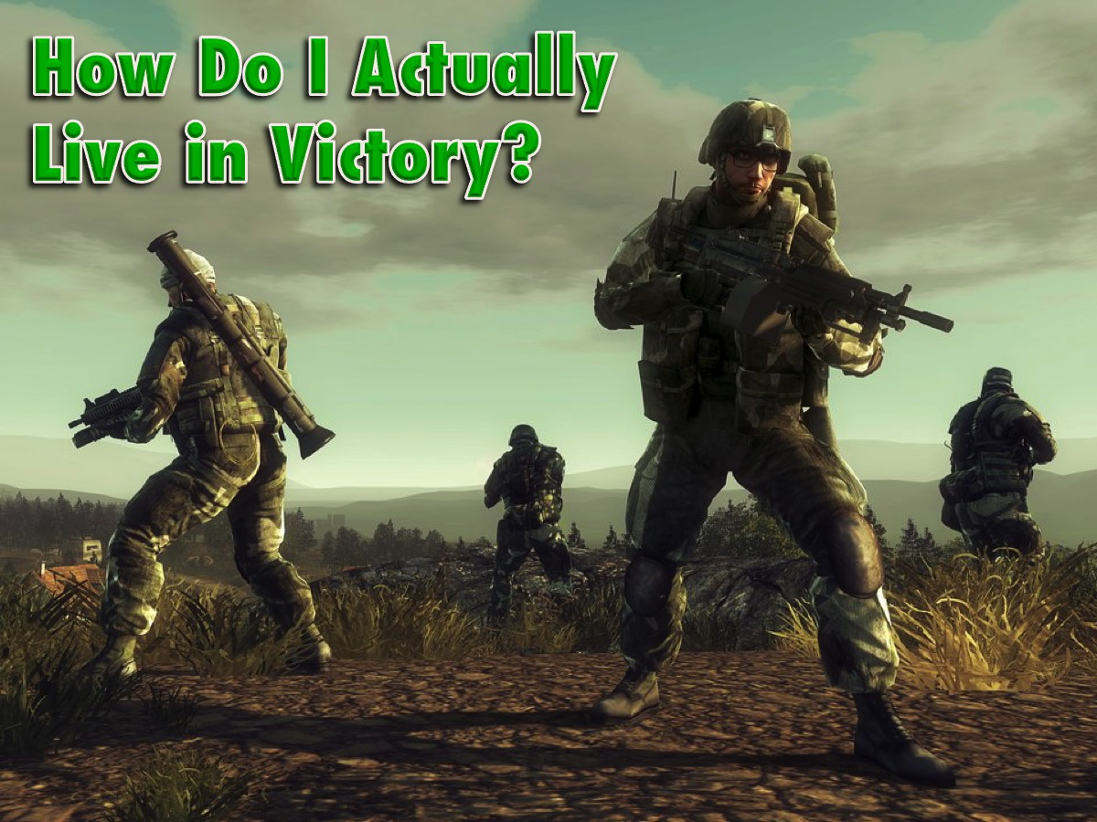
Notes:
How Do I Actually Live in Victory?

Slide 52
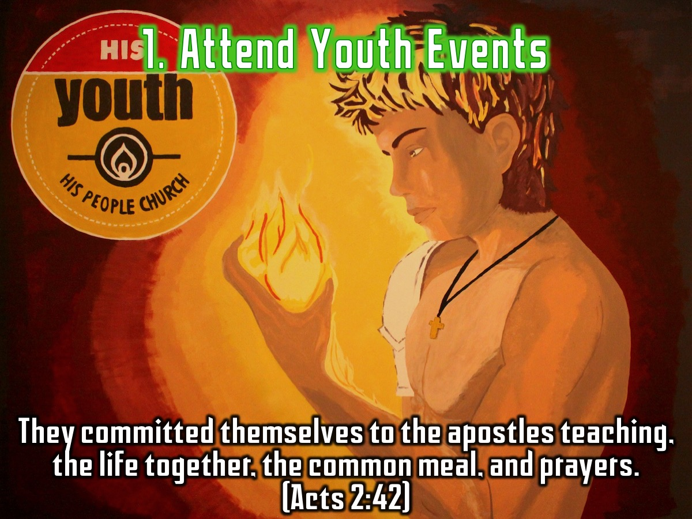
Notes:
1. Attend Youth Events. They committed themselves to the apostles teaching, the life together, the common meal, and prayers. (Acts 2:42)

Slide 53
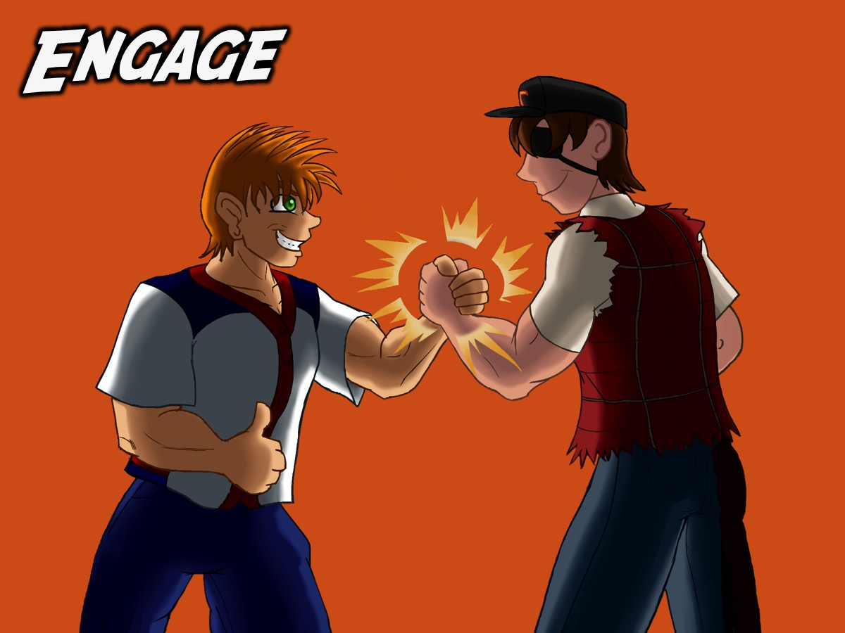
Notes:
Our Friday night events are aimed at engaging you and providing a small group experience.

Slide 54

Notes:
Our Sunday mornings are primarily aimed at Establishing you in the faith.

Slide 55
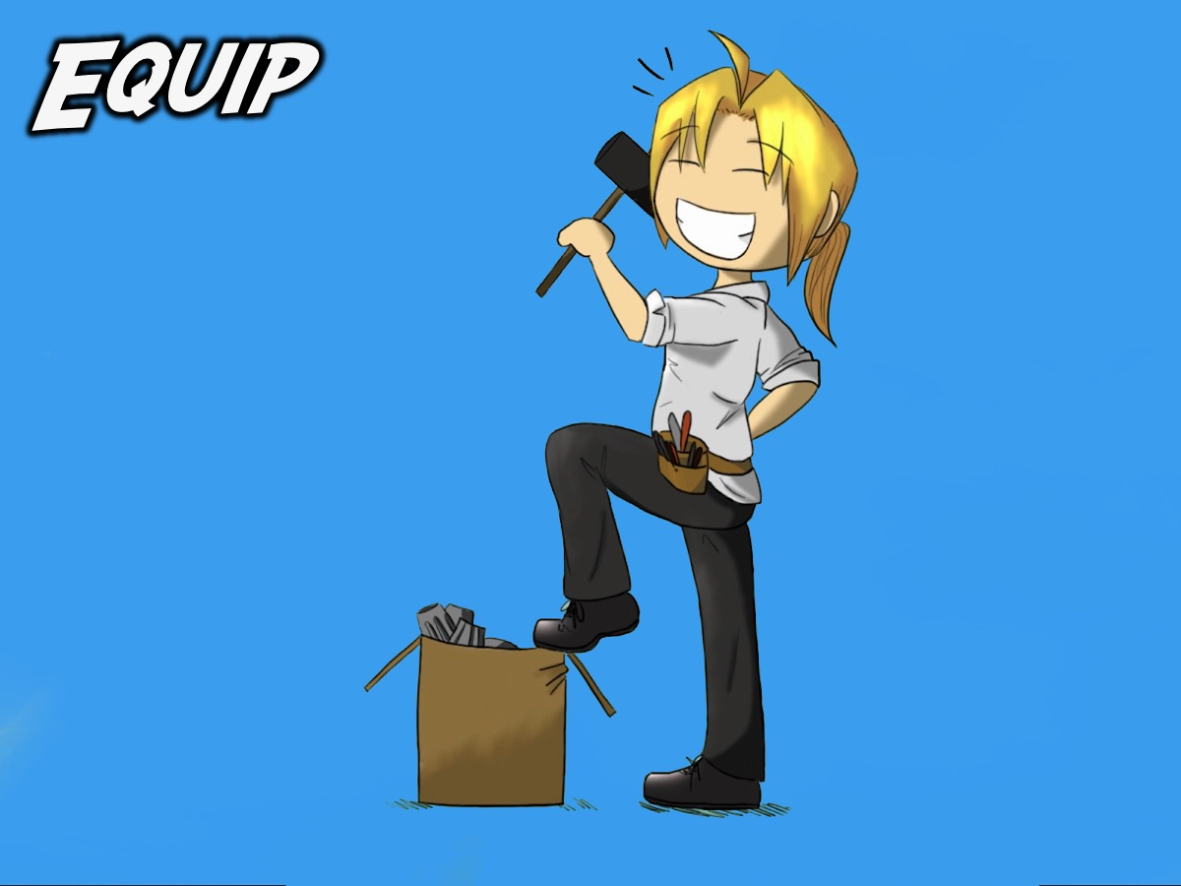
Notes:
Our leaders event for those ready to serve are designed to equip you for ministry.

Slide 56
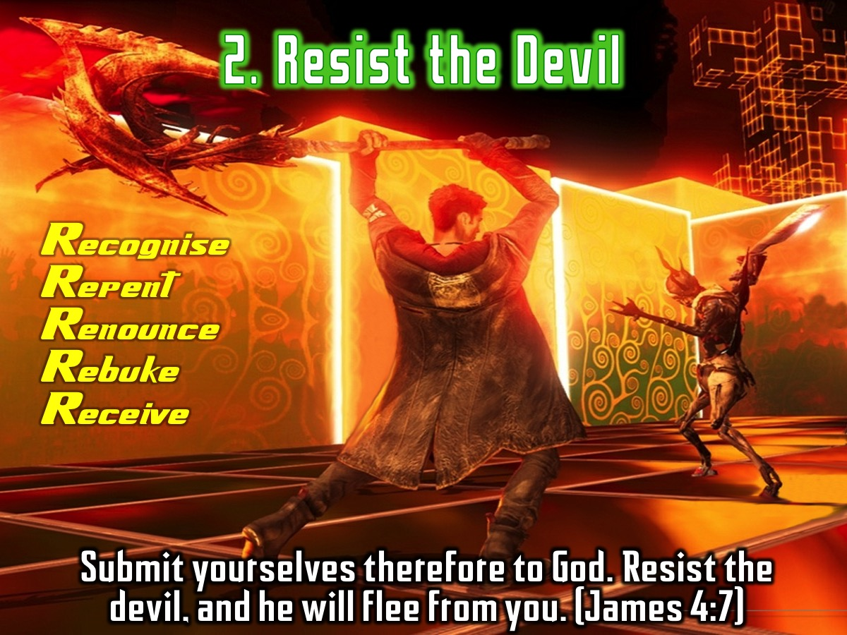
Notes:
2. Resist the Devil: Submit yourselves therefore to God. Resist the devil, and he will flee from you. (James 4:7). Practise the process of deliverance that we have used in the past five weeks to deal with the big five issues: Recognise the issue, Repent by turning your back on it, Renounce it’s power over you, Rebuke the Devil and Receive blessings in the place of curses.

Slide 57
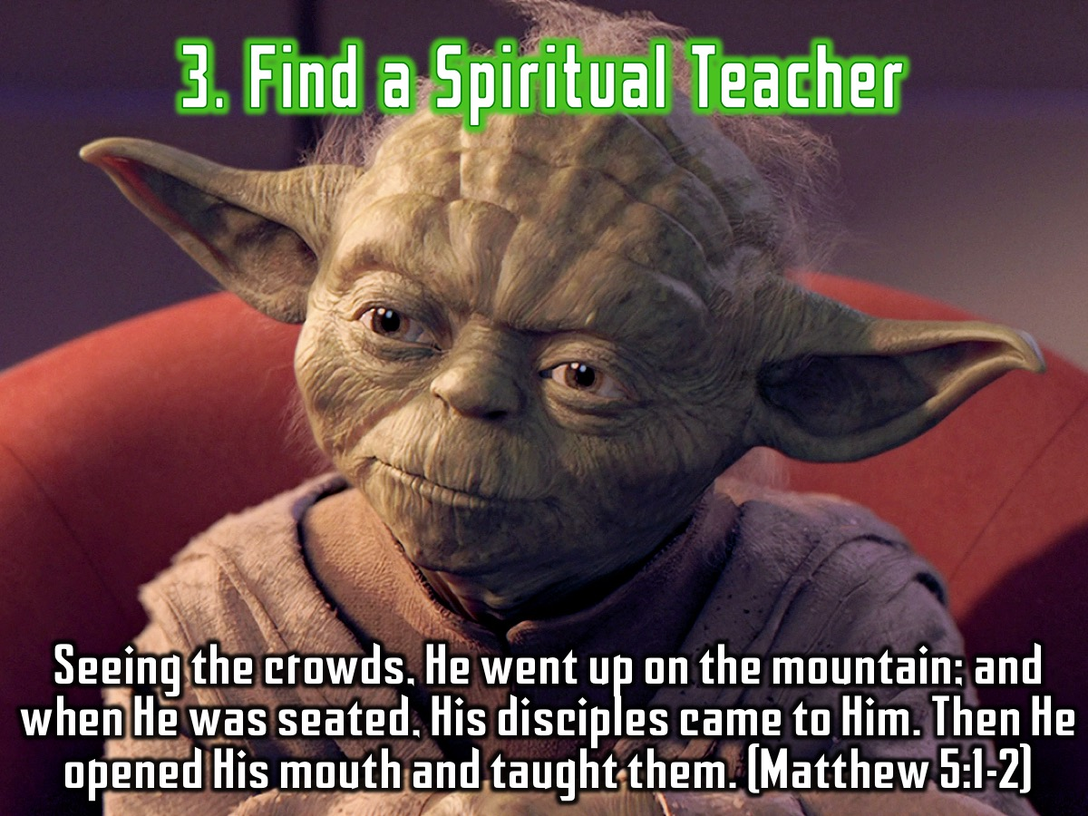
Notes:
3. Find a Spiritual Teacher. Seeing the crowds, He went up on the mountain; and when He was seated, His disciples came to Him. Then He opened His mouth and taught them. (Matthew 5:1-2)

Slide 58
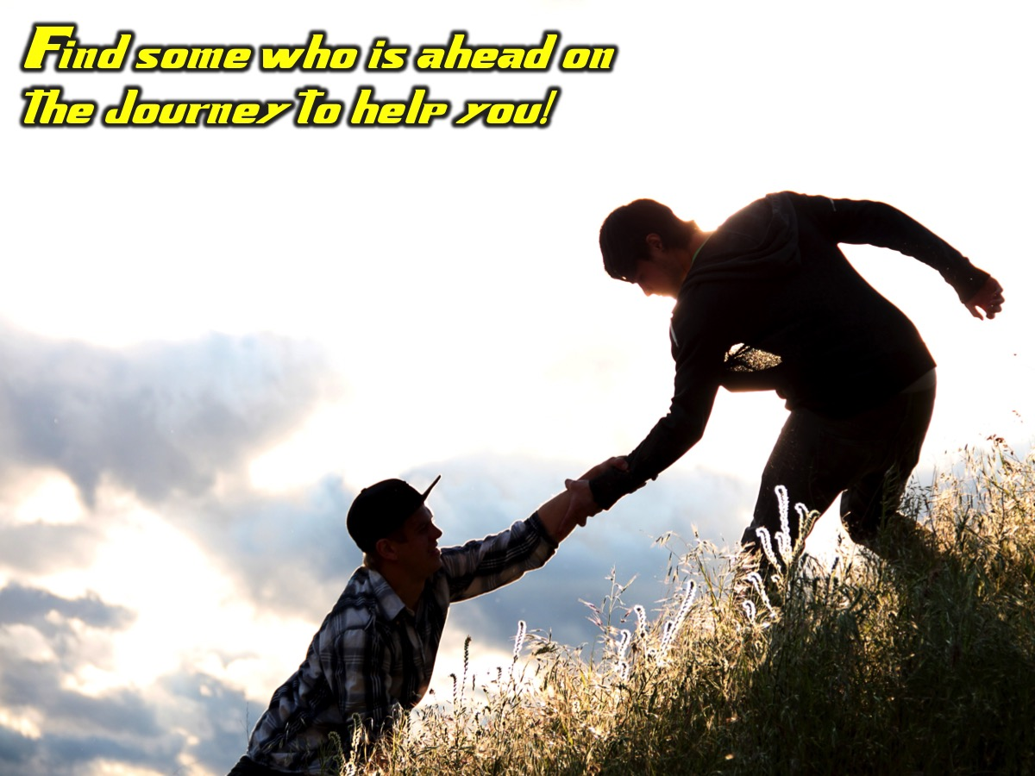
Notes:
Find some who is ahead on the journey to help you!

Slide 59
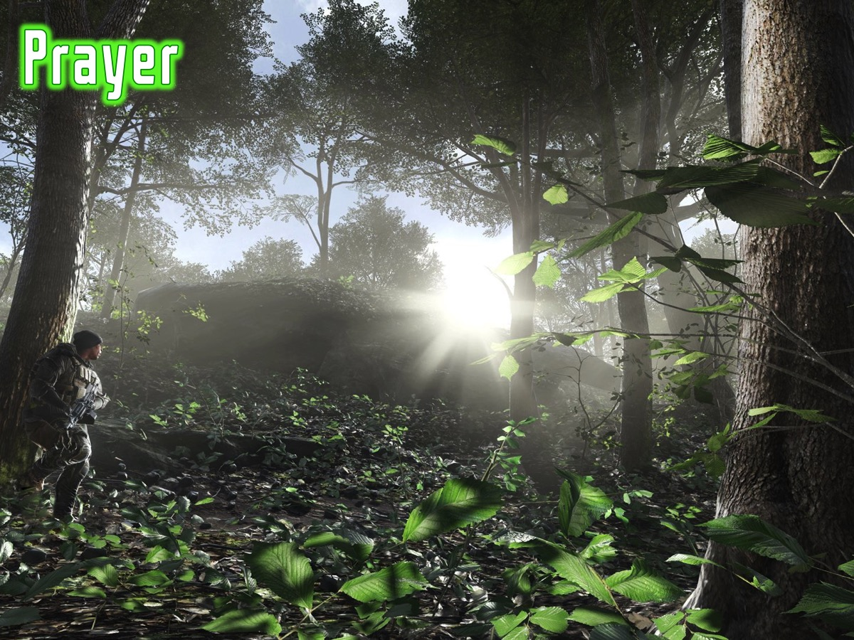
Notes:
Prayer

Slide 60
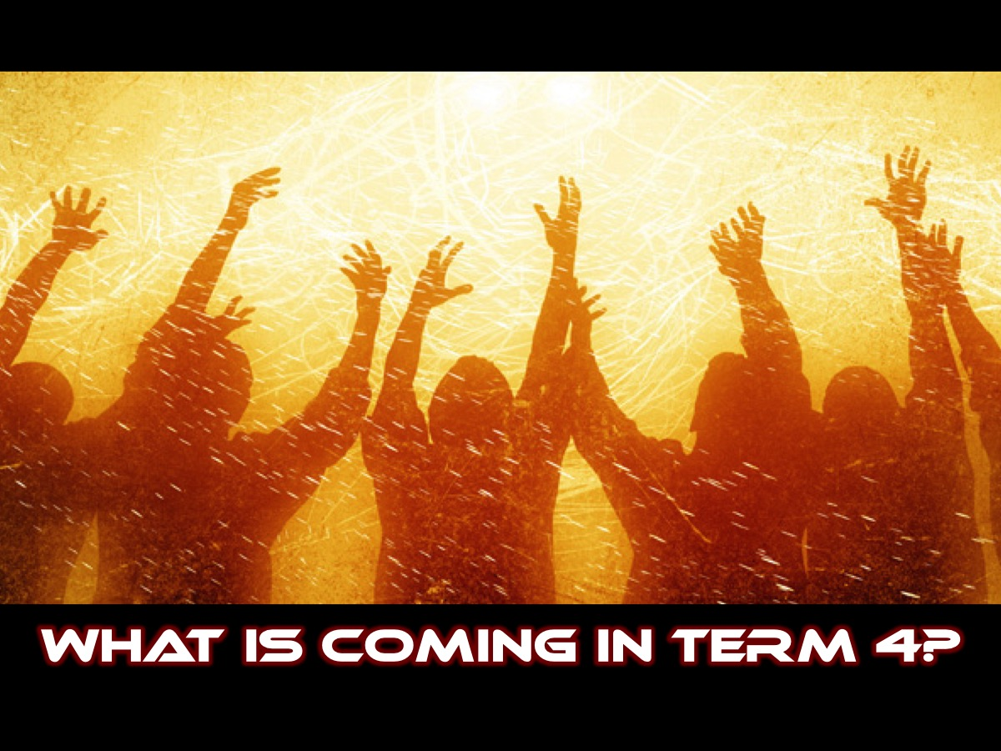
Notes:
So what is happening on Sunday mornings next term?

Slide 61

Notes:
Video: Revelation Series Promo. Get it on YouTube at: https://www.youtube.com/watch?v=bfyrfBsFb-4

Slide 62

Notes:
In term 4 we are launching the Revelation Series where we will be getting into the last book of the Bible - The Revelation of Jesus Christ!

