Slide 1
Notes:
Welcome to Victory Sunday!

Slide 2
Notes:
Video: An edited version of Official Call of Duty: Advanced Warfare Live Action Trailer - "Discover Your Power”. Get it on YouTube at: https://www.youtube.com/watch?v=GccGbdLqTmQ

Slide 3
Notes:
In week 1 we explored Preparing for Victory.

Slide 4
Notes:
The Bible teaches that we can and should live victorious lives.

Slide 5
Notes:
Victory Sunday will be a launch pad into victory!

Slide 6
Notes:
There are three reasons to attend Victory Sunday:

Slide 7
Notes:
How many of you were able to complete the Preparing for Victory Booklet? Those of you who were missed last Sunday - here is a copy for you to work through this coming week.

Slide 8
Notes:
In week 2 we will be taking at look at how Transformation happens.

Slide 9
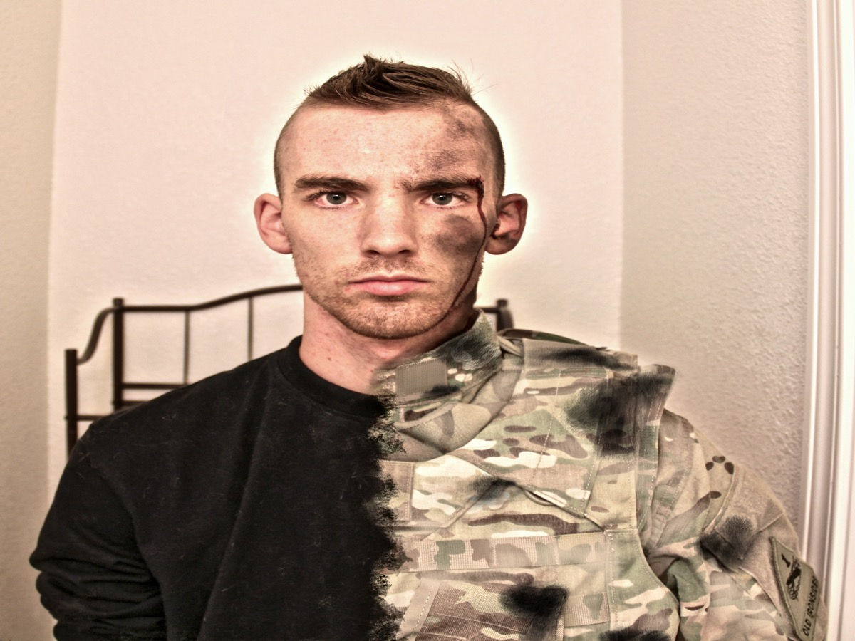
Notes:
This image shows something of the transformation from a civilian to a battle-hardened soldier!

Slide 10
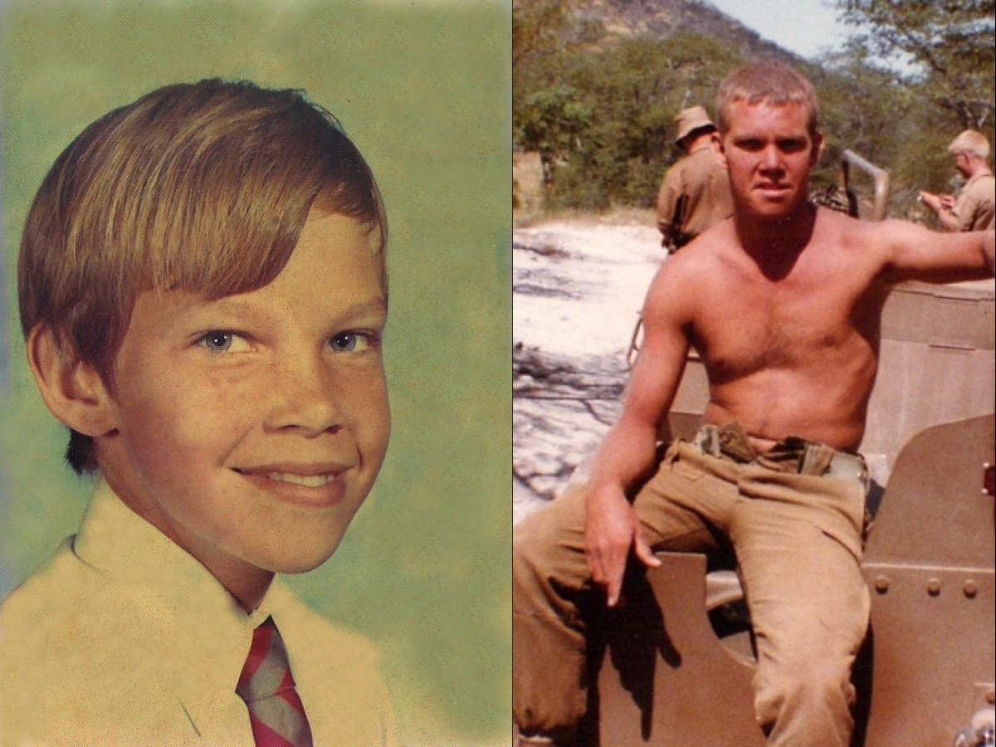
Notes:
In my life I too experienced something of the transformation that takes place when an ordinary person leaves home, joins the army and becomes a soldier.

Slide 11
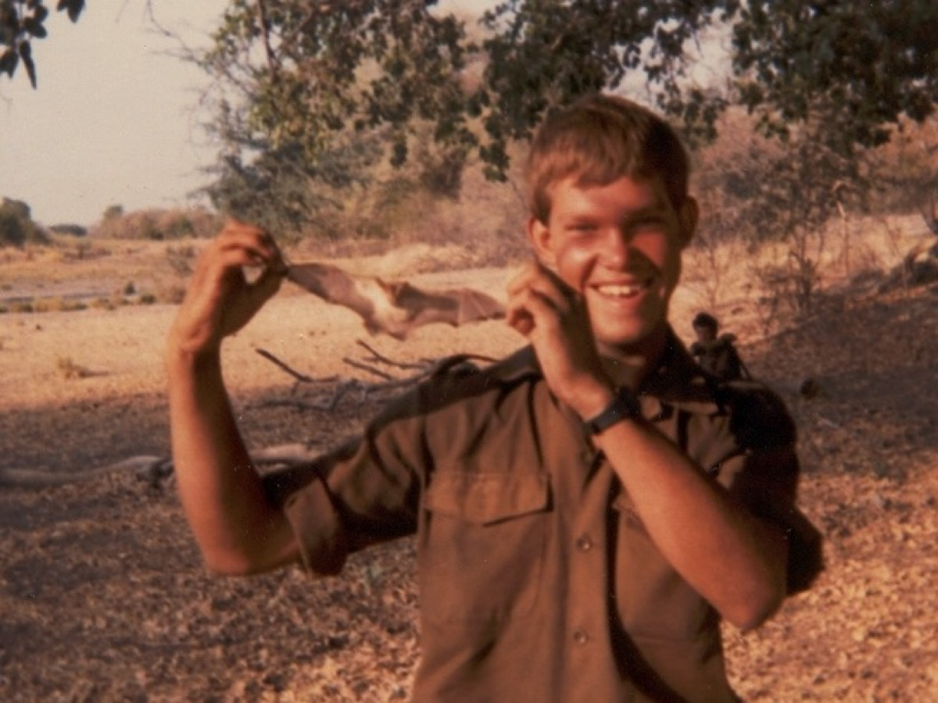
Notes:
Sure there were fun moments, like catching bats

Slide 12
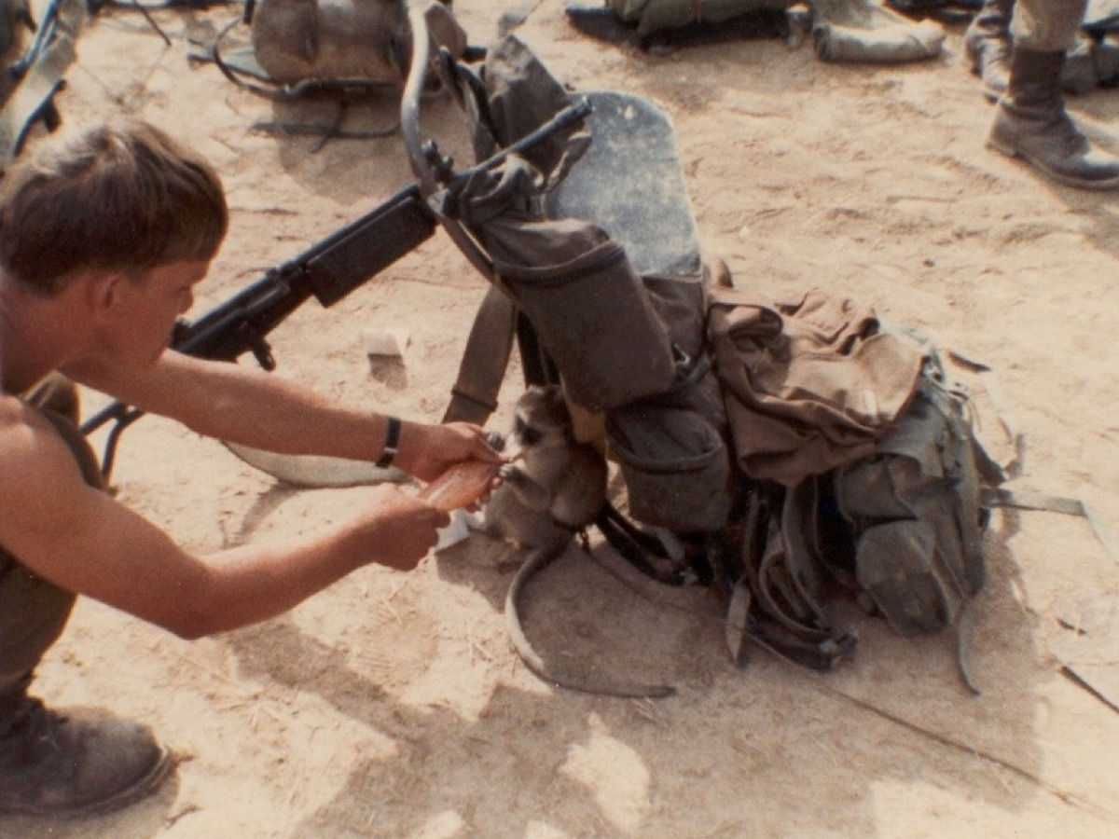
Notes:
Looking after a monkey

Slide 13
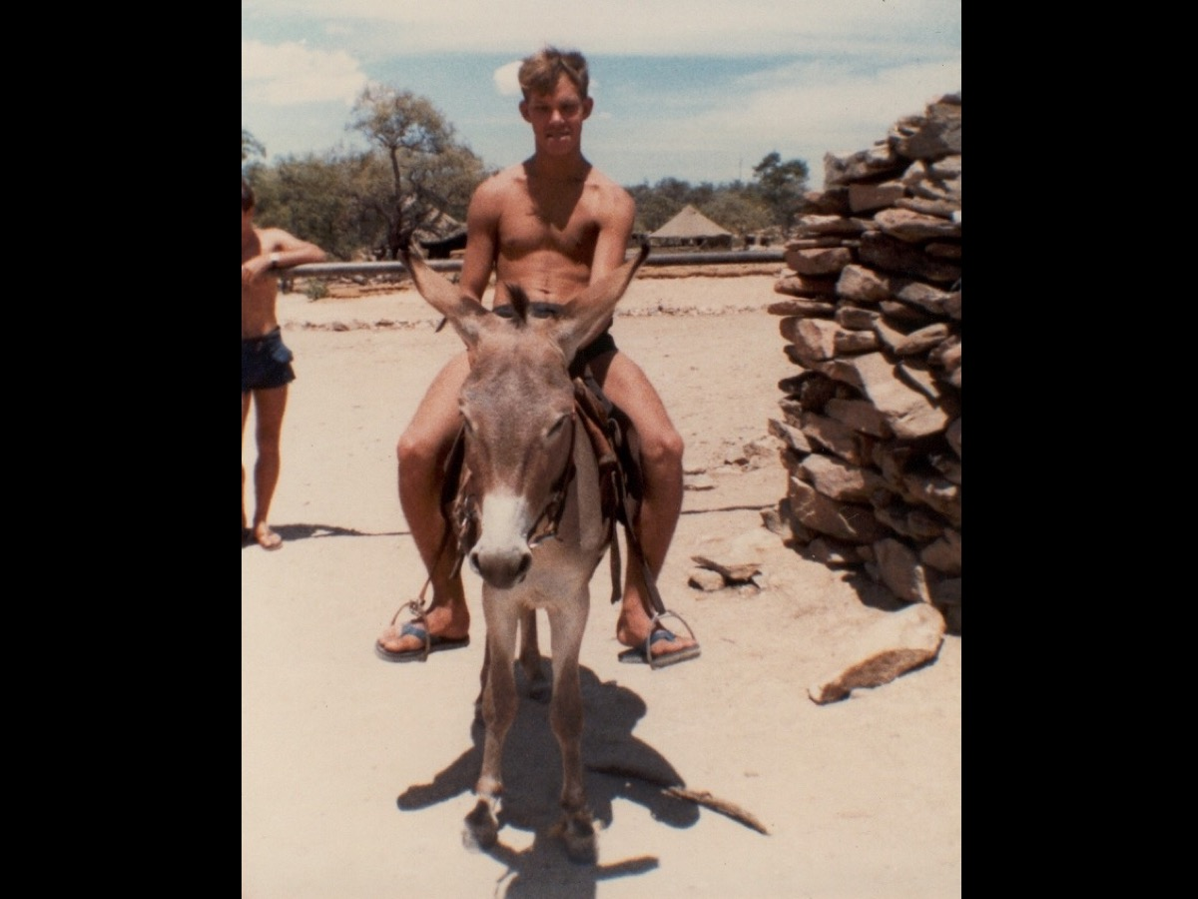
Notes:
Riding on a donkey

Slide 14
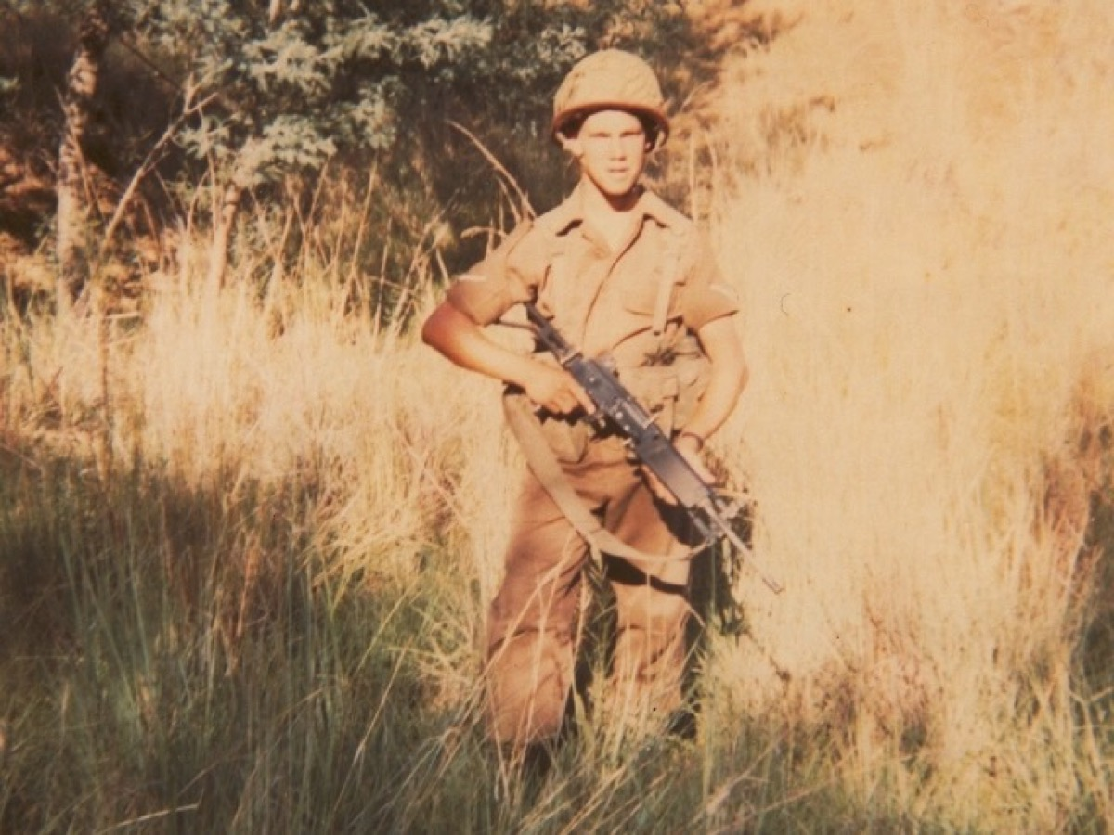
Notes:
But basic training was hard work

Slide 15
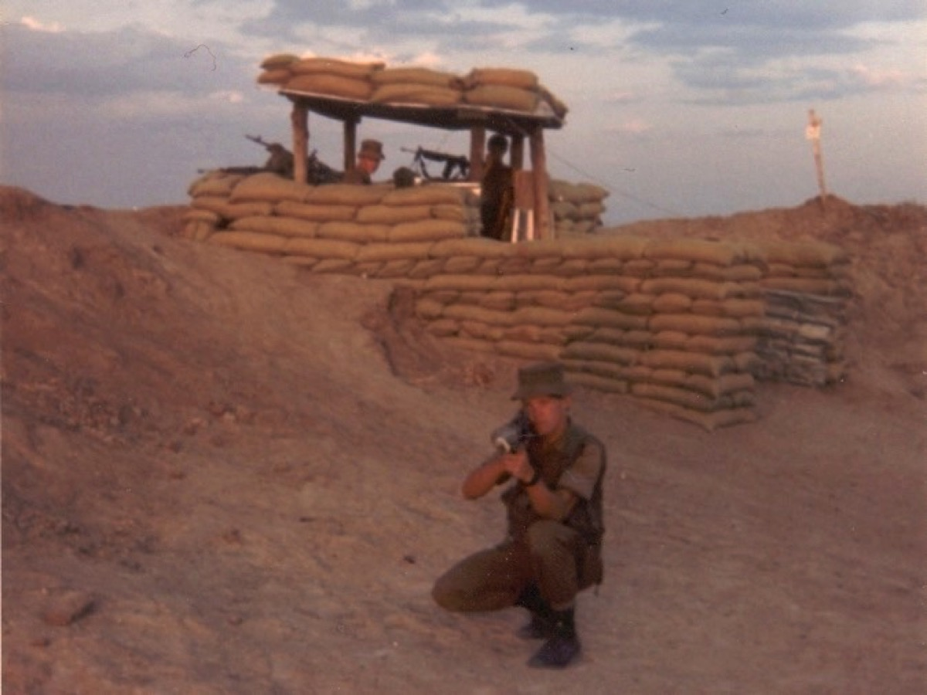
Notes:
Learning to shoot various weapons, like this rocket propelled granade launcher – RP5

Slide 16
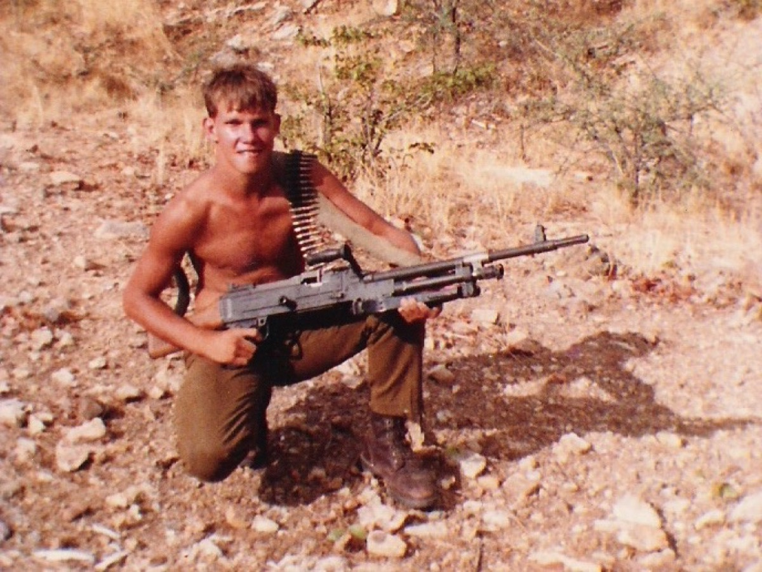
Notes:
Or this Light Machine Gun (LMG) – not very light actually

Slide 17
Notes:
I even got to shoot a river.

Slide 18
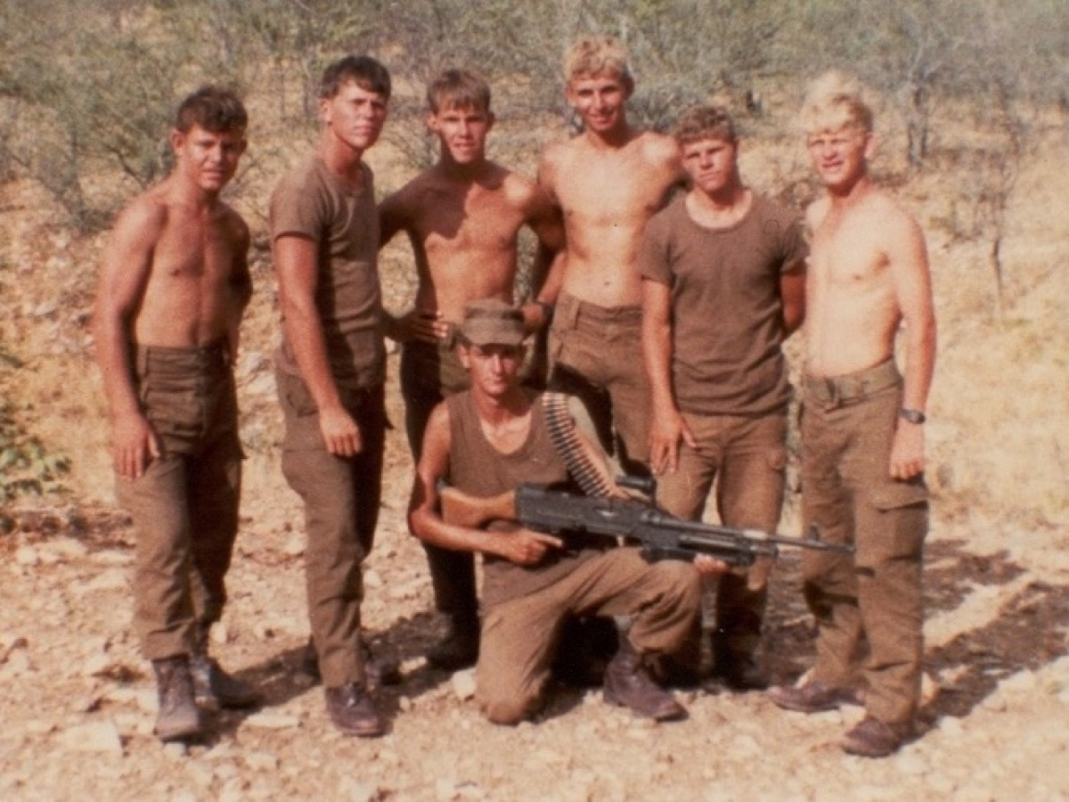
Notes:
As section leader I was responsible for the lives of other young men

Slide 19
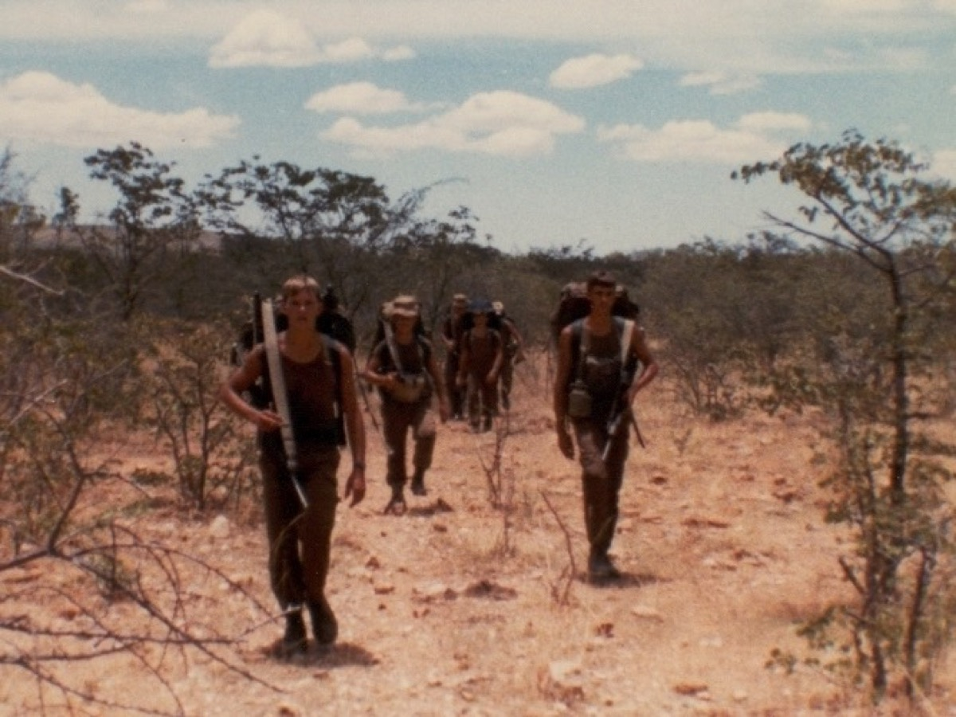
Notes:
While we walked on patrol looking for the enemy

Slide 20
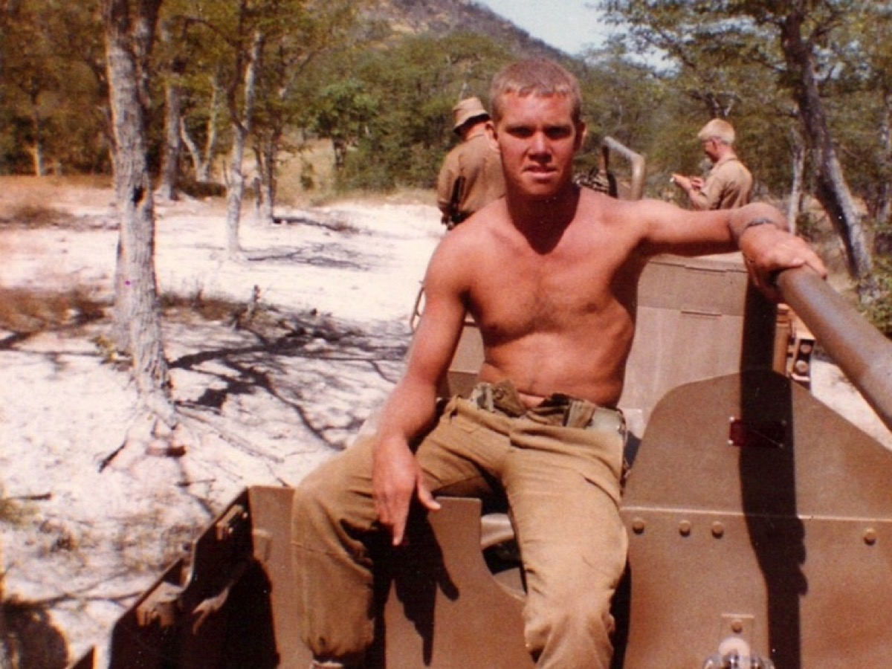
Notes:
I think that the little boy who left home at age 18 became a man on the battle field.

Slide 21
Notes:
Here is a video about basic training in the US Army.

Slide 22
Notes:
Video: Basic training in the US Army – from Civilian to Soldier – an edited version of a clip on YouTube: http://www.youtube.com/watch?v=88IxOAOWre0

Slide 23
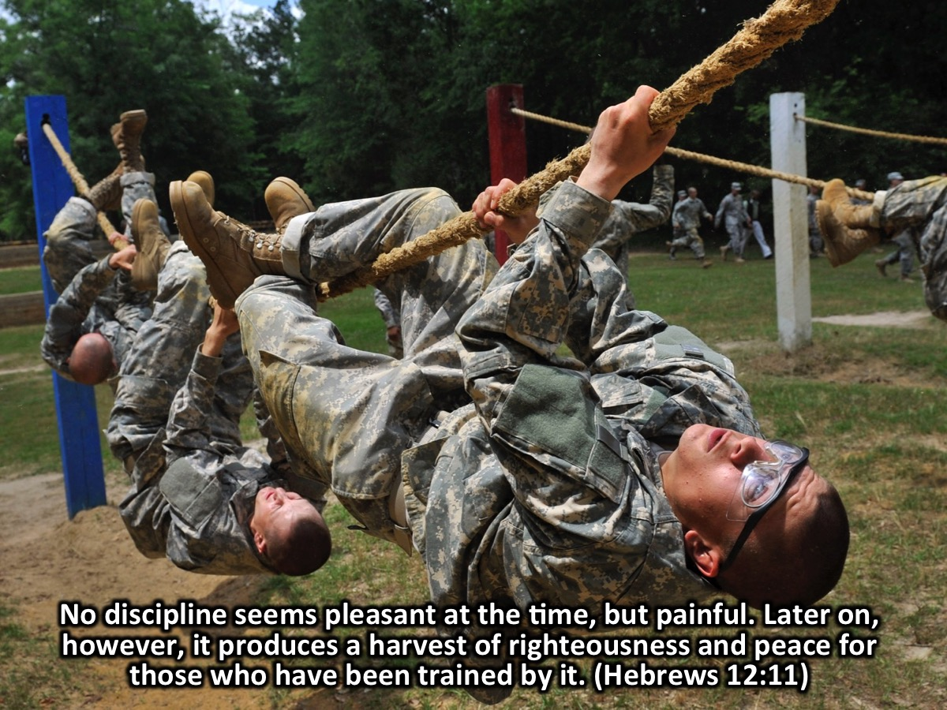
Notes:
The Bible has some deep insight into the importance of training or discipline: “No discipline seems pleasant at the time, but painful. Later on, however, it produces a harvest of righteousness and peace for those who have been trained by it.” (Hebrews 12:11)

Slide 24
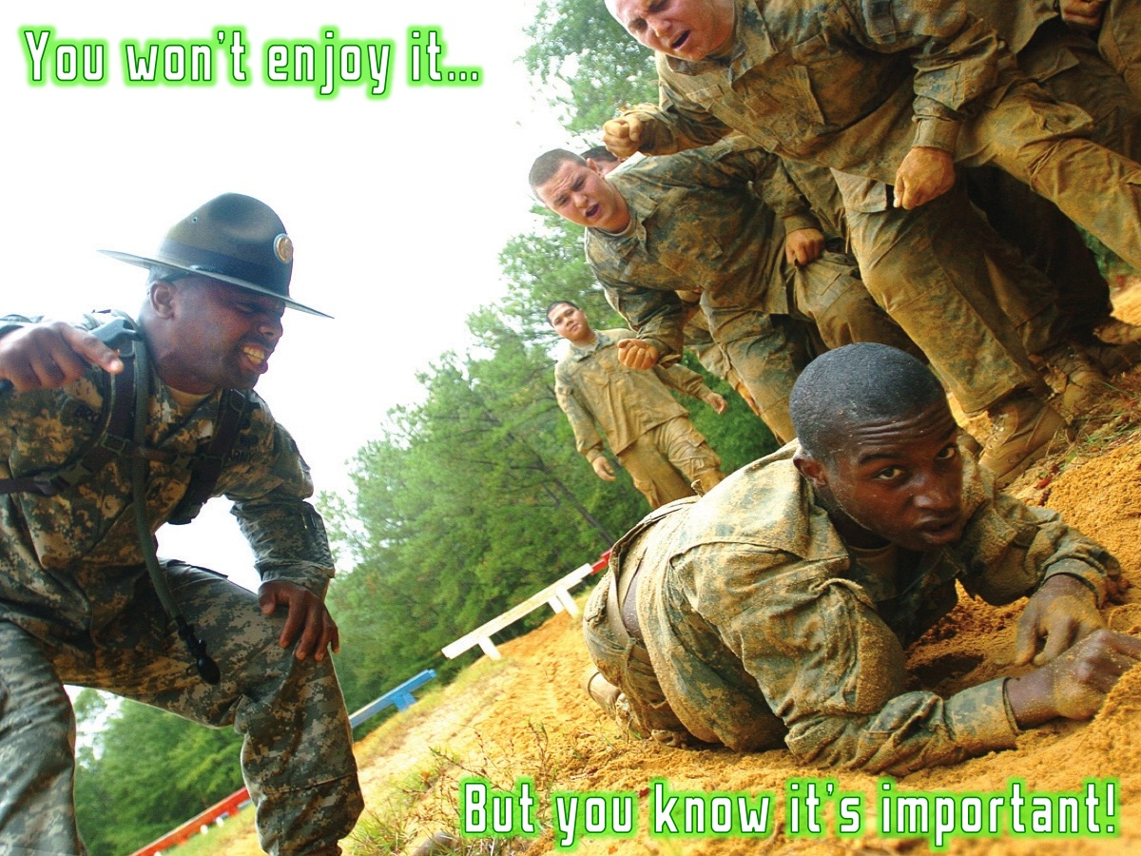
Notes:
And for sure, no one enjoyed basic training – but you know that it is important!

Slide 25
Notes:
We are in a war – a spiritual war

Slide 26
Notes:
There are angels and demons all around us engaged in battle

Slide 27
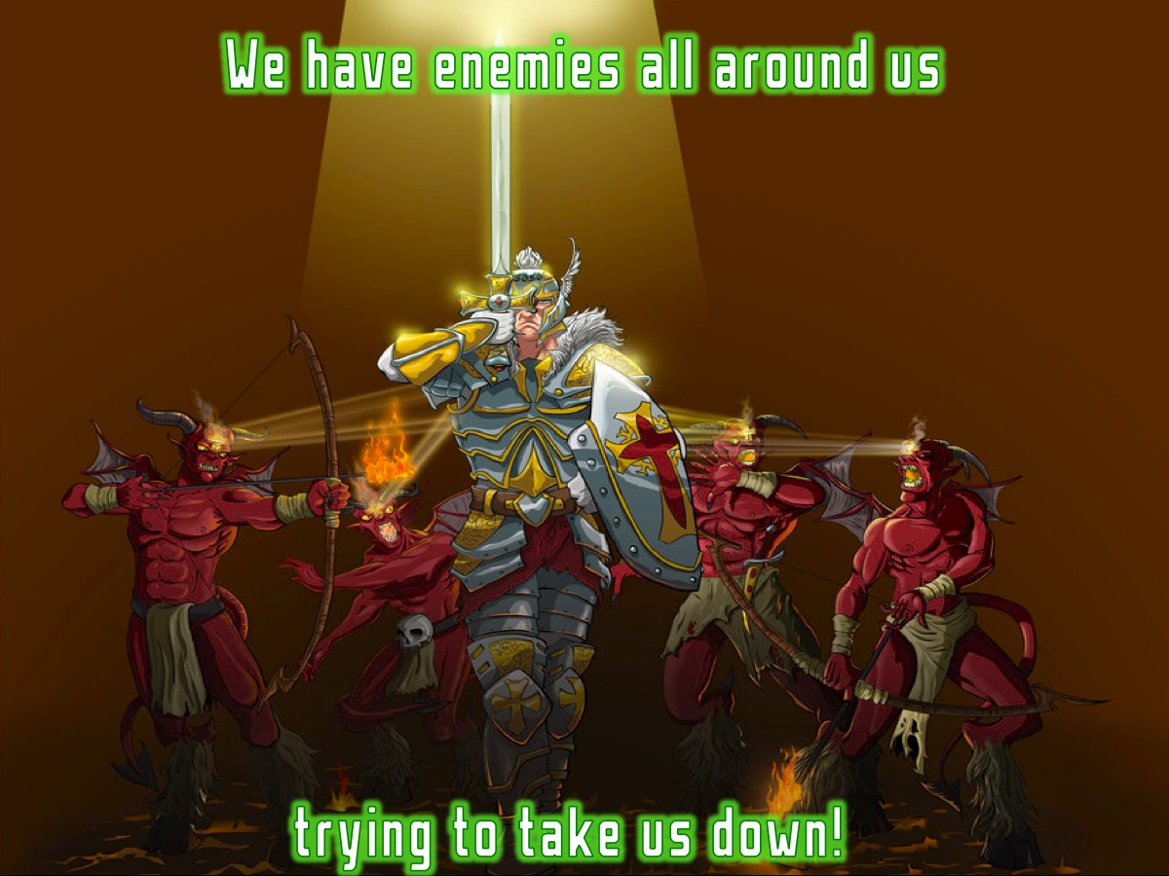
Notes:
We have enemies all around us trying to take us down!

Slide 28
Notes:
Are you ready for battle?

Slide 29
Notes:
We are urged to put on the full armour of God! “Therefore put on the full armor of God, so that when the day of evil comes, you may be able to stand your ground.” (Ephesians 6:13)

Slide 30
Notes:
The weapons of our warfare are not carnal (fleshly) but mighty through God to the pulling down of strong holds. (2 Corinthians 10:4)

Slide 31
Notes:
We are in active duty – solders on a faith ops! We need to be changed!!!

Slide 32
Notes:
There are three types of change: The Greek definition of conform, transform, and reform will help us understand their meanings.

Slide 33
Notes:
(1) Conform: (Gr. Suschematizo) to fashion or shape one thing to be like another (Rom.12: 2). It is choosing to live by the system of worldly thinking.

Slide 34
Notes:
(2) Reform: (Gr. diorthosis) to make straight, to correct a previous bad behavior. (Hebrews 9:10; Acts 24:2). It is choosing to live by a set of cultural accepted norms and standards.

Slide 35
Notes:
(3) Transform - (Gr. Metamorphoo) to change into another form; to be transformed into something different. (Rom.12: 2; 2 Cor.3: 18). It is choosing to live by sound Bible doctrine - the word of God (Genesis 45:1-15; Titus 1:9).

Slide 36
Notes:
Reformation and conformation are primarily external and dependent on human effort while transformation is a complete change, internal and external, and is not the result of human effort. Reformation and conformity is what we do to change while transformation is what God does to change us.

Slide 37
Notes:
Change is a Partnership: Philippians 2:12-13 says: "Work out your salvation with fear and trembling - it is God who produces in you the desire and power to please him."

Slide 38
Notes:
How Does God Change Us: The Bible reveals three agents that God uses to change us:

Slide 39
Notes:
1. Truth - Hearing, holding to, and knowing truth brings freedom. As we hear, understand, and respond to God's written word, we will experience freedom and lasting change. To the Jews who had believed him, Jesus said, "If you hold to my teaching, you are really my disciples. Then you will know the truth, and the truth will set you free." (John 8:31-32). Truth we are ignorant of does not change us. We must first know the truth, then be set free.

Slide 40
Notes:
2. The Holy Spirit - Sin produces bondage but the Spirit of God brings freedom. As we experience the presence and power of the Holy Spirit, we will be set free, changed, and transformed into God's likeness. Now the Lord is the Spirit, and where the Spirit of the Lord is, there is freedom. And we, who with unveiled faces all reflect the Lords glory, are being transformed into his likeness with ever-increasing glory, which comes from the Lord, who is the Spirit. (2 Corinthians 3:17-18). The more we expect and experience the presence of the Holy Spirit, the more we will be changed into his likeness.

Slide 41
Notes:
3. A Renewed Mind - Lasting change starts internally in the mind and eventually transforms external action. As we read, study and meditate on God's word, our minds will be renewed and we will be transformed. Do not conform any longer to the pattern of this world but be transformed by the renewing of your mind. Then you will be able to test and approve what Gods will is-his good, pleasing and perfect will. (Romans 12:2). There is no middle ground. Either we are conforming to the world or we are renewing our minds.

Slide 42
Notes:
Personal Application: Find someone that you will be willing to walk in accountability for the rest of this series and answer these questions: (1) Do you need transformation? (2) What attitudes must change? (3) What habits must change? (4) What relationships must change?

Slide 43
Notes:
Let’s pray!

Slide 44
Notes:
Next Week: In week 3 we will be looking at what the Cross has to do with victory in our lives.

