Slide 1

Notes:
Welcome to Victory Sunday - today is week 3 of our series!

Slide 2
Notes:
Video: Official Call of Duty® Black Ops III Reveal Trailer. Get it on YouTube at: https://www.youtube.com/watch?v=58Pspqx0XGs

Slide 3

Notes:
In week 1 we looked at the importance of Preparing for Victory.

Slide 4

Notes:
Last week we looked at how Transformation happens.

Slide 5
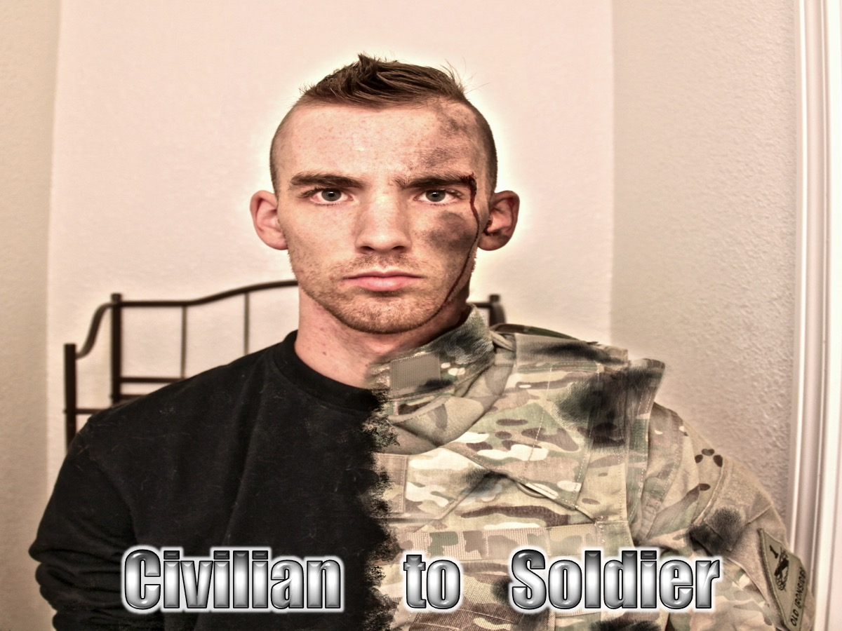
Notes:
We looked at how civilians are transformed into soldiers through basic training!

Slide 6

Notes:
We talked about three types of change: (1) Conform, (2) Reform and (3) Transform.

Slide 7
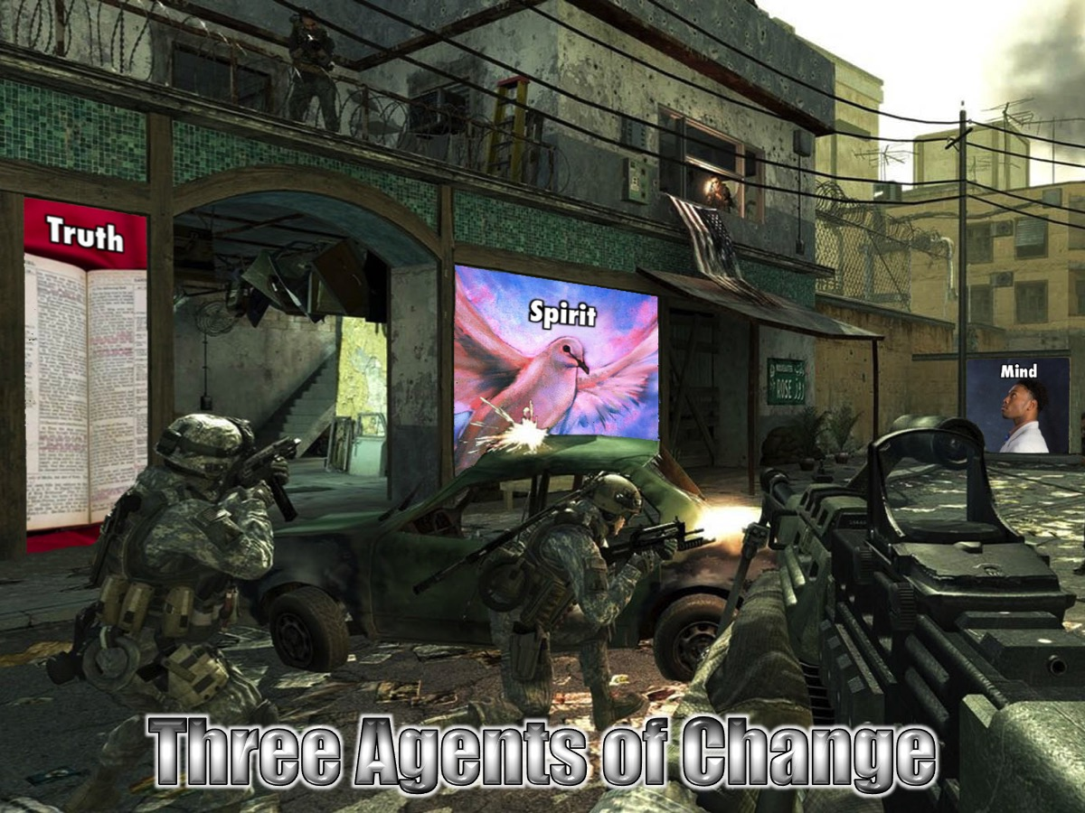
Notes:
We discussed three agents of Change that God uses to change us: (1) Truth, (2) Holy Spirit, (3) Renewed Mind.

Slide 8

Notes:
This week we will be looking at what the Cross has to do with victory in our lives.

Slide 9
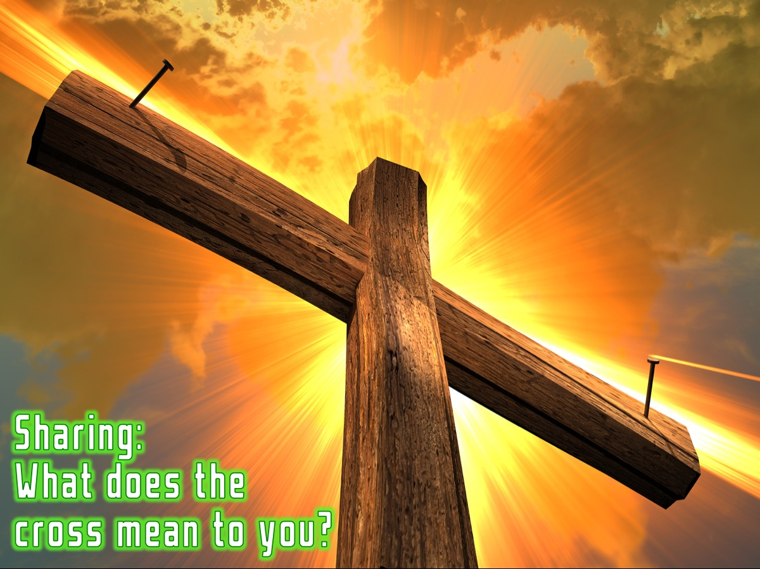
Notes:
Sharing: Turn to the person next to you and ask them: “What does the cross mean to you?”

Slide 10
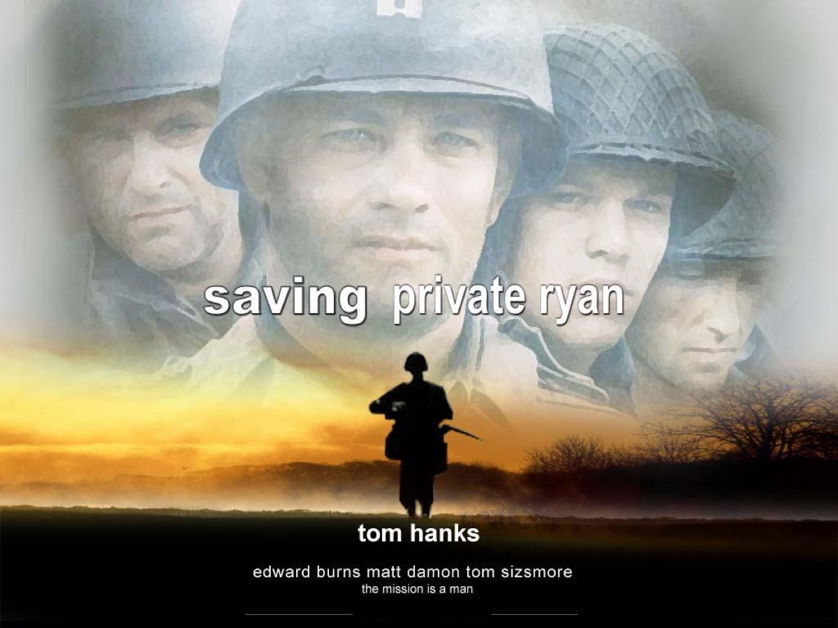
Notes:
Have any of you seen the movie: Saving private Ryan? Here is the trailer that tells the story…

Slide 11

Notes:
Video: Saving Private Ryan Official Trailer. Get it on YouTube at: https://www.youtube.com/watch?v=2BJU8RcARVI

Slide 12
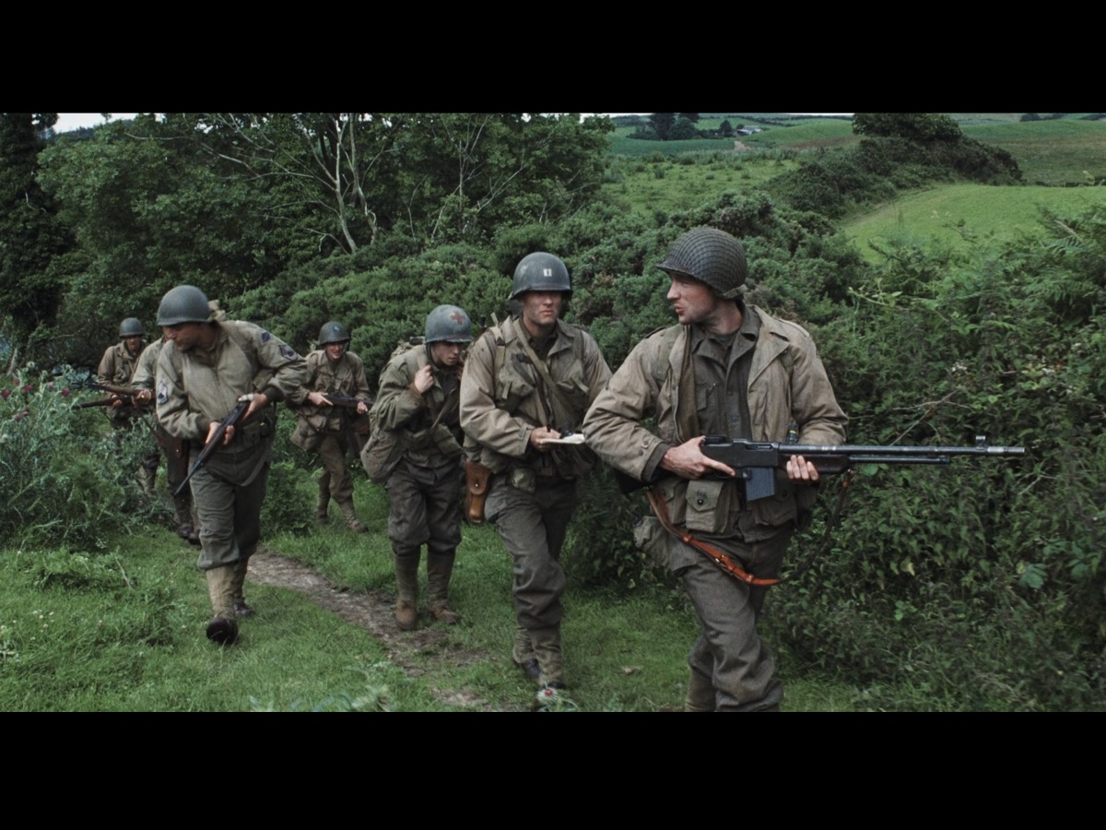
Notes:
This is the small group of soldiers who were sent behind enemy lines under the leadership of Captain Miller (played by Tom Hanks) to rescue Private Ryan because 3 of his brothers had just been killed in action and the army did not want his Mother to lose another son!

Slide 13
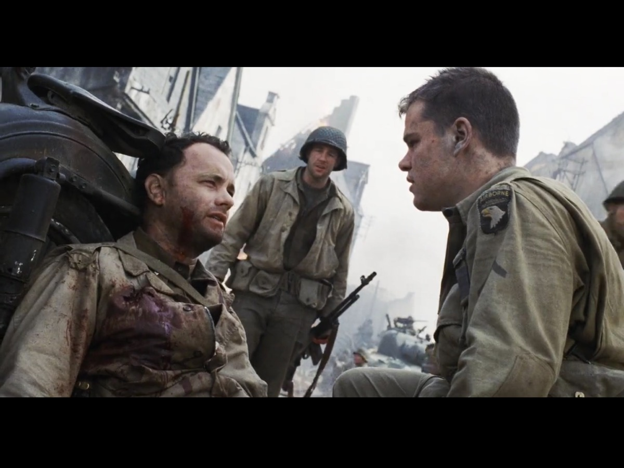
Notes:
Some of the men, including Captain Miller, sacrifice their lives trying to save him but in the end the mission is successful because Private Ryan is saved!

Slide 14
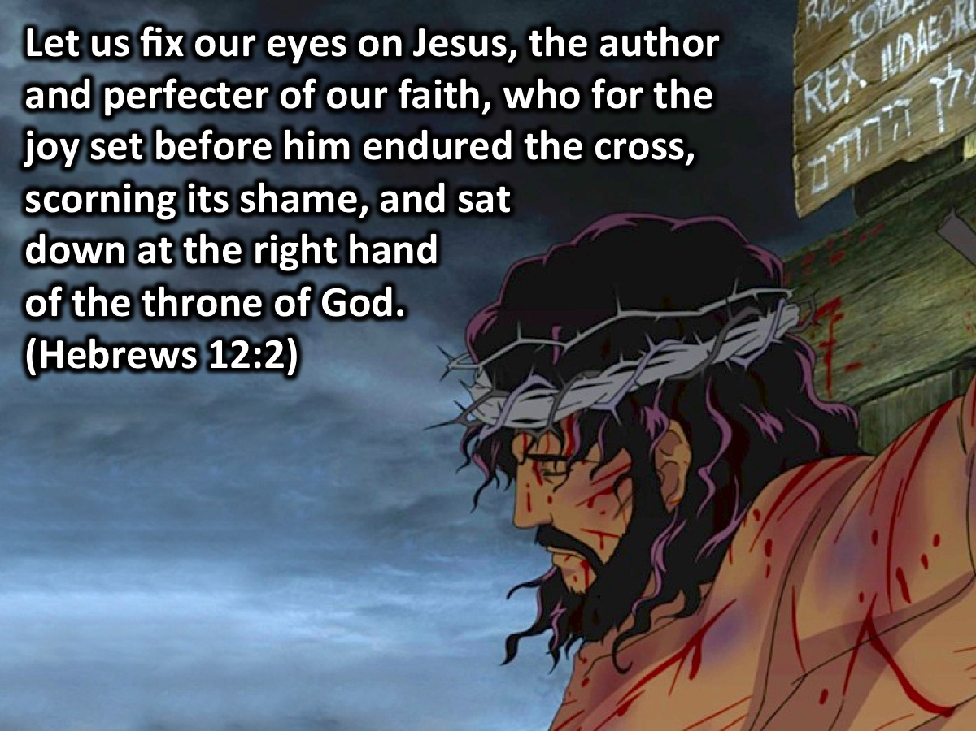
Notes:
Let us fix our eyes on Jesus, the author and perfecter of our faith, who for the joy set before him endured the cross, scorning its shame, and sat down at the right hand of the throne of God. (Hebrews 12:2). What was the joy set before Jesus? It was bringing us back into a relationship with Father God! Restoring lost sons and daughters into the kingdom! Like Captain Miller who set out to save private Ryan – Jesus set out with a mission to save us through his death on the cross.

Slide 15
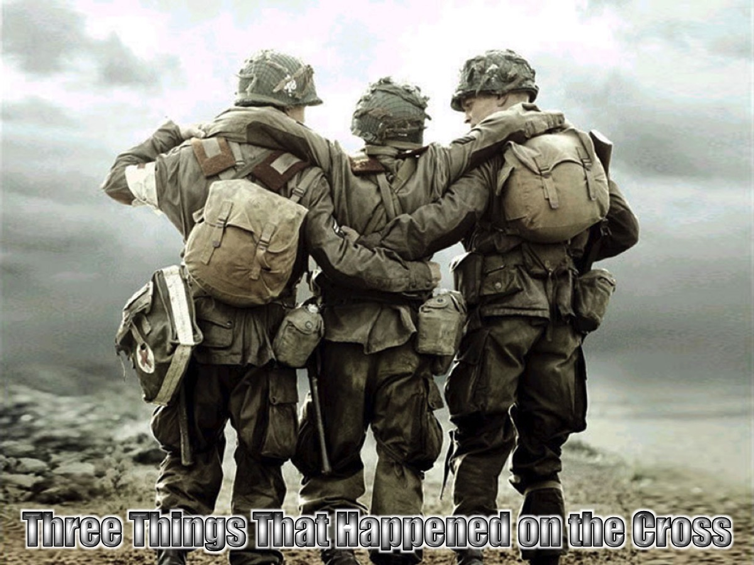
Notes:
The cross was the central message of the New Testament apostles. To understand and experience the cross of Christ, we must understand the three things that happened on the cross. But first here is a video from the movie, Son of God.

Slide 16
Notes:
Video: Edited version of “Son of God: Cross”. Get it on YouTube at: https://www.youtube.com/watch?v=h9UN7IpxrNM

Slide 17
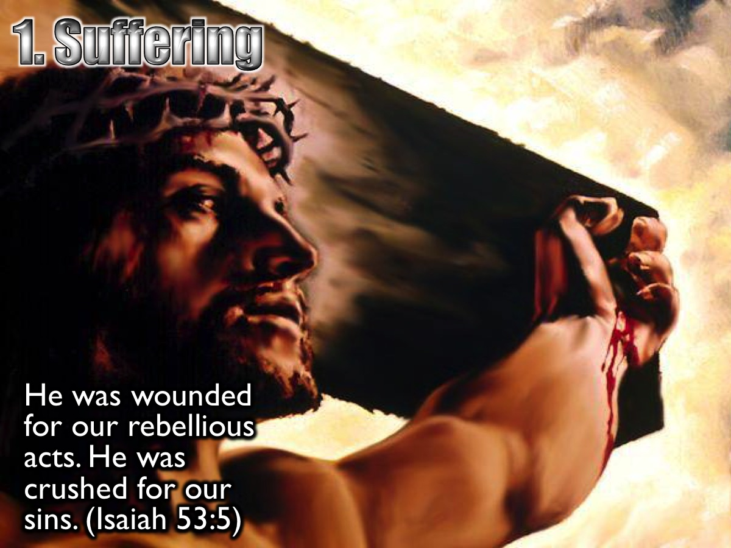
Notes:
1. Suffering. Jesus suffered the pain of the cross because of my sins. He was wounded for our rebellious acts. He was crushed for our sins. He was punished so that we could have peace, and we received healing from his wounds. (Isaiah 53:5)

Slide 18
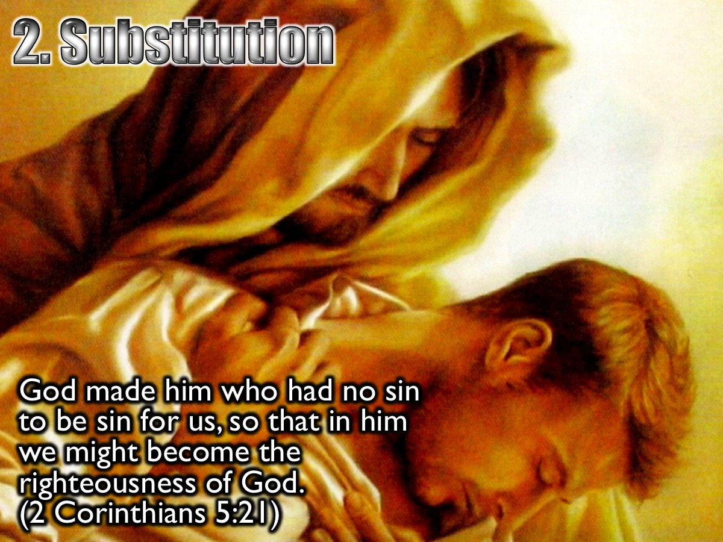
Notes:
2. Substitution. Jesus took our place on the cross, becoming our sin and suffering our punishment, so we could receive his righteousness. God made him who had no sin to be sin for us, so that in him we might become the righteousness of God. (2 Corinthians 5:21)

Slide 19
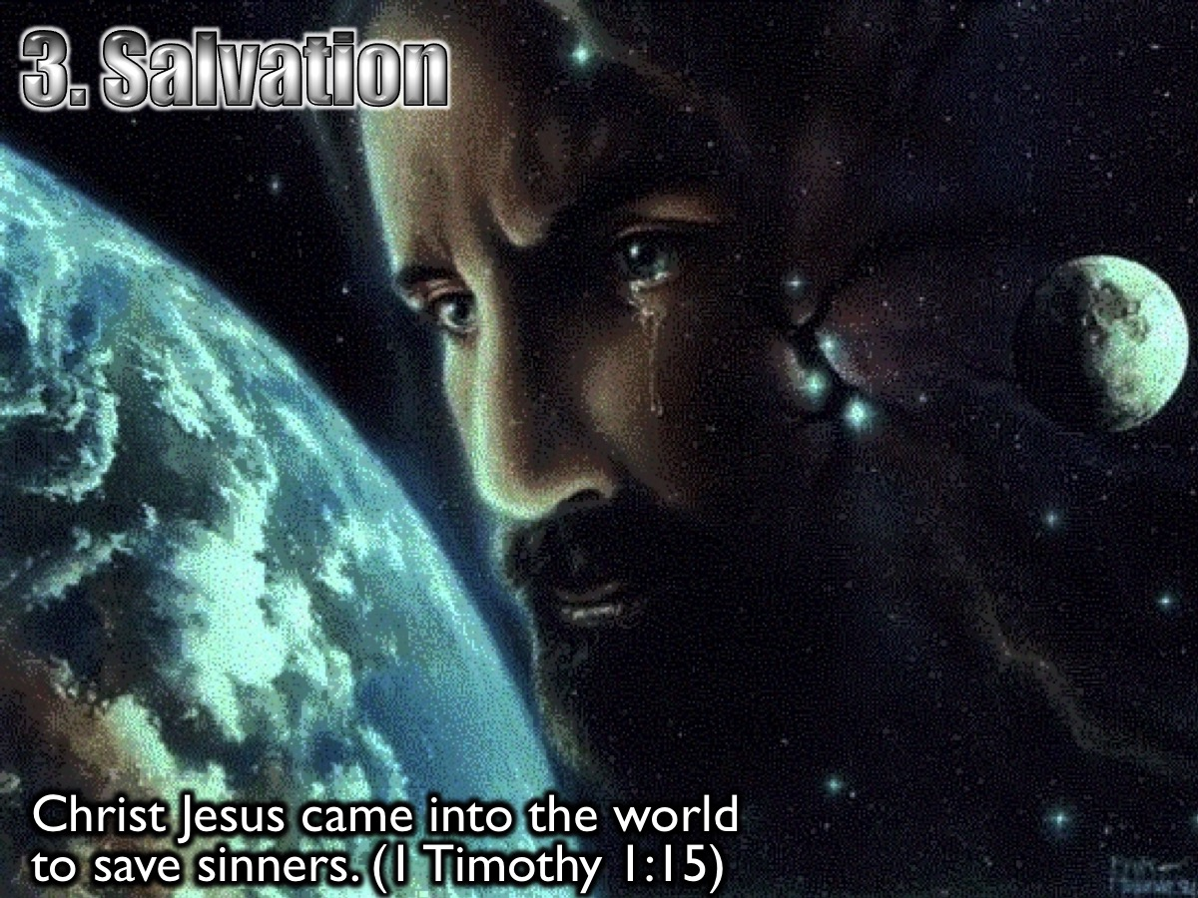
Notes:
3. Salvation. Jesus came to seek and save the Lost – to save sinners from the wrath of God. Christ Jesus came into the world to save sinners. (1 Timothy 1:15). Since we have now been justified by his blood, how much more shall we be saved from God's wrath through him! (Romans 5:9)

Slide 20
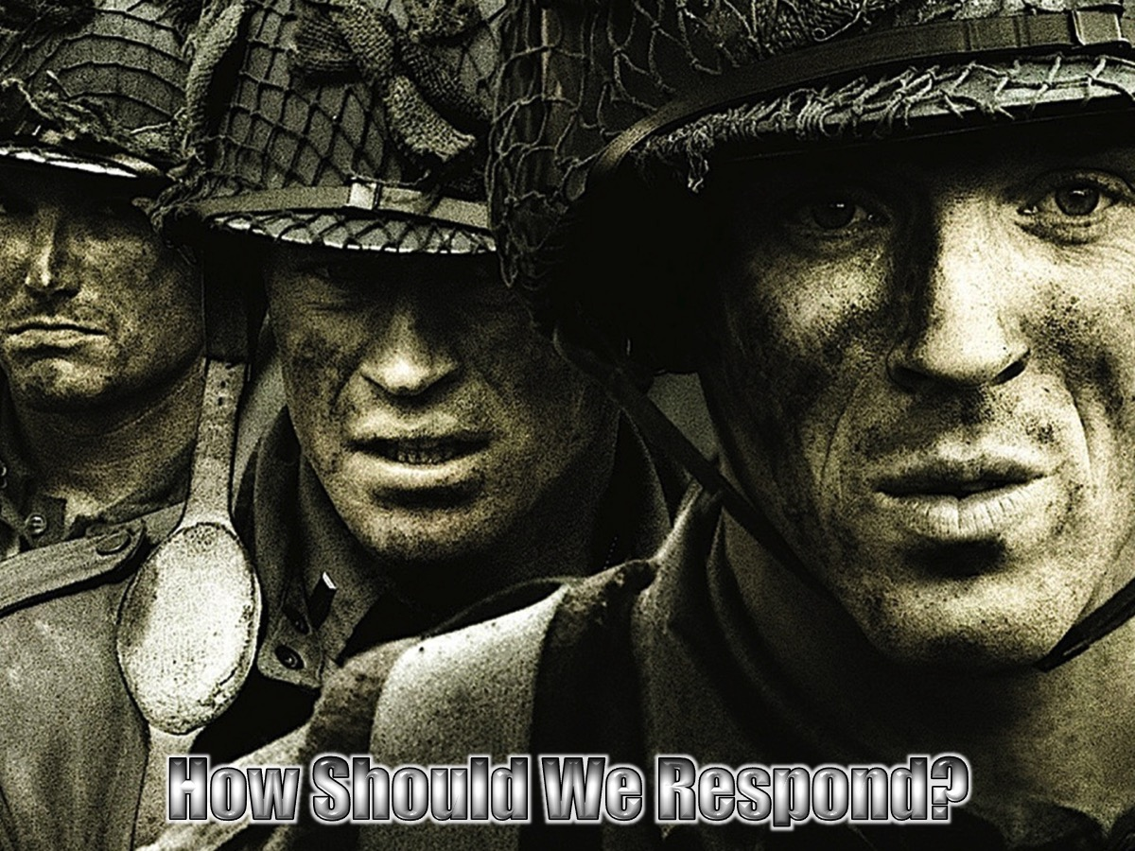
Notes:
How Should We Respond to What Jesus Did on the Cross?

Slide 21
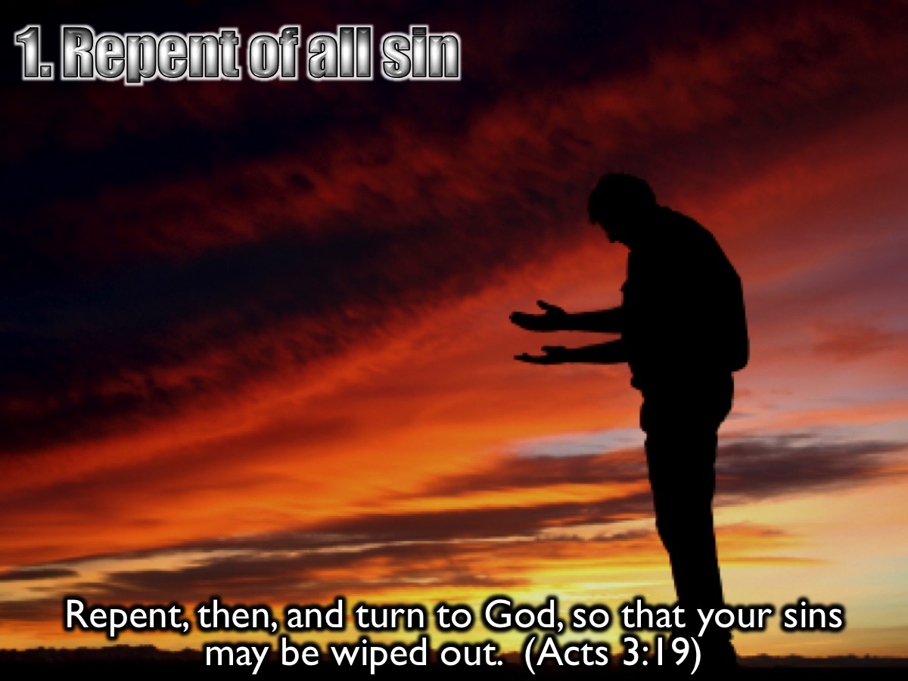
Notes:
1. Repent of all sin. Repent, then, and turn to God, so that your sins may be wiped out. (Acts 3:19)

Slide 22
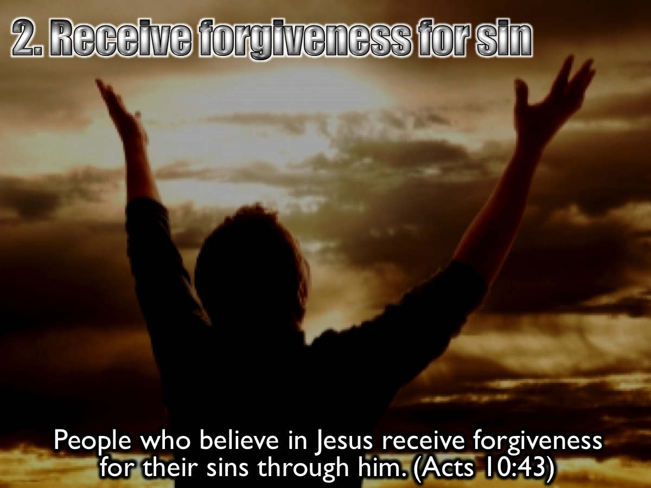
Notes:
2. Receive forgiveness for Sin. People who believe in the one named Jesus receive forgiveness for their sins through him. (Acts 10:43)

Slide 23
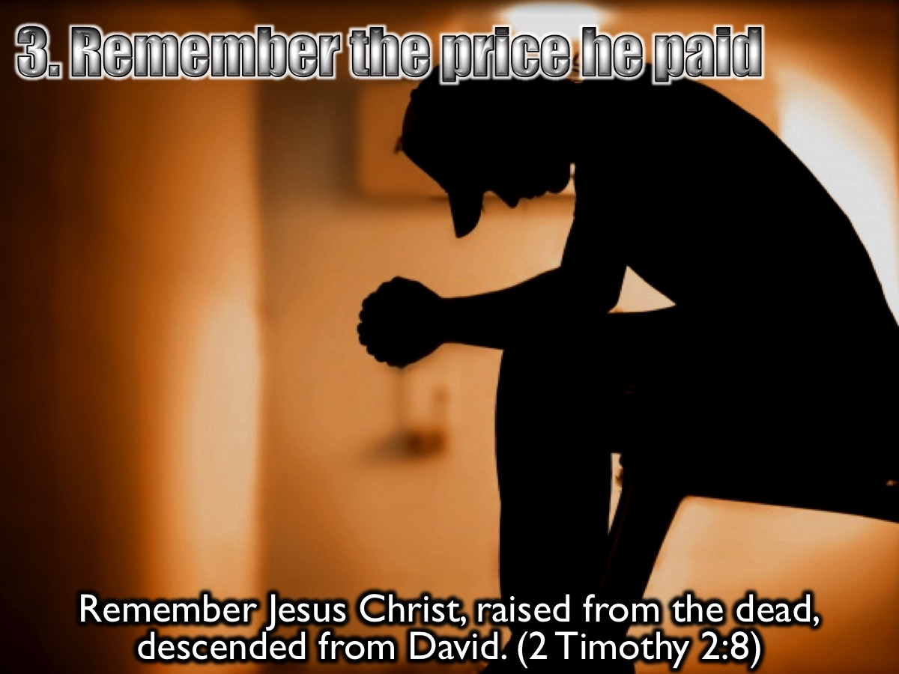
Notes:
3. Remember the price he paid for our sin. Remember Jesus Christ, raised from the dead, descended from David. (2 Timothy 2:8)

Slide 24
Notes:
Video: Edited version of “Son of God: Resurrection”. Get it on YouTube at: https://www.youtube.com/watch?v=2BJU8RcARVI

Slide 25
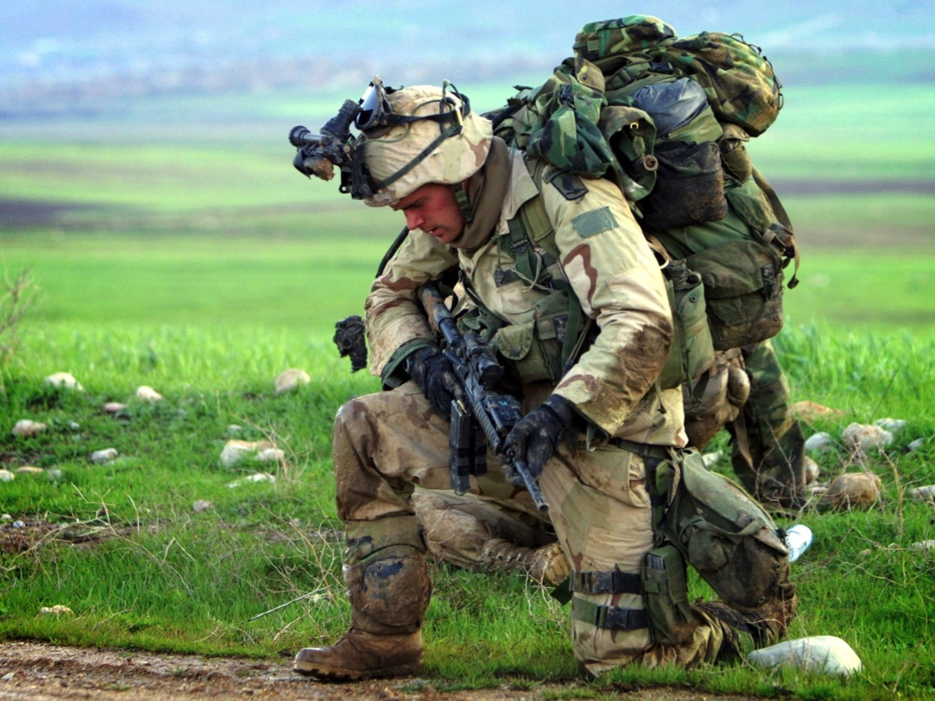
Notes:
If you have never received Jesus as your Saviour – now is a good time to receive him as your Lord and Saviour! Let’s all stand. If you have never asked Jesus to be your Saviour, I want you to raise your hand so I can pray with you. (Lead them in a sinner’s prayer). If you prayed that prayer for the first time then please come forward so I can pray for you (pray for them). Please follow Debbie into the kitchen so we can take your details and given you a booklet.

Slide 26
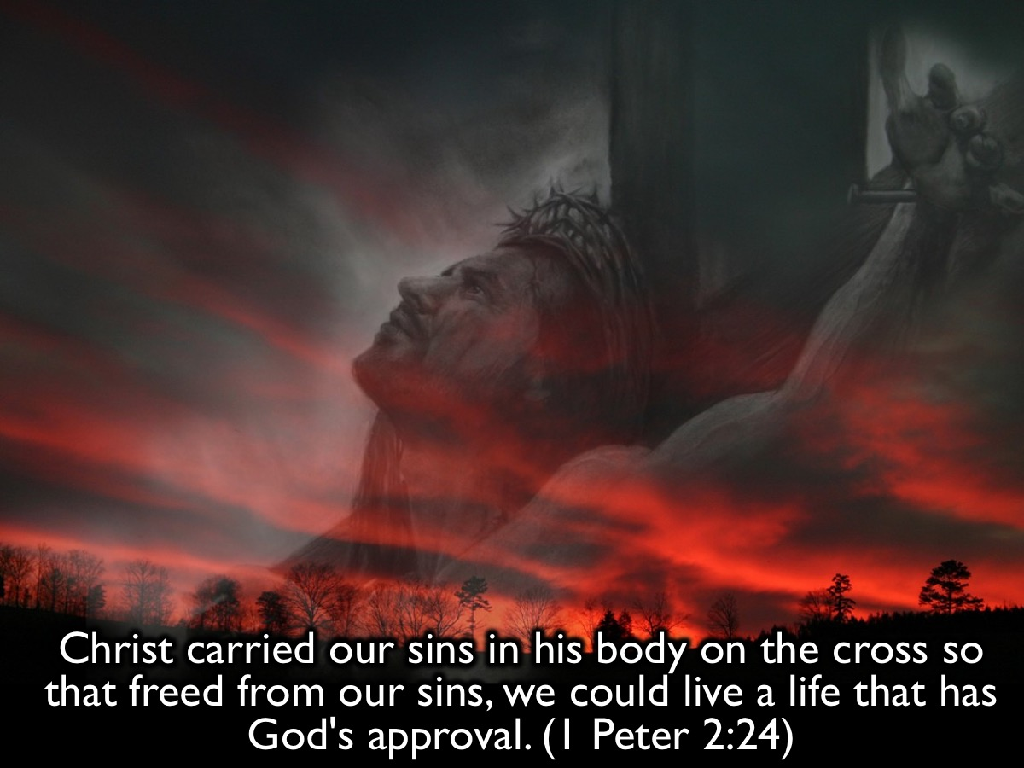
Notes:
The cross has everything to do with victory! “Christ carried our sins in his body on the cross so that freed from our sins, we could live a life that has God's approval.” (1 Peter 2:24)

Slide 27
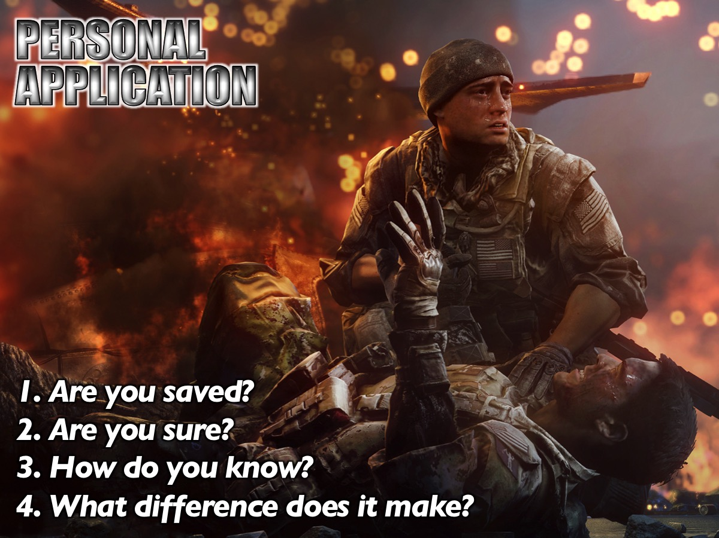
Notes:
Personal Application: Get into your accountability pairs once again and reflect on these questions: (1) Are you saved? (2) Are you sure? (3) How do you know you are saved? (4) What difference does it make?

Slide 28
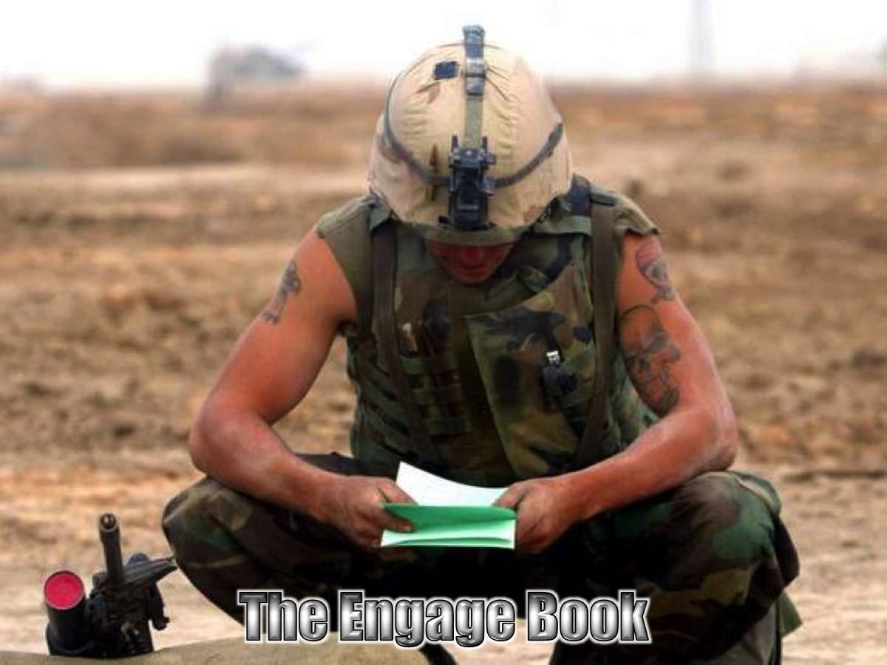
Notes:
If you have not worked through the Engage book (the One 2 One for Teens) – then be sure to grab a copy today and start working through it this week.

Slide 29
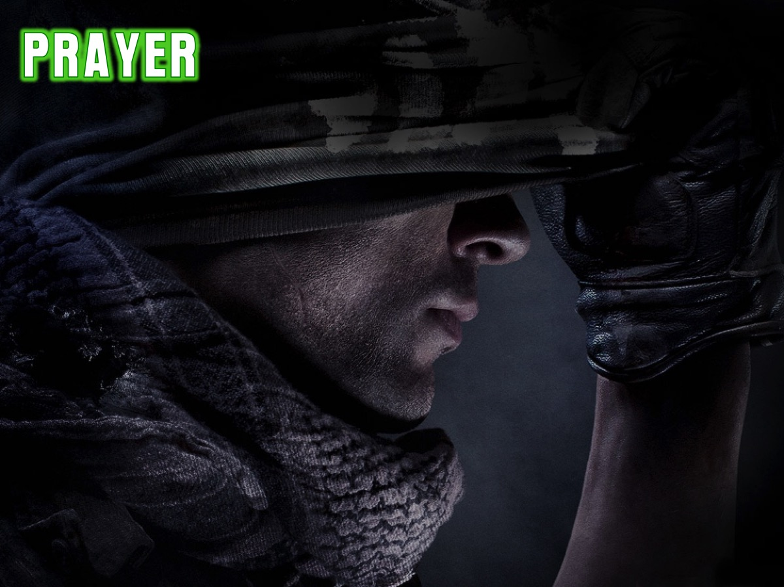
Notes:
Let’s pray!

Slide 30

Notes:
In week 4 we will be looking at how our identity affects our victory.

Slide 31
Notes:
Soldiers will look after their own – but you have to be one of them to be protected! Otherwise you are their target!

