Slide 1

Notes:
Welcome to Victory Sunday - today is week 4 in the Call to Victory series!

Slide 2
Notes:
Video: Call of Duty Ghosts Live-Action Trailer Epic Night Out. Get it on YouTube at: https://www.youtube.com/watch?v=MNxh7umVOZ0

Slide 3

Notes:
In week 1 we explored Preparing for Victory.

Slide 4

Notes:
In week 2 we looked at look at how Transformation happens.

Slide 5

Notes:
In week 3 we looked at what the Cross has to do with victory in our lives.

Slide 6

Notes:
The movie Saving Private Ryan gave a great example of how soldiers risked their own lives to save a fellow soldier.

Slide 7

Notes:
We learnt that three things happened on the cross:

Slide 8
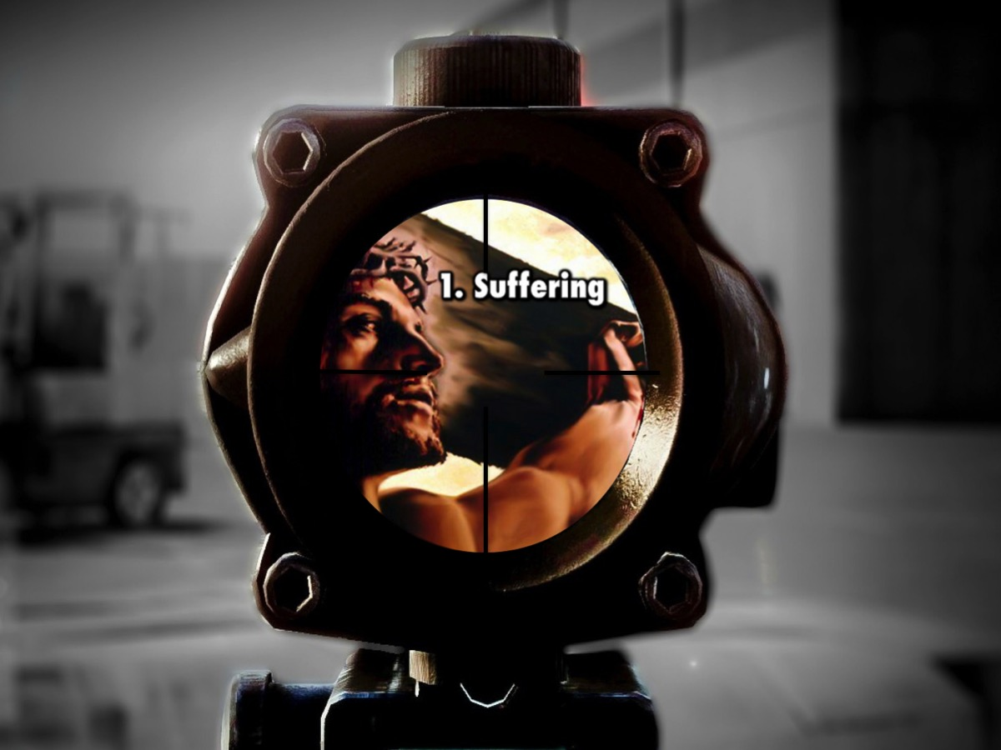
Notes:
1. Suffering. Jesus suffered the pain of the cross because of my sins.

Slide 9
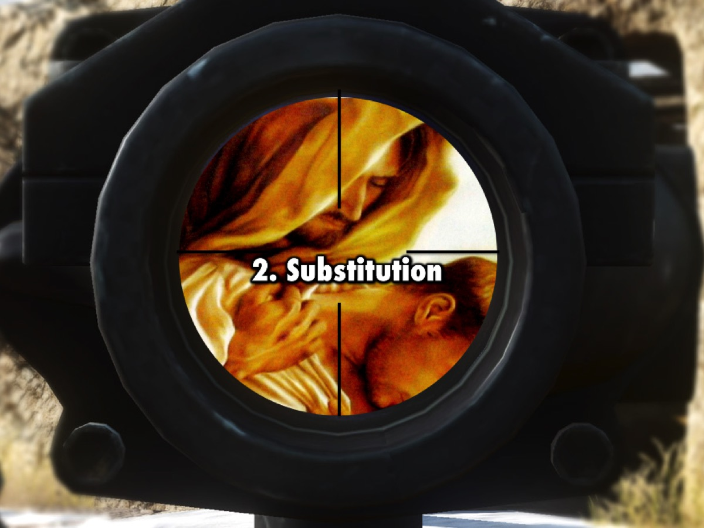
Notes:
2. Substitution. Jesus took our place on the cross, becoming our sin and suffering our punishment, so we could receive his righteousness.

Slide 10
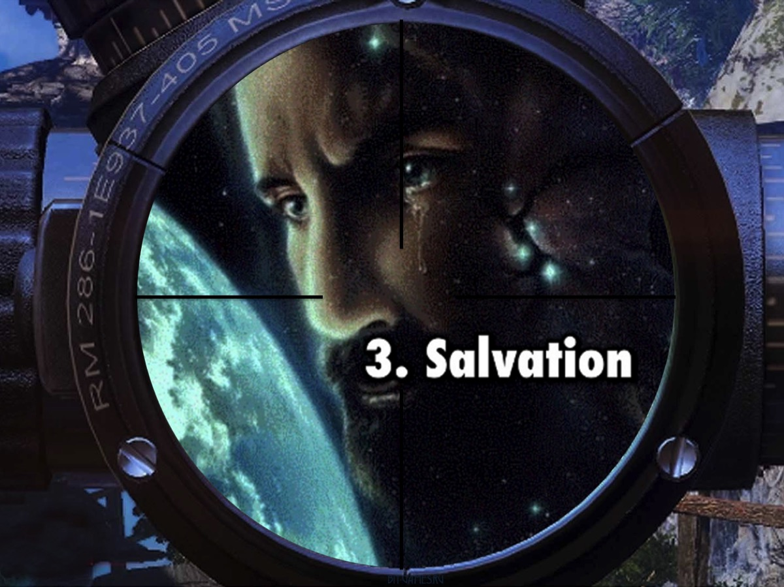
Notes:
3. Salvation. Jesus came to seek and save the Lost – to save sinners from the wrath of God.

Slide 11

Notes:
We also looked at how we should respond to what Jesus did on the Cross:

Slide 12
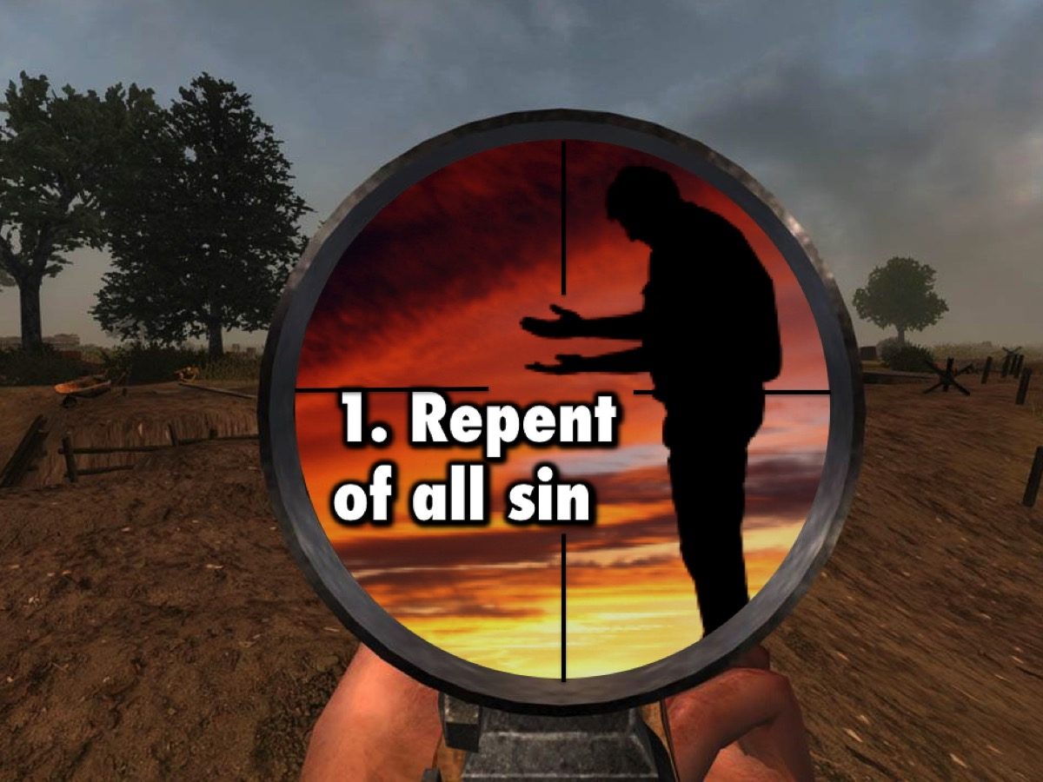
Notes:
1. Repent of all sin.

Slide 13
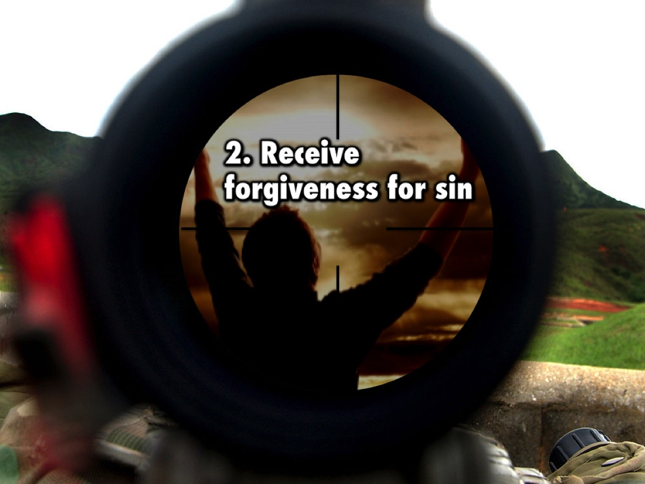
Notes:
2. Receive forgiveness for Sin.

Slide 14
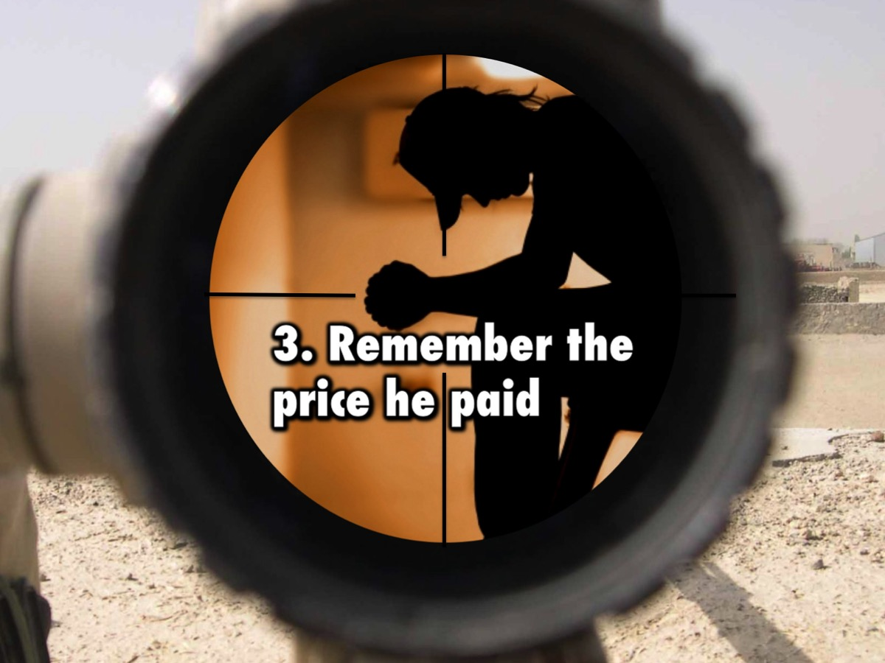
Notes:
3. Remember the price he paid for our sin.

Slide 15

Notes:
Today we will be looking at how our identity affects our victory. We will discover what God thinks about us.

Slide 16

Notes:
Who am I? Any solider must know who they are!

Slide 17
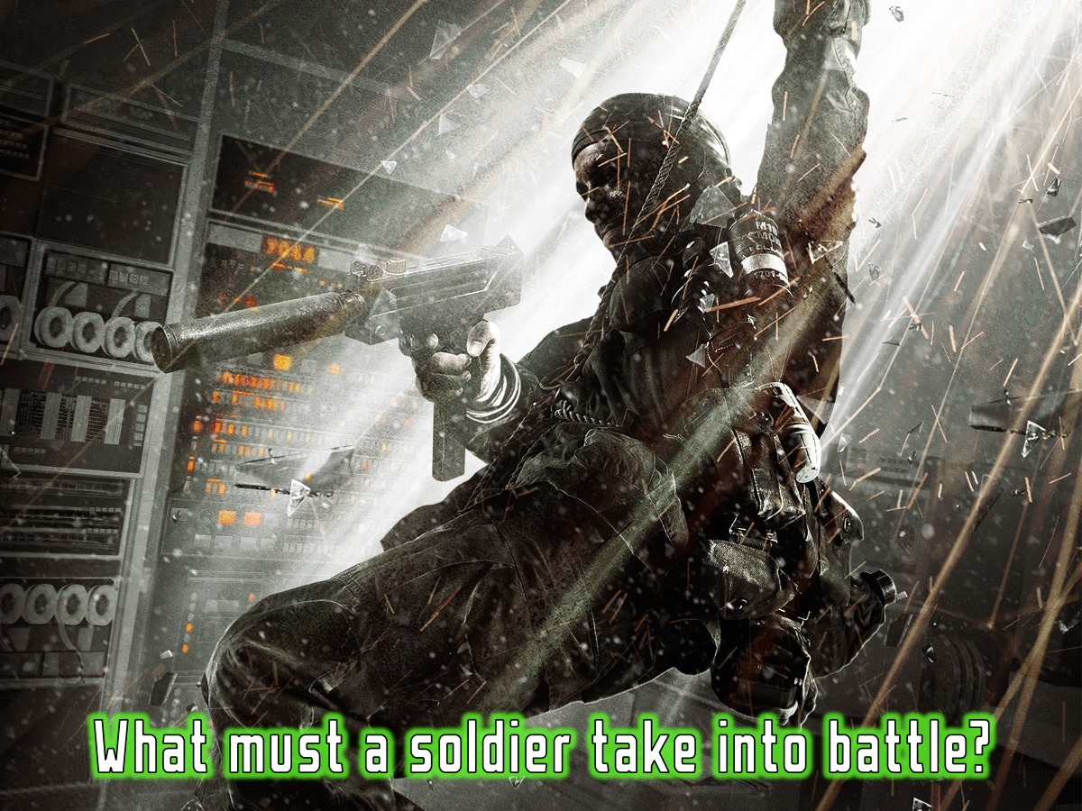
Notes:
What must a soldier take into battle?

Slide 18
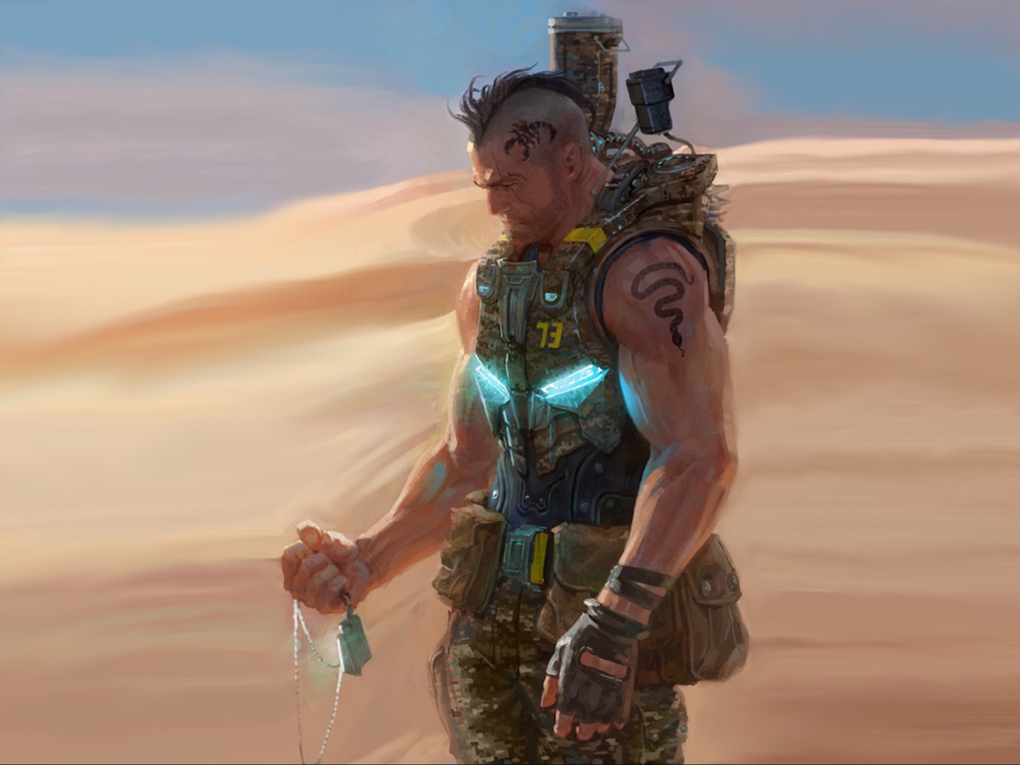
Notes:
Of course he needs his rifle but most importantly he must take his dog tags!

Slide 19
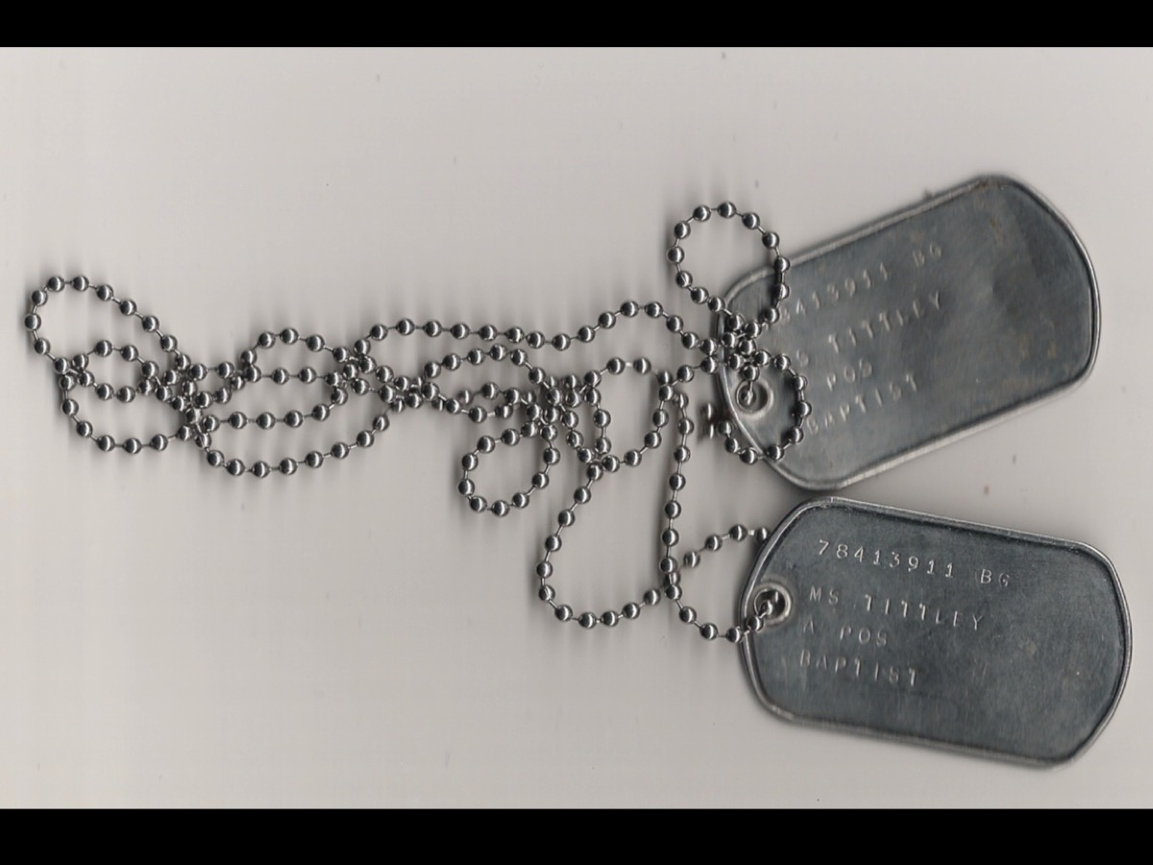
Notes:
Here is the original set of dog tags that Pastor Mark received when he became a soldier! It shows his number, which indicated the year in which he was recruited (1978), his name, his blood type (A Positive) and his church (Baptist). If a soldier is killed in battle - one of the tags is placed in the body bag to make sure the body can be identified and the other is taken back to base by the officer in charge as a record of the fallen soldier.

Slide 20
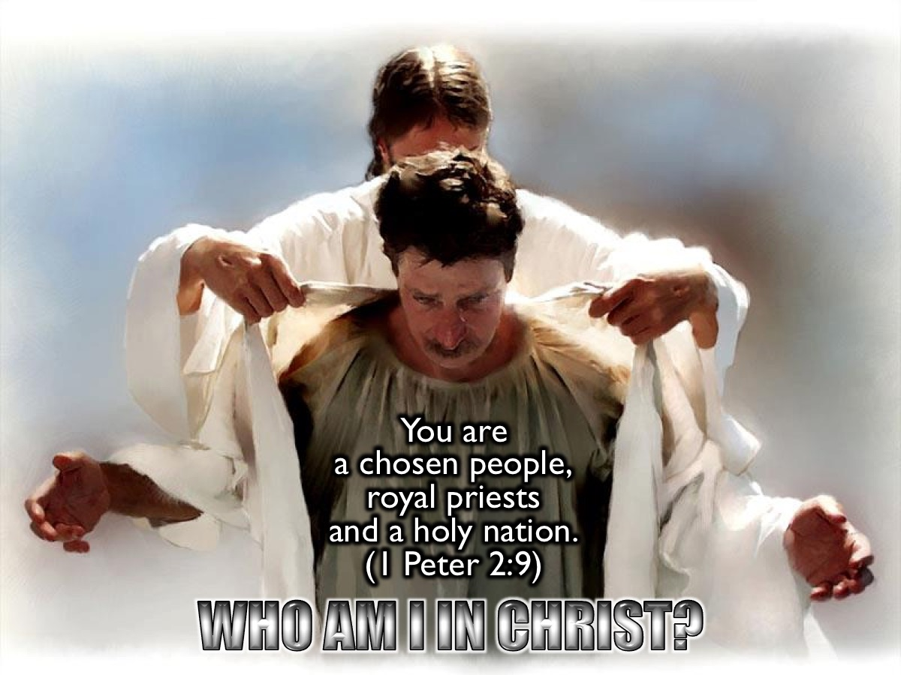
Notes:
Today we want to explore our identity in Jesus: Who am I in Christ? There are three pictures of who we are in Christ in the Bible – and each one has an implication connected to it. The three images are found in this verse: “You are a chosen people, a royal priesthood and a holy nation.” (1 Peter 2:9)

Slide 21
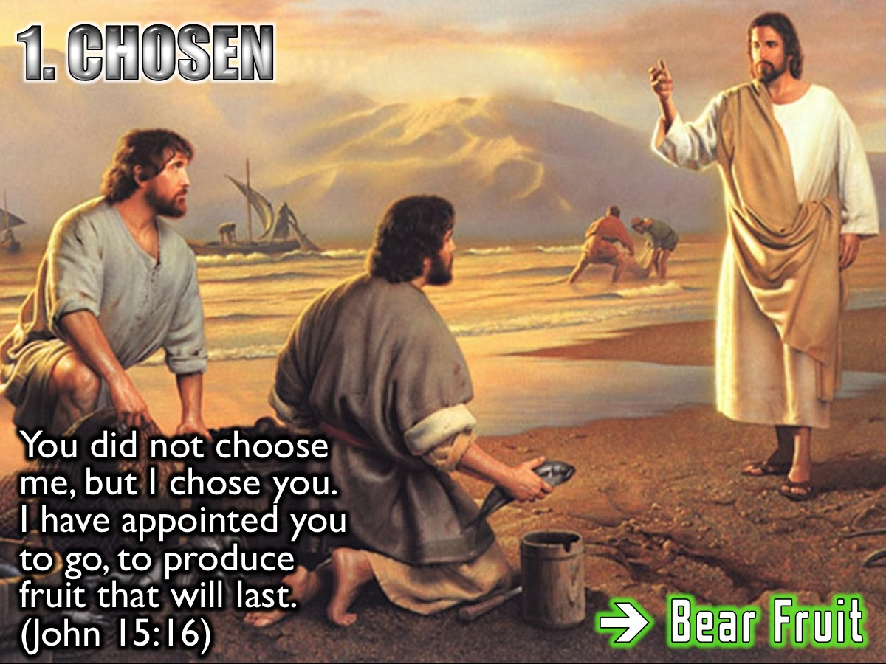
Notes:
1. We are Chosen. Jesus said: “You didn't choose me, but I chose you. I have appointed you to go, to produce fruit that will last.” (John 15:16). God chose us because he loved us not because of anything we had done. The implication: Because I am chosen I must bear fruit!

Slide 22
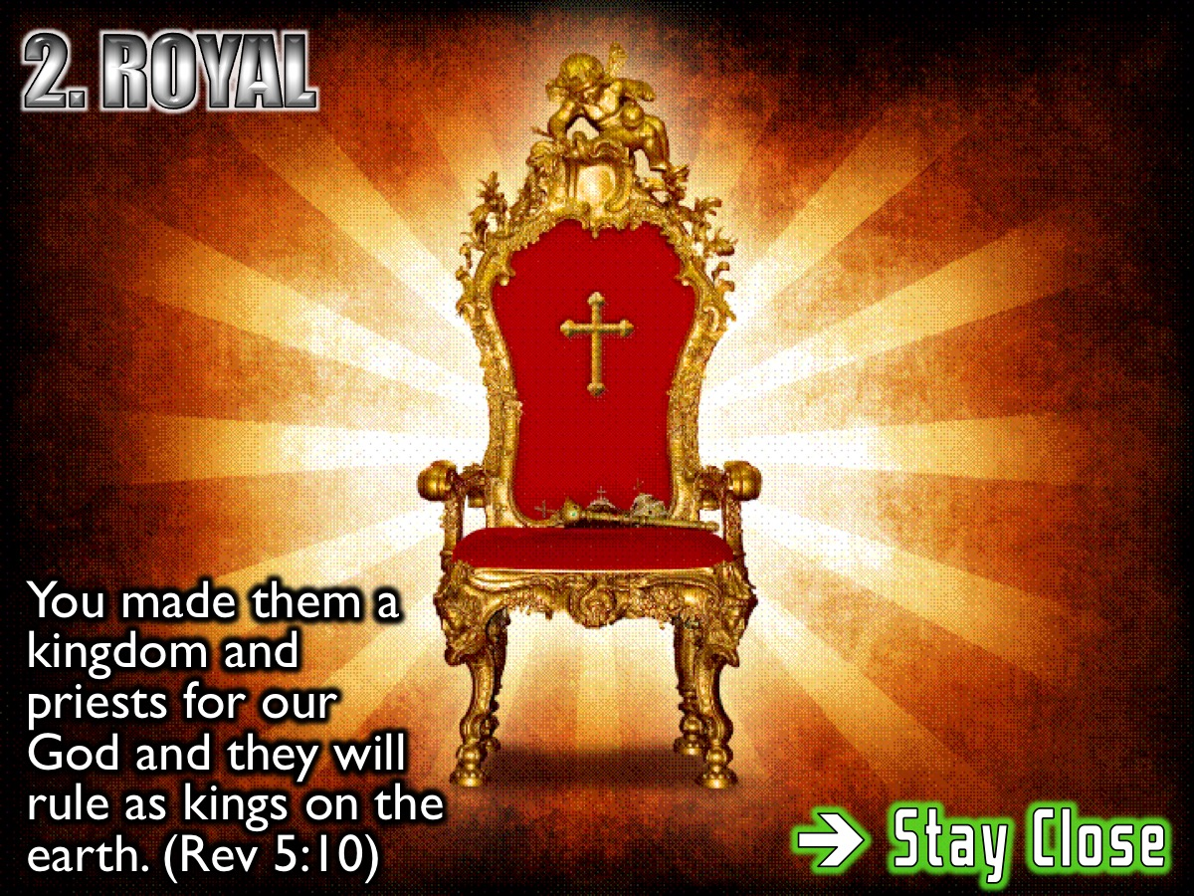
Notes:
2. We are Royal. “You made them a kingdom and priests for our God. They will rule as kings on the earth.” (Revelation 5:10). We are a royal priesthood – like priests we have special access to God. The implication: Because I am Royal I must live close to God.

Slide 23
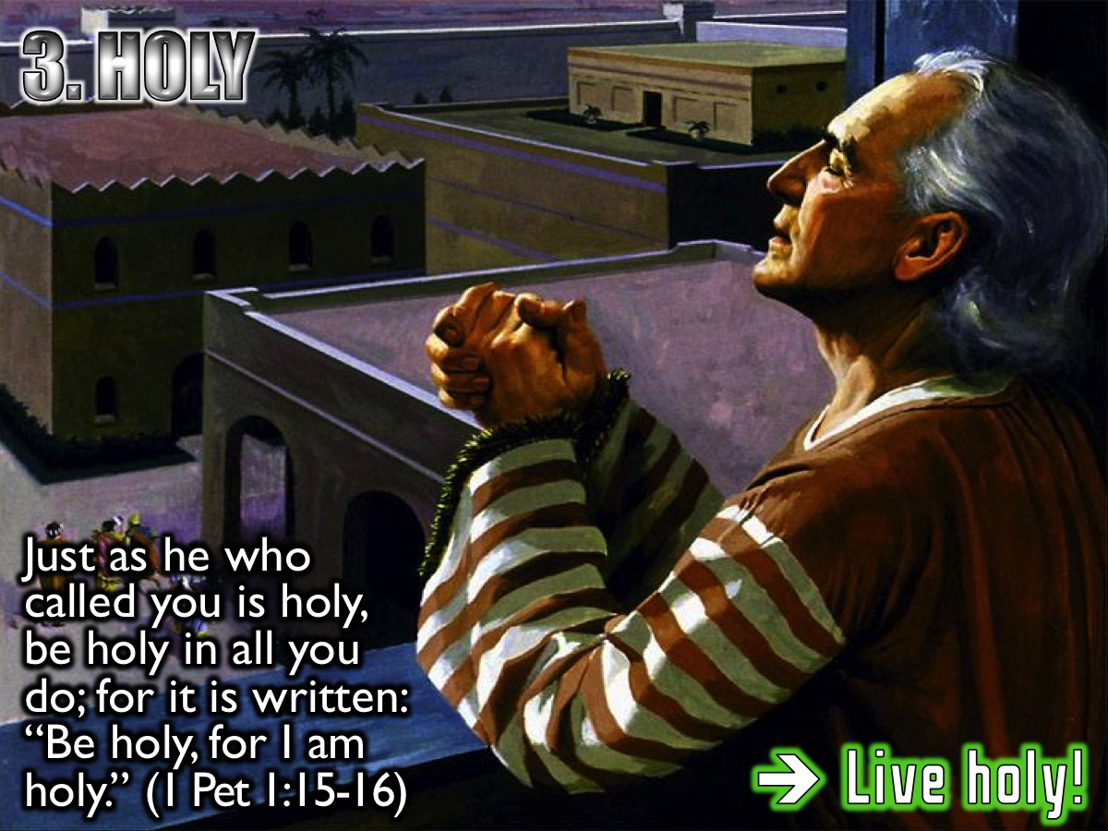
Notes:
3. We are Holy. “But just as he who called you is holy, so be holy in all you do; for it is written: "Be holy, because I am holy." (1 Peter 1:15-16). Holiness is a heart issue. It is who we are before what we do. The Implication: Because I am holy I must live a holy life.

Slide 24
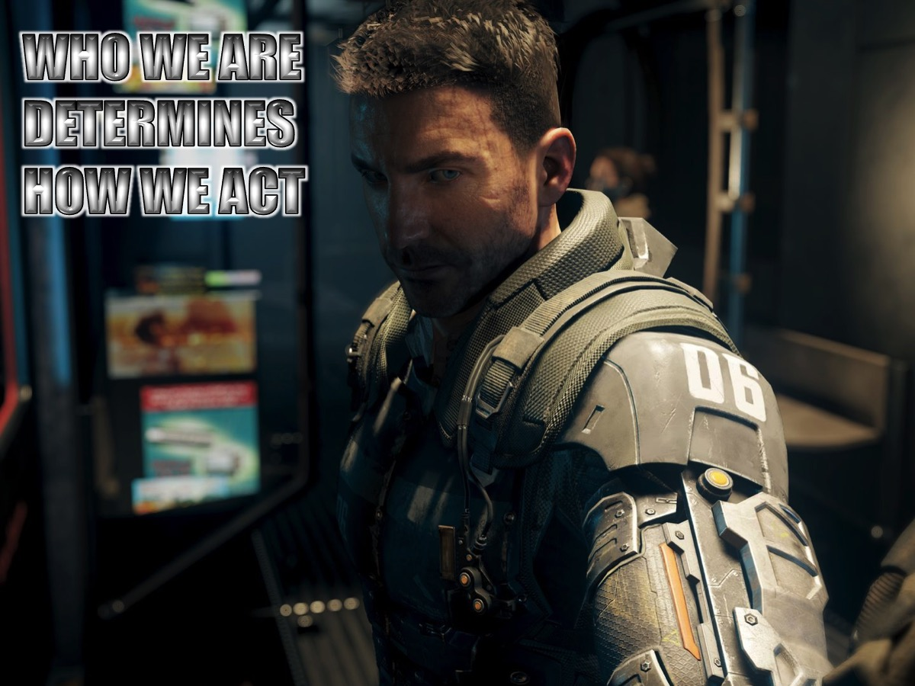
Notes:
Who we are determines how we act!

Slide 25
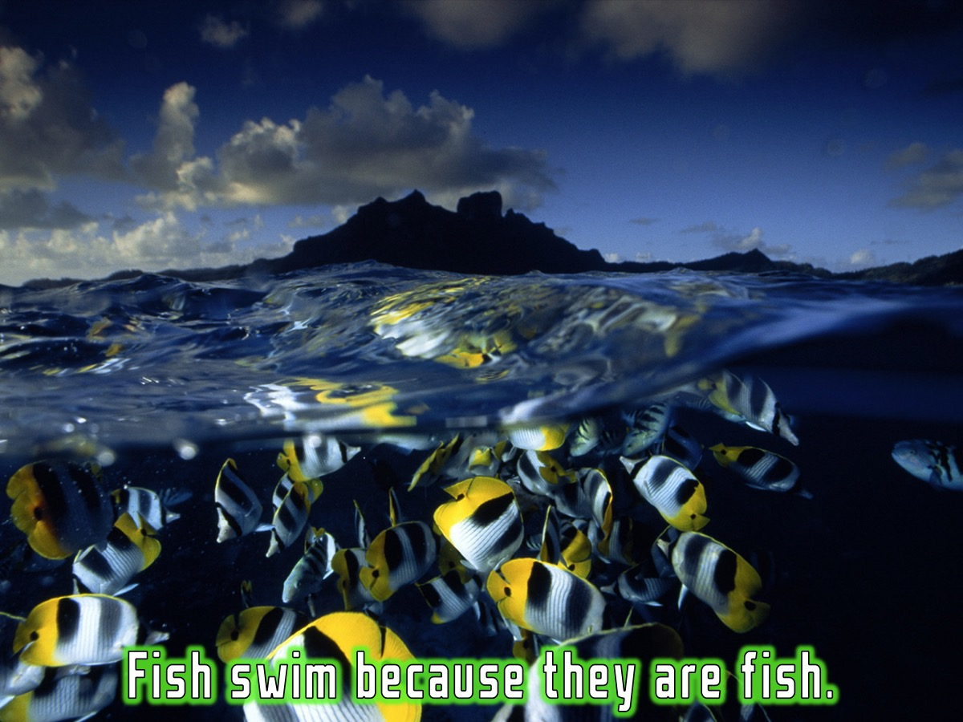
Notes:
* Fish swim because they are fish.

Slide 26
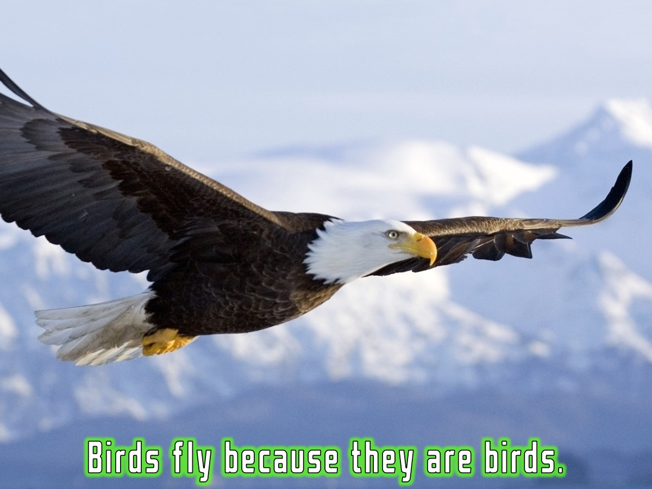
Notes:
* Birds fly because they are birds.

Slide 27
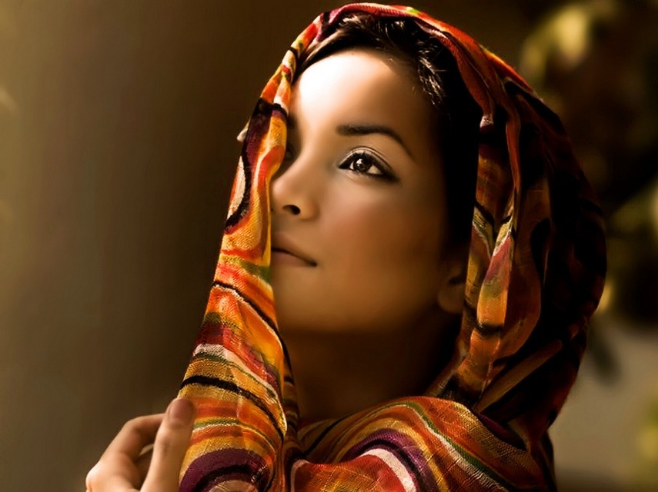
We are chosen, royal, holy - act like it!
Notes:
* We are chosen, royal and holy: so we should act like we are chosen, royal and holy!

Slide 28
Notes:
Video: He is my identity. Watch it on YouTube at: https://www.youtube.com/watch?v=tyHMmyUCrJY
I purchased a fairly decent quality version from this website:
http://beamerfilms.com/sermon-videos/sermon-videos-illustrations/he-is-my-identity

Slide 29

BAPTISM OF FIRE
Notes:
Have you heard of the phrase ‘Baptism of Fire” – it refers to a situation where soldiers come under heavy attack from their enemy and bullets are flying around all over the place! Well there is another baptism that believers need to experience!

Slide 30
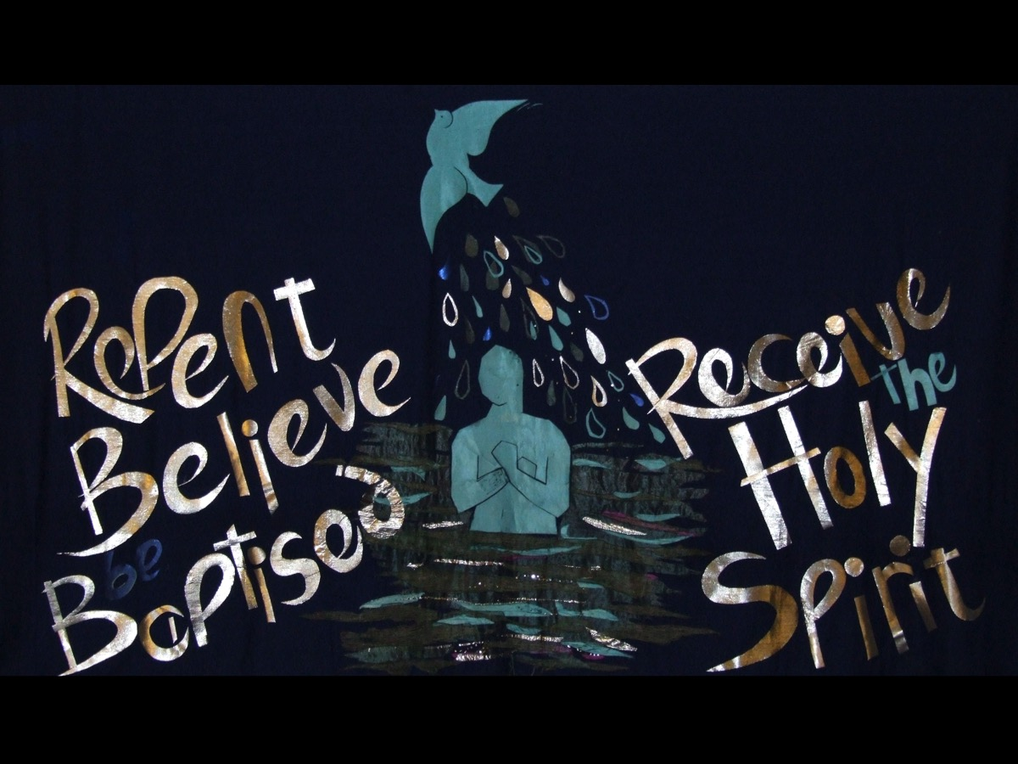
Notes:
The New Testament spoke of a package deal – a whole set of actions that needed to happen when you became a follower of Jesus: (1) Repent, (2) Believe, (3) Be Baptised in Water and (4) Receive the Holy Spirit.

Slide 31
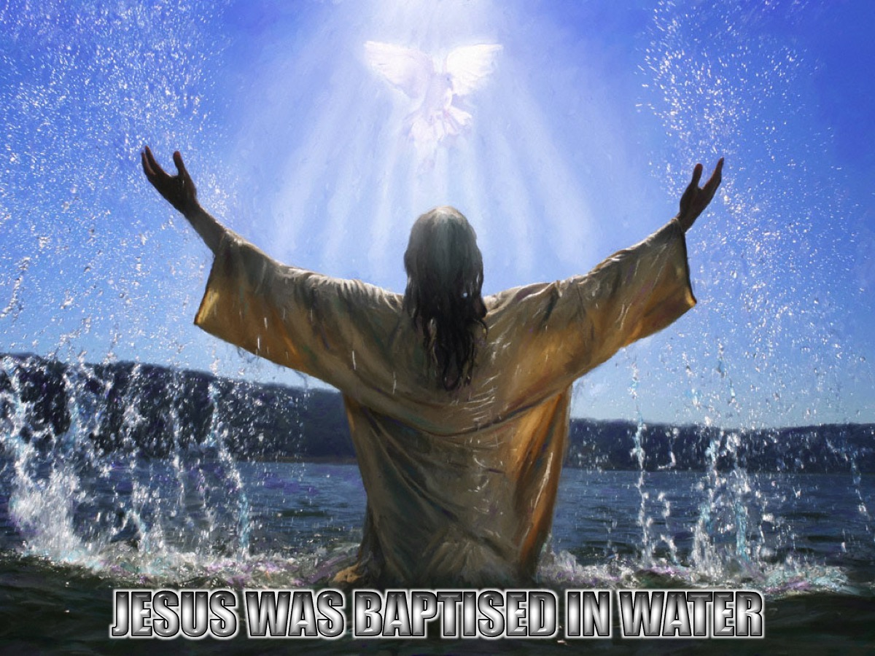
Notes:
Jesus was baptised in water. Here is a video clip of that experience from the Visual Bible! (Matthew 3)

Slide 32
Notes:
Video: Jesus’ baptism from the Visual Bible – Matthew 3

Slide 33
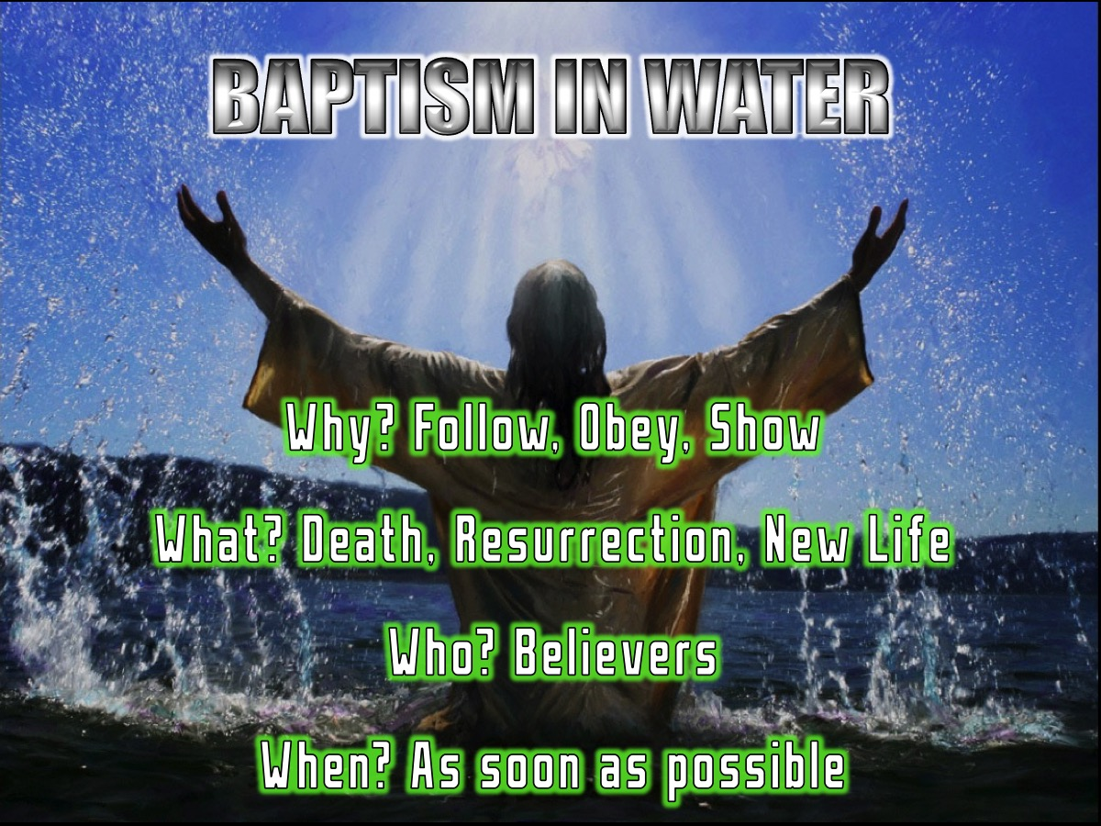
Notes:
Here is what water baptism is all about:
* Why should we be baptised? (1) To follow Jesus’ example, (2) To obey Jesus’ command and (3) To show you are a believer.
* What is water baptism all about? (1) It illustrates Jesus’ burial and resurrection, (2) It illustrates my new life as a Christian, (3) It does not make you a Christian: it shows that you believe. (3) It does not save you: you are saved by faith in Jesus.
* Who should be baptised? Everyone who believes in Jesus! “Those who believed and accepted his message were baptised.” (Acts 2:41)
* When should we be baptised? As soon as you have believed! “Those who believed were baptised that day.” (Acts 2:41)

Slide 34
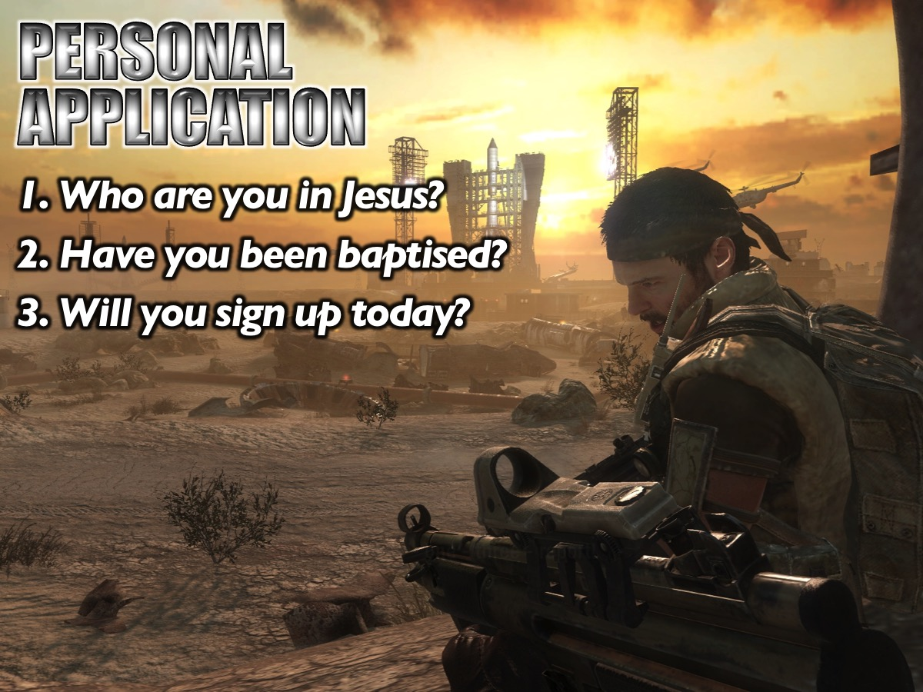
Notes:
Personal Application: Get back into your accountability pairs and ask each other these questions: (1) Who are you in Jesus? (2) Have you been baptised? (3) Will you sign up today?

Slide 35

Notes:
Let’s pray! If you have not been baptised in water - there is opportunity on the 30th August this month for you to be obedient to Jesus and follow his example by being baptised. I would like you to stand so that I can pray for you - and then you can put your name on the list and get some material and a consent form for your parents to sign.

Slide 36

Notes:
Next week we will look at the first of five big issues in our lives: Generational Curses.

