Slide 1

Notes:
Welcome to Victory Sunday! This is week 6 in our series - and once again we start with a video clip.

Slide 2
Notes:
Video: Ghost Recon Future Soldier - Be part of the Elite. Get it on YouTube at: http://www.youtube.com/watch?v=U64mQiwaA6Y

Slide 3
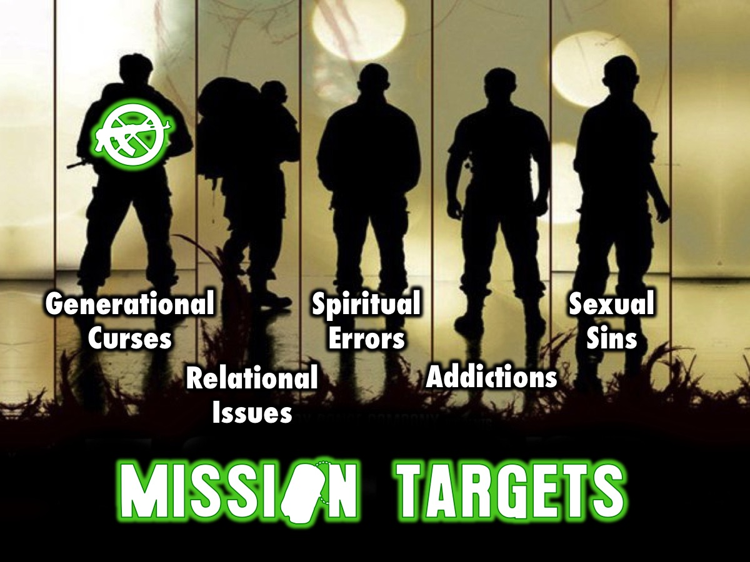
Notes:
Over five weeks we have the following targets to destroy: Generational Curses, Relational Issues, Spiritual Errors, Sexual Sins and Addictions.

Slide 4

Notes:
Last week we looked at the first of five big issues in our lives that we need victory from: Generational Curses.

Slide 5

Notes:
We looked at some common generational curses: Financial Lack, Incurable Disease, Mental Illness, Pregnancy Trouble, Failure or Oppression or Home Disunity.

Slide 6
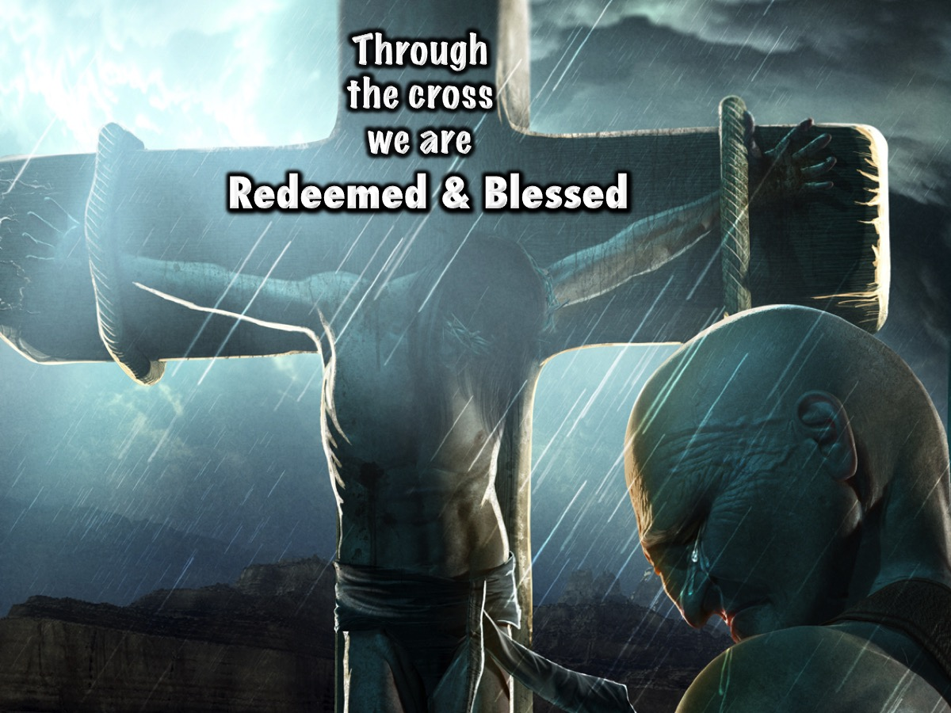
Notes:
We learnt that curses can be destroyed because through the cross we are Redeemed and Blessed: Christ paid the price so that the blessing promised to Abraham would come to us. (Galatians 3:14)

Slide 7

Notes:
This week we are going to look at the second of five big issues in our lives: Relational Issues.

Slide 8
Notes:
Video: Ghost Recon Online. Alone we fight…together we dominate.. Get it on YouTube at: http://www.youtube.com/watch?v=IXz87t6fw-w

Slide 9

Notes:
Alone we fight…

Slide 10
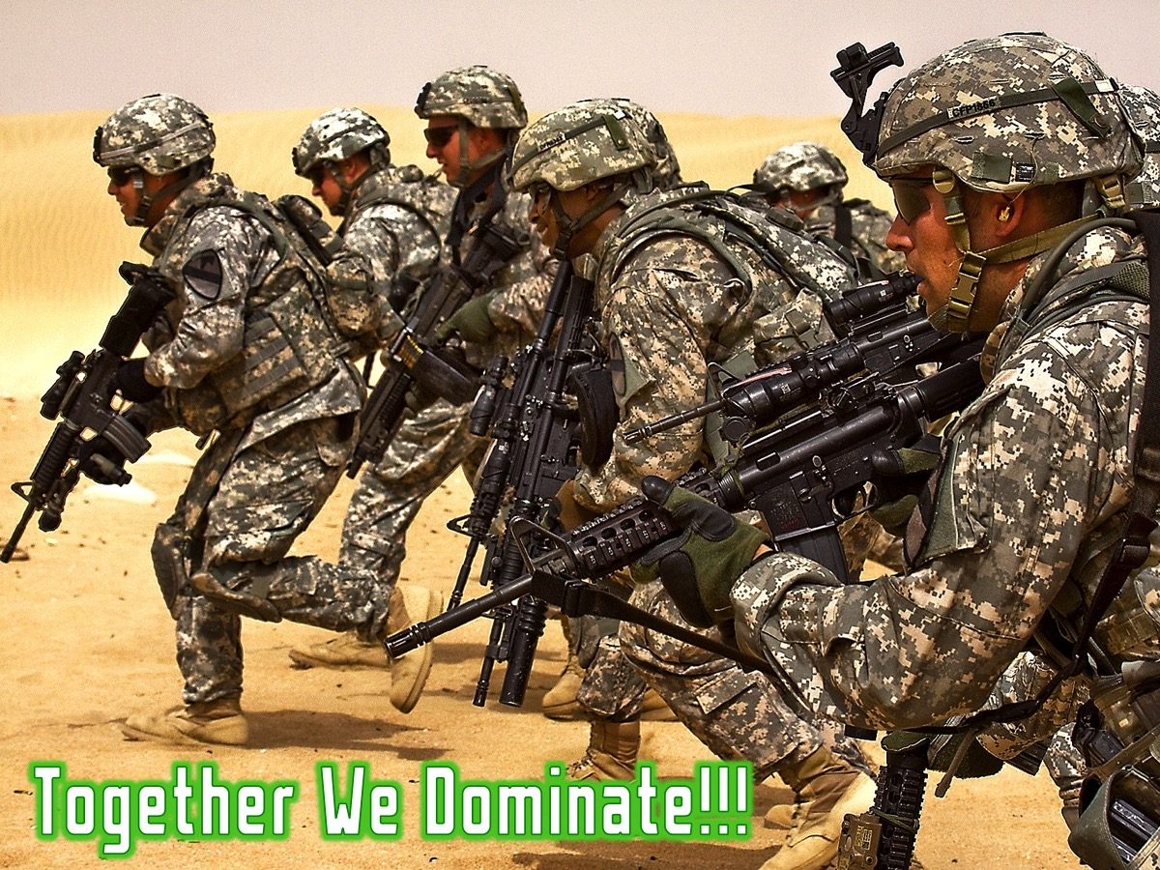
Notes:
…Together we dominate!

Slide 11
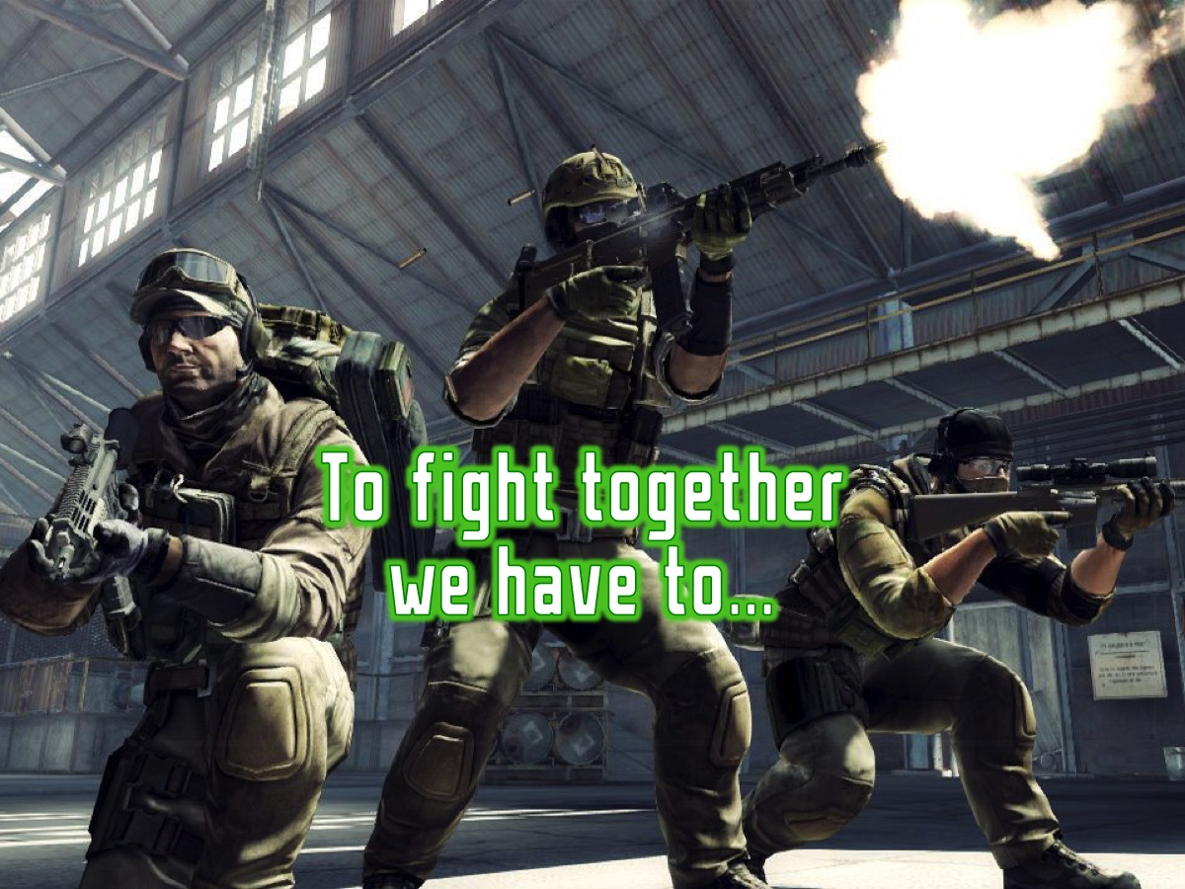
Notes:
To fight together we have to…

Slide 12
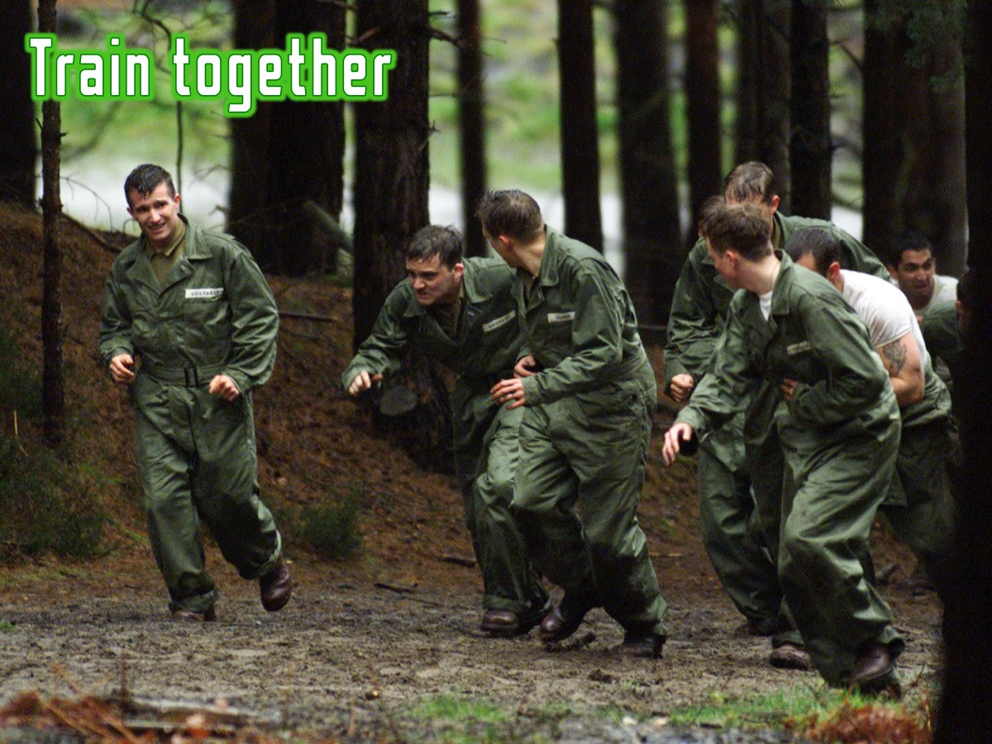
Notes:
* Train together

Slide 13
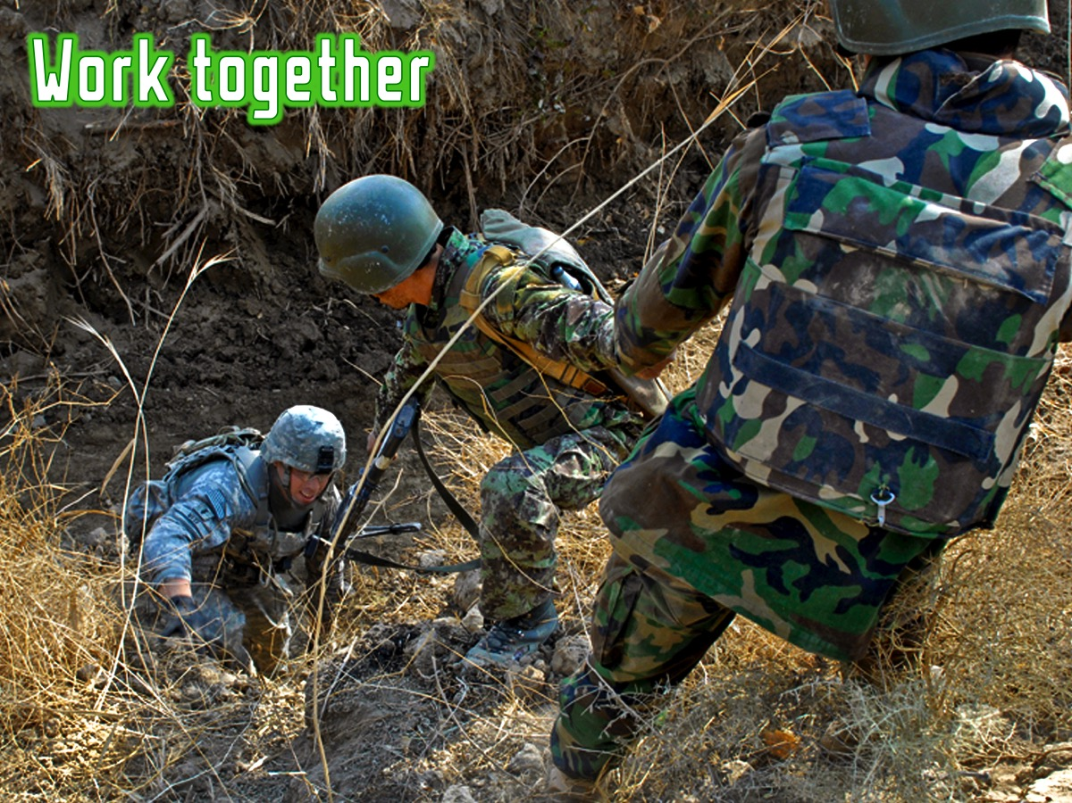
Notes:
* Work together

Slide 14
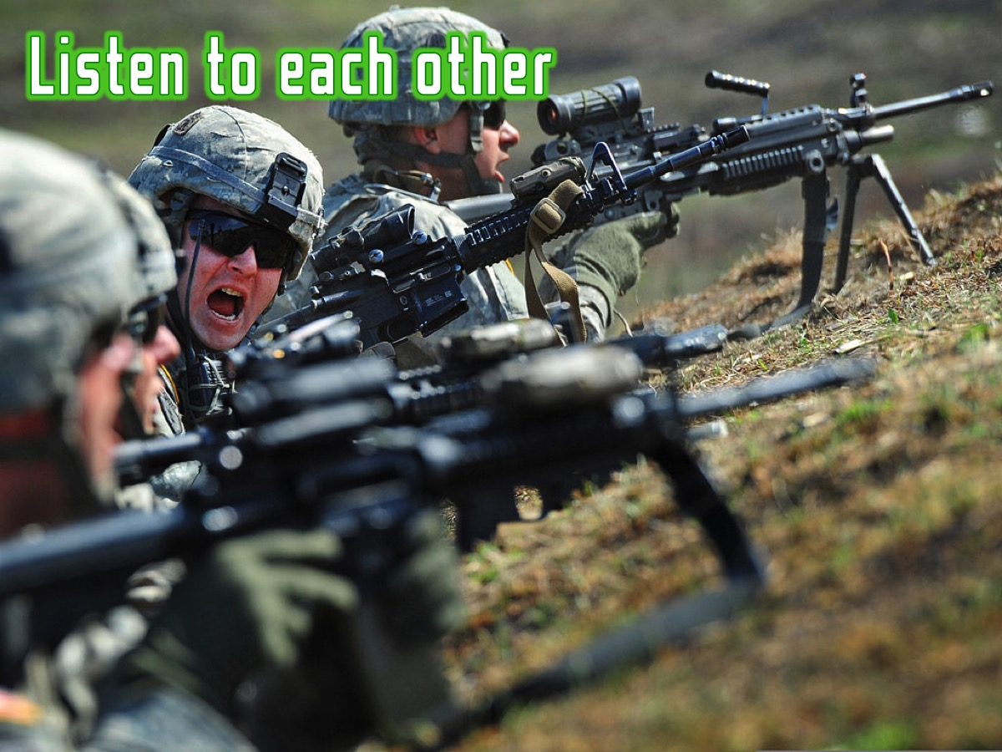
Notes:
* Listen to each other

Slide 15
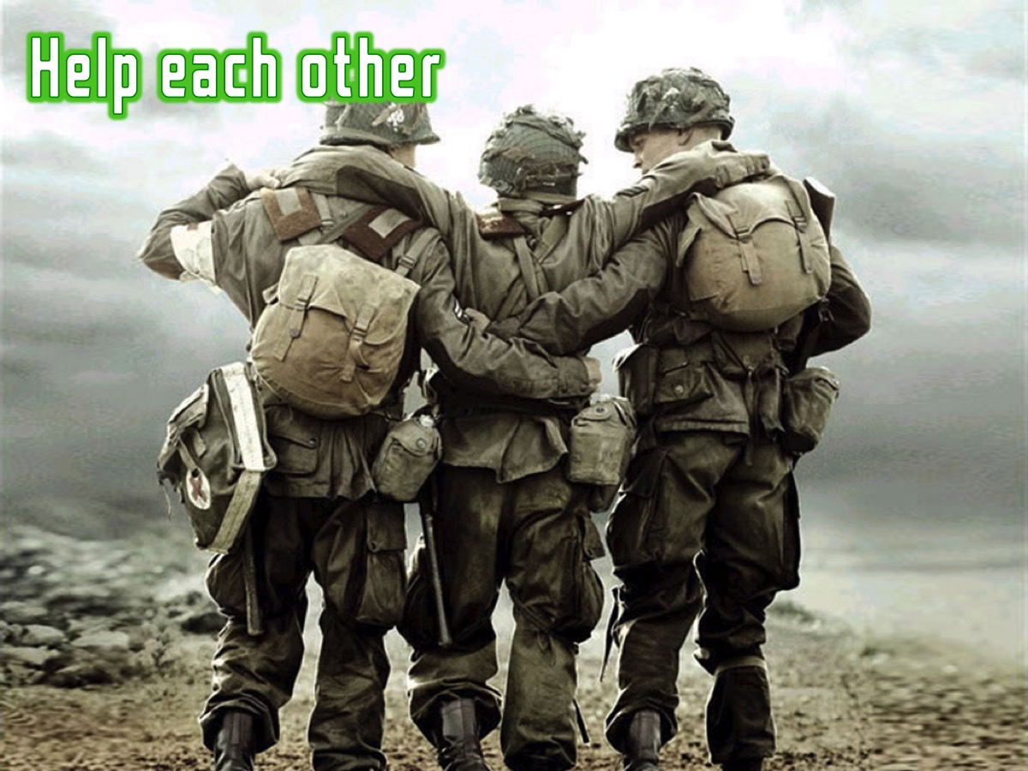
Notes:
* Help each other

Slide 16
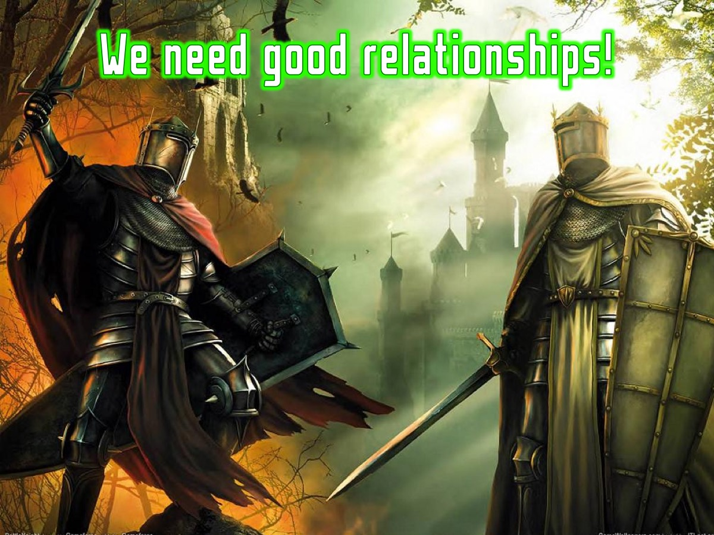
Notes:
If we are going to survive, just like soldiers, we need good relationships!

Slide 17

Notes:
Here are some of the destructive relational habits that destroy our relationships:

Slide 18

Notes:
Actually, we could call these issues, Satan’s relationship tactics!

Slide 19
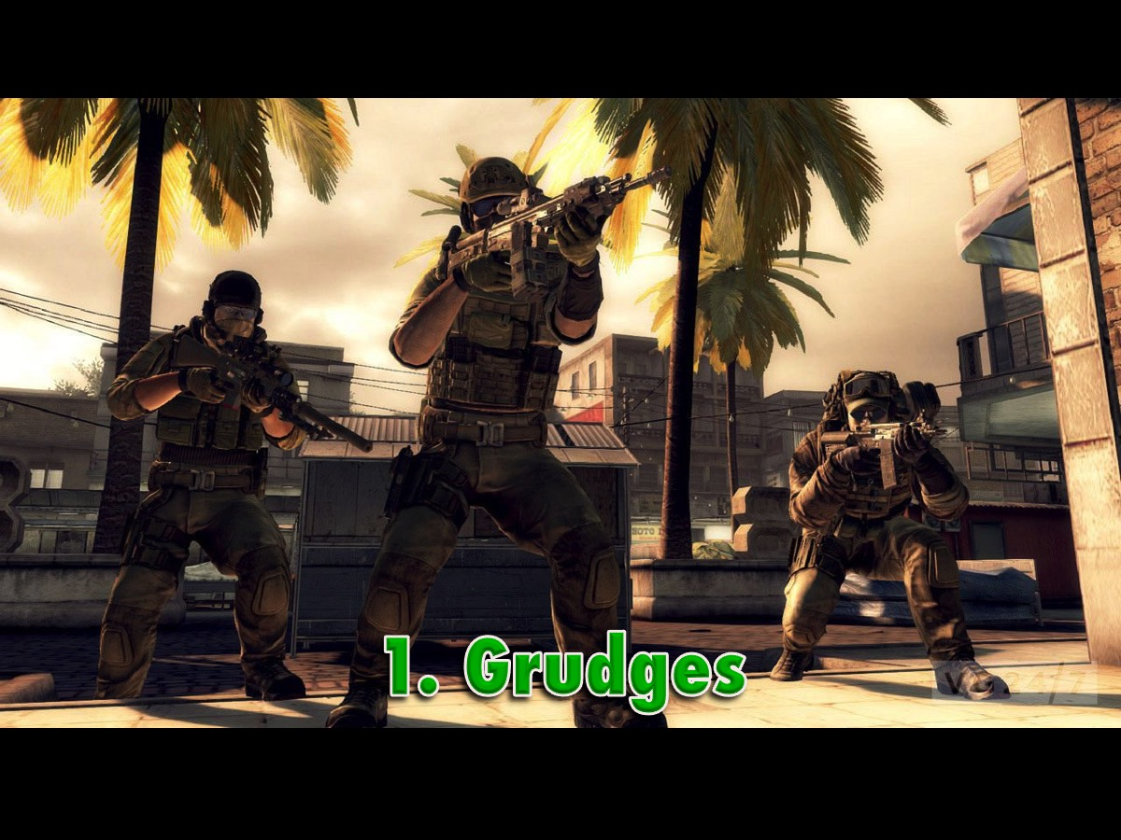
Notes:
1. Grudges

Slide 20
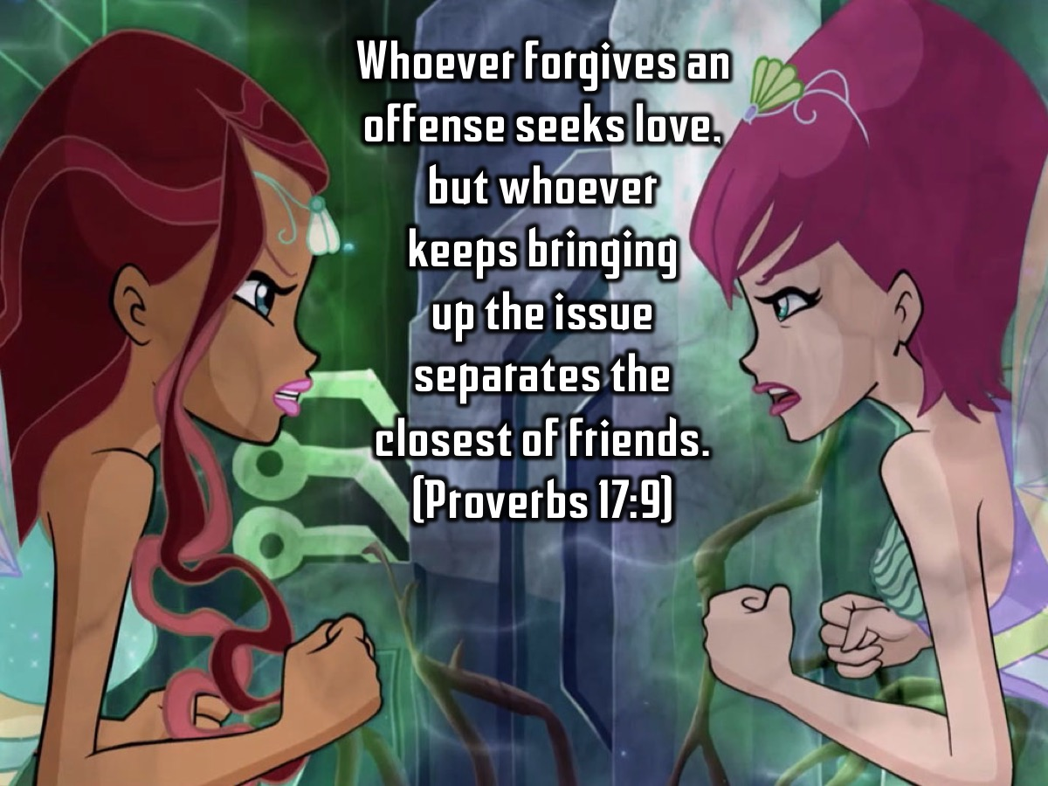
Notes:
Whoever forgives an offense seeks love, but whoever keeps bringing up the issue separates the closest of friends. (Proverbs 17:9)

Slide 21
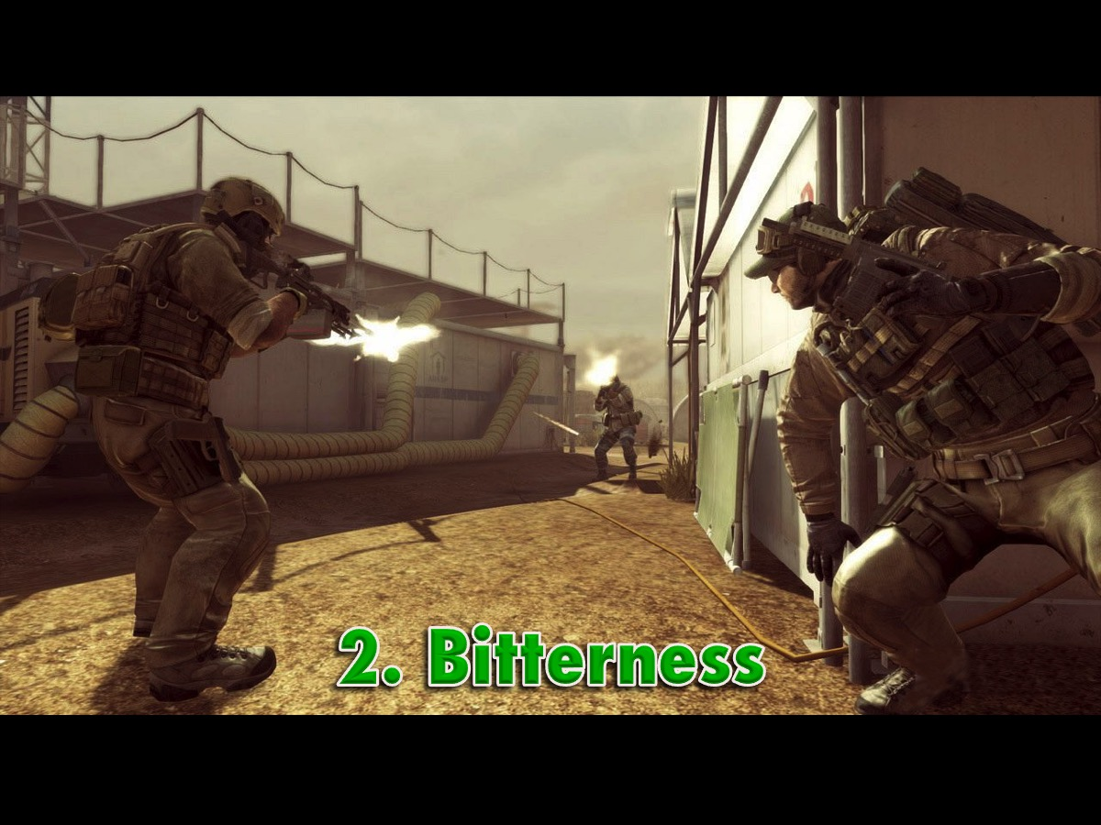
Notes:
2. Bitterness. If we do not properly deal with offense through forgiveness, then roots of bitterness will grow and pollute and eventually harden your heart and mind until you are as cold as a rock.

Slide 22
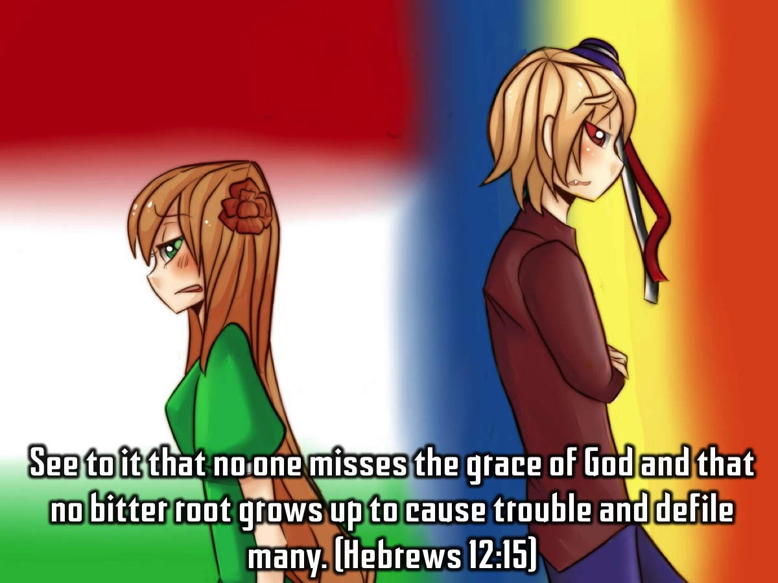
Notes:
See to it that no one misses the grace of God and that no bitter root grows up to cause trouble and defile many. (Hebrews 12:15)

Slide 23
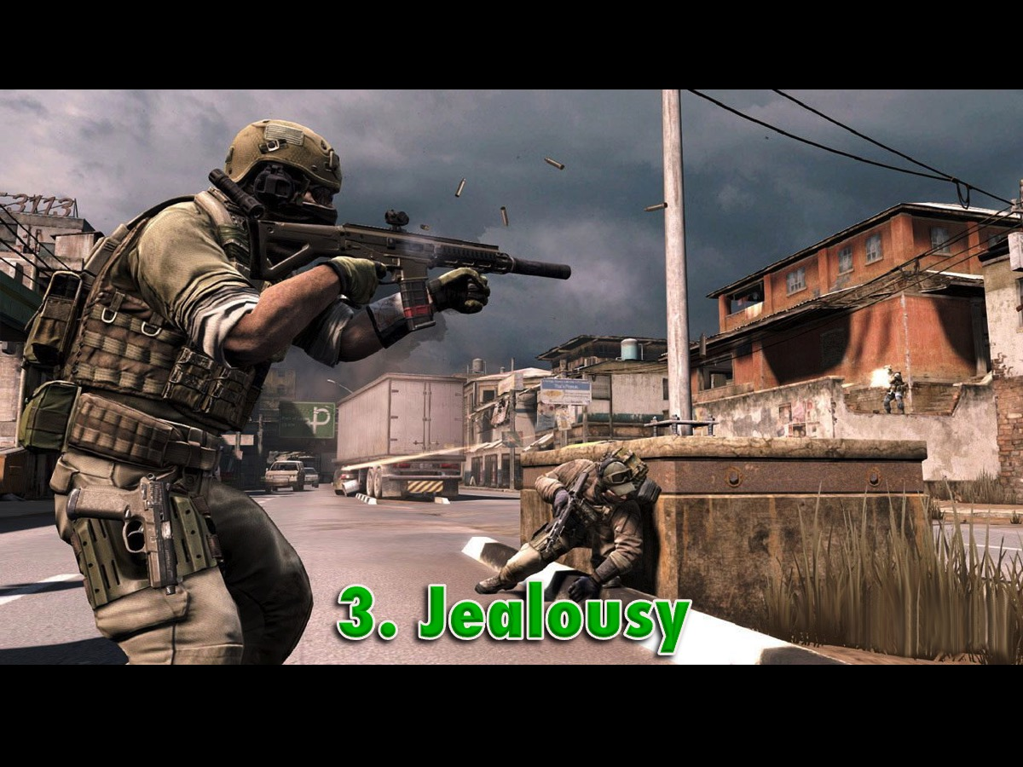
Notes:
3. Jealousy

Slide 24
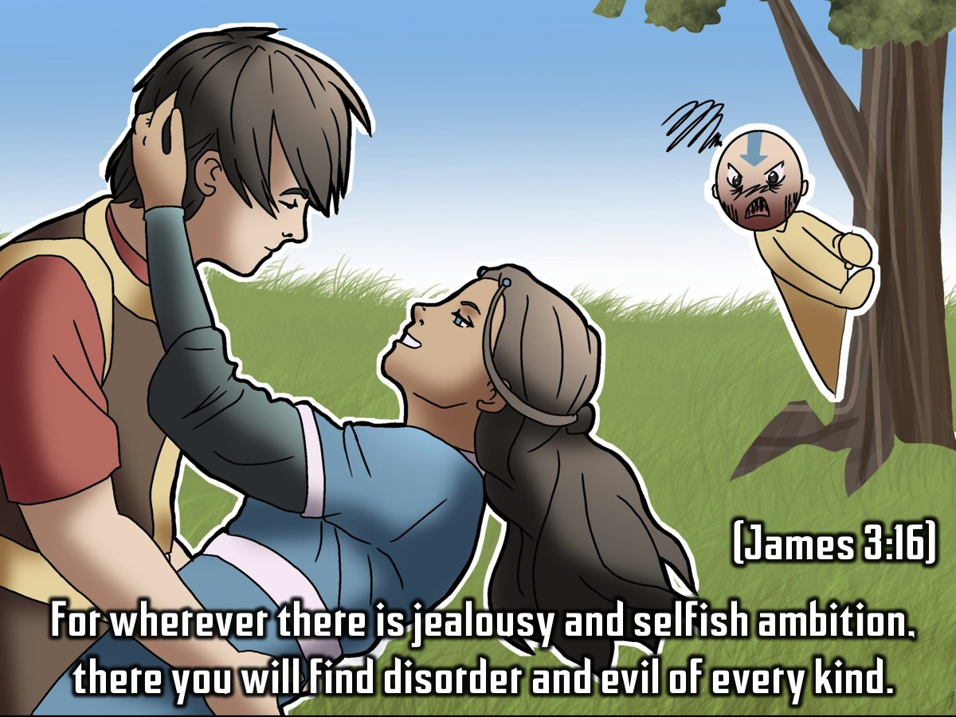
Notes:
For wherever there is jealousy and selfish ambition, there you will find disorder and evil of every kind. (James 3:16)

Slide 25
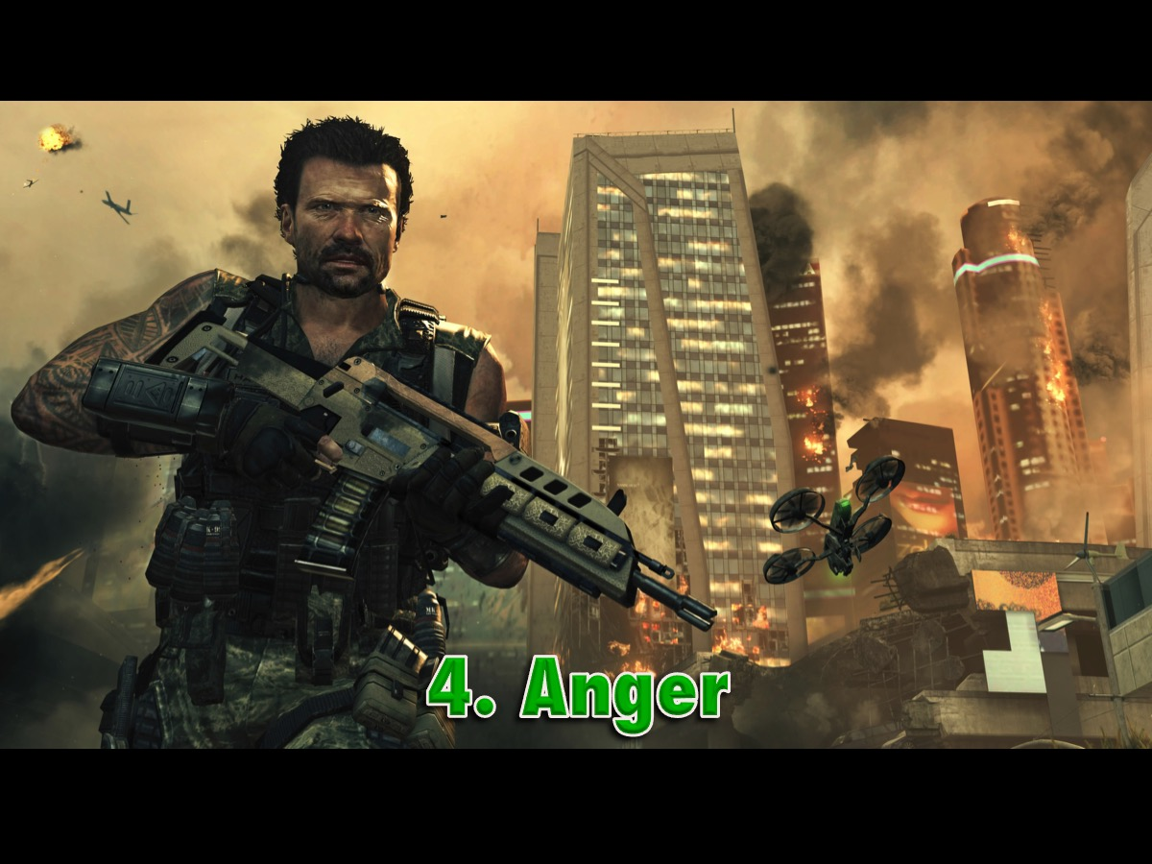
Notes:
4. Anger

Slide 26
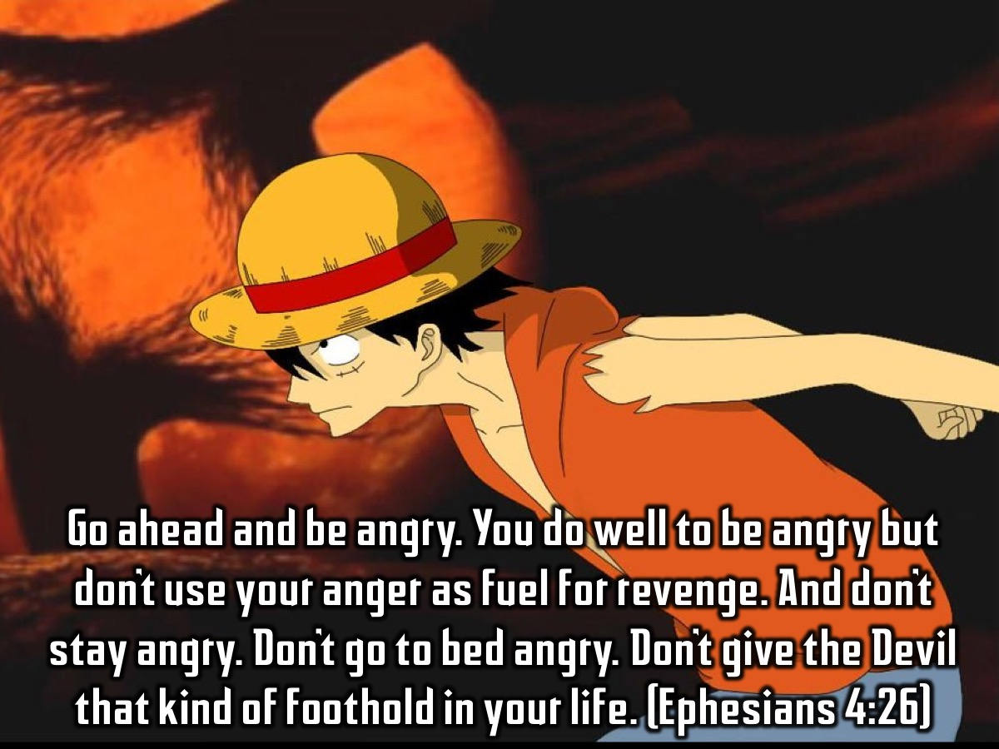
Notes:
Go ahead and be angry. You do well to be angry—but don’t use your anger as fuel for revenge. And don’t stay angry. Don’t go to bed angry. Don’t give the Devil that kind of foothold in your life. (Ephesians 4:26)

Slide 27

Notes:
5. Gossip

Slide 28
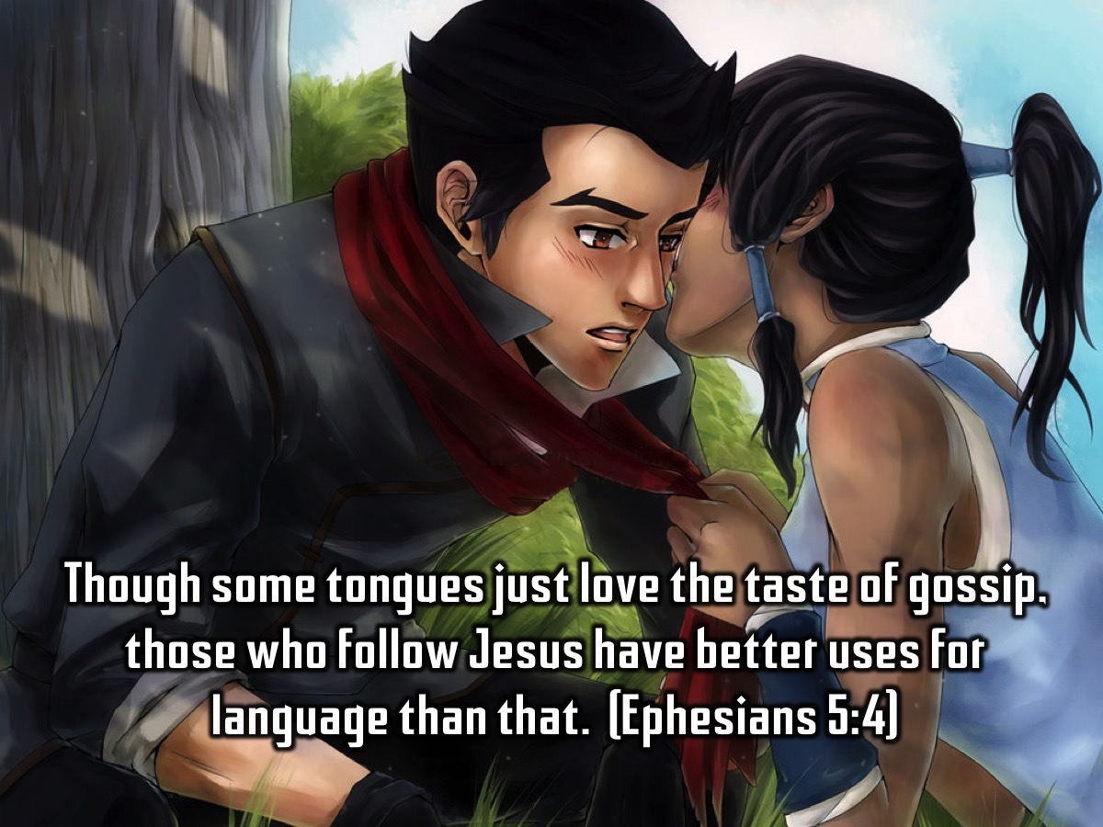
Notes:
Though some tongues just love the taste of gossip, those who follow Jesus have better uses for language than that. (Ephesians 5:4)

Slide 29
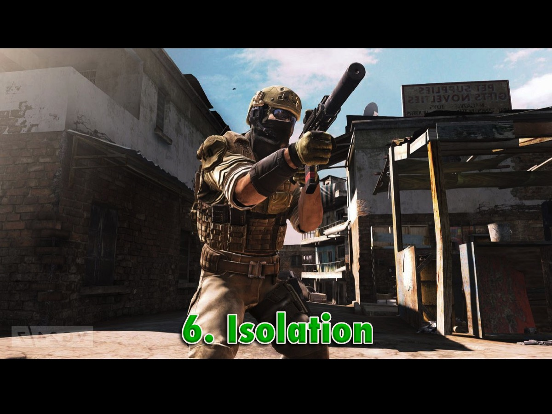
Notes:
6. Isolation

Slide 30
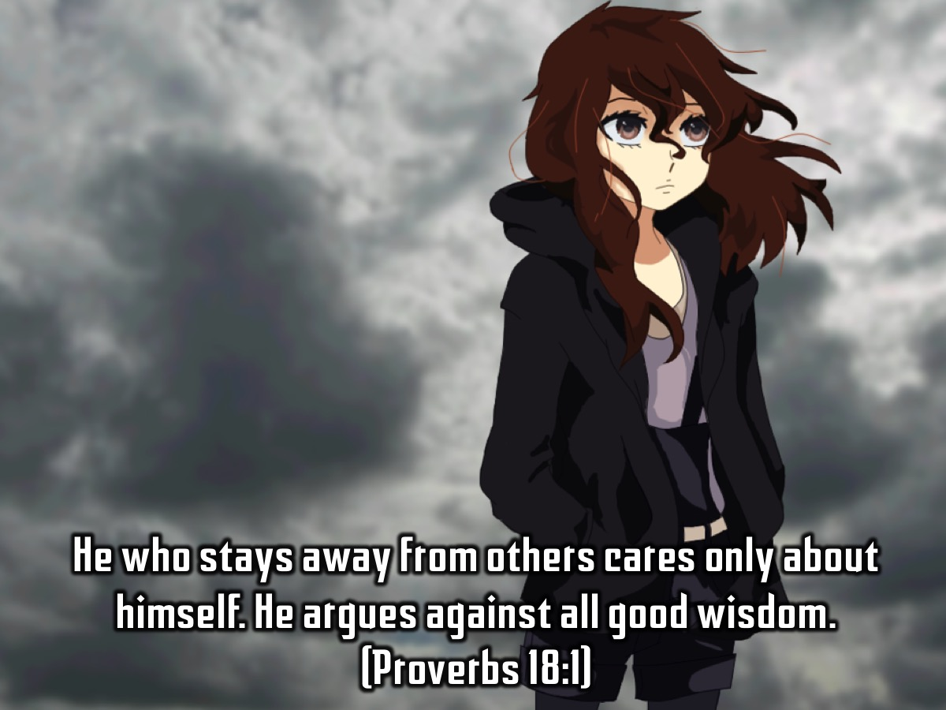
Notes:
He who stays away from others cares only about himself. He argues against all good wisdom. (Proverbs 18:1)

Slide 31
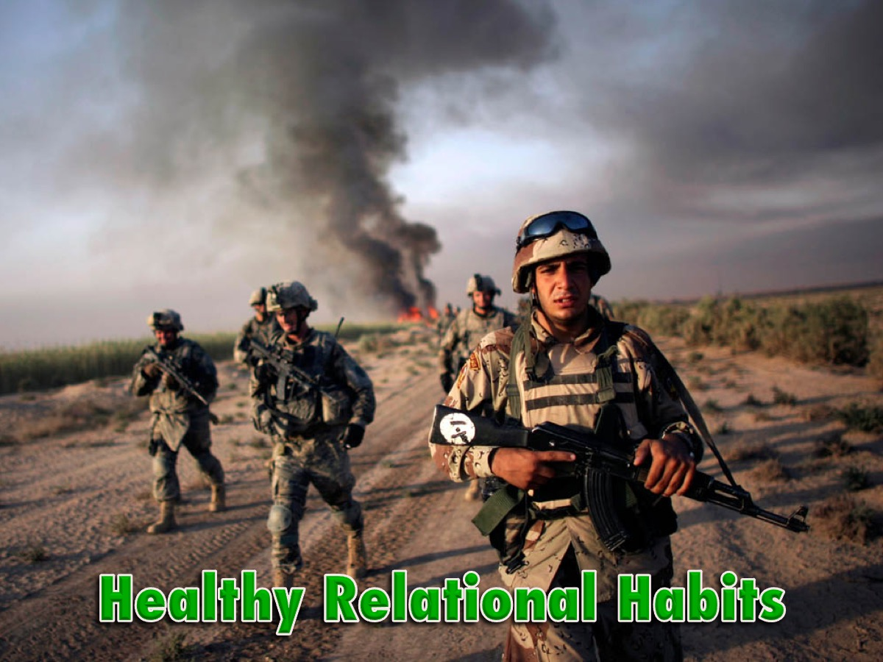
Notes:
In order to walk free from these bad ways of relating, we must practise healthy relational habits!

Slide 32

Notes:
Actually, we could call these habits, God’s relationship tactics!

Slide 33
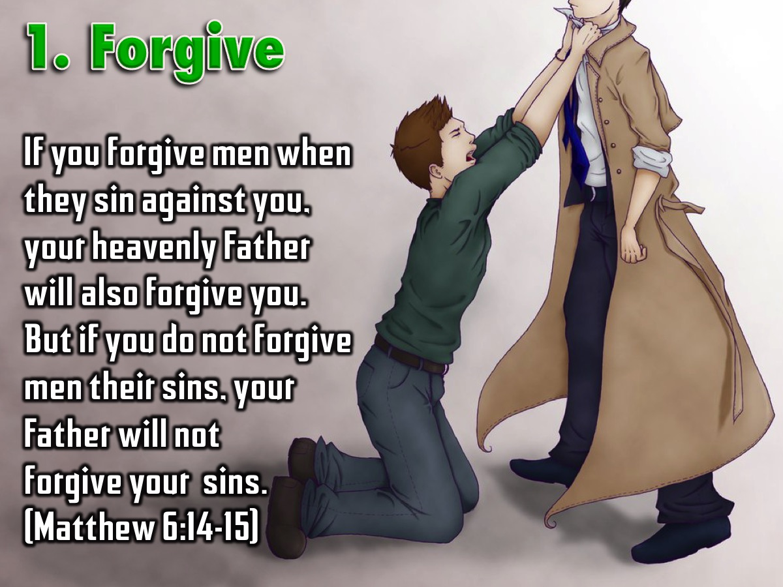
Notes:
1. Forgive – Forgive people who offend you. If you forgive men when they sin against you, your heavenly Father will also forgive you. But if you do not forgive men their sins, your Father will not forgive your sins. (Matthew 6:14-15). And Jesus also said that we are to forgive 70 times 7 times (Matthew 18:21-22).

Slide 34
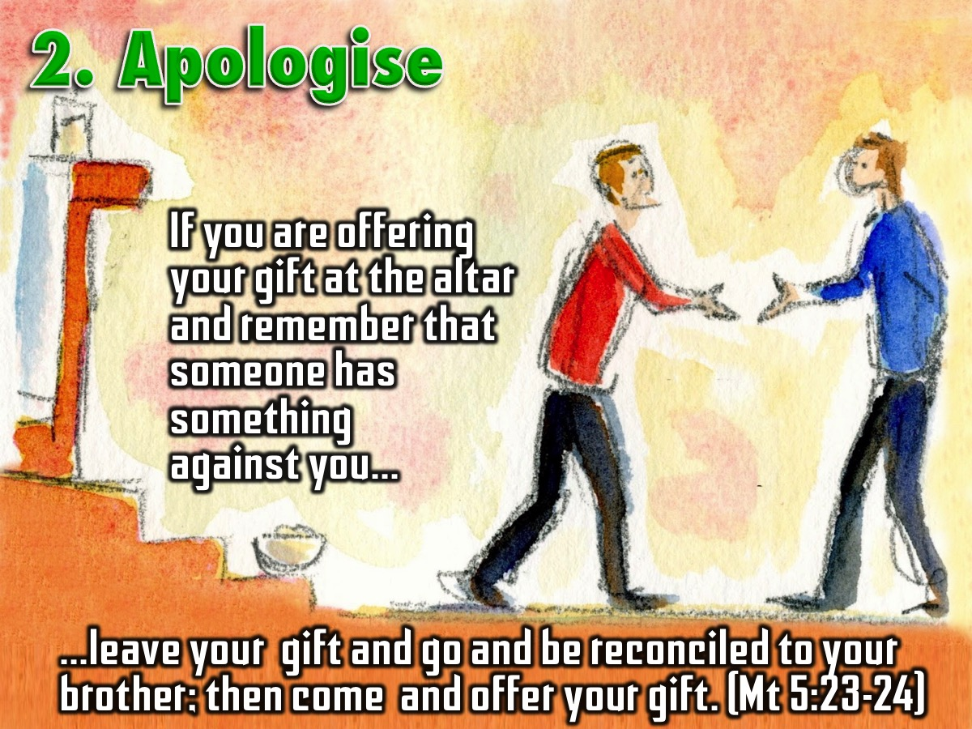
Notes:
2. Apologise – Say sorry when you have done wrong and ask people to forgive you. “If you are offering your gift at the altar and remember that someone has something against you, leave your gift and go and be reconciled to your brother; then come and offer your gift.” Matthew 5:23-24

Slide 35
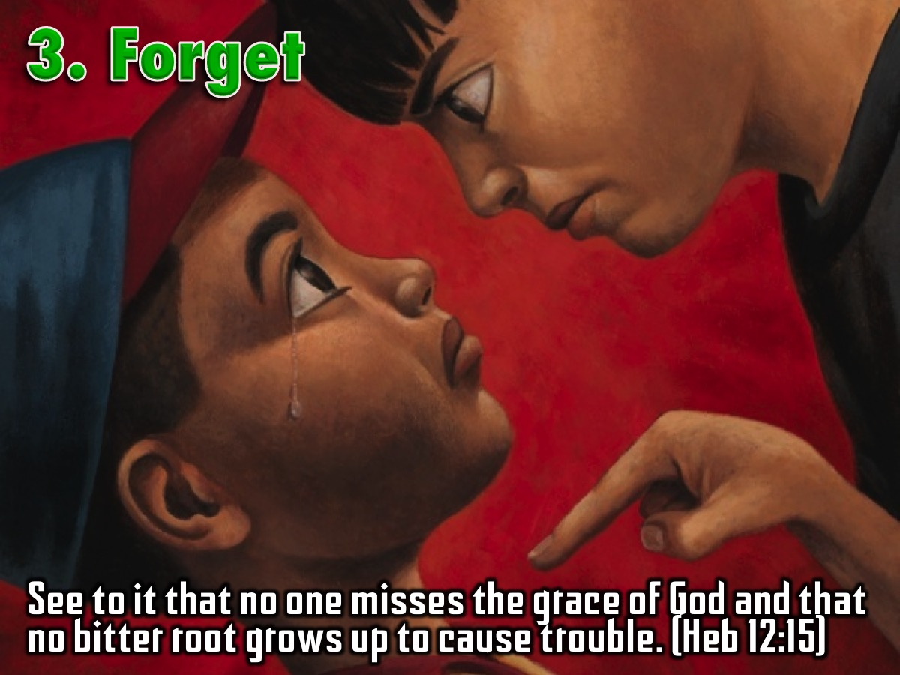
Notes:
3. Forget - Let Go of Bitterness, don’t hold grudges! “See to it that no one misses the grace of God and that no bitter root grows up to cause trouble.” (Hebrews 12:15)

Slide 36
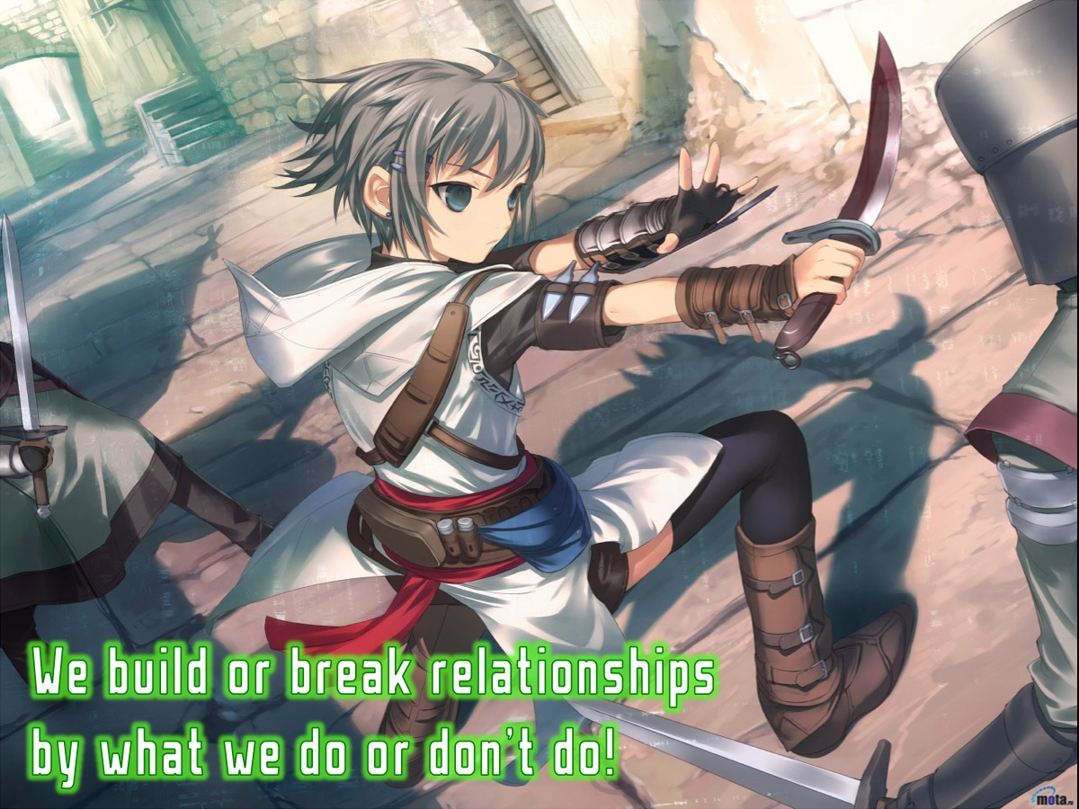
Notes:
Clearly we build or break relationships by what we do or don’t do!

Slide 37
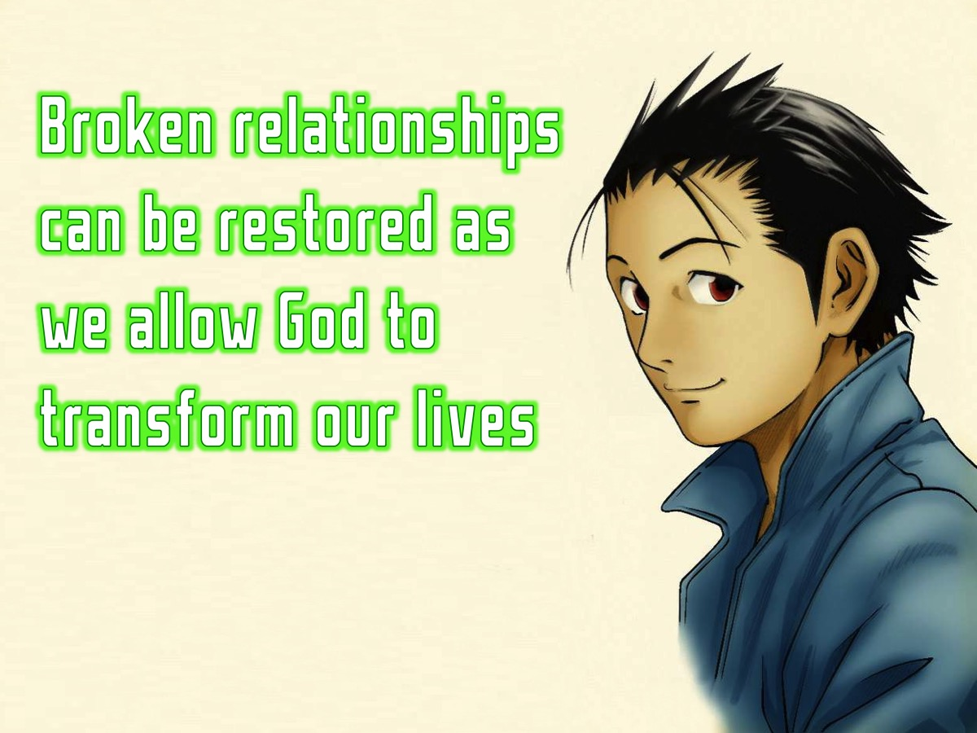
Notes:
Broken relationships can be restored as we allow God to transform our lives!

Slide 38
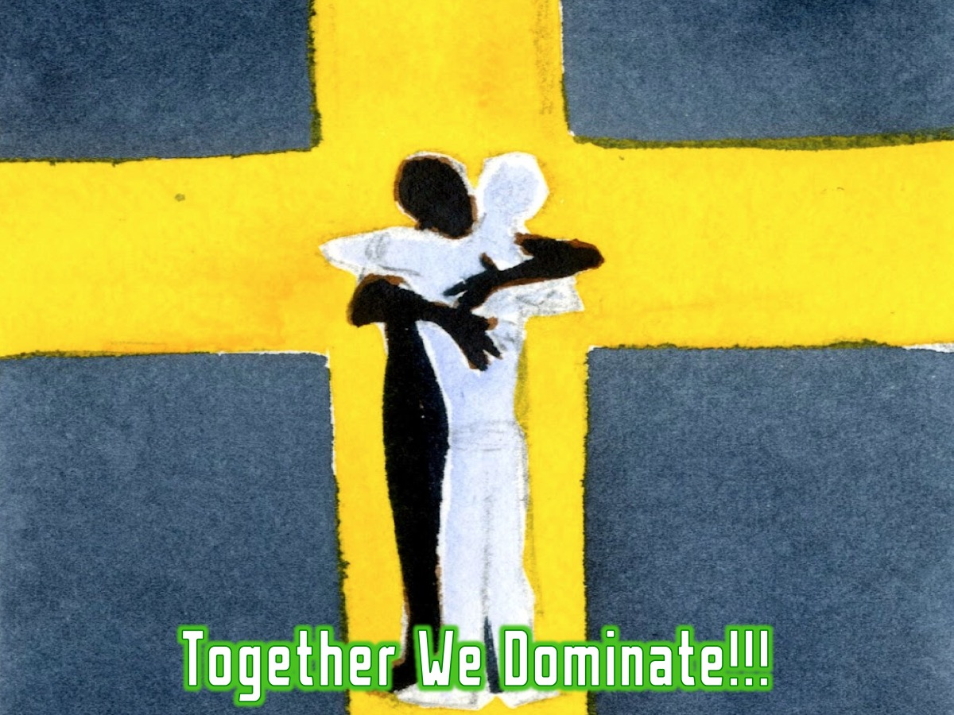
Notes:
Remember, together we dominate!

Slide 39

Notes:
Spend a few minutes completing the personal profile on relational issues.

Slide 40
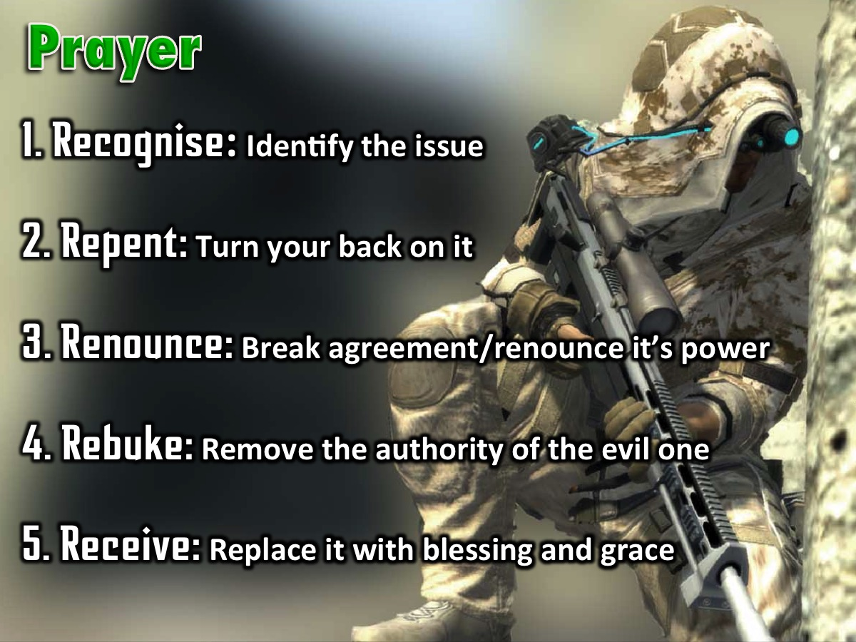
Notes:
Prayer! The Process of Deliverance. To experience freedom in the area of relational issues sins we are going to pray through the process of deliverance: (1) The first step to victory is to Recognise any issue that God has brought to your attention that you need to deal with. (2) The second step is Repent – where you commit to turn your back on the issue, choose to renew your mind and ask God to help you think differently about it. (3) The third step is to Renounce – which means to fall out of agreement with the issue and renounce its power over your life. If it is a curse you fall out of agreement with the curse and you renounce its power to operate in your life, you renounce its power to operate in your children’s life - when you have them one day - and the generations to come. If it is sin you have been involved in, you renounce the power of that sin. You close the door on the enemy - he does not have a hold on you anymore! The enemy no longer has authority to operate in your life in the area. (4) The fourth step is Rebuke – when we rebuke the evil one, any demonic spirit that is associated with the issue has to leave – there is no shouting - it just has to go because you have taken its authority away. (5) The fifth step is Receive – where you now ask God to replace what has been taken away with his blessing and grace. Where there was unforgiveness and bitterness you pray to receive God’s grace to forgive; where there was a curse you receive the Lord’s blessing to replace the curse – we speak and announce the blessings of God in areas of poverty for example.

Slide 41
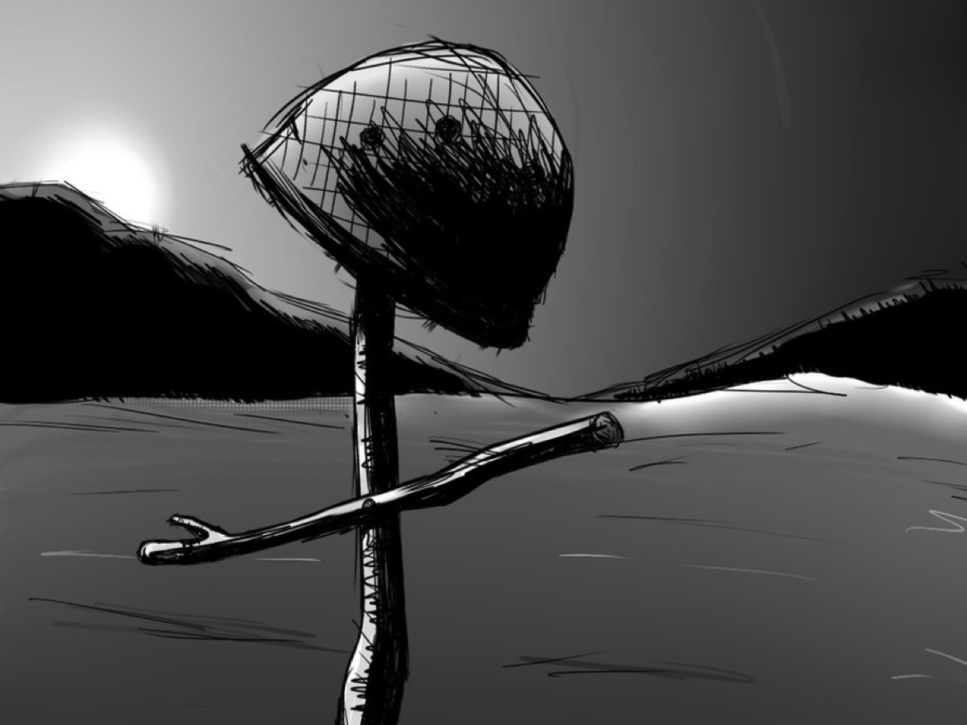
Notes:
As a sign that your relational issues have been dealt with you need to crumple up your personal profile and come and place them in the helmet on the stage and we will destroy them for you!

Slide 42

Notes:
In week 7 we will look at the third of five big issues in our lives: Spiritual Errors.

