Slide 1

Notes:
Welcome to Victory Sunday! This is week 7 and as usual we start with a video clip.

Slide 2
Notes:
Video: Tom Clancy's Rainbow Six Siege Official - Operator Gameplay Trailer. Get it on YouTube at: https://www.youtube.com/watch?v=lG9PuYxh_q0

Slide 3
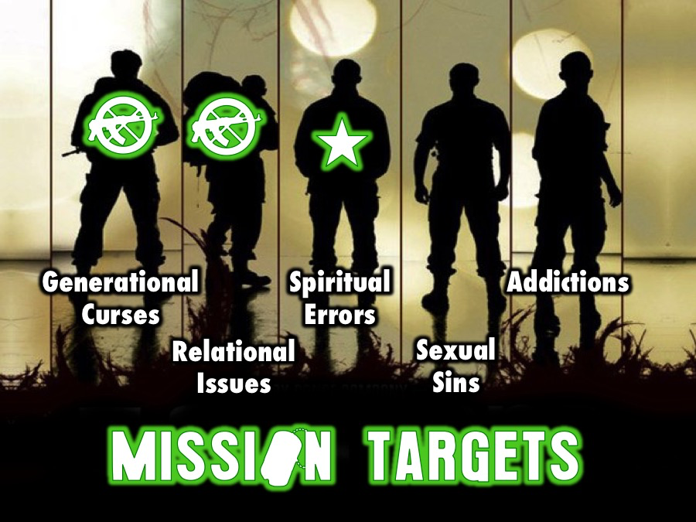
Notes:
Over five weeks we have the following targets to destroy: Generational Curses, Relational Issues, Spiritual Errors, Sexual Sins and Addictions.

Slide 4

Notes:
Last week we looked at the second of five big issues in our lives: Relational Issues.

Slide 5
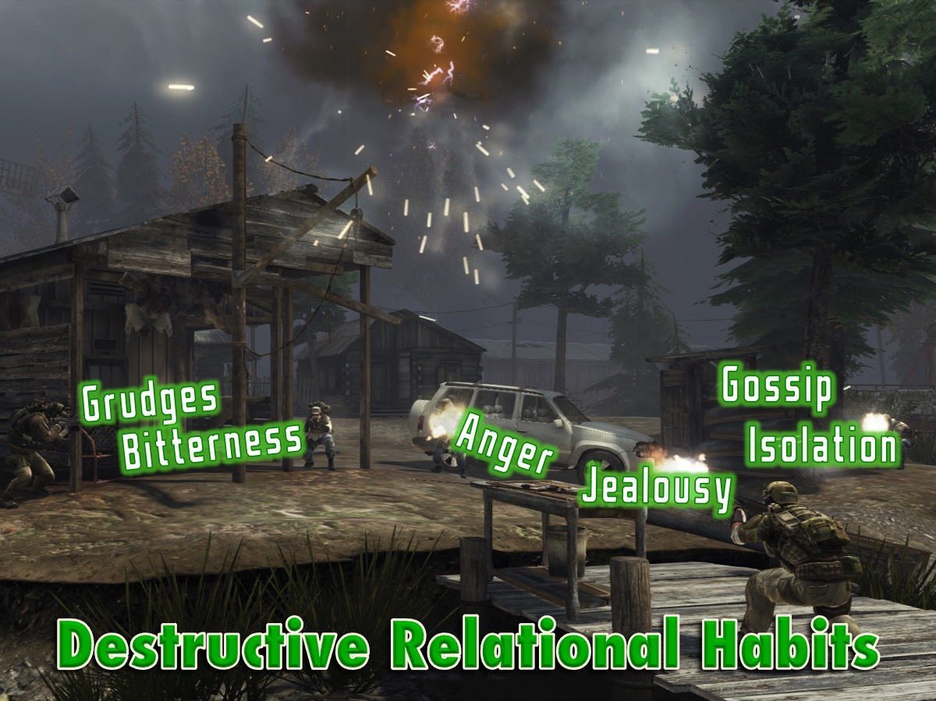
Notes:
We saw that there are at last six destructive relational habits: grudges, bitterness, anger, jealousy, gossip and isolation.

Slide 6
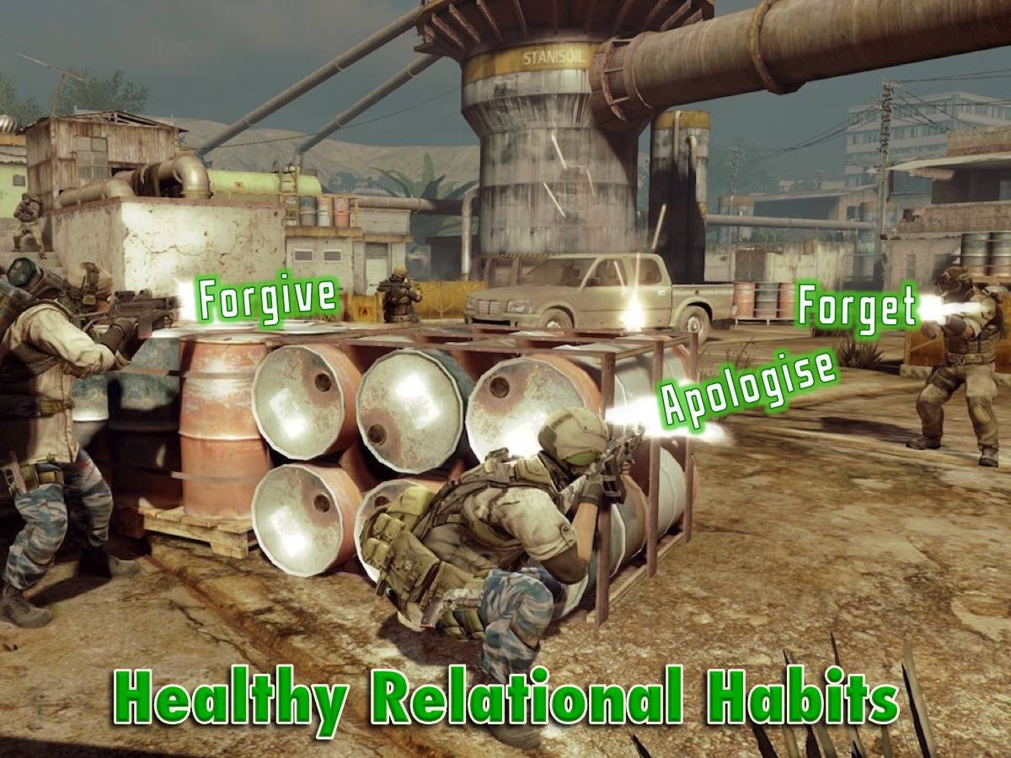
Notes:
But there are also healthy relational habits that we can practise, including forgive, apologise and forget.

Slide 7
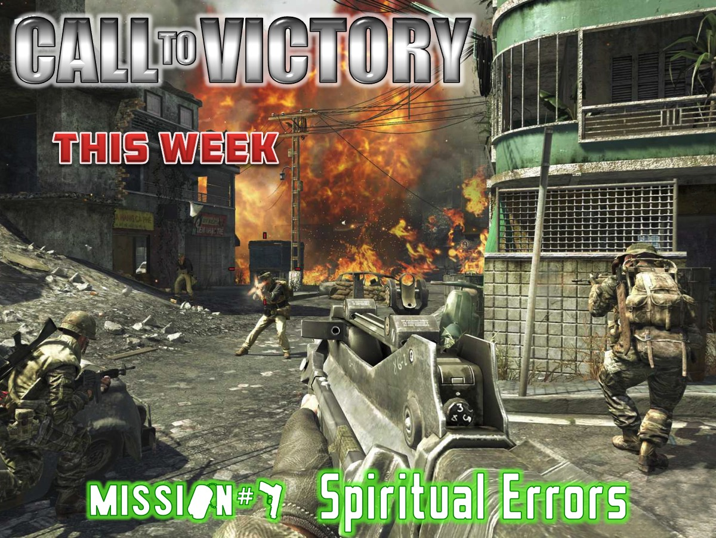
Notes:
This week we are going to look at the third of five big issues in our lives: Spiritual Errors.

Slide 8
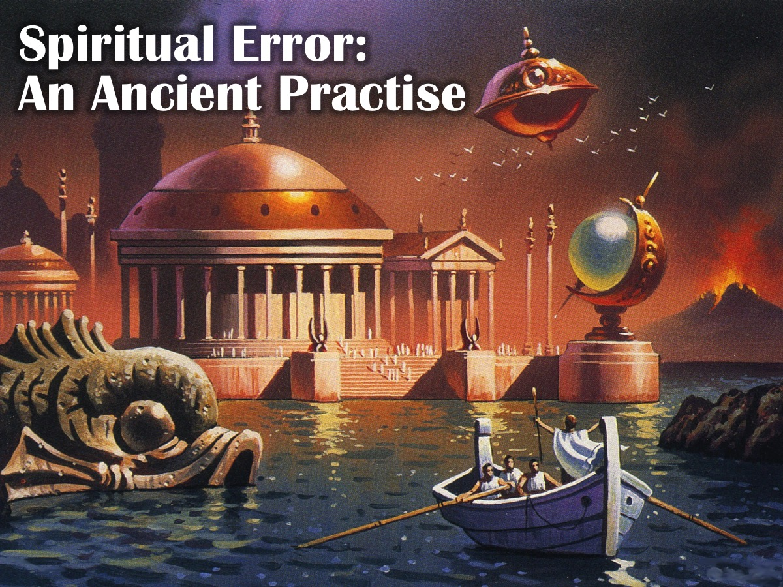
Notes:
Spiritual error is an ancient practise!

Slide 9
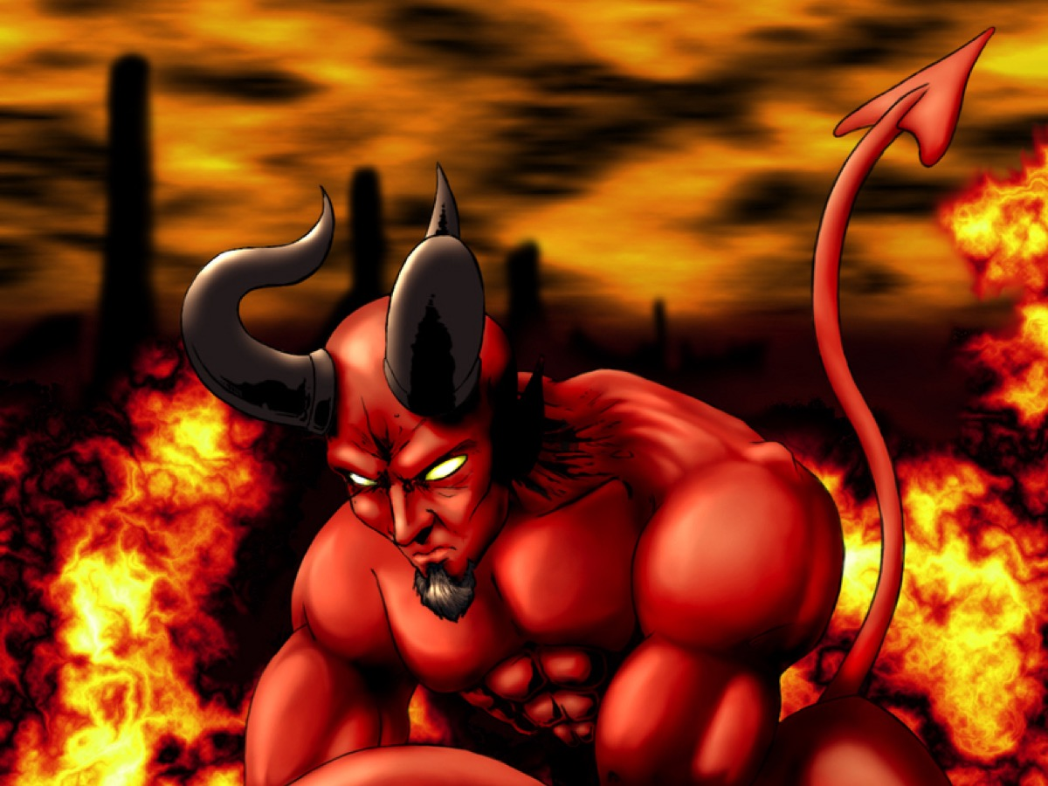
Notes:
Before the world began, this chap decided he wanted to be better than God and not his worship leader. This is like our youth pastor deciding that he wants to take over the church and he launces a coup! But Lucifer was defeated and kicked out of heaven and sent down to earth. Spiritual error!!!

Slide 10
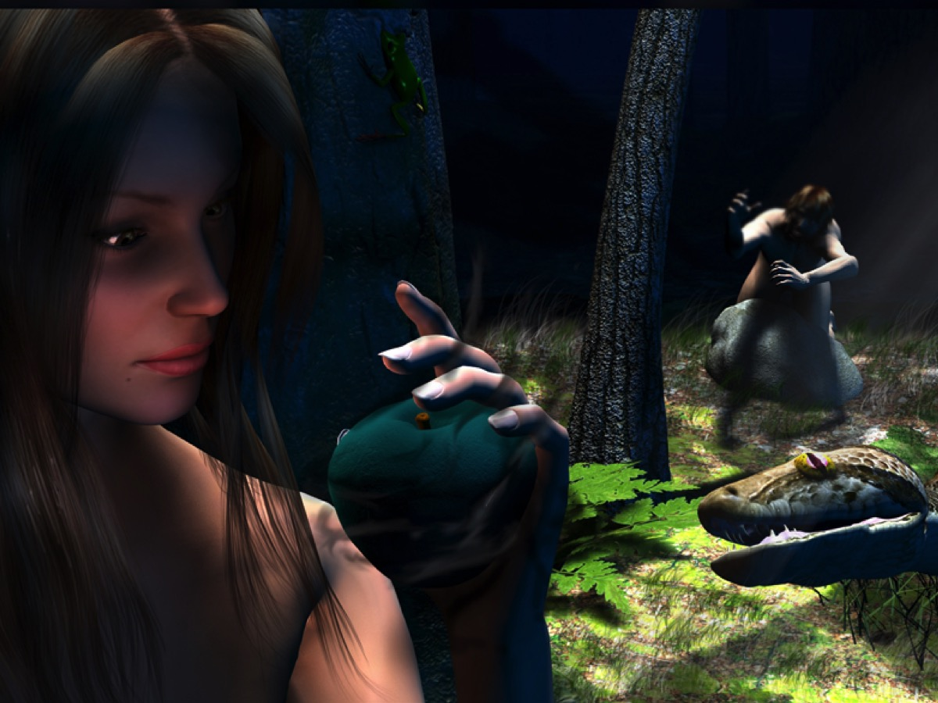
Notes:
On earth, we find Adam and Eve in paradise – the garden of Eden. There is a milkshake tree, free airtime tree, candyfloss tree. The Devil comes and says: “Did God really say you would die if you ate the fruit???” He messed with their minds and they conspired to sin against God! Spiritual error!!!

Slide 11
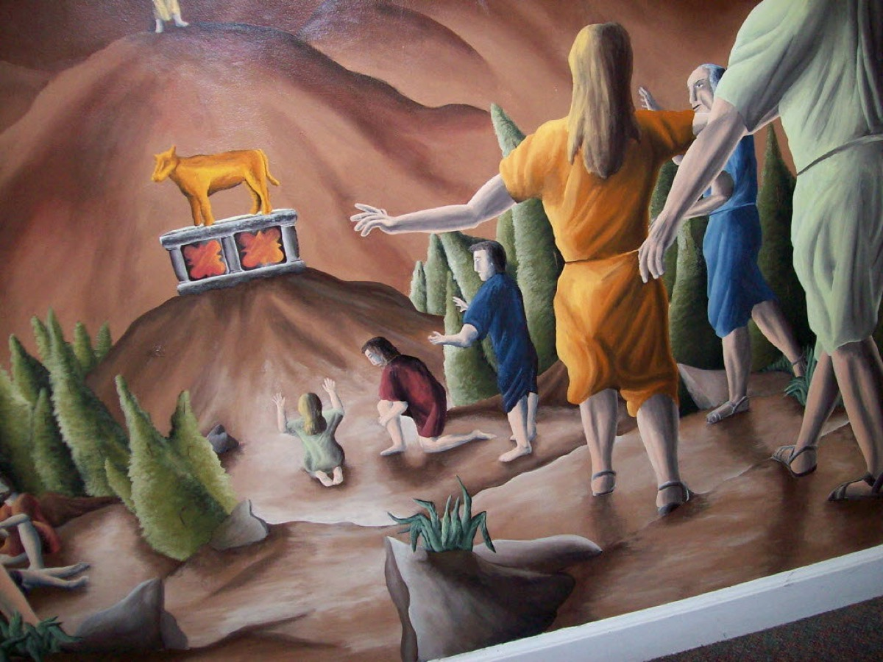
Notes:
Do you remember when Moses went to fetch the Ten Commanments, he returns and finds people are worship a calf and the people are thanking it for delivering them out of Egypt! Spiritual error!!!

Slide 12
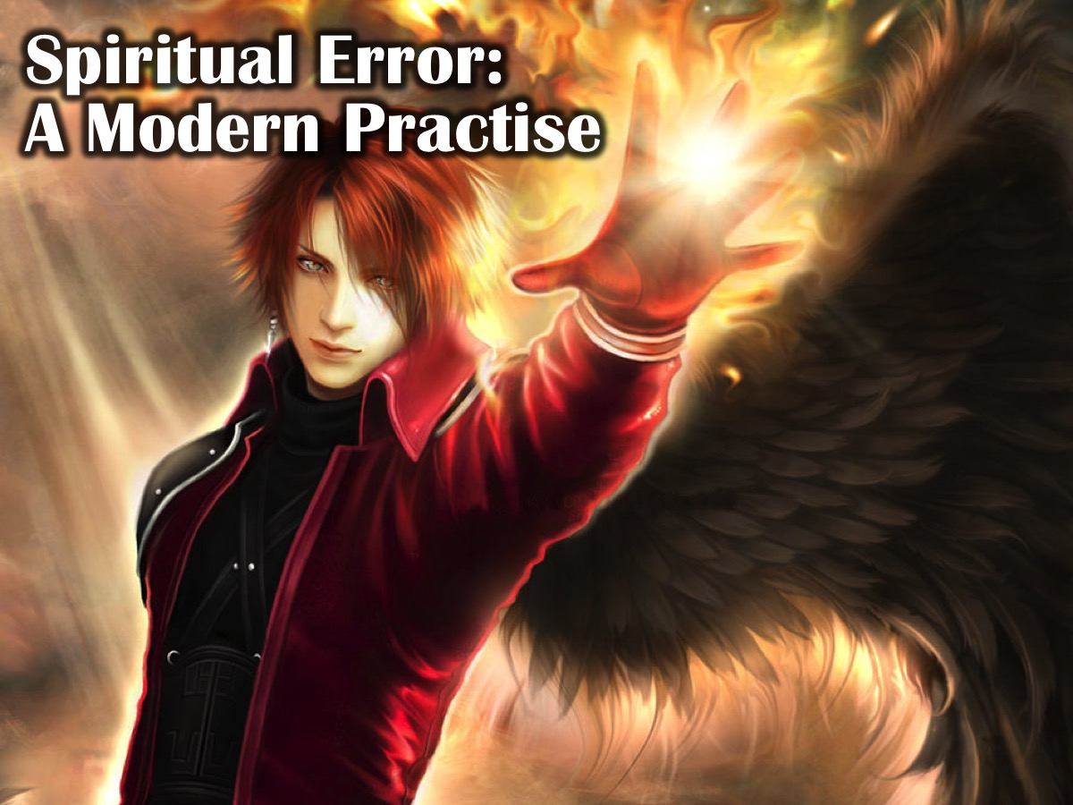
Notes:
Spiritual error is also a modern practise.

Slide 13

Notes:
How many of you watched the movie 2012 – about how the world was supposed to end in that year?

Slide 14
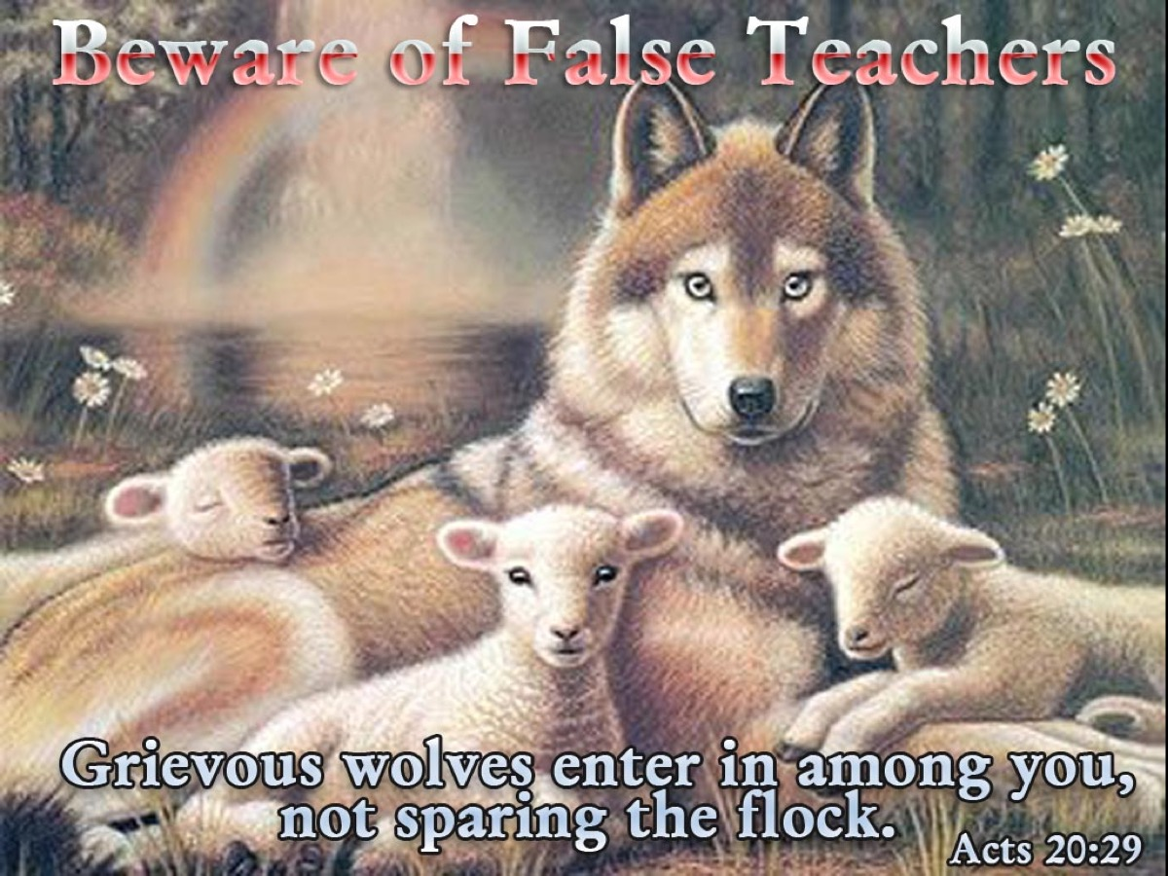
Notes:
There are true and false prophets in the world today! Acts 20:29 says: Beware of false teachers: grievous wolves enter in among you, not sparing the flock.

Slide 15
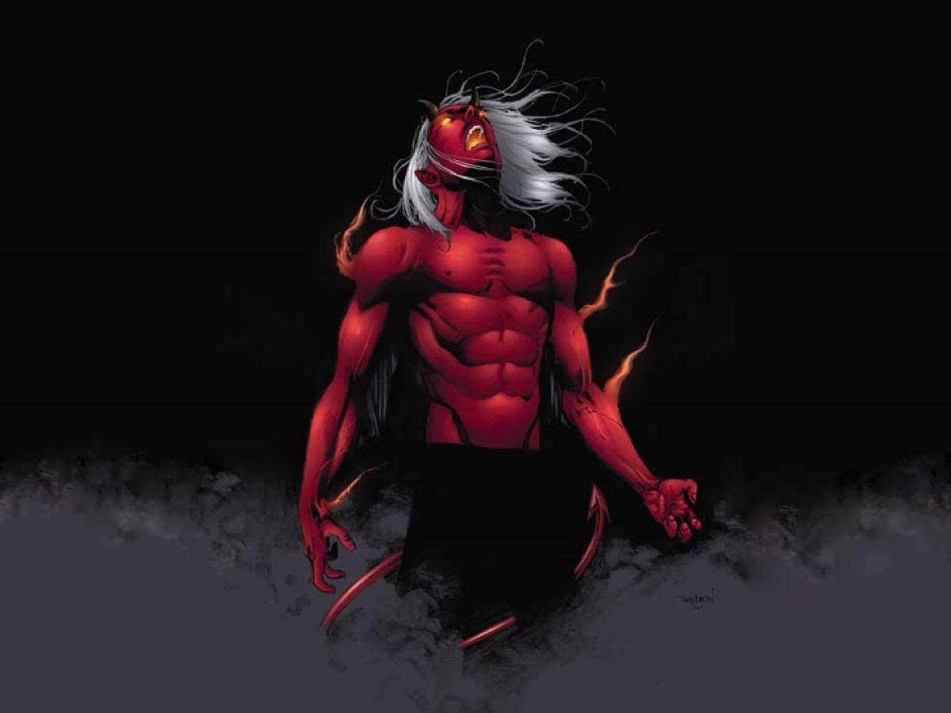
Notes:
Today many people actually openly worship the devil! Spiritual error!!!

Slide 16
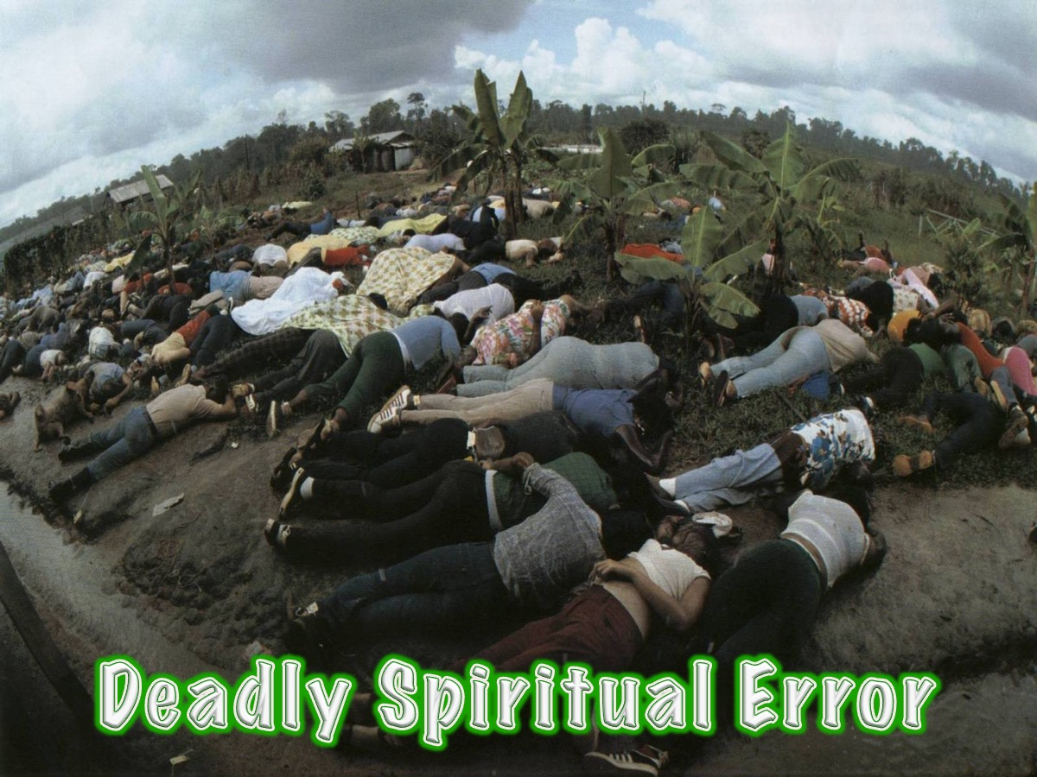
Notes:
Spiritual error can be deadly! Some year ago a church leader, Jones Jones, had his followers commit suicide so they could go to heaven with him!

Slide 17
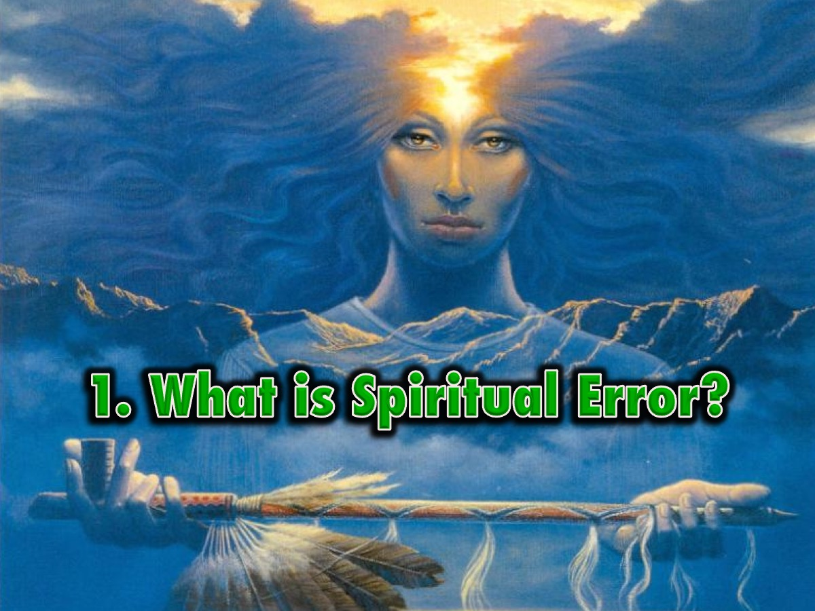
Notes:
1. What is Spiritual Error?

Slide 18
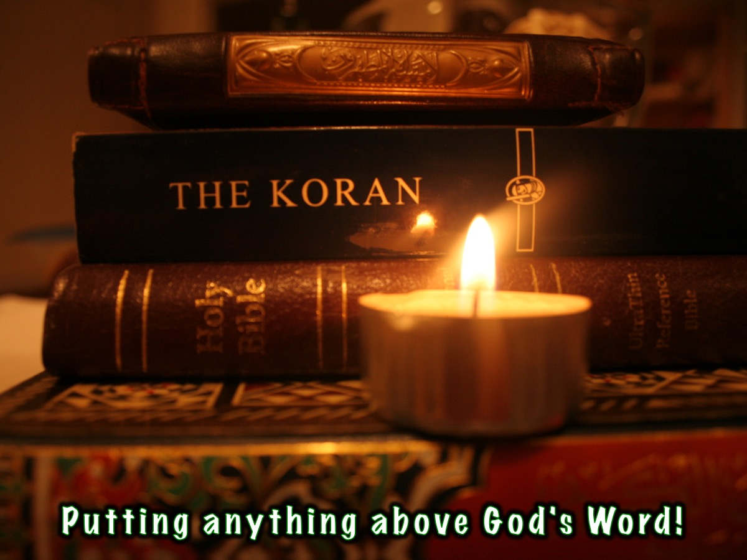
Notes:
Spiritual error is putting anything about God’s Word!

Slide 19
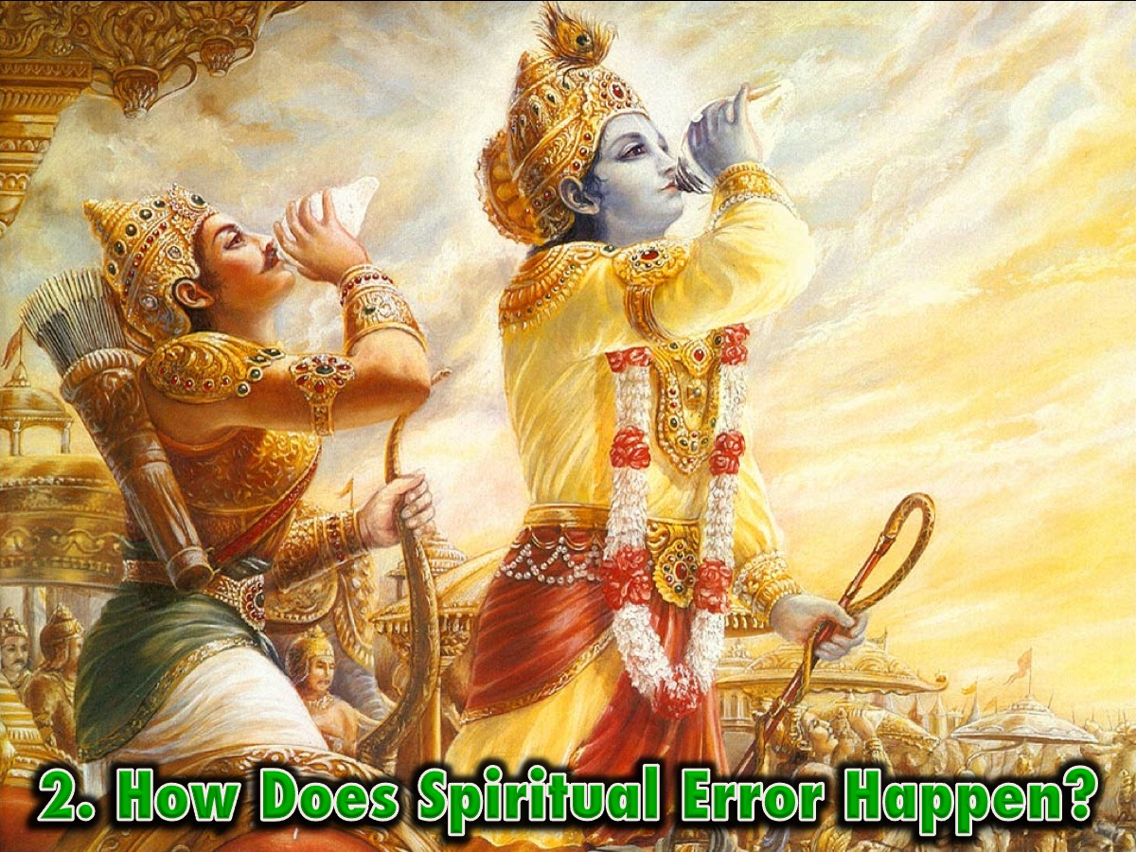
Notes:
2. How Does Spiritual Error Happen?

Slide 20
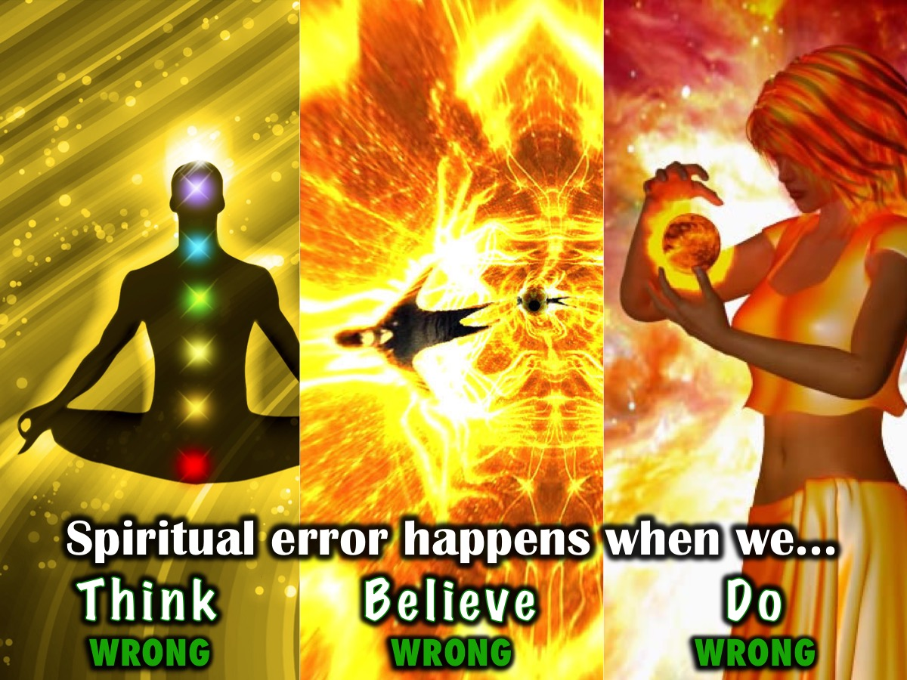
Notes:
Spiritual error happens when we Think, Believe and then Do wrong!

Slide 21

Notes:
A. Think Wrong – Another Idea over God’s Word

Slide 22
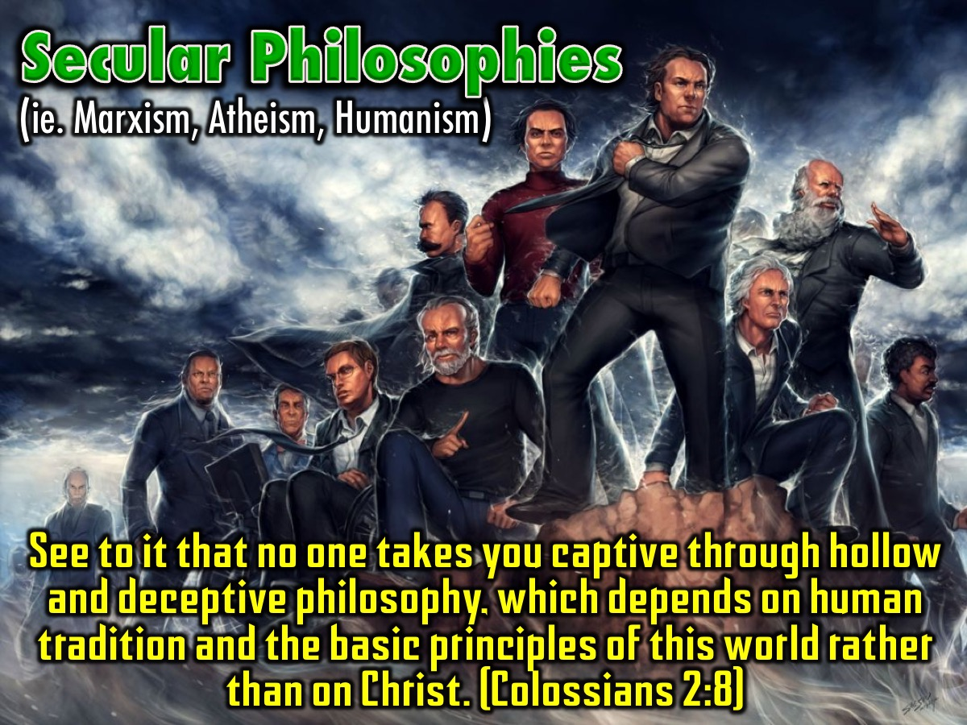
Notes:
Secular Philosophies - (ie. Marxism, Atheism, Humanism). See to it that no one takes you captive through hollow and deceptive philosophy, which depends on human tradition and the basic principles of this world rather than on Christ. (Colossians 2:8)

Slide 23
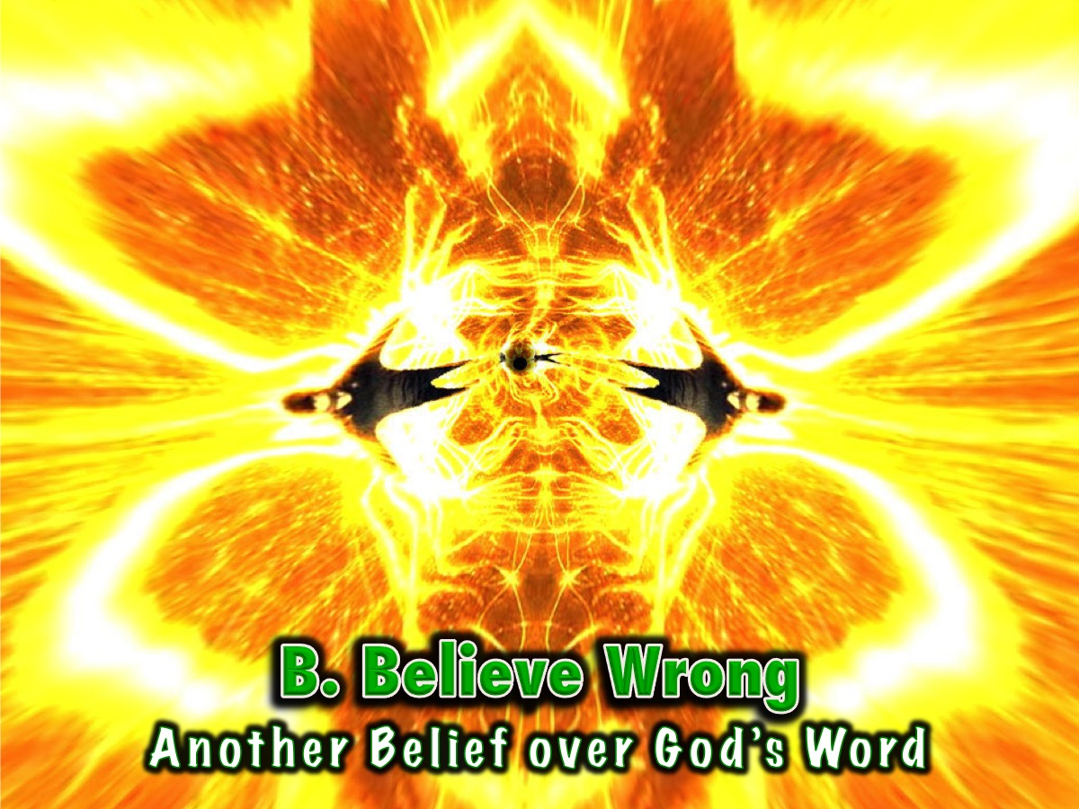
Notes:
B. Believe Wrong – Another Belief over God’s Word

Slide 24
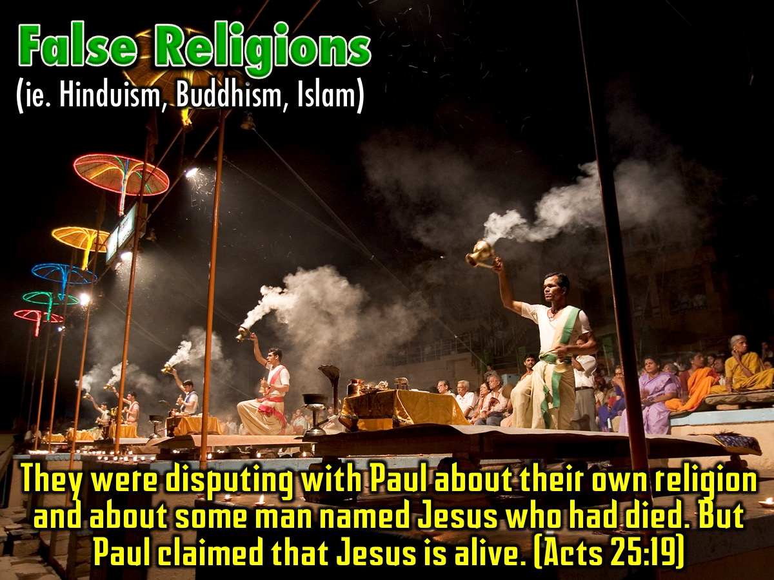
Notes:
False Religions - (ie. Hinduism, Buddhism, Islam). They were disputing with Paul about their own religion and about some man named Jesus who had died. But Paul claimed that Jesus is alive. (Acts 25:19)

Slide 25
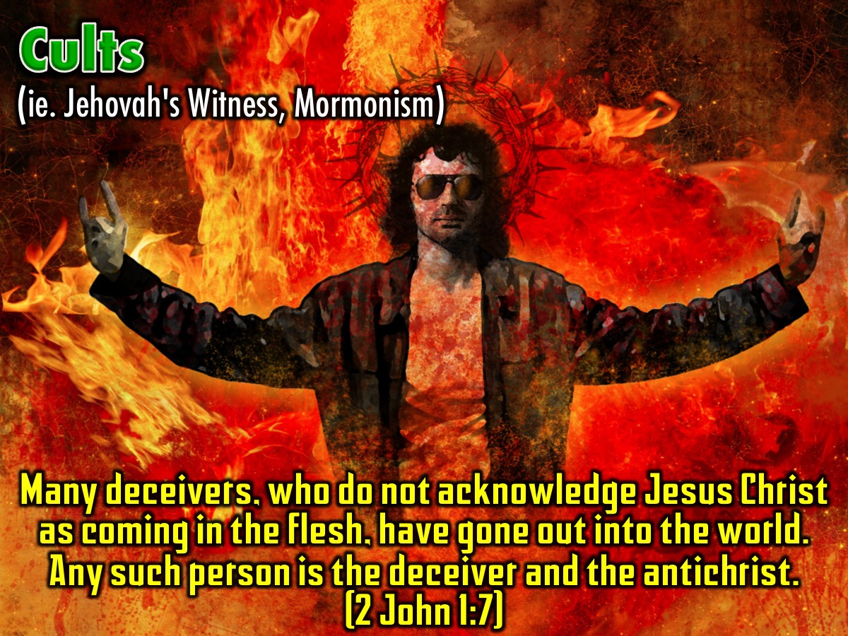
Notes:
Cults - (ie. Jehovah's Witness, Mormonism). Many deceivers, who do not acknowledge Jesus Christ as coming in the flesh, have gone out into the world. Any such person is the deceiver and the antichrist. (2 John 1:7)

Slide 26
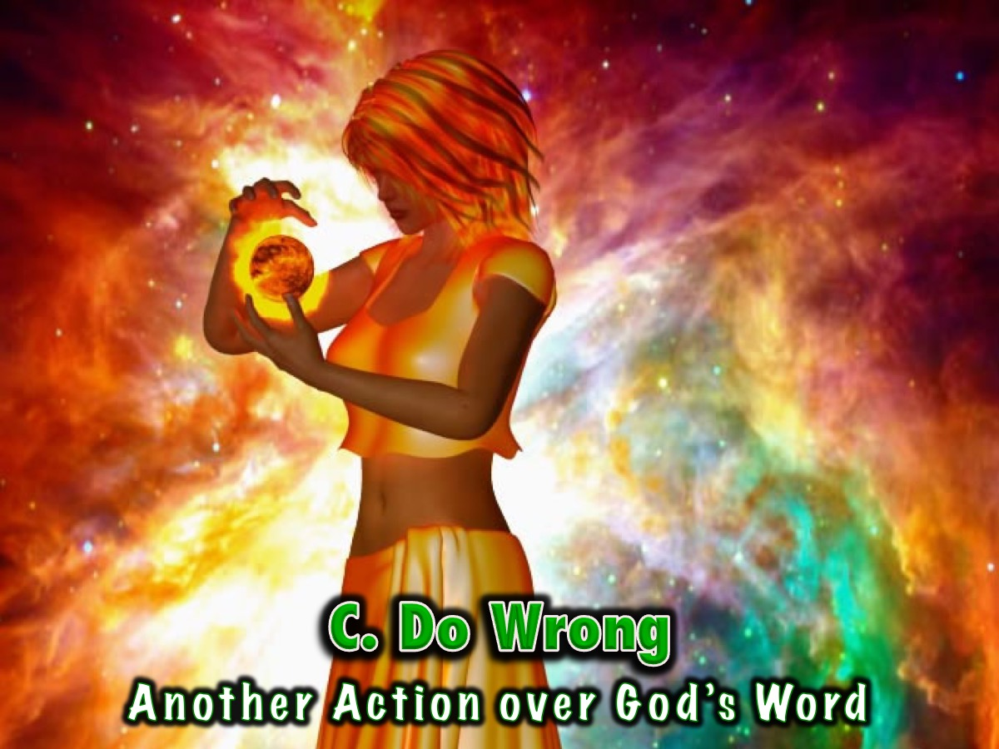
Notes:
C. Do Wrong – Another Action over God’s Word

Slide 27
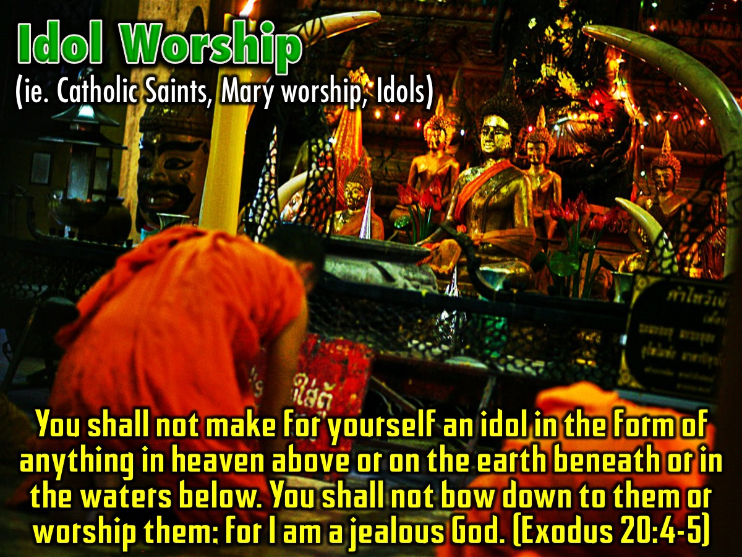
Notes:
Idol Worship - (ie. Catholic saints, Mary worship, idols). You shall not make for yourself an idol in the form of anything in heaven above or on the earth beneath or in the waters below. You shall not bow down to them or worship them; for I am a jealous God. (Exodus 20:4-5)

Slide 28
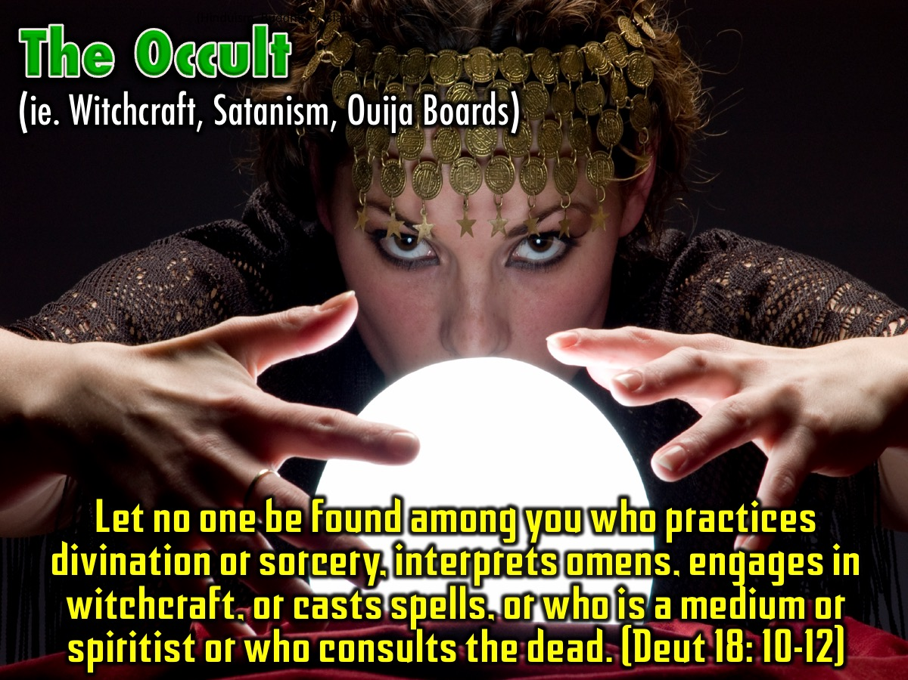
Notes:
The Occult - (ie. Witchcraft, Satanism, Ouija boards). Let no one be found among you who practices divination or sorcery, interprets omens, engages in witchcraft, or casts spells, or who is a medium or spiritist or who consults the dead. (Deuteronomy 18: 10-12)

Slide 29
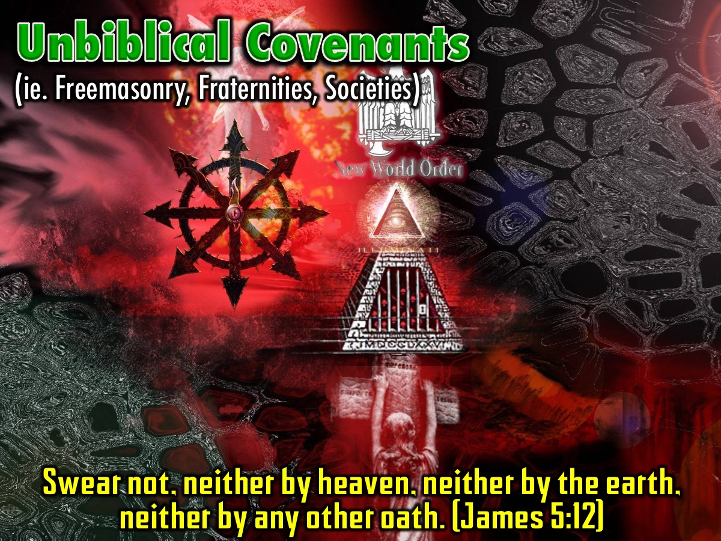
Notes:
Unbiblical Covenants - (ie. Freemasonry, fraternities, societies). Swear not, neither by heaven, neither by the earth, neither by any other oath. (James 5:12).

Slide 30
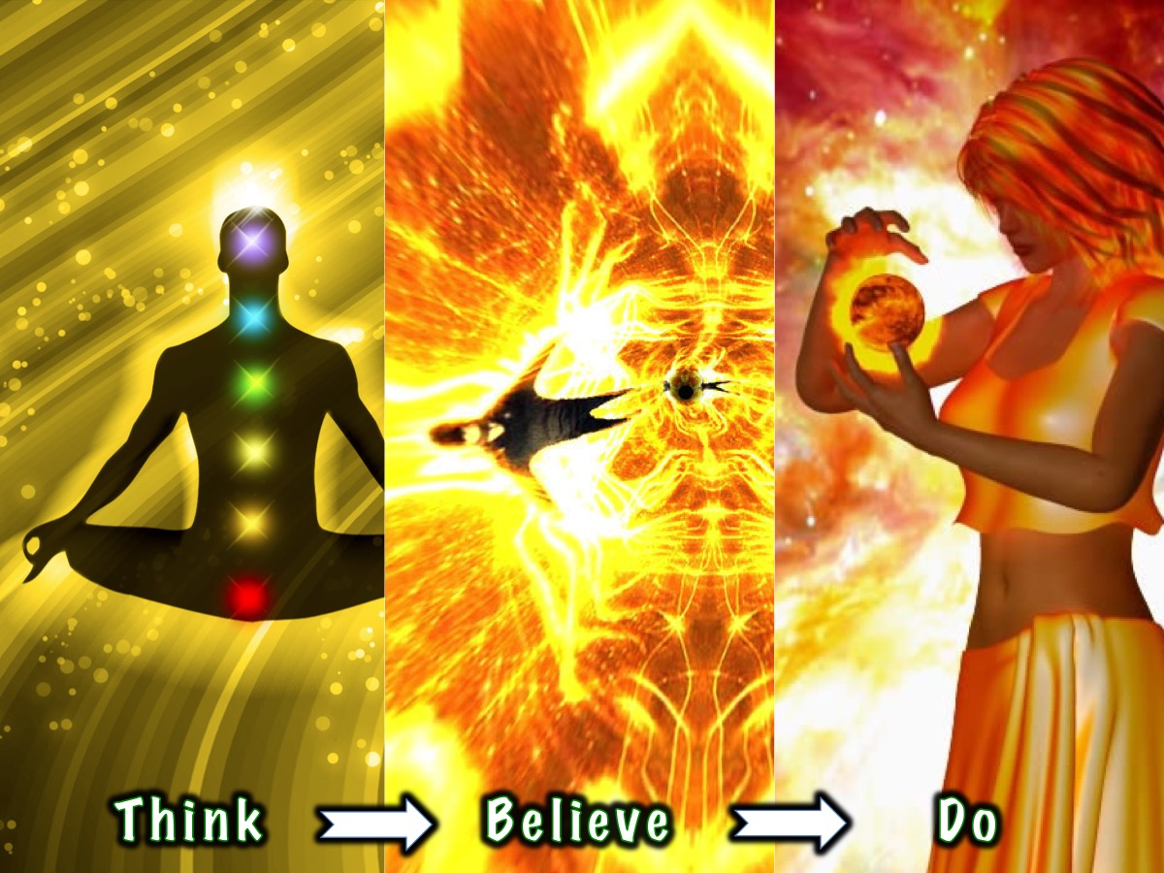
Notes:
Remember, spiritual error is a process where we Think, Believe and then Do wrong!

Slide 31
Notes:
Video: Idol Worship by the Skit Guys – download from YouTube: http://www.youtube.com/watch?v=QPil9Br-5lE

Slide 32

Notes:
Spend a few minutes completing the personal profile on Spiritual Errors.

Slide 33
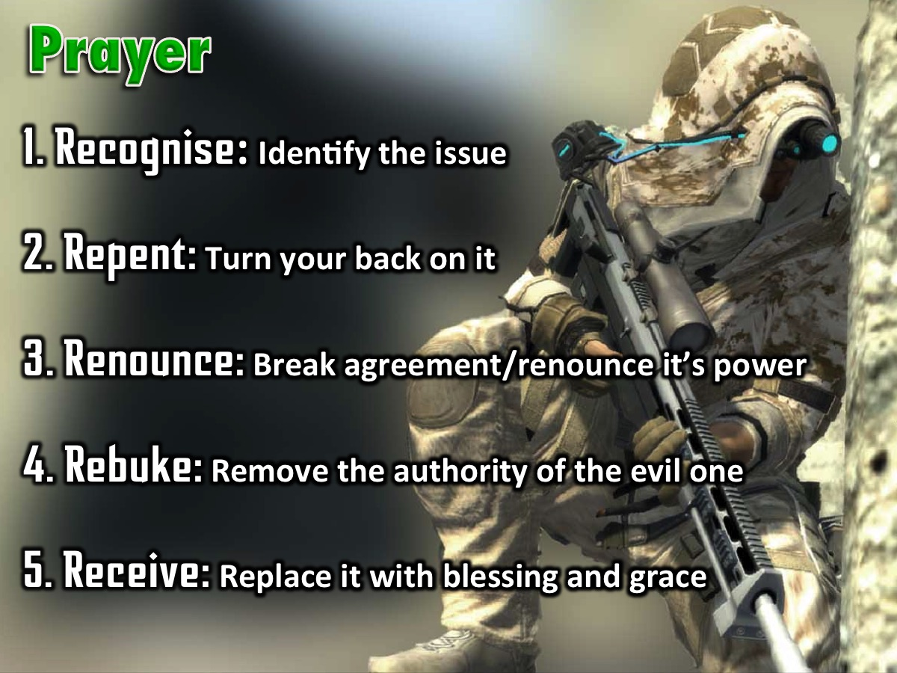
Notes:
Prayer! The Process of Deliverance. To experience freedom in the area of spiritual errors we are going to pray through the process of deliverance: (1) The first step to victory is to Recognise any issue that God has brought to your attention that you need to deal with. (2) The second step is Repent – where you commit to turn your back on the issue, choose to renew your mind and ask God to help you think differently about it. (3) The third step is to Renounce – which means to fall out of agreement with the issue and renounce its power over your life. If it is a curse you fall out of agreement with the curse and you renounce its power to operate in your life, you renounce its power to operate in your children’s life - when you have them one day - and the generations to come. If it is sin you have been involved in, you renounce the power of that sin. You close the door on the enemy - he does not have a hold on you anymore! The enemy no longer has authority to operate in your life in the area. (4) The fourth step is Rebuke – when we rebuke the evil one, any demonic spirit that is associated with the issue has to leave – there is no shouting - it just has to go because you have taken its authority away. (5) The fifth step is Receive – where you now ask God to replace what has been taken away with his blessing and grace. Where there was unforgiveness and bitterness you pray to receive God’s grace to forgive; where there was a curse you receive the Lord’s blessing to replace the curse – we speak and announce the blessings of God in areas of poverty for example.

Slide 34
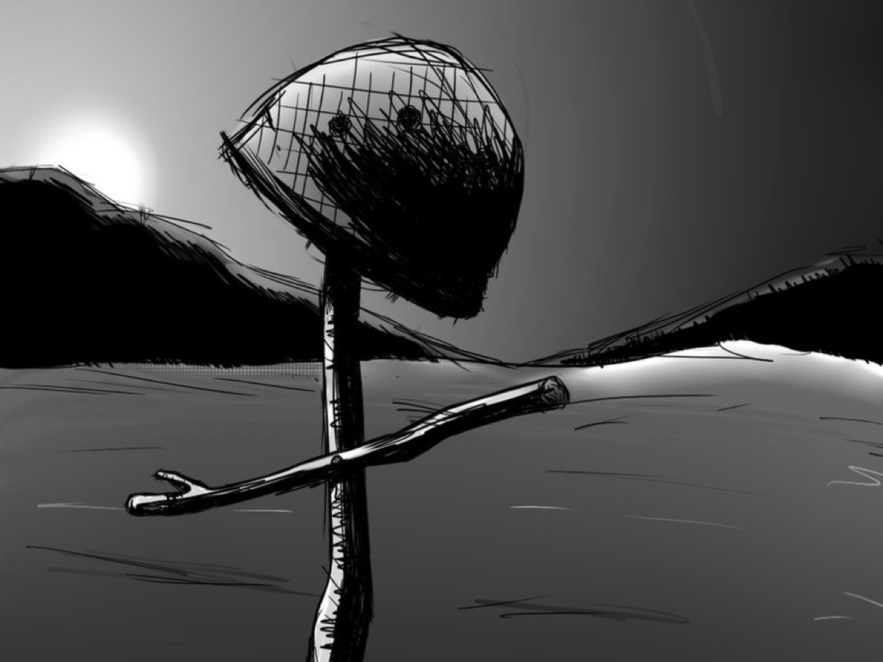
Notes:
As a sign that you have been set free from spiritual errors you need to crumple up your personal profile and come and place them in the helmet on the stage and we will destroy them for you!

Slide 35
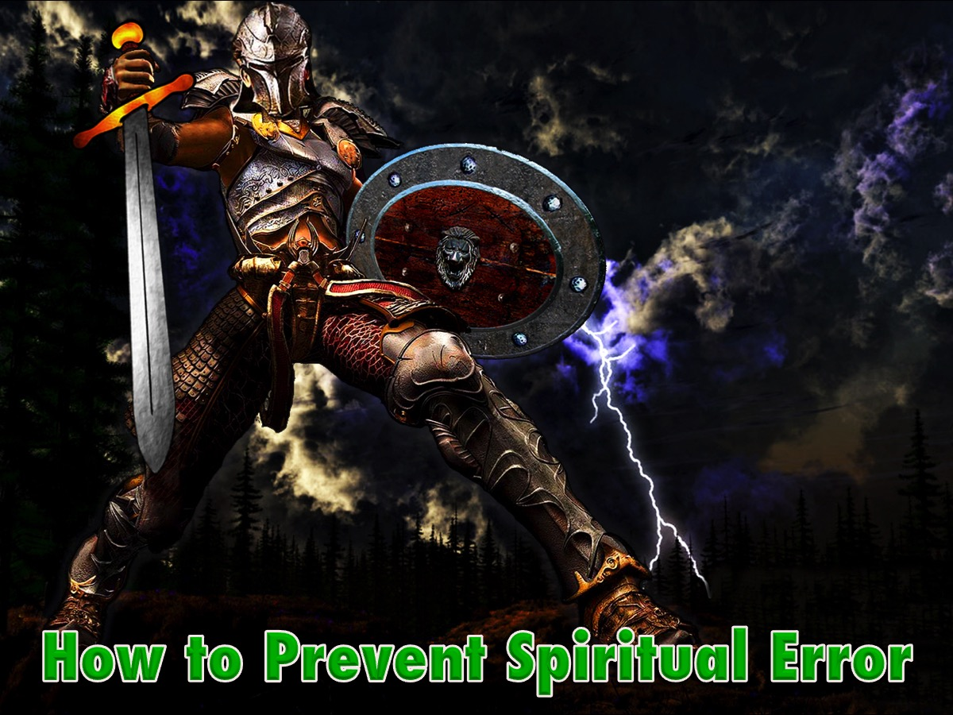
Notes:
How to Prevent Spiritual Error. Here are some things you can do to protect yourself from falling victim to spiritual error in the future:

Slide 36
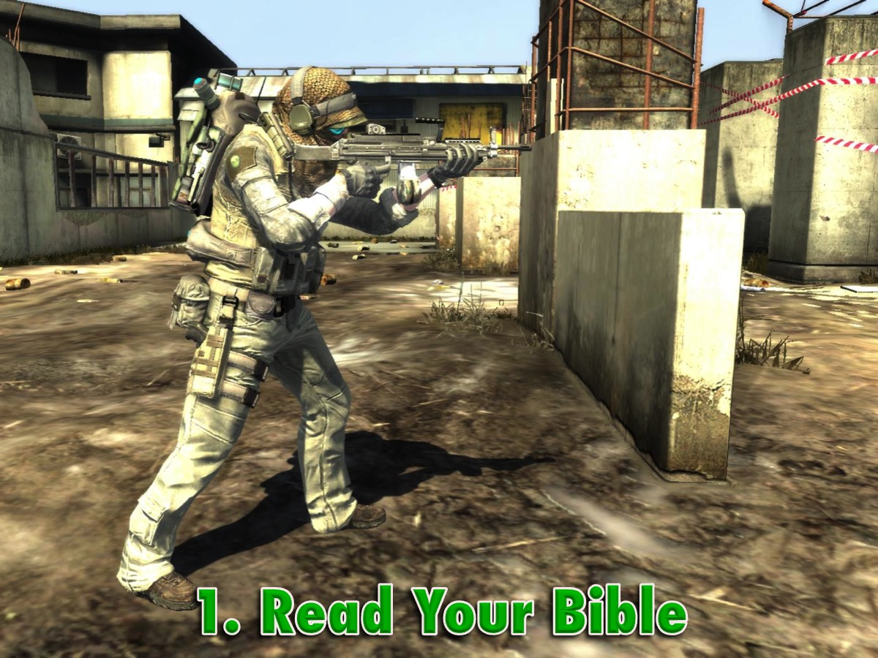
Notes:
1. Read Your Bible

Slide 37
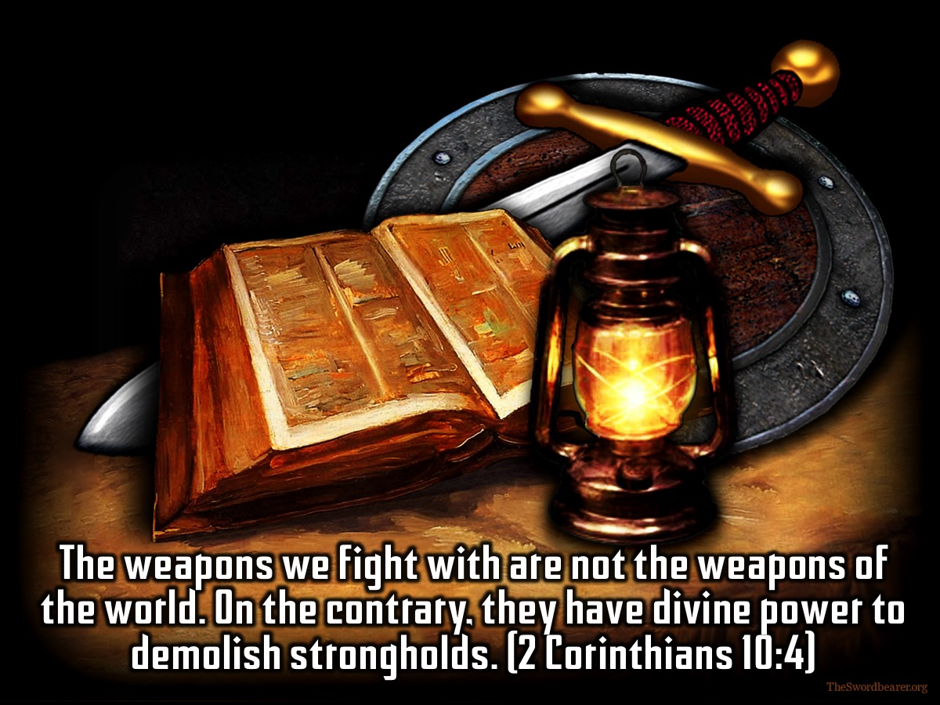
Notes:
Every Scripture passage is inspired by God. All of them are useful for teaching, pointing out errors, correcting people, and training them for a life that has God's approval. They equip God's servants so that they are completely prepared to do good things. (2 Timothy 3:16-17)

Slide 38
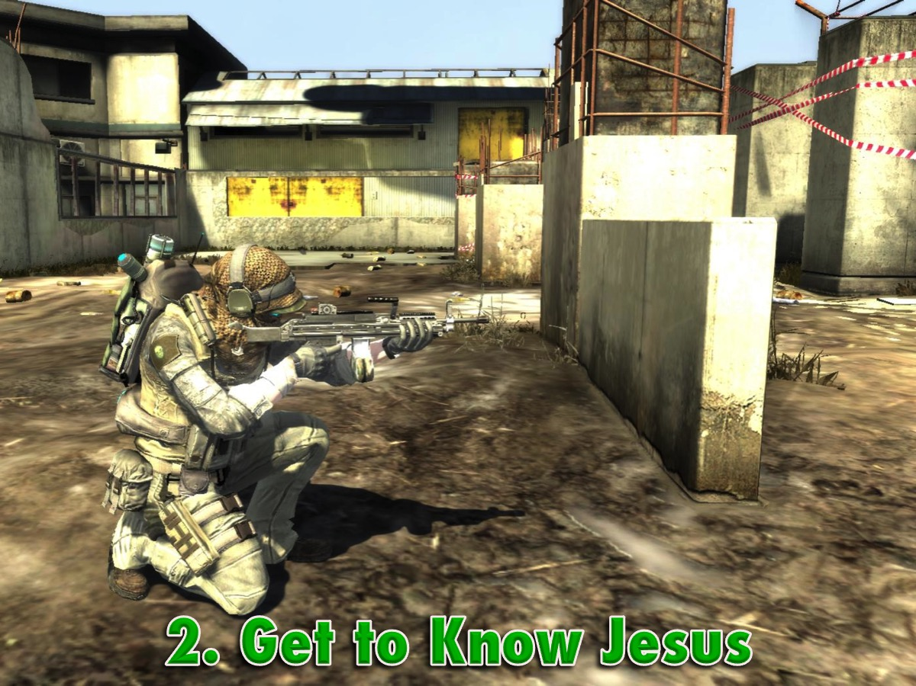
Notes:
2. Get to Know Jesus

Slide 39

Notes:
I am the way, the truth and the life. No one comes to the father except through me. (John 14:6)

Slide 40
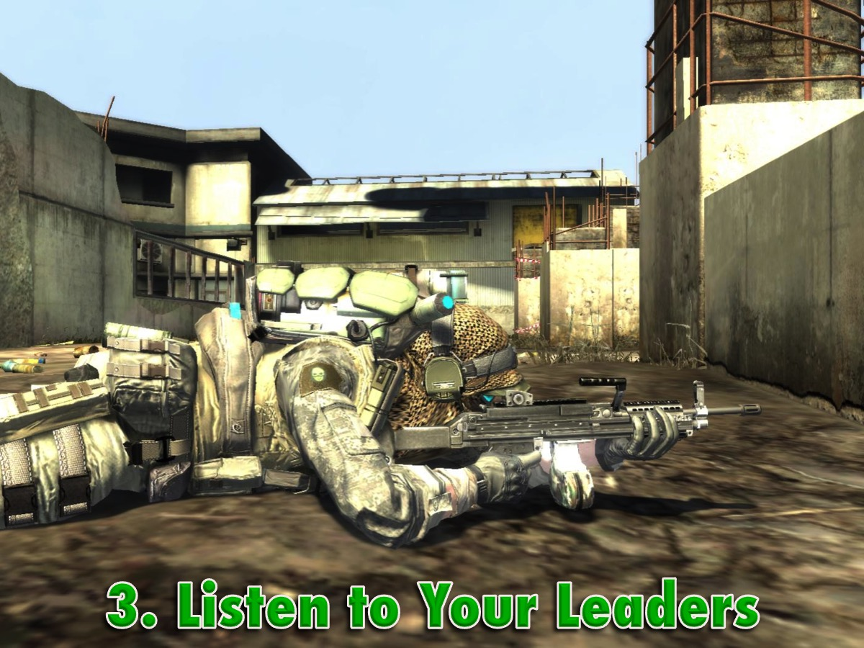
Notes:
3. Listen to Your Leaders

Slide 41
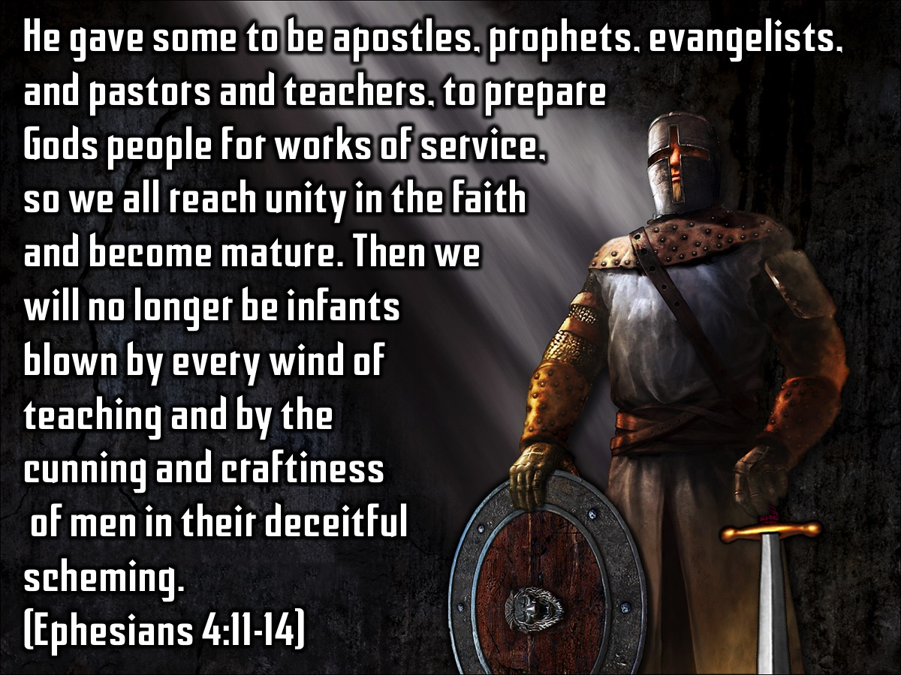
Notes:
He gave some to be apostles, prophets, evangelists, and pastors and teachers, to prepare Gods people for works of service, so we all reach unity in the faith and become mature. Then we will no longer be infants blown by every wind of teaching and by the cunning and craftiness of men in their deceitful scheming. (Ephesians 4:11-14)

Slide 42
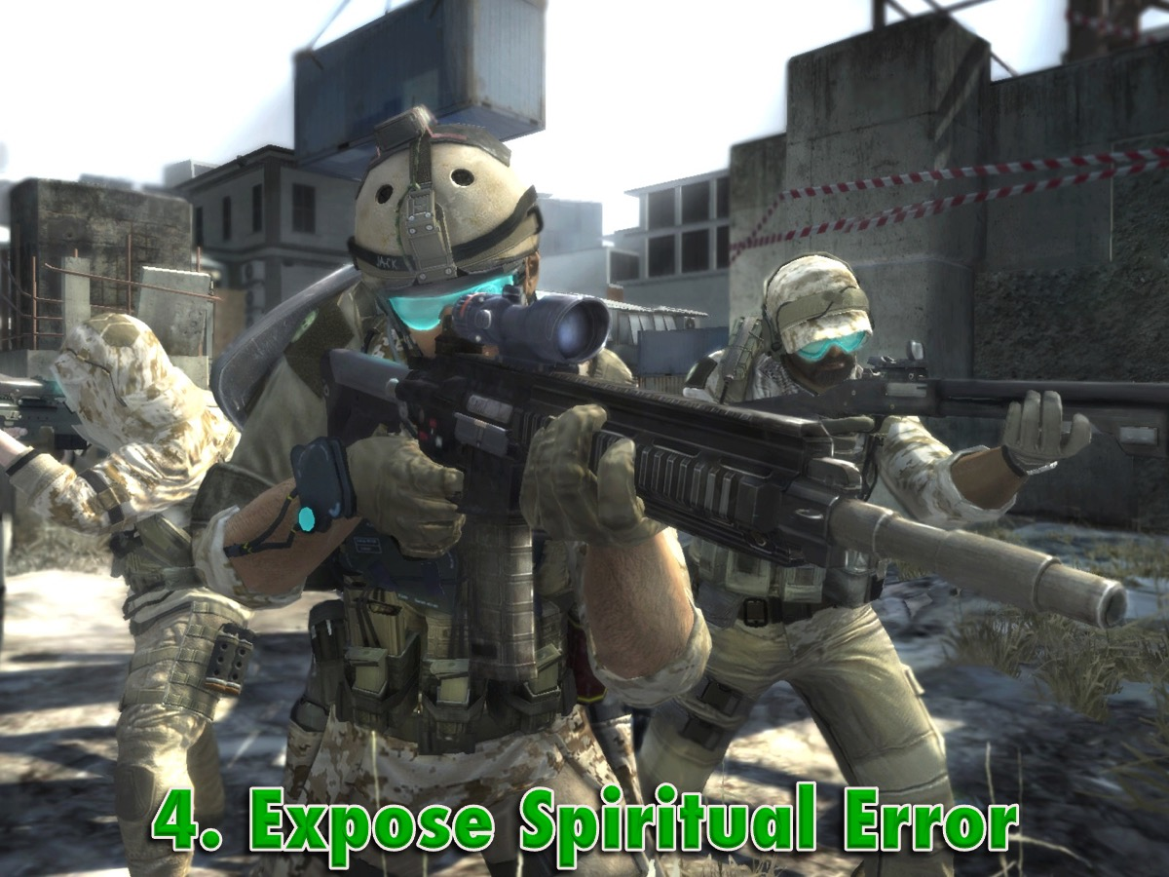
Notes:
4. Expose Spiritual Error

Slide 43
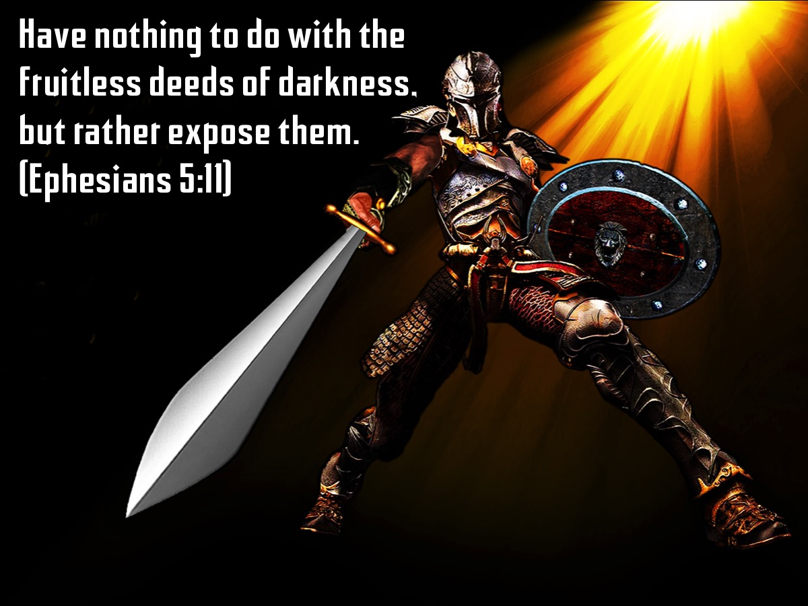
Notes:
Have nothing to do with the fruitless deeds of darkness, but rather expose them. (Ephesians 5:11)

Slide 44

Notes:
5. Live by a New Standard

Slide 45
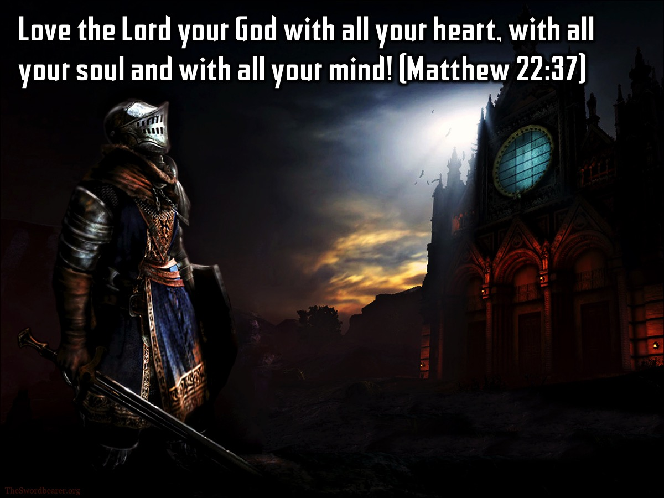
Notes:
Love the Lord your God with all your heart, with all your soul and with all your mind! (Matthew 22:37)

Slide 46
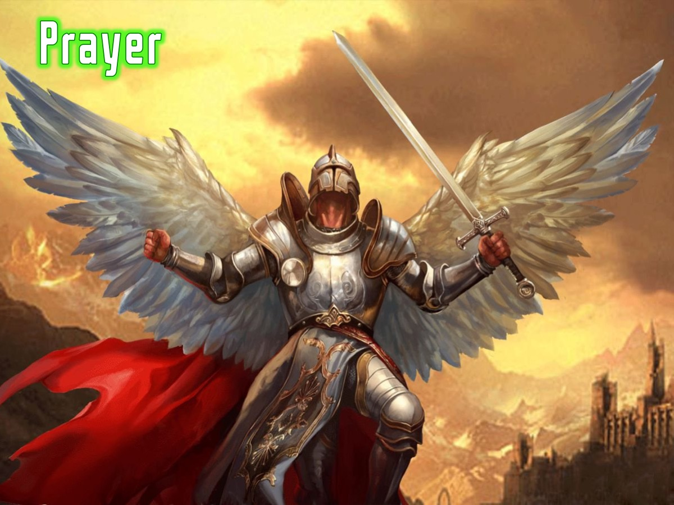
Notes:
Prayer

Slide 47

Notes:
Next week we will be looking at the fourth big issues in our lives: Sexual Sins.

