Slide 1

Notes:
Welcome to Victory Sunday! As usual we kick off with a video clip.

Slide 2
Notes:
Video: Battlefield Capture the Flag. Get it on YouTube at: http://www.youtube.com/watch?v=wK5f7az5dIY

Slide 3
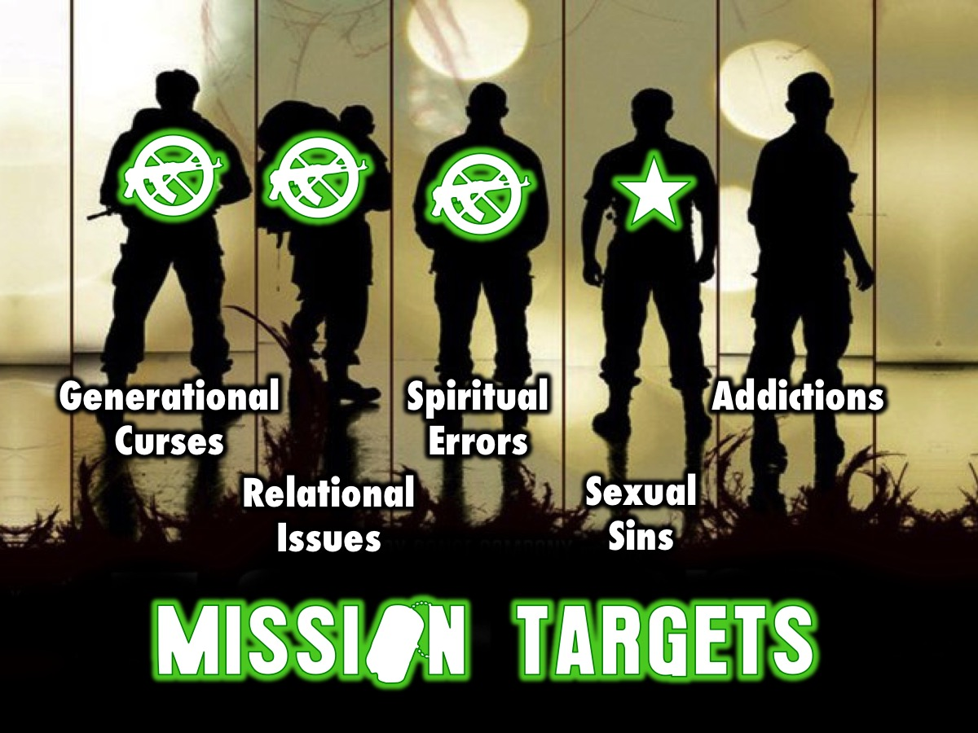
Notes:
Over five weeks we have the following targets to destroy: Generational Curses, Relational Issues, Spiritual Errors, Sexual Sins and Addictions.

Slide 4

Notes:
Last week we looked at the fourth of five big issues in our lives: Spiritual Errors.

Slide 5
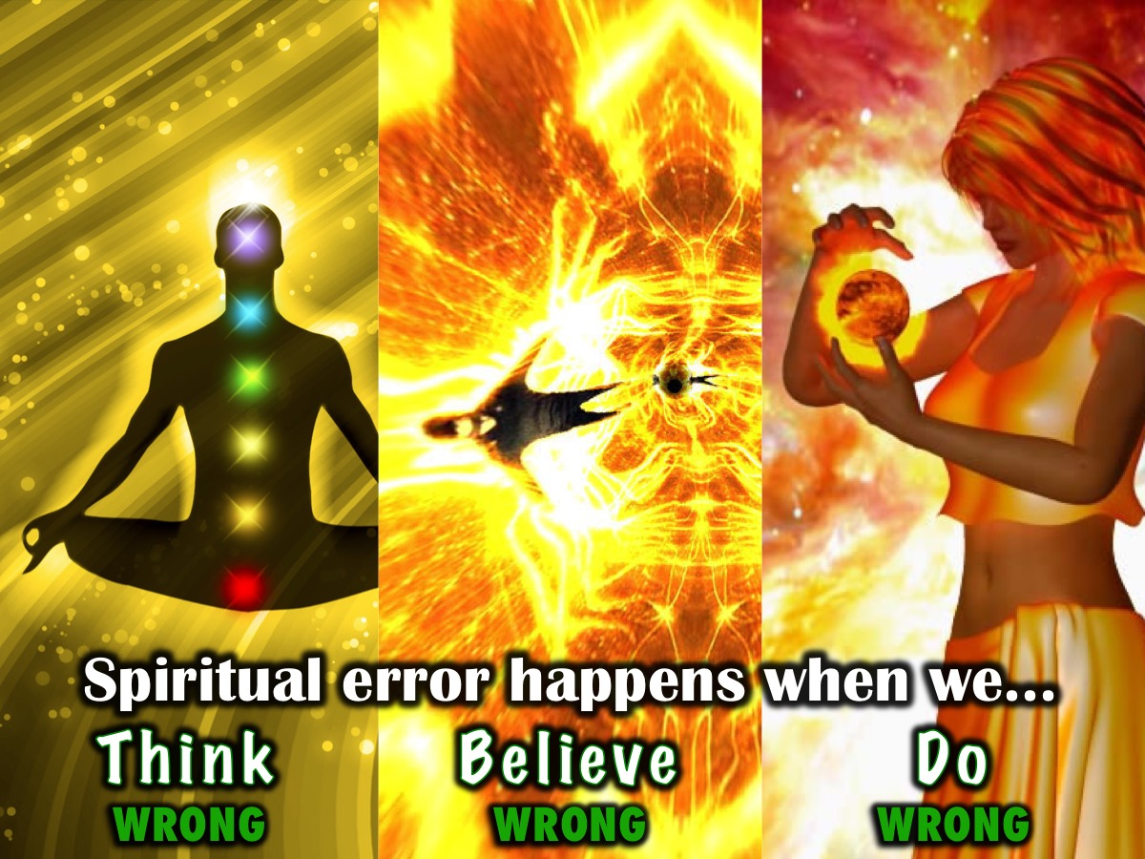
Notes:
We learnt that spiritual error happens when we Think, Believe and Do wrong.

Slide 6
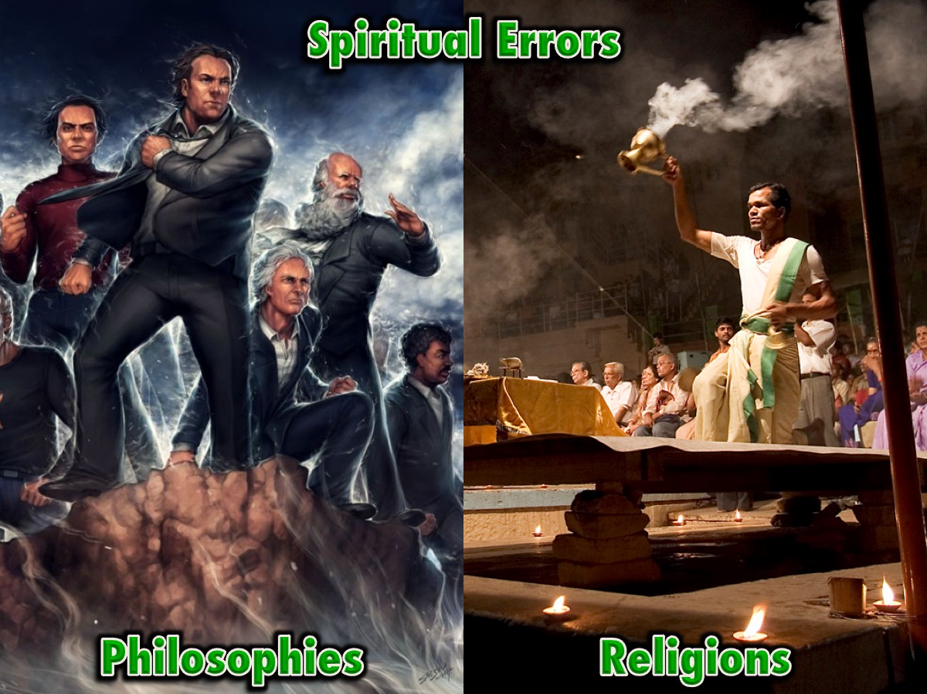
Notes:
Here are some of the Spiritual Errors we looked at:
Secular Philosophies and False Religions

Slide 7
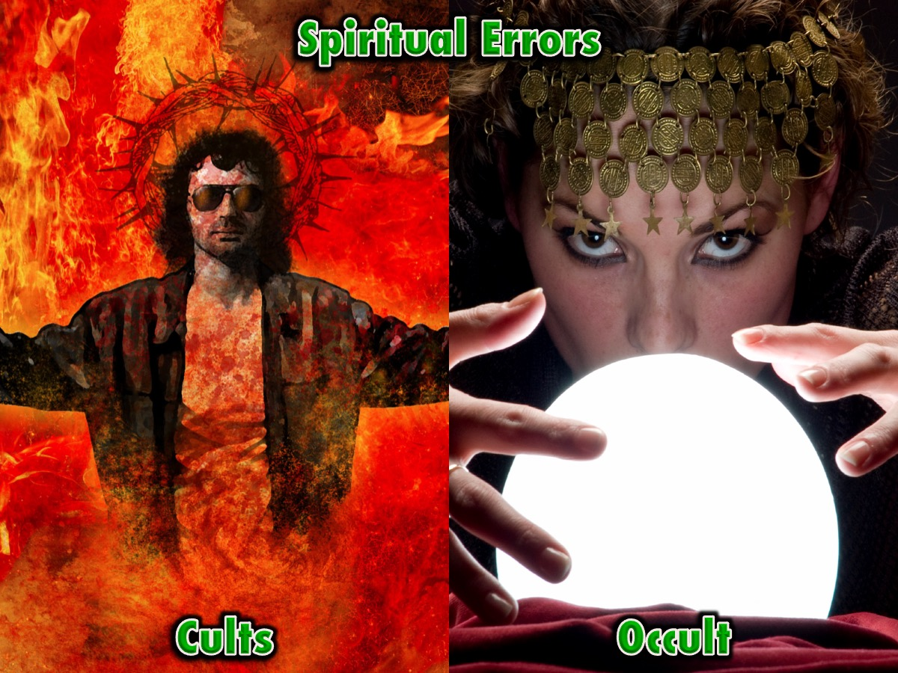
Notes:
Cults and the Occult

Slide 8
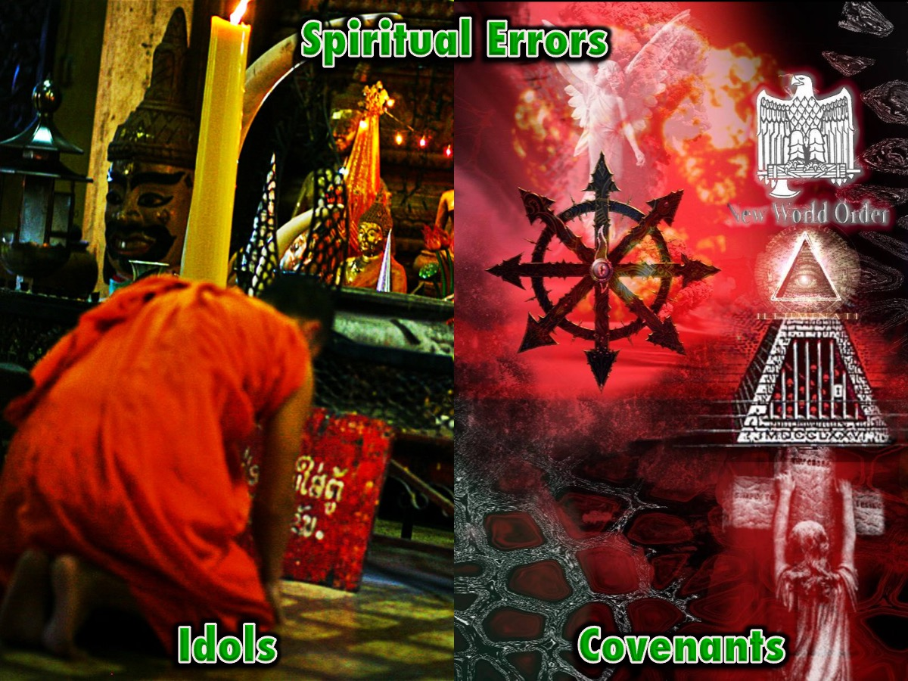
Notes:
Idol Worship and Unbiblical Covenants

Slide 9
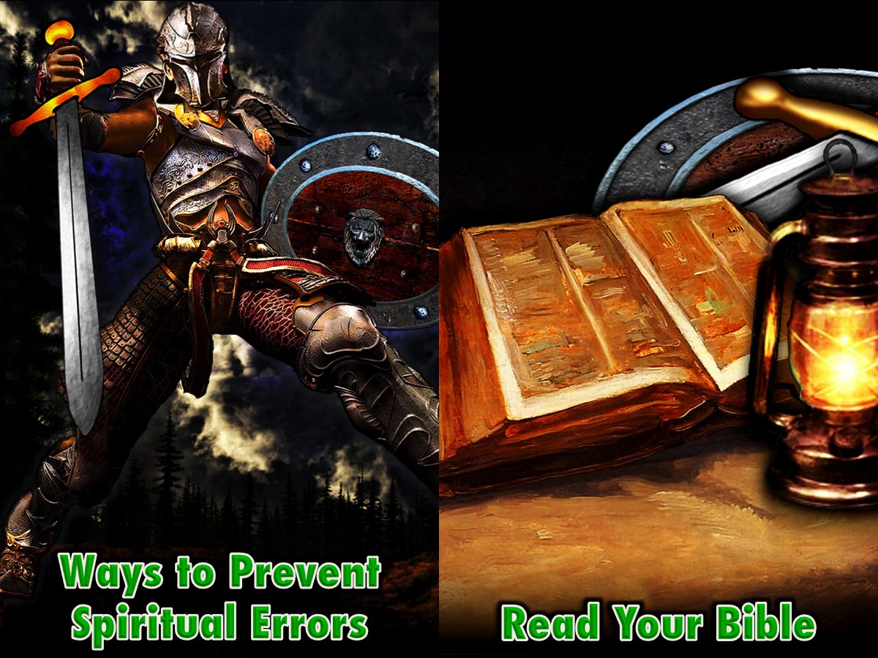
Notes:
We learnt that there are ways to prevent spiritual error:
(1) Read Your Bible

Slide 10
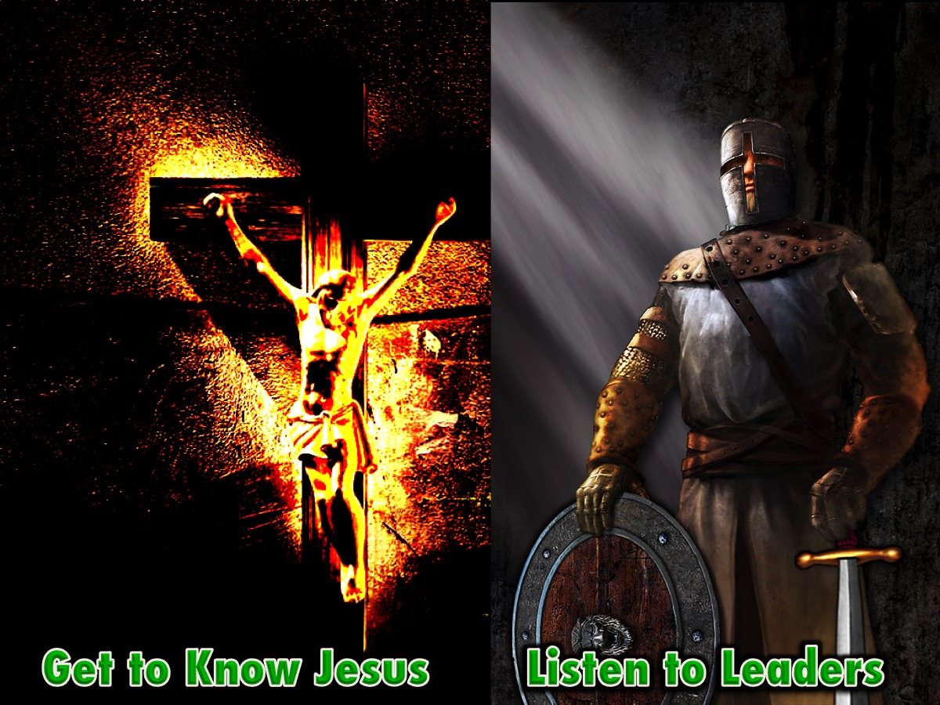
Notes:
(2) Get to Know Jesus and (3) Listen to Your Leaders

Slide 11
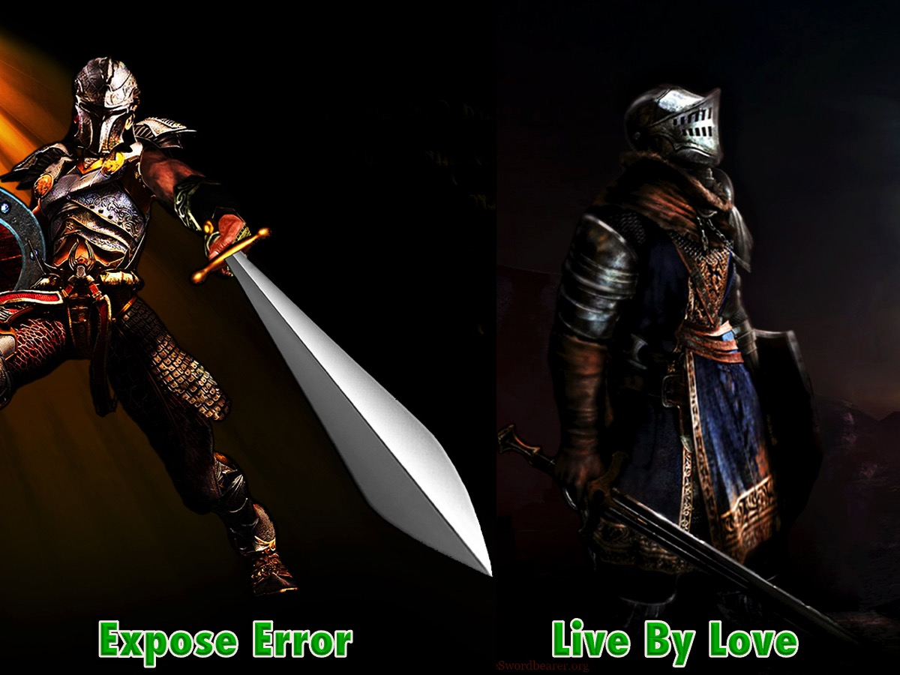
Notes:
(4) Expose Error and (5) Live by a New Standard of Love

Slide 12

Notes:
This week we are going to look at the fourth of five big issues in our lives: Sexual Sins.

Slide 13

Notes:
We live in a sexual minefield! Here are some issues that are traps in the area of sexuality…

Slide 14
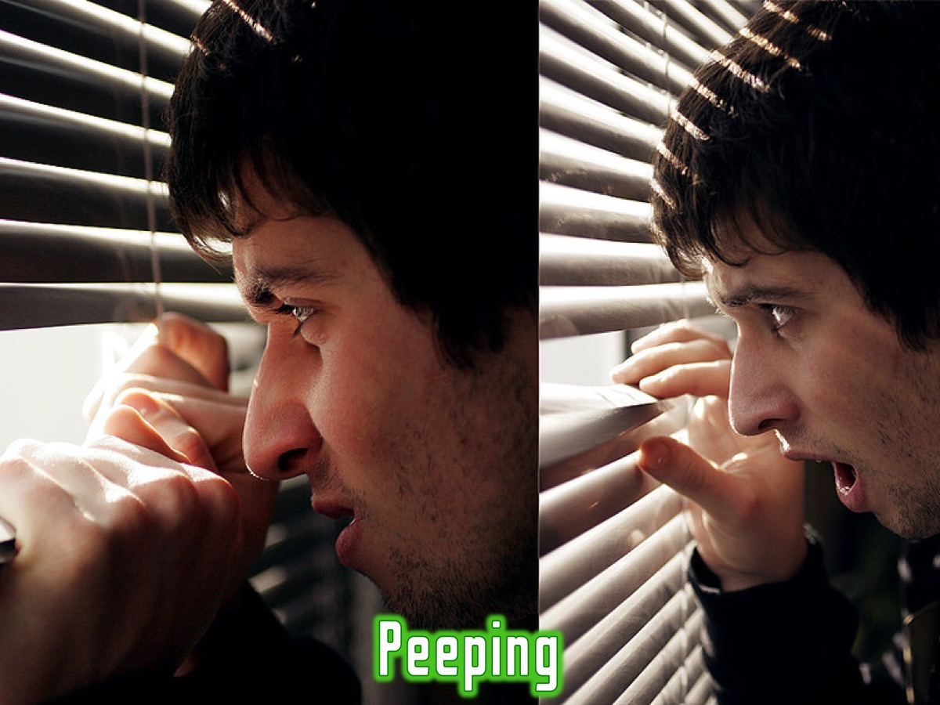
Notes:
* Peeping

Slide 15

Notes:
* Flirting

Slide 16

Notes:
* Pornography

Slide 17
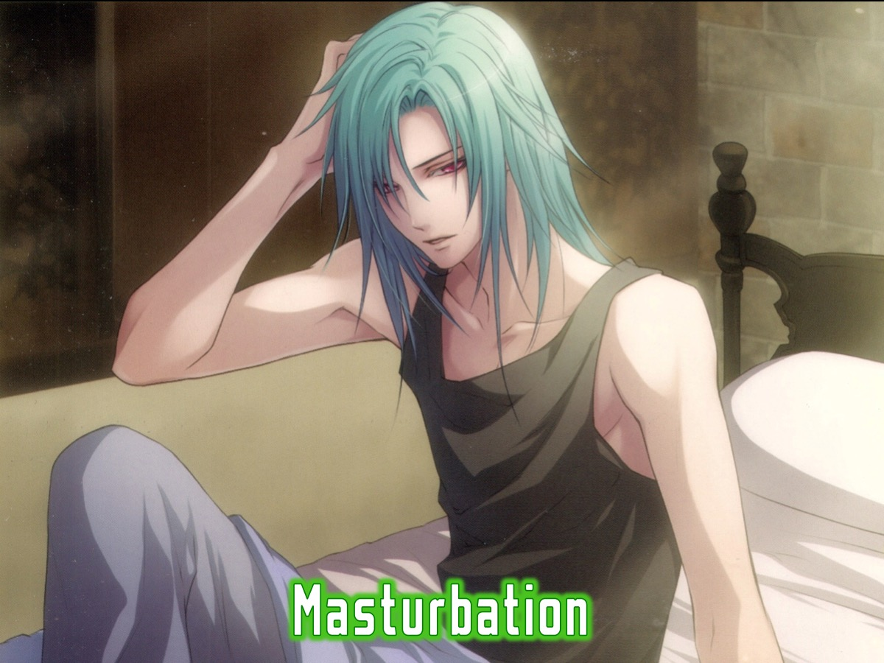
Notes:
* Masturbation

Slide 18
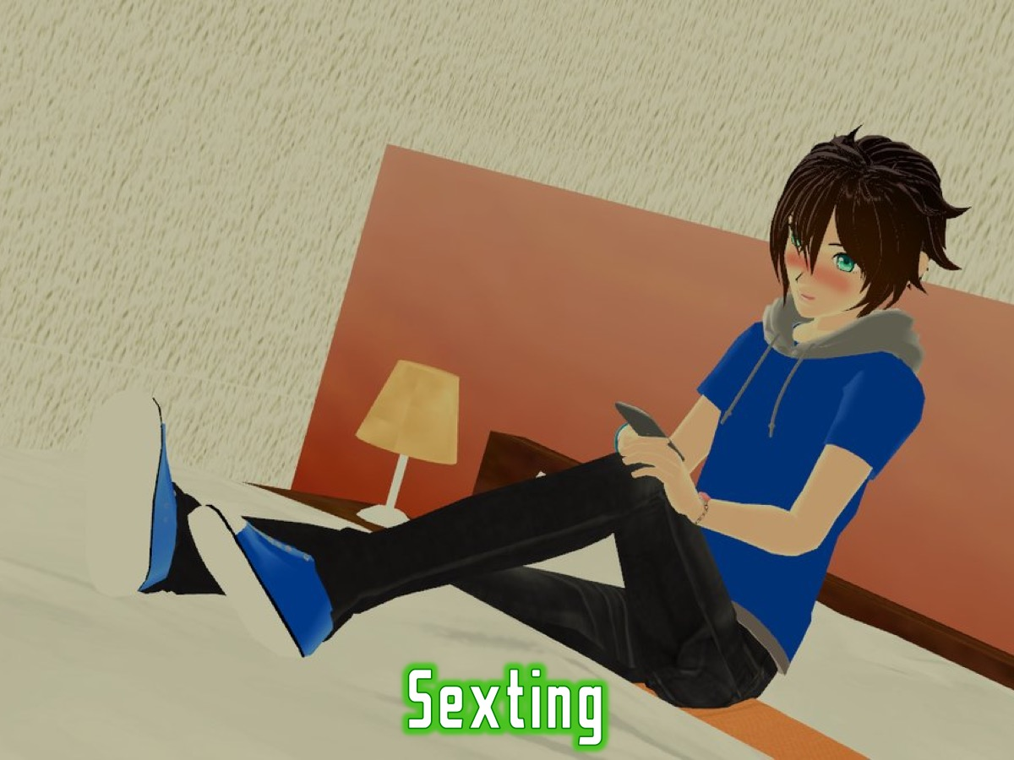
Notes:
* Sexting

Slide 19
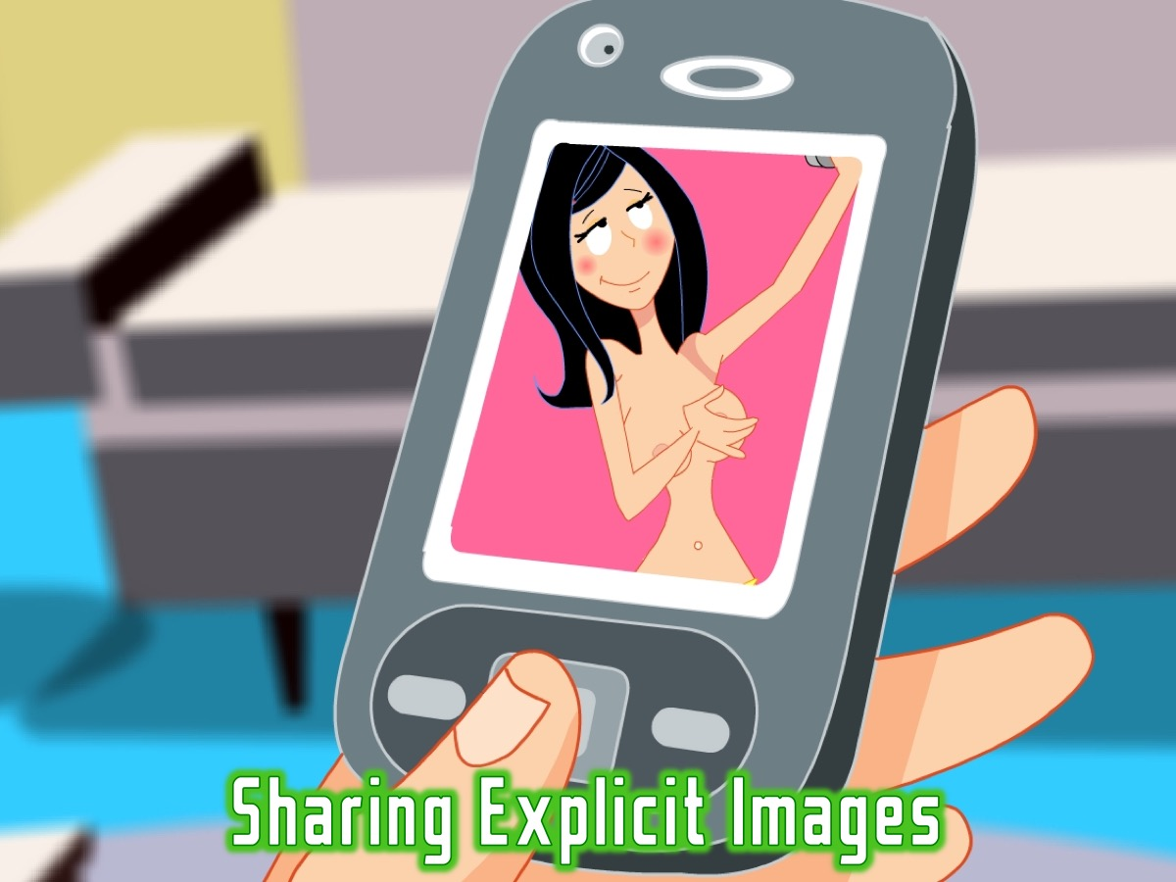
Notes:
* Sharing Explicit Images

Slide 20
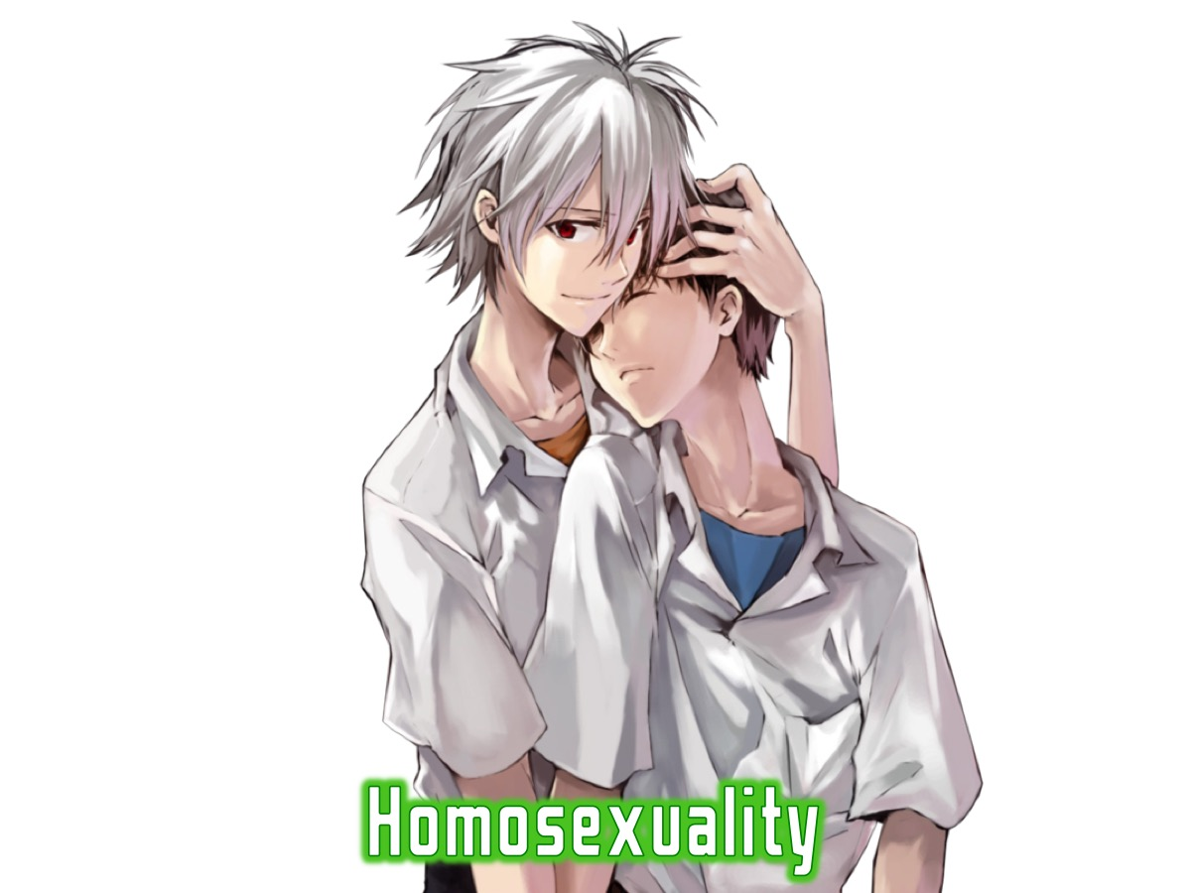
Notes:
* Homosexuality

Slide 21

Notes:
* Sex before marriage

Slide 22

Notes:
Why are we vulnerable to attack?

Slide 23
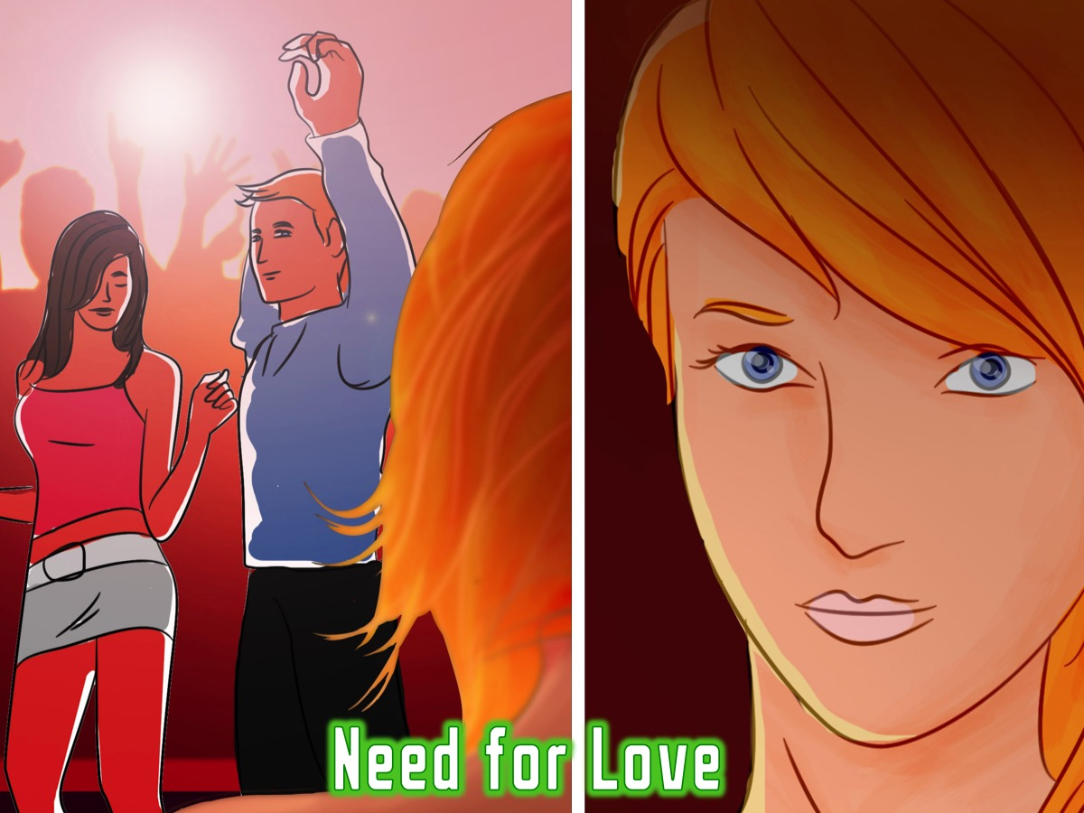
Notes:
* The Need for Love

Slide 24

Notes:
* Passion and Affections

Slide 25
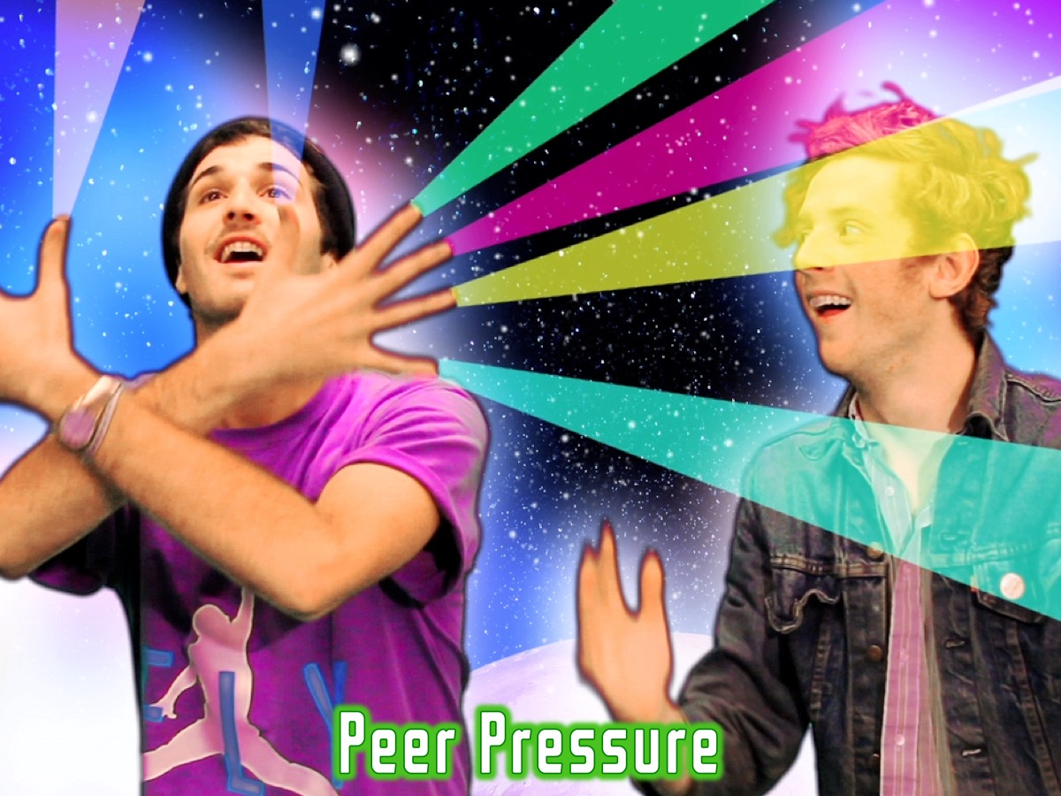
Notes:
* Peer Pressure

Slide 26
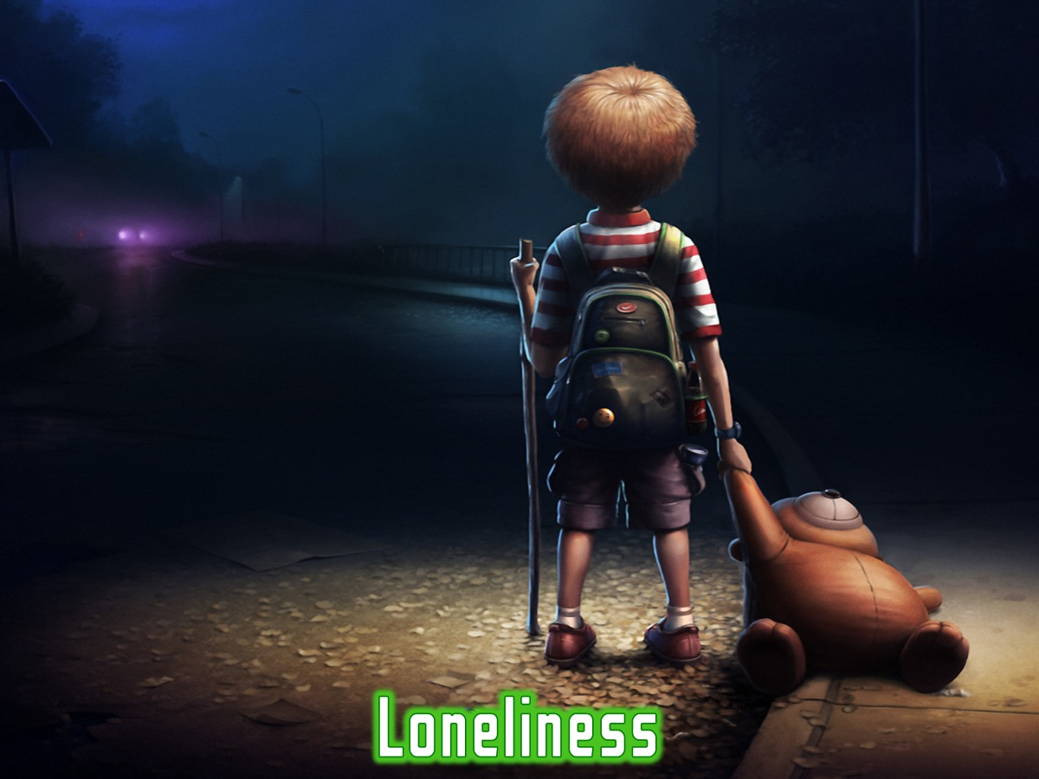
Notes:
* Loneliness

Slide 27

Notes:
* Media Influences

Slide 28

Notes:
* Evil Desires

Slide 29
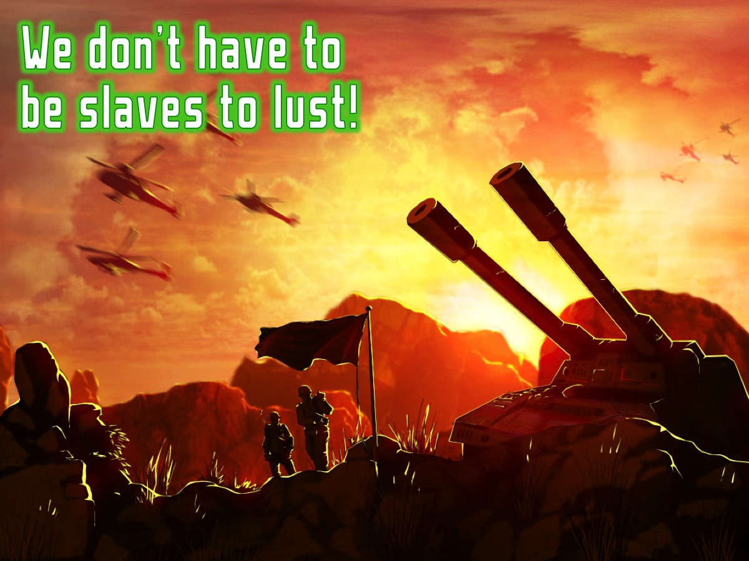
Notes:
But we don’t have to be slaves to lust!

Slide 30
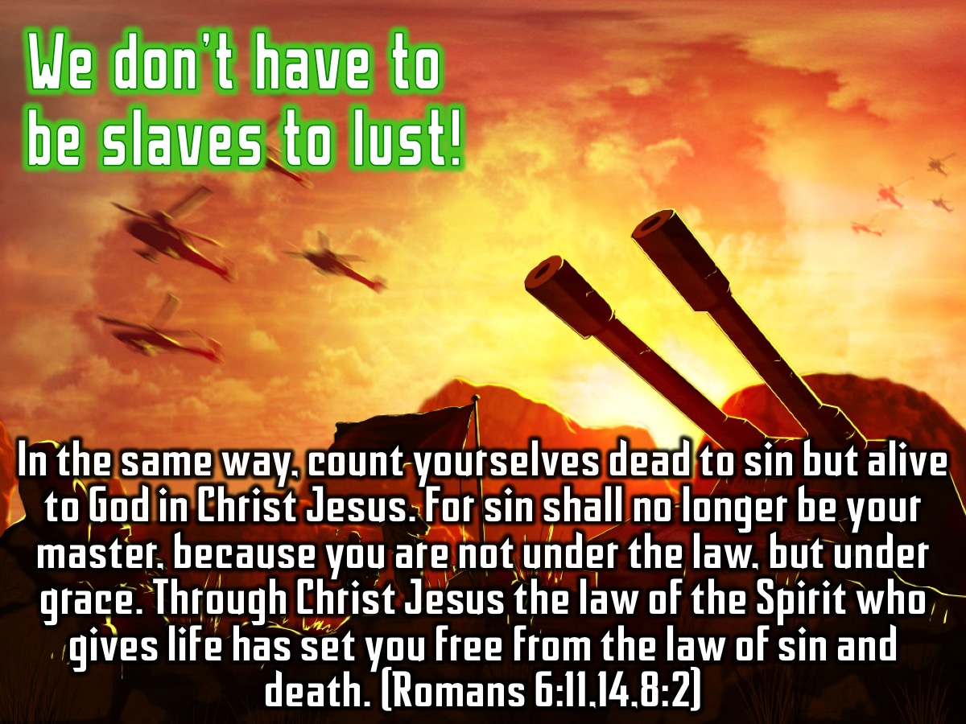
Notes:
In the same way, count yourselves dead to sin but alive to God in Christ Jesus. For sin shall no longer be your master, because you are not under the law, but under grace. Through Christ Jesus the law of the Spirit who gives life has set you free from the law of sin and death. (Romans 6:11,14,8:2)

Slide 31
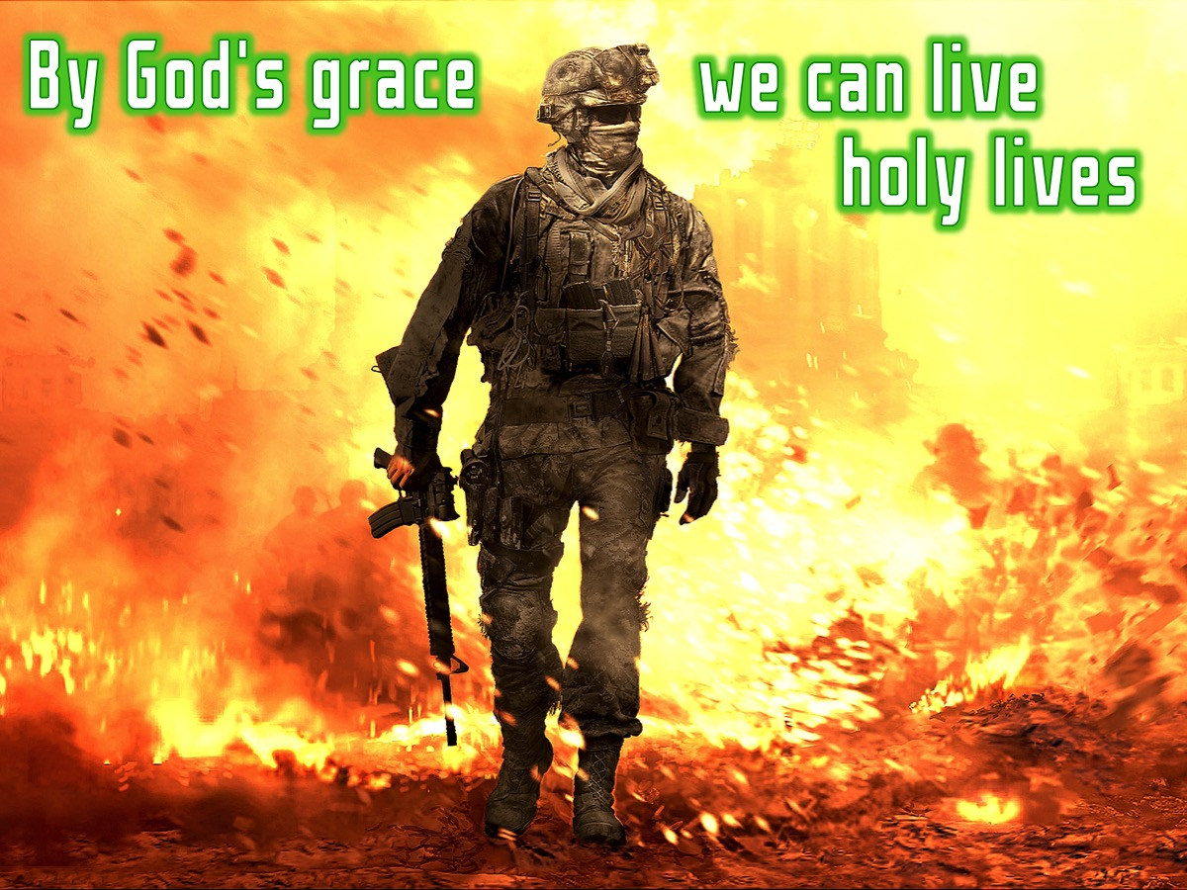
Notes:
By God’s grace we can live holy lives!

Slide 32

Notes:
Here are 8 keys to victory in the area of your sexuality:

Slide 33

Notes:
Firstly, you need to Make Boundaries. How do you do this?

Slide 34
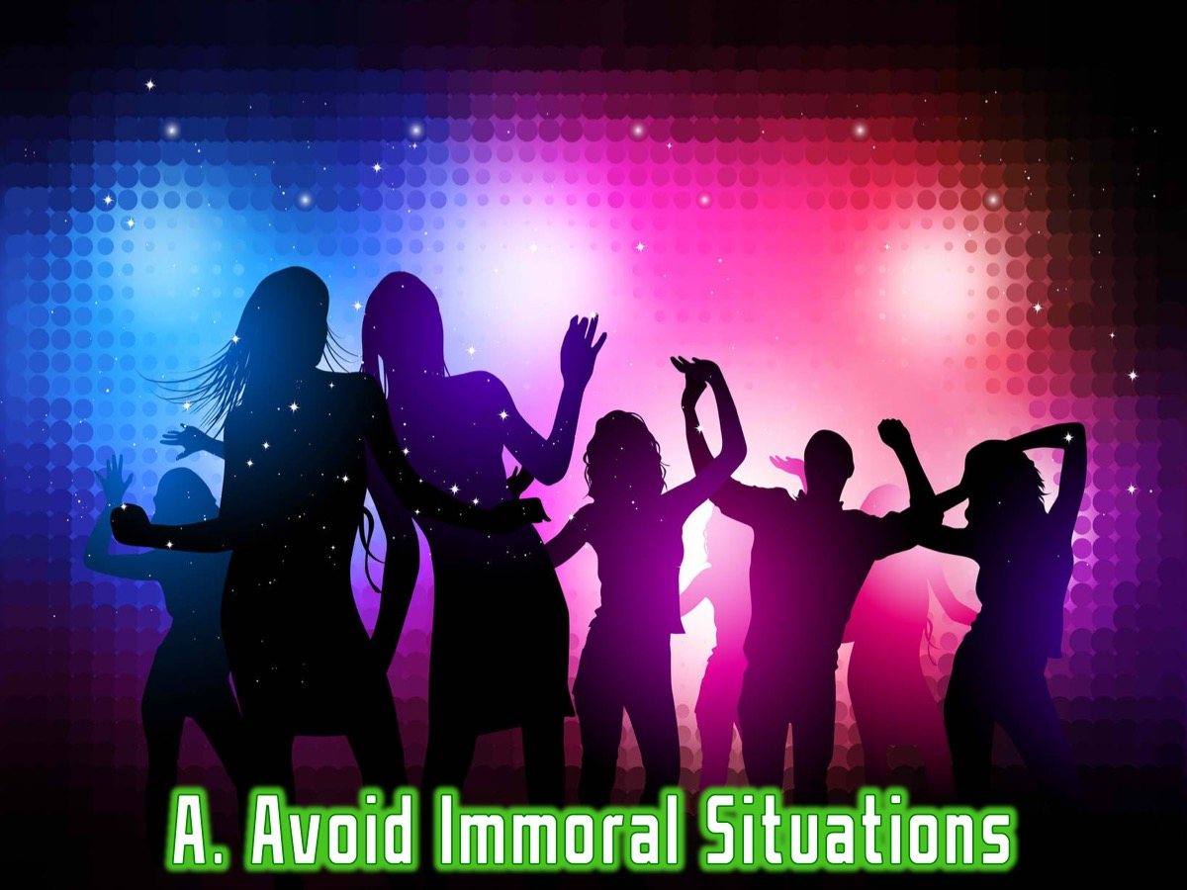
Notes:
A. Avoid Immoral Situations

Slide 35
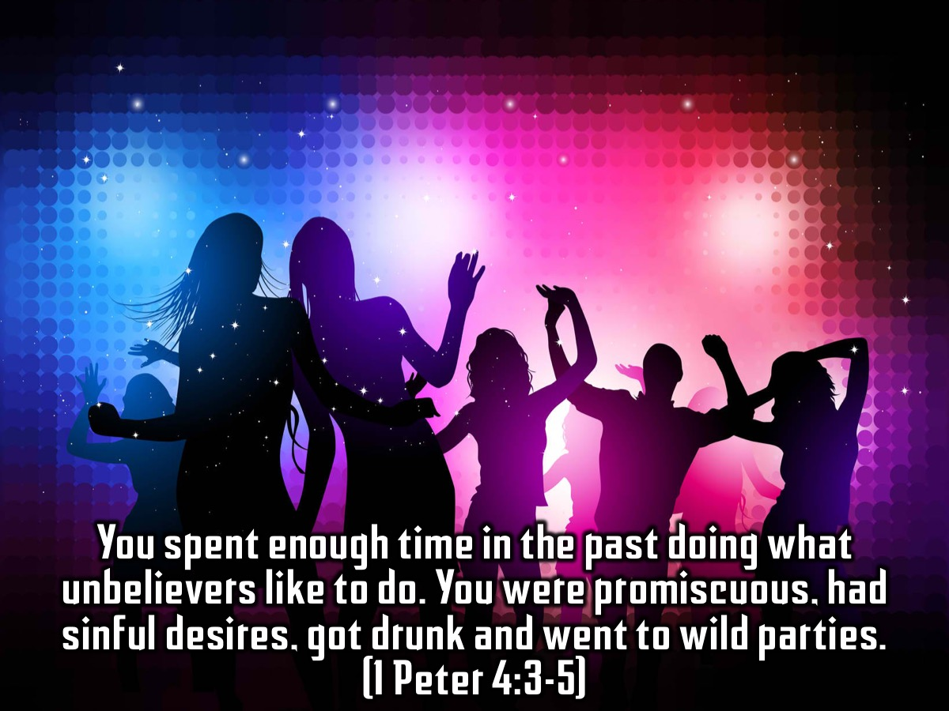
Notes:
You spent enough time in the past doing what unbelievers like to do. You were promiscuous, had sinful desires, got drunk and went to wild parties. (1 Peter 4:3-5)

Slide 36

Notes:
B. Have Godly Relationships

Slide 37
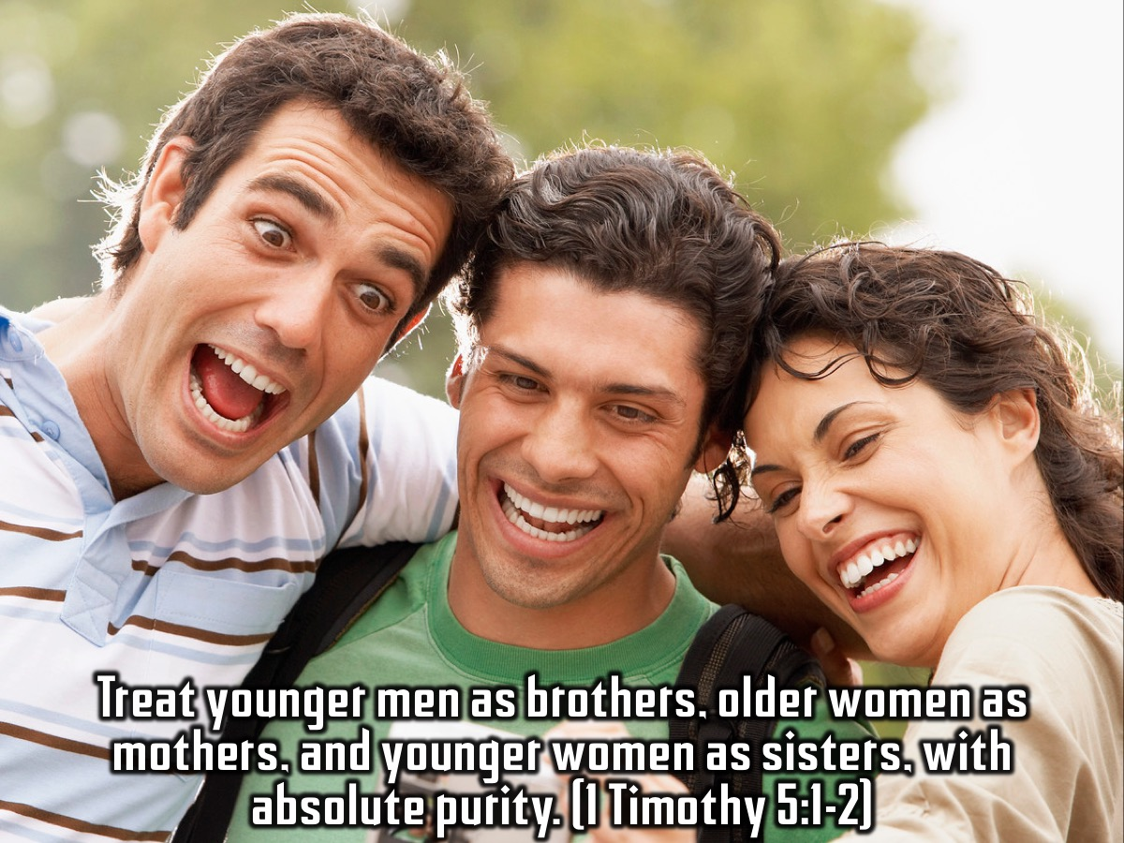
Notes:
Treat younger men as brothers, older women as mothers, and younger women as sisters, with absolute purity. (1 Timothy 5:1-2)

Slide 38
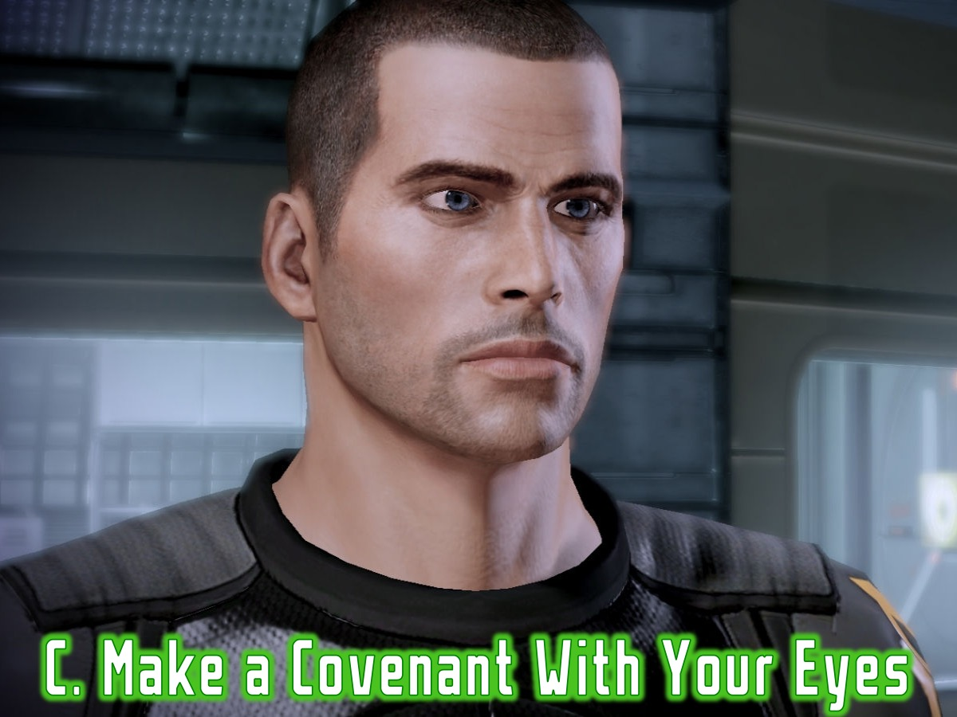
Notes:
C. Make a Covenant With Your Eyes

Slide 39
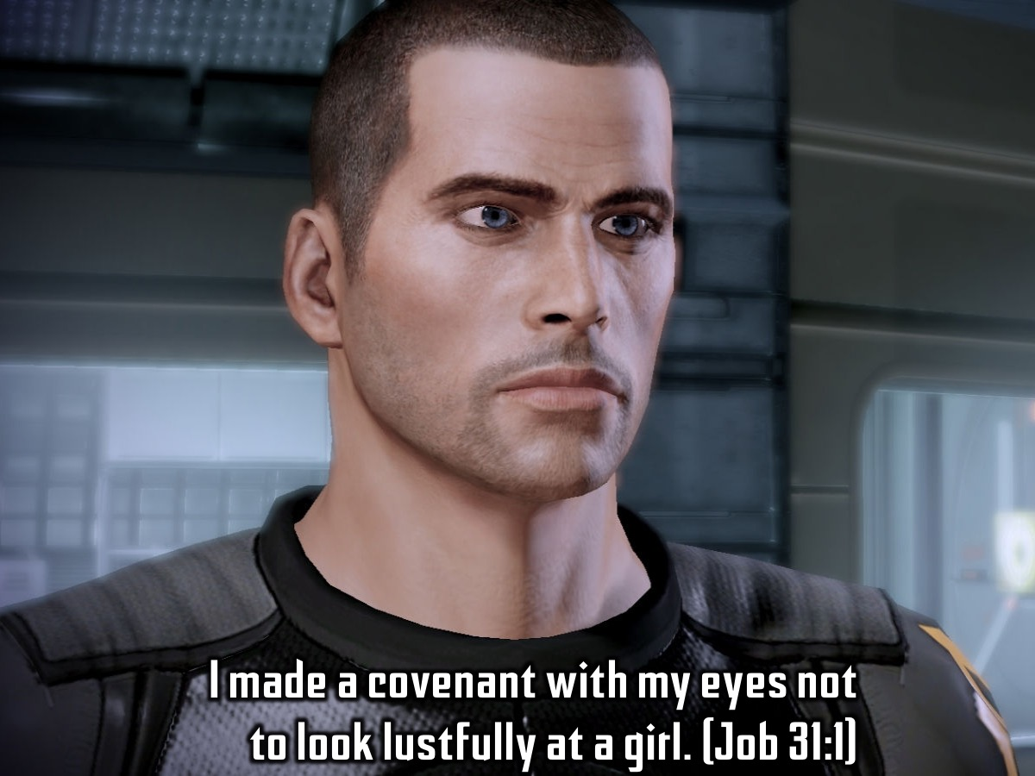
Notes:
I made a covenant with my eyes not to look lustfully at a girl. (Job 31:1)

Slide 40
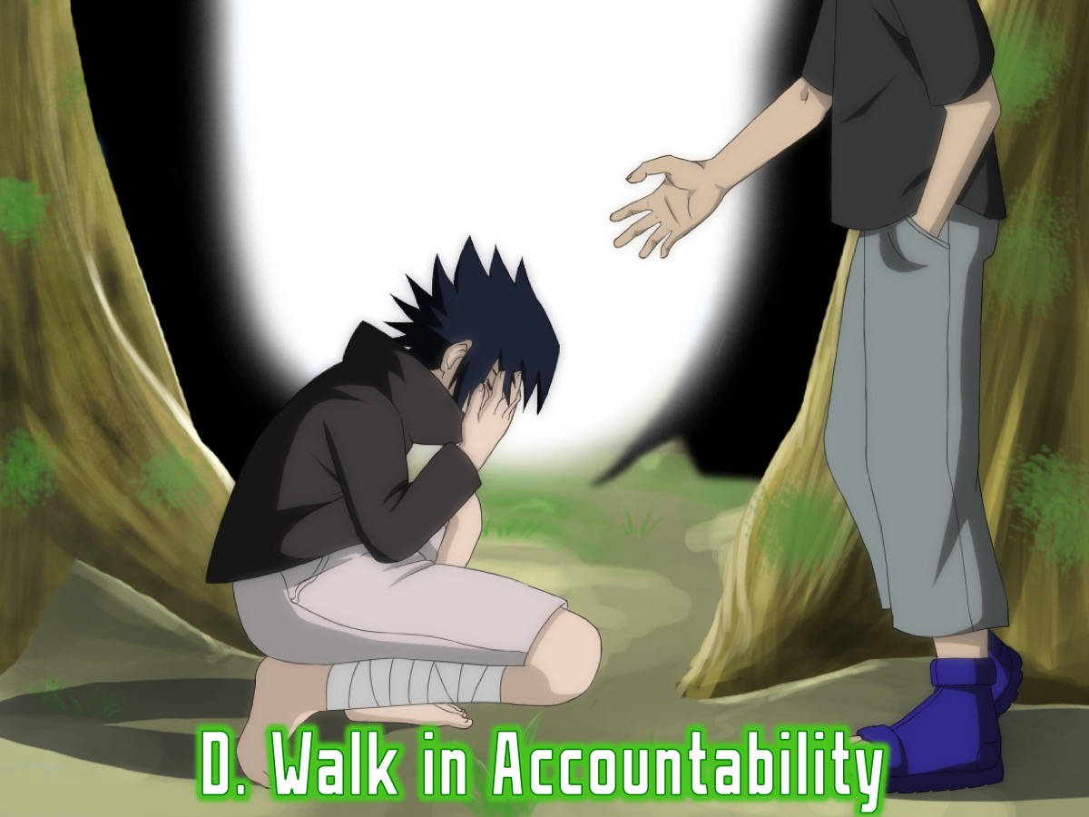
Notes:
D. Walk in Accountability

Slide 41
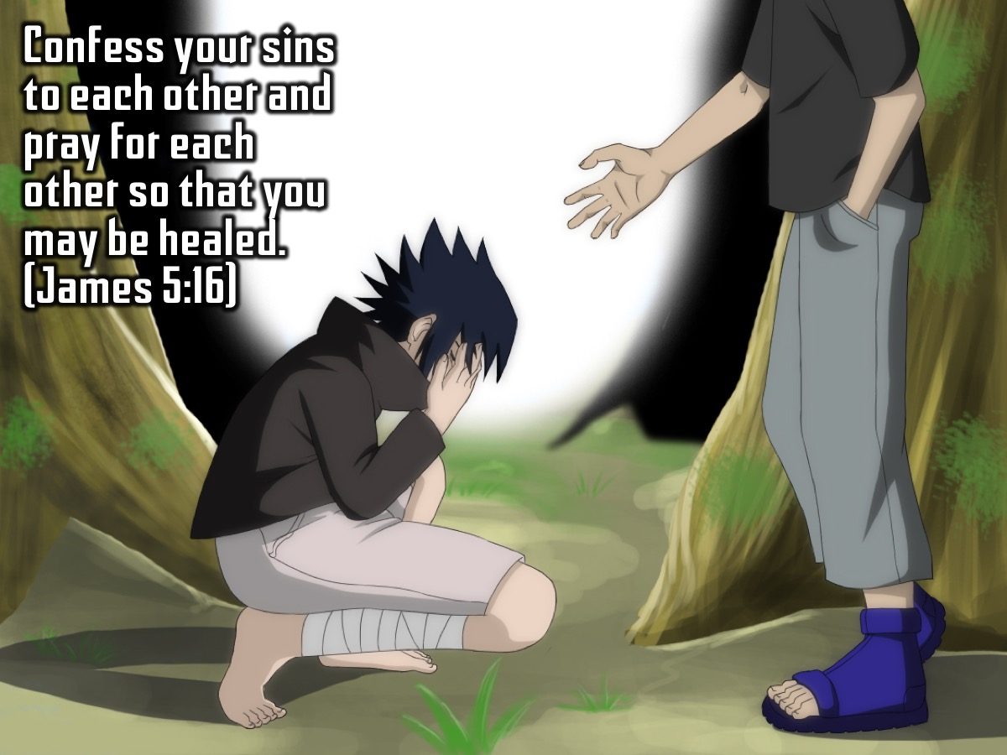
Notes:
Confess your sins to each other and pray for each other so that you may be healed. (James 5:16)

Slide 42

Notes:
Secondly you need to Renew Your Mind. So how do you actually do this?

Slide 43

Notes:
A. Accept God’s Moral Standards

Slide 44
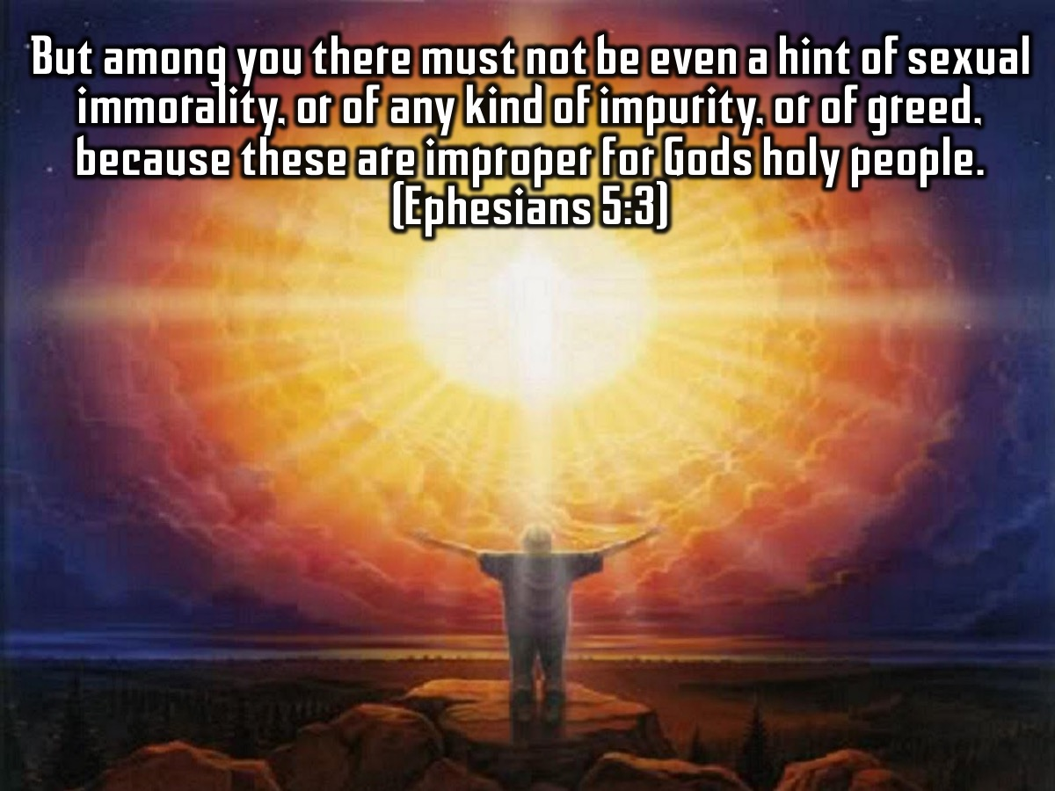
Notes:
But among you there must not be even a hint of sexual immorality, or of any kind of impurity, or of greed, because these are improper for Gods holy people. (Ephesians 5:3).

Slide 45
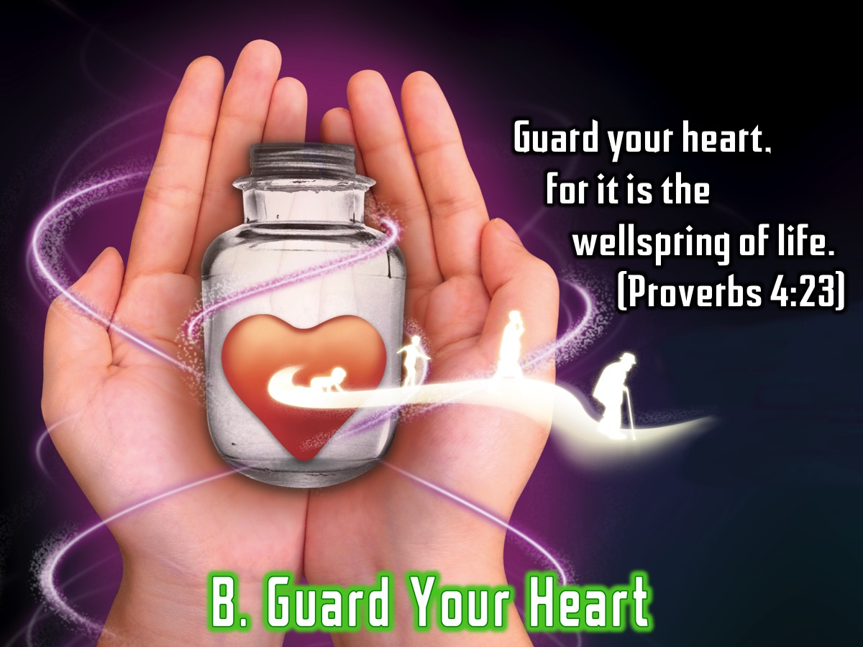
Notes:
B. Guard Your Heart. Guard your heart, for it is the wellspring of life. (Proverbs 4:23).

Slide 46
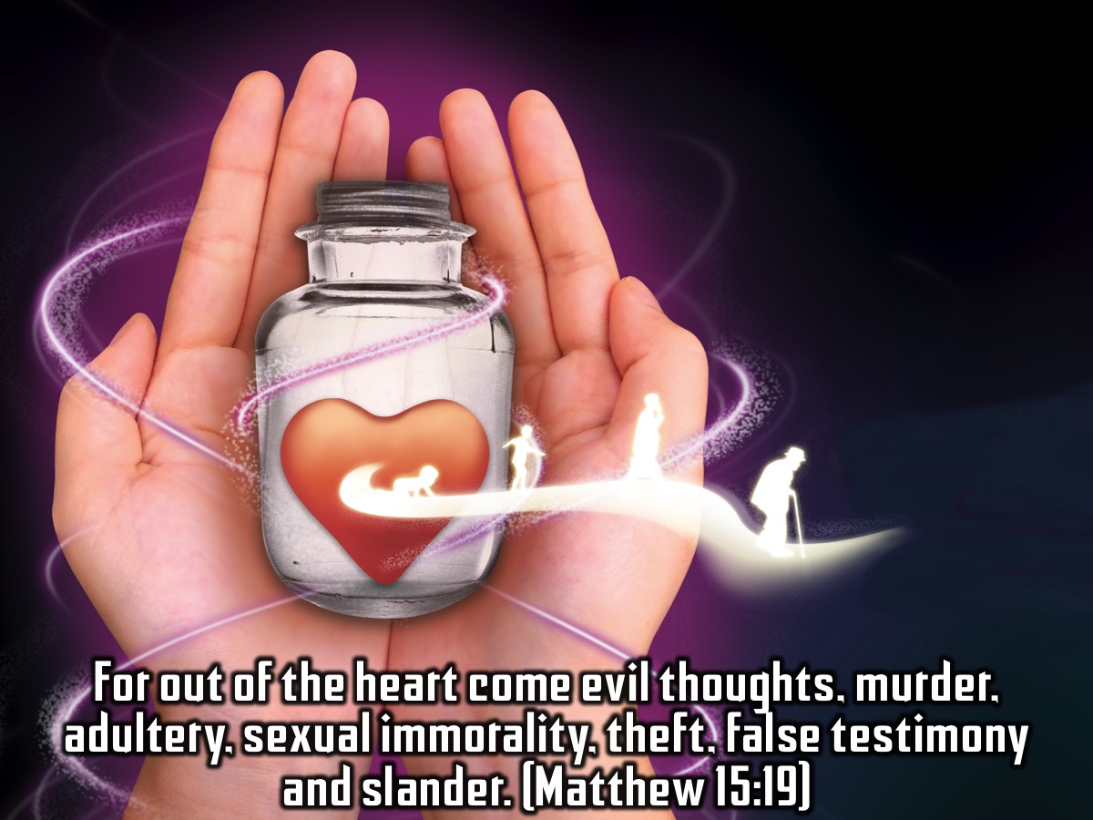
Notes:
For out of the heart come evil thoughts, murder, adultery, sexual immorality, theft, false testimony and slander. (Matthew 15:19)

Slide 47

Notes:
C. Believe Victory is Possible

Slide 48
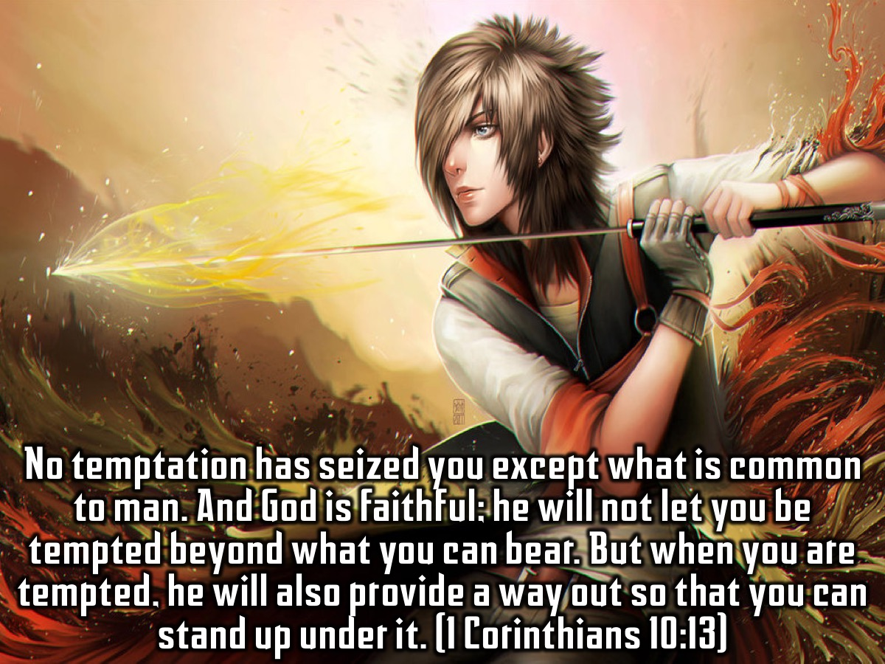
Notes:
No temptation has seized you except what is common to man. And God is faithful; he will not let you be tempted beyond what you can bear. But when you are tempted, he will also provide a way out so that you can stand up under it. (1 Corinthians 10:13)

Slide 49

Notes:
D. Fill Your Mind With God’s Word

Slide 50
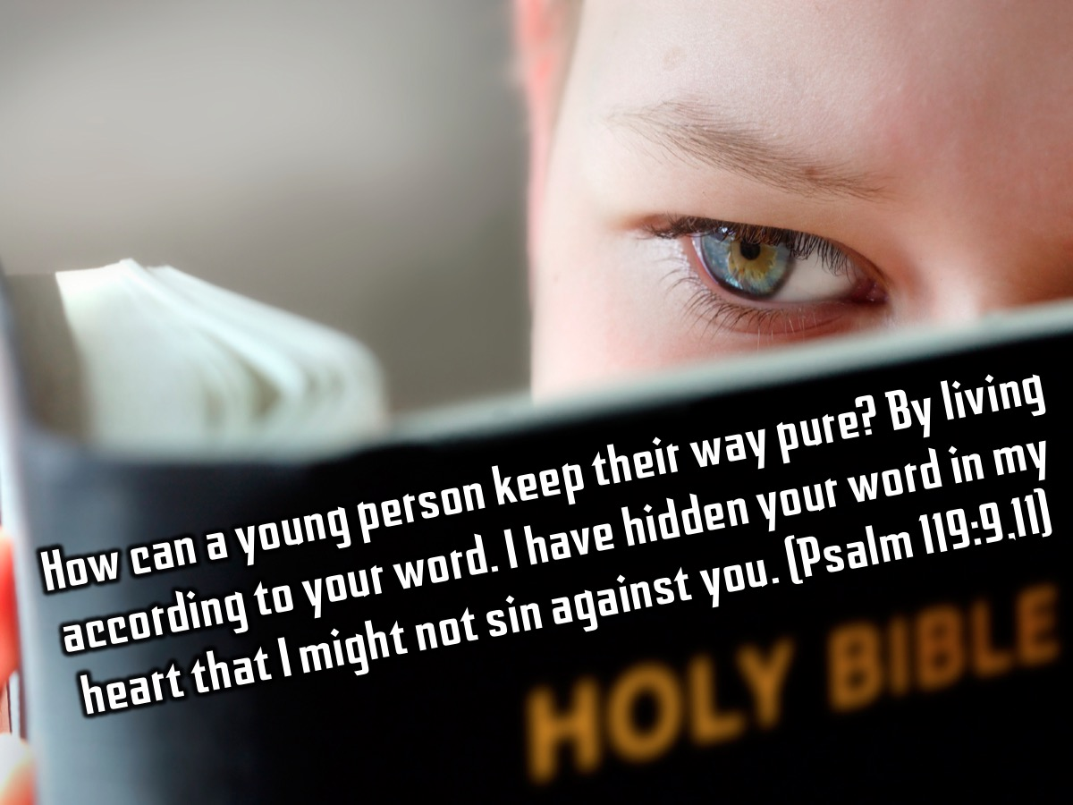
Notes:
How can a young person keep their way pure? By living according to your word. I have hidden your word in my heart that I might not sin against you. (Psalm 119:9,11)

Slide 51

Notes:
Spend a few minutes completing the personal profile on Sexual Sins.

Slide 52
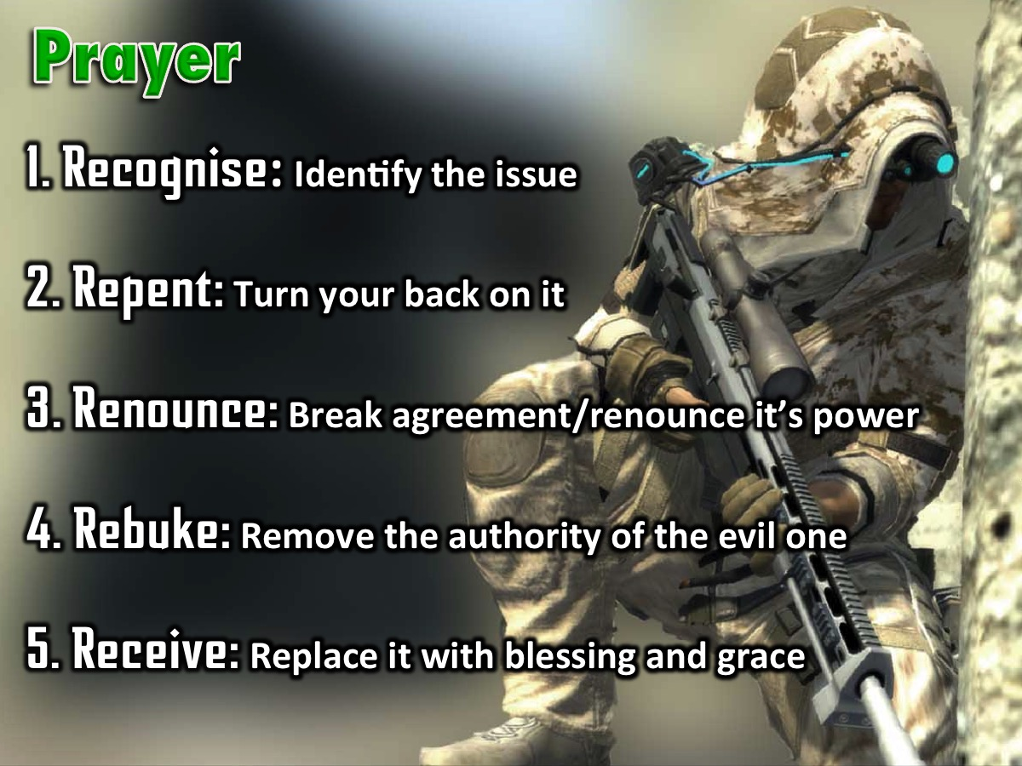
Notes:
Prayer! The Process of Deliverance. To experience freedom in the area of sexual sins we are going to pray through the process of deliverance: (1) The first step to victory is to Recognise any issue that God has brought to your attention that you need to deal with. (2) The second step is Repent – where you commit to turn your back on the issue, choose to renew your mind and ask God to help you think differently about it. (3) The third step is to Renounce – which means to fall out of agreement with the issue and renounce its power over your life. If it is a curse you fall out of agreement with the curse and you renounce its power to operate in your life, you renounce its power to operate in your children’s life - when you have them one day - and the generations to come. If it is sin you have been involved in, you renounce the power of that sin. You close the door on the enemy - he does not have a hold on you anymore! The enemy no longer has authority to operate in your life in the area. (4) The fourth step is Rebuke – when we rebuke the evil one, any demonic spirit that is associated with the issue has to leave – there is no shouting - it just has to go because you have taken its authority away. (5) The fifth step is Receive – where you now ask God to replace what has been taken away with his blessing and grace. Where there was unforgiveness and bitterness you pray to receive God’s grace to forgive; where there was a curse you receive the Lord’s blessing to replace the curse – we speak and announce the blessings of God in areas of poverty for example.

Slide 53
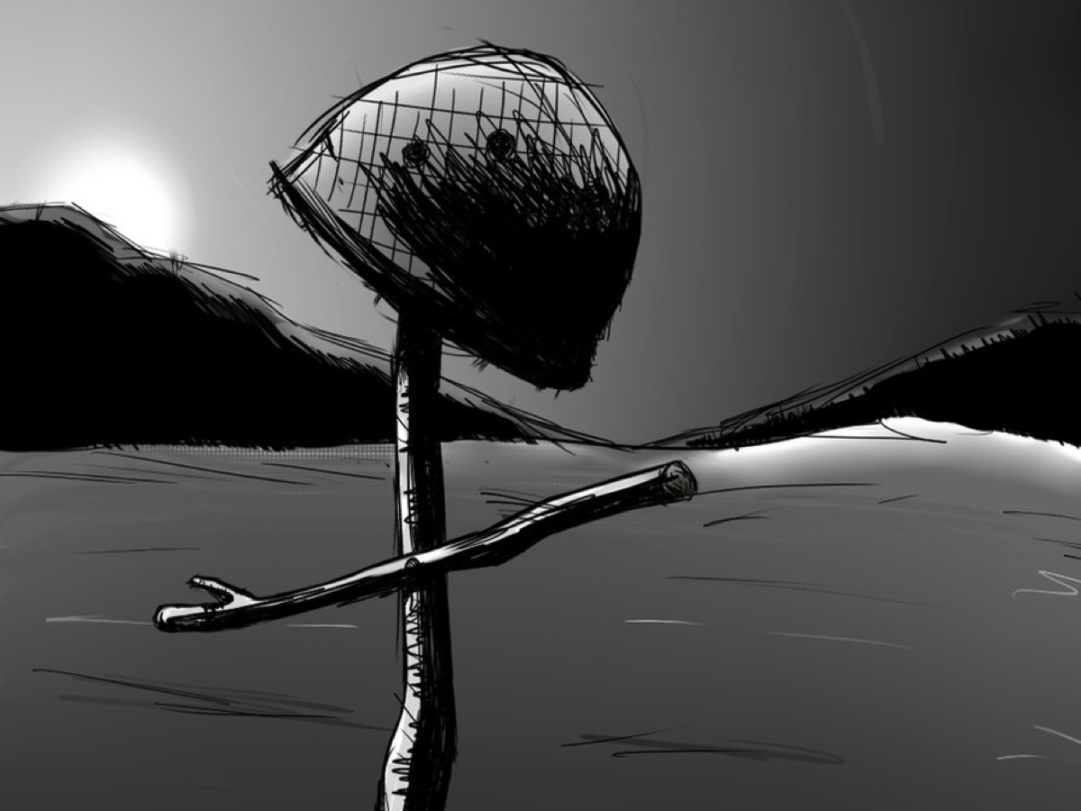
Notes:
As a sign that you have been set free from sexual sins you need to crumple up your personal profile and come and place them in the helmet on the stage and we will destroy them for you!

Slide 54

Notes:
Next week we will be looking at the fifth big issues in our lives: Addictions.

