Slide 1

Notes:
Welcome to Victory Sunday! This is week 9 of the series and as usual we start with a video clip.

Slide 2
Notes:
Video: Battlefield Are You Ready? Get it on YouTube at: http://www.youtube.com/watch?v=8uGmR-1izM0

Slide 3
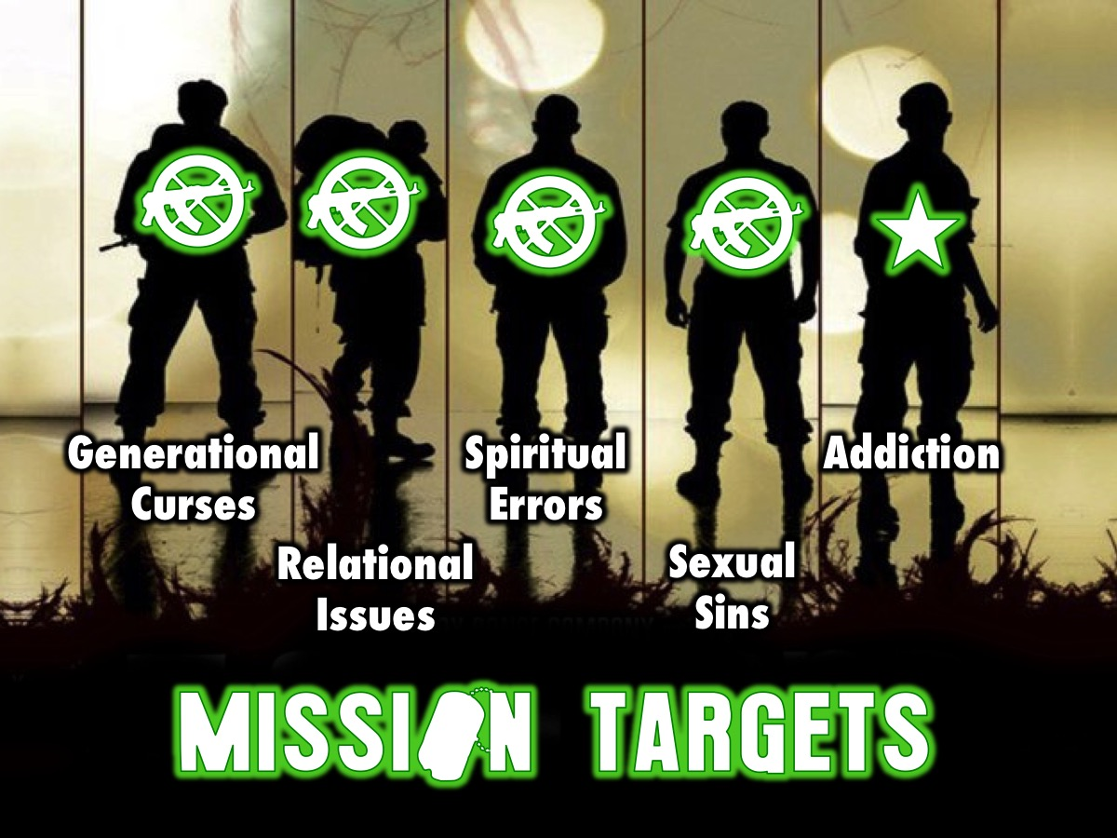
Notes:
Over five weeks we have the following targets to destroy: Generational Curses, Relational Issues, Spiritual Errors, Sexual Sins and Addiction.

Slide 4

Notes:
Last week we looked at the fourth of five big issues in our lives: Sexual Sins.

Slide 5
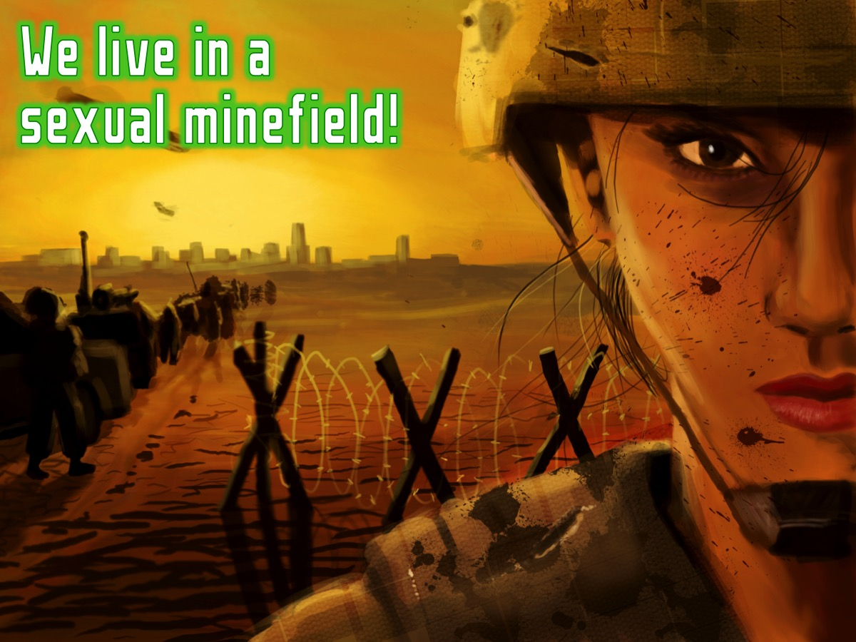
Notes:
We learnt that we live in a sexual mine field but…

Slide 6
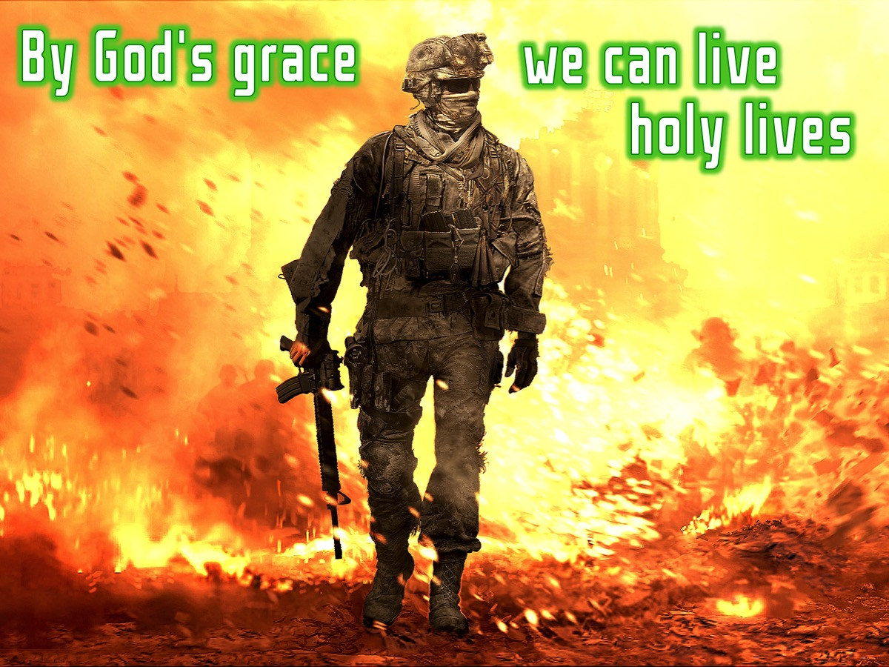
Notes:
By God’s grace we can live holy lives.

Slide 7
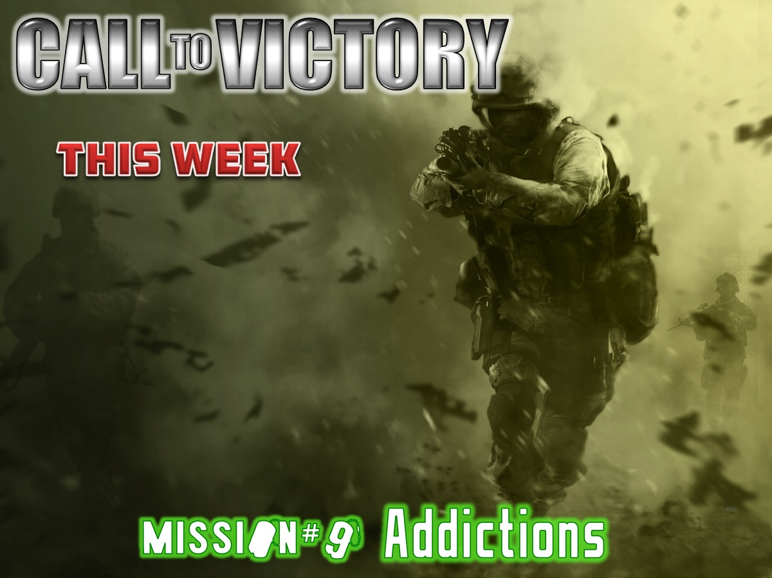
Notes:
This week we are going to look at the last of five big issues in our lives: Addictions.

Slide 8
Notes:
Video: Cellphone Addiction: Get it on YouTube at: https://www.youtube.com/watch?v=tSVnqXoqq3Y

Slide 9
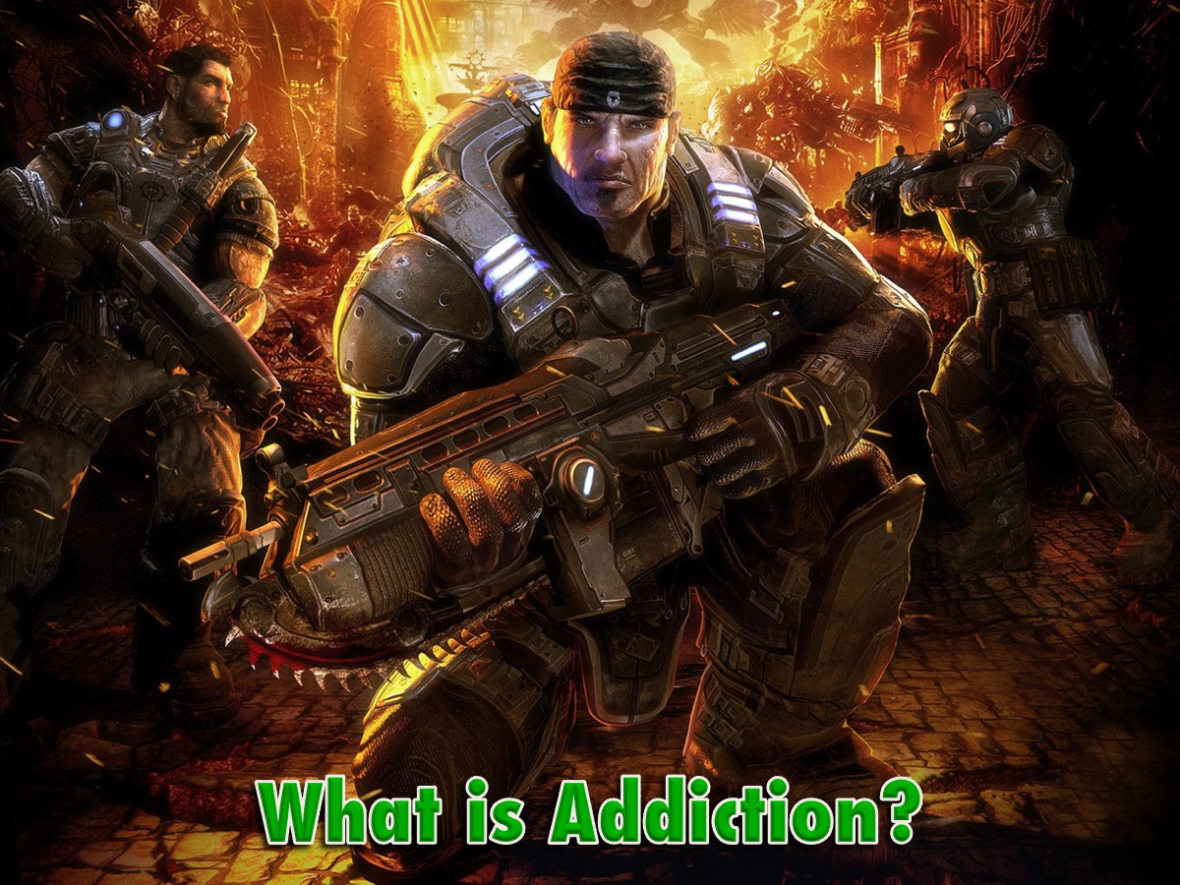
Notes:
What is addiction? Think about the video for a while – what did you learn about addiction from watching it?

Slide 10
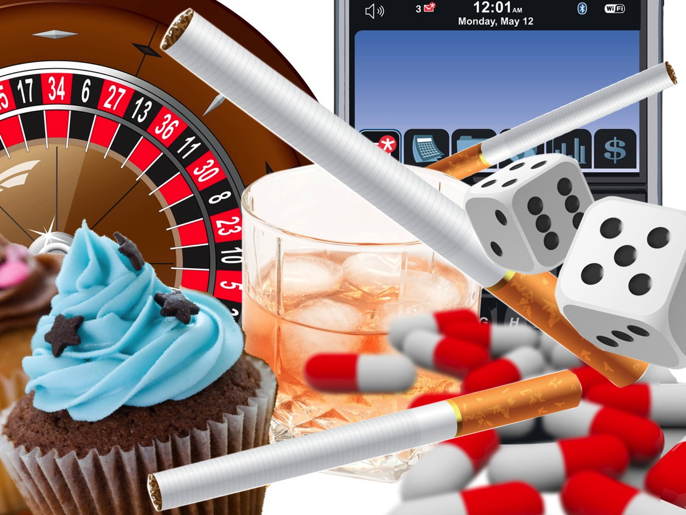
Notes:
Here are some images that could represent addictions in our lives…

Slide 11
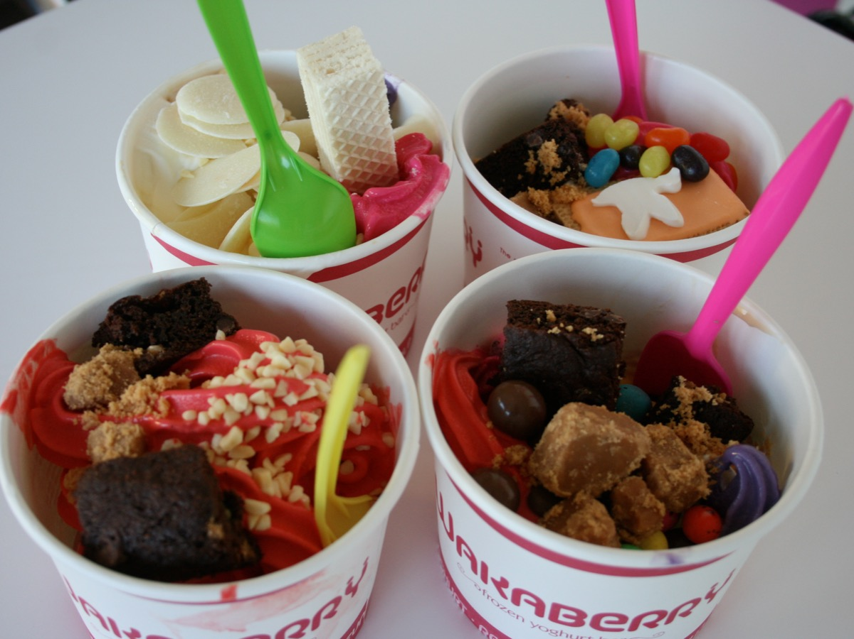
Notes:
* Wakaberry’s Ice-cream

Slide 12
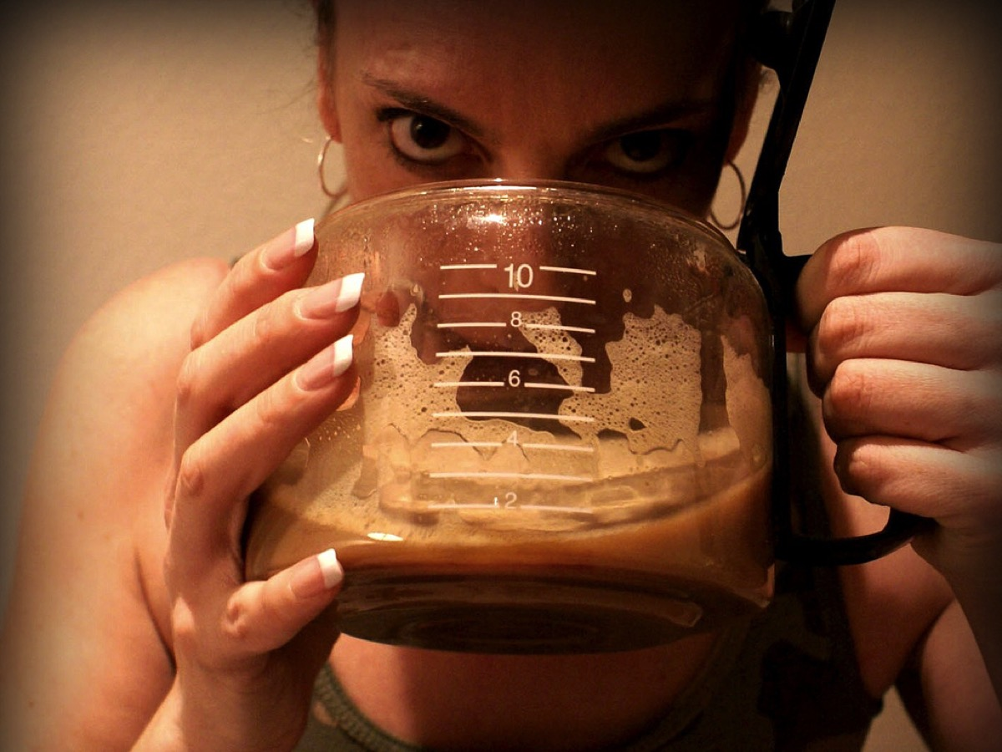
Notes:
* Coffee

Slide 13
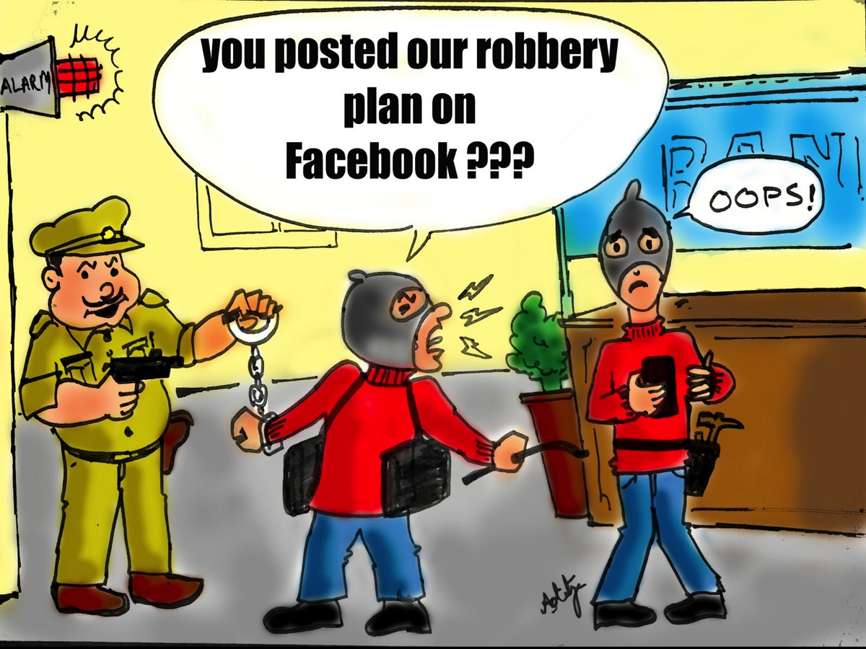
Notes:
* Facebooking

Slide 14
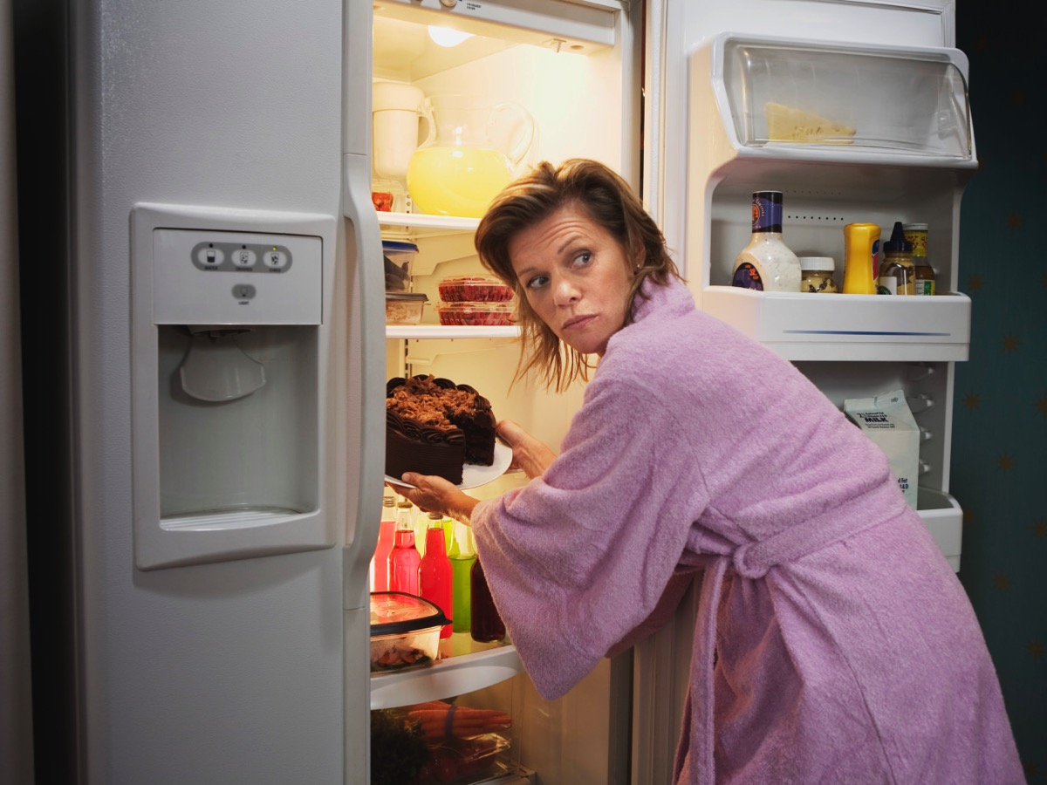
Notes:
* Eating

Slide 15
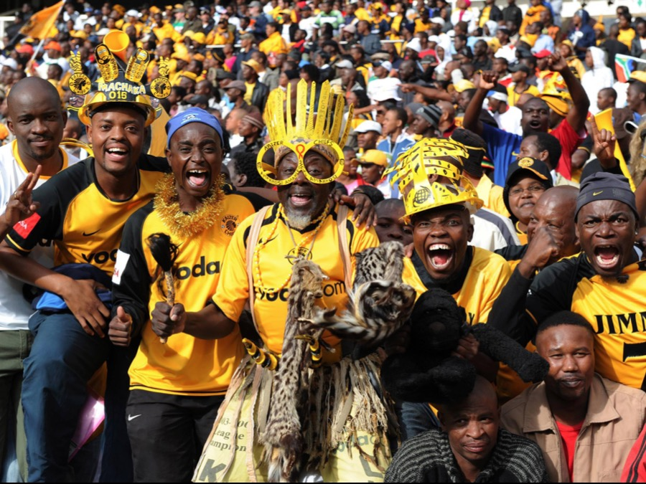
Notes:
* Sport

Slide 16

Notes:
* Shopping

Slide 17
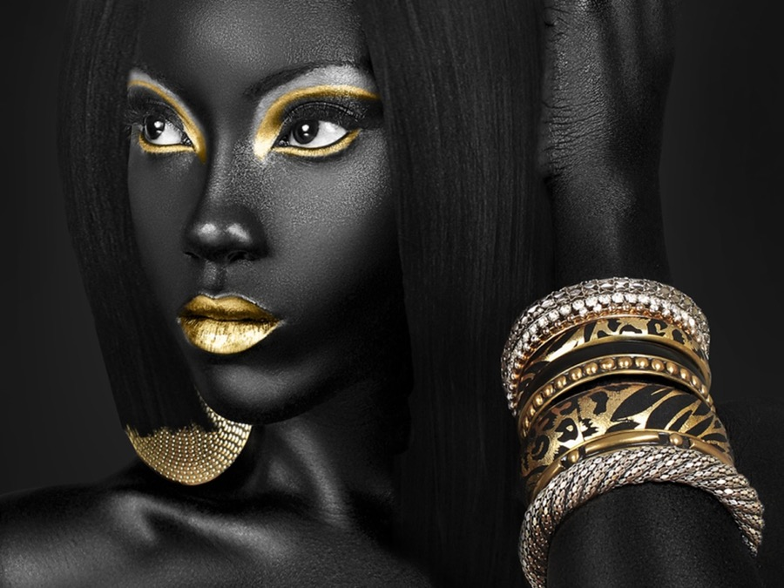
Notes:
* Glamour

Slide 18
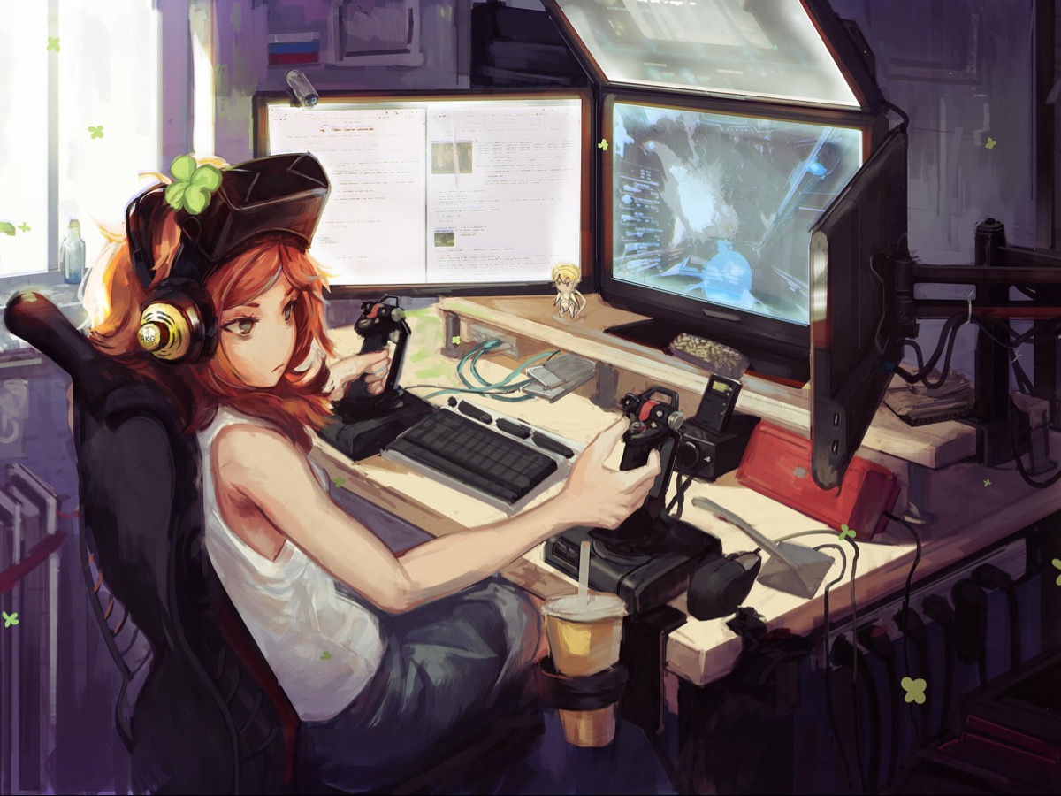
Notes:
* Gaming

Slide 19
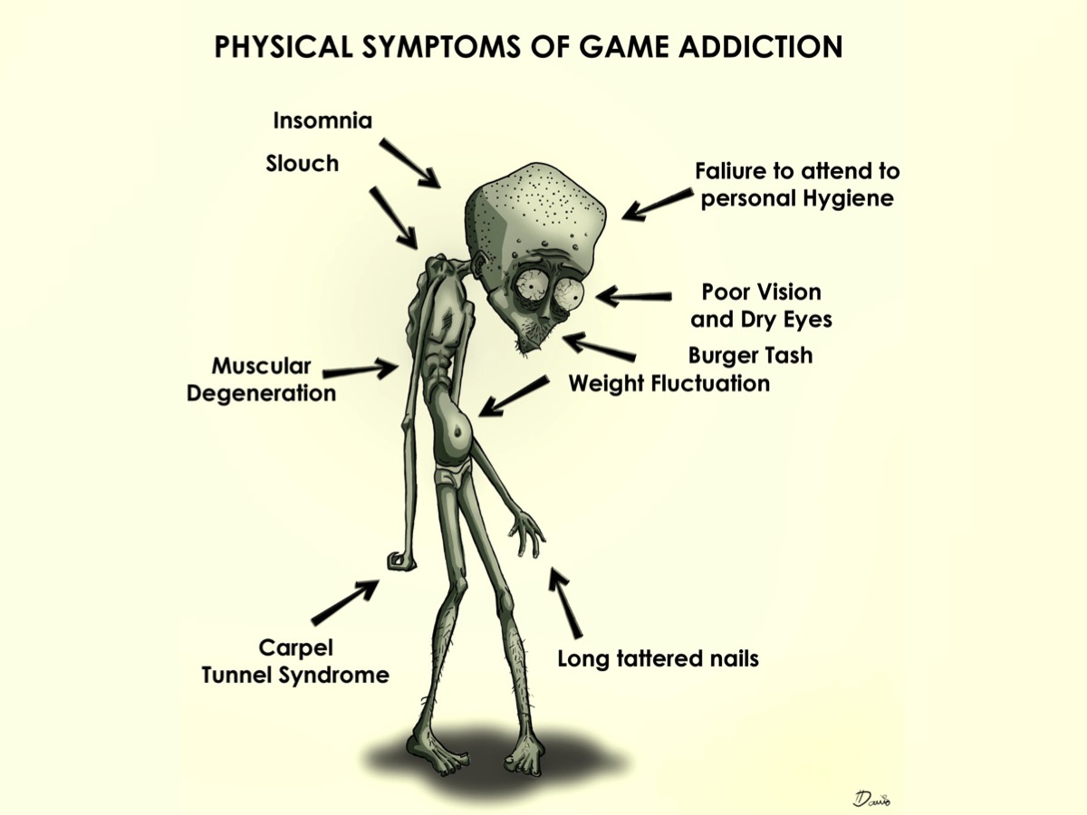
Notes:
Here is a fun cartoon of some of the physical symptoms of game addiction: Insomnia, slouching, muscular degeneration, weight fluctuation, carpel tunnel syndrome, long tattered nails, poor vision and dry eyes, and failure to attend to personal hygiene.

Slide 20
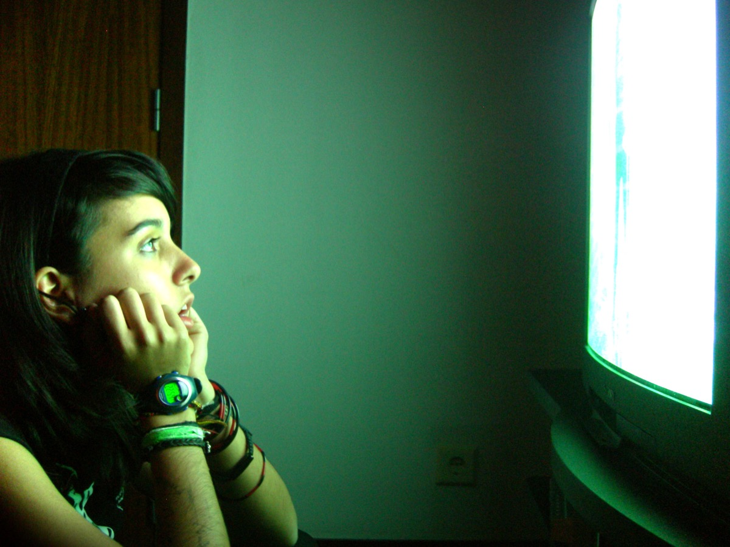
Notes:
* TV

Slide 21

Notes:
* Pornography

Slide 22
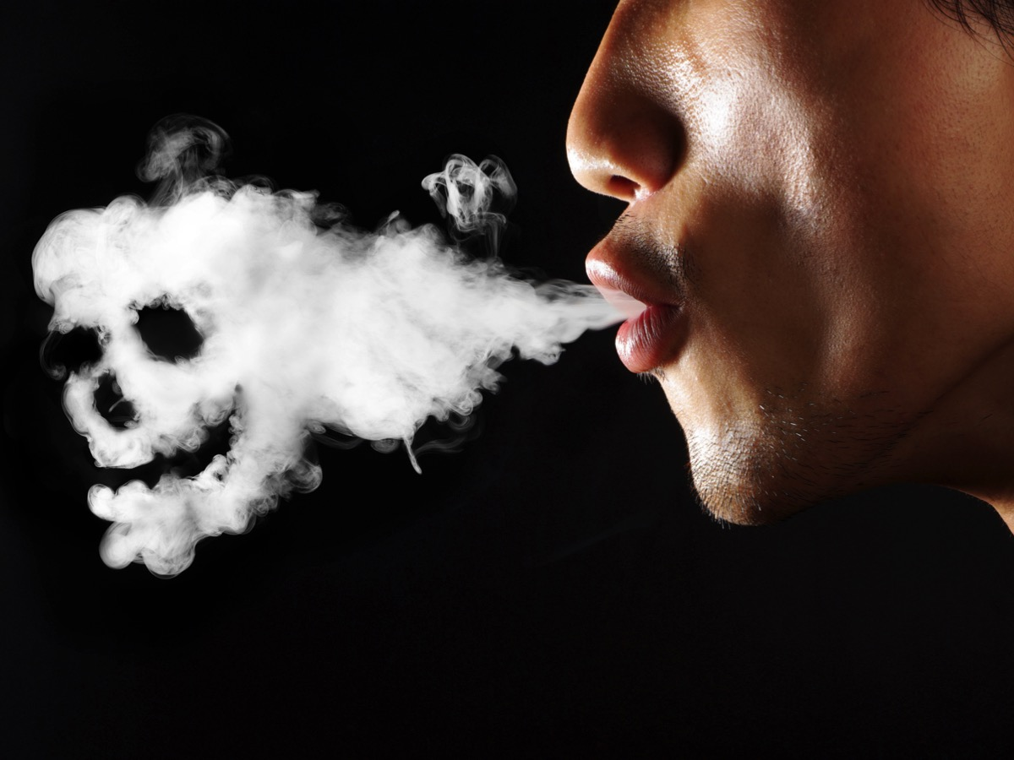
Notes:
* Smoking

Slide 23
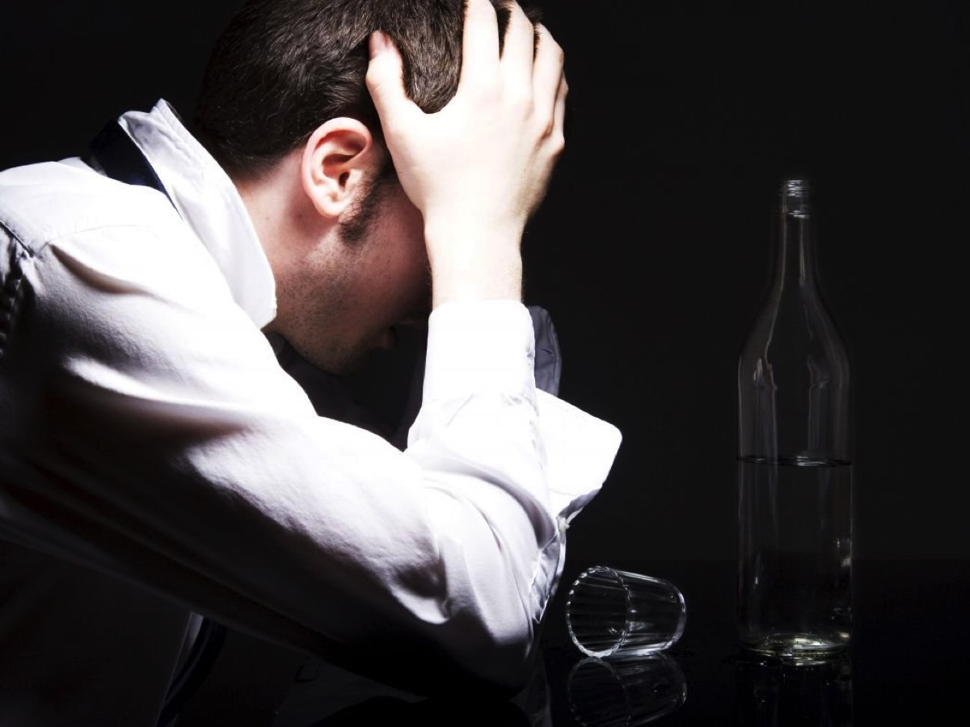
Notes:
* Drinking

Slide 24
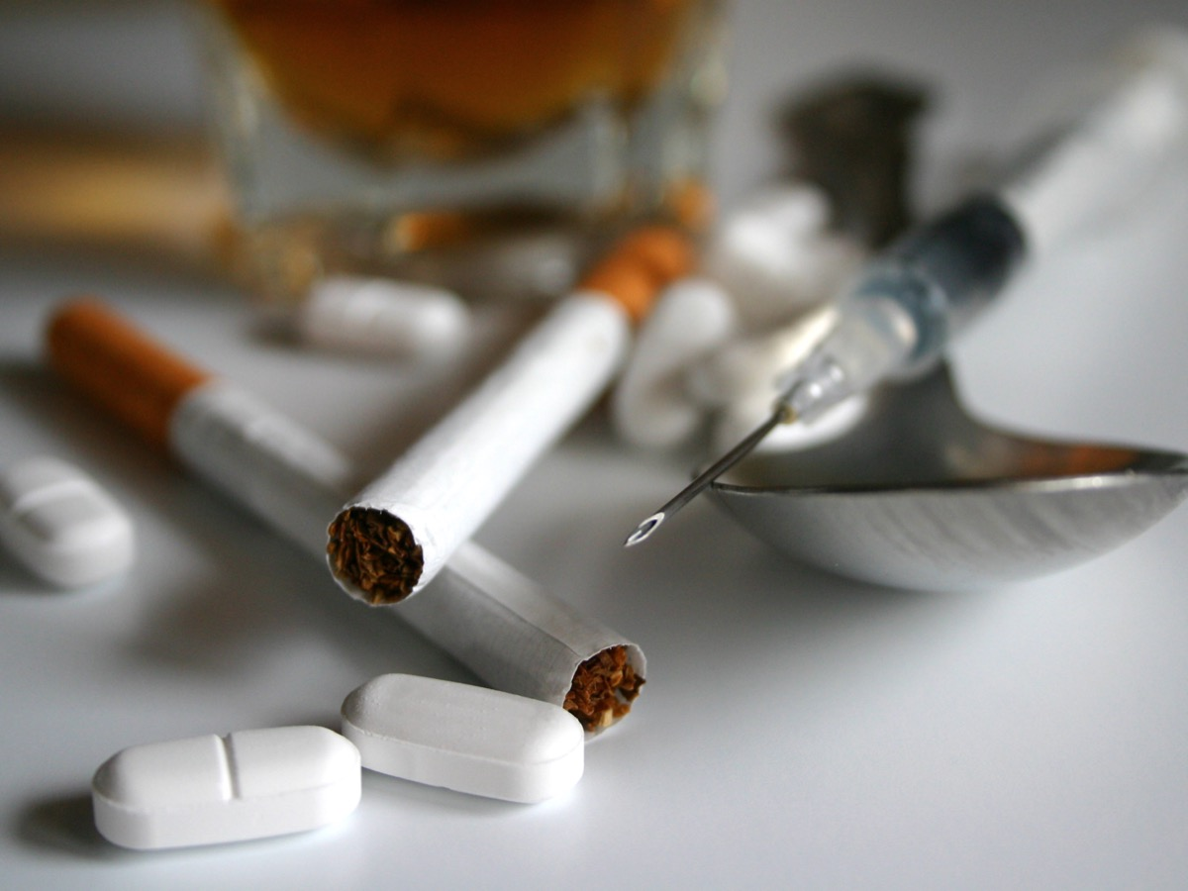
Notes:
* Drugs

Slide 25
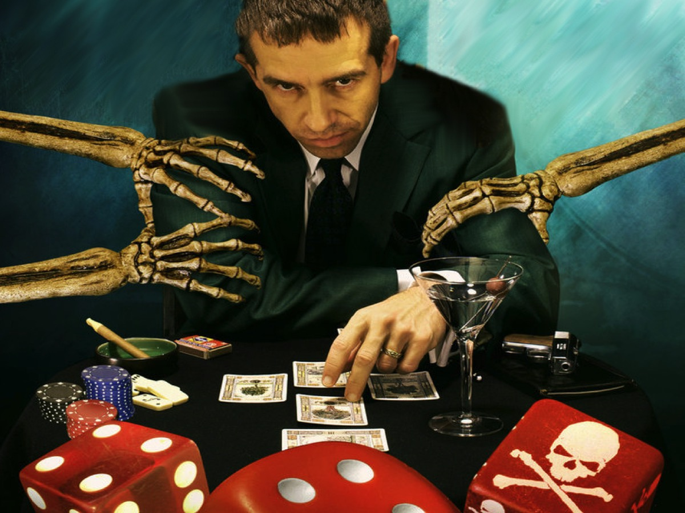
Notes:
* Gambling

Slide 26
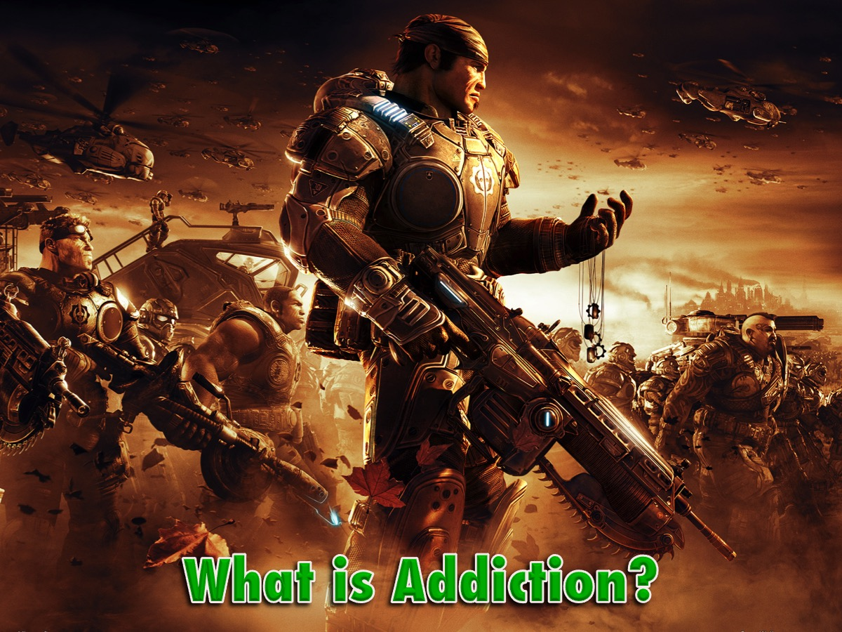
Notes:
So, what is addiction?

Slide 27
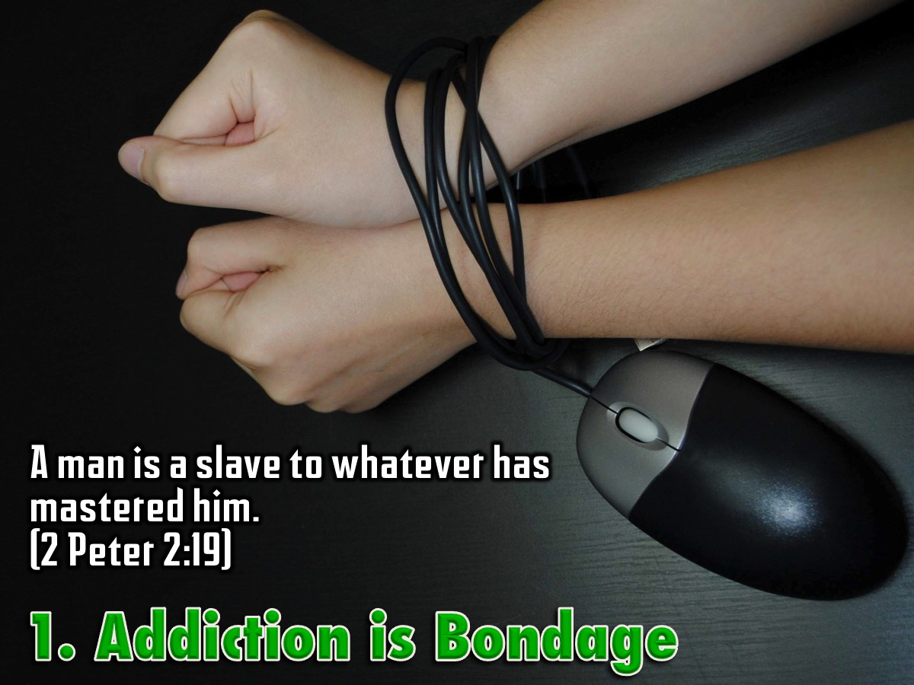
Notes:
1. Addiction is Bondage - A man is a slave to whatever has mastered him. (2 Peter 2:19)

Slide 28
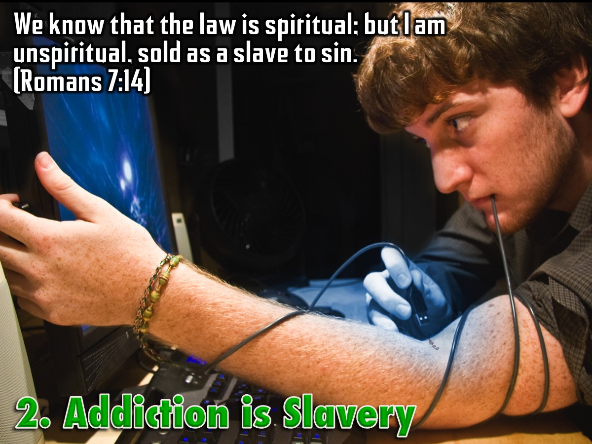
Notes:
2. Addiction is Slavery - We know that the law is spiritual; but I am unspiritual, sold as a slave to sin. (Romans 7:14)

Slide 29
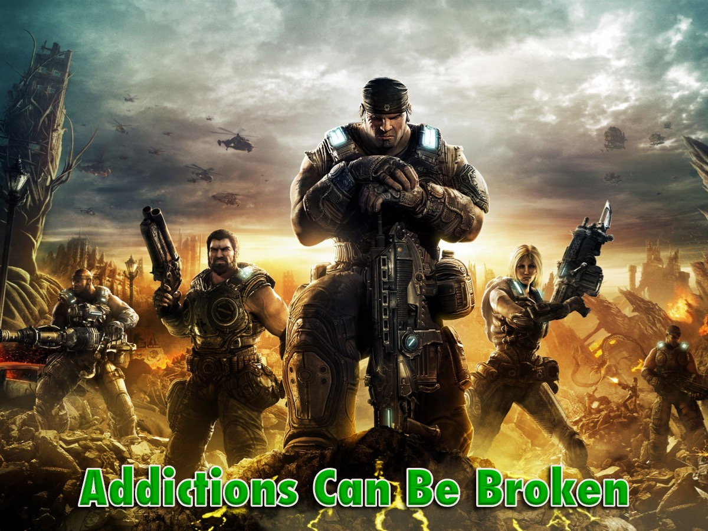
Notes:
But here is the good news, addictions can be broken!

Slide 30
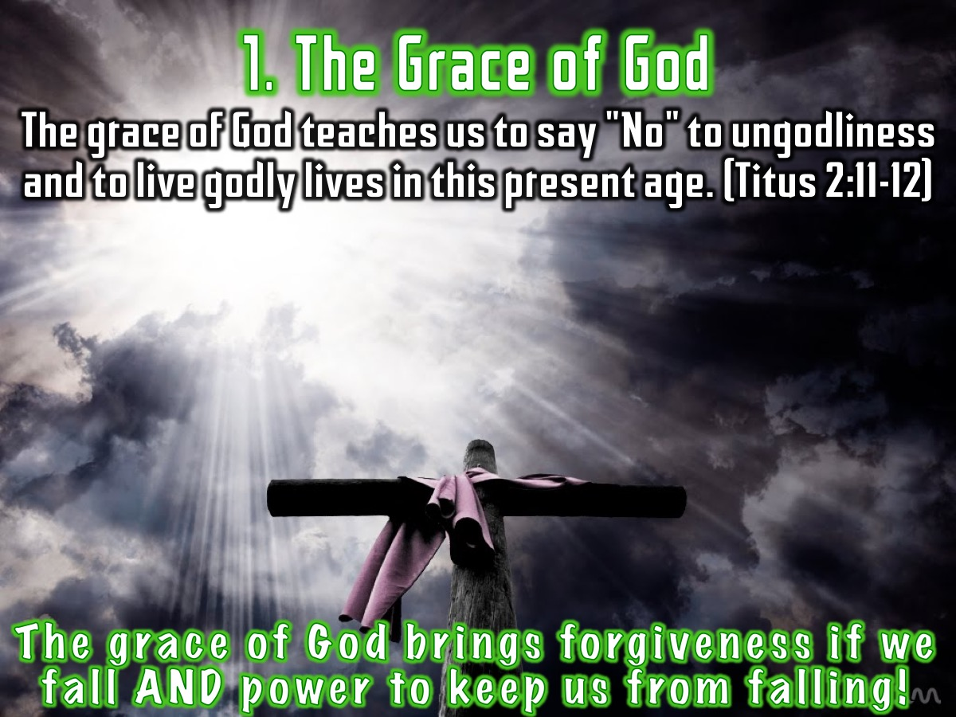
Notes:
1. The Grace of God. The grace of God brings forgiveness if we fall AND power to keep us from falling! “The grace of God teaches us to say "No" to ungodliness and to live godly lives in this present age.” (Titus 2:11-12)

Slide 31
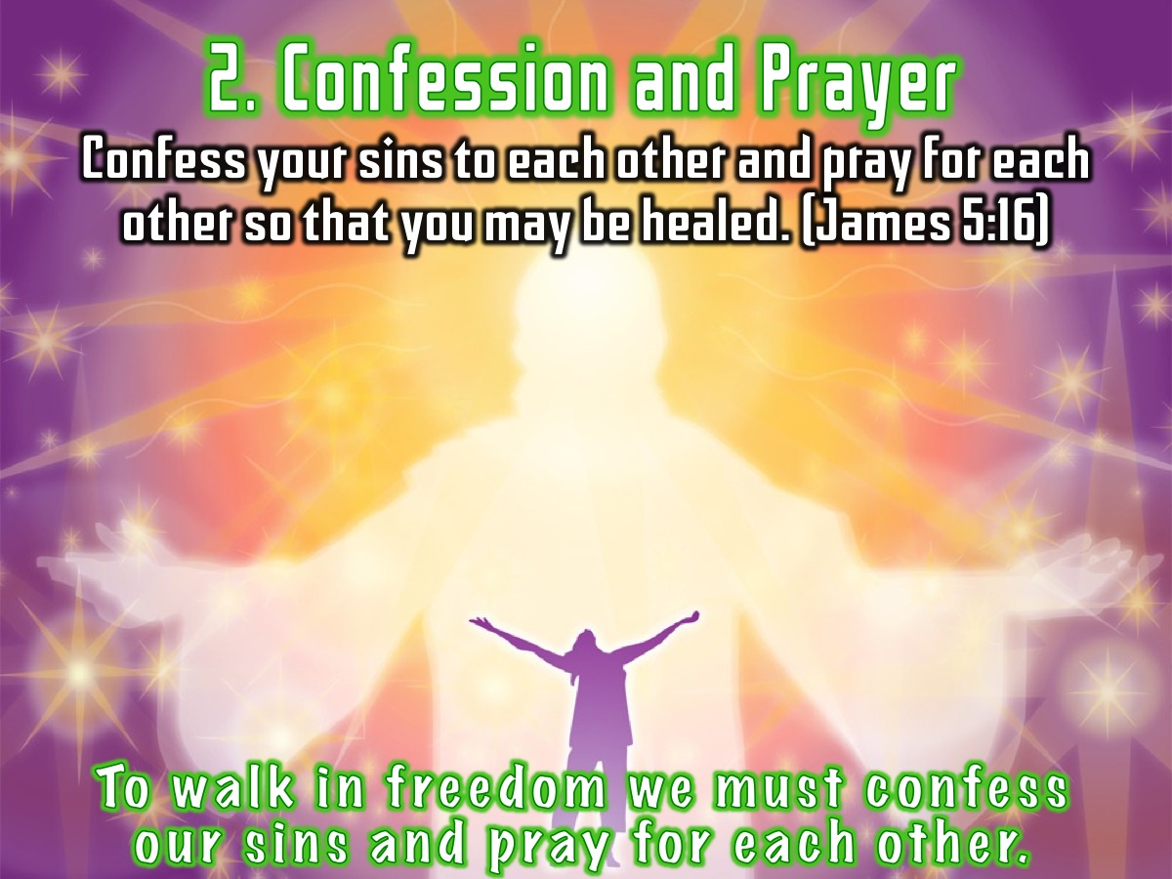
Notes:
2. Confession and Prayer. To walk in freedom we must confess our sins and pray for each other. “Confess your sins to each other and pray for each other so that you may be healed.” (James 5:16)

Slide 32
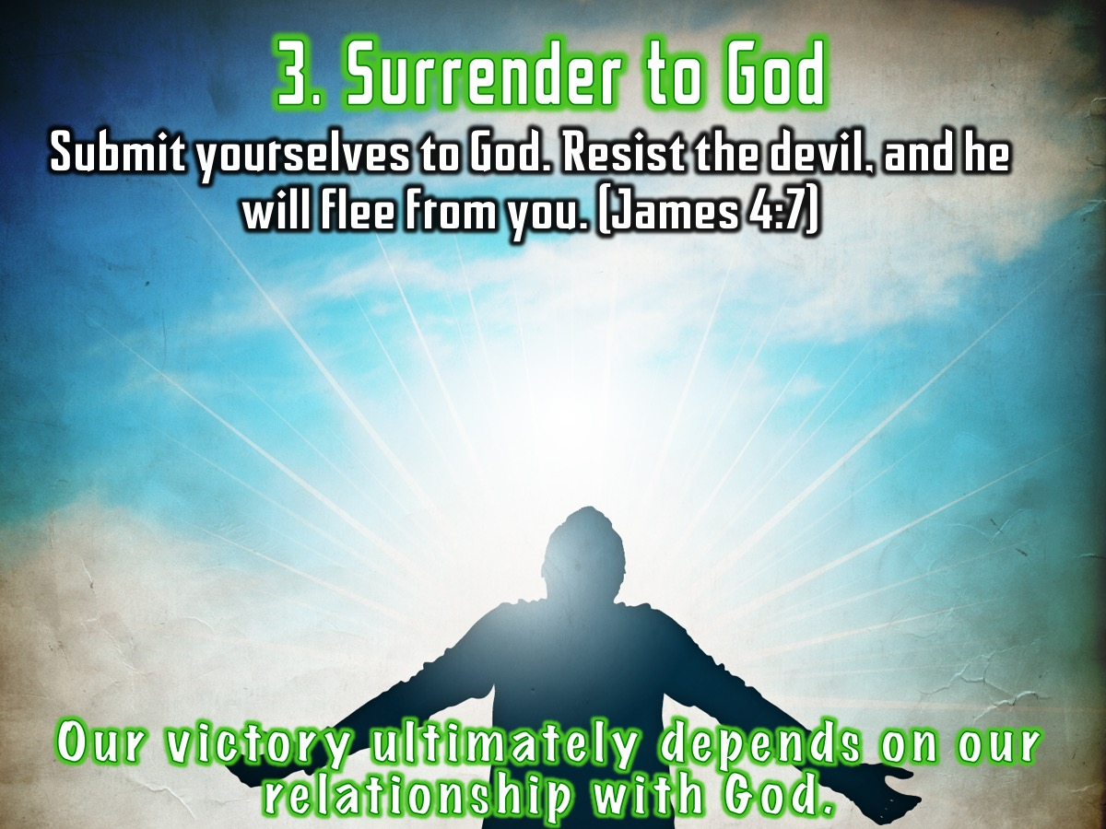
Notes:
3. Surrender to God. Our victory ultimately depends on our relationship with God so we need to submit to him! “Submit yourselves to God. Resist the devil, and he will flee from you.“ (James 4:7)

Slide 33
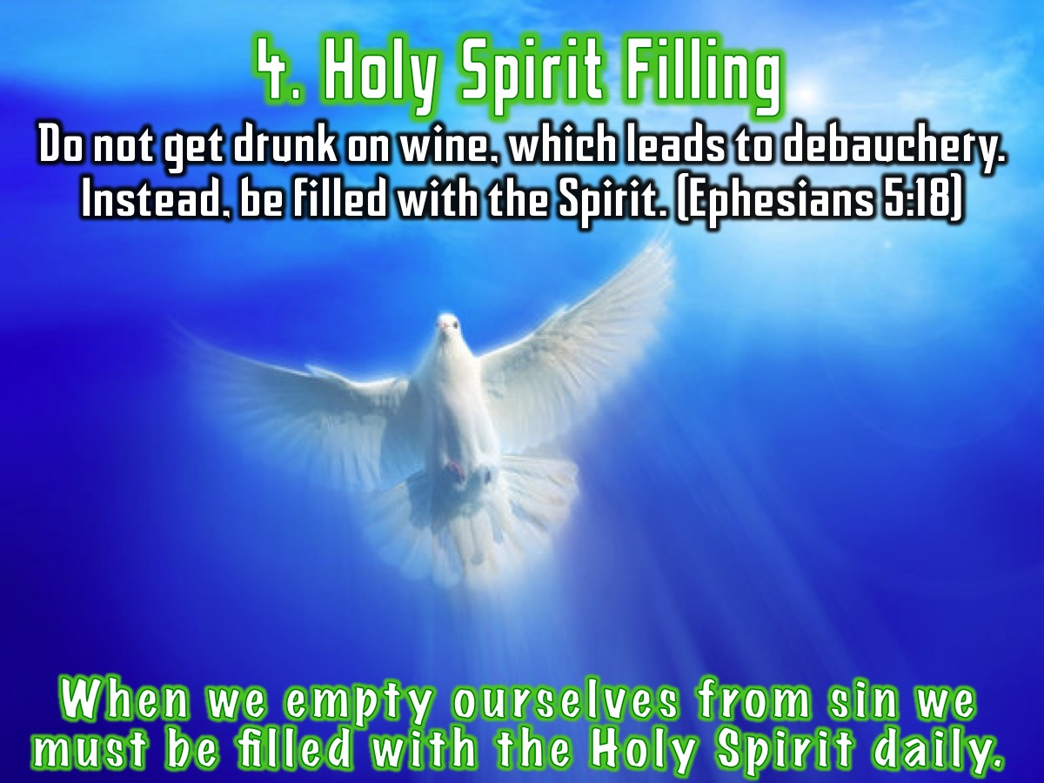
Notes:
4. Holy Spirit Filling. When we empty ourselves from sin we must be filled with the Holy Spirit daily. “Do not get drunk on wine, which leads to debauchery. Instead, be filled with the Spirit.” (Ephesians 5:18)

Slide 34

Notes:
Spend a few minutes completing the personal profile on Addiction.

Slide 35
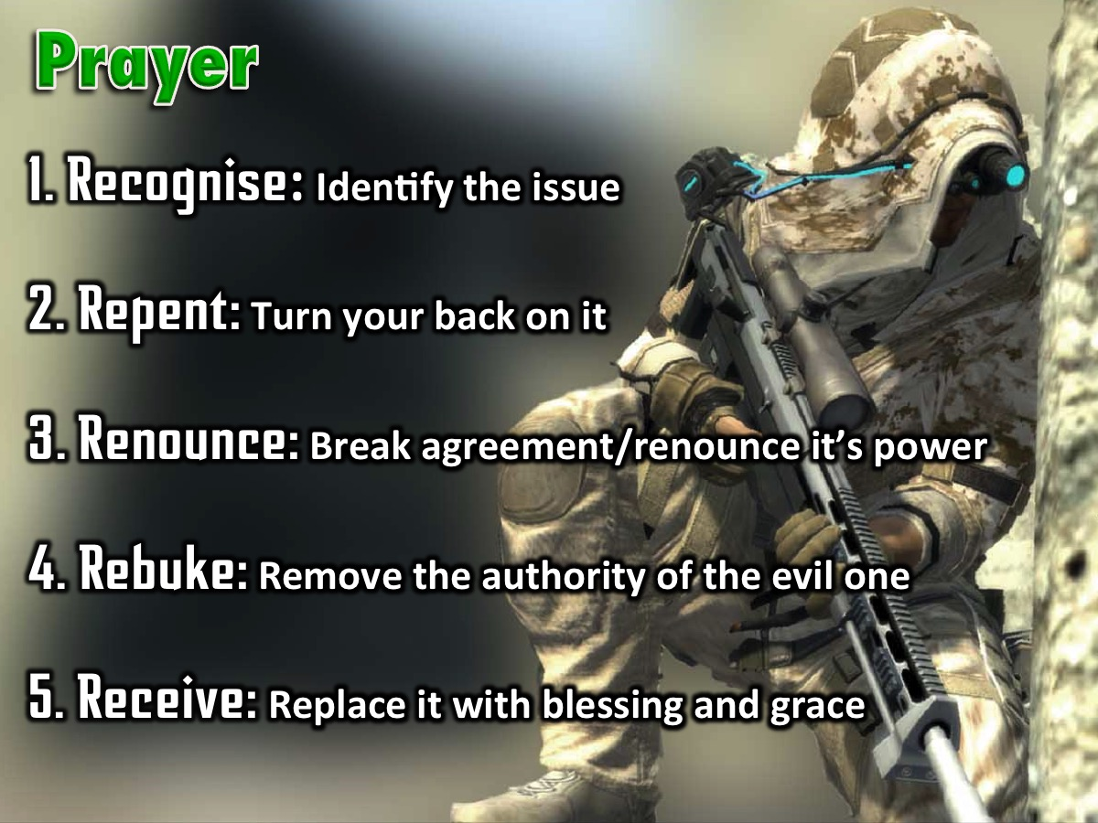
Notes:
Prayer! The Process of Deliverance. To experience freedom from addictions we are going to pray through the process of deliverance: (1) The first step to victory is to Recognise any issue that God has brought to your attention that you need to deal with. (2) The second step is Repent – where you commit to turn your back on the issue, choose to renew your mind and ask God to help you think differently about it. (3) The third step is to Renounce – which means to fall out of agreement with the issue and renounce its power over your life. If it is a curse you fall out of agreement with the curse and you renounce its power to operate in your life, you renounce its power to operate in your children’s life - when you have them one day - and the generations to come. If it is sin you have been involved in, you renounce the power of that sin. You close the door on the enemy - he does not have a hold on you anymore! The enemy no longer has authority to operate in your life in the area. (4) The fourth step is Rebuke – when we rebuke the evil one, any demonic spirit that is associated with the issue has to leave – there is no shouting - it just has to go because you have taken its authority away. (5) The fifth step is Receive – where you now ask God to replace what has been taken away with his blessing and grace. Where there was unforgiveness and bitterness you pray to receive God’s grace to forgive; where there was a curse you receive the Lord’s blessing to replace the curse – we speak and announce the blessings of God in areas of poverty for example.

Slide 36
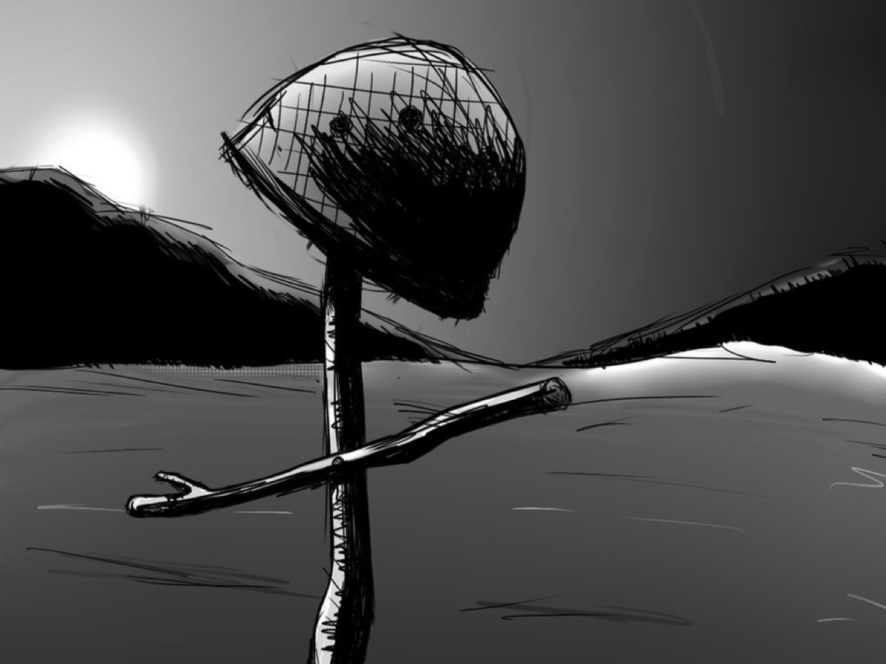
Notes:
As a sign that you have been set free from addictions you need to crumple up your personal profile and come and place them in the helmet on the stage and we will destroy them for you!

Slide 37
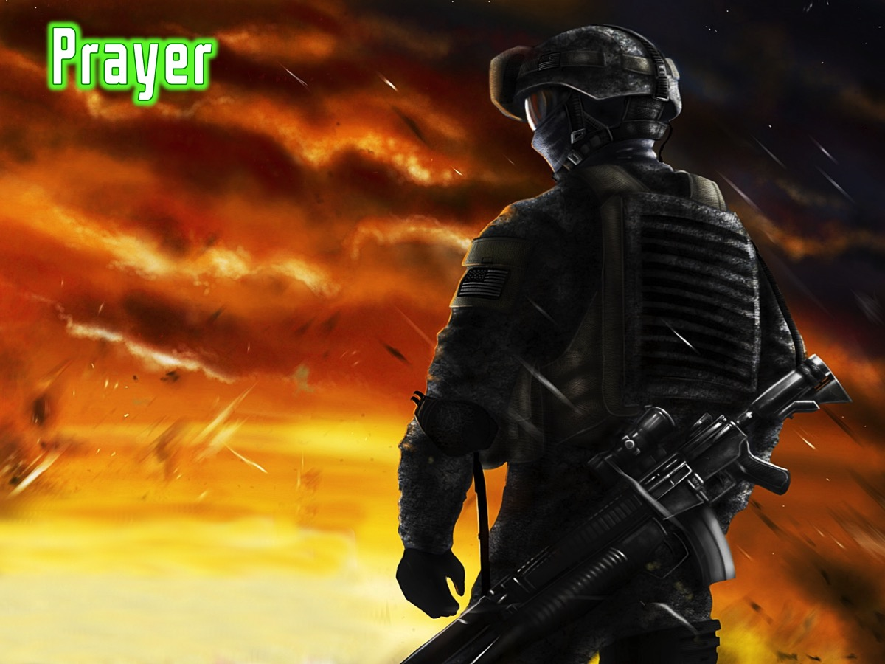
Notes:
Prayer

Slide 38

Notes:
Next week we will end this series as we look at how to keep living in victory!

