Slide 1
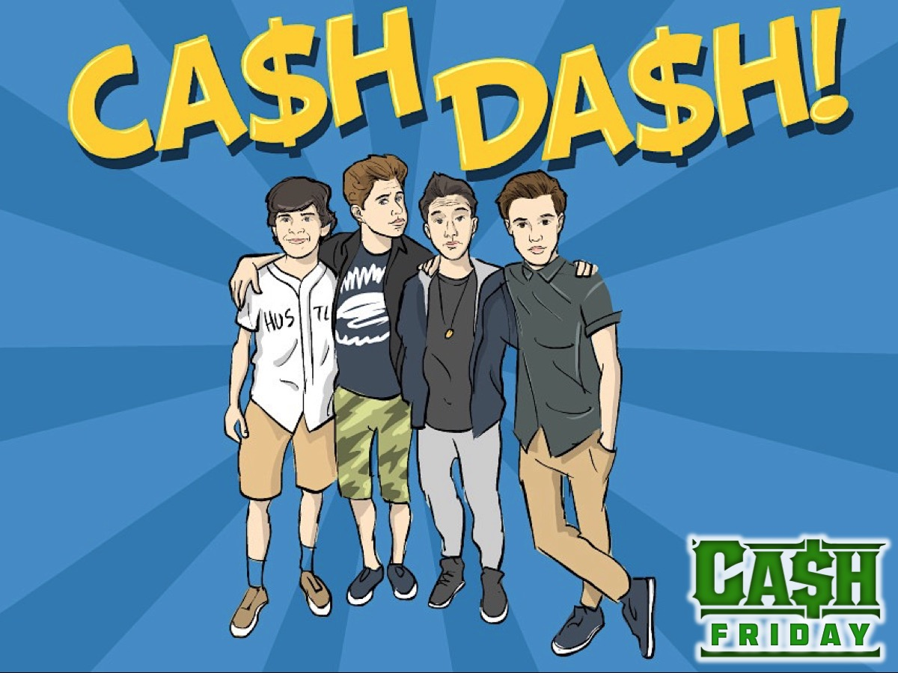
Notes:
Tonight is Cash Dash Night
Time: 7:40-7:50 - Welcome, Announcements and Instructions

Slide 2
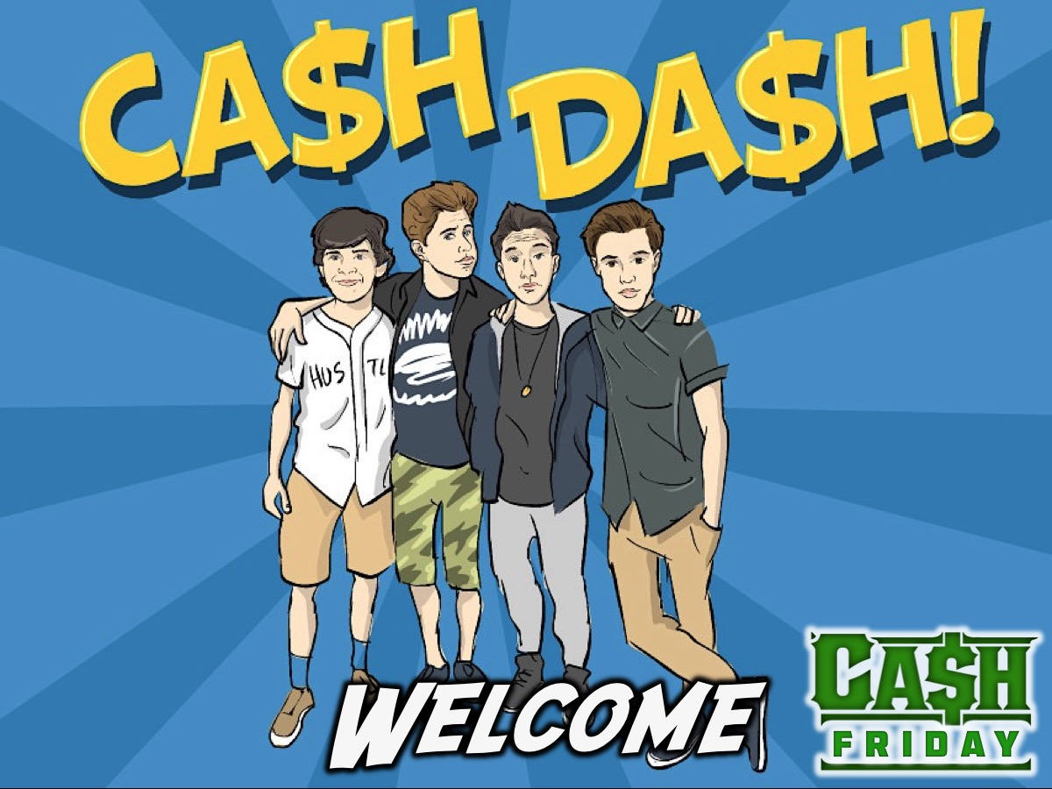
Notes:
Welcome to all our regulars and if there are any newcomers – please come up onto stage so we can welcome you!

Slide 3
Notes:
Team Up: It is time to get into 6 equal-sized teams. (Our teen leaders will go downstairs to hide money among the cars)

Slide 4
Notes:
There are 50 R10 notes hidden on the property. Choose 2 People from your team to Dash for the Cash. Come back when you find 2 notes and send the next 2 people. You have a limited amount of time to find the cash so move it! The group with the most cash will also win the cash you don’t find.

Slide 5
Notes:
Team Talk: So what are you going to do with your money? Talk about it in your group. It is your money but you have to agree on what to do with it.

Slide 6
Notes:
Teams Talk: Send one person to the round table. Talk with the other leaders about the possibility of doing something together with the money.

Slide 7
Notes:
Decision Time: Return to your groups and make a final decision about what to do with the money. Send someone to share your decision with the whole group.

Slide 8
Notes:
Small Groups. Here are the questions for our small group time: (1) How did your group come to a decision about using the cash? (2) How is the Cash Dash experience like real life? (3) What values did you observe tonight? I.e. Greed, Generosity, Selfishness, etc. (4) What values are shown in the way that you handle cash? (5) What do we learn about money from this verse? "A generous person will prosper; whoever refreshes others will be refreshed.” (Proverbs 11:25). (6) Pray for each other to be generous with cash.

Slide 9
Notes:
Refreshments: It is time for Hot Chocolate and biscuits.

Slide 10
Notes:
Next Friday night is Monopoly Millionaire Night

