Slide 1
Notes:
Champions Night is dedicated to discovering the champion of five activities that are regular in our youth room: Foosball, FIFA, Table Tennis, Pool and Dance. We have a live DJ who will help us to warm up for the championship for 30 minutes and then we will have 45 minutes to compete to find the champion in each activity.

Slide 2
Notes:
Welcome to regulars and newcomers.

Slide 3
Notes:
To get warmed up for Champions Night we have a DJ who will be spinning some tracks for us!

Slide 4
Notes:
We are looking for five champions tonight…

Slide 5
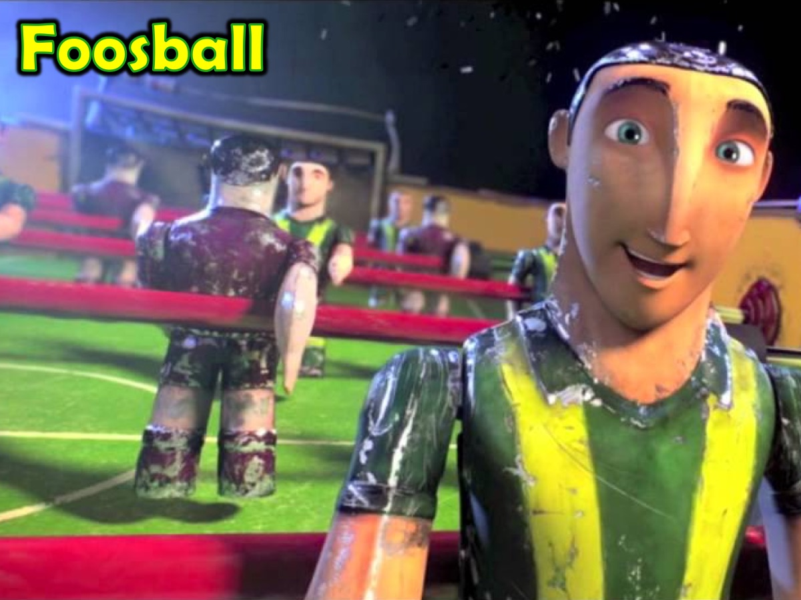
Notes:
The Foosball Champion

Slide 6
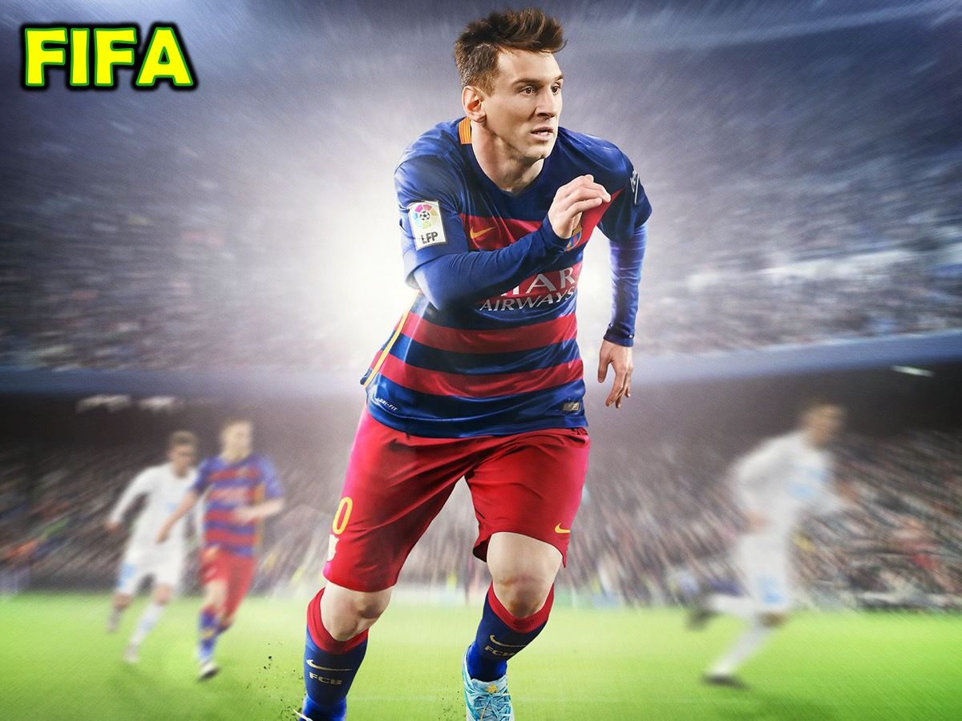
Notes:
The FIFA Champion

Slide 7
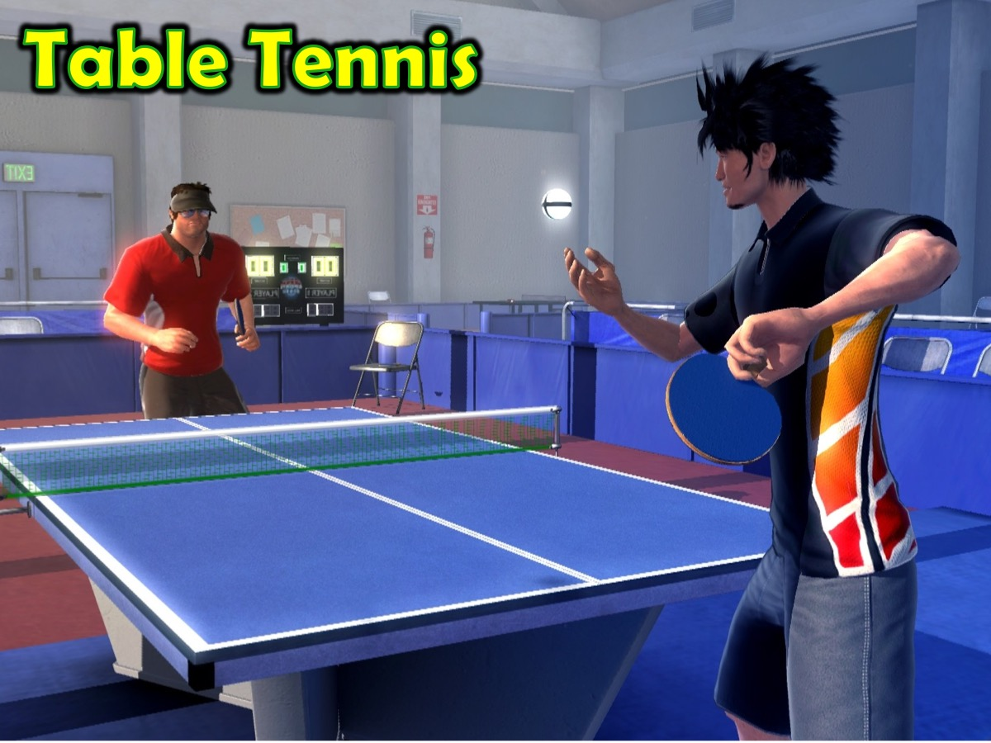
Notes:
The Table Tennis Champion

Slide 8
Notes:
The Pool Champion

Slide 9
Notes:
The Dance Champion

Slide 10
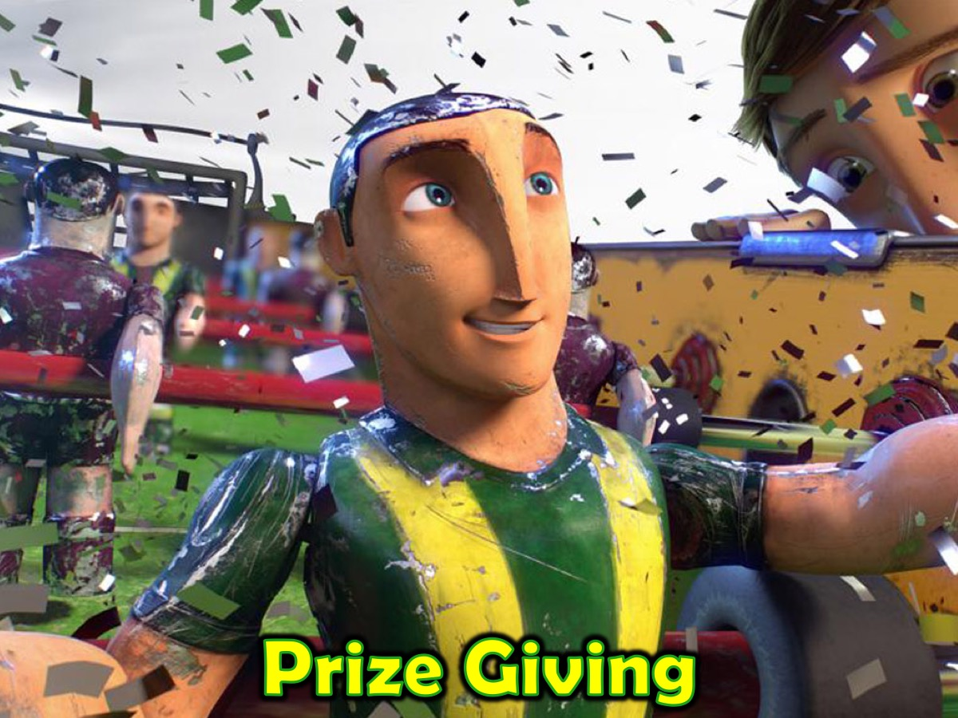
Notes:
Prize Giving: The winner of each section will win a prize…

Slide 11
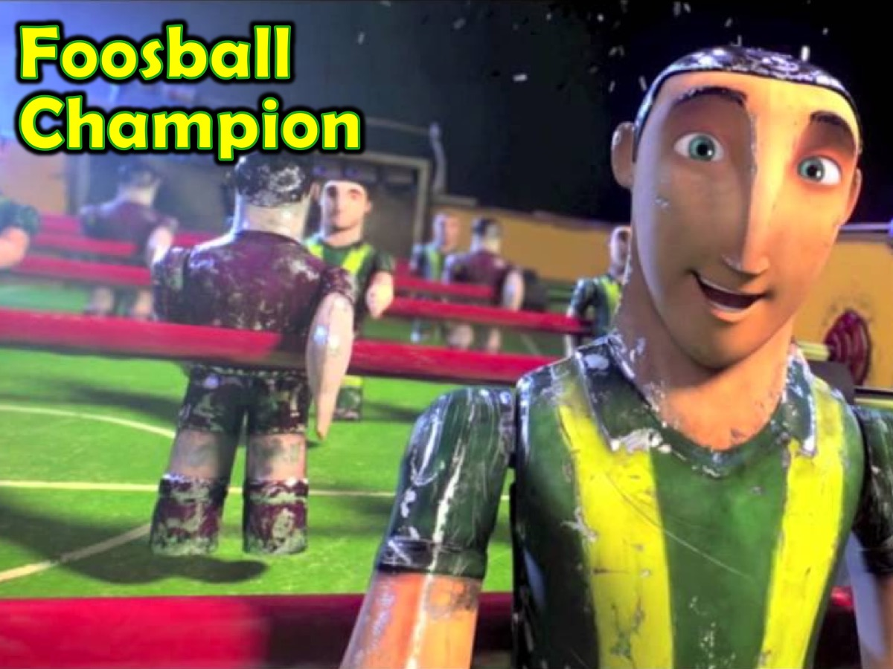
Notes:
The Foosball Champion

Slide 12
Notes:
The FIFA Champion

Slide 13
Notes:
The Table Tennis Champion

Slide 14
Notes:
The Pool Champion

Slide 15
Notes:
The Dance Champion

Slide 16
Notes:
Small Groups: Here are the questions for our small group time tonight: (1) What was your Best experience of Winning ever? (2) What was your Worst experience of Losing ever?(3) What can you do to become a better Winner/Loser? (4) Pray for each other to become a better Winner/Loser.

Slide 17
Notes:
Next Friday night is our matric Farewell - make sure you sign up if you have not done so already.

Slide 18
Notes:
On Sunday morning we launch the four-week Spirit Series.

Slide 19
Notes:
We will be watching one of the Alpha videos and will chat in small groups to find our who He is.

Slide 20
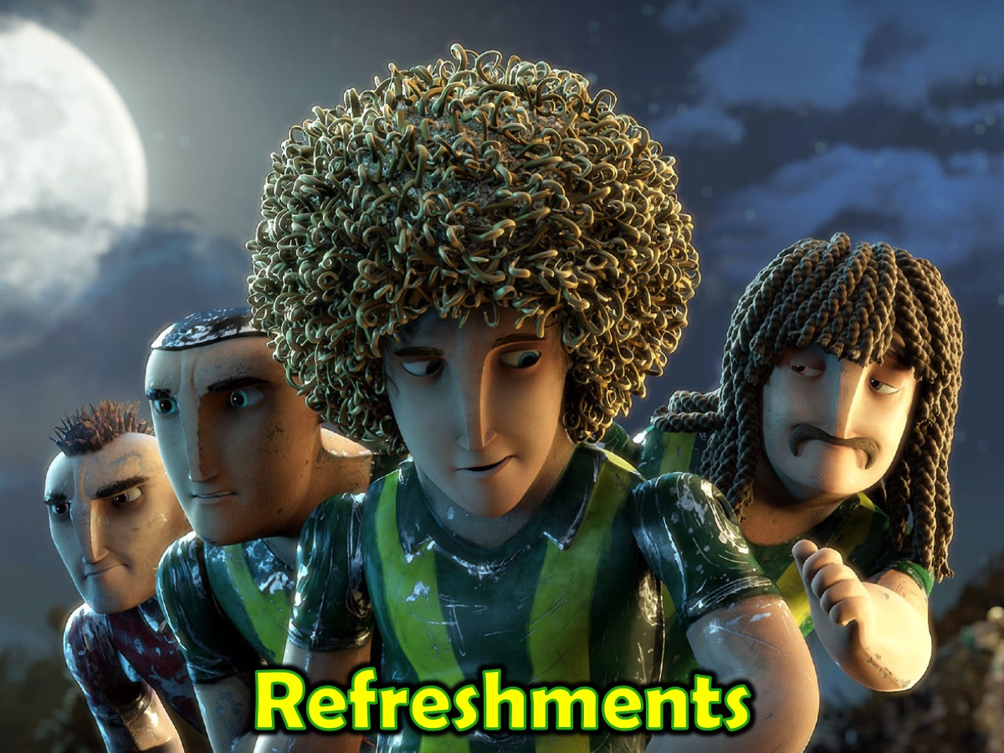
Notes:
It is time for Refreshments.

