Slide 1

Notes:
Welcome to Chat Friday

Slide 2
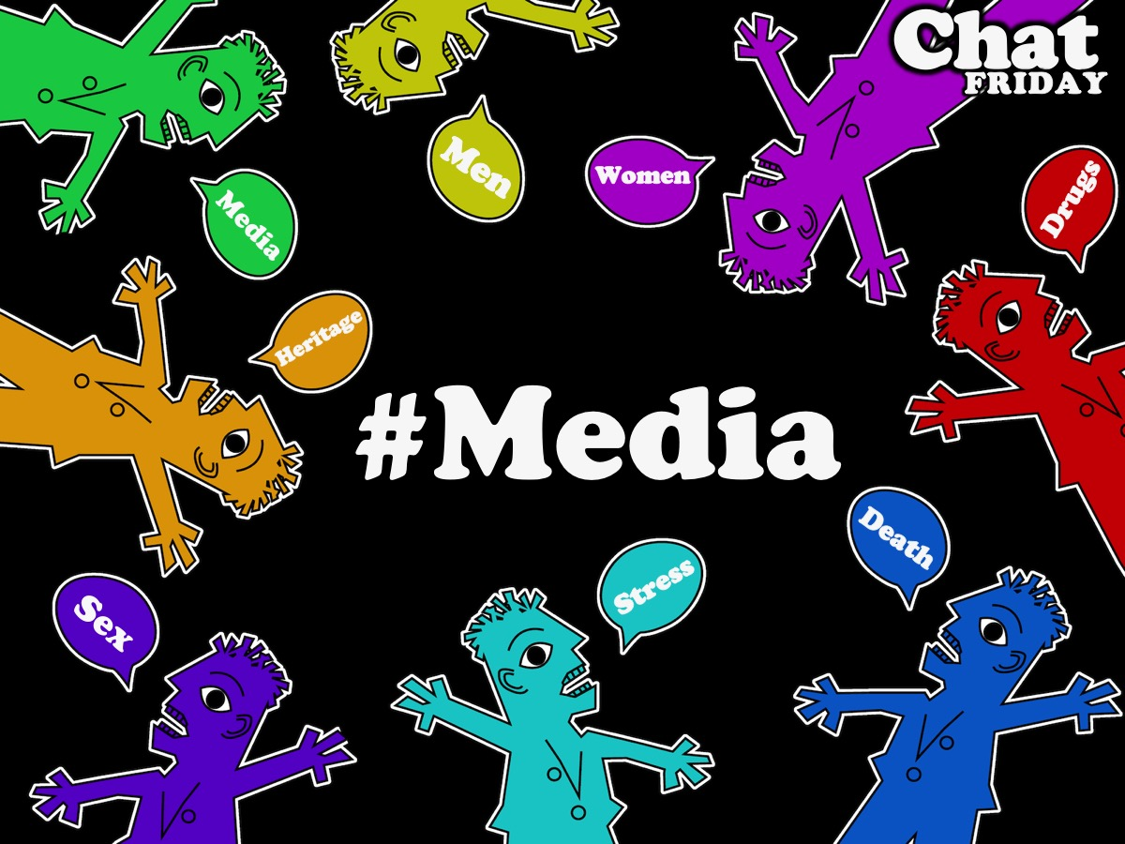
Notes:
Tonight we will be chatting about Media.

Slide 3

Notes:
Welcome to regulars and newcomers

Slide 4
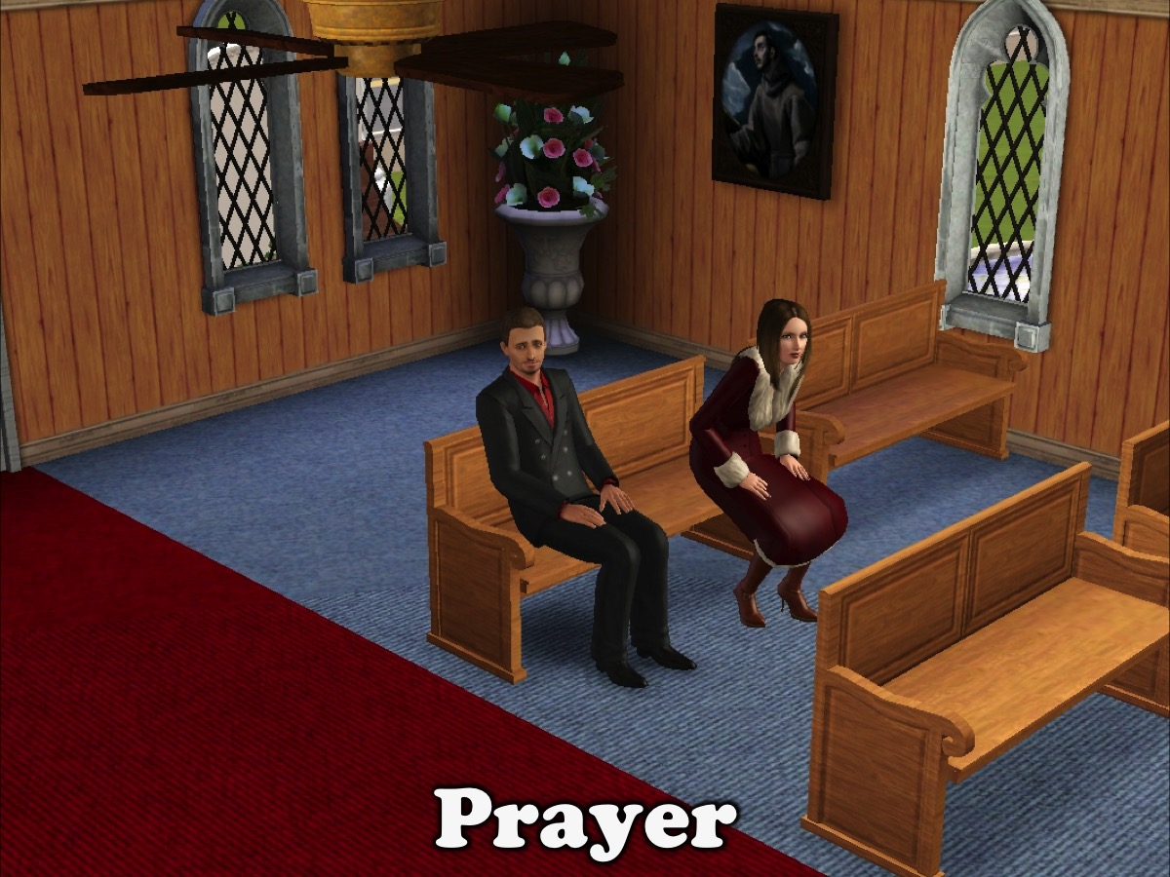
Notes:
Prayer: Let’s open our meeting in prayer.

Slide 5
Notes:
Tonight we will be chatting about Media.

Slide 6

Notes:
Game Time: We’re playing a game called “GUESS THAT ICON!”

Slide 7
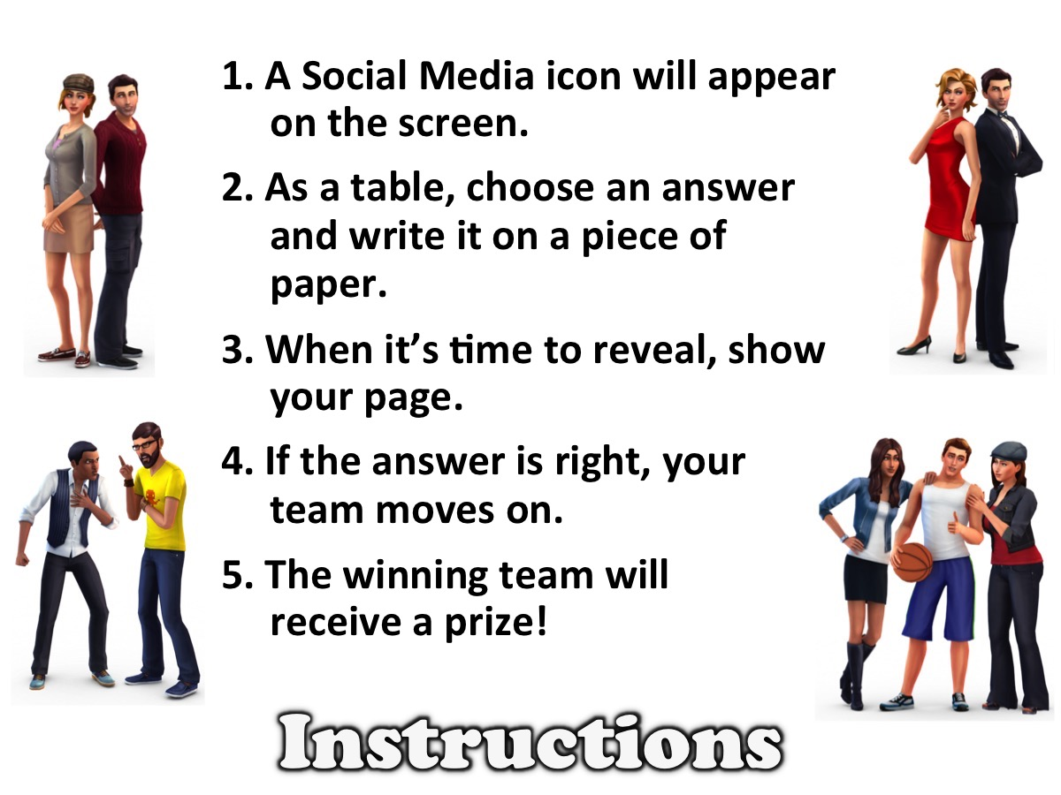
Notes:
Instructions for Game: (1) A Social Media icon will appear on the screen. (2) As a table, choose an answer and write it on a piece of paper. (3) When it’s time to reveal, show your page. (4) If the answer is right, your team moves on. (5) The winning team will receive a prize!

Slide 8

Notes:
Facebook

Slide 9

Notes:
Facebook

Slide 10

Notes:
Twitter

Slide 11

Notes:
Twitter

Slide 12

Notes:
Instagram

Slide 13

Notes:
Instagram

Slide 14

Notes:
Google Plus

Slide 15

Notes:
Google Plus

Slide 16

Notes:
SnapChat

Slide 17

Notes:
SnapChat

Slide 18

Notes:
Youtube

Slide 19

Notes:
Youtube

Slide 20

Notes:
LinkedIn

Slide 21

Notes:
LinkedIN

Slide 22

Notes:
9Gag

Slide 23

Notes:
9Gag

Slide 24

Notes:
Pinterest

Slide 25

Notes:
Pinterest

Slide 26

Notes:
Skype

Slide 27

Notes:
Skype

Slide 28

Notes:
Vimeo

Slide 29

Notes:
Vimeo

Slide 30

Notes:
Tumblr

Slide 31

Notes:
Tumblr

Slide 32

Notes:
Flickr

Slide 33

Notes:
Flickr

Slide 34

Notes:
Reddit

Slide 35

Notes:
Reddit

Slide 36

Notes:
Wordpress

Slide 37

Notes:
Wordpress

Slide 38

Notes:
Wattpad

Slide 39

Notes:
Wattpad

Slide 40

Notes:
Soundcloud

Slide 41

Notes:
Soundcloud

Slide 42

Notes:
Bebo

Slide 43

Notes:
Bebo

Slide 44

Notes:
Goodreads

Slide 45

Notes:
Goodreads

Slide 46

Notes:
Picasa

Slide 47

Notes:
Picasa

Slide 48

Notes:
Buffer

Slide 49

Notes:
Buffer

Slide 50

Notes:
Blogger

Slide 51

Notes:
Blogger

Slide 52

Notes:
StumbleUpon

Slide 53

Notes:
StumbleUpon

Slide 54

Notes:
Yelp

Slide 55

Notes:
Yelp

Slide 56

Notes:
Qzone

Slide 57

Notes:
Qzone

Slide 58

Notes:
Weibo

Slide 59

Notes:
Weibo

Slide 60
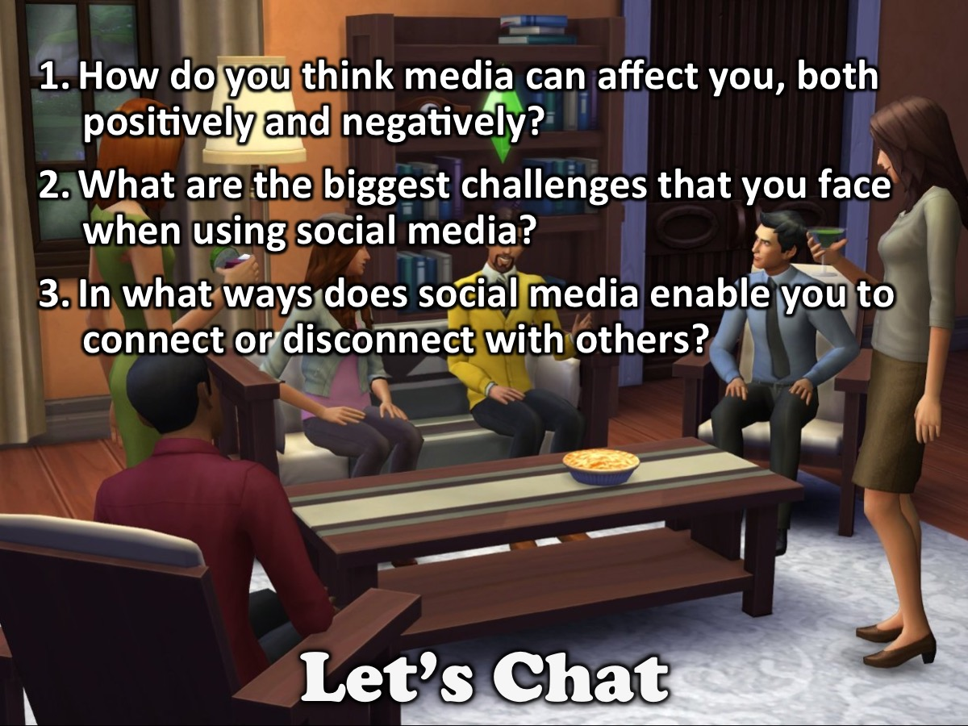
Notes:
Small Groups: Here are the Chat Questions for this Friday Night:
1. How do you think media can affect you, both positively and negatively?
2. What are the biggest challenges that you face when using social media?
3. In what ways does social media enable you to connect or disconnect with others?

Slide 61

Notes:
Video: We are going to watch a video about our social media habits.

Slide 62
Notes:
Video: Look Up by Gary Turk. Get it on YouTube at: https://youtu.be/Z7dLU6fk9QY

Slide 63
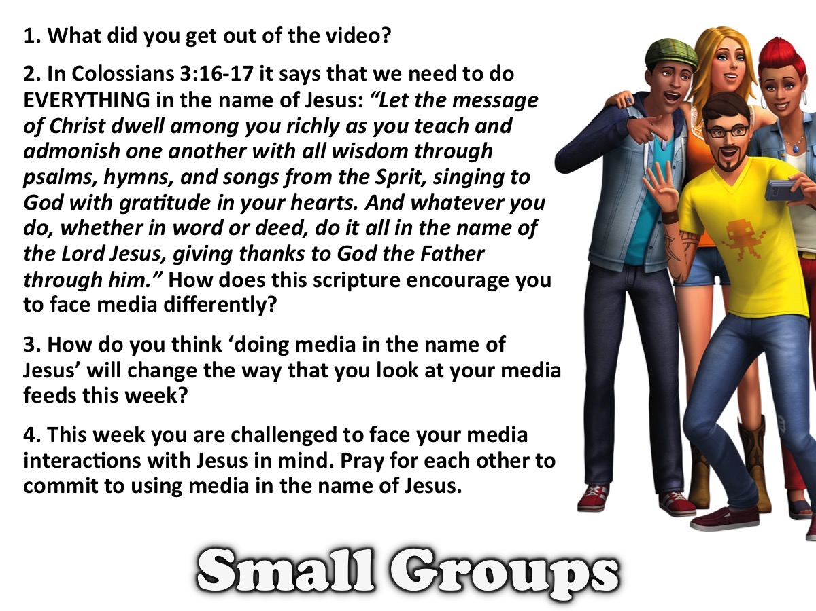
Notes:
Small Groups: Here are the small group questions for this Friday night: (1) What did you get out of the video? (2) In Colossians 3:16-17 it says that we need to do EVERYTHING in the name of Jesus: “Let the message of Christ dwell among you richly as you teach and admonish one another with all wisdom through psalms, hymns, and songs from the Sprit, singing to God with gratitude in your hearts. And whatever you do, whether in word or deed, do it all in the name of the Lord Jesus, giving thanks to God the Father through him.”
How does this scripture encourage you to face media differently? (3) How do you think ‘doing media in the name of Jesus’ will change the way that you look at your media feeds this week?(4) This week you are challenged to face your media interactions with Jesus in mind. Pray for each other to commit to using media in the name of Jesus.

Slide 64

Notes:
Announcements: On Sunday mornings we are presenting The Victory Series.

Slide 65

Notes:
Announcements: Next Friday it is #Men Night.

Slide 66
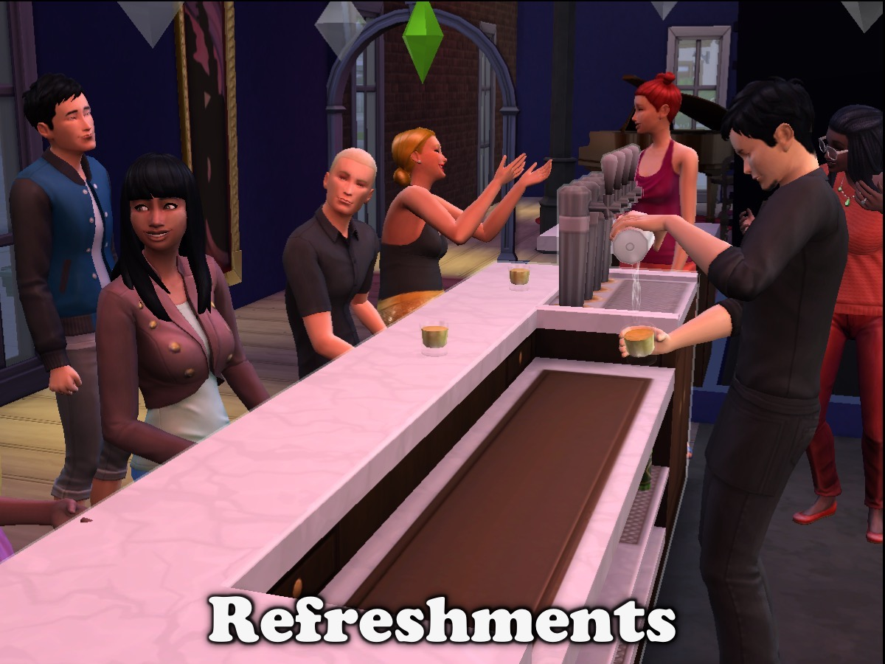
Notes:
Refreshments: It is time for refreshments.

Slide 67
Notes:
Chat Friday

