Slide 1
Notes:
Welcome to Chat Friday

Slide 2
Notes:
Welcome: Welcome to regulars and newcomers

Slide 3
Notes:
Prayer: Let’s open our meeting in prayer.

Slide 4
Notes:
Tonight is #Men night.

Slide 5
Notes:
Game Time: (1) As a group, come up with a song, dance, or skit about #Men. (2) You have 10 minutes to prepare. (3) Your performance must be under two minutes long. (4) Each Group will present on stage. (5) Judges will decide who wins. Your performance must be: (1) Interesting. (2) Energetic. (3) Thought-provoking.

Slide 6
Notes:
Winners receive a prize.

Slide 7
Notes:
Small Group Interaction: (1) What is the first thing that comes to mind when you see the word #Men? (2) What role do you think men should play in society? (3) What do you think a real man should look like?

Slide 8
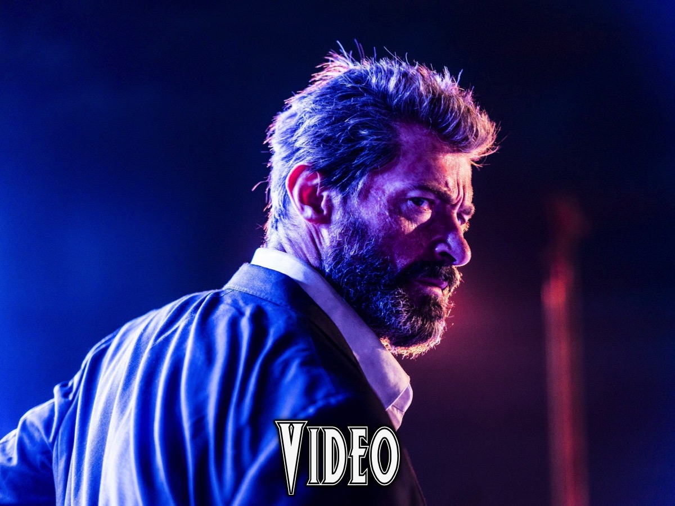
Notes:
Video: We are going to watch a video about Men.

Slide 9
Notes:
Video: Lecrae on Biblical Manhood. Get it on YouTube at: https://www.youtube.com/watch?v=ornQifE2Z2M

Slide 10
Notes:
Small Group Interaction: (1) What did you get out of the video? (2) How is Jesus an example of the perfect man? (3) And Jesus grew in wisdom and stature, and in favour with God and man.” (Luke 2:52) “But we have one who has been tempted in every way, just as we are - yet he did not sin.” (Hebrews 4:15) (3) How can men show Christ-like Masculinity? (4) Pray for the men in your group to become God-fearing men, who strive to be like Christ.

Slide 11
Notes:
Announcements: On Sunday mornings we are presenting The Victory Series.

Slide 12
Notes:
Announcements: Next Friday it is #Women Night.

Slide 13
Notes:
Refreshments: It is time for refreshments.

