Slide 1

Notes:
Welcome to Chat Friday

Slide 2

Notes:
Welcome to regulars and newcomers!

Slide 3

Notes:
Prayer: Let’s open our meeting in prayer.

Slide 4
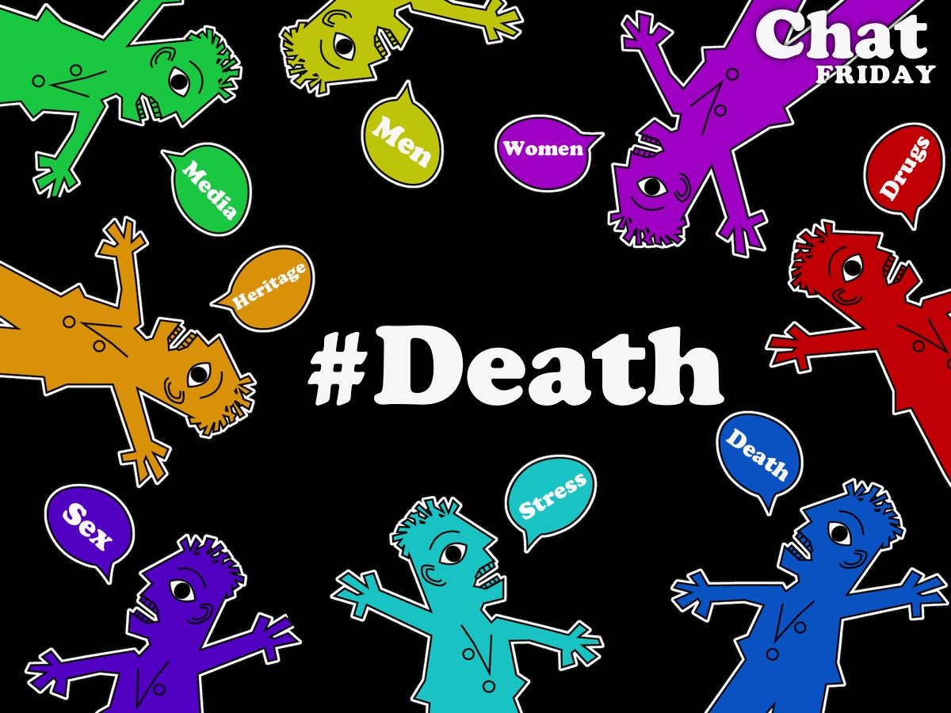
Notes:
Tonight is #Death night.

Slide 5

Game
Notes:
We’re going to be playing a game!

Slide 6
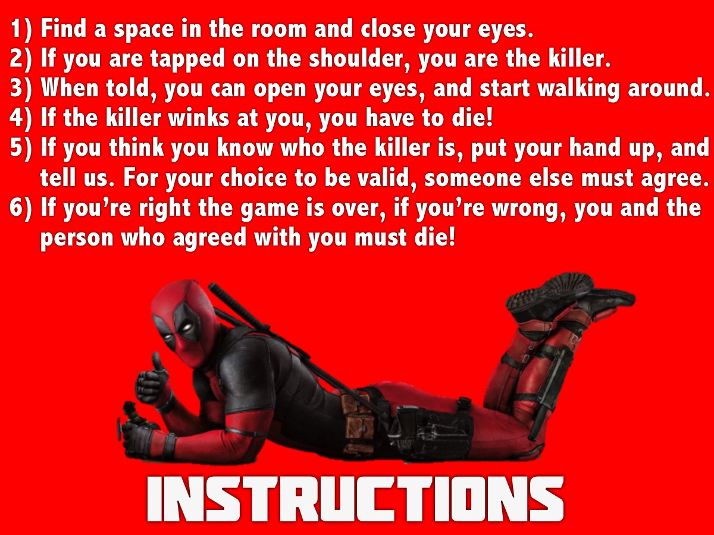
Notes:
Instructions on how to play: (1) Find a space in the room and close your eyes. (2) If you are tapped on the shoulder, you are the killer. (3) When told, you can open your eyes, and start walking around. (4) If the killer winks at you, you have to die! (5) If you think you know who the killer is, put your hand up, and tell us. For your choice to be valid, someone else must agree. (6) If you’re right the game is over, if you’re wrong, you and the person who agreed with you must die!

Slide 7
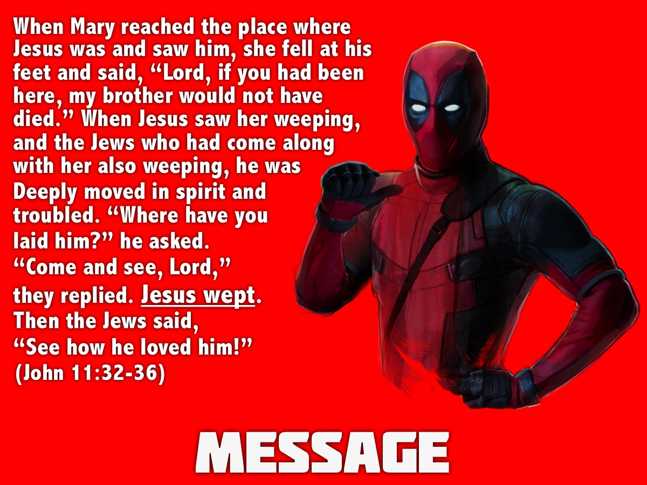
Notes:
Message: A short message from John 11:32-26: When Mary reached the place where Jesus was and saw him, she fell at his feet and said, “Lord, if you had been here, my brother would not have died.” When Jesus saw her weeping, and the Jews who had come along with her also weeping, he was deeply moved in spirit and troubled. “Where have you laid him?” he asked. “Come and see, Lord,” they replied. Jesus wept. Then the Jews said, “See how he loved him!” (John 11:32-36).
“Jesus was deeply moved in spirit and was troubled”
Jesus Wept - Shortest verse in the Bible, yet is so powerful.
Our God is with us In our grief, our misery, and our suffering.
Jesus knew he would raise Lazarus from the dead, but he still wept!

Slide 8
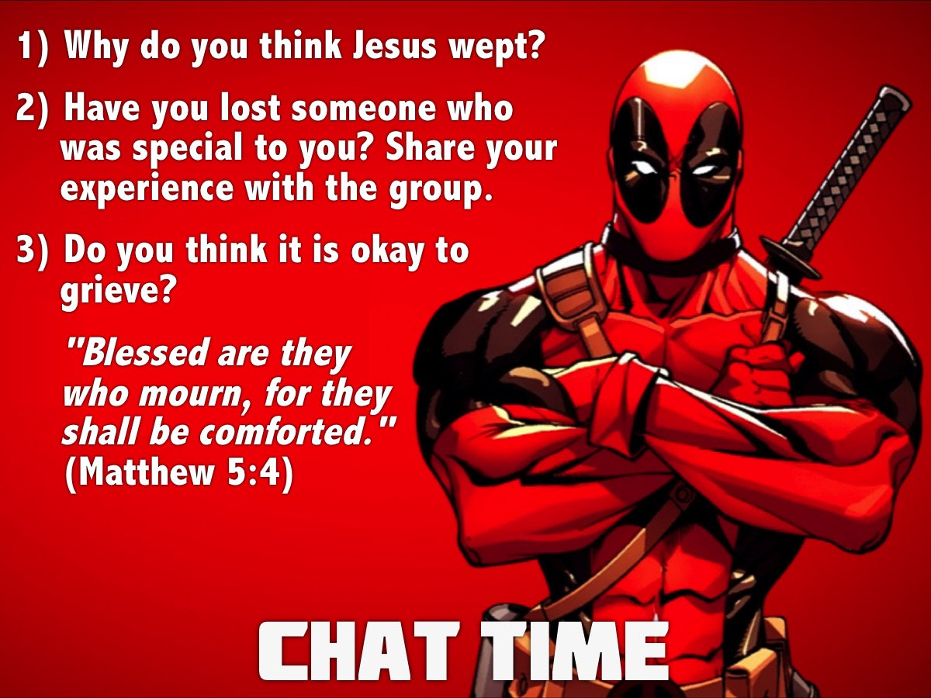
Notes:
Chat Time: (1) Why do you think Jesus wept? (2) Have you lost someone who was special to you? Share your experience with the group. (3) Do you think it is okay to grieve? "Blessed are they who mourn, for they shall be comforted." (Matthew 5:4)

Slide 9
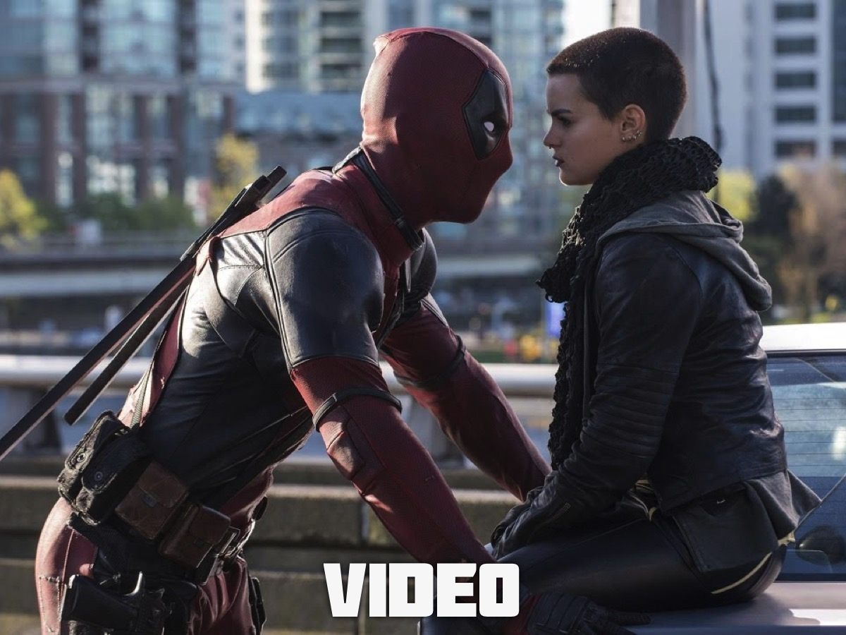
Notes:
We are going to watch a short film titled, 5 STAGES OF GRIEF.

Slide 10
Notes:
Video: Five Stages of Grief. Get it on YouTube at: https://www.youtube.com/watch?v=X581AeAIrbI. Length: 12 minutes.

Slide 11
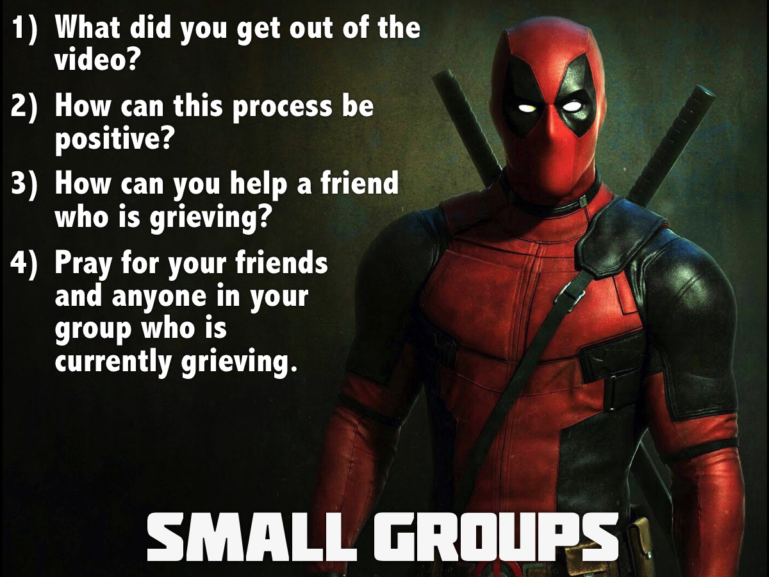
Notes:
Small Group Interaction: (1) What did you get out of the video? (2) How can this process be positive? (3) How can you help a friend who is grieving? (4) Pray for your friends and anyone in your group who is currently grieving.

Slide 12

Notes:
3 Things you can do to help your friends who are grieving:
(1) Hang! Be available to spend time with, talk to, and pray with your friend.
(2) Hug! Let them know you love and care about them through physical touch, words, acts of service or just being together.
(3) Hush! Listen without giving lectures, sermons or meaningless sayings. A simple, “I’m sorry,” is often all that is necessary to say.

Slide 13

Notes:
Announcements: On Sunday mornings we are presenting The Victory Series. This week Sunday's topic is all about getting freedom from Relational Issues.

Slide 14

Notes:
Announcements: Next Friday it is our Matric Farewell Night.

Slide 15

Notes:
Refreshments: It is time for refreshments.

